Slide 1

AUGUST 2026
MONTHLY MAINTENANCE WORKSHOP
Best Practice Sharing & Repetitive Problem Resolution
Click or Scan QR

Slide 2
Workshop agenda
★
▲
📈
🏢
BEST PRACTICES
SHARING
REPETITIVE / CHRONIC
PROBLEM
DISCUSSION
ACTION REVIEW &
KPI TRENDS
HORIZONTAL
DEPLOYMENT
Click or Scan QR

Slide 3
Department: Instrumentation & Automation
BEST PRACTICE: blade thickness
OBJECTIVE / PURPOSE
CALCULATION TABLE
blade thickness
Timestamp | Unit | Load (MW) | Steam Temp (°C)
2026-07-18 08:00 | Unit-1 | 250 | 540
2026-07-18 09:00 | Unit-1 | 255 | 541
2026-07-18 10:00 | Unit-1 | 248 | 539
2026-07-18 11:00 | Unit-1 | 260 | 542
PROBLEM ADDRESSED
problem addreesssed for blade thickness
METHODOLOGY / INNOVATION
nothing special adopted
IMPACT / SAVING
Cost Impact: Approx Rs. 229.05 Lakhs.
Click or Scan QR

Slide 4
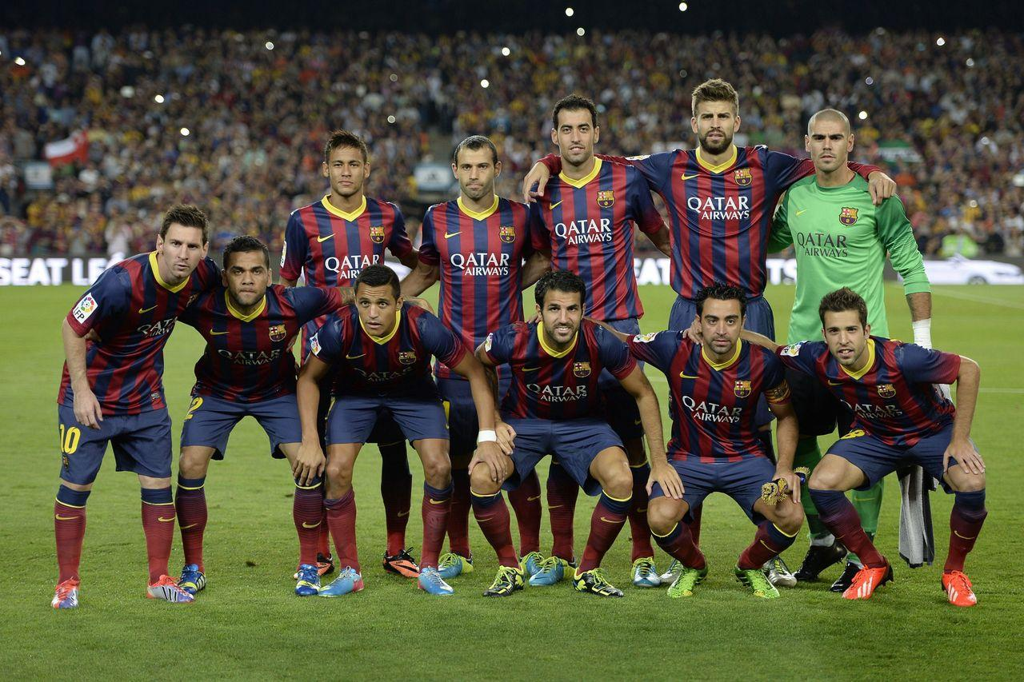

PHOTOS & EVIDENCE: blade thickness
BEFORE
AFTER
NO FILE
SUPPORTING
Click or Scan QR

Slide 5
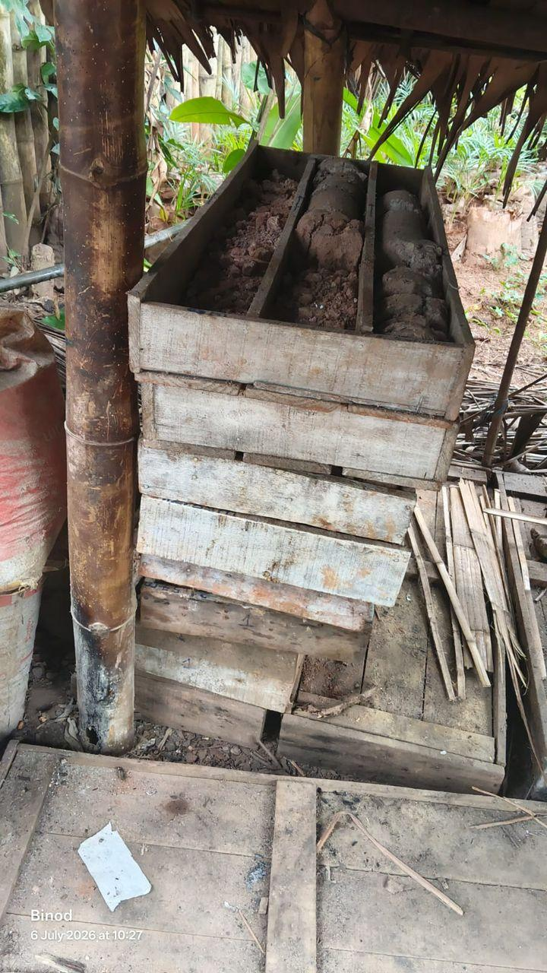
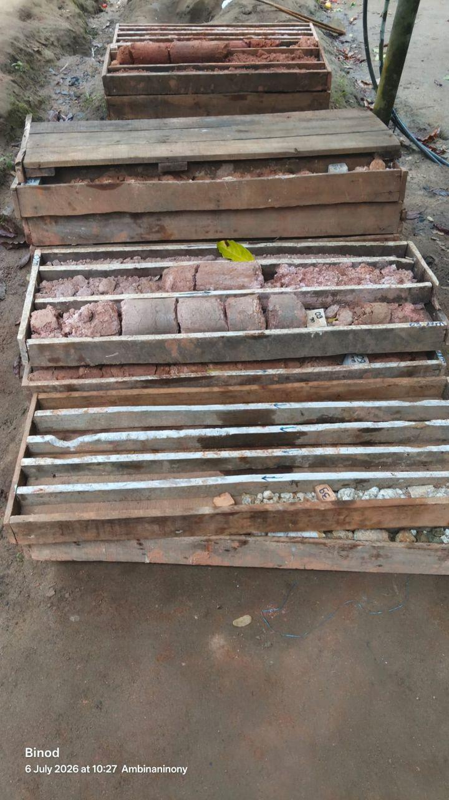
Department: Instrumentation & Automation
SUPPORTING : Supporting Doc: blade thickness
CUSTOM TABLE
Column_1 | Column_2 | Column_3 | Column_4 | Column_5 | Column_6 | Column_7 | Column_8 | Column_9 | Column_10
ID001 | Plant C | East | 422 | 87.48 | Stopped | 20.5 | 582.8 | 7 | OK
ID002 | Plant B | East | 439 | 51.24 | Stopped | 42.4 | 914.3 | 7 | OK
ID003 | Plant C | East | 491 | 48.03 | Maintenance | 42.2 | 975.8 | 8 | Warning
ID004 | Plant C | East | 307 | 12.85 | Maintenance | 36.7 | 819.8 | 4 | Warning
ID005 | Plant C | South | 146 | 59.11 | Running | 23.4 | 868.5 | 1 | Warning
ID006 | Plant A | West | 256 | 52.81 | Running | 25.7 | 666 | 6 | OK
ID007 | Plant A | North | 351 | 59.58 | Maintenance | 24.8 | 589.3 | 10 | Warning
ID008 | Plant C | South | 455 | 30.18 | Maintenance | 29.7 | 839.1 | 6 | Critical
ID009 | Plant A | West | 309 | 99.88 | Maintenance | 25.6 | 504.2 | 1 | OK
ID010 | Plant B | North | 493 | 30.58 | Running | 31.5 | 914.5 | 3 | Warning
SUPPORTING PICTURES
Click or Scan QR

Slide 6
Tracker
Monthly Maintenance Workshop
Category | Total Nos. of Entries | Nos. of entries for Action | Remarks
Best Practice | 01 | 01 | -
Repetitive Problem | 00 | 00 | -
Click or Scan QR

Slide 7
Best Practice: Monthly Maintenance Workshop
Horizontal Deployment Tracker:
Department | Best Practice Title | Area/ Department to be Implemented | Deadline | Remarks
Instrumentation & Automation | blade thickness | - | - | -
Click or Scan QR

Slide 8
Repetitive Problem: Monthly Maintenance Workshop
Suggestion Tracker:
Dept. | Equipment Details | Problem Statement | Discussion/ Initial Suggestion during workshop | Suggester Name | Team name for Analyse the problem | Analysis Target Date | Remarks
No Repetitive Problems recorded yet.
Click or Scan QR

Slide 9
OUTSTANDING SUGGESTIONS
"BIaiiab"
— 172 (Maintenance & Engineering Dept)
Click or Scan QR

Slide 10
We Want Your Feedback!
Scan the QR Code to submit your suggestions live.

