Slide 1
Predicting how football game will be end
Presented by:
Dima Girya
Snir Okashi
https://github.com/DimaGirya/FootballPreditionML

Slide 2
Data Source and Problem Definition
Data source: https://www.sportmonks.com/football-api/
Problem definition: We analyze statistics up to a specific minute (for example, minute 70) to predict the game's outcome (whether the local team will win or not).
Data about game for each minute: score, attacks, dangerous attacks, on target, of target, corners, possession, teams, league, weather

Slide 3
More about data:
We have data of matches from next leagues:
Premier League, Championship, Serie A, La Liga, Ligue 1, Super Lig, Europa League, Liga Portugal, Eredivisie, Bundesliga, Pro League, Ekstraklasa, FA Cup, Allsvenskan, Eliteserien, Superliga, Premiership, Champions League, Admiral Bundesliga, Super League, 1. HNL, Europa Conference League, Copa Del Rey, Coppa Italia, UEFA Europa League Play-offs. Total 29110 records.
We separate data into 2 datasets:
Train/test: from 2017.08.01 to 2022-01-01 - 21378 records
Validation: from 2022-01-01 to 2023-05-01 - 7732 records

Slide 4
Scoring and base model
Our base model is relatively strong and straightforward. It looks at which team is leading at the current minute and assumes that they will win. At minute 70, it achieves an accuracy of 86.548% on the validation dataset.
Target of project: Get result better that base model

Slide 5
Data Exploration and Feature Engineering

Slide 6
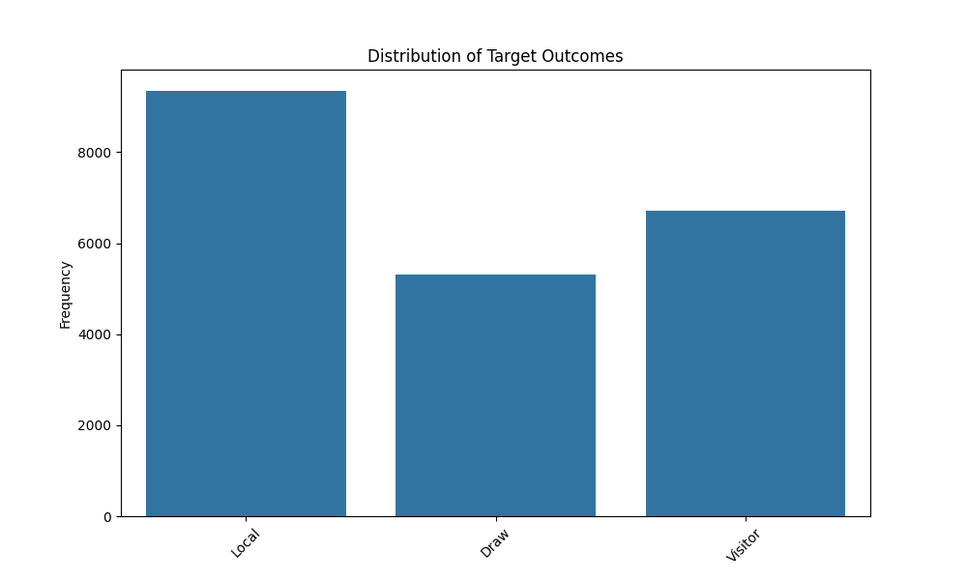
Balance of target
As we can see, the local team wins more often than drawing or losing to the visitor team

Slide 7
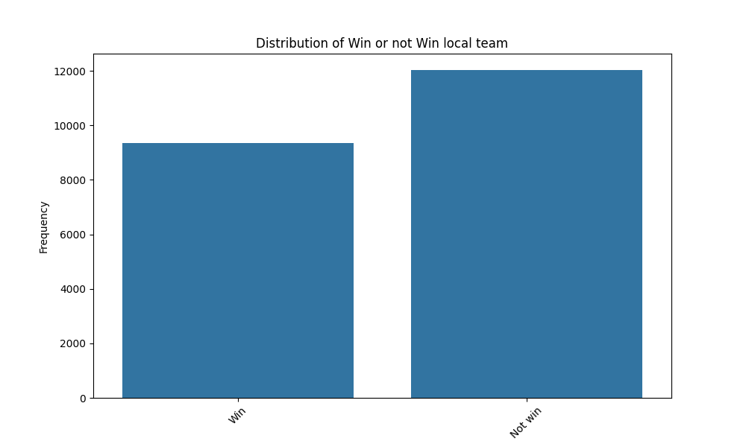
Binary classification
To avoid unbalanced data among three classes, we merged visitor team wins and draws into a one class and applied downsampling to the majority class.

Slide 8
Balance features
We have next data about each minute and each team (local and visitor): Score, attacks, dangerous attacks, on target, of target, corners, possession
For each statistic, we have two fields (for example, localTeamAttacks and visitorTeamAttacks). We created new features called 'balance.' For instance, the balanceAttacks feature is calculated as:
balanceAttacks = localTeamAttacks - visitorTeamAttacks

Slide 9
Features
scoreBalance – balance of goals until minute X
attacksBalance – balance of attacks until minute X
dangerousAttacksBalance – balance of dangerous attacks until minute X
onTargetBalance – balance of onTarget strikes
offTargetBalance – balance of ofTarget strikes
cornersBalance – corners balance
possession and possessionBalance - amount of time a team controls the ball compared to their opponents during a match.
localTeamWins - how much local team wins in last 10 games
visitorTeamWins – how much visitor team wins in last 10 games
teamWinsBalance – balance between local team and visitor team wins

Slide 10
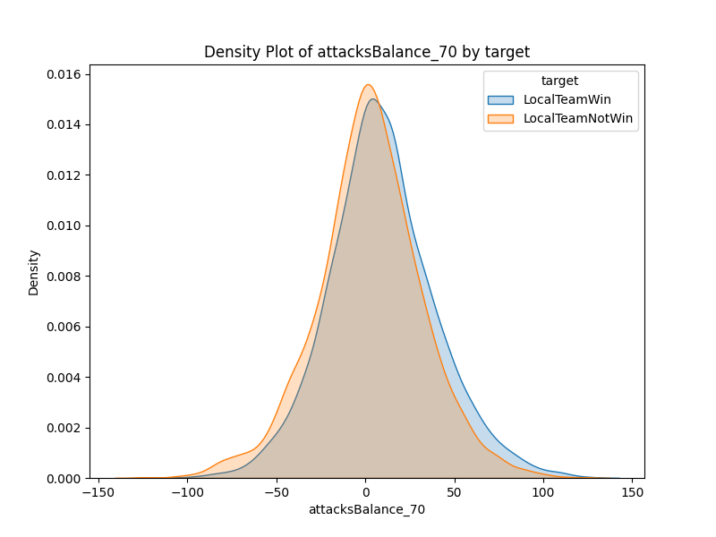
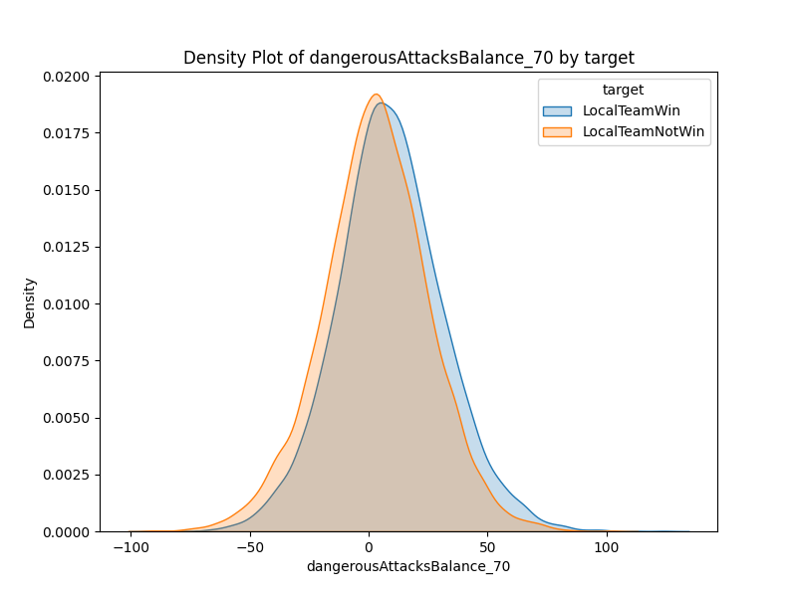
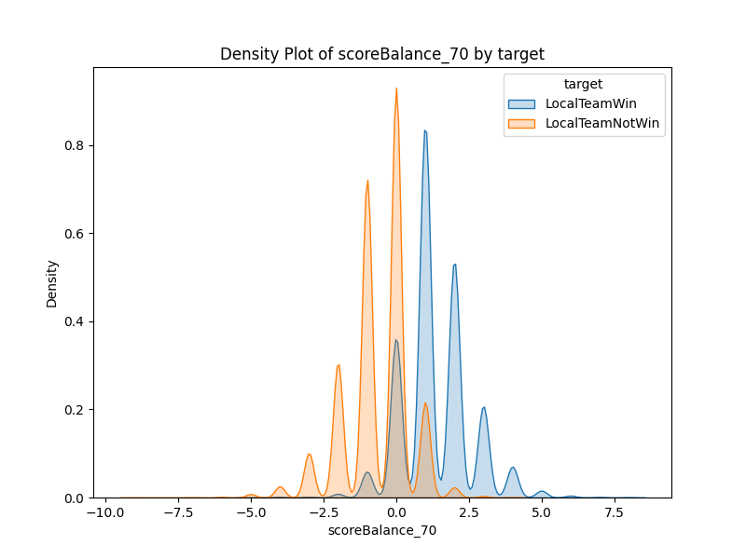
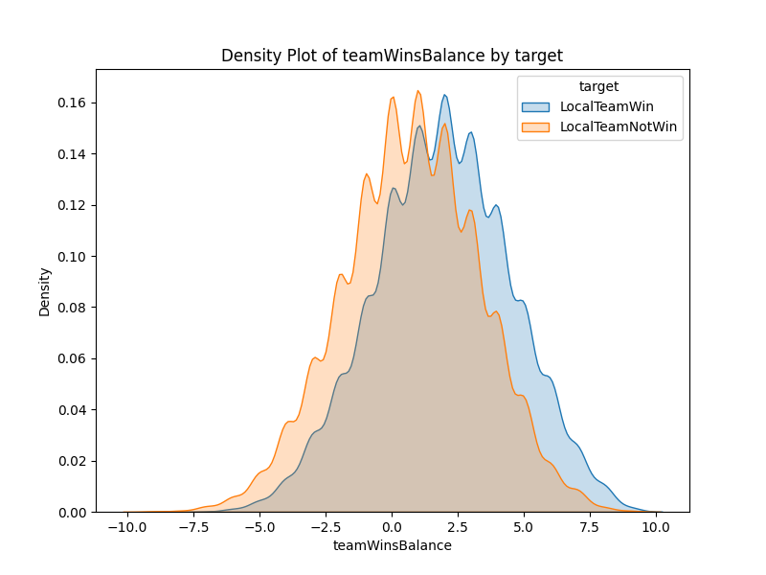
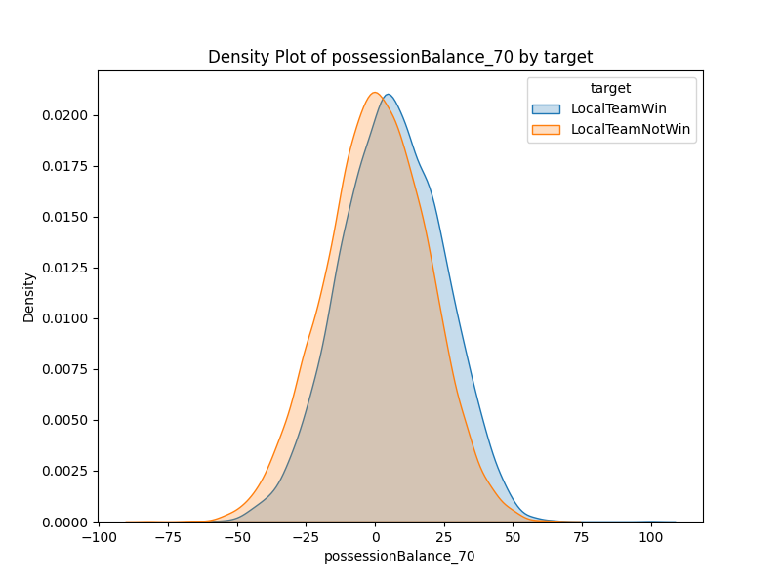
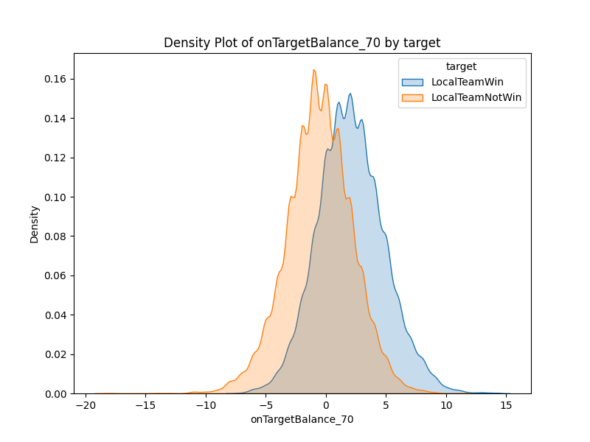
Visualization of data

Slide 11
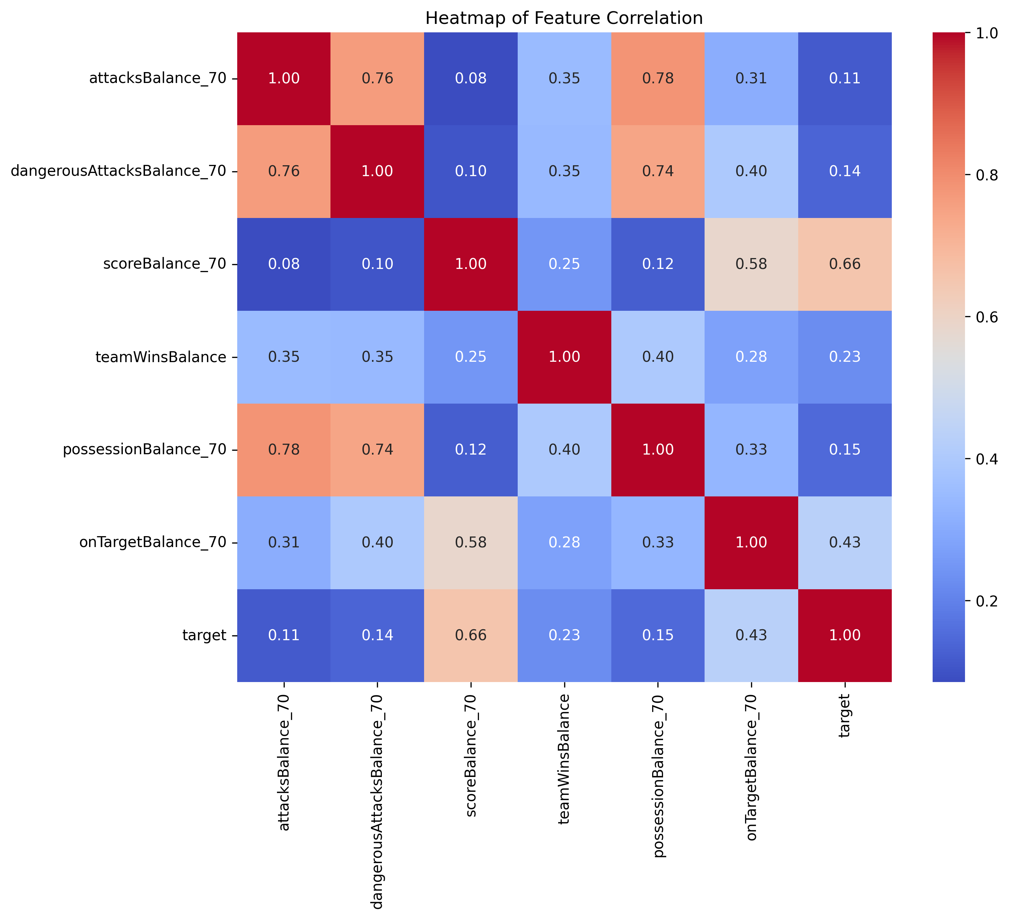

Slide 12
Data Pre Processing

Slide 13
Missing values
In 4,362 records, data regarding the weather was missing, so we decided not to use weather features due to their weak influence on the target and missing data.
Data on local or visitor team scores was missing in some records. Upon investigation, we determined that this was because there were no goals scored by either the local or visitor teams in these matches, so these values were set to 0.

Slide 14
Normalization
Wins columns was divide to number of previous matches (10) to scale from 0 to 1
Balance fields are derived from negative values if the local team has less than the visitor team's statistics, or positive if the local team has more statistics than the visitor team. Different fields have different ranges, so we implemented a custom normalization method to scale from -1 to 1

Slide 15
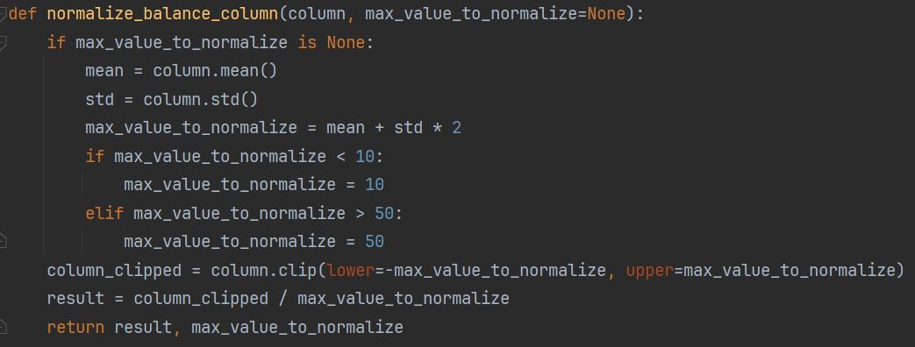
Normalization

Slide 16
Model training

Slide 17
Problem of strong base model
Most models during training received similar or slightly lower results than the base model
Only a few combinations of hyperparameters and features give results more than the base model, with a maximum improvement of 0.1%.

Slide 18
Models – all data (minute 60)
Model | Score (minute 60)
Base model | 81.62
SVC | 81.35
LinearSVC | 81.58
GradientBoostingClassifier | 80.66
RandomForestClassifier | 81.54
LogisticRegression | 81.28
KNeighbors | 79.84

Slide 19
Models – all data (minute 70)
Model | Score (minute 70)
Base model | 86.20
SVC | 86.20 (same as base model)
LinearSVC | 85.85
GradientBoostingClassifier | 86.03
RandomForestClassifier | 86.29 (more then base model)
LogisticRegression | 85.77
KNeighbors | 84.07

Slide 20
Models – all data (minute 80)
Model | Score (minute 80)
Base model | 90.46
SVC | 90.46 (same as base model)
LinearSVC | 90.46 (same as base model)
GradientBoostingClassifier | 90.46 (same as base model)
RandomForestClassifier | 90.46 (same as base model)
LogisticRegression | 90.46 (same as base model)
KNeighbors | 88.41

Slide 21
Models – Top 5 leagues
Model | Score (minute 70)
Base model | 86.54
SVC | 86.34
LinearSVC | 86.13
GradientBoostingClassifier | 86.46
RandomForestClassifier | 86.54 (same as base model)
LogisticRegression | 85.84
KNeighbors | 83.71

Slide 22
Models – without goals data
Model | Score (minute 70)
SVC | 69.77
LinearSVC | 69.52
GradientBoostingClassifier | 69.47
RandomForestClassifier | 69.14
LogisticRegression | 69.51
KNeighbors | 57.46

Slide 23
Models
GradientBoostingClassifier – improve best model on 0.01% in partial dataset when only match from Liga Portugal and Premier League
RandomForestClassifier - improve best model on 0.01%
LogisticRegression - improve best model only on 0.00164%
SVC - improve best model only on 0.00025%
KNN not improved best model

Slide 24
Questions?

