Slide 1
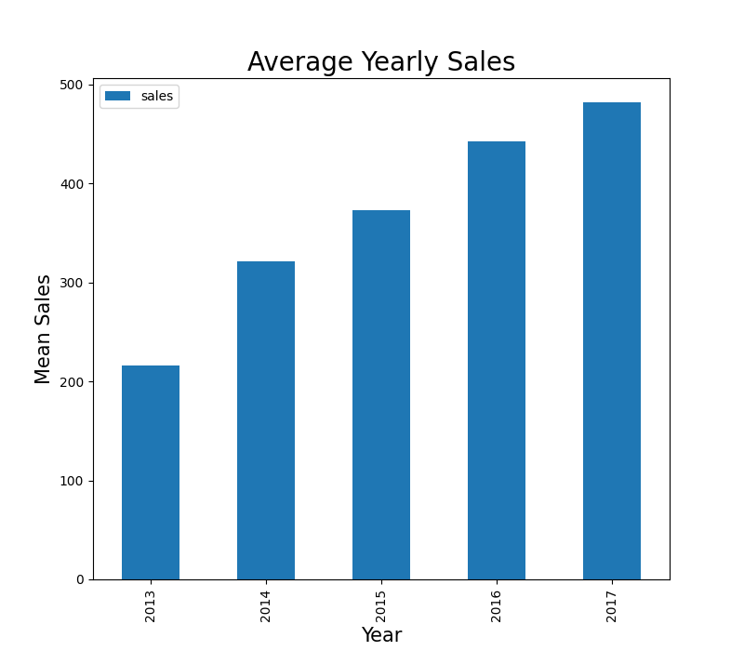
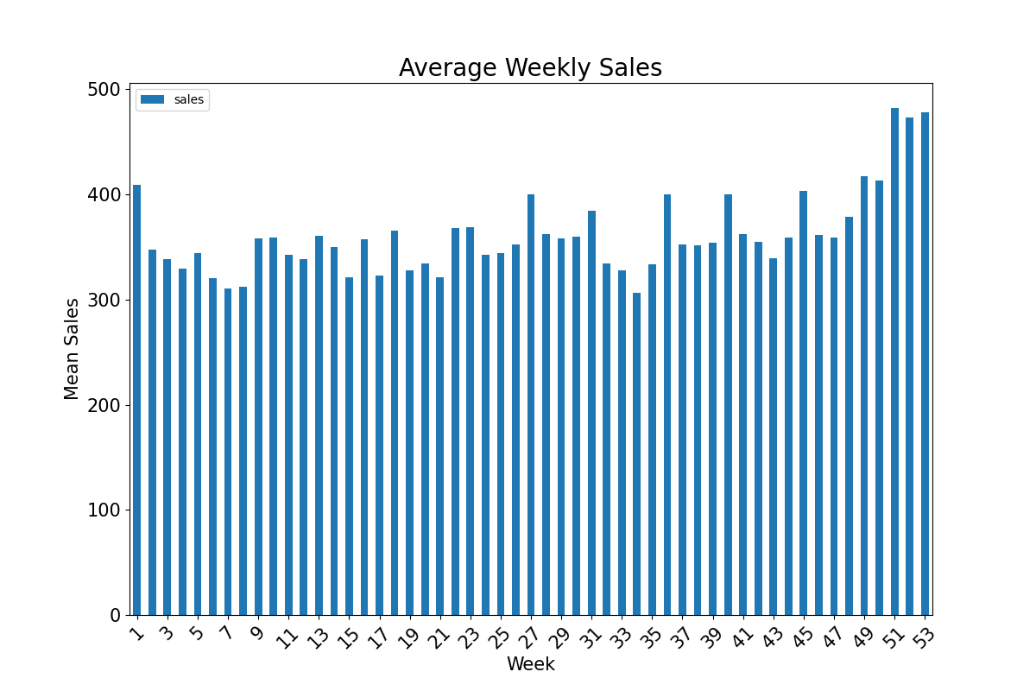
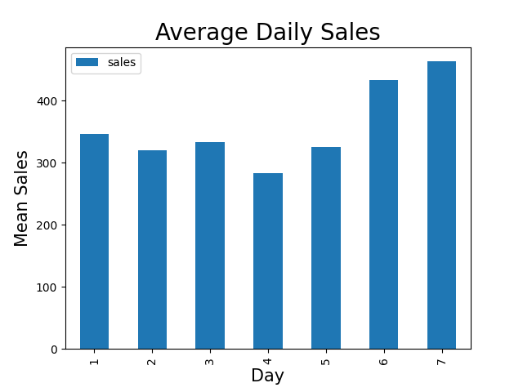
Simple Plots
Mean values of sales increases linearly over the years.

Slide 2
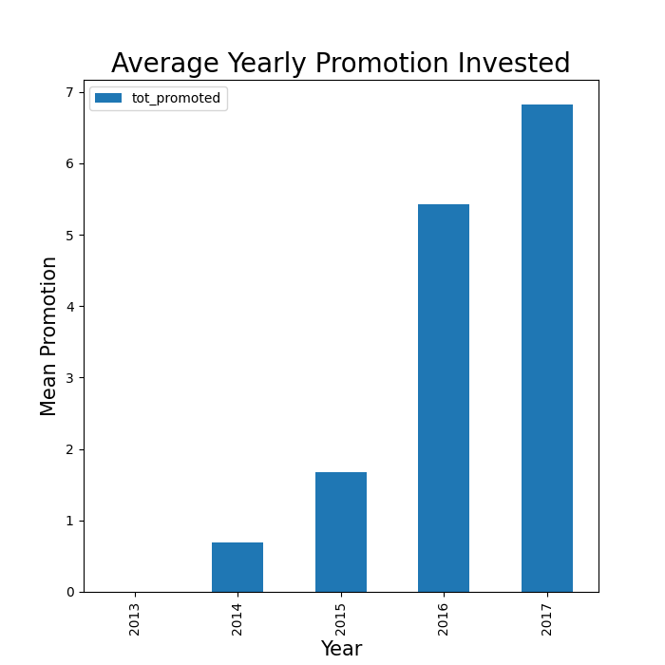
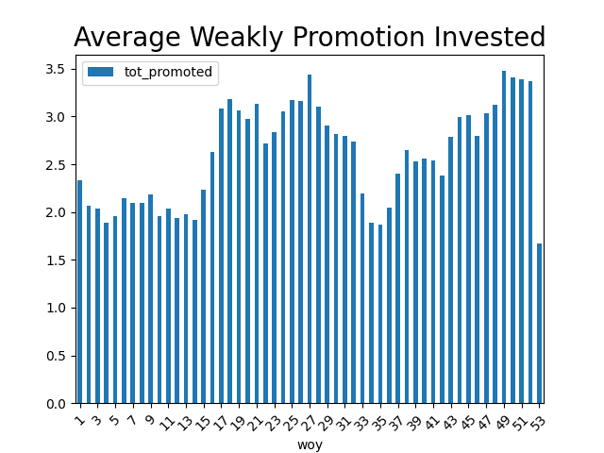
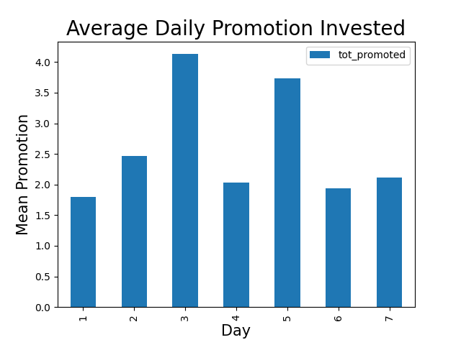
Simple Plots
Mean promotion values increase every year.
The first few weeks of the year are promoted the lowest.

Slide 3
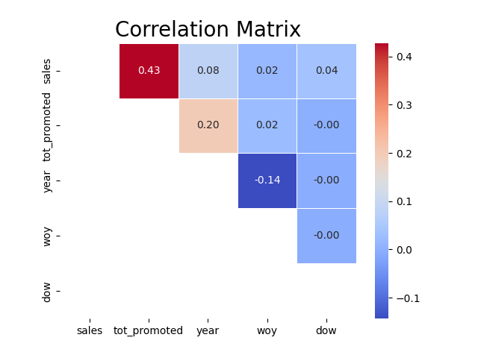
Correlation Matrix
We can see here that promotion has positive linear correlation with sales where all other factors have low correlation.

Slide 4
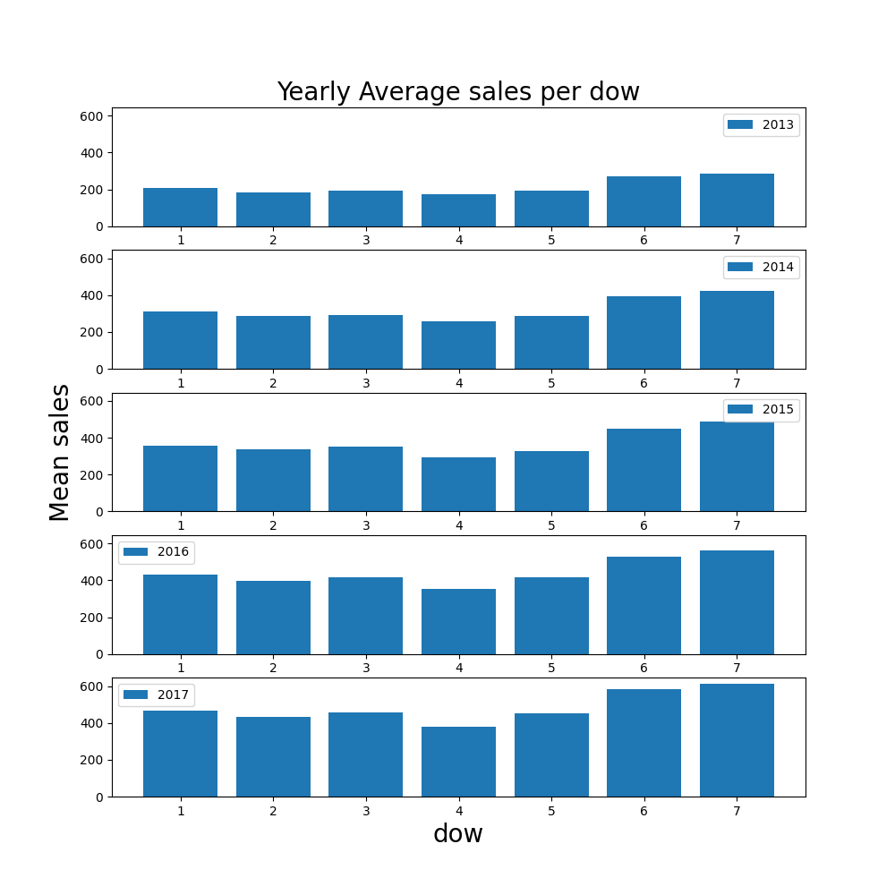
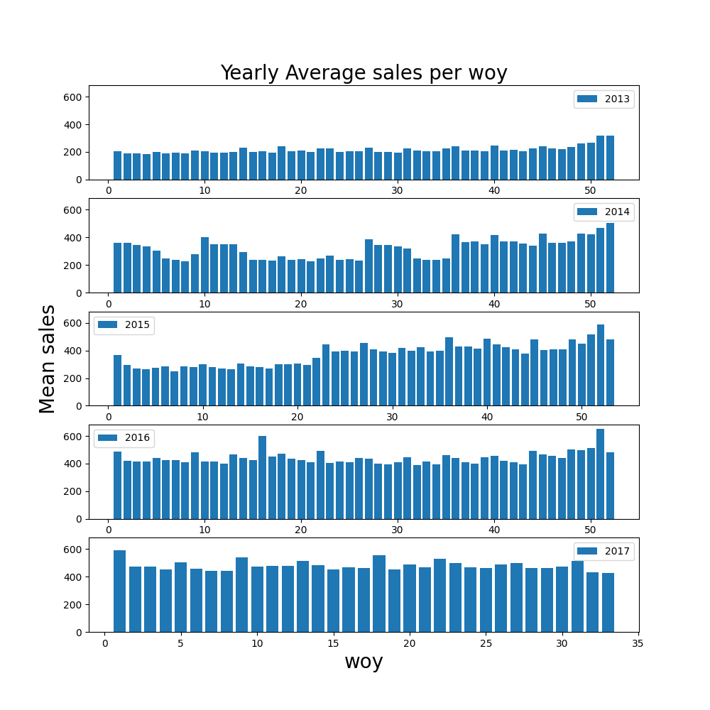
Yearly Plots - Sales
Sales increase over the years.
6th and 7th days are making most of the sales
Weeks are approximately uniform regarding to sales.

Slide 5
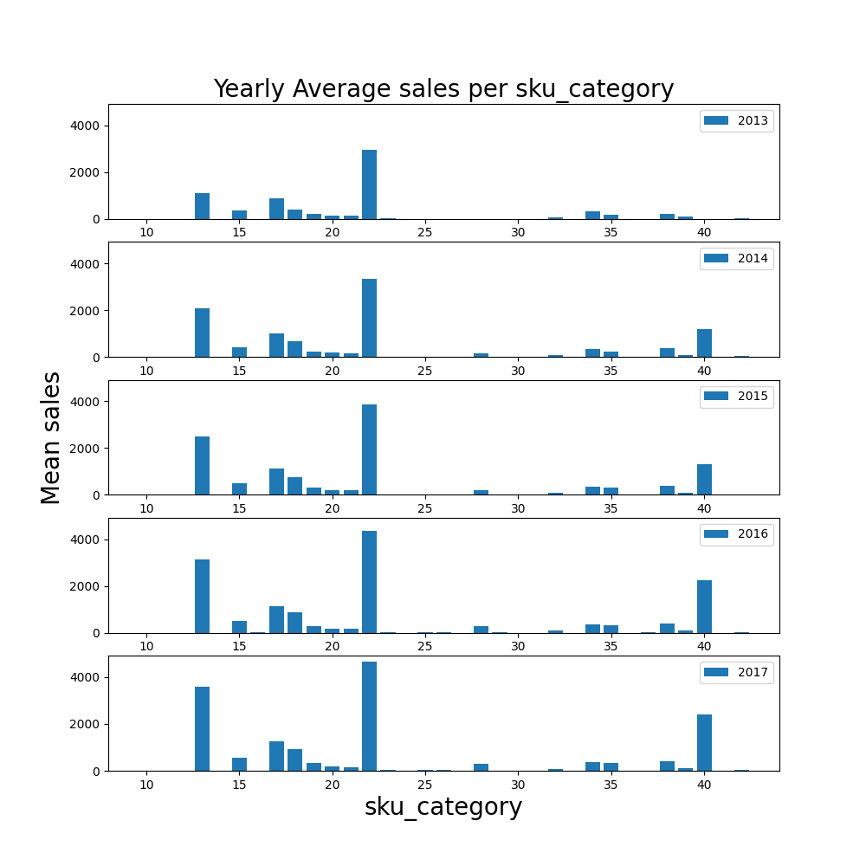
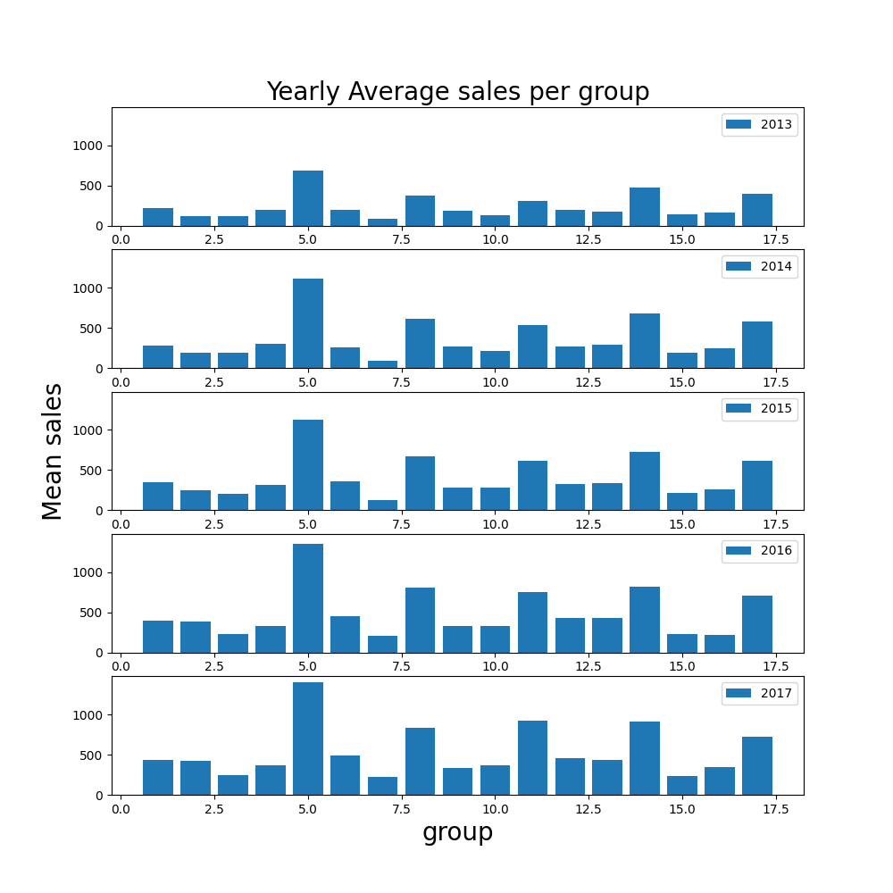
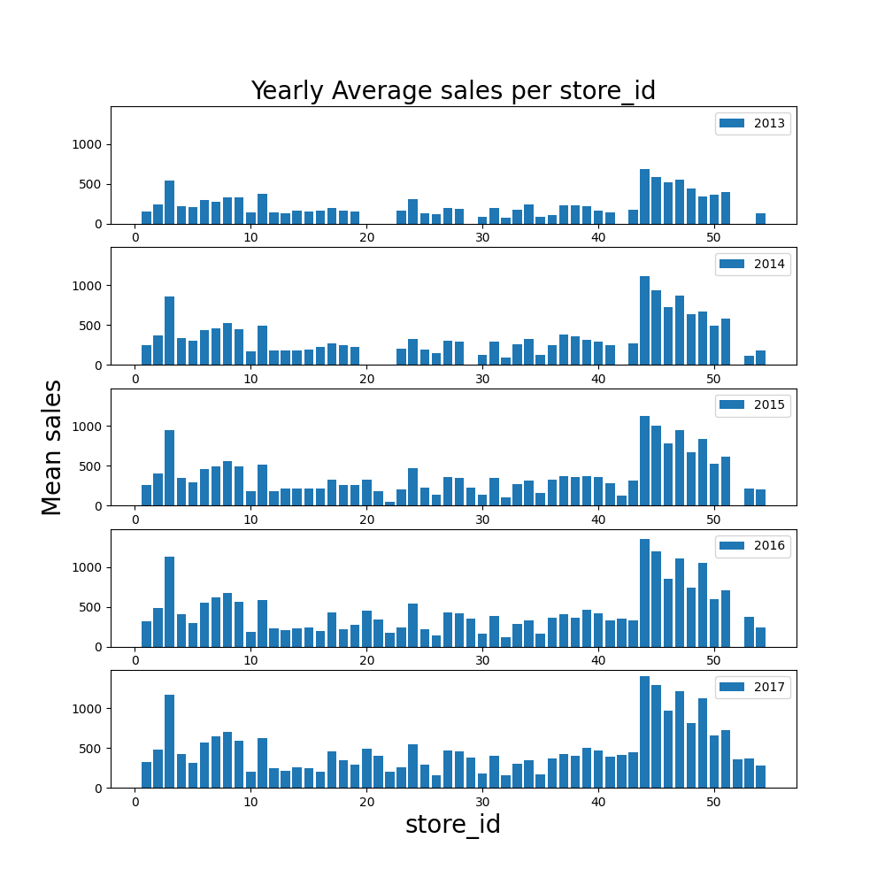
Yearly Plots - Sales
Most products consistently barley sell
Some stores are consistently better than others
Groups also have consistent differences in sales

Slide 6
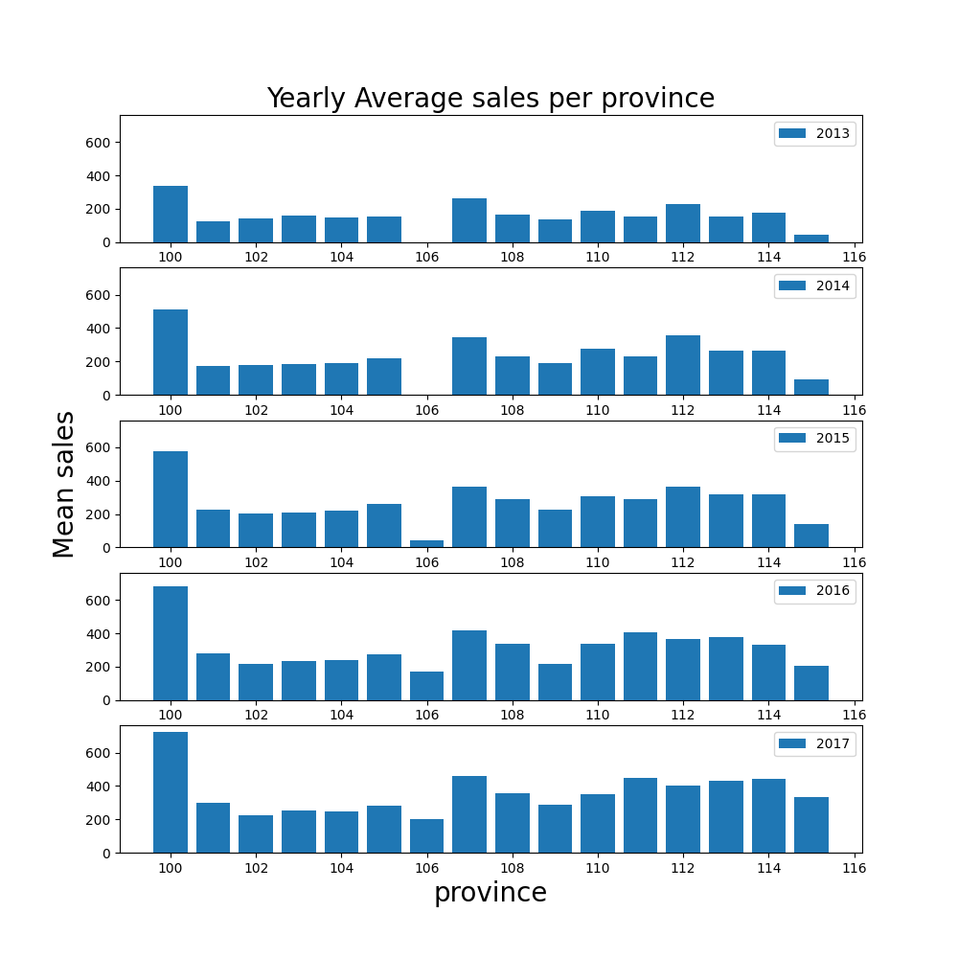
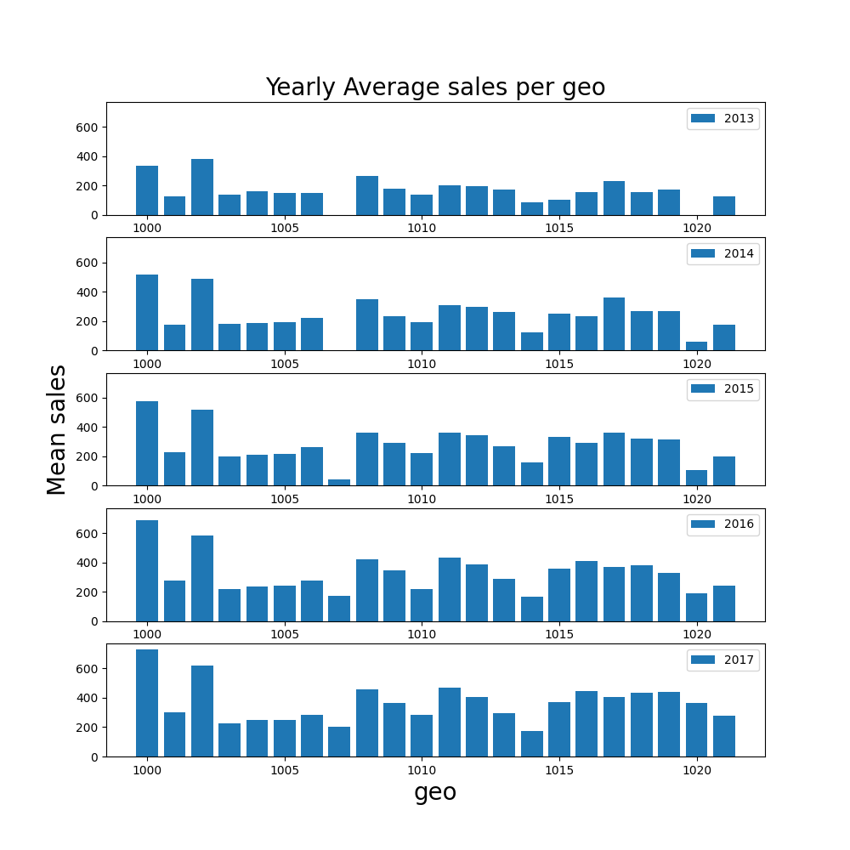
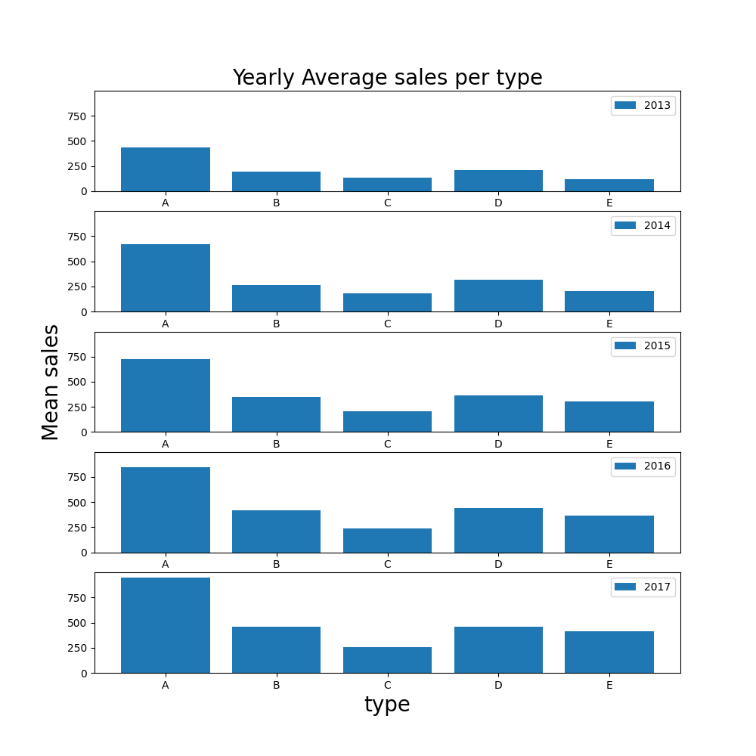
Yearly Plots - Sales
High correlation between Province and Geo
Type A is consistently the highest, where C is consistently the lowest.

Slide 7
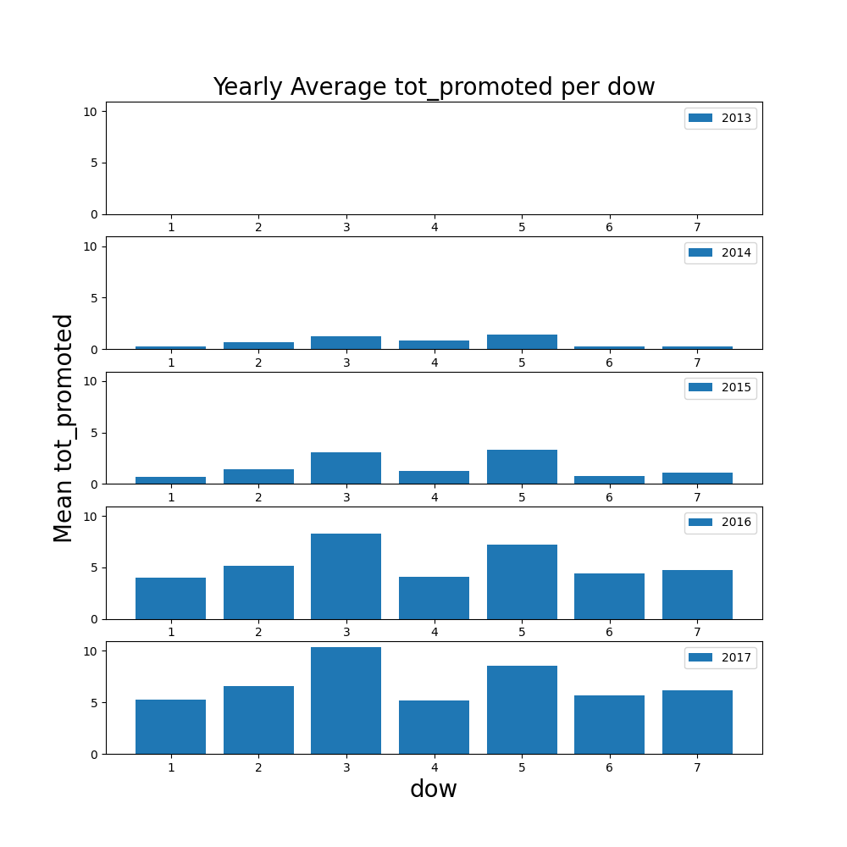
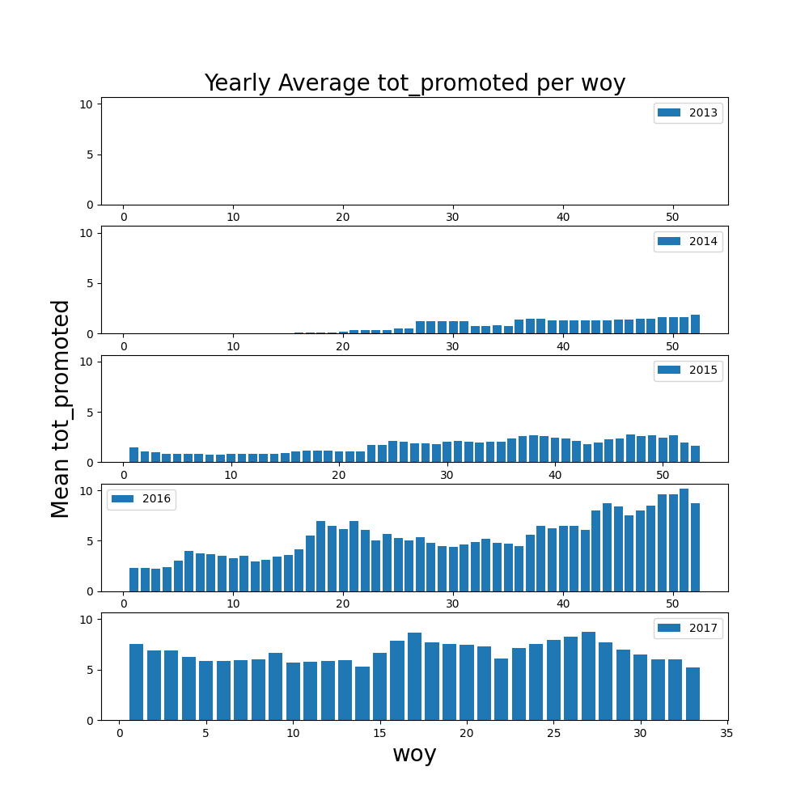
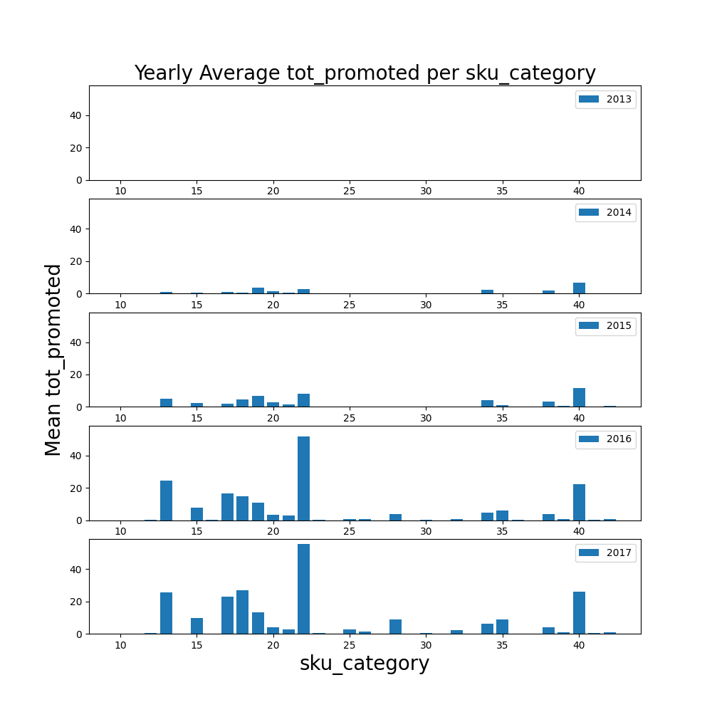
Yearly Plots - Promotions
Promotion of products is increasing over the years.
Promotion is highest at 3th day and 5th day.
Promotion is a bit higher approximately at the second half of the year
Promotion is mainly focused on specific products – with high correlation with products which sell a lot.

Slide 8
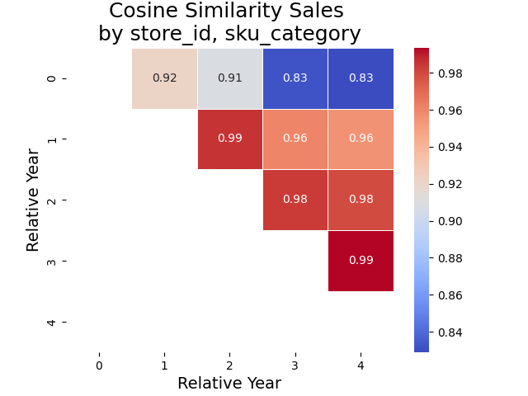
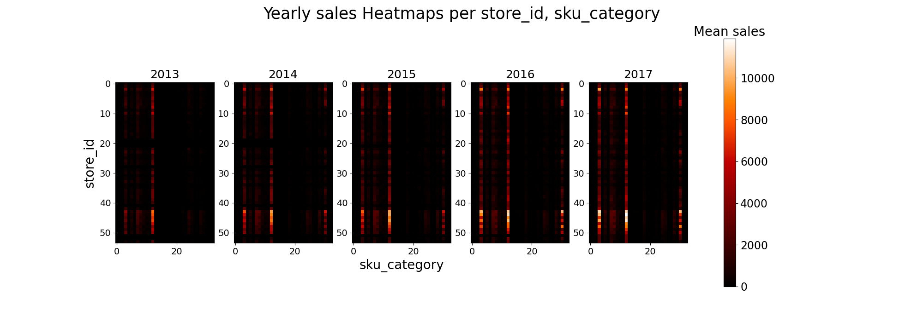
Yearly Heat maps - Sales
We can see the popular products sell among most of the stores. The pattern is consistent over the years.
Upon examining the correlations matrix, it was observed that the cosine similarity tends to increase as the years become closer. As a result of this finding, I attempted to assign greater significance to more recent samples.

Slide 9
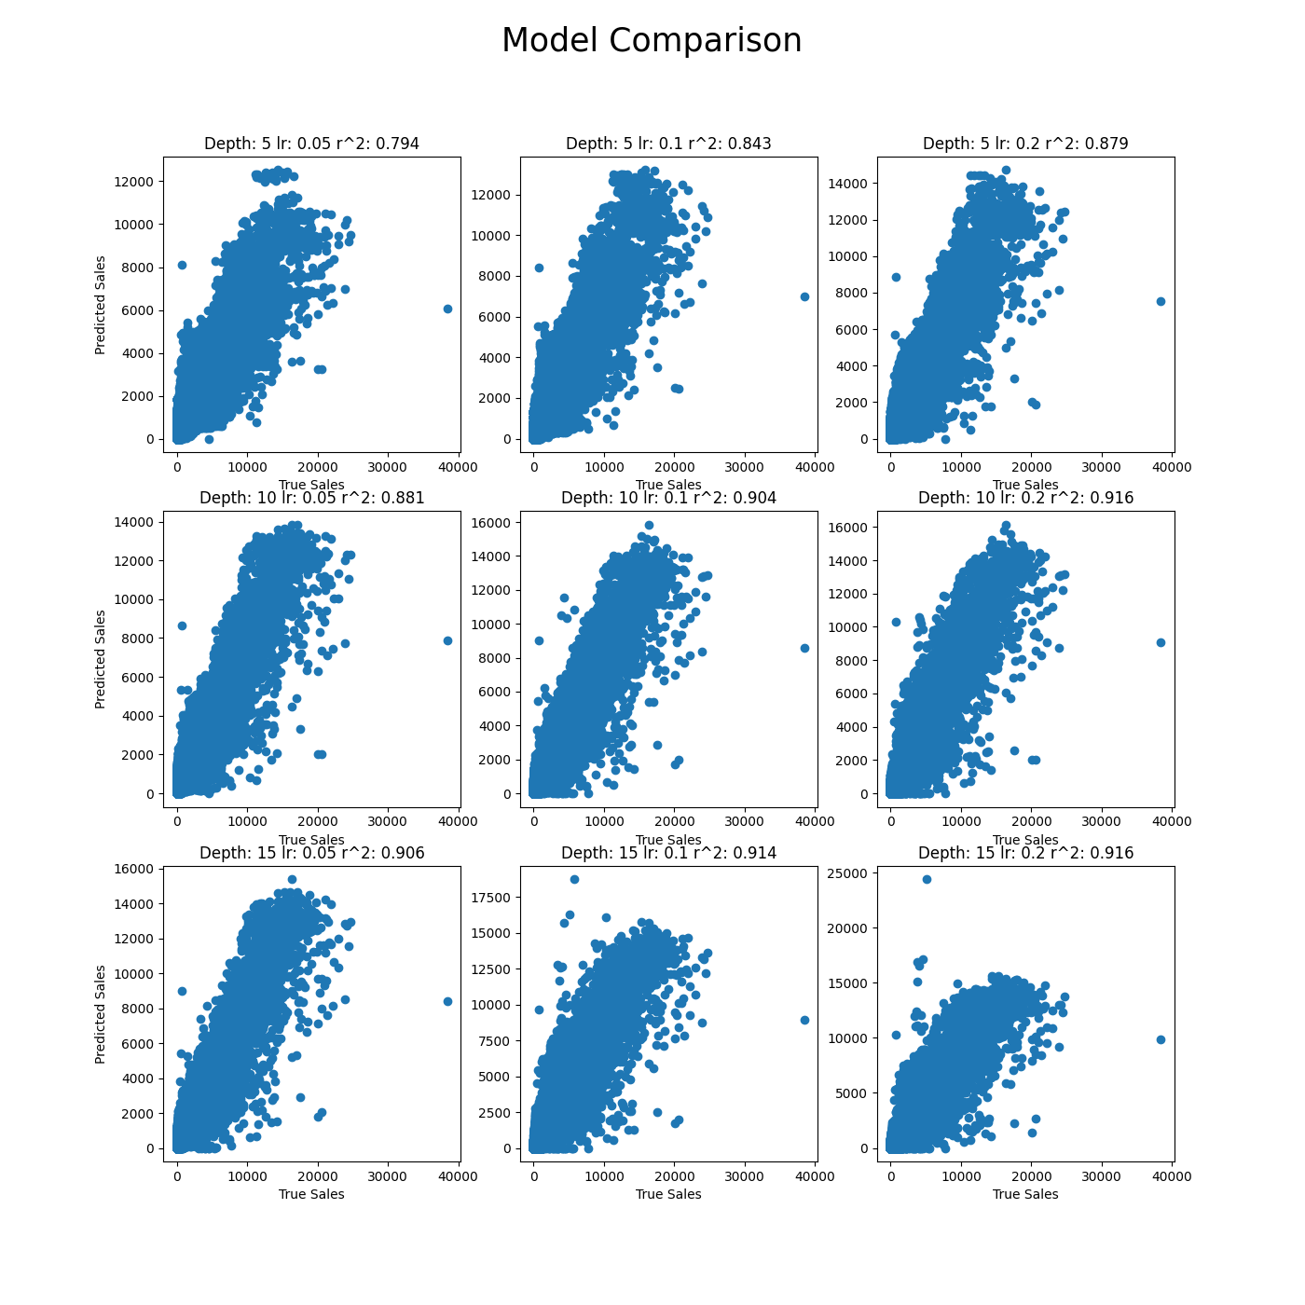
Model Comparison
No store csv data
No weighted samples
Best result is 0.916 R^2

Slide 10
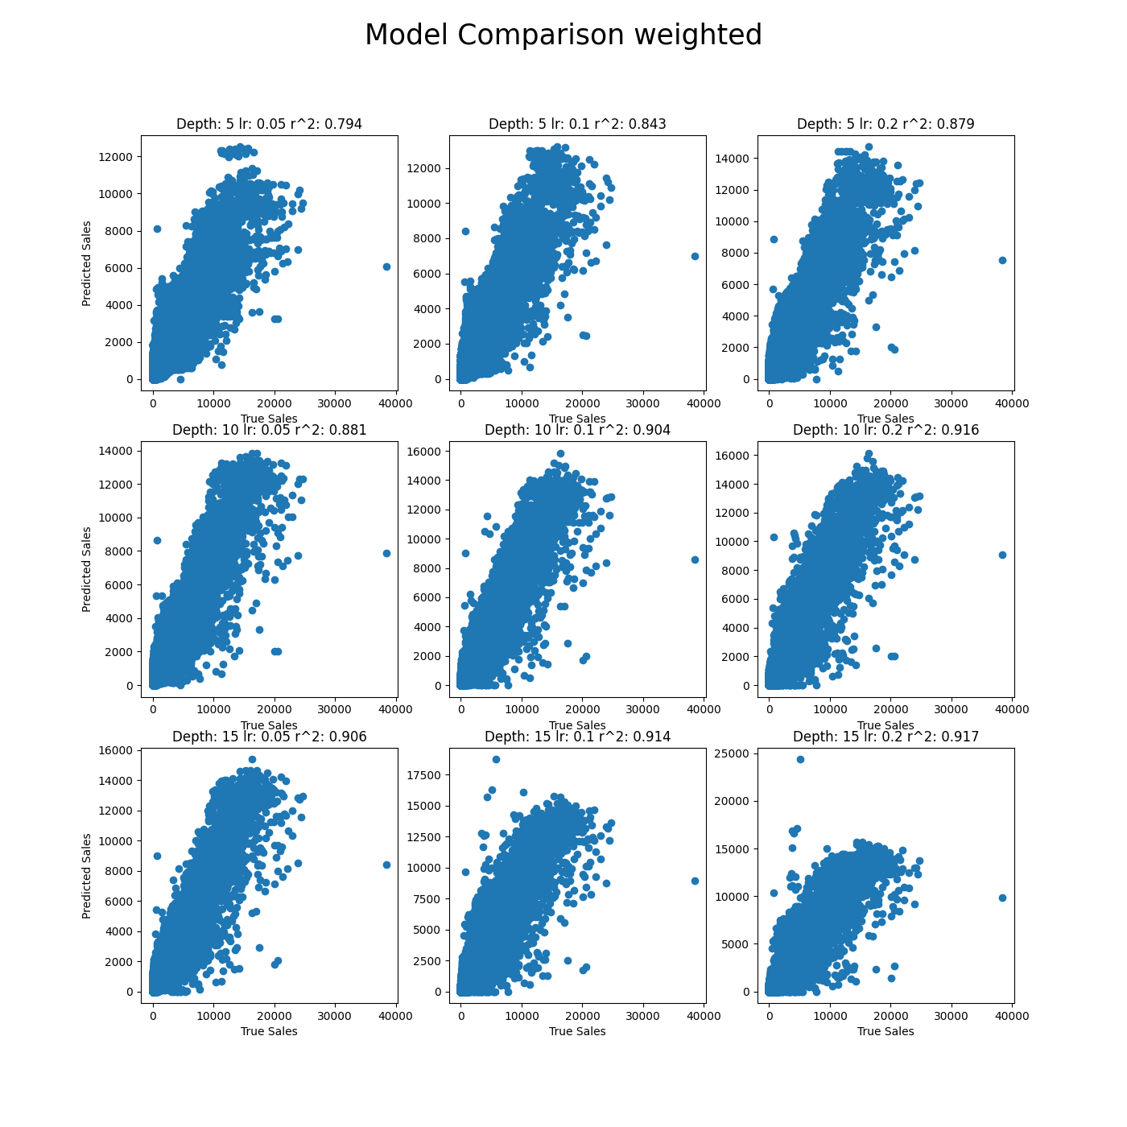
Model Comparison
No store csv data
Weighted samples: 2013: 1, 2014: 1.1, 2015: 1.2, 2016: 1.3, 2017: 1.4
Best result is 0.917 R^2

Slide 11
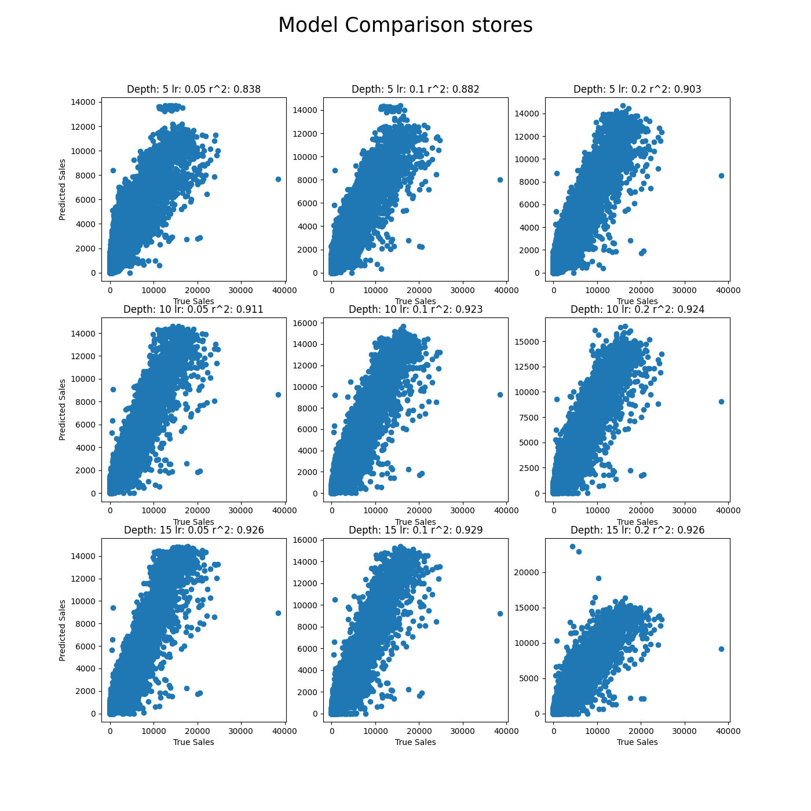
Model Comparison
Only store csv data
No weighted samples
Best result is 0.929 R^2

Slide 12
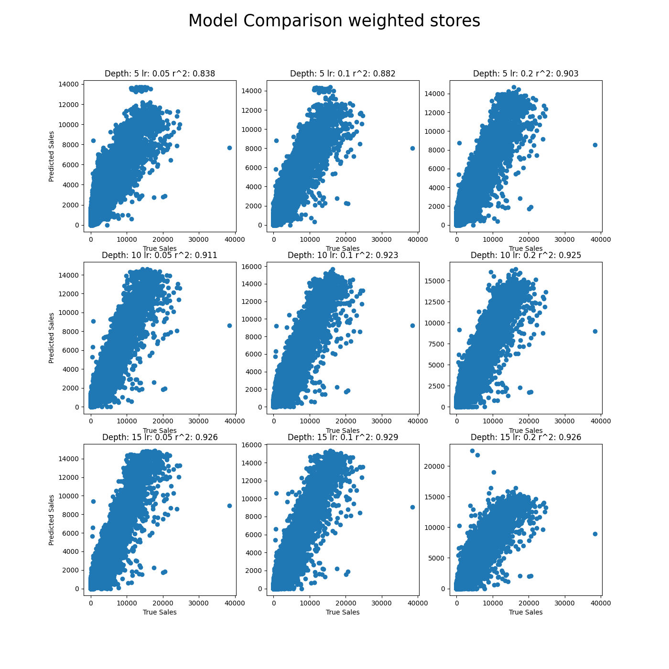
Model Comparison
Only store csv data
No weighted samples
Best result is 0.929 R^2

Slide 13
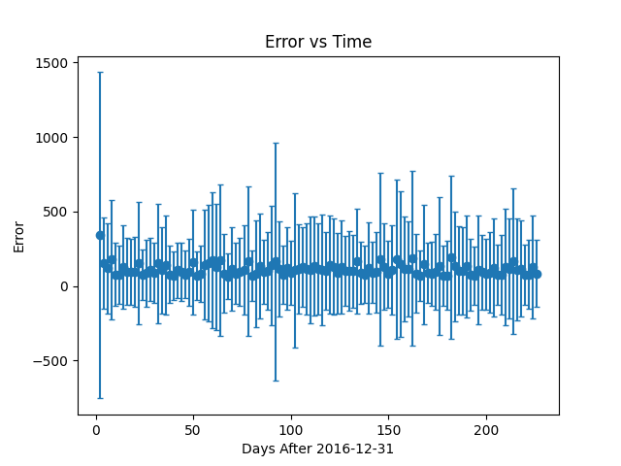
Models’ Horizon
The error distribution is relatively uniform across time.
Relatively good horizon.

