Slide 1
INTRODUCTION TO MFCS
In general it is not necessary in computer science to learn all the mathematical topics that are present.
The trend is to select the various topics in mathematics that are essential to the study of computer science areas.
Mathematical topics that are discussed are logic, set theory, algebraic structures, graph theory.
These topics will support many areas of computer science such as automata, artificial intelligence, syntactic analysis, switching theory, programming languages

Slide 2
Mathematical logic is used to read and understand technical articles and books in computer science.
Set theory, relations, recursive functions are mostly used in programming languages.
Algebraic structures are used for syntactic analysis, error detecting and correcting codes.
Graph theory is used in minimal-path problems, fault detection and diagnosis in computers

Slide 3
UNIT-I
Mathematical Logic
Statements and Notations
Connectives
Well Formed Formulas
Normal Forms
Theory of Inference

Slide 4
Logic
Deals with the methods of reasoning.
Provides rules and techniques for determining whether a given
argument is valid.
Concerned with all kinds of reasoning
Legal arguments.
Mathematical proofs.
Conclusions in scientific theory based upon set of hypotheses.
Main aim
Provide rules that determine whether any particular argument or reasoning is valid (correct).

Slide 5
Uses of Logic reasoning
Mathematics | to prove theorems.
Computer Science | to verify the correctness of programs and to prove theorems.
Natural and Physical Sciences | to draw conclusions from experiments.
Social Sciences, and everyday lives | to solve a multitude of problems.

Slide 6
Statements/Propositions and notations
Statement: A declarative sentence which is either true or false but not both.
Example:
Delhi is capital of the India - True
2+3=5 - True
SNIST is located at Miyapur - False

Slide 7
NOT A STATEMENT – NEITHER TRUE NOR FALSE
Is Canada a Country : it is a question.
Please close the door : it is a request.
X+3=7 : truth value depends upon the value of X
1+101=110 : truth value depends upon the context
Get out of the class : it is a command
Jungle book is greatest movie of all the time : it is an opinion

Slide 8
Types of Statements:
1) Primitive/Primary/Atomic/Simple statements
Declarative statements:
Cannot be further broken down or analyzed into simpler sentences
Have one and only of two possible truth-values.
true (T or 1)
false (F or 0)
Denoted by distinct symbols A, B, C, …, P, Q, ….
Ex: P : The weather is cloudy.
Q : It is raining today.
R : It is snowing.

Slide 9
2)Compound/molecular statement: Statements that involve one or more of the connectives are compound statements (otherwise they are simple statements).
Example:
If you finish your homework then you can watch T.V.
This is a question if and only if this is an answer.
I have read this and I understand the concept.

Slide 10
Truth Table
Truth table displays the relationship among the truth-values of propositions. The truth value of a proposition ‘p’ is made up off individual propositions p₁,p₂,…..p_{n}.
Connectives
Negation
Conjunction
Disjunction
Conditional/Implication
BiConditional/Bi-implication

Slide 11
Negation (⎤, ~, not, --)
Connective that modifies a statement.
Unary operation operates on a single statement.
Formed by introducing the word “not” at a proper place
in the statement or by prefixing the statement with the
phrase “It is not the case that”.
~P or not P.
Truth Table
P | ~P
T | F
F | T

Slide 12
P: London is a city
~P :London is not a city
~P :It is not the case that London is a city
P: I went to my class yesterday
~P : I did not go to my class yesterday
~P : I was absent from my class yesterday
~P : It is not the case that I went to my class yesterday

Slide 13
Conjunction (∧)
P ∧ Q (P and Q).
Truth-value T whenever both P and Q have the truth-values T;
otherwise truth-value F.
Truth Table
Ex:
P : The weather is cloudy.
Q : It is raining today.
P ∧ Q : The weather is cloudy and it is raining today.
P | Q | P ∧ Q
T | T | T
T | F | F
F | T | F
F | F | F

Slide 14
Ex:
P: It is raining today
Q: There are 20 tables in this room
It is raining today and there are 20 tables in this room
Jack and Jill went up the hill
Jack went up the hill and Jill went up the hill
P : Jack went up the hill
Q : Jill went up the hill
Roses are red and violets are blue
He opened the book and started to read

Slide 15
Disjunction / inclusive or (∨)
P ∨ Q (P or Q).
Truth value F only when both P and Q have the truth value F;
otherwise Truth-value T.
Truth Table
Ex:
P : The weather is cloudy.
Q : It is raining today.
P ∨ Q : The weather is cloudy or it is raining today.
P | Q | P ∨ Q
T | T | T
T | F | T
F | T | T
F | F | F

Slide 16
Examples:
I shall watch the game on television or go to the game
There is something wrong with the blub or with the wiring

Slide 17
Exclusive or
Either P is true or Q is true, but not both.
Truth Table
P | Q | P ⊕ Q
T | T | F
T | F | T
F | T | T
F | F | F

Slide 18
Implication or Conditional
P → Q
P premise, hypothesis, or antecedent of the implication.
Q conclusion or consequent of the implication.
Truth Table
P | Q | P → Q
T T F F | T F T F | T F T T

Slide 19
Valid principles of implication that are sometimes considered paradoxical.
i) A False antecedent P implies any proposition Q.
ii) A True consequent Q is implied by any proposition P.
P implies Q
if P then Q
P only if Q
P is a sufficient condition for Q
Q is a necessary condition for P
Q if P
Q follows from P
Q provided P
Q is a consequence of P
Q whenever P

Slide 20
Example:
"If you get an A, then I'll give you a dollar."
The statement will be true if I keep my promise and false if I don't.
Suppose it's true that you get an A and it's true that I give you a dollar. Since I kept my promise, the implication is {\it true}. This corresponds to the first line in the table.
Suppose it's true that you get an A but it's false that I give you a dollar. Since I didn't keep my promise, the implication is false. This corresponds to the second line in the table.
What if it's false that you get an A? Whether or not I give you a dollar, I haven't broken my promise. Thus, the implication can't be false, so (since this is a two-valued logic) it must be true. This explains the last two lines of the table.

Slide 21
Examples:
P: the sun is shining today
Q: 2 + 7 > 4
If the sun is shining today, then 2 + 7 > 4
“If I get the book , then I shall read it tonight”
“If I get the book, then this room is red”
“If I get the money, then I shall buy the car”

Slide 22
If Jerry takes Calculus or Ken takes Sociology, then Larry will take English
J: Jerry takes Calculus
K: Ken takes Sociology
L: Larry takes English
  (J ∨ K) → L
The crop will be destroyed if there is a flood
C: The crop will be destroyed
F: There is a flood
  F → C

Slide 23
Biconditional
Biconditional P ↔ Q
Conjunction of the conditionals P → Q and Q → P.
True : when P and Q have the same truth-values.
False : otherwise.
↔ P if and only if Q - P iff Q
- P is necessary and sufficient for Q
P | Q | P ↔ Q
T | T | T
T | F | F
F | T | F
F | F | T

Slide 24
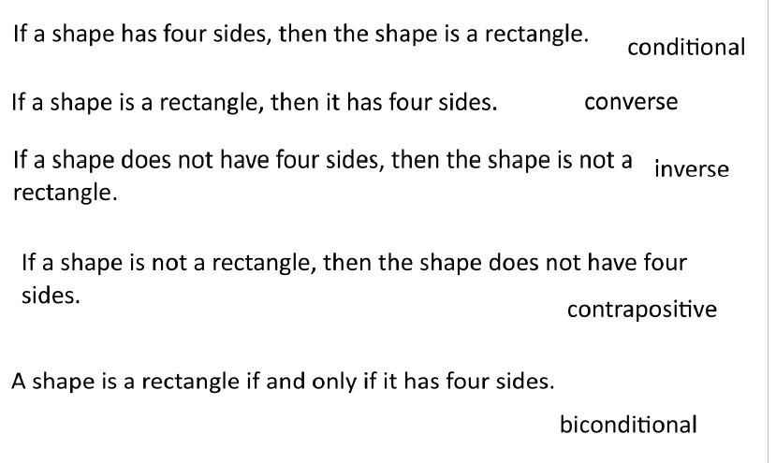
Example

Slide 25
Precedence of logical connectives is:
  ~ highest
  ^ second highest
  V third highest
  → fourth highest
  ↔ fifth highest

Slide 26
Truth table
P | Q | P → Q | Q → P | P ↔ Q
T T F F | T F T F | T F T T | T T F T | T F F T
Construct the truth table for the formula
~(P ∧ Q) ↔ (~P ∨ ~Q)

Slide 27
Well-formed formulas (WFF)
Expression consisting of
statements (Propositions/variables)
parentheses
connecting symbols.

Slide 28
A statement variable standing alone is a well-formed formula.
If A is a well-formed formula, then ~A is a well-formed formula.
If A and B are well-formed formulas, then (A ∧ B), (A ∨ B), (A → B), and (A ↔ B) are well-formed formulas.
A string of symbols containing the statement variables, connectives, and parentheses is a well-formed formula, iff it can be obtained by finitely many applications of 1, 2, and 3 above.

Slide 29
Tautologies
A statement formula which is true regardless of the truth values of the statements which replace the variables in it is called a universally valid formula or a tautology or a logical truth
A statement formula which is false regardless of the truth values of the statements which replace the variables in it is called a contradiction

Slide 30
Converse
Converse of P → Q
Q → P
Opposite/Inverse
Opposite/Inverse of P → Q
(~P) → (~Q)
Contrapositive
Contrapositive of P → Q
~Q → ~P
Tautology / Identically True
Propositional function whose truth-value is true for all possible values of the propositional variables.
Ex: P ∨ ~P.

Slide 31
Truth Table
P Q | P→Q | ~P | ~P∨Q | ~Q | ~Q→~P | Converse Q → P | Opposite ~P → ~Q
T T T F F T F F | T F T T | F F T T | T F T T | F T F T | T F T T | T T F T | T T F T

Slide 32
Contradiction / Absurdity / Identically False
Propositional function whose truth-value is always false.
Ex: P ∧ ~P.
Contingency
Propositional function that is neither a tautology nor a contradiction.
Verify whether it is Tautology or not?
1. (P ∧ Q) → P
2. (P ∧ Q) → Q
3. P → (P ∨ Q)
4. Q → (P ∨ Q)
5. ~P → (P → Q)
6. ~(P → Q) → P
7. (P ∧ (P → Q)) → Q
8. (~P ∧ (P ∨ Q)) → Q
9. (~Q ∧ (P → Q)) → ~P
10. ((P → Q) ∧ (Q → R)) → (P → R)

Slide 33
Equivalence of Formulas/Logical Equivalence
Two well-formed formulas A and B are said to be equivalent, if the truth value of A is equal to the truth value of B for every one of the 2^{n} possible sets of truth values assigned.
The Statement formulas A and B are equivalent provided A↔B is a tautology.
It is represented by A <=> B
Equivalent Formulas:
Commutative Properties
P ∨ Q ≡ Q ∨ P
P ∧ Q ≡ Q ∧ P
Associative Properties
P ∨ (Q ∨ R) ≡ (P ∨ Q) ∨ R
P ∧ (Q ∧ R) ≡ (P ∧ Q) ∧ R

Slide 34
Distributive Properties
P ∨ (Q ∧ R) ≡ (P ∨ Q) ∧ (P∨ R)
P ∧ (Q ∨ R) ≡ (P ∧ Q) ∨ (P ∧ R)
Idempotent Properties
P ∨ P ≡ P
P ∧ P ≡ P
Properties of Negation (De Morgan’s Law)
~(~P) ≡ P
~(P ∨ Q) ≡ (~P) ∧ (~Q)
~(P ∧ Q) ≡ (~P) ∨ (~Q)

Slide 35
Identity Law
P ∧T ≡ P
P ∨ F ≡ P
Domination Law
P ∨ T ≡ T
P ∧ F ≡ F
Absorption Law
P ∨ (P ∧ Q) ≡ P
P ∧ (P ∨ Q) ≡ P
Law of Complementation
P ∨ ~P ≡ T
P ∧ ~P ≡ F

Slide 36
DeMorgan’s laws
~(P ∨ Q) ≡ (~P) Λ (~Q) and ~(P Λ Q) ≡ (~P) ∨ (~Q)
Law of Double Negation
P ≡ ~(~P).
(P → Q) ≡ (~P) ∨ Q (Law of implication)
(P → Q) ≡ (~Q → ~P) (Law of contrapositive)

Slide 37
Properties of operations on equivalence
(P → Q) ≡ ((~P) ∨ Q)
(P → Q) ≡ (~Q → ~P)
(P ↔ Q) ≡ ((P → Q) ∧ (Q → P))
~(P → Q) ≡ (P ∧ ~Q)
~(P ↔ Q) ≡ ((P ∧ ~Q) ∨ (Q ∧ ~P))
P↔ Q ≡ (P ∧ Q) ∨ (~P ∧ ~Q)

Slide 38
Tautological Implications
A Statement P is said to tautologically imply a Statement Q if and only if P→Q is a tautology. We shall denote this as P =>Q.
Here, P and Q are related to the extent that, Whenever P has the truth value T then so does Q.

Slide 39
Tautological Implications:
P^Q=>P
P^Q=>Q
P=>PVQ
~P=>P->Q
Q=>P->Q
~(P->Q) => P
~(P->Q) => ~Q
P^ (P->Q) => Q
~Q ^ (P->Q) => ~P
~P ^ (PvQ)=>Q
(P->Q)^(Q->R)=>P->R
(PvQ) ^ (P->R)^(Q->R)=>R

Slide 40
Duality Law
Two formulas A and A* are said to be duals of each other if either one can be obtained from the other by replacing ^ by v and v by ^.
A(P,Q,R) : P v (Q ^ R)
A*(P,Q,R) : P ^ (Q v R)
If the formula A contains special variables T or F then its dual A* is obtained by replacing T by F and F by T.
The connectives ^ and v are called duals of each other.

Slide 41
Theorem
Statement: let A an A* are dual formulas and P1,P2,….Pn be all the atomic variables that occur in A and A*.We write as A(P1,P2,….Pn)
A*(P1,P2,….Pn ) then we say that
~ A(P1,P2,….Pn )⬄A*(~P1,~P2,….~Pn )
Using the demorgan’s law:
~(P ∨ Q) ≡ (~P) ∧ (~Q)
~(P ∧ Q) ≡ (~P) ∨ (~Q)
We can show ~ A(P1,P2,….Pn )⬄A*(~P1,~P2,….~Pn )
Thus, the negation of the formula is equivalent to its dual in which every variable is replaced by its negation.

Slide 42
Example:
Verify the equivalence of
A(P,Q,R) : ~P ^ ~(Q v R)
A*(P,Q,R) : ~P v ~(Q ^ R)

Slide 43
Normal forms
Let A(P₁,P₂,……, P_{n}) be a statement formula where P₁,P₂,……, P_{n} are the atomic variables.
If we consider all possible assignments of the truth values to P₁,P₂,……, P_{n} and obtain the resulting truth values of the formula A.
Such a truth table contains 2^{n} rows.
If A has the truth value T for at least one combination of truth values assigned to P₁,P₂,……, P_{n} then A is said to be satisfiable.
The problem of determining , in a finite number of steps, whether a given statement formula is a tautology or a contradiction or at least satisfiable is known as a decision problem.

Slide 44
Elementary Product
Product of the variables and their negations in a formula.
Ex: P
Q
~P ∧ Q
~Q ∧ P ∧ ~P
P ∧ ~P
Q ∧ ~P

Slide 45
Elementary Sum
Sum of the variables and their negations in a formula.
Ex: P
~P ∨ Q
~Q ∨ P ∨ ~P
P ∨ ~P
Q ∨ ~P
Factor of the elementary sum or product
any part of an elementary sum or product, which is itself is an elementary sum or product.
Ex: Factors of ~Q ∧ P ∧ ~P
~Q
P ∧ ~P
~Q ∧ P

Slide 46
Disjunctive Normal Forms
A formula equivalent to a given formula and consists of a sum of elementary products of the given formula.
Examples
1. Obtain Disjunctive Normal Form of P ∧ (P → Q).
P ∧ (P → Q) ⇔ P ∧ (~P ∨ Q) [since P→Q ≡(~P ∨ Q)]
⇔ (P ∧ ~P) ∨ (P ∧ Q) [Distributive law]

Slide 47
2.Obtain Disjunctive Normal Form of ~(P ∨ Q) ↔ (P ∧ Q).
~(P ∨ Q) ↔ (P ∧ Q)
⇔ (~(P ∨ Q) ∧ (P ∧ Q)) ∨ ((P ∨ Q) ∧ ~(P ∧ Q))
since [R ↔ S ⇔ (R ∧ S) ∨ (~R ∧ ~S)]
⇔ (~P ∧ ~Q ∧ P ∧ Q) ∨ ((P ∨ Q) ∧ (~P ∨ ~Q) [Distributive law]
⇔ (~P ∧ ~Q ∧ P ∧ Q) ∨ ((P ∨ Q) ∧ (~P ∨ ~Q))
⇔ (~P ∧ ~Q ∧ P ∧ Q) ∨ ((P ∨ Q) ∧ ~P)
∨ ((P ∨ Q) ∧ ~Q)
⇔ (~P ∧ ~Q ∧ P ∧ Q) ∨ (P ∧ ~P) ∨ (Q ∧ ~P)
∨ (P ∧ ~Q) ∨ (Q ∧ ~Q)
a b c

Slide 48
Conjunctive Normal Forms
A formula equivalent to a given formula and consists of a product of elementary sums of the given formula.
Examples
1. Obtain Conjunctive Normal Form of P ∧ (P → Q).
P ∧ (P → Q) ⇔ P ∧ (~P ∨ Q) [law of implication]

Slide 49
2.Obtain Conjunctive Normal Form of ~(P ∨ Q) ↔ (P ∧ Q).
~(P ∨ Q) ↔ (P ∧ Q)
⇔ (~(P ∨ Q) → (P ∧ Q)) ∧ ((P ∧ Q) → ~(P ∨ Q))
since [R ↔ S ⇔ (R → S) ∧ (S → R)]
⇔ ((P ∨ Q) ∨ (P ∧ Q)) ∧ (~(P ∧ Q) ∨ (~P ∧ ~Q)
[since P→Q ≡(~P ∨ Q)]
⇔ ((P ∨ Q ∨ P) ∧ (P ∨ Q ∨ Q))
∧ ((~P ∨ ~Q) ∨ (~P ∧ ~Q)
[Distributive law]
⇔ (P ∨ Q ∨ P) ∧ (P ∨ Q ∨ Q)
∧ (~P ∨ ~Q ∨ ~P) ∧ (~P ∨ ~Q ∨ ~Q)

Slide 50
3.Obtain Conjunctive Normal Form of Q ∨ (P ∧ ~Q) ∨ (~P ∧ ~Q).
Q ∨ (P ∧ ~Q) ∨ (~P ∧ ~Q)
⇔ Q ∨ ((P ∨ ~P) ∧ ~Q)
⇔ (Q ∨ (P ∨ ~P)) ∧ (Q ∨ ~Q)
⇔ (Q ∨ P ∨ ~P) ∧ (Q ∨ ~Q)

Slide 51
P→ {(P →Q)∧ ~(~Q ∨ ~ P))
~{P→(Q∧R)}
(~P ∨ ~ Q) →(P ↔ ~ Q)
(P→ (Q →R))∧(~P → (~Q ∧ ~ R))
(~P ∨ ~ Q) →(P ↔ ~ Q) (CNF)

Slide 52
Principal Disjunctive Normal Forms
Let P and Q be two statement variables.
Let us construct all possible formulas which consists of conjunctions of P or its negation and conjunctions of Q or its negation.
None of the formulas should contain both a variable and its negation.
Ex: either P ∧ Q or Q ∧ P is included but not both.
For two variables P and Q , there are 2² such formulas given by
P ∧ Q, P ∧ ~ Q , ~ P ∧ Q and ~ P ∧ ~ Q
→ these formulas are called minterms.

Slide 53
From the truth tables of these minterms, it is clear that no two minterms are equivalent
Each minterm has the truth value T for exactly one combination of the truth values of the variables P and Q.
For a given formula , an equivalent formula consisting of disjunction of minterms only is known as its principal disjunctive normal form.
Also called sum-of –products canonical form.

Slide 54
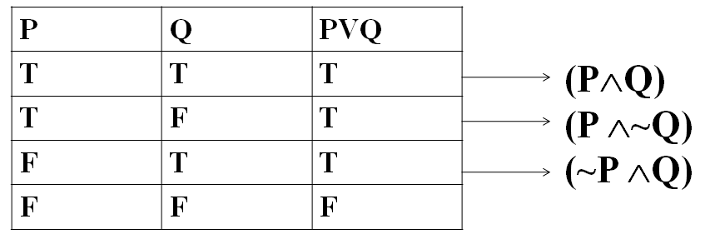
Procedure to obtain PDNF:
Method 1: For every truth value T of given formula in truth table obtain its corresponding minterm and have their sum to obtain PDNF.
Example: Obtain PDNF of (PVQ)

Slide 55
Method II:
Replace →, ↔ by their equivalent terms in ~,V, ∧.
Apply negation to the statement variables only using demorgans law & apply distributive law
Remove the elementary products which are always false
Obtain the minterms by introducing missing factors.
Delete identical minterms

Slide 56
Example: Obtain the PDNF of P→ Q
P→ Q
⇔ ~PVQ [law of implication]
⇔[~P ∧(QV~Q)] V[Q ∧(PV~P)] [since (Q ∧~Q) ⇔ T]
⇔(~P ∧Q) V (~P∧~Q) V (Q ∧P) V (Q ∧~P) [Distributive law]
⇔(~P ∧Q) V (Q ∧P) V (Q ∧~P)

Slide 57
Principal Conjunctive Normal Forms
Let us construct all possible formulas which consists of conjunctions of P or its negation and conjunctions of Q or its negation.
None of the formulas should contain both a variable and its negation.
Ex: either P ∨ Q or Q ∨ P is included but not both.
For two variables P and Q , there are 2² such formulas given by
P ∨ Q, P ∨ ~ Q , ~ P ∨ Q and ~ P ∨ ~ Q
→ these formulas are called maxterms.

Slide 58
For a given formula , an equivalent formula consisting of conjunctions of maxterms only is known as its principal conjunctive normal form.
Also called products-of-sums canonical form.

Slide 59
Obtain the PCNF for (P → R) ∧ (Q ↔ P)
(P → R) ∧ (Q ↔ P)
⇔(~PVR) ∧ { (~QVP) V (~PVQ) }
⇔{ (~PVR) V(Q ∧~Q)} ∧ {(~QVP) V(R ∧~R)} ∧ {(~PVQ) V(R ∧~R)}
⇔(~PVRVQ) ∧(~PVRV~Q) ∧(~QVPVR) ∧(~QVPV~R) ∧ (~PVQVR)∧(~PVQV~R) [Distributive law]
⇔(~PVQVR) ∧(~PVRV~Q) ∧(~QVPVR) ∧(~QVPV~R) ∧(~PVQV~R)

Slide 60
Obtain the principal disjunctive normal forms of the following.
~P ∨ Q
(P ∧ Q) ∨ (~P ∧ R) ∨ (Q ∧ R).
P ∨ (~P→(~Q →~R))
Obtain the principal conjunctive normal forms of the following.
(~P → R) ∧ (Q ↔ P)
(Q → P) ∧ (~P ∧ Q)
Show that the following are equivalent formulas.
P ∨ (P ∧ Q) ⇔ P
P ∨ (~P ∧ Q) ⇔ P ∨ Q

Slide 61
Exercises
1. Construct the truth tables for the following
[(P ∨ Q) Λ (~R)] ↔ Q
(P ∨ Q) Λ (~P) ∨ (~R)]
{(P Λ Q) ∨ (~P Λ R)} ∨ (Q Λ R)
[(P ∨ Q) Λ (~R)] ↔ (Q → R)
2. Prove that the following are tautologies:
~(P ∨ Q) ∨ [(~P) Λ Q] ∨ P.
[(P → Q) Λ (R → S) Λ (P ∨ R)]→ (Q ∨ S)
[(P → R) Λ (Q → R)] → [(P ∨ Q) → R]
{(P → (Q ∨ R)] Λ (~Q)}→ (P → R)
{[(P ∨ Q) → R] Λ (~P)}→ (Q → R)
3. Consider the propositions:
P: David is playing pool.
Q: David is inside.
R: David is doing his homework.
S: David is listening to music.
Translate the following sentences into symbolic notation using P, Q, R, S, ~, ∨, Λ and parentheses only.
Either David is playing pool or he is inside.
Neither is David playing pool, nor he is doing his homework.
David is playing pool and not doing his homework.
David is inside doing his homework, not playing pool.
David is inside doing his homework while listening to music.
David is not listening to music, nor is he playing pool; neither is he doing his homework.

Slide 62
Mathematical Reasoning
We need mathematical reasoning to
determine whether a mathematical argument is
correct or incorrect and
construct mathematical arguments.
Mathematical reasoning is not only important for conducting proofs and program verification, but also for artificial intelligence systems (drawing inferences).

Slide 63
Validity Using Truth Tables
Let A and B be two statement formulas.
We say that “ B logically follows from A” or “ B is a valid conclusion of the premise A” iff A → B is a tautology, that is A ⇒ B.
From a set of premises {H₁ , H₂ , …. , H_{n} } a conclusion C follows logically iff H₁ ∧ H₂ ∧ …. ∧ H_{n} ⇒ C ---------- (1)
Given a set of premises and a conclusion, it is possible to determine whether the conclusion logically follows from the given premises by constructing truth tables
“Truth table technique” for the determination of the validity of a conclusion

Slide 64
Validity Using Truth Tables
Determine whether the conclusion C follows logically from the premises H₁ and H₂ .
H₁ : P → Q H₂: P C: Q
H₁ : P → Q H₂: ~P C: Q
H₁: P → Q H₂: ~ (P ∧ Q) C: ~P
H₁ : ~P H₂:P ↔ Q C:~ (P ∧ Q)
H₁ : P → Q H₂:Q C: P

Slide 65
Rules of Inference
Rule P: A premise may be introduced at any point in the derivation
Rule T: A formula S may be introduced in a derivation if S is tautologically implied by any one or more of the preceding formulas in the derivation

Slide 66
Rules of Inference
Rules of inference provide the justification of the steps used in a proof.
One important rule is called modus ponens or the law of detachment. It is based on the tautology
(p∧(p→q)) → q. We write it in the following way:
p
p → q
____
∴ q
The two hypotheses p and p → q are
written in a column, and the conclusion
below a bar, where ∴ means “therefore”.

Slide 67
It is valid inference because [p ∧ (p → q)] → q is a tautology.
p | q | p → q | p ∧ p → q | [p ∧ p → q]→ q
T | T | T | T | T
T | F | F | F | T
F | T | T | F | T
F | F | T | F | T

Slide 68
The difference between implication and inference is the truth of either p or q. But the truth of both p and p→q does guarantee the truth of q.
In place of propositions p and q in rule of detachment we can substitute propositional functions of any degree of complexity.
Ex: p ∧ (q ∨ ~r)
[p ∧ (q ∨ ~r)]→ s ∧ [(~t) ∨ u]
-----------------------------
∴ s ∧ (~t) ∨ u

Slide 69
Rules of Inference
The general form of a rule of inference is:
p₁
p₂
.
.
.
p_{n}
____
∴ q
The rule states that if p₁ and p₂ and … and p_{n} are all true, then q is true as well.
These rules of inference can be used in any mathematical argument and do not
require any proof.

Slide 70
Rules of inference related to the language of propositions:
Rules of Tautological Name
inference form
1. p p→p∨q Addition
-----
∴p∨q
2. p∧q (p∧q)→p Simplification
-----
∴p
3. p
p→q [p∧(p→p)]→q Modus ponens/
------ Rule of detachment
∴q

Slide 71
4. ~q
p→q [~q∧( p→q)]→~p modus tollens
------
∴~p
5. p∨q
~p [(p∨q)∧(~p)]→q disjunctive
----- syllogism
∴q
6. p→q
q→r [(p→q)∧(q→r)]→[p→r] Hypothetical
----- syllogism /
∴p→r Transitive rule

Slide 72
7. p
q conjunction
-----
∴p∧q
8. (p→q)∧(r→s) [(p→q)∧(r→s)∧(p∨r)]→[q∨s]
p∨r Constructive dilemma
----
∴q∨s
9. (p→q)∧(r→s) [(p→q)∧(r→s)∧(~q∨~s)]→[~p∨~r]
~q ∨~s Destructive dilemma
--------
∴~p∨~r
Fundamental Rule 3: DeMorgan’s laws
~(p∨q)≡~p∧~q
~(p∧q)≡~p∨~q
Fundamental Rule 4: Law of Contrapositive
p→q≡~q→~p

Slide 73
Arguments
Just like a rule of inference, an argument consists of one or more hypotheses and a conclusion.
We say that an argument is valid, if whenever all its hypotheses are true, its conclusion is also true.
However, if any hypothesis is false, even a valid argument can lead to an incorrect conclusion.

Slide 74
Arguments
example:
“If it rains today, then we will not have a barbeque today. If we do not have a barbeque today, then we will have a barbeque tomorrow.
Therefore, if it rains today, then we will have a barbeque tomorrow.”
This is a valid argument: If its hypotheses are true, then its conclusion is also true.

Slide 75
Arguments
Let us formalize the previous argument:
p: “It is raining today.”
q: “We will not have a barbecue today.”
r: “We will have a barbecue tomorrow.”
So the argument is of the following form:
p→q
q→r
_____
∴ p→r
Hypothetical syllogism

Slide 76
Arguments
Another example:
Gary is intelligent or a good actor.
If Gary is intelligent, then he can count
from 1 to 10.
Gary can only count from 1 to 2.
Therefore, Gary is a good actor.
i: “Gary is intelligent.”
a: “Gary is a good actor.”
c: “Gary can count from 1 to 10.”

Slide 77
Arguments
i: “Gary is intelligent.”
a: “Gary is a good actor.”
c: “Gary can count from 1 to 10.”
Step 1: ¬c Hypothesis
Step 2: i → c Hypothesis
Step 3: ¬i Modus tollens Steps 1 & 2
Step 4: a ∨ i Hypothesis
Step 5: a Disjunctive Syllogism
Steps 3 & 4
Conclusion: a (“Gary is a good actor.”)

Slide 78
Example:
If I study,I will not fail in the examination.
If I donot watch TV in the evenings,I will study
I failed in the examination.
Therefore,I must have watched TV in the Evening.

Slide 79

Example: Verify whether the following arguments are valid or not:
1)P->Q, R->S, PvR => QvS
2)P->Q, R->S, ~Qv~S => ~(P^R)
3)P->Q, Q->R, P =>R
4) ~Q, P->Q =>~P
5)S.T SvR IS TAUTOLOGICALLY IMPLIED BY (PvQ)^(P->R)^(Q->S)
6) S.T R^(PvQ) is valid conclusion from the premises PvQ, Q->R, P->M and ~M.
7)P->Q,Q->~R, R, Pv(J^S) => J^S
8) ~J->(MvN),(HvG)->~J, HvG =>MvN

Slide 80
Rule CP: Rule of Conditional Proof.
If we can derive S from R and a set of premises, then we can derive R-> S from the set of premises alone.
If the conclusion is of the form R-> S, then R is taken as an additional premise and S is derived from the given premises and R
Show that R-> S can be derived from the premises P-> (Q-> S), ~RvP, and Q.

Slide 81
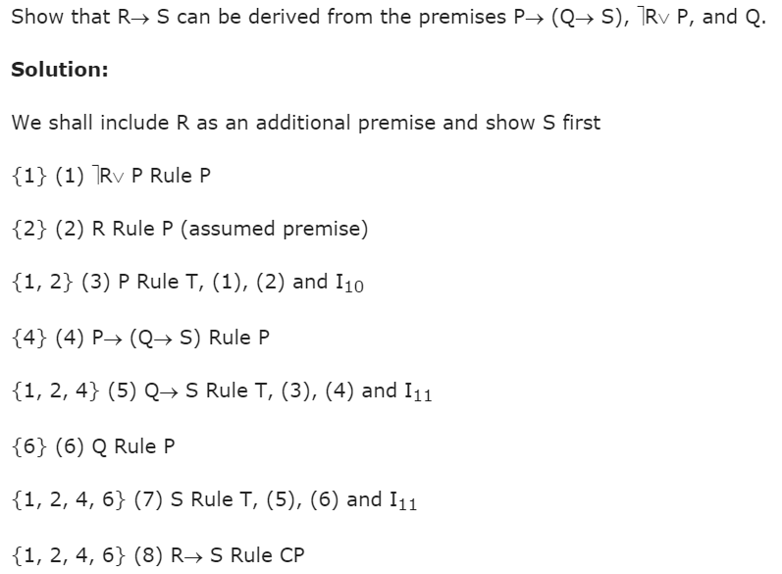

Slide 82
Consistency of Premises and Indirect Method of Proof.
A set of formulas H₁,H₂,…,H_{m} is said to be consistent if their conjunction has the truth value T for some assignment of the truth values to the atomic variables appearing in H₁,H₂,…,H_{m}.
If, for every assignment of the truth values to the atomic variables, atleast one of the formulas H₁,H₂,…,H_{m} is false, so that their conjunction is identically false, then the formulas H₁,H₂,…,H_{m} are called inconsistent.

Slide 83
A set of formulas H₁, H₂,…,H_{m} are inconsistent if their conjunction implies a contradiction.
That is, H_{1,} H₂ … H_{m} => R ^ ~R
where R is any formula. R ^~R is a contradiction.

Slide 84
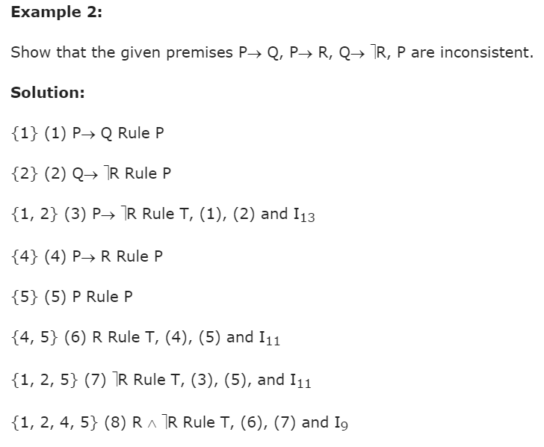

Slide 85
Show the following premises are inconsistent
If Jack misses many classes through illness, then he fails high school.
If Jack fails high school, then he is uneducated.
If Jack reads a lot of books, then he is not uneducated.
Jack misses many classes through illness and reads a lot of books.

Slide 86
Indirect Method of Proof
In order to show that a conclusion C follows logically from the premises H₁, H₂, … , H_{m}
we assume that C is false and consider ~ C as an additional premises.
H_{1,} H₂ … H_{m} ,~C=> R ^ ~R
Using Rule CP,
H_{1,} H₂ … H_{m} => ~C→(R ^ ~R)
There fore, H_{1,} H₂ … H_{m} => C
{Since P→(Q ^ ~Q)=>~P}

Slide 87
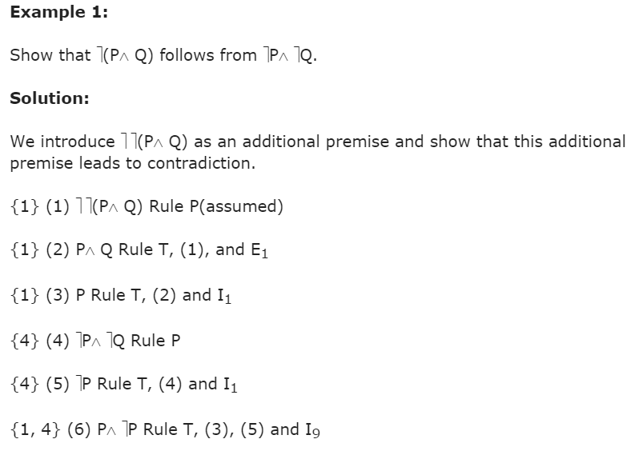

Slide 88
Show that ~P follows from the premises (R→~Q),RvS, S→~Q,P→Q using indirect method of proof.

Slide 89
Automatic Theorem Proving
Variables: The capital letters A,B,C,…,P,Q,R,… are used as statement variables. Also used as statement formulas.
Connectives: The connectives ~,^,v,→,↔ appear in the formulas with the precedence as ~ with highest followed by ^ and so on.

Slide 90
String of Formulas: A string of formulas is defined as follows.
A) Any formula is a string of formulas
B) If α and β are strings of formulas, then
α , β and β, α are strings of formulas.
C) Only those strings which are obtained by steps (A) and (B) are strings of formulas, with the exception of empty string which is also a string of formulas.
Sequents : If α and β are strings of formulas, then α → β is called a sequent in which α is called antecedent and β is called consequent.

Slide 91
Sequents (Contd.,)
s
A sequent α → β is true if and only if either at least one of the formulas of the antecedent is false or at least one of the formulas of the consequent is true.
Thus
A, B, C → D, E, F is true iff (A ∧ B ∧ C) →(D ∨ E ∨ F) is true .
α ⇒ β means that α → β is true.
The empty antecedent is interpreted as ‘true’ or T
The empty consequent is interpreted as ‘false’ or F
Axiom schema: If α and β are strings of formulas such that every formula in both α and β is a variable only, then the sequent α → β is an axiom iff α and β have at least one variable in common.
s
s
s
s

Slide 92
Axioms –theorems -Rules
s
Ex: A,B,C → P,B,R is an axiom.
If α → β is an axiom, then α ⇒ β.
Theorem: The following sequents are theorems of our system.
a) Every axiom is a theorem .
b) If a sequent α is a theorem and a sequent β results from α through the use of one of the 10 rules of the system which are given below, then β is a theorem.
c) Sequents obtained by (a) and (b) are the only theorems.
Rules: The following rules are used to combine formulas within strings by introducing connectives.Corresponding to each of the connectives there are two rules, one for introducing the connective in the antecedent and the other for its introduction in the consequent.
s
s

Slide 93
Rules for Automatic Theorem proving
Antecedent rules:
Rule ∼ ⇒ : If α , β ⇒ X , γ then α , ∼X , β ⇒ γ
Rule ∧ ⇒ : If X, Y, α , β ⇒ γ then α , X ∧Y , β ⇒ γ
Rule ∨ ⇒ : If X, α , β ⇒ γ and Y, α , β ⇒ γ ,
then α , X ∨ Y, β ⇒ γ
Rule →⇒ : If Y, α , β ⇒ γ and α , β ⇒ X , γ
then α , X → Y, β ⇒ γ
Rule ↔ ⇒ : If X,Y, α, β ⇒ γ and α , β ⇒ X, Y,γ
then α, X↔Y, β ⇒ γ
s
s
s
s
s
s
s
s`
s
s
s
s
s

Slide 94
Rules for Automatic Theorem proving (contd.,)
Consequent rules:
Rule ⇒∼ : If X, α ⇒ β, γ then α ⇒ β, ∼X ,γ
Rule ⇒∧ : If α ⇒ X, β, γ and α ⇒ Y, β, γ
then α ⇒ β, X ∧ Y, γ
Rule ⇒∨ : If α ⇒ X, Y, β, γ then α ⇒ β, X ∨ Y, γ
Rule ⇒→ : If X , α ⇒ Y, β, γ then α ⇒ β , X → Y, γ
Rule ⇒↔ : If X , α ⇒ Y, β, γ and Y,α ⇒ X, β, γ
then α ⇒ β, X↔Y, γ
s
s
s
s
s
s
s
s
s
s
s
s

Slide 95
Examples
Ex: Using Automatic theorem proving, Show that P∨Q follows from P.
Solution: we need to show that
(1) ⇒ P →(P∨Q )
(1) if (2) P ⇒( P ∨ Q ) ( By the rule, ⇒→ )
(2) if (3) P ⇒ P , Q ( By the rule, ⇒ ∨ )
Now, (3) is an axiom
Hence, the theorem (1) follows.
s
s
s

Slide 96
Ex: Using Automatic theorem proving,
Show that P does not follow from P∨Q.
Solution:
Assume
(1) ⇒ (P∨Q ) →P
(1) if (2) ( P ∨ Q ) ⇒P ( By the rule, ⇒→ )
(2) if (3) P ⇒ P and (4) Q ⇒P ( By the rule, ∨ ⇒ )
Note that (3)is an axiom, but (4) is not.
Hence, P does not follow from P∨Q.
s
s
s
s

Slide 97
Ex: Using Automatic theorem proving, prove the following
(a) {P∧(∼P∧Q)} →R
(b) R → {P ∨ (∼P ∨Q)}
s
Solution: (a) To show (1) ⇒ {P∧(∼P∧Q)} →R
(1) if (2) {P∧(∼P∧Q)} ⇒ R ( By using the rule, ⇒→, twice)
(2) if (3) {P,∼P,Q)} ⇒ R ( By the rule, ∧ ⇒ )
(3) if (4) {P,Q)} ⇒{P, R} ( By the rule, ∼ ⇒ )
Now (4) is an axiom , therefore the result follows.
(b) To show (1) ⇒ R → {P ∨ (∼P ∨Q)}
(1) if (2) R ⇒ {P ∨ (∼P ∨Q)} ( By the rule, ⇒→ )
(2) if (3) R ⇒ {P,∼P, Q)} ( By using the rule, ⇒ ∨ , twice)
(3) if (4) {R,P} ⇒ {P, Q)} ( By using the rule, ⇒ ∼)
Now (4) is an axiom , therefore the result follows.
s
s
s
s
s
s
s

Slide 98
Ex: Using Automatic theorem proving, Show that
⇒ {∼Q ∧ (P → Q)} → ∼P
s
s
Solution: (1) ⇒ {∼Q ∧ (P → Q)} → ∼P
(1) if (2) {∼Q ∧ (P → Q)} ⇒ ∼P ( By the rule, ⇒→ )
(2) if (3) {∼Q , (P → Q)} ⇒ ∼P ( By the rule, ∧ ⇒ )
(3) if (4) (P → Q) ⇒ ∼P, Q ( By the rule, ∼ ⇒ )
(4) if (5) Q ⇒ ∼P, Q and
(6) ⇒ P, ∼P, Q ( By the rule, → ⇒ )
(5) if (7) P, Q ⇒ Q ( By the rule, → ∼)
(6) if (8) P ⇒ P, Q ( By the rule, → ∼)
Now (7) and (8) are axioms, hence the theorem (1) follows.
s
s
s
s
s
s
s

Slide 99
Ex: With reference to automatic theorem proving, Show that S∨R is tautologically implied by (P∨Q)∧(P→R) ∧(Q→S).
s
Solution: (1) ⇒ {(P∨Q)∧(P→R) ∧(Q→S)} →(S∨R)
(1) if (2) {(P∨Q)∧(P→R) ∧(Q→S)} ⇒(S∨R) (By the rule, ⇒→)
(2) if (3) {(P∨Q)∧(P→R) ∧(Q→S)} ⇒ S,R (By the rule, ⇒∨ )
(3) if (4) {(P∨Q),(P→R),(Q→S)} ⇒ S,R (By the rule, ∧ ⇒)
(4) if (5) {P,(P→R),(Q→S)} ⇒ S,R
and (6) {Q, (P→R),(Q→S)} ⇒ S,R (By the rule, ∨ ⇒)
(5) if (7) {P,R,(Q→S)} ⇒ S,R and (8) {P,(Q→S)} ⇒P,S,R
(By the rule →⇒)
(7) if (9) P,R,S ⇒ S,R and (10) P,R ⇒S,R,Q (By the rule →⇒)
(8) if (11) P,S ⇒P, S,R and (12) P⇒P,S,R,Q (By the rule →⇒)
s
s
s
s
s
s
s
s
s
s
s

Slide 100
Contd.,
s
s
(6) if (13) {Q, R,(Q→S)} ⇒ S,R and (14) {Q,(Q→S)} ⇒ S,R,P (By the rule →⇒)
(13) if (15) Q,R,S ⇒ S,R and (16) Q, R ⇒ S,R,Q
(By the rule →⇒)
(14) if (17) Q,S ⇒ S,R,P and (18) Q ⇒ S,R,P,Q
(By the rule →⇒)
Now (9) to (12) and (15) to (18) are all axioms
Hence, the result follows.
s
s
s
s

