Slide 1
UNIT-III
Relations and Their Properties

Slide 2
Relations
A relation is represented by a set of ordered pairs
If A = {a, b} and B = {1, 2, 3}, then a relation R₁ from A to B might be, for example, R₁ = {(a, 2), (a, 3), (b, 2)}.
The first element in each ordered pair comes from set A, and the second element in each ordered pair comes from set B.
A Relation is denoted with special symbols or capital letters.

Slide 3
Relations
Binary relations represent relationships between the elements of two sets.
A binary relation R from set A to set B is defined by: R ⊆ A × B
If (a,b) ∈ R, we write:
  aRb (a is related to b by R)
If (a,b) ∉ R, we write:
  aRb (a is not related to b by R)
/

Slide 4
Example
Example:
A = {0,1,2}
B = {a,b}
A × B = {(0,a), (0,b), (1,a), (1,b), (2,a), (2,b)}
Then R = {(0,a), (0,b), (1,a), (2,b)} is a relation from A to B.
  Can we write 0Ra ? yes
  Can we write 2Rb ? yes
  Can we write 1Rb ? no

Slide 5
Example
A relation may be represented graphically or as a table:
R | a | b
0 | X | X
1 | X
2 |  | X
0
1
2
a
b
We can see that 0Ra but 1Rb.
/

Slide 6
Functions as Relations
A function is a relation that has the restriction that each element of A can be related to exactly one element of B.
Relation
Function
1
a
1
a
b
b

Slide 7
Relations on a Set
Relations can also be from a set to itself.
A relation on the set A is a relation from set A to set A, i.e., R ⊆ A × A
Let A = {1, 2, 3, 4}
Which ordered pairs are in the relation R = {(a,b) | a divides b}?
R = {(1,1), (1,2), (1,3), (1,4), (2,2), (2,4), (3,3), (4,4)}

Slide 8
Relations on a Set
Which of these relations (on the set of integers) contain each of the pairs (1,1), (1,2), (2,1), (1,-1), and (2,2)?
  R₁ = {(a,b) | a ≤ b}
  R₂ = {(a,b) | a > b}
  R₃ = {(a,b) | a = b, a = −b}
  R₄ = {(a,b) | a = b}
  R₅ = {(a,b) | a = b + 1}
  R₆ = {(a,b) | a + b ≤ 3}
Notes:
(1,1) is in R1, R3, R4, and R6. (1,2) is in R1 and R6. (2,1) is in R2, R5, and R6. (-1,1) is in R2, R3, and R6. (2,2) is in R1, R3, and R4.

Slide 9
Relations on a Set
The pair (1,1) is in R₁, R₃, R₄ and R₆
The pair (1,2) is in R₁ and R₆
The pair (2,1) is in R₂ , R₅ and R₆
The pair (1,-1) is in R₂ , R₃ and R₆
The pair (2,2) is in R₁ , R₃ and R₄
Notes:
(1,1) is in R1, R3, R4, and R6. (1,2) is in R1 and R6. (2,1) is in R2, R5, and R6. (-1,1) is in R2, R3, and R6. (2,2) is in R1, R3, and R4.

Slide 10
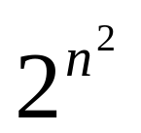
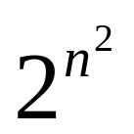
Relations on a Set
A relation on a set A is a subset of A × A.
If A has n elements, how many elements are there in A × A?
n²
We know that a set with m elements has 2^{m} subsets, so how many subsets are there of A × A?
How many relations are there on a set with n elements?
Notes:
(1,1) is in R1, R3, R4, and R6. (1,2) is in R1 and R6. (2,1) is in R2, R5, and R6. (-1,1) is in R2, R3, and R6. (2,2) is in R1, R3, and R4.

Slide 11
Relations on a Set
There are relations on a set with n elements.
How many relations are there on set S = {a, b, c}?
There are 3 elements in set S, so S × S has 3² = 9 elements.
Therefore, there are 2⁹ = 512 different relations on the set S = {a, b, c}.
Notes:
(1,1) is in R1, R3, R4, and R6. (1,2) is in R1 and R6. (2,1) is in R2, R5, and R6. (-1,1) is in R2, R3, and R6. (2,2) is in R1, R3, and R4.

Slide 12
Properties of Relations
Reflexive: A binary relation R in a set A is reflexive if for every element a ∈ A, (a, a) ∈ R.
For Example, the relation ≤ is reflexive in the set of real numbers since for any x, we have x ≤ x

Slide 13
Example
Determine the properties of the following relations on {1, 2, 3, 4}
  R₁ = {(1,1), (1,2), (2,1), (2,2), (3,4), (4,1), (4,4)}
  R₂ = {(1,1), (1,2), (2,1)}
  R₃ = {(1,1), (1,2), (1,4), (2,1), (2,2), (3,3), (4,1), (4,4)}
  R₄ = {(2,1), (3,1), (3,2), (4,1), (4,2), (4,3)}
  R₅ = {(1,1), (1,2), (1,3), (1,4), (2,2), (2,3), (2,4), (3,3), (3,4), (4,4)}
  R₆ = {(3,4)}
Which of these is reflexive?

Slide 14
Example
Which of these is reflexive?
  R₁ = {(1,1), (1,2), (2,1), (2,2), (3,4), (4,1), (4,4)}
  R₂ = {(1,1), (1,2), (2,1)}
  R₃ = {(1,1), (1,2), (1,4), (2,1), (2,2), (3,3), (4,1), (4,4)}
  R₄ = {(2,1), (3,1), (3,2), (4,1), (4,2), (4,3)}
  R₅ = {(1,1), (1,2), (1,3), (1,4), (2,2), (2,3), (2,4), (3,3), (3,4), (4,4)}
  R₆ = {(3,4)}
The relations R₃ and R₅ are reflexive because they contain all pairs of the form (a,a); the other don’t [they are all missing (3,3)].

Slide 15
Properties of Relations
Let R be a relation on set A.
R is symmetric if:
(b, a) ∈ R whenever (a, b) ∈ R, where a, b ∈ A.
A relation is symmetric iff “a is related to b” implies that “b is related to a”.

Slide 16
Example
Which of these is symmetric?
  R₁ = {(1,1), (1,2), (2,1), (2,2), (3,4), (4,1), (4,4)}
  R₂ = {(1,1), (1,2), (2,1)}
  R₃ = {(1,1), (1,2), (1,4), (2,1), (2,2), (3,3), (4,1), (4,4)}
  R₄ = {(2,1), (3,1), (3,2), (4,1), (4,2), (4,3)}
  R₅ = {(1,1), (1,2), (1,3), (1,4), (2,2), (2,3), (2,4), (3,3), (3,4), (4,4)}
  R₆ = {(3,4)}
The relations R₂ and R₃ are symmetric because in each case (b,a) belongs to the relation whenever (a,b) does.
The other relations aren’t symmetric.

Slide 17
Properties of Relations
Let R be a relation on set A.
R is antisymmetric if whenever (a, b) ∈ R and (b, a) ∈ R, then a = b, where a, b ∈ A.
A relation is antisymmetric iff there are no pairs of distinct elements with a related to b and b related to a. That is, the only way to have a related to b and b related to a is for a and b to be the same element.
Symmetric and antisymmetric are NOT exactly opposites.

Slide 18
Example
Which of these is antisymmetric?
  R₁ = {(1,1), (1,2), (2,1), (2,2), (3,4), (4,1), (4,4)}
  R₂ = {(1,1), (1,2), (2,1)}
  R₃ = {(1,1), (1,2), (1,4), (2,1), (2,2), (3,3), (4,1), (4,4)}
  R₄ = {(2,1), (3,1), (3,2), (4,1), (4,2), (4,3)}
  R₅ = {(1,1), (1,2), (1,3), (1,4), (2,2), (2,3), (2,4), (3,3), (3,4), (4,4)}
  R₆ = {(3,4)}
The relations R₄, R₅ are antisymmetric because there is no pair of elements a and b with a ≠ b such that both (a,b) and (b,a) belong to the relation.
The other relations aren’t antisymmetric.

Slide 19
Properties of Relations
Let R be a relation on set A.
R is transitive if whenever (a ,b) ∈ R and (b, c) ∈ R, then (a, c) ∈ R, where a, b, c ∈ A.

Slide 20
Example
Which of these is transitive?
  R₁ = {(1,1), (1,2), (2,1), (2,2), (3,4), (4,1), (4,4)}
  R₂ = {(1,1), (1,2), (2,1)}
  R₃ = {(1,1), (1,2), (1,4), (2,1), (2,2), (3,3), (4,1), (4,4)}
  R₄ = { (2,1), (3,1), (3,2), (4,1), (4,2) , (4,3)}
  R₅ = {(1,1), (1,2), (1,3), (1,4), (2,2), (2,3), (2,4), (3,3), (3,4), (4,4)}
  R₆ = {(3,4)}
The relations R₄, R₅ are transitive because if (a,b) and (b,c) belong to the relation, then (a,c) does also.
The other relations aren’t transitive.

Slide 21
Combining Relations
Relations from A to B are subsets of A × B.
For example, if A = {1, 2} and B= {a, b}, then
A × B = {(1, a), (1, b), (2, a), (2, b)}
Two relations from A to B can be combined in any way that two sets can be combined. Specifically, we can find the union, intersection, and difference of the two relations.

Slide 22
Combining Relations
Let A = {1, 2, 3} and B= {1, 2, 3, 4}, and suppose we have the relations:
R₁ = {(1,1), (2,2), (3,3)} , and
R₂ = {(1,1), (1,2), (1,3), (1,4)}.
Then we can find the union, intersection, and difference of the relations:
R₁ ∪ R₂ = {(1,1), (1,2), (1,3), (1,4), (2,2), (3,3)}
R₁ ∩ R₂ = {(1,1)}
R₁ - R₂ = {(2,2), (3,3)}
R₂ - R₁ = {(1,2), (1,3), (1,4)}

Slide 23
Composition of Relations
If R₁ is a relation from A to B and R₂ is a relation from B to C, then the composition of R₁ with R₂ (denoted R₁ □ R₂) is the relation from A to C.
  If (a, b) is a member of R₁ and (b, c) is a member of R₂, then (a, c) is a member of R₁ □ R₂, where a ∈ A, b ∈ B, c ∈ C.

Slide 24
Example
Let
  A={a,b,c}, B={w,x,y,z}, C={A,B,C,D}
  R₁={(a,z),(b,w)}, R₂={(w,B),(w,D),(x,A)}
Find R₂ □ R₁

Slide 25
Example
Given the following relations, find R □ S :
  R = {(1,1), (1,4), (2,3), (3,1), (3,4)}
  S = {(1,0),(2,0), (3,1), (3,2), (4,1)}
Construct the ordered pairs in R□ S as follows:
for each ordered pair in R
for each ordered pair in S
if (r₁ , r₂) (s₁ , s₂) are the same
then (r₁, s₂) belongs to R □ S

Slide 26
Example
Given the following relations, find R □ S :
  R = {(1,1), (1,4), (2,3), (3,1), (3,4)}
  S = {(1,0),(2,0), (3,1), (3,2), (4,1)}
Construct the ordered pairs in R □ S :
R □ S = {(1,0), (1,1), (2,1), (2,2), (3,0), (3,1)}

Slide 27
The Powers of a Relation
The powers of a relation R are recursively defined from the definition of a composite of two relations.
Let R be a relation on the set A. The powers R^{n}, for n = 1, 2, 3, … are defined recursively by:
R¹ = R
R^{n+1} = R^{n} □ R :
  So:
  R² = R □ R
  R³ = R² □ R = (R □ R) □ R)
  etc.

Slide 28
The Powers of a Relation
Let R = {(1,1), (2,1), (3,2), (4,3)}
Find the powers R^{n} , where n = 1, 2, 3, 4, …
R¹ = R = {(1,1), (2,1), (3,2), (4,3)}
R² = R □ R = {(1,1), (2,1), (3,1), (4,2)}
R³ = R² □ R = {(1,1), (2,1), (3,1), (4,1)}
R⁴ = R³ □ R = {(1,1), (2,1), (3,1), (4,1)}
R⁵ = R⁴ □ R = {(1,1), (2,1), (3,1), (4,1)}

Slide 29
Let
  A={a,b,c}, B={w,x,y,z}, C={A,B,C,D}
  R₁={(a,z),(b,w)}, R₂={(w,B),(w,D),(x,A)}
Find R₁ □ R₂

Slide 30
Representing Relations

Slide 31
Representing Relations Using Matrices
Let R be a relation from A to B
  A = {a₁, a₂, … , a_{m}}
  B = {b₁, b₂, … , b_{n}}
The zero-one matrix representing the relation R has a 1 as its (i, j) entry when a_{i} is related to b_{j} and a 0 in this position if a_{i} is not related to b_{j}.

Slide 32
Example
Let R be a relation from A to B
  A={a, b, c}
  B={d, e}
  R={(a, d), (b, e), (c, d)}
Find the relation matrix for R

Slide 33
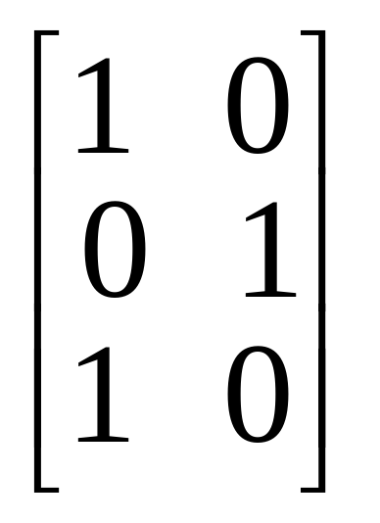
Relation Matrix
Let R be a relation from A to B
  A={a, b, c}
  B={d, e}
  R={(a, d), (b, e), (c, d)}
Note that A is represented by the rows and B by the columns in the matrix.
Cell_{ij} in the matrix contains a 1 iff a_{i} is related to b_{j}.

Slide 34
Relation Matrices and Properties
Let R be a binary relation on a set A and let M be the zero-one matrix for R.
  R is reflexive iff M_{ii} = 1 for all i
  R is symmetric iff M is a symmetric matrix, i.e., M = M^{T}
  R is antisymmetric if M_{i j}= 0 or M_{ji} = 0 for all i ≠ j

Slide 35
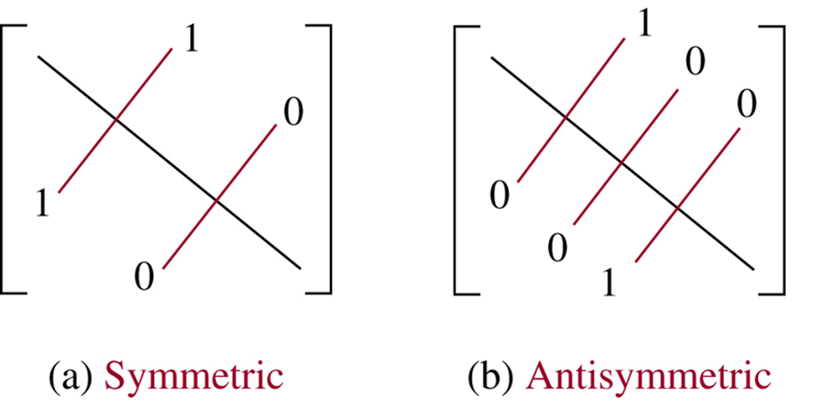
Relation Matrices and Properties

Slide 36
Example
Suppose that the relation R on a set is represented by the matrix M_{R}.
⎡
1
1
0
⎤
⎢
⎥
M
=
1
1
1
R
⎢
⎥
⎢
0
1
1
⎥
⎣
⎦
Is R reflexive, symmetric, and / or antisymmetric?

Slide 37
Example
⎡
1
1
0
⎤
Is R reflexive?
Is R symmetric?
Is R antisymmetric?
⎢
⎥
M
=
1
1
1
R
⎢
⎥
⎢
0
1
1
⎥
⎣
⎦
All the diagonal elements = 1, so R is reflexive.
The lower left triangle of the matrix = the upper right triangle, so R is symmetric.
To be antisymmetric, it must be the case that no more than one element in a symmetric position on either side of the diagonal = 1. But M₂₃ = M₃₂ = 1. So R is not antisymmetric.

Slide 38
Representing Relations Using Digraphs
Represent:
  each element of the set by a point
  each ordered pair using an arc with its direction indicated by an arrow

Slide 39
Representing Relations Using Digraphs
A directed graph (or digraph) consists of a set V of vertices (or nodes) together with a set E of ordered pairs of elements of V called edges (or arcs).
The vertex a is called the initial vertex of the edge (a, b).
The vertex b is called the terminal vertex of the edge (a, b).

Slide 40
Example
Let R be a relation on set A
  A={a, b, c}
  R={(a, b), (a, c), (b, b), (c, a), (c, b)}.
Draw the digraph that represents R
a
b
c

Slide 41
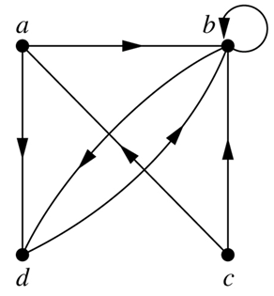
Representing Relations Using Digraphs
This is a digraph with:
V = {a, b, c}
E = {(a, b), (a, d), (b, b),
(b, d), (c, a), (c, b), (d, b)}
Note that edge (b, b) is represented using an arc from vertex b back to itself. This kind of an edge is called a loop.

Slide 42
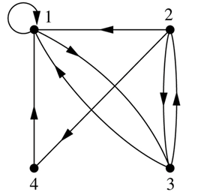
Example
What are the ordered pairs in the relation R represented by the directed graph to the left?
This digraph represents the relation
R = {(1,1), (1,3), (2,1), (2,3), (2,4), (3,1), (3,2), (4,1)}
on the set {1, 2, 3, 4}.

Slide 43
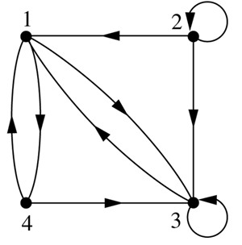
Example
What are the ordered pairs in the relation R represented by the directed graph to the left?
R = {(1,3), (1,4), (2,1), (2,2), (2,3), (3,1), (3,3), (4,1), (4,3)}

Slide 44
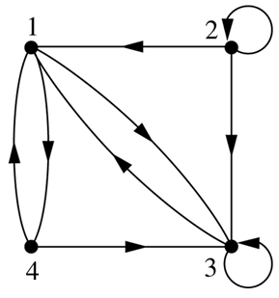
Example
According to the digraph representing R:
is (4,3) an ordered pair in R?
is (3,4) an ordered pair in R?
is (3,3) an ordered pair in R?
(4,3) is an ordered pair in R
(3,4) is not an ordered pair in R – no arrowhead pointing from 3 to 4
(3,3) is an ordered pair in R – loop back to itself

Slide 45
Relation Digraphs and Properties
A relation digraph can be used to determine whether the relation has various properties
  Reflexive - must be a loop at every vertex.
  Symmetric - for every edge between two distinct points there must be an edge in the opposite direction.
  Antisymmetric - There are never two edges in opposite direction between two distinct points.
  Transitive - If there is an edge from x to y and an edge from y to z, there must be an edge from x to z.

Slide 46
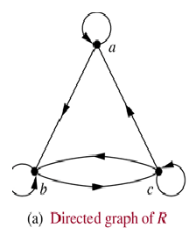
Example
According to the digraph representing R:
is R reflexive?
is R symmetric?
is R antisymmetric?
is R transitive?
R is reflexive – there is a loop at every vertex
R is not symmetric – there is an edge from a to b but not from b to a
R is not antisymmetric – there are edges in both directions connecting b and c
R is not transitive – there is an edge from a to b and an edge from b to c, but not from a to c

Slide 47
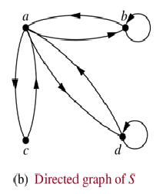
Example
According to the digraph representing S:
is S reflexive?
is S symmetric?
is S antisymmetric?
is S transitive?
S is not reflexive – there aren’t loops at every vertex
S is symmetric – for every edge from one distinct vertex to another, there is a matching edge in the opposite direction
S is not antisymmetric – there are edges in both directions connecting a and b
S is not transitive – there is an edge from c to a and an edge from a to b, but not from c to b

Slide 48
Homework Exercise
Label the relations below as reflexive (or not), symmetric (or not), antisymmetric (or not), and transitive (or not).
A B C D
Notes:
A: not reflexive, symmetric, antisymmetric, transitive
B: not reflexive, not symmetric, not antisymmetric, not transitive
C: not reflexive, not symmetric, antisymmetric, not transitive
D: not reflexive, not symmetric, antisymmetric, transitive

Slide 49
Equivalence Relations

Slide 50
Equivalence Relations
A relation on set A is called an equivalence relation if it is:
  reflexive,
  symmetric, and
  transitive

Slide 51
Equivalence Relations
Two elements a and b that are related by an equivalence relation are said to be equivalent.
We use the notation
a ∼ b
to denote that a and b are equivalent elements with repect to a particular equivalence relation.

Slide 52
Example
Let R be a relation on set A, where A = {1, 2, 3, 4, 5} and R = {(1,1), (2,2), (3,3), (4,4), (5,5), (1,3), (3,1)}
Is R an equivalence relation?
We can solve this by drawing a relation digraph:
  Reflexive – there must be a loop at every vertex.
  Symmetric - for every edge between two distinct points there must be an edge in the opposite direction.
  Transitive - if there is an edge from x to y and an edge from y to z, there must be an edge from x to z.

Slide 53
Example
1
2
3
4
5
Is R an equivalence relation? yes

Slide 54
Example – Congruence modulo m
Let R = {(a, b) | a ≡ b (mod m)} be a relation on the set of integers and m be a positive integer > 1.
Is R an equivalence relation?
  Reflexive – is it true that a ≡ a (mod m)}? yes
  Symmetric – is it true that if a ≡ b (mod m) then b ≡ a (mod m)? yes
  Transitive - is it true that if a ≡ b (mod m) and b ≡ c (mod m) then a ≡ c (mod m)? yes

Slide 55
Example
Suppose that R is the relation on the set of strings of English letters such that aRb iff l(a) = l(b), where l(x) is the length of the string x.
Is R an equivalence relation?

Slide 56
Example
Since l(a) = l(a), then aRa for any string a. So R is reflexive.
Suppose aRb, so that l(a) = l(b). Then it is also true that l(b) = l(a), which means that bRa. Consequently, R is symmetric.
Suppose aRb and bRc. Then l(a) = l(b) and l(b) = l(c). Therefore, l(a) = l(c) and so aRc. Hence, R is transitive.
Therefore, R is an equivalence relation.

Slide 57
Equivalence Class
Let R be a equivalence relation on set A.
The set of all elements that are related to an element a of A is called the equivalence class of a.
The equivalence class of a with respect to R is:
  [a]_{R} = {s | (a,s) ∈ R}
  When only one relation is under consideration, we will just write [a].

Slide 58
Equivalence Class
If R is a equivalence relation on a set A, the equivalence class of the element a is:
[a]_{R} = {s | (s, a) ∈ R}
If b ∈ [a]_{R} , then b is called a representative of this equivalence class.

Slide 59
Equivalence Class
Let R be the relation on the set of integers such that aRb iff a = b or a = -b. We can show that this is an equivalence relation.
The equivalence class of element a is
[a] = {a, -a}
Examples:
[7] = {7, -7} [-5] = {5, -5}
[0] = {0}

Slide 60
Equivalence Example
Consider the equivalence relation R on set A. What are the equivalence classes?
A = {1, 2, 3, 4, 5}
R = {(1,1), (2,2), (3,3), (4,4), (5,5), (1,3), (3,1)}
Just look at the aRb relationships. Which elements are related to which?
[1] = {1, 3} [2] = {2}
[3] = {3, 1} [4] = {4}
[5] = {5}

Slide 61
A useful theorem about classes
  Let R be an equivalence relation on a set A. These statements for a and b of A are equivalent:
  Equivalence classes are EITHER
  equal or
  disjoint
aRb
[a] = [b]
[a] ∩ [b] = ∅

Slide 62
Partitions
A partition of a set A divides A into non-overlapping subsets:
Let S be a given set and A={A1,A2,….Am} where each Ai,i-1,2… is a subset of S
Set A is called covering of S and setsA1,A2,… are said to cover S
A partition of a set A is a collection of disjoint nonempty subsets of A that have A as their union. Then the subsets are called blocks of the partition.
Example 2
S = {a, b, c, d, e, f }
S₁ = {a, d, e}
S₂ = {b}
S₃ = {c, f }
P = {S₁, S₂, S₃}
P is a partition of set S

Slide 63
Partitions and Equivalence Relations
Let R be an equivalence relation on set S
  then the equivalence classes of R form a partition of S
Conversely, if {A_{i} | i ∈ I } is a partition of set S,
  then there is an equivalence relation R that has the sets A_{i} (i ∈ I) as its equivalence classes

Slide 64
Example
If S = {1, 2, 3, 4, 5, 6}, then
A₁ = {1, 3, 4}
A₂ = {2, 5}
A₃ = {6}
form a partition of S, because:
  these sets are disjoint
  the union of these sets is S.

Slide 65
Example
If S = {1, 2, 3, 4, 5, 6}, then
A₁ = {1, 3, 4, 5}
A₂ = {2, 5}
A₃ = {6}
do not form a partition of S, because:
  these sets are not disjoint (5 occurs in two different sets)

Slide 66
Example
If S = {1, 2, 3, 4, 5, 6}, then
A₁ = {1, 3}
A₂ = {2, 5}
A₃ = {6}
do not form a partition of S, because:
  the union of these sets is not S (since 4 is not a member of any of the subsets, but is a member of S).

Slide 67
Example
If S = {1, 2, 3, 4, 5, 6}, then
A₁ = {1, 3, 4}
A₂ = {2, 5}
A₃ = {6, 7}
do not form a partition of S, because:
  the union of these sets is not S (since 7 is a member of set A₃ but is not a member of S).

Slide 68
Constructing an Equivalence Relation from a Partition
Given set S = {1, 2, 3, 4, 5, 6} and a partition of S,
A₁ = {1, 2, 3}
A₂ = {4, 5}
A₃ = {6}
then we can find the ordered pairs that make up the equivalence relation R produced by that partition.

Slide 69
Constructing an Equivalence Relation from a Partition
The subsets in the partition of S,
A₁ = {1, 2, 3}
A₂ = {4, 5}
A₃ = {6}
are the equivalence classes of R. This means that the pair (a,b) ∈ R iff a and b are in the same subset of the partition.

Slide 70
Constructing an Equivalence Relation from a Partition
Let’s find the ordered pairs that are in R:
A₁ = {1, 2, 3} → (1,1), (1,2), (1,3), (2,1),
(2,2), (2,3), (3,1), (3,2), (3,3)
A₂ = {4, 5} → (4,4), (4,5), (5,4), (5,5)
A₃ = {6} → (6,6)
So R is just the set consisting of all these ordered pairs:
R = {(1,1), (1,2), (1,3), (2,1), (2,2), (2,3), (3,1), (3,2), (3,3), (4,4), (4,5), (5,4), (5,5), (6,6)}

Slide 71
Compatibility Relation
A relation R in set A is said to be a compatibility relation if it is reflexive and symmetric.
Example: Let A={ball, bed, dog, let, egg} and the relation R be given by
R = {(x, y) / x, y e A ^ x R y if x and y contain some common letter}

Slide 72
Maximal Compatibility Relation
Let X be a set and R is a compatibility relation on X.A is a subset of X is called a maximal compatibility block if any element of A is compatible to every other element of A and no element of X –A is compatible to all the elements of A.

Slide 73
Partial ordering
A relation R on a set S is called a partial ordering or partial order if it is:
  reflexive
  antisymmetric
  transitive
A set S together with a partial ordering R is called a partially ordered set, or poset, and is denoted by (S, R).

Slide 74
Example
Let R be a relation on set A. Is R a partial order?
A = {1, 2, 3, 4}
R = {(1,1), (1,2), (1,3), (1,4), (2,2),
(2,3), (2,4), (3,3), (3,4), (4,4)}

Slide 75
Example
Is R a partial order?
R = {(1,1), (1,2), (1,3), (1,4), (2,2), (2,3), (2,4), (3,3), (3,4), (4,4)}
To be a partial order, R must be reflexive, antisymmetric, and transitive.
R is reflexive because R includes (1,1), (2,2), (3,3) and (4,4).
R is antisymmetric because for every pair (a,b) in R, (b,a) is not in R (unless a = b).
R is transitive because for every pair (a,b) in R, if (b,c) is in R then (a,c) is also in R.

Slide 76
Example
So, given
A = {1, 2, 3, 4}
R = {(1,1), (1,2), (1,3), (1,4), (2,2),
(2,3), (2,4), (3,3), (3,4), (4,4)}
R is a partial order, and
(A, R) is a poset.

Slide 77
Example
Is the “≥” relation a partial ordering on the set of integers?
  Since a ≥ a for every integer a, ≥ is reflexive
  If a ≥ b and b ≥ a, then a = b. Hence ≥ is anti-symmetric.
  Since a ≥ b and b ≥ c implies a ≥ c, ≥ is transitive.
  Therefore “≥” is a partial ordering on the set of integers and (Z, ≥) is a poset.

Slide 78
Comparable / Incomparable
In a poset the notation a ≼ b denotes (a, b) ∈ R
  The “less than or equal to” (≤)is just an example of partial ordering
The elements a and b of a poset (S, ≼) are called comparable if either a≼b or b≼a.
The elements a and b of a poset (S, ≼) are called incomparable if neither a≼b nor b≼a.
In the poset (Z⁺, |):
  Are 3 and 9 comparable? Yes; 3 divides 9
  Are 5 and 7 comparable? No; neither divides the other

Slide 79
Total Order
We said: “Partial ordering” because pairs of elements may be incomparable.
If every two elements of a poset (S, ≼) are comparable, then S is called a totally ordered or linearly ordered set and ≼ is called a total order or linear order.
A totally ordered set is also called a chain.

Slide 80
Total Order
The poset (Z, ≤) is totally ordered. Why?
Every two elements of Z are comparable; that is, a ≤ b or b ≤ a for all integers.
The poset (Z⁺, |) is not totally ordered. Why?
It contains elements that are incomarable; for example 5 7.
/

Slide 81
Lexicographic Order
We say that (a₁, a₂) is less than (b₁, b₂) – that is, (a₁, a₂) ≤ (b₁, b₂) – either if:
a₁ ≤ b₁ , or
a₁ = b₁ and a₂ ≤ b₂

Slide 82
Lexicographic Order
In the poset poset (Z × Z, ≼),
is (3, 5) ≤ (4, 8)? yes
is (3, 8) ≤ (4, 5)? yes
is (4, 9) ≤ (4, 11)? yes

Slide 83
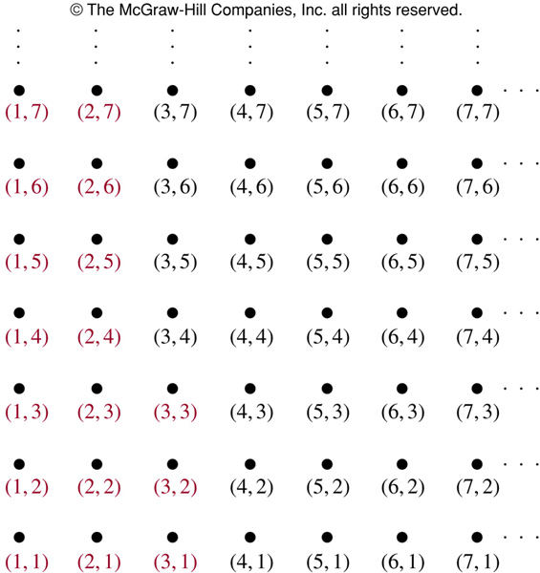
Lexicographic Order
The ordered pairs in red are all less than (3,4).

Slide 84
Lexicographic Order
Consider the strings consisting of lowercase characters.
Let n_{A} be the number of characters in string A and n_{B} be the number of characters in string B. Let n be the smaller of the two values.
For i = 1 to n, compare character A_{i} with B_{i}:
  If A_{i} matches B_{i}, and n_{A} = n_{B}, then A = B.
  If A_{i} matches B_{i}, but n_{A} < n_{B}, then A < B.
  If A_{i} matches B_{i}, but n_{B} < n_{A}, then B < A.
  If, for some i ≤ n, character A_{i} comes before B_{i} in the alphabet, then A < B.

Slide 85
Lexicographic Order
Those are the actual rules by which words are listed in order in the dictionary.
For example, discreet ≤ discrete, because these strings differ in the 7th position, and e ≤ t.
Also, discreet ≤ discreetness, because these strings agree for the first 8 characters (the length of the shorter string), but the second string has more letters.
Finally, discrete ≤ discretion, because these strings differ in the 8th position, and e ≤ i.

Slide 86
Hasse Diagram
A Hasse diagram is a graphical representation of a poset.
Since a poset is by definition reflexive and transitive (and antisymmetric), the graphical representation for a poset can be compacted.
For example, why do we need to include loops at every vertex? Since it’s a poset, it must have loops there.

Slide 87
Constructing a Hasse Diagram
Start with the digraph of the partial order.
Remove the loops at each vertex.
Remove all edges that must be present because of the transitivity.
Arrange each edge so that all arrows point up.
Remove all arrowheads.

Slide 88
Example
Construct the Hasse diagram for ({1, 2, 3}, ≤)
3
2
1
3
2
1
1
2 3
1
2 3
1
2 3

Slide 89
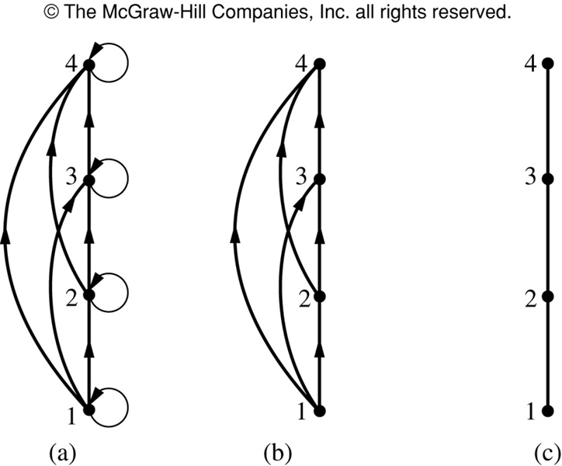
Hasse Diagram Example
Steps in the construction
of the
Hasse diagram
for
({1, 2, 3, 4}, ≤)

Slide 90
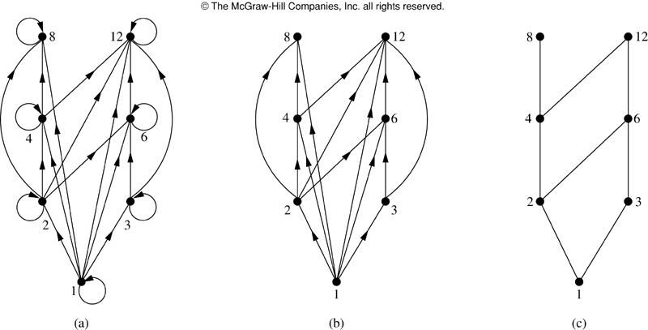
Hasse Diagram Example
Steps in the construction of the Hasse diagram for
({1, 2, 3, 4, 6, 8, 12}, |)

Slide 91
Hasse Diagram Terminology
Let (S, ≼) be a poset.
a is maximal in (S, ≼) if there is no b∈S such that a≼b. (top of the Hasse diagram)
a is minimal in (S, ≼) if there is no b∈S such that b≼a. (bottom of the Hasse diagram)

Slide 92
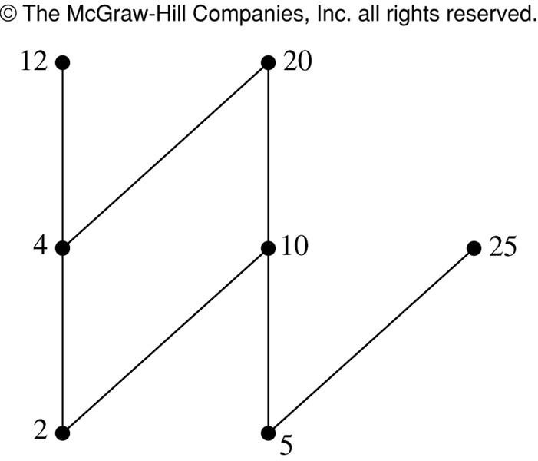
Hasse Diagram Terminology
Which elements of the poset ({, 2, 4, 5, 10, 12, 20, 25}, | ) are maximal? Which are minimal?
The Hasse diagram for this poset shows that the maximal elements are: 12, 20, 25
The minimal elements are: 2, 5

Slide 93
Hasse Diagram Terminology
Let (S, ≼) be a poset.
a is the greatest element of (S, ≼) if b≼a for all b∈S…
  It must be unique
a is the least element of (S, ≼) if a≼b for all b∈S.
  It must be unique

Slide 94
Hasse Diagram Terminology
Does the poset represented by this Hasse diagram have a greatest element? If so, what is it? Does it have a least element? If so, what is it?
The poset represented by this Hasse diagram does not have a greatest element, because the greatest element must be unique.
It does have a least element, a.
b c d
a

Slide 95
Hasse Diagram Terminology
Does the poset represented by this Hasse diagram have a greatest element? If so, what is it? Does it have a least element? If so, what is it?
d e
c
a b
The poset represented by this Hasse diagram has neither a greatest element nor a least element, because they must be unique.

Slide 96
Hasse Diagram Terminology
Does the poset represented by this Hasse diagram have a greatest element? If so, what is it? Does it have a least element? If so, what is it?
The poset represented by this Hasse diagram does not have a least element, because the least element must be unique.
It does have a greatest element, d.
d
c
a b

Slide 97
Hasse Diagram Terminology
Does the poset represented by this Hasse diagram have a greatest element? If so, what is it? Does it have a least element? If so, what is it?
d
b c
a
The poset represented by this Hasse diagram has a greatest element, d.
It also has a least element, a.

Slide 98
Hasse Diagram Terminology
Let A be a subset of (S, ≼).
If u∈S such that a≼u for all a∈A, then u is called an upper bound of A.
If l∈S such that l≼a for all a∈A, then l is called an lower bound of A.
If x is an upper bound of A and x≼z whenever z is an upper bound of A, then x is called the least upper bound of A.
  It must be unique
If y is a lower bound of A and z≼y whenever z is a lower bound of A, then y is called the greatest lower bound of A.
  It must be unique

Slide 99
Example
h j
g f
d e
b c
a
Maximal: h, j
Minimal: a
Greatest element: None
Least element: a
Upper bound of {a,b,c}: e, f, j, h
Least upper bound of {a,b,c}: e
Lower bound of {a,b,c}: a
Greatest lower bound of {a,b,c}: a

Slide 100
Lattices
A lattice is a partially ordered set in which every pair of elements has both a least upper bound and greatest lower bound.
f
e
c d
b
a
h
e f g
b c d
a

Slide 101
The greatest lower bound of a subset {a, b} ⊆ L is denoted by a * b
Least upper bound by a b
The GLB {a, b}= a * b is called the meet or product of a and b
The LUB {a, b}= a b is called the join or sum of a and b
+
+

Slide 102
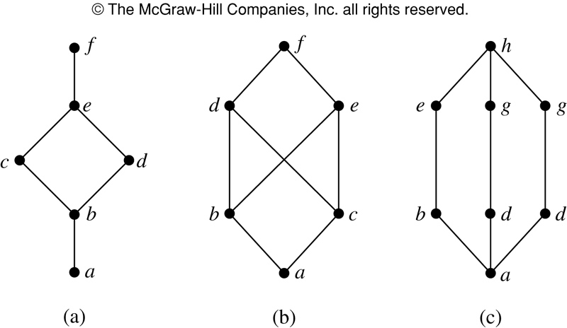
Lattice example
Are the following three posets lattices?

Slide 103
Lattice example
Are the following three posets lattices?
(a) Yes
(b) No; elements b and c have no least upper bound.
(c) Yes

Slide 104
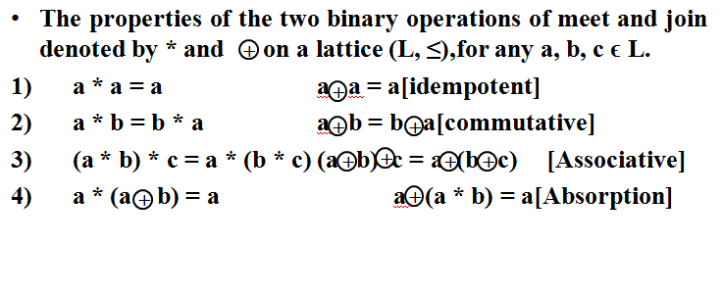
Properties of lattices

Slide 105
Lattices as Algebraic systems
A lattice is an algebraic system (L, *, ) with two binary operations * and on L, which satisfies
    commutative
    associative and
    absorption laws.
+
+

Slide 106
Sublattice
Let (L, *, ) be a lattice and let S ⊆ L be a subset of L.The algebraic system (S, *, ) is sublattice of (L, *, ) iff S is closed under both the binary operations * and
+
+
+
+

Slide 107
Lattice Homomorphism
Product of Lattices
Boolean Algebra

Slide 108
Conclusion
In this chapter we have studied:
Relations and their properties
How to represent relations
Closures of relations
Equivalence relations
Partial orderings

Slide 109
Unit-III : Algebraic Structures
Algebraic systems Examples and general properties
Semi groups
Monoids
Groups
Sub groups
Homomorphism & Isomorphism

Slide 110
Algebraic systems
N = {1,2,3,4,…..∝ } = Set of all natural numbers.
Z = { 0, ± 1, ± 2, ± 3, ± 4 , ….. ∝} = Set of all integers.
Q = Set of all rational numbers.
R = Set of all real numbers.
Binary Operation: The binary operator * is said to be a binary operation (closed operation) on a non empty set A, if
a * b ∈ A for all a, b ∈ A (Closure property).
Ex: The set N is closed with respect to addition and multiplication but not w.r.t subtraction and division.
Algebraic System: A set ‘A’ with one or more binary (closed) operations defined on it is called an algebraic system.
Ex: (N, + ), (Z, +, – ), (R, +, . , – ) are algebraic systems.

Slide 111
Properties
Commutative: Let * be a binary operation on a set A. The operation * is said to be commutative in A if a * b= b * a for all a, b in A
Associativity: Let * be a binary operation on a set A. The operation * is said to be associative in A if (a * b) * c = a *( b * c) for all a, b, c in A
Identity: For an algebraic system (A, *), an element ‘e’ in A is said to be an identity element of A if a * e = e * a = a for all a ∈ A.
Note: For an algebraic system (A, *), the identity element, if exists, is unique.
Inverse: Let (A, *) be an algebraic system with identity ‘e’. Let a be an element in A. An element b is said to be inverse of A if
a * b = b * a = e

Slide 112
Semi group
Semi Group: An algebraic system (A, *) is said to be a semi group if
1. * is closed operation on A.
2. * is an associative operation, for all a, b, c in A.
  Ex. (N, +) is a semi group.
  Ex. (N, .) is a semi group.
  Ex. (N, – ) is not a semi group.
Monoid: An algebraic system (A, *) is said to be a monoid if the following conditions are satisfied.
1) * is a closed operation in A.
2) * is an associative operation in A.
3) There is an identity in A.

Slide 113
Monoid
Ex. Show that the set ‘N’ is a monoid with respect to multiplication
Solution: Here, N = {1,2,3,4,……}
1. Closure property : We know that product of two natural numbers is again a natural number.
i.e., a.b = b.a for all a,b ∈ N
∴ Multiplication is a closed operation.
2. Associativity : Multiplication of natural numbers is associative.
i.e., (a.b).c = a.(b.c) for all a,b,c ∈ N
3. Identity : We have, 1 ∈ N such that
a.1 = 1.a = a for all a ∈ N.
∴ Identity element exists, and 1 is the identity element.
Hence, N is a monoid with respect to multiplication.

Slide 114
Sub semigroup & sub monoid
Sub semigroup : Let (S, * ) be a semigroup and let T be a subset of S. If T is closed under operation * , then (T, * ) is called a sub semigroup of (S, * ).
Ex: (N, .) is semigroup and T is set of multiples of positive integer m then (T,.) is a sub semigroup.
Sub monoid : Let (S, * ) be a monoid with identity e, and let T be a non- empty subset of S. If T is closed under the operation * and e ∈ T, then (T, * ) is called a sub monoid of (S, * ).
Ex: (R,*) is a monoid and N is set of natural numbers (N,*) is a sub monoid.

Slide 115
Group
Group: An algebraic system (G, *) is said to be a group if the following conditions are satisfied.
1) * is a closed operation.
2) * is an associative operation.
3) There is an identity in G.
4) Every element in G has inverse in G.
Abelian group (Commutative group): A group (G, *) is said to be abelian (or commutative) if
a * b = b * a for all a, b ϵ G.
Abelian Semi group (Commutative semi group): A semi group (G, *) is said to be abelian (or commutative) if
a * b = b * a for all a, b ϵ G.

Slide 116
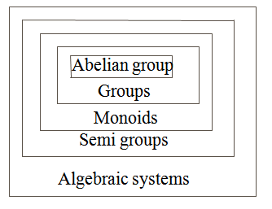
Algebraic system

Slide 117
Theorem
In a Group (G, * ) the following properties hold good
1. Identity element is unique.
2. Inverse of an element is unique.
3. Cancellation laws hold good
a * b = a * c ⇒ b = c (left cancellation law)
a * c = b * c ⇒ a = b (Right cancellation law)
4. (a * b) ⁻¹ = b⁻¹ * a⁻¹
In a group, the identity element is its own inverse.
Order of a group : The number of elements in a group is called order of the group.
Finite group: If the order of a group G is finite, then G is called a finite group.

Slide 118
Ex. Show that, the set of all integers is a group with respect to addition.
Solution: Let Z = set of all integers.
Let a, b, c are any three elements of Z.
1. Closure property : We know that, Sum of two integers is again an integer.
i.e., a + b ∈ Z for all a,b ∈ Z
2. Associativity: We know that addition of integers is associative.
i.e., (a+b)+c = a+(b+c) for all a,b,c ∈ Z.
3. Identity : We have 0 ∈ Z and a + 0 = a for all a ∈ Z .
∴ Identity element exists, and ‘0’ is the identity element.
4. Inverse: To each a ∈ Z , we have – a ∈ Z such that
a + ( – a ) = 0
Each element in Z has an inverse.
5. Commutativity: We know that addition of integers is commutative.
i.e., a + b = b +a for all a,b ∈ Z.
Hence, ( Z , + ) is an abelian group.

Slide 119
Ex. Show that set of all non zero real numbers is a group wrt multiplication .
Solution: Let R* = set of all non zero real numbers.
Let a, b, c are any three elements of R* .
1. Closure property : We know that, product of two nonzero real numbers is again a nonzero real number .
i.e., a . b ∈ R* for all a,b ∈ R* .
2. Associativity: We know that multiplication of real numbers is associative.
i.e., (a.b).c = a.(b.c) for all a,b,c ∈ R* .
3. Identity : We have 1 ∈ R* and a .1 = a for all a ∈ R* .
∴ Identity element exists, and ‘1’ is the identity element.
4. Inverse: To each a ∈ R* , we have 1/a ∈ R* such that
a .(1/a) = 1 i.e., Each element in R* has an inverse.
5.Commutativity: We know that multiplication of real numbers is commutative.
i.e., a . b = b . a for all a,b ∈ R*.
Hence, ( R* , . ) is an abelian group.

Slide 120
Ex: Show that set of all real numbers ‘R’ is not a group with respect to multiplication.
Solution: We have 0 ∈ R .
The multiplicative inverse of 0 does not exist.
Hence. R is not a group.
Ex. Show that set of all non zero rational numbers is a group with respect to multiplication

Slide 121
Ex. Let (Z, *) be an algebraic structure, where Z is the set of integers and the operation * is defined by n * m = maximum of (n, m). Show that (Z, *) is a semi group. Is (Z, *) a monoid ?. Justify your answer.
Solution: Let a , b and c are any three integers.
Closure property: Now, a * b = maximum of (a, b) ∈ Z for all a,b ∈ Z
Associativity : (a * b) * c = maximum of {a,b,c} = a * (b * c)
∴ (Z, *) is a semi group.
Identity : There is no integer x such that
a * x = maximum of (a, x) = a for all a ∈ Z
∴ Identity element does not exist. Hence, (Z, *) is not a monoid.

Slide 122
Ex. Show that the set of all strings ‘S’ is a monoid under the operation ‘concatenation of strings’. Is S a group wrt the above operation? Justify your answer.
Solution: Let us denote the operation
‘concatenation of strings’ by + .
Let s₁, s₂, s₃ are three arbitrary strings in S.
Closure property: Concatenation of two strings is again a string.
i.e., s₁+s₂ ∈ S
Associativity: Concatenation of strings is associative.
(s₁+ s₂ ) + s₃ = s₁+ (s₂ + s₃ )
Identity: We have null string , λ ∈ S such that s₁ + λ = S.
∴ S is a monoid.
Note: S is not a group, because the inverse of a non empty string does not exist under concatenation of strings.

Slide 123
Ex. Let S be a finite set, and let F(S) be the collection of all functions f: S → S under the operation of composition of functions, then show that F(S) is a monoid. Is S a group w.r.t the above operation? Justify your answer.
Solution:
Let f₁, f₂, f₃ are three arbitrary functions on S.
Closure property: Composition of two functions on S is again a function on S.
i.e., f₁o f₂ ∈ F(S)
Associativity: Composition of functions is associative.
i.e., (f₁ o f₂ ) o f₃ = f₁ o (f₂ o f₃ )
Identity: We have identity function I : S→S
such that f₁ o I = f₁.
∴ F(S) is a monoid.
Note: F(S) is not a group, because the inverse of a non bijective function on S does not exist.

Slide 124
Ex. If M is set of all non singular matrices of order ‘n x n’. then show that M is a group w.r.t. matrix multiplication.
Is (M, *) an abelian group?. Justify your answer.
Solution: Let A,B,C ∈ M.
1.Closure property : Product of two non singular matrices is again a non singular matrix, because
⏐AB⏐ = ⏐A⏐ . ⏐B⏐ ≠ 0 ( Since, A and B are nonsingular)
i.e., AB ∈ M for all A,B ∈ M .
2. Associativity: Marix multiplication is associative.
i.e., (AB)C = A(BC) for all A,B,C ∈ M .
3. Identity : We have I_{n} ∈ M and A I_{n} = A for all A ∈ M .
∴ Identity element exists, and ‘I_{n}’ is the identity element.
4. Inverse: To each A ∈ M, we have A⁻¹ ∈ M such that
A A⁻¹ = I_{n} i.e., Each element in M has an inverse.
∴ M is a group w.r.t. matrix multiplication.
We know that, matrix multiplication is not commutative.
Hence, M is not an abelian group.

Slide 125
Ex. Show that the set of all positive rational numbers forms an abelian group under the composition * defined by a * b = (ab)/2 .
Solution: Let A = set of all positive rational numbers.
Let a,b,c be any three elements of A.
1. Closure property: We know that, Product of two positive rational numbers is again a rational number.
i.e., a *b ∈ A for all a,b ∈ A .
2. Associativity: (a*b)*c = (ab/2) * c = (abc) / 4
a*(b*c) = a * (bc/2) = (abc) / 4
3. Identity : Let e be the identity element.
We have a*e = (a e)/2 …(1) , By the definition of *
again, a*e = a …..(2) , Since e is the identity.
From (1)and (2), (a e)/2 = a ⇒ e = 2 and 2 ∈ A .
∴ Identity element exists, and ‘2’ is the identity element in A.

Slide 126
4. Inverse: Let a ∈ A
let us suppose b is inverse of a.
Now, a * b = (a b)/2 ….(1) (By definition of inverse.)
Again, a * b = e = 2 …..(2) (By definition of inverse)
From (1) and (2), it follows that
(a b)/2 = 2
⇒ b = (4 / a) ∈ A
∴ (A ,*) is a group.
Commutativity: a * b = (ab/2) = (ba/2) = b * a
Hence, (A,*) is an abelian group.

Slide 127
Ex. Let R be the set of all real numbers and * is a binary operation defined by a * b = a + b + a b. Show that (R, *) is a monoid. Is (R, *) a group?. Justify your answer.
Try for yourself.
identity = 0
inverse of a = – a / (a+1)

Slide 128
Finite groups
Ex. Show that G = {1, -1} is an abelian group under multiplication.
Solution: The composition table of G is
. 1 – 1
1 1 – 1
– 1 – 1 1
1. Closure property: Since all the entries of the composition table are the elements of the given set, the set G is closed under multiplication.
2. Associativity: The elements of G are real numbers, and we know that multiplication of real numbers is associative.
3. Identity : Here, 1 is the identity element and 1∈ G.
4. Inverse: From the composition table, we see that the inverse elements of
1 and – 1 are 1 and – 1 respectively.
Hence, G is a group w.r.t multiplication.
5. Commutativity: The corresponding rows and columns of the table are identical. Therefore the binary operation . is commutative.
Hence, G is an abelian group w.r.t multiplication..

Slide 129
Ex. Show that G = {1, ω, ω²} is an abelian group under multiplication. Where 1, ω, ω² are cube roots of unity.
Solution: The composition table of G is
. 1 ω ω²
1 1 ω ω²
ω ω ω² 1
ω² ω² 1 ω
1. Closure property: Since all the entries of the composition table are the elements of the given set, the set G is closed under multiplication.
2. Associativity: The elements of G are complex numbers, and we know that multiplication of complex numbers is associative.
3. Identity : Here, 1 is the identity element and 1∈ G.
4. Inverse: From the composition table, we see that the inverse elements of
1 ω, ω² are 1, ω², ω respectively.
Hence, G is a group w.r.t multiplication.
5. Commutativity: The corresponding rows and columns of the table are identical. Therefore the binary operation . is commutative.
Hence, G is an abelian group w.r.t. multiplication.

Slide 130
Ex. Show that G = {1, –1, i, –i } is an abelian group under multiplication.
Solution: The composition table of G is
. 1 –1 i -i
1 1 -1 i - i
-1 -1 1 -i i
i i -i -1 1
-i -i i 1 -1
1. Closure property: Since all the entries of the composition table are the elements of the given set, the set G is closed under multiplication.
2. Associativity: The elements of G are complex numbers, and we know that multiplication of complex numbers is associative.
3. Identity : Here, 1 is the identity element and 1∈ G.
4. Inverse: From the composition table, we see that the inverse elements of 1 -1, i, -i are 1, -1, -i, i respectively.
5. Commutativity: The corresponding rows and columns of the table are identical. Therefore the binary operation . is commutative. Hence, (G, .) is an abelian group

Slide 131
Modulo systems.
Addition modulo m ( +_{m} )
let m is a positive integer. For any two positive integers a and b
a +_{m} b = a + b if a + b < m
a +_{m} b = r if a + b ≥ m where r is the remainder obtained
by dividing (a+b) with m.
Multiplication modulo p ( ×_{p} )
let p is a positive integer. For any two positive integers a and b
a ×_{p} b = a b if a b < p
a ×_{p} b = r if a b ≥ p where r is the remainder obtained
by dividing (ab) with p.
Ex. 3 ×₅ 4 = 2 , 5 ×₅ 4 = 0 , 2 ×₅ 2 = 4

Slide 132
Ex. The set G = {0,1,2,3,4,5} is a group with respect to addition modulo 6.
Solution: The composition table of G is
+₆ 0 1 2 3 4 5
0 0 1 2 3 4 5
1 1 2 3 4 5 0
2 2 3 4 5 0 1
3 3 4 5 0 1 2
4 4 5 0 1 2 3
5 5 0 1 2 3 4
1. Closure property: Since all the entries of the composition table are the elements of the given set, the set G is closed under +₆ .
2. Associativity: The binary operation +₆ is associative in G.
for ex. (2 +₆ 3) +₆ 4 = 5 +₆ 4 = 3 and
2 +₆ ( 3 +₆ 4 ) = 2 +₆ 1 = 3
3. Identity : Here, The first row of the table coincides with the top row. The element heading that row , i.e., 0 is the identity element.

Slide 133
4. . Inverse: From the composition table, we see that the inverse elements of 0, 1, 2, 3, 4. 5 are 0, 5, 4, 3, 2, 1 respectively.
5. Commutativity: The corresponding rows and columns of the table are identical. Therefore the binary operation +₆ is commutative.
Hence, (G, +₆ ) is an abelian group.

Slide 134
Ex. The set G = {1,2,3,4,5,6} is a group with respect to multiplication modulo 7.
Solution: The composition table of G is
×₇ 1 2 3 4 5 6
1 1 2 3 4 5 6
2 2 4 6 1 3 5
3 3 6 2 5 1 4
4 4 1 5 2 6 3
5 5 3 1 6 4 2
6 6 5 4 3 2 1
Closure property: Since all the entries of the composition table are the elements of the given set, the set G is closed under ×₇ .
2. Associativity: The binary operation ×₇ is associative in G.
for ex. (2 ×₇ 3) ×₇ 4 = 6 ×₇ 4 = 3 and
2 ×₇ ( 3 ×₇ 4 ) = 2 ×₇ 5 = 3

Slide 135
3. Identity : Here, The first row of the table coincides with the top row. The element heading that row , i.e., 1 is the identity element.
4. . Inverse: From the composition table, we see that the inverse elements of 1, 2, 3, 4, 5 ,6 are 1, 4, 5, 2, 3, 6 respectively.
5. Commutativity: The corresponding rows and columns of the table are identical. Therefore the binary operation ×₇ is commutative.
Hence, (G, ×₇ ) is an abelian group.

Slide 136
Sub groups
Def. A non empty sub set H of a group (G, *) is a sub group of G, if (H, *) is a group.
Note: For any group {G, *}, {e, * } and (G, * ) are trivial sub groups.
Ex. G = {1, -1, i, -i } is a group w.r.t multiplication.
H₁ = { 1, -1 } is a subgroup of G .
H₂ = { 1 } is a trivial subgroup of G.
Ex. ( Z , + ) and (Q , + ) are sub groups of the group (R +).
Theorem: A non empty sub set H of a group (G, *) is a sub group of G iff
i) a * b ∈ H ∀ a, b ∈ H
ii) a⁻¹ ∈ H ∀ a ∈ H

Slide 137
Ex. Show that the intersection of two sub groups of a group G is again a sub group of G.
Proof: Let (G, *) be a group.
Let H₁ and H₂ are two sub groups of G.
Let a , b ∈ H₁ ∩ H₂ .
Now, a , b ∈ H₁ ⇒ a * b⁻¹ ∈ H₁ ( Since, H₁ is a subgroup of G)
again, a , b ∈ H₂ ⇒ a * b⁻¹ ∈ H₂ ( Since, H₂ is a subgroup of G)
∴ a * b⁻¹ ∈ H₁ ∩ H₂ .
Hence, H₁ ∩ H₂ is a subgroup of G .

Slide 138
Ex. Show that the union of two sub groups of a group G need not be a sub group of G.
Proof: Let G be an additive group of integers.
Let H₁ = { 0, ±2, ±4, ±6, ±8, …..}
and H₂ = { 0, ±3, ±6, ±9, ±12, …..}
Here, H₁ and H₂ are groups w.r.t addition.
Further, H₁ and H₂ are subsets of G.
∴ H₁ and H₂ are sub groups of G.
H₁ ∪ H₂ = { 0, ±2, ±3, ±4, ±6, …..}
Here, H₁ ∪ H₂ is not closed w.r.t addition.
For ex. 2 , 3 ∈ G
But, 2 + 3 = 5 and 5 does not belongs to H₁ ∪ H₂ .
Hence, H₁ ∪ H₂ is not a sub group of G.

Slide 139
Homomorphism and Isomorphism.
Homomorphism : Consider the groups ( G, *) and ( G¹, ⊕)
A function f : G → G¹ is called a homomorphism if
f ( a * b) = f(a) ⊕ f (b)
Isomorphism : If a homomorphism f : G → G¹ is a bijection then f is called isomorphism between G and G¹ .
Then we write G ≡ G¹

Slide 140
Ex. Let R be a group of all real numbers under addition and R⁺ be a group of all positive real numbers under multiplication. Show that the mapping f : R → R⁺ defined by f(x) = 2^{x} for all x ∈ R is an isomorphism.
Solution: First, let us show that f is a homomorphism.
Let a , b ∈ R .
Now, f(a+b) = 2^{a+b}
= 2ª 2^{b}
= f(a).f(b)
∴ f is an homomorphism.
Next, let us prove that f is a Bijection
For any a , b ∈ R, Let, f(a) = f(b)
⇒ 2ª = 2^{b}
⇒ a = b
∴ f is one-to-one.
Next, take any c ∈ R⁺.
Then log₂ c ∈ R and f (log₂ c ) = 2 ^{log2 c} = c.
⇒ Every element in R⁺ has a pre image in R.
i.e., f is onto.
∴ f is a bijection
Hence, f is an isomorphism.

Slide 141
Ex. Let R be a group of all real numbers under addition and R⁺ be a group of all positive real numbers under multiplication. Show that the mapping f : R⁺ → R defined by f(x) = log₁₀ x for all x ∈ R is an isomorphism.
Solution: First, let us show that f is a homomorphism.
Let a , b ∈ R⁺ .
Now, f(a.b) = log₁₀ (a.b)
= log₁₀ a + log₁₀ b
= f(a) + f(b)
∴ f is an homomorphism.
Next, let us prove that f is a Bijection
For any a , b ∈ R⁺ , Let, f(a) = f(b)
⇒ log₁₀ a = log₁₀ b
⇒ a = b
∴ f is one-to-one.
Next, take any c ∈ R.
Then 10^{c} ∈ R and f (10^{c}) = log₁₀ 10^{c} = c.
⇒ Every element in R has a pre image in R⁺ .
i.e., f is onto.
∴ f is a bijection
Hence, f is an isomorphism.

Slide 142
Theorem
Theorem: Consider the groups ( G₁, *) and ( G₂, ⊕) with identity elements e₁ and e₂ respectively. If f : G₁ → G₂ is a group homomorphism, then prove that
a) f(e₁) = e₂
b) f(a⁻¹) = [f(a)]⁻¹
c) If H₁ is a sub group of G₁ and H₂ = f(H₁),
then H₂ is a sub group of G₂.
d) If f is an isomorphism from G₁ onto G₂,
then f ^{–1} is an isomorphism from G₂ onto G_{1.}
Proof: a) we have in G₂,
e₂ ⊕ f(e₁) = f (e₁) ( since, e₂ is identity in G₂)
= f (e_{1 *} e₁) ( since, e₁ is identity in G₁)
= f(e₁) ⊕ f(e₁) ( since f is a homomorphism)
e₂ = f(e₁) ( By right cancellation law )
b) For any a ∈ G₁, we have
f(a) ⊕ f(a⁻¹) = f (a * a⁻¹) = f(e₁) = e₂
and f(a⁻¹) ⊕ f(a) = f (a⁻¹ * a) = f(e₁) = e₂
∴ f(a⁻¹) is the inverse of f(a) in G₂
i.e., [f(a)]⁻¹ = f(a⁻¹)

Slide 143
c) H₂ = f (H₁) is the image of H₁ under f; this is a subset of G₂.
Let x , y ∈ H₂.
Then x = f(a) , y = f(b) for some a,b ∈H₁
Since, H₁is a subgroup of G₁, we have a * b⁻¹ ∈ H₁.
Consequently,
x ⊕ y⁻¹ = f(a) ⊕ [f(b)]⁻¹
= f(a) ⊕ f(b⁻¹)
= f (a * b⁻¹) ∈f(H₁) = H₂
Hence, H₂ is a subgroup of G₂.
d) Since f : G₁ → G₂ is an isomorphism, f is a bijection.
∴ f ^{–1} : G₂ → G₁ exists and is a bijection.
Let x, y ∈ G_{2.} Then x ⊕ y ∈ G₂
and there exists a, b ∈ G₁ such that x = f(a) and y = f(b).
∴ f ^{–1} (x ⊕ y ) = f ^{–1} (f(a) ⊕ f(b) )
= f ^{–1} (f (a* b ) )
= a * b
= f ^{–1} (x) * f ^{–1} (y)
This shows that f ^{–1} : G₂ → G₁ is an homomorphism as well.
∴ f ^{–1} is an isomorphism.

