Slide 1

NAME:
NITHISH S
REGISTER/ NMID:
DEPARTMENT
COLLEGE / UNIVERSITY:
222402735/
asunm163u24cs102
B.SC COMPUTER SCIENCE
HINDUSTAN COLLEGE OF ARTS AND SCIENCE
/ UNIVERSITY OF
MADRAS

Slide 2
DIGITAL PORTFOLIO

Slide 3

AGENDA
Problem statement
Project Overview
End Users
Tools and technologies
Portfolio design and layout
Features and functionality
Result and screenshot
Conclusion
GitHub link

Slide 4


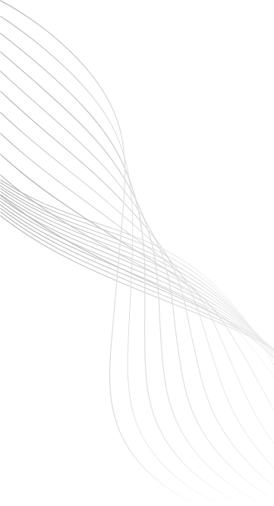


PROBLEM STATEMENT
Resumes are limited and not interactive
Need a personal website to showcase skills and project
Require a simple, responsive, and user-friendly portfolio

Slide 5

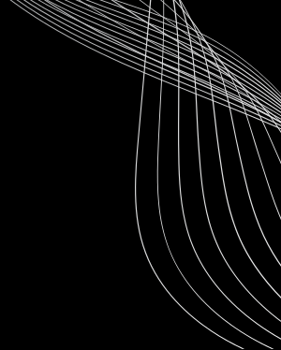

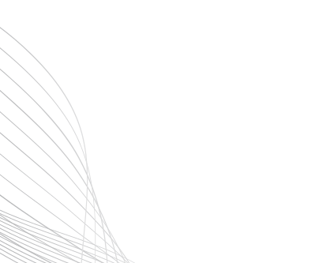
PROJECT OVERVIEW
A Personal website created to highlight my skills, project and achievements. It features a clean, responsive and user-friendly design, ensuring smooth navigation across devices .
Build using HTML, CSS, and JavaScript, It serves
as a professional platform to present my work effectively

Slide 6
WHO ARE THE END USERS?
Recruiters & faculty - To review my skills, project,and achievements.
Peers & general audience - To explore my work and connect with me

Slide 7
TOOLS AND TECHNIQUES
LANGUAGE : HTML, CSS, JAVASCRIPT
TECHNIQUES : Responsive Web Design, CSS Styling, Javascript Interactive

Slide 8
PORTFOLIO DESIGN AND LAYOUT
Design : Clean , morden and visually appealing with smooth navigation
Layout : Fully responsive grid- based layout, optimized for desktop & mobile
Style : Consistent color scheme, readable typography, and interactive elements

Slide 9
FEATURES AND FUNCTIONALITY
Showcases skills, projects, and achievements.
Responsive design with smooth navigation.
Contact section for easy communication.

Slide 10

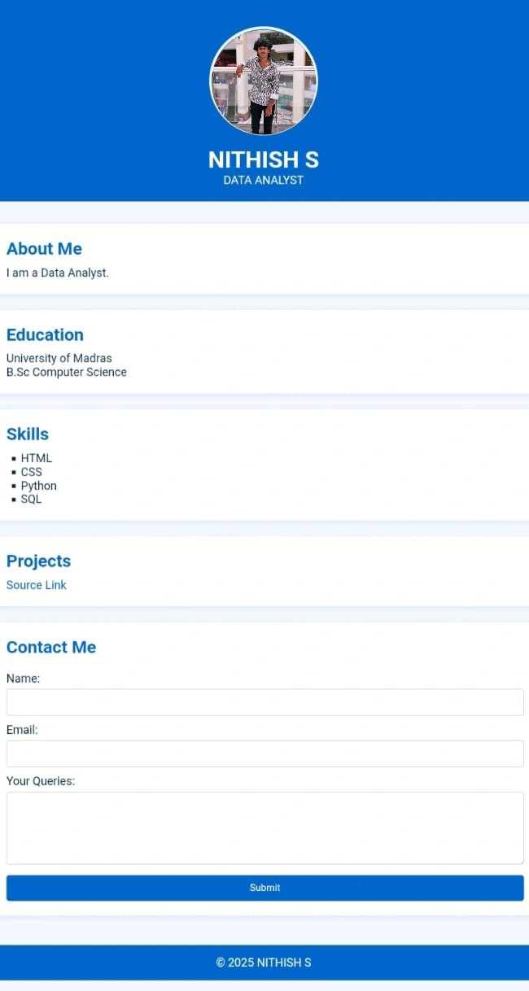
RESULTS AND SCREENSHOT
Side bar nativation menu
Any Queries? Send a Message and Get a pop-up response

Slide 11

CONCLUSION
Engages recruiters & employers with a clear skill showcase.
Delivers smooth, responsive experience across all devices.
Builds strong professional identity through modern
.

