Slide 1
SHOWNESS
WHERE
SCIENCE
MEETS
SELF-CARE
Wellness & Salon Website
Project Presentation
• HTML + CSS based multi-page website
• Clinic, salon, content and appointment experience
01

Slide 2
1. Project Overview
A single digital destination for wellness, beauty and grooming
Purpose
Present Showness as a complete wellness destination that combines clinic treatments with salon services.
Audience
Visitors looking for skincare, hair, beauty, grooming, wellness information and appointment options.
Experience
Visual pages, service categories, treatment cards, articles, gallery media and contact/booking forms.
• The homepage immediately separates the two core offerings: Wellness Clinic and Salon.
• The shared navigation connects Home, About, Services, Blog, Gallery and Contact Us.
• The design uses a consistent Showness identity across the pages.
02

Slide 3
2. Website Structure
Main pages and navigation flow
Home
Page
About
Page
Services
Page
Wellness Clinic
Page
Salon
Page
Blog
Page
Gallery
Page
Contact Us
Page
03

Slide 4
3. Home Page
Two-part entry point: Wellness Clinic + Salon
• Showness logo and brand name are positioned at the top.
• The screen is divided into two 50% sections for the clinic and salon.
• Each section contains a heading, supporting description and CLICK HERE button.
• Buttons navigate directly to wellnessclinic.html and salon.html.
SHOWNESS
Home About Services Blog Gallery Contact
WELLNESS CLINIC / SALON
Wellness Clinic
Where Science meets Beauty
Salon
04

Slide 5
4. About Page
Brand story, service positioning and customer trust
Brand Message
“Confidence begins with self care.” The page introduces Showness as a place where premium clinic and salon services meet.
Science + Self-Care
The page explains the combination of advanced dermatology treatments and luxury grooming services.
Trust & Comfort
Services are described as being delivered by trained experts in a space focused on comfort, safety and trust.
• Dedicated service blocks connect visitors to Wellness Clinic and Salon.
• Customer reviews are presented as five-star testimonials.
• The page ends with a “Ready for a Glow-Up” call-to-action and footer information.
05

Slide 6
5. Services Page
A visual gateway to the two main service areas
• Hero section introduces the Services page.
• “Our Best Treatments” presents visual links to the Wellness Clinic and Salon.
• The page includes a testimonials section with customer reviews.
• The design uses large image cards, flexible rows and a dark teal visual theme.
SHOWNESS
Home About Services Blog Gallery Contact
SERVICES
Our Best Treatments
Wellness Clinic
Salon
06

Slide 7
6. Wellness Clinic
Treatment discovery + appointment-oriented cards
Core Areas
Skin Rejuvenation • Corrective Care • Age-Defying Treatments
Treatment Categories
Hydra Facial • Hair Loss • Laser Hair Removal • Skin Lightening • Chemical Peels • Acne Treatment
Advanced Treatments
Q-Switch • Filler & Botox • PRP • RF Skin Tightening • CO2 Laser • HIFU
Example: Hydra Facial
Showness Wellness Clinic • Kompally
₹13,000 → ₹10,000 • 23% off
4.6 rating (59)
Example: Hair Loss
Showness Wellness Clinic • Kondapur
₹8,000 → ₹6,000 • 25% off
4.7 rating (82)
Booking UI
Each treatment card includes treatment name, description, location, rating, price and a “Book Appointment” button.
07

Slide 8
7. Salon Page
Head-to-toe grooming and beauty services
Hair & Grooming
Precision cuts, beard trims and styling.
Skin & Glow
Facials, spa rituals and makeup services.
Hands, Feet & Nails
Luxury care for hands, feet and nails.
• Men’s Grooming — starting at ₹299
• Hair — starting at ₹499
• Beauty — starting at ₹599
• Manicures & Pedicures — starting at ₹399
• Makeup — starting at ₹1499
• Spa — starting at ₹999
Design Approach
The page uses image/text service blocks, a dark teal content panel, golden headings and rounded image cards to create a premium salon feel.
08

Slide 9
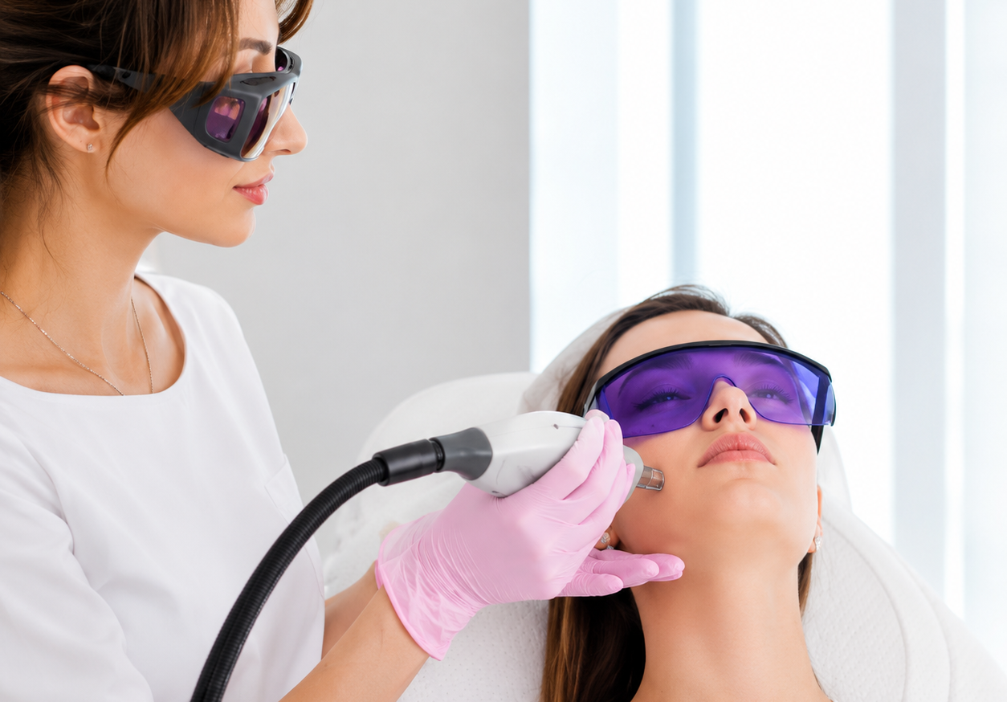
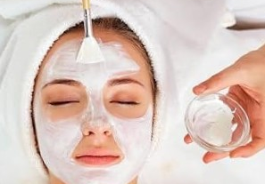
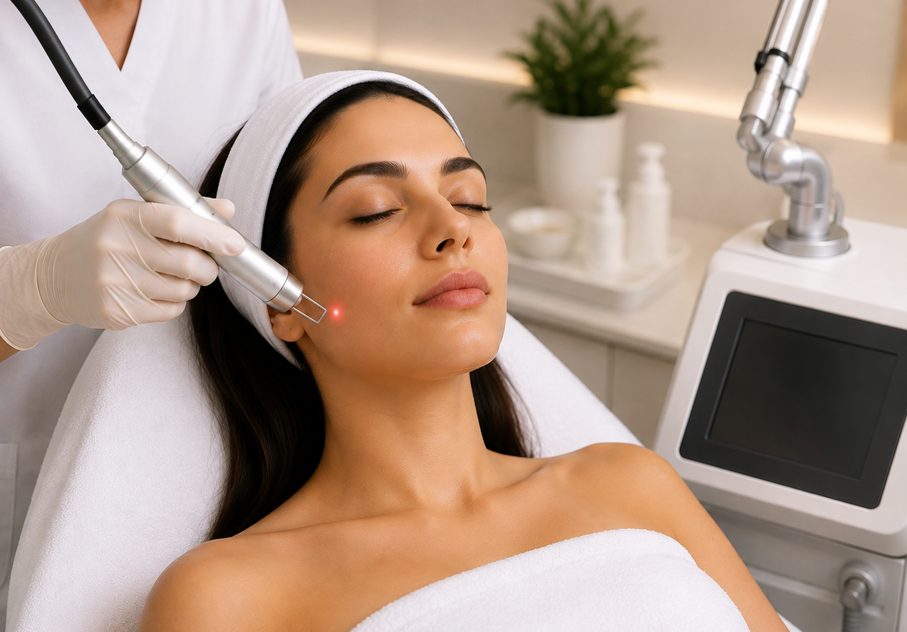
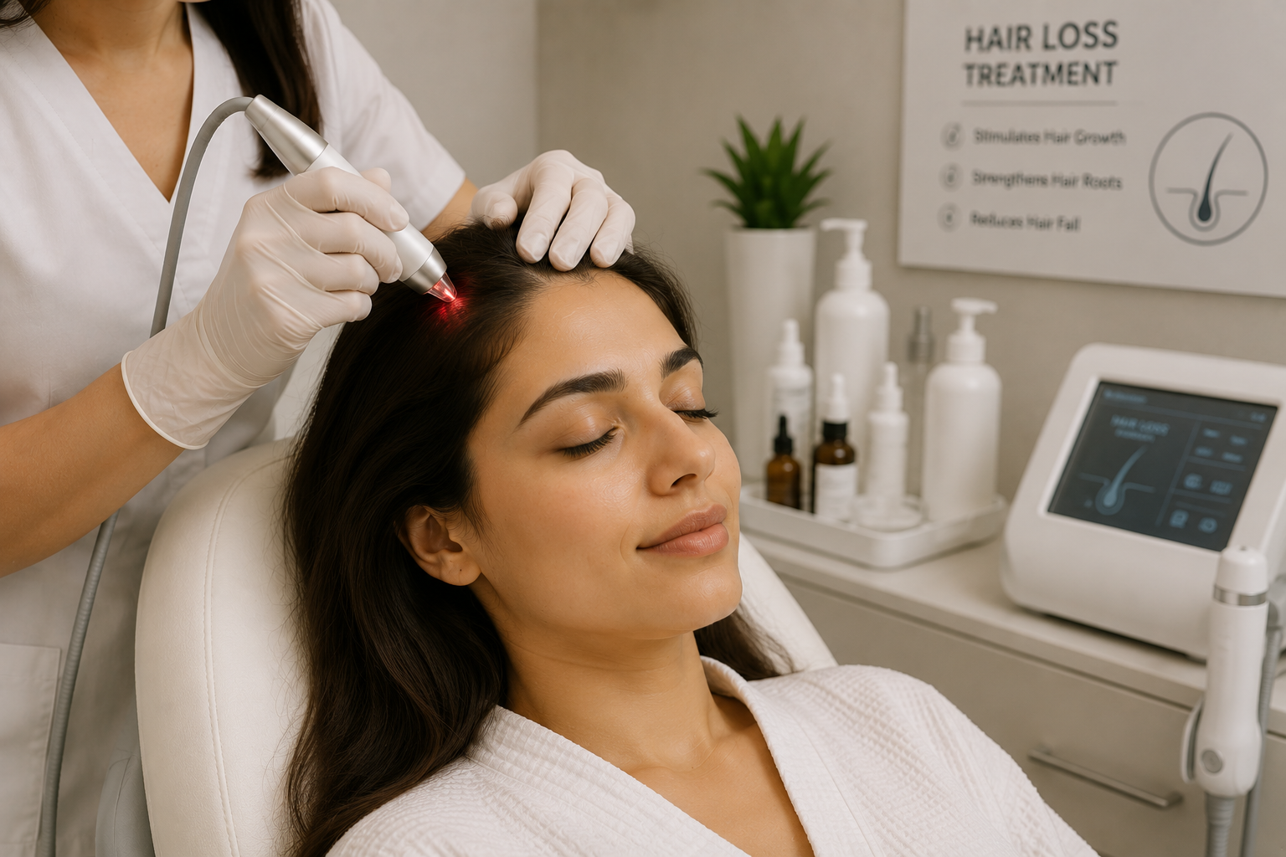
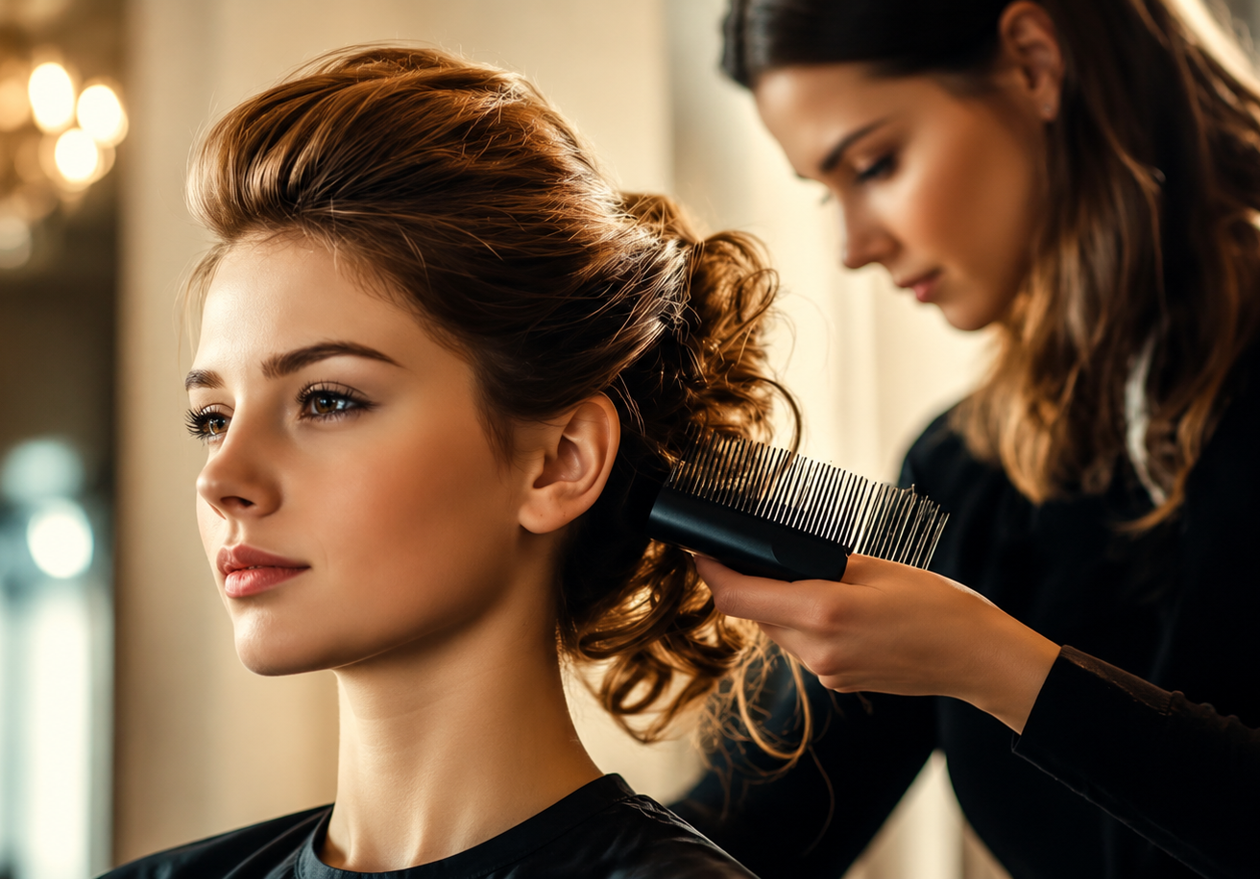
8. Blog & Gallery
Content + visual storytelling
Blog
Recent posts include acne scar transformations, choosing chemical peels, fractional CO2 laser, PRP for hair growth and laser hair removal.
Gallery
The gallery combines static images with autoplay, muted, looping videos and includes an Enquire Now section.
ACNE SCARS
CHEMICAL PEELS
CO2 LASER
HAIR LOSS
VIDEO
09

Slide 10
9. Contact & Appointment
Designed to turn visitors into enquiries
Contact Information
Phone: +91 94333 4521
Email: info@showness.in
Working Hours
Monday – Sunday
9:00 AM – 9:00 PM
Appointment Form
Name • Email • Number
Submit button for enquiry
• The page also lists branches including Komaplly, Kondapur, Ramanthapur and Madhapur.
• Social icons are available in the navigation/footer areas.
• The form is a simple front-end appointment/enquiry interface in the supplied HTML.
10

Slide 11
10. Technologies & Implementation
What is visible in the supplied source files
HTML5
Semantic page structure using headings, paragraphs, images, links, forms, details/summary, video and buttons.
CSS3
Flexbox layouts, backgrounds, transitions, keyframes, transforms, rounded cards and responsive-style wrapping.
Navigation
Shared navigation connects the main pages; Services expands to Wellness Clinic and Salon.
@keyframes slide {
from { transform: translateY(100%);
opacity: 0; }
to { transform: translateY(0);
opacity: 1; }
}
.heading2 a:hover { color: gold; }
Source CSS Highlights
• translateY / translateX reveals
• scale and fade effects
• hover underline navigation
• object-fit / background-size
• flex-wrap for page layouts
11

Slide 12
11. Animation & Visual Design
Motion is used to make the pages feel more interactive
Slide Reveal
Elements enter vertically with translateY and opacity changes.
Image Reveal
About-page images use left/right translateX animations.
Scale / Bloom
Gallery and wellness sections use scale-based reveal effects and card animations.
Load
Enter
Hover
Scroll
Hero text appears
Images slide in
Navigation turns gold
Some cards use view-timeline CSS
12

Slide 13
12. Project Outcome
What the supplied website delivers
• A multi-page Showness website with a clear clinic + salon identity.
• A consistent navigation system across the major pages.
• Detailed wellness treatments with prices, ratings, locations and booking buttons.
• Salon categories with starting prices and descriptive service cards.
• Educational blog content and a visual gallery with images and videos.
• Contact, working hours, branches and appointment enquiry interfaces.
• A premium visual language built around dark teal, cream, white and gold accents.
Core message
Where Science Meets Self-Care
13

Slide 14
THANK YOU
SHOWNESS WELLNESS & SALON WEBSITE
Home • About • Services • Wellness Clinic • Salon • Blog • Gallery • Contact
14

