Slide 1


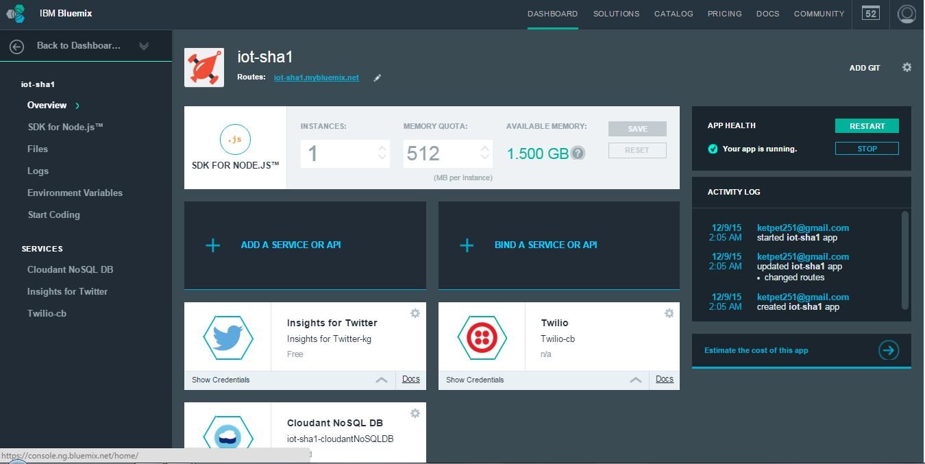
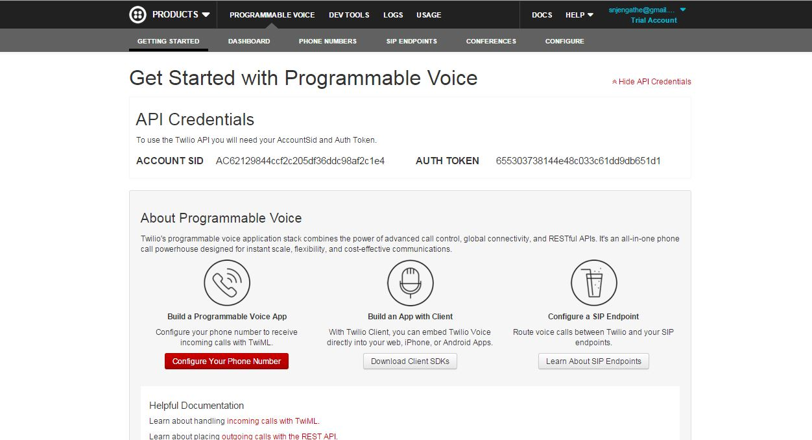
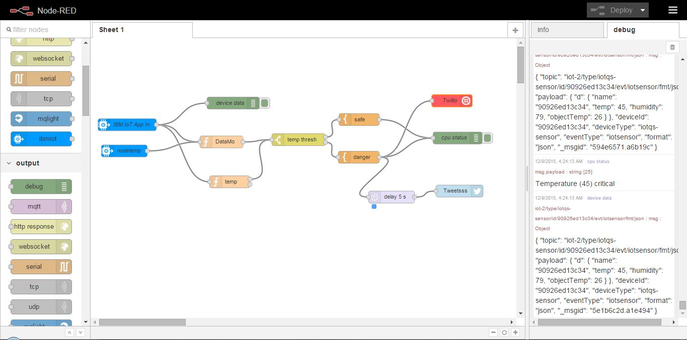
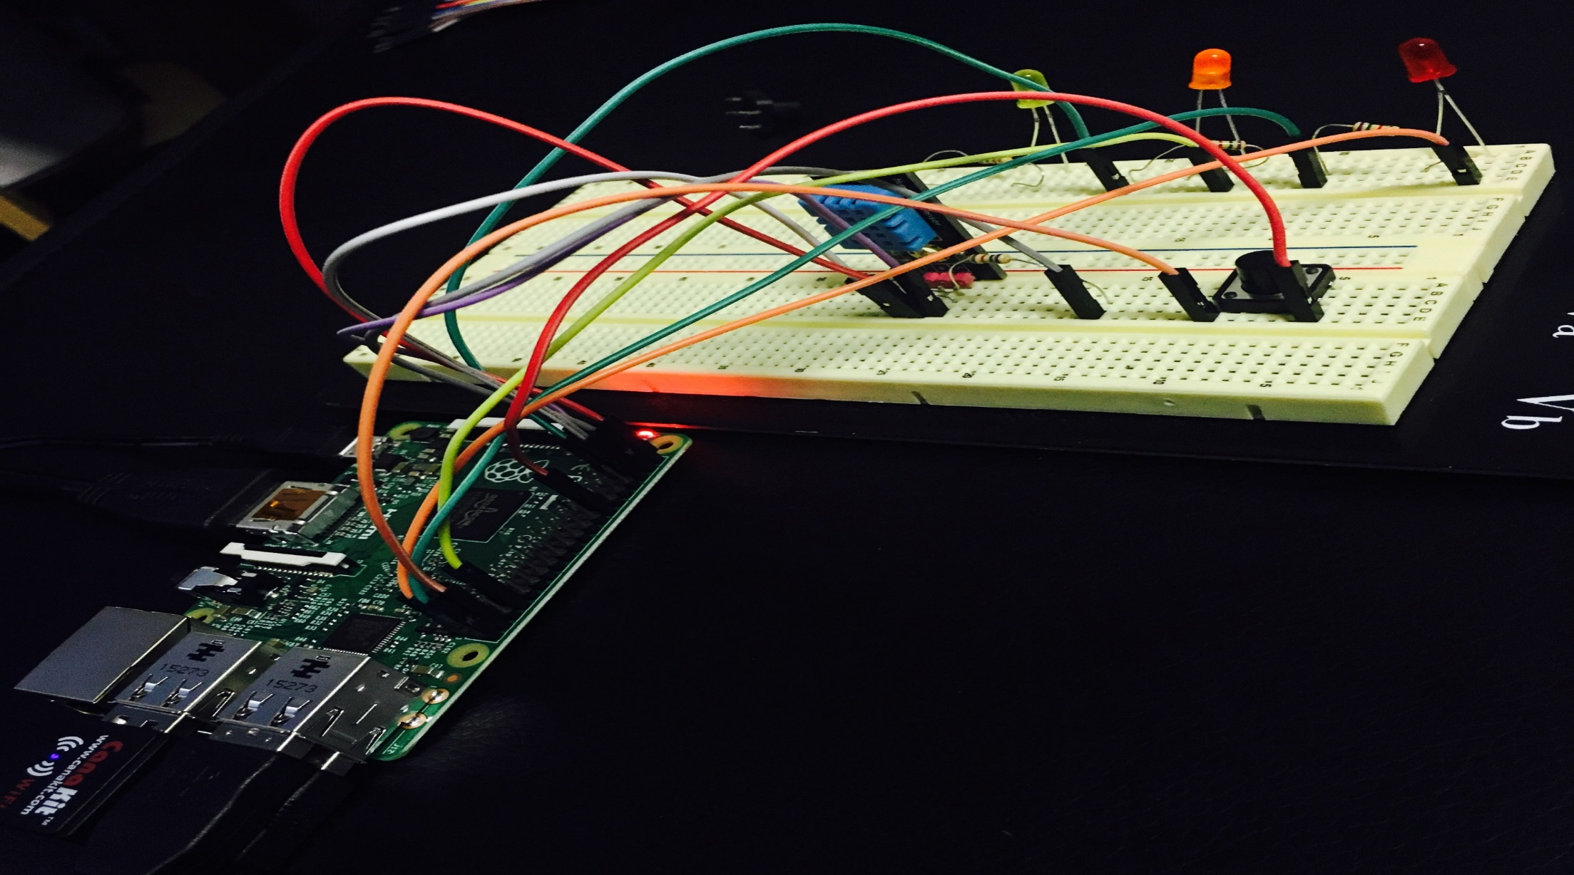
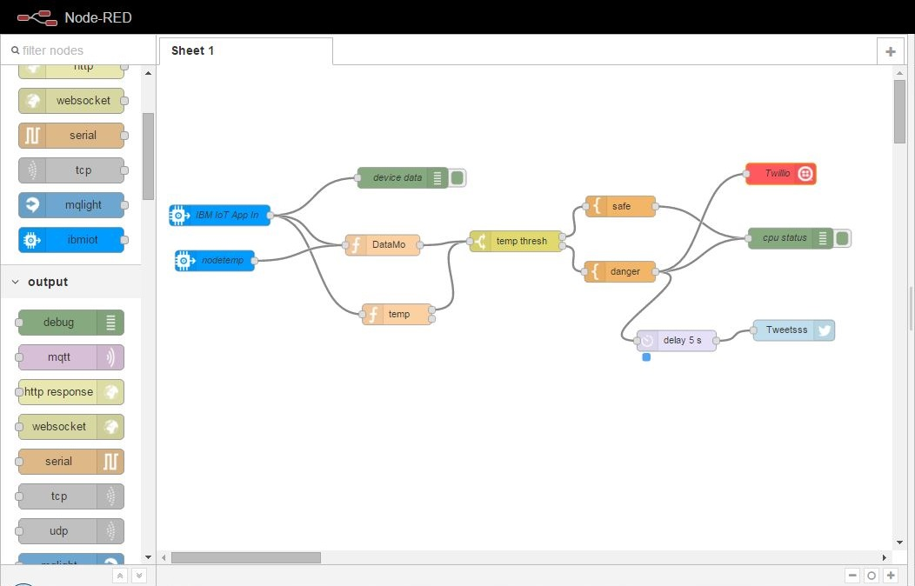
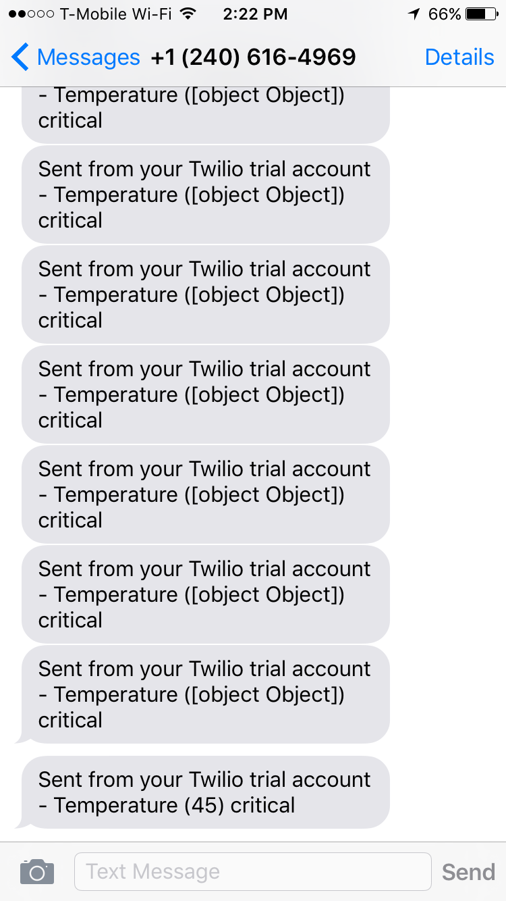
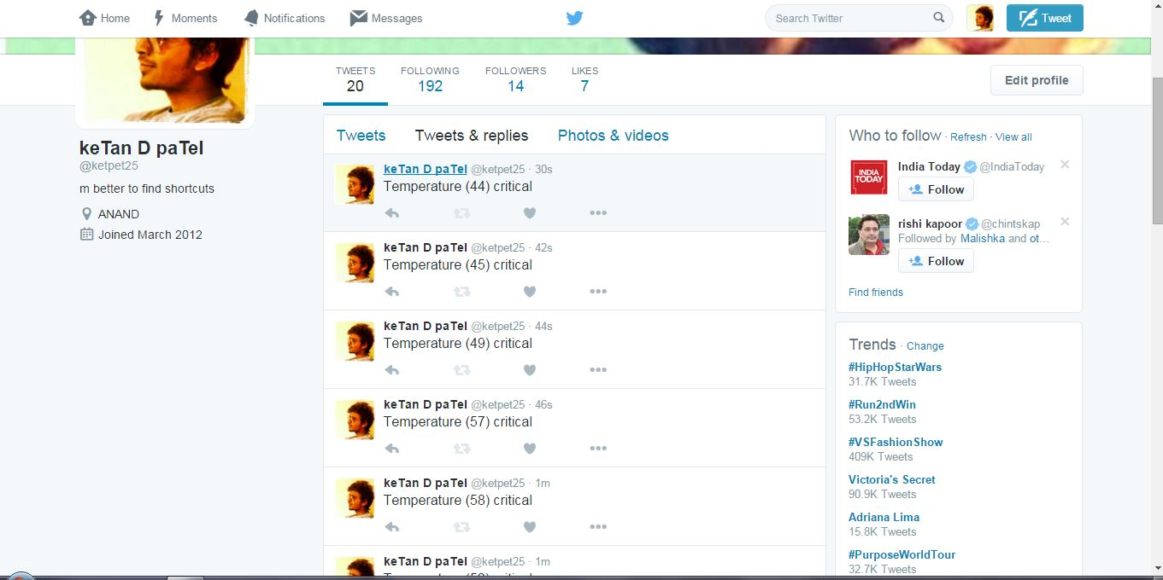
Temperature & Humidity Data Using IOT with Raspberry Pi.
Shashank Jengathe, Ketankumar Patel, Akash Gandhi
Department of Information Systems
California State University, Los Angeles
Purpose
Methods
Results
Implementation of IBM Bluemix services such as Internet of things, Node Red and Twilio to analyze data form the sensor connected to the Raspberry Pi.
Loging in to the Bluemix account gives us access to all the Runtime Environment, Applications & services which helps enabling us to use them and deploy . Connection of Bluemix and Raspberry Pi 2 and binding the services of Twilio to the Internet of things Boiler plates.
Using Node red we will get the desired output for the temperature and humidity sensing data which will help us in developing more applications.
Applications & Services
Background
The modern approach of IBM Bluemix & Internet of things is used to fetch the data coming from the sensor connected to the Raspberry Pi device which will helps us to gather the temperature and humidity data at a real time.
In additional we are using the Twilio service provided by the Bluemix to alert the user by sending the text message to the user if any changes occurred in the temperature and the humidity sensing data. This will helps us to minimize the risks associated with the high and low temperature however these temperature fluctuations may cause the fatal damage to the things which are sensible to change in the temperature.
We used real-time temperature and humidity data to post it on the social networking using twitter. The data can be easily posted on the users twitter account. This services are created by using Rode red application which is provided by the IBM services. These services are easy to run and deploy at your own website and helps the users to make better use of the cutting edge technology
Running Application & Outputs
Twilio provides us the better understanding of the real time scenario of the temperature which we are using to fetch from the raspberry pi device.
Requirements
Creating Runtime environment node,js and binding the applications Internet of Things, Node Red, Twilio, Twitter Analysis.
Have to provide login credentials for the twitter to post the temperature & humidity data.
Real-time posts to the twitter and receiving text messages to the mobile phone.
Bluemix Account
Twitter Account
Twilio Account
Raspberry Pi 2
Temperature and Humidity Sensors
Resistors
Jumper cables
Breadboard
Text Messages Received by Twilio
Tweets Posted on Twitter
A
B
Conclusion
To summarize, this project is about creating the services and deploying it to the Bluemix using Raspberry Pi2 device with the additional temperature /humidity sensors can be helpful to lot of peoples to creating real-time application like home automations, small scale industrial application can be used in the medical monitoring applications, observing real-time environmental conditions i.e. rise/ fall in the temperature , humidity etc.

