Slide 1

Access to Healthcare
Medhacks 2017

Slide 2


Slide 3
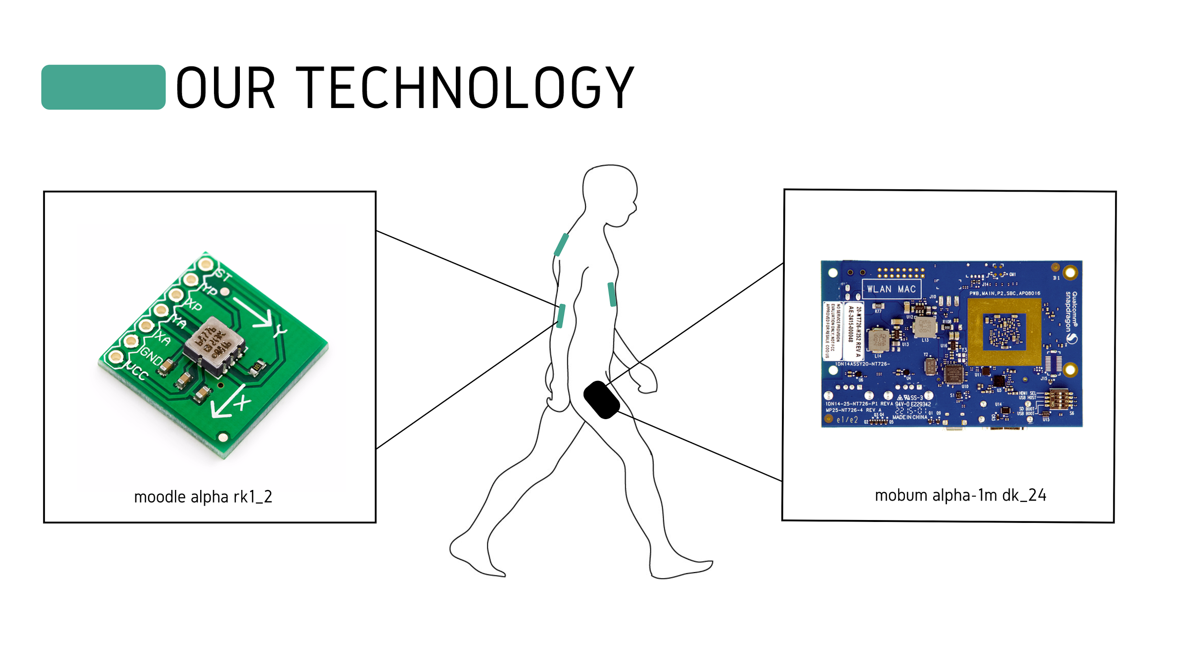

Slide 4
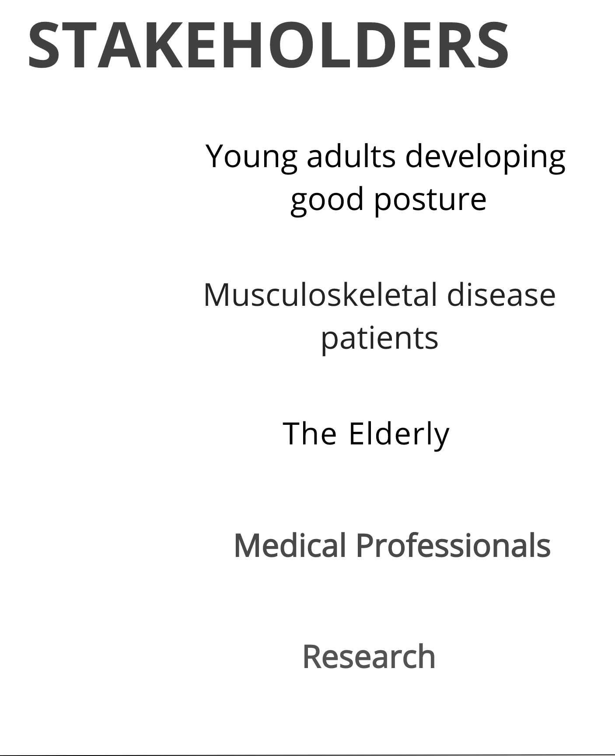





Slide 5
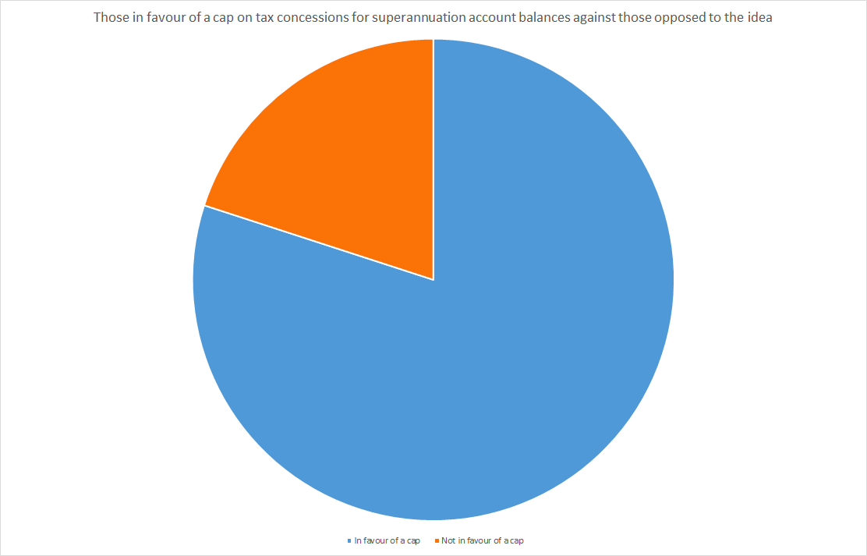
Percentage of People Who Have or Will Experience Lower Back Pain
80%
National Institutes of Health

Slide 6
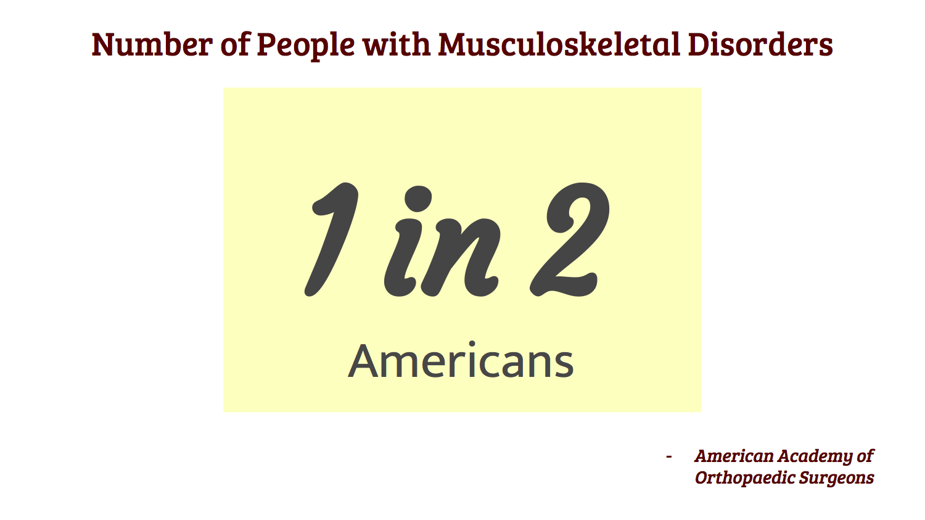

Slide 7
