Slide 1
</>
PYTHON WEB FRAMEWORK · WORKSHOP SESSION
Flask
A 30-minute introduction
Browser
→
Request
→
Flask
→
Response
I'll talk through each concept while running the code live —
you can just watch, follow along, and ask questions.

Slide 2
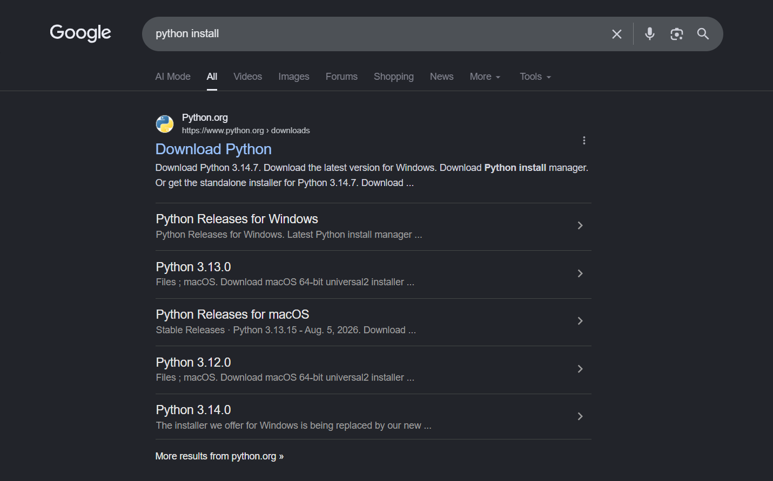

Slide 3
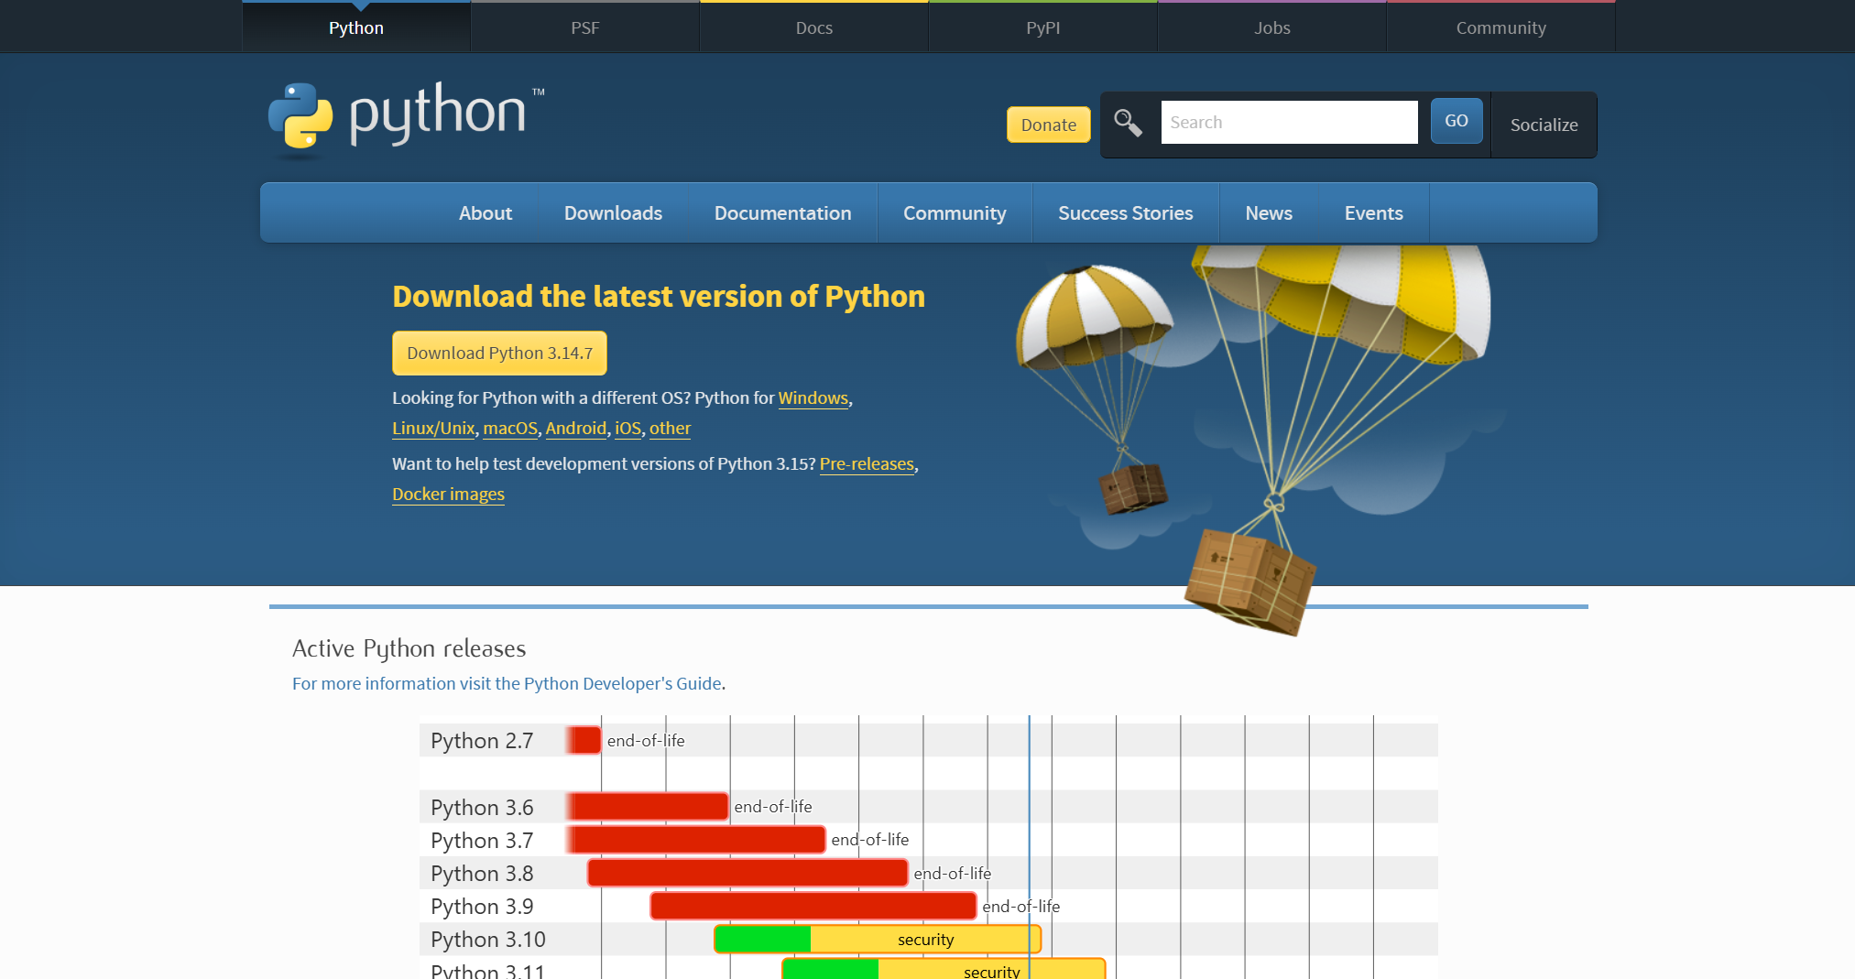

Slide 4
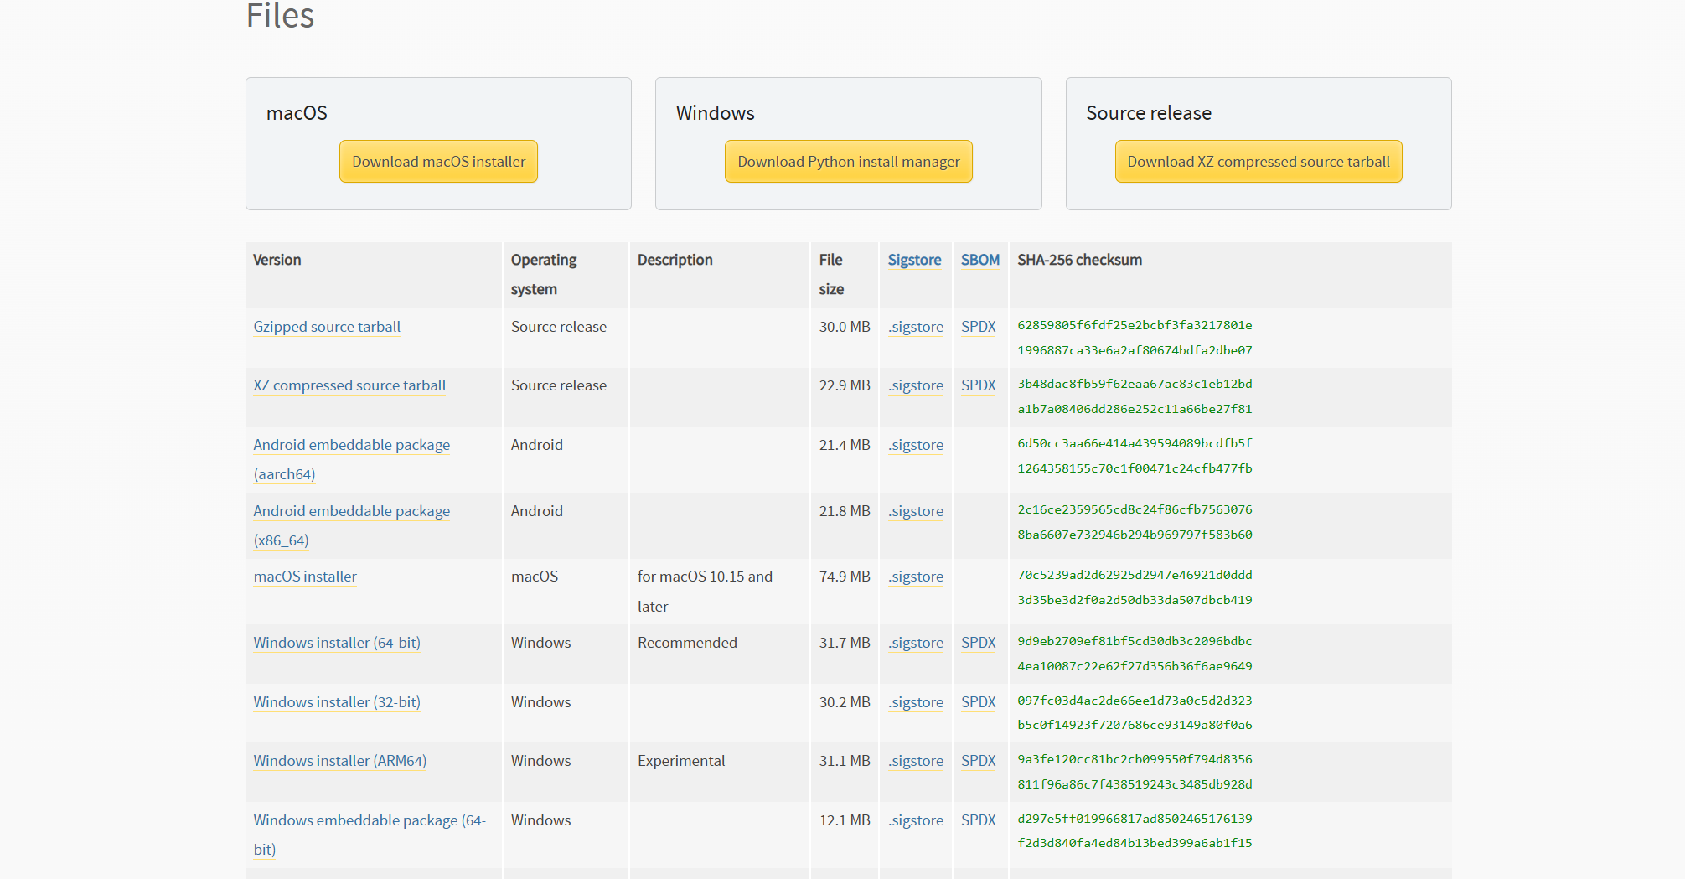

Slide 5
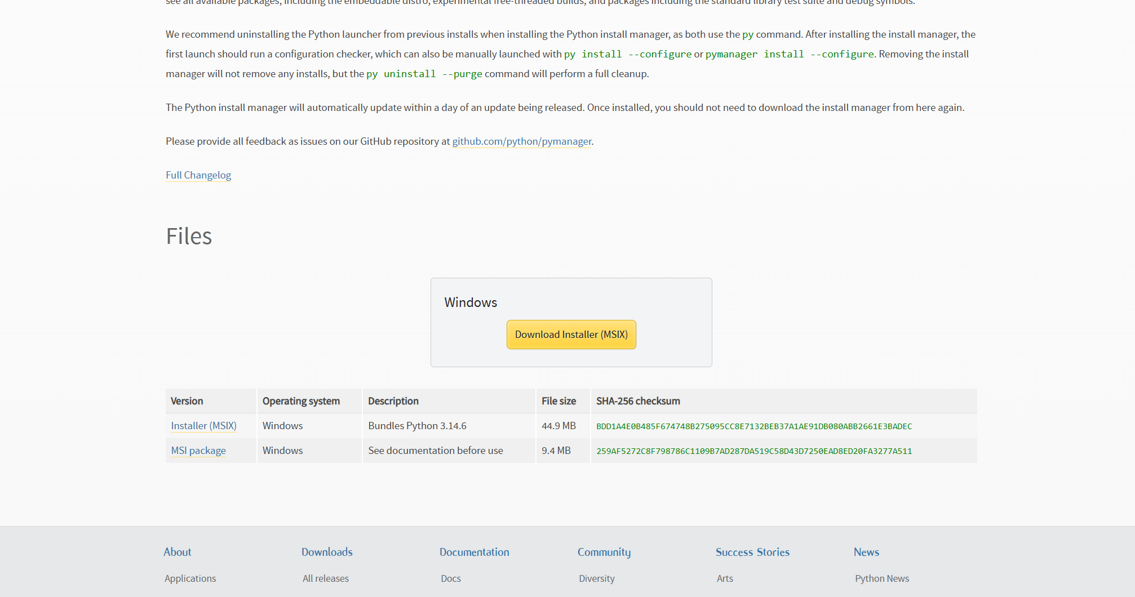

Slide 6
THE BIG PICTURE
How Flask handles a request
→
→
→
Browser
Request
Flask
Response
You type a URL
Sent over the web
Your Python app
Sent back to you
Flask's job: receive the request, decide what to do, send back a response.
02 / 24

Slide 7
STEP 1 · FIRST REQUEST
The simplest Flask app
home.py
①
Flask(__name__)
from flask import Flask app = Flask(__name__) @app.route("/") def home(): return "Hello World!" app.run()
creates the Flask app
②
app
our Flask application
③
@app.route()
maps URL → function
④
app.run()
starts the server
● LIVE DEMO
03 / 24

Slide 8
STEP 2 · ROUTING
Different URLs, different functions
URL
→
Flask Route
→
Python Function
→
Response
app.py
app.py
@app.route("/") def home(): return "Hello World!"
@app.route("/about") def about(): return "This is the About page"
One app, many routes — each URL maps to its own function.
● LIVE DEMO
04 / 24

Slide 9
STEP 3 · DYNAMIC ROUTES
URLs can carry data
name.py
/hello/satya
@app.route("/hello/<name>") def hello(name): return f"Hello {name}! Welcome to my website."
↓
name = "satya"
↓
Python function
↓
Response
Whatever comes after /hello/ becomes the name variable.
● LIVE DEMO
05 / 24

Slide 10
STEP 5 · THE POST REQUEST
GET vs. POST
GET
POST
Purpose
Get / request data
Send data
How triggered
Open a URL / navigate
Form / client sends request
Where data goes
URL
Request body
Visible in URL?
✓ Yes
✕ No
Can I type the URL?
✓ Yes
✕ No
Example
/users?name=satya
POST /login
Browser → GET /users?name=satya
Form → POST /login (data in body)
GET asks for something. POST sends something.
● LIVE DEMO
07 / 24

Slide 11
STEP 4 · THE GET REQUEST
GET: the default request
Browser opens URL
→
GET request
→
Flask route
→
Response
requestget.py
①
Default method
@app.route("/", methods=["GET"]) def home(): return "GET request received!"
normal browser navigation sends GET
②
methods=["GET"]
makes it explicit in the route
● LIVE DEMO
06 / 24

Slide 12
STEP 6 · HTML FORMS
Connecting a form to Flask
①
<form>
Login
wraps the inputs
②
<input>
Username
creates each field
Password
③
<button>
submits the form
Login
④
name="username"
identifies the field to Flask
08 / 24

Slide 13
STEP 7 · FORM SUBMISSION
Where does the form data go?
GET
POST
/login?username=satya&password=1234
/login
Data → URL
(query parameters, visible)
Data → Request Body
(not shown in the URL)
● LIVE DEMO
09 / 24

Slide 14
STEP 8 · FORM ACTION
method vs. action
Login page
login.html
<form method="POST" action="/login">
↓
Click "Login"
↓
①
method
POST /login
HOW the form sends its data
↓
②
action
Flask /login route
WHERE the form sends it
● LIVE DEMO
10 / 24

Slide 15
STEP 9 · REQUEST.FORM
Flask receives the form data
HTML Form
login.py
↓
@app.route("/login", methods=["POST"]) def login(): username = request.form.get("username") password = request.form.get("password") return f"Username: {username}, Password: {password}"
POST /login
↓
Flask
↓
request.form
↓
Python gets the values
● LIVE DEMO
11 / 24

Slide 16
STEP 10 · RENDER_TEMPLATE
Keep HTML out of Python
HTML can live separately from Python — Flask just loads it when needed.
app.py templates/ login.html
①
templates/
the folder Flask looks in
②
render_template()
loads and returns the HTML file
app.py
@app.route("/") def home(): return render_template( "login.html")
● LIVE DEMO
12 / 24

Slide 17
STEP 11 · VALIDATION
We have the data. Now let's check it.
username + password
Valid
Invalid
Success
Error
validateforms.py
if username == "admin" and password == "1234": return "Login successful!"
● LIVE DEMO
13 / 24

Slide 18
STEP 12 · STORAGE
Where do users come from?
Dictionary
storedict.py
users = { "admin": "1234", "satya": "abcd" }
↓
Temporary
↓
Server stops
↓
Data disappears
It works — but it only lives as long as the app is running.
● LIVE DEMO
14 / 24

Slide 19
STEP 13 · SQLITE
Data that stays
Dictionary → temporary
vs
SQLite → persistent
sqlconn.py
import sqlite3 conn = sqlite3.connect("users.db") conn.close()
● LIVE DEMO
15 / 24

Slide 20
STEP 14 · CREATE TABLE
Defining the users table
createtable.py
Python
conn.execute(""" CREATE TABLE IF NOT EXISTS users ( username TEXT, password TEXT ) """)
↓
CREATE TABLE
↓
users table exists
● LIVE DEMO
16 / 24

Slide 21
STEP 15 · INSERT
Adding a new user
Python
insert.py
conn.execute( "INSERT INTO users(username, password) VALUES('admin', '1234')" ) conn.commit()
↓
INSERT
↓
users table
↓
New user stored
● LIVE DEMO
17 / 24

Slide 22
STEP 16 · SELECT
Finding a user
SELECT
select.py
result = conn.execute( "SELECT * FROM users WHERE username = 'admin'" ) user = result.fetchone()
↓
Find user
↓
Matching row
↓
fetchone()
admin
1234
● LIVE DEMO
18 / 24

Slide 23
STEP 17 · PUTTING IT ALL TOGETHER
From Browser Request to Authentication
Login page
↓
HTML form
↓
POST /login
↓
request.form
↓
SQLite
↓
SELECT user
↓
Check password
↓
Success / Invalid
● LIVE DEMO
19 / 24

Slide 24
RECAP
What we covered
Routes
Dynamic Routes
GET
POST
Forms
request.form
Validation
SQLite
Insert / Select
Auth
Thank you!
Questions? Let's build something.
24 / 24

Slide 25
STEP 18 · FLASK SESSIONS
Remembering the logged-in user
app.secret_key lets Flask securely sign session data.
app.py
POST /login
from flask import session app.secret_key = "secret" session["user"] = username
↓
Check credentials
↓
session["user"] = username
↓
redirect("/home")
①
session["user"] = username
remember the logged-in user
↓
/home checks session
②
if "user" not in session
↓
check whether they're logged in
Allow / redirect to login
③
session.clear()
log the user out
● LIVE DEMO
20 / 24

Slide 26
STEP 19 · .GITIGNORE
Keeping secrets out of Git
Tells Git which files or folders should NOT be tracked or pushed to GitHub.
.gitignore
Project ├── app.py ├── .env ← secret values └── .gitignore ← tells Git to ignore .env
.env __pycache__/ *.pyc
⚠ Never push .env containing real secrets to GitHub.
● LIVE DEMO
21 / 24

Slide 27
STEP 20 · .ENV + SECRET KEY
Storing the secret key safely
BEFORE — hardcoded
.env
app.secret_key = "secret"
SECRET_KEY=my-secret-key
.env
→
load_dotenv()
→
os.getenv(...)
→
app.secret_key
app.py
import os from dotenv import load_dotenv load_dotenv() app.secret_key = os.getenv("SECRET_KEY")
$ pip install python-dotenv
.env goes in .gitignore — the secret never reaches GitHub.
● LIVE DEMO
22 / 24

Slide 28
STEP 21 · THE COMPLETE PICTURE
The full authentication journey
Login Page
↓
POST /login
↓
request.form
↓
Validate credentials
↓
SQLite
↓
Session
↓
Protected Home
↓
Logout
↓
session.clear()
23 / 24

Slide 29
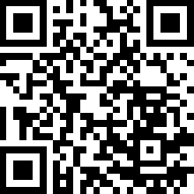
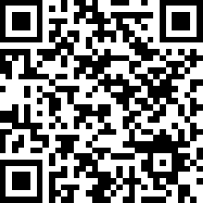
GitHub Links
Flask Skill lab
Menu - Assignment

Slide 30
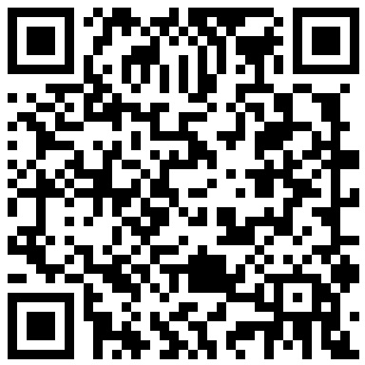
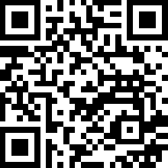
Contact
Kavin Krishnan C
Satyendra Nayak K

Slide 31
RECAP
What we covered
Routes
Dynamic Routes
GET
POST
Forms
request.form
Validation
SQLite
Insert / Select
Auth
Thank you!
Questions? Let's build something.
24 / 24

