Slide 1

Basic Notation
$4x_{1} −5x_{2}=−13$
$$−2x_{1}+3x_{2}=9$$
In matrix notation
$$A=\left[\begin{matrix}4 & −5 \\ −2 & 3\end{matrix}\right], b=\left[\begin{matrix}−13 \\ 9\end{matrix}\right], x=\left[\begin{matrix}x_{1} \\ x_{2}\end{matrix}\right]$$
$$Ax=b$$
-Vector:
$x^{m}∈R^{m} :$ vector
$i_{th}$ element of $x=x_{i}$; $x= \left[\begin{matrix}x_{1} \\ ⋮ \\ \begin{aligned}x_{i} \\ ⋮\end{aligned}\end{matrix}\right]$
-Matrix:
$m$ rows , $n$ columns : $A∈R^{m×n}$
${\left(i,j\right)}_{th}$ element
$$A_{mn}=\left[\begin{matrix}a_{11} & ⋯ & a_{1n} \\ ⋮ & a_{ij} & ⋮ \\ a_{1m} & ⋯ & a_{mn}\end{matrix}\right]$$
$j_{th}$column vector of $A_{mn}=A_{:,j}$ , $i_{th}$ row vector $A_{i,:}$

Slide 2

2. Matrix multiplication
${ A}^{m×n}, B^{n×p}$ , $C=AB∈R^{m×p}$
$$C_{ij}= \sum_{k=1}^{n}{A_{ik}B_{kj}}$$
2.1 Vector – Vector Products
dot product = inner product
$x, y∈R^{n}$ , $x∙y=\left(x,y\right)=x^{T}y ∈R$
$$x^{T}y= \left[\begin{matrix}x_{1} & … & x_{n}\end{matrix}\right]\left[\begin{matrix}y_{1} \\ ⋮ \\ y_{n}\end{matrix}\right]=\sum_{i=1}^{n}{x_{i}y_{i}}$$
2.2 Matrix – Vector Products
$$A∈R^{m×n}, x∈R^{n} =R^{n×1}$$
$$Ax∈R^{m×1}$$
2.3 Useful properties
$$A\left(BC\right)=\left(AB\right)C$$
$$A\left(B+C\right)=AB+AC$$

Slide 3
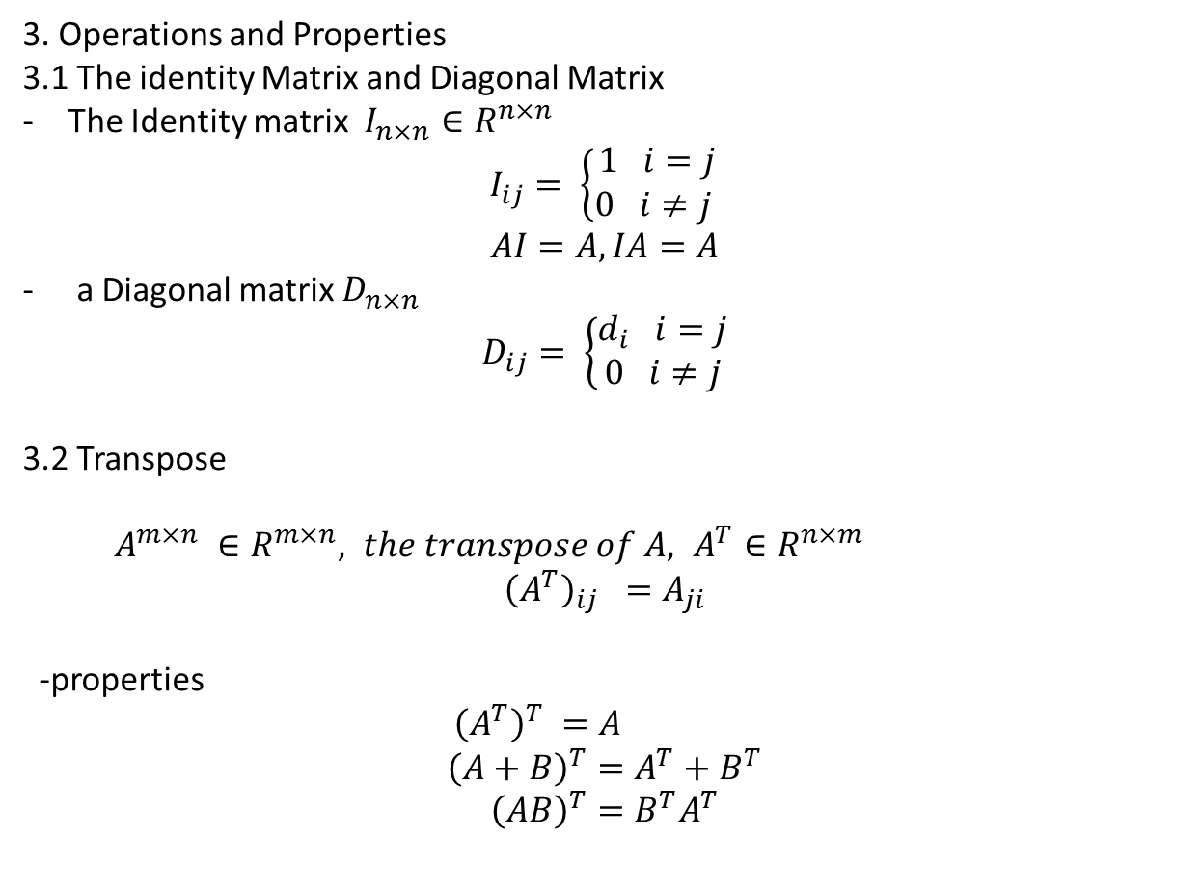
3. Operations and Properties
3.1 The identity Matrix and Diagonal Matrix
The Identity matrix $I_{n×n}∈R^{n×n}$
$$I_{ij}= \left\{\begin{aligned}1 i=j \\ 0 i≠j \end{aligned}\right.$$
$$AI=A, IA=A$$
a Diagonal matrix $D_{n×n}$
$$D_{ij}= \left\{\begin{aligned}d_{i} i=j \\ 0 i≠j\end{aligned}\right.$$
3.2 Transpose
$A^{m×n} ∈R^{m×n}, the transpose of A, A^{T}∈R^{n×m}$
$${\left(A^{T}\right)}_{ij} =A_{ji}$$
-properties
${\left(A^{T}\right)}^{T} =A$
$${\left(A+B\right)}^{T}=A^{T}+B^{T}$$
$${\left(AB\right)}^{T}=B^{T}A^{T}$$

Slide 4
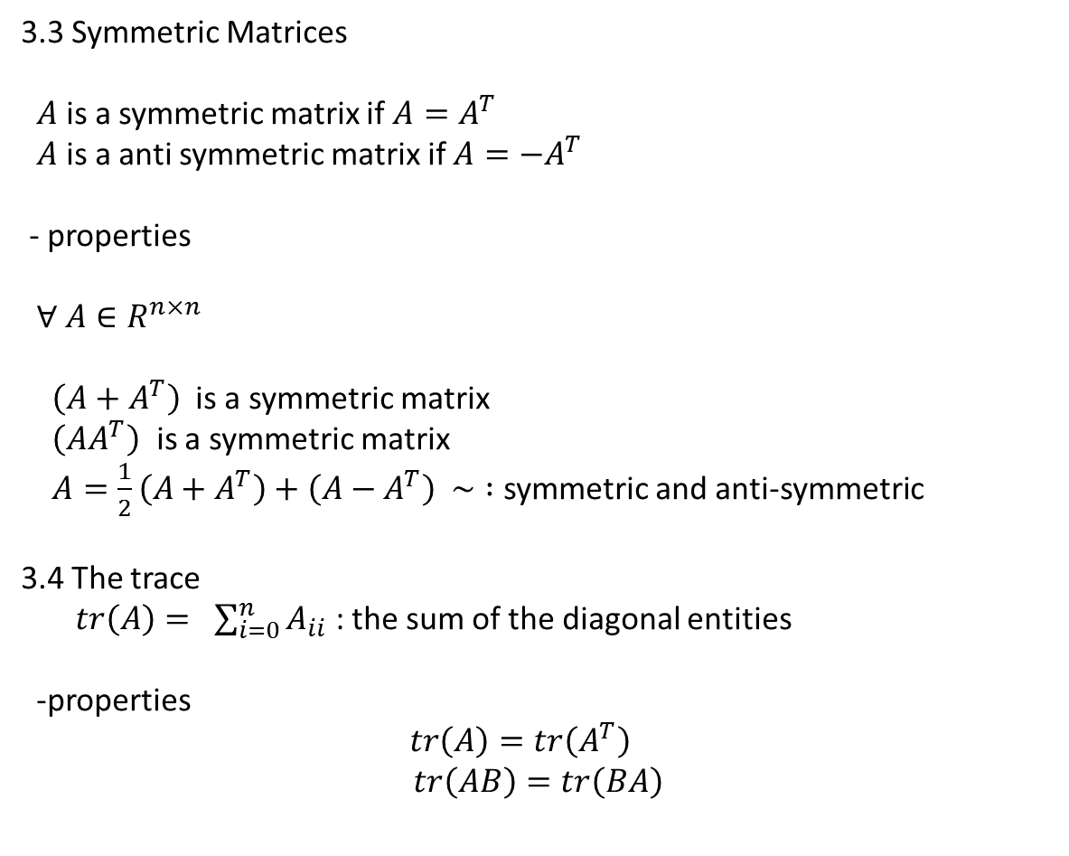
3.3 Symmetric Matrices
$A$ is a symmetric matrix if $A=A^{T}$
$A$ is a anti symmetric matrix if $A=−A^{T}$
- properties
$∀ A∈R^{n×n}$
$\left(A+A^{T}\right)$is a symmetric matrix
$\left(AA^{T}\right)$ is a symmetric matrix
$A=\frac{1}{2}\left(A+A^{T}\right)+\left(A−A^{T}\right) \sim :$ symmetric and anti-symmetric
3.4 The trace
$tr\left(A\right)= \sum_{i=0}^{n}{A_{ii}}$ : the sum of the diagonal entities
-properties
$tr\left(A\right)=tr\left(A^{T}\right)$
$$tr\left(AB\right)=tr\left(BA\right)$$

Slide 5
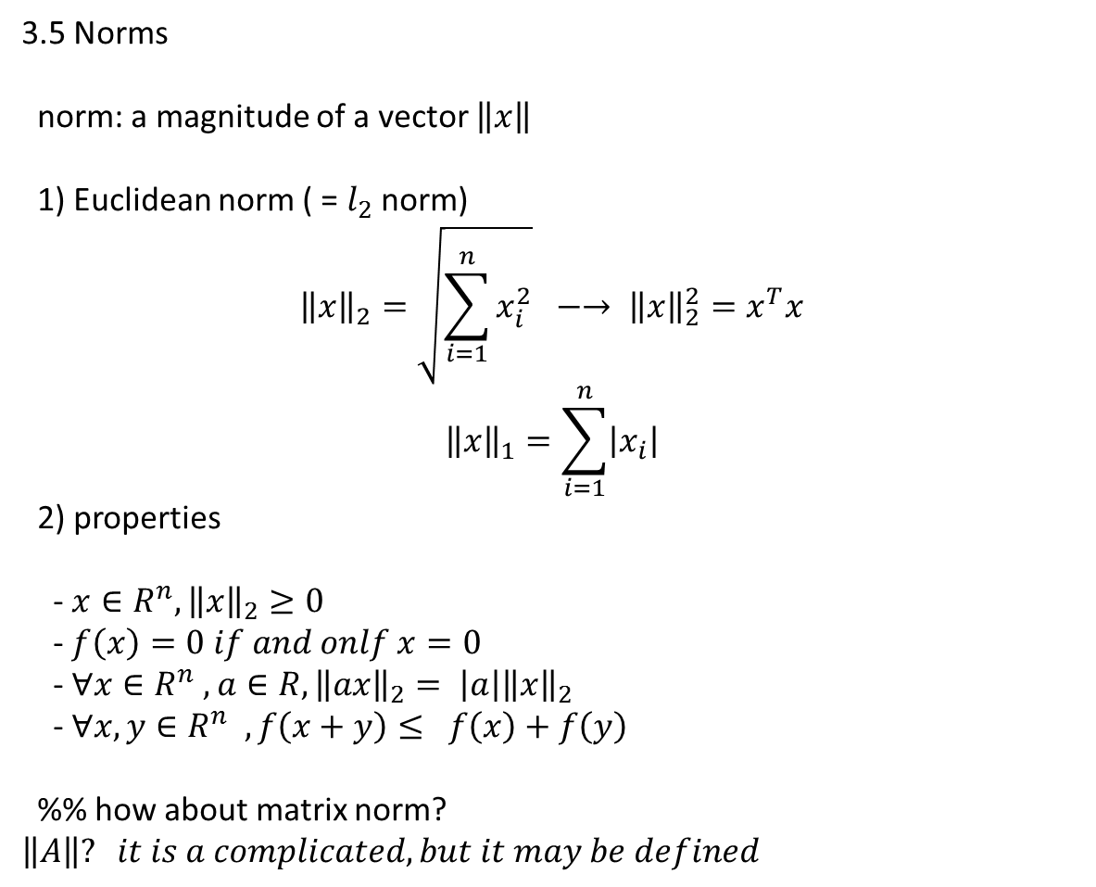
3.5 Norms
norm: a magnitude of a vector $\left\|x\right\|$
1) Euclidean norm ( = $l_{2}$ norm)
$${\left\|x\right\|}_{2}=\sqrt{\sum_{i=1}^{n}{x_{i}^{2}}} −→ {\left\|x\right\|}_{2}^{2}=x^{T}x$$
$${\left\|x\right\|}_{1}=\sum_{i=1}^{n}{\left|x_{i}\right|}$$
2) properties
- $x∈R^{n}, {\left\|x\right\|}_{2}≥0$
- $f\left(x\right)=0 if and onlf x=0$
- $∀x∈R^{n} , a∈R, {\left\|ax\right\|}_{2}= \left|a\right|{\left\|x\right\|}_{2}$
- $∀x,y∈R^{n} , f\left(x+y\right)≤ f\left(x\right)+f\left(y\right)$
%% how about matrix norm? $\left\|A\right\|? it is a complicated, but it may be defined$

Slide 6
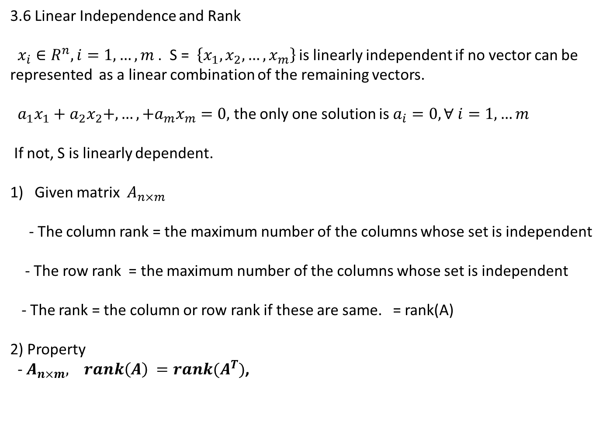
3.6 Linear Independence and Rank
$x_{i}∈R^{n}, i=1,…,m$. S = $\left\{x_{1}, x_{2},…,x_{m}\right\}$ is linearly independent if no vector can be represented as a linear combination of the remaining vectors.
$a_{1}x_{1}+a_{2}x_{2}+,…,+a_{m}x_{m}=0,$ the only one solution is $a_{i}=0, ∀ i=1,…m$
If not, S is linearly dependent.
Given matrix $A_{n×m}$
- The column rank = the maximum number of the columns whose set is independent
- The row rank = the maximum number of the columns whose set is independent
- The rank = the column or row rank if these are same. = rank(A)
2) Property
- $A_{n×m}, rank\left(A\right) =rank(A^{T})$,

Slide 7
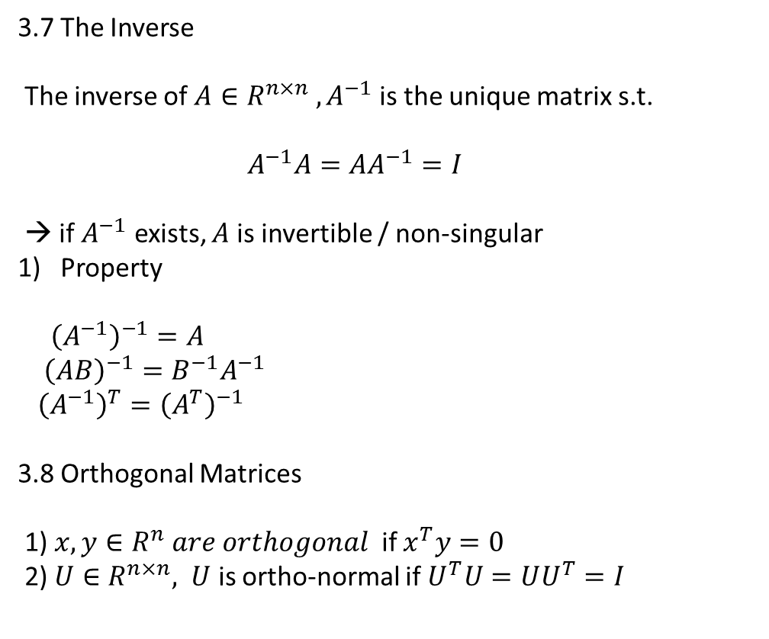
3.7 The Inverse
The inverse of $A∈R^{n×n} , A^{−1}$ is the unique matrix s.t.
$A^{−1}A=AA^{−1}=I$
→ if $A^{−1}$ exists, $A$ is invertible / non-singular
Property
${\left(A^{−1}\right)}^{−1}=A$
${\left(AB\right)}^{−1}=B^{−1}A^{−1}$
${\left(A^{−1}\right)}^{T}={\left(A^{T}\right)}^{−1}$
3.8 Orthogonal Matrices
1) $x,y∈R^{n} are orthogonal$ if $x^{T}y=0$
2) $U∈R^{n×n}, U$ is ortho-normal if $U^{T}U=UU^{T}=I$

Slide 8
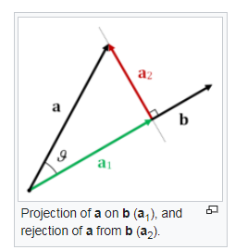
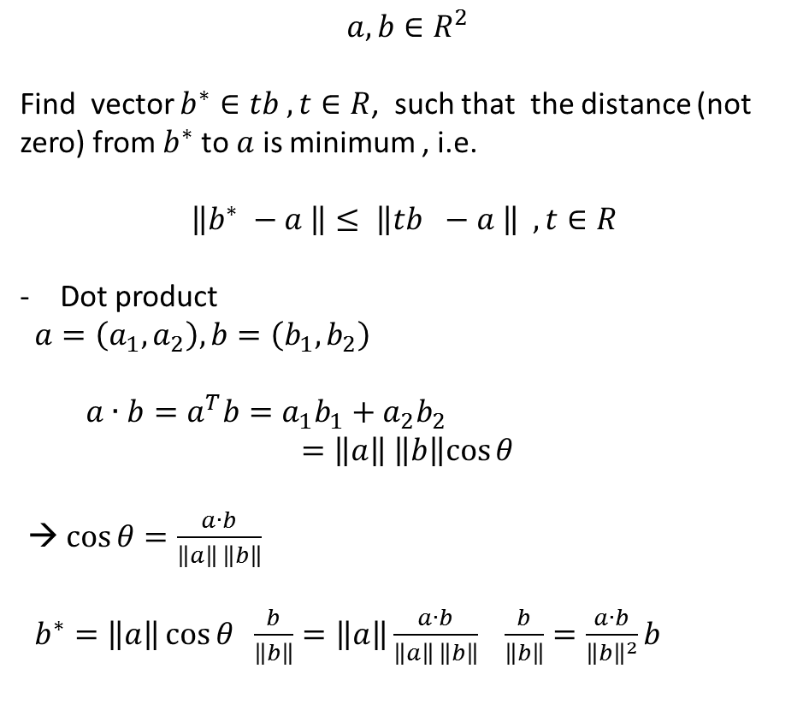
3.9 Range and Null space of a Matrix
1) Projection https://en.wikipedia.org/wiki/Vector_projection
$$a,b∈R^{2}$$
Find vector $b^{∗}∈tb , t∈R$, such that the distance (not zero) from $b^{∗}$to $a$ is minimum , i.e.
$$\left\|b^{∗} −a \right\|≤ \left\|tb −a \right\| , t∈R$$
Dot product
$a=\left(a_{1}, a_{2}\right), b=\left(b_{1}, b_{2}\right)$
$a∙b=a^{T}b=a_{1}b_{1}+a_{2}b_{2}$
$$=\left\|a\right\| \left\|b\right\|cos{θ}$$
→ $\cos{θ=\frac{a∙b}{\left\|a\right\| \left\|b\right\|}}$
$b^{∗}=\left\|a\right\|\cos{θ \frac{b}{\left\|b\right\|}}=\left\|a\right\|\frac{a∙b}{\left\|a\right\| \left\|b\right\|} \frac{b}{\left\|b\right\|}=\frac{a∙b}{{\left\|b\right\|}^{2}}b$

