Slide 1
Stochastic Model,Estimation and Control – PCE 6205
Prof: Seungnam Kim
Bd 605 / the second room
snkim070155@gmail.com, snkim0701@daum.net
Telegram: Kim Sn
C.P. +099-480-7269
Experiences: Control engineer: Kalman / …

Slide 2
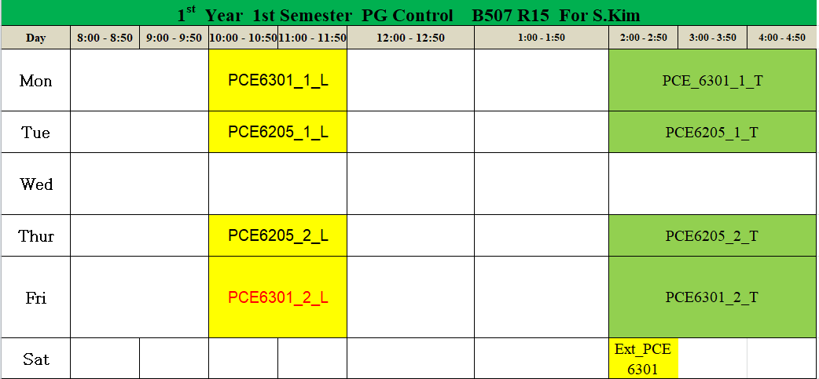
Course Schedule : Face-to-Face Schedule
**_x_y:
** : the course code number
x : group
y : (L, Lecture), (T, Tutorial)
1) Every Lecture will start at 10AM, at B507 , Rm15
The Attendance should be checked. It is mandatory
2) Every Tutorials will stat at 2 PM. At Computer Room.
This is optional. But I will check.

Slide 3
3. Materials
1) Textbook
-“Stochastic Processes, Estimation and Control”,J.L.Speyer,SIAM, 2008
-”Differential Equations and Linear Algebra”, Gilbert Strang,MIT,2014
→ google : https://b-ok.africa/
2) All materials will be uploaded at
https://github.com/snkim0701 --> 2020_Stochastic
4. S/W Tools
- matlab / simulink

Slide 4
5. Goals
- be familiar with the applications of stochastic processes in engineering
- analyze random processes and its application in control systems
- be familiar with Gauss Markov process
- understand the Kalman filter algorithm in continuous and discrete linear
system
6. Assessments
- Attendance(10)
+ face to face + on-line :
- 2 Assignments / 1 Test (30): should be written in Microsoft word
- mid-term(30):
- final term(30)
%% Today attendance :
1) please send an e-mail to me to snkim0701@gmail.com

