Slide 1
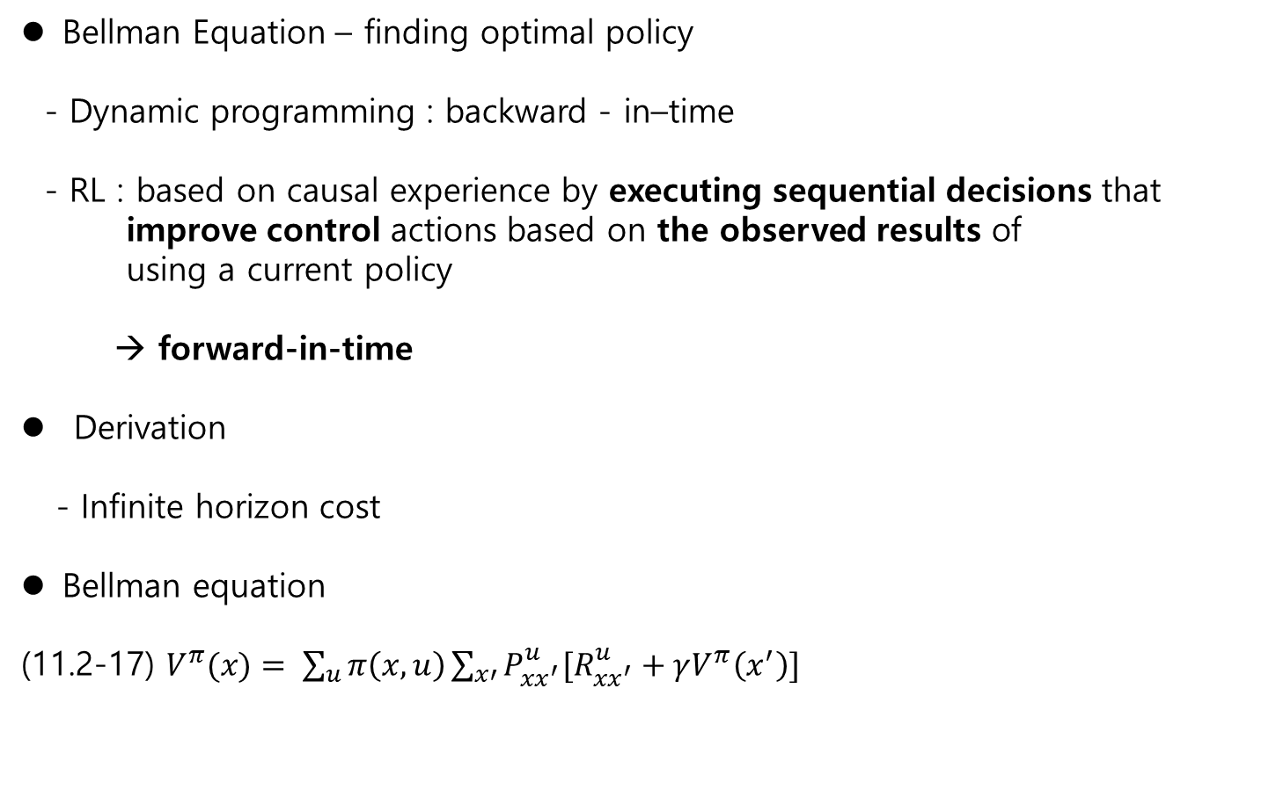
11.2 MDP Ch.11 Reinforcement Learning
Bellman Equation – finding optimal policy
- Dynamic programming : backward - in–time
- RL : based on causal experience by executing sequential decisions that
improve control actions based on the observed results of
using a current policy
→ forward-in-time
Derivation
- Infinite horizon cost
Bellman equation
(11.2-17) $V^{π}(x)= \sum_{u}{π\left(x,u\right)}\sum_{x′}{P_{xx^{′}}^{u}[R_{xx^{′}}^{u}+γV^{π}\left(x^{′}\right)]}$

Slide 2

Dynamic programming
Optimal Control
Let
$x_{k+1}=f^{k}(x_{k}, u_{k})$
- Cost
(6.2-2) $J_{i}\left(x_{i}\right)=φ\left(N, x_{N}\right)+ \sum_{k=i}^{N−1}{L^{k}\left(x_{k},u_{k}\right)}$
(6.2-4) $J_{k}^{∗}\left(x_{k}\right)=\min_{u_{k}}{(L^{k}\left(x_{k}, u_{k}\right) +J_{k+1}^{∗}\left(x_{k+1}\right)})$
Bellman’s Remark.
“An optimal policy has the property that no matter what the previous decision(i.e., controls) has been, the remaining decisions must an optimal policy with regard to the state resulting from those previous decision.”

Slide 3
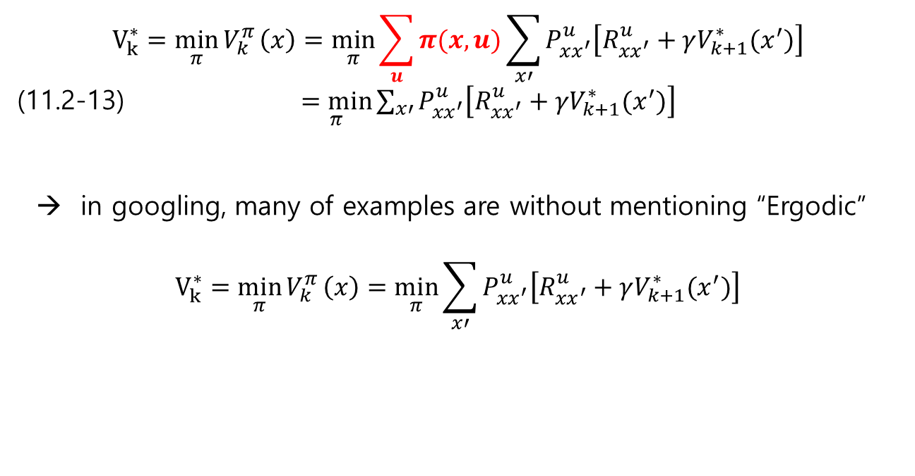
11.2 MDP Ch.11 Reinforcement Learning
Comments on optimal policy and value in googling
1) If the states transition matrix is ergodic, then
$$V_{k}^{∗}=\min_{π}{V_{k}^{π}}\left(x\right)=\min_{π}{\sum_{u}{π(x,u)}\sum_{x′}{P_{xx^{′}}^{u}\left[R_{xx^{′}}^{u}+γV_{k+1}^{∗}(x^{′})\right] }}$$
(11.2-13) $\underset{π}{=min}{\sum_{x′}{P_{xx^{′}}^{u}\left[R_{xx^{′}}^{u}+γV_{k+1}^{∗}(x^{′})\right] }}$
→ in googling, many of examples are without mentioning “Ergodic”
$$V_{k}^{∗}=\min_{π}{V_{k}^{π}}\left(x\right)=\min_{π}{\sum_{x′}{P_{xx^{′}}^{u}\left[R_{xx^{′}}^{u}+γV_{k+1}^{∗}(x^{′})\right] }}$$

Slide 4
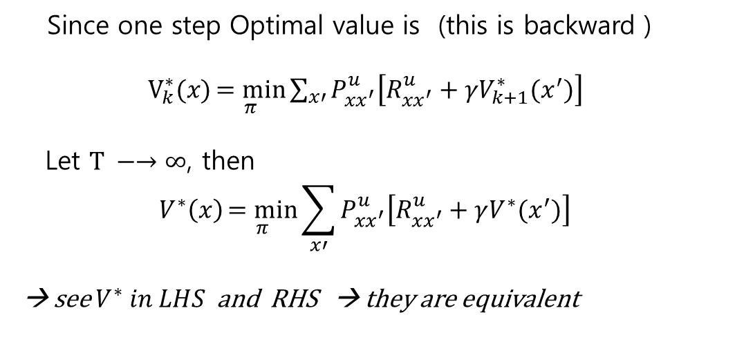
On-line feedforward Optimal Value
Since one step Optimal value is (this is backward )
$V_{k}^{∗}(x)\underset{π}{=min}{\sum_{x′}{P_{xx^{′}}^{u}\left[R_{xx^{′}}^{u}+γV_{k+1}^{∗}(x^{′})\right] }}$
Let $\text{T} −→∞$, then
$$V^{∗}\left(x\right)\underset{π}{=min}{\sum_{x′}{P_{xx^{′}}^{u}\left[R_{xx^{′}}^{u}+γV_{}^{∗}(x^{′})\right] }}$$
→ see $V^{∗} in LHS$ and RHS → they are equivalent

Slide 5
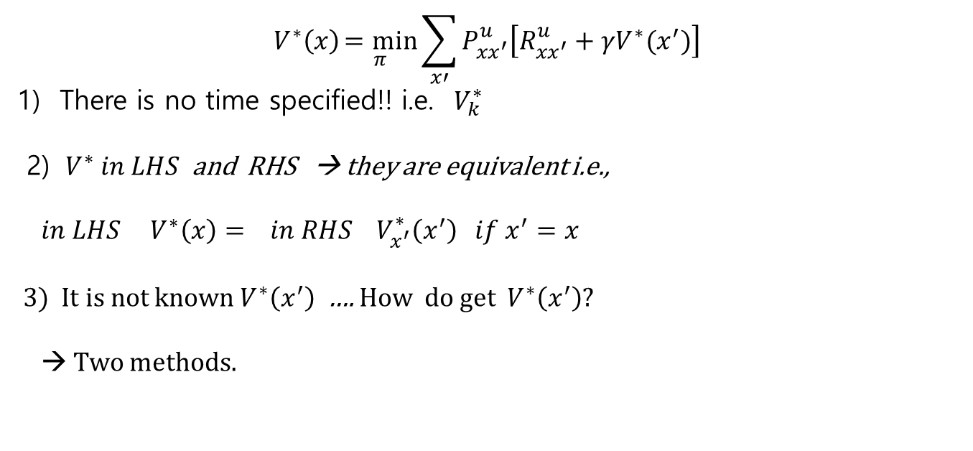
On-line feedforward Optimal Value – Continue…
$$V^{∗}\left(x\right)\underset{π}{=min}{\sum_{x′}{P_{xx^{′}}^{u}\left[R_{xx^{′}}^{u}+γV_{}^{∗}(x^{′})\right] }}$$
1) There is no time specified!! i.e. $V_{k}^{∗}$
2) $V^{∗} in LHS$ and RHS → they are equivalent i.e.,
$in LHS V^{∗}\left(x\right)= in RHS V_{x^{′}}^{∗}\left(x^{′}\right) if x^{′}=x$
3) It is not known $V^{∗}\left(x^{′}\right)$ …. How do get $V^{∗}\left(x^{′}\right)$?
→ Two methods.

Slide 6

11.3 policy evaluation and improvement
Problem
Given a current policy $π\left(x,u\right)$ find
$V^{π}\left(x\right)=E_{π}\left\{ J_{k} | x_{k}=x\right\}= \sum_{u}{π\left(x,u\right)}\sum_{x′}{P_{xx^{′}}^{u}[R_{xx^{′}}^{u}+γV^{π}\left(x^{′}\right)]}$
With measurement $x$ ,
one step Reward : $R_{xx^{′}}^{u}$
future Reward : $V^{π}\left(x^{′}\right)$ → estimated →
Two methods
- Policy iteration
policy evaluation
policy improvement
- Value iteration

Slide 7
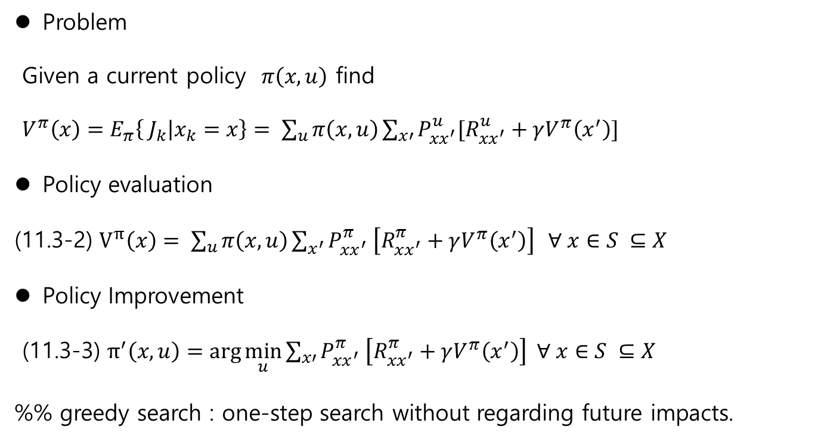
11.3 policy evaluation and improvement
Problem
Given a current policy $π\left(x,u\right)$ find
$V^{π}\left(x\right)=E_{π}\left\{ J_{k} | x_{k}=x\right\}= \sum_{u}{π\left(x,u\right)}\sum_{x′}{P_{xx^{′}}^{u}[R_{xx^{′}}^{u}+γV^{π}\left(x^{′}\right)]}$
Policy evaluation
(11.3-2) $V^{π}\left(x\right)= \sum_{u}{π\left(x,u\right)}\sum_{x^{′}}{P_{xx^{′}}^{π} \left[R_{xx^{′}}^{π}+γV^{π}\left(x^{′}\right)\right]} ∀ x∈S ⊆X$
Policy Improvement
(11.3-3) $π^{′}\left(x,u\right)=\arg{\min_{u}{\sum_{x′}{P_{xx^{′}}^{π} \left[R_{xx^{′}}^{π}+γV^{π}\left(x^{′}\right)\right] ∀ x∈S ⊆X }}}$
%% greedy search : one-step search without regarding future impacts.

Slide 8
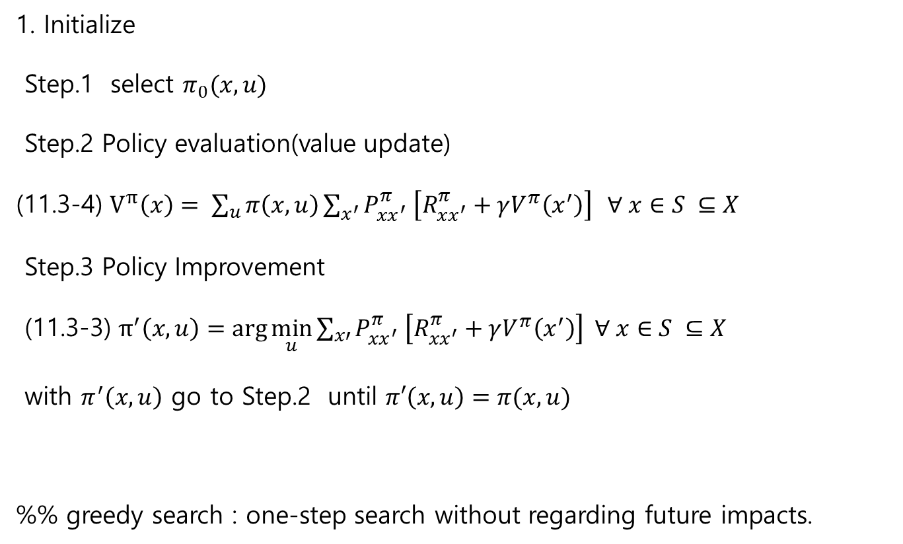
11.3 policy iteration - evaluation and improvement
1. Initialize
Step.1 select $π_{0}(x,u)$
Step.2 Policy evaluation(value update)
(11.3-4) $V^{π}\left(x\right)= \sum_{u}{π\left(x,u\right)}\sum_{x^{′}}{P_{xx^{′}}^{π} \left[R_{xx^{′}}^{π}+γV^{π}\left(x^{′}\right)\right]} ∀ x∈S ⊆X$
Step.3 Policy Improvement
(11.3-3) $π^{′}\left(x,u\right)=\arg{\min_{u}{\sum_{x′}{P_{xx^{′}}^{π} \left[R_{xx^{′}}^{π}+γV^{π}\left(x^{′}\right)\right] ∀ x∈S ⊆X }}}$
with $π^{′}\left(x,u\right)$ go to Step.2 until $π′\left(x,u\right)=π(x,u)$
%% greedy search : one-step search without regarding future impacts.

Slide 9
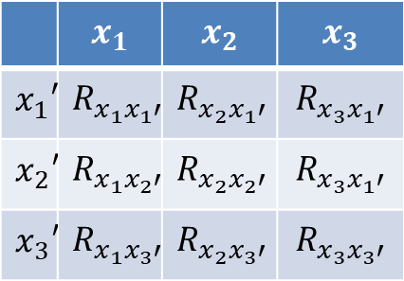
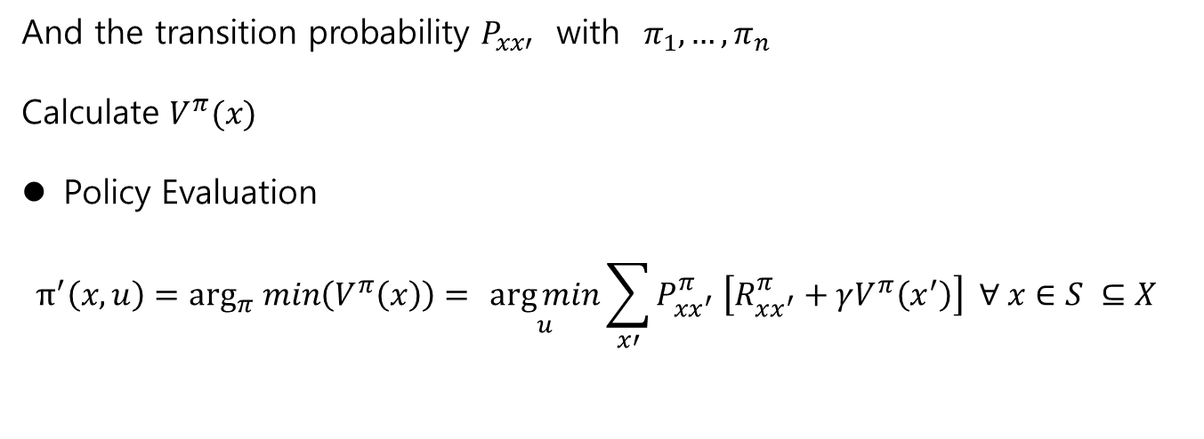
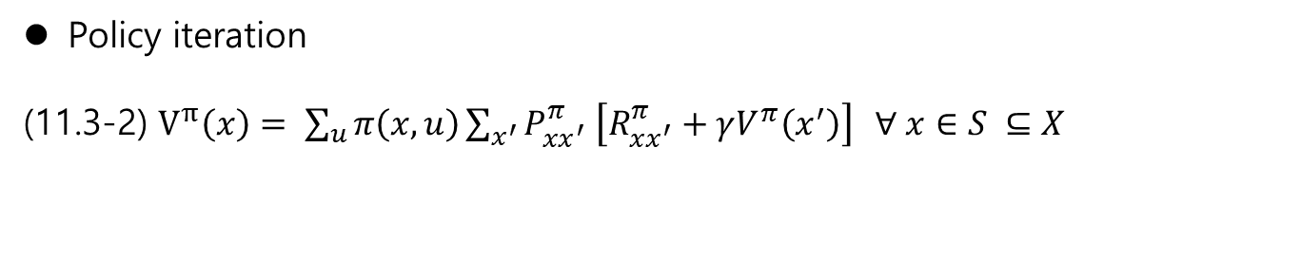
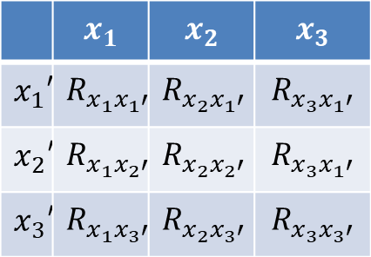
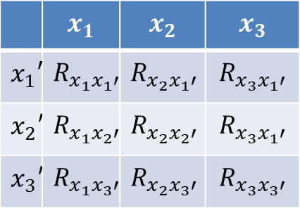
11.3 policy evaluation and improvement
Policy iteration
(11.3-2) $V^{π}\left(x\right)= \sum_{u}{π\left(x,u\right)}\sum_{x^{′}}{P_{xx^{′}}^{π} \left[R_{xx^{′}}^{π}+γV^{π}\left(x^{′}\right)\right]} ∀ x∈S ⊆X$
$R_{xx′} :$With $π_{1}$ $π_{2}$,…., $π_{n}$
 | $$x_{1}$$ | $$x_{2}$$ | $$x_{3}$$
$$x_{1}′$$ | $$R_{x_{1}x_{1}′}$$ | $$R_{x_{2}x_{1}′}$$ | $$R_{x_{3}x_{1}′}$$
$$x_{2}′$$ | $$R_{x_{1}x_{2}′}$$ | $$R_{x_{2}x_{2}′}$$ | $$R_{x_{3}x_{1}′}$$
$$x_{3}′$$ | $$R_{x_{1}x_{3}′}$$ | $$R_{x_{2}x_{3}′}$$ | $$R_{x_{3}x_{3}′}$$
 | $$x_{1}$$ | $$x_{2}$$ | $$x_{3}$$
$$x_{1}′$$ | $$R_{x_{1}x_{1}′}$$ | $$R_{x_{2}x_{1}′}$$ | $$R_{x_{3}x_{1}′}$$
$$x_{2}′$$ | $$R_{x_{1}x_{2}′}$$ | $$R_{x_{2}x_{2}′}$$ | $$R_{x_{3}x_{1}′}$$
$$x_{3}′$$ | $$R_{x_{1}x_{3}′}$$ | $$R_{x_{2}x_{3}′}$$ | $$R_{x_{3}x_{3}′}$$
 | $$x_{1}$$ | $$x_{2}$$ | $$x_{3}$$
$$x_{1}′$$ | $$R_{x_{1}x_{1}′}$$ | $$R_{x_{2}x_{1}′}$$ | $$R_{x_{3}x_{1}′}$$
$$x_{2}′$$ | $$R_{x_{1}x_{2}′}$$ | $$R_{x_{2}x_{2}′}$$ | $$R_{x_{3}x_{1}′}$$
$$x_{3}′$$ | $$R_{x_{1}x_{3}′}$$ | $$R_{x_{2}x_{3}′}$$ | $$R_{x_{3}x_{3}′}$$
And the transition probability $P_{xx′}$ with $π_{1},…, π_{n}$
Calculate $V^{π}(x)$
Policy Evaluation
$$π^{′}\left(x,u\right)=\arg_{π} min\left(V^{π}\left(x\right)\right)={\underset{u}{\arg{min}}{\sum_{x′}{P_{xx^{′}}^{π} \left[R_{xx^{′}}^{π}+γV^{π}\left(x^{′}\right)\right] ∀ x∈S ⊆X }}}$$

Slide 10
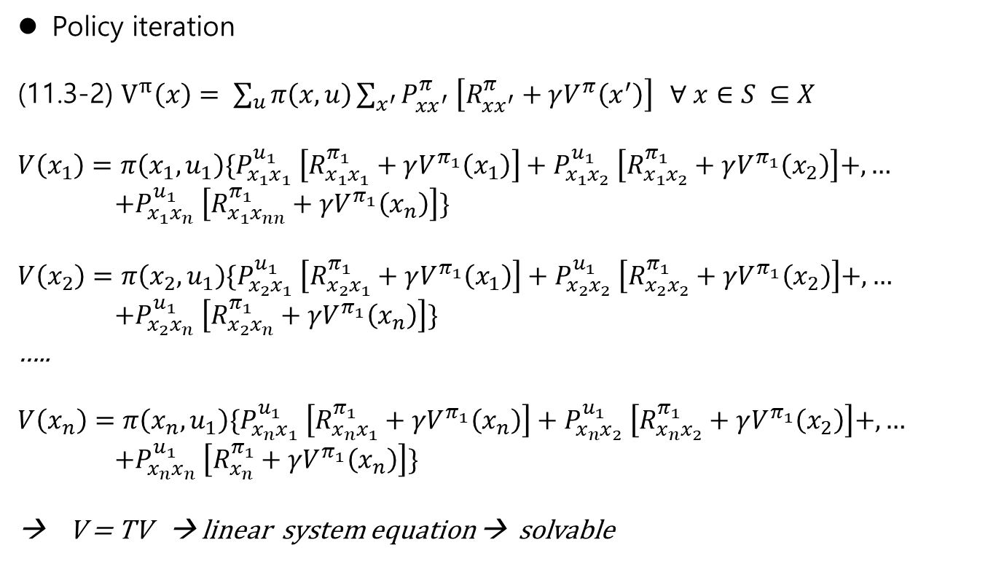
11.3 policy evaluation and improvement
Policy iteration
(11.3-2) $V^{π}\left(x\right)= \sum_{u}{π\left(x,u\right)}\sum_{x^{′}}{P_{xx^{′}}^{π} \left[R_{xx^{′}}^{π}+γV^{π}\left(x^{′}\right)\right]} ∀ x∈S ⊆X$
$$V\left(x_{1}\right)=π\left(x_{1},u_{1}\right)\{P_{x_{1}x_{1}}^{u_{1}} \left[R_{x_{1}x_{1}}^{π_{1}}+γV^{π_{1}}\left(x_{1}\right)\right]+P_{x_{1}x_{2}}^{u_{1}} \left[R_{x_{1}x_{2}}^{π_{1}}+γV^{π_{1}}\left(x_{2}\right)\right]+,…$$
$$+P_{x_{1}x_{n}}^{u_{1}} \left[R_{x_{1}x_{nn}}^{π_{1}}+γV^{π_{1}}\left(x_{n}\right)\right]\}$$
$$V\left(x_{2}\right)=π\left(x_{2},u_{1}\right)\{P_{x_{2}x_{1}}^{u_{1}} \left[R_{x_{2}x_{1}}^{π_{1}}+γV^{π_{1}}\left(x_{1}\right)\right]+P_{x_{2}x_{2}}^{u_{1}} \left[R_{x_{2}x_{2}}^{π_{1}}+γV^{π_{1}}\left(x_{2}\right)\right]+,…$$
$$+P_{x_{2}x_{n}}^{u_{1}} \left[R_{x_{2}x_{n}}^{π_{1}}+γV^{π_{1}}\left(x_{n}\right)\right]\}$$
…..
$$V\left(x_{n}\right)=π\left(x_{n},u_{1}\right)\{P_{x_{n}x_{1}}^{u_{1}} \left[R_{x_{n}x_{1}}^{π_{1}}+γV^{π_{1}}\left(x_{n}\right)\right]+P_{x_{n}x_{2}}^{u_{1}} \left[R_{x_{n}x_{2}}^{π_{1}}+γV^{π_{1}}\left(x_{2}\right)\right]+,…$$
$$+P_{x_{n}x_{n}}^{u_{1}} \left[R_{x_{n}}^{π_{1}}+γV^{π_{1}}\left(x_{n}\right)\right]\}$$
→ V = TV → linear system equation → solvable
%% greedy search : one-step search without regarding future impacts

Slide 11
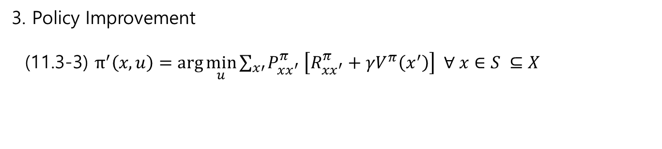
11.3 policy iteration - evaluation and improvement
3. Policy Improvement
(11.3-3) $π^{′}\left(x,u\right)=\arg{\min_{u}{\sum_{x′}{P_{xx^{′}}^{π} \left[R_{xx^{′}}^{π}+γV^{π}\left(x^{′}\right)\right] ∀ x∈S ⊆X }}}$

Slide 12
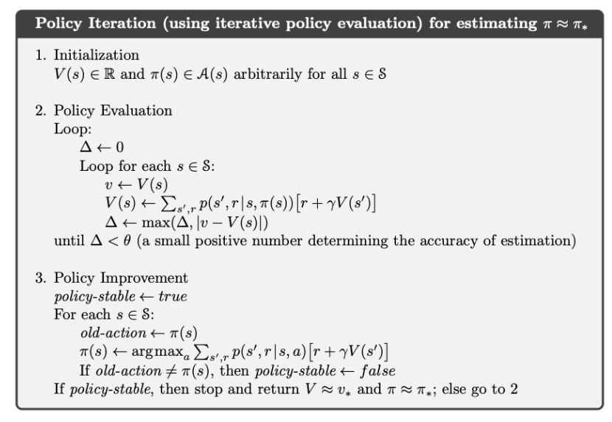
11.3 policy iteration - evaluation and improvement
3. Approximation…
With ergodic assumption,
max→ min
https://ai.stackexchange.com/questions/20532/why-do-value-iteration-and-policy-iteration-obtain-similar-policies-even-though

Slide 13
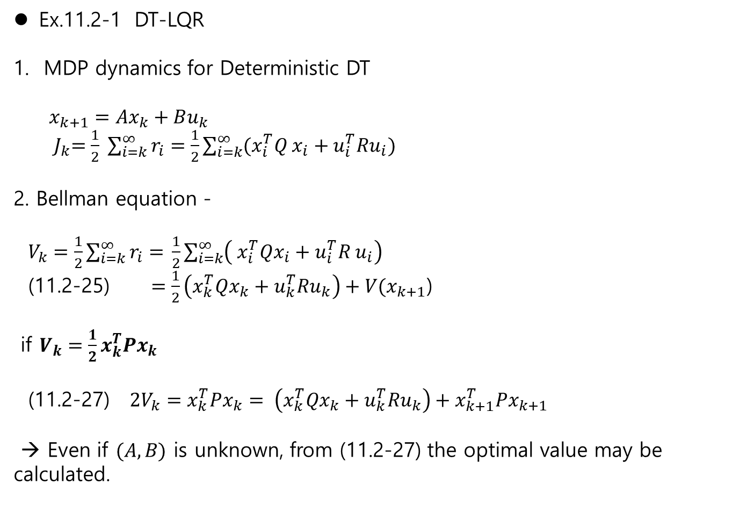
11.2 MDP Ch.11 Reinforcement Learning
Ex.11.2-1 DT-LQR
MDP dynamics for Deterministic DT
$x_{k+1}=Ax_{k}+Bu_{k}$
${ J}_{k}=\frac{1}{2} \sum_{i=k}^{∞}{r_{i}=\frac{1}{2}\sum_{i=k}^{∞}{(x_{i}^{T}Q x_{i}+u_{i}^{T}Ru_{i})}}$
2. Bellman equation -
$V_{k}=\frac{1}{2}\sum_{i=k}^{∞}{r_{i}= }\frac{1}{2}\sum_{i=k}^{∞}{\left( x_{i}^{T}Qx_{i}+u_{i}^{T}R u_{i}\right)}$
(11.2-25) $=\frac{1}{2}\left(x_{k}^{T}Qx_{k}+u_{k}^{T}Ru_{k}\right)+V(x_{k+1}$)
if $V_{k}=\frac{1}{2}x_{k}^{T}Px_{k}$
(11.2-27) $2V_{k}=x_{k}^{T}Px_{k}= \left(x_{k}^{T}Qx_{k}+u_{k}^{T}Ru_{k}\right)+x_{k+1}^{T}Px_{k+1}$
→ Even if $(A,B)$ is unknown, from (11.2-27) the optimal value may be calculated.

Slide 14
11.2 MDP Ch.11 Reinforcement Learning
Ex.11.2-1 DT-LQR
MDP dynamics for Deterministic DT
$x_{k+1}=Ax_{k}+Bu_{k}$
${ J}_{k}=\frac{1}{2} \sum_{i=k}^{∞}{r_{i}=\frac{1}{2}\sum_{i=k}^{∞}{(x_{i}^{T}Q x_{i}+u_{i}^{T}Ru_{i})}}$
2. Bellman equation -
$V_{k}=\frac{1}{2}\sum_{i=k}^{∞}{r_{i}= }\frac{1}{2}\sum_{i=k}^{∞}{\left( x_{i}^{T}Qx_{i}+u_{i}^{T}R u_{i}\right)}$
(11.2-25) $=\frac{1}{2}\left(x_{k}^{T}Qx_{k}+u_{k}^{T}Ru_{k}\right)+V(x_{k+1}$)
if $V_{k}=\frac{1}{2}x_{k}^{T}Px_{k}$
(11.2-27) $2V_{k}=x_{k}^{T}Px_{k}= \left(x_{k}^{T}Qx_{k}+u_{k}^{T}Ru_{k}\right)+x_{k+1}^{T}Px_{k+1}$
→ Even if $(A,B)$ is unknown, from (11.2-27) the optimal value may be calculated.

Slide 15
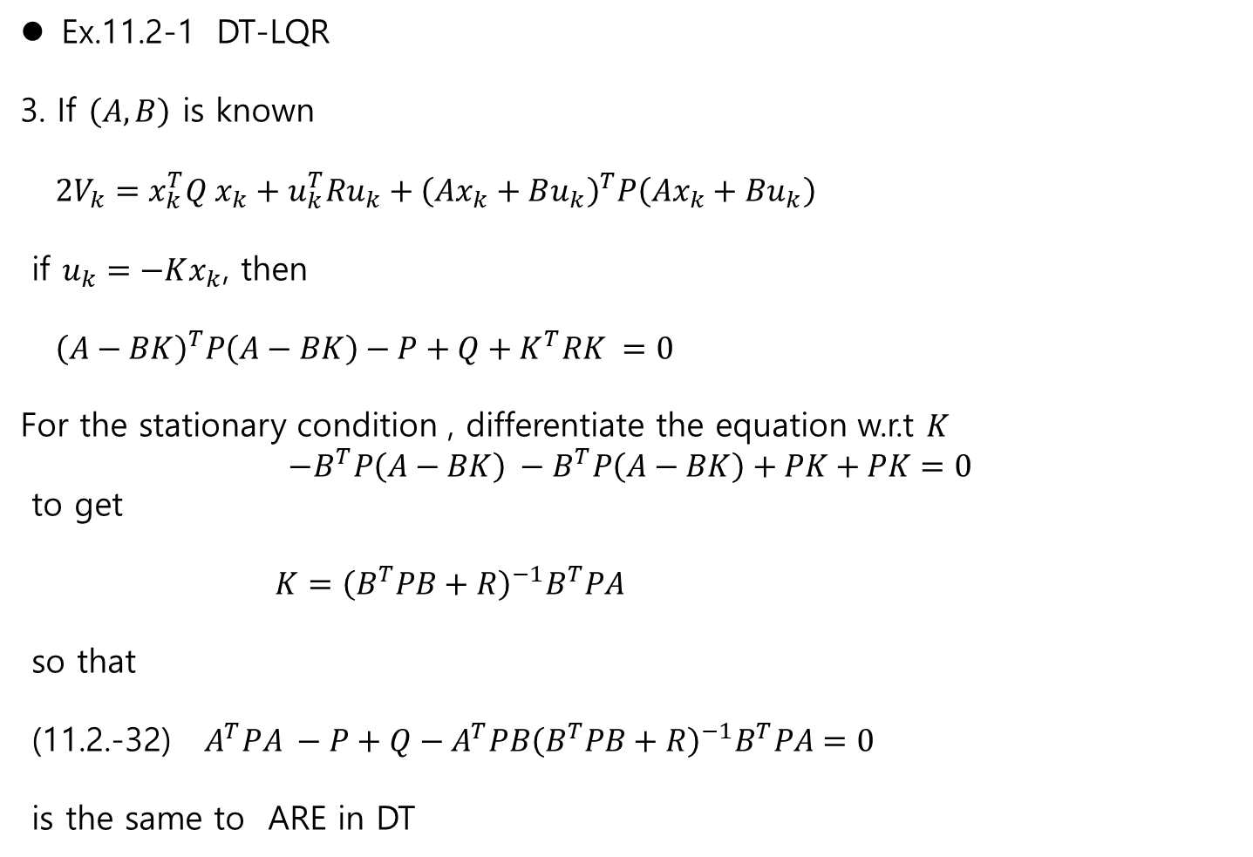
11.2 MDP Ch.11 Reinforcement Learning
Ex.11.2-1 DT-LQR
3. If $\left(A,B\right)$ is known
$2V_{k}=x_{k}^{T}Q x_{k}+u_{k}^{T}Ru_{k}+{\left(Ax_{k}+Bu_{k}\right)}^{T}P\left(Ax_{k}+Bu_{k}\right)$
if $u_{k}=−Kx_{k}$, then
${\left(A−BK\right)}^{T}P\left(A−BK\right)−P+Q+K^{T}RK =0$
For the stationary condition , differentiate the equation w.r.t $K$
$${−B}^{T}P\left(A−BK\right) −B^{T}P\left(A−BK\right)+PK+PK=0$$
to get
$K={\left(B^{T}PB+R\right)}^{−1}B^{T}PA$
so that
(11.2.-32) $A^{T}PA −P+Q−A^{T}PB{\left(B^{T}PB+R\right)}^{−1}B^{T}PA=0$
is the same to ARE in DT

Slide 16
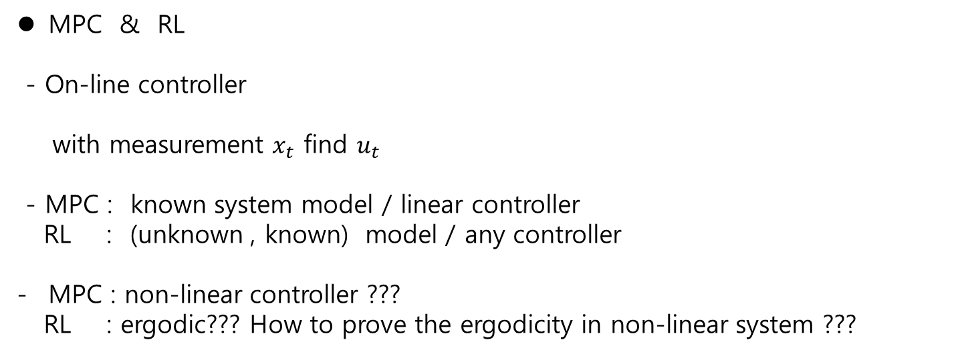
11.2 MDP Ch.11 Reinforcement Learning
MPC & RL
- On-line controller
with measurement $x_{t}$ find $u_{t}$
- MPC : known system model / linear controller
RL : (unknown , known) model / any controller
MPC : non-linear controller ???
RL : ergodic??? How to prove the ergodicity in non-linear system ???

