Slide 1
Supervised learning
Machine learning
Supervised
(in, out) → rules → (new in, ?)
- classification
- Regression
Unsupervised
- input data unknown output
- clustering
ML : based on knowledge
- coding skill / data handling / machine learning algorithm / mathematics

Slide 2
Supervised learning
Supervised ML
Goal:
Given (input, output), Find a rule to predict an output of a new input
- Classification
: binary / multiclass classification
- Regression
: real number ( floating – point number)

Slide 3
Supervised learning
Data
- samples : 5
- features : 5
- it is Given . It may not be generated by YOU
 | Height | Age | M/F | Favorite color | Weight
1 | 165 | 21 | M | Red | 56
2 | 150 | 26 | M | Green | 65
3 | 170 | 42 | F | Green | 55
4 | 160 | 32 | F | Yellow | 47
5 | 185 | 28 | F | Red | 55
new | 175 | 33 | M | Red | ?

Slide 4
Supervised Learning
Supervised Learning
Popular algorithms
-k-Nearest Neighbors (K-NN)
-Linear Models (SVM)
-Naïve Bayes Classifiers
-Decision Trees
-Ensembles of Decision Trees
-Kernelized Support Vector machine
-Neural Networks(Deep Learning)

Slide 5
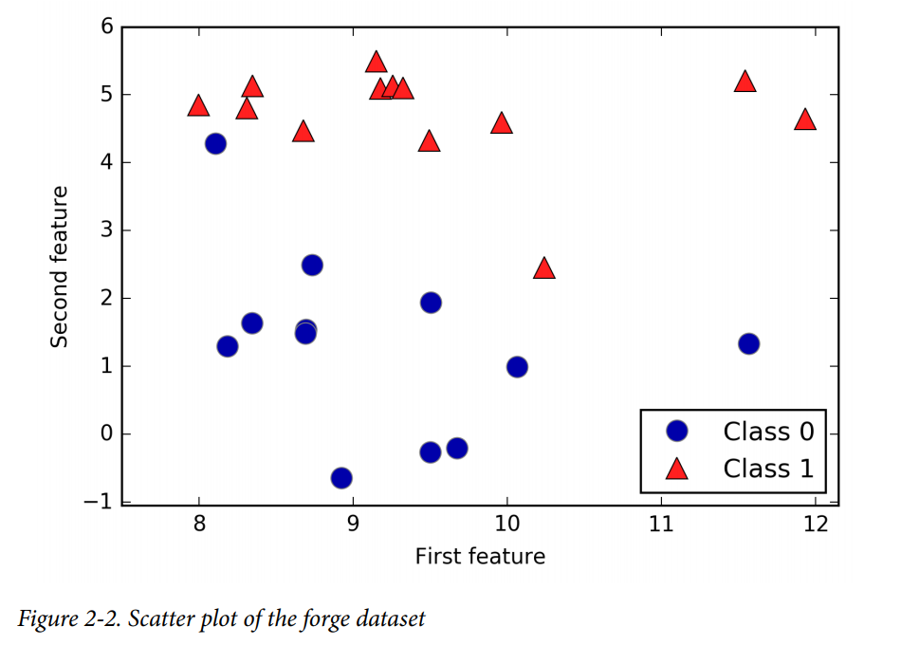
K-NN
Supervised learning
Classification
- given Data = (input features, output class)
Find output class if a new input data
Ex
- input features: 2 features
- output class : Class 1 , 2
Find class of a new data classification
Learning and Test
- Data: training set, test set
- Given training set, known (in, out), design a rule to minimize error
error = predicted by the train set, known output of the test set

Slide 6
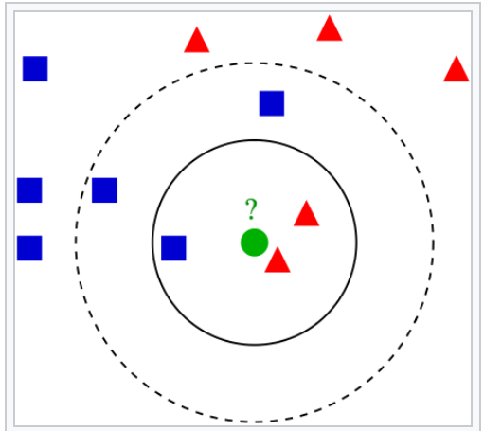
K-NN
Supervised learning
Concept
“k” : the number of “closest samples
increase distance until # of neighbors to be K
classify : “vote” of the classification among
the k-closest samples
Ex. k=3: red
Ex. k=5 : blue
Which “k” should be selected?

Slide 7
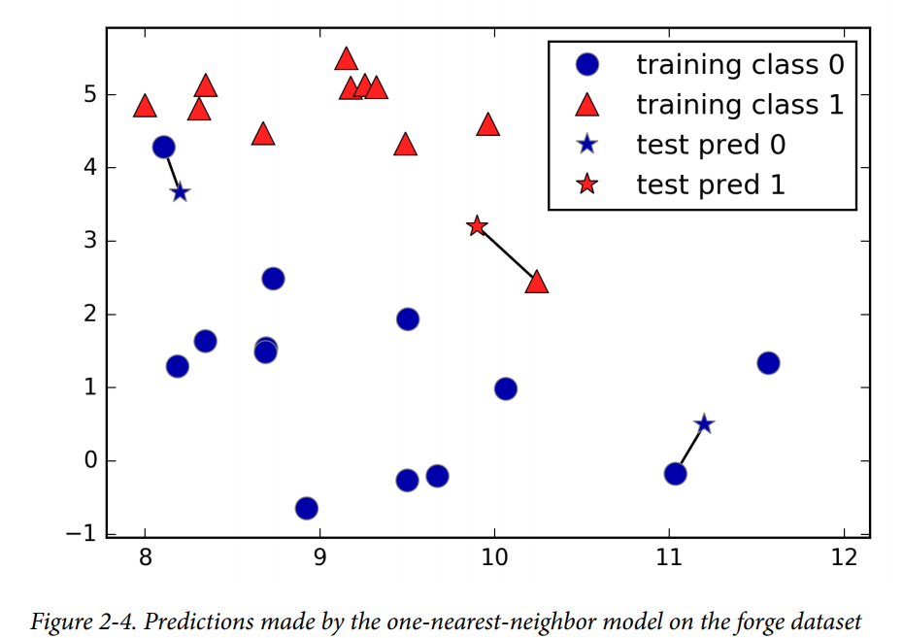
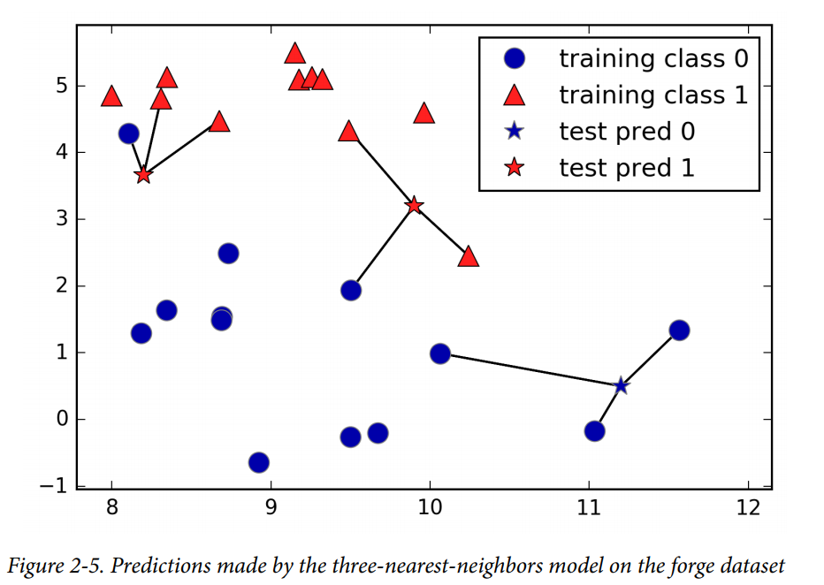
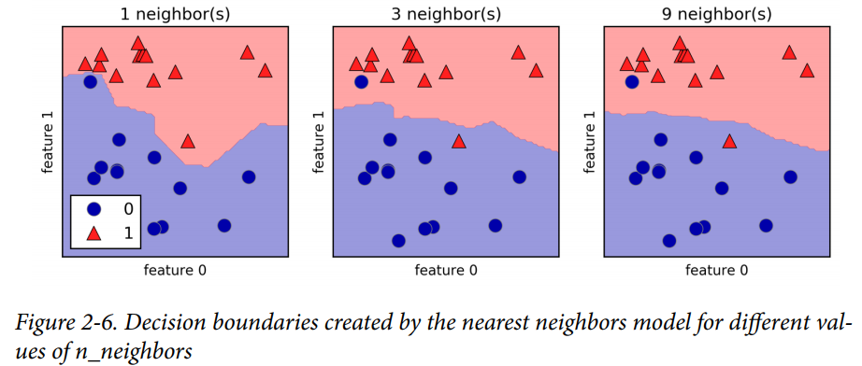
K-NN
Supervised llearning
Decision Boundary

Slide 8
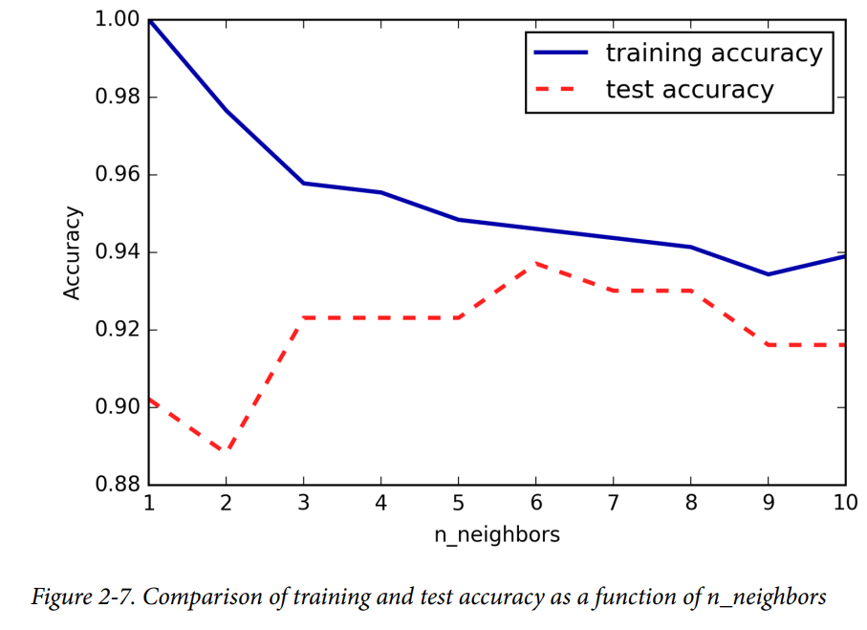
K-NN
Supervised llearning
Selection “k”
- Selection “K” based on accuracy
Accuracy procedure
- divide data into two sets as training and test set
- increase “ k = 1,2,… s.t. to find the maximum accuracy of the test set.
- here “k = 6” test accuracy
is maximized

Slide 9
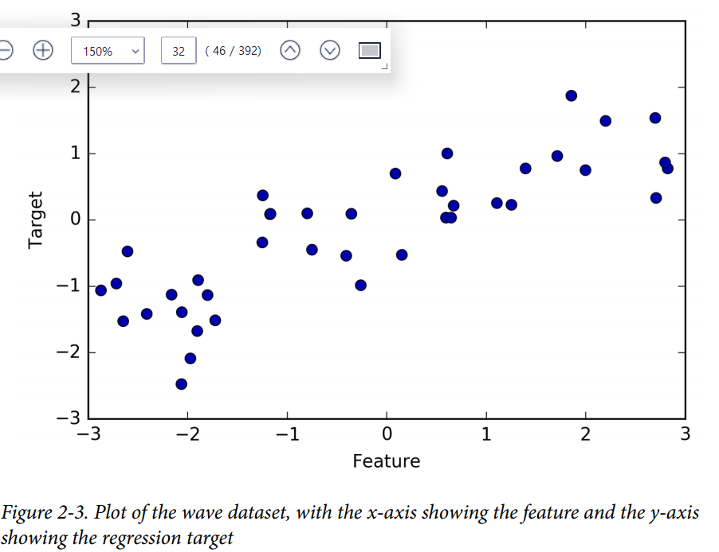
K-NN
Supervised - Regression
Regression -KNN
given Data = (input features, output value)
Find output values if a new input data
Ex_1
- input feature: 1 feature
- output value in [-3 , 3]

Slide 10
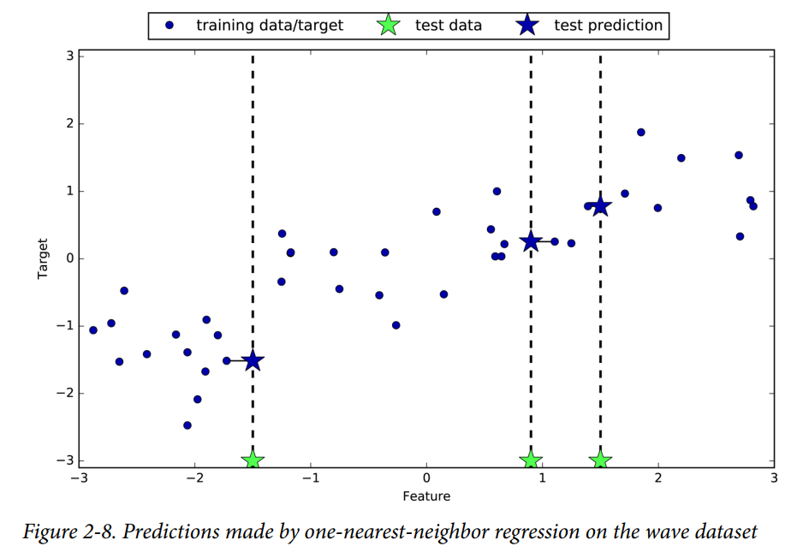
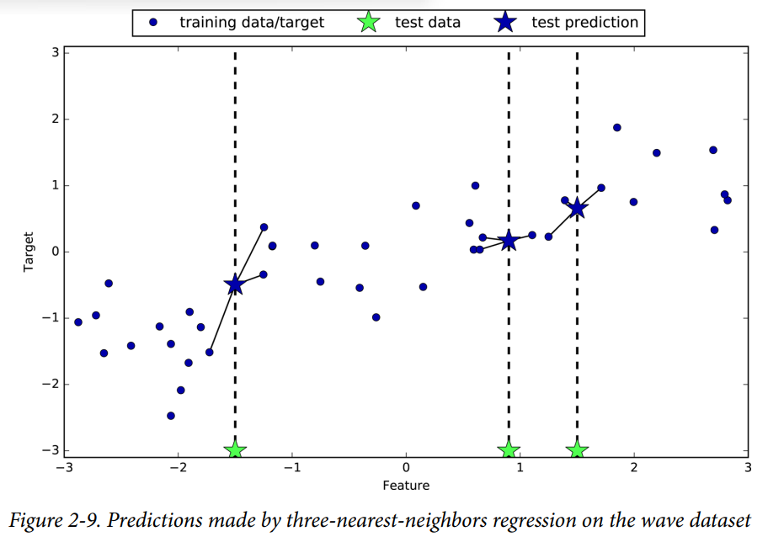
K-NN
Supervised - Regression
Concept
In the closest k samples, the output is the mean or average of the samples

Slide 11
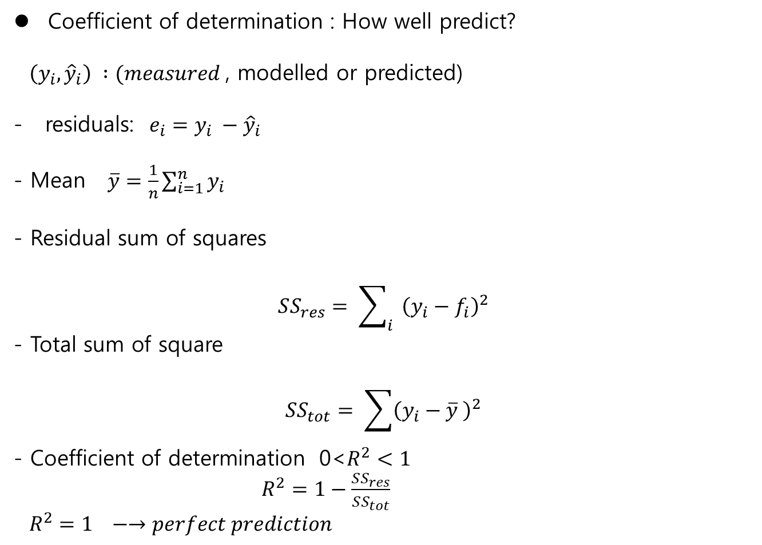
K-NN
Regression Score
Coefficient of determination : How well predict?
$\left(y_{i}, {\hat{y}}_{i}\right) :(measured$, modelled or predicted)
- residuals: $e_{i}=y_{i} −{\hat{y}}_{i}$
- Mean $\overline{y}=\frac{1}{n}\sum_{i=1}^{n}{y_{i}}$
- Residual sum of squares
$$SS_{res}= \sum_{i}{{\left(y_{i}−f_{i}\right)}^{2}}$$
- Total sum of square
$$SS_{tot}= \sum{{\left(y_{i}−\overline{y} \right)}^{2}}$$
- Coefficient of determination 0<$R^{2}<1$
$R^{2}=1−\frac{SS_{res}}{SS_{tot}}$
$R^{2}=1 −→perfect prediction$

Slide 12
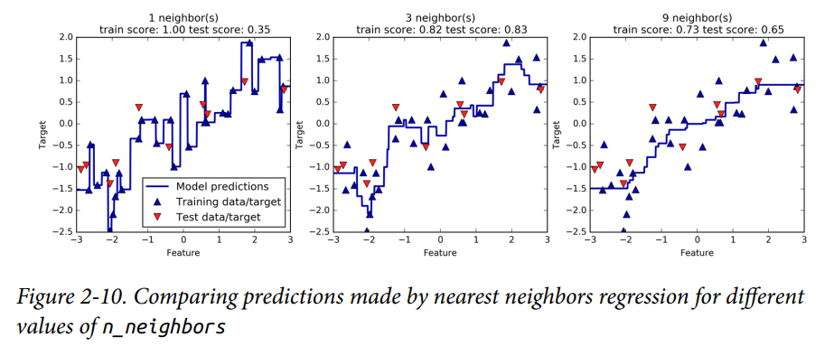
K-NN
Supervised - Regression
Accuracy
- “k=3”, the test score is maximized.

Slide 13
K-NN
Supervised - Regression
Strength , Weakness and Parameters
- Two parameters
# of neighbors(k) / measure the distance
-Strength : easy to understand
-Weakness:
+ large set : # of features
+ sparse data set : most of features are “0”

Slide 14

Linear model
Supervised - Regression
Linear Model
Linear model for regression
$\hat{y}=w\left[0\right]∗x\left[0\right]+w\left[1\right]∗x\left[1\right]+,…w\left[p\right]∗x\left[p\right]+b$
$x\left[i\right] ;features$
$w\left[i\right], b$: parameters to be learned

Slide 15

Linear model
Supervised - Regression
Ordinary linear regression (OLS)
$\hat{y}=w\left[0\right]x\left[0\right]+w\left[1\right]x\left[1\right]+,…w\left[p\right]x\left[p\right]+b$
$x\left[i\right] ;features$
$w\left[i\right], b$: parameters to be learned
- Minimum mean square error
${\min_{w}\left\|y −Aw\right\|}_{2}^{2}$
The best learned solution (in short notation)
$$\hat{w}={\left(A^{T}A\right)}^{−1}A^{T}y$$

Slide 16
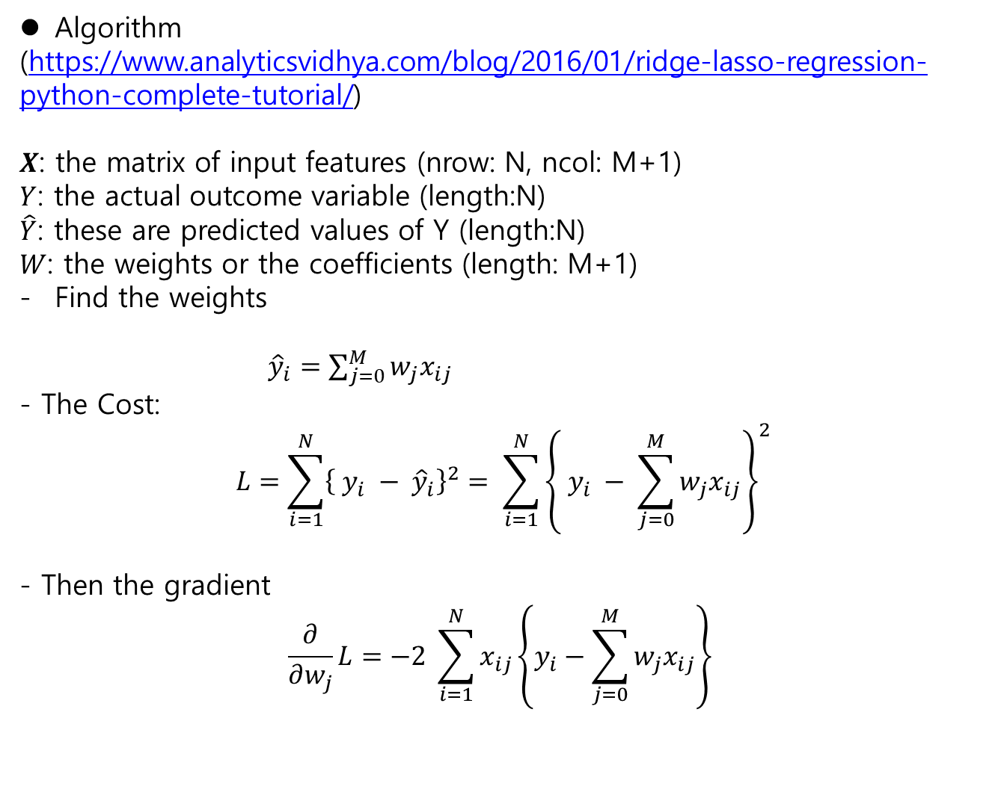
OLS Regression
Supervised Learning
Algorithm
(https://www.analyticsvidhya.com/blog/2016/01/ridge-lasso-regression-python-complete-tutorial/)
$X$: the matrix of input features (nrow: N, ncol: M+1)
$Y$: the actual outcome variable (length:N)
$\hat{Y}$: these are predicted values of Y (length:N)
$W$: the weights or the coefficients (length: M+1)
Find the weights
${\hat{y}}_{i}=\sum_{j=0}^{M}{w_{j}x_{ij}}$
- The Cost:
$$L=\sum_{i=1}^{N}{{\left\{ y_{i} − {\hat{y}}_{i}\right\}}^{2}= \sum_{i=1}^{N}{{\left\{ y_{i} − \sum_{j=0}^{M}{w_{j}x_{ij}}\right\}}^{2}}}$$
- Then the gradient
$$\frac{∂}{∂w_{j}}L=−2 \sum_{i=1}^{N}{x_{ij}\left\{y_{i}−\sum_{j=0}^{M}{w_{j}x_{ij}}\right\}}$$

Slide 17
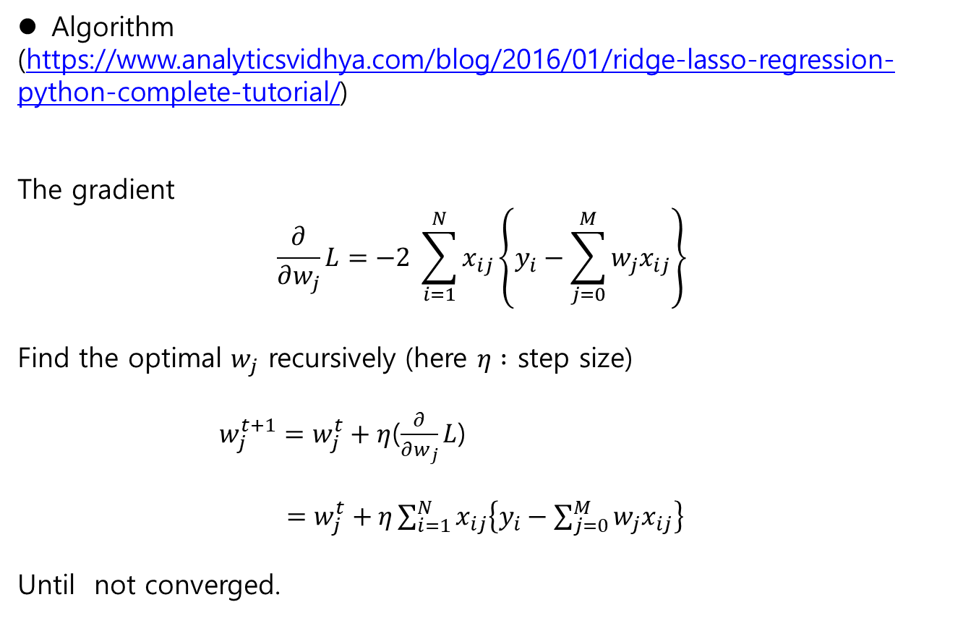
OLS Regression
Supervised Learning
Algorithm
(https://www.analyticsvidhya.com/blog/2016/01/ridge-lasso-regression-python-complete-tutorial/)
The gradient
$$\frac{∂}{∂w_{j}}L=−2 \sum_{i=1}^{N}{x_{ij}\left\{y_{i}−\sum_{j=0}^{M}{w_{j}x_{ij}}\right\}}$$
Find the optimal $w_{j}$ recursively (here $η :$ step size)
$w_{j}^{t+1}=w_{j}^{t}+η$($\frac{∂}{∂w_{j}}L$)
$=w_{j}^{t}+η\sum_{i=1}^{N}{x_{ij}\left\{y_{i}−\sum_{j=0}^{M}{w_{j}x_{ij}}\right\}}$
Until not converged.

Slide 18
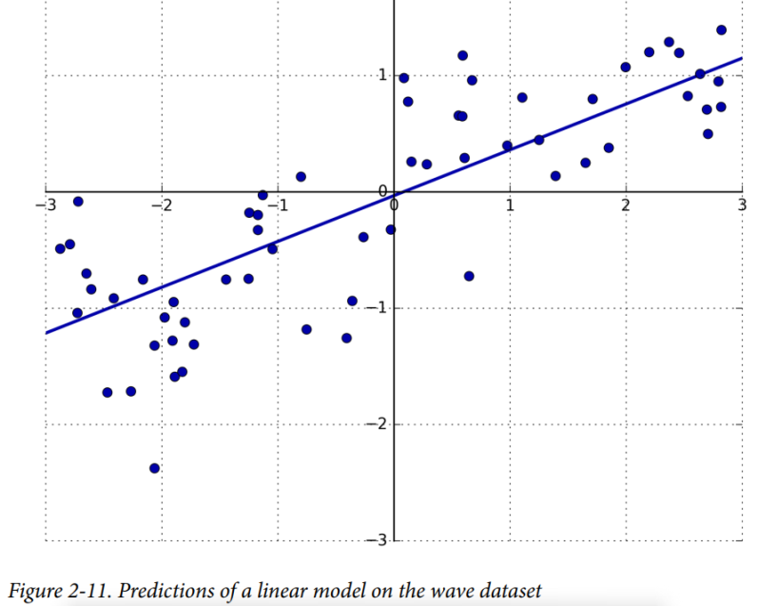
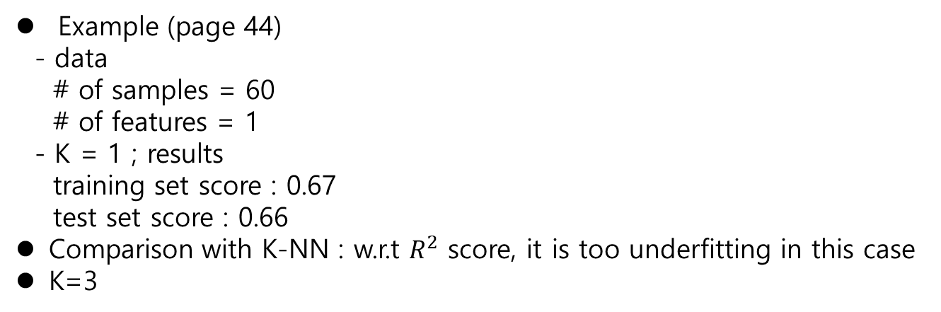
OLS
Supervised Learning
Example (page 44)
- data
# of samples = 60
# of features = 1
- K = 1 ; results
training set score : 0.67
test set score : 0.66
Comparison with K-NN : w.r.t $R^{2}$ score, it is too underfitting in this case
K=3

Slide 19
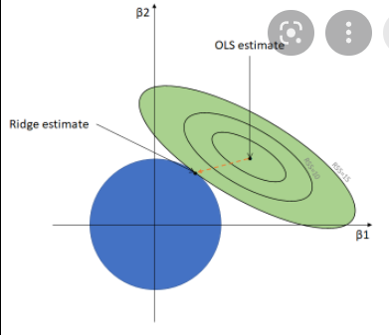
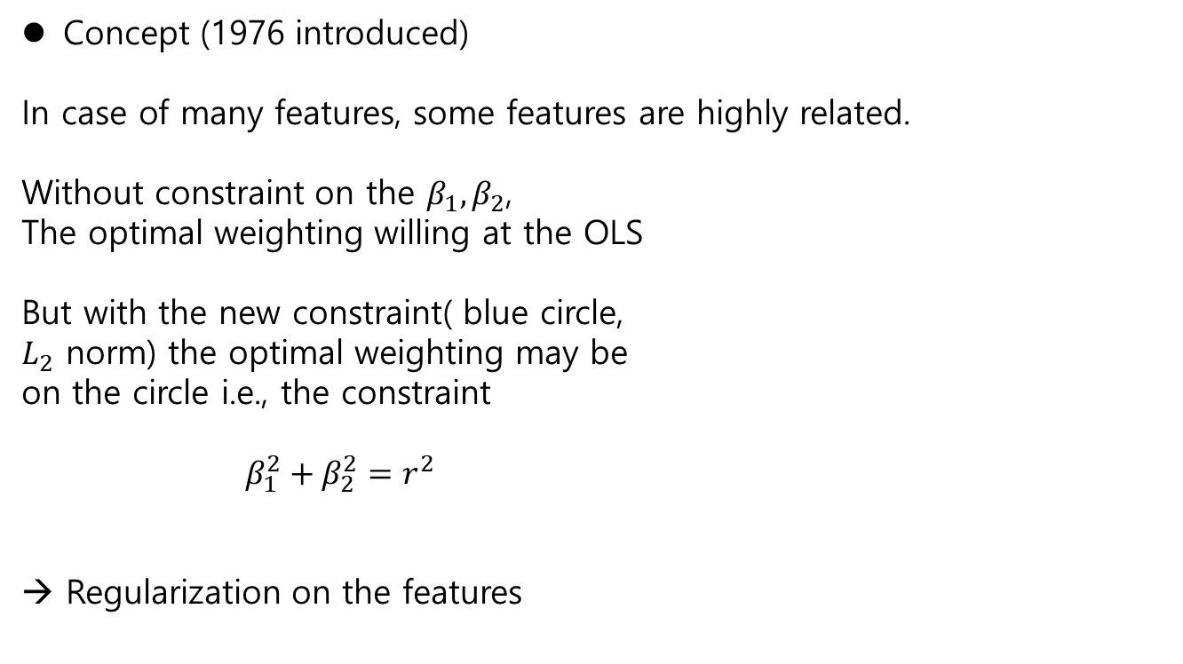
Linear Model - Ridge Regression
Supervised Learning
Concept (1976 introduced)
In case of many features, some features are highly related.
Without constraint on the $β_{1}, β_{2}$,
The optimal weighting willing at the OLS
But with the new constraint( blue circle,
$L_{2}$ norm) the optimal weighting may be
on the circle i.e., the constraint
$β_{1}^{2}+β_{2}^{2}=r^{2}$
→ Regularization on the features

Slide 20
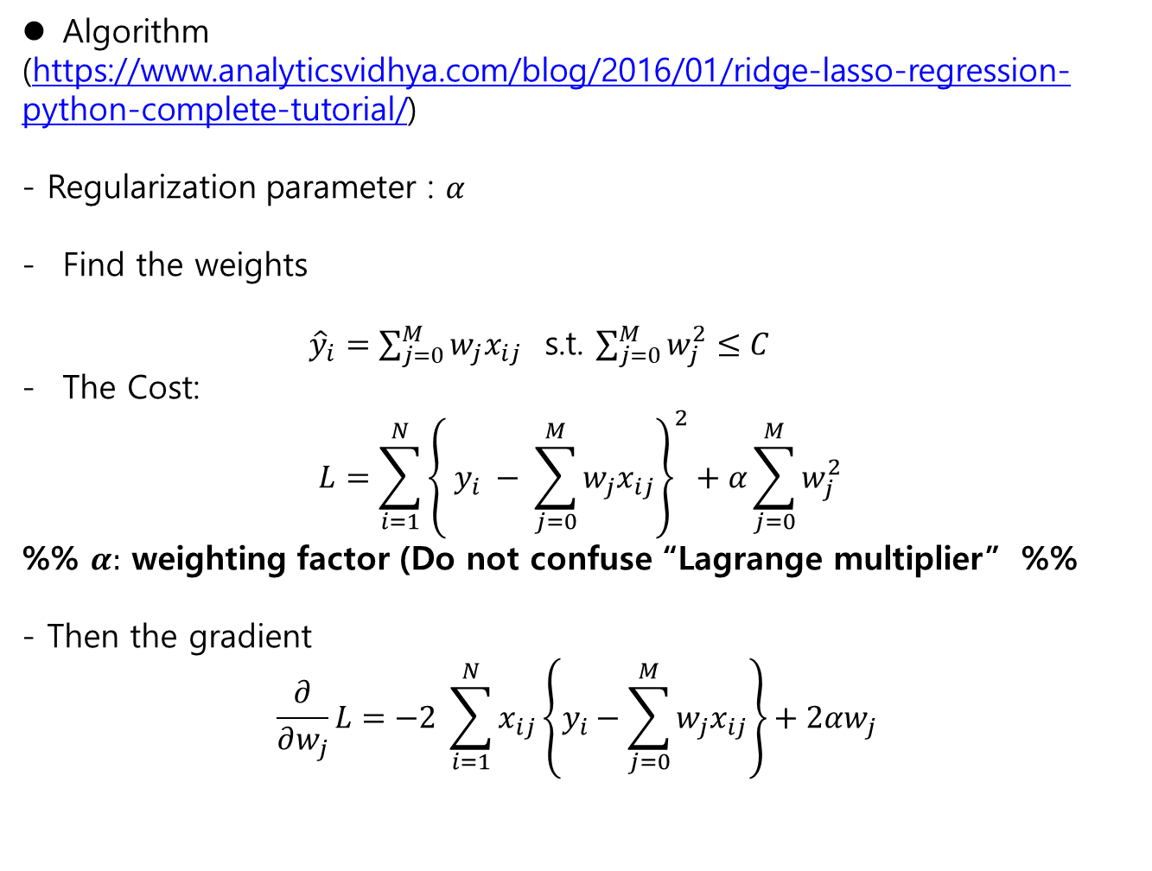
Linear Model - Ridge Regression
Supervised Learning
Algorithm
(https://www.analyticsvidhya.com/blog/2016/01/ridge-lasso-regression-python-complete-tutorial/)
- Regularization parameter : $α$
Find the weights
${\hat{y}}_{i}=\sum_{j=0}^{M}{w_{j}x_{ij}}$ s.t. $\sum_{j=0}^{M}{w_{j}^{2}}≤C$
The Cost:
$$L=\sum_{i=1}^{N}{{\left\{ y_{i} − \sum_{j=0}^{M}{w_{j}x_{ij}}\right\}}^{2}+α\sum_{j=0}^{M}{w_{j}^{2}}}$$
%% $α:$ weighting factor (Do not confuse “Lagrange multiplier” %%
- Then the gradient
$$\frac{∂}{∂w_{j}}L=−2 \sum_{i=1}^{N}{x_{ij}\left\{y_{i}−\sum_{j=0}^{M}{w_{j}x_{ij}}\right\}+2αw_{j}}$$

Slide 21
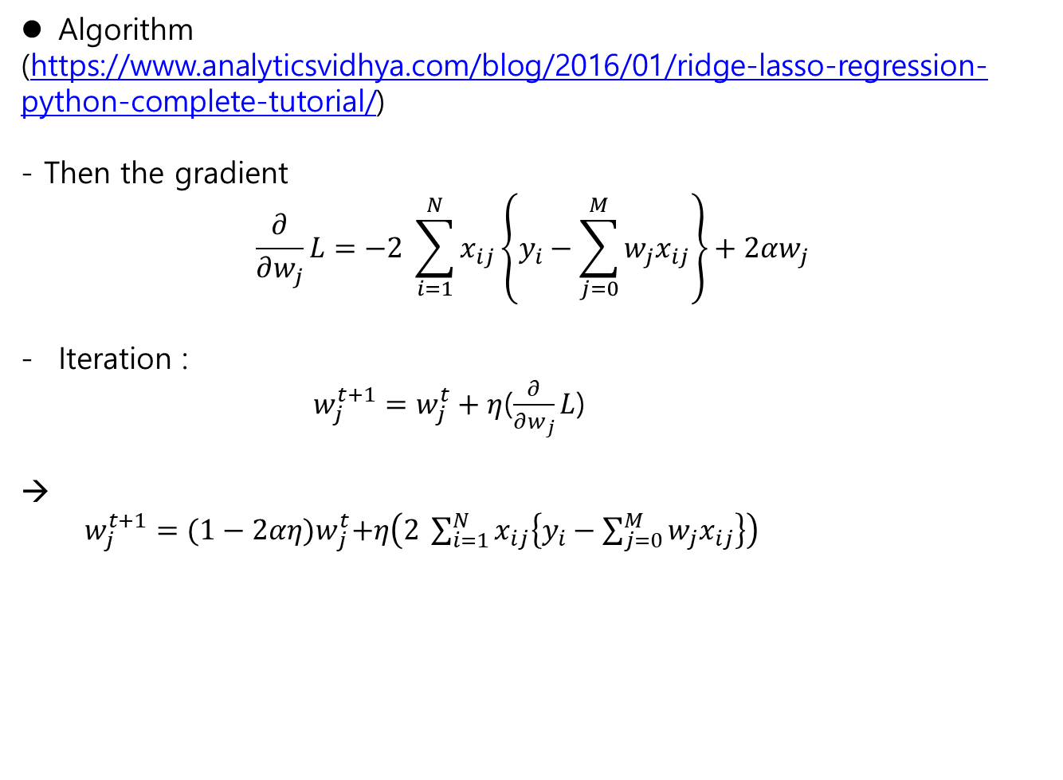
Linear Model - Ridge Regression
Supervised Learning
Algorithm
(https://www.analyticsvidhya.com/blog/2016/01/ridge-lasso-regression-python-complete-tutorial/)
- Then the gradient
$$\frac{∂}{∂w_{j}}L=−2 \sum_{i=1}^{N}{x_{ij}\left\{y_{i}−\sum_{j=0}^{M}{w_{j}x_{ij}}\right\}+2αw_{j}}$$
Iteration :
$w_{j}^{t+1}=w_{j}^{t}+η$($\frac{∂}{∂w_{j}}L$)
→
$w_{j}^{t+1}={(1−2αη)w}_{j}^{t}+η\left(2 \sum_{i=1}^{N}{x_{ij}\left\{y_{i}−\sum_{j=0}^{M}{w_{j}x_{ij}}\right\}}\right)$

Slide 22
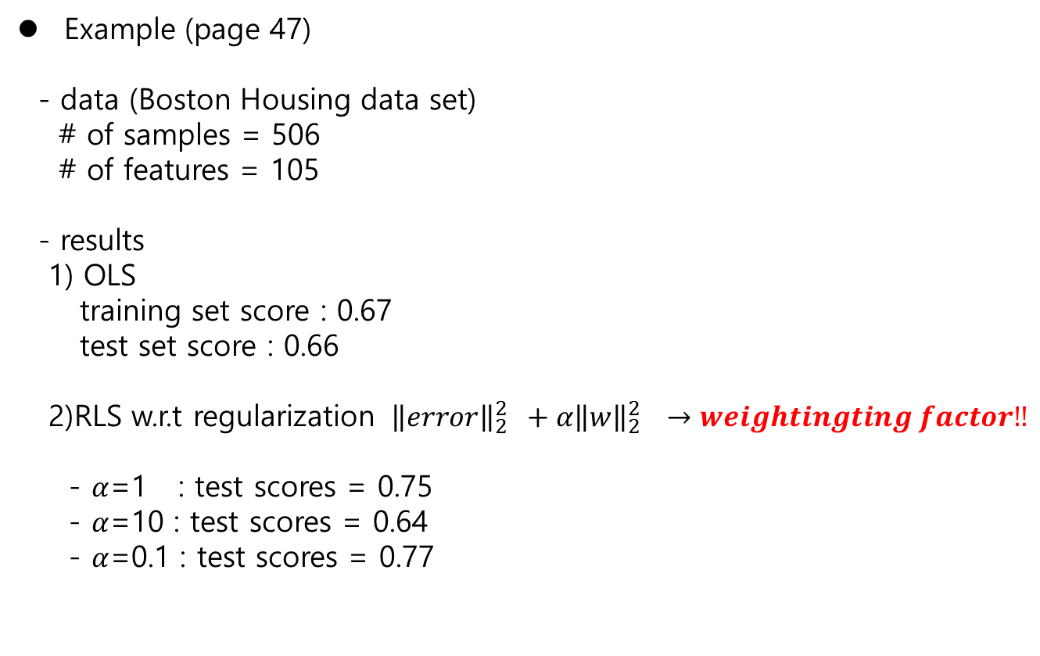
Linear Model - Ridge Regression
Supervised Learning
Example (page 47)
- data (Boston Housing data set)
# of samples = 506
# of features = 105
- results
1) OLS
training set score : 0.67
test set score : 0.66
2)RLS w.r.t regularization ${ {\left\|error\right\|}_{2}^{2} +α\left\|w\right\|}_{2}^{2} →weightingting factor‼$
- $α$=1 : test scores = 0.75
- $α$=10 : test scores = 0.64
- $α$=0.1 : test scores = 0.77

Slide 23
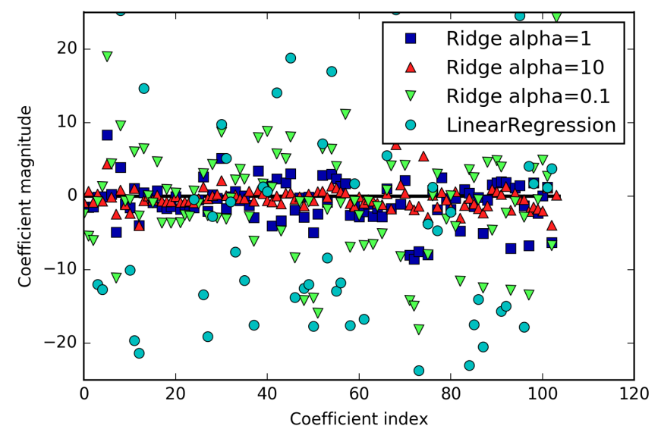
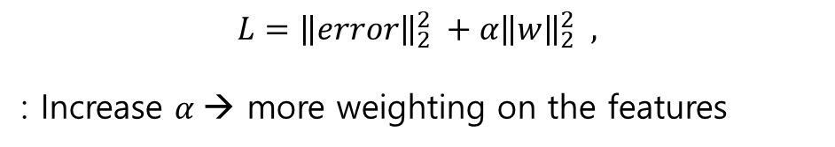
Linear Model - Ridge Regression
Supervised Learning
Results (page 50)
$$L={\left\|error\right\|}_{2}^{2} +α{\left\|w\right\|}_{2}^{2} ,$$
: Increase $α$→ more weighting on the features

Slide 24
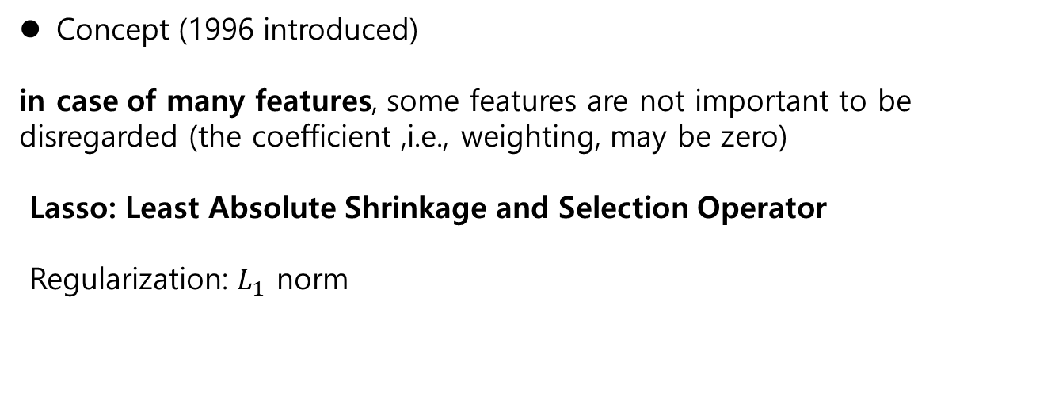
Linear Model - Lasso Regression
Supervised Learning
Concept (1996 introduced)
in case of many features, some features are not important to be disregarded (the coefficient ,i.e., weighting, may be zero)
Lasso: Least Absolute Shrinkage and Selection Operator
Regularization: $L_{1}$ norm

Slide 25
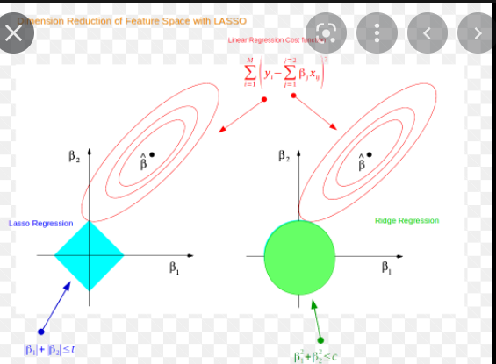
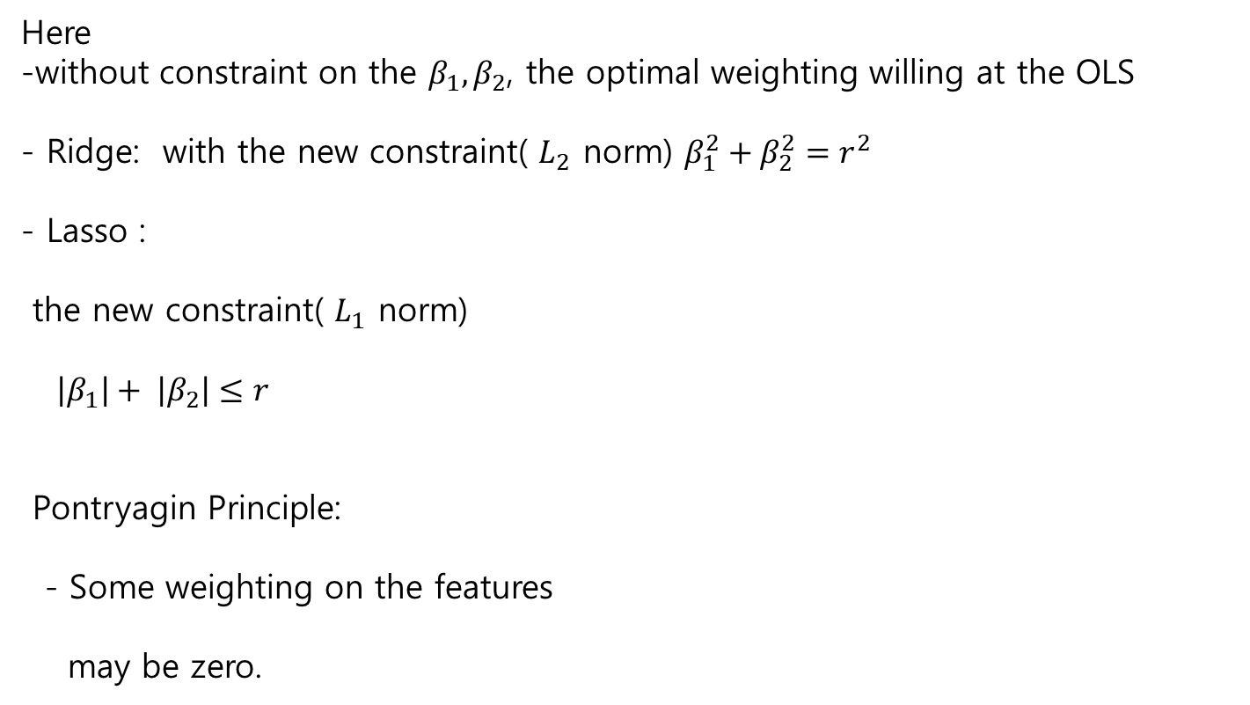
Linear Model - Lasso Regression
Supervised Learning
Here
-without constraint on the $β_{1}, β_{2}$, the optimal weighting willing at the OLS
- Ridge: with the new constraint( $L_{2}$ norm) $β_{1}^{2}+β_{2}^{2}=r^{2}$
- Lasso :
the new constraint( $L_{1}$ norm)
$\left|β_{1}\right|+ \left|β_{2}\right|≤r$
Pontryagin Principle:
- Some weighting on the features
may be zero.

Slide 26
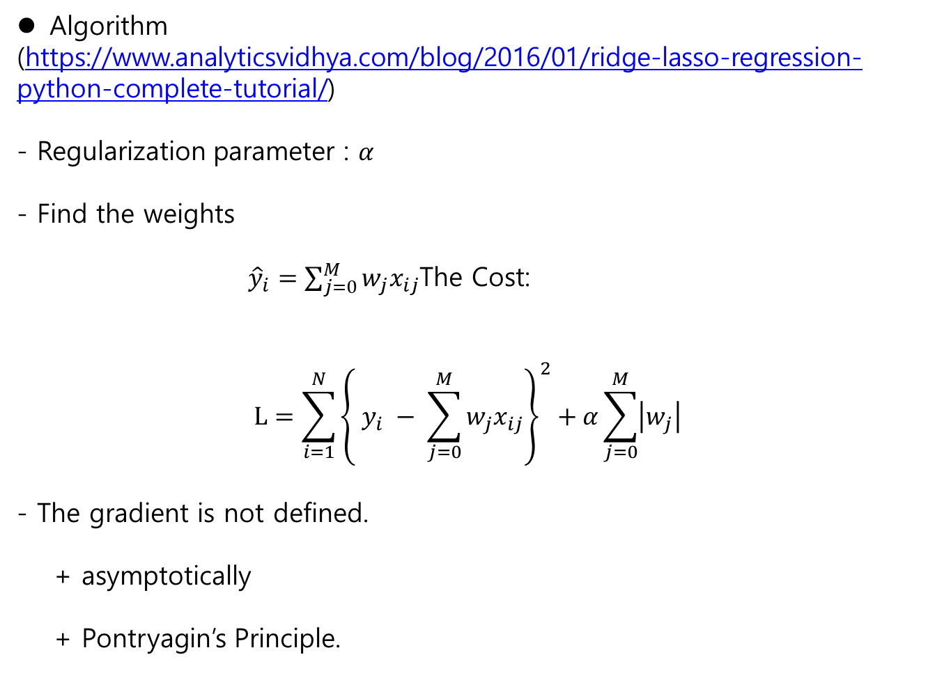
Linear Model - Lasso Regression
Supervised Learning
Algorithm
(https://www.analyticsvidhya.com/blog/2016/01/ridge-lasso-regression-python-complete-tutorial/)
- Regularization parameter : $α$
- Find the weights
${\hat{y}}_{i}=\sum_{j=0}^{M}{w_{j}x_{ij}}$The Cost:
$$L=\sum_{i=1}^{N}{{\left\{ y_{i} − \sum_{j=0}^{M}{w_{j}x_{ij}}\right\}}^{2}+α\sum_{j=0}^{M}{\left|w_{j}\right|}}$$
- The gradient is not defined.
+ asymptotically
+ Pontryagin’s Principle.

Slide 27
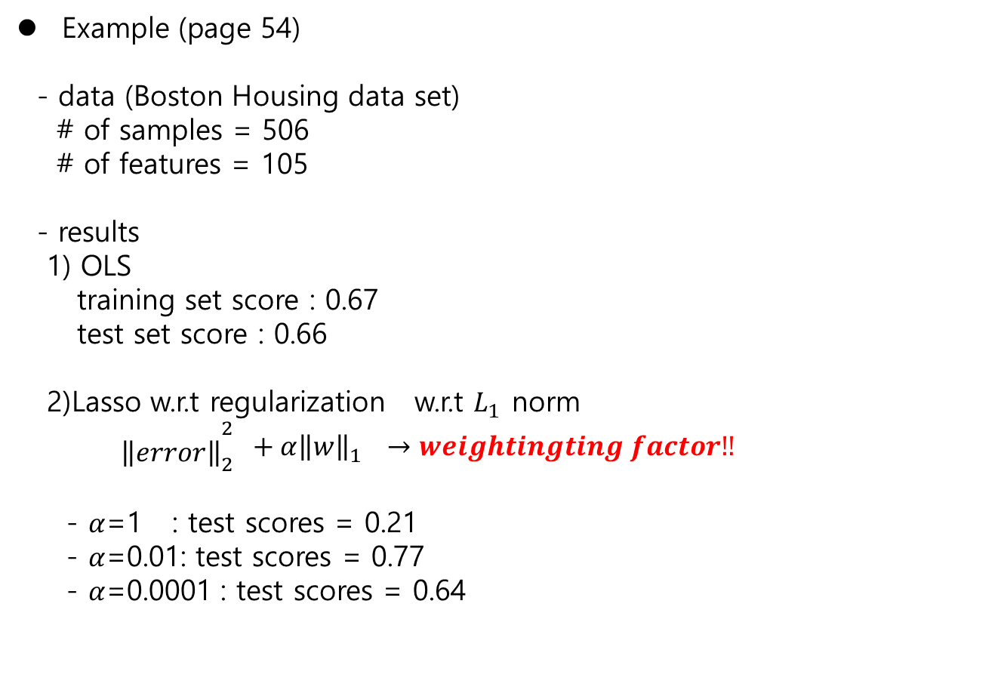
Linear Model - Lasso Regression
Supervised Learning
Example (page 54)
- data (Boston Housing data set)
# of samples = 506
# of features = 105
- results
1) OLS
training set score : 0.67
test set score : 0.66
2)Lasso w.r.t regularization w.r.t $L_{1}$ norm
${ {\begin{aligned} \\ \left\|error\right\|\end{aligned}}_{2}^{2} +α\left\|w\right\|}_{1}^{} →weightingting factor‼$
- $α$=1 : test scores = 0.21
- $α$=0.01: test scores = 0.77
- $α$=0.0001 : test scores = 0.64

Slide 28
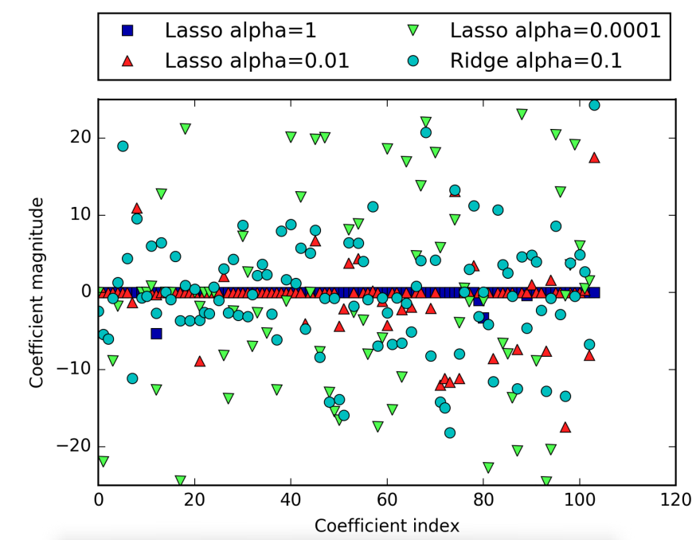
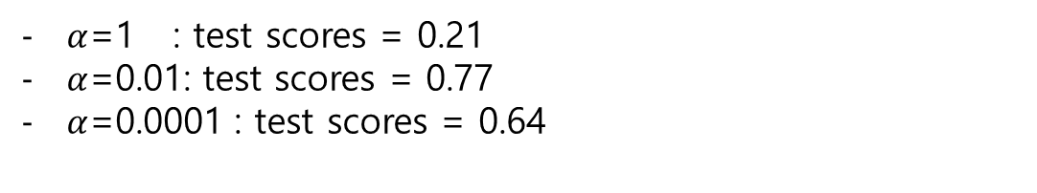
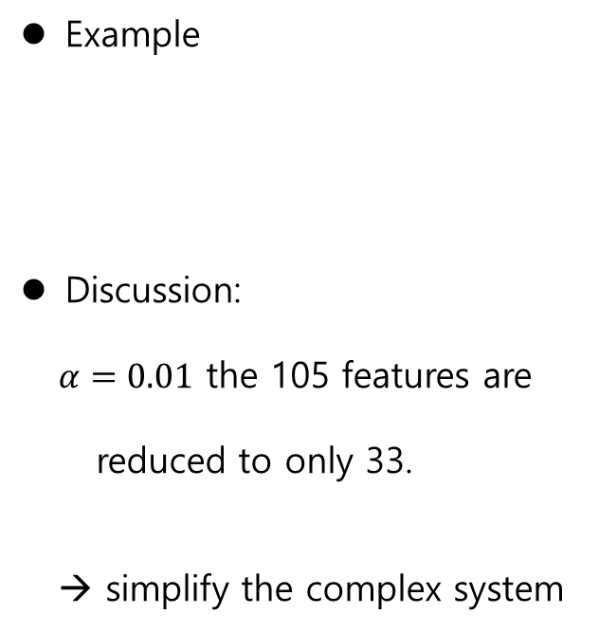
Linear Model - Lasso Regression
Supervised Learning
Example
Discussion:
$α=0.01$ the 105 features are
reduced to only 33.
→ simplify the complex system
$α$=1 : test scores = 0.21
$α$=0.01: test scores = 0.77
$α$=0.0001 : test scores = 0.64

Slide 29
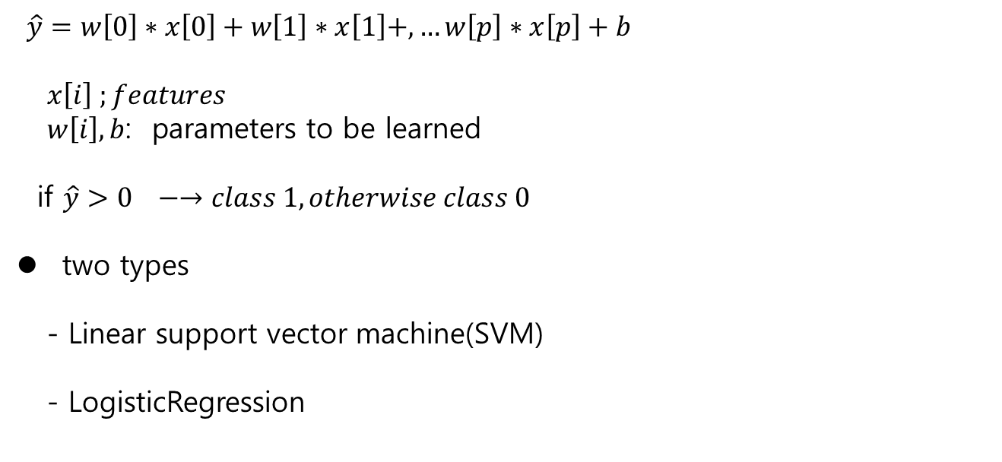
Linear Model - Classification
Supervised Learning
Classification
Binary classification
$\hat{y}=w\left[0\right]∗x\left[0\right]+w\left[1\right]∗x\left[1\right]+,…w\left[p\right]∗x\left[p\right]+b$
$x\left[i\right] ;features$
$w\left[i\right], b$: parameters to be learned
if $\hat{y}>0 −→class 1, otherwise class 0$
two types
- Linear support vector machine(SVM)
- LogisticRegression

Slide 30
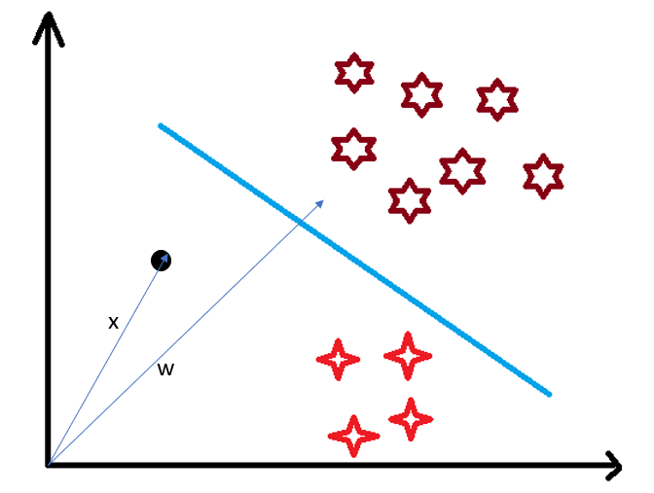
Linear Model - Classification
Supervised Learning
Concepts
-decision boundary
separate classes
Line / hyperplane ,..
- how to find the decision
boundary?

Slide 31

Linear Model - Classification
Supervised Learning
Concepts
$W:the normal vector of D$
- 3 cases
$X on the D : X∙W=c$
$X in Class A : X∙W<c$
$X in Class B: X∙W<c$

Slide 32
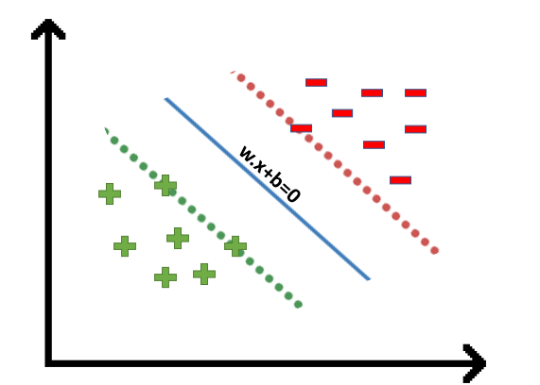
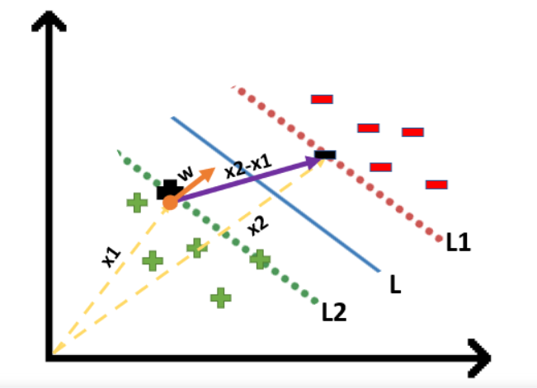
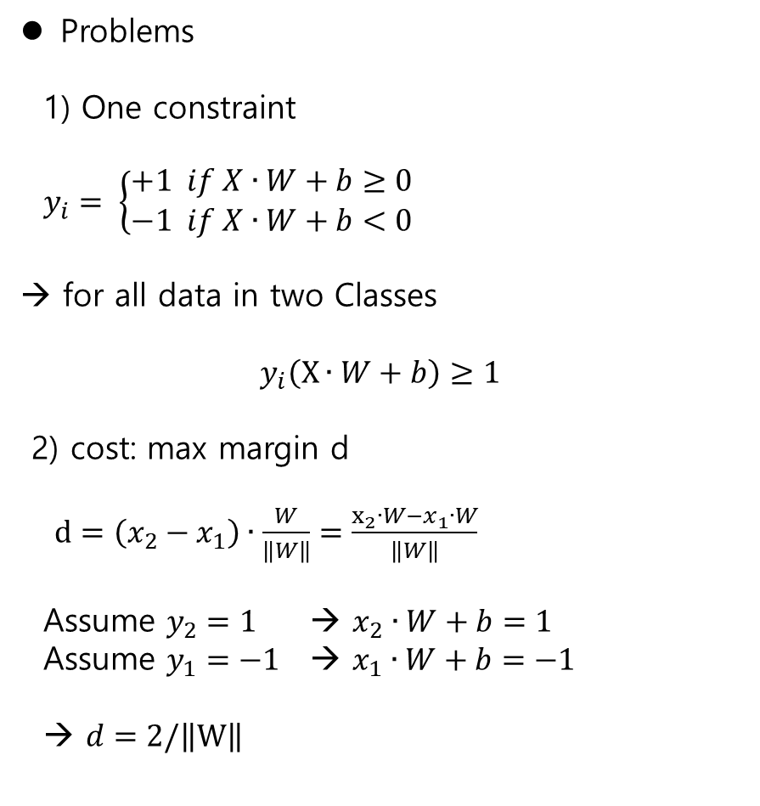
Linear Model - Classification
Supervised Learning
Problems
1) One constraint
$y_{i}= \left\{\begin{aligned}+1 if X∙W+b≥0 \\ −1 if X∙W+b<0\end{aligned}\right.$
→ for all data in two Classes
$$y_{i}\left(X∙W+b\right)≥1$$
2) cost: max margin d
$d=\left(x_{2}−x_{1}\right)∙\frac{W}{\left\|W\right\|}=\frac{x_{2}∙W−x_{1}∙W}{\left\|W\right\|}$
Assume $y_{2}=1$ → $x_{2}∙W+b=1$
Assume $y_{1}=−1$ → $x_{1}∙W+b=−1$
→ $d=2/\left\|W\right\|$

Slide 33

Linear Model - Classification
Supervised Learning
Problems
$\arg{\max_{(W, b)}{d}=2/\left\|W\right\| } s.t y_{i}\left(X∙W+b\right)≥1$
→
$\arg{\min_{(W, b)}\left\|W\right\| } s.t y_{i}\left(X∙W+b\right)≥1$

Slide 34
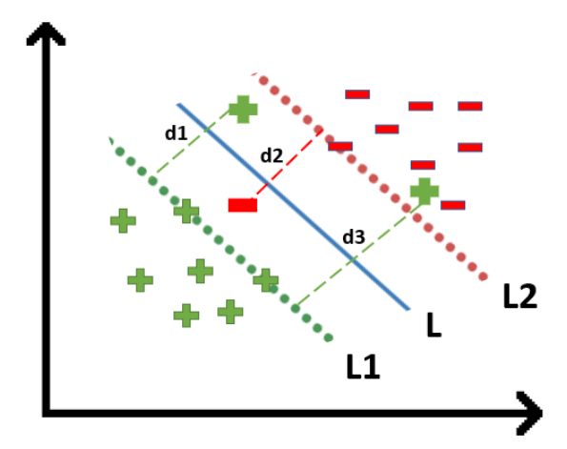

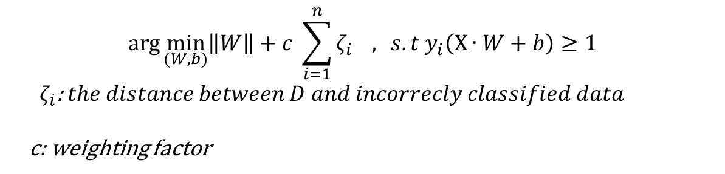
Linear Model - Classification
Supervised Learning
Hard Margin SVM
Soft Margin SVM
- to regulate the incorrect classification
$$\arg{\min_{(W, b)}\left\|W\right\| } s.t y_{i}\left(X∙W+b\right)≥1$$
$$\arg{\min_{(W, b)}\left\|W\right\|+c \sum_{i=1}^{n}{ζ_{i}} , } s.t y_{i}\left(X∙W+b\right)≥1$$
${ ζ}_{i}$: $the distance between D and incorrecly classified data$
c: weighting factor

Slide 35
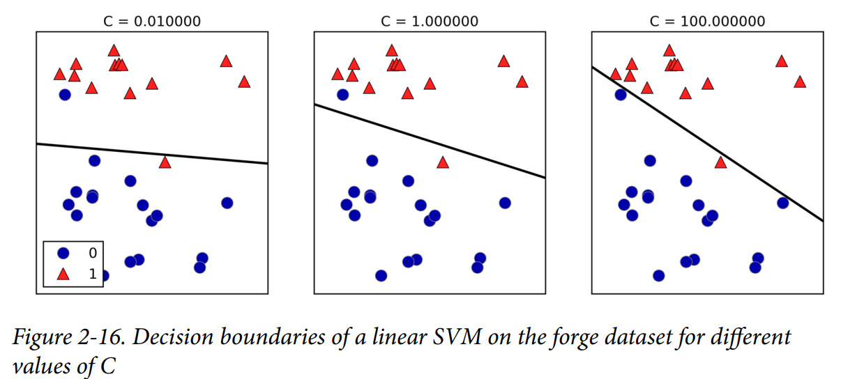
Linear Model - Classification
Supervised Learning
Example (page. 56)
- Soft Margin SVM

Slide 36
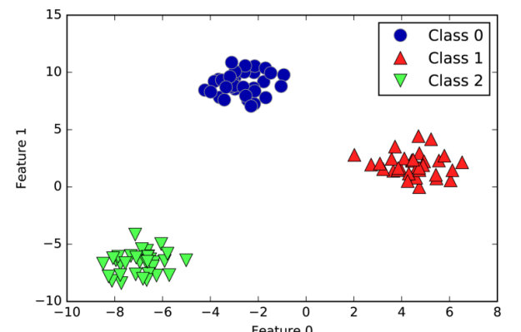
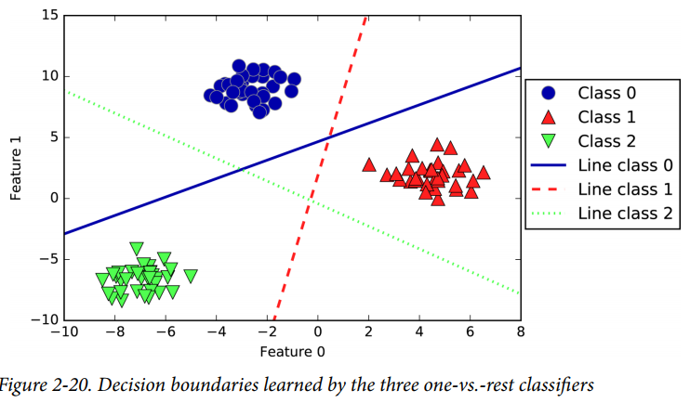
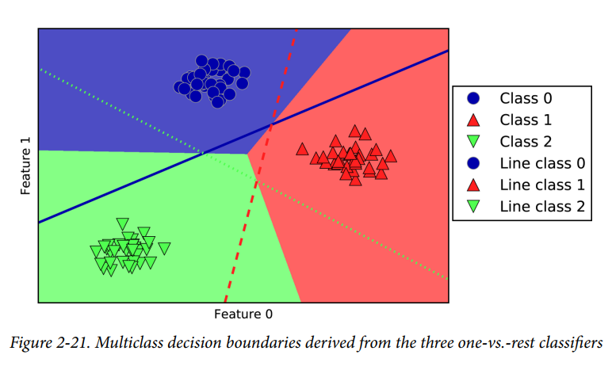
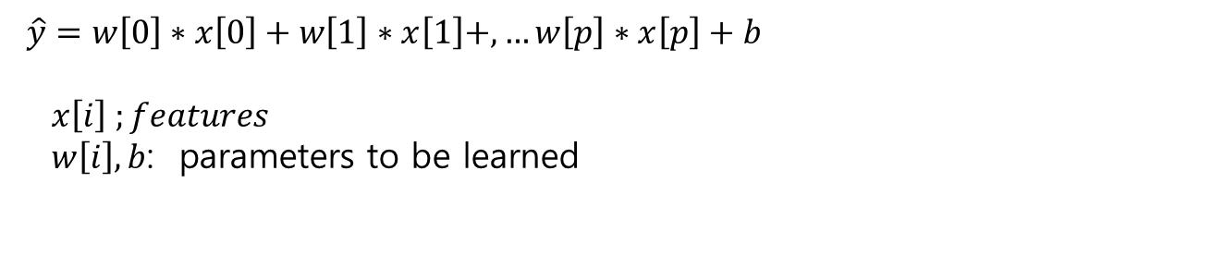
Linear Model – Classification- Multiclass
Supervised Learning
Linear Models for Multiclass classification (p.64)
One-vs. –rest algorithm
$\hat{y}=w\left[0\right]∗x\left[0\right]+w\left[1\right]∗x\left[1\right]+,…w\left[p\right]∗x\left[p\right]+b$
$x\left[i\right] ;features$
$w\left[i\right], b$: parameters to be learned

