Slide 1
Intelligence
-Human intelligence
-Artificial Intelligence
Machine Learning
- Supervise learning
- Unsupervised learning
- Reinforcement Learning
Reinforcement learning ← → Model predictive Control(MPC)
- Model based
- Model free based

Slide 2
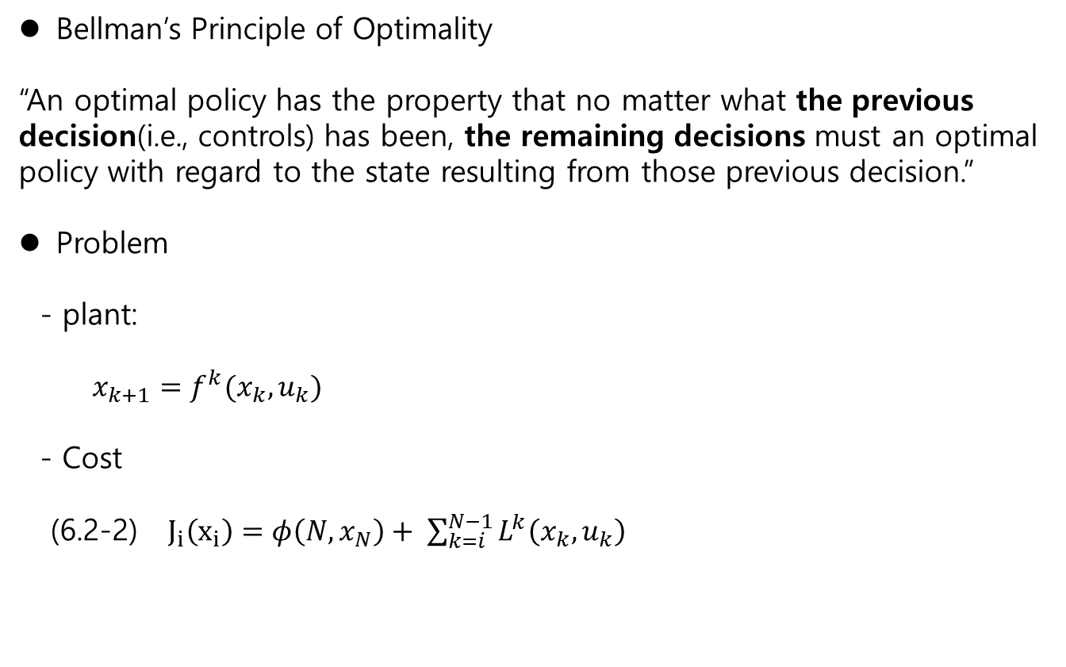
Bellman’s Principle of Optimality
“An optimal policy has the property that no matter what the previous decision(i.e., controls) has been, the remaining decisions must an optimal policy with regard to the state resulting from those previous decision.”
Problem
- plant:
$x_{k+1}=f^{k}(x_{k}, u_{k})$
- Cost
(6.2-2) $J_{i}\left(x_{i}\right)=φ\left(N, x_{N}\right)+ \sum_{k=i}^{N−1}{L^{k}\left(x_{k},u_{k}\right)}$

Slide 3

Ch.6 Dynamic programming
Optimal Control
Let
$$\dot{x}=f(x,u,t)$$
And the cost
$$J\left(0\right)=φ\left(x\left(T\right), T\right) + \int_{0}^{T}{L(x\left(t\right),u\left(t\right),t)}dt$$
Analytic method
Dynamic programming
Bellman’s Remark
“An optimal policy has the property that no matter what the previous decision(i.e., controls) has been, the remaining decisions must an optimal policy with regard to the state resulting from those previous decision.”

Slide 4
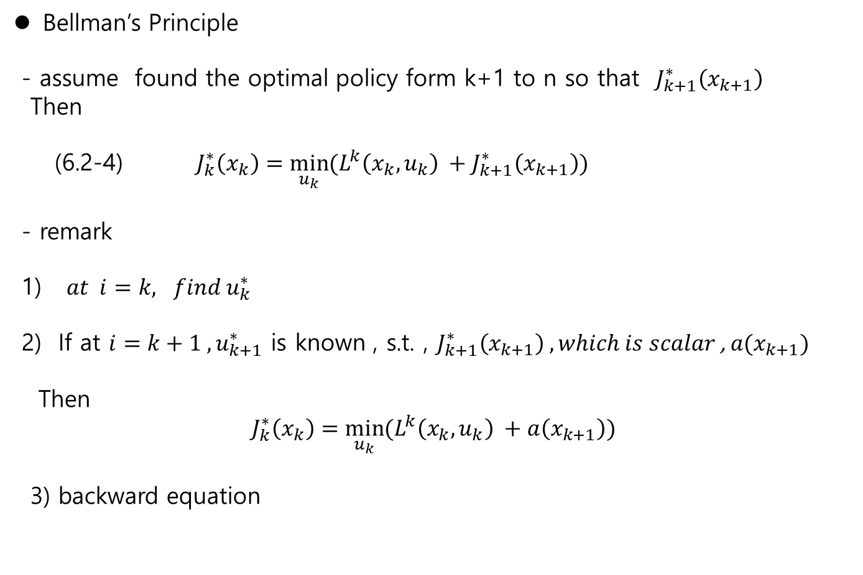
Ch.6 Dynamic programming
Bellman’s Principle
- assume found the optimal policy form k+1 to n so that $J_{k+1}^{∗}\left(x_{k+1}\right)$
Then
(6.2-4) $J_{k}^{∗}\left(x_{k}\right)=\min_{u_{k}}{(L^{k}\left(x_{k}, u_{k}\right) +J_{k+1}^{∗}\left(x_{k+1}\right)})$
- remark
1) $at i=k, find u_{k}^{∗}$
2) If at $i=k+1 , u_{k+1}^{∗}$ is known , s.t. , $J_{k+1}^{∗}\left(x_{k+1}\right) , which is scalar$, $a(x_{k+1})$
Then
$$J_{k}^{∗}\left(x_{k}\right)=\min_{u_{k}}{(L^{k}\left(x_{k}, u_{k}\right) +a\left(x_{k+1}\right))}$$
3) backward equation

Slide 5
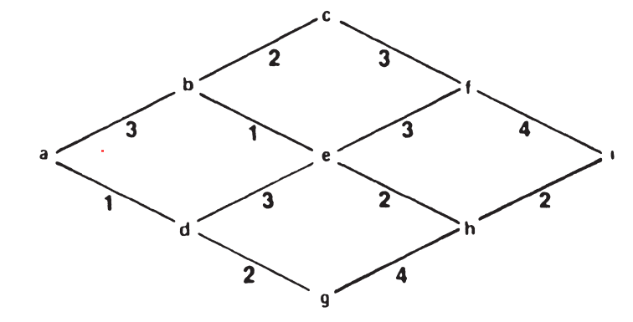
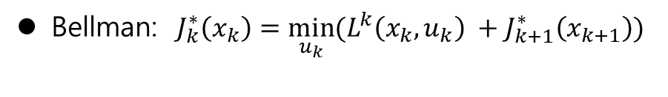
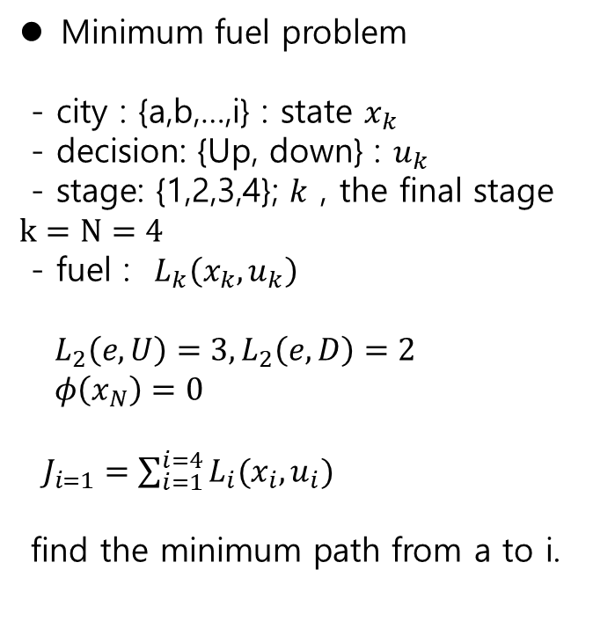
Ch.6 Dynamic programming
Minimum fuel problem
- city : {a,b,…,i} : state $x_{k}$
- decision: {Up, down} : $u_{k}$
- stage: {1,2,3,4}; $k$ , the final stage $k=N=4$
- fuel : $L_{k}\left(x_{k}, u_{k}\right)$
$L_{2}\left(e, U\right)=3, L_{2}\left(e,D\right)=2$
$φ\left(x_{N}\right)=0$
$J_{i=1}=\sum_{i=1}^{i=4}{L_{i}(x_{i}, u_{i})}$
find the minimum path from a to i.
Bellman: $J_{k}^{∗}\left(x_{k}\right)=\min_{u_{k}}{(L^{k}\left(x_{k}, u_{k}\right) +J_{k+1}^{∗}\left(x_{k+1}\right)})$

Slide 6
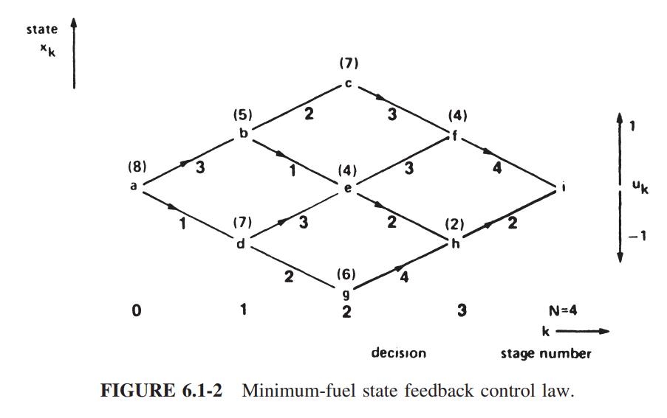

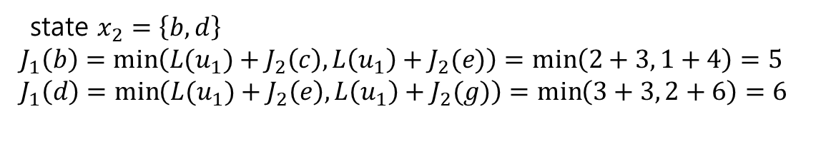
Ch.6 Dynamic programming
Minimum fuel problem
1) at $k=4, \left(the final stage\right)$
no decision is made
2) at $k=3$
state $x_{3}=\left\{f,h\right\}$
$J_{3}\left(f\right)=4, J_{3}\left(h\right)=2$
3) at k=2
state $x_{3}=\left\{c,e,g\right\}$
$J_{2}\left(c\right)=\min\left({L(u}_{2})+J_{3}\left(f\right)\right)=3$
$J_{2}\left(e\right)=\min\left({L(u}_{2})+J_{3}\left(f\right), {L(u}_{2})+J_{3}(h)\right)=\min{( 3+4, 2+2 )}=4$
$J_{2}\left(g\right)=\min\left({L(u}_{2})+J_{3}\left(h\right)\right)=6$
4) at k=1
5) At k=1
state $x_{1}=\left\{a\right\}$
$J_{0}\left(a\right)=\min\left({L(u}_{1})+J_{1}\left(b\right), L\left(u_{1}\right)+J_{1}(d)\right)=\min\left(3+5,1+6\right)=7$
In conclusion: a → d → e → h → I = (1+3+2+2) = 8
state $x_{2}=\left\{b,d\right\}$
$J_{1}\left(b\right)=\min\left({L(u}_{1})+J_{2}\left(c\right), L\left(u_{1}\right)+J_{2}(e)\right)=\min\left(2+3, 1+4\right)=5$
$J_{1}\left(d\right)=\min\left({L(u}_{1})+J_{2}\left(e\right), L\left(u_{1}\right)+J_{2}(g)\right)=\min\left(3+3, 2+6\right)=6$

Slide 7

Ch.6 Dynamic programming
Ex.6.2-2 (Discrete LQR )
Plant
$x_{k+1}=f^{k}(x_{k}, u_{k})$
Cost:
$$J_{i}\left(x_{i}\right)=\frac{1}{2}x_{N}^{T}S_{N}x_{N}+\frac{1}{2}\sum_{k=i}^{N−1}{(x_{k}^{T}Qx_{k}+u_{k}^{T}Ru_{k})}$$
Solution Procedure
At $k=N ,$ $J_{N}^{∗}=\frac{1}{2}x_{N}^{T}S_{N}x_{N}$
At $k=N−1$
$J_{N−1}=\frac{1}{2}x_{N−1}^{T}Q_{N−1}+\frac{1}{2}u_{N−1}^{T}Ru_{N−1}+\frac{1}{2}x_{N}^{T}S_{N}x_{N}$ $$= \frac{1}{2}x_{N−1}^{T}Q_{N−1}+\frac{1}{2}u_{N−1}^{T}Ru_{N−1}+\frac{1}{2}{\left(Ax_{N−1}+Bu_{N−1}\right)}^{T}S_{N}(Ax_{N−1}+Bu_{N−1})$$

Slide 8
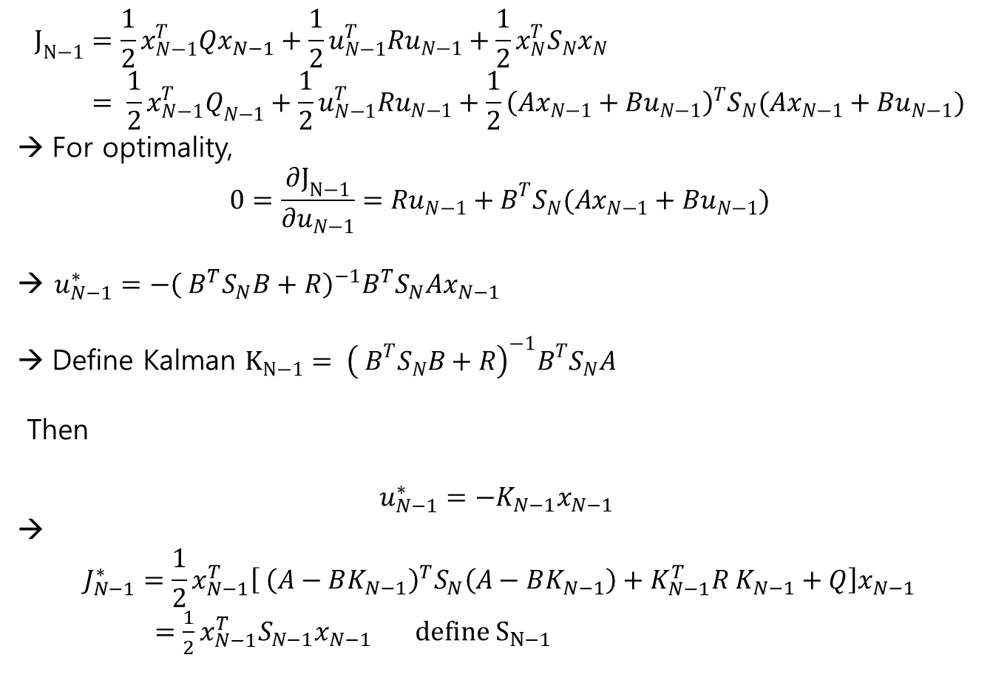
Discrete-LQG Ch.6 Dynamic programming
$$J_{N−1}=\frac{1}{2}x_{N−1}^{T}Qx_{N−1}+\frac{1}{2}u_{N−1}^{T}Ru_{N−1}+\frac{1}{2}x_{N}^{T}S_{N}x_{N} \\ = \frac{1}{2}x_{N−1}^{T}Q_{N−1}+\frac{1}{2}u_{N−1}^{T}Ru_{N−1}+\frac{1}{2}{\left(Ax_{N−1}+Bu_{N−1}\right)}^{T}S_{N}(Ax_{N−1}+Bu_{N−1})$$
For optimality,
$$0=\frac{∂J_{N−1}}{∂u_{N−1}}=Ru_{N−1}+B^{T}S_{N}(Ax_{N−1}+Bu_{N−1})$$
→ $u_{N−1}^{∗}=−{\left( B^{T}S_{N}B+R\right)}^{−1}B^{T}S_{N}Ax_{N−1}$
Define Kalman $K_{N−1}= {\left( B^{T}S_{N}B+R\right)}^{−1}B^{T}S_{N}A$
Then
$$u_{N−1}^{∗}=−K_{N−1}x_{N−1}$$
→
$$J_{N−1}^{∗}=\frac{1}{2}x_{N−1}^{T}\left[ {\left(A−BK_{N−1}\right)}^{T}S_{N}\left(A−BK_{N−1}\right)+K_{N−1}^{T}R K_{N−1}+Q\right]x_{N−1}$$
$=\frac{1}{2}x_{N−1}^{T}S_{N−1}x_{N−1} define S_{N−1}$

Slide 9
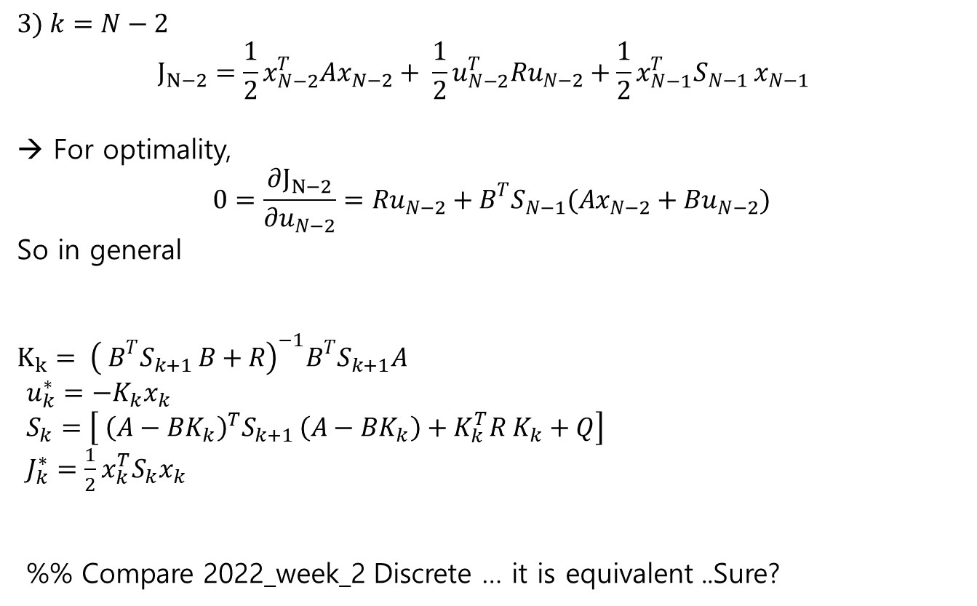
Discrete-LQG Ch.6 Dynamic programming
$$3) k=N−2$$
$$J_{N−2}=\frac{1}{2}x_{N−2}^{T}Ax_{N−2}+ \frac{1}{2}u_{N−2}^{T}Ru_{N−2}+\frac{1}{2}x_{N−1}^{T}S_{N−1 }x_{N−1 }$$
→ For optimality,
$$0=\frac{∂J_{N−2}}{∂u_{N−2}}=Ru_{N−2}+B^{T}S_{N−1}(Ax_{N−2}+Bu_{N−2})$$
So in general
$$K_{k}= {\left( B^{T}S_{k+1 }B+R\right)}^{−1}B^{T}S_{k+1}A$$
$u_{k}^{∗}=−K_{k}x_{k}$
$S_{k}=\left[ {\left(A−BK_{k}\right)}^{T}S_{k+1 }\left(A−BK_{k}\right)+K_{k}^{T}R K_{k}+Q\right]$
$J_{k}^{∗}=\frac{1}{2}x_{k}^{T}S_{k}x_{k}$
%% Compare 2022_week_2 Discrete … it is equivalent ..Sure?

Slide 10
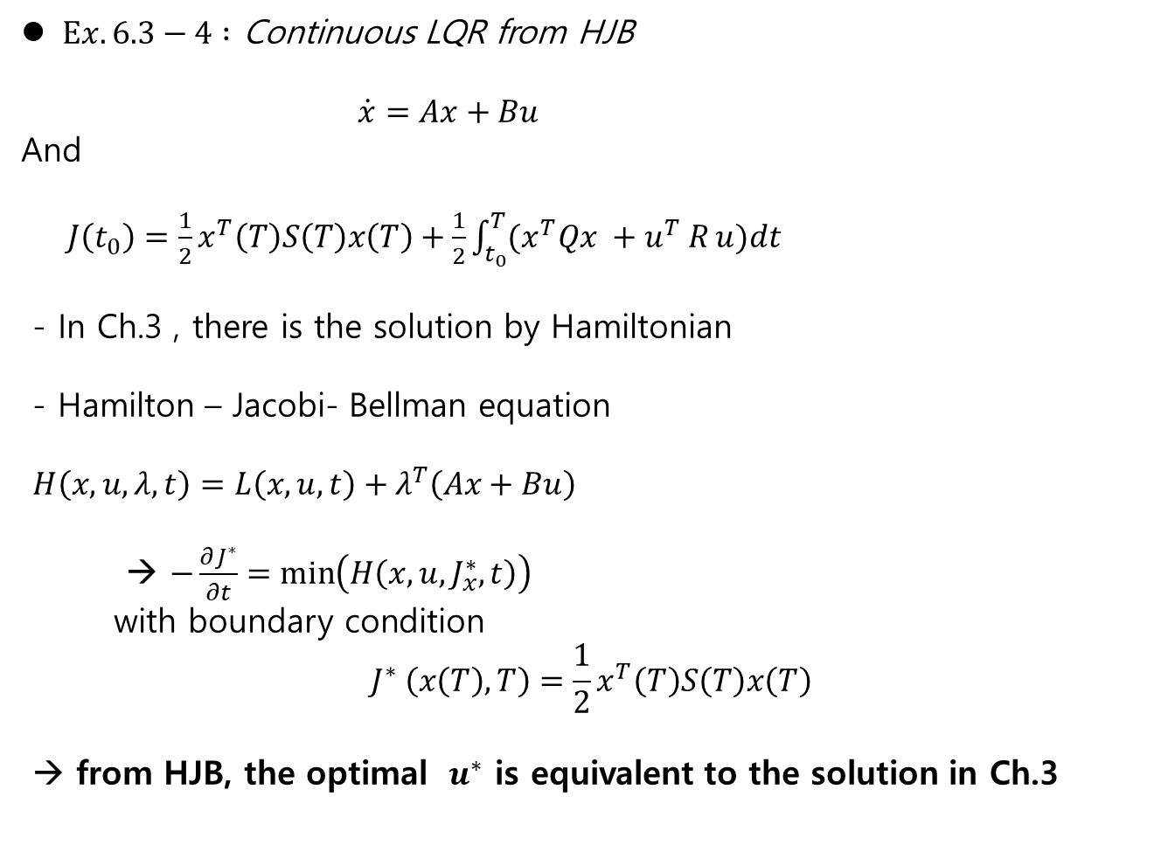
Continuous LQR Ch.6 Dynamic programming
$Ex. 6.3−4 :$ Continuous LQR from HJB
$\dot{x}=Ax+Bu$
And
$J\left(t_{0}\right)=\frac{1}{2}x^{T}\left(T\right)S\left(T\right)x\left(T\right)+\frac{1}{2}\int_{t_{0}}^{T}{(x^{T}Qx +u^{T} R}u)dt$
- In Ch.3 , there is the solution by Hamiltonian
- Hamilton – Jacobi- Bellman equation
$H\left(x,u,λ,t\right)=L\left(x,u,t\right)+λ^{T}\left(Ax+Bu\right)$
→ $−\frac{∂J^{∗}}{∂t}=\min\left(H\left(x,u,J_{x}^{∗},t\right)\right)$
with boundary condition
$$J^{∗} \left(x\left(T\right),T\right)=\frac{1}{2}x^{T}\left(T\right)S\left(T\right)x\left(T\right)$$
→ from HJB, the optimal $u^{∗}$ is equivalent to the solution in Ch.3

Slide 11
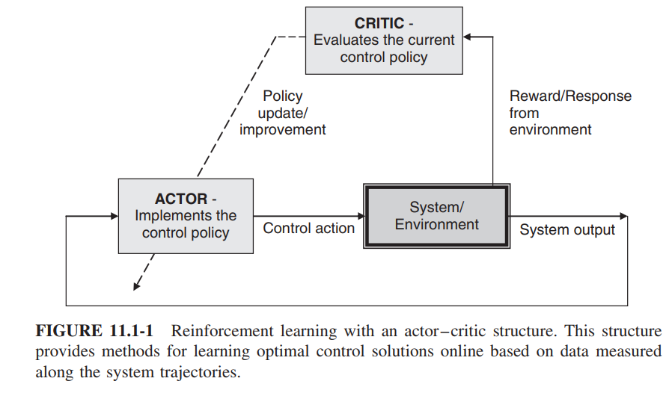
Ch.11 Reinforcement Learning
Reinforcement Learning

Slide 12
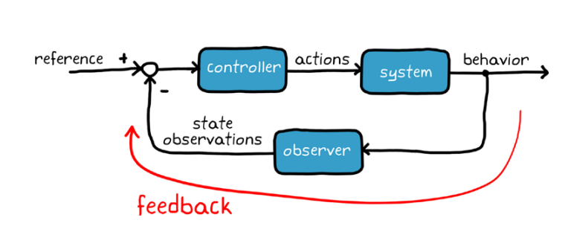
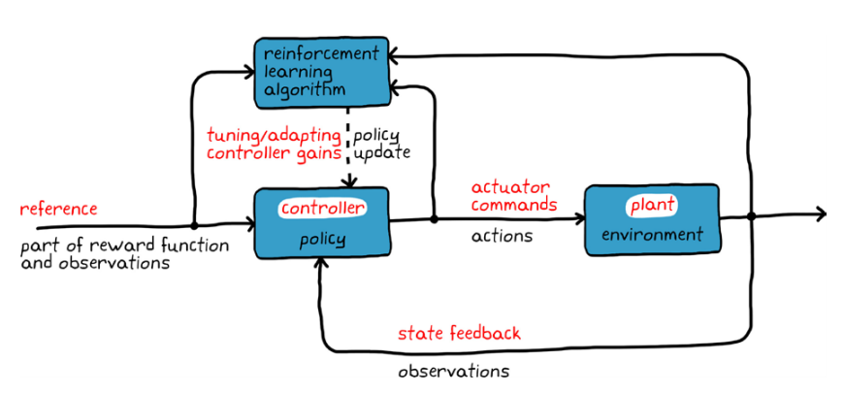
Ch.11 Reinforcement Learning
Reinforcement learning
[1] General Control Problem
general | RL
controller | policy
plant | environment
state | state reward
control | action
[1]: NE 10-3 Reinforcement learning with matlab

Slide 13
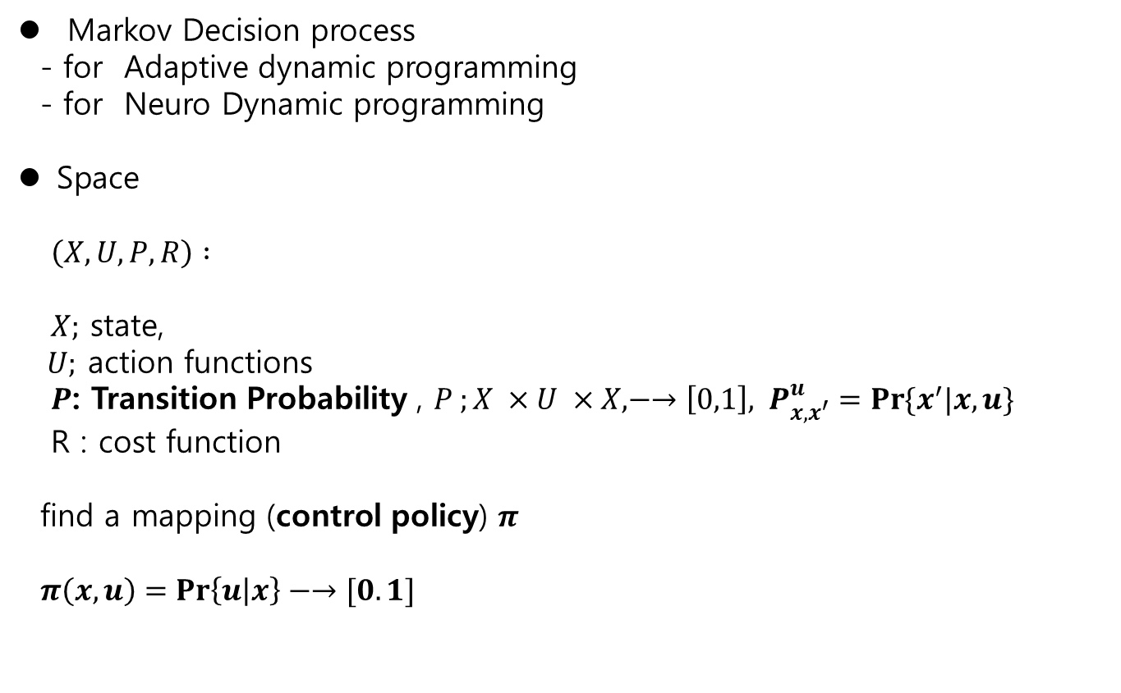
11.2 MDP Ch.11 Reinforcement Learning
Markov Decision process
- for Adaptive dynamic programming
- for Neuro Dynamic programming
Space
$\left(X,U,P,R\right) :$
$X;$ state,
$U;$ action functions
$P$: Transition Probability , $P ;X ×U ×X, −→\left[0,1\right], { P}_{x,x^{′}}^{u}=\operatorname{Pr}{\{x^{′}|x,u\}}$
R : cost function
find a mapping (control policy) $π$
$π\left(x,u\right)=\operatorname{Pr}\left\{u | x\right\}−→[0.1]$

Slide 14
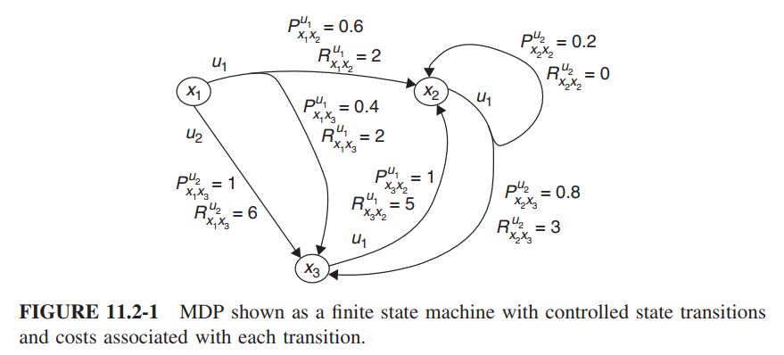
11.2 MDP Ch.11 Reinforcement Learning
(X,U,P,R)
$$x_{1} −→x_{2} : u_{1} :P_{x_{1}x_{2}}^{u_{1}}, P_{x_{1}x_{3}}^{u_{1}}, :R_{x_{1}x_{2}}^{u_{1}}, R_{x_{1}x_{3}}^{u_{1}}$$

Slide 15
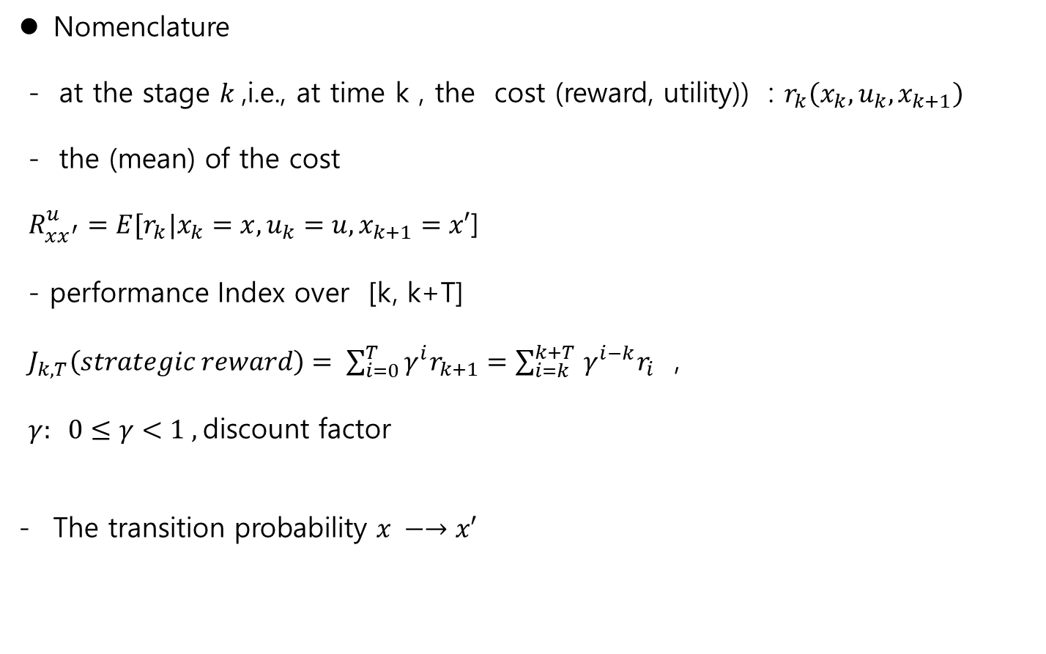
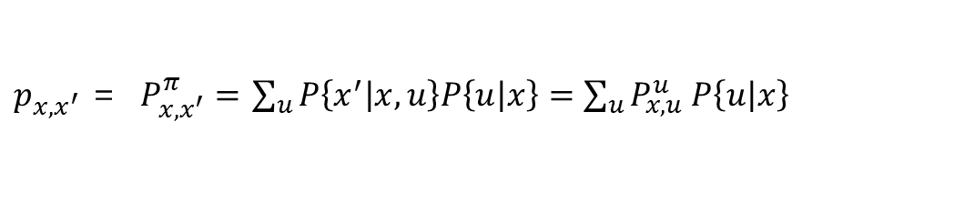
11.2 MDP Ch.11 Reinforcement Learning
Nomenclature
- at the stage $k$,i.e., at time k , the cost (reward, utility)) : $r_{k}\left(x_{k}, u_{k}, x_{k+1}\right)$
- the (mean) of the cost
$R_{xx^{′}}^{u}=E[r_{k}|x_{k}=x, u_{k}=u,x_{k+1}=x′$]
- performance Index over [k, k+T]
$J_{k,T}\left(strategic reward\right)= \sum_{i=0}^{T}{γ^{i}r_{k+1}=\sum_{i=k}^{k+T }{γ^{i−k}r_{i}}}$ ,
$γ: 0≤γ<1 ,$discount factor
The transition probability $x −→x′$
$p_{x,x^{′}}$ = $P_{x,x^{′}}^{π}=$ $\sum_{u}{P\left\{x^{′} | x,u\right\}P\left\{u | x\right\}=\sum_{u}{P_{x,u}^{u} P\left\{u | x\right\}} }$
** called as - Champman – Kolmogorov identity

Slide 16

Markov - supplement
Markov process - time evolution system
$x_{k+1}=x_{k}+w$ , $x_{0}$
$z_{k}=x_{k}+v$
up to time $k$
measurements $z_{0}, z_{1},z_{2},….., z_{k}$
the estimator for $x_{k}$
${\hat{x}}_{k} \sim f\left(x_{0}, x_{1},…,x_{k}\right)$
→ too many measurement !! → it is a batch type process

Slide 17

Markov - supplement
Markov Process
$P\left(X_{n+1}=x | X_{n}=x_{n},X_{n−1}=x_{n−1},….,X_{1}=x_{1}\right)$
$=P\left(X_{n+1}=x | X_{n}=x_{n} \right)$
Time evolution system
${\hat{x}}_{k} \sim f\left(x_{0}, x_{1},…,x_{k}\right)$
$E\left[x_{k} | x_{k−1}, x_{k−2},…,x_{1}\right]=E[x_{k}|x_{k−1}]$
→ recursive method !!

Slide 18
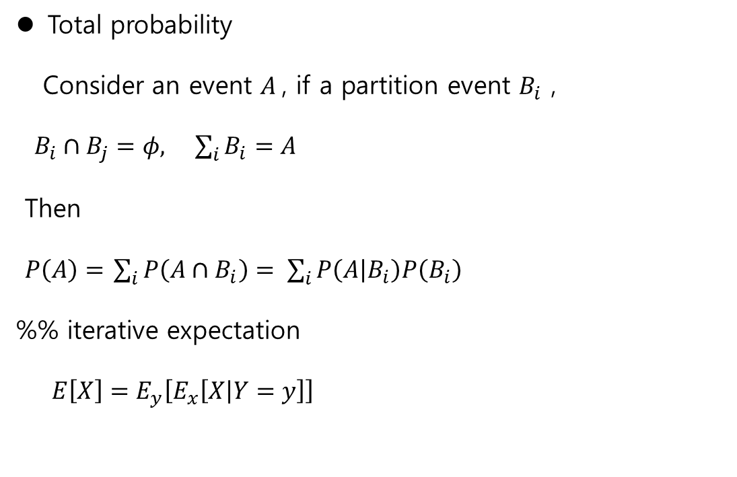
Total probability - supplement
Total probability
Consider an event $A$, if a partition event $B_{i}$ ,
$B_{i}∩B_{j}=φ, \sum_{i}{B_{i}}=A$
Then
$P\left(A\right)=$ $\sum_{i}{P\left(A∩B_{i}\right)= \sum_{i}{P\left(A | B_{i}\right)P\left(B_{i}\right)}}$
%% iterative expectation
$E\left[X\right]=E_{y}\left[E_{x}\left[X | Y=y\right]\right]$

Slide 19


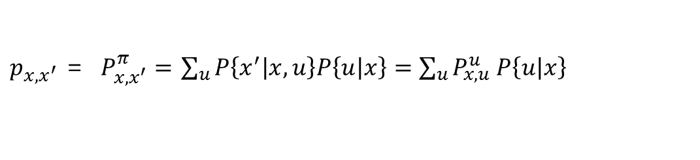

Markov - Total probability - supplement
$$u_{1}$$
$$u_{2}$$
X
X’
$$u_{3}$$
$p_{x,x^{′}}$ = $P_{x,x^{′}}^{π}=$ $\sum_{u}{P\left\{x^{′} | x,u\right\}P\left\{u | x\right\}=\sum_{u}{P_{x,u}^{u} P\left\{u | x\right\}} }$

Slide 20
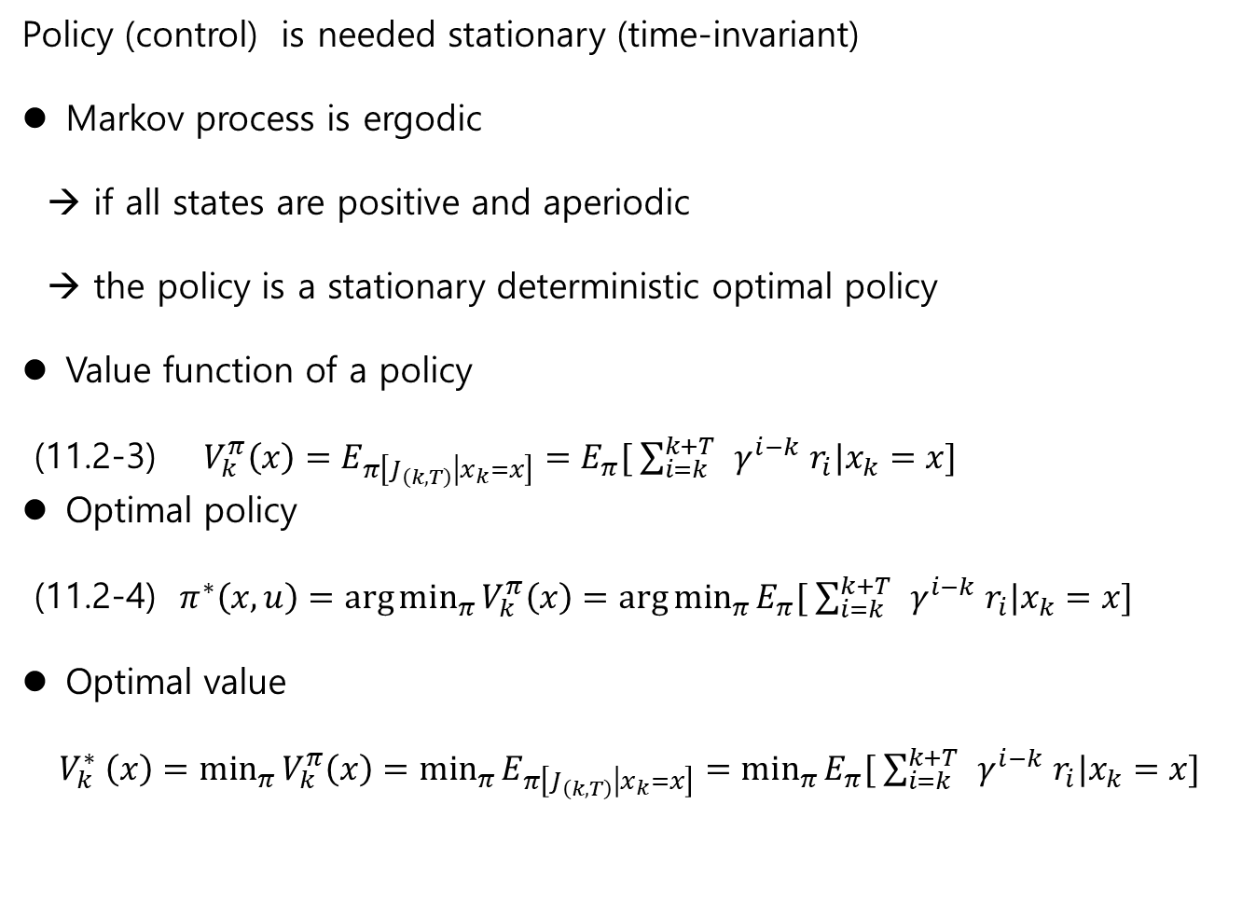
11.2 MDP Ch.11 Reinforcement Learning
Policy (control) is needed stationary (time-invariant)
Markov process is ergodic
→ if all states are positive and aperiodic
→ the policy is a stationary deterministic optimal policy
Value function of a policy
(11.2-3) $V_{k}^{π}\left(x\right)=E_{π\left[J_{\left(k,T\right)} | x_{k}=x\right]}=E_{π}[ \sum_{i=k}^{k+T }{ γ^{i−k} r_{i}|x_{k}=x}]$
Optimal policy
(11.2-4) $π^{∗}\left(x,u\right)=\arg{\min_{π}{V_{k}^{π}\left(x\right)=\arg{\min_{π}{E_{π}[ \sum_{i=k}^{k+T }{ γ^{i−k} r_{i}|x_{k}=x}] }}}}$
Optimal value
$V_{k}^{∗} \left(x\right)=\min_{π}{V_{k}^{π}\left(x\right)=\min_{π}{E_{π\left[J_{\left(k,T\right)} | x_{k}=x\right]}}=\min_{π}{E_{π}[ \sum_{i=k}^{k+T }{ γ^{i−k} r_{i}|x_{k}=x}] }}$

