Slide 1
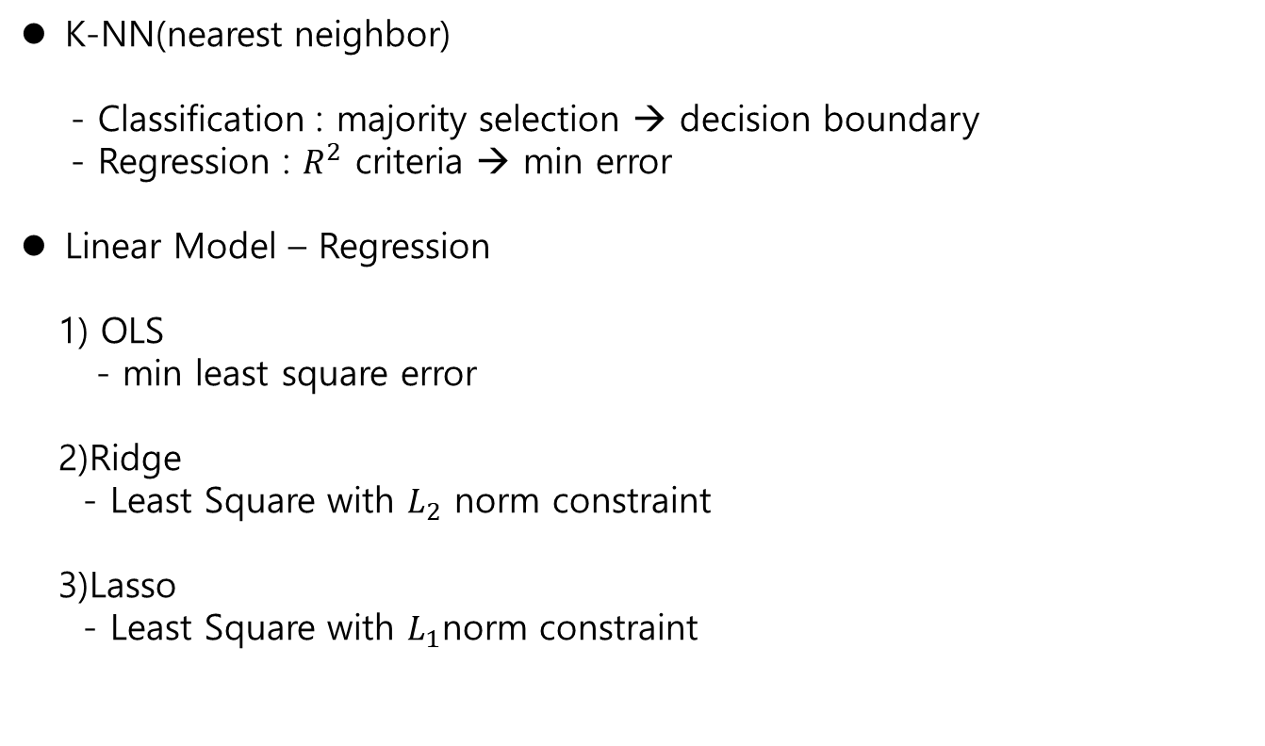
Review
Supervised learning
K-NN(nearest neighbor)
- Classification : majority selection → decision boundary
- Regression : $R^{2}$ criteria → min error
Linear Model – Regression
1) OLS
- min least square error
2)Ridge
- Least Square with $L_{2}$ norm constraint
3)Lasso
- Least Square with $L_{1}$norm constraint

Slide 2
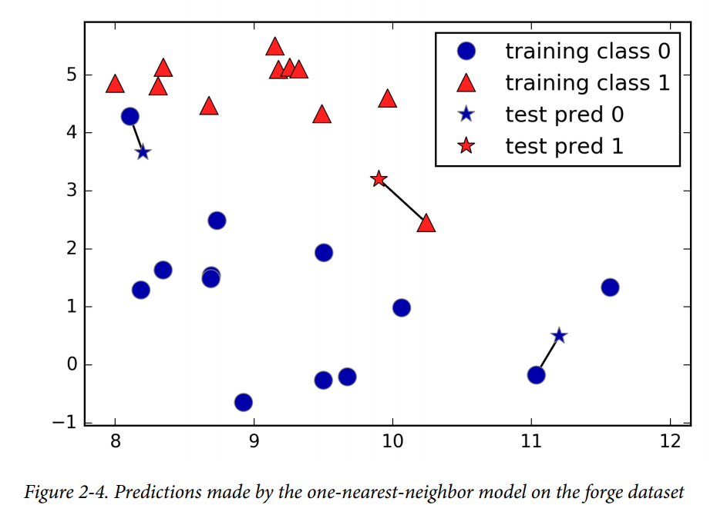
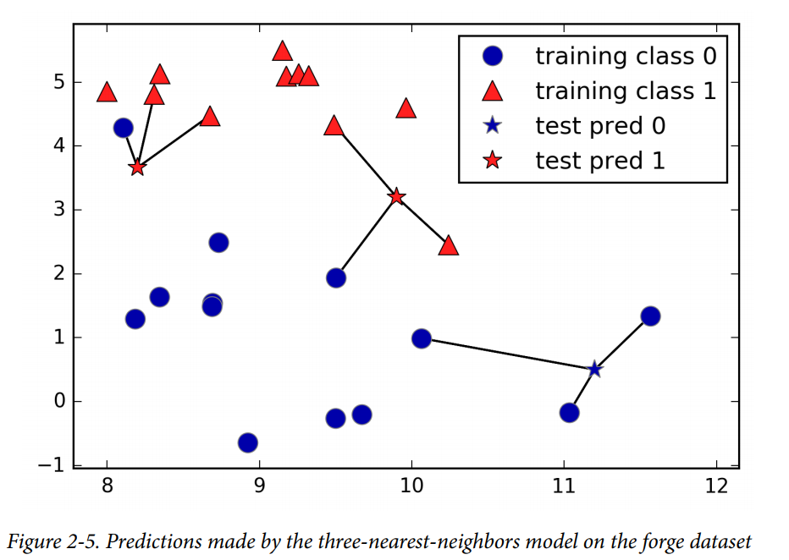
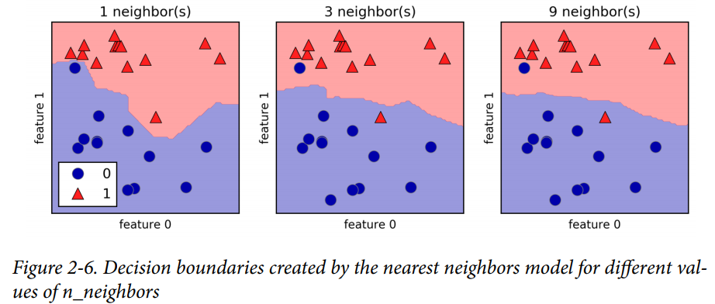
K-NN
Supervised llearning
Classification : Decision Boundary

Slide 3
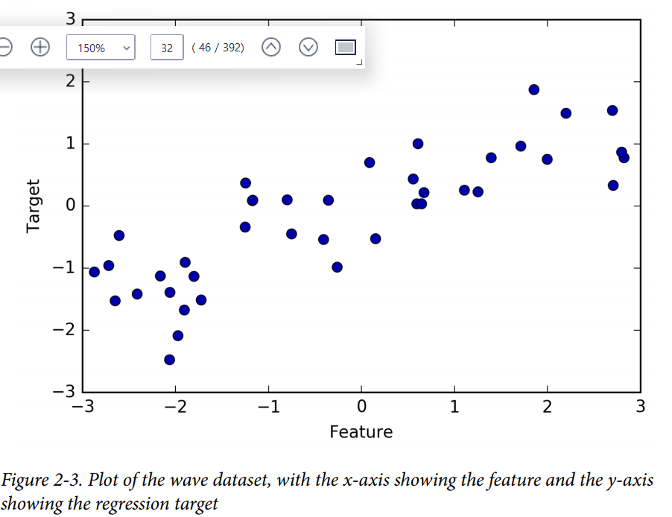
Review
Supervised learning
K-NN: Regression

Slide 4

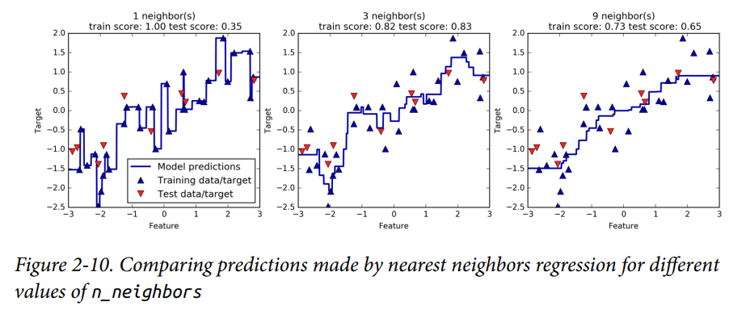
Review
Supervised learning
K-NN: Regression

Slide 5
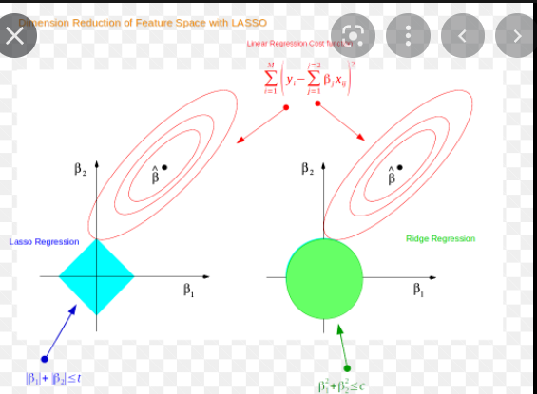
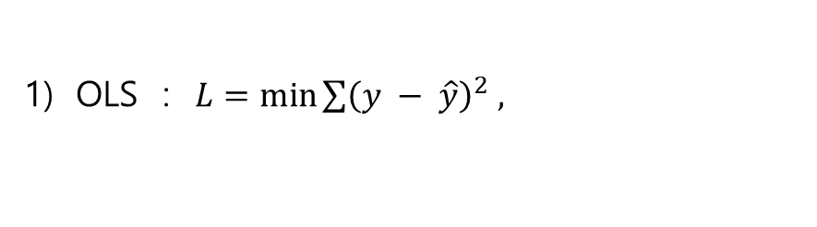
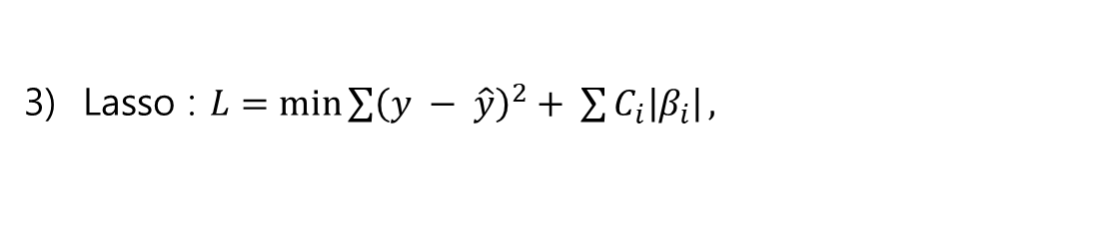
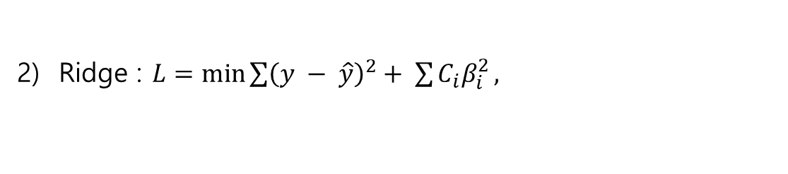
Linear Model - Regression
Supervised Learning
OLS : $L=\min{\sum{{\left(y − \hat{y}\right)}^{2} , }}$
2) Ridge : $L=\min{\sum{{\left(y − \hat{y}\right)}^{2}+ \sum{C_{i}β_{i}^{2}}, }}$
3) Lasso : $L=\min{\sum{{\left(y − \hat{y}\right)}^{2}+ \sum{C_{i}\left|β_{i}\right|}, }}$

Slide 6
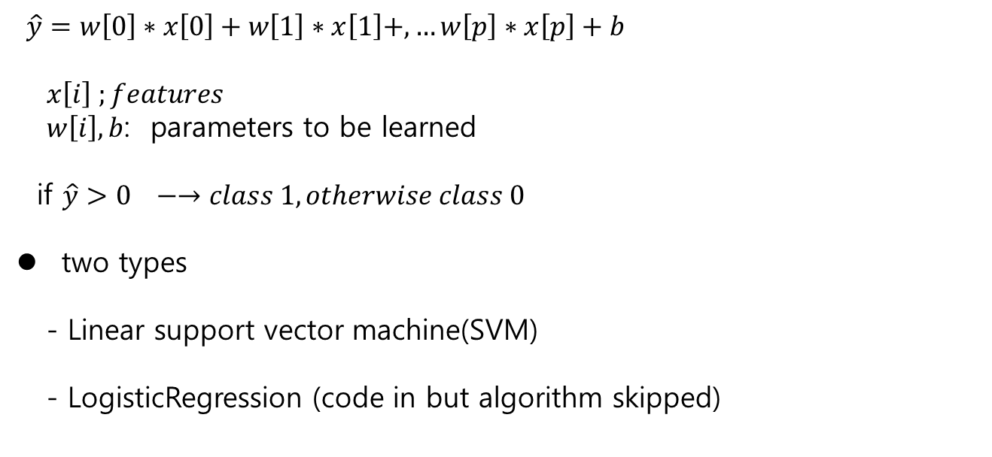
Linear Model - Classification
Supervised Learning
Classification
Binary classification
$\hat{y}=w\left[0\right]∗x\left[0\right]+w\left[1\right]∗x\left[1\right]+,…w\left[p\right]∗x\left[p\right]+b$
$x\left[i\right] ;features$
$w\left[i\right], b$: parameters to be learned
if $\hat{y}>0 −→class 1, otherwise class 0$
two types
- Linear support vector machine(SVM)
- LogisticRegression (code in but algorithm skipped)

Slide 7
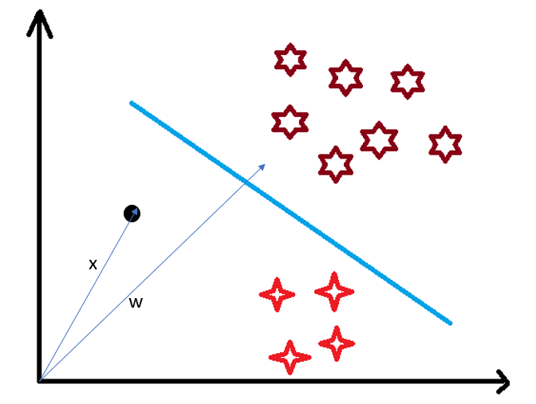
Linear Model - Classification
Supervised Learning
Concepts
-decision boundary
separate classes
Line / hyperplane ,..
- how to find the decision
boundary?

Slide 8

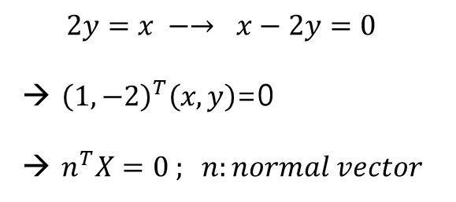
Linear Model - Classification
Supervised Learning
$$2y=x −→ x−2y=0$$
→ ${\left(1,−2\right)}^{T}\left(x,y\right)$=0
→ $n^{T}X=0 ; n:normal vector$
y
$$n^{T}X+b=0 , b:shift$$
x

Slide 9

Linear Model - Classification
Supervised Learning
Concepts
$W:the normal vector of D$
- 3 cases
$X on the D : X∙W=c$
$X in Class A : X∙W<c$
$X in Class B: X∙W>c$
B
A

Slide 10
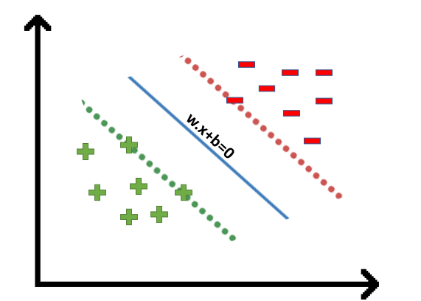
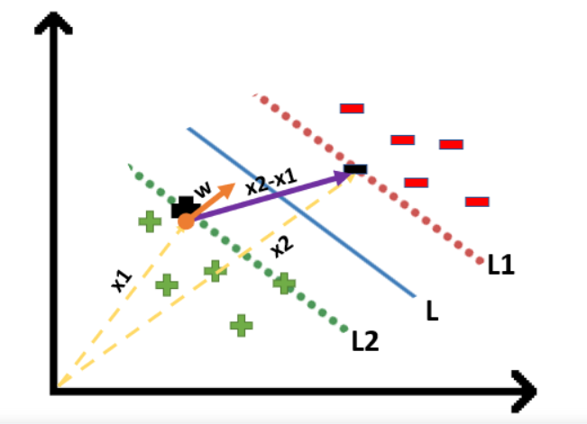
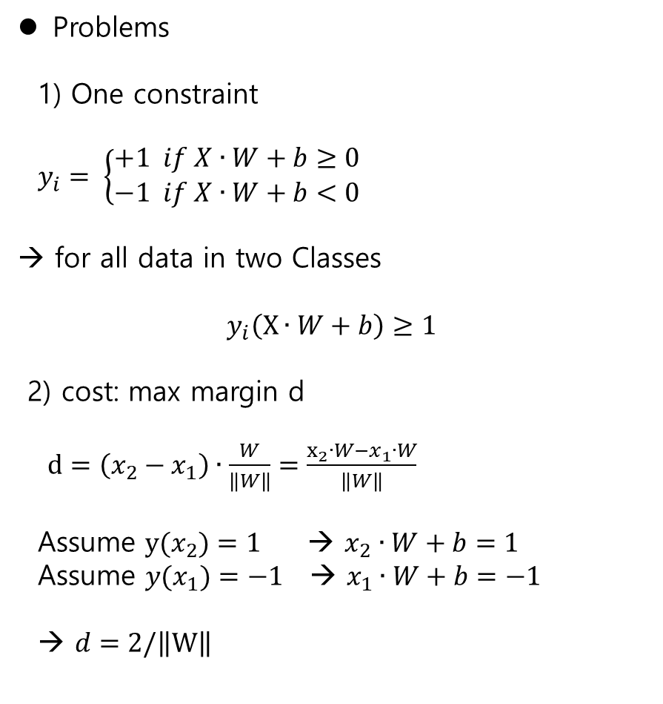
Linear Model - Classification
Supervised Learning
Problems
1) One constraint
$y_{i}= \left\{\begin{aligned}+1 if X∙W+b≥0 \\ −1 if X∙W+b<0\end{aligned}\right.$
→ for all data in two Classes
$$y_{i}\left(X∙W+b\right)≥1$$
2) cost: max margin d
$d=\left(x_{2}−x_{1}\right)∙\frac{W}{\left\|W\right\|}=\frac{x_{2}∙W−x_{1}∙W}{\left\|W\right\|}$
Assume $y(x_{2})=1$ → $x_{2}∙W+b=1$
Assume ${y(x}_{1})=−1$ → $x_{1}∙W+b=−1$
→ $d=2/\left\|W\right\|$

Slide 11

Linear Model - Classification
Supervised Learning
Problems
$\arg{\max_{(W, b)}{d}=2/\left\|W\right\| } s.t y_{i}\left(X∙W+b\right)≥1$
→
$\arg{\min_{(W, b)}\left\|W\right\| } s.t y_{i}\left(X∙W+b\right)≥1$

Slide 12
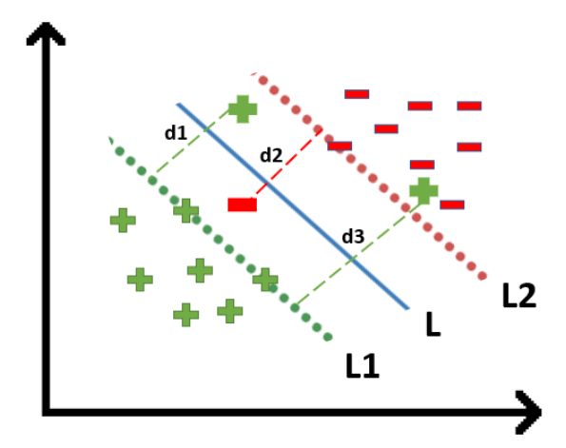

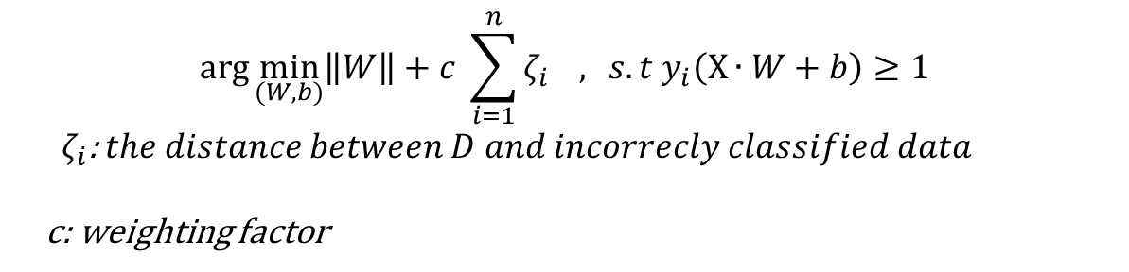
Linear Model - Classification
Supervised Learning
Hard Margin SVM
Soft Margin SVM
- to regulate the incorrect classification
$$\arg{\min_{(W, b)}\left\|W\right\| } s.t y_{i}\left(X∙W+b\right)≥1$$
$$\arg{\min_{(W, b)}\left\|W\right\|+c \sum_{i=1}^{n}{ζ_{i}} , } s.t y_{i}\left(X∙W+b\right)≥1$$
${ ζ}_{i}$: $the distance between D and incorrecly classified data$
c: weighting factor

Slide 13
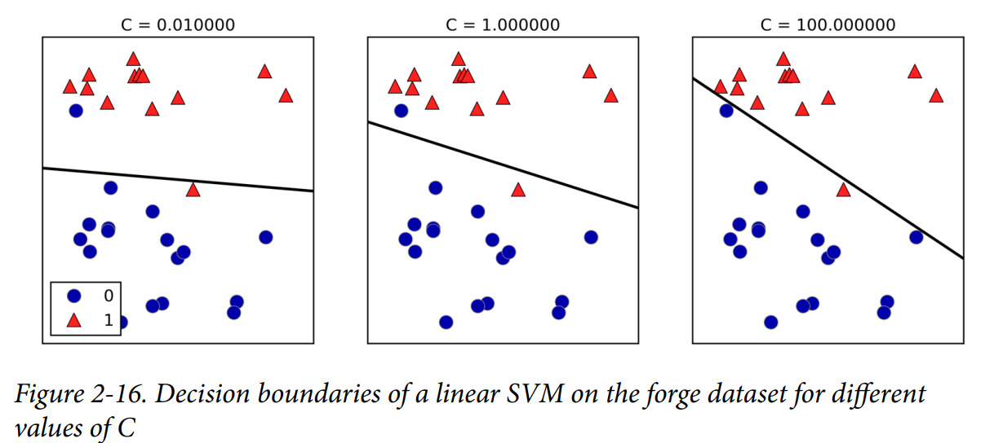
Linear Model - Classification
Supervised Learning
Example (page. 56)
- Soft Margin SVM

Slide 14
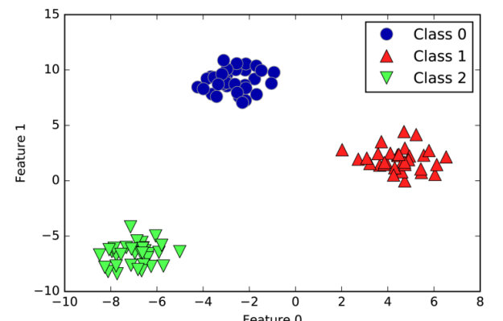
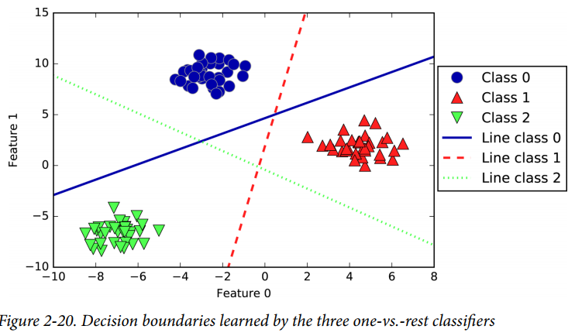
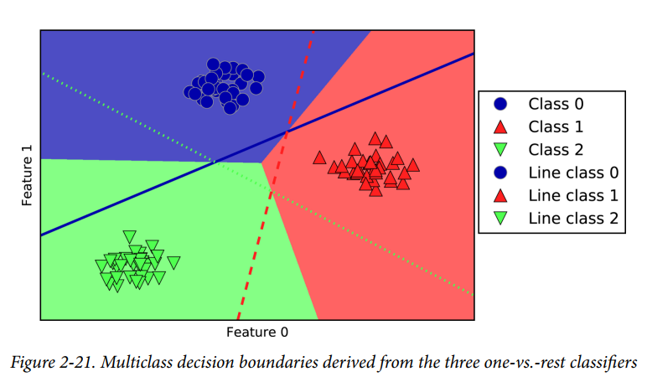
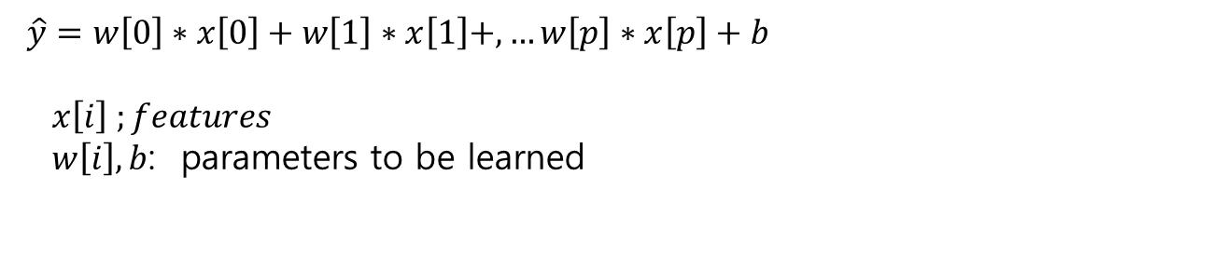
Linear Model – Classification- Multiclass
Supervised Learning
Linear Models for Multiclass classification (p.64)
One-vs. –rest algorithm
$\hat{y}=w\left[0\right]∗x\left[0\right]+w\left[1\right]∗x\left[1\right]+,…w\left[p\right]∗x\left[p\right]+b$
$x\left[i\right] ;features$
$w\left[i\right], b$: parameters to be learned

Slide 15
Decision Tree - Introduction
Supervised Learning
Consider a data set of two classification
-
+++
- - -
- KNN / SVM are difficult to find the decision boundary.
→ Decision Tree

Slide 16
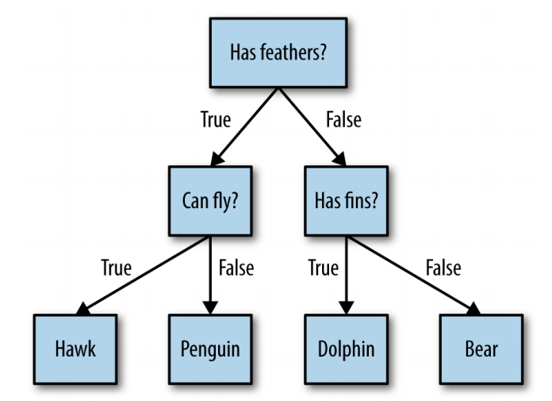
Decision Tree - Introduction
Supervised Learning
Concept
- questions and answers (if-else)
- data ={Hawk, Penguin, Dolphin, Bear}
decision tree (animal tree)
leaf( node)
(the tree is upside-down)

Slide 17

Decision Tree - Entropy
Supervised Learning
Entropy
$Entropy=E= \sum{−p_{i}\log{p_{i}}}$ , where log base is 2
- If $E$is large , more uncertainty, less information
Entropy ~ complexity :
More complex → more uncertain
- Less Entropy (less complexity) → less uncertainty

Slide 18
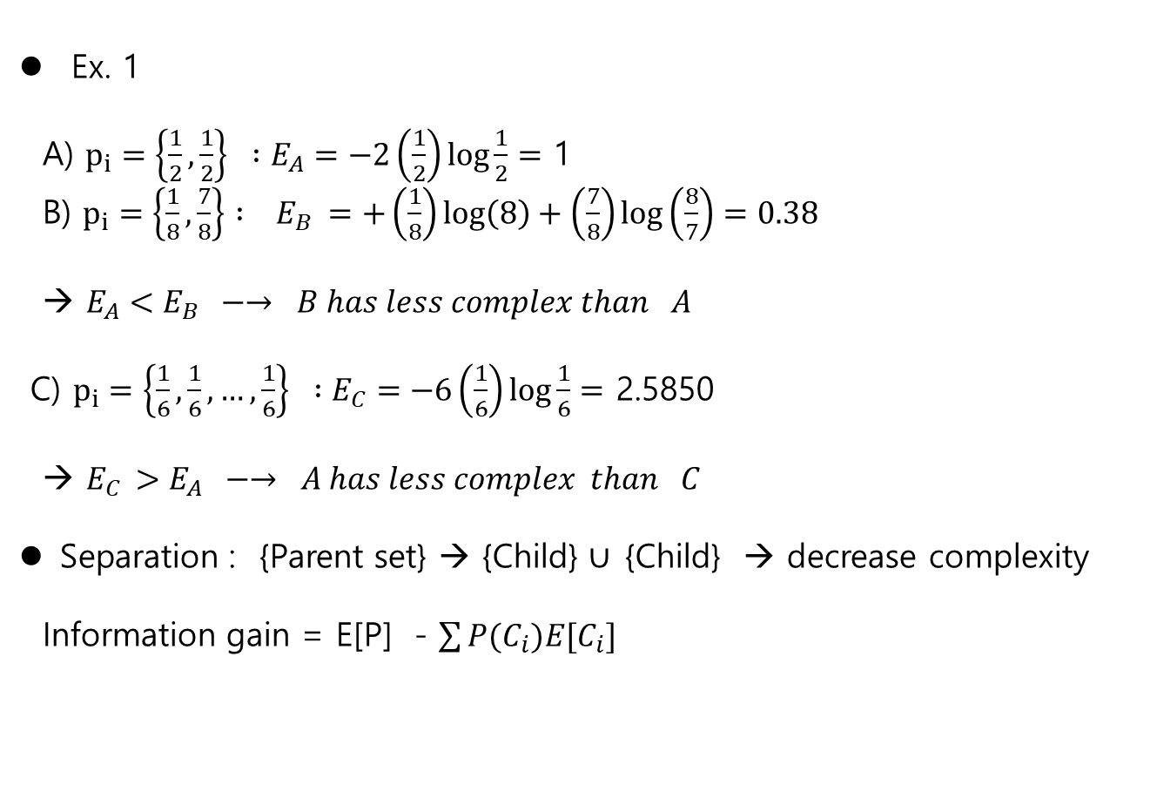
Decision Tree - Entropy
Supervised Learning
Ex. 1
A) $p_{i}=\left\{\frac{1}{2},\frac{1}{2}\right\} :E_{A}=−2\left(\frac{1}{2}\right)\log{\frac{1}{2}}=$ 1
B) $p_{i}=\left\{\frac{1}{8},\frac{7}{8}\right\} : E_{B} =+\left(\frac{1}{8}\right)\log\left(8\right)+\left(\frac{7}{8}\right)\log\left(\frac{8}{7}\right)=0.38$
→ $E_{A}<E_{B} −→ B has less complex than A$
C) $p_{i}=\left\{\frac{1}{6},\frac{1}{6},…,\frac{1}{6}\right\} :E_{C}=−6\left(\frac{1}{6}\right)\log{\frac{1}{6}}=$ 2.5850
→ $E_{C }>E_{A} −→ A has less complex than C$
Separation : {Parent set} → {Child} $∪ \text{\{}\text{Child}\text{\} }$ → decrease complexity
Information gain = E[P] - $\sum{P(C_{i})E[C_{i}]}$

Slide 19
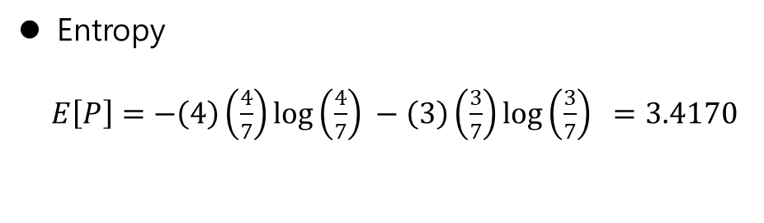
Decision Tree- Entropy
Supervised Learning
-
+++
- - -
Entropy
$E\left[P\right]=−\left(4\right)\left(\frac{4}{7}\right)\log\left(\frac{4}{7}\right) −\left(3\right)\left(\frac{3}{7}\right)\log\left(\frac{3}{7}\right) =3.4170$

Slide 20
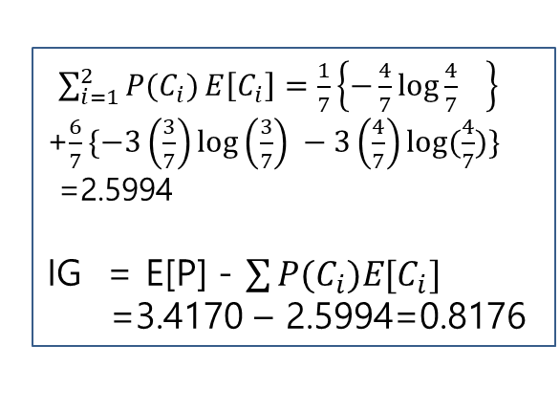
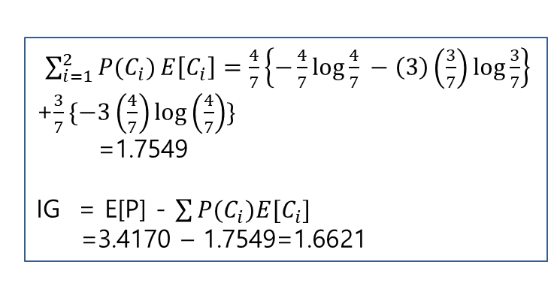
Decision Tree- Decision Boundary
Supervised Learning
Decision boundary : information Gain(IG)
-
+++
- - -
-
+++
- - -
A
B
-
+++
- - -
-
+ + + -
- - -
$\sum_{i=1}^{2}{P(C_{i})}E\left[C_{i}\right]=\frac{1}{7}\left\{−\frac{4}{7}\log{\frac{4}{7}} \right\}$
+$\frac{6}{7}\{−3\left(\frac{3}{7}\right)\log\left(\frac{3}{7}\right) −3\left(\frac{4}{7}\right)log⁡(\frac{4}{7})\}$
=2.5994
IG = E[P] - $\sum{P(C_{i})E[C_{i}]}$
=3.4170 – 2.5994=0.8176
$\sum_{i=1}^{2}{P(C_{i})}E\left[C_{i}\right]=\frac{4}{7}\left\{−\frac{4}{7}\log{\frac{4}{7}} −\left(3\right)\left(\frac{3}{7}\right)\log{\frac{3}{7}}\right\}$
+$\frac{3}{7}\{−3\left(\frac{4}{7}\right)\log\left(\frac{4}{7}\right)\}$
=1.7549
IG = E[P] - $\sum{P(C_{i})E[C_{i}]}$
=3.4170 – 1.7549=1.6621
Boundary B is better than A

Slide 21
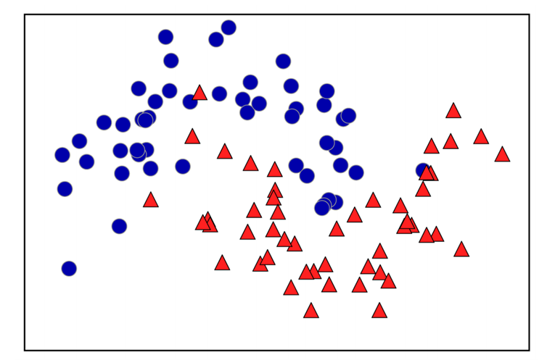
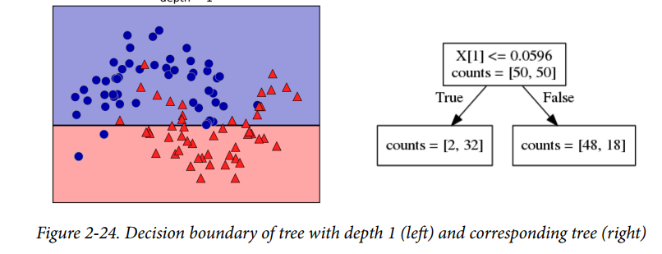
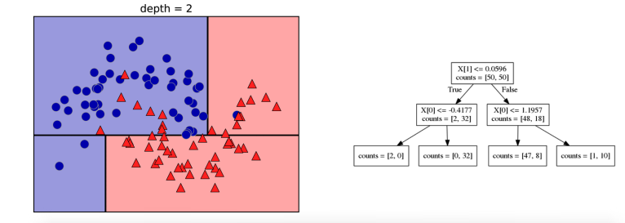
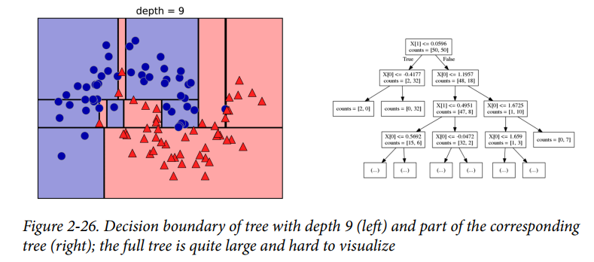
Decision Tree- Decision Boundary
Supervised Learning
Example – w/o code

Slide 22
Decision Tree- Decision Boundary
Supervised Learning
Pros and Cons
1) Pro
- easily visualized and understood (at least for small trees)
- invariant to scaling of the data, continuous, discrete, binary features.
2) Cons
- Over fitted

