Slide 1
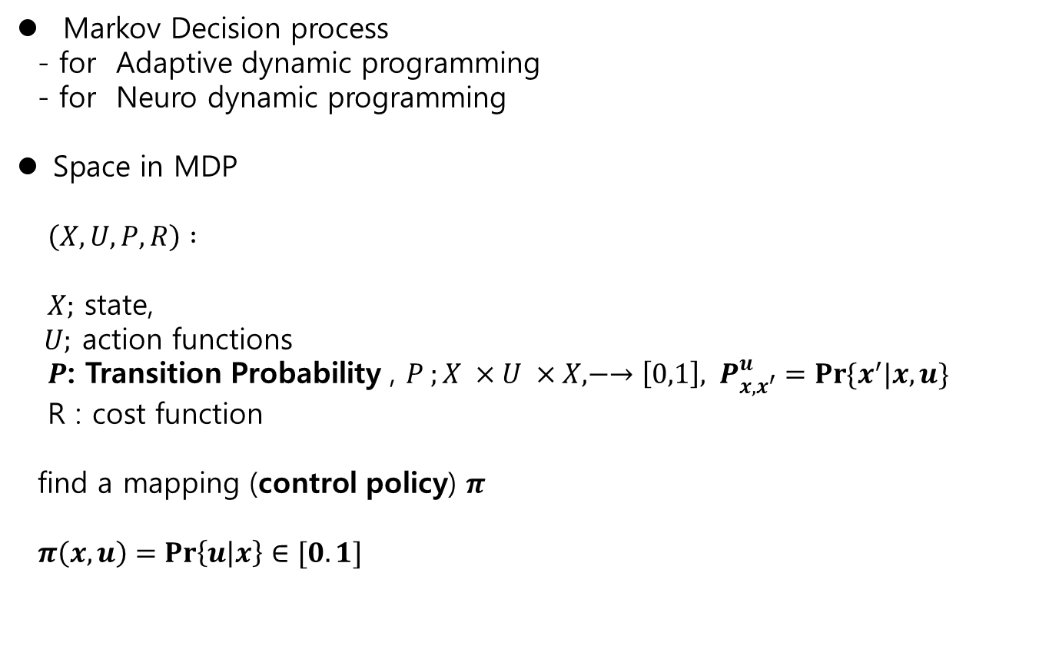
11.2 MDP Ch.11 Reinforcement Learning
Markov Decision process
- for Adaptive dynamic programming
- for Neuro dynamic programming
Space in MDP
$\left(X,U,P,R\right) :$
$X;$ state,
$U;$ action functions
$P$: Transition Probability , $P ;X ×U ×X, −→\left[0,1\right], { P}_{x,x^{′}}^{u}=\operatorname{Pr}{\{x^{′}|x,u\}}$
R : cost function
find a mapping (control policy) $π$
$π\left(x,u\right)=\operatorname{Pr}\left\{u | x\right\}∈[0.1]$

Slide 2
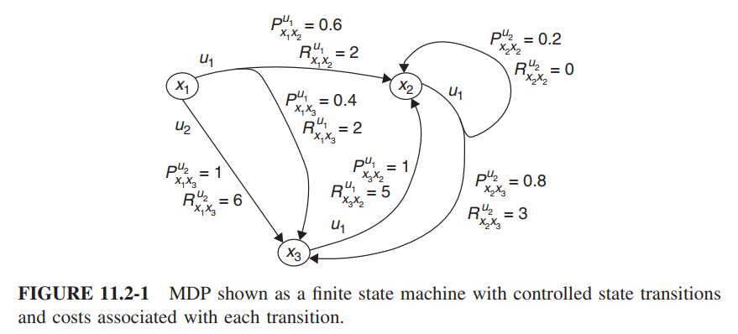
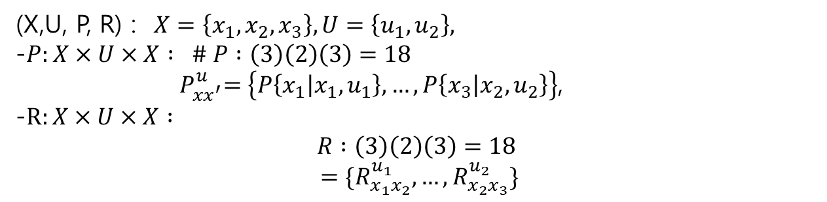
11.2 MDP Ch.11 Reinforcement Learning
(X,U, P, R) : $X=\left\{x_{1}, x_{2}, x_{3}\right\}, U=\left\{u_{1},u_{2}\right\},$
-$P:X×U×X : \# P :\left(3\right)\left(2\right)\left(3\right)=18$
${ P}_{xx^{′}}^{u}=\left\{P\left\{x_{1} | x_{1},u_{1}\right\},…,P\left\{x_{3} | x_{2},u_{2}\right\}\right\}$,
-
$$=\{R_{x_{1}x_{2}}^{u_{1}}, …,R_{x_{2}x_{3}}^{u_{2}}\}$$

Slide 3
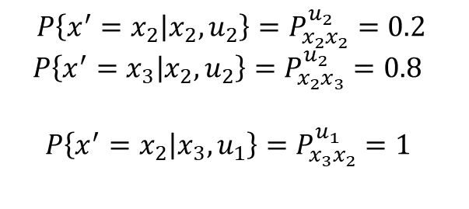
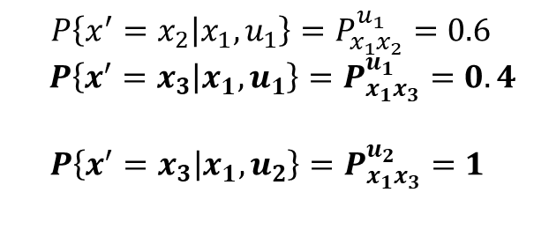
11.2 MDP Ch.11 Reinforcement Learning
$$P\left\{x^{′}=x_{2} | x_{1},u_{1}\right\}=P_{x_{1}x_{2}}^{u_{1}}=0.6$$
$P\left\{x^{′}=x_{3} | x_{1},u_{1}\right\}=P_{x_{1}x_{3}}^{u_{1}}=0.4$
$$P\left\{x^{′}=x_{3} | x_{1}, u_{2}\right\}=P_{x_{1}x_{3}}^{u_{2}}=1$$
$$P\left\{x^{′}=x_{2} | x_{2},u_{2}\right\}=P_{x_{2}x_{2}}^{u_{2}}=0.2$$
$P\left\{x^{′}=x_{3} | x_{2},u_{2}\right\}=P_{x_{2}x_{3}}^{u_{2}}=0.8$
$$P\left\{x^{′}=x_{2} | x_{3},u_{1}\right\}=P_{x_{3}x_{2}}^{u_{1}}=1$$

Slide 4

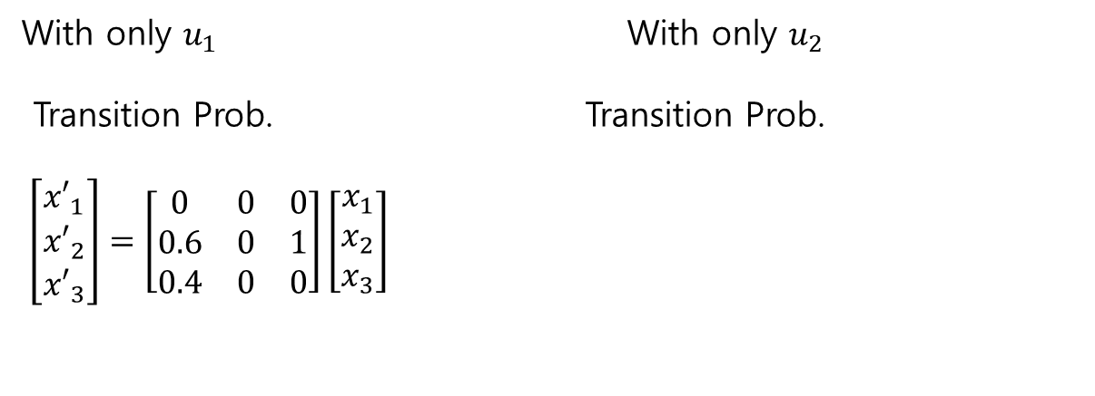
11.2 MDP Ch.11 Reinforcement Learning
With only $u_{1}$ With only $u_{2}$
Transition Prob. Transition Prob.
$\left[\begin{matrix}{x′}_{1} \\ {x′}_{2} \\ {x′}_{3}\end{matrix}\right]=\left[\begin{matrix}0 & 0 & 0 \\ 0.6 & 0 & 1 \\ 0.4 & 0 & 0\end{matrix}\right]\left[\begin{matrix}x_{1} \\ x_{2} \\ x_{3}\end{matrix}\right]$
$$\left[\begin{matrix}{x′}_{1} \\ {x′}_{2} \\ {x′}_{3}\end{matrix}\right]=\left[\begin{matrix}0 & 0 & 0 \\ 1 & 0.2 & 0 \\ 0 & 0.8 & 0\end{matrix}\right]\left[\begin{matrix}x_{1} \\ x_{2} \\ x_{3}\end{matrix}\right]$$

Slide 5
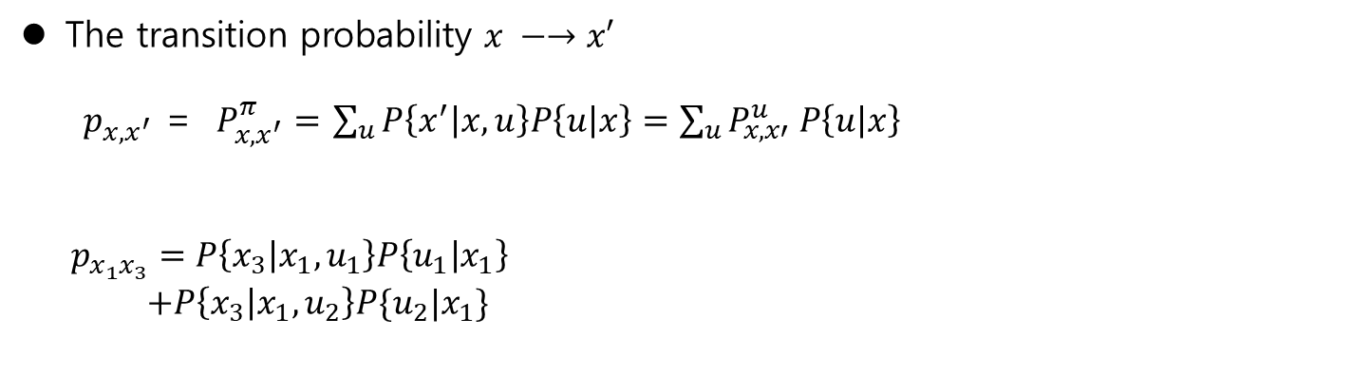
11.2 MDP Ch.11 Reinforcement Learning
The transition probability $x −→x′$
$p_{x,x^{′}}$ = $P_{x,x^{′}}^{π}=$ $\sum_{u}{P\left\{x^{′} | x,u\right\}P\left\{u | x\right\}=\sum_{u}{P_{x,x′}^{u} P\left\{u | x\right\}} }$
$p_{x_{1}x_{3}}=P\left\{x_{3} | x_{1},u_{1}\right\}P\left\{u_{1} | x_{1}\right\}$
$+P\left\{x_{3} | x_{1},u_{2}\right\}P\{u_{2}|x_{1}\}$

Slide 6
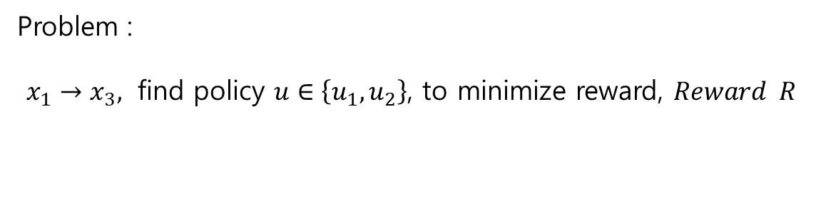
11.2 MDP Ch.11 Reinforcement Learning
Problem :
$x_{1}→x_{3},$ find policy $u∈\left\{u_{1}, u_{2}\right\}$, to minimize reward, $Reward R$

Slide 7
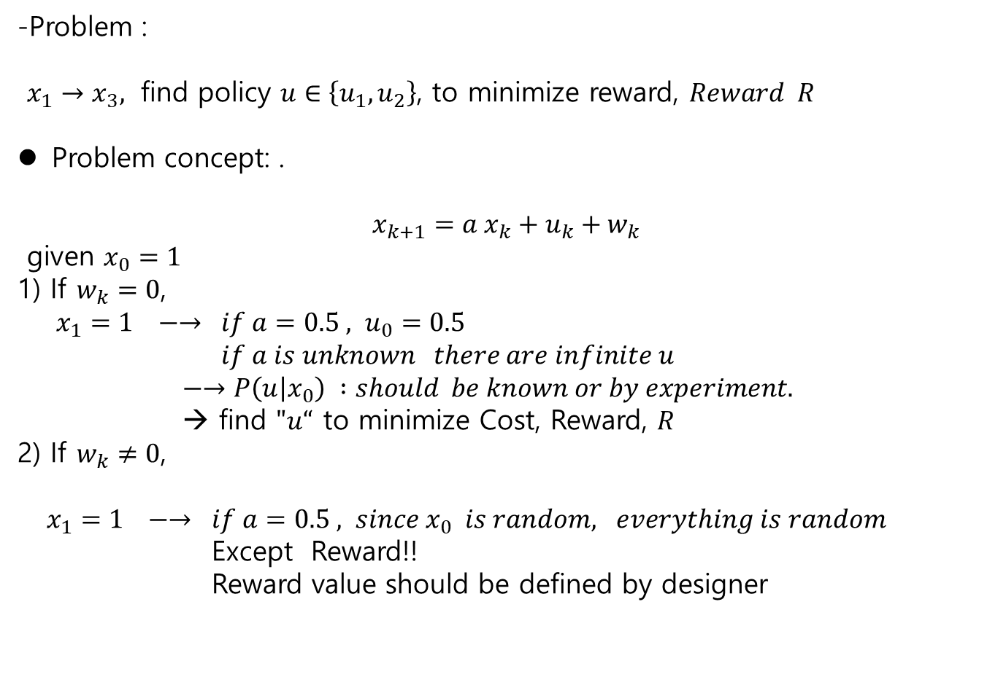
11.2 MDP Ch.11 Reinforcement Learning
-Problem :
$x_{1}→x_{3},$ find policy $u∈\left\{u_{1}, u_{2}\right\}$, to minimize reward, $Reward R$
Problem concept: .
$$x_{k+1}=a x_{k}+u_{k}+w_{k}$$
given $x_{0}=1$
1) If $w_{k}=0$,
$x_{1}=1 −→ if a=0.5 , u_{0}=0.5$
$if a is unknown there are infinite u$
$−→P\left(u | x_{0}\right) :should be known or by experiment.$
→ find $"u“$ to minimize Cost, Reward, $R$
2) If $w_{k}≠0$,
$x_{1}=1 −→ if a=0.5 , since x_{0} is random, everything is random$
Except Reward!!
Reward value should be defined by designer

Slide 8
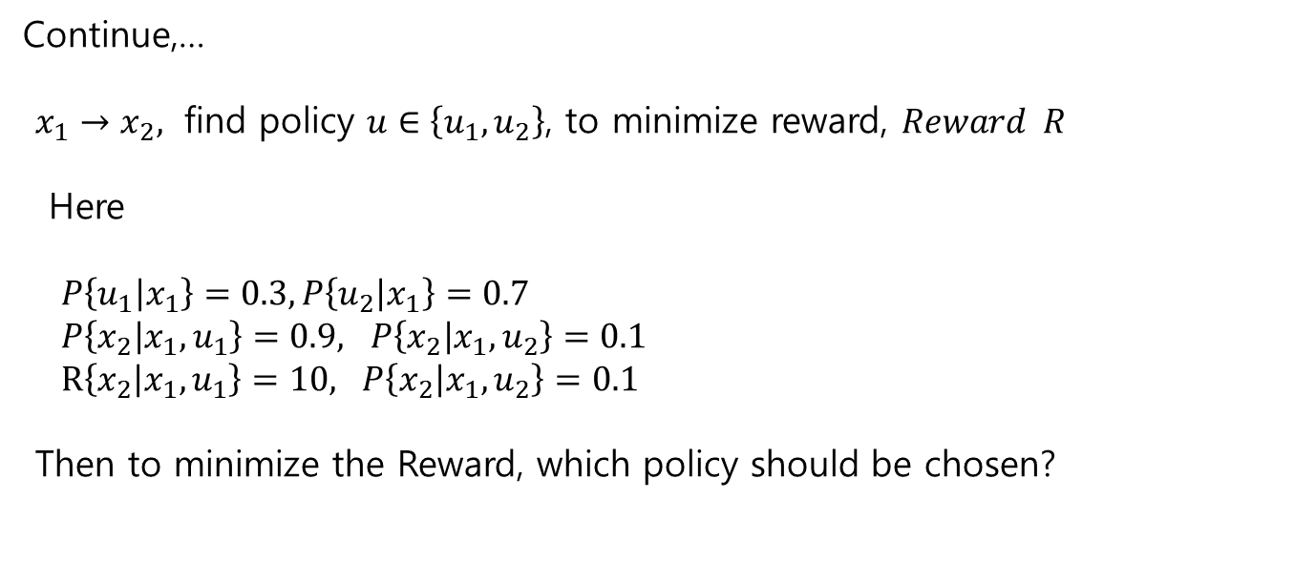
11.2 MDP Ch.11 Reinforcement Learning
Continue,…
$x_{1}→x_{2},$ find policy $u∈\left\{u_{1}, u_{2}\right\}$, to minimize reward, $Reward R$
Here
$P\left\{u_{1} | x_{1}\right\}=0.3, P\left\{u_{2} | x_{1}\right\}=0.7$
$P\left\{x_{2} | x_{1}, u_{1}\right\}=0.9, P\left\{x_{2} | x_{1}, u_{2}\right\}=0.1$
$R\left\{x_{2} | x_{1}, u_{1}\right\}=10, P\left\{x_{2} | x_{1}, u_{2}\right\}=0.1$
Then to minimize the Reward, which policy should be chosen?

Slide 9
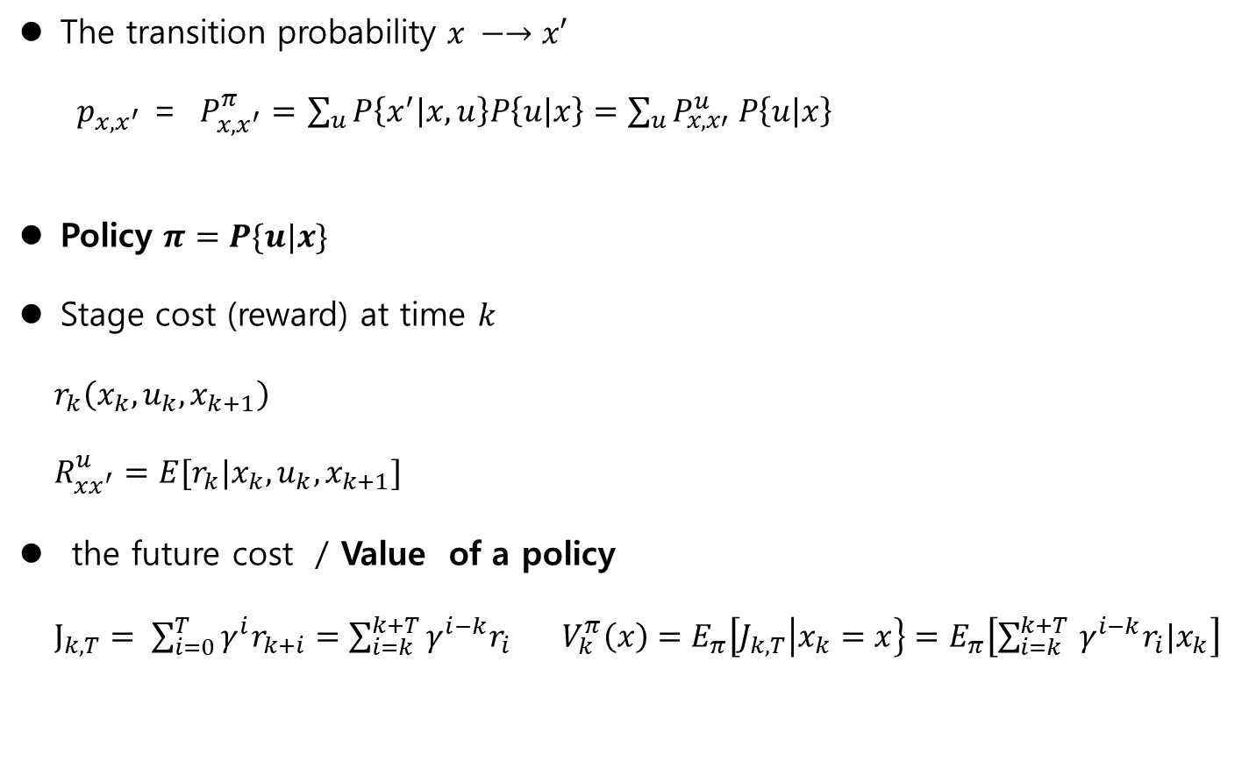
11.2 MDP Ch.11 Reinforcement Learning
The transition probability $x −→x′$
$p_{x,x^{′}}$ = $P_{x,x^{′}}^{π}=$ $\sum_{u}{P\left\{x^{′} | x,u\right\}P\left\{u | x\right\}=\sum_{u}{P_{x,x′}^{u} P\left\{u | x\right\}} }$
Policy $π=P\{u|x\}$
Stage cost (reward) at time $k$
$r_{k}\left(x_{k}, u_{k}, x_{k+1}\right)$
$R_{xx^{′}}^{u}=E[r_{k}|x_{k},u_{k},x_{k+1}]$
the future cost / Value of a policy
$J_{k,T}= \sum_{i=0}^{T}{γ^{i}r_{k+i}}=\sum_{i=k}^{k+T}{γ^{i−k}r_{i} V_{k}^{π}\left(x\right)=E_{π}\left[J_{k,T} | x_{k}=x\right\}=E_{π}\left[\sum_{i=k}^{k+T }{γ^{i−k}r_{i}|x_{k}}\right]}$

Slide 10
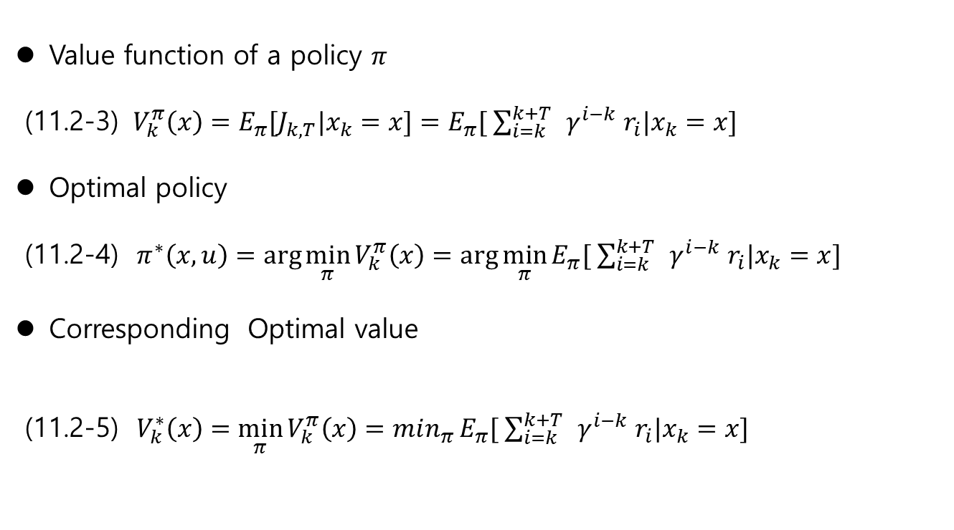
11.2 MDP Ch.11 Reinforcement Learning
Value function of a policy $π$
(11.2-3) $V_{k}^{π}\left(x\right)=E_{π}[J_{k,T}|x_{k}=x]=E_{π}[ \sum_{i=k}^{k+T }{ γ^{i−k} r_{i}|x_{k}=x}]$
Optimal policy
(11.2-4) $π^{∗}\left(x,u\right)=\arg{\min_{π}{V_{k}^{π}\left(x\right)=\arg{\min_{π}{E_{π}[ \sum_{i=k}^{k+T }{ γ^{i−k} r_{i}|x_{k}=x}] }}}}$
Corresponding Optimal value
(11.2-5) $V_{k}^{∗}\left(x\right)=\min_{π}{V_{k}^{π}\left(x\right)}=min_{π}{E_{π}[ \sum_{i=k}^{k+T }{ γ^{i−k} r_{i}|x_{k}=x}]}$

Slide 11
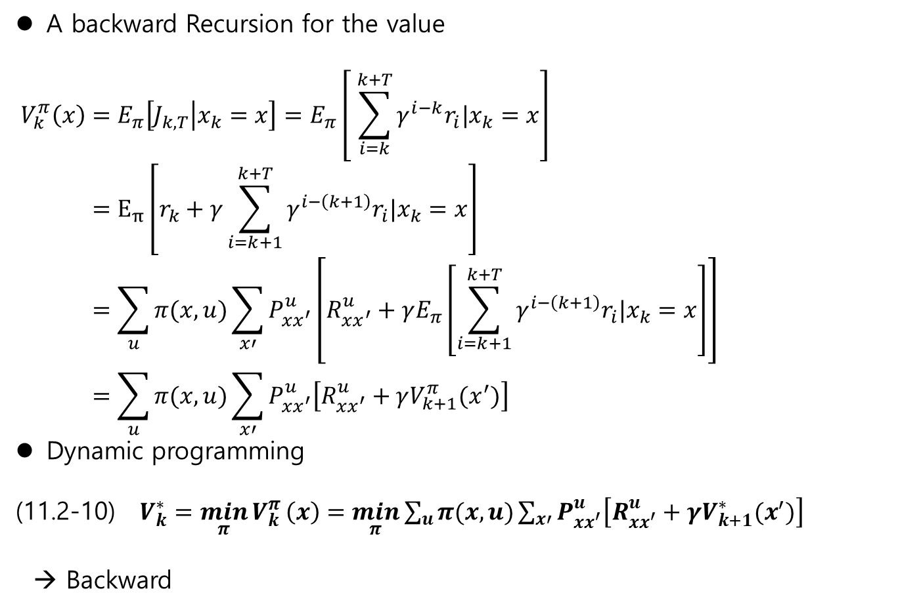
11.2 MDP Ch.11 Reinforcement Learning
A backward Recursion for the value
$$V_{k}^{π}\left(x\right)=E_{π}\left[J_{k,T} | x_{k}=x\right]=E_{π}\left[ \sum_{i=k}^{k+T}{γ^{i−k}r_{i}|x_{k}=x}\right] \\ =E_{π}\left[r_{k}+γ\sum_{i=k+1}^{k+T}{γ^{i−\left(k+1\right)}r_{i}|x_{k}=x}\right] \\ =\sum_{u}{π(x,u)}\sum_{x′}{P_{xx^{′}}^{u}\left[R_{xx^{′}}^{u}+γE_{π}\left[\sum_{i=k+1}^{k+T}{γ^{i−\left(k+1\right)}r_{i}|x_{k}=x}\right]\right]} \\ =\sum_{u}{π(x,u)}\sum_{x′}{P_{xx^{′}}^{u}\left[R_{xx^{′}}^{u}+γV_{k+1}^{π}(x^{′})\right] }$$
Dynamic programming
(11.2-10) $V_{k}^{∗}=\min_{π}{V_{k}^{π}}\left(x\right)=\min_{π}{\sum_{u}{π(x,u)}\sum_{x′}{P_{xx^{′}}^{u}\left[R_{xx^{′}}^{u}+γV_{k+1}^{∗}(x^{′})\right] }}$
→ Backward

Slide 12
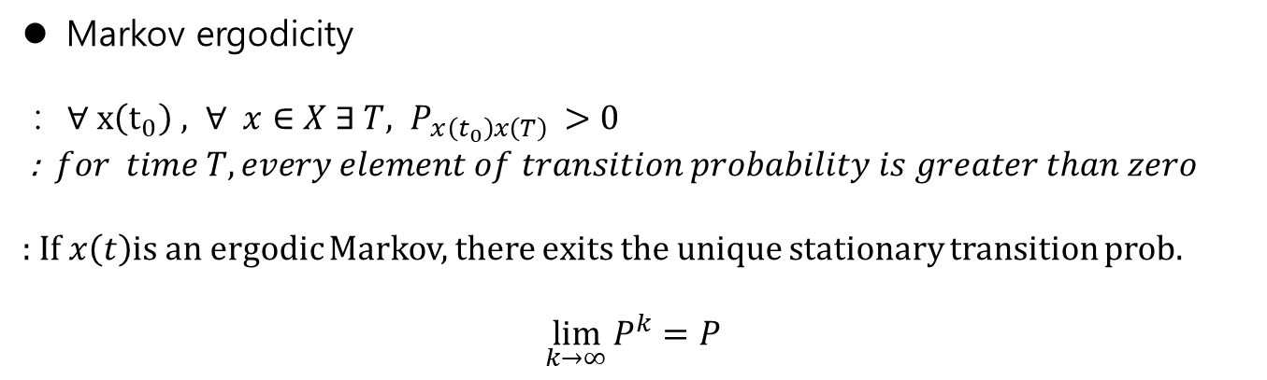
11.2 MDP Ch.11 Reinforcement Learning
Markov ergodicity
: $∀ x\left(t_{0}\right) , ∀ x∈X ∃ T, P_{x\left(t_{0}\right)x\left(T\right) }>0$
: $for time T, every element of transition probability is greater than zero$
: If $x\left(t\right)$is an ergodic Markov, there exits the unique stationary transition prob.
$$\lim_{k→∞}{P^{k}=P}$$

Slide 13
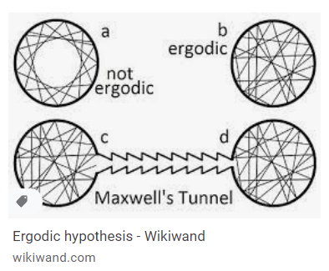
11.2 MDP Ch.11 Reinforcement Learning
Fact :
Under some conditions on the transition matrix, it is convergent to a unique constant matrix.
→ the matrix is ergodic
Ergodic in physical concept
Ergodic process:

Slide 14

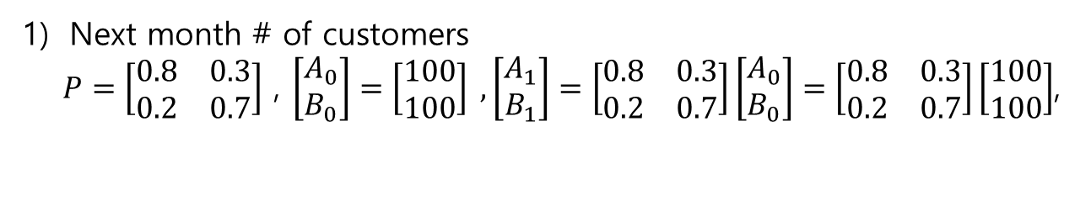



11.2 MDP Ch.11 Reinforcement Learning
Ex.
the customer trends in a month
$$P_{B|A}=0.2$$
$$P_{A|A}=0.8$$
$$P_{B|B}=0.7$$
A store
B store
$$P_{A|B}=0.3$$
Next month # of customers
$P=\left[\begin{matrix}0.8 & 0.3 \\ 0.2 & 0.7\end{matrix}\right]$ , $\left[\begin{matrix}A_{0} \\ B_{0}\end{matrix}\right]=\left[\begin{matrix}100 \\ 100\end{matrix}\right] ,\left[\begin{matrix}A_{1} \\ B_{1}\end{matrix}\right]=\left[\begin{matrix}0.8 & 0.3 \\ 0.2 & 0.7\end{matrix}\right]\left[\begin{matrix}A_{0} \\ B_{0}\end{matrix}\right]=\left[\begin{matrix}0.8 & 0.3 \\ 0.2 & 0.7\end{matrix}\right]\left[\begin{matrix}100 \\ 100\end{matrix}\right]$,

Slide 15
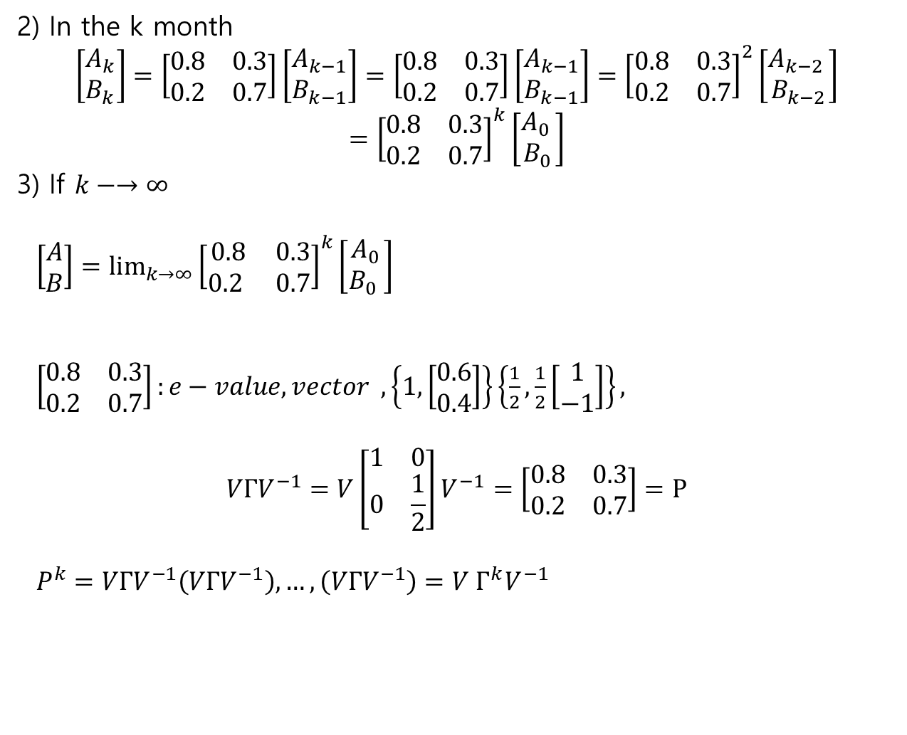
11.2 MDP Ch.11 Reinforcement Learning
2) In the k month
$$\left[\begin{matrix}A_{k} \\ B_{k}\end{matrix}\right]=\left[\begin{matrix}0.8 & 0.3 \\ 0.2 & 0.7\end{matrix}\right]\left[\begin{matrix}A_{k−1} \\ B_{k−1}\end{matrix}\right]=\left[\begin{matrix}0.8 & 0.3 \\ 0.2 & 0.7\end{matrix}\right]\left[\begin{matrix}A_{k−1} \\ B_{k−1}\end{matrix}\right]={\left[\begin{matrix}0.8 & 0.3 \\ 0.2 & 0.7\end{matrix}\right]}^{2}\left[\begin{matrix}A_{k−2 } \\ B_{k−2}\end{matrix}\right]$$
$$={\left[\begin{matrix}0.8 & 0.3 \\ 0.2 & 0.7\end{matrix}\right]}^{k}\left[\begin{matrix}A_{0 } \\ B_{0}\end{matrix}\right]$$
3) If $k−→∞$
$\left[\begin{matrix}A \\ B\end{matrix}\right]={\lim_{k→∞}\left[\begin{matrix}0.8 & 0.3 \\ 0.2 & 0.7\end{matrix}\right]}^{k}\left[\begin{matrix}A_{0} \\ B_{0} \end{matrix}\right]$
$\left[\begin{matrix}0.8 & 0.3 \\ 0.2 & 0.7\end{matrix}\right]:e−value, vector , \left\{1, \left[\begin{matrix}0.6 \\ 0.4\end{matrix}\right]\right\}\left\{\frac{1}{2},\frac{1}{2}\left[\begin{matrix}1 \\ −1\end{matrix}\right]\right\},$
$$VΓV^{−1}=V\left[\begin{matrix}1 & 0 \\ 0 & \frac{1}{2}\end{matrix}\right]V^{−1}=\left[\begin{matrix}0.8 & 0.3 \\ 0.2 & 0.7\end{matrix}\right]=P$$
$P^{k}=VΓV^{−1}\left(VΓV^{−1}\right),…,\left(VΓV^{−1}\right)=V Γ^{k}V^{−1}$

Slide 16
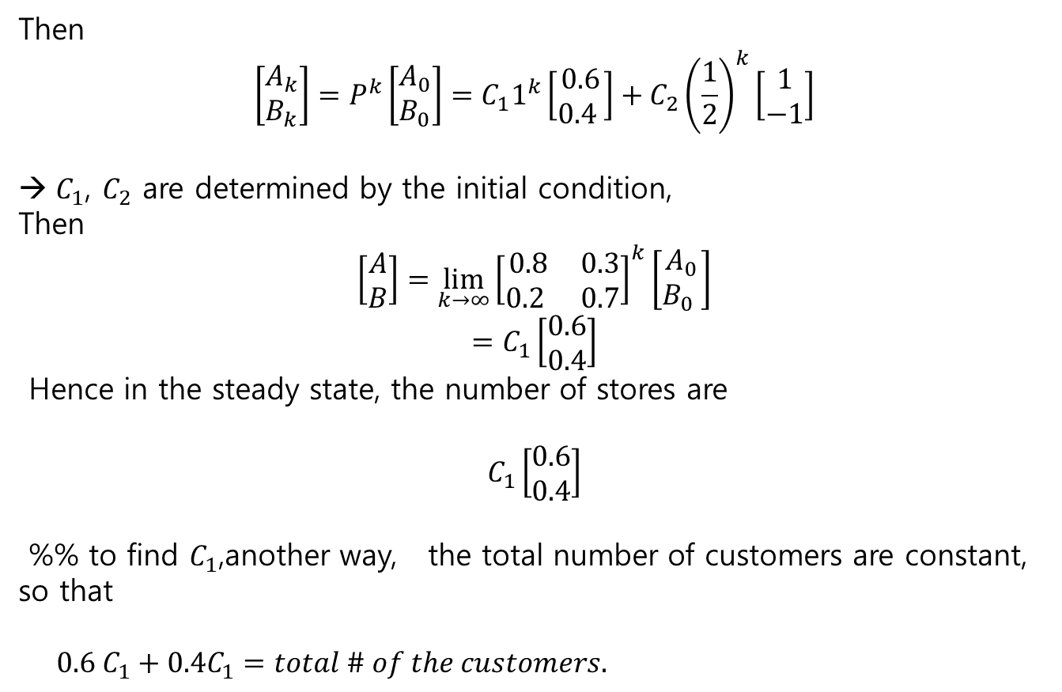
11.2 MDP Ch.11 Reinforcement Learning
Then
$$\left[\begin{matrix}A_{k} \\ B_{k}\end{matrix}\right]=P^{k}\left[\begin{matrix}A_{0} \\ B_{0}\end{matrix}\right]=C_{1}1^{k}\left[\begin{matrix}0.6 \\ 0.4 \end{matrix}\right]+C_{2}{\left(\frac{1}{2}\right)}^{k}\left[\begin{matrix}1 \\ −1\end{matrix}\right]$$
$C_{1}$, $C_{2}$ are determined by the initial condition,
Then
$$\left[\begin{matrix}A \\ B\end{matrix}\right]={\lim_{k→∞}\left[\begin{matrix}0.8 & 0.3 \\ 0.2 & 0.7\end{matrix}\right]}^{k}\left[\begin{matrix}A_{0} \\ B_{0} \end{matrix}\right]$$
$$=C_{1}\left[\begin{matrix}0.6 \\ 0.4\end{matrix}\right]$$
Hence in the steady state, the number of stores are
$$C_{1}\left[\begin{matrix}0.6 \\ 0.4\end{matrix}\right]$$
%% to find $C_{1}$,another way, the total number of customers are constant, so that
$0.6 C_{1}+0.4C_{1}=total \# of the customers.$

Slide 17
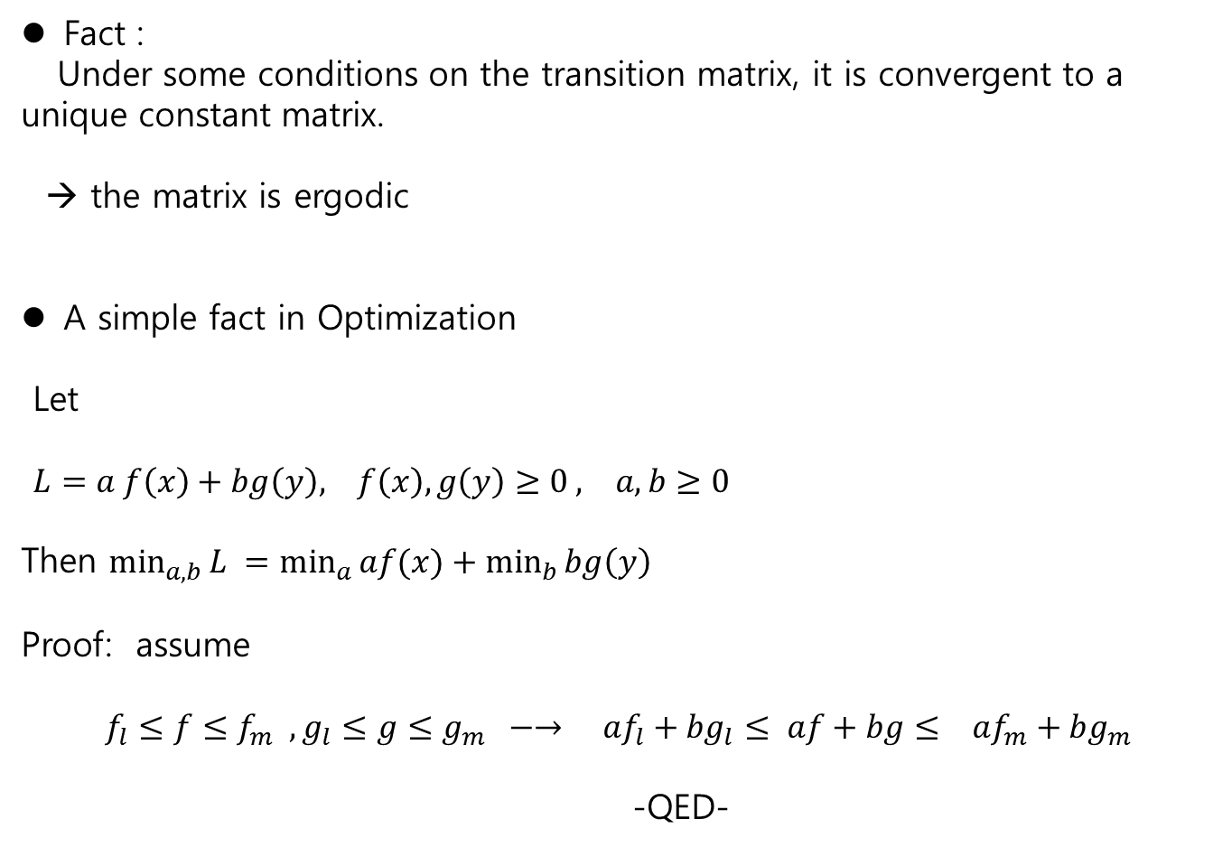
11.2 MDP Ch.11 Reinforcement Learning
Fact :
Under some conditions on the transition matrix, it is convergent to a unique constant matrix.
→ the matrix is ergodic
A simple fact in Optimization
Let
$L=a f\left(x\right)+bg\left(y\right), f\left(x\right), g\left(y\right)≥0 , a, b≥0$
Then $\min_{a,b}{L }=\min_{a}{af(x)}+\min_{b}{bg\left(y\right)}$
Proof: assume
$f_{l}≤f≤f_{m} , g_{l}≤g≤g_{m} −→ {af}_{l}+{bg}_{l}≤ af+bg≤ af_{m}+bg_{m}$
-QED-

Slide 18
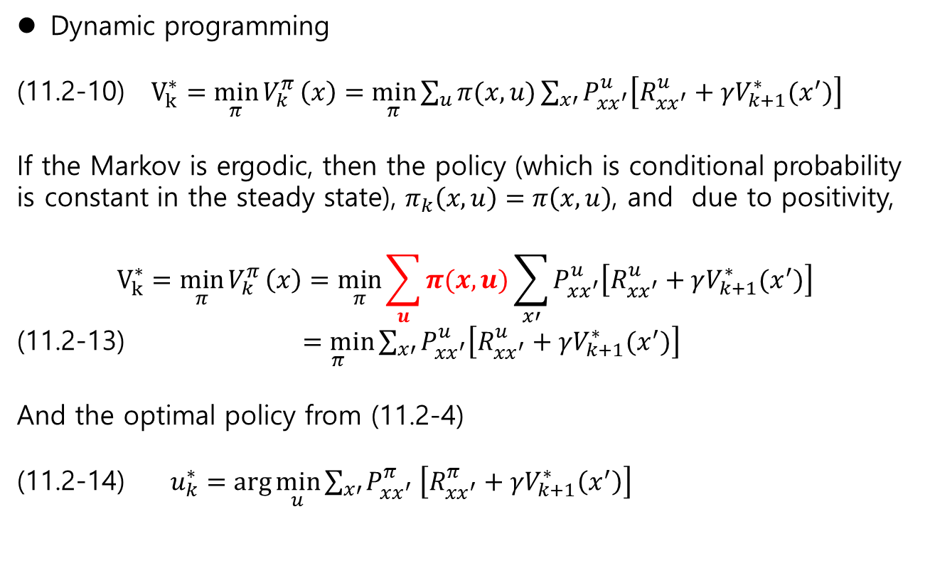
11.2 MDP Ch.11 Reinforcement Learning
Dynamic programming
(11.2-10) $V_{k}^{∗}=\min_{π}{V_{k}^{π}}\left(x\right)=\min_{π}{\sum_{u}{π(x,u)}\sum_{x′}{P_{xx^{′}}^{u}\left[R_{xx^{′}}^{u}+γV_{k+1}^{∗}(x^{′})\right] }}$
If the Markov is ergodic, then the policy (which is conditional probability is constant in the steady state), $π_{k}\left(x,u\right)=π\left(x,u\right)$, and due to positivity,
$$V_{k}^{∗}=\min_{π}{V_{k}^{π}}\left(x\right)=\min_{π}{\sum_{u}{π(x,u)}\sum_{x′}{P_{xx^{′}}^{u}\left[R_{xx^{′}}^{u}+γV_{k+1}^{∗}(x^{′})\right] }}$$
(11.2-13) $\underset{π}{=min}{\sum_{x′}{P_{xx^{′}}^{u}\left[R_{xx^{′}}^{u}+γV_{k+1}^{∗}(x^{′})\right] }}$
And the optimal policy from (11.2-4)
(11.2-14) $u_{k}^{∗}=\arg{\min_{u}{\sum_{x′}{P_{xx^{′}}^{π} \left[R_{xx^{′}}^{π}+γV_{k+1}^{∗}\left(x^{′}\right)\right]}}}$

Slide 19
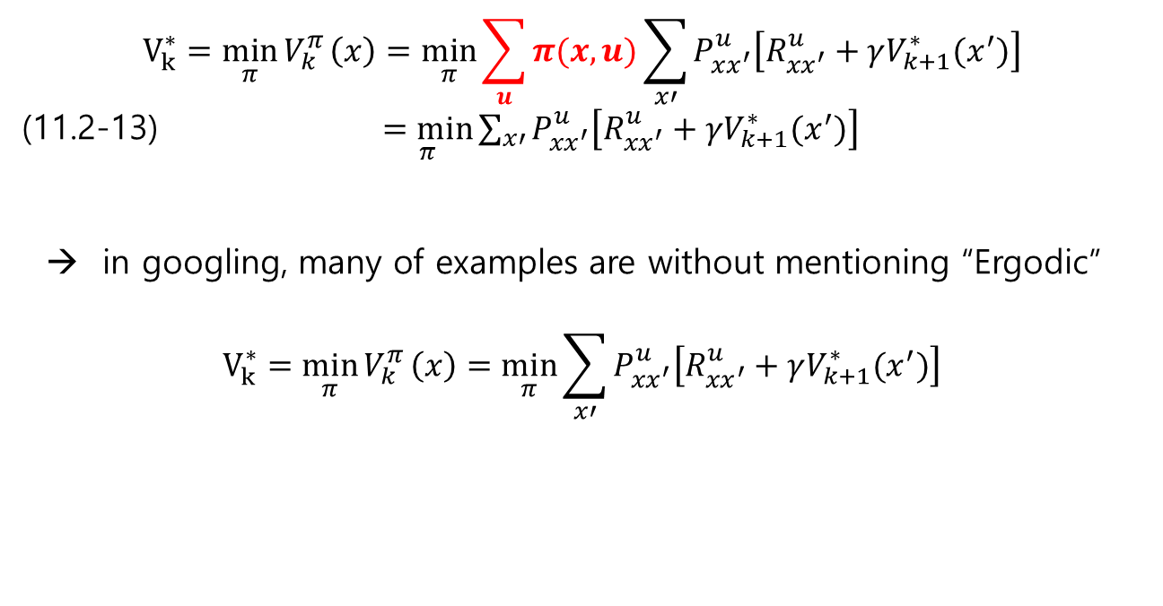
11.2 MDP Ch.11 Reinforcement Learning
Comments on optimal policy and value in googling
1) If the states transition matrix is ergodic, then
$$V_{k}^{∗}=\min_{π}{V_{k}^{π}}\left(x\right)=\min_{π}{\sum_{u}{π(x,u)}\sum_{x′}{P_{xx^{′}}^{u}\left[R_{xx^{′}}^{u}+γV_{k+1}^{∗}(x^{′})\right] }}$$
(11.2-13) $\underset{π}{=min}{\sum_{x′}{P_{xx^{′}}^{u}\left[R_{xx^{′}}^{u}+γV_{k+1}^{∗}(x^{′})\right] }}$
→ in googling, many of examples are without mentioning “Ergodic”
$$V_{k}^{∗}=\min_{π}{V_{k}^{π}}\left(x\right)=\min_{π}{\sum_{x′}{P_{xx^{′}}^{u}\left[R_{xx^{′}}^{u}+γV_{k+1}^{∗}(x^{′})\right] }}$$

Slide 20
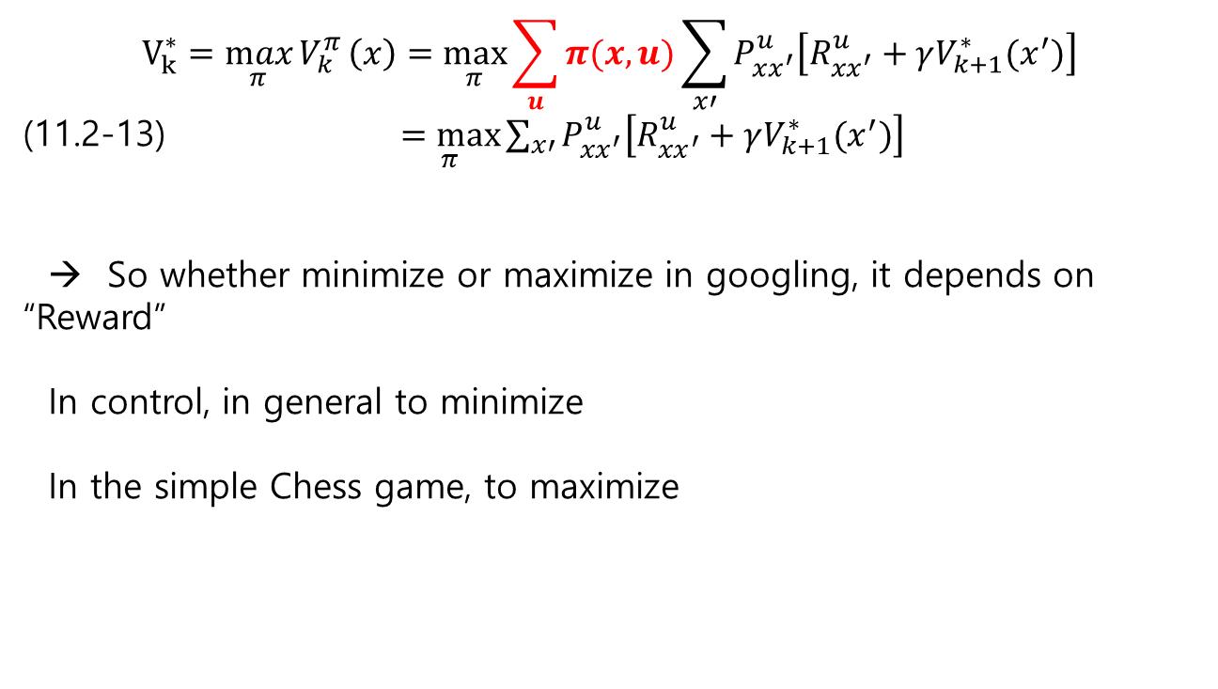
11.2 MDP Ch.11 Reinforcement Learning
Comments on optimal policy and value in googling
1) If the states transition matrix is ergodic, then
$$V_{k}^{∗}=\max_{π}{V_{k}^{π}}\left(x\right)=\max_{π}{\sum_{u}{π(x,u)}\sum_{x′}{P_{xx^{′}}^{u}\left[R_{xx^{′}}^{u}+γV_{k+1}^{∗}(x^{′})\right] }}$$
(11.2-13) $\underset{π}{=max}{\sum_{x′}{P_{xx^{′}}^{u}\left[R_{xx^{′}}^{u}+γV_{k+1}^{∗}(x^{′})\right] }}$
→ So whether minimize or maximize in googling, it depends on “Reward”
In control, in general to minimize
In the simple Chess game, to maximize

