Slide 1

Problem - recursive
Kalman Estimator
Estimation
$z=x+v$
measurements $z_{0}, z_{1},z_{2},….., z_{k}$
the estimator for $x$
$\hat{x}=E[z]$
or
$\hat{x}=E\left[x\right|z]$
$= \int{x}f\left(x | z\right)dx$
$= \int{x}\frac{f\left(x,z\right)}{f\left(z\right)} dx$

Slide 2

Problem - recursive
Kalman Estimator
Time revolution system estimation
Consider
$x_{k+1}=x_{k}+w$ , $x_{0}$
$z_{k}=x_{k}+v$
up to time $k$
measurements $z_{0}, z_{1},z_{2},….., z_{k}$
the estimator
${\hat{x}}_{k} \sim f\left(z_{0}, z_{1},…,z_{k}\right)$
→ too many measurement !! → it is a batch type process

Slide 3

Problem - Markov
Markov Process
$P\left(X_{n+1}=x | X_{n}=x_{n},X_{n−1}=x_{n−1},….,X_{1}=x_{1}\right)$
$=P\left(X_{n+1}=x | X_{n}=x_{n} \right)$
Time evolution system
${\hat{x}}_{k} \sim f\left(z_{0}, z_{1},…,z_{k}\right)$ → Since $x=z−v$,
$E\left[x_{k} | z_{k}, z_{k−1},…,x_{0}\right]=E[x_{k}|z_{k−1}]$
→ recursive method !!

Slide 4

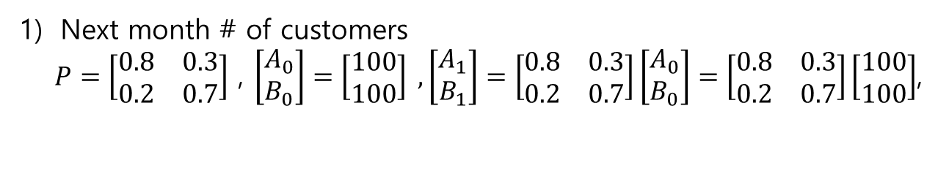



Markov Process
Ex.
the customer trends in a month
$$P_{B|A}=0.2$$
$$P_{A|A}=0.8$$
$$P_{B|B}=0.7$$
A store
B store
$$P_{A|B}=0.3$$
Next month # of customers
$P=\left[\begin{matrix}0.8 & 0.3 \\ 0.2 & 0.7\end{matrix}\right]$ , $\left[\begin{matrix}A_{0} \\ B_{0}\end{matrix}\right]=\left[\begin{matrix}100 \\ 100\end{matrix}\right] ,\left[\begin{matrix}A_{1} \\ B_{1}\end{matrix}\right]=\left[\begin{matrix}0.8 & 0.3 \\ 0.2 & 0.7\end{matrix}\right]\left[\begin{matrix}A_{0} \\ B_{0}\end{matrix}\right]=\left[\begin{matrix}0.8 & 0.3 \\ 0.2 & 0.7\end{matrix}\right]\left[\begin{matrix}100 \\ 100\end{matrix}\right]$,

Slide 5
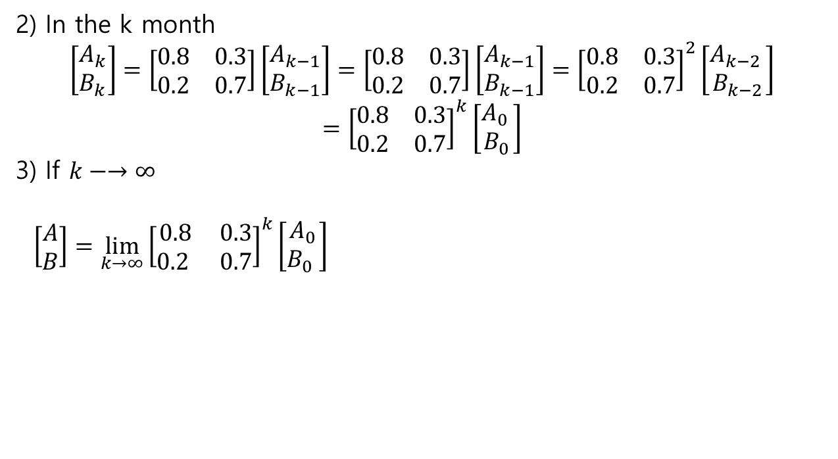
Markov Process
2) In the k month
$$\left[\begin{matrix}A_{k} \\ B_{k}\end{matrix}\right]=\left[\begin{matrix}0.8 & 0.3 \\ 0.2 & 0.7\end{matrix}\right]\left[\begin{matrix}A_{k−1} \\ B_{k−1}\end{matrix}\right]=\left[\begin{matrix}0.8 & 0.3 \\ 0.2 & 0.7\end{matrix}\right]\left[\begin{matrix}A_{k−1} \\ B_{k−1}\end{matrix}\right]={\left[\begin{matrix}0.8 & 0.3 \\ 0.2 & 0.7\end{matrix}\right]}^{2}\left[\begin{matrix}A_{k−2 } \\ B_{k−2}\end{matrix}\right]$$
$$={\left[\begin{matrix}0.8 & 0.3 \\ 0.2 & 0.7\end{matrix}\right]}^{k}\left[\begin{matrix}A_{0 } \\ B_{0}\end{matrix}\right]$$
3) If $k−→∞$
$\left[\begin{matrix}A \\ B\end{matrix}\right]={\lim_{k→∞}\left[\begin{matrix}0.8 & 0.3 \\ 0.2 & 0.7\end{matrix}\right]}^{k}\left[\begin{matrix}A_{0} \\ B_{0} \end{matrix}\right]$

Slide 6
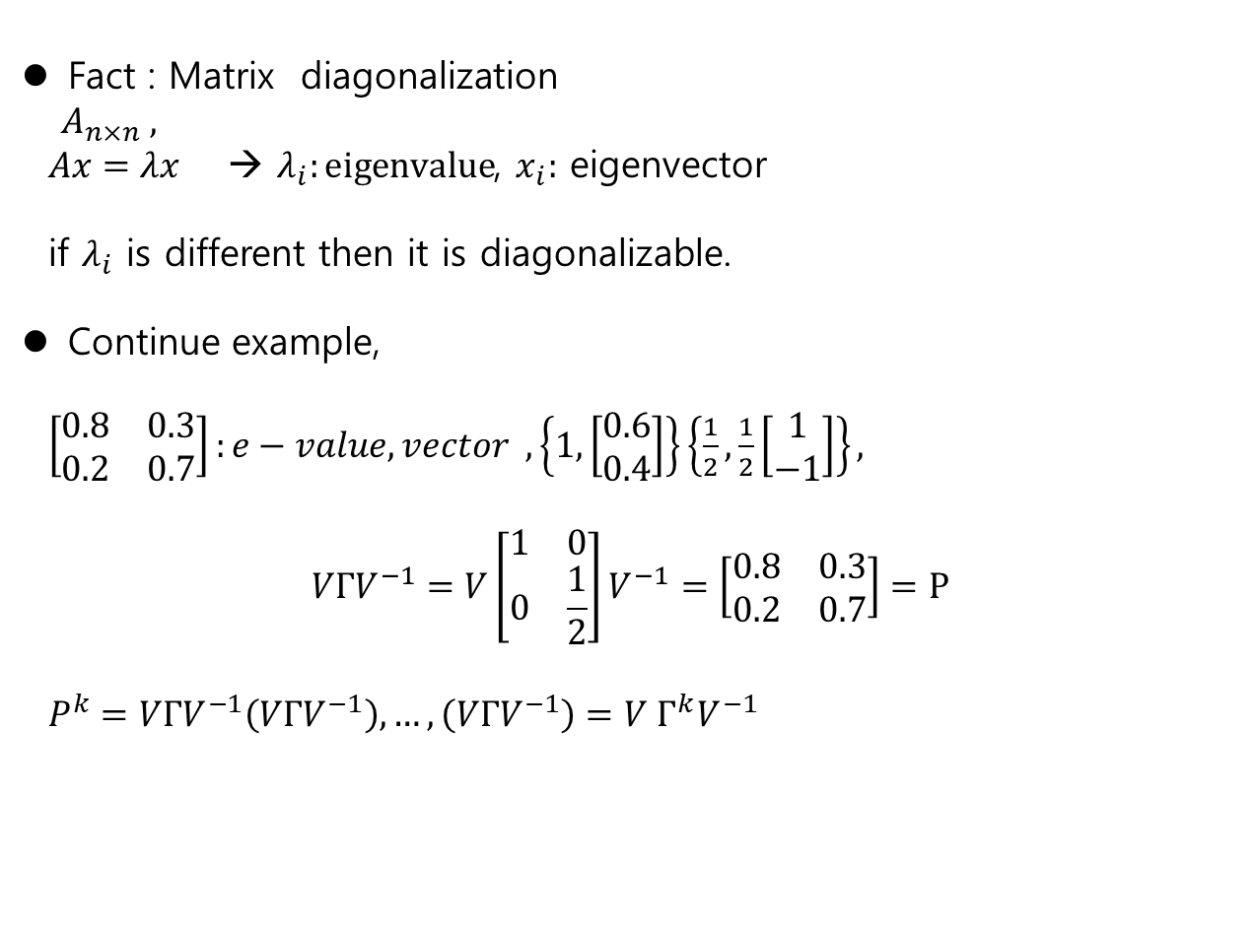
Markov Process
Fact : Matrix diagonalization
$A_{n×n} ,$
$Ax=λx$ → $λ_{i}:eigenvalue$, $x_{i}:$ eigenvector
if $λ_{i}$ is different then it is diagonalizable.
Continue example,
$\left[\begin{matrix}0.8 & 0.3 \\ 0.2 & 0.7\end{matrix}\right]:e−value, vector , \left\{1, \left[\begin{matrix}0.6 \\ 0.4\end{matrix}\right]\right\}\left\{\frac{1}{2},\frac{1}{2}\left[\begin{matrix}1 \\ −1\end{matrix}\right]\right\},$
$$VΓV^{−1}=V\left[\begin{matrix}1 & 0 \\ 0 & \frac{1}{2}\end{matrix}\right]V^{−1}=\left[\begin{matrix}0.8 & 0.3 \\ 0.2 & 0.7\end{matrix}\right]=P$$
$P^{k}=VΓV^{−1}\left(VΓV^{−1}\right),…,\left(VΓV^{−1}\right)=V Γ^{k}V^{−1}$

Slide 7
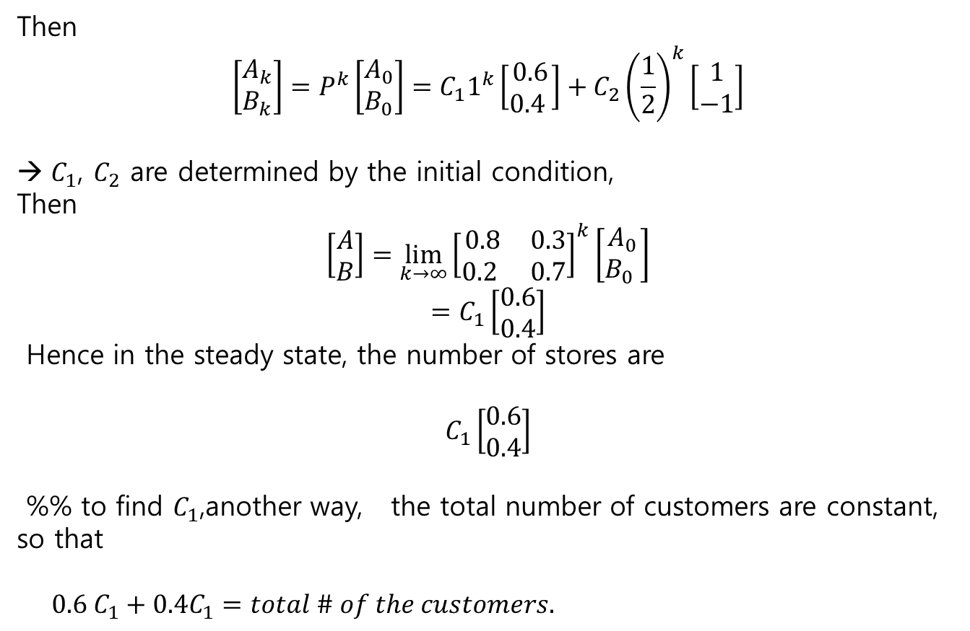
Markov Process
Then
$$\left[\begin{matrix}A_{k} \\ B_{k}\end{matrix}\right]=P^{k}\left[\begin{matrix}A_{0} \\ B_{0}\end{matrix}\right]=C_{1}1^{k}\left[\begin{matrix}0.6 \\ 0.4 \end{matrix}\right]+C_{2}{\left(\frac{1}{2}\right)}^{k}\left[\begin{matrix}1 \\ −1\end{matrix}\right]$$
$C_{1}$, $C_{2}$ are determined by the initial condition,
Then
$$\left[\begin{matrix}A \\ B\end{matrix}\right]={\lim_{k→∞}\left[\begin{matrix}0.8 & 0.3 \\ 0.2 & 0.7\end{matrix}\right]}^{k}\left[\begin{matrix}A_{0} \\ B_{0} \end{matrix}\right]$$
$$=C_{1}\left[\begin{matrix}0.6 \\ 0.4\end{matrix}\right]$$
Hence in the steady state, the number of stores are
$$C_{1}\left[\begin{matrix}0.6 \\ 0.4\end{matrix}\right]$$
%% to find $C_{1}$,another way, the total number of customers are constant, so that
$0.6 C_{1}+0.4C_{1}=total \# of the customers.$

Slide 8
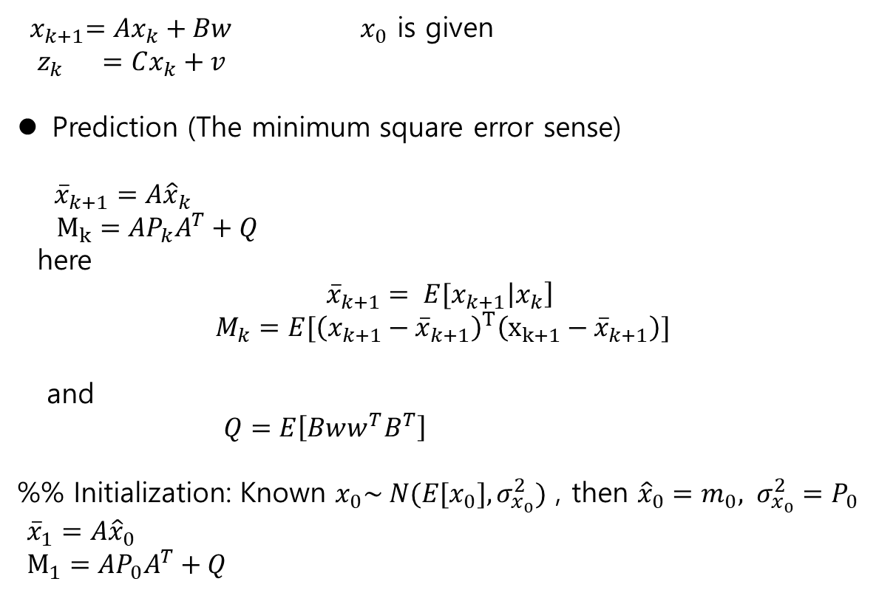
Kalman Filter(Estimator) – Recursive / on-line
${ x}_{k+1}=Ax_{k}+Bw$ $x_{0}$ is given
$z_{k} =Cx_{k}+v$
Prediction (The minimum square error sense)
${\overline{x}}_{k+1}=A{\hat{x}}_{k}$
$M_{k}=AP_{k}A^{T}+Q$
here
$${\overline{x}}_{k+1}= E[x_{k+1}\left|x_{k}\right]$$
$$M_{k}=E[{\left(x_{k+1}−{\overline{x}}_{k+1}\right)}^{T}\left(x_{k+1}−{\overline{x}}_{k+1}\right)]$$
and
$Q=E\left[Bww^{T}B^{T}\right]$
%% Initialization: Known $x_{0}\sim N(E[x_{0}],σ_{x_{0}}^{2})$ , then ${\hat{x}}_{0}=m_{0}, σ_{x_{0}}^{2}=P_{0}$
${\overline{x}}_{1}=A{\hat{x}}_{0}$
$M_{1}=AP_{0}A^{T}+Q$

Slide 9

Kalman Filter(Estimator) – Recursive / on-line
$${\overline{x}}_{k+1}=A{\hat{x}}_{k}$$
$M_{k}=AP_{k}A^{T}+Q$
Estimation (The minimum square error sense)
${\hat{x}}_{k}={\overline{x}}_{k}+K_{k}(z_{k}−C{\overline{x}}_{k}$)
$K_{k}=−P_{k}^{−1}C^{T}V$
here
$${\hat{x}}_{k}= E[x_{k}\left|x_{k−1}\right]$$
$$P_{k}=E[{\left(x_{k}−{\hat{x}}_{k}\right)}^{T}\left(x_{k}−{\hat{x}}_{k}\right)]$$
which satisfies
$$P_{k}^{−1}=(M_{k}^{−1}+C^{T}V^{−1}C)$$
and
$V=E\left[vv^{T}\right]$
Innovation
$r_{k} =z_{k}−C{\overline{x}}_{k}$

Slide 10
Kalman Filter(Estimator) – Recursive / on-line
Summary
- Plant :
${ x}_{k+1}=Ax_{k}+Bw$ $x_{0}$ is given
$z_{k} =Cx_{k}+v$
1) Prediction 2) Innovation 3)Estimation(Update)
${\overline{x}}_{k+1}=A{\hat{x}}_{k}$ $r_{k} =z_{k}−C{\overline{x}}_{k}$ ${\hat{x}}_{k}={\overline{x}}_{k}+K_{k}r_{k}$
$M_{k}=AP_{k}A^{T}+Q$ $S_{k} =CM_{k}C^{T}+V P_{k} =\left(I−K_{k}C\right)M_{k}$
$K_{k}=M_{k}H^{T}S_{k}^{−1}$

Slide 11
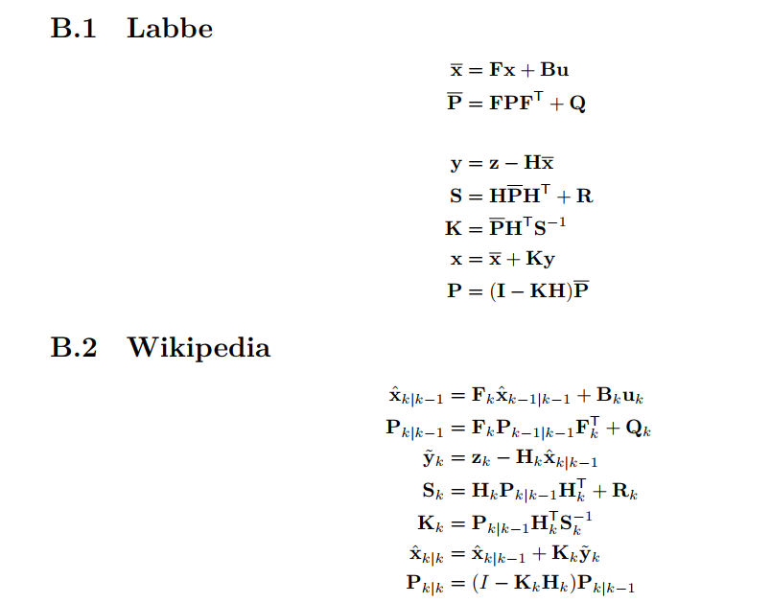
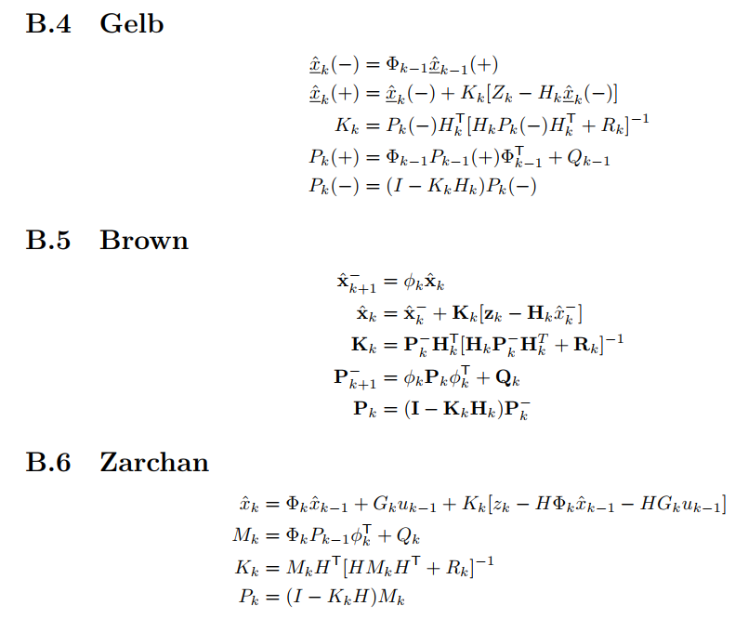
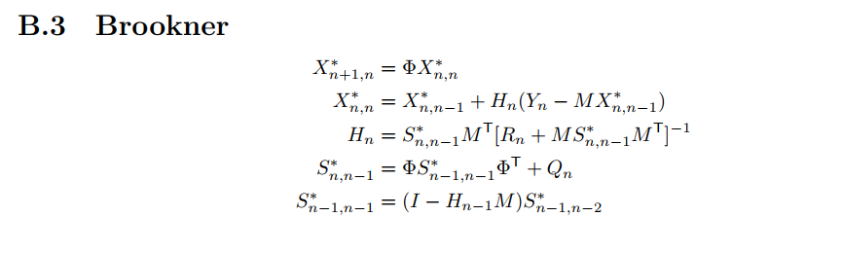
Many variants

Slide 12
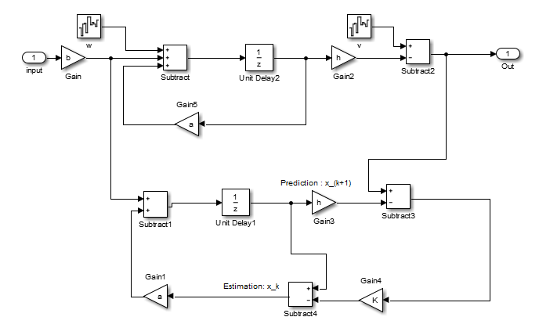
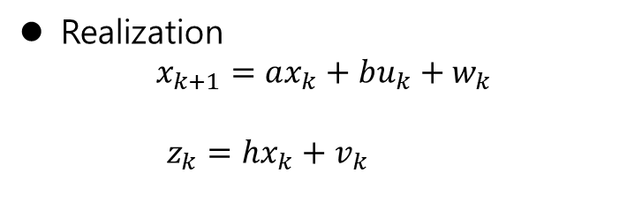
Kalman estimator realization
Realization
$$x_{k+1}=ax_{k}+bu_{k}+w_{k}$$
$z_{k}=hx_{k}+v_{k}$

Slide 13
Kalman estimator realization
System
Computer

Slide 14
Kalman estimator realization
System
input : command , disturbance , noise
output : output
Computer
input : command , system output(measurement)
output : state estimator

Slide 15
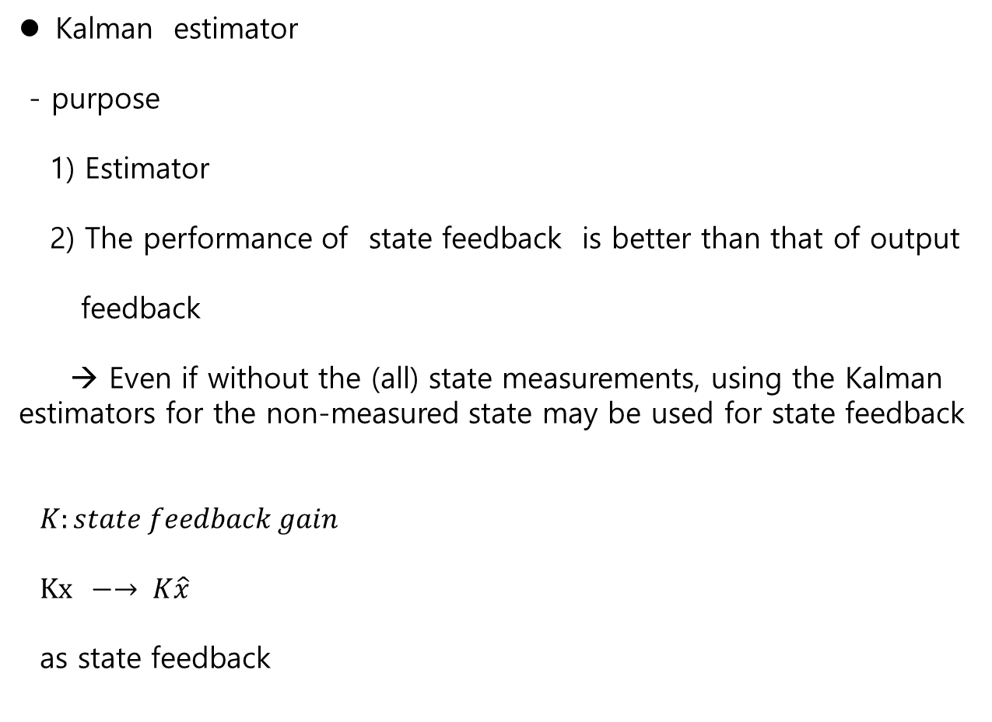
Kalman estimator realization
Kalman estimator
- purpose
1) Estimator
2) The performance of state feedback is better than that of output
feedback
→ Even if without the (all) state measurements, using the Kalman estimators for the non-measured state may be used for state feedback
$K:state feedback gain$
$Kx −→ K\hat{x}$
as state feedback

