Slide 1


Estimator
Estimator : Conditional Expectation
example: $(X,Y)$
Define
$Z=X+Y$
$E\left[X | Z=\frac{1}{2}\right]= \frac{1}{4}$
$E\left[X | Z=1\right]= \frac{1}{2}$
$E\left[X | Z=\frac{3}{2}\right]= \frac{3}{4}$
$$f\left(x,y\right)= \left\{\begin{aligned}1 0<x<1, 0<y<1 \\ 0 otherwise \end{aligned}\right.$$

Slide 2
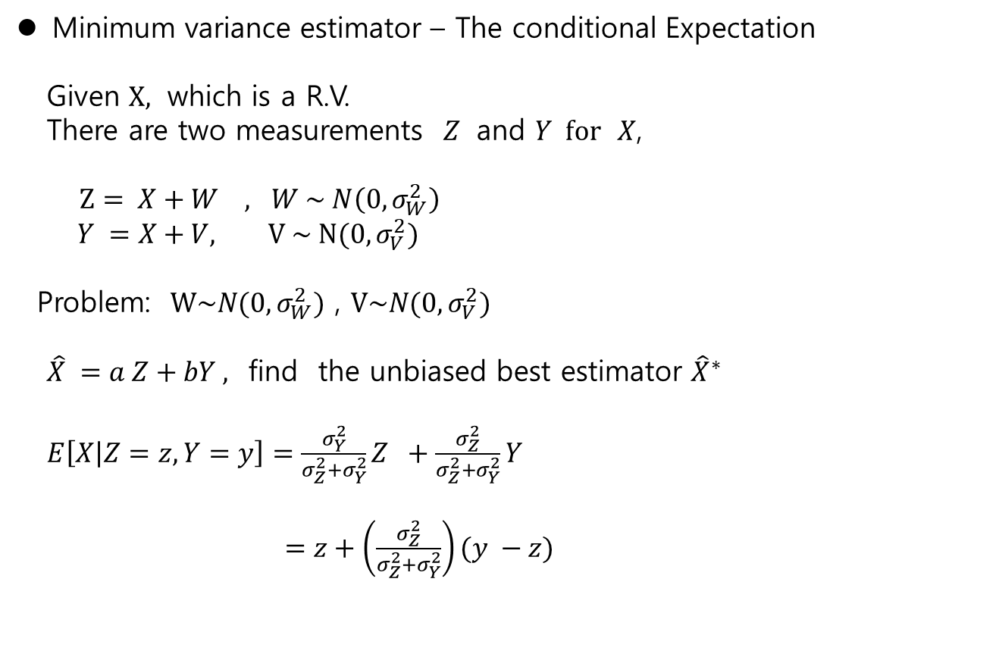
Estimator
Minimum variance estimator – The conditional Expectation
Given $X,$ which is a R.V.
There are two measurements $Z$ and $Y for$ $X$,
$Z= X+W , W \sim N\left(0, σ_{W}^{2}\right)$
$Y =X+V, V \sim N(0, σ_{V}^{2})$
Problem: $W\sim N(0,σ_{W}^{2})$ , $V\sim N(0,σ_{V}^{2})$
$\hat{X} =a Z+bY ,$ find the unbiased best estimator ${\hat{X}}^{∗}$
$E\left[X | Z=z,Y=y\right]=\frac{σ_{Y}^{2}}{σ_{Z}^{2}+σ_{Y}^{2}}Z +\frac{σ_{Z}^{2}}{σ_{Z}^{2}+σ_{Y}^{2}}Y$
$=z+\left(\frac{σ_{Z}^{2}}{σ_{Z}^{2}+σ_{Y}^{2}}\right)(y −z)$

Slide 3
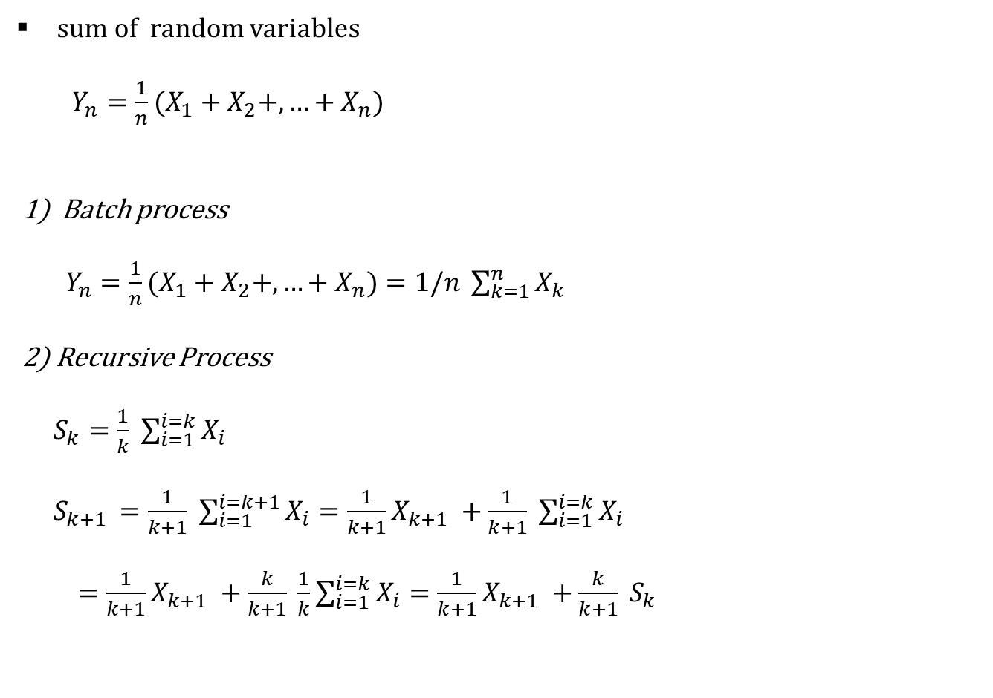
Batch/ Recursive type
sum of random variables
$Y_{n}={\frac{1}{n}(X}_{1}+X_{2}+,…+X_{n}$)
1) Batch process
$Y_{n}={\frac{1}{n}(X}_{1}+X_{2}+,…+X_{n})=1/n \sum_{k=1}^{n}{X_{k}}$
2) Recursive Process
$S_{k}=\frac{1}{k} \sum_{i=1}^{i=k}{X_{i}}$
$S_{k+1 }=\frac{1}{k+1} \sum_{i=1}^{i=k+1}{X_{i}}=\frac{1}{k+1}X_{k+1} +\frac{1}{k+1} \sum_{i=1}^{i=k}{X_{i}}$
$=\frac{1}{k+1}X_{k+1} +\frac{k}{k+1} \frac{1}{k}\sum_{i=1}^{i=k}{X_{i}}=\frac{1}{k+1}X_{k+1} +\frac{k}{k+1} S_{k}$

Slide 4

Estimator
Time evolution system
$x_{k+1}=Ax_{k}+B_{u}u_{k}+B_{w}w$
$z_{k} =Cx_{k}+v$
Terminology :
$A:$ system matrix
$B_{u}:$ input matrix
$B_{w}:$ system noise matrix ( disturbance)
$C$: output matrix (measurement matrix)
$w$: system noise : gaussian $N(0, σ_{w}^{2})$
$v$: output noise : gaussian, $N(0, σ_{v}^{2})$

Slide 5

Estimator
Estimate
$x_{k+1}=Ax_{k}+B_{w}w$ $x_{0}$ is given
$z_{k} =Cx_{k}+v$
Fact : $x_{k} , y_{k}$ are gaussian R.V.
Problem : the best estimator of $x_{k}$ given ${\{z_{1}, z_{2},…,z}_{k}\}$

Slide 6
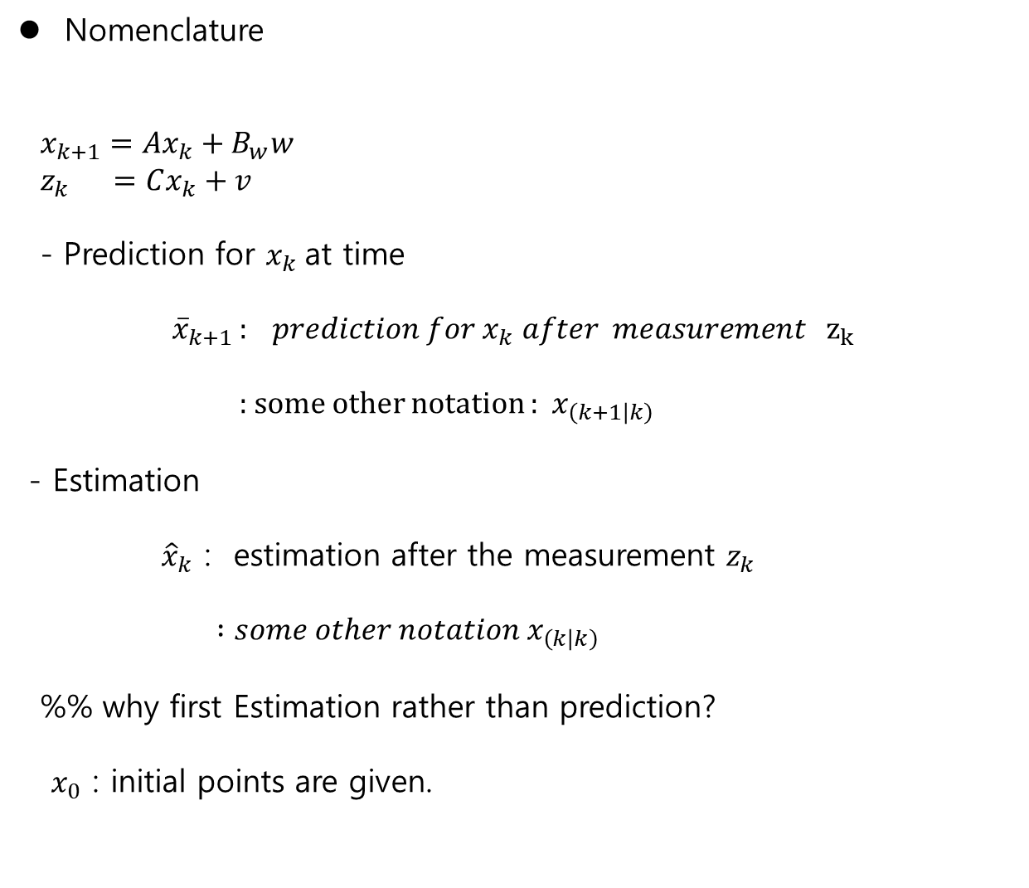
Estimator
Nomenclature
$x_{k+1}=Ax_{k}+B_{w}w$
$z_{k} =Cx_{k}+v$
- Prediction for $x_{k}$at time
$${\overline{x}}_{k+1 }: prediction for x_{k} after measurement z_{k}$$
: some other notation : $x_{\left(k+1 | k\right)}$
- Estimation
${\hat{x}}_{k}$ : estimation after the measurement $z_{k}$
$:some other notation x_{\left(k | k\right)}$
%% why first Estimation rather than prediction?
$x_{0}$ : initial points are given.

Slide 7

Estimator
Observability
$x_{k+1}=Ax_{k}$
$z_{k} =Cx_{k}$
-the system is observable if $x_{k}∈R^{n}$ is obtained by ${\{z_{1}, z_{2},…,z}_{k}\}$
- $\left(A,C\right)$ is observable if
$\left[C;CA;CA^{2};…CA^{n}\right]$is full-rank

Slide 8

Ex.
velocity = Constant,
$\frac{d\left(pos\right)}{dt}=vel$
$\left[\begin{matrix}pos \\ vel \end{matrix}\right]= \left[\begin{matrix}x_{1} \\ x_{2}\end{matrix}\right]$
$\left[\begin{matrix}{\dot{x}}_{1} \\ {\dot{x}}_{2}\end{matrix} \right]=\left[\begin{matrix}0 & 1 \\ 0 & 0\end{matrix}\right]\left[\begin{matrix}x_{1} \\ x_{2}\end{matrix}\right]$
1) measure position 2) measure velocity
$y=[ 1 0]\left[\begin{matrix}x_{1} \\ x_{2}\end{matrix}\right]$ $y=[ 0 1]\left[\begin{matrix}x_{1} \\ x_{2}\end{matrix}\right]$

Slide 9

Estimator
Sum of gaussians (2022_Week_4_Mul..)
Given $X \sim N\left(m_{X} , σ_{X}^{2}\right)$ and $v \sim N(0, σ_{v}^{2})$ and they are independent,
Consider a R.V. $Y$
$Z=aX+v$
FACT :
1) $Z\sim N\left(m_{Y}, σ_{z}^{2}\right)$ : $Z$ is a gaussian.
2) $m_{Z}=m_{X}$
3) $σ_{Z}^{2}={a^{2}σ}_{X}^{2}+σ_{v}^{2}$

Slide 10
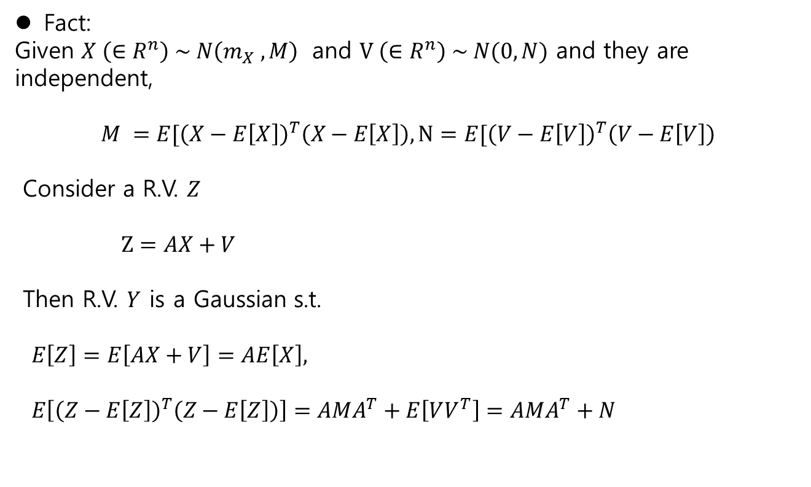
Estimator
Fact:
Given $X \left(∈R^{n}\right) \sim N\left(m_{X} , M\right)$ and $V \left(∈R^{n}\right) \sim N(0,N)$ and they are independent,
$$M =E[{\left(X−E\left[X\right]\right)}^{T}\left(X−E\left[X\right]\right), N=E[{\left(V−E\left[V\right]\right)}^{T}\left(V−E\left[V\right]\right)$$
Consider a R.V. $Z$
$Z=AX+V$
Then R.V. $Y$ is a Gaussian s.t.
$E\left[Z\right]=E\left[AX+V\right]=AE\left[X\right],$
$E\left[{\left(Z−E\left[Z\right]\right)}^{T}\left(Z−E\left[Z\right]\right)\right]=AMA^{T}+E\left[VV^{T}\right]=AMA^{T}+N$

Slide 11

Estimator
Time revolution system estimation
Consider
$x_{k+1}=x_{k}+w$ , $x_{0}$
$z_{k}=x_{k}+v$
up to time $k$
measurements $z_{0}, z_{1},z_{2},….., z_{k}$
the estimator
${\hat{x}}_{k} \sim f\left(x_{0}, x_{1},…,x_{k}\right)$
→ too many measurement !! → it is a batch type process

Slide 12

Estimator
Markov Process
$P\left(X_{n+1}=x | X_{n}=x_{n},X_{n−1}=x_{n−1},….,X_{1}=x_{1}\right)$
$=P\left(X_{n+1}=x | X_{n}=x_{n} \right)$
Time evolution system
${\hat{x}}_{k} \sim f\left(x_{0}, x_{1},…,x_{k}\right)$
$E\left[x_{k} | x_{k−1}, x_{k−2},…,x_{1}\right]=E[x_{k}|x_{k−1}]$
→ recursive method !!

Slide 13
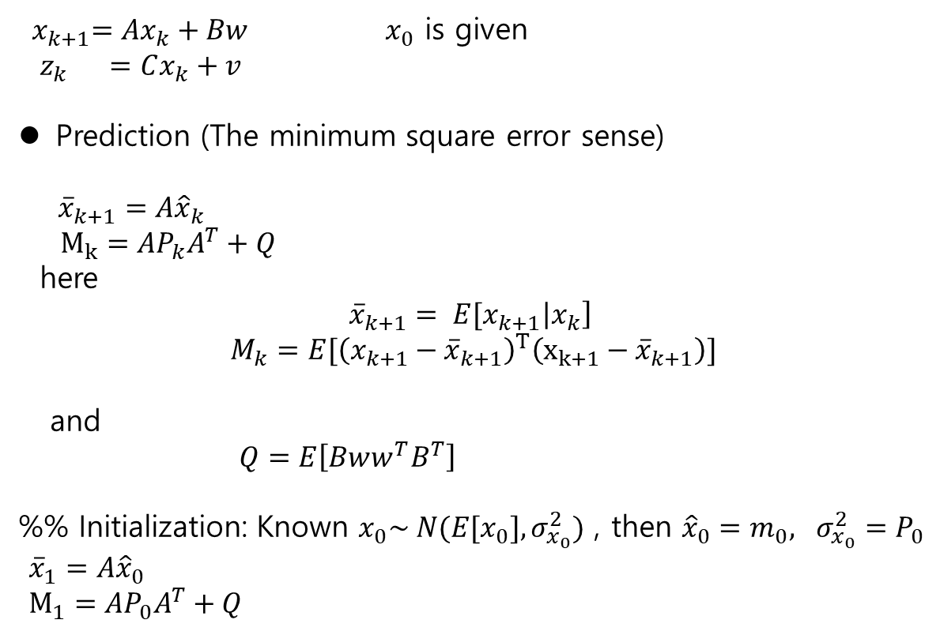
Estimator
${ x}_{k+1}=Ax_{k}+Bw$ $x_{0}$ is given
$z_{k} =Cx_{k}+v$
Prediction (The minimum square error sense)
${\overline{x}}_{k+1}=A{\hat{x}}_{k}$
$M_{k}=AP_{k}A^{T}+Q$
here
$${\overline{x}}_{k+1}= E[x_{k+1}\left|x_{k}\right]$$
$$M_{k}=E[{\left(x_{k+1}−{\overline{x}}_{k+1}\right)}^{T}\left(x_{k+1}−{\overline{x}}_{k+1}\right)]$$
and
$Q=E\left[Bww^{T}B^{T}\right]$
%% Initialization: Known $x_{0}\sim N(E[x_{0}],σ_{x_{0}}^{2})$ , then ${\hat{x}}_{0}=m_{0}, σ_{x_{0}}^{2}=P_{0}$
${\overline{x}}_{1}=A{\hat{x}}_{0}$
$M_{1}=AP_{0}A^{T}+Q$

Slide 14

Estimator
$${\overline{x}}_{k+1}=A{\hat{x}}_{k}$$
$M_{k}=AP_{k}A^{T}+Q$
Estimation (The minimum square error sense)
${\hat{x}}_{k}={\overline{x}}_{k}+K_{k}(z_{k}−C{\overline{x}}_{k}$)
$K_{k}=−P_{k}^{−1}C^{T}V$
here
$${\hat{x}}_{k}= E[x_{k}\left|x_{k−1}\right]$$
$$P_{k}=E[{\left(x_{k}−{\hat{x}}_{k}\right)}^{T}\left(x_{k}−{\hat{x}}_{k}\right)]$$
which satisfies
$$P_{k}^{−1}=(M_{k}^{−1}+C^{T}V^{−1}C)$$
and
$V=E\left[vv^{T}\right]$
Innovation
$r_{k} =z_{k}−C{\overline{x}}_{k}$

Slide 15

Estimator
Summary
- Plant :
${ x}_{k+1}=Ax_{k}+Bw$ $x_{0}$ is given
$z_{k} =Cx_{k}+v$
1) Prediction 2) Innovation 3)Estimation(Update)
${\overline{x}}_{k+1}=A{\hat{x}}_{k}$ $r_{k} =z_{k}−C{\overline{x}}_{k}$ ${\hat{x}}_{k}={\overline{x}}_{k}+K_{k}r_{k}$
$M_{k}=AP_{k}A^{T}+Q$ $S_{k} =CM_{k}C^{T}+V P_{k} =\left(I−K_{k}C\right)M_{k}$
$K_{k}=M_{k}H^{T}S_{k}^{−1}$

Slide 16
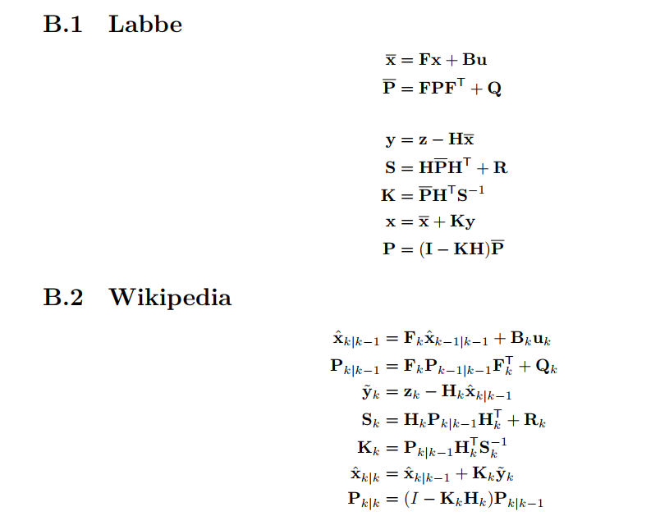
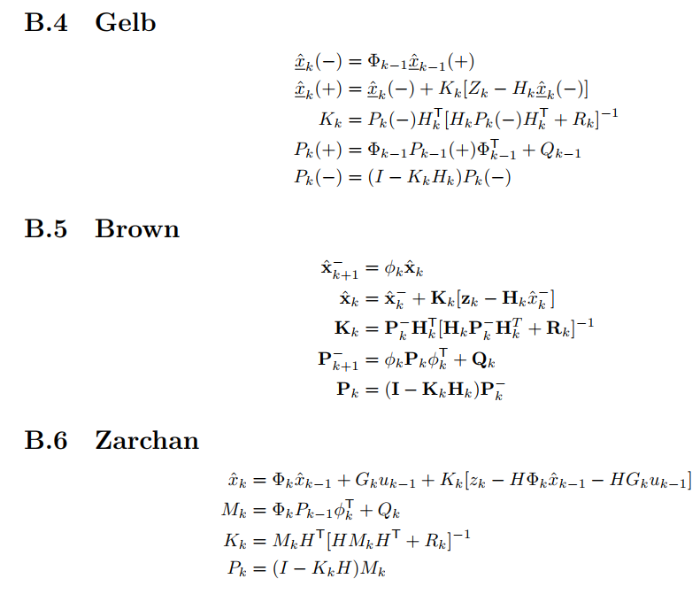
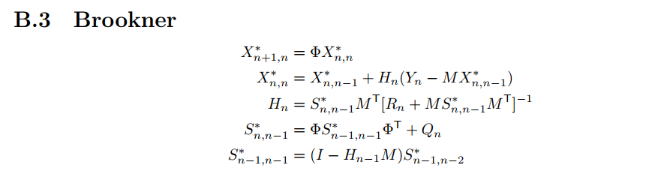
Estimator

