Slide 1
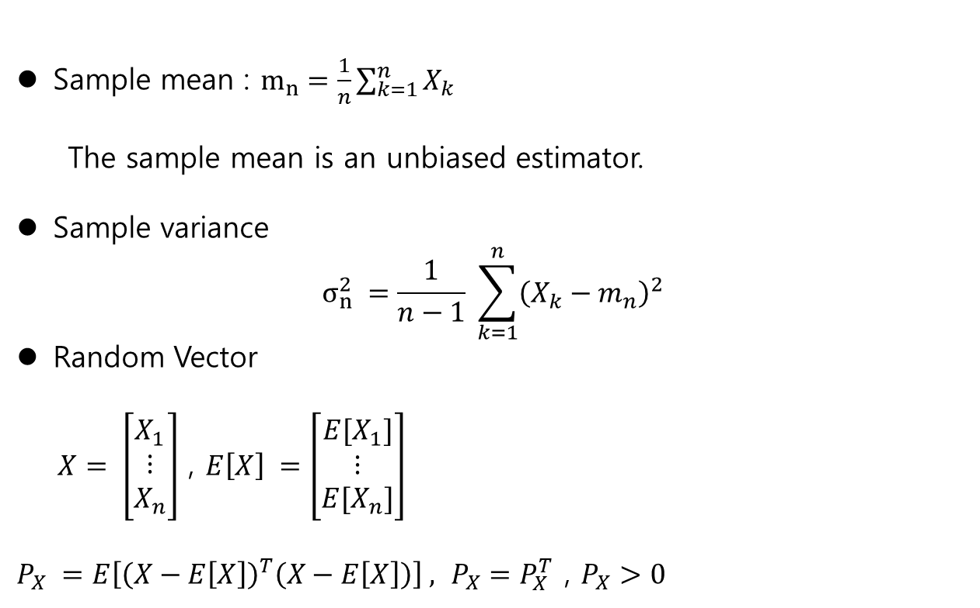
Review
Sample mean : $m_{n}=\frac{1}{n}\sum_{k=1}^{n}{X_{k}}$
The sample mean is an unbiased estimator.
Sample variance
$$σ_{n}^{2} =\frac{1}{n−1} \sum_{k=1}^{n}{{\left(X_{k}−m_{n}\right)}^{2}}$$
Random Vector
$X= \left[\begin{matrix}X_{1} \\ ⋮ \\ X_{n}\end{matrix}\right]$ , $E\left[X\right] =\left[\begin{matrix}{E[X}_{1}] \\ ⋮ \\ {E[X}_{n}]\end{matrix}\right]$
$P_{X} =E\left[{\left(X−E\left[X\right]\right)}^{T}\left(X−E\left[X\right]\right)\right] ,$ $P_{X}=P_{X}^{T}$ , $P_{X}>0$

Slide 2
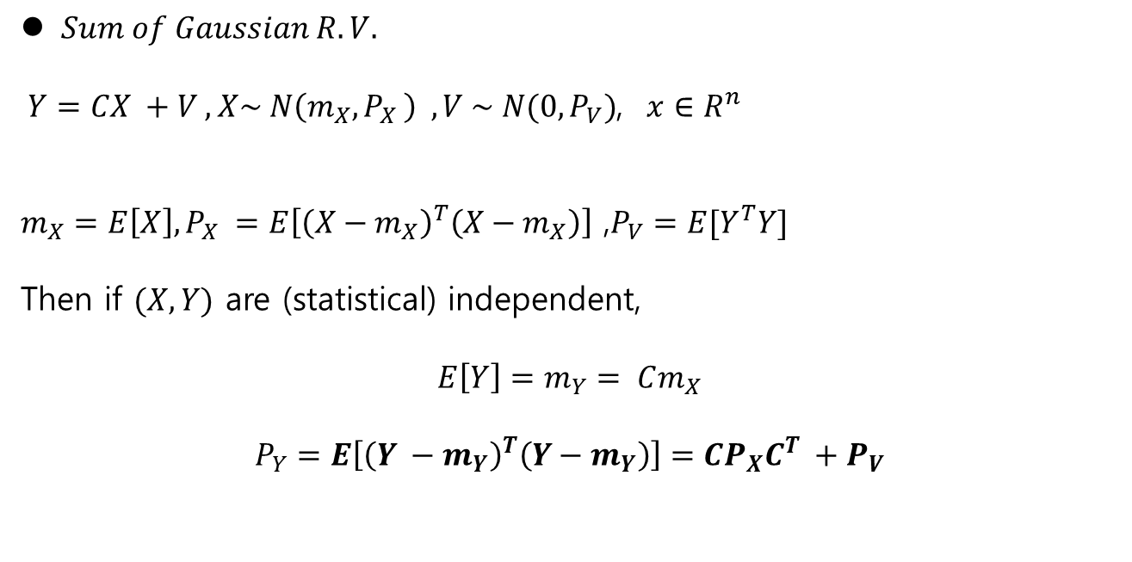
Review
$Sum of Gaussian R.V.$
$Y=CX +V , X\sim N\left(m_{X}{, P}_{X}\right) , V \sim N(0, P_{V})$, $x∈R^{n}$
$m_{X}=E\left[X\right], P_{X} =E\left[{\left(X−m_{X}\right)}^{T}\left(X−m_{X}\right)\right]$ ,$P_{V}=E[Y^{T}Y]$
Then if $(X,Y)$ are (statistical) independent,
$$E\left[Y\right]=m_{Y}= Cm_{X}$$
$$P_{Y}=E\left[{\left(Y −m_{Y}\right)}^{T}\left(Y−m_{Y}\right)\right]=CP_{X}C^{T} +P_{V}$$

Slide 3
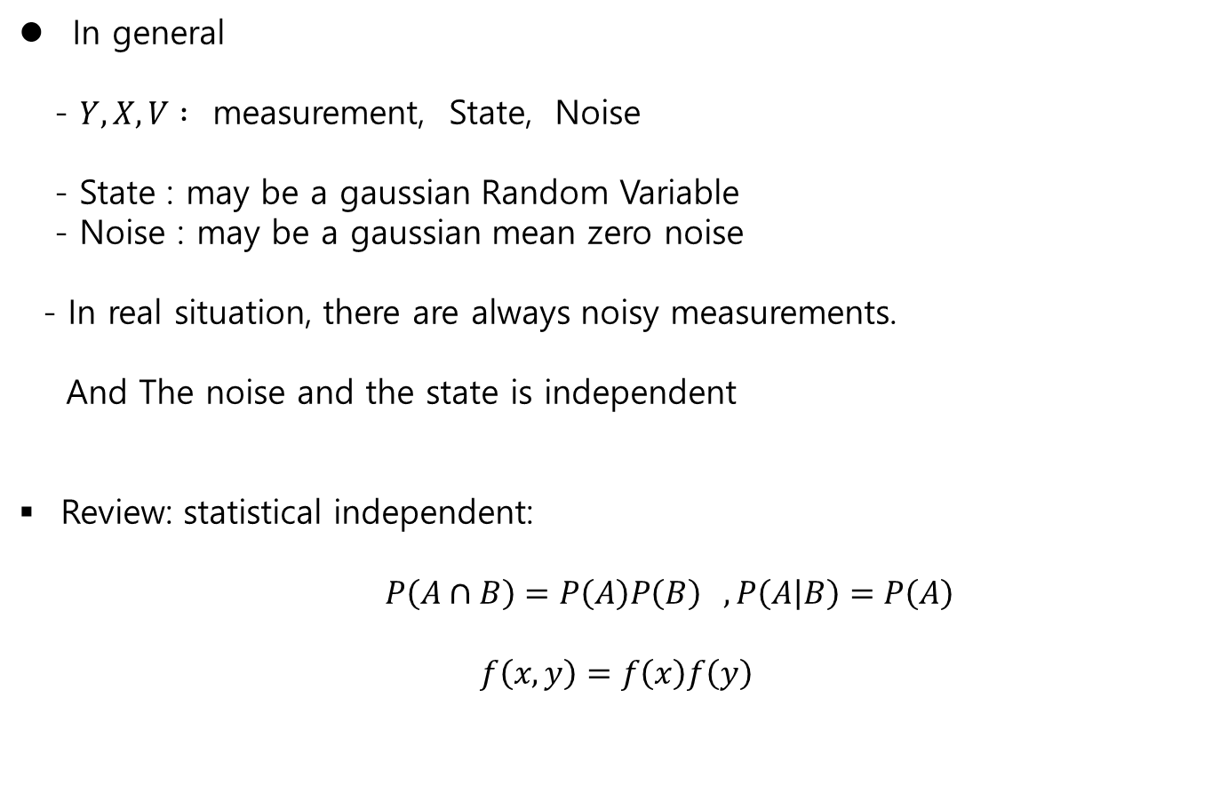
Sum of R.V.
In general
- $Y, X, V :$ measurement, State, Noise
- State : may be a gaussian Random Variable
- Noise : may be a gaussian mean zero noise
- In real situation, there are always noisy measurements.
And The noise and the state is independent
Review: statistical independent:
$P\left(A∩B\right)=P\left(A\right)P\left(B\right) , P\left(A | B\right)=P\left(A\right)$
$$f\left(x,y\right)=f\left(x\right)f\left(y\right)$$

Slide 4

Independent Sum of R.V.
Diagonalization
If the eigenvalues of $A$ are different, then $∃ a M ,$
$$MAM^{−1}=D,$$
where $D$ is a diagonal matrix
Positive symmetric matrix $M_{n×n}$
Def: $x^{T}Mx >0 , ∀ x∈R^{n} , x≠0$
- Properties
$∃ N$ such that $N M N^{T}=D , D$ is a diagonal matrix

Slide 5
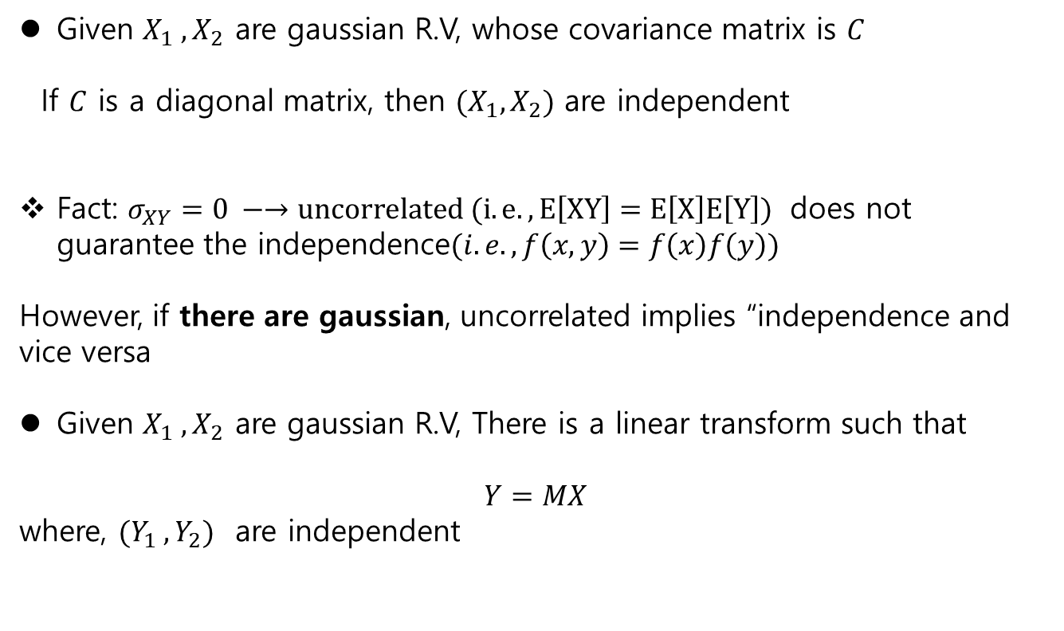
Gaussian - Independent Sum of R.V.
Given $X_{1} ,X_{2}$ are gaussian R.V, whose covariance matrix is $C$
If $C$ is a diagonal matrix, then $(X_{1}, X_{2})$ are independent
Fact: $σ_{XY}=0 −→uncorrelated (i.e., E\left[XY\right]=E\left[X\right]E\left[Y\right])$ does not guarantee the independence$(i.e., f\left(x,y\right)=f\left(x\right)f\left(y\right))$
However, if there are gaussian, uncorrelated implies “independence and vice versa
Given $X_{1} ,X_{2}$ are gaussian R.V, There is a linear transform such that
$$Y=MX$$
where, $(Y_{1} ,Y_{2})$ are independent

Slide 6
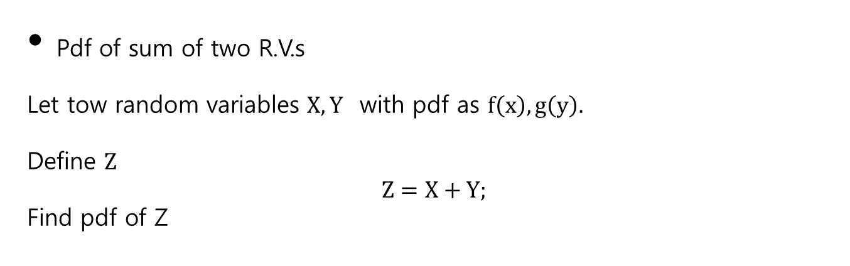
Pdf Sum of R.V.
Pdf of sum of two R.V.s
Let tow random variables $X,Y$ with pdf as $f\left(x\right), g\left(y\right).$
Define $Z$
$$Z=X+Y;$$
Find pdf of Z

Slide 7



Pdf Sum of R.V.
$f\left(z\right)=\frac{dF_{Z}\left(z\right)}{dz}$
Y
$${F_{Z}\left(z\right) = P}_{z}\left(Z≤z \right)=P_{Z}(Z≤x+y)$$
X
$$z=x+y$$

Slide 8

pdf Sum of R.V.
y
$$f\left(x,y\right)= \left\{\begin{aligned}1 0<x<1, 0<y<1 \\ 0 otherwise \end{aligned}\right.$$
x
a b c d
a: z<=0
b: 0<z<1
c: 1<z < 2
d: 2< z

Slide 9
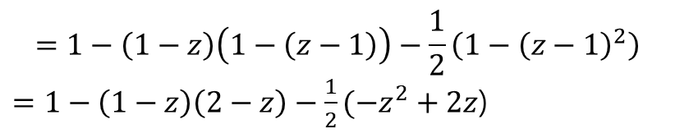
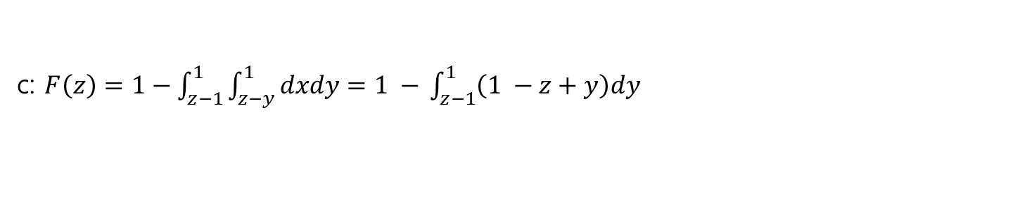
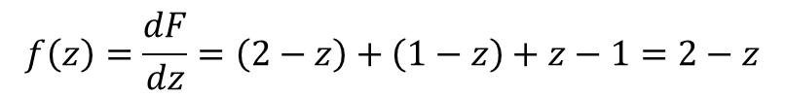
Pdf Sum of R.V.
y
a: z<=0
b: 0<z<1
c: 1<z < 2
d: 2< z
x
a b c d
c: $F\left(z\right)=1−\int_{z−1}^{1}{\int_{z−y}^{1}{dxdy}}=1 −$ $\int_{z−1}^{1}{\left(1 −z+y\right)dy}$
$$=1−\left(1−z\right)\left(1−\left(z−1\right)\right)−\frac{1}{2}\left(1−{\left(z−1\right)}^{2}\right)$$
$=1−\left(1−z\right)\left(2−z\right)−\frac{1}{2}(−z^{2}+2z$)
$$f\left(z\right)=\frac{dF}{dz}=\left(2−z\right)+\left(1−z\right)+z−1=2−z$$

Slide 10
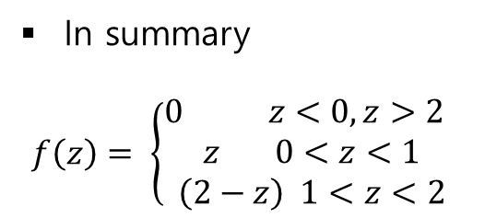
Pdf Sum of R.V.
In summary
$$f\left(z\right)= \left\{\begin{aligned}0 z<0, z>2 \\ z 0<z<1 \\ \left(2−z\right) 1<z<2\end{aligned}\right.$$

Slide 11
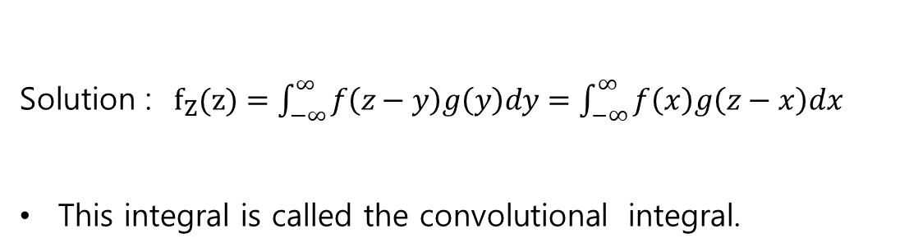
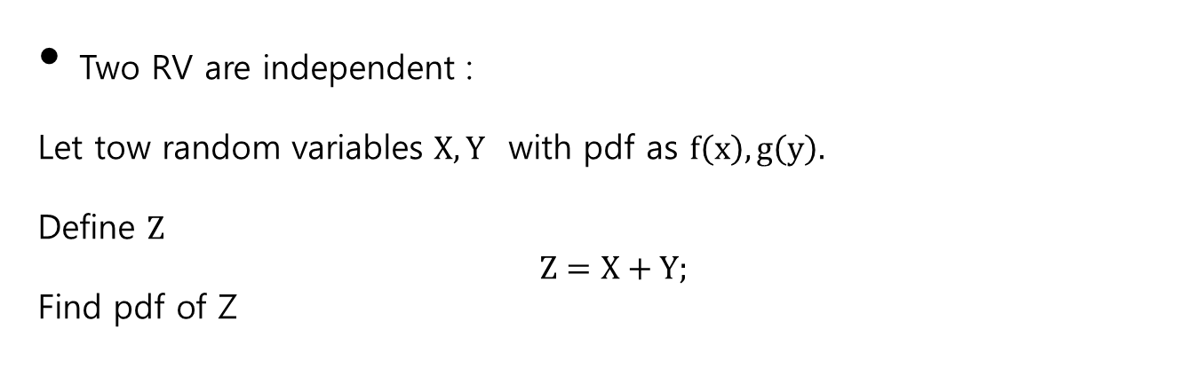
Pdf : independent – convolution Sum of R.V.
Two RV are independent :
Let tow random variables $X,Y$ with pdf as $f\left(x\right), g\left(y\right).$
Define $Z$
$$Z=X+Y;$$
Find pdf of Z
Solution : $f_{Z}(z)=\int_{−∞}^{∞}{f\left(z−y\right)g\left(y\right)dy=\int_{−∞}^{∞}{f\left(x\right)g\left(z−x\right)dx }}$
This integral is called the convolutional integral.

Slide 12
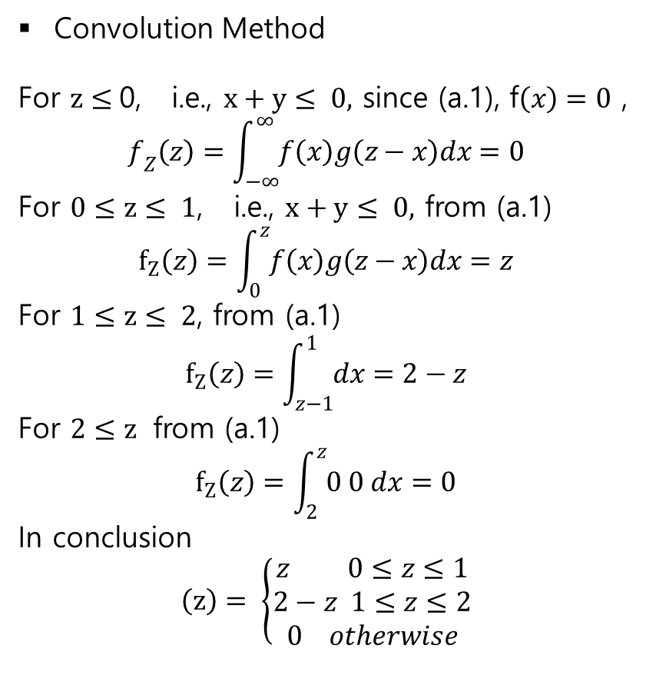
Pdf : independent – convolution Sum of R.V.
Convolution Method
For $z≤$0, i.e., $x+y≤ 0,$ since (a.1), f$\left(x\right)=0$ ,
$$f_{Z}\left(z\right)=\int_{−∞}^{∞}{f\left(x\right)g\left(z−x\right)dx}=0$$
For $0≤z≤ 1$, i.e., $x+y≤ 0,$ from (a.1)
$$f_{Z}\left(z\right)=\int_{0}^{z}{f\left(x\right)g\left(z−x\right)dx}=z$$
For $1≤z≤ 2$, from (a.1)
$$f_{Z}\left(z\right)=\int_{z−1}^{1}{dx}=2−z$$
For $2≤z$ from (a.1)
$$f_{Z}\left(z\right)=\int_{2}^{z}{0 0 dx}=0$$
In conclusion
$$\left(z\right)= \left\{\begin{aligned}z 0≤z≤1 \\ 2−z 1≤z≤2 \\ 0 otherwise\end{aligned}\right.$$

Slide 13

Pdf : independent – convolution Sum of R.V.
$$f(z)=\int_{−∞}^{∞}{f\left(z−y\right)g\left(y\right)dy=\int_{−∞}^{∞}{f\left(x\right)g\left(z−x\right)dx }}$$
In the Laplace Domain , the inverse is
$$H\left(s\right)X\left(s\right)−−−→\int_{−0}^{∞}{h\left(t′\right)x\left(t−t′\right)dt′ }$$
2) Graph
- Given $f(x)$, what is $f(z−x)$ ?
>> $z=0, f\left(−x\right)$
>> now $z$ is not zero, then

Slide 14









Pdf : independent – convolution Sum of R.V.
$$f(z)=\int_{−∞}^{∞}{f\left(z−y\right)g\left(y\right)dy=\int_{−∞}^{∞}{f\left(x\right)g\left(z−x\right)dx }}$$
$$f(−x)$$
$$f(x)$$
$$a$$
$$−a$$
$$f(z−x)$$
$$f(z−x)$$
$$z−a$$
$$z−a$$

Slide 15
Pdf : independent – convolution Sum of R.V.
$$f(z)=\int_{−∞}^{∞}{f\left(z−y\right)g\left(y\right)dy=\int_{−∞}^{∞}{f\left(x\right)g\left(z−x\right)dx }}$$
$$f(−x)$$
$$f(x)$$
$$a$$
$$−a$$
$$f(z−x)$$
$$f(z−x)$$
$$z−a$$
$$z−a$$

Slide 16
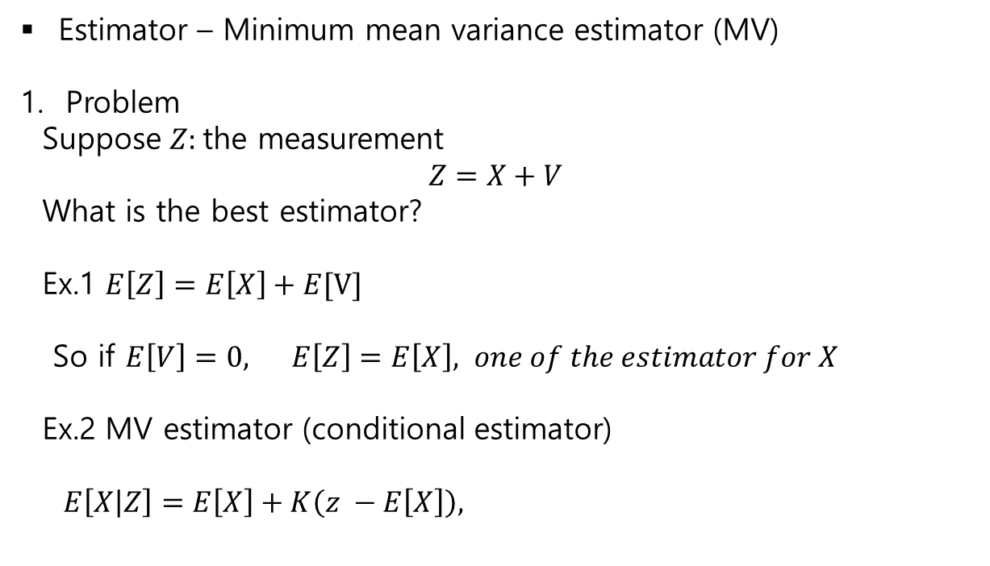
Estimator Sum of R.V.
Estimator – Minimum mean variance estimator (MV)
Problem
Suppose $Z:$the measurement
$$Z=X+V$$
What is the best estimator?
Ex.1 $E\left[Z\right]=E\left[X\right]+E[V]$
So if $E\left[V\right]=0, E\left[Z\right]=E\left[X\right], one of the estimator for X$
Ex.2 MV estimator (conditional estimator)
$E\left[X | Z\right]=E\left[X\right]+K\left(z −E\left[X\right]\right),$

Slide 17
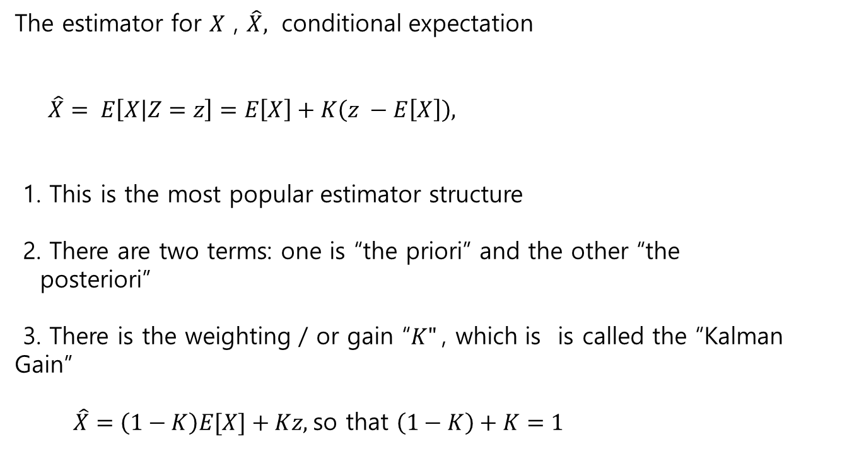
Estimator - weighting Sum of R.V.
The estimator for $X$ , $\hat{X},$ conditional expectation
$\hat{X}= E\left[X | Z=z\right]=E\left[X\right]+K\left(z −E\left[X\right]\right),$
1. This is the most popular estimator structure
2. There are two terms: one is “the priori” and the other “the
posteriori”
3. There is the weighting / or gain “$K"$, which is is called the “Kalman Gain”
$\hat{X}=\left(1−K\right)E[X]+Kz,$so that $\left(1−K\right)+K=1$

Slide 18

Estimator - weighting Sum of R.V.
Weighting
$$\left(X_{1}, X_{2},X_{3}\right)$$
$$E\left[X\right] =\frac{1}{3}\left(X_{1}+X_{2}+X_{3}\right)$$
$$=\frac{1}{3}X_{x}+\frac{1}{3}X_{2}+\frac{1}{3}X_{3}$$
Here 1+3 + 1/3+ 1/3 = 1.
Equal weighting $\frac{1}{3}$on each variable

Slide 19
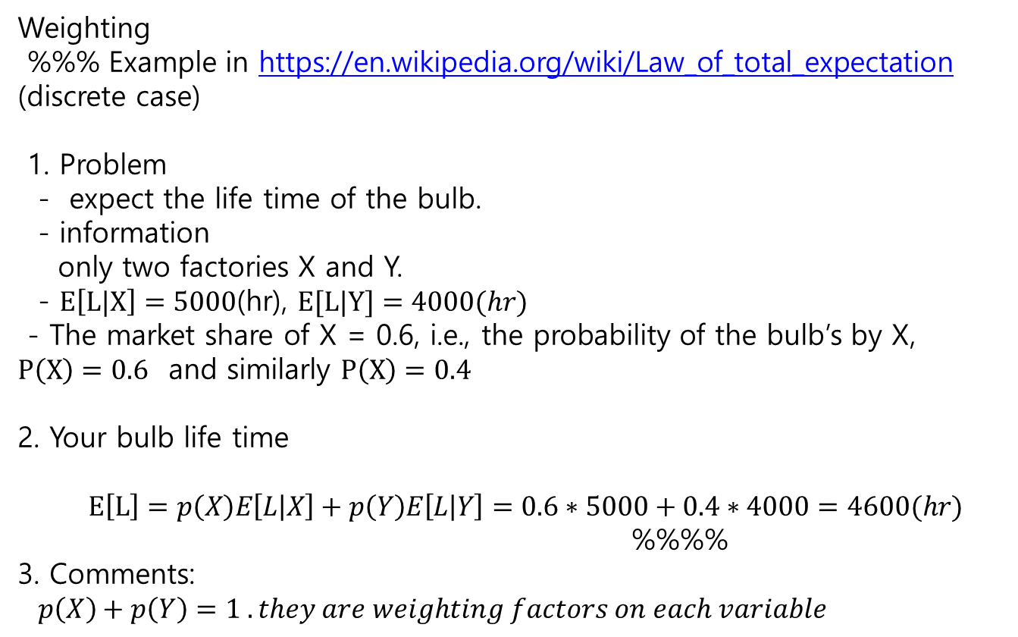
Estimator - weighting Sum of R.V.
Weighting
%%% Example in https://en.wikipedia.org/wiki/Law_of_total_expectation (discrete case)
1. Problem
- expect the life time of the bulb.
- information
only two factories X and Y.
- $E\left[L|X\right]=5000$(hr), $E[L|Y]=4000(hr)$
- The market share of X = 0.6, i.e., the probability of the bulb’s by X, $P\left(X\right)=0.6$ and similarly $P\left(X\right)=0.4$
2. Your bulb life time
$E\left[L\right]=p\left(X\right)E\left[L | X\right]+p\left(Y\right)E\left[L | Y\right]=0.6∗5000+0.4∗4000=4600(hr)$
%%%%
3. Comments:
$p\left(X\right)+p\left(Y\right)=1 . they are weighting factors on each variable$

