Slide 1
PCE6205 Stochastic Model, Estimation and Control (Probability)
ASTU
12/03/2022, S.Kim

Slide 2
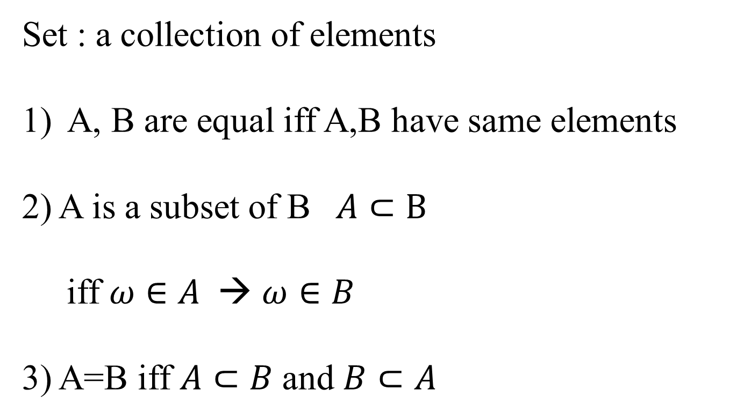
Set Theory
Set : a collection of elements
A, B are equal iff A,B have same elements
2) A is a subset of B $A⊂B$
iff $ω∈A$ → $ω∈B$
3) A=B iff $A⊂B$and $B⊂A$

Slide 3
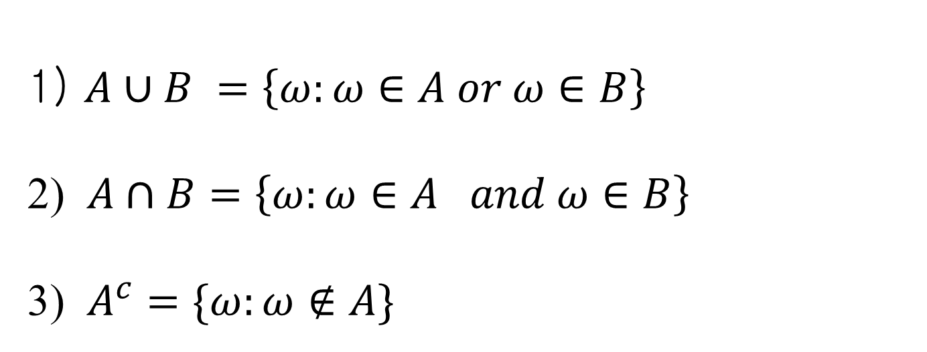
Set Theory
1) $A∪B =\left\{ω:ω∈A or ω∈B\right\}$
2) $A∩B=\left\{ω:ω∈A and ω∈B\right\}$
3) $A^{c}=\{ω:ω∉A\}$

Slide 4

Set Theory- De Morgan Th
$A⊂B →B^{c}⊂A^{c}$
2) ${\left(A∩B\right)}^{c}=A^{c}∩B^{c}$
3) ${(A∪B)}^{c}=A^{c}∪B^{c}$

Slide 5
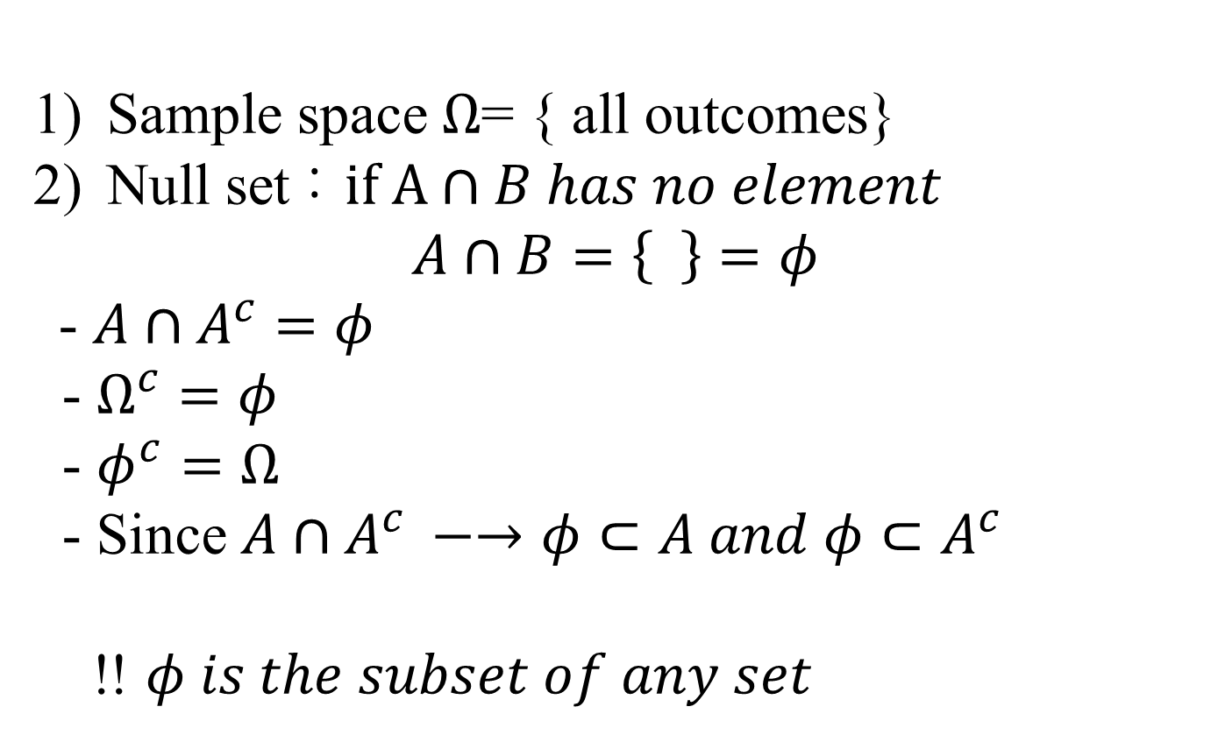
Set Theory
Sample space $Ω$= { all outcomes}
Null set : $if A∩B has no element$
$$A∩B=\left\{ \right\}=φ$$
- $A∩A^{c}=φ$
- $Ω^{c}=φ$
- $φ^{c}=Ω$
- Since $A∩A^{c} −→φ⊂A and φ⊂A^{c}$
!! $φ is the subset of any set$

Slide 6
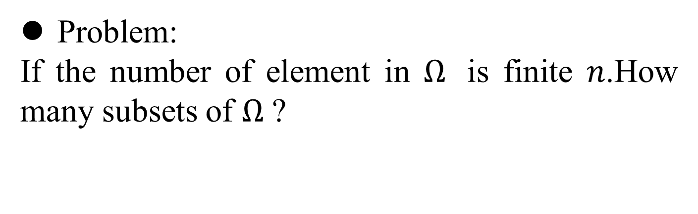
Set Theory
Problem:
If the number of element in $Ω$ is finite $n$.How many subsets of $Ω$ ?

Slide 7
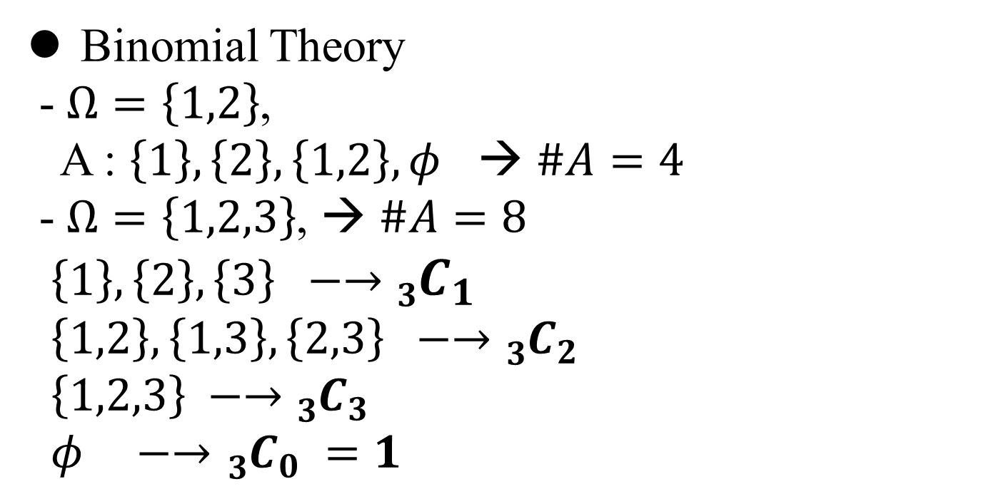
Set Theory
Binomial Theory
- $Ω=\left\{1,2\right\}$,
A : $\left\{1\right\}, \left\{2\right\}, \left\{1,2\right\}, φ$ → $\#A=4$
- $Ω=\left\{1,2,3\right\}$, → $\#A=8$
$\left\{1\right\}, \left\{2\right\},\left\{3\right\} −→$ ${}_{3}^{}{C_{1}}$
$\left\{1,2\right\}, \left\{1,3\right\},\left\{2,3\right\} −→$ ${}_{3}^{}{C_{2}}$
$\left\{1,2,3\right\} −→$ ${}_{3}^{}{C_{3}}$
$φ −→{}_{3}^{}{C_{0} =1}$

Slide 8
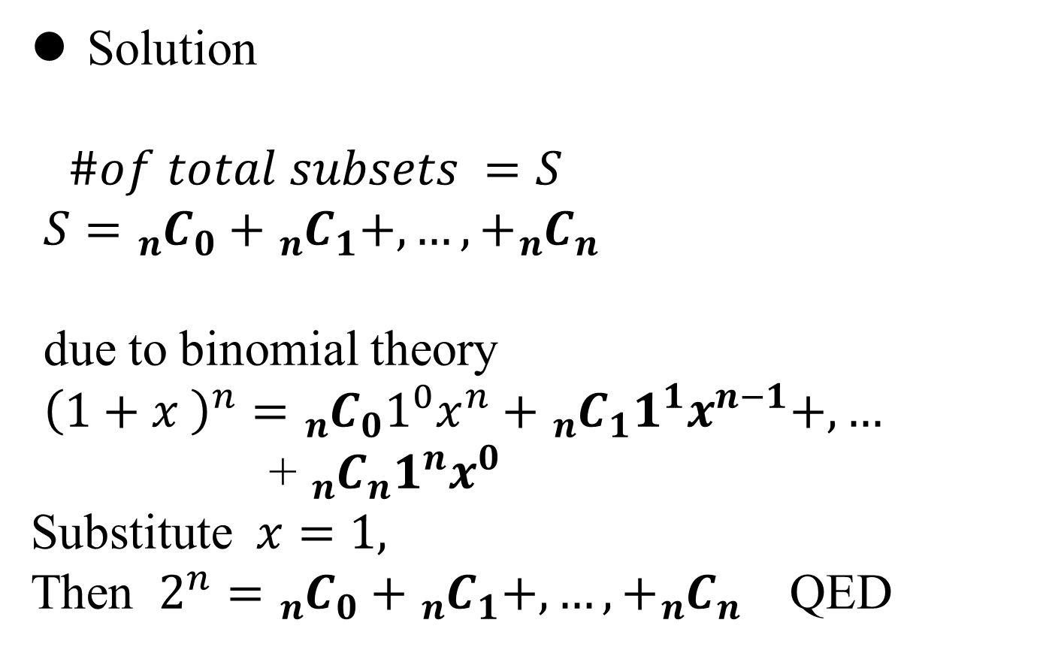
Set Theory
Solution
$\#of total subsets =S$
$S={}_{n}^{}{C_{0}+{}_{n}^{}{C_{1}}+,…,+{}_{n}^{}{C_{n} }}$
due to binomial theory
${\left(1+x \right)}^{n}={{}_{n}^{}{C_{0}}1}^{0}x^{n}+{}_{n}^{}{C_{1}1^{1}x^{n−1}+,…}$
+ ${}_{n}^{}{C_{n}1^{n}x^{0}}$
Substitute $x=1,$
Then $2^{n}={}_{n}^{}{C_{0}+{}_{n}^{}{C_{1}}+,…,+{}_{n}^{}{C_{n} }}$ QED

Slide 9
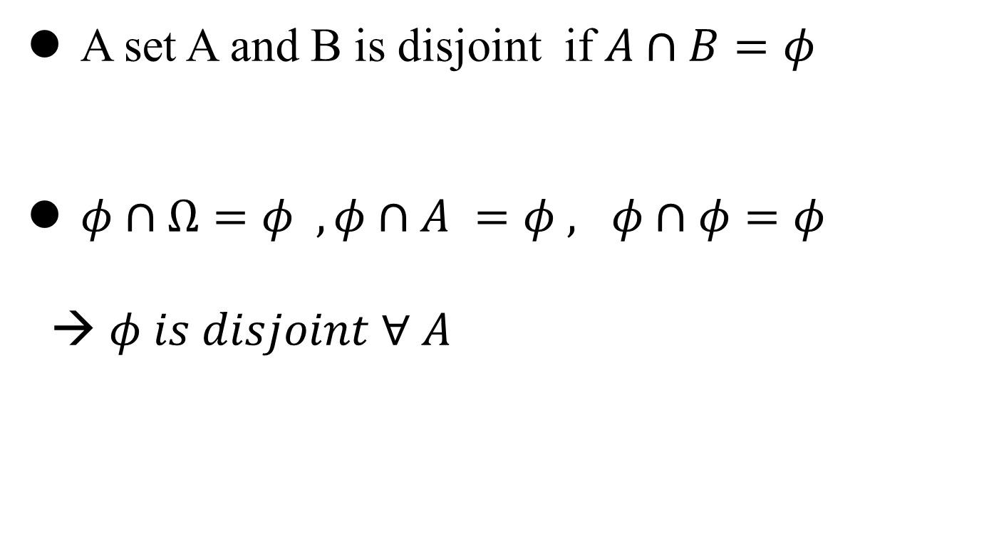
Set Theory - disjoint
A set A and B is disjoint if $A∩B=φ$
$φ∩Ω=φ , φ∩A =φ , φ∩φ=φ$
→ $φ is disjoint ∀ A$

Slide 10
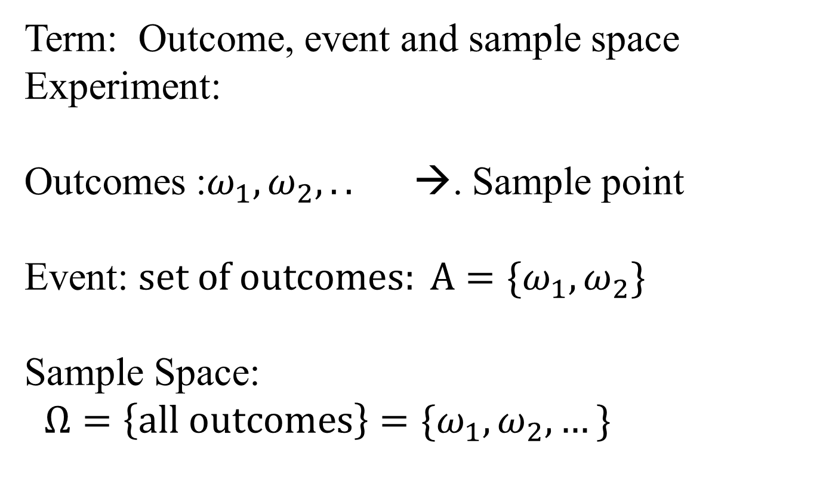
Probability
Term: Outcome, event and sample space
Experiment:
Outcomes :$ω_{1}, ω_{2},..$ →. Sample point
Event: $set of outcomes: A=\{ω_{1}, ω_{2}\}$
Sample Space:
$Ω=\left\{all outcomes\right\}=\{ω_{1},ω_{2},…\}$

Slide 11
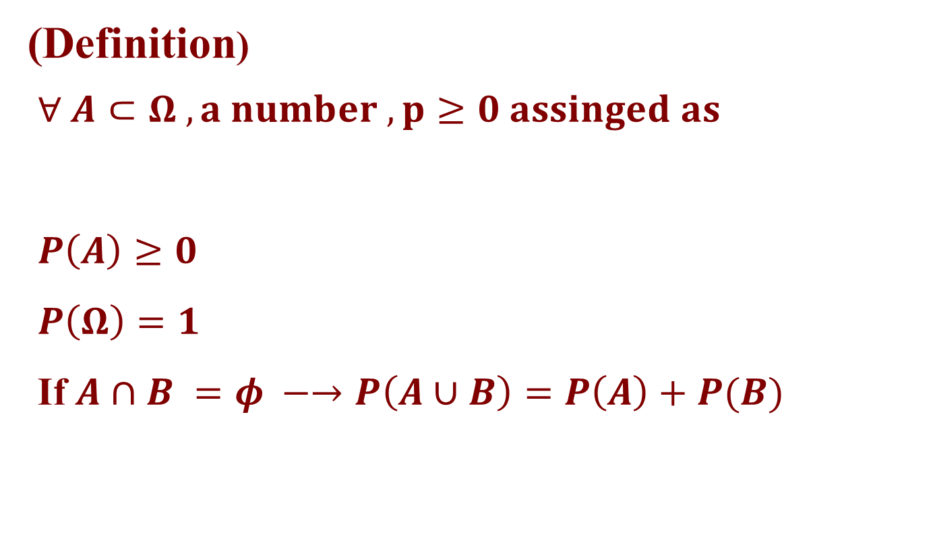
Probability
(Definition)
$∀ A⊂Ω , a number , p≥0 assinged as$
$P\left(A\right)≥0$
$P\left(Ω\right)=1$
If $A∩B =φ −→P\left(A∪B\right)=P\left(A\right)+P(B)$

Slide 12

Probability
$P\left(A^{c}\right)=1 −P\left(A\right)$
$P\left(A∪B\right)=P\left(A\right)+P\left(B\right) −P(A∩B)$

Slide 13
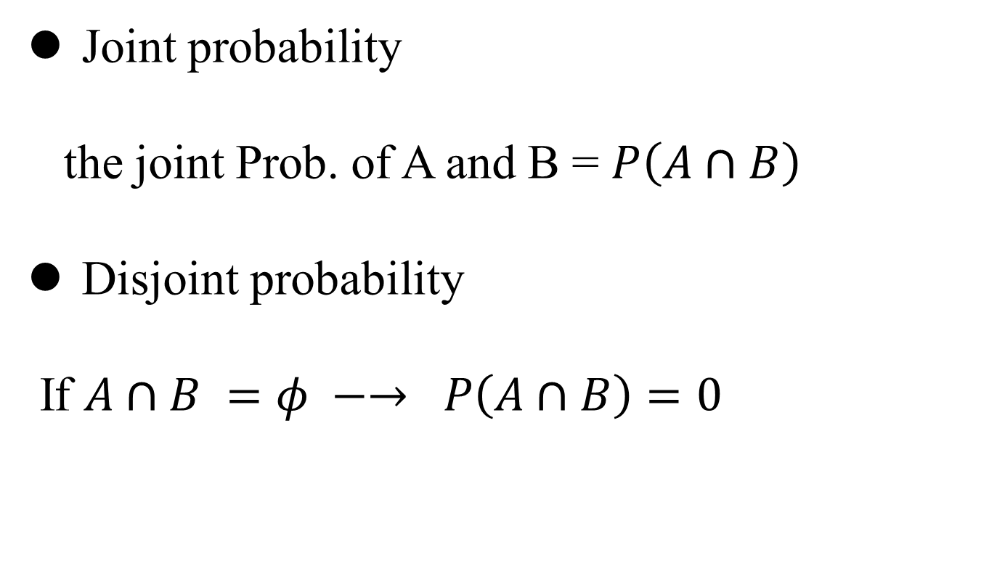
Joint Probability
Joint probability
the joint Prob. of A and B = $P\left(A∩B\right)$
Disjoint probability
If $A∩B =φ −→ P\left(A∩B\right)=0$

Slide 14
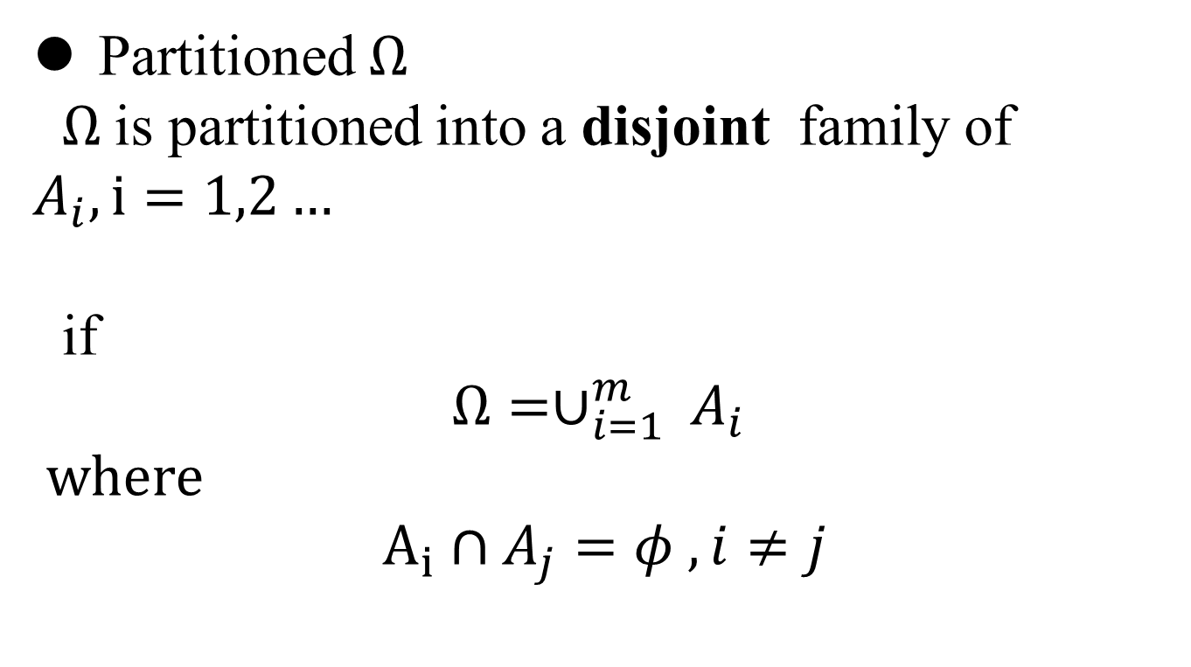
Partitioned Sample Space
Partitioned $Ω$
$Ω$is partitioned into a disjoint family of $A_{i}, i=1,2…$
if
$$Ω=∪_{i=1}^{m} A_{i}$$
where
$$A_{i}∩A_{j}=φ , i≠j$$

Slide 15
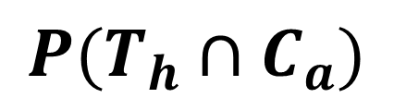

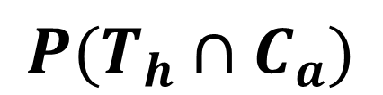

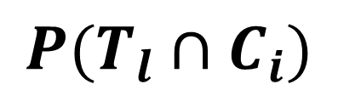
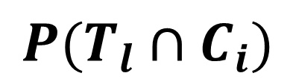
Two families partitioned
Covid: $C_{a} ,C_{i} active , inactive$
Temperature : ${ T}_{h}, T_{l}$ high , low
$$Ω=ASTU students$$
$$P(T_{h}∩C_{a})$$
$$P(T_{h}∩C_{a})$$
$$P(T_{l}∩C_{i})$$
$$P(T_{l}∩C_{i})$$

Slide 16
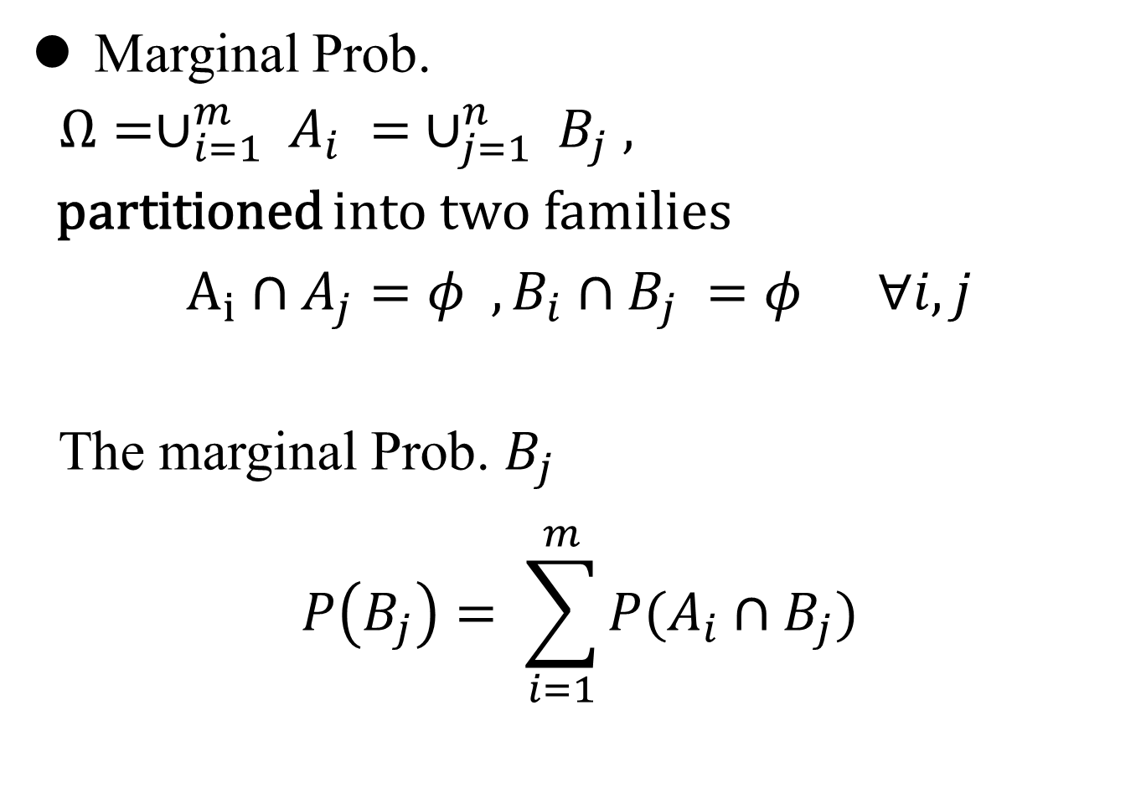
Marginal Prob.
Marginal Prob.
$Ω=∪_{i=1}^{m} A_{i} = ∪_{j=1}^{n} B_{j} ,$
partitioned into two families
$$A_{i}∩A_{j}=φ , B_{i}∩B_{j} =φ ∀i,j$$
The marginal Prob. $B_{j}$
$$P\left(B_{j}\right)= \sum_{i=1}^{m}{P(A_{i}∩B_{j})}$$

Slide 17
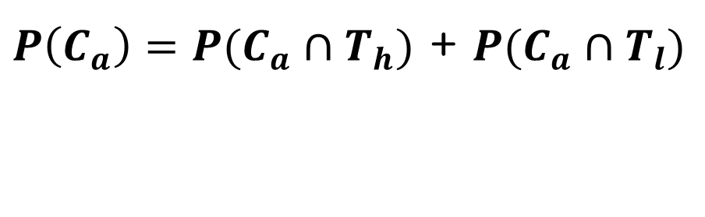
Marginal Prob.
$P\left(C_{a}\right)=P(C_{a}∩T_{h})$ + $P(C_{a}∩T_{l})$
$$P(T_{h}∩C_{a})$$
$$P(T_{h}∩C_{a})$$
$$P(T_{l}∩C_{i})$$
$$P(T_{l}∩C_{i})$$

Slide 18
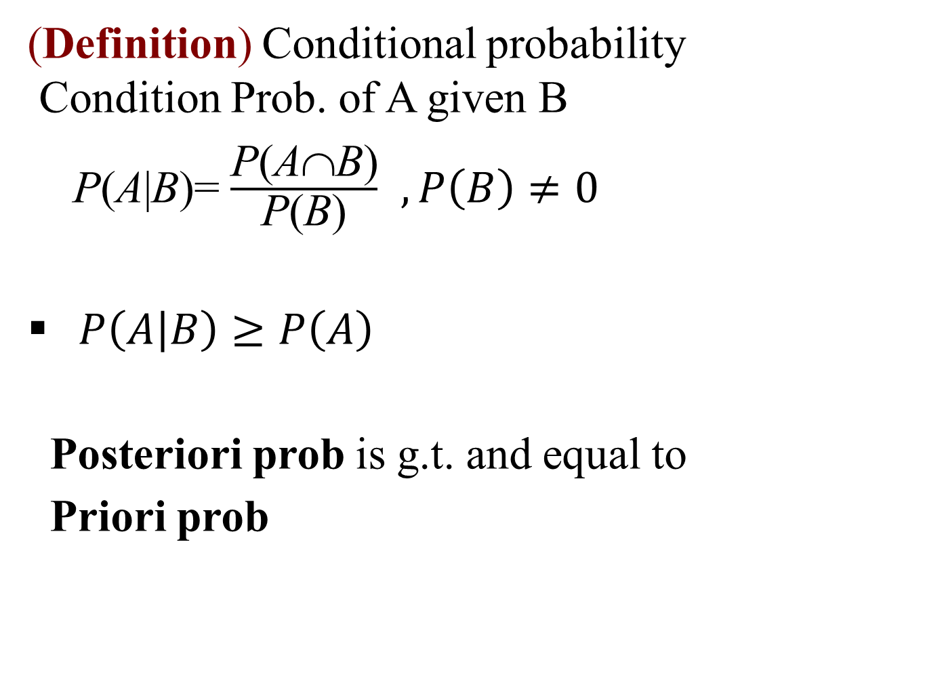
Conditional Prob
(Definition) Conditional probability
Condition Prob. of A given B
P(A|B)= $\frac{\text{P}\text{(}\text{A}\text{∩}\text{B}\text{)}}{\text{P}\text{(}\text{B}\text{)}}$ $, P\left(B\right)≠0$
$P\left(A | B\right)≥P\left(A\right)$
Posteriori prob is g.t. and equal to
Priori prob

Slide 19
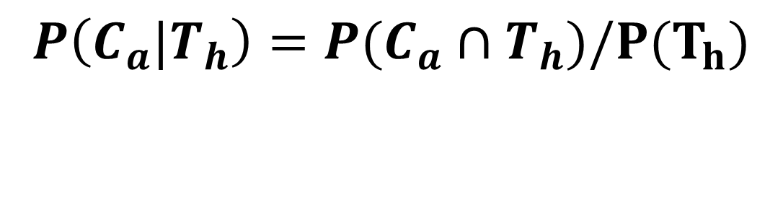
Conditional Prob.
$$P\left(C_{a}|T_{h}\right)=P(C_{a}∩T_{h})/P(T_{h})$$
$$P(T_{h}∩C_{a})$$
$$P(T_{h}∩C_{a})$$
$$P(T_{l}∩C_{i})$$
$$P(T_{l}∩C_{i})$$

Slide 20
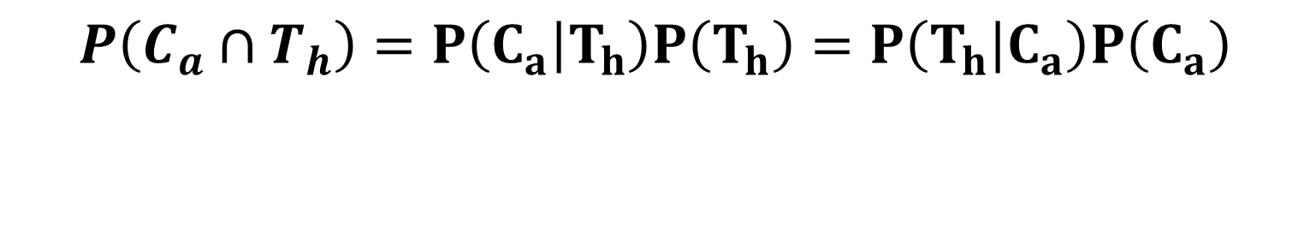
Conditional Prob.
$$P\left(C_{a}∩T_{h}\right)=P\left(C_{a} | T_{h}\right)P\left(T_{h}\right)=P\left(T_{h} | C_{a}\right)P\left(C_{a}\right)$$
$$P(T_{h}∩C_{a})$$
$$P(T_{h}∩C_{a})$$
$$P(T_{l}∩C_{i})$$
$$P(T_{l}∩C_{i})$$

Slide 21
Independent Event
(Definition) Independence and dependence
If two events A and B are independent,
P(A∩B)= P(A)P(B)
Hence
P(A|B)= P(A)
P(B|A)=P(B)

Slide 22
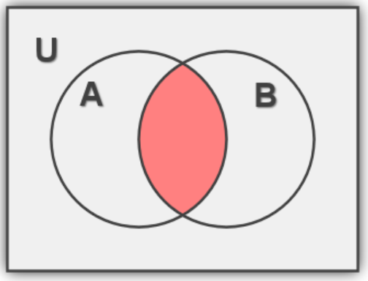

Independent Event
!! Disjoint is not same to Independent
$A∩B =φ$ → P(A∩B) = 0
P(A∩B)

Slide 23
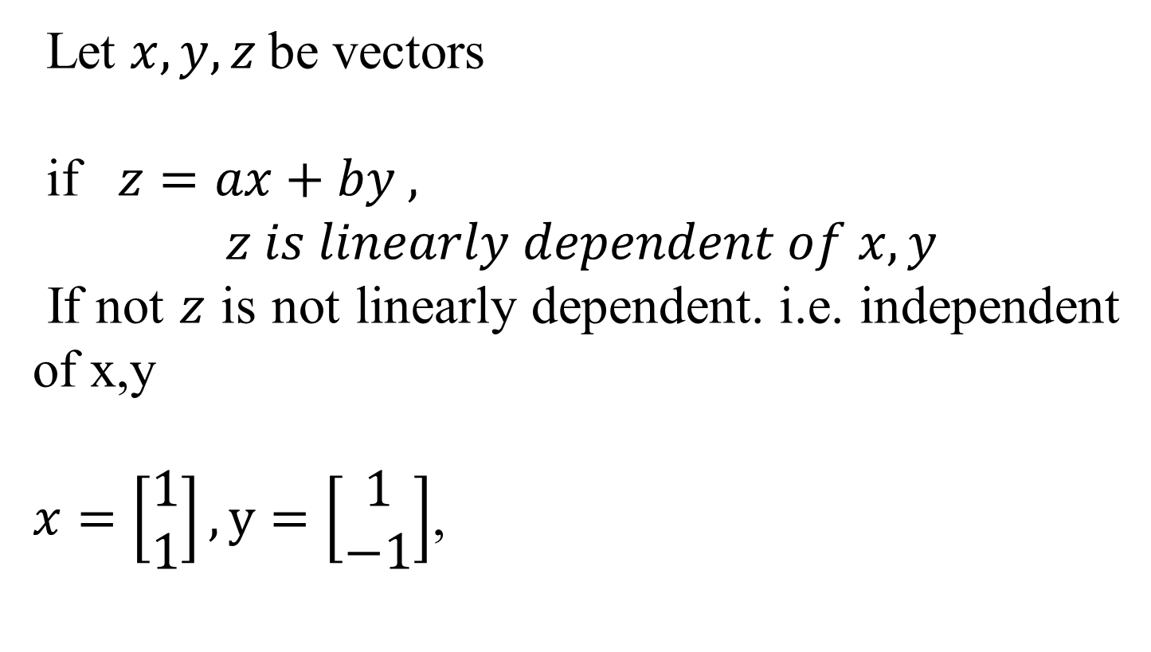
Linear independent
Let $x,y,z$be vectors
if $z=ax+by ,$
$$z is linearly dependent of x,y$$
If not $z$ is not linearly dependent. i.e. independent of x,y
$x=\left[\begin{matrix}1 \\ 1\end{matrix}\right], y=\left[\begin{matrix}1 \\ −1\end{matrix}\right]$,

Slide 24
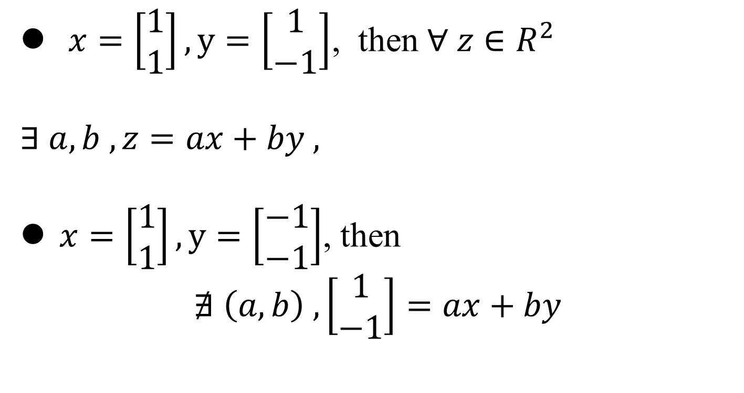
Linear independent
$x=\left[\begin{matrix}1 \\ 1\end{matrix}\right], y=\left[\begin{matrix}1 \\ −1\end{matrix}\right]$, then $∀ z∈R^{2}$
$∃ a,b , z=ax+by ,$
$x=\left[\begin{matrix}1 \\ 1\end{matrix}\right], y=\left[\begin{matrix}−1 \\ −1\end{matrix}\right]$, then
$$∄ \left(a,b\right) , \left[\begin{matrix}1 \\ −1\end{matrix}\right]=ax+by$$

Slide 25

Independent Event
Example 10: In the trial to roll a single die, the two events were
A= ″It is multiples of 2″
B= ″It is multiples of 3″
Are the two events independent?
Solution:
The sample space is S= {1,2,3,4,5,6}
n(S)= 6

Slide 26
Independent Event
A= ″It is multiples of 2″= {2,4,6}
B= ″It is multiples of 3″= {3,6}
P(A)= n(A)/n(S)= 3/6=1/2
P(B)= n(B)/n(S)= 2/6=1/3
A∩B= {6}
P(A∩B)= n(A∩B)/n(S)= 1/6
∴Since P(A∩B)= P(A)P(B), they are independent.

Slide 27

Q&A

