Slide 1
PCE6205 Stochastic (Random Variable)
2022-03-20
Prof.S.Kim

Slide 2
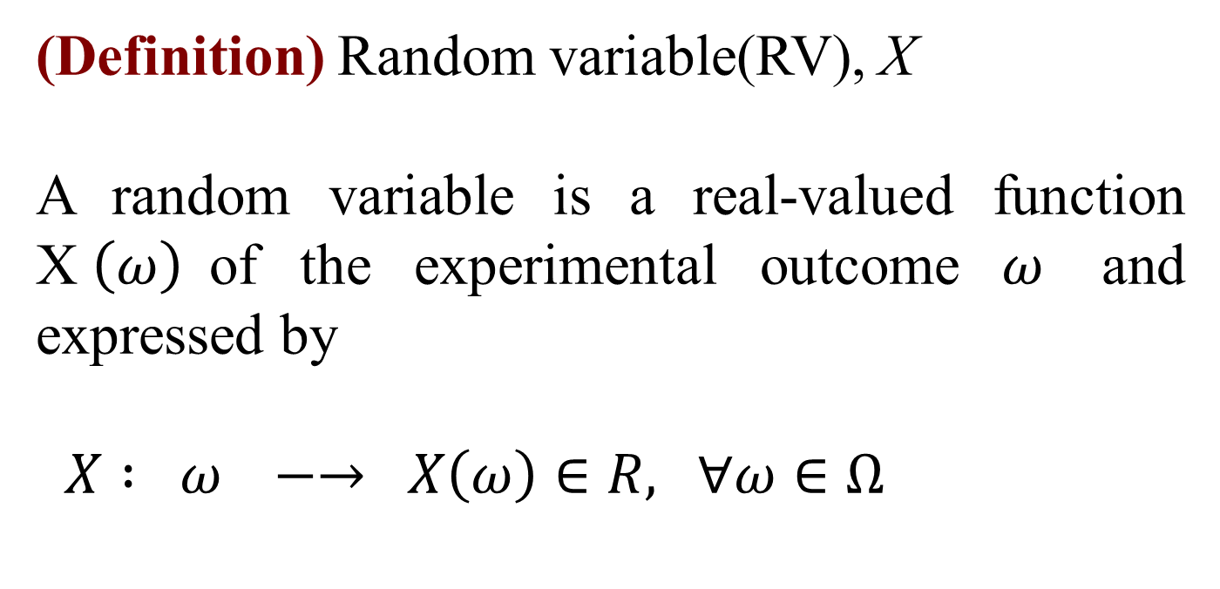
2.1 Random Variable
(Definition) Random variable(RV), X
A random variable is a real-valued function X$\left(ω\right)$of the experimental outcome $ω$ and expressed by
$X : ω −→ X\left(ω\right)∈R,$ $∀ω∈Ω$

Slide 3
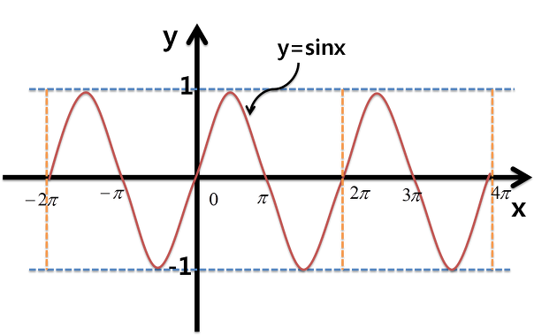

2.1 Random Variable
Function : $f\left(x\right)$
$$f: f\left(x\right) −→y ∀ x∈Domain, y∈range$$
Domain
Range

Slide 4


2.1 Random Variable
This is not a function
$$x^{2}+y^{2}=1, y\left(x\right)=±\sqrt{1−x^{2}}$$
Domain
Range

Slide 5
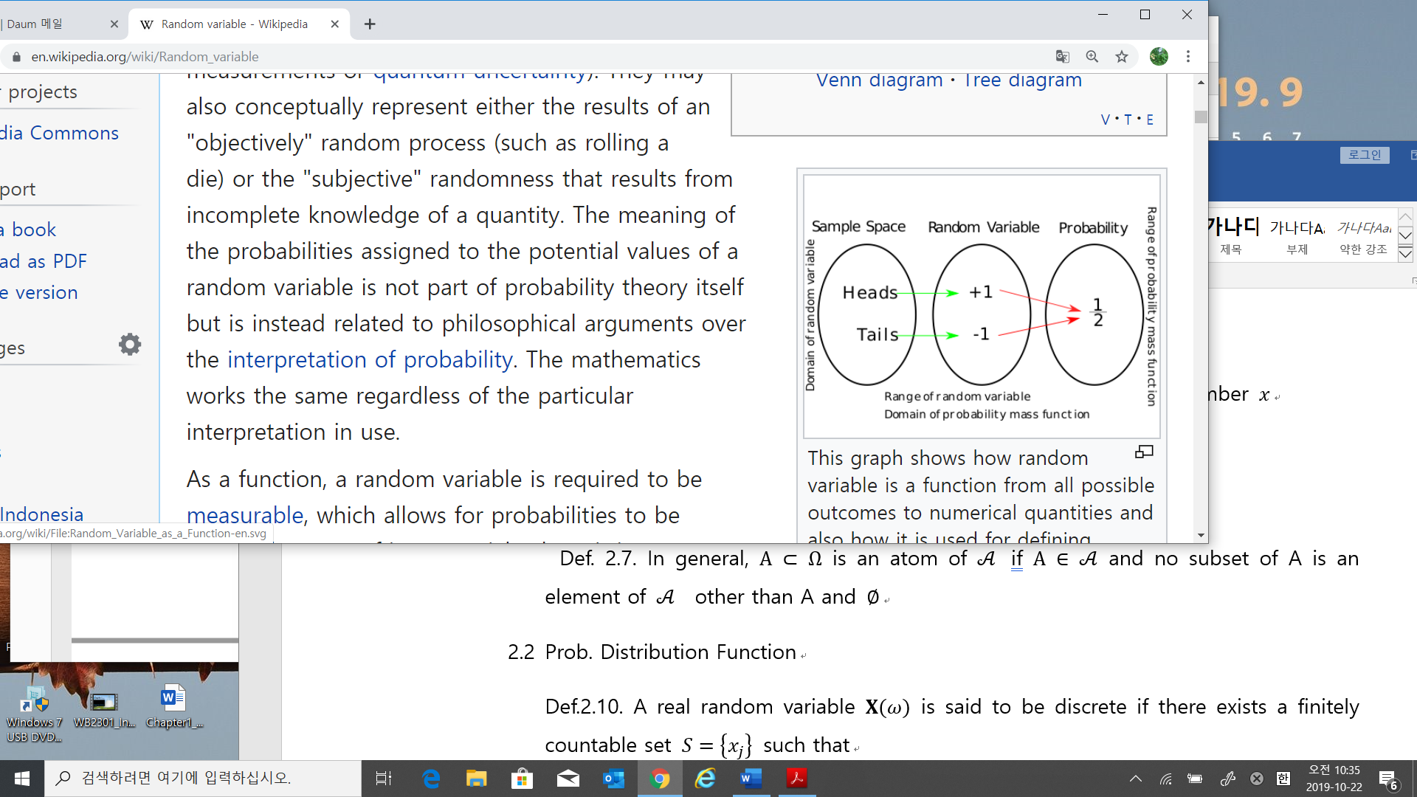

2.1 Random Variable
Function : X
$$X: X\left(ω\right) −→x ∀ x∈Ω, y∈R$$

Slide 6
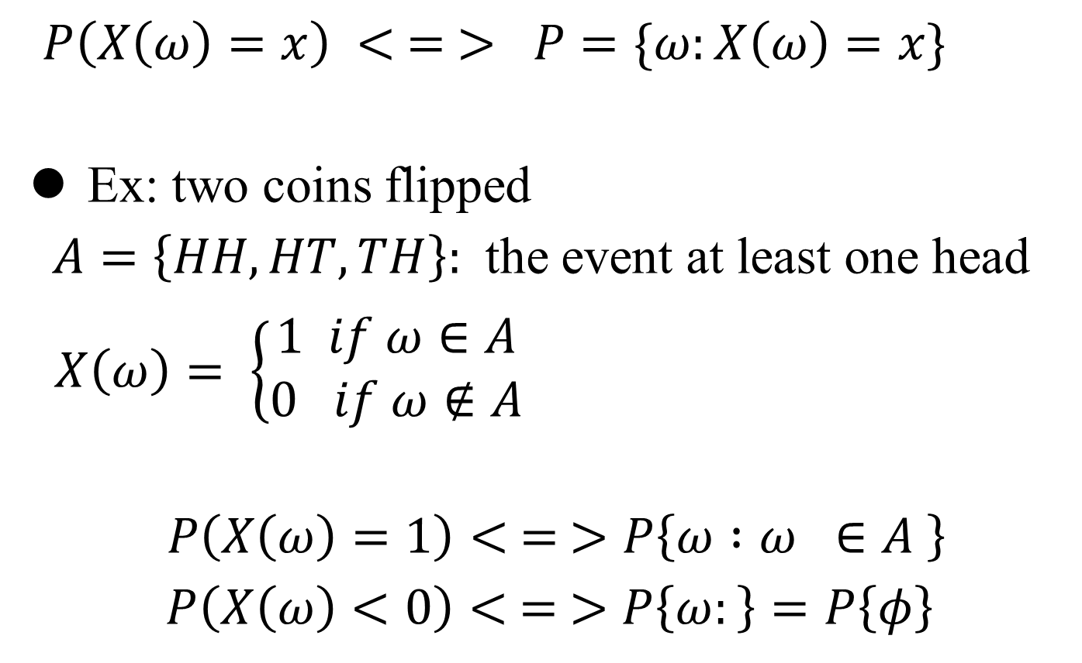
2.2 Prob. in RVs
$P\left(X\left(ω\right)=x\right) < = > P=\{ω:X\left(ω\right)=x\}$
Ex: two coins flipped
$A=\left\{HH,HT,TH\right\}:$ the event at least one head
$X\left(ω\right)= \left\{\begin{aligned}1 if ω∈A \\ 0 if ω∉A\end{aligned}\right.$
$P\left(X\left(ω\right)=1\right)< = >P\left\{ω :ω ∈A \right\}$
$$P\left(X\left(ω\right)<0\right)< = >P\left\{ω:\right\}=P\left\{φ\right\}$$

Slide 7
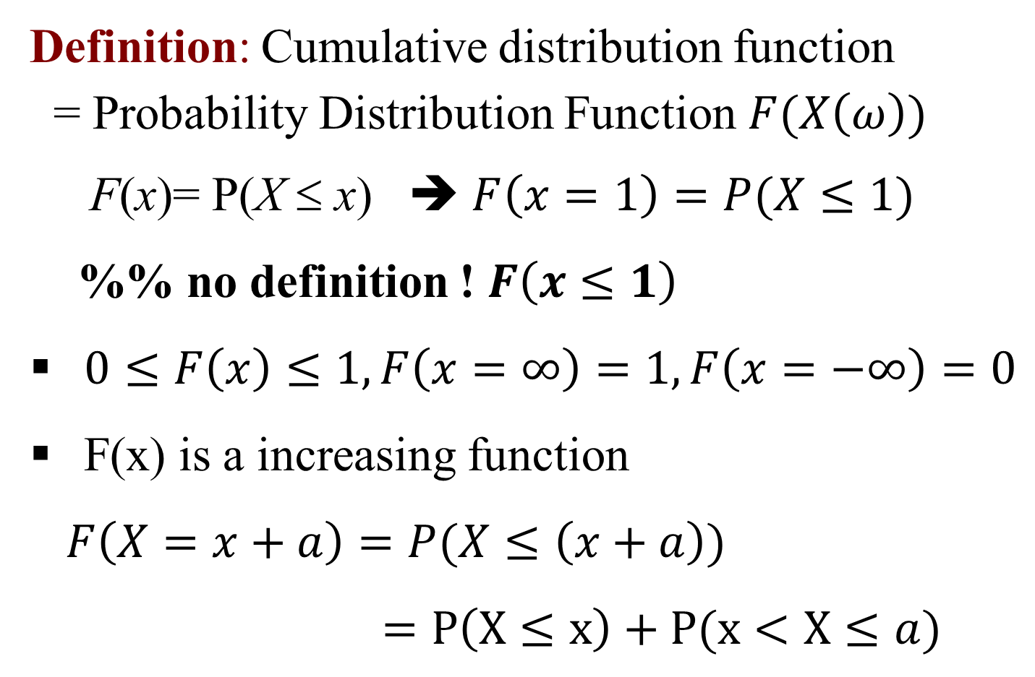
2.3 CDF
Definition: Cumulative distribution function
= Probability Distribution Function $F(X\left(ω\right))$
F(x)= P(X ≤ x) ➔ $F\left(x=1\right)=P(X≤1)$
%% no definition ! $F\left(x≤1\right)$
$0≤F\left(x\right)≤1,F\left(x=∞\right)=1, F\left(x=−∞\right)=0$
F(x) is a increasing function
$F\left(X=x+a\right)=P(X≤\left(x+a\right))$
$=P\left(X≤x\right)+P(x<X≤a)$

Slide 8
2.3 CDF
f(x)
x
0
a
b

Slide 9
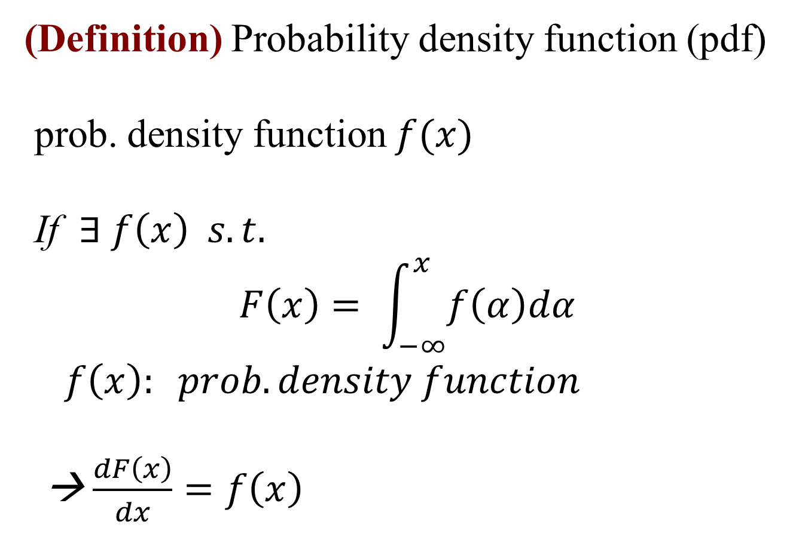
2.4 Probability Density Function
(Definition) Probability density function (pdf)
prob. density function $f(x)$
If $∃ f\left(x\right) s.t.$
$$F\left(x\right)= \int_{−∞}^{x}{f\left(α\right)dα}$$
$f\left(x\right): prob.density function$
→ $\frac{dF\left(x\right)}{dx}=f\left(x\right)$

Slide 10
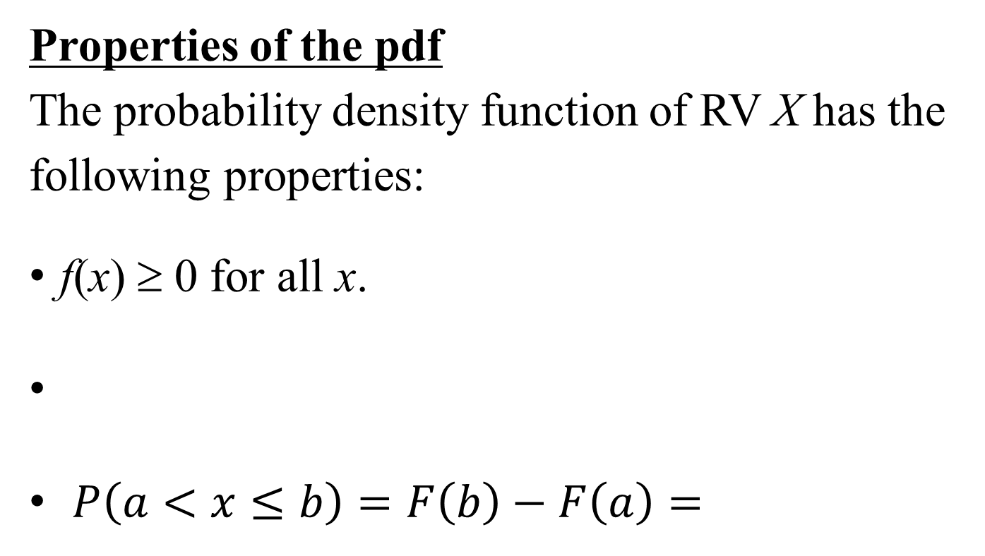

2.4 Probability Density Function
Properties of the pdf
The probability density function of RV X has the following properties:
f(x) ≥ 0 for all x.
$P\left(a<x≤b\right)=F\left(b\right)−F\left(a\right)=$
$$\int_{a}^{b }{f(x)}dx$$

Slide 11
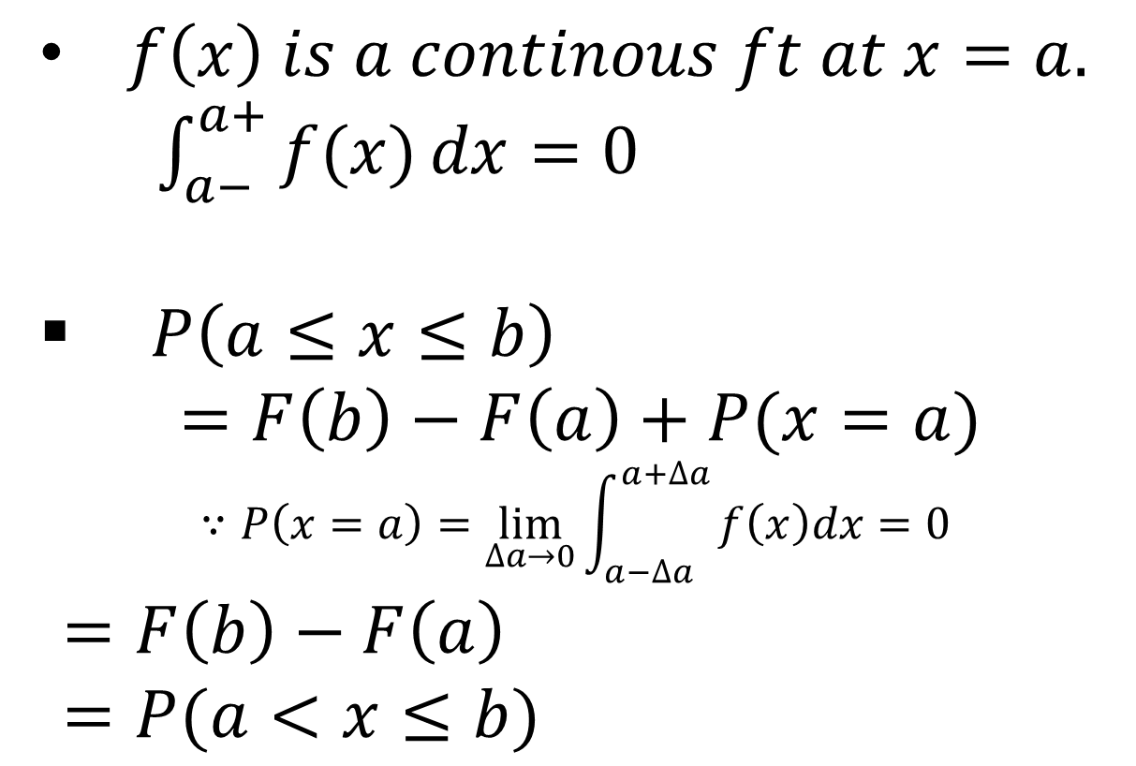
2.4 Probability Density Function
$f\left(x\right) is a continous ft at x=a.$
$\int_{a−}^{a+}{f(x)}dx=0$
$P\left(a≤x≤b\right)$
$$=F\left(b\right)−F\left(a\right)+P(x=a)$$
$$∵P\left(x=a\right)=\lim_{∆a→0}{\int_{a−∆a}^{a+∆a }{f\left(x\right)dx=0 }}$$
$=F\left(b\right)−F\left(a\right)$
$=P(a<x≤b)$

Slide 12
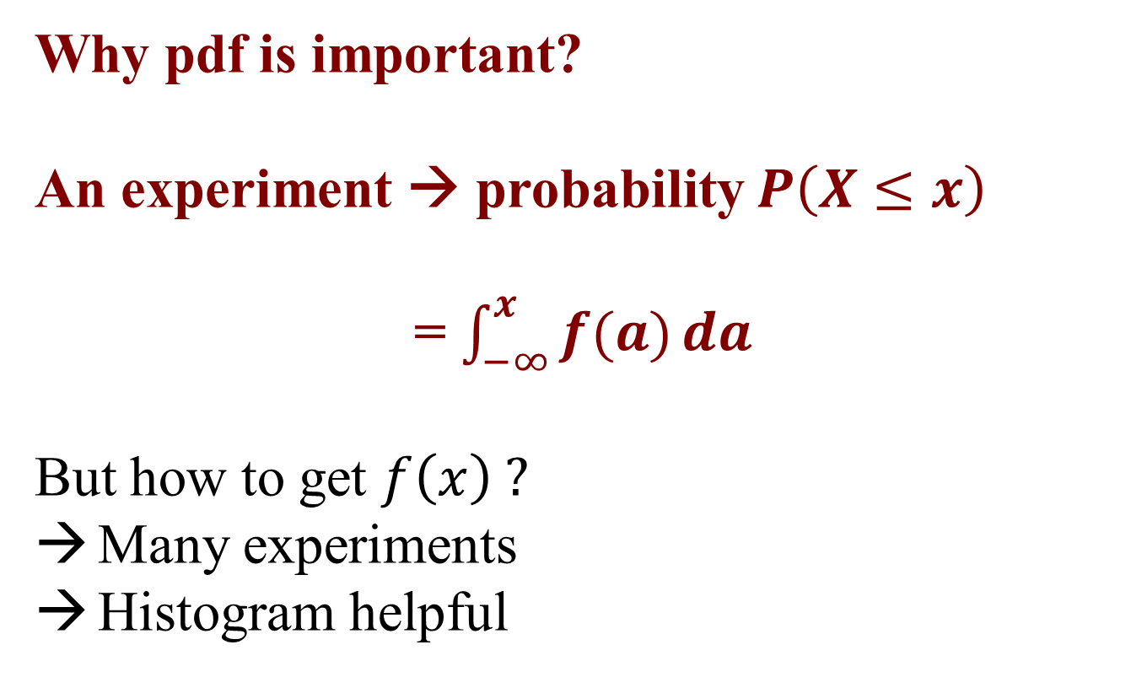
2.5 Useful PDFs
Why pdf is important?
An experiment → probability $P\left(X≤x\right)$
= $\int_{−∞}^{x}{f(a)}da$
But how to get $f\left(x\right) ?$
Many experiments
Histogram helpful

Slide 13
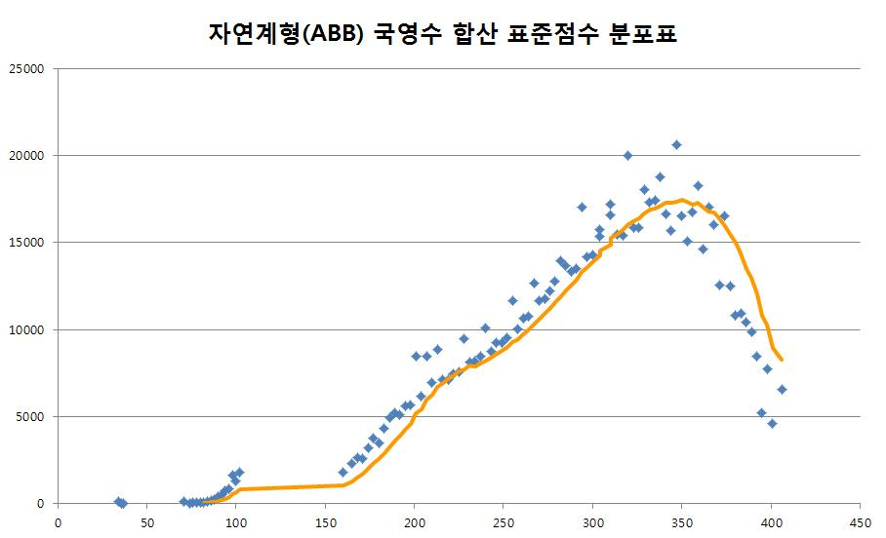
2.5 Useful PDFs
Example: Distribution of students' scores

Slide 14
2.5 Probability Density Function
Example 6: Given the pdf of RV X,
(1) Find constant c.
(2) Find P(-2≤ X≤ 1).
f(x)
2c
x
0
2

Slide 15
2.5 Probability Density Function
Solution: (1) From the property of pdf

Slide 16
2.5 Probability Density Function
(2)

Slide 17
2.5 Probability Density Function
Quiz 1: Consider the pdf of RV X.
(1) Find a.
(2) Find P(0< X ≤ 1).

Slide 18
2.5 Probability Density Function
Solution: (1) From the property of pdf

Slide 19
2.5 Probability Density Function
f(x)
1
x
0
2

Slide 20
2.5 Probability Density Function
(2)

Slide 21
2.6 PDF & CDF
Example 9: Given the pdf of the random variable X, find the probability distribution function F(x).
f(x)
1/2
x
x
0
2
Solution:
1. When x < 0,

Slide 22
2.6 PDF & CDF
2. When 0 ≤ x < 2,
f(x)
1/2
x
0
x
2

Slide 23
2.6 PCF & CDF
3. When x ≥ 2
f(x)
1/2
x
0
2
x

Slide 24
2.4 PDF & CDF
Thus
F(x)
1
x
0
2

Slide 25
2.4 PDF & CDF
Example 10: Consider the pdf of the RV X.
(1) Find F(x).
(2) Obtain P(2 ≤ X ≤ 3).
f(x)
2/3
x
0
2
3
Solution: (1)

Slide 26
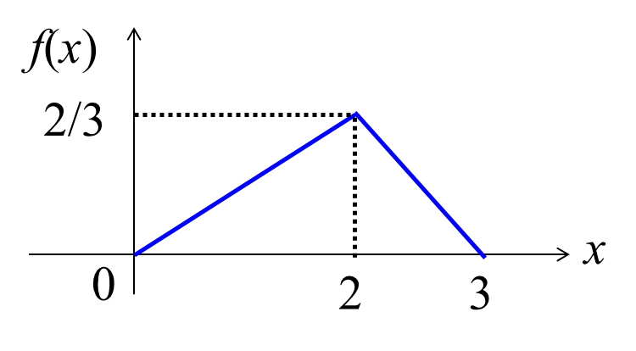
2.4 PDF & CDF
x
1. When 0 < x
2. When 0 ≤ x < 2

Slide 27
2.4 PDF & CDF
x
3. When 2 ≤ x < 3

Slide 28
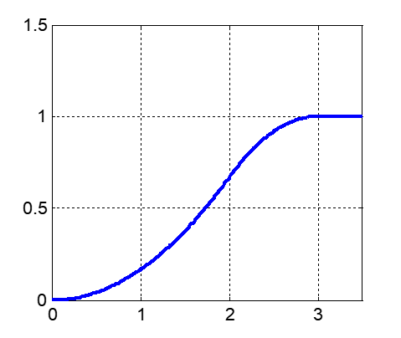
2.4 PDF & CDF
4. When x ≥ 3

Slide 29
2.4 PDF & CDF
(2)

Slide 30
2.4 PDF & CDF
Example 11: Given the probability distribution function F(x) of the RV X, find P(3 < X <5).
Solution 1:

Slide 31
2.4 PDF & CDF
Solution 2: Obtaining the pdf of the RV X
Thus,

Slide 32
2.5 Useful PDFs
(Definition) Uniform distribution
The pdf of the uniform distribution is constant over the interval (a, b). The pdf of X is given by
f(x)
1/(b-a)
a
0
b
x

Slide 33
2.5 Useful PDFs
Its cdf
1. when a ≤ x < b
2. when x ≥ b
F(x)
1
a
0
b
x

Slide 34
2.5 Useful PDFs
(Definition) Exponential distribution
The RV X that equals the distance between successive Poisson process with mean λ >0 is an exponential distribution with parameter λ.
The pdf of X is

Slide 35
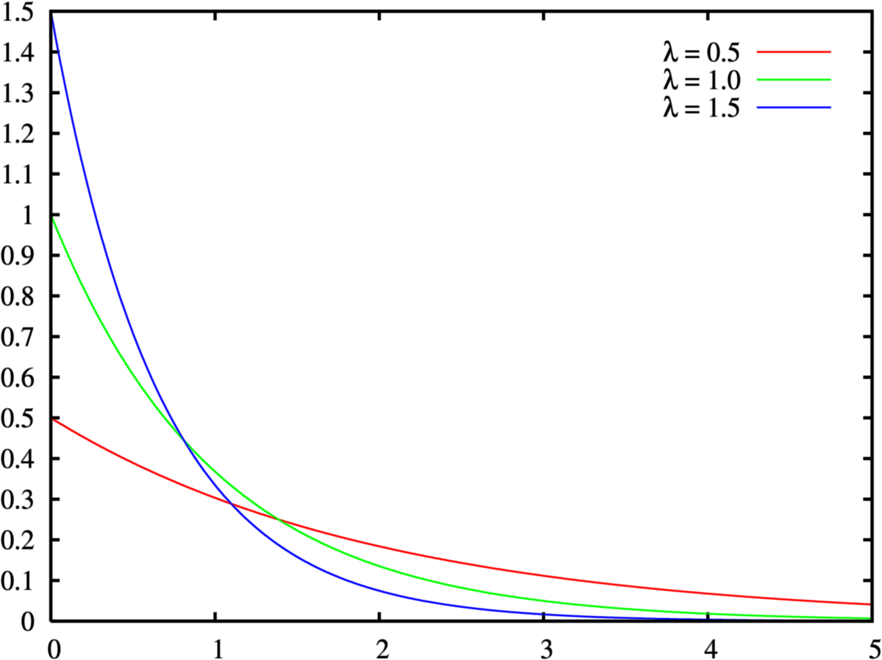
2.5 Useful PDFs
Exponential probability density function
f(x)
x

Slide 36
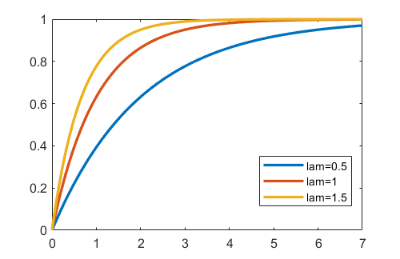
2.5 Useful PDFs
For x > 0, its cdf is

Slide 37
2.5 Useful PDFs
(Definition) Gaussian(normal) distribution
X~ N(μ,σ²).

Slide 38
2.5 Useful PDFs
Properties of normal distribution
It is symmetrical about x = m and has the maximum value at this point.
At x=m±3σ, it approaches the x-axis.
The expected value and variance of X are m and σ², respectively.
The degree of scattering varies depending on.
f(x)
m-3σ
m
m+3σ
x
f(x)
σ=1
σ=2
σ=3
m
x

Slide 39
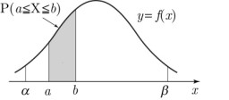
2.5 Useful PDFs

Slide 40
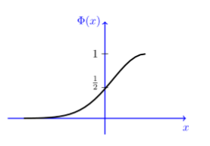
2.5 Useful PDFs
CDF of the standard normal
F(x)

Slide 41
2.6 Joint cdf
For RVs X and Y,
The joint cumulative distribution function(jcdf) of X and Y is defined as
F_{XY}(x_{i},y_{i}) = P[X ≤ x_{i}, Y ≤ y_{i}]
The jcdf is nondecreasing and has the following properties:
(1) F_{XY}(x₁,y₁) ≤ F_{XY}(x₂,y₂) if x₁≤ x₂ and y₁≤ y₂
(2) F_{XY}(-∞,y₁)= F_{XY}(x₂,-∞)= 0
(3) F_{XY}(∞,∞)= 1

Slide 42
2.6 Joint cdf
If we let one of the variables approach infinity while keeping the other fixed, we obtain the marginal cumulative distribution functions
F_{X} (x) = F_{XY}(x,∞) = P[X ≤ x, Y ≤ ∞] = P[X ≤ x]
and
F_{Y} (y) = F_{XY}(∞,y) = P[X ≤ ∞, Y ≤ y] = P[Y ≤ y]

Slide 43
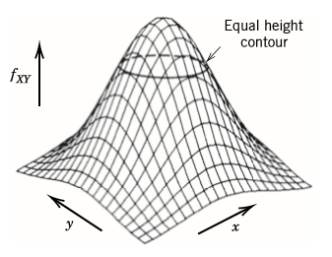
2.6 Joint pdf
For continuous RVs X and Y
The jpdf f_{XY}(x,y) of X and Y is
(1) f_{XY}(x,y) ≥ 0 for ∀x,y
(2)
(3)

Slide 44
2.7 Marginal pdf
Marginal probability density:
Independence:
RVs X and Y are independent if and only if
f_{XY}(x,y)= f_{X} (x) f_{Y}(y)

Slide 45
2.7 Marginal pdf
Example 12: The jpdf of two RVs X and Y are
(1) Find a.
(2) Find f_{X}(x), f_{Y}(y). Are X and Y independent?
Solution: (1) From the definition of jpdf

Slide 46
2.7 Marginal pdf

Slide 47
2.7 Marginal pdf
(2)
(3)
They are independent.

Slide 48
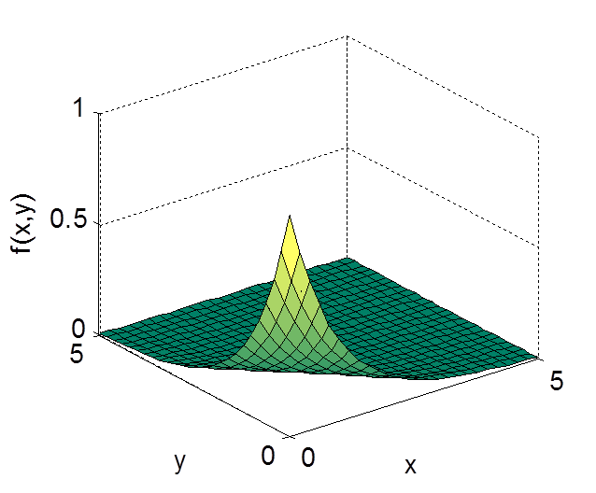
2.7 Marginal pdf

Slide 49
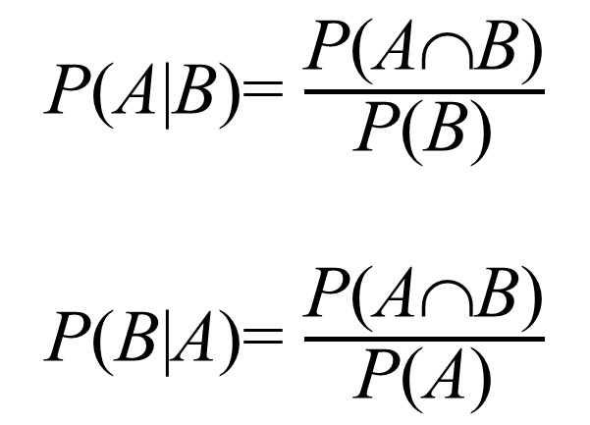
2.8 Conditional pdf
Bayes Rule:
P(A∩B)= P(B)P(A|B)
= P(A)P(B|A)
Conditional pdf:
P(A|B)= $\frac{\text{P}\text{(}\text{A}\text{∩}\text{B}\text{)}}{\text{P}\text{(}\text{B}\text{)}}$
P(B|A)= $\frac{\text{P}\text{(}\text{A}\text{∩}\text{B}\text{)}}{\text{P}\text{(}\text{A}\text{)}}$

