Slide 1

Estimator
Estimator : Sum of random variables
The measurement $Z$
$$Z=X+Y$$
- The Estimator for $X, \hat{X}= E[X]$
1) $E\left[Z\right]=E\left[X+Y\right]=E\left[X\right]+E\left[Y\right]$
→ $\hat{X}=E\left[X\right]=E\left[Z\right]−E[Y]$
→ $E\left[Z\right] = \left\{\begin{aligned}\int_{−∞}^{∞}{zf_{Z}(z)}dz \\ \sim \sum_{i=1}^{n}{Z_{i}}\text{ (}\text{if} Z_{i} \text{is} \text{i}\text{.}\text{i}\text{.}\text{d}\text{) }\end{aligned}\right.$
2) If $E\left[Y\right]=0 \left(the bias of the sensor is zero\right) −→E\left[X\right]\sim \frac{1}{n}\sum_{i=1}^{n}{z_{i}}$

Slide 2

Conditional Expectation .
Estimator
The conditional expectation $\hat{X}=E[X|Z]$
Week_6 Sum of Random Variables
$$Z=X+Y$$
- Given the joint probability of $(x,y)$ find the pdf of $z$

Slide 3
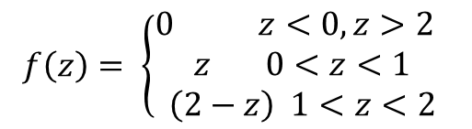



Conditional Expectation .
$$f\left(x,y\right)= \left\{\begin{aligned}1 0<x<1, 0<y<1 \\ 0 otherwise \end{aligned}\right.$$
y
$$f(x,y)$$
1
0 1
x
$$f\left(z\right)= \left\{\begin{aligned}0 z<0, z>2 \\ z 0<z<1 \\ \left(2−z\right) 1<z<2\end{aligned}\right.$$
$$f(z)$$
1 2 z

Slide 4
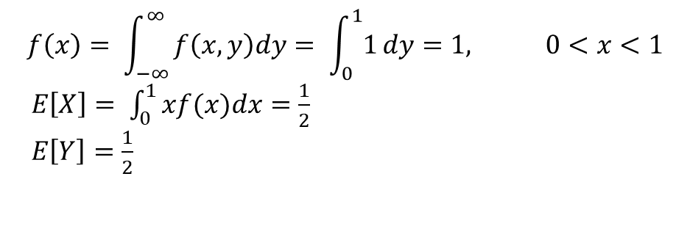
Conditional Expectation .
$$f\left(x,y\right)= \left\{\begin{aligned}1 0<x<1, 0<y<1 \\ 0 otherwise \end{aligned}\right.$$
y
$$f(x,y)$$
1
0 1
x
$$f\left(x\right)= \int_{−∞}^{∞}{f\left(x,y\right)dy= \int_{0}^{1}{1}dy}=1, 0<x<1$$
$E\left[X\right]= \int_{0}^{1}{xf(x)dx=\frac{1}{2} }$
$E\left[Y\right]=\frac{1}{2}$

Slide 5
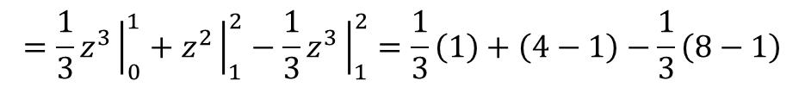
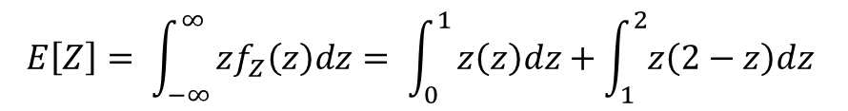

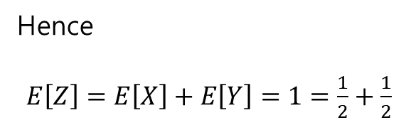
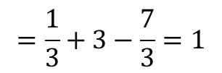
Conditional Expectation .
$E[Z]$
$$E\left[Z\right]= \int_{−∞}^{∞}{zf_{Z}\left(z\right)dz= \int_{0}^{1}{z\left(z\right)dz+\int_{1}^{2}{z\left(2−z\right)dz} }}$$
$$=\frac{1}{3}z^{3}{\left.​\right|}_{0}^{1}+z^{2}{\left.​\right|}_{1}^{2}−\frac{1}{3}z^{3}{\left.​\right|}_{1}^{2}=\frac{1}{3}\left(1\right)+\left(4−1\right)−\frac{1}{3}\left(8−1\right)$$
$$=\frac{1}{3}+3−\frac{7}{3}=1$$
Hence
$E\left[Z\right]=E\left[X\right]+E\left[Y\right]=1=\frac{1}{2}+\frac{1}{2}$

Slide 6
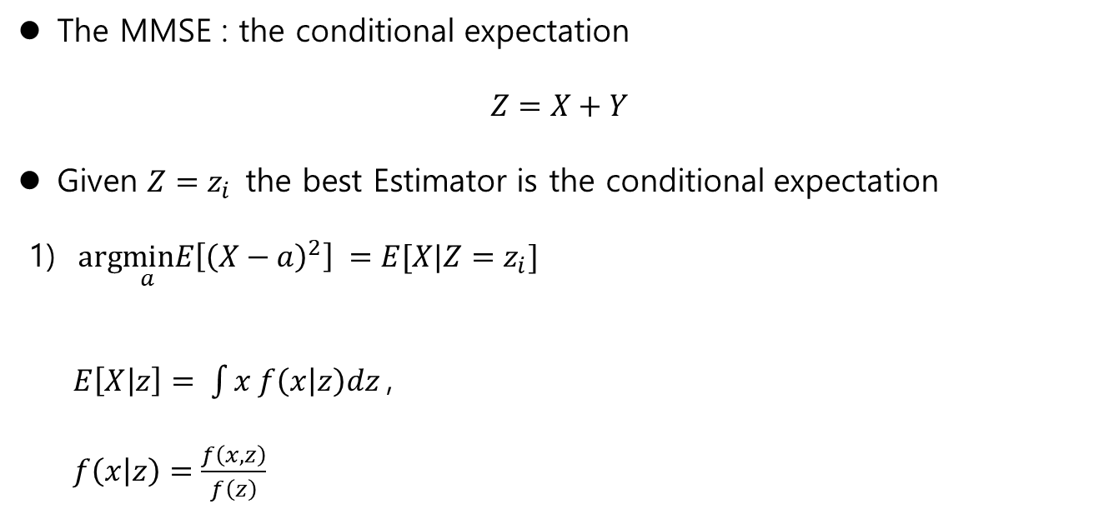
Conditional Expectation .
The MMSE : the conditional expectation
$$Z=X+Y$$
Given $Z=z_{i}$the best Estimator is the conditional expectation
1) $arg\min_{a}E\left[{\left(X−a\right)}^{2}\right] =E[X|Z=z_{i}]$
$E\left[X | z\right]= \int{x f\left(x | z\right)dz}$,
$f\left(x | z\right)=\frac{f\left(x,z\right)}{f\left(z\right)}$

Slide 7
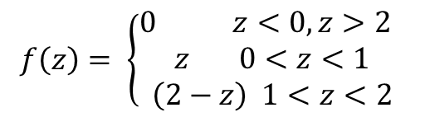

Conditional Expectation .
y
$$f\left(x,y\right)= \left\{\begin{aligned}1 0<x<1, 0<y<1 \\ 0 otherwise \end{aligned}\right.$$
$$f(x,y)$$
1
0 1
x
$$f\left(z\right)= \left\{\begin{aligned}0 z<0, z>2 \\ z 0<z<1 \\ \left(2−z\right) 1<z<2\end{aligned}\right.$$
$$f(z)$$
1 2 z

Slide 8
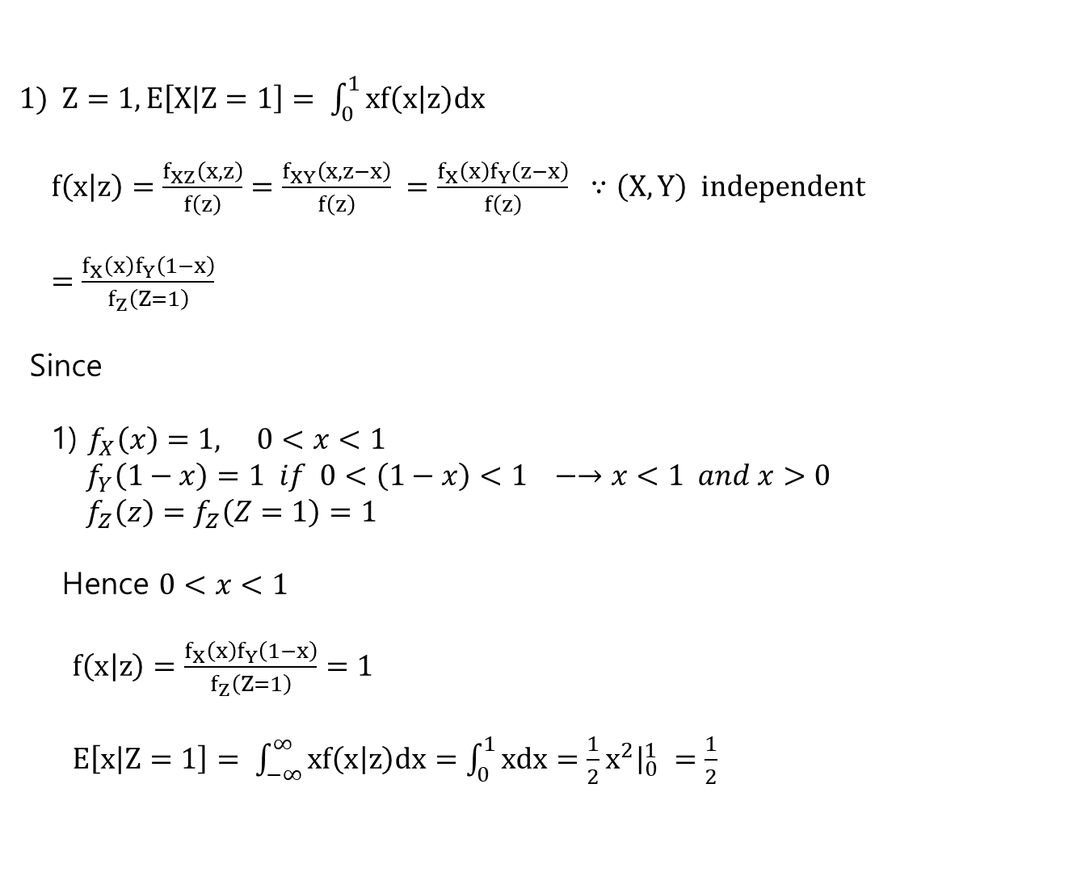
Conditional Expectation .
1) $Z=1, E\left[X | Z=1\right]= \int_{0}^{1}{xf\left(x | z\right)dx}$
$f\left(x | z\right)=\frac{f_{XZ}\left(x,z\right)}{f\left(z\right)}=\frac{f_{XY}\left(x,z−x\right)}{f\left(z\right)} =\frac{f_{X}\left(x\right)f_{Y}\left(z−x\right)}{f\left(z\right)} ∵\left(X,Y\right) independent$
$=\frac{f_{X}\left(x\right)f_{Y}\left(1−x\right)}{f_{Z}\left(Z=1\right)}$
Since
1) $f_{X}\left(x\right)=1, 0<x<1$
${ f}_{Y}\left(1−x\right)=1 if 0<\left(1−x\right)<1 −→x<1 and x>0$
$f_{Z}\left(z\right)=f_{Z}\left(Z=1\right)=1$
Hence $0<x<1$
$f\left(x | z\right)=\frac{f_{X}\left(x\right)f_{Y}\left(1−x\right)}{f_{Z}\left(Z=1\right)}=1$
$E\left[x | Z=1\right]= \int_{−∞}^{∞}{xf\left(x | z\right)dx=\int_{0}^{1}{xdx}=\frac{1}{2}x^{2}{\left.​\right|}_{0}^{1} =\frac{1}{2}}$

Slide 9
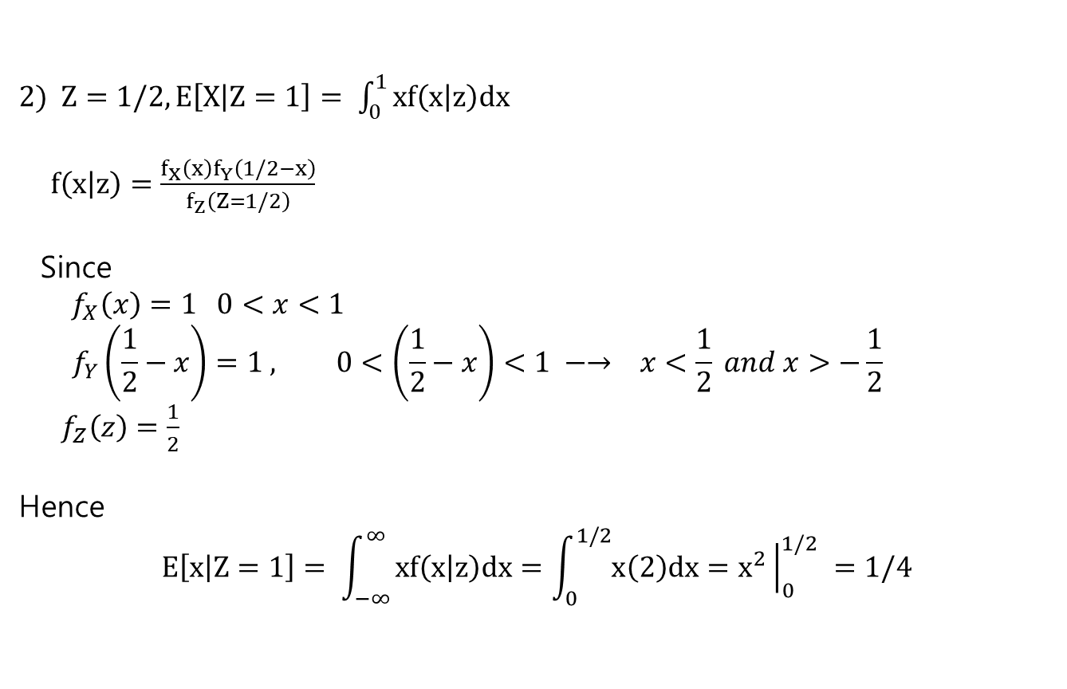
Conditional Expectation .
2) $Z=1/2, E\left[X | Z=1\right]= \int_{0}^{1}{xf\left(x | z\right)dx}$
$f\left(x | z\right)=\frac{f_{X}\left(x\right)f_{Y}\left(1/2−x\right)}{f_{Z}\left(Z=1/2\right)}$
Since
$f_{X}\left(x\right)=1 0<x<1$
$$f_{Y}\left(\frac{1}{2}−x\right)=1 , 0<\left(\frac{1}{2}−x\right)<1 −→ x<\frac{1}{2} and x>−\frac{1}{2}$$
$f_{Z}\left(z\right)=\frac{1}{2}$
Hence
$$E\left[x | Z=1\right]= \int_{−∞}^{∞}{xf\left(x | z\right)dx=\int_{0}^{1/2}{x\left(2\right)dx}=x^{2}{\left.​\right|}_{0}^{1/2} =1/4}$$

Slide 10
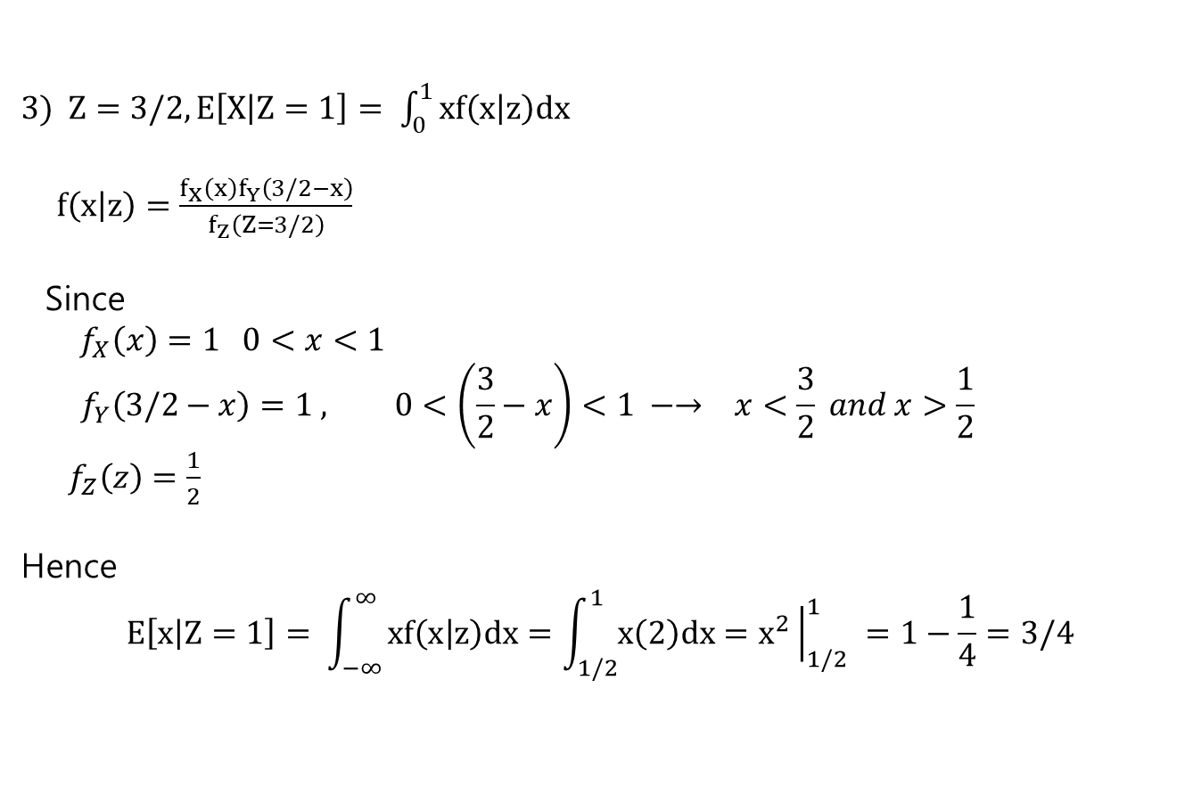
Conditional Expectation .
3) $Z=3/2, E\left[X | Z=1\right]= \int_{0}^{1}{xf\left(x | z\right)dx}$
$f\left(x | z\right)=\frac{f_{X}\left(x\right)f_{Y}\left(3/2−x\right)}{f_{Z}\left(Z=3/2\right)}$
Since
$f_{X}\left(x\right)=1 0<x<1$
$$f_{Y}\left(3/2−x\right)=1 , 0<\left(\frac{3}{2}−x\right)<1 −→ x<\frac{3}{2} and x>\frac{1}{2}$$
$f_{Z}\left(z\right)=\frac{1}{2}$
Hence
$$E\left[x | Z=1\right]= \int_{−∞}^{∞}{xf\left(x | z\right)dx=\int_{1/2}^{1}{x\left(2\right)dx}=x^{2}{\left.​\right|}_{1/2}^{1} =1−\frac{1}{4}=3/4}$$

Slide 11

Conditional Expectation .
In conclusion
$Z=\frac{1}{2} −→E[X|Z]=\frac{1}{4}$
$Z=1 −→E[X|Z]=\frac{1}{2}$
$Z=\frac{3}{2} −→E\left[X | Z\right]=\frac{3}{4}$
** Compare with $E\left[X\right]=\frac{1}{2}$
** If $Z=2$, $E\left[X\right]= ?$

Slide 12
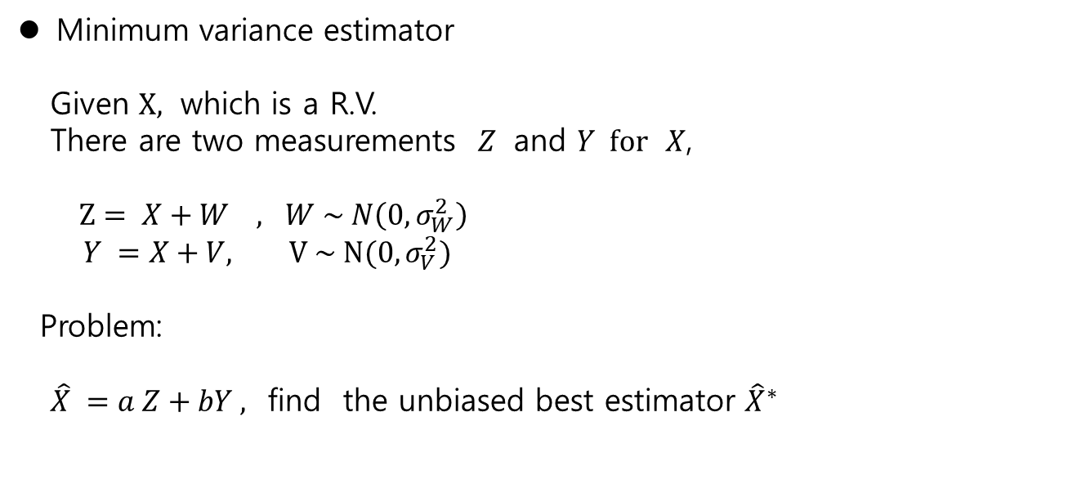
MV Estimator
Minimum variance estimator
Given $X,$ which is a R.V.
There are two measurements $Z$ and $Y for$ $X$,
$Z= X+W , W \sim N\left(0, σ_{W}^{2}\right)$
$Y =X+V, V \sim N(0, σ_{V}^{2})$
Problem:
$\hat{X} =a Z+bY ,$ find the unbiased best estimator ${\hat{X}}^{∗}$

Slide 13

MV Estimator
Solution
Assume
$\hat{X}=aZ+bY$,
$E\left[Z\right]=E\left[W\right] =0 , σ_{Z}^{2}=σ_{W}^{2}$
$E\left[Y\right]=E\left[V\right]=0, σ_{Y}^{2}=σ_{V}^{2}$
Find the weighting $a, b$ to get the unbiased best estimator
1) unbiased estimator
$E\left[\hat{X}\right]=aE\left[X\right]+bE\left[X\right] =\left(a+b\right)E\left[X\right] −→ a+b=1$
2) find (a,b) such that min $E[{\left(X−\hat{X} \right)}^{2}]$

Slide 14

MV Estimator
Solution(Heuristically)
1) $\hat{X} =aZ +bY$ $a>b if σ_{Y}^{2} > σ_{Z}^{2}$
$\hat{X}= \frac{a}{σ_{Z}^{2}}Z +\frac{b}{σ_{Y}^{2}}Y$
2) $a+b=1$
Then
$$\hat{X}= \frac{a}{σ_{Z}^{2}}Z +\frac{b}{σ_{Y}^{2}}Y =\frac{1}{\left(\frac{1}{σ_{Z}^{2}}\right)+\left(\frac{1}{σ_{Y}^{2}}\right)}(\frac{1}{σ_{Z}^{2}}Z +\frac{1}{σ_{Y}^{2}})Y$$

Slide 15

MV Estimator
$$\hat{X}= \frac{a}{σ_{Z}^{2}}Z +\frac{b}{σ_{Y}^{2}}Y =\frac{1}{\left(\frac{1}{σ_{Z}^{2}}\right)+\left(\frac{1}{σ_{Y}^{2}}\right)}\left(\frac{1}{σ_{Z}^{2}}Z +\frac{1}{σ_{Y}^{2}}\right)Y$$
$$=\frac{σ_{Y}^{2}}{σ_{Z}^{2}+σ_{Y}^{2}}Z +\frac{σ_{Z}^{2}}{σ_{Z}^{2}+σ_{Y}^{2}}Y$$
$$=Z+\left(\frac{σ_{Z}^{2}}{σ_{Z}^{2}+σ_{Y}^{2}}\right)(Y −Z)$$
Here, at later we may prove,
The kalman gain $K =\frac{σ_{Z}^{2}}{σ_{Z}^{2}+σ_{Y}^{2}}$

Slide 16
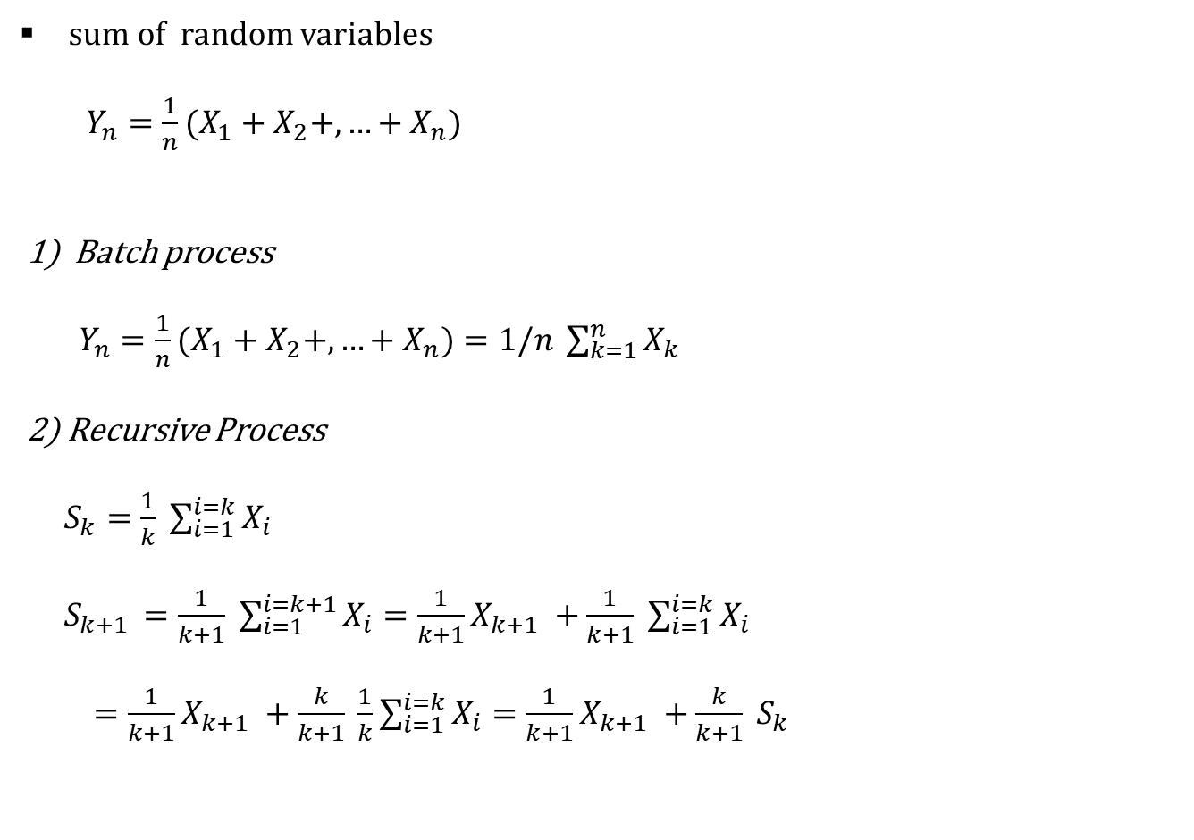
Batch/ Recursive type
sum of random variables
$Y_{n}={\frac{1}{n}(X}_{1}+X_{2}+,…+X_{n}$)
1) Batch process
$Y_{n}={\frac{1}{n}(X}_{1}+X_{2}+,…+X_{n})=1/n \sum_{k=1}^{n}{X_{k}}$
2) Recursive Process
$S_{k}=\frac{1}{k} \sum_{i=1}^{i=k}{X_{i}}$
$S_{k+1 }=\frac{1}{k+1} \sum_{i=1}^{i=k+1}{X_{i}}=\frac{1}{k+1}X_{k+1} +\frac{1}{k+1} \sum_{i=1}^{i=k}{X_{i}}$
$=\frac{1}{k+1}X_{k+1} +\frac{k}{k+1} \frac{1}{k}\sum_{i=1}^{i=k}{X_{i}}=\frac{1}{k+1}X_{k+1} +\frac{k}{k+1} S_{k}$

Slide 17
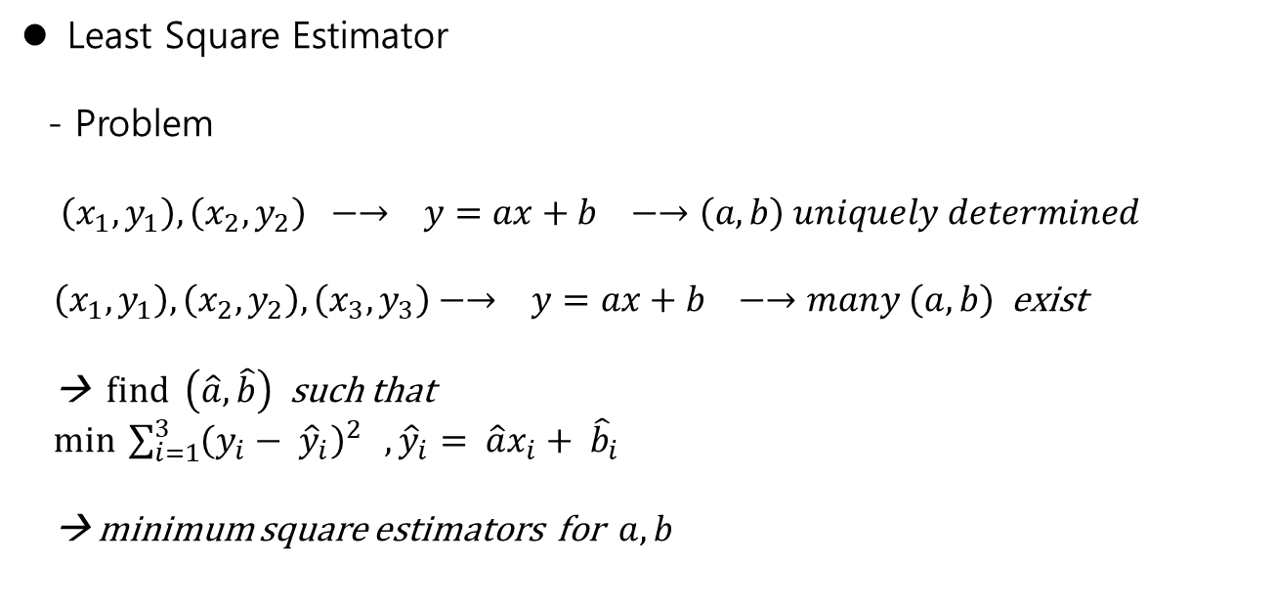
Batch/ Recursive type
Least Square Estimator
- Problem
$\left(x_{1}, y_{1}\right), \left(x_{2},y_{2}\right) −→ y=ax+b −→\left(a,b\right) uniquely determined$
$\left(x_{1}, y_{1}\right), \left(x_{2},y_{2}\right), \left(x_{3}, y_{3}\right)−→ y=ax+b −→many \left(a,b\right)$ exist
→ find $\left(\hat{a}, \hat{b}\right)$ such that
$\min{ \sum_{i=1}^{3}{{\left(y_{i}− {\hat{y}}_{i}\right)}^{2}} }, {\hat{y}}_{i}= \hat{a}x_{i}+ {\hat{b}}_{i}$
→ minimum square estimators for $a, b$

Slide 18
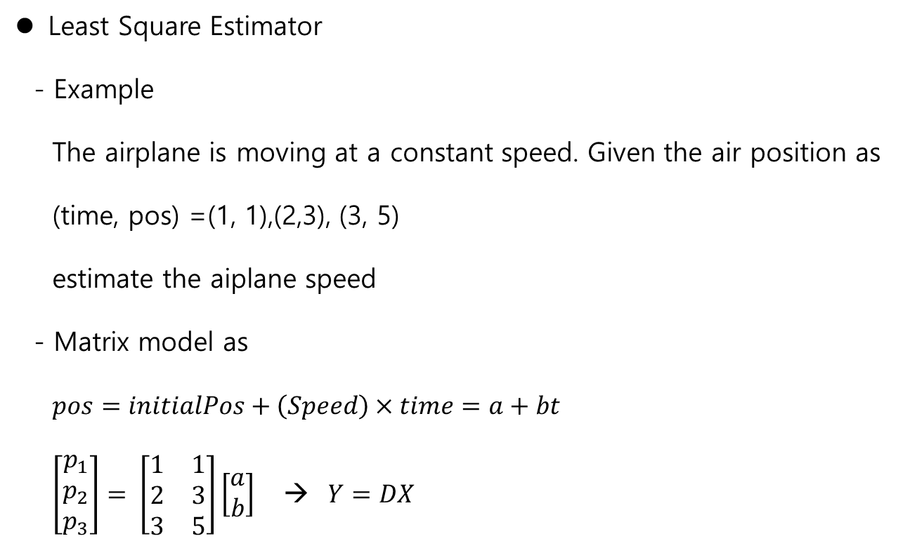
Batch/ Recursive type
Least Square Estimator
- Example
The airplane is moving at a constant speed. Given the air position as
(time, pos) =(1, 1),(2,3), (3, 5)
estimate the aiplane speed
- Matrix model as
$pos=initialPos+\left(Speed\right)×time=a+bt$
$\left[\begin{matrix}p_{1} \\ p_{2} \\ p_{3}\end{matrix}\right]= \left[\begin{matrix}1 & 1 \\ 2 & 3 \\ 3 & 5\end{matrix}\right]\left[\begin{matrix}a \\ b\end{matrix}\right]$ → $Y=DX$

Slide 19
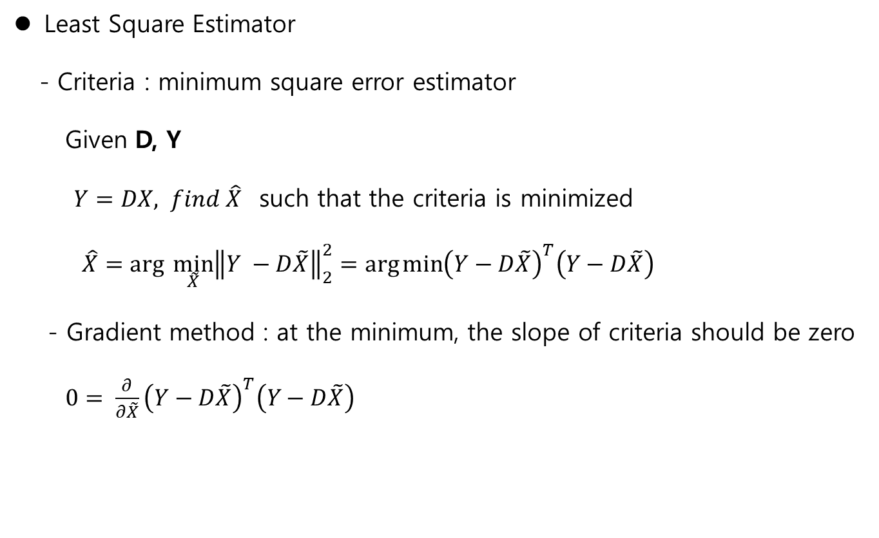
Least Square Estimator
Least Square Estimator
- Criteria : minimum square error estimator
Given D, Y
$Y=DX, find \hat{X}$ such that the criteria is minimized
$\hat{X}=arg \min_{\tilde{X}}{{\left\|Y −D\tilde{X}\right\|}_{2}^{2}}=\arg{\min{{\left(Y−D\tilde{X}\right)}^{T}\left(Y−D\tilde{X}\right)}}$
- Gradient method : at the minimum, the slope of criteria should be zero
$0= \frac{∂}{∂\tilde{X}}{\left(Y−D\tilde{X}\right)}^{T}\left(Y−D\tilde{X}\right)$

Slide 20

Least Square Estimator
Vector differentiation
$\frac{∂}{∂x}\left(y^{2}−2yx+x^{2}\right)=−2y+2x$
$\frac{∂}{∂X}\left(ax_{1}+bx_{2}\right) = \left[\begin{matrix}\frac{∂}{∂x_{1}}(ax_{1}+bx_{2}) \\ \frac{∂}{∂x_{2}}(ax_{1}+bx_{2})\end{matrix}\right]=\left[\begin{matrix}a \\ b\end{matrix}\right]$
← → $\frac{∂}{∂X}\left({\left[\begin{matrix}a \\ b\end{matrix}\right]}^{T}\left[\begin{matrix}x_{1} \\ x_{2}\end{matrix}\right]\right)=\frac{∂}{∂X}\left(A^{T}X\right)={\left(A^{T}\right)}^{T}=A$
← → $\frac{∂}{∂X}\left({\left[\begin{matrix}x_{1} \\ x_{2}\end{matrix}\right]}^{T}\left[\begin{matrix}a \\ b\end{matrix}\right]\right)=\frac{∂}{∂X}\left(X^{T}A\right)=A$

Slide 21

Least Square Estimator
$0= \frac{∂}{∂\tilde{X}}{\left(Y−D\tilde{X}\right)}^{T}\left(Y−D\tilde{X}\right)$
$=\frac{∂}{∂\tilde{X}}\left\{ Y^{T}Y −Y^{T}D\tilde{X} − {\tilde{X}}^{T}D^{T}Y + {\tilde{X}}^{T}D^{T}D\tilde{X}\right)$
$=−{\left(Y^{T}D\right)}^{T}−\left(D^{T}Y\right)+D^{T}D \tilde{X}+{\left({\tilde{X}}^{T}D^{T}D\right)}^{T}$
$={−D}^{T}Y−D^{T}Y+D^{T}D\tilde{X}+D^{T}D\tilde{X}$
Rearrange it to give
$2\left(D^{T}D\right)\tilde{X}=2D^{T}Y$
So that
$\tilde{X}={\left(D^{T}D\right)}^{−1}D^{T}Y if {\left(D^{T}D\right)}^{−1} exists$

Slide 22
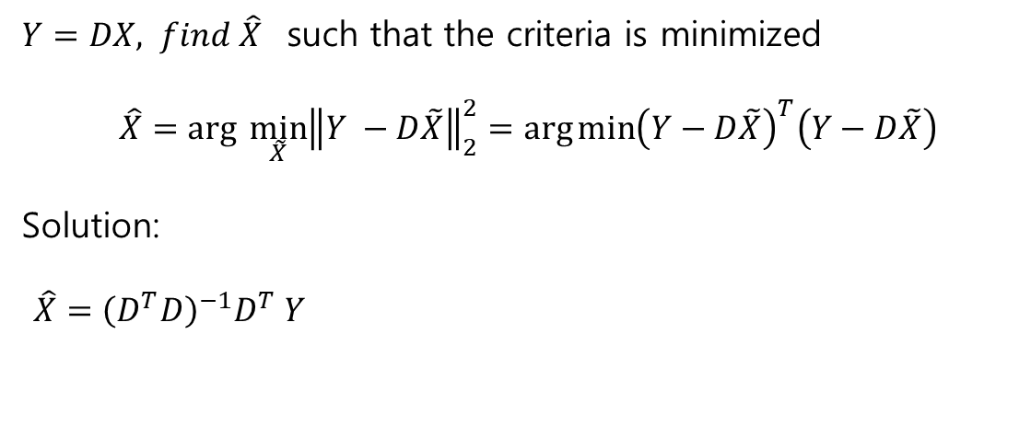
Least Square Estimator
$Y=DX, find \hat{X}$ such that the criteria is minimized
$\hat{X}=arg \min_{\tilde{X}}{{\left\|Y −D\tilde{X}\right\|}_{2}^{2}}=\arg{\min{{\left(Y−D\tilde{X}\right)}^{T}\left(Y−D\tilde{X}\right)}}$
Solution:
$\hat{X}={\left(D^{T}D\right)}^{−1}D^{T} Y$

