Slide 1
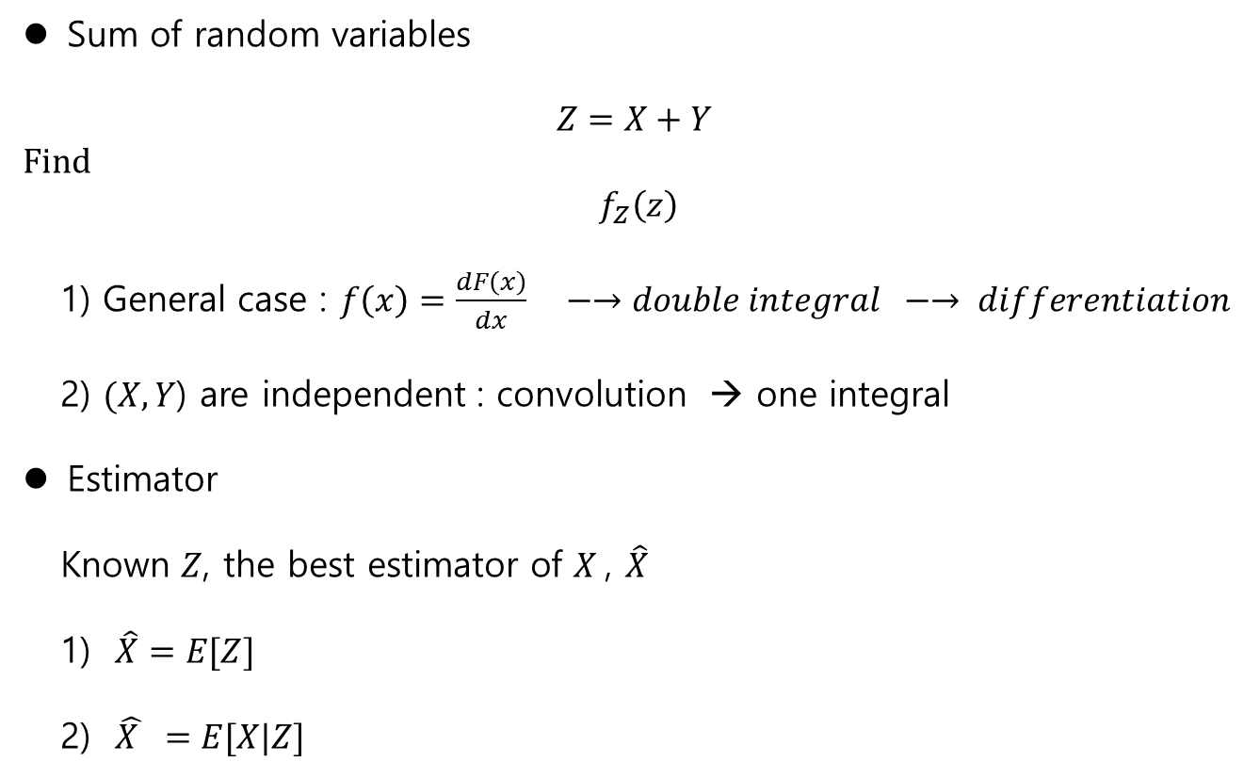
Sum of R.V.’s
Sum of random variables
$$Z=X+Y$$
Find
$$f_{Z}\left(z\right)$$
1) General case : $f\left(x\right)=\frac{dF\left(x\right)}{dx} −→double integral −→ differentiation$
2) $(X,Y$) are independent : convolution → one integral
Estimator
Known $Z$, the best estimator of $X$, $\hat{X}$
1) $\hat{X}=E[Z]$
2) $\hat{X } =E[X|Z]$

Slide 2

Weighting
Weighting
$(X_{1}, X_{2},…, X_{n})$
$m_{n}=\frac{1}{N}\sum_{k=1}^{N}{X_{k}}=\frac{1}{N}\left(X_{1}+X_{2}+,…+X_{N}\right),$
-the equivalent weighting : $\frac{1}{N}$
-the exponential weighting :
$\frac{n\left(n+1\right)}{2}= \left(1+2+,…,+n\right)$
$$\hat{X}=\frac{\left(X_{1}+2X_{2}+ ,…,+nX_{N}\right)}{n(n+1)/2}$$

Slide 3
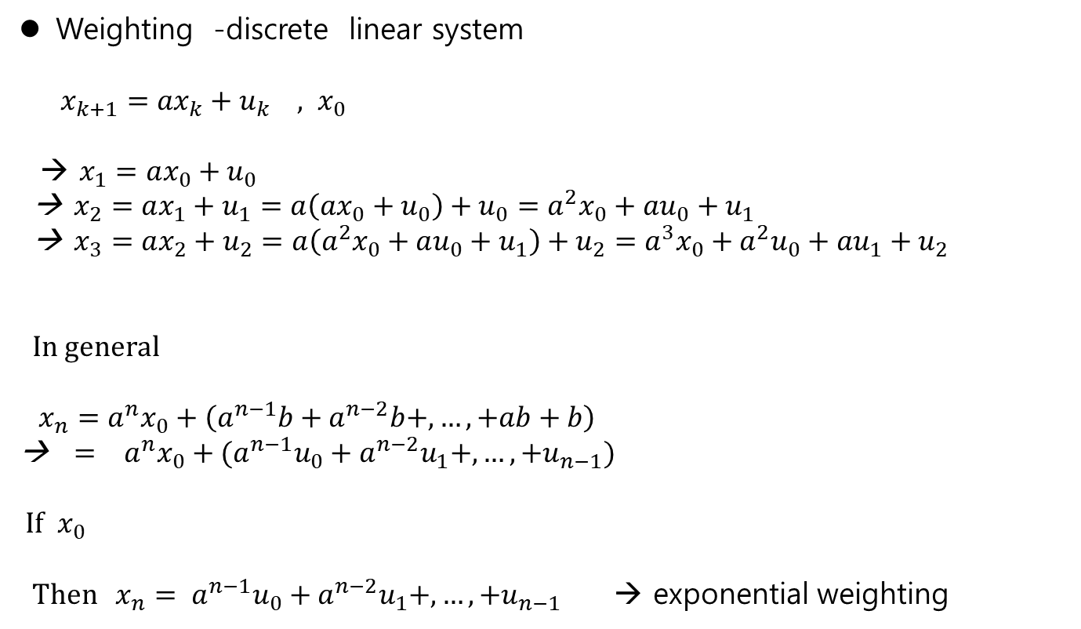
Weighting – Discrete system response
Weighting -discrete linear system
$x_{k+1}={ax}_{k}+u_{k} , x_{0}$
→ $x_{1}=ax_{0}+u_{0}$
→ $x_{2}=ax_{1}+u_{1}=a\left(ax_{0}+u_{0}\right)+u_{0}=a^{2}x_{0}+au_{0}+u_{1}$
→ $x_{3}=ax_{2}+u_{2}=a\left(a^{2}x_{0}+au_{0}+u_{1}\right)+u_{2}=a^{3}x_{0}+a^{2}u_{0}+au_{1}+u_{2}$
In general
$x_{n}=a^{n}x_{0}+\left(a^{n−1}b+a^{n−2}b+,…, +ab+b\right)$
→ $= a^{n}x_{0}+(a^{n−1}u_{0}+a^{n−2}u_{1}+,…,+u_{n−1})$
If $x_{0}$
Then $x_{n}= a^{n−1}u_{0}+a^{n−2}u_{1}+,…,+u_{n−1}$ → exponential weighting

Slide 4
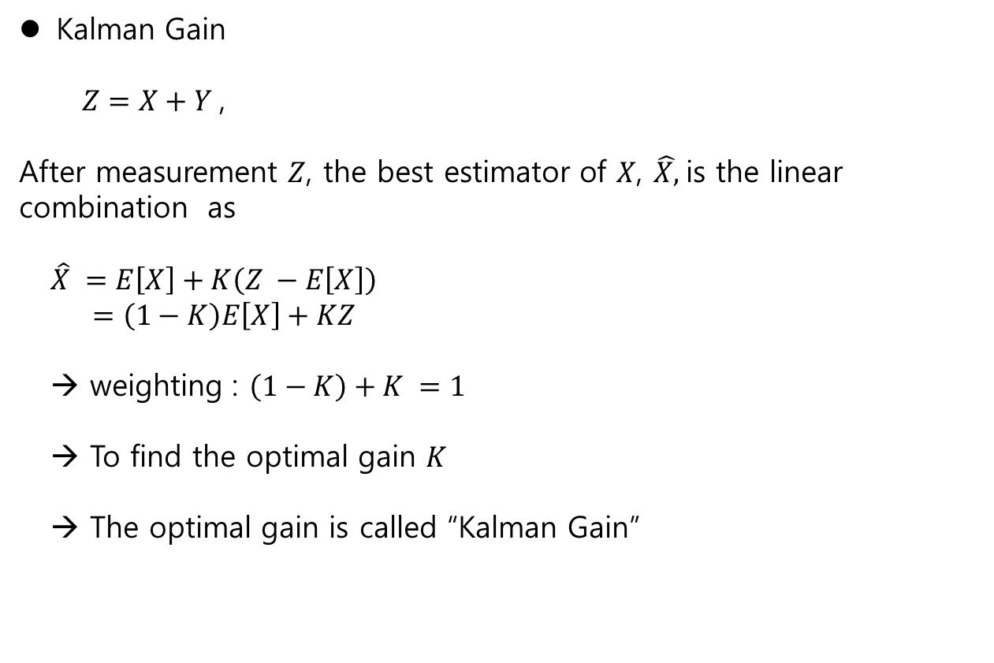
Weighting- Kalman gain
Kalman Gain
$Z=X+Y$,
After measurement $Z$, the best estimator of $X$, $\hat{X,}$is the linear combination as
$\hat{X} =E\left[X\right]+K\left(Z −E\left[X\right]\right)$
$=\left(1−K\right)E\left[X\right]+KZ$
→ weighting : $\left(1−K\right)+K =1$
→ To find the optimal gain $K$
→ The optimal gain is called “Kalman Gain”

Slide 5

Weighting – argument
Minimum variance estimator - argument
$f\left(x,y\right)=x^{2}+y^{2}$
The function has two arguments $x,y$
- notation:
$J\left(x\right)=x^{2}+2x+1$
$\min_{x}{J(x)} =1 at x=0$
-$\arg{\min_{x}{J(x)}=0}$
$− arg{\min_{x} E{\left[(X−\hat{X}\right)}^{2}]{}= {\hat{X}}^{∗}}$

Slide 6
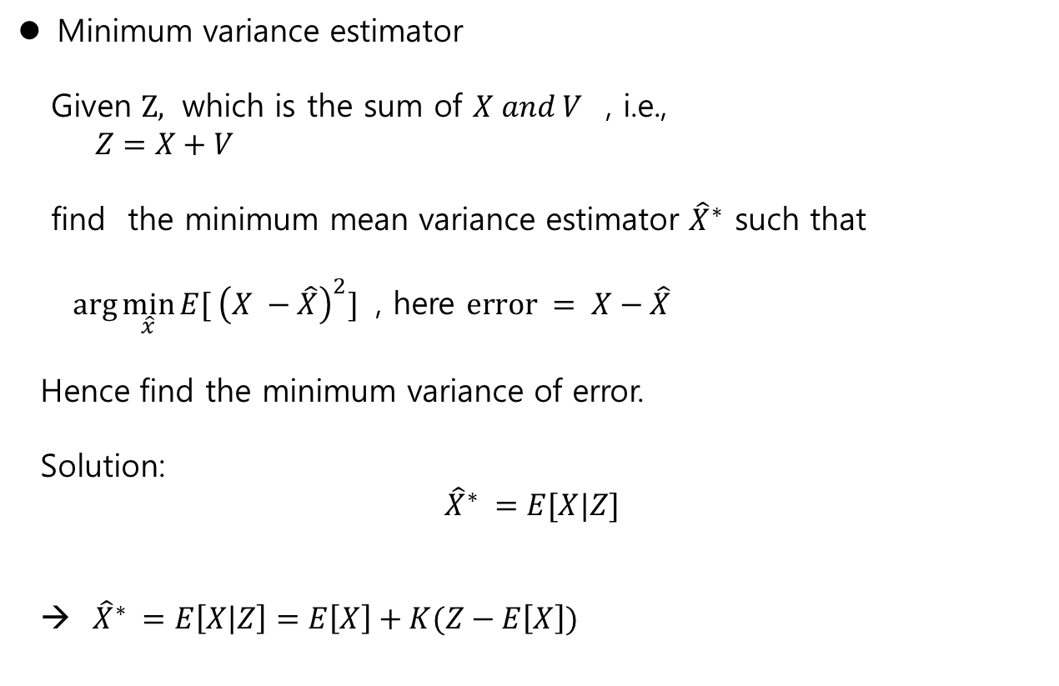
MV Estimator
Minimum variance estimator
Given $Z,$ which is the sum of $X and V$ , i.e.,
$Z=X+V$
find the minimum mean variance estimator ${\hat{X}}^{∗}$ such that
$\arg{\min_{\hat{x}}{E[ {\left(X −\hat{X}\right)}^{2}] }}$ , here $error = X−\hat{X}$
Hence find the minimum variance of error.
Solution:
$${\hat{X}}^{∗} =E[X|Z]$$
→ ${\hat{X}}^{∗} =E\left[X | Z\right]=E\left[X\right]+K(Z−E\left[X\right])$

Slide 7
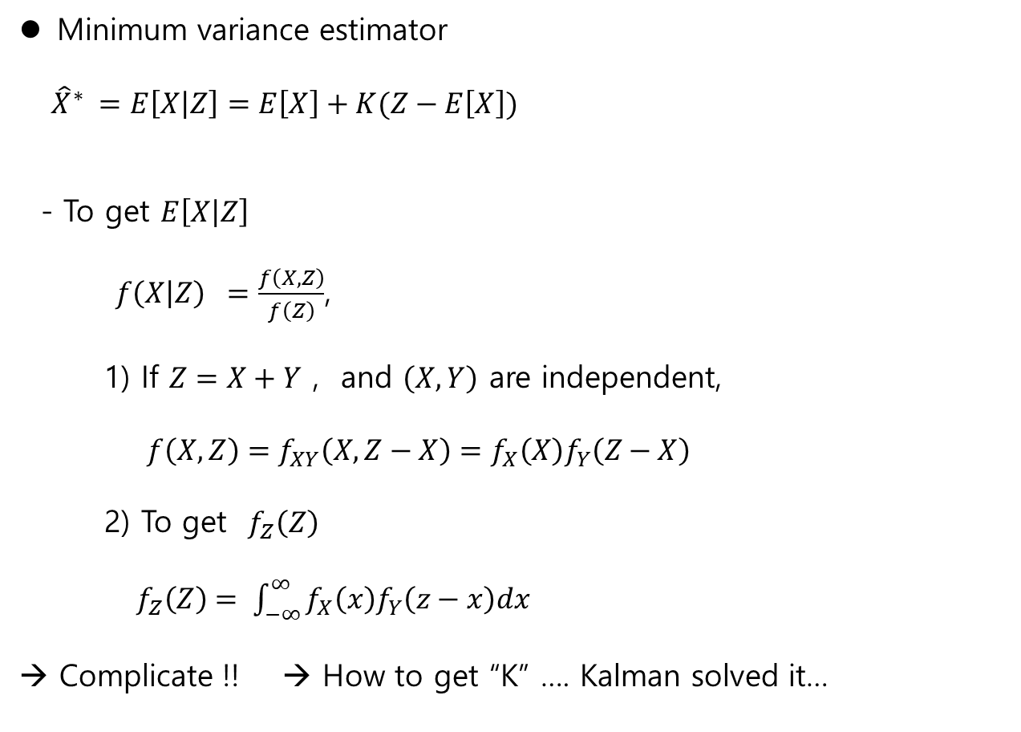
MV Estimator
Minimum variance estimator
${\hat{X}}^{∗} =E\left[X | Z\right]=E\left[X\right]+K(Z−E\left[X\right])$
- To get $E\left[X | Z\right]$
$f\left(X | Z\right) =\frac{f\left(X,Z\right)}{f\left(Z\right)}$,
1) If $Z=X+Y$ , and $\left(X,Y\right)$ are independent,
$f\left(X,Z\right)=f_{XY}\left(X, Z−X\right)=f_{X}\left(X\right)f_{Y}\left(Z−X\right)$
2) To get $f_{Z}\left(Z\right)$
$f_{Z}\left(Z\right)= \int_{−∞}^{∞}{f_{X}\left(x\right)f_{Y}\left(z−x\right)dx}$
→ Complicate !! → How to get “K” …. Kalman solved it…

Slide 8
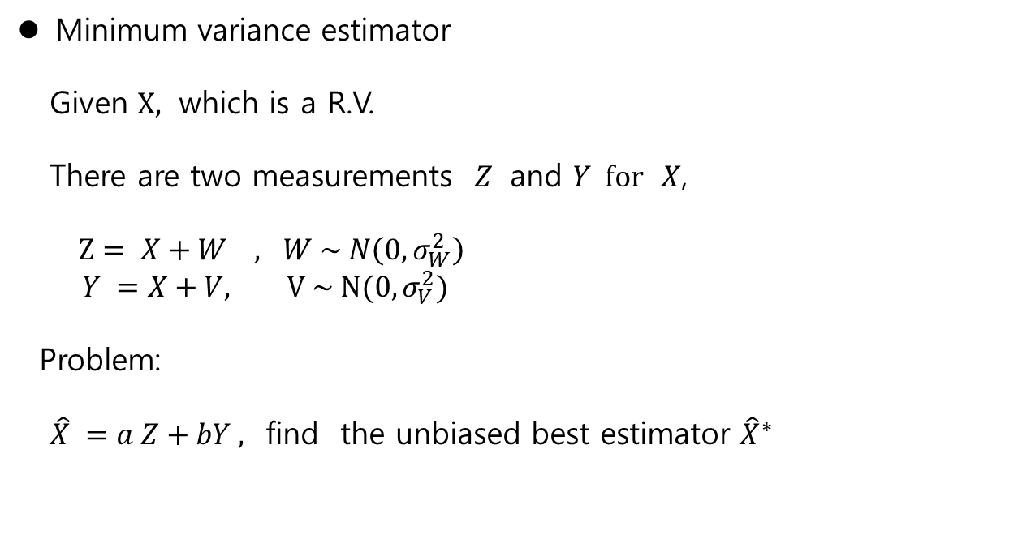
MV Estimator
Minimum variance estimator
Given $X,$ which is a R.V.
There are two measurements $Z$ and $Y for$ $X$,
$Z= X+W , W \sim N\left(0, σ_{W}^{2}\right)$
$Y =X+V, V \sim N(0, σ_{V}^{2})$
Problem:
$\hat{X} =a Z+bY ,$ find the unbiased best estimator ${\hat{X}}^{∗}$

Slide 9

MV Estimator
Solution
Assume
$\hat{X}=aZ+bY$,
$E\left[Z\right]=E\left[W\right] =0 , σ_{Z}^{2}=σ_{W}^{2}$
$E\left[Y\right]=E\left[V\right]=0, σ_{Y}^{2}=σ_{V}^{2}$
Find the weighting $a, b$ to get the unbiased best estimator
1) unbiased estimator
$E\left[\hat{X}\right]=aE\left[X\right]+bE\left[X\right] =\left(a+b\right)E\left[X\right] −→ a+b=1$
2) find (a,b) such that min $E[{\left(X−\hat{X} \right)}^{2}]$

Slide 10
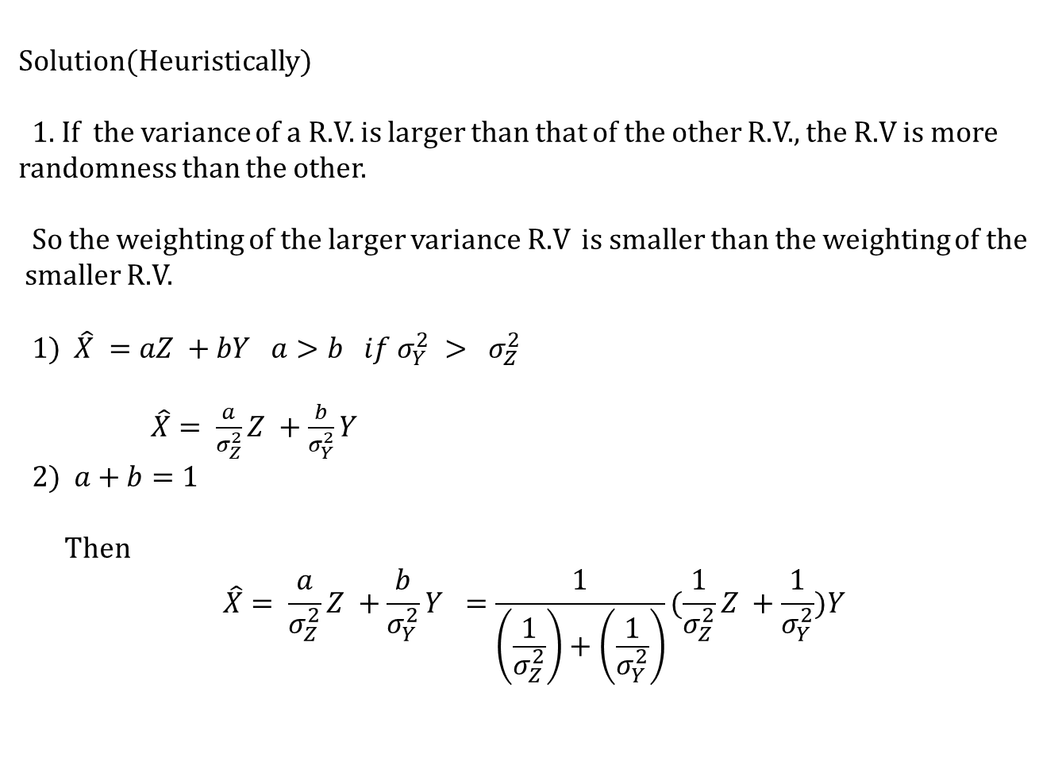
MV Estimator
Solution(Heuristically)
1. If the variance of a R.V. is larger than that of the other R.V., the R.V is more randomness than the other.
So the weighting of the larger variance R.V is smaller than the weighting of the
smaller R.V.
1) $\hat{X} =aZ +bY$ $a>b if σ_{Y}^{2} > σ_{Z}^{2}$
$\hat{X}= \frac{a}{σ_{Z}^{2}}Z +\frac{b}{σ_{Y}^{2}}Y$
2) $a+b=1$
Then
$$\hat{X}= \frac{a}{σ_{Z}^{2}}Z +\frac{b}{σ_{Y}^{2}}Y =\frac{1}{\left(\frac{1}{σ_{Z}^{2}}\right)+\left(\frac{1}{σ_{Y}^{2}}\right)}(\frac{1}{σ_{Z}^{2}}Z +\frac{1}{σ_{Y}^{2}})Y$$

Slide 11

MV Estimator
$$\hat{X}= \frac{a}{σ_{Z}^{2}}Z +\frac{b}{σ_{Y}^{2}}Y =\frac{1}{\left(\frac{1}{σ_{Z}^{2}}\right)+\left(\frac{1}{σ_{Y}^{2}}\right)}\left(\frac{1}{σ_{Z}^{2}}Z +\frac{1}{σ_{Y}^{2}}\right)Y$$
$$=\frac{σ_{Y}^{2}}{σ_{Z}^{2}+σ_{Y}^{2}}Z +\frac{σ_{Z}^{2}}{σ_{Z}^{2}+σ_{Y}^{2}}Y$$
$$=Z+\left(\frac{σ_{Z}^{2}}{σ_{Z}^{2}+σ_{Y}^{2}}\right)(Y −Z)$$
Here, at later we may prove,
The kalman gain $K =\frac{σ_{Z}^{2}}{σ_{Z}^{2}+σ_{Y}^{2}}$

Slide 12
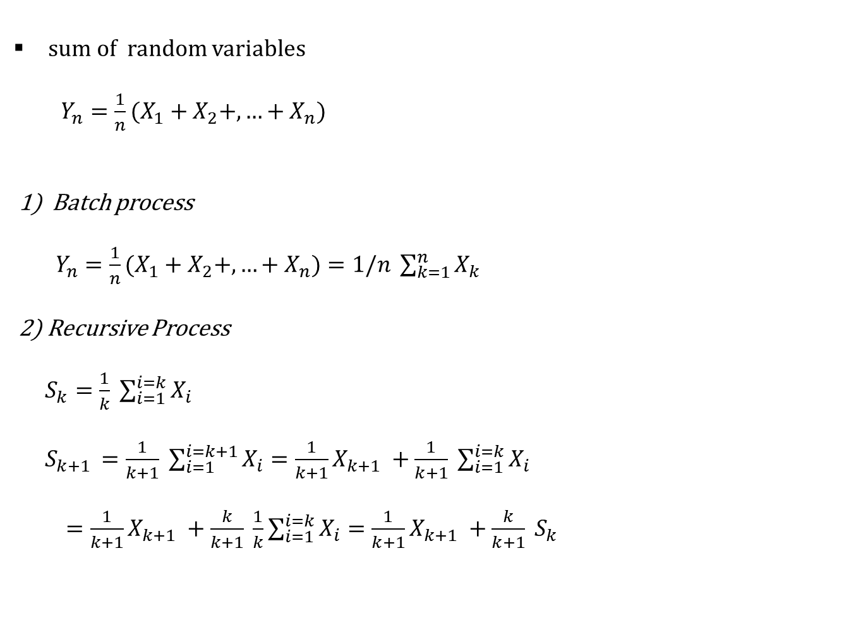
Batch/ Recursive type
sum of random variables
$Y_{n}={\frac{1}{n}(X}_{1}+X_{2}+,…+X_{n}$)
1) Batch process
$Y_{n}={\frac{1}{n}(X}_{1}+X_{2}+,…+X_{n})=1/n \sum_{k=1}^{n}{X_{k}}$
2) Recursive Process
$S_{k}=\frac{1}{k} \sum_{i=1}^{i=k}{X_{i}}$
$S_{k+1 }=\frac{1}{k+1} \sum_{i=1}^{i=k+1}{X_{i}}=\frac{1}{k+1}X_{k+1} +\frac{1}{k+1} \sum_{i=1}^{i=k}{X_{i}}$
$=\frac{1}{k+1}X_{k+1} +\frac{k}{k+1} \frac{1}{k}\sum_{i=1}^{i=k}{X_{i}}=\frac{1}{k+1}X_{k+1} +\frac{k}{k+1} S_{k}$

Slide 13

Batch/ Recursive type
Merits for recursive way
1) The memory size is lower than the batch type
2) The result can be acquired at every step, which is more informative
$$Y_{n}={\frac{1}{n}(X}_{1}+X_{2}+,…+X_{n})=1/n \sum_{k=1}^{n}{X_{k}}$$
$S_{k} =\frac{1}{k}\sum_{i=1}^{k}{X_{k}}$
$S_{k+1} = \frac{1}{k+1}X_{k+1} +\frac{k}{k+1} S_{k}$

