Slide 1
PCE6205 Stochastic Model, Estimation and Control (Expectation and Variance)
2022-03-27
Prof.S.Kim

Slide 2
Review
Random variable
CDF (PDF: Distribution)
pdf (probability density)
Joint Prob.
Marginal Prob.

Slide 3
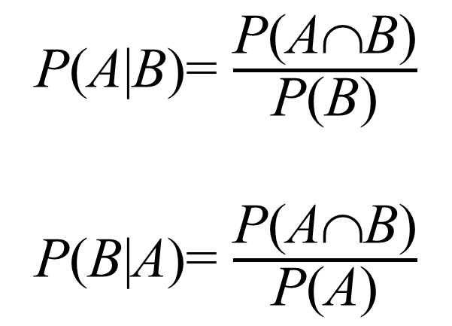
2.8 Conditional pdf
Bayes Rule:
P(A∩B)= P(B)P(A|B)
= P(A)P(B|A)
Conditional pdf:
P(A|B)= $\frac{\text{P}\text{(}\text{A}\text{∩}\text{B}\text{)}}{\text{P}\text{(}\text{B}\text{)}}$
P(B|A)= $\frac{\text{P}\text{(}\text{A}\text{∩}\text{B}\text{)}}{\text{P}\text{(}\text{A}\text{)}}$

Slide 4
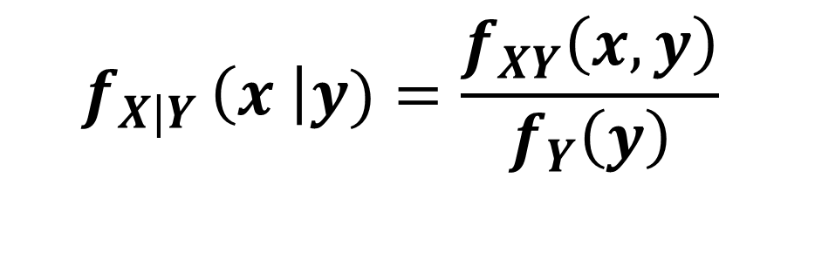
2.8 Conditional pdf
Conditional pdf:
Given a R.V. Y = y , the conditional pdf of X
$$f_{X|Y }\left(x \right|y)=\frac{f_{XY}\left(x,y\right)}{f_{Y}\left(y\right)}$$

Slide 5
2.8 Conditional pdf
Conditional pdf:
P(A∩B)= P(B)P(A|B)
= P(A)P(B|A)
P(A|B)= $\frac{\text{P}\text{(}\text{A}\text{∩}\text{B}\text{)}}{\text{P}\text{(}\text{B}\text{)}}$
P(B|A)= $\frac{\text{P}\text{(}\text{A}\text{∩}\text{B}\text{)}}{\text{P}\text{(}\text{A}\text{)}}$

Slide 6
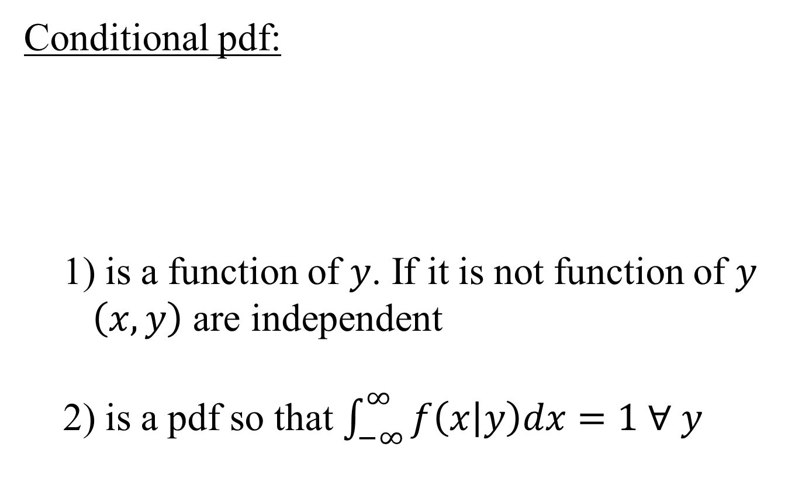
2.8 Conditional pdf
Conditional pdf:
1) is a function of $y$. If it is not function of $y$
$\left(x,y\right)$ are independent
2) is a pdf so that $\int_{−∞}^{∞}{f\left(x | y\right)dx=1 ∀ y}$

Slide 7
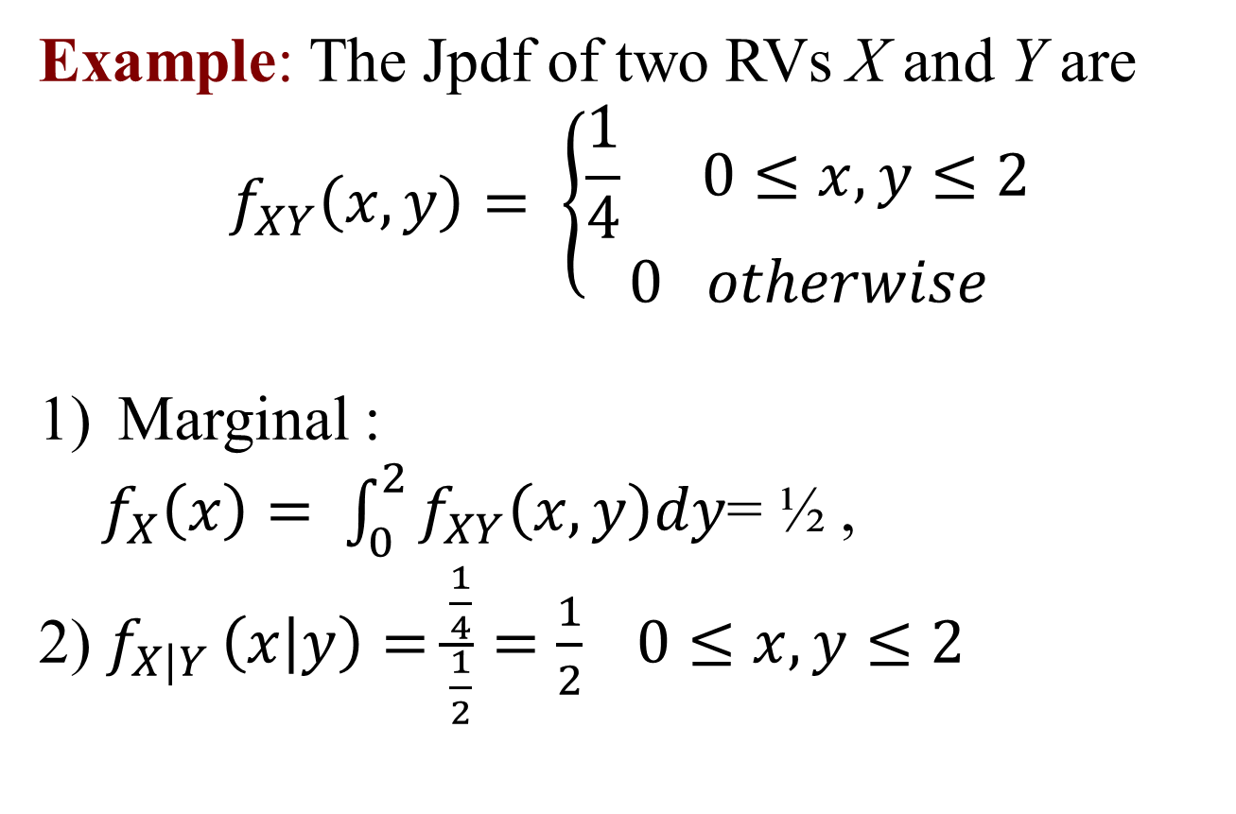
2.8 Conditional pdf
Example: The Jpdf of two RVs X and Y are
$$f_{XY}\left(x,y\right)= \left\{\begin{aligned}\frac{1}{4} 0≤x, y≤2 \\ 0 otherwise\end{aligned}\right.$$
Marginal :
$f_{X}\left(x\right)= \int_{0}^{2}{f_{XY}\left(x,y\right)dy}$= ½ ,
2) $f_{X|Y }\left(x | y\right)=\frac{\frac{1}{4}}{\frac{1}{2}}=\frac{1}{2} 0≤x,y≤2$

Slide 8

2.8 Conditional pdf
Example: The jpdf of two RVs X and Y are
1) marginal $f_{Y}\left(y\right)= \int_{−∞}^{∞}{f_{XY}\left(x,y\right)dx =e^{−y} , y≥0 }$
2) conditional
$f_{\left(X | Y\right)}=\frac{f\left(x,y\right)}{f\left(y\right)}=e^{−x} , x≥0$

Slide 9
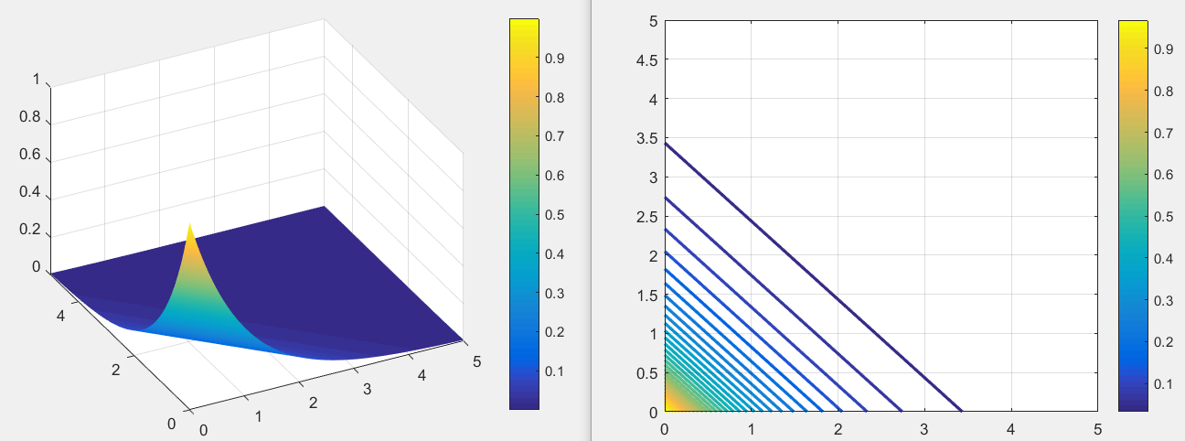

Slide 10
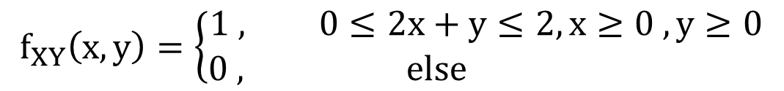
2.8 Conditional pdf
Ex. : The Jpdf of two RVs X and Y are
$$f_{XY}\left(x,y\right)=\left\{\begin{aligned}1 , 0≤2x+y≤2, x≥0 , y≥0 \\ 0 , else \end{aligned}\right.$$
y
x

Slide 11

2.8 Conditional pdf
1)
Check $\iint_{−∞}^{∞}{f\left(x,y\right)dydx}=1$
$\int_{0}^{1}{\int_{0}^{2}{\frac{1}{2}dydx}}=\int_{0}^{1}{1dx}=1$
y
x

Slide 12



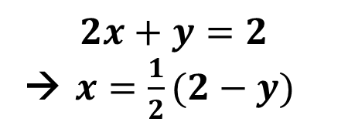
2.8 Conditional pdf
2) Marginal
3) Conditional pdf
$$f_{X|Y}\left(x | y\right)=\frac{f\left(x,y\right)}{f\left(y\right)}=\frac{2}{2−y}$$
$$f\left(y\right)= \int_{−∞}^{∞}{f(x,y)}dx$$
$=\int_{0}^{\frac{1}{2}(2−y)}{\left(1\right)dx}$
$$=\frac{1}{2}(2−y)$$
y
x
$$dx$$
$$2x+y=2$$
→ $x=\frac{1}{2}(2−y)$

Slide 13
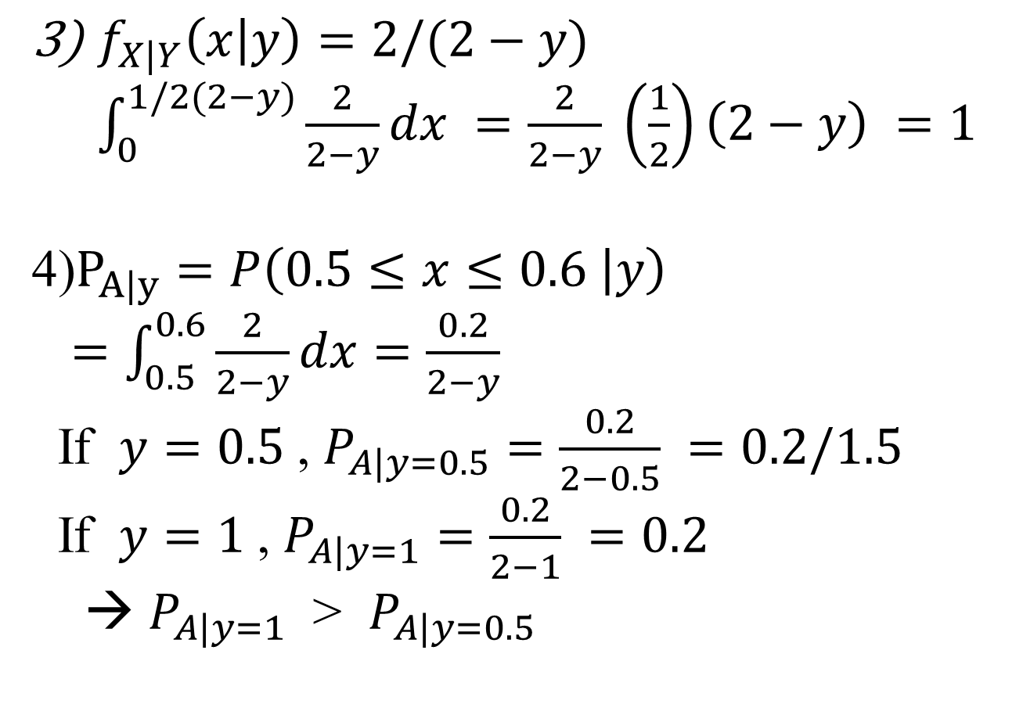
2.8 Conditional pdf
$f_{X|Y}\left(x | y\right)=2/(2−y)$
$\int_{0}^{1/2(2−y)}{\frac{2}{2−y}dx =\frac{2}{2−y} \left(\frac{1}{2}\right)\left(2−y\right) }=1$
4)$P_{A|y}=P\left(0.5≤x≤0.6 | y\right)$
$=\int_{0.5}^{0.6}{\frac{2}{2−y}dx=\frac{0.2}{2−y}}$
If $y=0.5$, $P_{A|y=0.5}=\frac{0.2}{2−0.5} =0.2/1.5$
If $y=1$, $P_{A|y=1}=\frac{0.2}{2−1} =0.2$
→ $P_{A|y=1}$ > $P_{A|y=0.5}$

Slide 14
3.1 Expectation
(Definition) Expectation of X
Expectation(or Expected value, Mean, Average) of RV X is expressed by
Discrete RV case:
Continuous RV case:

Slide 15
3.1 Expectation
(Theorem) Properties of the expected value
When X is RV, and a and b are real values, the expected value has the following properties:
(1) E(a)= a
(2) E(aX)= aE(X)= a⋅m where E(X)= m
(3) E(aX+b)= aE(X)+b= a⋅m+b
Proof:

Slide 16
3.1 Expectation
Example 3: Find the expected value X when the probability of the RV X is
X | 0 | 1 | 2 | Total
P(X= x) | 0.1 | 0.6 | 0.3 | 1.0
Solution:
E(X)= 0×0.1+1×0.6+2×0.3=1.2

Slide 17
3.1 Expectation
Example 4: Find the expected value of X when the pdf of the RV X is
f(x)
1
x
-1
0
1

Slide 18
3.1 Expectation
Solution:

Slide 19
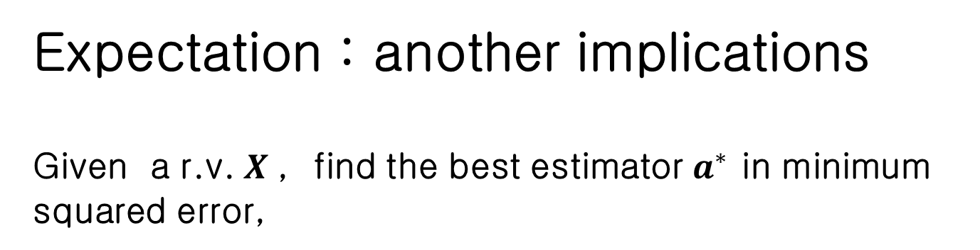
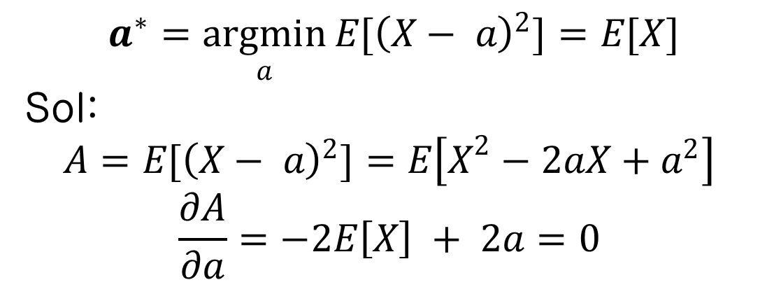
3.1 Expectation
Expectation : another implications
Given a r.v. $X$, find the best estimator $a^{∗}$ in minimum squared error,
$$a^{∗}=\underset{a}{argmin}{E[{\left(X− a\right)}^{2}}]=E[X]$$
Sol:
$$A=E[{\left(X− a\right)}^{2}]=E\left[X^{2}−2aX+a^{2}\right]$$
$$\frac{∂A}{∂a}=−2E\left[X\right] + 2a=0$$

Slide 20

3.4 Variance
$$m=E\left[x\right]$$
Variance :
The squared error between X and the best estimator
Standard Deviation

Slide 21

3.4 Variance
Example 6: RV X is the number of three coin flips face up and the probability distribution is as table. Find Var(X) and σ.
X | 0 | 1 | 2 | 3 | Total
P(X= x) | 1/8 | 3/8 | 3/8 | 1/8 | 1
Solution:

Slide 22
3.4 Variance

Slide 23
3.4 Variance
Example 7: Given the pdf of a RV X as shown in the figure,
(1) Find a.
(2) Find E(X) and Var(X).
f(x)
a
x
-1
0
1

Slide 24
3.4 Variance
Solution: (1) In order for f(x) to be a pdf
(2) Mean

Slide 25
3.4 Variance
Variance

Slide 26
3.5 Mean and Variance of PDFs
(Definition) Uniform distribution
The pdf of the uniform distribution is given by
f(x)
1/(b-a)
a
0
b
x

Slide 27
3.5 Mean and Variance of PDFs
Mean
Variance

Slide 28
3.5 Mean and Variance of PDFs
Therefore,

Slide 29
3.5 Mean and Variance of PDFs
(Definition) Exponential distribution
The pdf of exponentially distributed RV X is
Mean

Slide 30
3.5 Mean and Variance of PDFs
Variance
Therefore,

Slide 31
3.5 Mean and Variance of PDFs
(Definition) Gaussian(normal) distribution
The Gaussian distribution has a bell-shaped pdf and mean μ and standard deviation σ completely describe the statistics. Sometimes referred to as
X ~ N(μ, σ²).

Slide 32
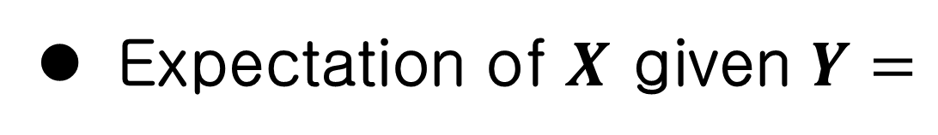
3.2 Conditional Expectation
Expectation of $X$ given $Y=$

Slide 33
3.2 Conditional Expectation
Example 7: Suppose the joint density of X and Y is given by
Find E(X|Y=1).
Solution:

Slide 34
3.2 Conditional Expectation
Conditional pdf is
Therefore,

Slide 35
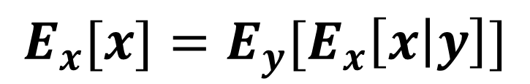
3.2 Conditional Expectation
(Definition) Iterated Expectations
Let us look again at the law of total probability for expectation.
$${E_{x}[x]=E}_{y}[E_{x}\left[x | y\right]]$$

Slide 36
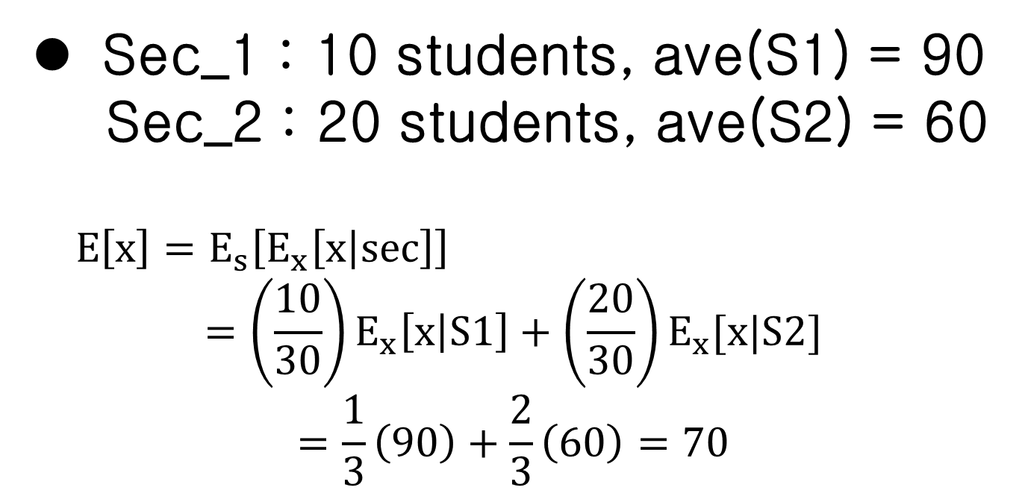
3.2 Conditional Expectation
Sec_1 : 10 students, ave(S1) = 90
Sec_2 : 20 students, ave(S2) = 60
$E\left[x\right]=E_{s}\left[E_{x}\left[x | sec\right]\right]$
$$=\left(\frac{10}{30}\right)E_{x}\left[x | S1\right]+\left(\frac{20}{30}\right)E_{x}[x|S2]$$
$$=\frac{1}{3}\left(90\right)+\frac{2}{3}\left(60\right)=70$$

Slide 37
3.8 Correlation and Covariance
Expectation of the product of two RVs X and Y
If E(XY)= E(X)E(Y), X and Y are said to be
uncorrelated.
If X and Y are independent, f_{XY}(x,y)= f_{X} (x) f_{Y}(y).
Therefore,

Slide 38
3.8 Correlation and Covariance
If X and Y are independent, they are also uncorrelated. However, the converse is not true
If E(XY)= 0, X and Y are said to be orthogonal.

Slide 39
3.8 Correlation and Covariance
Covariance of X and Y
The properties of covariance
1. Cov(X,X) = Var(X);
2. If X and Y are independent, then Cov(X,Y) = 0; 3. Cov(X,Y)= Cov(Y,X);
4. Cov(aX,Y)= aCov(X,Y);
5. Cov(X+c,Y)= Cov(X,Y);
6. Cov(X+Y,Z)= Cov(X,Z)+Cov(Y,Z);

Slide 40
3.8 Correlation and Covariance
Correlation coefficient
The correlation coefficient of two RVs X and Y is defined as the covariance of the standardized versions of X and Y as
where

Slide 41
3.8 Correlation and Covariance
Then,

Slide 42
3.8 Correlation and Covariance
Consider two random variables X and Y :
If ρ(X,Y) = 0, X and Y are called uncorrelated.
If ρ(X,Y) > 0, X and Y are called positively correlated.
If ρ(X,Y) < 0, X and Y are called negatively correlated.

Slide 43
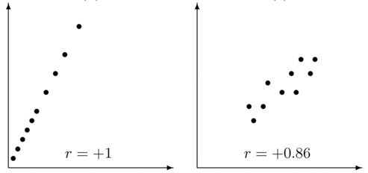
3.8 Correlation and Covariance
1. When Y= X, E[(X-m_{X})(Y-m_{Y})]= Var(X)
ρ
ρ

Slide 44
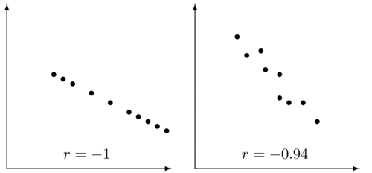
3.8 Correlation and Covariance
2. When Y= -X, E[(X-m_{X})(Y-m_{Y})]= -Var(X)
ρ
ρ

Slide 45
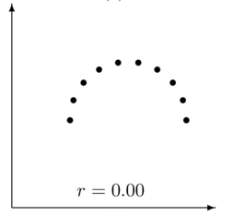
3.8 Correlation and Covariance
3. When X and Y are uncorrelated, that is, E(XY) = E(X)E(Y)
ρ

