Slide 1

Review Week_3
Conditional pdf
$$f_{X|Y }\left(x | y\right) =\frac{f_{XY}\left(x,y\right)}{f_{Y}\left(y\right)}$$
The conditional pdf : a posteriori pdf
$P\left(A | Y=y_{1}\right) ≥P\left(A | Y=y_{2}\right)$
Expectation = mean
$$\overline{x}=E\left[X\right]= \int_{−∞}^{∞}{x f(x)}dx$$
Variance $σ^{2}$
$$σ^{2}\left(X\right)=E\left[{\left(X −E\left[x\right]\right)}^{2}\right]= \int{{\left(x −E\left(x\right)\right)}^{2} f\left(x\right) dx}$$

Slide 2

Review Week_3
Conditional Expectation
$$E\left[X | Y=y\right]= \int{xf(x|y)}dx$$
Iterated Conditional Expectation
$${E_{x}[x]=E}_{y}[E_{x}\left[x | y\right]]$$

Slide 3

Estimator - unbiased
Unbiased estimator
R.V. $X$ .
Estimator of $X$ , $\hat{X}$
If $E\left[X\right] =E[\hat{X}]$ , $\hat{X}$ is an unbiased estimator of $X$
(Remember the minimum least square estimator of $X$ is $E[X]$)

Slide 4
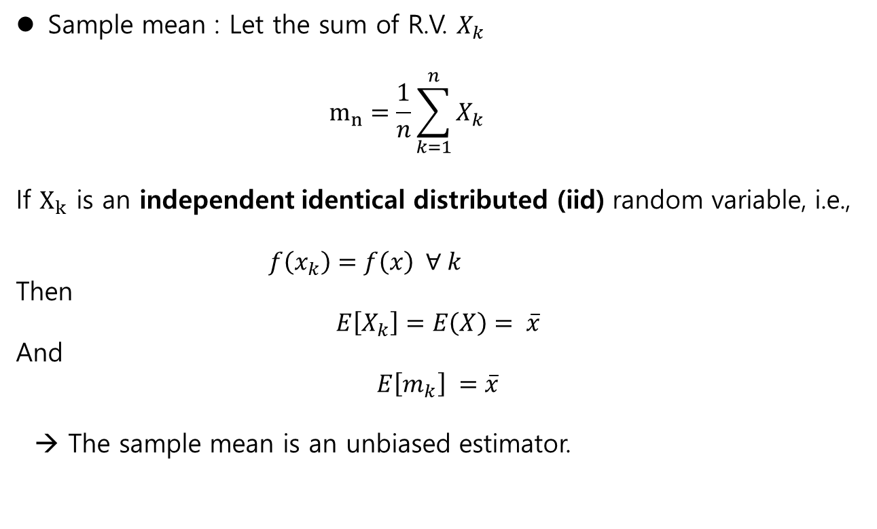
Sample mean
Sample mean : Let the sum of R.V. $X_{k}$
$$m_{n}=\frac{1}{n}\sum_{k=1}^{n}{X_{k}}$$
If $X_{k}$ is an independent identical distributed (iid) random variable, i.e.,
$f\left(x_{k}\right)=f\left(x\right) ∀ k$
Then
$$E\left[X_{k}\right]=E\left(X\right)= \overline{x}$$
And
$$E\left[m_{k}\right] =\overline{x}$$
→ The sample mean is an unbiased estimator.

Slide 5
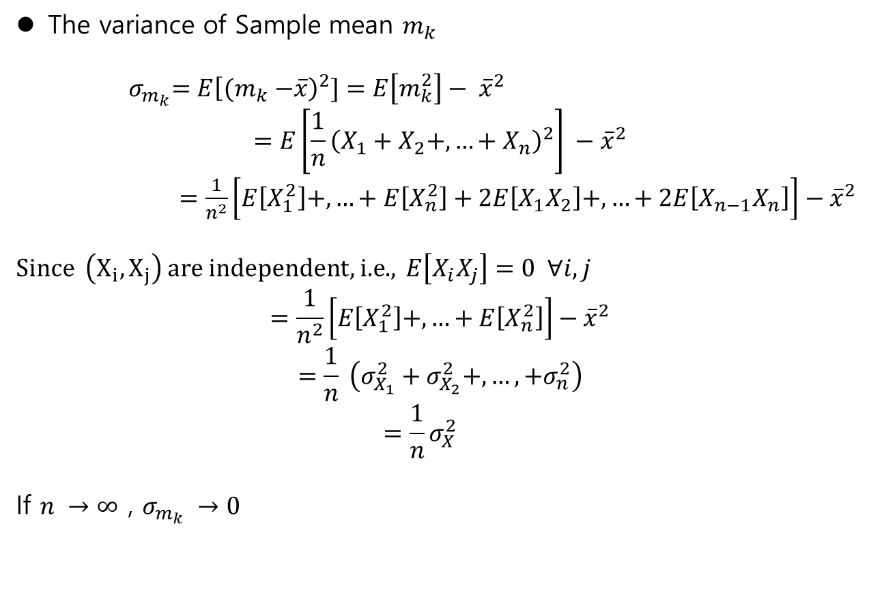
Sample mean
The variance of Sample mean $m_{k}$
${ σ}_{m_{k}}=E{\left[{(m}_{k} −\overline{x}\right)}^{2}]=E\left[m_{k}^{2}\right]− {\overline{x}}^{2}$
$$=E\left[\frac{1}{n}{\left(X_{1}+X_{2}+,…+X_{n}\right)}^{2}\right] −{\overline{x}}^{2}$$
$=\frac{1}{n^{2}}\left[E\left[X_{1}^{2}\right]+,…+E\left[X_{n}^{2}\right]+2E\left[X_{1}X_{2}\right]+,…+2E\left[X_{n−1}X_{n}\right]\right]−{\overline{x}}^{2}$
Since $\left(X_{i}, X_{j}\right)$ are independent, i.e., $E\left[X_{i}X_{j}\right]=0 ∀i,j$
$$=\frac{1}{n^{2}}\left[E\left[X_{1}^{2}\right]+,…+E\left[X_{n}^{2}\right]\right]−{\overline{x}}^{2}$$
$$=\frac{1}{n} \left(σ_{X_{1}}^{2}+σ_{X_{2}}^{2}+,…,+σ_{n}^{2}\right)$$
$$=\frac{1}{n}σ_{X}^{2}$$
If $n →∞$ , $σ_{m_{k}} →0$

Slide 6
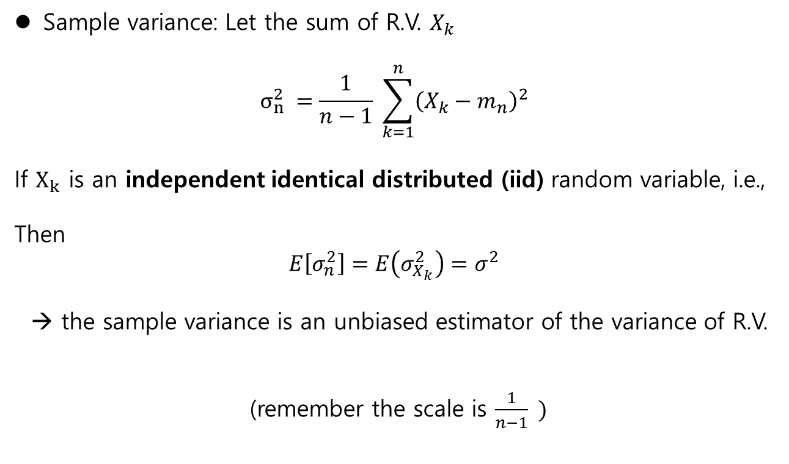
Sample varaince
Sample variance: Let the sum of R.V. $X_{k}$
$$σ_{n}^{2} =\frac{1}{n−1} \sum_{k=1}^{n}{{\left(X_{k}−m_{n}\right)}^{2}}$$
If $X_{k}$ is an independent identical distributed (iid) random variable, i.e.,
Then
$$E\left[σ_{n}^{2}\right]=E\left(σ_{X_{k}}^{2}\right)=σ^{2}$$
→ the sample variance is an unbiased estimator of the variance of R.V.
(remember the scale is $\frac{1}{n−1} )$

Slide 7

Correlation
Given $X,Y$
Covariance :
$$σ_{XY}=E[(X−E\left[x\right])(E\left[Y−E\left[Y\right]\right)]$$
Correlation :
$$E\left[XY\right]$$
-Properties
1) uncorrelated : if $E\left[XY\right]=E\left[X\right]E\left[Y\right]$
2) Orthogonal : if $E\left[XY\right]=0$
%% If $(X,Y)$ are independent, then uncorrelated.

Slide 8

Gaussian – linear transform
Given $X \sim N\left(m_{X} , σ_{X}^{2}\right)$ and $v \sim N(0, σ_{v}^{2})$ and they are independent,
Consider a R.V. $Y$
$Y=aX+v$
FACT :
1) $Y\sim N\left(m_{Y}, σ_{Y}^{2}\right)$ : $Y$ is a gaussian.
2) $m_{Y}=m_{X}$
3) $σ_{Y}^{2}={a^{2}σ}_{X}^{2}+σ_{v}^{2}$

Slide 9
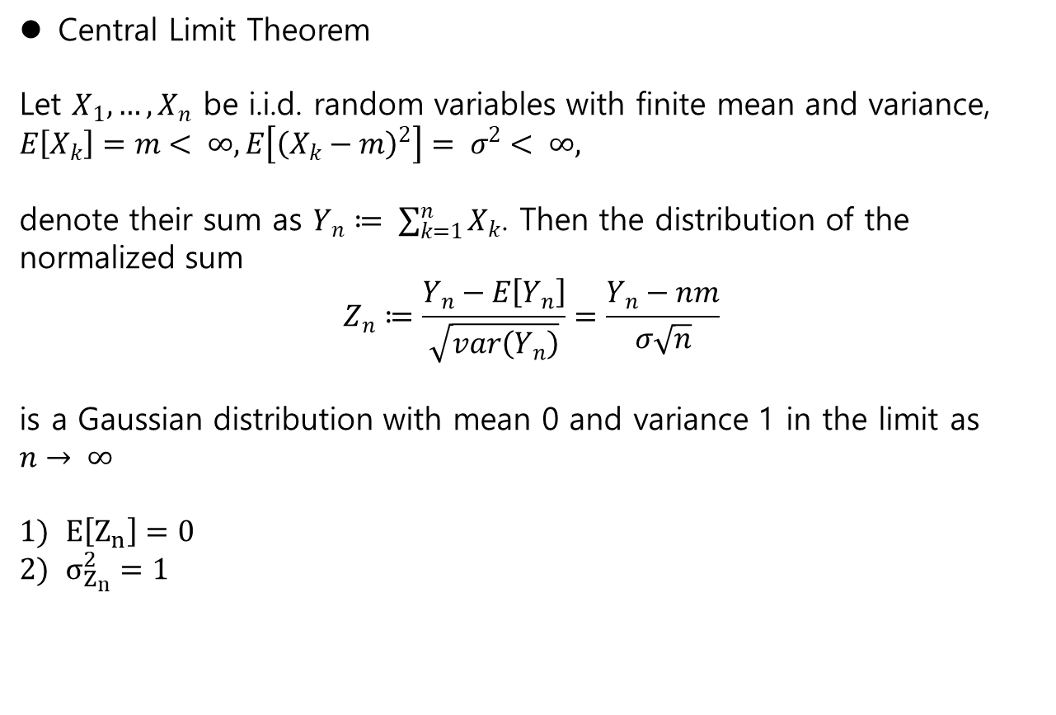
Central Limit Theorem
Central Limit Theorem
Let $X_{1},…, X_{n}$ be i.i.d. random variables with finite mean and variance,
$E\left[X_{k}\right]=m< ∞, E\left[{\left(X_{k}−m\right)}^{2}\right]= σ^{2}< ∞,$
denote their sum as $Y_{n}≔ \sum_{k=1}^{n}{X_{k}}$. Then the distribution of the normalized sum
$$Z_{n}≔\frac{Y_{n}−E\left[Y_{n}\right]}{\sqrt{var\left(Y_{n}\right)}}=\frac{Y_{n}−nm}{σ\sqrt{n}}$$
is a Gaussian distribution with mean 0 and variance 1 in the limit as $n→ ∞$
$E\left[Z_{n}\right]=0$
$σ_{Z_{n}}^{2}=1$

Slide 10
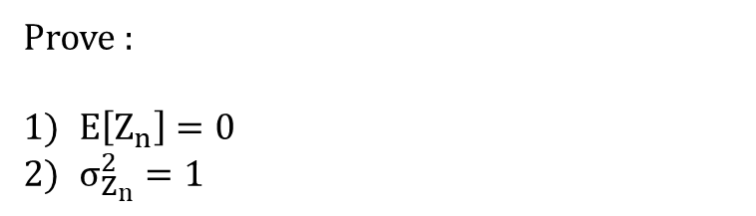
Home Work , Week_3-1
Prove :
$E\left[Z_{n}\right]=0$
$σ_{Z_{n}}^{2}=1$

Slide 11
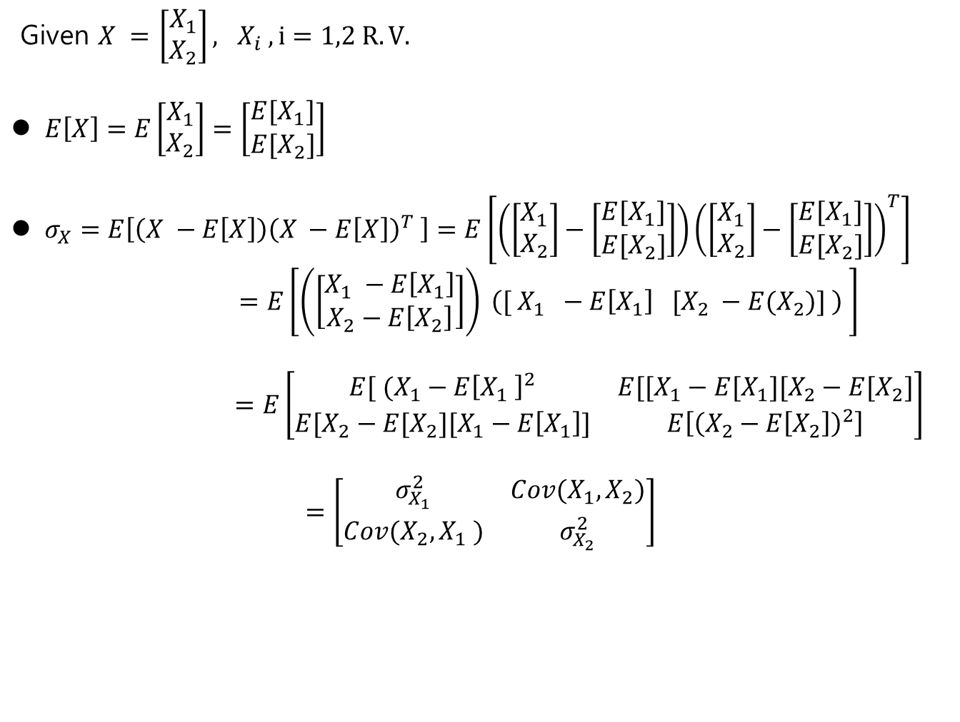
Random vector
Given $X =$ $\left[\begin{matrix}X_{1} \\ X_{2}\end{matrix}\right], X_{i} , i=1,2 R.V.$
$E\left[X\right]=E\left[\begin{matrix}X_{1} \\ X_{2}\end{matrix}\right]=\left[\begin{matrix}{E[X}_{1}] \\ {E[X}_{2}]\end{matrix}\right]$
$σ_{X}=E\left[\left(X −E\left[X\right]\right){\left(X −E\left[X\right]\right)}^{T} \right]=E\left[\left(\left[\begin{matrix}X_{1} \\ X_{2}\end{matrix}\right]−\left[\begin{matrix}{E[X}_{1}] \\ {E[X}_{2}]\end{matrix}\right]\right){\left(\left[\begin{matrix}X_{1} \\ X_{2}\end{matrix}\right]−\left[\begin{matrix}{E[X}_{1}] \\ {E[X}_{2}]\end{matrix}\right]\right)}^{T}\right]$
$$=E\left[\left(\left[\begin{matrix}X_{1} −E\left[X_{1}\right] \\ X_{2}−E\left[X_{2}\right]\end{matrix}\right]\right) \left([ X_{1} −E\left[X_{1}\right] [X_{2} −E(X_{2})] \right) \right]$$
$=E\left[\begin{matrix}E[ (X_{1}−E{\left[X_{1} \right]}^{2} & E[[X_{1}−E[X_{1}][X_{2}−E[X_{2}] \\ E[X_{2}−E[X_{2}][X_{1}−E\left[X_{1}\right]] & E\left[{\left(X_{2}−E\left[X_{2}\right]\right)}^{2}\right]\end{matrix}\right]$
$$=\left[\begin{matrix}σ_{X_{1}}^{2} & Cov(X_{1}, X_{2}) \\ Cov(X_{2}, X_{1} ) & σ_{X_{2}}^{2}\end{matrix}\right]$$

Slide 12
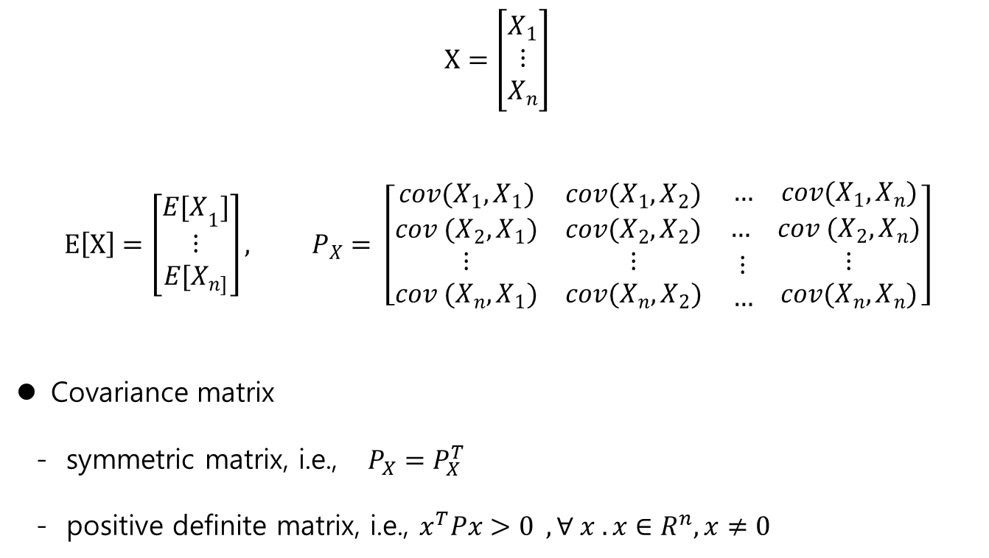
Random vector
In general
$$X=\left[\begin{matrix}X_{1} \\ ⋮ \\ X_{n}\end{matrix}\right]$$
$$E\left[X\right]=\left[\begin{matrix}{E[X}_{1}] \\ ⋮ \\ E[X_{n]}\end{matrix}\right], P_{X}= \left[\begin{matrix}cov(X_{1}, X_{1}) & cov(X_{1},X_{2}) & \begin{matrix}… & cov(X_{1}, X_{n})\end{matrix} \\ cov (X_{2}, X_{1}) & cov(X_{2}, X_{2}) & \begin{matrix}… & cov (X_{2}, X_{n})\end{matrix} \\ \begin{matrix}⋮ \\ cov (X_{n}, X_{1})\end{matrix} & \begin{matrix}⋮ \\ cov(X_{n}, X_{2})\end{matrix} & \begin{matrix}\begin{matrix}⋮ \\ …\end{matrix} & \begin{matrix}⋮ \\ cov(X_{n}, X_{n})\end{matrix}\end{matrix}\end{matrix}\right]$$
Covariance matrix
- symmetric matrix, i.e., $P_{X}=P_{X}^{T}$
- positive definite matrix, i.e., $x^{T}Px>0 , ∀ x . x∈R^{n}, x≠0$

Slide 13

Random vector - Gaussian
Let $X_{1},…, X_{n}$ are gaussian random variables. Then the joint pdf of $X$
$$X=\left[\begin{matrix}X_{1} \\ ⋮ \\ X_{n}\end{matrix}\right]$$
Is given by
$$m_{X}=\left[\begin{matrix}{E[X}_{1}] \\ ⋮ \\ E[X_{n]}\end{matrix}\right], C_{X}= \left[\begin{matrix}cov(X_{1}, X_{1}) & cov(X_{1},X_{2}) & \begin{matrix}… & cov(X_{1}, X_{n})\end{matrix} \\ cov (X_{2}, X_{1}) & cov(X_{2}, X_{2}) & \begin{matrix}… & cov (X_{2}, X_{n})\end{matrix} \\ \begin{matrix}⋮ \\ cov (X_{n}, X_{1})\end{matrix} & \begin{matrix}⋮ \\ cov(X_{n}, X_{2})\end{matrix} & \begin{matrix}\begin{matrix}⋮ \\ …\end{matrix} & \begin{matrix}⋮ \\ cov(X_{n}, X_{n})\end{matrix}\end{matrix}\end{matrix}\right]$$

Slide 14

Gaussian Random vector - Diagonalization
Diagonalization
the eigenvalues of $A$ are different, $∃ M ,$
$$MAM^{−1}=D,$$
where $D$ is a diagonal matrix
Positive symmetric matrix $M_{n×n}$
Def: $x^{T}Mx >0 , ∀ x∈R^{n} , x≠0$
- Properties
$∃ N$ such that $N M N^{T}=D , D$ is a diagonal matrix

Slide 15
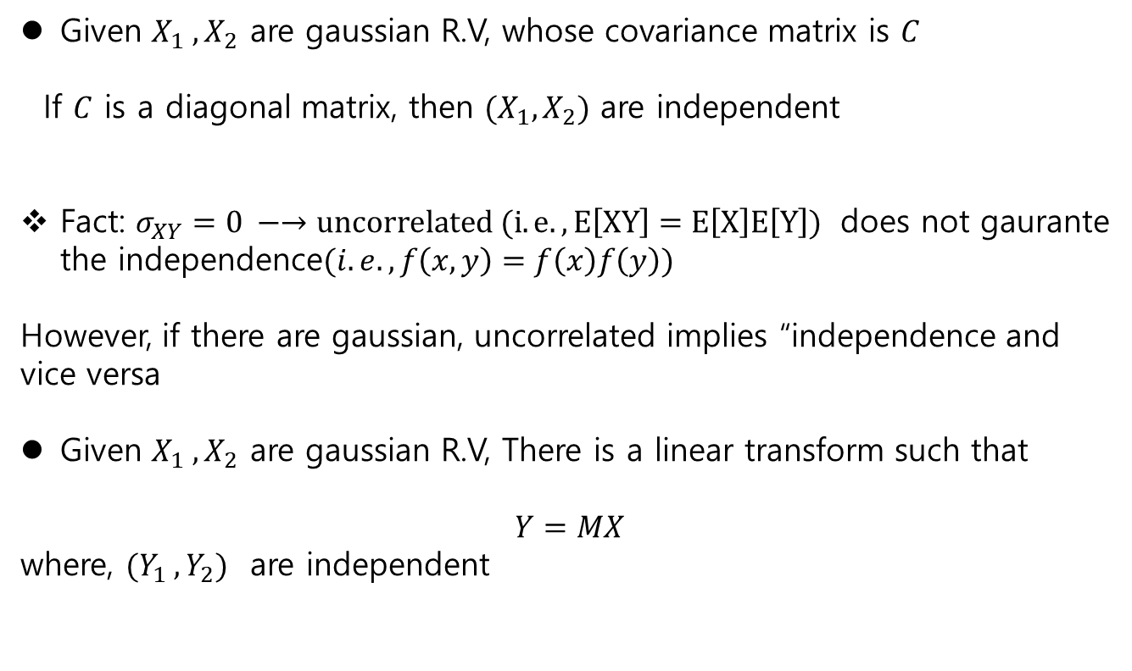
Random vector
Given $X_{1} ,X_{2}$ are gaussian R.V, whose covariance matrix is $C$
If $C$ is a diagonal matrix, then $(X_{1}, X_{2})$ are independent
Fact: $σ_{XY}=0 −→uncorrelated (i.e., E\left[XY\right]=E\left[X\right]E\left[Y\right])$ does not gaurante the independence$(i.e., f\left(x,y\right)=f\left(x\right)f\left(y\right))$
However, if there are gaussian, uncorrelated implies “independence and vice versa
Given $X_{1} ,X_{2}$ are gaussian R.V, There is a linear transform such that
$$Y=MX$$
where, $(Y_{1} ,Y_{2})$ are independent

