Slide 1

Ch.5 Stochastic Processes and Stochastic Calculus
Continuous time process
$$x=at+v, v:noise$$
$\frac{dx}{dt} =\frac{d\left(at\right)}{dt} +\frac{dv}{dt}$
If v is but not differentiable,
1) $E\left[\frac{d\left(x\right)}{dt} \right], σ_{x}^{2} ?$
→ $\dot{x}=Ax+Bw −→ E\left[x\right], σ_{x}^{2} ?$

Slide 2
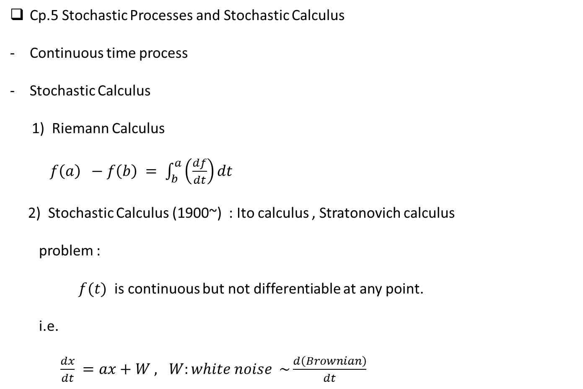
Cp.5 Stochastic Processes and Stochastic Calculus
Continuous time process
Stochastic Calculus
1) Riemann Calculus
$f\left(a\right) −f\left(b\right) = \int_{b}^{a}{\left(\frac{df}{dt}\right)dt}$
2) Stochastic Calculus (1900~) : Ito calculus , Stratonovich calculus
problem :
$f(t)$ is continuous but not differentiable at any point.
i.e.
$\frac{dx}{dt} =ax+W , W:white noise \sim \frac{d\left(Brownian\right)}{dt}$

Slide 3
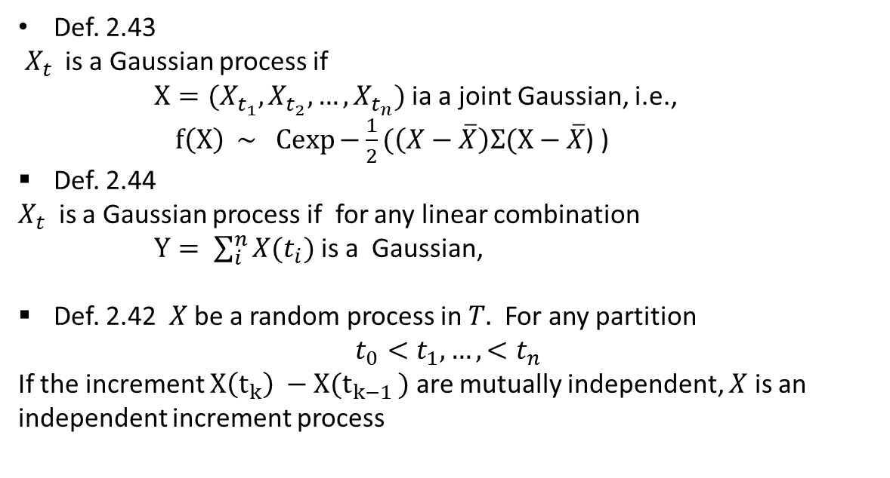
Def. 2.43
$X_{t}$ is a Gaussian process if
$X=(X_{t_{1}}, X_{t_{2}},…, X_{t_{n}})$ ia a joint Gaussian, i.e.,
$f\left(X\right) \sim Cexp{−\frac{1}{2}(\left(X−\overline{X}\right)Σ(X−\overline{X}}$) )
Def. 2.44
$X_{t}$ is a Gaussian process if for any linear combination
$Y= \sum_{i}^{n}{X(t_{i})}$ is a Gaussian,
Def. 2.42 $X$ be a random process in $T.$ For any partition
$$t_{0}<t_{1},…,<t_{n}$$
If the increment $X\left(t_{k}\right) −X(t_{k−1 })$ are mutually independent, $X$ is an independent increment process

Slide 4
Two are Gaussian Process
One is not an independent increment. The other is an independent increment

Slide 5
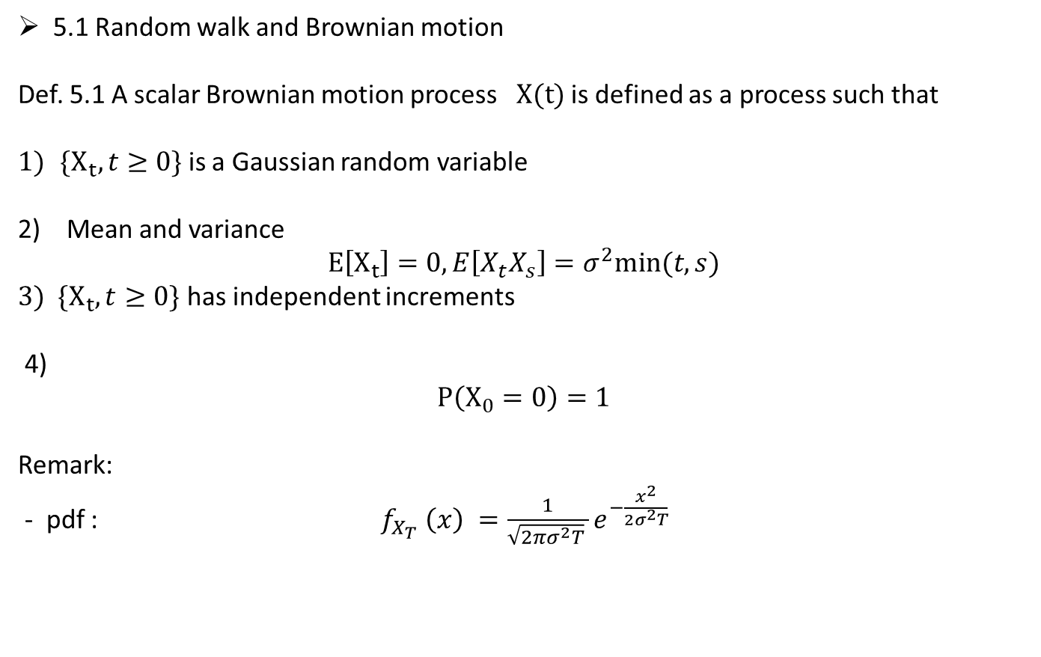
5.1 Random walk and Brownian motion
Def. 5.1 A scalar Brownian motion process $X(t)$ is defined as a process such that
$\{X_{t}, t≥0\}$ is a Gaussian random variable
2) Mean and variance
$$E\left[X_{t}\right]=0, E\left[X_{t}X_{s}\right]=σ^{2}min⁡(t,s)$$
$3) \{X_{t}, t≥0\}$ has independent increments
4)
$$P\left(X_{0}=0\right)=1$$
Remark:
- pdf : $f_{X_{T}} \left(x\right) =\frac{1}{\sqrt{2πσ^{2}T} }e^{−\frac{x^{2}}{2σ^{2}T}}$

Slide 6
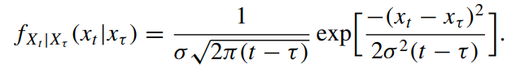
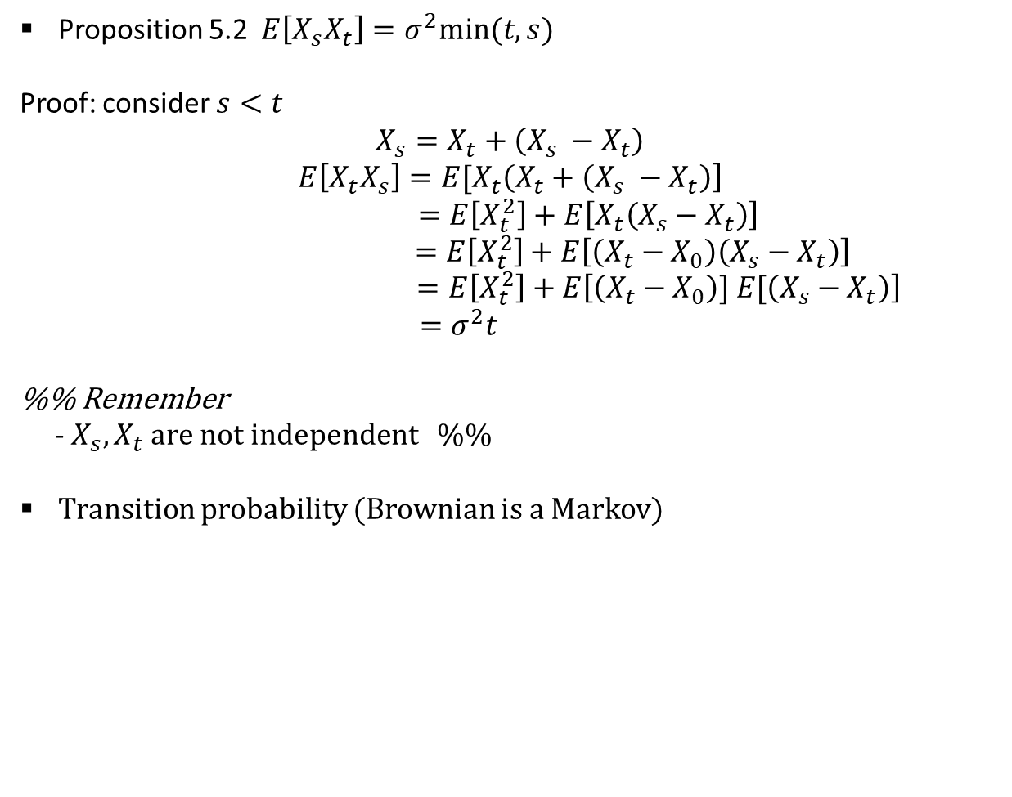
Proposition 5.2 $E\left[X_{s}X_{t}\right]=σ^{2}min⁡(t,s)$
Proof: consider $s<t$
$$X_{s}=X_{t}+\left(X_{s} −X_{t}\right)$$
$$E\left[X_{t}X_{s}\right]=E[X_{t}\left(X_{t}+\left(X_{s} −X_{t}\right)\right]$$
$$=E\left[X_{t}^{2}\right]+E\left[X_{t}\left(X_{s}−X_{t}\right)\right]$$
$$=E\left[X_{t}^{2}\right]+E\left[\left(X_{t}−X_{0}\right)\left(X_{s}−X_{t}\right)\right]$$
$=E\left[X_{t}^{2}\right]+E\left[\left(X_{t}−X_{0}\right)] E[\left(X_{s}−X_{t}\right)\right]$
$$=σ^{2}t$$
%% Remember
- $X_{s}, X_{t}$ are not independent %%
Transition probability (Brownian is a Markov)

Slide 7
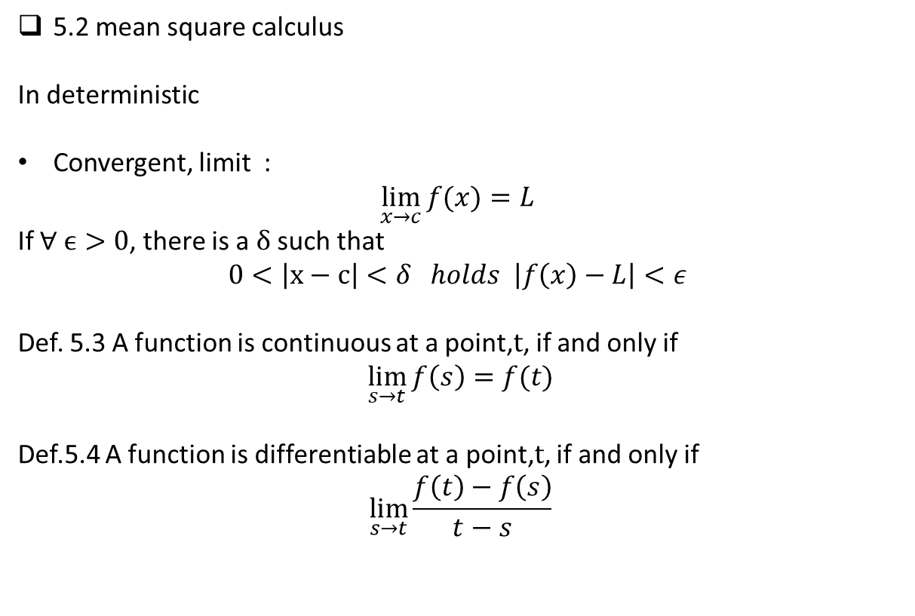
5.2 mean square calculus
In deterministic
Convergent, limit :
$$\lim_{x→c}{f(x)}=L$$
If $∀ ϵ>0$, there is a $δ$ such that
$$0<\left|x−c\right|<δ holds \left|f\left(x\right)−L\right|<ε$$
Def. 5.3 A function is continuous at a point,$t$, if and only if
$$\lim_{s→t}{f\left(s\right)}=f(t)$$
Def.5.4 A function is differentiable at a point,$t$, if and only if
$$\lim_{s→t}{\frac{f\left(t\right)−f\left(s\right)}{t−s}}$$

Slide 8
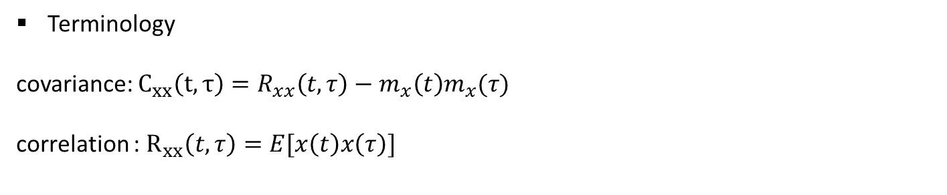

Def. 5.5 random sequence $x_{n}$
$x_{n} →x in probability$
$∀ε>0 , \lim_{n→∞ }{P\left( \left\{ ω:\left|x_{n}\left(ω\right)−x\left(ω\right)\right|>ε \right\}\right)=0}$
Def. 5.7
$x_{n} →x in mean square$
$\lim_{k→∞}{E\left[ {\left(x_{k}−x\right)}^{2} \right]=0}$
Terminology
covariance: $C_{xx}\left(t,τ\right)=R_{xx}\left(t,τ\right)−m_{x}\left(t\right)m_{x}(τ)$
correlation : $R_{xx}\left(t,τ\right)=E[x\left(t\right)x\left(τ\right)]$

Slide 9
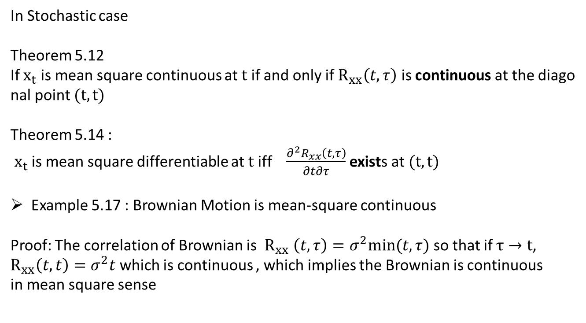
In Stochastic case
Theorem 5.12
If $x_{t}$ is mean square continuous at $t$ if and only if $R_{xx}\left(t, τ\right)$ is continuous at the diagonal point $(t,t)$
Theorem 5.14 :
$x_{t}$ is mean square differentiable at $t$ iff $\frac{∂^{2}R_{xx}\left(t,τ\right)}{∂t∂τ}$exists at $(t,t)$
Example 5.17 : Brownian Motion is mean-square continuous
Proof: The correlation of Brownian is $R_{xx} \left(t, τ\right)=σ^{2}min⁡(t,τ)$ so that if $τ→t$,
$R_{xx}\left(t,t\right)=σ^{2}t$ which is continuous , which implies the Brownian is continuous
in mean square sense

Slide 10
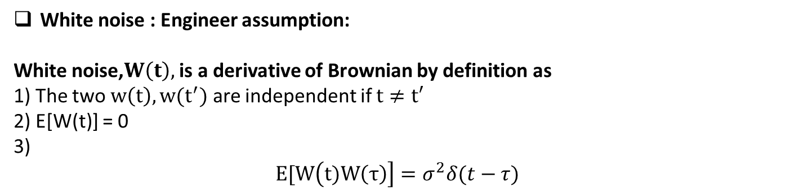

Brownian is not differentiable : Important fact in stochastic differential,
Brownian motion.
$$R_{xx}\left(t,τ\right) =\left\{\begin{aligned}σ^{2}τ if τ<t \\ σ^{2}t if τ>t \end{aligned}\right.$$
$\frac{∂^{2}R_{xx}\left(t,τ\right)}{∂t∂τ}=\frac{∂}{∂t} ∂/∂τ\left\{\begin{aligned}σ^{2}τ if τ<t \\ σ^{2}t if τ>t \end{aligned} =\frac{∂}{∂t}\left\{\begin{aligned}σ^{2} if τ<t \\ σ^{2}t if τ>t \end{aligned} =\left\{\begin{aligned}0 if τ<t \\ σ^{2} if τ>t \end{aligned} \right.\right.\right.$
Not differentiable
Brownian is not differentiable at any points.
White noise : Engineer assumption:
White noise,$W\left(t\right),$ is a derivative of Brownian by definition as
1) The two $w\left(t\right), w(t^{′})$ are independent if $t≠t′$
2) E[W(t)] = 0
3)
$$E[W\left(t)W\left(τ\right)\right]=σ^{2}δ(t−τ)$$

Slide 11
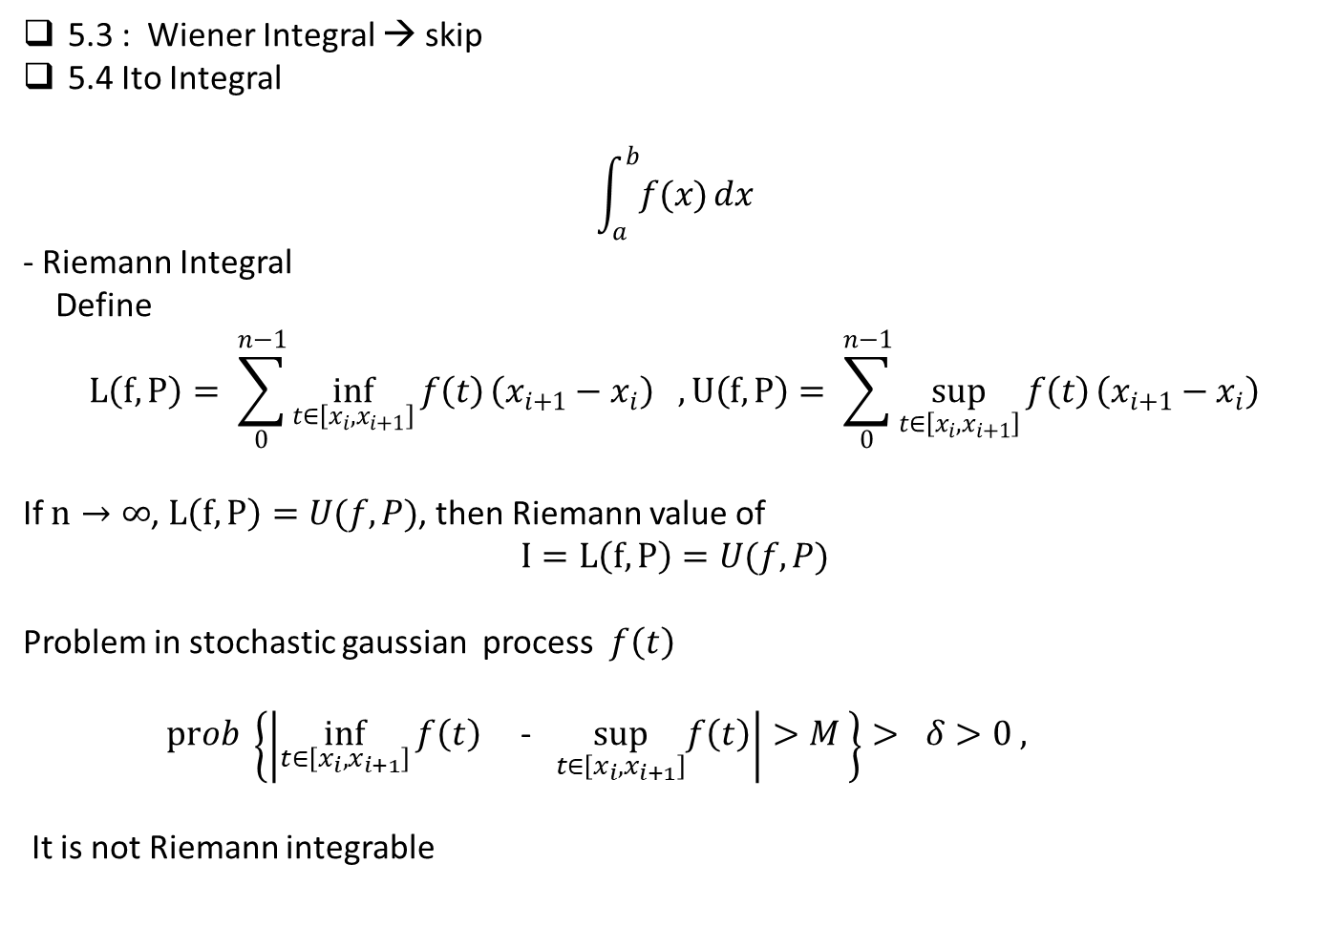
5.3 : Wiener Integral → skip
5.4 Ito Integral
$$\int_{a}^{b}{f(x)}dx$$
- Riemann Integral
Define
$$L\left(f,P\right)= \sum_{0}^{n−1}{\inf_{t∈\left[x_{i}, x_{i+1}\right]}{f\left(t\right)}}\left(x_{i+1}−x_{i}\right) , U\left(f,P\right)= \sum_{0}^{n−1}{\sup_{t∈\left[x_{i}, x_{i+1}\right]}{f\left(t\right)}}\left(x_{i+1}−x_{i}\right)$$
If $n→∞$, $L\left(f,P\right)=U(f,P)$, then Riemann value of
$$I=L\left(f,P\right)=U(f,P)$$
Problem in stochastic gaussian process $f\left(t\right)$
$prob \left\{\left|\inf_{t∈\left[x_{i}, x_{i+1}\right]}{f\left(t\right)}\text{ − }\sup_{t∈\left[x_{i}, x_{i+1}\right]}f\left(t\right)\right|>M \right\}> δ>0 ,$
It is not Riemann integrable

Slide 12

Ito Integral
$$I=\int_{a}^{b}{f(x)}dβ$$
$$−→ \sum_{i=0}^{n−1}{f\left(x_{i}\right)(β_{i+1}−β_{i})}$$
Riemann integral
$$L\left(f,P\right)= \sum_{0}^{n−1}{\inf_{t∈\left[x_{i}, x_{i+1}\right]}{f\left(t\right)}}\left(x_{i+1}−x_{i}\right) , U\left(f,P\right)= \sum_{0}^{n−1}{\sup_{t∈\left[x_{i}, x_{i+1}\right]}{f\left(t\right)}}\left(x_{i+1}−x_{i}\right)$$
Ex. Riemann Integral
$$\int_{0}^{t}{x_{t} dx}=\frac{1}{2}x^{2}\left(t\right)$$

Slide 13
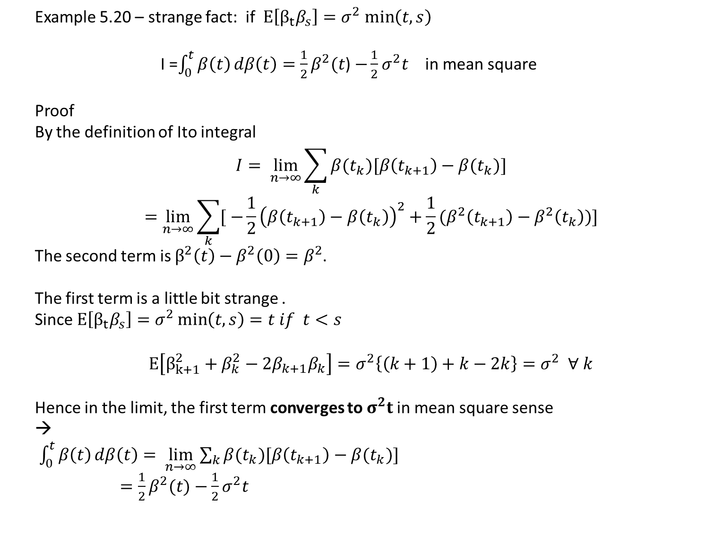
Example 5.20 – strange fact: if $E\left[β_{t}β_{s}\right]=σ^{2} min\left(t,s\right)$
I =$\int_{0}^{t}{β\left(t\right)}dβ\left(t\right)=\frac{1}{2}β^{2}(t$) $−\frac{1}{2}σ^{2}t$ in mean square
Proof
By the definition of Ito integral
$$I= \lim_{n→∞}{\sum_{k}{β(t_{k})[β\left(t_{k+1}\right)−β(t_{k})}]}$$
$$=\lim_{n→∞}{\sum_{k}{[ −\frac{1}{2}{\left(β\left(t_{k+1}\right)−β\left(t_{k}\right)\right)}^{2}+\frac{1}{2}(β^{2}\left(t_{k+1}\right)−β^{2}\left(t_{k}\right))]}}$$
The second term is $β^{2}\left(t\right)−β^{2}\left(0\right)=β^{2}$.
The first term is a little bit strange .
Since $E\left[β_{t}β_{s}\right]=σ^{2}\min\left(t,s\right)=t if t<s$
$$E\left[β_{k+1}^{2}+β_{k}^{2}−2β_{k+1}β_{k}\right]=σ^{2}\left\{\left(k+1\right)+k−2k\right\}=σ^{2} ∀ k$$
Hence in the limit, the first term converges to $σ^{2}t$ in mean square sense
→
$\int_{0}^{t}{β\left(t\right)}dβ\left(t\right)= \lim_{n→∞}{\sum_{k}{β(t_{k})[β\left(t_{k+1}\right)−β(t_{k})}]}$
$=\frac{1}{2}β^{2}(t)−\frac{1}{2}σ^{2}t$

Slide 14
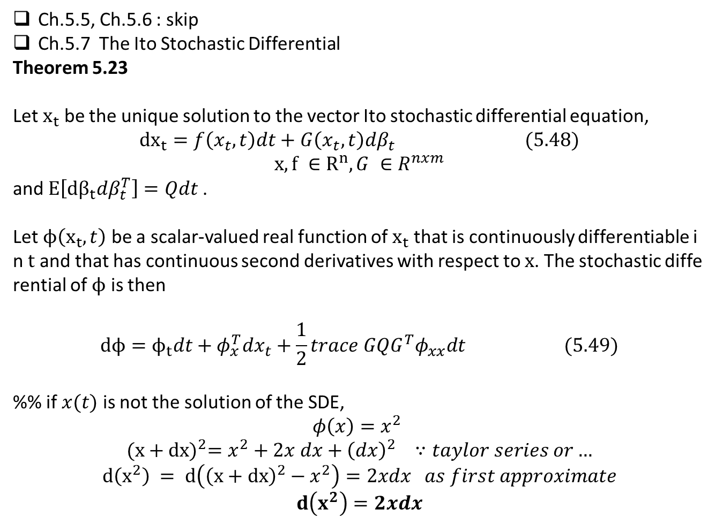
Ch.5.5, Ch.5.6 : skip
Ch.5.7 The Ito Stochastic Differential
Theorem 5.23
Let $x_{t}$ be the unique solution to the vector Ito stochastic differential equation,
$${dx}_{t}=f\left(x_{t}, t\right)dt+G\left(x_{t},t\right)dβ_{t} (5.48)$$
$$x, f ∈R^{n}, G ∈R^{nxm}$$
and $E\left[dβ_{t}dβ_{t}^{T}\right]=Qdt$.
Let $ϕ\left(x_{t},t\right)$ be a scalar-valued real function of $x_{t}$ that is continuously differentiable in $t$ and that has continuous second derivatives with respect to $x$. The stochastic differential of $ϕ$ is then
$$dϕ=ϕ_{t}dt+φ_{x}^{T}dx_{t}+\frac{1}{2}trace GQG^{T}φ_{xx}dt (5.49)$$
%% if $x(t)$ is not the solution of the SDE,
$$φ\left(x\right)=x^{2}$$
$${(x+dx)}^{2}=x^{2}+2x dx+{\left(dx\right)}^{2} ∵taylor series or…$$
$$d\left(x^{2}\right) = d\left({\left(x+dx\right)}^{2}−x^{2}\right)=2xdx as first approximate$$
$$d\left(x^{2}\right)=2xdx$$

Slide 15
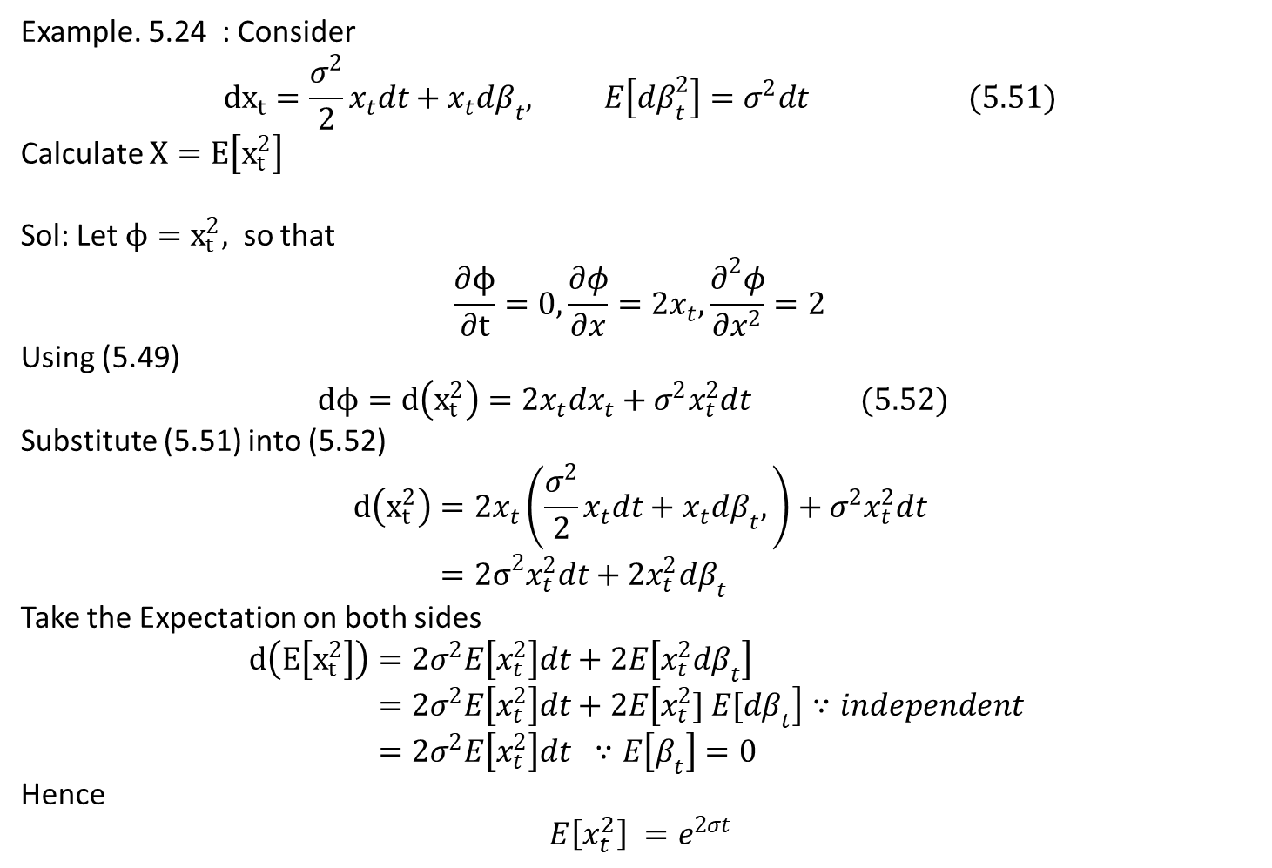
Example. 5.24 : Consider
$${dx}_{t}=\frac{σ^{2}}{2}x_{t}dt+x_{t}dβ_{t}, E\left[dβ_{t}^{2}\right]=σ^{2}dt (5.51)$$
Calculate $X=E\left[x_{t}^{2}\right]$
Sol: Let $ϕ=x_{t}^{2},$ so that
$$\frac{∂ϕ}{∂t}=0,\frac{∂φ}{∂x}=2x_{t},\frac{∂^{2}φ}{∂x^{2}}=2$$
Using (5.49)
$$dϕ=d\left(x_{t}^{2}\right)=2x_{t}dx_{t}+σ^{2}x_{t}^{2}dt (5.52)$$
Substitute (5.51) into (5.52)
$$d\left(x_{t}^{2}\right)=2x_{t}\left(\frac{σ^{2}}{2}x_{t}dt+x_{t}dβ_{t},\right)+σ^{2}x_{t}^{2}dt \\ ={2σ}^{2}x_{t}^{2}dt+2x_{t}^{2}dβ_{t}$$
Take the Expectation on both sides
$$d\left(E\left[x_{t}^{2}\right]\right)=2σ^{2}E\left[x_{t}^{2}\right]dt+2E\left[x_{t}^{2}dβ_{t}\right] \\ =2σ^{2}E\left[x_{t}^{2}\right]dt+2E\left[x_{t}^{2}] E[dβ_{t}\right]∵independent \\ =2σ^{2}E\left[x_{t}^{2}\right]dt ∵E\left[β_{t}\right]=0$$
Hence
$$E\left[x_{t}^{2}\right] =e^{2σt}$$

Slide 16
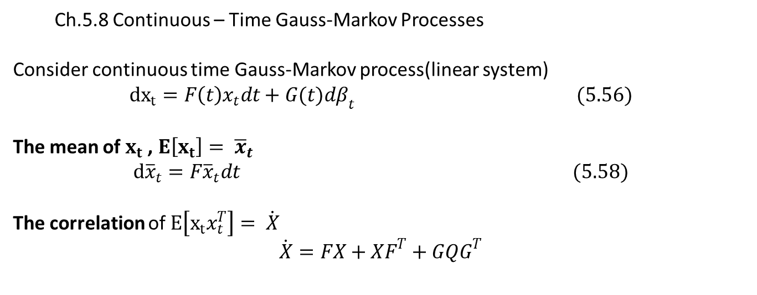
Ch.5.8 Continuous – Time Gauss-Markov Processes
Consider continuous time Gauss-Markov process(linear system)
$${dx}_{t}=F\left(t\right)x_{t}dt+G(t)dβ_{t} (5.56)$$
The mean of $x_{t}$ , $E\left[x_{t}\right]= {\overline{x}}_{t}$
$$d{\overline{x}}_{t}=F{\overline{x}}_{t}dt (5.58)$$
The correlation of $E\left[x_{t}x_{t}^{T}\right]= \dot{X}$
$$\dot{X}=FX+XF^{T}+GQG^{T}$$

Slide 17

Proof: (Using Theorem 5.23 in the vector case)
1) Mean
$$E\left[x_{t}\right]= {\overline{x}}_{t}$$
$$d{\overline{x}}_{t}=F{\overline{x}}_{t}dt (5.58)$$
$E\left[d{\overline{x}}_{t}\right]=FE\left[x_{t}dt\right]+E\left[G\left(t\right)dβ_{t}\right]=F{\overline{x}}_{t}$
Since
$E\left[dβ_{t}\right] −→ E\left[β_{t+δt} −β_{t}\right] =0$

Slide 18
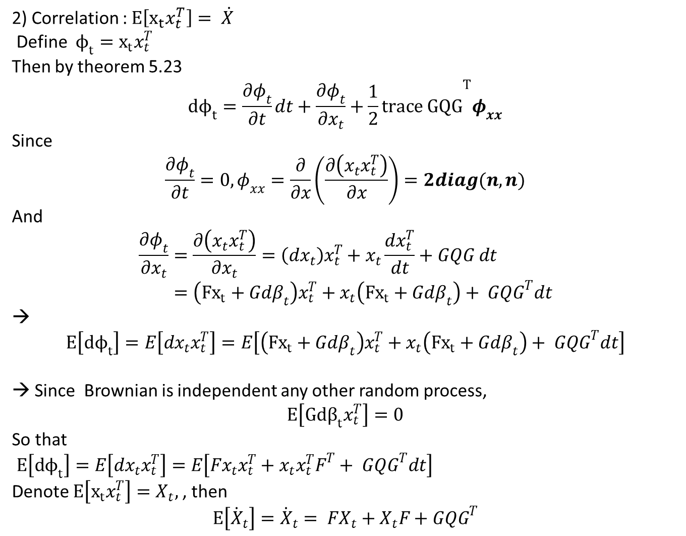
2) Correlation : $E\left[x_{t}x_{t}^{T}\right]= \dot{X}$
Define $ϕ_{t}=x_{t}x_{t}^{T}$
Then by theorem 5.23
$$dϕ_{t}=\frac{∂φ_{t}}{∂t}dt+\frac{∂φ_{t}}{∂x_{t}}+{\frac{1}{2}trace GQG}^{T}φ_{xx}$$
Since
$$\frac{∂φ_{t}}{∂t}=0, φ_{xx}=\frac{∂}{∂x}\left(\frac{∂\left(x_{t}x_{t}^{T}\right)}{∂x}\right)=2diag(n,n)$$
And
$$\frac{∂φ_{t}}{∂x_{t}}=\frac{∂\left(x_{t}x_{t}^{T}\right)}{∂x_{t}}=\left(dx_{t}\right)x_{t}^{T}+x_{t}\frac{dx_{t}^{T}}{dt}+GQG dt \\ =\left({Fx}_{t}+Gdβ_{t}\right)x_{t}^{T}+x_{t}\left({Fx}_{t}+Gdβ_{t}\right)+ GQG^{T}dt$$
→
$$E\left[dϕ_{t}\right]=E\left[dx_{t}x_{t}^{T}\right]=E\left[\left({Fx}_{t}+Gdβ_{t}\right)x_{t}^{T}+x_{t}\left({Fx}_{t}+Gdβ_{t}\right)+ GQG^{T}dt\right]$$
→ Since Brownian is independent any other random process,
$$E\left[Gdβ_{t}x_{t}^{T}\right]=0$$
So that
$E\left[dϕ_{t}\right]=E\left[dx_{t}x_{t}^{T}\right]=E\left[Fx_{t}x_{t}^{T}+x_{t}x_{t}^{T}F^{T}+ GQG^{T}dt\right]$
Denote $E\left[x_{t}x_{t}^{T}\right]=X_{t},$, then
$$E\left[{\dot{X}}_{t}\right]={\dot{X}}_{t}= FX_{t}+X_{t}F+GQG^{T}$$

Slide 19
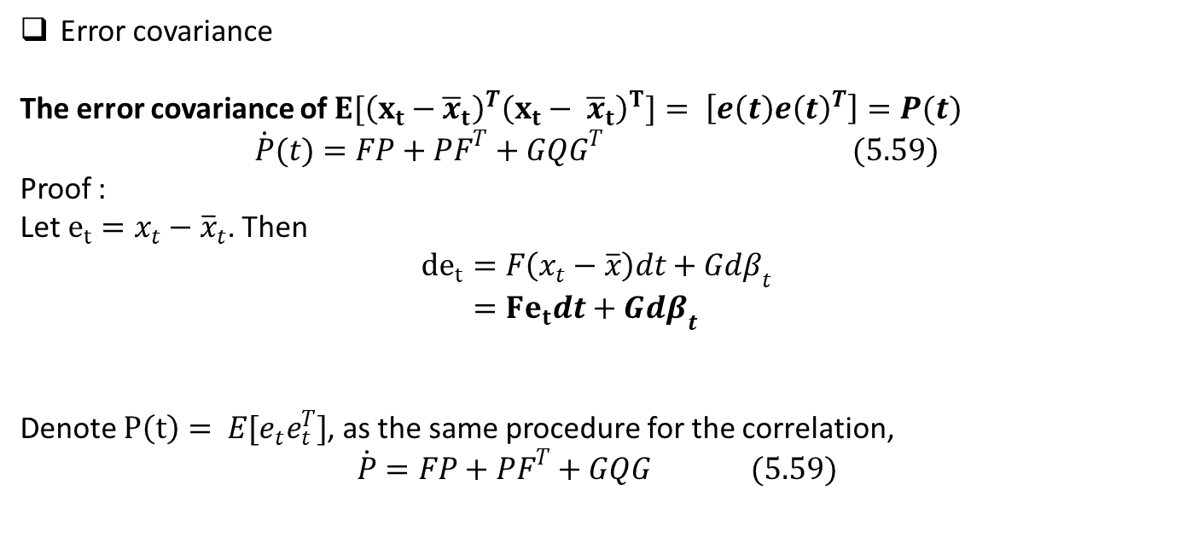
Error covariance
The error covariance of $E[{\left(x_{t}−{\overline{x}}_{t}\right)}^{T}{\left(x_{t}− {\overline{x}}_{t}\right)}^{T}]= \left[e\left(t\right)e{\left(t\right)}^{T}\right]=P(t)$
$$\dot{P}(t)=FP+PF^{T}+GQG^{T} (5.59)$$
Proof :
Let $e_{t}=x_{t}−{\overline{x}}_{t}$. Then
$${de}_{t}=F\left(x_{t}−\overline{x}\right)dt+Gdβ_{t} \\ ={Fe}_{t}dt+Gdβ_{t}$$
Denote $P\left(t\right)= E[e_{t}e_{t}^{T}]$, as the same procedure for the correlation,
$$\dot{P}=FP+PF^{T}+GQG (5.59)$$

Slide 20
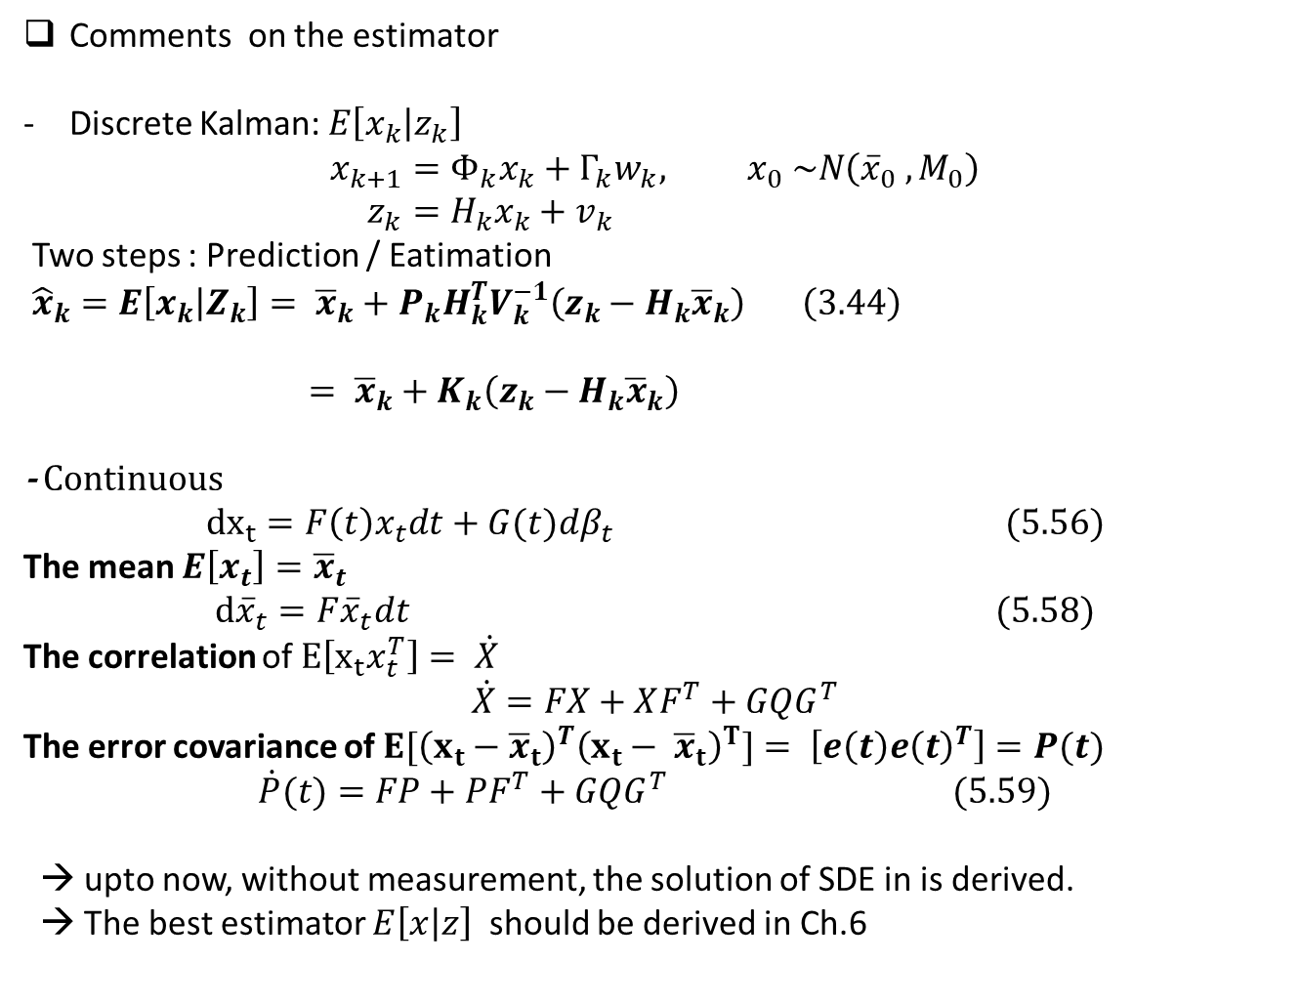
Comments on the estimator
Discrete Kalman: $E\left[x_{k} | z_{k}\right]$
$$x_{k+1}=Φ_{k}x_{k}+Γ_{k}w_{k}, x_{0} \sim N\left({\overline{x}}_{0} , M_{0}\right) \\ z_{k}=H_{k}x_{k}+v_{k}$$
Two steps : Prediction / Eatimation
${\hat{x}}_{k}=E\left[x_{k} | Z_{k}\right]= {\overline{x}}_{k}+P_{k}H_{k}^{T}V_{k}^{−1}\left(z_{k}−H_{k}{\overline{x}}_{k}\right) \left(3.44\right)$
$= {\overline{x}}_{k}+K_{k}\left(z_{k}−H_{k}{\overline{x}}_{k}\right)$
- Continuous
$${dx}_{t}=F\left(t\right)x_{t}dt+G(t)dβ_{t} (5.56)$$
The mean $E\left[x_{t}\right]={\overline{x}}_{t}$
$$d{\overline{x}}_{t}=F{\overline{x}}_{t}dt (5.58)$$
The correlation of $E\left[x_{t}x_{t}^{T}\right]= \dot{X}$
$$\dot{X}=FX+XF^{T}+GQG^{T}$$
The error covariance of $E[{\left(x_{t}−{\overline{x}}_{t}\right)}^{T}{\left(x_{t}− {\overline{x}}_{t}\right)}^{T}]= \left[e\left(t\right)e{\left(t\right)}^{T}\right]=P(t)$
$$\dot{P}(t)=FP+PF^{T}+GQG^{T} (5.59)$$
→ upto now, without measurement, the solution of SDE in is derived.
→ The best estimator $E\left[x | z\right]$ should be derived in Ch.6

Slide 21

%% Engineering Method
Consider
$$\frac{dx}{dt}=Fx+Gw, w=\frac{dβ}{dt} (e.1)$$
$$E\left[w\right]=0, E\left[W_{t}W_{s}\right]=Qδ(t−s)$$
The solution of (e.1) is
$$x\left(t\right)=e^{Ft}x\left(0\right)+ \int_{0}^{t}{e^{F\left(t−τ\right)}Gw dτ} (e.2)$$
1) The mean is
$$E\left[x\left(t\right)\right]=E\left[e^{Ft}x\left(0\right)+ \int_{0}^{t}{e^{F\left(t−τ\right)}Gw dτ}\right] \\ =E\left[e^{Ft}x\left(0\right)\right]+\int_{0}^{t}{e^{F\left(t−τ\right)}GE[w] dτ} \\ =E\left[e^{Ft}x\left(0\right)\right]$$
which is equivalent to the solution of (5.58)

Slide 22
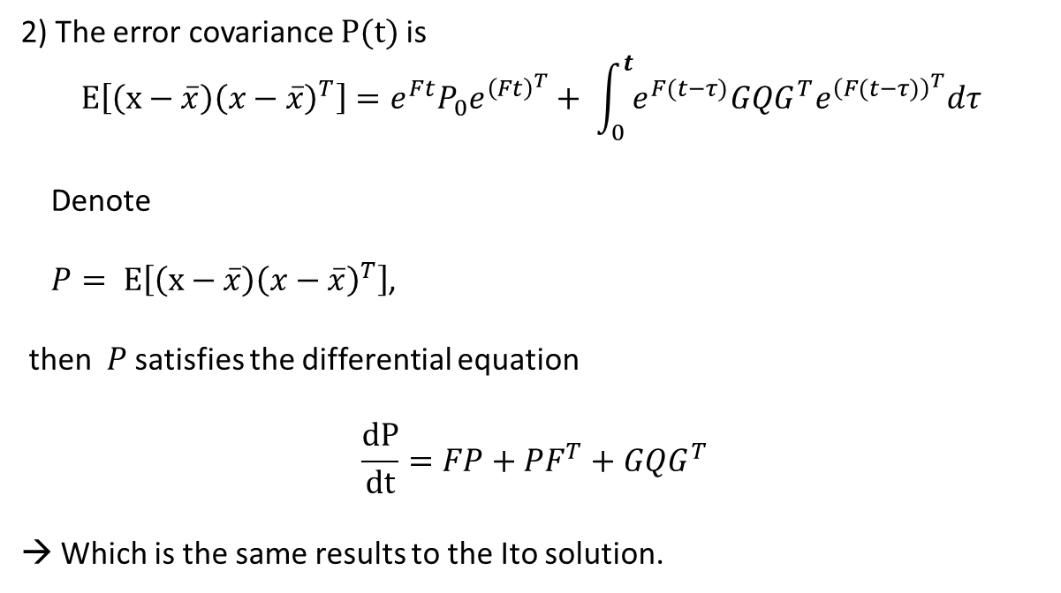
2) The error covariance $P(t)$ is
$$E\left[\left(x−\overline{x}\right){\left(x−\overline{x}\right)}^{T}\right]=e^{Ft}P_{0}e^{{\left(Ft\right)}^{T}}+ \int_{0}^{t}{e^{F(t−τ)}GQG^{T}e^{{\left(F(t−τ)\right)}^{T}}dτ}$$
Denote
$P= E\left[\left(x−\overline{x}\right){\left(x−\overline{x}\right)}^{T}\right]$,
then $P$ satisfies the differential equation
$$\frac{dP}{dt}=FP+PF^{T}+GQG^{T}$$
→ Which is the same results to the Ito solution.

Slide 23
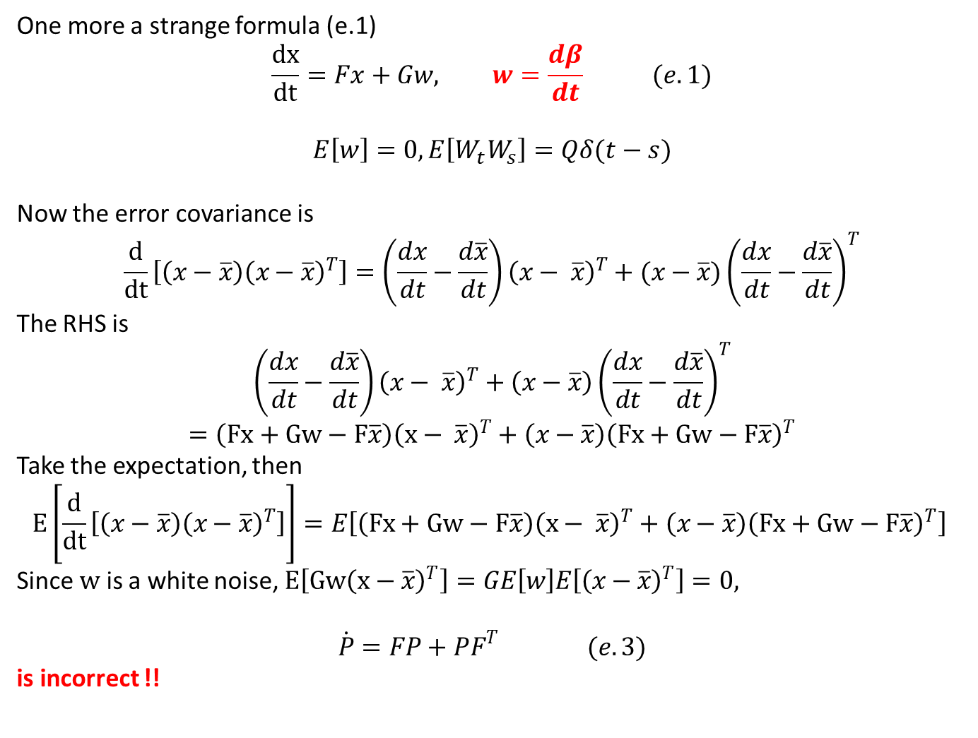
One more a strange formula (e.1)
$$\frac{dx}{dt}=Fx+Gw, w=\frac{dβ}{dt} (e.1)$$
$$E\left[w\right]=0, E\left[W_{t}W_{s}\right]=Qδ(t−s)$$
Now the error covariance is
$$\frac{d}{dt}\left[\left(x−\overline{x}\right){\left(x−\overline{x}\right)}^{T}\right]=\left(\frac{dx}{dt}−\frac{d\overline{x}}{dt}\right){\left(x− \overline{x}\right)}^{T}+(x−\overline{x}){\left(\frac{dx}{dt}−\frac{d\overline{x}}{dt}\right)}^{T}$$
The RHS is
$$\left(\frac{dx}{dt}−\frac{d\overline{x}}{dt}\right){\left(x− \overline{x}\right)}^{T}+\left(x−\overline{x}\right){\left(\frac{dx}{dt}−\frac{d\overline{x}}{dt}\right)}^{T}$$
$$=\left(Fx+Gw−F\overline{x}\right){\left(x− \overline{x}\right)}^{T}+\left(x−\overline{x}\right){\left(Fx+Gw−F\overline{x}\right)}^{T}$$
Take the expectation, then
$$E\left[\frac{d}{dt}\left[\left(x−\overline{x}\right){\left(x−\overline{x}\right)}^{T}\right]\right]=E\left[\left(Fx+Gw−F\overline{x}\right){\left(x− \overline{x}\right)}^{T}+\left(x−\overline{x}\right){\left(Fx+Gw−F\overline{x}\right)}^{T}\right]$$
Since $w$ is a white noise, $E\left[Gw{\left(x−\overline{x}\right)}^{T}\right]=GE\left[w\right]E\left[{\left(x−\overline{x}\right)}^{T}\right]=0,$
$$\dot{P}=FP+PF^{T} (e.3)$$
is incorrect !!

