Slide 1
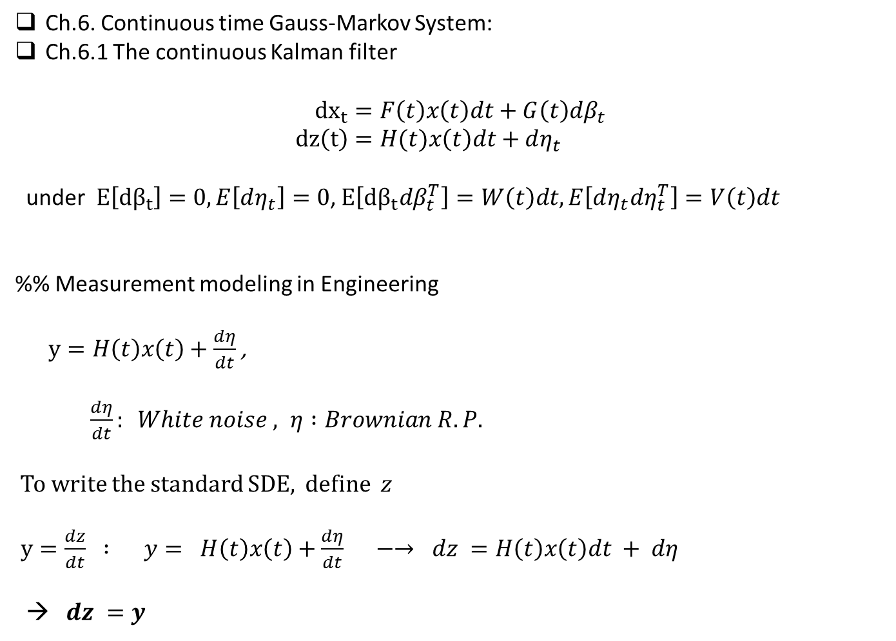
Ch.6. Continuous time Gauss-Markov System:
Ch.6.1 The continuous Kalman filter
$${dx}_{t}=F\left(t\right)x\left(t\right)dt+G\left(t\right)dβ_{t} \\ dz\left(t\right)=H(t)x\left(t\right)dt+dη_{t}$$
under $E\left[dβ_{t}\right]=0, E\left[dη_{t}\right]=0$, $E\left[dβ_{t}dβ_{t}^{T}\right]=W\left(t\right)dt, E\left[dη_{t}dη_{t}^{T}\right]=V\left(t\right)dt$
%% Measurement modeling in Engineering
$y=H\left(t\right)x\left(t\right)+\frac{dη}{dt}$ ,
$\frac{dη}{dt}: White noise , η :Brownian R.P.$
To write the standard SDE, define $z$
$y=\frac{dz}{dt} : y= H\left(t\right)x\left(t\right)+\frac{dη}{dt} −→ dz =H\left(t\right)x\left(t\right)dt + dη$
→ $dz =y$

Slide 2
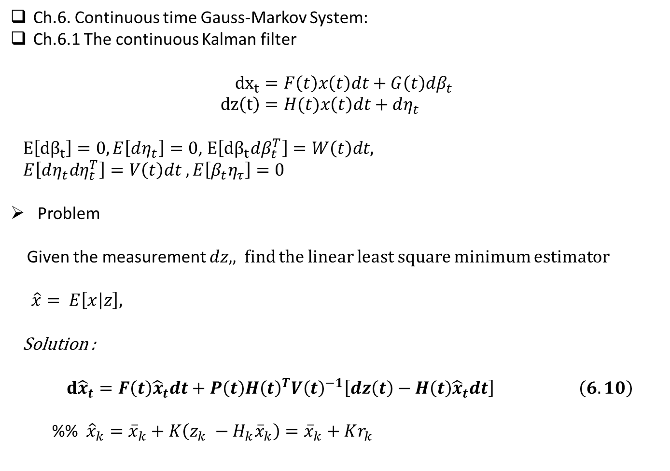
Ch.6. Continuous time Gauss-Markov System:
Ch.6.1 The continuous Kalman filter
$${dx}_{t}=F\left(t\right)x\left(t\right)dt+G\left(t\right)dβ_{t} \\ dz\left(t\right)=H(t)x\left(t\right)dt+dη_{t}$$
$E\left[dβ_{t}\right]=0, E\left[dη_{t}\right]=0$, $E\left[dβ_{t}dβ_{t}^{T}\right]=W\left(t\right)dt,$
$E\left[dη_{t}dη_{t}^{T}\right]=V\left(t\right)dt , E\left[β_{t}η_{τ}\right]=0$
Problem
Given the measurement $dz, ,$find the linear least square minimum estimator
$\hat{x}= E\left[x | z\right],$
Solution :
$d{\hat{x}}_{t}=F\left(t\right){\hat{x}}_{t}dt+P\left(t\right)H{\left(t\right)}^{T}V{\left(t\right)}^{−1}\left[dz\left(t\right)−H\left(t\right){\hat{x}}_{t}dt\right] \left(6.10\right)$
%% ${\hat{x}}_{k}={\overline{x}}_{k}+K\left(z_{k} −H_{k}{\overline{x}}_{k}\right)={\overline{x}}_{k}+Kr_{k}$

Slide 3

Orthogonal properties
$e\left(t\right)=x\left(t\right) −\hat{x}(t)$
- by Brownian process
$E\left[e\left(τ\right)dη{\left(σ\right)}^{T}\right]=0$
- By Orthogonal Lemma
$E\left[e\left(σ\right) \hat{x}{\left(τ\right)}^{T}\right]=0$

Slide 4

Solution Procedure:
1) Define the innovation process $r\left(t\right)$
$$dr\left(t\right)=dz −H\hat{x} dt$$
$=Hx dt+dη_{t}−H\hat{x}dt$
$=H\left(x −\hat{x}\right)dt+dη_{t}$
$=He\left(t\right)dt+dη_{t}$
Assume :
$$\hat{x}= \int_{t_{0}}^{t}{L\left(t,σ\right)dr\left(σ\right) (6.4)}$$
%% The final answer
$$d{\hat{x}}_{t}=F\left(t\right){\hat{x}}_{t}dt+P\left(t\right)H{\left(t\right)}^{T}V{\left(t\right)}^{−1}\left[dz\left(t\right)−H\left(t\right){\hat{x}}_{t}dt\right] \left(6.10\right)$$

Slide 5

Consider
$$E\left[\left(x\left(t\right) − \hat{x}\left(t\right)\right)dr{\left(τ\right)}^{T}\right]= 0$$
→ $E\left[x\left(t\right)dr{\left(τ\right)}^{T}\right]= \int_{t_{0}}^{t}{L\left(t,σ\right)E[}dr\left(σ\right)dr{\left(τ\right)}^{T}]$
Here (p 199)
$E\left[dr\left(σ\right)dr{\left(τ\right)}^{T}\right]= \left\{\begin{aligned}V\left(τ\right)dτ , σ≥τ \\ V\left(σ\right)dσ , τ≥σ\end{aligned}\right.$
→ $E\left[dr\left(σ\right)dr{\left(τ\right)}^{T}\right]=V(τ)δ\left(σ−τ\right)dσ$
$$E\left[x\left(t\right)dr{\left(τ\right)}^{T}\right]= \int_{t_{0}}^{t}{L\left(t,σ\right)E[}dr\left(σ\right)dr{\left(τ\right)}^{T}]$$
$=\int_{t_{0}}^{t}{L\left(t,σ\right)}V\left(τ\right)δ(σ −τ)dσ$
$=L\left(t, τ\right)V\left(τ\right)dτ (6.7)$

Slide 6
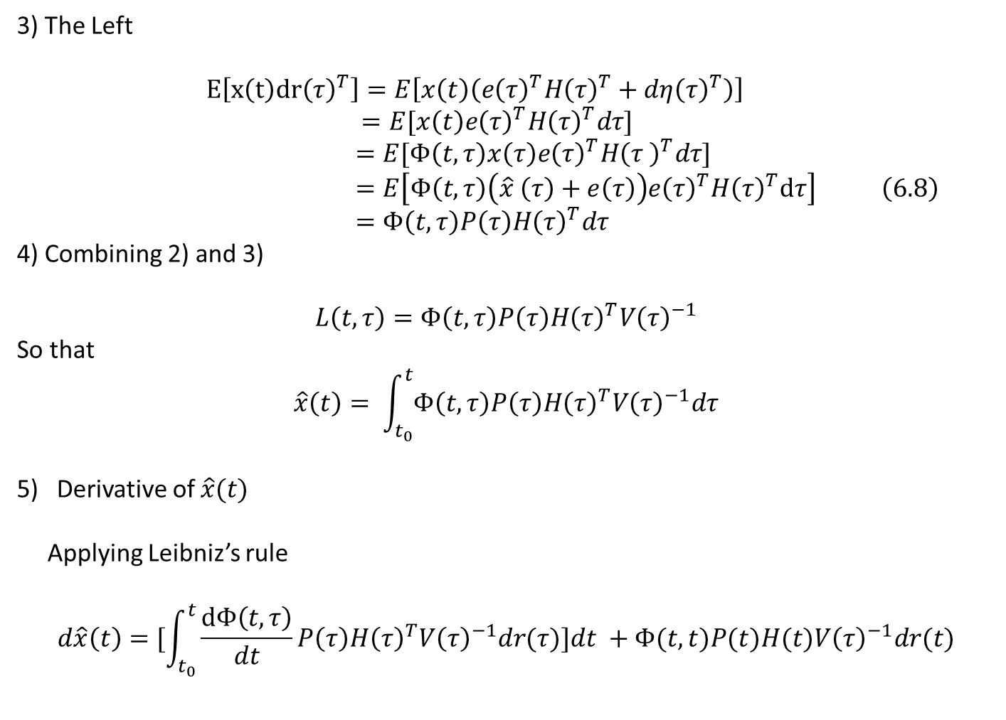
3) The Left
$E\left[x\left(t\right)dr{\left(τ\right)}^{T}\right]=E\left[x\left(t\right)\left(e{\left(τ\right)}^{T}H{\left(τ\right)}^{T}+dη{\left(τ\right)}^{T}\right)\right]$
$=E[x\left(t\right)e{\left(τ\right)}^{T}H{\left(τ\right)}^{T}dτ]$
$=E[Φ\left(t,τ\right)x\left(τ\right)e{\left(τ\right)}^{T}H{\left(τ \right)}^{T}dτ]$
$=E\left[Φ\left(t,τ\right)\left(\hat{x} \left(τ\right)+e\left(τ\right)\right)e{\left(τ\right)}^{T}H{\left(τ\right)}^{T}dτ\right] \left(6.8\right)$
$=Φ\left(t,τ\right)P\left(τ\right)H{\left(τ\right)}^{T}dτ$
4) Combining 2) and 3)
$$L\left(t,τ\right)=Φ\left(t,τ\right)P\left(τ\right)H{\left(τ\right)}^{T}V{\left(τ\right)}^{−1}$$
So that
$$\hat{x}\left(t\right)= \int_{t_{0}}^{t}{Φ\left(t,τ\right)P\left(τ\right)H{\left(τ\right)}^{T}V{\left(τ\right)}^{−1}dτ}$$
Derivative of $\hat{x}(t)$
Applying Leibniz’s rule
$$d\hat{x}\left(t\right)=[\int_{t_{0}}^{t}{\frac{dΦ\left(t,τ\right)}{dt}P\left(τ\right)H{\left(τ\right)}^{T}V{\left(τ\right)}^{−1}dr(τ)]dt +Φ(t,t)P(t)H(t)V{\left(τ\right)}^{−1}dr(t)}$$

Slide 7
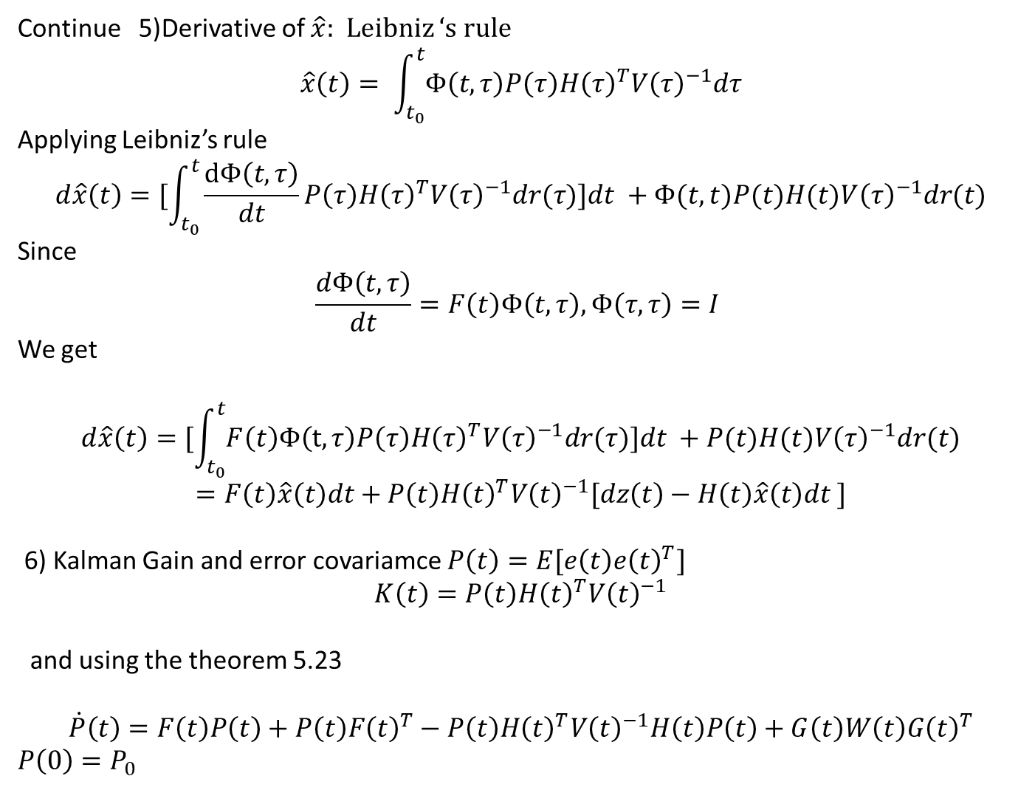
Continue 5)Derivative of $\hat{x}:$ Leibniz ‘s rule
$$\hat{x}\left(t\right)= \int_{t_{0}}^{t}{Φ\left(t,τ\right)P\left(τ\right)H{\left(τ\right)}^{T}V{\left(τ\right)}^{−1}dτ}$$
Applying Leibniz’s rule
$$d\hat{x}\left(t\right)=[\int_{t_{0}}^{t}{\frac{dΦ\left(t,τ\right)}{dt}P\left(τ\right)H{\left(τ\right)}^{T}V{\left(τ\right)}^{−1}dr(τ)]dt +Φ(t,t)P(t)H(t)V{\left(τ\right)}^{−1}dr(t)}$$
Since
$$\frac{dΦ\left(t,τ\right)}{dt}=F\left(t\right)Φ\left(t,τ\right), Φ\left(τ, τ\right)=I$$
We get
$$d\hat{x}\left(t\right)=[\int_{t_{0}}^{t}{F\left(t\right)Φ\left(t,τ\right)P\left(τ\right)H{\left(τ\right)}^{T}V{\left(τ\right)}^{−1}dr(τ)]dt +P(t)H(t)V{\left(τ\right)}^{−1}dr(t)}$$
$$=F\left(t\right)\hat{x}\left(t\right)dt+P\left(t\right)H{\left(t\right)}^{T}V{\left(t\right)}^{−1}[dz\left(t\right)−H\left(t\right)\hat{x}\left(t\right)dt ]$$
6) Kalman Gain and error covariamce $P\left(t\right)=E[e\left(t\right)e{\left(t\right)}^{T}]$
$$K\left(t\right)=P\left(t\right)H{\left(t\right)}^{T}V{\left(t\right)}^{−1}$$
and using the theorem 5.23
$$\dot{P}\left(t\right)=F\left(t\right)P\left(t\right)+P\left(t\right)F{\left(t\right)}^{T}−P\left(t\right)H{\left(t\right)}^{T}V{\left(t\right)}^{−1}H\left(t\right)P\left(t\right)+G\left(t\right)W\left(t\right)G{\left(t\right)}^{T}$$
$P\left(0\right)=P_{0}$

Slide 8
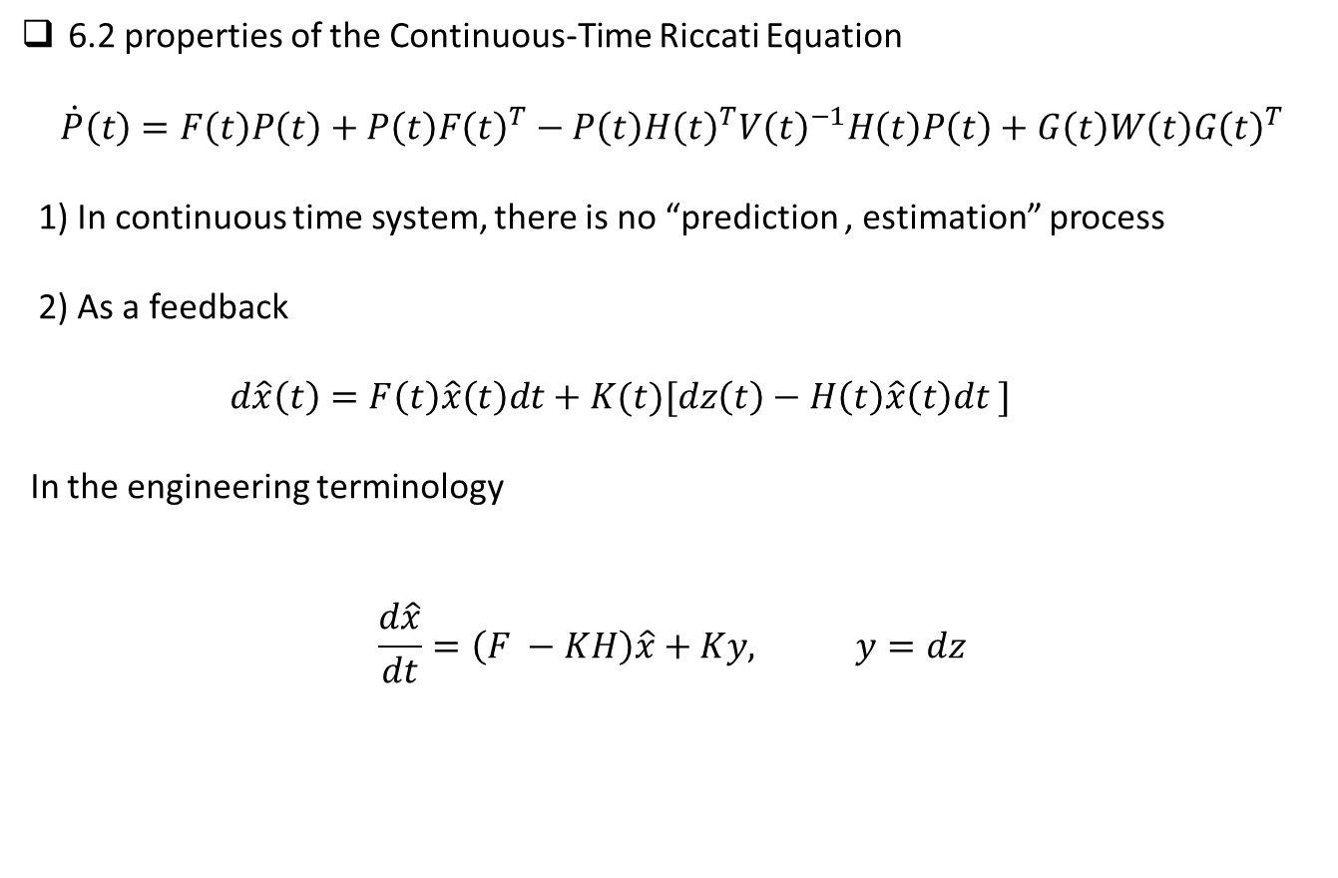
6.2 properties of the Continuous-Time Riccati Equation
$$\dot{P}\left(t\right)=F\left(t\right)P\left(t\right)+P\left(t\right)F{\left(t\right)}^{T}−P\left(t\right)H{\left(t\right)}^{T}V{\left(t\right)}^{−1}H\left(t\right)P\left(t\right)+G\left(t\right)W\left(t\right)G{\left(t\right)}^{T}$$
1) In continuous time system, there is no “prediction , estimation” process
2) As a feedback
$d\hat{x}\left(t\right)=F\left(t\right)\hat{x}\left(t\right)dt+K(t)[dz\left(t\right)−H\left(t\right)\hat{x}\left(t\right)dt ]$
In the engineering terminology
$$\frac{d\hat{x}}{dt}=\left(F −KH\right)\hat{x}+Ky, y=dz$$

Slide 9
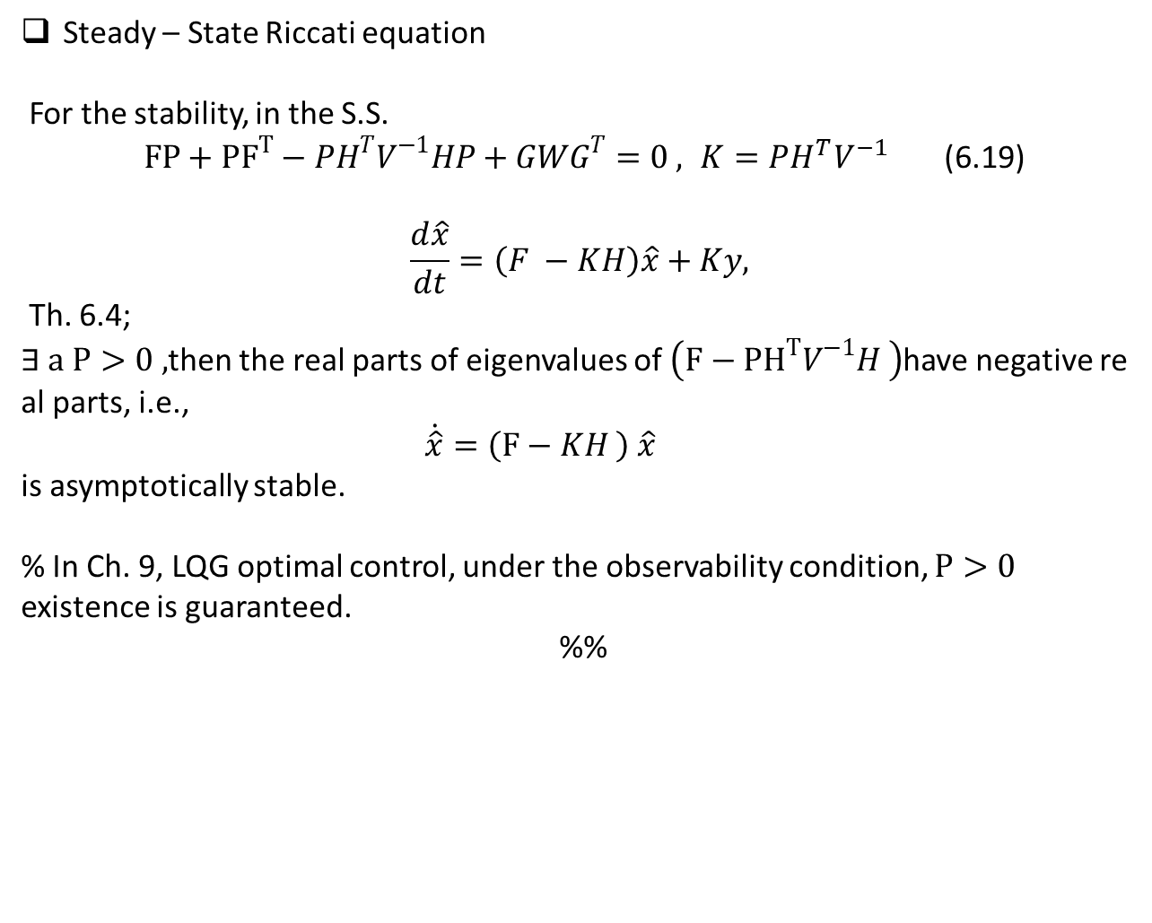
Steady – State Riccati equation
For the stability, in the S.S.
$FP+{PF}^{T}−PH^{T}V^{−1}HP+GWG^{T}=0 , K=PH^{T}V^{−1}$ (6.19)
$$\frac{d\hat{x}}{dt}=\left(F −KH\right)\hat{x}+Ky,$$
Th. 6.4;
$∃ a P>0 ,$then the real parts of eigenvalues of $\left(F−{PH}^{T}V^{−1}H \right)$have negative real parts, i.e.,
$\dot{\hat{x}}=\left(F−KH \right) \hat{x}$
is asymptotically stable.
% In Ch. 9, LQG optimal control, under the observability condition, $P>0$ existence is guaranteed.
%%

Slide 10
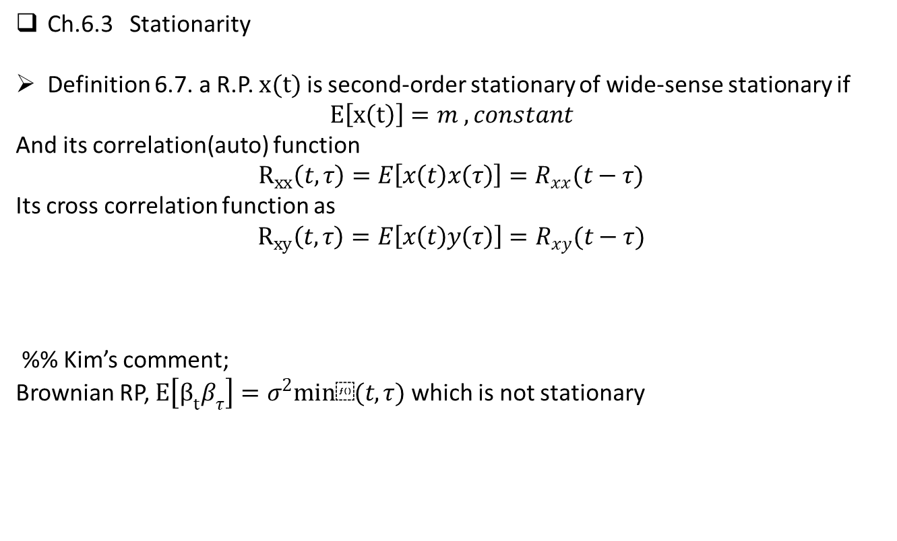
Ch.6.3 Stationarity
Definition 6.7. a R.P. $x(t)$ is second-order stationary of wide-sense stationary if
$$E\left[x\left(t\right)\right]=m , constant$$
And its correlation(auto) function
$$R_{xx}\left(t,τ\right)=E\left[x\left(t\right)x\left(τ\right)\right]=R_{xx}(t−τ)$$
Its cross correlation function as
$$R_{xy}\left(t,τ\right)=E\left[x\left(t\right)y\left(τ\right)\right]=R_{xy}(t−τ)$$
%% Kim’s comment;
Brownian RP, $E\left[β_{t}β_{τ}\right]=σ^{2}min⁡(t,τ)$ which is not stationary

Slide 11
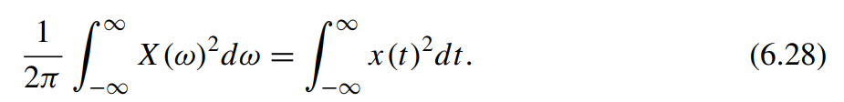

6.4 Power Spectral Densities
6.4.1 Fourier Transforms
Fourier transforms
$$X\left(ω\right)≔\frac{1}{a} \int_{−∞}^{∞}{xe^{−jωt}dt} \\ x\left(t\right)≔\frac{1}{b}\int_{−∞}^{∞}{X\left(ω\right)e^{jωt}}dt$$
Where $ab=2π$
Parseval’s theorem

Slide 12
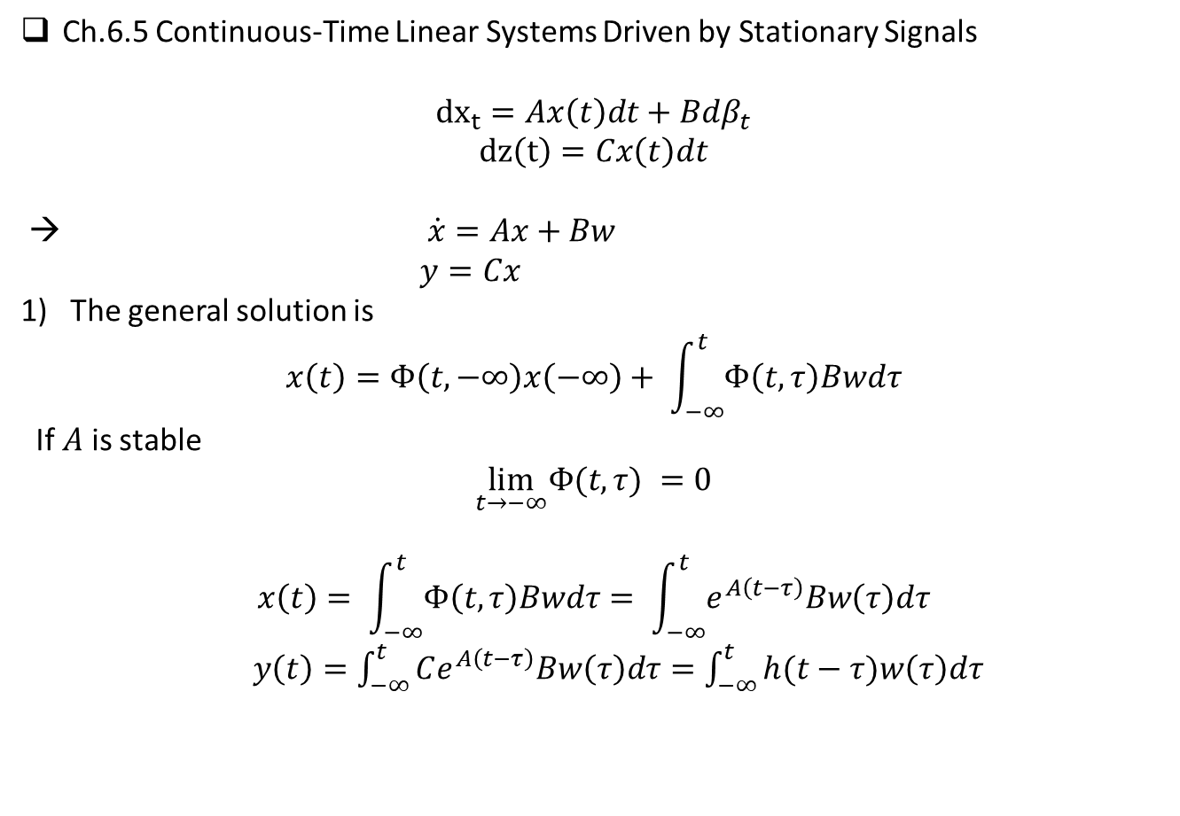
Ch.6.5 Continuous-Time Linear Systems Driven by Stationary Signals
$${dx}_{t}=Ax\left(t\right)dt+Bdβ_{t}$$
$$dz\left(t\right)=Cx\left(t\right)dt$$
→ $\dot{x}=Ax+Bw$
$y=Cx$
The general solution is
$$x\left(t\right)=Φ\left(t,−∞\right)x\left(−∞\right)+ \int_{−∞}^{t}{Φ\left(t,τ\right)Bwdτ}$$
If $A$ is stable
$$\lim_{t→−∞}Φ(t,{τ) =0}$$
$$x\left(t\right)= \int_{−∞}^{t}{Φ\left(t,τ\right)Bwdτ}= \int_{−∞}^{t}{e^{A\left(t−τ\right)}Bw\left(τ\right)dτ}$$
$y\left(t\right)=\int_{−∞}^{t}{Ce^{A\left(t−τ\right)}Bw\left(τ\right)dτ}=\int_{−∞}^{t}{h(t−τ)w\left(τ\right)dτ}$

Slide 13
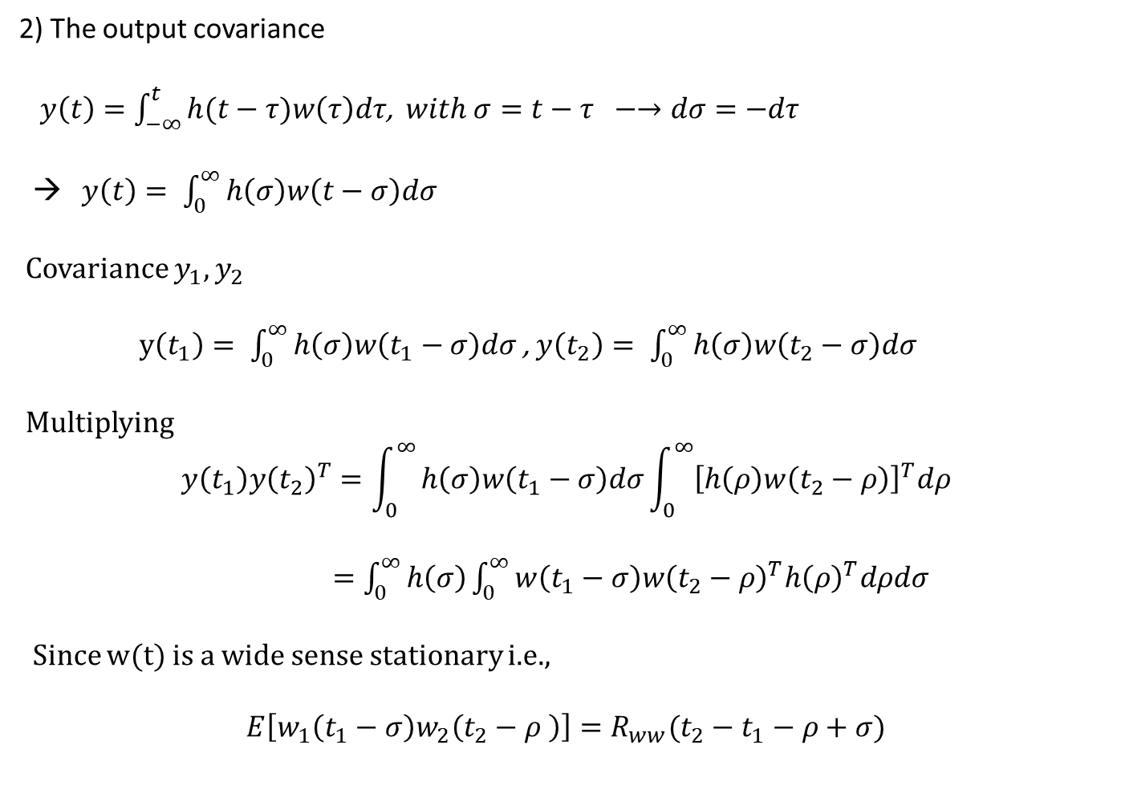
2) The output covariance
$y\left(t\right)=\int_{−∞}^{t}{h(t−τ)w\left(τ\right)dτ}$, $with σ=t−τ −→dσ=−dτ$
→ $y\left(t\right)= \int_{0}^{∞}{h\left(σ\right)w\left(t−σ\right)dσ}$
Covariance $y_{1}, y_{2}$
$y\left(t_{1}\right)= \int_{0}^{∞}{h\left(σ\right)w\left(t_{1}−σ\right)dσ}$ , $y\left(t_{2}\right)= \int_{0}^{∞}{h\left(σ\right)w\left(t_{2}−σ\right)dσ}$
Multiplying
$$y\left(t_{1}\right)y{\left(t_{2}\right)}^{T}=\int_{0}^{∞}{h\left(σ\right)w\left(t_{1}−σ\right)dσ\int_{0}^{∞}{{\left[h\left(ρ\right)w\left(t_{2}−ρ\right)\right]}^{T}dρ}}$$
$=\int_{0}^{∞}{h\left(σ\right)\int_{0}^{∞}{w\left(t_{1}−σ\right)w{\left(t_{2}−ρ\right)}^{T}h{\left(ρ\right)}^{T}dρdσ}}$
Since $w(t)$ is a wide sense stationary i.e.,
$$E\left[w_{1}\left(t_{1}−σ\right)w_{2}\left(t_{2}−ρ \right)\right]=R_{ww}(t_{2}−t_{1}−ρ+σ)$$

Slide 14
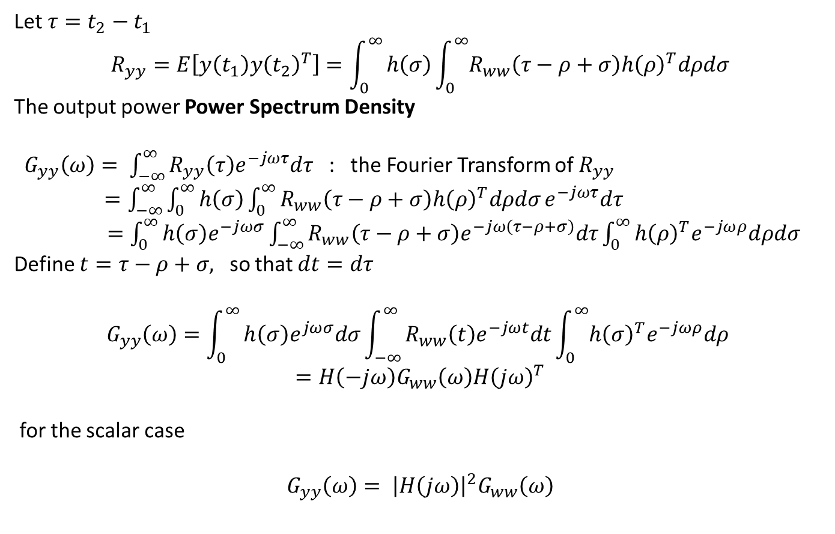
Let $τ=t_{2}−t_{1}$
$$R_{yy}=E\left[y\left(t_{1}\right)y{\left(t_{2}\right)}^{T}\right]=\int_{0}^{∞}{h\left(σ\right)\int_{0}^{∞}{R_{ww}\left(τ−ρ+σ\right)h{\left(ρ\right)}^{T}dρdσ}}$$
The output power Power Spectrum Density
$G_{yy}\left(ω\right)= \int_{−∞}^{∞}{R_{yy}\left(τ\right)e^{−jωτ}dτ}$ : the Fourier Transform of $R_{yy}$
$=\int_{−∞}^{∞}{\int_{0}^{∞}{h\left(σ\right)\int_{0}^{∞}{R_{ww}\left(τ−ρ+σ\right)h{\left(ρ\right)}^{T}dρdσ}}}e^{−jωτ}dτ$
$=\int_{0}^{∞}{h\left(σ\right)e^{−jωσ}\int_{−∞}^{∞}{R_{ww}\left(τ−ρ+σ\right)e^{−jω\left(τ−ρ+σ\right)}dτ\int_{0}^{∞}{h{\left(ρ\right)}^{T}e^{−jωρ}dρdσ}}}$
Define $t=τ−ρ+σ,$ so that $dt=dτ$
$$G_{yy}\left(ω\right)=\int_{0}^{∞}{h\left(σ\right)e^{jωσ}dσ\int_{−∞}^{∞}{R_{ww}\left(t\right)e^{−jωt}dt\int_{0}^{∞}{h{\left(σ\right)}^{T}e^{−jωρ}dρ} }}$$
$$=H\left(−jω\right)G_{ww}\left(ω\right)H{\left(jω\right)}^{T}$$
for the scalar case
$$G_{yy}\left(ω\right)= {\left|H\left(jω\right)\right|}^{2}G_{ww}\left(ω\right)$$

Slide 15

Ex. 6.12(application output power)
The input spectrum is
$G_{ww}\left(ω\right)=G_{0}$
The filter spectrum is
$$H\left(jω\right)=\frac{1}{1+jωT}$$
Then the output PSD is
$G_{yy}\left(ω\right)=\frac{G_{0}}{1+T^{2}ω^{2}}$
The mean-square output is
$$E{\left[y\left(t\right)\right]}^{2}=\frac{1}{2π} 2\int_{0}^{∞}{{\left|\frac{1}{1+jωT }\right|}^{2}G_{0}dω}$$
$$=\frac{1}{π}G_{0}\int_{0}^{∞}{\frac{dω}{1+T^{2}ω^{2}}=\frac{G_{0}}{4T}}$$

