Slide 1
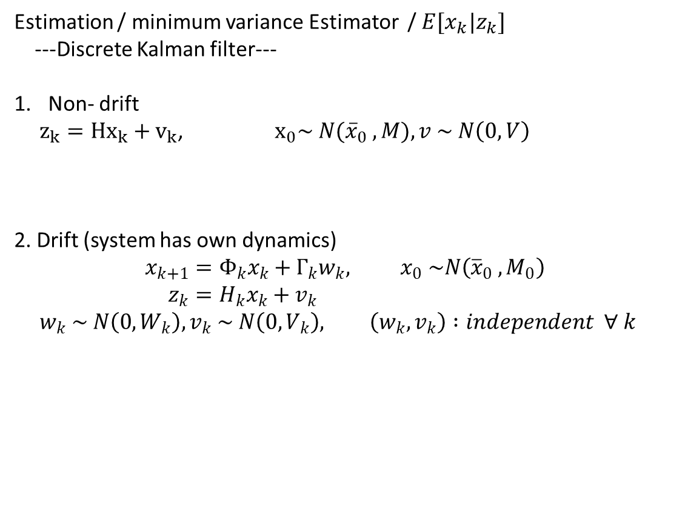
Estimation / minimum variance Estimator / $E[x_{k}|z_{k}]$
---Discrete Kalman filter---
Non- drift
$z_{k}={Hx}_{k}+v_{k}$, ${ x}_{0}\sim N({\overline{x}}_{0} , M), v \sim N\left(0, V\right)$
2. Drift (system has own dynamics)
$$x_{k+1}=Φ_{k}x_{k}+Γ_{k}w_{k}, x_{0} \sim N\left({\overline{x}}_{0} , M_{0}\right) \\ z_{k}=H_{k}x_{k}+v_{k}$$
$$w_{k} \sim N\left(0, W_{k}\right), v_{k} \sim N\left(0, V_{k}\right), \left(w_{k}, v_{k}\right) :independent ∀ k$$

Slide 2
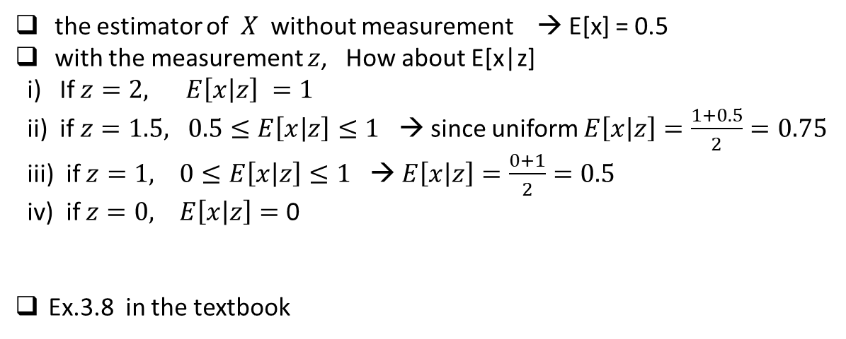
Review the conditional estimation
z = x+ y
Y
X
z = x+y
the estimator of $X$ without measurement → E[x] = 0.5
with the measurement $z$, How about E[x|z]
i) If $z=2, E\left[x | z\right] =1$
ii) if $z=1.5, 0.5≤E\left[x | z\right]≤1$ → since uniform $E\left[x | z\right]=\frac{1+0.5}{2}=0.75$
iii) if $z=1, 0≤E\left[x | z\right]≤1$ → $E\left[x | z\right]=\frac{0+1}{2}=0.5$
iv) if $z=0, E\left[x | z\right]=$ 0
Ex.3.8 in the textbook

Slide 3
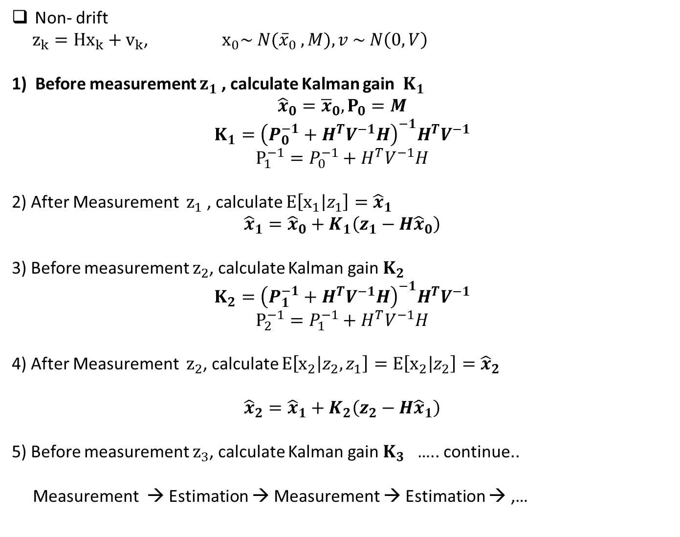
Non- drift
$z_{k}={Hx}_{k}+v_{k}$, ${ x}_{0}\sim N({\overline{x}}_{0} , M), v \sim N\left(0, V\right)$
1) Before measurement $z_{1}$ , calculate Kalman gain $K_{1}$
$${\hat{x}}_{0}={\overline{x}}_{0}, P_{0}=M$$
$$K_{1}={\left(P_{0}^{−1}+H^{T}V^{−1}H\right)}^{−1}H^{T}V^{−1}$$
$$P_{1}^{−1}=P_{0}^{−1}+H^{T}V^{−1}H$$
2) After Measurement $z_{1}$ , calculate $E\left[x_{1} | z_{1}\right]={\hat{x}}_{1}$
$${\hat{x}}_{1}={\hat{x}}_{0}+K_{1}\left(z_{1}−H{\hat{x}}_{0}\right)$$
3) Before measurement $z_{2}$, calculate Kalman gain $K_{2}$
$$K_{2}={\left(P_{1}^{−1}+H^{T}V^{−1}H\right)}^{−1}H^{T}V^{−1}$$
$$P_{2}^{−1}=P_{1}^{−1}+H^{T}V^{−1}H$$
4) After Measurement $z_{2}$, calculate $E\left[x_{2} | z_{2}, z_{1}\right]=E\left[x_{2} | z_{2}\right]={\hat{x}}_{2}$
$${\hat{x}}_{2}={\hat{x}}_{1}+K_{2}\left(z_{2}−H{\hat{x}}_{1}\right)$$
5) Before measurement $z_{3}$, calculate Kalman gain $K_{3}$ ….. continue..
Measurement → Estimation → Measurement → Estimation → ,…

Slide 4
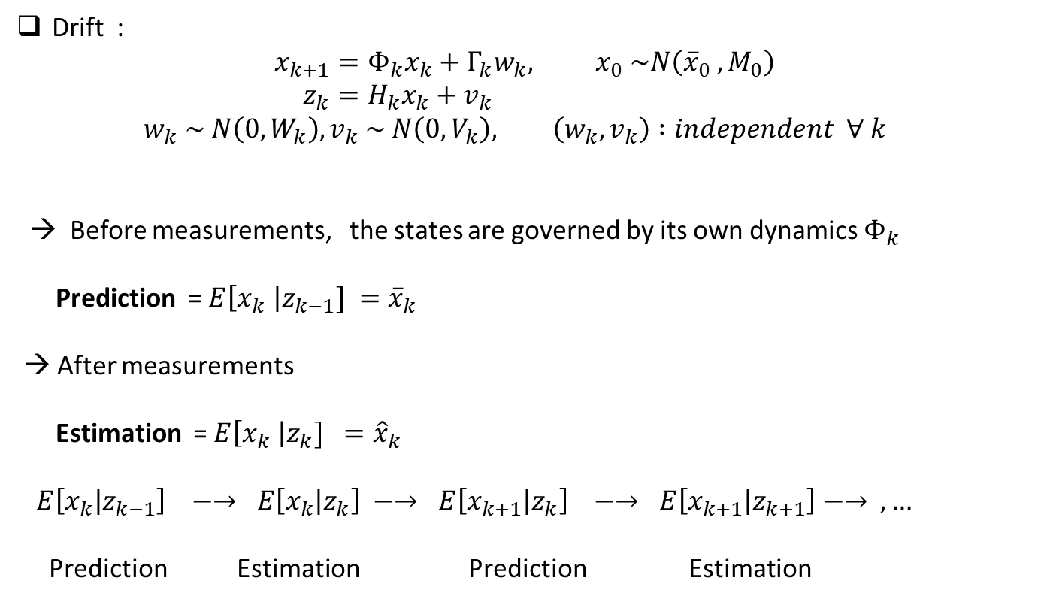
Drift :
$$x_{k+1}=Φ_{k}x_{k}+Γ_{k}w_{k}, x_{0} \sim N\left({\overline{x}}_{0} , M_{0}\right) \\ z_{k}=H_{k}x_{k}+v_{k}$$
$$w_{k} \sim N\left(0, W_{k}\right), v_{k} \sim N\left(0, V_{k}\right), \left(w_{k}, v_{k}\right) :independent ∀ k$$
→ Before measurements, the states are governed by its own dynamics $Φ_{k}$
Prediction = $E\left[x_{k} \right|z_{k−1}] ={\overline{x}}_{k}$
→ After measurements
Estimation = $E\left[x_{k} \right|z_{k}] ={\hat{x}}_{k}$
$E\left[x_{k} | z_{k−1}\right] −→ E\left[x_{k} | z_{k}\right] −→ E\left[x_{k+1} | z_{k}\right] −→ E\left[x_{k+1} | z_{k+1}\right]−→ ,…$
Prediction Estimation Prediction Estimation

Slide 5
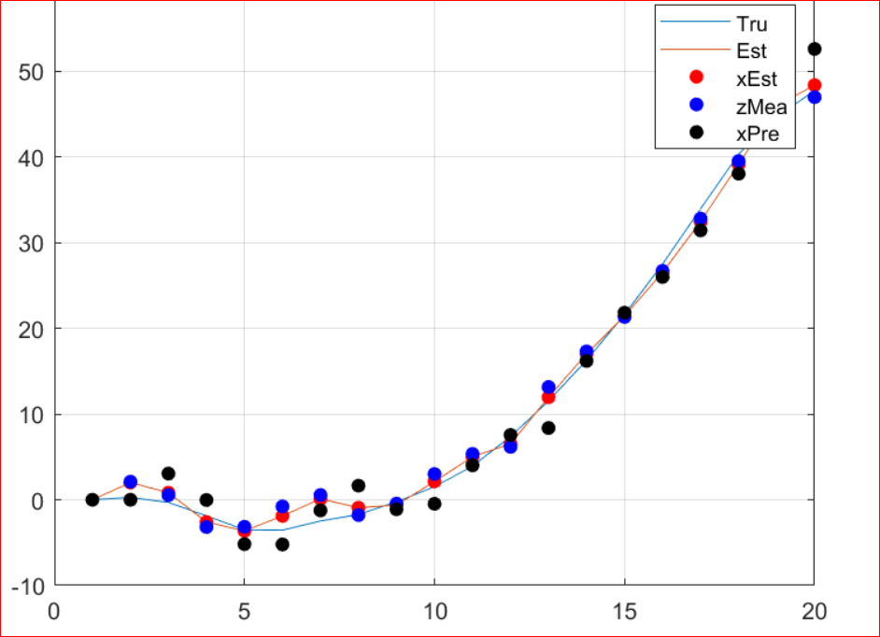

Slide 6
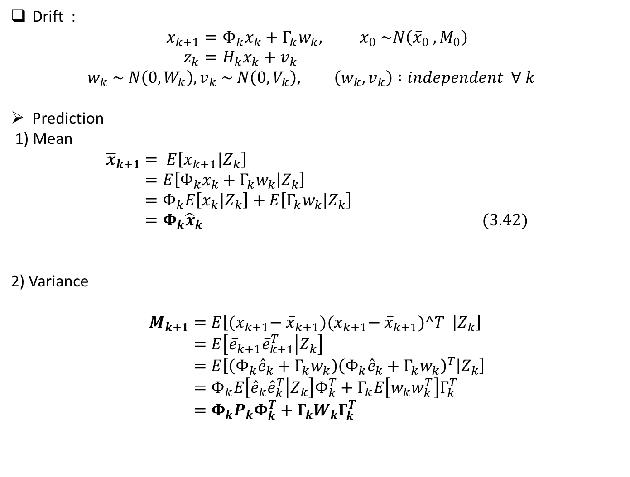
Drift :
$$x_{k+1}=Φ_{k}x_{k}+Γ_{k}w_{k}, x_{0} \sim N\left({\overline{x}}_{0} , M_{0}\right) \\ z_{k}=H_{k}x_{k}+v_{k}$$
$$w_{k} \sim N\left(0, W_{k}\right), v_{k} \sim N\left(0, V_{k}\right), \left(w_{k}, v_{k}\right) :independent ∀ k$$
Prediction
1) Mean
$${\overline{x}}_{k+1}= E\left[x_{k+1} | Z_{k}\right] \\ =E\left[Φ_{k}x_{k}+Γ_{k}w_{k} | Z_{k}\right] \\ =Φ_{k}E\left[x_{k} | Z_{k}\right]+E\left[Γ_{k}w_{k} | Z_{k}\right] \\ =Φ_{k}{\hat{x}}_{k} (3.42)$$
2) Variance
$$M_{k+1}=E\left[{(x}_{k+1}− {\overline{x}}_{k+1}){(x}_{k+1}− {\overline{x}}_{k+1})^T | Z_{k}\right] \\ =E\left[{\overline{e}}_{k+1}{\overline{e}}_{k+1}^{T} | Z_{k}\right] \\ =E\left[\left(Φ_{k}{\hat{e}}_{k}+Γ_{k}w_{k}\right){\left(Φ_{k}{\hat{e}}_{k}+Γ_{k}w_{k}\right)}^{T} | Z_{k}\right] \\ =Φ_{k}E\left[{\hat{e}}_{k}{\hat{e}}_{k}^{T} | Z_{k}\right]Φ_{k}^{T}+Γ_{k}E\left[w_{k}w_{k}^{T}\right]Γ_{k}^{T} \\ =Φ_{k}P_{k}Φ_{k}^{T}+Γ_{k}W_{k}Γ_{k}^{T}$$

Slide 7
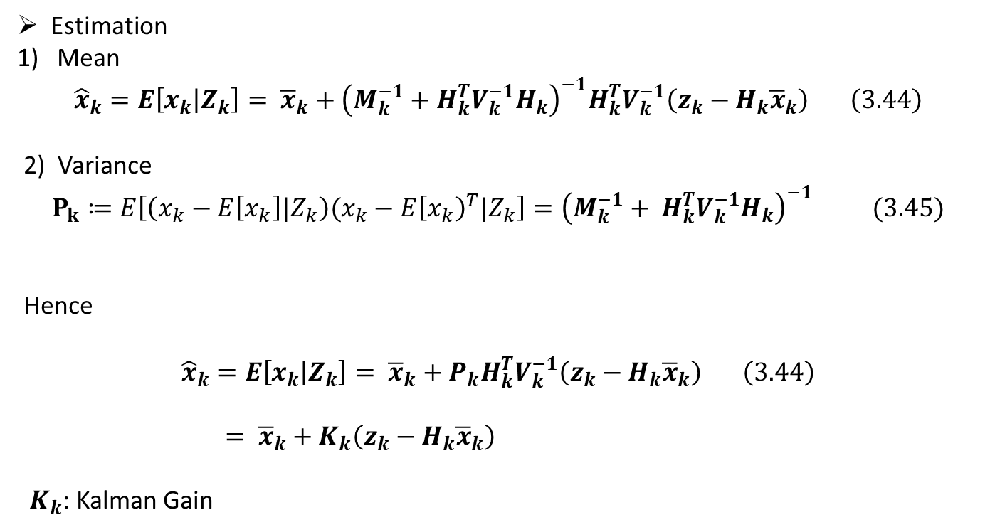
Estimation
Mean
$${\hat{x}}_{k}=E\left[x_{k} | Z_{k}\right]= {\overline{x}}_{k}+{\left(M_{k}^{−1}+H_{k}^{T}V_{k}^{−1}H_{k}\right)}^{−1}H_{k}^{T}V_{k}^{−1}\left(z_{k}−H_{k}{\overline{x}}_{k}\right) \left(3.44\right)$$
2) Variance
$$P_{k}≔E\left[\left(x_{k}−E\left[x_{k}\right]|Z_{k}\right)(x_{k}−E{\left[x_{k}\right)}^{T}|Z_{k}\right]={\left(M_{k}^{−1}+ H_{k}^{T}V_{k}^{−1}H_{k}\right)}^{−1} (3.45)$$
Hence
$${\hat{x}}_{k}=E\left[x_{k} | Z_{k}\right]= {\overline{x}}_{k}+P_{k}H_{k}^{T}V_{k}^{−1}\left(z_{k}−H_{k}{\overline{x}}_{k}\right) \left(3.44\right)$$
$= {\overline{x}}_{k}+K_{k}\left(z_{k}−H_{k}{\overline{x}}_{k}\right)$
$K_{k}$: Kalman Gain

Slide 8
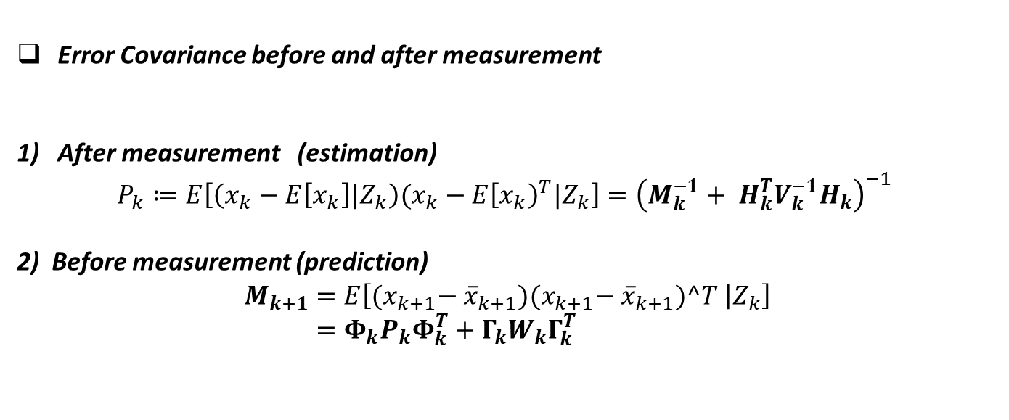
Error Covariance before and after measurement
After measurement (estimation)
$$P_{k}≔E\left[\left(x_{k}−E\left[x_{k}\right]|Z_{k}\right)(x_{k}−E{\left[x_{k}\right)}^{T}|Z_{k}\right]={\left(M_{k}^{−1}+ H_{k}^{T}V_{k}^{−1}H_{k}\right)}^{−1}$$
2) Before measurement (prediction)
$$M_{k+1}=E\left[{(x}_{k+1}− {\overline{x}}_{k+1}){(x}_{k+1}− {\overline{x}}_{k+1})^T | Z_{k}\right] \\ =Φ_{k}P_{k}Φ_{k}^{T}+Γ_{k}W_{k}Γ_{k}^{T}$$

Slide 9
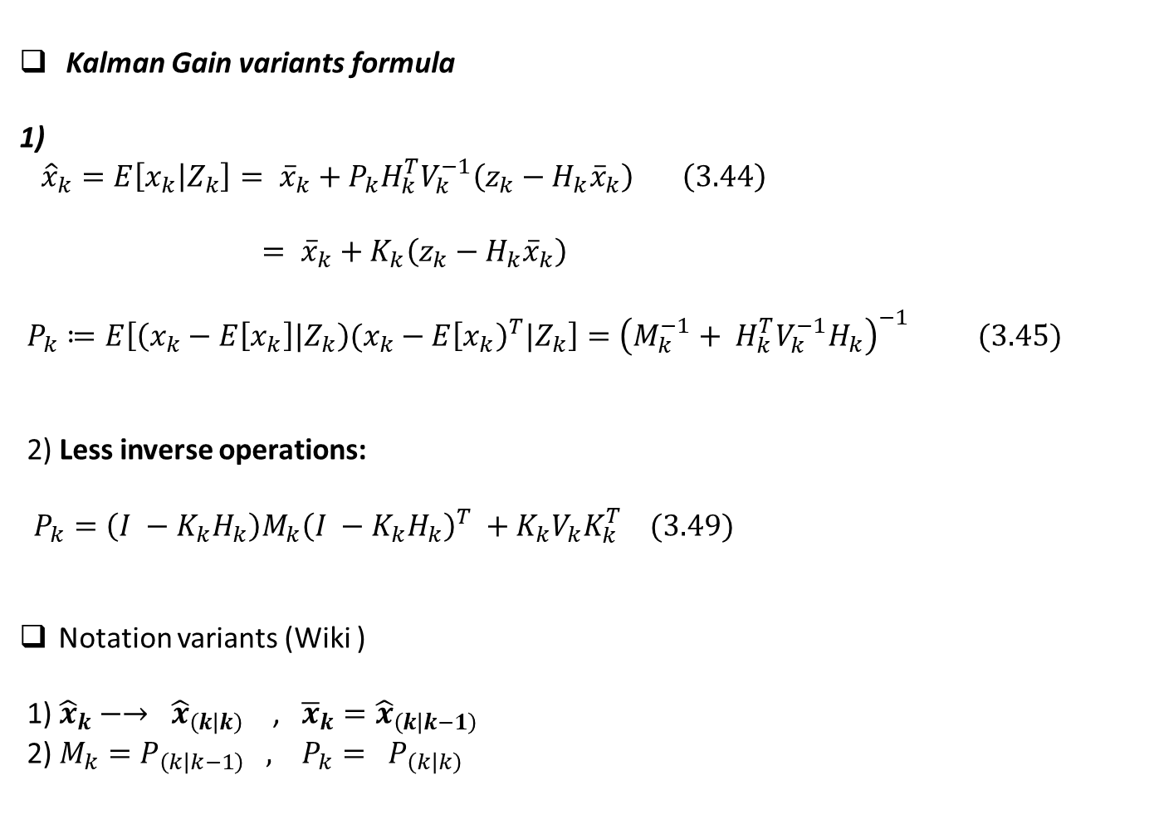
Kalman Gain variants formula
1)
${\hat{x}}_{k}=E\left[x_{k} | Z_{k}\right]= {\overline{x}}_{k}+P_{k}H_{k}^{T}V_{k}^{−1}\left(z_{k}−H_{k}{\overline{x}}_{k}\right) \left(3.44\right)$
$= {\overline{x}}_{k}+K_{k}\left(z_{k}−H_{k}{\overline{x}}_{k}\right)$
$P_{k}≔E\left[\left(x_{k}−E\left[x_{k}\right]|Z_{k}\right)(x_{k}−E{\left[x_{k}\right)}^{T}|Z_{k}\right]={\left(M_{k}^{−1}+ H_{k}^{T}V_{k}^{−1}H_{k}\right)}^{−1} (3.45)$
2) Less inverse operations:
$P_{k}=\left(I −K_{k}H_{k}\right)M_{k}{\left(I −K_{k}H_{k}\right)}^{T} +K_{k}V_{k}K_{k}^{T} (3.49)$
Notation variants (Wiki )
1) ${\hat{x}}_{k}−→ {\hat{x}}_{\left(k | k\right)}$ , ${\overline{x}}_{k}={\hat{x}}_{\left(k | k−1\right)}$
2) $M_{k}=P_{\left(k | k−1\right)} , P_{k}= P_{\left(k | k\right)}$

Slide 10
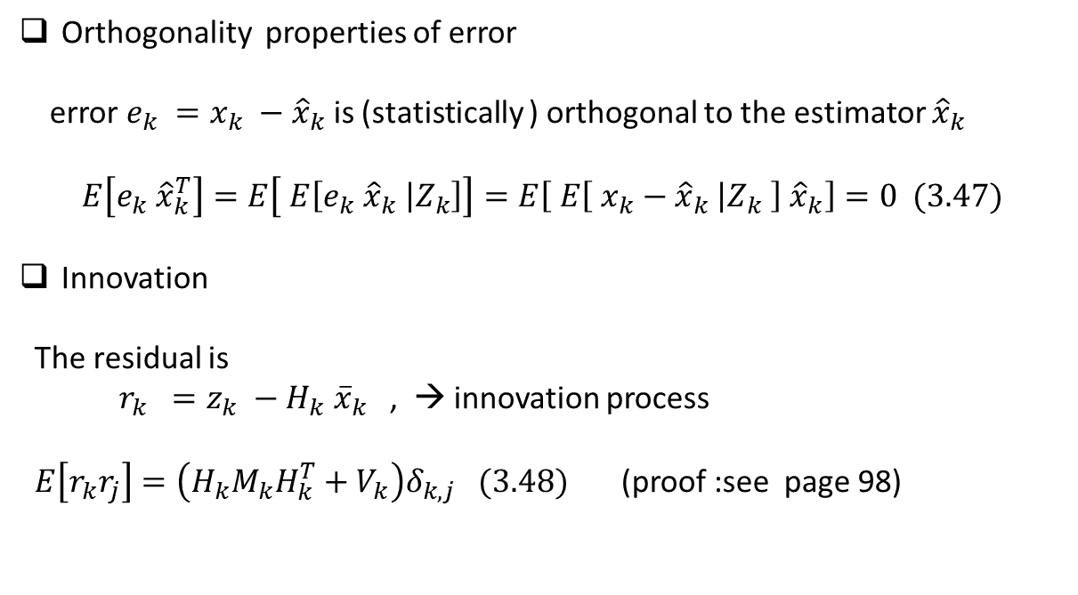
Orthogonality properties of error
error $e_{k} =x_{k} −{\hat{x}}_{k}$ is (statistically ) orthogonal to the estimator ${\hat{x}}_{k}$
$$E\left[e_{k} {\hat{x}}_{k}^{T}\right]=E\left[ E\left[e_{k} {\hat{x}}_{k} | Z_{k}\right]\right]=E\left[ E\left[ x_{k}−{\hat{x}}_{k} | Z_{k} \right] {\hat{x}}_{k}\right]=0 (3.47)$$
Innovation
The residual is
$r_{k} =z_{k} −H_{k} {\overline{x}}_{k}$ , → innovation process
$E\left[r_{k}r_{j}\right]=\left(H_{k}M_{k}H_{k}^{T}+V_{k}\right)δ_{k,j} (3.48)$ (proof :see page 98)

Slide 11
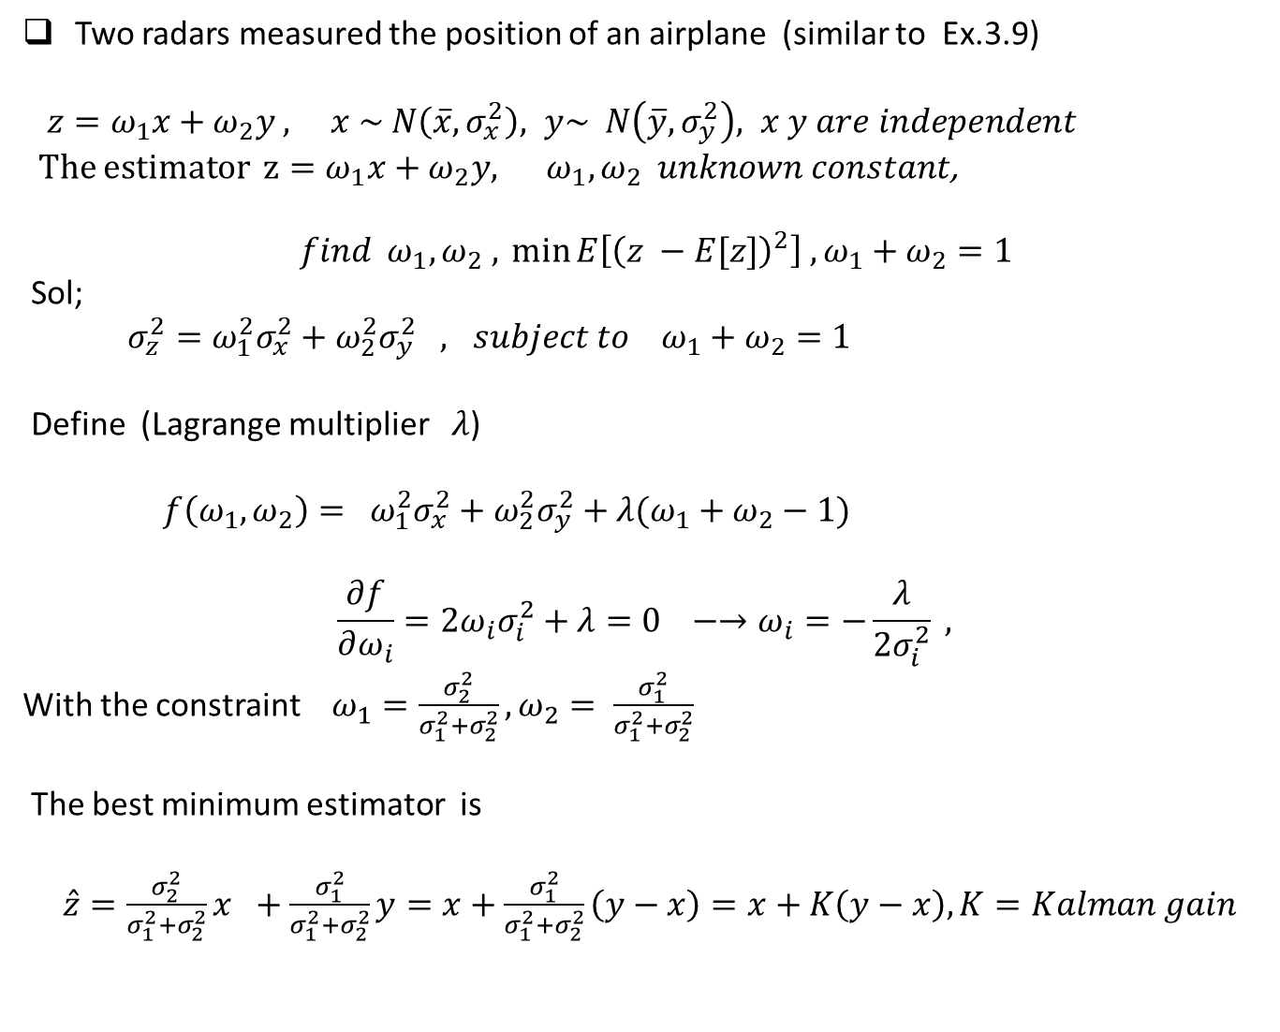
Two radars measured the position of an airplane (similar to Ex.3.9)
$z=ω_{1}x+ω_{2}y , x \sim N\left(\overline{x}, σ_{x}^{2}\right), y\sim N\left(\overline{y}, σ_{y}^{2}\right), x y are independent$
The estimator $z=ω_{1}x+ω_{2}y, ω_{1},ω_{2} unknown constant$,
$$find ω_{1}, ω_{2} ,{\min{E\left[{\left(z −E[z]\right)}^{2}\right] , ω_{1}+ω_{2}=1}}$$
Sol;
$σ_{z}^{2}=ω_{1}^{2}σ_{x}^{2}+ω_{2}^{2}σ_{y}^{2} , subject to ω_{1}+ω_{2}=1$
Define (Lagrange multiplier $λ$)
${ f\left(ω_{1}, ω_{2}\right)= ω}_{1}^{2}σ_{x}^{2}+ω_{2}^{2}σ_{y}^{2}+λ(ω_{1}+ω_{2}−1)$
$$\frac{∂f}{∂ω_{i}}=2ω_{i}σ_{i}^{2}+λ=0 −→ω_{i}=−\frac{λ}{2σ_{i}^{2}} ,$$
With the constraint $ω_{1}=\frac{σ_{2}^{2}}{σ_{1}^{2}+σ_{2}^{2}}, ω_{2}= \frac{σ_{1}^{2}}{σ_{1}^{2}+σ_{2}^{2}}$
The best minimum estimator is
$\hat{z}=\frac{σ_{2}^{2}}{σ_{1}^{2}+σ_{2}^{2}}x +\frac{σ_{1}^{2}}{σ_{1}^{2}+σ_{2}^{2}}y=x+\frac{σ_{1}^{2}}{σ_{1}^{2}+σ_{2}^{2}}\left(y−x\right)=x+K\left(y−x\right), K=Kalman gain$

