Slide 1
Ch.7 Extended Kalman Filter
- Kalman : Linear System
- Non – Linear System
1) Extended Kalman Filter : 1970, Jazwinski
2) Unscented Kalman Filter ; 1990, Julier
3) Particle Filter : 2000, Big Data
4) Gaussian Process: Batch Process, Machine-learning
%% Filter application –googling
- fault detection
- battery estimation for Electric Vehicle
- localization
%% Control application
- LQR
%%
- Neural network
- Artificial Intelligence – Robotics

Slide 2

Non-linearity
$\frac{dx}{dt}= f\left(x\right)= −x\left(1−x^{2}\right) (1)$
- Stability
Find $f\left(x^{∗}\right)=0$
Check the slope around stationary points
- plot $f\left(x\right)$
→ The system is asymptotic stable at the stationary point.

Slide 3
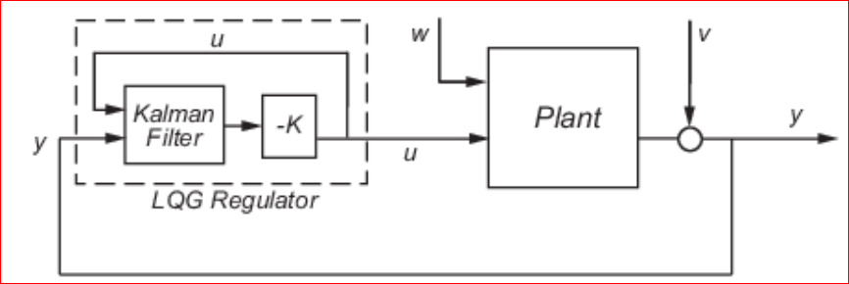
Linear system
- Estimation (Identification)
feedback state controllers
Plant : Linear / non-linear
https://www.mathworks.com/help/control/getstart/linear-quadratic-gaussian-lqg-design.html

Slide 4
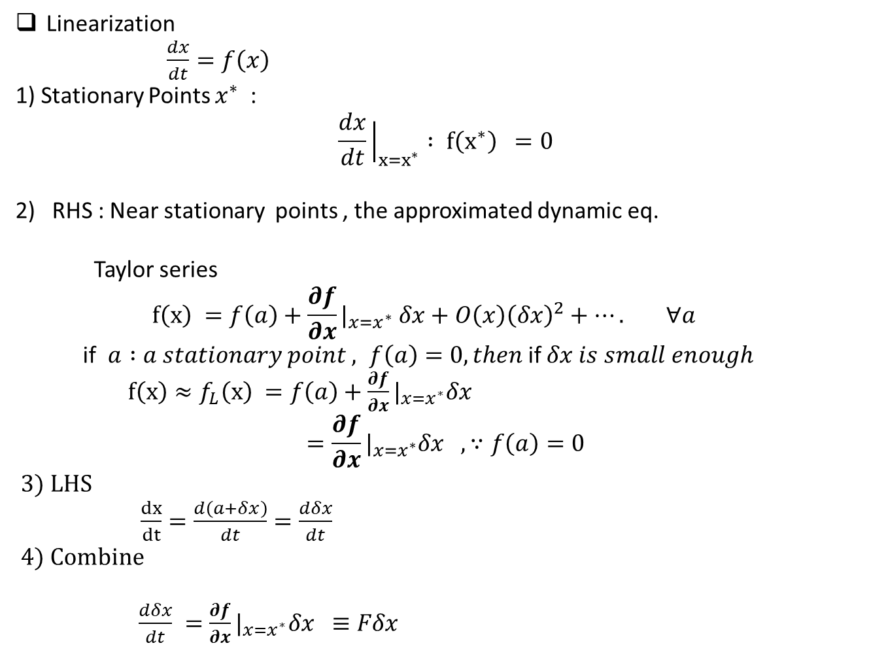
Linearization
$\frac{dx}{dt}=f\left(x\right)$
1) Stationary Points $x^{∗}$:
$$\frac{dx}{dt}{\left.​\right|}_{x=x^{∗}} : f\left(x^{∗}\right) =0$$
RHS : Near stationary points , the approximated dynamic eq.
Taylor series
$$f\left(x\right) =f\left(a\right)+\frac{∂f}{∂x}|_{x=x^{∗}} δx+O\left(x\right){\left(δx\right)}^{2}+…. ∀a$$
if $a :a stationary point , f\left(a\right)=0, then$if $δx is small enough$
$f\left(x\right)≈f_{L}\left(x\right) =f\left(a\right)+\frac{∂f}{∂x}|_{x=x^{∗}}δx$
$$=\frac{∂f}{∂x}|_{x=x^{∗}}δx , ∵f\left(a\right)=0$$
3) LHS
$\frac{dx}{dt}=\frac{d\left(a+δx\right)}{dt}=\frac{dδx}{dt}$
4) Combine
$\frac{dδx}{dt} =\frac{∂f}{∂x}|_{x=x^{∗}}δx ≡Fδx$

Slide 5
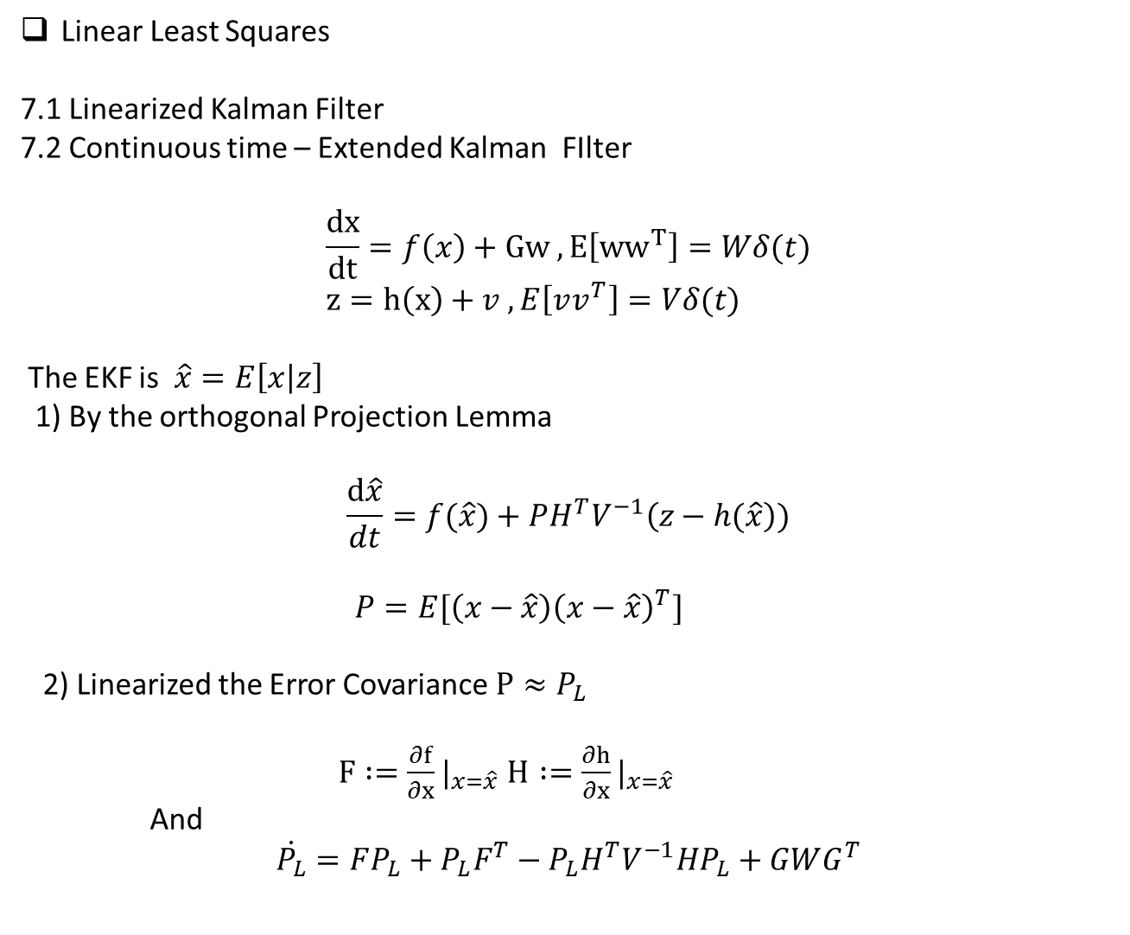
Linear Least Squares
7.1 Linearized Kalman Filter
7.2 Continuous time – Extended Kalman FIlter
$$\frac{dx}{dt}=f\left(x\right)+Gw , E\left[{ww}^{T}\right]=Wδ(t) \\ z=h\left(x\right)+v , E\left[vv^{T}\right]=Vδ(t)$$
The EKF is $\hat{x}=E\left[x | z\right]$
1) By the orthogonal Projection Lemma
$$\frac{d\hat{x}}{dt}=f(\hat{x})+PH^{T}V^{−1}\left(z−h(\hat{x}\right))$$
$P=E[\left(x−\hat{x}\right){\left(x−\hat{x}\right)}^{T}]$
2) Linearized the Error Covariance $P≈P_{L}$
$F :=\frac{∂f}{∂x}|_{x=\hat{x}}$ $H :=\frac{∂h}{∂x}|_{x=\hat{x}}$
And
$$\dot{P_{L}}=FP_{L}+P_{L}F^{T}−P_{L}H^{T}V^{−1}HP_{L}+GWG^{T}$$

Slide 6

%% Do not confuse EKF with a Linearized system as
$$\frac{d\hat{x}}{dt}=F\hat{x}+PHV^{−1}\left(z−H\hat{x}\right))$$
%% HW_Week_9
Summarize the contents. – Do not copy the others --Plagiarism
https://en.wikipedia.org/wiki/Extended_Kalman_filter

Slide 7
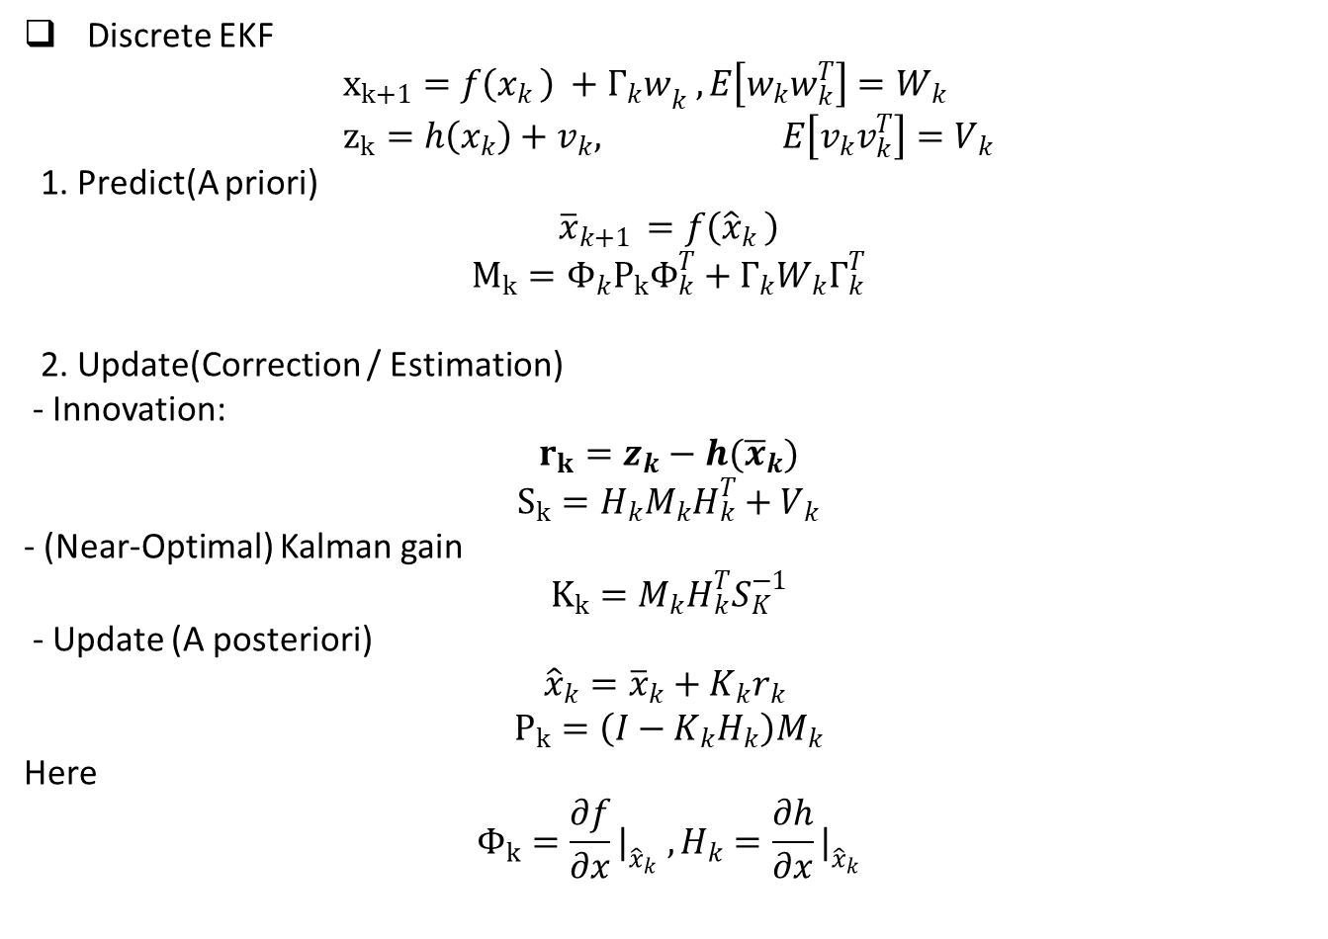
Discrete EKF
$$x_{k+1}=f\left(x_{k }\right) +{Γ_{k}w}_{k} , E\left[w_{k}w_{k}^{T}\right]=W_{k} \\ z_{k}=h\left(x_{k}\right)+v_{k}, E\left[v_{k}v_{k}^{T}\right]=V_{k}$$
1. Predict(A priori)
$${\overline{x}}_{k+1 }=f\left({\hat{x}}_{k }\right)$$
$$M_{k}=Φ_{k}P_{k}Φ_{k}^{T}+Γ_{k}W_{k}Γ_{k}^{T}$$
2. Update(Correction / Estimation)
- Innovation:
$$r_{k}=z_{k}−h({\overline{x}}_{k})$$
$$S_{k}=H_{k}M_{k}H_{k}^{T}+V_{k}$$
- (Near-Optimal) Kalman gain
$$K_{k}=M_{k}H_{k}^{T}S_{K}^{−1}$$
- Update (A posteriori)
$${\hat{x}}_{k}={\overline{x}}_{k}+K_{k}r_{k}$$
$$P_{k}=\left(I−K_{k}H_{k}\right)M_{k}$$
Here
$$Φ_{k}=\frac{∂f}{∂x}|_{{\hat{x}}_{k}} , H_{k}=\frac{∂h}{∂x}|_{{\hat{x}}_{k}}$$

Slide 8
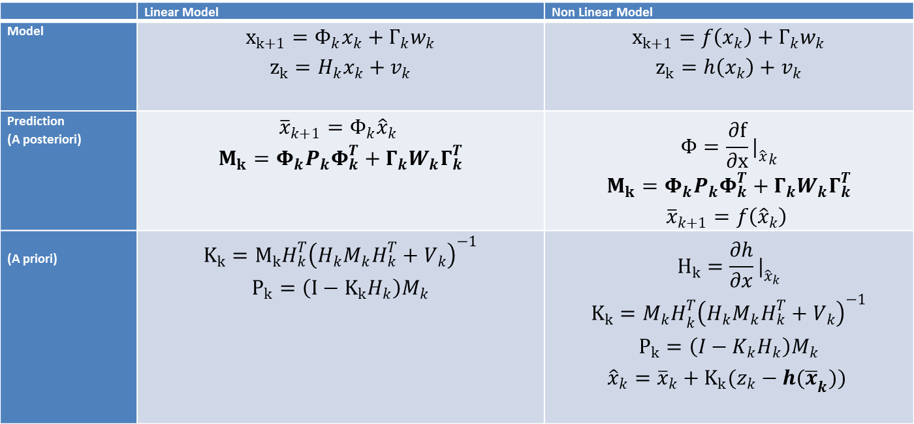
 | Linear Model | Non Linear Model
Model | $$x_{k+1}=Φ_{k}x_{k}+Γ_{k}w_{k}$$ $$z_{k}=H_{k}x_{k}+v_{k}$$ | $$x_{k+1}=f\left(x_{k}\right)+Γ_{k}w_{k}$$ $$z_{k}=h\left(x_{k}\right)+v_{k}$$
Prediction (A posteriori) | $${\overline{x}}_{k+1}=Φ_{k}{\hat{x}}_{k}$$ $$M_{k}=Φ_{k}P_{k}Φ_{k}^{T}+Γ_{k}W_{k}Γ_{k}^{T}$$ | $$Φ=\frac{∂f}{∂x}{|_{\hat{x}}}_{k}$$ $$M_{k}=Φ_{k}P_{k}Φ_{k}^{T}+Γ_{k}W_{k}Γ_{k}^{T}$$ $${\overline{x}}_{k+1}=f\left({\hat{x}}_{k}\right)$$
(A priori) | $$K_{k}=M_{k}H_{k}^{T}{\left(H_{k}M_{k}H_{k}^{T}+V_{k}\right)}^{−1}$$ $$P_{k}=\left(I−K_{k}H_{k}\right)M_{k}$$ | $$H_{k}=\frac{∂h}{∂x}|_{{\hat{x}}_{k}}$$ $$K_{k}={M_{k}H}_{k}^{T}{\left(H_{k}M_{k}H_{k}^{T}+V_{k}\right)}^{−1}$$ $$P_{k}=\left(I−K_{k}H_{k}\right)M_{k}$$ $${\hat{x}}_{k}={\overline{x}}_{k}+K_{k}(z_{k}−{h(\overline{x}}_{k}))$$

Slide 9

Stability in non-linear system
Consider
$\dot{x}=f(x)$
Stability definition
1) The stationary points $x^{∗}$ is (Lyapunov) asymptotic stable if the linearized system at $x^{∗}$ is asymptotic stable
${\dot{x}}_{L}=F_{L} x , F_{L} =\frac{∂f}{∂x}{\left.​\right|}_{x=x^{∗}}$
If $x_{L}$ is not asymptotic stable, it may be stable, asymptotic stable or even unstable.

Slide 10
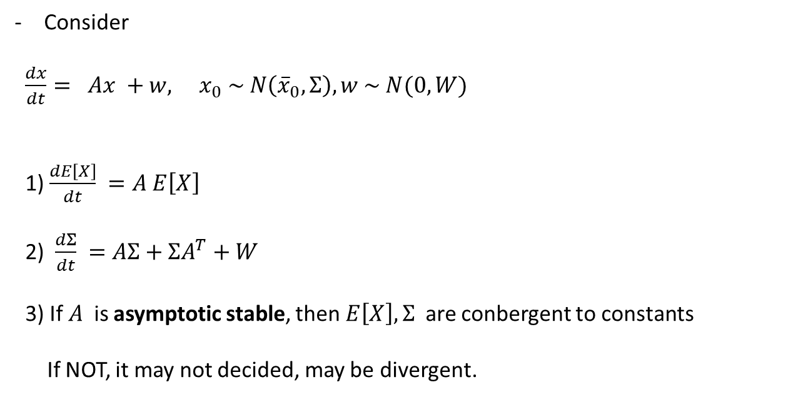
Consider
$\frac{dx}{dt}= Ax +w, x_{0} \sim N\left({\overline{x}}_{0}, Σ\right), w \sim N(0, W)$
1) $\frac{dE\left[X\right]}{dt} =A E\left[X\right]$
2) $\frac{dΣ}{dt} =AΣ+ΣA^{T}+W$
3) If $A$ is asymptotic stable, then $E\left[X\right], Σ$ are conbergent to constants
If NOT, it may not decided, may be divergent.

Slide 11

Unscented Kalman Filter
( reference : Kalman amd Baysian Filters in Python)
1. Non-linear random variables probability
$x \sim N(\overline{x}, σ_{x}^{2})$
$y=x^{2}$
Find $E\left[Y\right] . σ_{Y}^{2}$
$y=x^{2}$

Slide 12

1) Analytic way
https://stats.stackexchange.com/questions/192807/pdf-of-the-square-of-a-standard-normal-random-variable
$f_{Y}\left(y\right)=\frac{1}{\sqrt{2π}} \frac{1}{\sqrt{y}}e^{−\left(\frac{y}{2}\right)} , 0<y<∞ (1)$
$E\left[Y\right], Σ_{Y}$
→ $E\left[Y\right]=1 , Σ_{Y}=2$

Slide 13
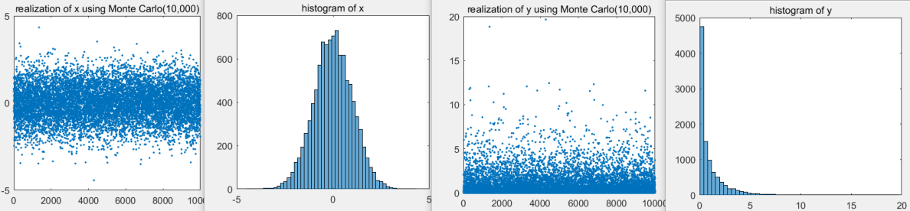

2) Monte Carlo simulation
% matlab code
n = 10000; % the number of simulations , as Monte Carlo
x = std.*randn(n,1); % mean=0,
histogram(x,50)
y = x.^2;
histogram(y,50)
The estimated values of
$E\left[Y\right]=1.00, Σ_{Y}=2.04$

Slide 14
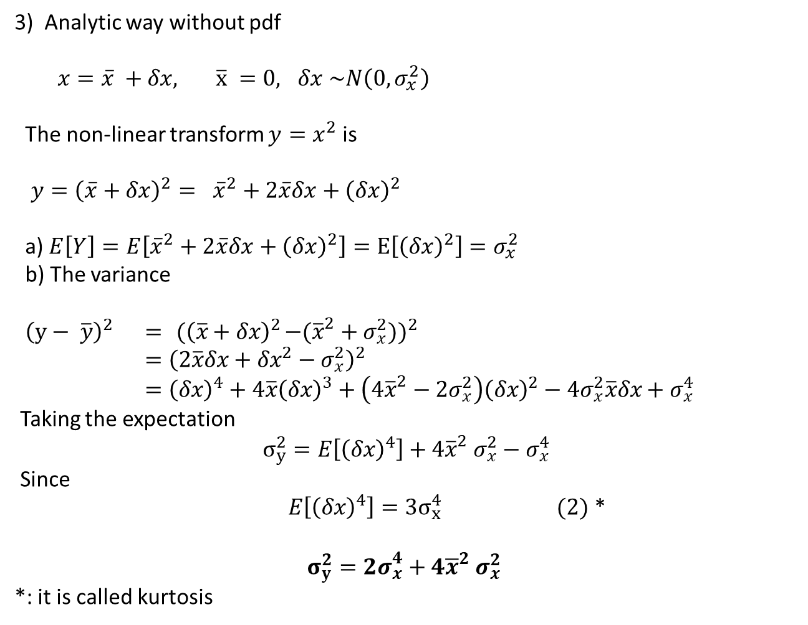
3) Analytic way without pdf
$x=\overline{x} +δx, \overline{x} =0, δx \sim N\left(0, σ_{x}^{2}\right)$
The non-linear transform $y=x^{2}$ is
$y={\left(\overline{x}+δx\right)}^{2}= {\overline{x}}^{2}+2\overline{x}δx+{\left(δx\right)}^{2}$
a) $E\left[Y\right]=E\left[{\overline{x}}^{2}+2\overline{x}δx+{\left(δx\right)}^{2}\right]=E\left[{\left(δx\right)}^{2}\right]=σ_{x}^{2}$
b) The variance
${ \left(y− \overline{y}\right)}^{2} ={ (\left(\overline{x}+δx\right)}^{2}−({\overline{x}}^{2}+σ_{x}^{2}))^{2}$ $$={\left(2\overline{x}δx+δx^{2}−σ_{x}^{2}\right)}^{2} \\ ={\left(δx\right)}^{4}+4\overline{x}{\left(δx\right)}^{3}+\left(4{\overline{x}}^{2}−2σ_{x}^{2}\right){\left(δx\right)}^{2}−4σ_{x}^{2}\overline{x}δx+σ_{x}^{4}$$
Taking the expectation
$$σ_{y}^{2}=E\left[{\left(δx\right)}^{4}\right]+4{\overline{x}}^{2} σ_{x}^{2}−σ_{x}^{4}$$
Since
$E\left[{\left(δx\right)}^{4}\right]=3σ_{x}^{4} (2)$ *
$$σ_{y}^{2}={2σ}_{x}^{4}+4{\overline{x}}^{2} σ_{x}^{2}$$
*: it is called kurtosis

Slide 15
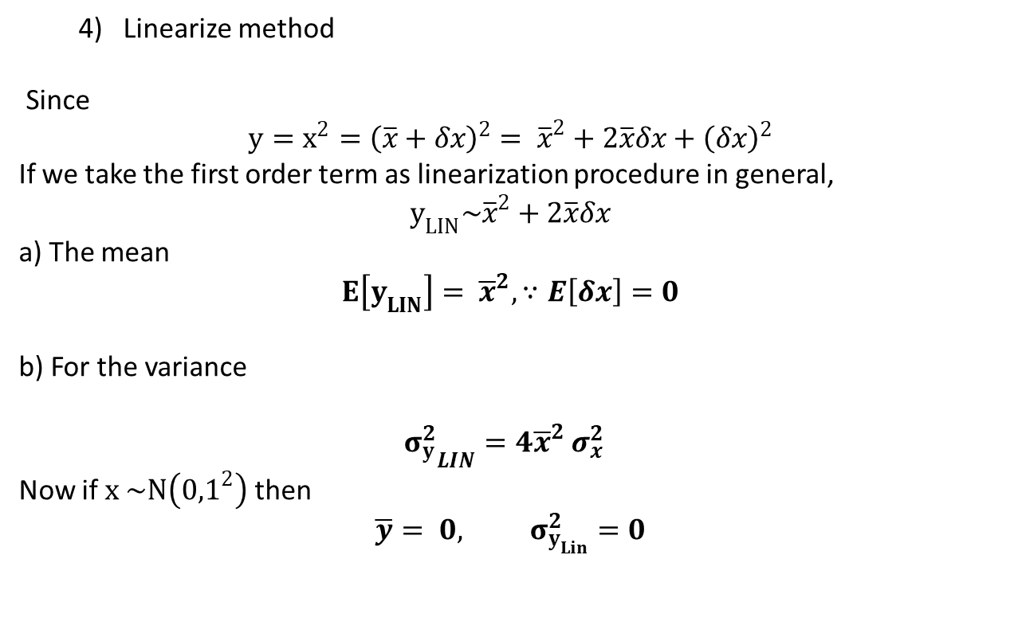
4) Linearize method
Since
$$y=x^{2}={\left(\overline{x}+δx\right)}^{2}= {\overline{x}}^{2}+2\overline{x}δx+{\left(δx\right)}^{2}$$
If we take the first order term as linearization procedure in general, $$y_{LIN}\sim {\overline{x}}^{2}+2\overline{x}δx$$
a) The mean
$$E\left[y_{LIN}\right]= {\overline{x}}^{2}, ∵E\left[δx\right]=0$$
b) For the variance
$${σ_{y}^{2}}_{LIN}=4{\overline{x}}^{2} σ_{x}^{2}$$
Now if $x \sim N\left({0,1}^{2}\right)$ then
$$\overline{y}= 0, σ_{y_{Lin}}^{2}=0$$

Slide 16
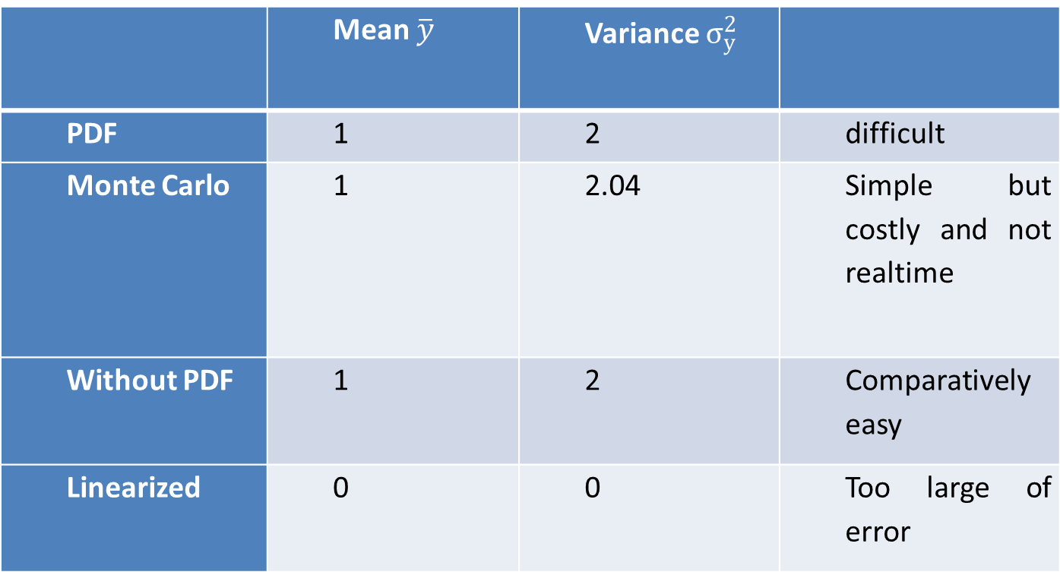
 | Mean $\overline{y}$ | Variance $σ_{y}^{2}$
PDF | 1 | 2 | difficult
Monte Carlo | 1 | 2.04 | Simple but costly and not realtime
Without PDF | 1 | 2 | Comparatively easy
Linearized | 0 | 0 | Too large of error

