Slide 1
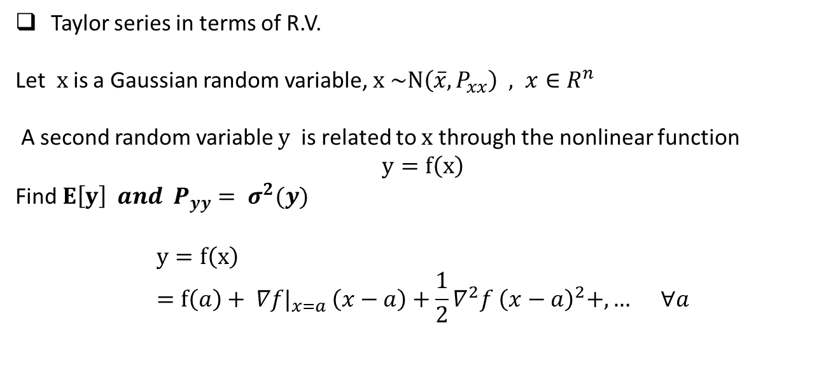
Taylor series in terms of R.V.
Let $x$ is a Gaussian random variable, $x \sim N\left(\overline{x}, P_{xx}\right) , x∈R^{n}$
A second random variable $y$ is related to $x$ through the nonlinear function
$$y=f\left(x\right)$$
Find $E\left[y\right] and$ $P_{yy}= σ^{2}(y)$
$$y=f\left(x\right) \\ =f\left(a\right)+ ∇f|_{x=a }\left(x−a\right)+\frac{1}{2}∇^{2}f {\left(x−a\right)}^{2}+,… ∀a$$

Slide 2
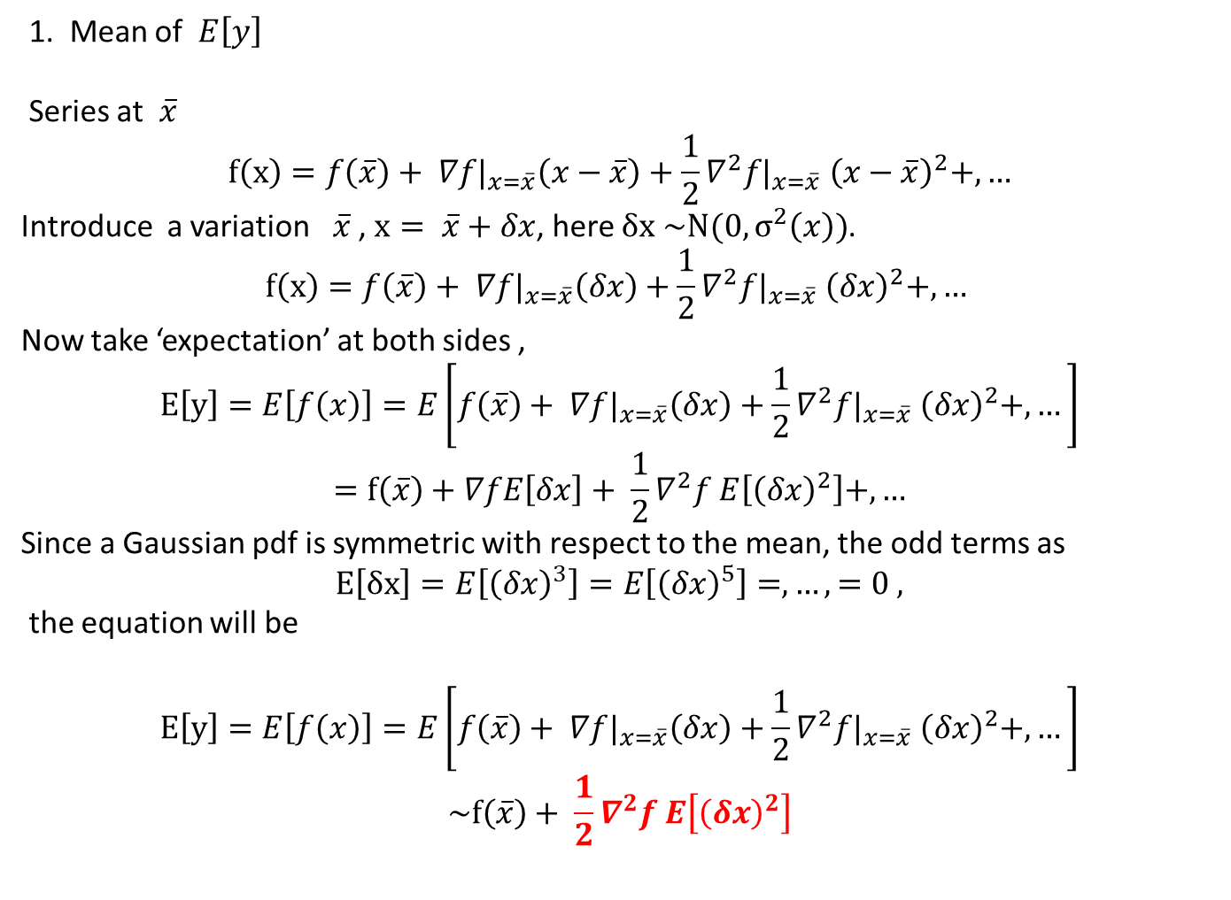
1. Mean of $E\left[y\right]$
Series at $\overline{x}$
$$f\left(x\right)=f\left(\overline{x}\right)+ ∇f|_{x=\overline{x}}\left(x−\overline{x}\right)+\frac{1}{2}∇^{2}f|_{x=\overline{x}} {\left(x−\overline{x}\right)}^{2}+,…$$
Introduce a variation $\overline{x}$ , $x= \overline{x}+δx$, here $δx \sim N(0, σ^{2}\left(x\right))$.
$$f\left(x\right)=f\left(\overline{x}\right)+ ∇f|_{x=\overline{x}}\left(δx\right)+\frac{1}{2}∇^{2}f|_{x=\overline{x}} {\left(δx\right)}^{2}+,…$$
Now take ‘expectation’ at both sides ,
$$E\left[y\right]=E\left[f\left(x\right)\right]=E\left[f\left(\overline{x}\right)+ ∇f|_{x=\overline{x}}\left(δx\right)+\frac{1}{2}∇^{2}f|_{x=\overline{x}} {\left(δx\right)}^{2}+,…\right]$$
$$=f\left(\overline{x}\right)+∇fE\left[δx\right]+ \frac{1}{2}∇^{2}f E\left[{\left(δx\right)}^{2}\right]+,…$$
Since a Gaussian pdf is symmetric with respect to the mean, the odd terms as
$$E\left[δx\right]=E\left[{\left(δx\right)}^{3}\right]=E\left[{\left(δx\right)}^{5}\right]=,…, =0 ,$$
the equation will be
$$E\left[y\right]=E\left[f\left(x\right)\right]=E\left[f\left(\overline{x}\right)+ ∇f|_{x=\overline{x}}\left(δx\right)+\frac{1}{2}∇^{2}f|_{x=\overline{x}} {\left(δx\right)}^{2}+,…\right]$$
$$\sim f\left(\overline{x}\right)+ \frac{1}{2}∇^{2}f E\left[{\left(δx\right)}^{2}\right]$$

Slide 3
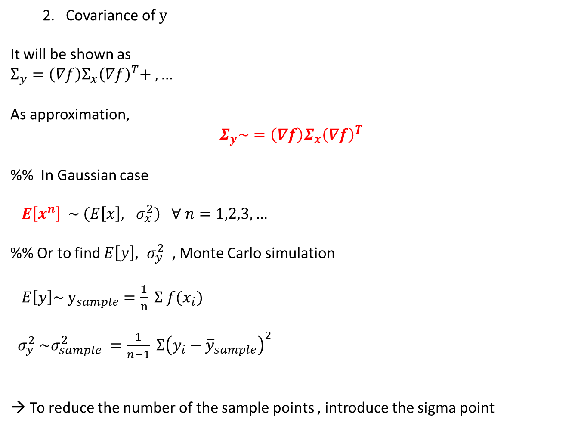
2. Covariance of $y$
It will be shown as
$Σ_{y}=\left(∇f\right)Σ_{x}{\left(∇f\right)}^{T}+ ,…$
As approximation,
$$Σ_{y}\sim =\left(∇f\right)Σ_{x}{\left(∇f\right)}^{T}$$
%% In Gaussian case
$E\left[x^{n}\right] \sim \left(E\left[x\right], σ_{x}^{2}\right) ∀ n=1,2,3,…$
%% Or to find $E\left[y\right], σ_{y}^{2}$ , Monte Carlo simulation
$E\left[y\right]\sim {\overline{y}}_{sample}=\frac{1}{n} Σ {f(x}_{i})$
$σ_{y}^{2} \sim σ_{sample}^{2} =\frac{1}{n−1} Σ{\left(y_{i}−{\overline{y}}_{sample}\right)}^{2}$
→ To reduce the number of the sample points , introduce the sigma point

Slide 4
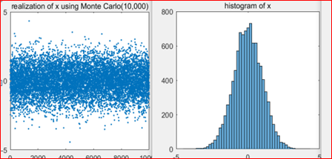
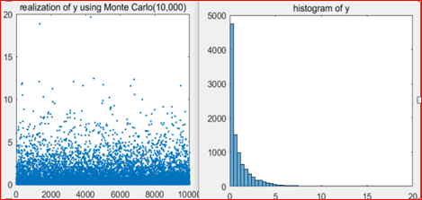
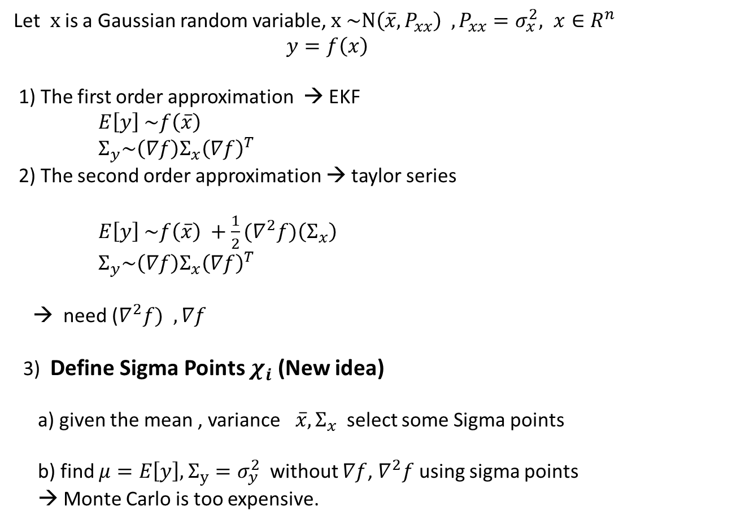
Unscented transform
Let $x$ is a Gaussian random variable, $x \sim N\left(\overline{x}, P_{xx}\right) , P_{xx}=σ_{x}^{2}, x∈R^{n}$
$y=f\left(x\right)$
1) The first order approximation → EKF
$E\left[y\right] \sim f\left(\overline{x}\right)$
$Σ_{y}\sim \left(∇f\right)Σ_{x}{\left(∇f\right)}^{T}$
2) The second order approximation → taylor series
$E\left[y\right] \sim f\left(\overline{x}\right) +{\frac{1}{2}(∇}^{2}f)\left(Σ_{x}\right)$
$Σ_{y}\sim \left(∇f\right)Σ_{x}{\left(∇f\right)}^{T}$
→ need ($∇^{2}f) , ∇f$
3) Define Sigma Points $χ_{i}$ (New idea)
a) given the mean , variance $\overline{x}, Σ_{x}$ select some Sigma points
b) find $μ=E\left[y\right], Σ_{y}=σ_{y}^{2}$ without $∇f$, $∇^{2}f$ using sigma points
→ Monte Carlo is too expensive.

Slide 5
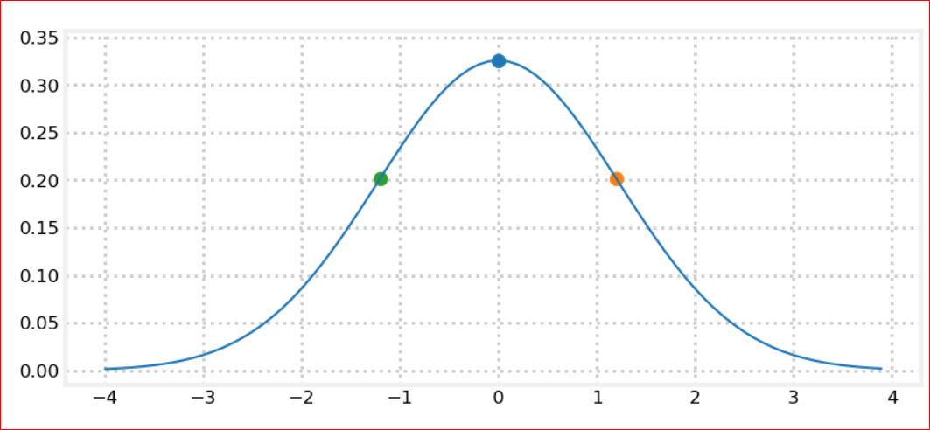
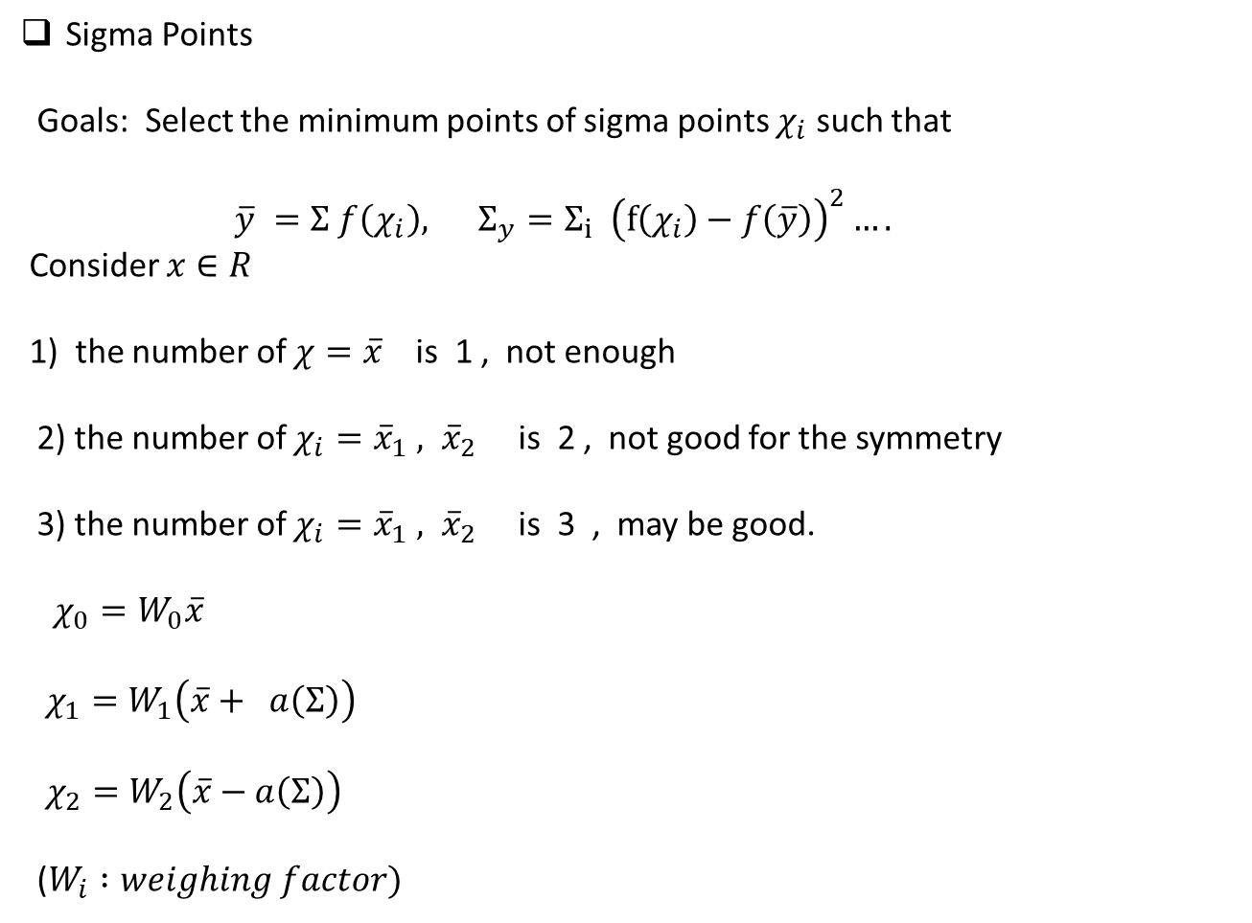
Sigma Points
Goals: Select the minimum points of sigma points $χ_{i}$ such that
$\overline{y} =Σ f\left(χ_{i}\right), Σ_{y}=Σ_{i} {\left(f\left(χ_{i}\right)−f\left(\overline{y}\right)\right)}^{2}….$
Consider $x∈R$
1) the number of $χ=\overline{x}$ is 1 , not enough
2) the number of $χ_{i}={\overline{x}}_{1} , {\overline{x}}_{2}$ is 2 , not good for the symmetry
3) the number of $χ_{i}={\overline{x}}_{1} , {\overline{x}}_{2}$ is 3 , may be good.
$χ_{0}=W_{0}\overline{x}$
$χ_{1}=W_{1}\left(\overline{x}+ a\left(Σ\right)\right)$
$χ_{2}=W_{2}\left(\overline{x}−a\left(Σ\right)\right)$
($W_{i} :weighing factor)$

Slide 6
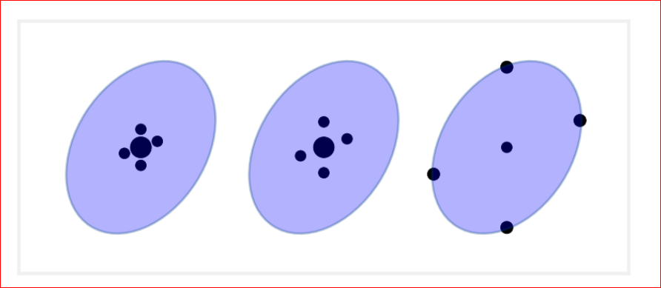
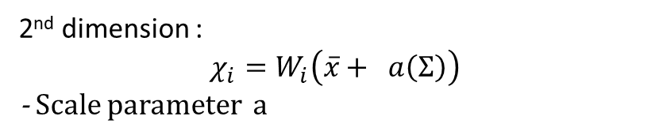
2nd dimension :
$$χ_{i}=W_{i}\left(\overline{x}+ a\left(Σ\right)\right)$$
- Scale parameter a
At the level curve of covariance, a1 <= a2 <= a3 , the Sigma points

Slide 7
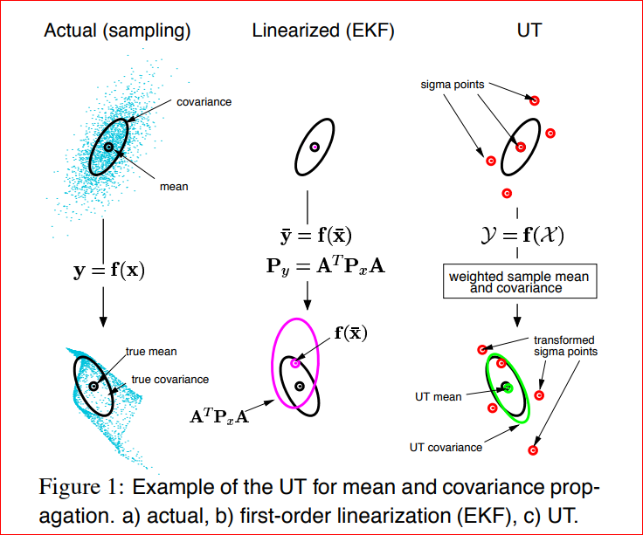
Non-linear filtering : Unscented Transform

Slide 8
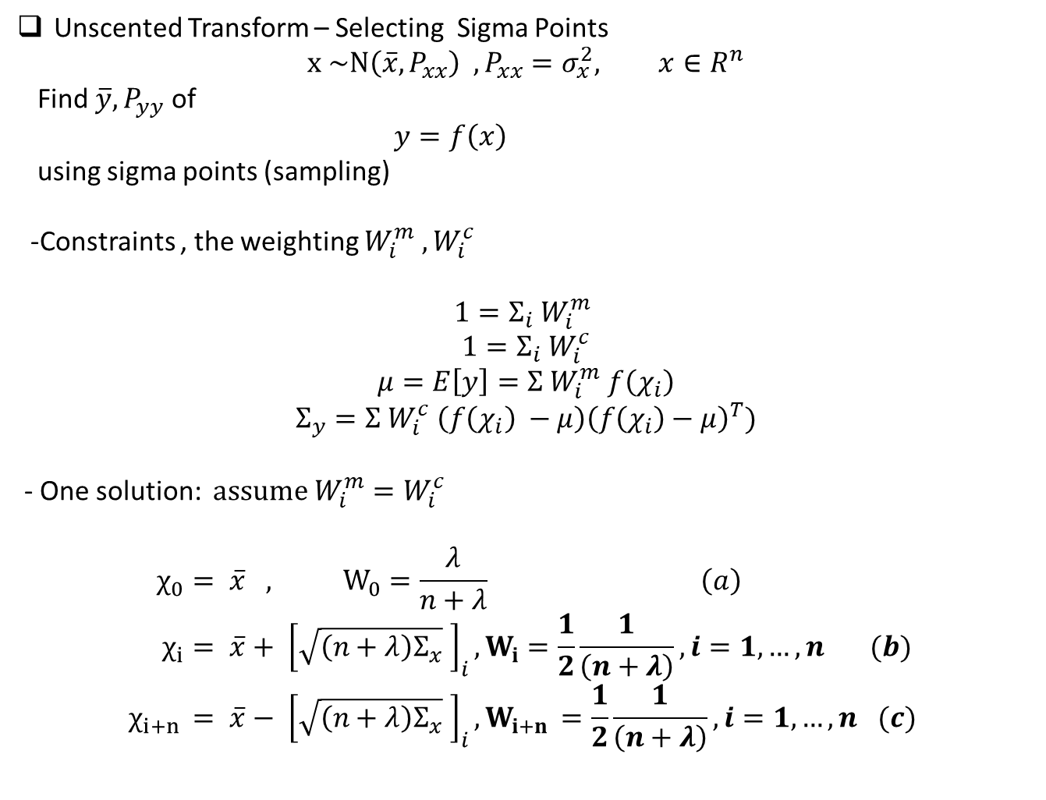
Unscented Transform – Selecting Sigma Points
$$x \sim N\left(\overline{x}, P_{xx}\right) , P_{xx}=σ_{x}^{2}, x∈R^{n}$$
Find $\overline{y}, P_{yy}$ of
$y=f\left(x\right)$
using sigma points (sampling)
-Constraints , the weighting $W_{i}^{m} , W_{i}^{c}$
$$1=Σ_{i} W_{i}^{m}$$
$$1=Σ_{i} W_{i}^{c}$$
$$μ=E\left[y\right]=Σ W_{i}^{m} f\left(χ_{i}\right)$$
$$Σ_{y}=Σ W_{i}^{c} \left(f\left(χ_{i}\right) −μ\right){\left(f\left(χ_{i}\right)−μ\right)}^{T})$$
- One solution: $assume W_{i}^{m}=W_{i}^{c}$
$$χ_{0}= \overline{x} , W_{0}=\frac{λ}{n+λ} \left(a\right) \\ χ_{i}= \overline{x}+ {\left[\sqrt{\left(n+λ\right)Σ_{x}} \right]}_{i}, W_{i}=\frac{1}{2}\frac{1}{\left(n+λ\right)}, i=1,…,n (b) \\ χ_{i+n }= \overline{x}− {\left[\sqrt{\left(n+λ\right)Σ_{x}} \right]}_{i}, W_{i+n }=\frac{1}{2}\frac{1}{\left(n+λ\right)}, i=1,…,n (c)$$

Slide 9
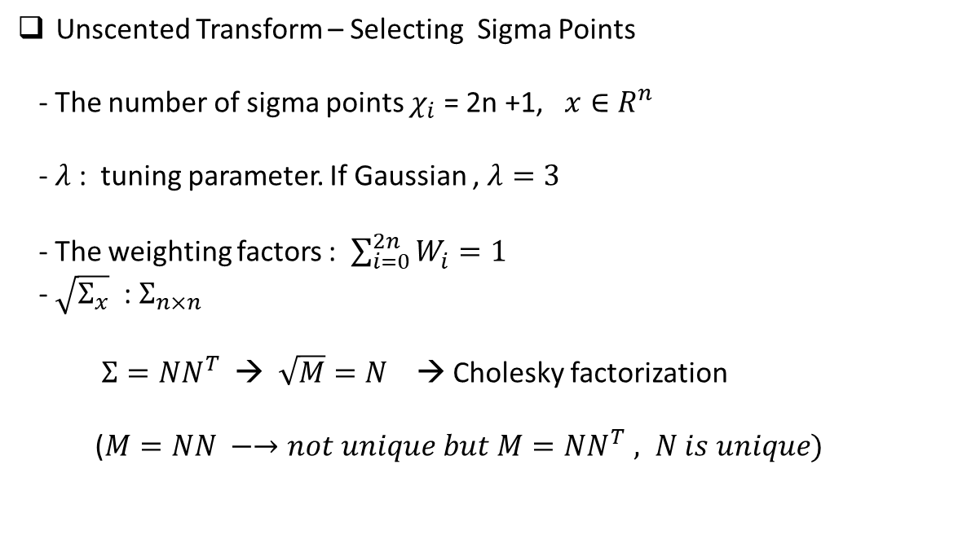
Unscented Transform – Selecting Sigma Points
- The number of sigma points $χ_{i}$ = 2n +1, $x∈R^{n}$
- $λ$: tuning parameter. If Gaussian , $λ=3$
- The weighting factors : $\sum_{i=0}^{2n}{W_{i}^{}}=1$
- $\sqrt{Σ_{x}}$ : $Σ_{n×n}$
$Σ=NN^{T}$ → $\sqrt{M}=N$ → Cholesky factorization
($M=NN −→not unique but M=NN^{T} , N is unique)$

Slide 10
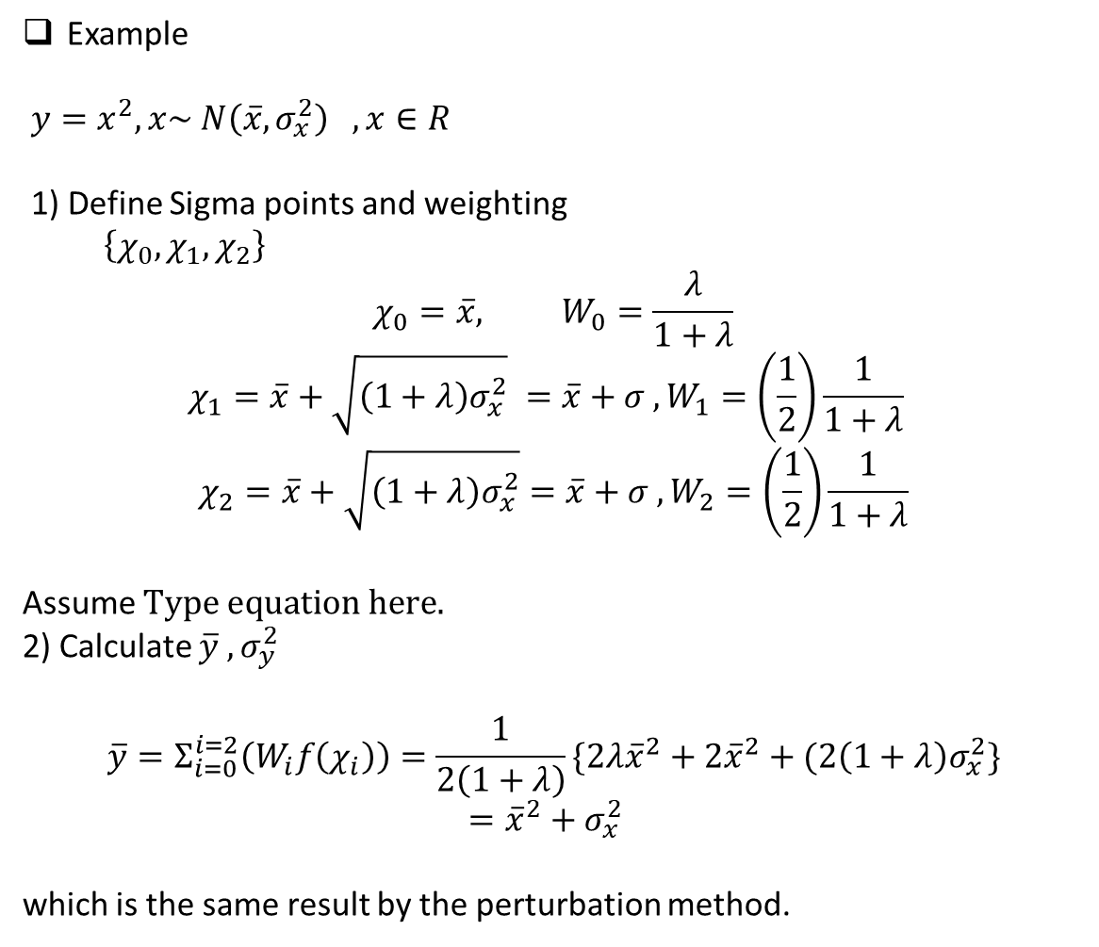
Example
$y=x^{2}, x\sim N\left(\overline{x}, σ_{x}^{2}\right) , x∈R$
1) Define Sigma points and weighting
$\left\{χ_{0}, χ_{1}, χ_{2}\right\}$
$$χ_{0}=\overline{x}, W_{0}=\frac{λ}{1+λ}$$
$$χ_{1}=\overline{x}+\sqrt{\left(1+λ\right)σ_{x}^{2}} =\overline{x}+σ , W_{1}=\left(\frac{1}{2}\right)\frac{1}{1+λ}$$
$$χ_{2}=\overline{x}+\sqrt{\left(1+λ\right)σ_{x}^{2}}=\overline{x}+σ , W_{2}=\left(\frac{1}{2}\right)\frac{1}{1+λ}$$
Assume
2) Calculate $\overline{y} , σ_{y}^{2}$
$$\overline{y}=Σ_{i=0}^{i=2}\left(W_{i}f\left(χ_{i}\right)\right)=\frac{1}{2\left(1+λ\right)}\{2λ{\overline{x}}^{2}+2{\overline{x}}^{2}+(2\left(1+λ\right)σ_{x}^{2}\}$$
$$={\overline{x}}^{2}+σ_{x}^{2}$$
which is the same result by the perturbation method.

Slide 11
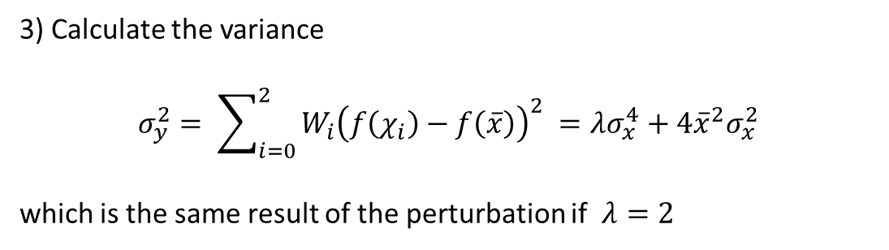
3) Calculate the variance
$$σ_{y}^{2}= \sum_{i=0}^{2}{W_{i}{\left(f\left(χ_{i}\right)−f\left(\overline{x}\right)\right)}^{2}} =λσ_{x}^{4}+4{\overline{x}}^{2}σ_{x}^{2}$$
which is the same result of the perturbation if $λ=2$

Slide 12
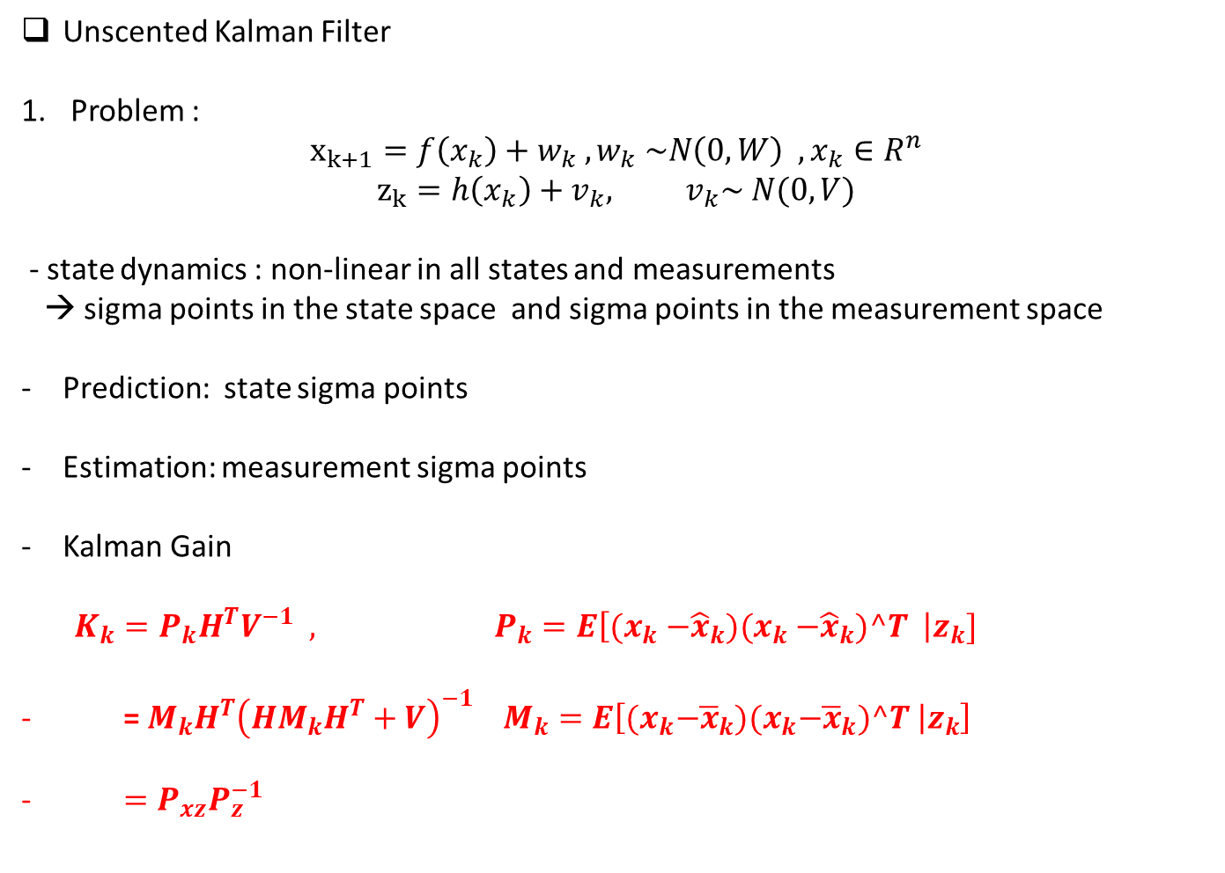
Unscented Kalman Filter
Problem :
$$x_{k+1}=f\left(x_{k}\right)+w_{k} , w_{k} \sim N\left(0, W\right) , x_{k}∈R^{n}$$
$$z_{k}=h\left(x_{k}\right)+v_{k}, v_{k}\sim N(0,V)$$
- state dynamics : non-linear in all states and measurements
→ sigma points in the state space and sigma points in the measurement space
Prediction: state sigma points
Estimation: measurement sigma points
Kalman Gain
$K_{k}=P_{k}H^{T}V^{−1} , P_{k}=E\left[{(x}_{k} −{\hat{x}}_{k}){(x}_{k} −{\hat{x}}_{k})^T \right|z_{k}]$
= $M_{k}H^{T}{\left(HM_{k}H^{T}+V\right)}^{−1} M_{k}=E\left[{(x}_{k}−{\overline{x}}_{k}){(x}_{k}−{\overline{x}}_{k})^T | z_{k}\right]$
$=P_{xz}P_{z}^{−1}$

Slide 13
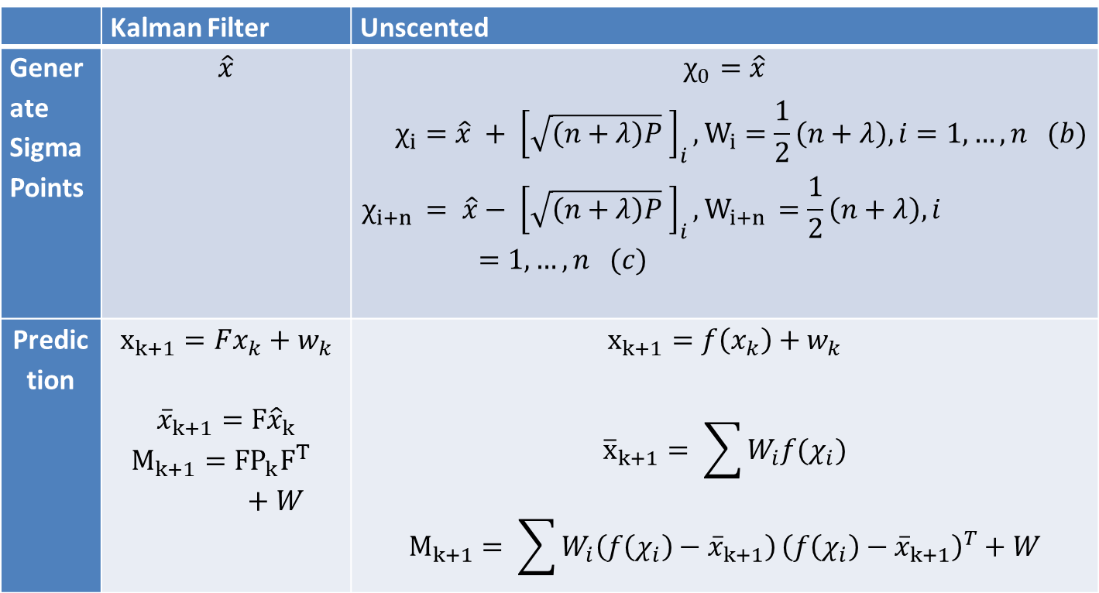
2. Prediction
$$x_{k+1}=f\left(x_{k}\right)+w_{k} , w_{k} \sim N\left(0, W\right) , x_{k}∈R^{n}$$
 | Kalman Filter | Unscented
Generate Sigma Points | $$\hat{x}$$ | $$χ_{0}=\hat{x}$$ $$χ_{i}=\hat{x} + {\left[\sqrt{\left(n+λ\right)P} \right]}_{i}, W_{i}=\frac{1}{2}\left(n+λ\right), i=1,…,n (b) \\ χ_{i+n }= \hat{x}− {\left[\sqrt{\left(n+λ\right)P} \right]}_{i}, W_{i+n }=\frac{1}{2}\left(n+λ\right), i=1,…,n (c)$$
Predic tion | $$x_{k+1}=Fx_{k}+w_{k}$$ $${\overline{x}}_{k+1}=F{\hat{x}}_{k}$$ $$M_{k+1}={{FP}_{k}F}^{T} +W$$ | $$x_{k+1}=f\left(x_{k}\right)+w_{k}$$ $${\overline{x}}_{k+1}= \sum{W_{i}f(χ_{i})}$$ $$M_{k+1}= \sum{W_{i}\left(f\left(χ_{i}\right)−{\overline{x}}_{k+1}\right)}{\left(f\left(χ_{i}\right)−{\overline{x}}_{k+1}\right)}^{T}+W$$

Slide 14

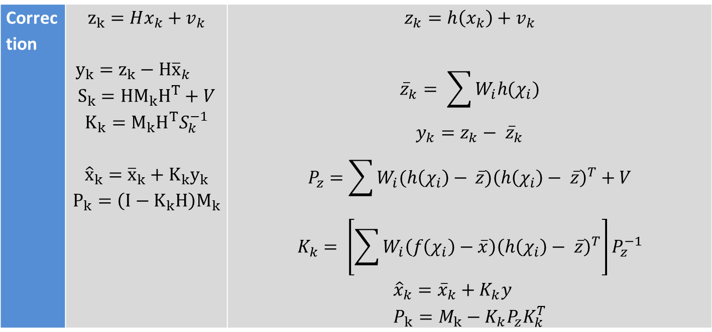
3. Estimation / Correction
$$z_{k}=h\left(x_{k}\right)+v_{k}, v_{k}\sim N(0,V)$$
Correc tion | $$z_{k}=Hx_{k}+v_{k}$$ $y_{k}=z_{k}−H{\overline{x}}_{k}$ $$S_{k}={{HM}_{k}H}^{T}+V$$ $$K_{k}={M_{k}H}^{T}S_{k}^{−1}$$ $${\hat{x}}_{k}={\overline{x}}_{k}+K_{k}y_{k}$$ $$P_{k}=\left(I−K_{k}H\right)M_{k}$$ | $$z_{k}=h\left(x_{k}\right)+v_{k}$$ $${\overline{z}}_{k}= \sum{W_{i}h(χ_{i})}$$ $$y_{k}=z_{k}− {\overline{z}}_{k}$$ $$P_{z}=\sum{W_{i}(h\left(χ_{i}\right)− }\overline{z}){\left(h\left(χ_{i}\right)− \overline{z}\right)}^{T}+V$$ $$K_{k}= \left[\sum{W_{i}\left(f\left(χ_{i}\right)−\overline{x}\right){\left(h\left(χ_{i}\right)− \overline{z}\right)}^{T}}\right]P_{z}^{−1}$$ $${\hat{x}}_{k}={\overline{x}}_{k}+K_{k}y \\ P_{k}=M_{k}−{K_{k}P}_{z}K_{k}^{T}$$

Slide 15
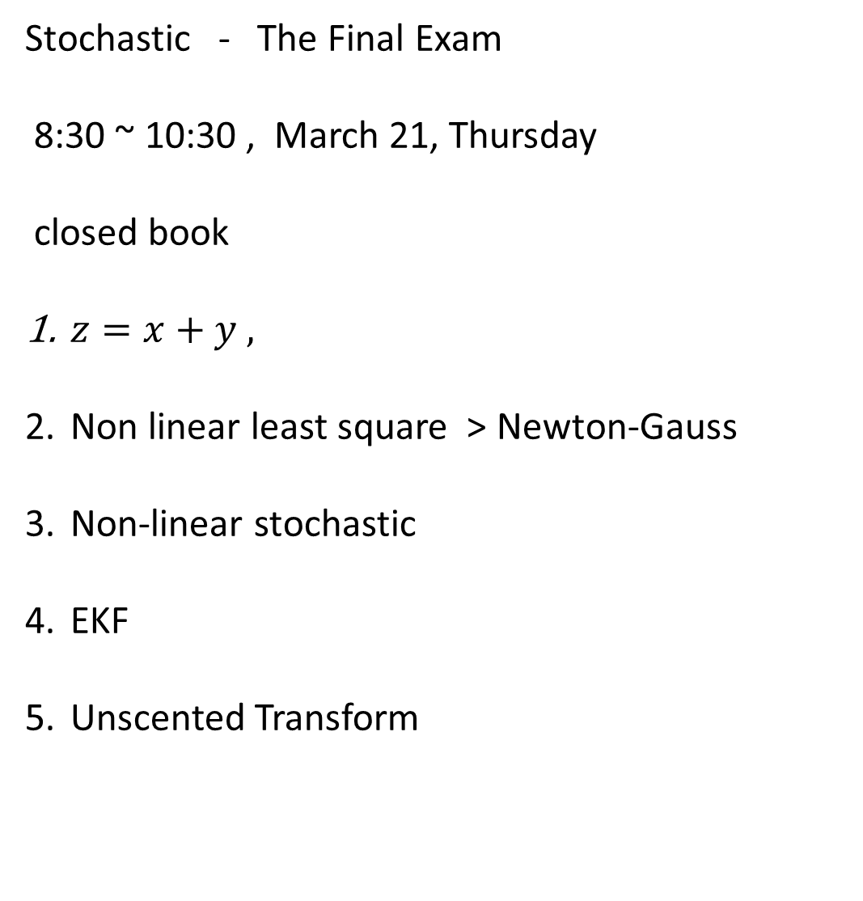
Stochastic - The Final Exam
8:30 ~ 10:30 , March 21, Thursday
closed book
$z=x+y ,$
Non linear least square > Newton-Gauss
Non-linear stochastic
EKF
Unscented Transform

