Slide 1
Ch.3 Batch and Recursive Bayesian Estimator
3.1 Batch linear regression
3.2 Recursive linear regression
3.3 Batch versus recursive estimation
3.4 Drift model for linear regression
3.5 State space model for linear regression with drift

Slide 2

Ch.3.1 Batch linear regression
Problem
$y_{k}=θ_{1}+θ_{2}t_{k}+ε_{k}$
$ε_{k}\sim N\left(0, σ^{2}\right), Θ=\left(θ_{1}, θ_{2}\right)\sim N\left(m_{0}, P_{0}\right)$
Given Data
$D=\left\{\left(t_{1},y_{1}\right),\left(t_{2}, y_{2}\right),…,\left(t_{n}, y_{n}\right)\right\}$ (for simple notation) $=y_{1:T}$
Estimate $Θ$
2) Pre-knowledge
- $p\left(y_{k} | Θ\right)= N\left(y_{k} | H_{k}Θ, σ^{2}\right)$ : likelihood ,
$p\left(y_{i}, y_{j} | Θ\right)=p\left(y_{i} | Θ\right)p\left(y_{j} | Θ\right),$i.e., ${\{y}_{k}\}$are conditionally independent
- $p\left(Θ\right)=N\left(Θ\right|m_{o}, P_{0})$ : prior
- $H_{k} =\left(1 t_{k}\right) row vector$

Slide 3

3.1-Continue
3) Batch Solution
The posterior is by Bayesian rule
$p\left(Θ | y_{1:T} \right) p\left(y_{1:T}\right)=p\left(y_{1:T} | Θ\right)p\left(Θ\right)$
Since $\{y_{k}\}$ is independent condition on $Θ$
$$p\left(y_{1:T} | Θ\right)=\prod_{k=1}^{T}{p(y_{k}|Θ)}$$
follows
$p\left(Θ | y_{1:T} \right)∝ p\left(Θ\right)\prod_{k=1}^{T}{p(y_{k}|Θ)}$
$$=N\left(Θ \right|m_{0},P_{0})\prod_{k=1}^{T}{p(y_{k}|Θ)}$$

Slide 4

3.1-Continue
3) Batch Solution
The product of the gaussian pdfs is gaussian, the mean and covariance of the posterior prob.
distribution $p\left(Θ | y_{1:T} \right)$ is
$m_{T} ={\left[ P_{0}^{−1}+\frac{1}{σ^{2}}H^{T}H\right]}^{−1}\left[\frac{1}{σ^{2}}H^{T}y+P_{0}^{−1}m_{0}\right]$
$$P_{T}={\left[P_{0}^{−1}+\frac{1}{σ^{2}}H^{T}H\right]}^{−1}$$
where $H_{k}=\left(1 t_{k}\right)$
$H=\left(\begin{matrix}H_{1} \\ ⋮ \\ H_{k}\end{matrix}\right)=\left(\begin{matrix}1 & t_{1} \\ ⋮ & ⋮ \\ 1 & t_{k}\end{matrix}\right) , y=\left(\begin{matrix}y_{1} \\ ⋮ \\ y_{k}\end{matrix}\right)$
%% comments in scalar case
$\frac{1}{c^{2}}=\frac{1}{a^{2}}+\frac{1}{b^{2}} −→ c≤a , c≤b$
→ the uncertainty of the sum is less than that of each uncertainty. %%

Slide 5
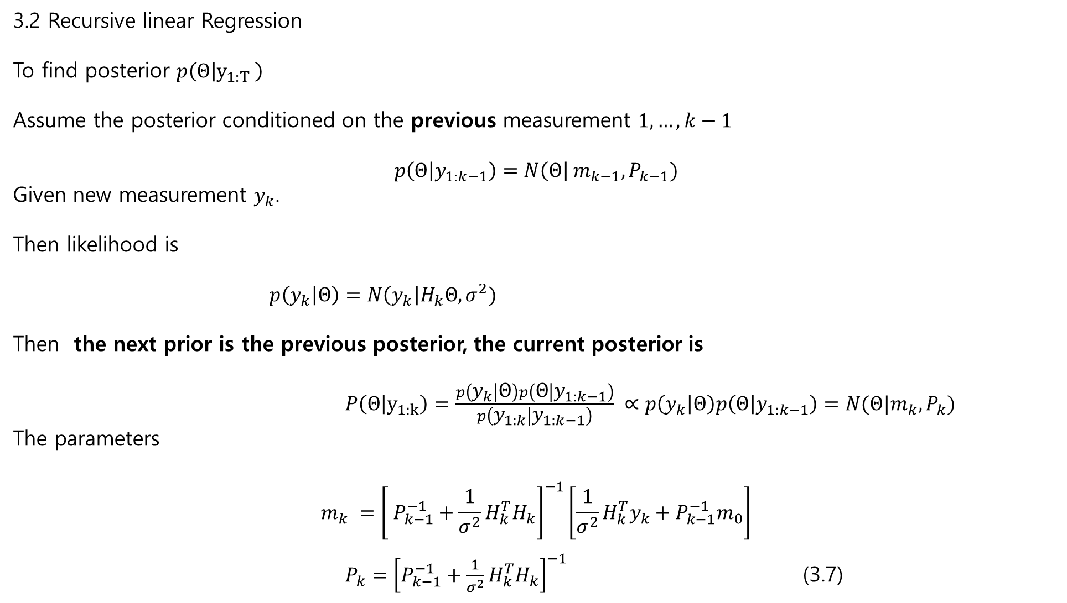
3.2 Recursive linear Regression
To find posterior $p\left(Θ | y_{1:T} \right)$
Assume the posterior conditioned on the previous measurement $1,…,k−1$
$$p\left(Θ | y_{1:k−1}\right)=N\left(Θ\right| m_{k−1}, P_{k−1})$$
Given new measurement $y_{k}$.
Then likelihood is
$p\left(y_{k} | Θ\right)=N\left(y_{k}\right|H_{k}Θ, σ^{2})$
Then the next prior is the previous posterior, the current posterior is
$P\left(Θ | y_{1:k}\right)=\frac{p\left(y_{k} | Θ\right)p\left(Θ | y_{1:k−1}\right)}{p\left(y_{1:k} | y_{1:k−1}\right)} ∝p\left(y_{k} | Θ\right)p\left(Θ | y_{1:k−1}\right)=N(Θ|m_{k}, P_{k})$
The parameters
$$m_{k} ={\left[ P_{k−1}^{−1}+\frac{1}{σ^{2}}H_{k}^{T}H_{k}\right]}^{−1}\left[\frac{1}{σ^{2}}H_{k}^{T}y_{k}+P_{k−1}^{−1}m_{0}\right]$$
$P_{k}={\left[P_{k−1}^{−1}+\frac{1}{σ^{2}}H_{k}^{T}H_{k}\right]}^{−1}$ (3.7)

Slide 6

3.2 Recursive linear Regression
Matrix inversion lemma
$$P_{k}={\left[P_{k−1}^{−1}+\frac{1}{σ^{2}}H_{k}^{T}H_{k}\right]}^{−1}$$
%% check the PG textbook Ch.3 %%
$$P_{k}=P_{k−1} −P_{k−1}H_{k}^{T}{\left[H_{k}P_{k−1}H_{K}^{T} +σ^{2}\right]}^{−1}H_{k}P_{k−1}$$
Introduce temporary $S_{k}, K_{k}$
$$S_{k}=H_{k}P_{k−1}H_{K}^{T}+σ^{2}$$
$$K_{K}=P_{k−1}H_{k}^{T}S_{K}^{−1}$$
$$m_{k}=m_{k−1}+K_{k}\left[y_{k}−H_{k}m_{k−1}\right]$$
$P_{k}=P_{k−1}−K_{K}S_{k}K_{k}^{T}$ (3.8)
→ No matrix inversion since $S_{k}$ is scalar due to scalar measurement

Slide 7
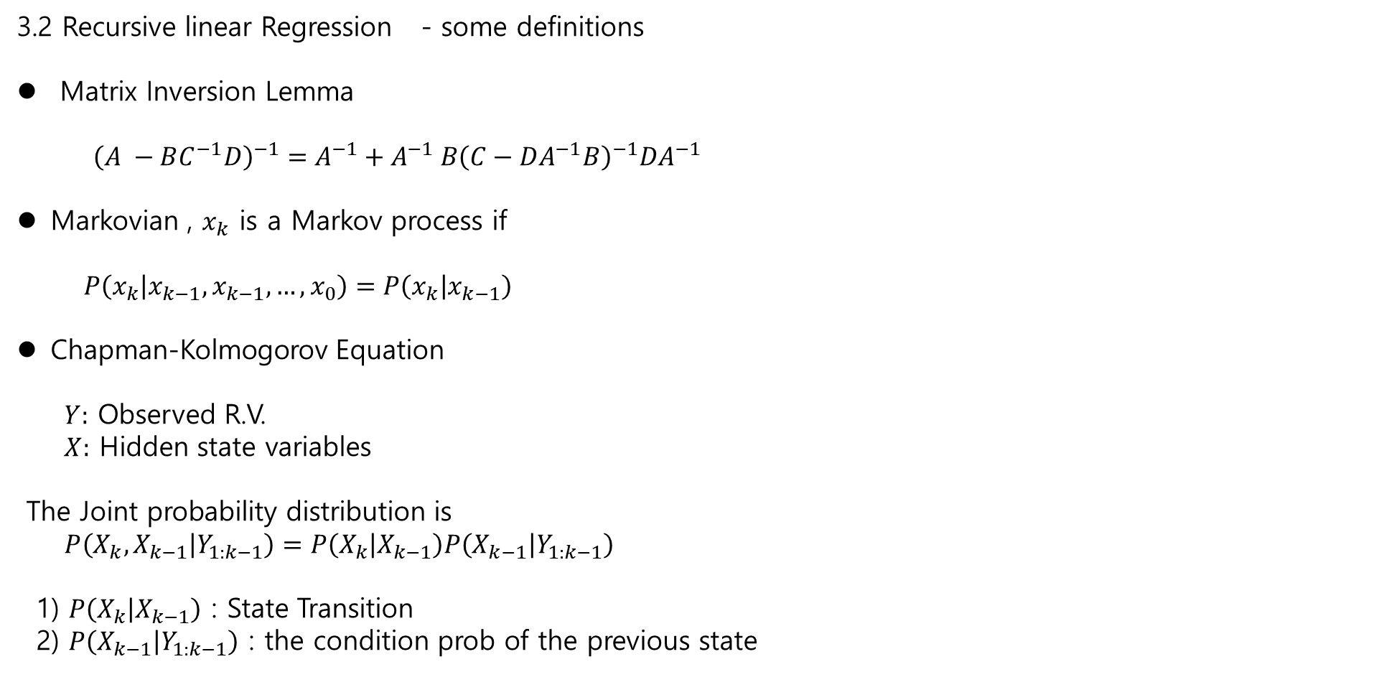
3.2 Recursive linear Regression - some definitions
Matrix Inversion Lemma
${\left(A −BC^{−1}D\right)}^{−1}=A^{−1}+A^{−1} B{\left(C−DA^{−1}B\right)}^{−1}DA^{−1}$
Markovian , $x_{k}$ is a Markov process if
$P\left(x_{k} | x_{k−1}, x_{k−1},…, x_{0}\right)=P\left(x_{k} | x_{k−1}\right)$
Chapman-Kolmogorov Equation
$Y:$ Observed R.V.
$X:$ Hidden state variables
The Joint probability distribution is
$P\left(X_{k}, X_{k−1} | Y_{1:k−1}\right)=P\left(X_{k} | X_{k−1}\right)P\left(X_{k−1} | Y_{1:k−1}\right)$
1) $P\left(X_{k} | X_{k−1}\right)$ : State Transition
2) $P\left(X_{k−1} | Y_{1:k−1}\right)$ : the condition prob of the previous state

Slide 8
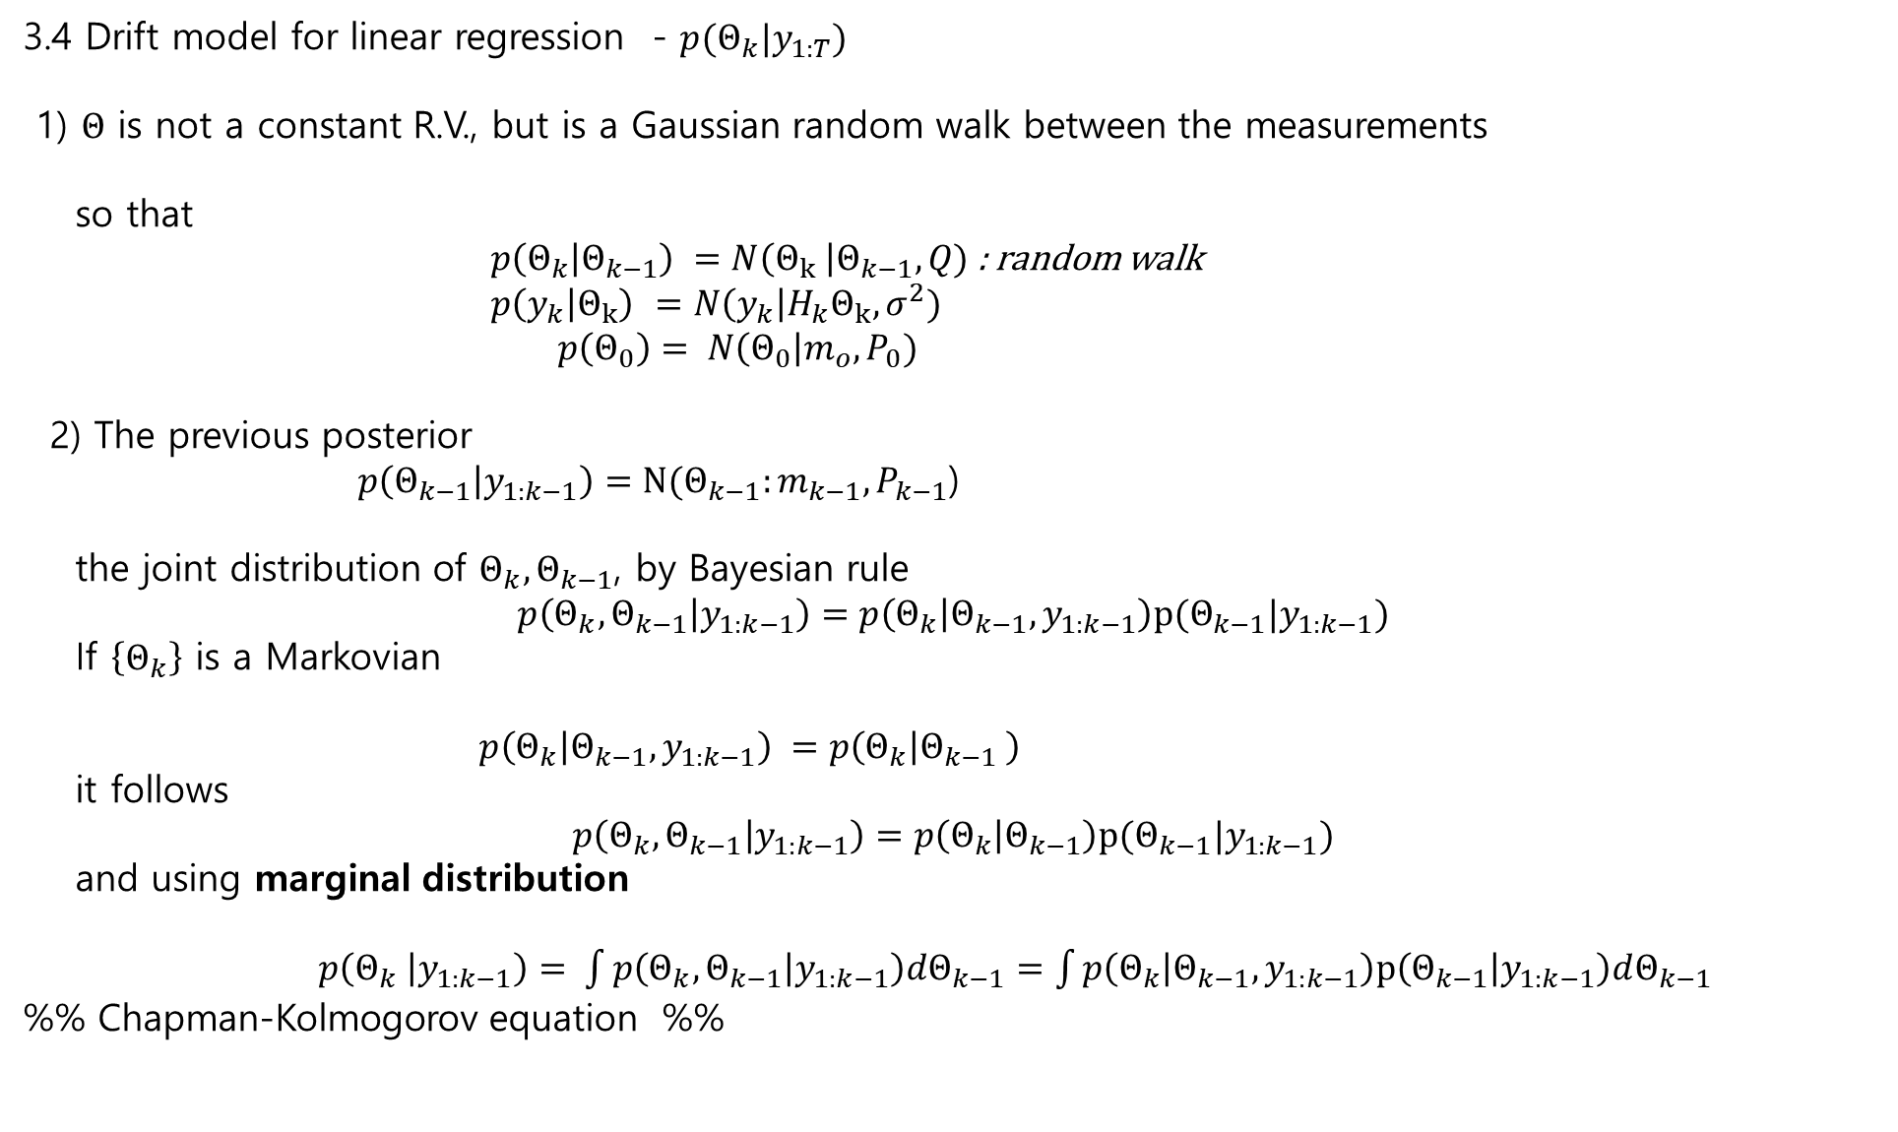
3.4 Drift model for linear regression - $p(Θ_{k}|y_{1:T})$
1) $Θ$ is not a constant R.V., but is a Gaussian random walk between the measurements
so that
$p\left(Θ_{k} | Θ_{k−1}\right) =N\left(Θ_{k} \right|Θ_{k−1}, Q)$: random walk
$p\left(y_{k} | Θ_{k}\right)$ $=N\left(y_{k}\right|H_{k}Θ_{k}, σ^{2})$
$p\left(Θ_{0}\right)= N\left(Θ_{0}\right|m_{o}, P_{0})$
2) The previous posterior
$p\left(Θ_{k−1} | y_{1:k−1}\right)=N(Θ_{k−1}:m_{k−1}, P_{k−1}$)
the joint distribution of $Θ_{k}, Θ_{k−1}$, by Bayesian rule
$$p\left(Θ_{k}, Θ_{k−1} | y_{1:k−1}\right)=p\left(Θ_{k} | Θ_{k−1},y_{1:k−1}\right)p(Θ_{k−1}|y_{1:k−1})$$
If $\left\{Θ_{k}\right\}$ is a Markovian
$p\left(Θ_{k} | Θ_{k−1},y_{1:k−1}\right) =p\left(Θ_{k} | Θ_{k−1} \right)$
it follows
$$p\left(Θ_{k}, Θ_{k−1} | y_{1:k−1}\right)=p\left(Θ_{k} | Θ_{k−1}\right)p(Θ_{k−1}|y_{1:k−1})$$
and using marginal distribution
$p\left(Θ_{k} | y_{1:k−1}\right)= \int{p\left(Θ_{k}, Θ_{k−1} | y_{1:k−1}\right)dΘ_{k−1}}=\int{p\left(Θ_{k} | Θ_{k−1}, y_{1:k−1}\right)p\left(Θ_{k−1} | y_{1:k−1}\right)dΘ_{k−1}}$
%% Chapman-Kolmogorov equation %%

Slide 9
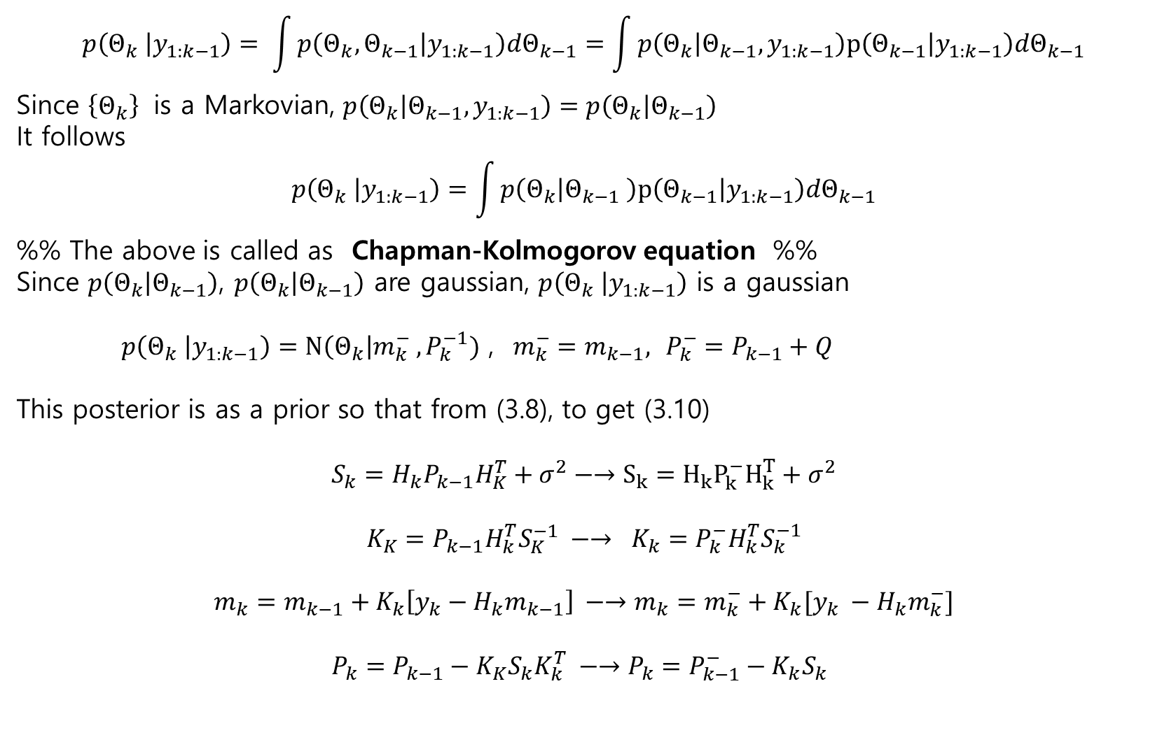
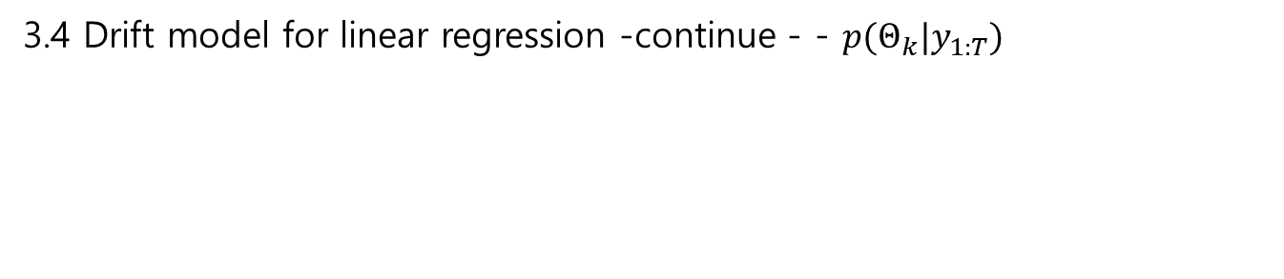
3.4 Drift model for linear regression -continue - - $p(Θ_{k}|y_{1:T})$
$$p\left(Θ_{k} | y_{1:k−1}\right)= \int{p\left(Θ_{k}, Θ_{k−1} | y_{1:k−1}\right)dΘ_{k−1}}=\int{p\left(Θ_{k} | Θ_{k−1}, y_{1:k−1}\right)p\left(Θ_{k−1} | y_{1:k−1}\right)dΘ_{k−1}}$$
Since $\left\{Θ_{k}\right\}$ is a Markovian, $p\left(Θ_{k} | Θ_{k−1}, y_{1:k−1}\right)=p\left(Θ_{k} | Θ_{k−1}\right)$
It follows
$$p\left(Θ_{k} | y_{1:k−1}\right)=\int{p\left(Θ_{k} | Θ_{k−1} \right)p\left(Θ_{k−1} | y_{1:k−1}\right)dΘ_{k−1}}$$
%% The above is called as Chapman-Kolmogorov equation %%
Since $p\left(Θ_{k} | Θ_{k−1}\right)$, $p\left(Θ_{k} | Θ_{k−1}\right)$ are gaussian, $p\left(Θ_{k} | y_{1:k−1}\right)$ is a gaussian
$p\left(Θ_{k} | y_{1:k−1}\right)=N\left(Θ_{k}\right|m_{k}^{−} , P_{k}^{−1})$ , $m_{k}^{−}=m_{k−1},$ $P_{k}^{−}=P_{k−1}+Q$
This posterior is as a prior so that from (3.8), to get (3.10)
$$S_{k}=H_{k}P_{k−1}H_{K}^{T}+σ^{2}−→S_{k}=H_{k}P_{k}^{−}H_{k}^{T}+σ^{2}$$
$$K_{K}=P_{k−1}H_{k}^{T}S_{K}^{−1} −→ K_{k}=P_{k}^{−}H_{k}^{T}S_{k}^{−1}$$
$$m_{k}=m_{k−1}+K_{k}\left[y_{k}−H_{k}m_{k−1}\right] −→m_{k}=m_{k}^{−}+K_{k}[y_{k} −H_{k}m_{k}^{−}]$$
$P_{k}=P_{k−1}−K_{K}S_{k}K_{k}^{T} −→P_{k}=P_{k−1}^{−}−K_{k}S_{k}$

Slide 10

3.5 State space model for linear regression with drift
State Space
$\left[\begin{matrix}x_{1,k} \\ x_{2,k}\end{matrix}\right]=A_{k−1}\left[\begin{matrix}x_{1,k} \\ x_{2,k}\end{matrix}\right]$ + $\left[\begin{matrix}q_{1,k−1} \\ q_{2,k−1}\end{matrix}\right]$
$$y_{k}=\left[1 0\right]\left[\begin{matrix}x_{1,k} \\ x_{2,k}\end{matrix}\right]+r_{k}$$
$$\left[\begin{matrix}q_{1,k−1} \\ q_{2,k−1}\end{matrix}\right]\sim N\left(0, Q\right), r_{k}\sim N(0, σ^{2})$$
2.1) Prediction
$$m_{k}^{−}=A_{k−1}m_{k−1}$$
$$P_{k}^{−}=A_{k−1}P_{k−1}A_{k−1}^{T} +Q_{k−1}$$
2.2) Update
$$S_{k}=H_{k}P_{k}^{−}H_{k}^{T}+σ^{2}$$
$$K_{K}=P_{k}^{−}H_{k}^{T}S_{k}^{−1}$$
$m_{k}=m_{k}^{−}+K_{k}[y_{k} −H_{k}m_{k}^{−}]$
$P_{k}=P_{k−1}^{−}−K_{k}S_{k}K_{k}^{T}$

Slide 11
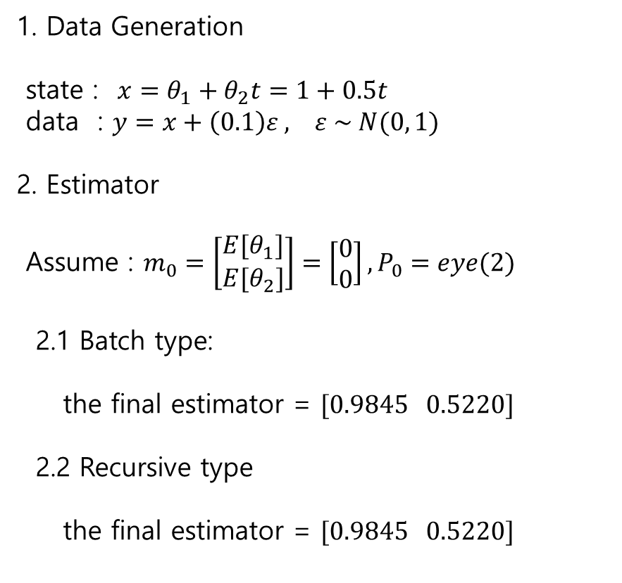
Example-Linear Regression – fixed unknown matlab
1. Data Generation
state : $x=θ_{1}+θ_{2}t=1+0.5t$
data : $y=x+\left(0.1\right)ε , ε \sim N(0, 1)$
2. Estimator
Assume : $m_{0}=\left[\begin{matrix}E[θ_{1}] \\ E[θ_{2}]\end{matrix}\right]=\left[\begin{matrix}0 \\ 0\end{matrix}\right], P_{0}=eye(2)$
2.1 Batch type:
the final estimator = $[0.9845 0.5220]$
2.2 Recursive type
the final estimator = $[0.9845 0.5220]$

Slide 12
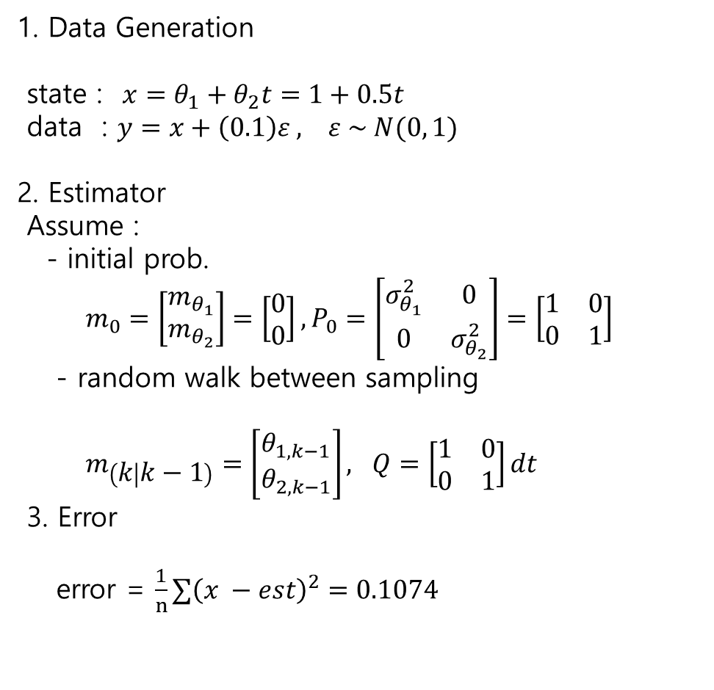
Example-Linear Regression – random walk between samplings
1. Data Generation
state : $x=θ_{1}+θ_{2}t=1+0.5t$
data : $y=x+\left(0.1\right)ε , ε \sim N(0, 1)$
2. Estimator
Assume :
- initial prob.
$m_{0}=\left[\begin{matrix}m_{θ_{1}} \\ m_{θ_{2}}\end{matrix}\right]=\left[\begin{matrix}0 \\ 0\end{matrix}\right], P_{0}=\left[\begin{matrix}σ_{θ_{1}}^{2} & 0 \\ 0 & σ_{θ_{2}}^{2}\end{matrix}\right]=\left[\begin{matrix}1 & 0 \\ 0 & 1\end{matrix}\right]$
- random walk between sampling
$m_{\left(k | k−1\right)}=\left[\begin{matrix}θ_{1, k−1} \\ θ_{2,k−1}\end{matrix}\right], Q=\left[\begin{matrix}1 & 0 \\ 0 & 1\end{matrix}\right]dt$
3. Error
error = $\frac{1}{n}∑{\left(x −est\right)}^{2}=0.1074$

Slide 13
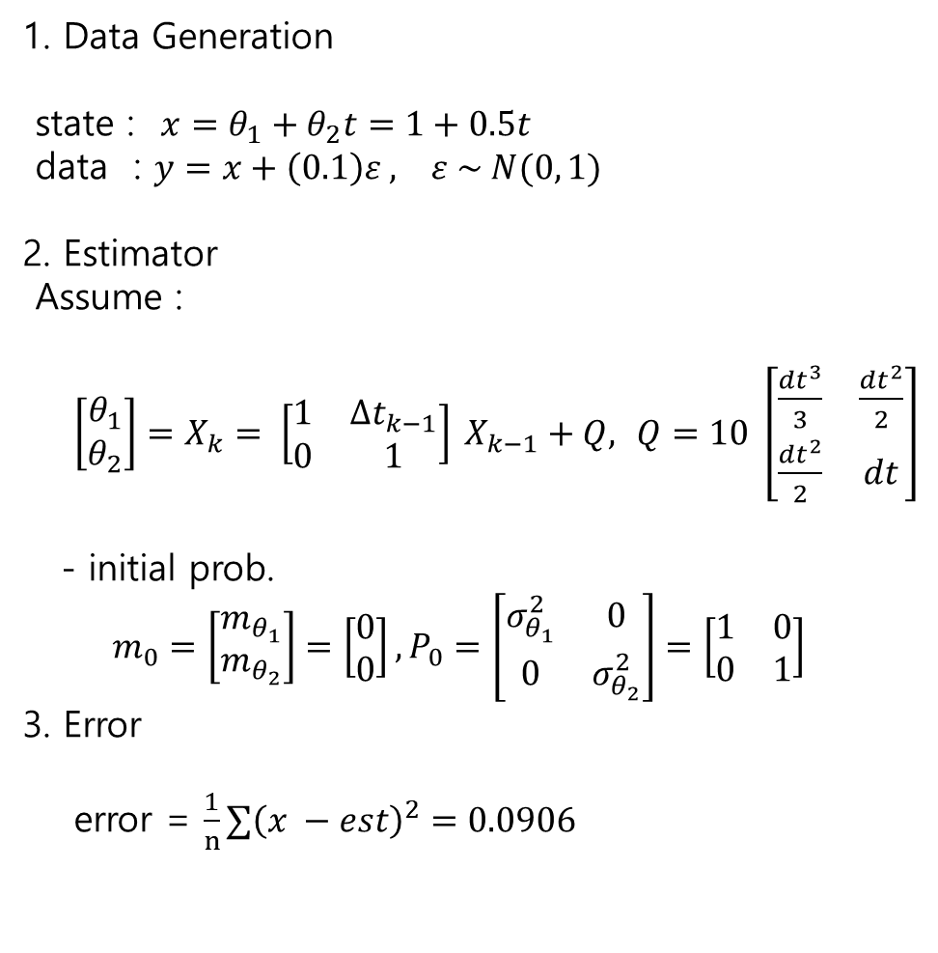
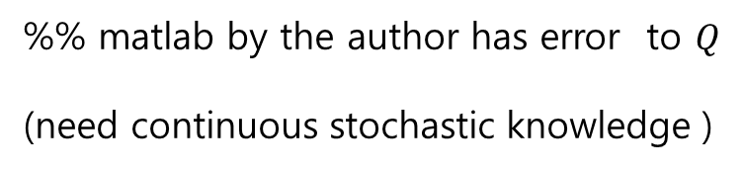
Example-Linear Regression – stat space model with constant speed
1. Data Generation
state : $x=θ_{1}+θ_{2}t=1+0.5t$
data : $y=x+\left(0.1\right)ε , ε \sim N(0, 1)$
2. Estimator
Assume :
$\left[\begin{matrix}θ_{1} \\ θ_{2}\end{matrix}\right]=X_{k}= \left[\begin{matrix}1 & Δt_{k−1} \\ 0 & 1\end{matrix}\right] X_{k−1}+Q,$ $Q=10 \left[\begin{matrix}\frac{dt^{3}}{3} & \frac{dt^{2}}{2} \\ \frac{dt^{2}}{2} & dt\end{matrix}\right]$
- initial prob.
$m_{0}=\left[\begin{matrix}m_{θ_{1}} \\ m_{θ_{2}}\end{matrix}\right]=\left[\begin{matrix}0 \\ 0\end{matrix}\right], P_{0}=\left[\begin{matrix}σ_{θ_{1}}^{2} & 0 \\ 0 & σ_{θ_{2}}^{2}\end{matrix}\right]=\left[\begin{matrix}1 & 0 \\ 0 & 1\end{matrix}\right]$
3. Error
error = $\frac{1}{n}∑{\left(x −est\right)}^{2}=0.0906$
%% matlab by the author has error to $Q$
(need continuous stochastic knowledge )

Slide 14
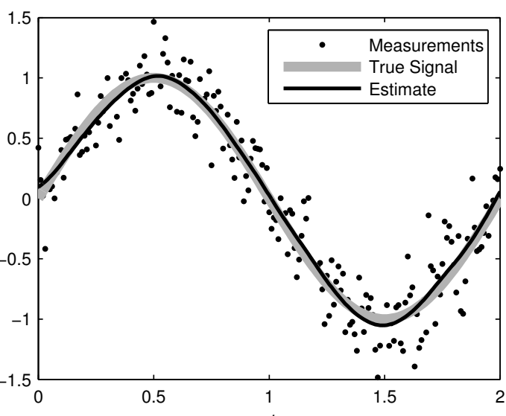
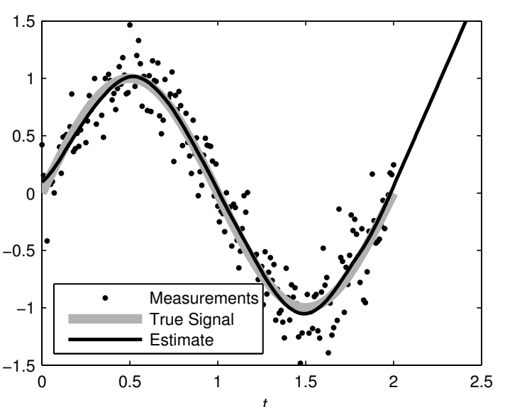
Example-Linear Regression – stat space model with constant speed
Smoother (ch.8)
Predictor

