Slide 1
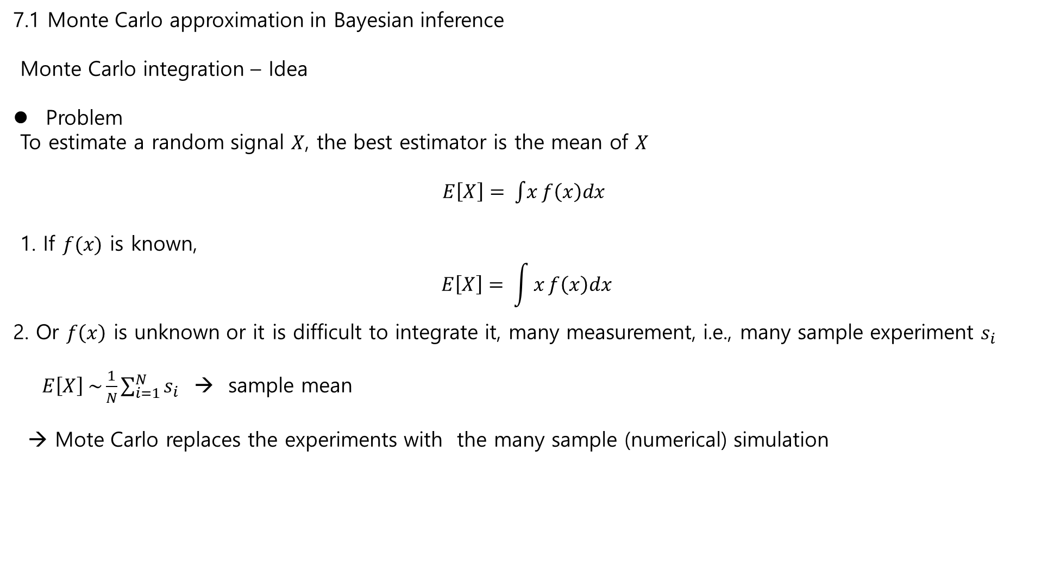
7.1 Monte Carlo approximation in Bayesian inference
Monte Carlo integration – Idea
Problem
To estimate a random signal $X$, the best estimator is the mean of $X$
$E\left[X\right]= \int{x}f\left(x\right)dx$
1. If $f(x)$ is known,
$$E\left[X\right]= \int{x}f\left(x\right)dx$$
2. Or $f\left(x\right)$ is unknown or it is difficult to integrate it, many measurement, i.e., many sample experiment $s_{i}$
$E\left[X\right] \sim \frac{1}{N}\sum_{i=1}^{N}{s_{i}}$ → sample mean
→ Mote Carlo replaces the experiments with the many sample (numerical) simulation

Slide 2

7.1 Monte Carlo approximation in Bayesian inference
Monte Carlo integration
Idea :
$I=\int_{0}^{1}{x^{2}dx}$
1. direct calculation
2. By Definition
$$\int_{0}^{1}{x^{2} dx} = \lim_{N→∞}{\sum_{i=1}^{N}{x_{i}^{2} (x_{i+1} −x_{i})} , 0≤x_{1}<x_{2},…<x_{N}=1}$$
$= \lim_{N→∞}{\frac{1}{N}}\sum_{i=1}^{N}{x_{i}^{2}}$.
3. Monte Carlo Method
Generate $N$ R.V, $s_{i}$with uniform distribution $[0, 1]$ and so that
$I= \int_{0}^{1}{x^{2}dx \sim \frac{1}{N} \sum_{i=1}^{N}{s_{i}^{2}} }$
Ex. N= 2; $I_{M}= {\frac{1}{2}(\left(\frac{1}{3}\right)}^{2}+{\left(\frac{2}{3}\right)}^{2})=0.277$
$=\frac{1}{4}\left({0.2}^{2}+{0.4}^{2}+{0.6}^{2}+{0.8}^{2}\right)=0.3$

Slide 3
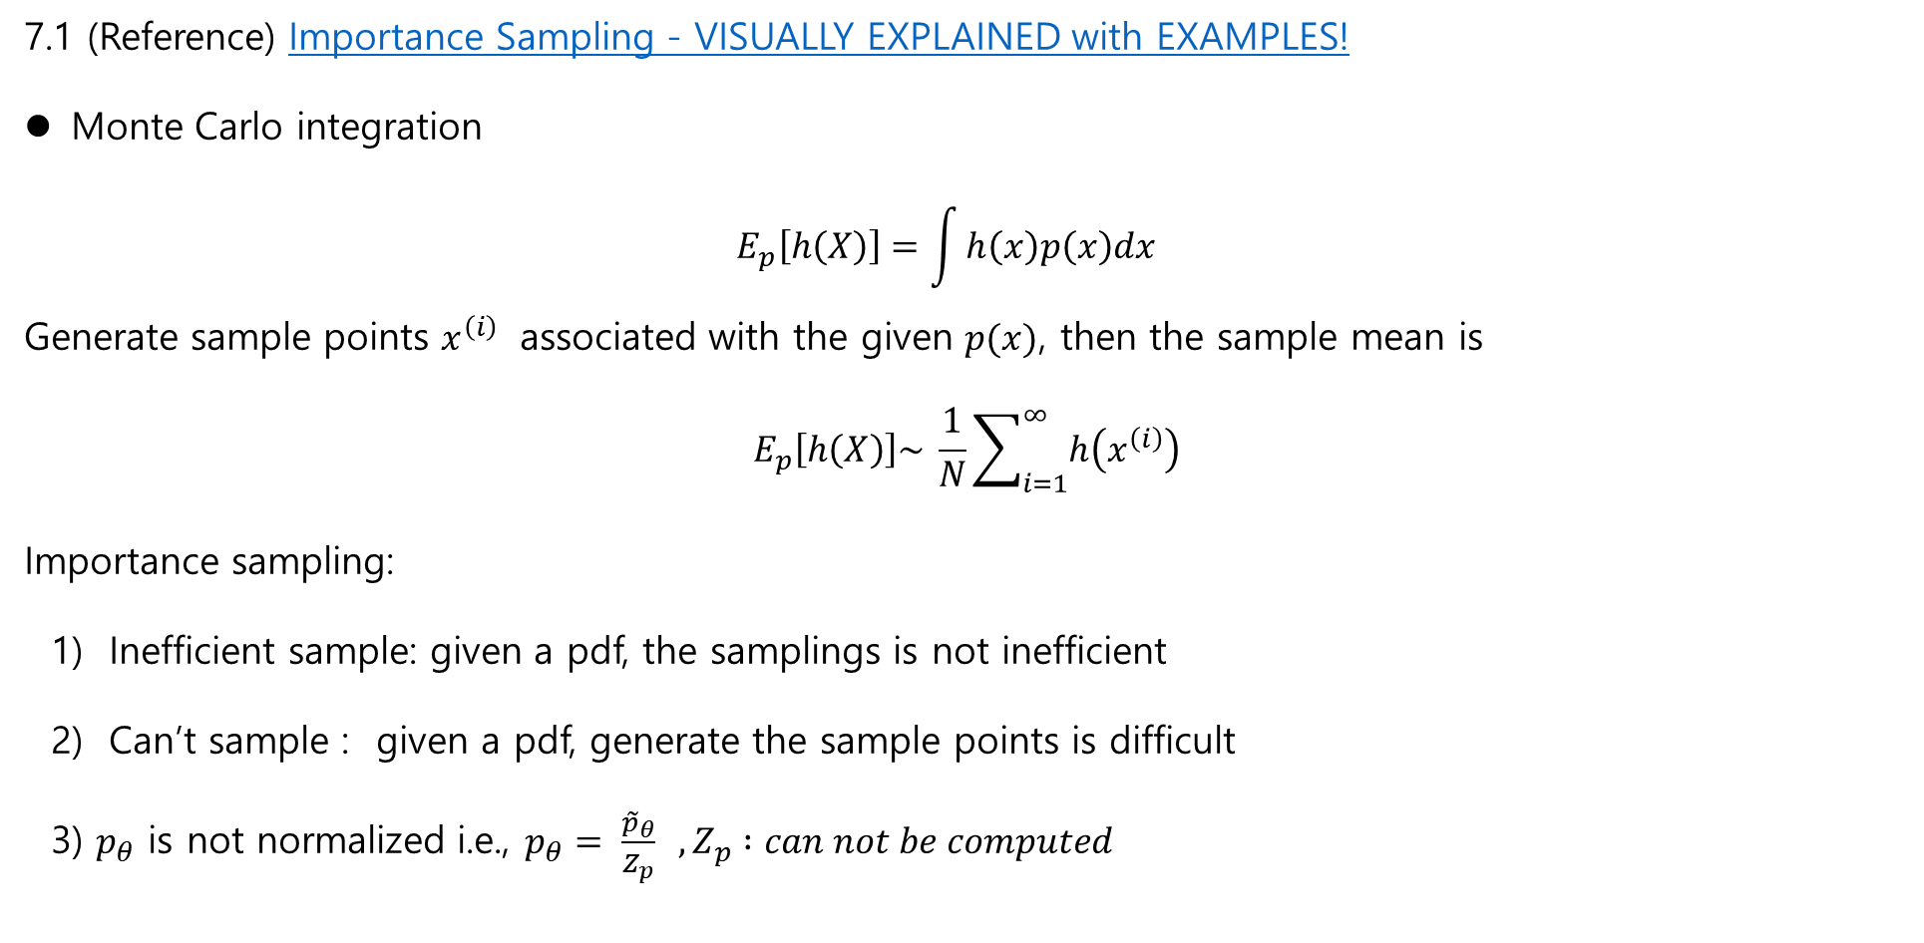
7.1 (Reference) Importance Sampling - VISUALLY EXPLAINED with EXAMPLES!
Monte Carlo integration
$$E_{p}\left[h\left(X\right)\right]=\int{h\left(x\right)p\left(x\right)dx }$$
Generate sample points $x^{\left(i\right)}$ associated with the given $p(x)$, then the sample mean is
$$E_{p}\left[h\left(X\right)\right]\sim \frac{1}{N}\sum_{i=1}^{∞}{h\left(x^{\left(i\right)}\right)}$$
Importance sampling:
1) Inefficient sample: given a pdf, the samplings is not inefficient
2) Can’t sample : given a pdf, generate the sample points is difficult
3) $p_{θ}$ is not normalized i.e., $p_{θ}= \frac{{\tilde{p}}_{θ}}{Z_{p}} , Z_{p} :can not be computed$

Slide 4
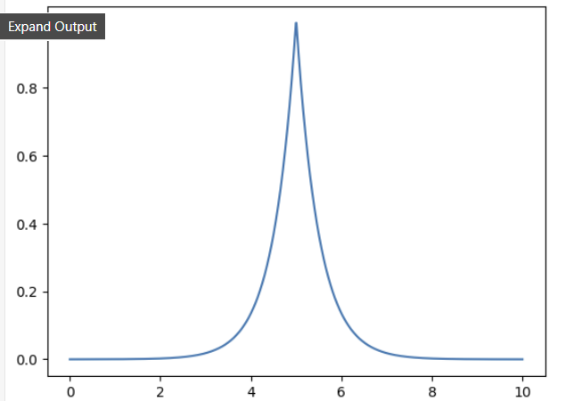
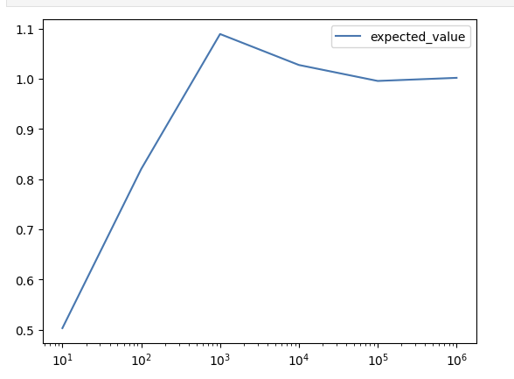
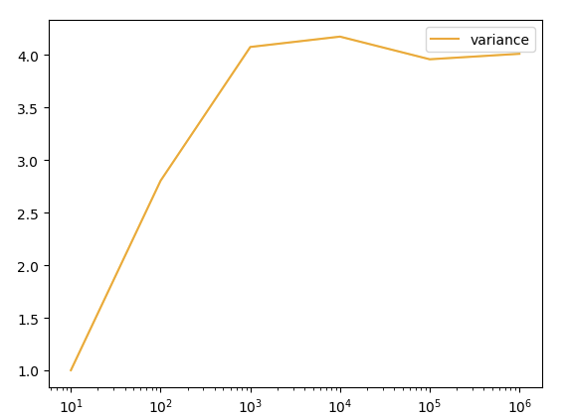

7.1 (Reference) Importance Sampling - VISUALLY EXPLAINED with EXAMPLES!
Example
$$I\left(x\right)= \int_{0}^{10}{e^{−2\left|x−5\right|}dx=1−\frac{1}{e^{10}} \sim 0.99}$$
Select a uniform pdf
$p\left(x\right)=\frac{1}{10}x\sim U(0,10)$,
$$I\left(x\right)= \int_{0}^{10}{e^{−2\left|x−5\right|}dx=10\int_{0}^{10}{e^{−2\left|x−5\right|}\left(\frac{1}{10}\right)dx \sim \frac{10}{N }\sum_{i=1}^{N}{h\left(x_{i}\right) , x_{i} \sim U(0,10)} }}$$

Slide 5
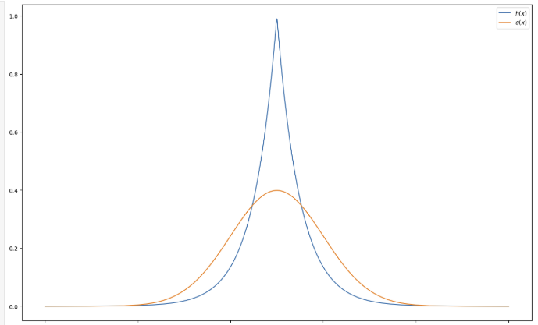
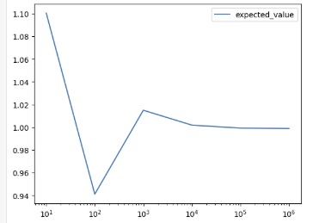
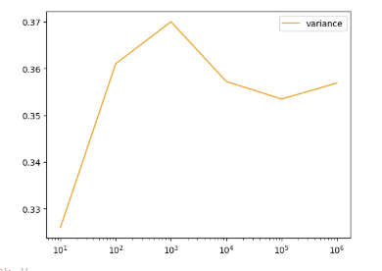

7.1 (Reference)
2) Select a proper pdf $q_{θ}$ as a gaussian
$q\left(x\right)=\frac{1}{\sqrt{2π}}e^{−\left(\frac{{\left(x−5\right)}^{2}}{2}\right)}, x\sim N\left(5,1\right)$
Then
$I\left(x\right)= \int_{0}^{10}{e^{−2\left|x−5\right|}dx=10\int_{0}^{10}{e^{−2\left|x−5\right|}p\left(x\right)dx}}$,
$=10$ $\int_{0}^{10}{e^{−2\left|x−5\right|}\left(\frac{p\left(x\right)}{q\left(x\right)}\right)q\left(x\right)dx}$
Using Monte Carlo , $x\sim N\left(5,1\right)$
$\sim 10 \sum_{i=1}^{N }{e^{−2\left|x^{\left(i\right)}−5\right|}\left(\frac{p\left(x^{\left(i\right)}\right)}{q\left(x^{\left(i\right)}\right)}\right)}$.
%% $q(x)$: importance
distribution
Importance region

Slide 6
7.1 Reference
Uniform sampling
Importance distribution
(Gaussian)
See the variance

Slide 7

7.1 Monte Carlo approximation in Bayesian inference
Problem:
$E_{p}\left[g\left(x\right) | y_{1:T}\right]= \int{g\left(x\right)p\left(x | y_{1:T}\right)dx }$
1. direct calculation
2. Monte Carlo Method
Generate $N$ R.V, $x^{\left(i\right)}\sim p\left(x | y_{1:T}\right)$
$E_{p}\left[g\left(x\right) | y_{1:T}\right] \sim \frac{1}{N}\sum_{i=1}^{i=N}{g(x^{(i)})}$
One of problems
how to generate sample points $x^{\left(i\right)}$ associated with $p\left(x | y_{1:T}\right)$

Slide 8
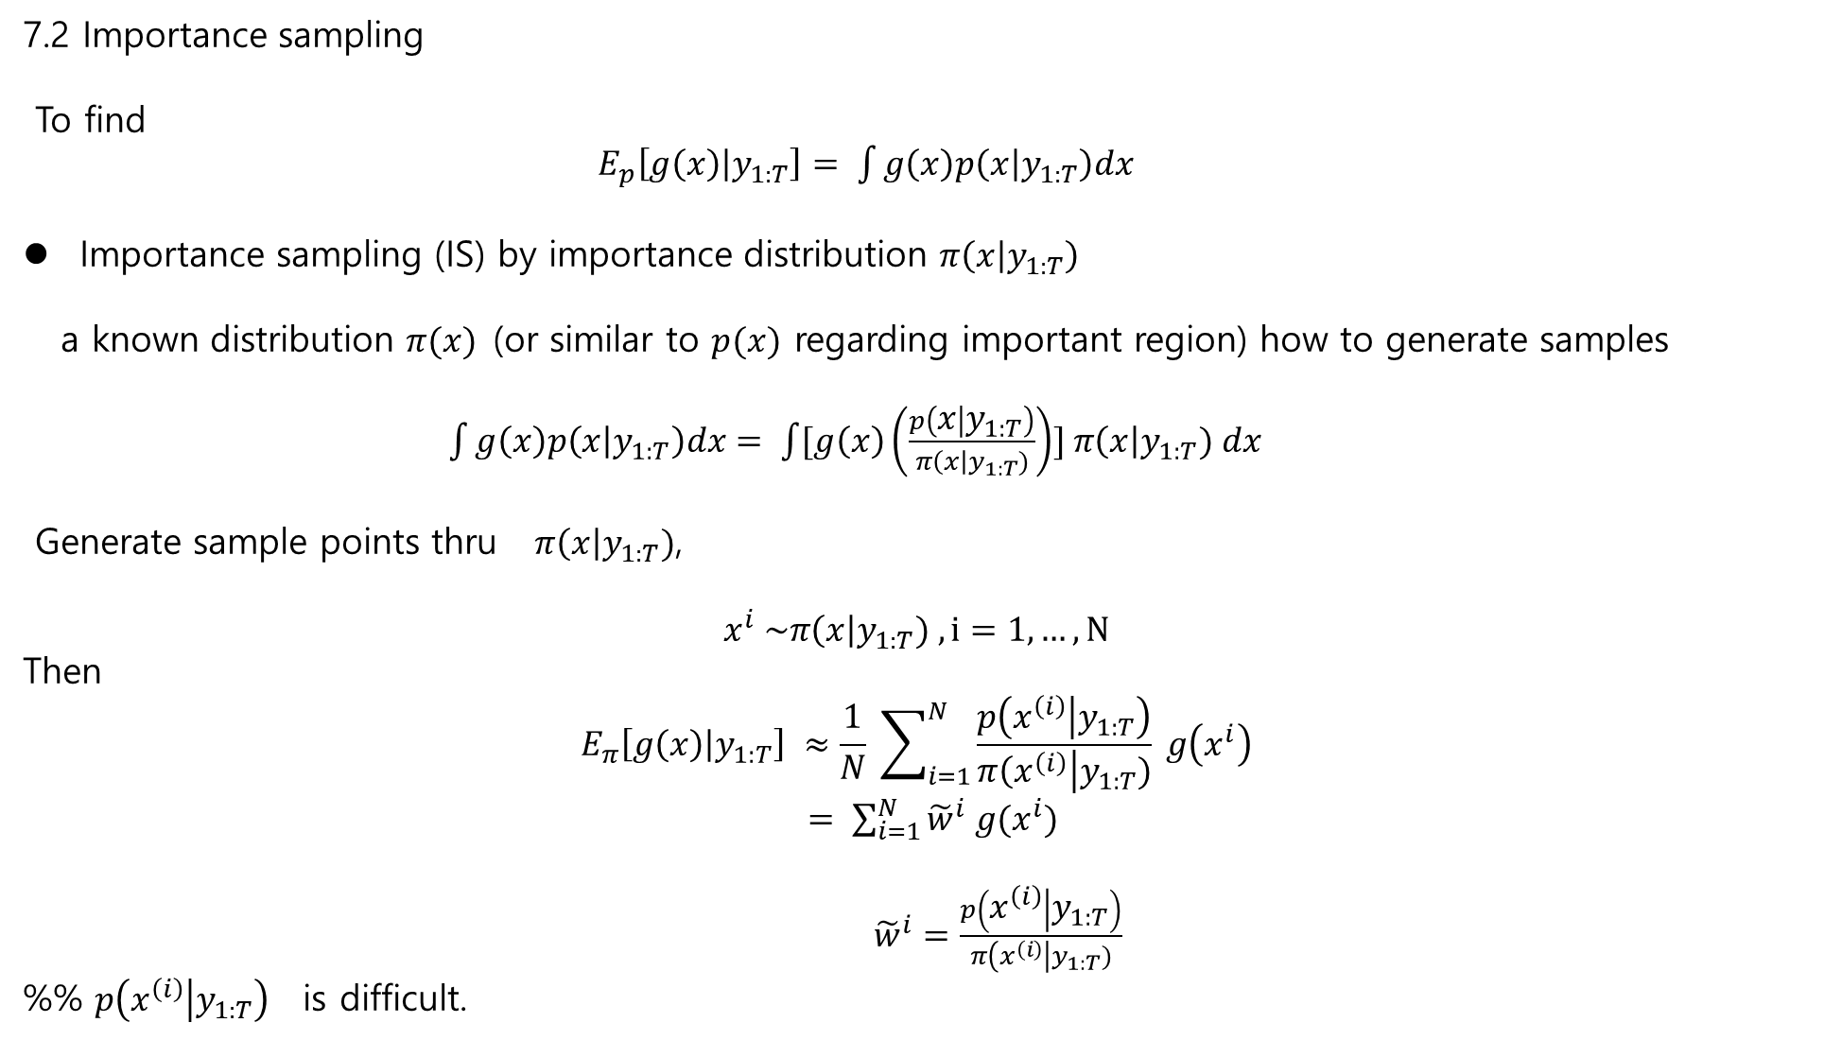
7.2 Importance sampling
To find
$E_{p}\left[g\left(x\right) | y_{1:T}\right]= \int{g\left(x\right)p\left(x | y_{1:T}\right)dx}$
Importance sampling (IS) by importance distribution $π\left(x | y_{1:T}\right)$
a known distribution $π(x)$(or similar to $p(x)$ regarding important region) how to generate samples
$\int{g\left(x\right)p\left(x | y_{1:T}\right)dx}= \int{[g\left(x\right)\left(\frac{p\left(x | y_{1:T}\right)}{π\left(x\right|y_{1:T})}\right)}] π\left(x\right|y_{1:T}) dx$
Generate sample points thru $π\left(x\right|y_{1:T})$,
$$x^{i} \sim π\left(x\right|y_{1:T}) , i=1,…,N$$
Then
$$E_{π}\left[g\left(x\right) | y_{1:T}\right] ≈\frac{1}{N} \sum_{i=1}^{N}{\frac{p\left(x^{\left(i\right)} | y_{1:T}\right)}{π\left(x^{\left(i\right)}\right|y_{1:T})}} g\left(x^{i}\right)$$
$= \sum_{i=1}^{N}{{\tilde{w}}^{i} g(x^{i})}$
${\tilde{w}}^{i}=\frac{p\left(x^{\left(i\right)} | y_{1:T}\right)}{π\left(x^{\left(i\right)}\right|y_{1:T})}$
%% $p\left(x^{\left(i\right)} | y_{1:T}\right)$ is difficult.

Slide 9
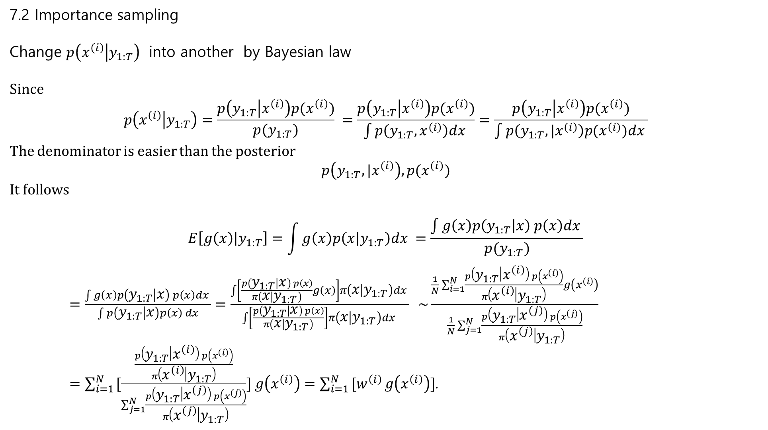
7.2 Importance sampling
Change $p\left(x^{\left(i\right)} | y_{1:T}\right)$ into another by Bayesian law
Since
$$p\left(x^{\left(i\right)} | y_{1:T}\right)=\frac{p\left(y_{1:T} | x^{\left(i\right)}\right)p(x^{\left(i\right)})}{p(y_{1:T})} =\frac{p\left(y_{1:T} | x^{\left(i\right)}\right)p(x^{\left(i\right)})}{\int{p\left(y_{1:T},x^{\left(i\right)}\right)dx }}=\frac{p\left(y_{1:T} | x^{\left(i\right)}\right)p(x^{\left(i\right)})}{\int{p\left(y_{1:T},{|x}^{\left(i\right)}\right)p(x^{\left(i\right)})dx }}$$
The denominator is easier than the posterior
$$p\left(y_{1:T},{|x}^{\left(i\right)}\right),p(x^{\left(i\right)})$$
It follows
$$E\left[g\left(x\right) | y_{1:T}\right]=\int{g\left(x\right)p\left(x | y_{1:T}\right)dx} =\frac{\int{g\left(x\right)p\left(y_{1:T} | x\right) p\left(x\right)dx }}{p(y_{1:T})}$$
$=\frac{\int{g\left(x\right)p\left(y_{1:T} | x\right) p\left(x\right)dx }}{\int{p\left(y_{1:T} | x\right)p\left(x\right) dx}}=\frac{\int{\left[\frac{p\left(y_{1:T} | x\right) p\left(x\right)}{π\left(x | y_{1:T}\right)}g\left(x\right)\right]π\left(x | y_{1:T}\right)dx }}{\int{\left[\frac{p\left(y_{1:T} | x\right) p\left(x\right)}{π\left(x | y_{1:T}\right)}\right]π\left(x | y_{1:T}\right)dx }} \sim \frac{\frac{1}{N}\sum_{i=1}^{N}{\frac{p\left(y_{1:T} | x^{\left(i\right)}\right) p\left(x^{\left(i\right)}\right)}{π\left(x^{\left(i\right)} | y_{1:T}\right)}g\left(x^{\left(i\right)}\right)}}{\frac{1}{N}\sum_{j=1}^{N}{\frac{p\left(y_{1:T} | x^{\left(j\right)}\right) p\left(x^{\left(j\right)}\right)}{π\left(x^{\left(j\right)} | y_{1:T}\right)}}}$
$=\sum_{i=1 }^{N}{[\frac{\frac{p\left(y_{1:T} | x^{\left(i\right)}\right) p\left(x^{\left(i\right)}\right)}{π\left(x^{\left(i\right)} | y_{1:T}\right)}}{\sum_{j=1}^{N}{\frac{p\left(y_{1:T} | x^{\left(j\right)}\right) p\left(x^{\left(j\right)}\right)}{π\left(x^{\left(j\right)} | y_{1:T}\right)}}}}] g\left(x^{\left(i\right)}\right)=\sum_{i=1 }^{N}{[w^{\left(i\right)}}g\left(x^{\left(i\right)}\right)]$.

Slide 10
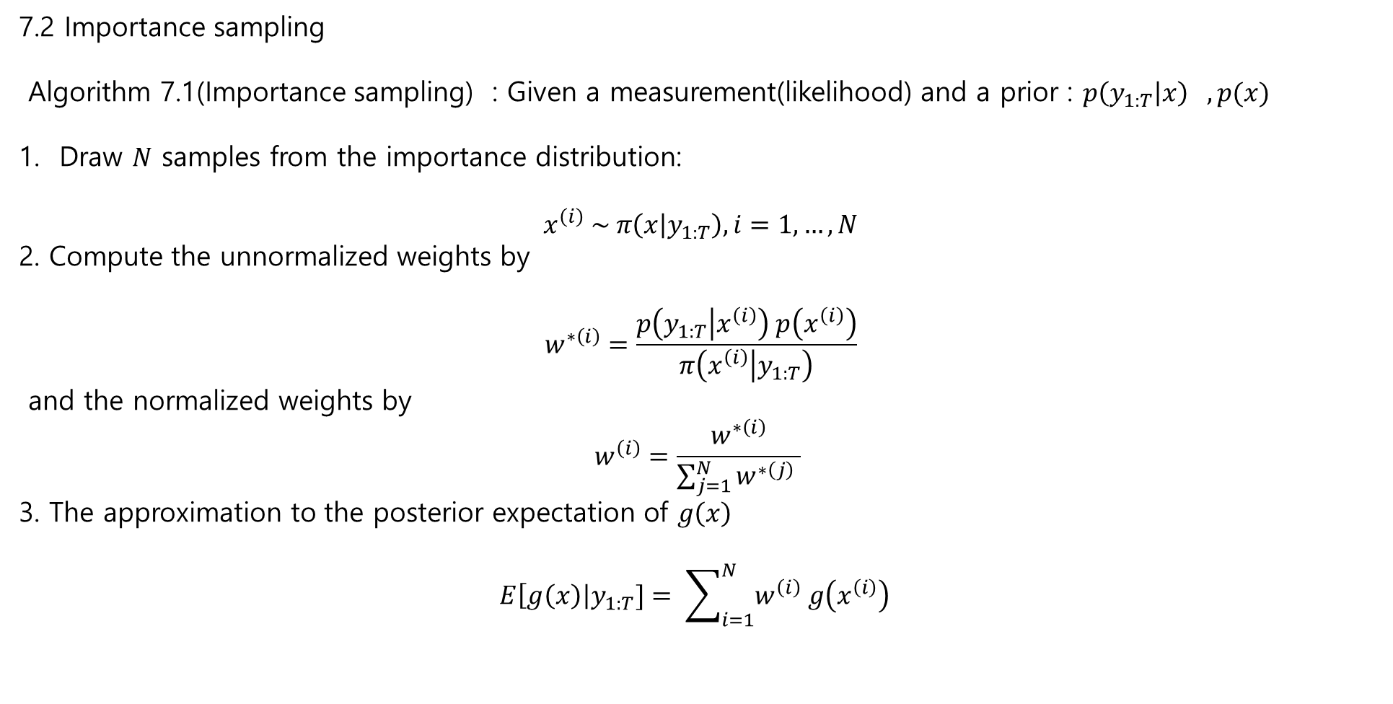
7.2 Importance sampling
Algorithm 7.1(Importance sampling) : Given a measurement(likelihood) and a prior : $p\left(y_{1:T} | x\right) , p(x)$
Draw $N$ samples from the importance distribution:
$$x^{\left(i\right)} \sim π\left(x | y_{1:T}\right), i=1,…,N$$
2. Compute the unnormalized weights by
$$w^{∗\left(i\right)}=\frac{p\left(y_{1:T} | x^{\left(i\right)}\right) p\left(x^{\left(i\right)}\right)}{π\left(x^{\left(i\right)} | y_{1:T}\right)}$$
and the normalized weights by
$$w^{\left(i\right)}=\frac{w^{∗\left(i\right)}}{\sum_{j=1}^{N}{w^{∗\left(j\right)} }}$$
3. The approximation to the posterior expectation of $g\left(x\right)$
$$E\left[g\left(x\right)\right|y_{1:T}]= \sum_{i=1}^{N}{w^{\left(i\right)} g\left(x^{\left(i\right)}\right) }$$

Slide 11
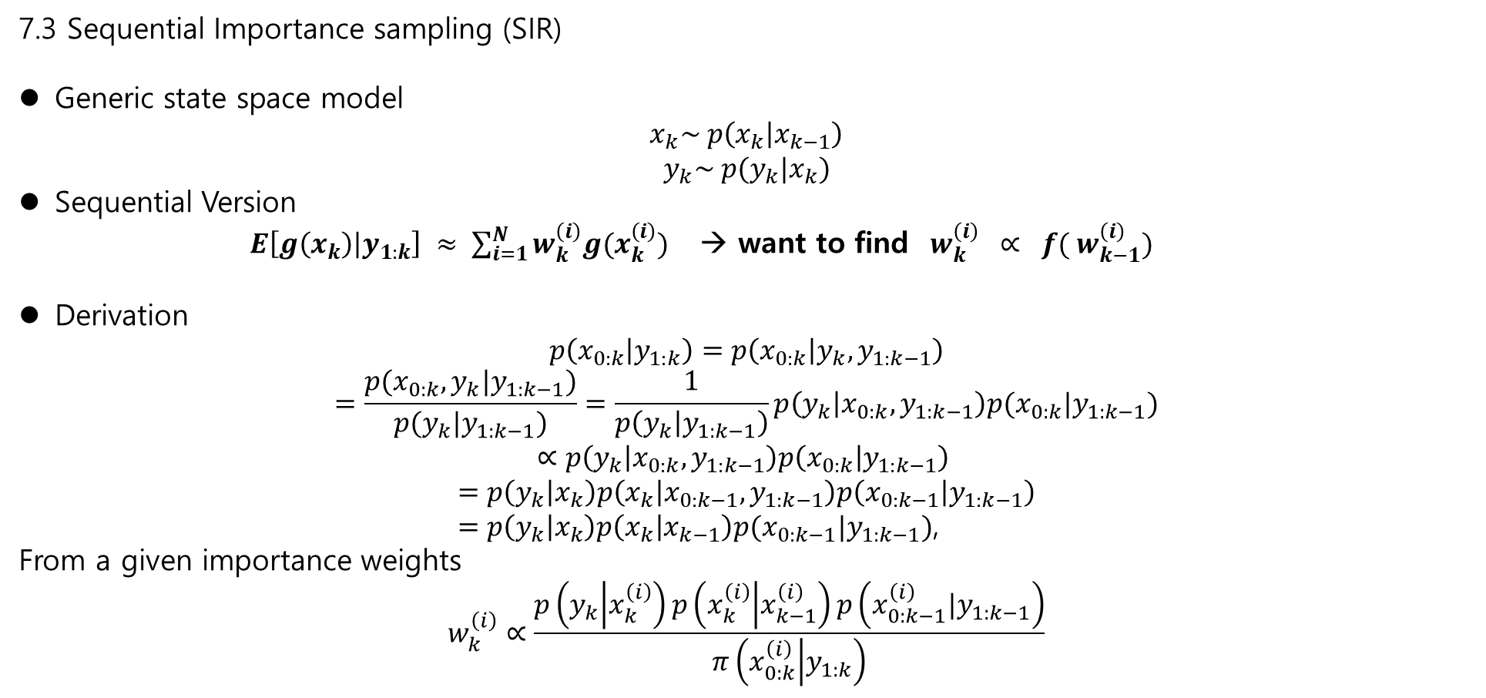
7.3 Sequential Importance sampling (SIR)
Generic state space model
$$x_{k}\sim p\left(x_{k} | x_{k−1}\right)$$
$$y_{k}\sim p(y_{k}|x_{k})$$
Sequential Version
$E\left[g\left(x_{k}\right) | y_{1:k}\right] ≈ \sum_{i=1}^{N}{w_{k}^{\left(i\right)}g(x_{k}^{\left(i\right)})}$ → want to find $w_{k}^{\left(i\right)} ∝ {f( w}_{k−1}^{\left(i\right)})$
Derivation
$$p\left(x_{0:k} | y_{1:k}\right)=p\left(x_{0:k} | y_{k}, y_{1:k−1}\right)$$
$$=\frac{p(x_{0:k}, y_{k}|y_{1:k−1})}{p(y_{k}|y_{1:k−1})}=\frac{1}{p\left(y_{k} | y_{1:k−1}\right)}p\left(y_{k} | x_{0:k}, y_{1:k−1}\right)p(x_{0:k}|y_{1:k−1})$$
$$∝p\left(y_{k} | x_{0:k}, y_{1:k−1}\right)p\left(x_{0:k} | y_{1:k−1}\right)$$
$$=p\left(y_{k} | x_{k}\right)p\left(x_{k} | x_{0:k−1}, y_{1:k−1}\right)p\left(x_{0:k−1} | y_{1:k−1}\right)$$
$=p\left(y_{k} | x_{k}\right)p\left(x_{k} | x_{k−1}\right)p(x_{0:k−1}|y_{1:k−1})$,
From a given importance weights
$$w_{k}^{\left(i\right)}∝\frac{p\left(y_{k} | x_{k}^{\left(i\right)}\right)p\left(x_{k}^{\left(i\right)} | x_{k−1}^{\left(i\right)}\right)p\left(x_{0:k−1}^{\left(i\right)}|y_{1:k−1}\right)}{π\left(x_{0:k}^{\left(i\right)} | y_{1:k}\right)}$$

Slide 12
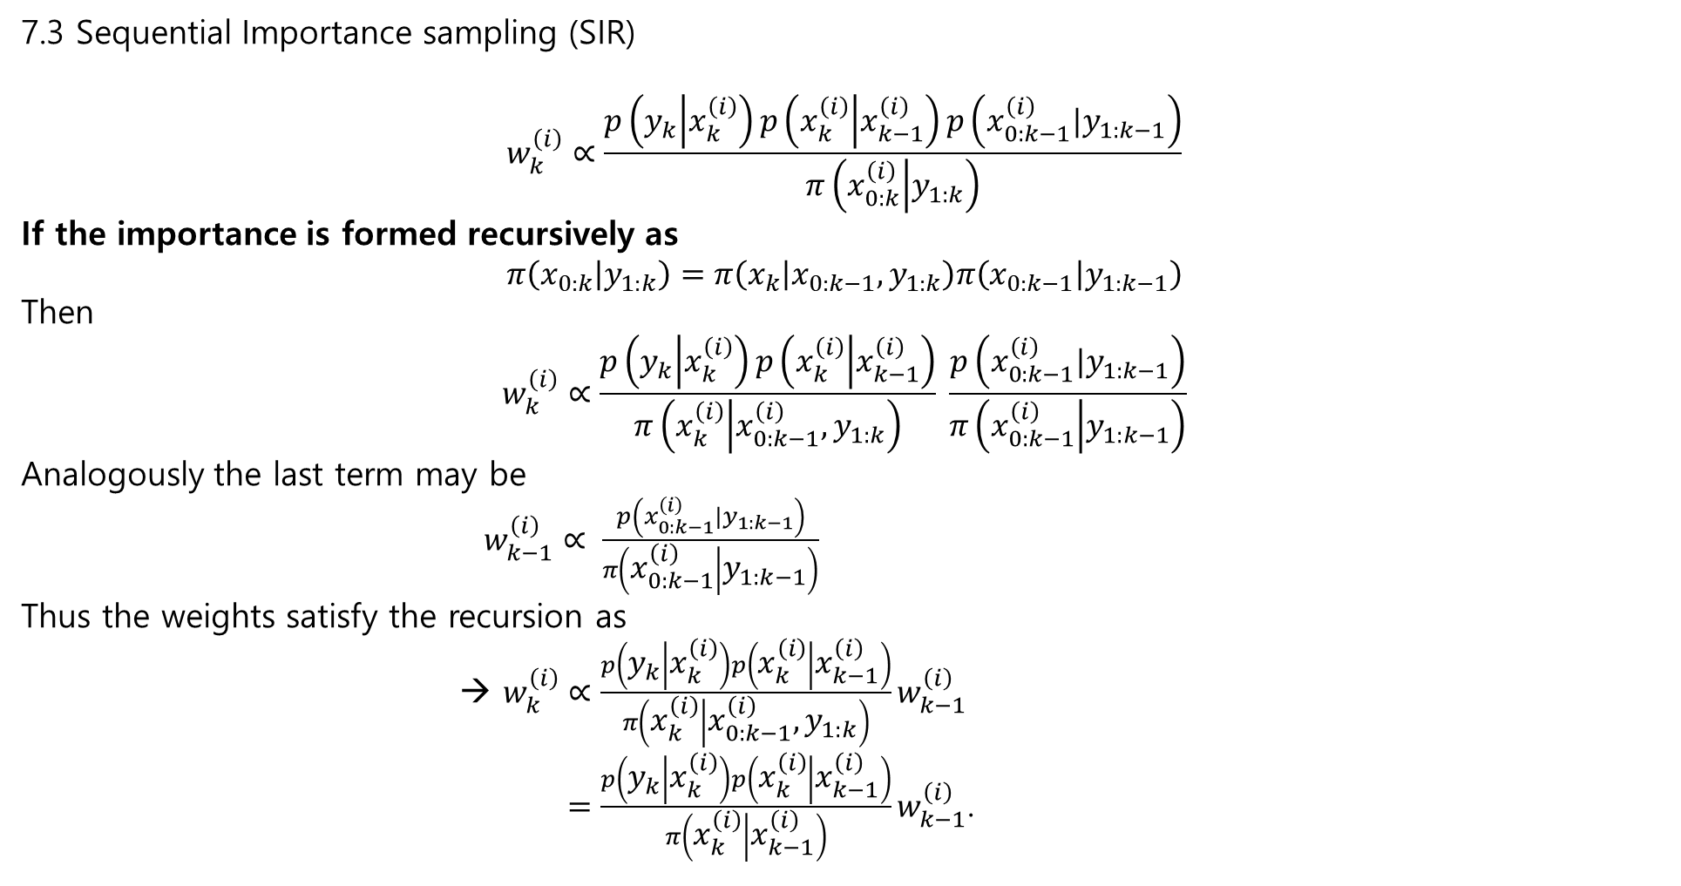
7.3 Sequential Importance sampling (SIR)
$$w_{k}^{\left(i\right)}∝\frac{p\left(y_{k} | x_{k}^{\left(i\right)}\right)p\left(x_{k}^{\left(i\right)} | x_{k−1}^{\left(i\right)}\right)p\left(x_{0:k−1}^{\left(i\right)}|y_{1:k−1}\right)}{π\left(x_{0:k}^{\left(i\right)} | y_{1:k}\right)}$$
If the importance is formed recursively as
$$π\left(x_{0:k} | y_{1:k}\right)=π\left(x_{k} | {x_{0:k−1},y}_{1:k}\right)π\left(x_{0:k−1} | y_{1:k−1}\right)$$
Then
$$w_{k}^{\left(i\right)}∝\frac{p\left(y_{k} | x_{k}^{\left(i\right)}\right)p\left(x_{k}^{\left(i\right)} | x_{k−1}^{\left(i\right)}\right)}{π\left(x_{k}^{\left(i\right)} | {x_{0:k−1}^{\left(i\right)},y}_{1:k}\right)} \frac{p\left(x_{0:k−1}^{\left(i\right)}|y_{1:k−1}\right)}{π\left(x_{0:k−1}^{\left(i\right)} | y_{1:k−1}\right)}$$
Analogously the last term may be
$w_{k−1}^{\left(i\right)}∝ \frac{p\left(x_{0:k−1}^{\left(i\right)}|y_{1:k−1}\right)}{π\left(x_{0:k−1}^{\left(i\right)} | y_{1:k−1}\right)}$
Thus the weights satisfy the recursion as
→ $w_{k}^{\left(i\right)}∝\frac{p\left(y_{k} | x_{k}^{\left(i\right)}\right)p\left(x_{k}^{\left(i\right)} | x_{k−1}^{\left(i\right)}\right)}{π\left(x_{k}^{\left(i\right)} | {x_{0:k−1}^{\left(i\right)},y}_{1:k}\right)}w_{k−1}^{\left(i\right)}$
$=\frac{p\left(y_{k} | x_{k}^{\left(i\right)}\right)p\left(x_{k}^{\left(i\right)} | x_{k−1}^{\left(i\right)}\right)}{π\left(x_{k}^{\left(i\right)} | x_{k−1}^{\left(i\right)}\right)}w_{k−1}^{\left(i\right)}$.

Slide 13
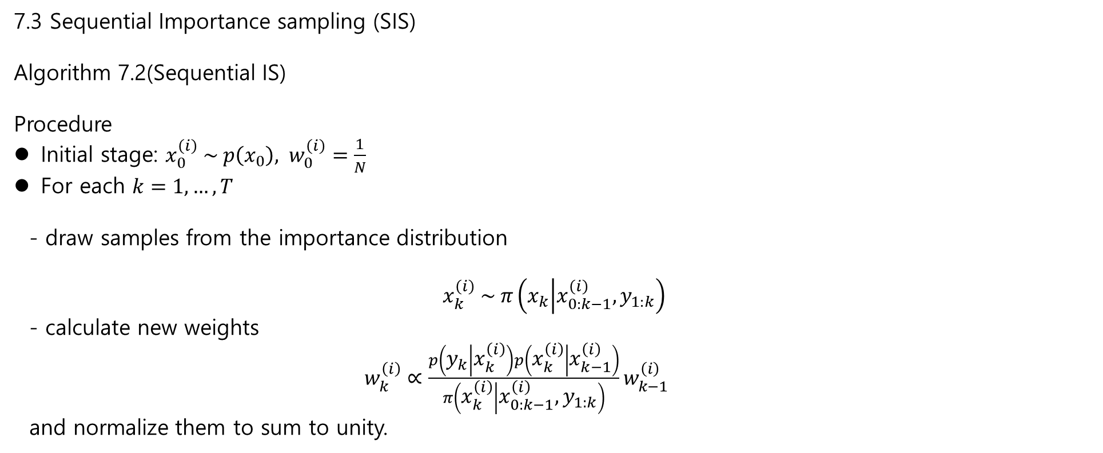
7.3 Sequential Importance sampling (SIS)
Algorithm 7.2(Sequential IS)
Procedure
Initial stage: $x_{0}^{\left(i\right)} \sim p\left(x_{0}\right), w_{0}^{\left(i\right)}=\frac{1}{N}$
For each $k=1,…,T$
- draw samples from the importance distribution
$$x_{k}^{\left(i\right)} \sim π\left(x_{k} | x_{0:k−1}^{\left(i\right)}, y_{1:k}\right)$$
- calculate new weights
$w_{k}^{\left(i\right)}∝\frac{p\left(y_{k} | x_{k}^{\left(i\right)}\right)p\left(x_{k}^{\left(i\right)} | x_{k−1}^{\left(i\right)}\right)}{π\left(x_{k}^{\left(i\right)} | {x_{0:k−1}^{\left(i\right)},y}_{1:k}\right)}w_{k−1}^{\left(i\right)}$
and normalize them to sum to unity.

Slide 14
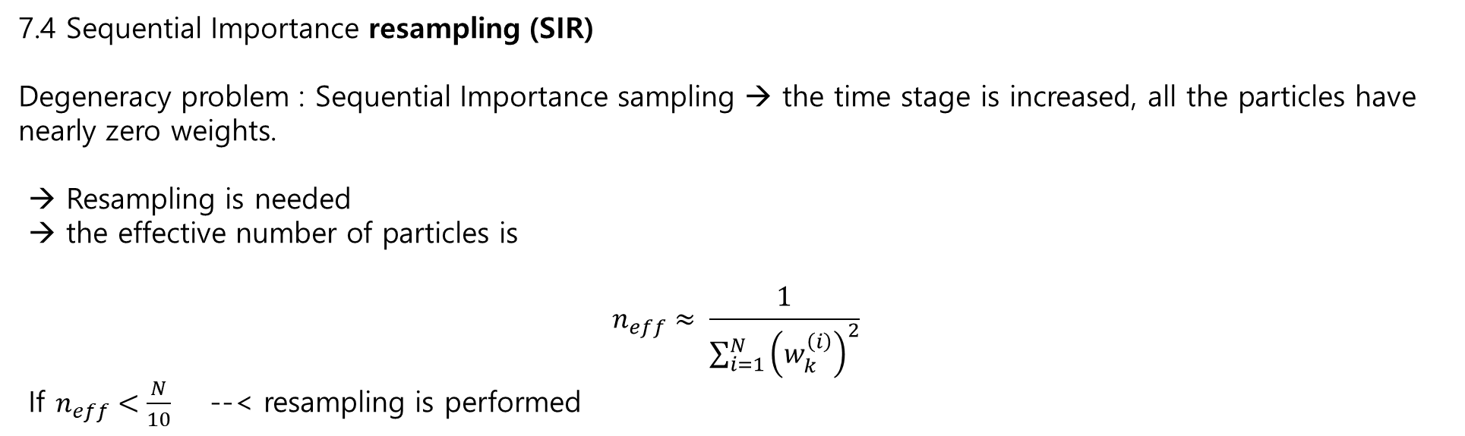
7.4 Sequential Importance resampling (SIR)
Degeneracy problem : Sequential Importance sampling → the time stage is increased, all the particles have nearly zero weights.
→ Resampling is needed
→ the effective number of particles is
$$n_{eff}≈ \frac{1}{\sum_{i=1}^{N}{{\left(w_{k}^{\left(i\right)}\right)}^{2}}}$$
If $n_{eff}<\frac{N}{10}$ --< resampling is performed

Slide 15
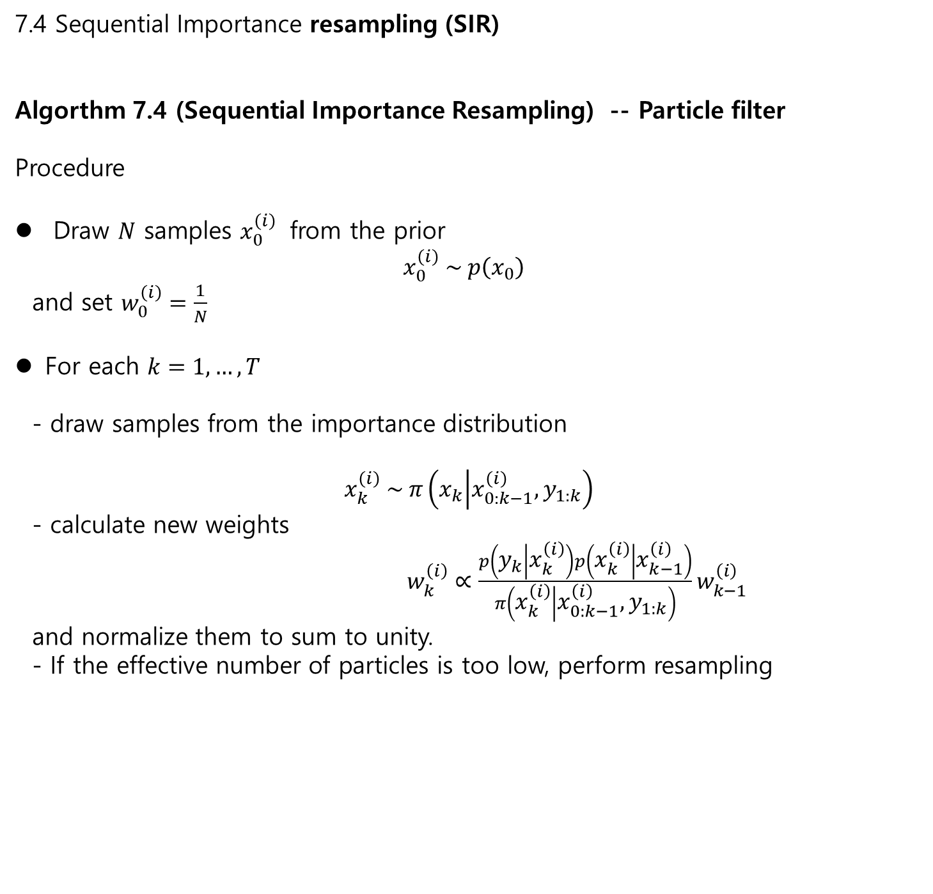
7.4 Sequential Importance resampling (SIR)
Algorthm 7.4 (Sequential Importance Resampling) -- Particle filter
Procedure
Draw $N$ samples $x_{0}^{\left(i\right)}$ from the prior
$$x_{0}^{\left(i\right)} \sim p\left(x_{0}\right)$$
and set $w_{0}^{\left(i\right)}=\frac{1}{N}$
For each $k=1,…,T$
- draw samples from the importance distribution
$$x_{k}^{\left(i\right)} \sim π\left(x_{k} | x_{0:k−1}^{\left(i\right)}, y_{1:k}\right)$$
- calculate new weights
$w_{k}^{\left(i\right)}∝\frac{p\left(y_{k} | x_{k}^{\left(i\right)}\right)p\left(x_{k}^{\left(i\right)} | x_{k−1}^{\left(i\right)}\right)}{π\left(x_{k}^{\left(i\right)} | {x_{0:k−1}^{\left(i\right)},y}_{1:k}\right)}w_{k−1}^{\left(i\right)}$
and normalize them to sum to unity.
- If the effective number of particles is too low, perform resampling

Slide 16
7.4 Sequential Importance resampling (SIR)
Algorthm 7.4 (Sequential Importance Resampling) -- Particle filter
Procedure
Draw $N$ samples $x_{0}^{\left(i\right)}$ from the prior
$$x_{0}^{\left(i\right)} \sim p\left(x_{0}\right)$$
and set $w_{0}^{\left(i\right)}=\frac{1}{N}$
For each $k=1,…,T$
- draw samples from the importance distribution
$$x_{k}^{\left(i\right)} \sim π\left(x_{k} | x_{0:k−1}^{\left(i\right)}, y_{1:k}\right)$$
- calculate new weights
$w_{k}^{\left(i\right)}∝\frac{p\left(y_{k} | x_{k}^{\left(i\right)}\right)p\left(x_{k}^{\left(i\right)} | x_{k−1}^{\left(i\right)}\right)}{π\left(x_{k}^{\left(i\right)} | {x_{0:k−1}^{\left(i\right)},y}_{1:k}\right)}w_{k−1}^{\left(i\right)}$
and normalize them to sum to unity.
- If the effective number of particles is too low, perform resampling

Slide 17
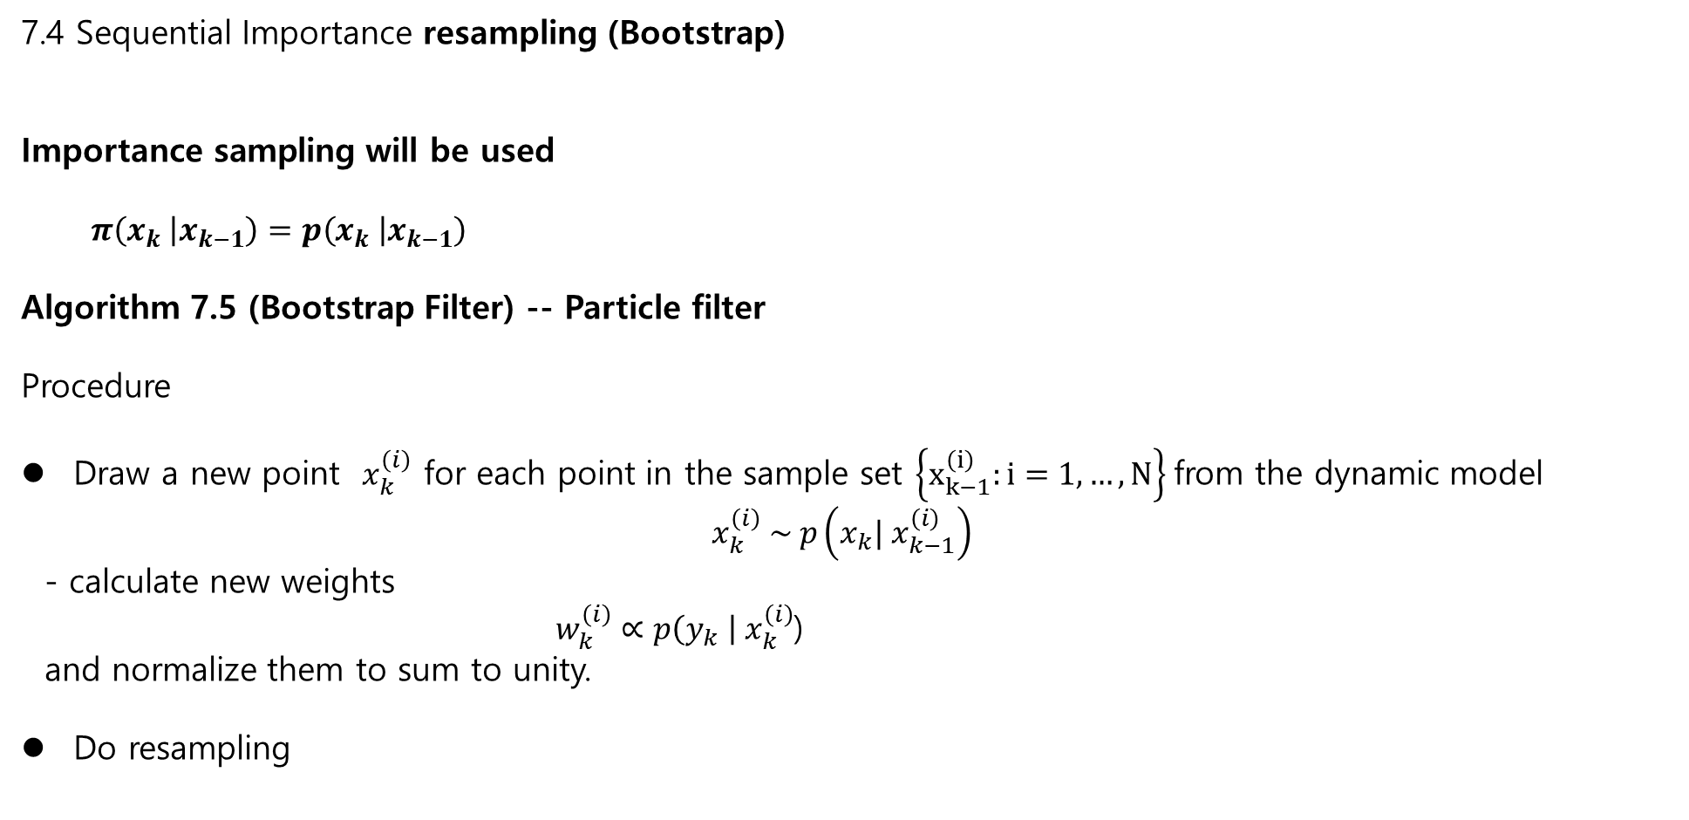
7.4 Sequential Importance resampling (Bootstrap)
Importance sampling will be used
$π\left(x_{k} | x_{k−1}\right)=p\left(x_{k} | x_{k−1}\right)$
Algorithm 7.5 (Bootstrap Filter) -- Particle filter
Procedure
Draw a new point $x_{k}^{\left(i\right)}$ for each point in the sample set $\left\{x_{k−1}^{\left(i\right)}:i=1,…, N\right\}$from the dynamic model
$$x_{k}^{\left(i\right)} \sim p\left(x_{k}| x_{k−1}^{\left(i\right)}\right)$$
- calculate new weights
$w_{k}^{\left(i\right)}∝p\left(y_{k} \right| x_{k}^{\left(i\right)}$)
and normalize them to sum to unity.
Do resampling

