Slide 1
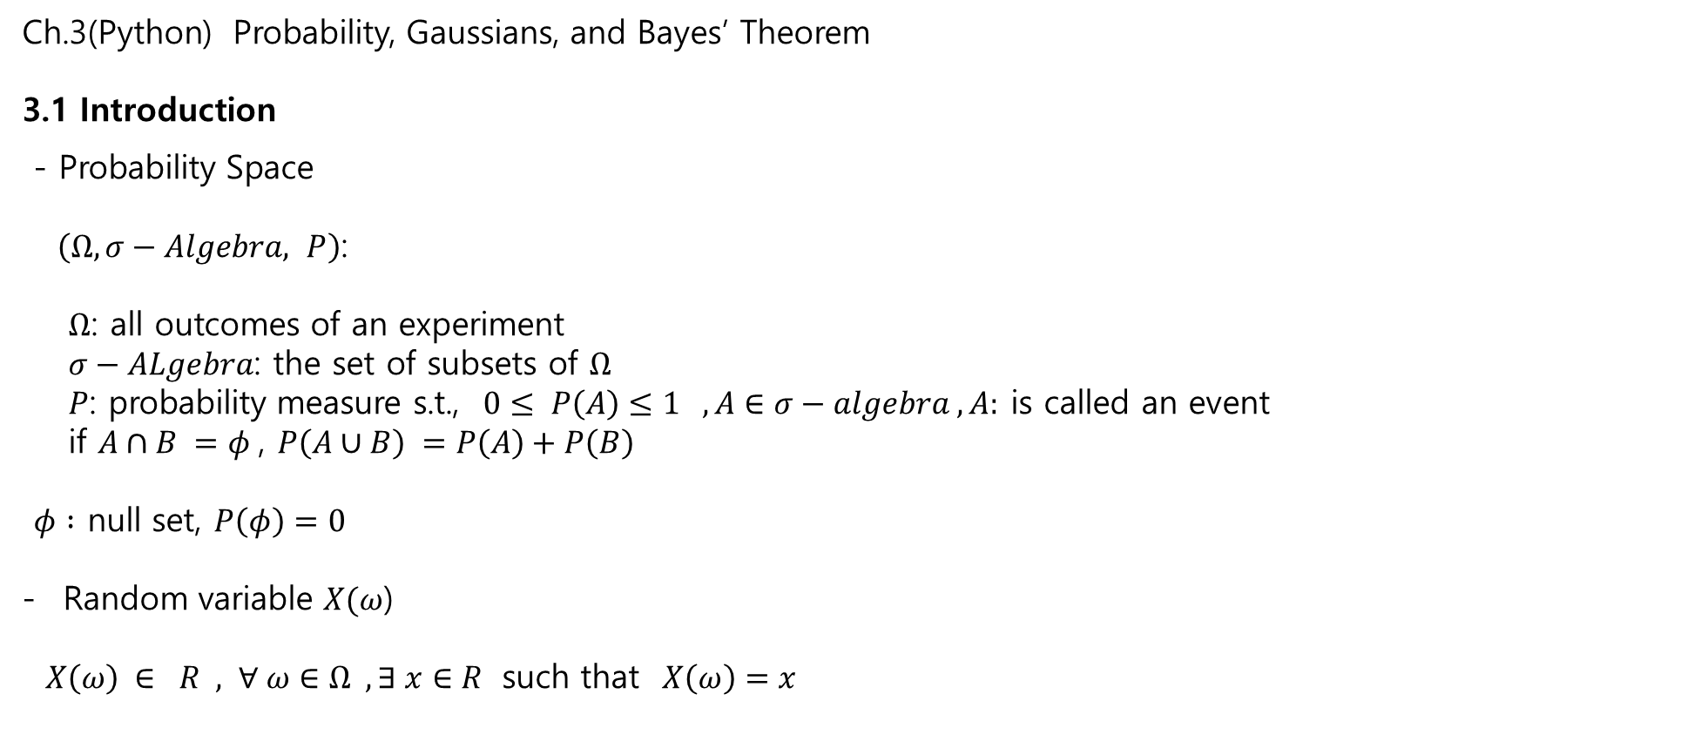
Ch.3(Python) Probability, Gaussians, and Bayes’ Theorem
3.1 Introduction
- Probability Space
$\left(Ω, σ−Algebra, P\right)$:
$Ω$: all outcomes of an experiment
$σ−ALgebra$: the set of subsets of $Ω$
$P$: probability measure s.t., $0≤ P\left(A\right)≤1 , A∈σ−algebra , A:$ is called an event
if $A∩B =φ$, $P\left(A∪B\right) =P\left(A\right)+P\left(B\right)$
$φ :$ null set, $P\left(φ\right)=0$
Random variable $X(ω$)
$X\left(ω\right) ∈ R , ∀ ω∈Ω , ∃ x∈R$ such that $X\left(ω\right)=x$

Slide 2

3.2 Mean, Variance and Standard Deviation
3.2.1Random variables
Random variable $X(ω$)
$∀ ω∈Ω , X\left(ω\right) ∈ R , ∃ x∈R$ such that $X\left(ω\right)=x$
3.3 Probability Distribution
$P(X=x)$ : the probability for $X=x$ in a sample space
1) $\sum{P(x)}=1$ , $\int{P\left(x\right)dx}=1$

Slide 3
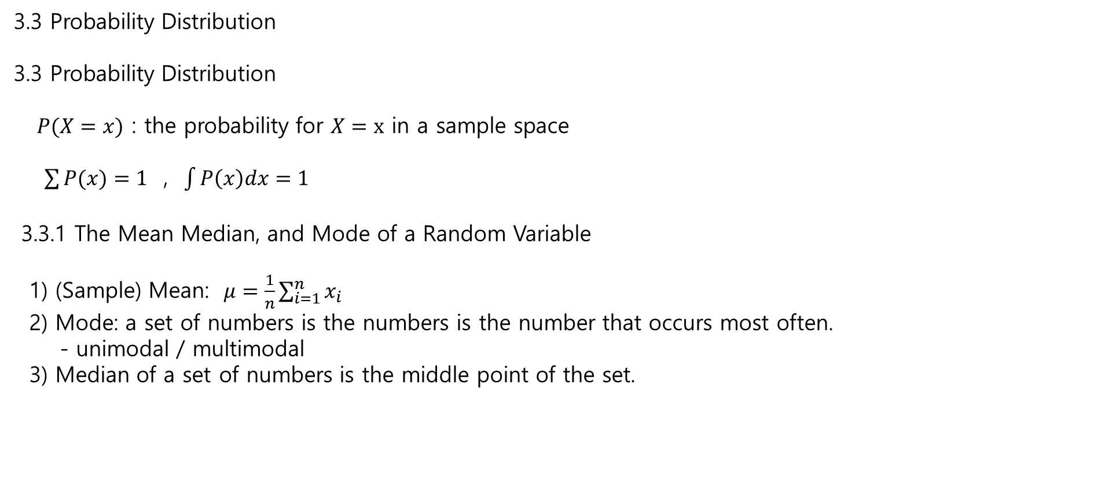
3.3 Probability Distribution
3.3 Probability Distribution
$P(X=x)$ : the probability for $X=x$ in a sample space
$\sum{P(x)}=1$ , $\int{P\left(x\right)dx}=1$
3.3.1 The Mean Median, and Mode of a Random Variable
1) (Sample) Mean: $μ=\frac{1}{n}\sum_{i=1}^{n}{x_{i}}$
2) Mode: a set of numbers is the numbers is the number that occurs most often.
- unimodal / multimodal
3) Median of a set of numbers is the middle point of the set.

Slide 4
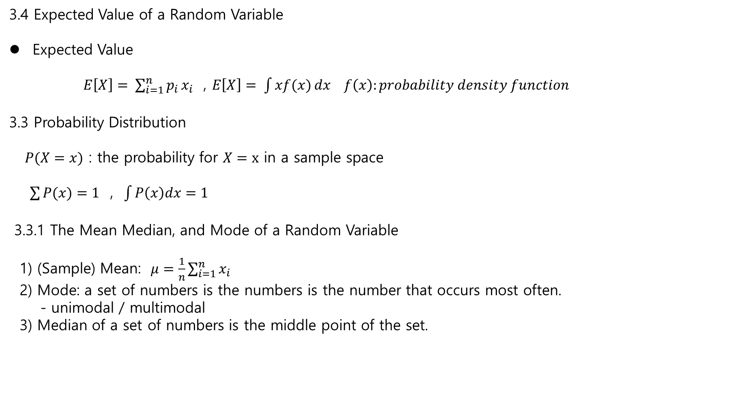
3.4 Expected Value of a Random Variable
Expected Value
$E\left[X\right]= \sum_{i=1}^{n}{p_{i}}x_{i}$ , $E\left[X\right]= \int{xf(x)}dx f\left(x\right):probability density function$
3.3 Probability Distribution
$P(X=x)$ : the probability for $X=x$ in a sample space
$\sum{P(x)}=1$ , $\int{P\left(x\right)dx}=1$
3.3.1 The Mean Median, and Mode of a Random Variable
1) (Sample) Mean: $μ=\frac{1}{n}\sum_{i=1}^{n}{x_{i}}$
2) Mode: a set of numbers is the numbers is the number that occurs most often.
- unimodal / multimodal
3) Median of a set of numbers is the middle point of the set.

Slide 5

3.4 Expected Value of a Random Variable
Expected Value
$E\left[X\right]= \sum_{i=1}^{n}{p_{i}}x_{i}$ , $E\left[X\right]= \int{xf(x)}dx f\left(x\right):probability density function$
%% One interpretation of E[X]
$X$ a random variable. The expectation is the minimum mean square estimator for $X, i.e.,$
$$\min_{a}{E{\left[\left(X−a\right)\right]}^{2}}=E\left(X\right)$$
Proof: $\frac{d}{da}\left(E[{\left(X−a\right)]}^{2}\right)=\frac{d}{da}\left(EX^{2}+a^{2}−2aE\left(X\right)\right)=2a−2E\left(X\right)$
$a=E(X)$, which minimizes the mean square .

Slide 6
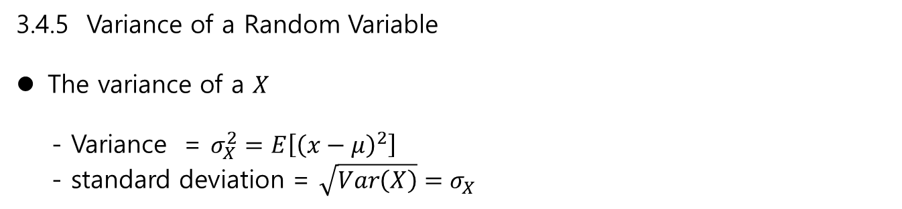
3.4.5 Variance of a Random Variable
The variance of a $X$
- Variance = $σ_{X}^{2}=E\left[{\left(x−μ\right)}^{2}\right]$
- standard deviation = $\sqrt{Var\left(X\right)}=σ_{X}$

Slide 7

3.5 / 3.6 / 3.7 /3.8 /3.9 Gaussians
Prob. Density function
$$f\left(x\right)=\frac{1}{σ\sqrt{2π}}\exp\left(−\frac{{\left(x−μ\right)}^{2}}{2σ^{2}}\right)$$
Prob. Distribution(Cumulative) function
$F\left(x\right)=P\left(X≤x\right) = \int_{−∞}^{x}{f\left(ξ\right)dξ}$
$X\sim N(μ, σ^{2})$
$E\left[X\right] = \int_{−∞}^{∞}{xf\left(x\right)dx} −→μ$
$E\left[{\left(X−μ\right)}^{2}\right]= \int_{−∞}^{∞}{{\left(x−μ\right)}^{2}f(x)}dx −−.>σ^{2}$
%%
$$z=\frac{x−μ}{σ} , dz =1/σ$$
And
$$\int_{−∞}^{∞}{\frac{z^{2}}{\sqrt{2π}}\exp\left(−\frac{z^{2}}{2}\right)dz =1 }$$

Slide 8

3.11 Computational Properties of Gaussian Interactive Gaussians
Independence in Random space
- Two Events A,B are independent if
$P\left(A∩B\right)=P\left(A\right)P\left(B\right)$ ← → $P\left(A | B\right) =\frac{P\left(A∩B\right)}{P\left(B\right)} =P\left(A\right)$ if $P\left(B\right)≠0$
- Two R.V’s are independent if
$f\left(x_{1}, x_{2}\right)=f\left(x_{1}\right)f\left(x_{2}\right)$ or $f\left(x_{1} | x_{2}\right) =f\left(x_{1}\right)$ - EnD -
Sum of two random variables
$Z=X+Y$
$f\left(z\right)= \int_{−∞}^{∞}{f_{X}\left(x\right) f_{Y}\left(z−x\right)}dx$

Slide 9

3.11 Computational Properties of Gaussian Interactive Gaussians
Sum of two independent R.V.s
$X_{1}\sim N\left(μ_{1}, σ_{1}^{2}\right), X_{2} \sim N\left(μ_{2}, σ_{2}^{2}\right)$ and $(X_{1}, X_{2})$ are independent
Define
$Z=X_{1}+X_{2}$,
Then
1) $E\left[Z \right]=μ_{1}+μ_{2}$, $σ_{z}^{2} =σ_{x1}^{2}+σ_{x2}^{2}$
2) $Z$ is a Gaussian R.V.
see Proof ( P.117 Python)
and By Convolution
$f_{Z}\left(z\right) = \int_{−∞}^{∞}{f_{x_{1}}\left(x\right) f_{x_{2}}\left(z−x_{1}\right) dx_{1}}$
and the product of two gaussian pdf is a gaussian

Slide 10

3.11 Computational Properties of Gaussian Interactive Gaussians
Conditional Probability
$X\sim N\left(μ_{x}, σ_{x}^{2}\right) , Z \sim N\left(μ_{z}, σ_{z}^{2}\right)$
The posterior is
$f\left(x | z\right)=\frac{f\left(z | x\right)f\left(x\right)}{f\left(z\right)}$
is a Gaussian prob. Density function with
$E\left[X | z\right]=\frac{σ_{z}^{2}μ_{x}+σ_{x}^{2}μ_{z}}{σ_{z}^{2}+σ_{x}^{2}}=\left(\frac{μ_{x}}{σ_{x}^{2}}+\frac{μ_{z}}{σ_{z}^{2}}\right)/(\frac{1}{σ_{x}^{2}}+\frac{1}{σ_{z}^{2}})$
$σ_{x|z }^{2} =\frac{σ_{x}^{2}σ_{z}^{2}}{σ_{x}^{2}+σ_{z}^{2}} =\frac{1}{\frac{1}{σ_{z}^{2}}+\frac{1}{σ_{x}^{2}}}$
%% This is important .

Slide 11

3.11 Computational Properties of Gaussian Interactive Gaussians
$X \sim N\left(μ_{x}, σ_{1}^{2}\right), V\sim N\left(μ_{v}, σ_{2}^{2}\right)$ and $(X,V)$ are independent.
$Z=XV$
1) $E\left[Z\right]= E\left[XV\right]=E\left[X\right]E\left[V\right]=μ_{x}μ_{v}$
2) $σ_{z}^{2}=μ_{x}^{2}σ_{x}^{2}+μ_{u}^{2}σ_{v}^{2}+σ_{x}^{2}σ_{y}^{2}$
However $Z$ is not a Gaussian !!

Slide 12
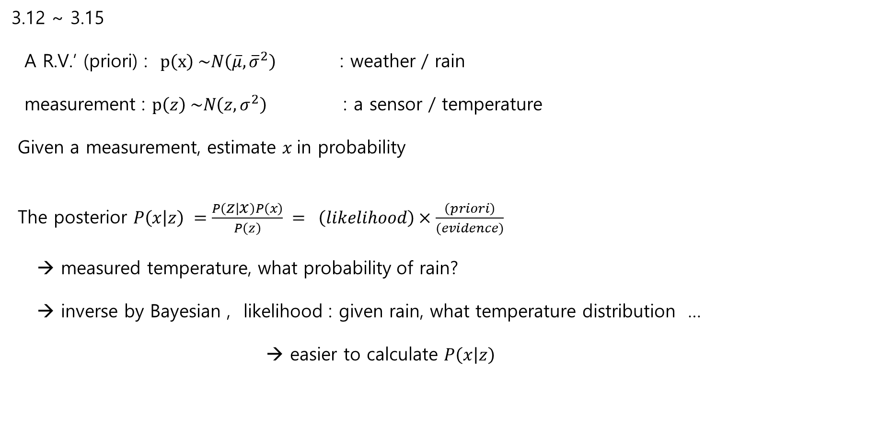
3.12 ~ 3.15
A R.V.’ (priori) : $p\left(x\right) \sim N\left(\overline{μ}, {\overline{σ}}^{2}\right)$ : weather / rain
measurement : $p\left(z\right) \sim N\left(z, σ^{2}\right)$ : a sensor / temperature
Given a measurement, estimate $x$in probability
The posterior $P\left(x | z\right) =\frac{P\left(z | x\right)P\left(x\right)}{P\left(z\right)} = \left(likelihood\right)×\frac{\left(priori\right)}{(evidence)}$
→ measured temperature, what probability of rain?
→ inverse by Bayesian , likelihood : given rain, what temperature distribution …
→ easier to calculate $P\left(x | z\right)$

Slide 13
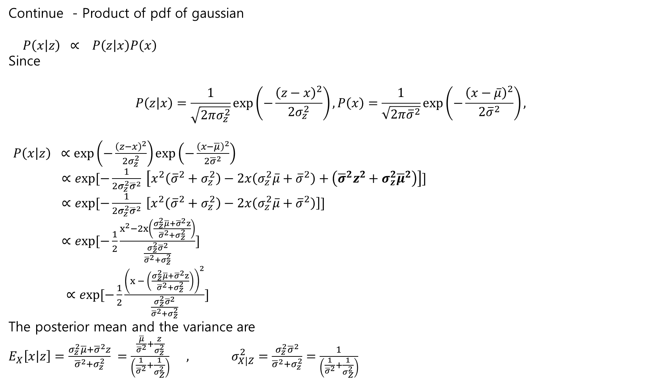
Continue - Product of pdf of gaussian
$P\left(x | z\right) ∝ P\left(z | x\right)P\left(x\right)$
Since
$$P\left(z | x\right)=\frac{1}{\sqrt{2πσ_{z}^{2}}}\exp\left(−\frac{{\left(z−x\right)}^{2}}{2σ_{z}^{2}}\right),P\left(x\right)=\frac{1}{\sqrt{2π{\overline{σ}}^{2}}}\exp\left(−\frac{{\left(x−\overline{μ}\right)}^{2}}{2{\overline{σ}}^{2}}\right),$$
$P\left(x | z\right) ∝\exp\left(−\frac{{\left(z−x\right)}^{2}}{2σ_{z}^{2}}\right)\exp\left(−\frac{{\left(x−\overline{μ}\right)}^{2}}{2{\overline{σ}}^{2}}\right)$
$∝exp[−\frac{1}{2σ_{z}^{2}{\overline{σ}}^{2}} \left[x^{2}\left({\overline{σ}}^{2}+σ_{z}^{2}\right)−2x\left(σ_{z}^{2}\overline{μ}+{\overline{σ}}^{2}\right)+\left({\overline{σ}}^{2}z^{2}+σ_{z}^{2}{\overline{μ}}^{2}\right)\right]]$
$∝exp[−\frac{1}{2σ_{z}^{2}{\overline{σ}}^{2}} \left[x^{2}\left({\overline{σ}}^{2}+σ_{z}^{2}\right)−2x\left(σ_{z}^{2}\overline{μ}+{\overline{σ}}^{2}\right)\right]]$
$∝exp[−\frac{1}{2}\frac{x^{2}−2x\left(\frac{σ_{z}^{2}\overline{μ}+{\overline{σ}}^{2}z}{{\overline{σ}}^{2}+σ_{z}^{2}}\right)}{\frac{σ_{z}^{2}{\overline{σ}}^{2}}{{\overline{σ}}^{2}+σ_{z}^{2}}}]$
$∝exp[−\frac{1}{2}\frac{{\left(x − \left(\frac{σ_{z}^{2}\overline{μ}+{\overline{σ}}^{2}z}{{\overline{σ}}^{2}+σ_{z}^{2}}\right)\right)}^{2}}{\frac{σ_{z}^{2}{\overline{σ}}^{2}}{{\overline{σ}}^{2}+σ_{z}^{2}}}]$
The posterior mean and the variance are
$E_{X}\left[x | z\right]=\frac{σ_{z}^{2}\overline{μ}+{\overline{σ}}^{2}z}{{\overline{σ}}^{2}+σ_{z}^{2}} =\frac{\frac{\overline{μ}}{{\overline{σ}}^{2}}+\frac{z}{σ_{z}^{2}}}{\left(\frac{1}{{\overline{σ}}^{2}}+\frac{1}{σ_{Z}^{2}}\right)} , σ_{X|Z}^{2}=\frac{σ_{z}^{2}{\overline{σ}}^{2}}{{\overline{σ}}^{2}+σ_{z}^{2}}=\frac{1}{\left(\frac{1}{{\overline{σ}}^{2}}+\frac{1}{σ_{Z}^{2}}\right)}$

