Slide 1
Ch.4 Bayesian filtering equations and exact solutions
4.1 Probabilistic state space models
4.2 Bayesian filtering equations
4.3 Kalman filter

Slide 2
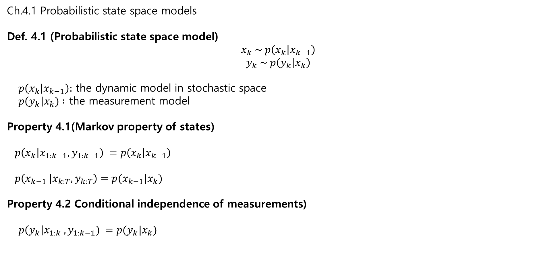
Ch.4.1 Probabilistic state space models
Def. 4.1 (Probabilistic state space model)
$$x_{k} \sim p\left(x_{k} | x_{k−1}\right)$$
$$y_{k} \sim p\left(y_{k} | x_{k}\right)$$
$p\left(x_{k} | x_{k−1}\right):$ the dynamic model in stochastic space
$p\left(y_{k}\right|x_{k}) :$ the measurement model
Property 4.1(Markov property of states)
$p\left(x_{k} | x_{1:k−1}, y_{1:k−1}\right) =p\left(x_{k} | x_{k−1}\right)$
$p\left(x_{k−1} | x_{k:T}, y_{k:T}\right)=p(x_{k−1}|x_{k})$
Property 4.2 Conditional independence of measurements)
$p\left(y_{k}\right|x_{1:k} , y_{1:k−1}) =p(y_{k}|x_{k})$

Slide 3

Ch.4.1 Probabilistic state space models
Ex. 4.1 (Gaussian random walk)
Problem:
$x_{k}=x_{k−1}+q_{k−1} , q_{k−1}\sim N\left(0, Q\right)$
$y_{k}=x_{k}+r_{k}$, $r_{k} \sim N\left(0, Q\right)$
In terms of pdf,
$$p\left(x_{k} | x_{k−1}\right)=N\left(x_{k}| x_{k−1}, Q\right)=\frac{1}{\sqrt{2πQ}}\exp\left(−\frac{1}{2Q} {\left(x_{k}−x_{k−1}\right)}^{2}\right)$$
$$p\left(y_{k} | x_{k}\right)=N\left({y_{k}| x}_{k}, R\right)=\frac{1}{\sqrt{2πR}}\exp\left(−\frac{1}{2R} {\left(y_{k}−x_{k}\right)}^{2}\right)$$
To find
$$p\left(x_{0:T} | y_{1:T}\right)=\frac{\left(p\left(y_{1:T} | x_{0:T}\right) p\left(x_{0:T}\right)\right)}{p\left(y_{1:T}\right)}$$
$$∝p\left(y_{1:T} | x_{0:T}\right) p\left(x_{0:T}\right)$$
→ To recursive way.

Slide 4
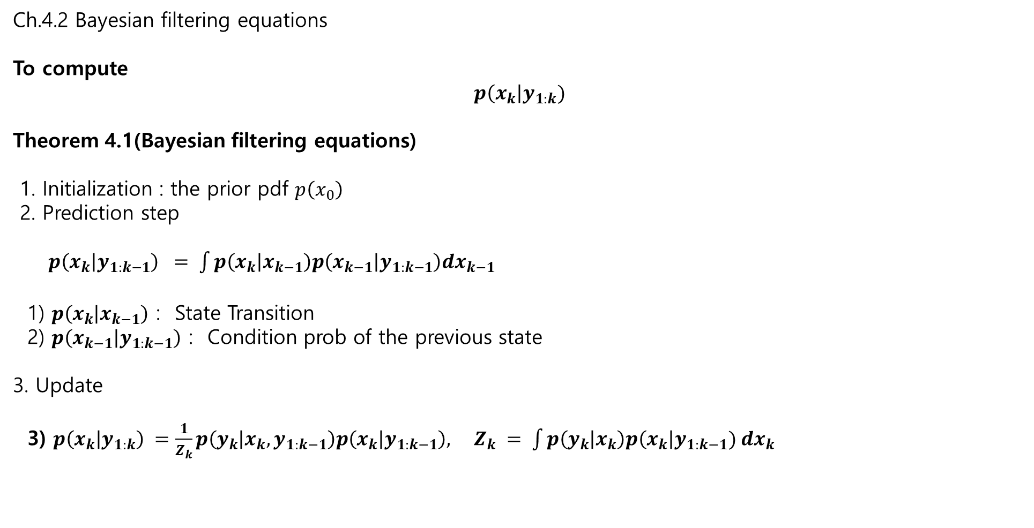
Ch.4.2 Bayesian filtering equations
To compute
$$p\left(x_{k}\right|y_{1:k})$$
Theorem 4.1(Bayesian filtering equations)
1. Initialization : the prior pdf $p\left(x_{0}\right)$
2. Prediction step
$p\left(x_{k} | y_{1:k−1}\right) = \int{p\left(x_{k} | x_{k−1}\right)p\left(x_{k−1} | y_{1:k−1}\right)dx_{k−1}}$
1) $p\left(x_{k} | x_{k−1}\right)$ : State Transition
2) $p\left(x_{k−1} | y_{1:k−1}\right)$ : Condition prob of the previous state
3. Update
3) $p\left(x_{k} | y_{1:k}\right) =\frac{1}{Z_{k}}p\left(y_{k} | x_{k}, y_{1:k−1}\right)p\left(x_{k} | y_{1:k−1}\right), Z_{k} = \int{p\left(y_{k} | x_{k}\right)p\left(x_{k}\right|y_{1:k−1}) dx_{k} }$

Slide 5


4.3 Kalman filter
The closed form solution to the Bayesian filtering equation
1. Model
$x_{k}=A_{k−1}x_{k−1}+q_{k−1} , x∈R^{n} , q_{k−1}\sim N\left(0, Q_{k−1}\right) \text{prior} x_{0} \sim N(m_{0},P_{0})$
$y_{k}=H_{k}x_{k}+r_{k} , y∈R^{m} , r_{k}\sim N(0,R_{k})$
2. Theorem 4.2 Kalman – Recursive method
$p\left(x_{k} | y_{1:k−1}\right)=N\left(x_{k}\right|m_{k}^{−}, P_{k}^{−}) :$ prediction
$p\left(x_{k} | y_{1:k} \right) =N\left(x_{k}\right|m_{k}, P_{k})$ = N(: estimation
$p\left(y_{k}\right|y_{1:k−1})=N\left(y_{k} | H_{k}m_{k}^{−}, S_{k}\right)$: measurement update
1) The Prediction step
$m_{k}^{−}=A_{k−1}m_{k−1}$
$P_{k}^{−}=A_{k−1}P_{k−1}A_{k−1}^{T}+Q_{k−1}$
2) The Update step
$v_{k}=y_{k}−H_{k}m_{k}^{−}$
$S_{k}=H_{k}P_{k}^{−}H_{k}^{T}+R_{k}$
$K_{k}=P_{k}^{−}H_{k}^{T}S_{k}^{−}$
$m_{k}=m_{k}^{−}+K_{k}v_{k}$
$P_{k}=P_{k}^{−}−K_{k}S_{k}K_{k}^{T}$

Slide 6
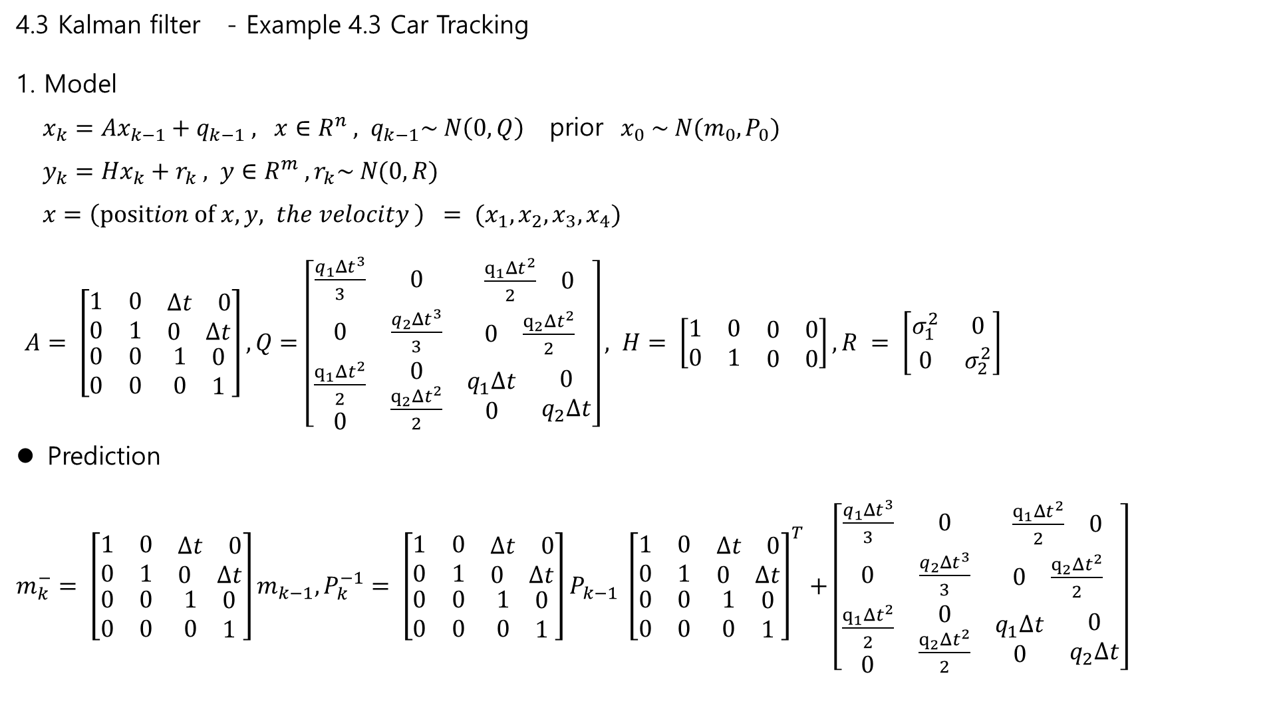
4.3 Kalman filter - Example 4.3 Car Tracking
1. Model
$x_{k}=Ax_{k−1}+q_{k−1} , x∈R^{n} , q_{k−1}\sim N\left(0, Q\right) \text{prior} x_{0} \sim N(m_{0},P_{0})$
$y_{k}=Hx_{k}+r_{k} , y∈R^{m} , r_{k}\sim N(0,R)$
$x=\left(position of x,y, the velocity \right) = (x_{1}, x_{2}, x_{3}, x_{4})$
$A= \left[\begin{matrix}1 & 0 & \begin{matrix}Δt & 0\end{matrix} \\ 0 & 1 & \begin{matrix}0 & Δt\end{matrix} \\ \begin{matrix}0 \\ 0\end{matrix} & \begin{matrix}0 \\ 0\end{matrix} & \begin{matrix}\begin{matrix}1 \\ 0\end{matrix} & \begin{matrix}0 \\ 1\end{matrix}\end{matrix}\end{matrix}\right], Q=\left[\begin{matrix}\frac{q_{1}Δt^{3}}{3} & 0 & \begin{matrix}\frac{q_{1}Δt^{2}}{2} & 0\end{matrix} \\ 0 & \frac{q_{2}Δt^{3}}{3} & \begin{matrix}0 & \frac{q_{2}Δt^{2}}{2}\end{matrix} \\ \begin{matrix}\frac{q_{1}Δt^{2}}{2} \\ 0\end{matrix} & \begin{matrix}0 \\ \frac{q_{2}Δt^{2}}{2}\end{matrix} & \begin{matrix}\begin{matrix}q_{1}Δt \\ 0\end{matrix} & \begin{matrix}0 \\ q_{2}Δt\end{matrix}\end{matrix}\end{matrix}\right], H= \left[\begin{matrix}1 & 0 & \begin{matrix}0 & 0\end{matrix} \\ 0 & 1 & \begin{matrix}0 & 0\end{matrix}\end{matrix}\right], R = \left[\begin{matrix}σ_{1}^{2} & 0 \\ 0 & σ_{2}^{2}\end{matrix}\right]$
Prediction
$m_{k}^{−}= \left[\begin{matrix}1 & 0 & \begin{matrix}Δt & 0\end{matrix} \\ 0 & 1 & \begin{matrix}0 & Δt\end{matrix} \\ \begin{matrix}0 \\ 0\end{matrix} & \begin{matrix}0 \\ 0\end{matrix} & \begin{matrix}\begin{matrix}1 \\ 0\end{matrix} & \begin{matrix}0 \\ 1\end{matrix}\end{matrix}\end{matrix}\right]m_{k−1}, P_{k}^{−1}= \left[\begin{matrix}1 & 0 & \begin{matrix}Δt & 0\end{matrix} \\ 0 & 1 & \begin{matrix}0 & Δt\end{matrix} \\ \begin{matrix}0 \\ 0\end{matrix} & \begin{matrix}0 \\ 0\end{matrix} & \begin{matrix}\begin{matrix}1 \\ 0\end{matrix} & \begin{matrix}0 \\ 1\end{matrix}\end{matrix}\end{matrix}\right]P_{k−1} {\left[\begin{matrix}1 & 0 & \begin{matrix}Δt & 0\end{matrix} \\ 0 & 1 & \begin{matrix}0 & Δt\end{matrix} \\ \begin{matrix}0 \\ 0\end{matrix} & \begin{matrix}0 \\ 0\end{matrix} & \begin{matrix}\begin{matrix}1 \\ 0\end{matrix} & \begin{matrix}0 \\ 1\end{matrix}\end{matrix}\end{matrix}\right]}^{T}+\left[\begin{matrix}\frac{q_{1}Δt^{3}}{3} & 0 & \begin{matrix}\frac{q_{1}Δt^{2}}{2} & 0\end{matrix} \\ 0 & \frac{q_{2}Δt^{3}}{3} & \begin{matrix}0 & \frac{q_{2}Δt^{2}}{2}\end{matrix} \\ \begin{matrix}\frac{q_{1}Δt^{2}}{2} \\ 0\end{matrix} & \begin{matrix}0 \\ \frac{q_{2}Δt^{2}}{2}\end{matrix} & \begin{matrix}\begin{matrix}q_{1}Δt \\ 0\end{matrix} & \begin{matrix}0 \\ q_{2}Δt\end{matrix}\end{matrix}\end{matrix}\right]$

Slide 7

4.3 Kalman filter - Example 4.3 Car Tracking
Update
$S_{k}=\left[\begin{matrix}1 & 0 & \begin{matrix}0 & 0\end{matrix} \\ 0 & 1 & \begin{matrix}0 & 0\end{matrix}\end{matrix}\right]P_{k}^{−}{\left[\begin{matrix}1 & 0 & \begin{matrix}0 & 0\end{matrix} \\ 0 & 1 & \begin{matrix}0 & 0\end{matrix}\end{matrix}\right]}^{T}+ \left[\begin{matrix}σ_{1}^{2} & 0 \\ 0 & σ_{2}^{2}\end{matrix}\right]$
$K_{k} =P_{k}^{−}{\left[\begin{matrix}1 & 0 & \begin{matrix}0 & 0\end{matrix} \\ 0 & 1 & \begin{matrix}0 & 0\end{matrix}\end{matrix}\right]}^{T}S_{k}^{−}$
$m_{k}=m_{k}^{−}+K_{k}\left(y_{k} −\left[\begin{matrix}1 & 0 & \begin{matrix}0 & 0\end{matrix} \\ 0 & 1 & \begin{matrix}0 & 0\end{matrix}\end{matrix}\right]m_{k}^{−}\right)$
$P_{k}=P_{k}^{−1}−K_{k}S_{k}K_{k}^{T}$:
Matlab : car_track_6.8_12.4

Slide 8
5. Extended and Unscented Kalman filtering
5.1 Taylor series expansions
5.2 Extended Kalman filter
5.3 Statistical linearization
5.4 Statistical linearized filter
5.5 Unscented transformation
5.6 Unscented Kalman filter

Slide 9
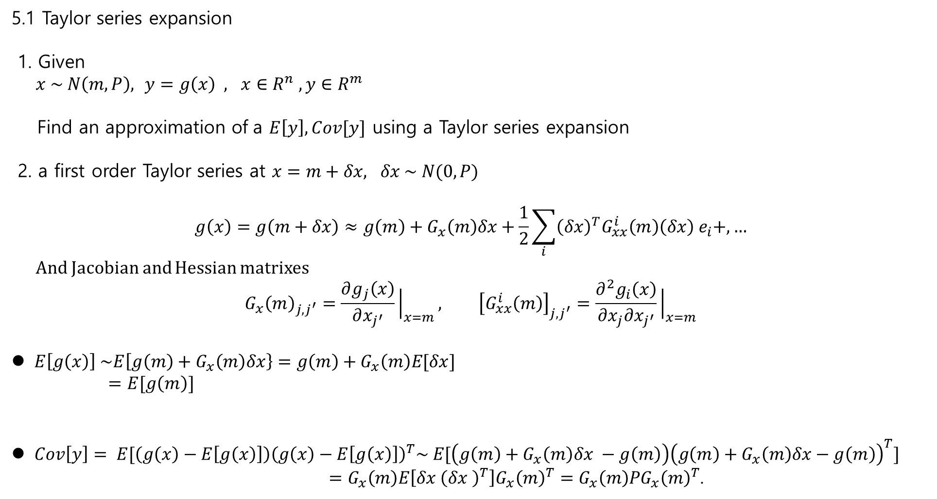
5.1 Taylor series expansion
1. Given
$x \sim N\left(m,P\right),$ $y=g\left(x\right) , x∈R^{n} , y∈R^{m}$
Find an approximation of a $E\left[y\right], Cov[y]$ using a Taylor series expansion
2. a first order Taylor series at $x=m+δx, δx \sim N(0, P)$
$$g\left(x\right)=g\left(m+δx\right)≈g\left(m\right)+G_{x}\left(m\right)δx+\frac{1}{2}\sum_{i}{{\left(δx\right)}^{T}G_{xx}^{i}\left(m\right)\left(δx\right) e_{i}+,…}$$
And Jacobian and Hessian matrixes
$$G_{x}{\left(m\right)}_{j,j^{′}}=\frac{∂g_{j}\left(x\right)}{∂x_{j^{′}}}{\left.​\right|}_{x=m}, {\left[G_{xx}^{i}\left(m\right)\right]}_{j,j^{′}}=\frac{∂^{2}g_{i}\left(x\right)}{∂x_{j}∂x_{j^{′}}}{\left.​\right|}_{x=m}$$
$E\left[g\left(x\right)\right] \sim E\left[g\left(m\right)+G_{x}\left(m\right)δx\right\}=g\left(m\right)+G_{x}\left(m\right)E[δx]$
$=E[g\left(m\right)]$
$Cov\left[y\right]= E[\left(g\left(x\right)−E\left[g\left(x\right)\right]\right){\left(g\left(x\right)−E\left[g\left(x\right)\right]\right)}^{T}\sim E[\left(g\left(m\right)+G_{x}\left(m\right)δx −g\left(m\right)\right){\left(g\left(m\right)+G_{x}\left(m\right)δx−g\left(m\right)\right)}^{T}]$
$=G_{x}\left(m\right)E\left[δx {\left(δx \right)}^{T}\right]G_{x}{\left(m\right)}^{T}=G_{x}\left(m\right)PG_{x}{\left(m\right)}^{T}$.

Slide 10
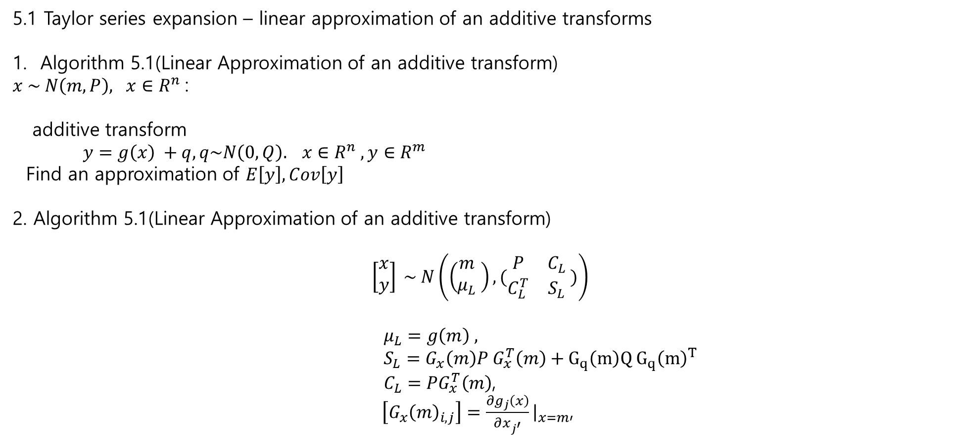
5.1 Taylor series expansion – linear approximation of an additive transforms
Algorithm 5.1(Linear Approximation of an additive transform)
$x \sim N\left(m,P\right), x∈R^{n}$:
additive transform
$y=g\left(x\right) +q, q\sim N\left(0, Q\right). x∈R^{n} , y∈R^{m}$
Find an approximation of $E\left[y\right], Cov\left[y\right]$
2. Algorithm 5.1(Linear Approximation of an additive transform)
$$\left[\begin{matrix}x \\ y\end{matrix}\right] \sim N\left(\left(\begin{matrix}m \\ μ_{L}\end{matrix} \right), (\begin{matrix}P & C_{L} \\ C_{L}^{T} & S_{L}\end{matrix} )\right)$$
$μ_{L}=g\left(m\right) ,$
$S_{L}=G_{x}\left(m\right)P G_{x}^{T}\left(m\right)+G_{q}\left(m\right)Q G_{q}{\left(m\right)}^{T}$
$C_{L}=PG_{x}^{T}\left(m\right)$,
$\left[G_{x}{\left(m\right)}_{i,j}\right]=\frac{∂g_{j}\left(x\right)}{∂x_{j^{′}}}{\left.​\right|}_{x=m}$,

Slide 11
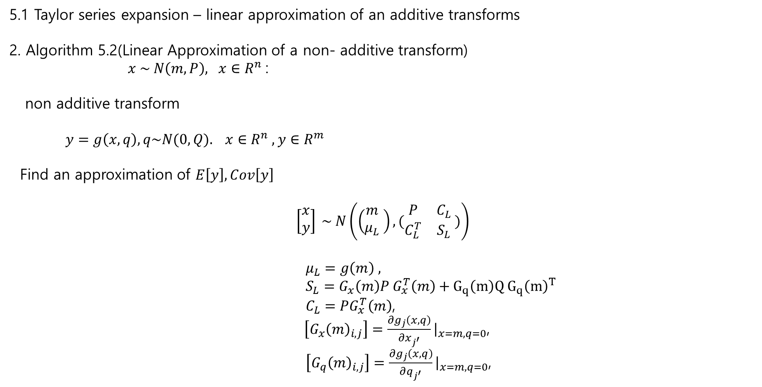
5.1 Taylor series expansion – linear approximation of an additive transforms
2. Algorithm 5.2(Linear Approximation of a non- additive transform)
$x \sim N\left(m,P\right), x∈R^{n}$:
non additive transform
$y=g\left(x,q\right), q\sim N(0,Q). x∈R^{n} , y∈R^{m}$
Find an approximation of $E\left[y\right], Cov\left[y\right]$
$$\left[\begin{matrix}x \\ y\end{matrix}\right] \sim N\left(\left(\begin{matrix}m \\ μ_{L}\end{matrix} \right), (\begin{matrix}P & C_{L} \\ C_{L}^{T} & S_{L}\end{matrix} )\right)$$
$μ_{L}=g\left(m\right) ,$
$S_{L}=G_{x}\left(m\right)P G_{x}^{T}\left(m\right)+G_{q}\left(m\right)Q G_{q}{\left(m\right)}^{T}$
$C_{L}=PG_{x}^{T}\left(m\right)$,
$\left[G_{x}{\left(m\right)}_{i,j}\right]=\frac{∂g_{j}\left(x,q\right)}{∂x_{j^{′}}}{\left.​\right|}_{x=m,q=0}$,
$\left[G_{q}{\left(m\right)}_{i,j}\right]=\frac{∂g_{j}\left(x,q\right)}{∂q_{j^{′}}}{\left.​\right|}_{x=m,q=0}$,

Slide 12


5.2 Extended Kalman Filter
Problem
$x_{k}=f\left(x_{k−1}\right)+q_{k−1}, q_{k−1} \sim N\left(0, Q_{k−1}\right)$
$y_{k}=h\left(x_{k}\right)+r_{k}, r_{k−1} \sim N\left(0, R_{k}\right)$.
Assume Gaussian Approximation of
$$p\left(x_{k} | y_{1:k}\right) ≈N\left(x_{k}\right|m_{k}, P_{k})$$
2. Algorithm 5.4 (Extended Kalman Filter)
Prediction
$m_{k}^{−} =f\left(m_{k−1}\right)$,
$P_{k}^{−}=F_{x}\left(m_{k−1}\right)P_{k−1}F_{x}^{T}\left(m_{k−1}\right)+Q_{k−1}$,
Update
$v_{k}=y_{k}−h\left(m_{k}^{−}\right)$,
$S_{k}=H_{x}\left(m_{k}^{−}\right)P_{k}^{−}H_{x}^{T}\left(m_{k}^{−}\right)+R_{k}$,
$K_{k}=P_{k}^{−}H_{k}^{T}\left(m_{k}^{−}\right)S_{k}^{−}$,
$m_{k}=m_{k}^{−}+K_{k}v_{k}$,
$P_{k}=P_{k}^{−}−K_{k}S_{k}K_{k}^{T}$.

Slide 13
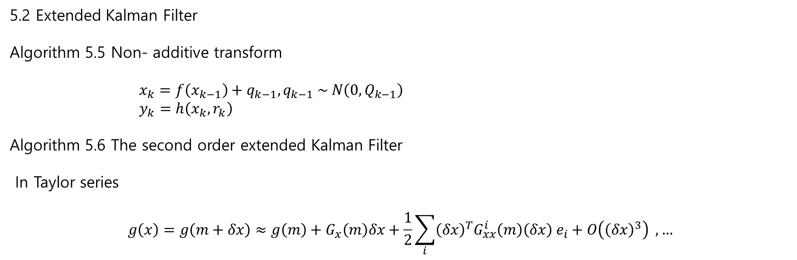
5.2 Extended Kalman Filter
Algorithm 5.5 Non- additive transform
$x_{k}=f\left(x_{k−1}\right)+q_{k−1}, q_{k−1} \sim N\left(0, Q_{k−1}\right)$
$y_{k}=h\left(x_{k}, r_{k}\right)$
Algorithm 5.6 The second order extended Kalman Filter
In Taylor series
$$g\left(x\right)=g\left(m+δx\right)≈g\left(m\right)+G_{x}\left(m\right)δx+\frac{1}{2}\sum_{i}{{\left(δx\right)}^{T}G_{xx}^{i}\left(m\right)\left(δx\right) e_{i}+O\left({\left(δx\right)}^{3}\right) ,…}$$

Slide 14
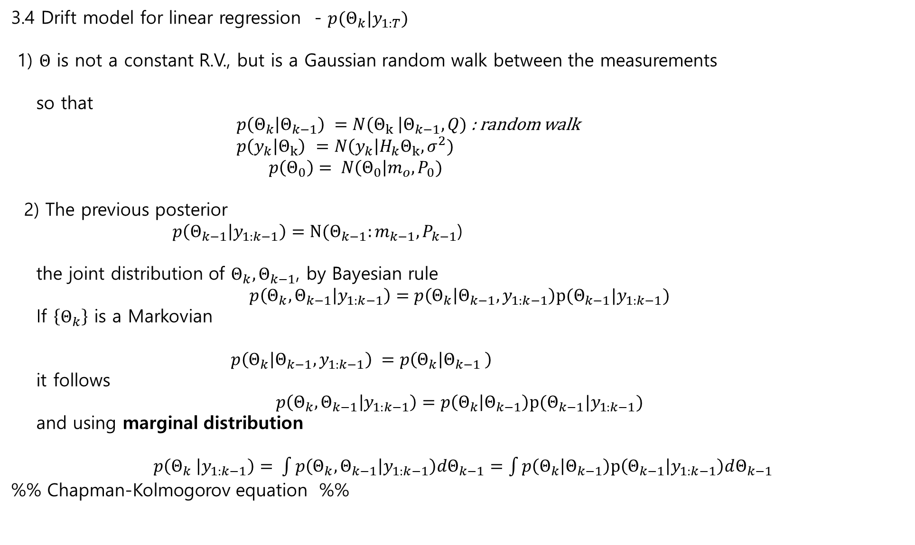
3.4 Drift model for linear regression - $p(Θ_{k}|y_{1:T})$
1) $Θ$ is not a constant R.V., but is a Gaussian random walk between the measurements
so that
$p\left(Θ_{k} | Θ_{k−1}\right) =N\left(Θ_{k} \right|Θ_{k−1}, Q)$: random walk
$p\left(y_{k} | Θ_{k}\right)$ $=N\left(y_{k}\right|H_{k}Θ_{k}, σ^{2})$
$p\left(Θ_{0}\right)= N\left(Θ_{0}\right|m_{o}, P_{0})$
2) The previous posterior
$p\left(Θ_{k−1} | y_{1:k−1}\right)=N(Θ_{k−1}:m_{k−1}, P_{k−1}$)
the joint distribution of $Θ_{k}, Θ_{k−1}$, by Bayesian rule
$$p\left(Θ_{k}, Θ_{k−1} | y_{1:k−1}\right)=p\left(Θ_{k} | Θ_{k−1},y_{1:k−1}\right)p(Θ_{k−1}|y_{1:k−1})$$
If $\left\{Θ_{k}\right\}$ is a Markovian
$p\left(Θ_{k} | Θ_{k−1},y_{1:k−1}\right) =p\left(Θ_{k} | Θ_{k−1} \right)$
it follows
$$p\left(Θ_{k}, Θ_{k−1} | y_{1:k−1}\right)=p\left(Θ_{k} | Θ_{k−1}\right)p(Θ_{k−1}|y_{1:k−1})$$
and using marginal distribution
$p\left(Θ_{k} | y_{1:k−1}\right)= \int{p\left(Θ_{k}, Θ_{k−1} | y_{1:k−1}\right)dΘ_{k−1}}=\int{p\left(Θ_{k} | Θ_{k−1}\right)p\left(Θ_{k−1} | y_{1:k−1}\right)dΘ_{k−1}}$
%% Chapman-Kolmogorov equation %%

