Slide 1
5. Extended and Unscented Kalman filtering
5.1 Taylor series expansions
5.2 Extended Kalman filter
5.3 Statistical linearization
5.4 Statistical linearized filter
5.5 Unscented transformation
5.6 Unscented Kalman filter

Slide 2
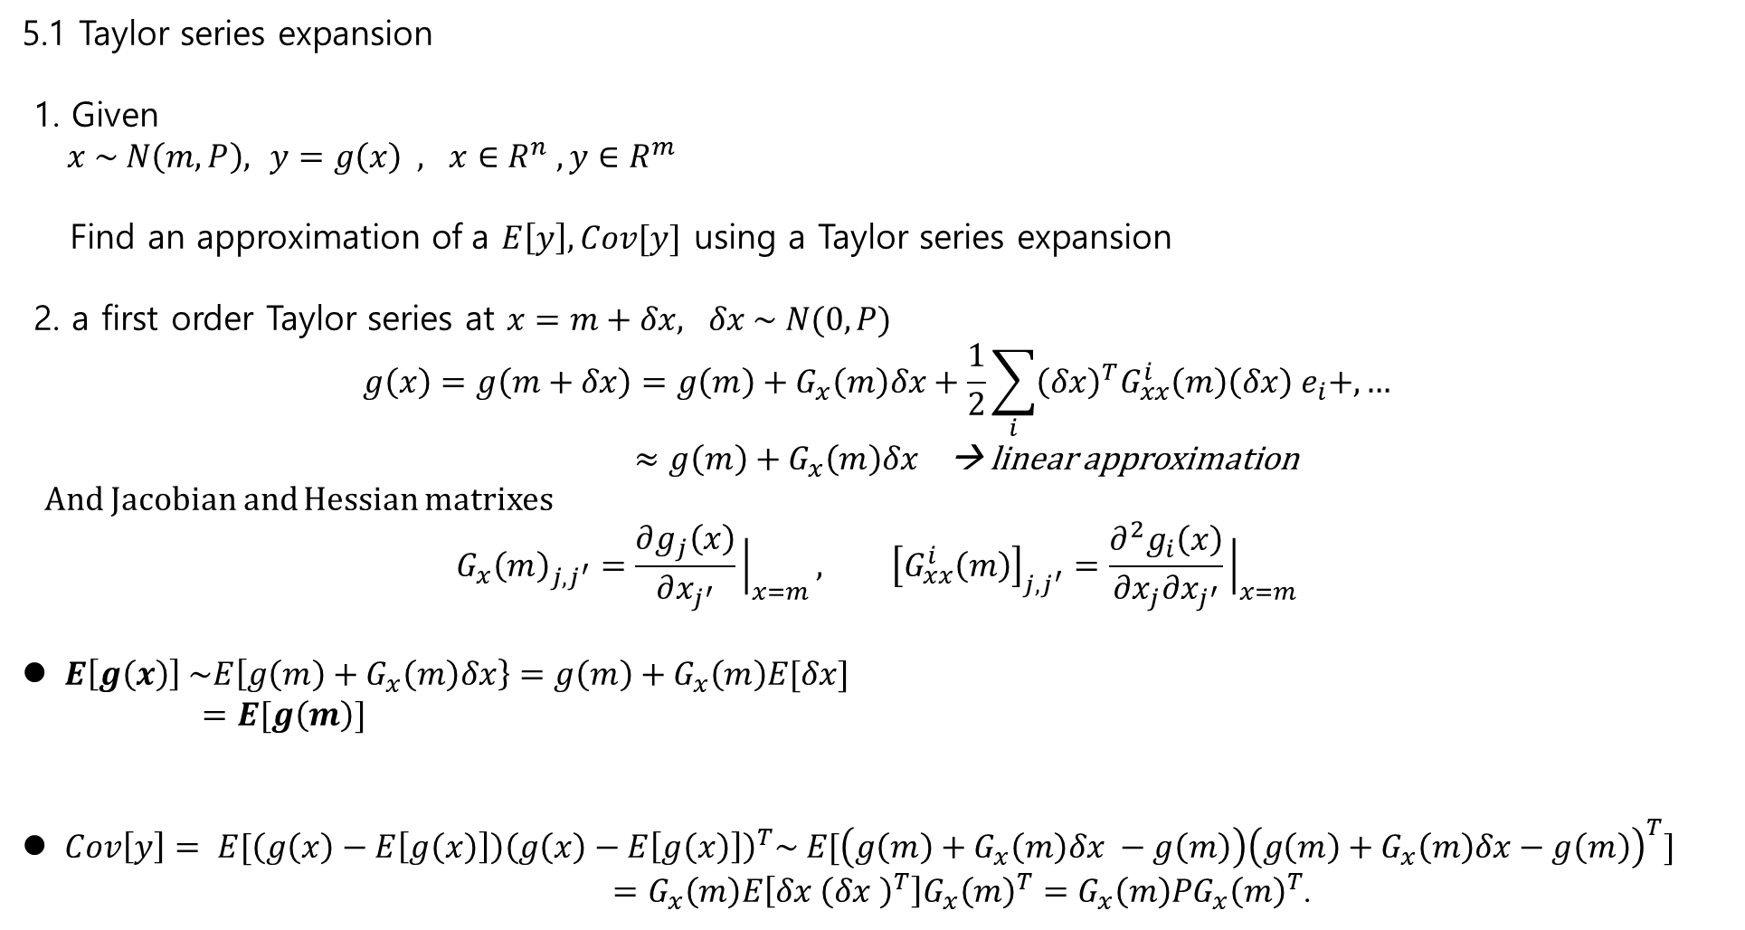
5.1 Taylor series expansion
1. Given
$x \sim N\left(m,P\right),$ $y=g\left(x\right) , x∈R^{n} , y∈R^{m}$
Find an approximation of a $E\left[y\right], Cov[y]$ using a Taylor series expansion
2. a first order Taylor series at $x=m+δx, δx \sim N(0, P)$
$$g\left(x\right)=g\left(m+δx\right)=g\left(m\right)+G_{x}\left(m\right)δx+\frac{1}{2}\sum_{i}{{\left(δx\right)}^{T}G_{xx}^{i}\left(m\right)\left(δx\right) e_{i}+,…}$$
$≈g\left(m\right)+G_{x}\left(m\right)δx$ → linear approximation
And Jacobian and Hessian matrixes
$$G_{x}{\left(m\right)}_{j,j^{′}}=\frac{∂g_{j}\left(x\right)}{∂x_{j^{′}}}{\left.​\right|}_{x=m}, {\left[G_{xx}^{i}\left(m\right)\right]}_{j,j^{′}}=\frac{∂^{2}g_{i}\left(x\right)}{∂x_{j}∂x_{j^{′}}}{\left.​\right|}_{x=m}$$
$E\left[g\left(x\right)\right] \sim E\left[g\left(m\right)+G_{x}\left(m\right)δx\right\}=g\left(m\right)+G_{x}\left(m\right)E[δx]$
$=E[g\left(m\right)]$
$Cov\left[y\right]= E[\left(g\left(x\right)−E\left[g\left(x\right)\right]\right){\left(g\left(x\right)−E\left[g\left(x\right)\right]\right)}^{T}\sim E[\left(g\left(m\right)+G_{x}\left(m\right)δx −g\left(m\right)\right){\left(g\left(m\right)+G_{x}\left(m\right)δx−g\left(m\right)\right)}^{T}]$
$=G_{x}\left(m\right)E\left[δx {\left(δx \right)}^{T}\right]G_{x}{\left(m\right)}^{T}=G_{x}\left(m\right)PG_{x}{\left(m\right)}^{T}$.

Slide 3
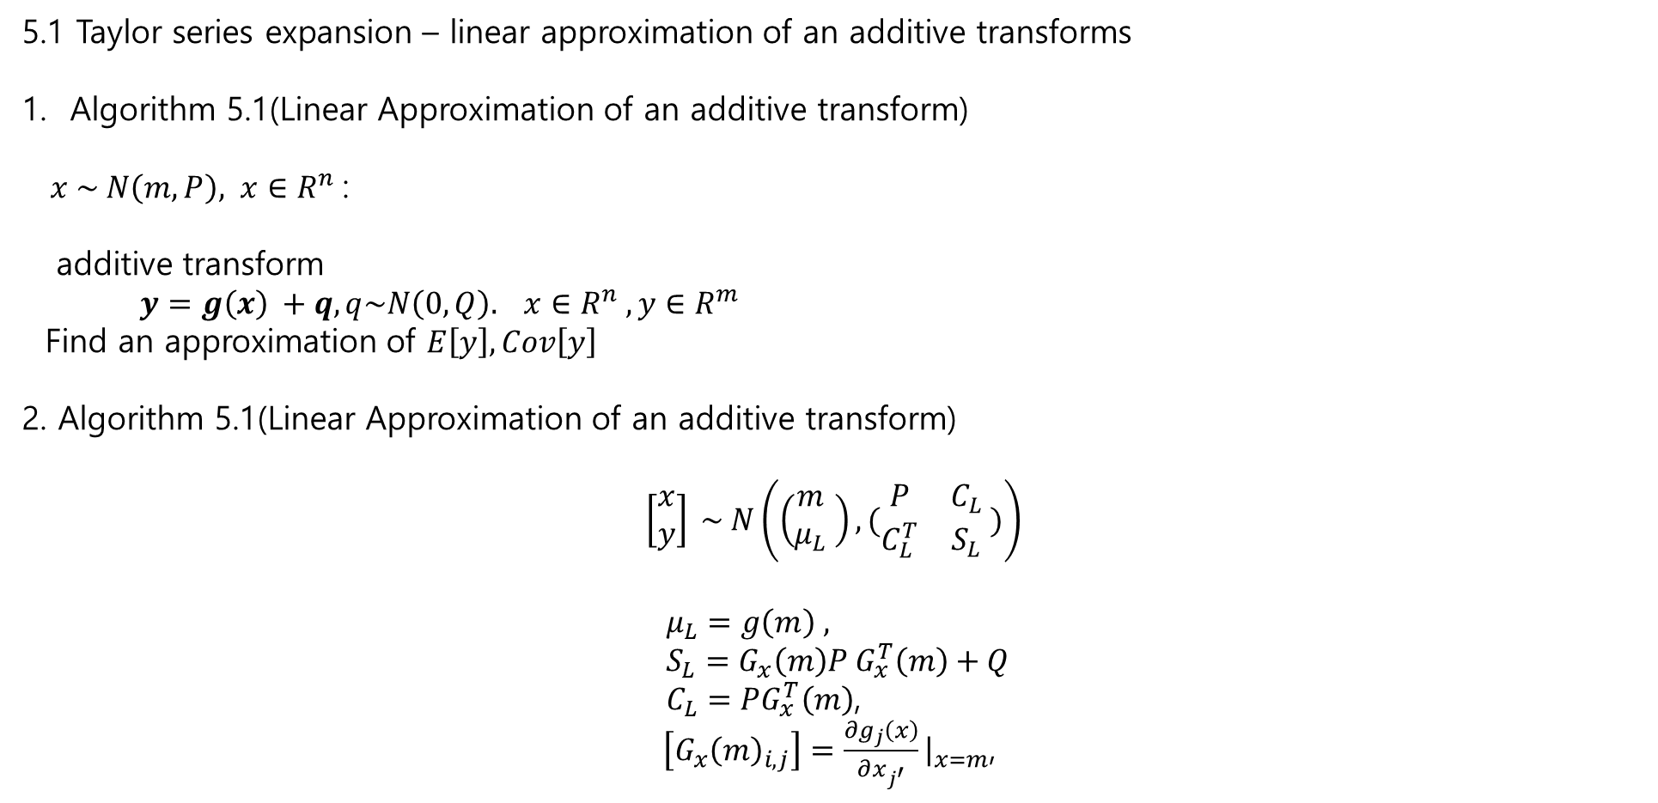
5.1 Taylor series expansion – linear approximation of an additive transforms
Algorithm 5.1(Linear Approximation of an additive transform)
$x \sim N\left(m,P\right), x∈R^{n}$:
additive transform
$y=g\left(x\right) +q, q\sim N\left(0, Q\right). x∈R^{n} , y∈R^{m}$
Find an approximation of $E\left[y\right], Cov\left[y\right]$
2. Algorithm 5.1(Linear Approximation of an additive transform)
$$\left[\begin{matrix}x \\ y\end{matrix}\right] \sim N\left(\left(\begin{matrix}m \\ μ_{L}\end{matrix} \right), (\begin{matrix}P & C_{L} \\ C_{L}^{T} & S_{L}\end{matrix} )\right)$$
$μ_{L}=g\left(m\right) ,$
$S_{L}=G_{x}\left(m\right)P G_{x}^{T}\left(m\right)+Q$
$C_{L}=PG_{x}^{T}\left(m\right)$,
$\left[G_{x}{\left(m\right)}_{i,j}\right]=\frac{∂g_{j}\left(x\right)}{∂x_{j^{′}}}{\left.​\right|}_{x=m}$,

Slide 4


5.2 Extended Kalman Filter
Problem
$x_{k}=f\left(x_{k−1}\right)+q_{k−1}, q_{k−1} \sim N\left(0, Q_{k−1}\right)$
$y_{k}=h\left(x_{k}\right)+r_{k}, r_{k−1} \sim N\left(0, R_{k}\right)$.
Assume Gaussian Approximation of
$$p\left(x_{k} | y_{1:k}\right) ≈N\left(x_{k}\right|m_{k}, P_{k})$$
2. Algorithm 5.4 (Extended Kalman Filter)
Prediction
$m_{k}^{−} =f\left(m_{k−1}\right)$,
$P_{k}^{−}=F_{x}\left(m_{k−1}\right)P_{k−1}F_{x}^{T}\left(m_{k−1}\right)+Q_{k−1}$,
Update
$v_{k}=y_{k}−h\left(m_{k}^{−}\right)$,
$S_{k}=H_{x}\left(m_{k}^{−}\right)P_{k}^{−}H_{x}^{T}\left(m_{k}^{−}\right)+R_{k}$,
$K_{k}=P_{k}^{−}H_{k}^{T}\left(m_{k}^{−}\right)S_{k}^{−}$,
$m_{k}=m_{k}^{−}+K_{k}v_{k}$,
$P_{k}=P_{k}^{−}−K_{k}S_{k}K_{k}^{T}$.

Slide 5
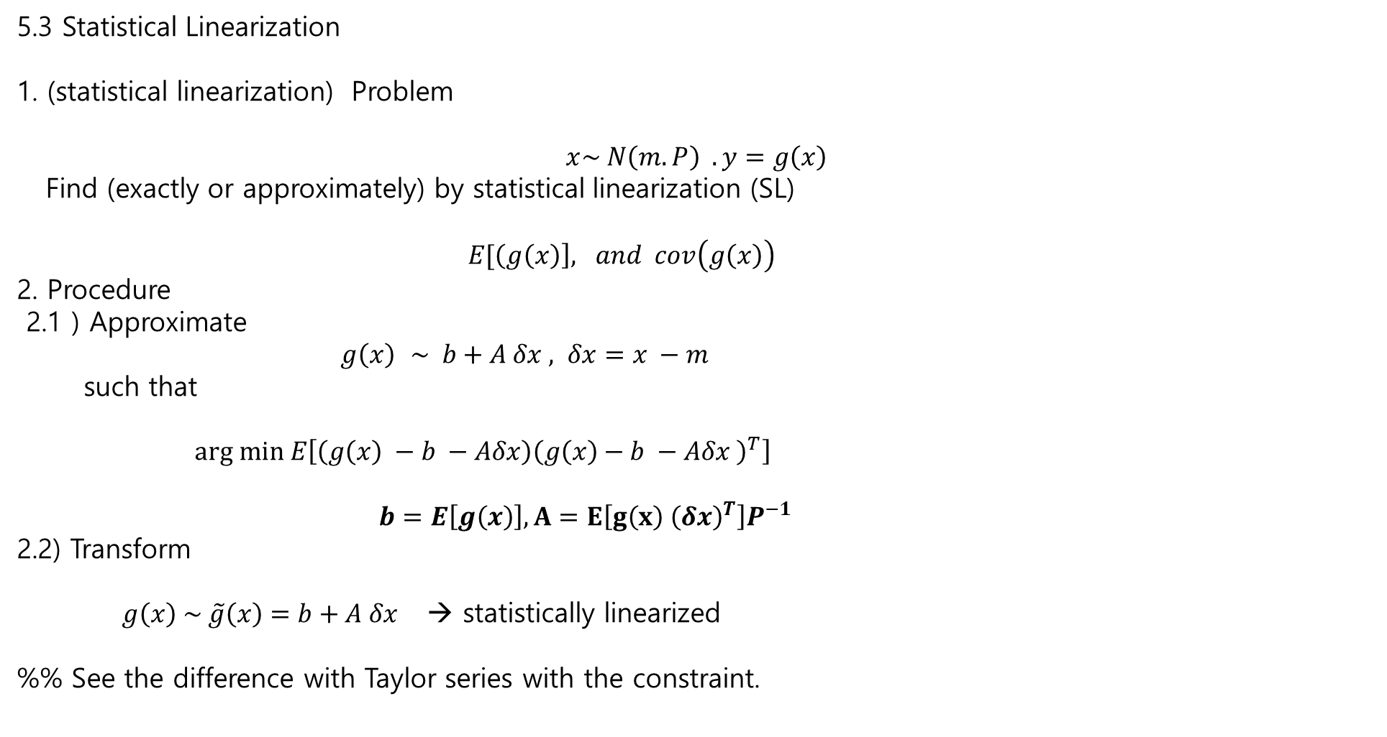
5.3 Statistical Linearization
1. (statistical linearization) Problem
$$x\sim N\left(m.P\right) . y=g\left(x\right)$$
Find (exactly or approximately) by statistical linearization (SL)
$E[\left(g\left(x\right)\right], and cov\left(g\left(x\right)\right)$
2. Procedure
2.1 ) Approximate
$g\left(x\right)$ $\sim b+A δx , δx=x −m$
such that
$arg min E\left[\left(g\left(x\right) −b −Aδx\right){\left(g\left(x\right)−b −Aδx \right)}^{T}\right]$
$b=E\left[g\left(x\right)\right], A=E\left[g\left(x\right) {\left(δx\right)}^{T}\right]P^{−1}$
2.2) Transform
$g\left(x\right) \sim \tilde{g}\left(x\right)=b+A δx$ → statistically linearized
%% See the difference with Taylor series with the constraint.

Slide 6


5.4 Statistical Linearization Filter
1. Model :
$$x_{k}=f\left(x_{k−1}\right)+q_{k−1}, q_{k−1} \sim N\left(0, Q_{k−1}\right)$$
$y_{k}=h\left(x_{k}\right)+r_{k}, r_{k−1} \sim N\left(0, R_{k}\right)$.
Algorithm 5.10 (for additive noise) : design SLF
Prediction
$m_{k}^{−} =f\left(x_{k−1}\right)$,
$P_{k}^{−}=E\left[f\left(x_{k−1}\right)δx_{k−1}^{T}\right]P_{k−1}^{−1}E{\left[f\left(x_{k−1}\right)δx_{k−1}^{T} \right]}^{T}+Q_{k−1}$,
where
$δx_{k−1}=x_{k−1} − m_{k−1} , x_{k−1} \sim N(m_{k−1},P_{k−1})$
Update
$v_{k}=y_{k}−E\left[h\left(x_{k}^{−}\right)\right]$,
$S_{k}=E\left[h\left(x_{k}^{−}\right)δ{\tilde{x}}_{k}^{T}\right]{\left(P_{k}^{−}\right)}^{−1}E{\left[h\left(x_{k}\right)δ{\tilde{x}}_{k}^{T}\right]}^{T}+R_{k}$,
$K_{k}=E{\left[h\left(x_{k}\right)δx_{k}^{T}\right]}^{T}S_{k}^{−1}$,
$m_{k}=m_{k}^{−}+K_{k}v_{k}$,
$P_{k}=P_{k}^{−}−K_{k}S_{k}K_{k}^{T}$.
where
$δ{\tilde{x}}_{k}=x_{k}−m_{k}^{−} , x_{k}\sim N\left(m_{k}^{−}, P_{k}^{−}\right)$

Slide 7

5.4 Statistical Linearization Filter
1).Example 3.7 (Noisy pendulum model)
$$\frac{d^{2}α}{dt^{2}}=−gsin\left(α\right)+q$$
$$y=\sin{α+r}$$
$$α:angle . y:the horizontal position$$
2). discretization model
$$\left(\begin{matrix}x_{1,k} \\ x_{2,k}\end{matrix}\right)= \left(\begin{matrix}x_{1k−1}+x_{2,k−1 }Δt \\ x_{2,k−1}−g\sin\left(x_{1,k−1}\right)Δt\end{matrix}\right)+q_{k−1}$$
$$y_{k}=\sin\left(x_{1,k}\right)+r_{k}$$
$$Q= \left(\begin{matrix}\frac{qΔt^{3}}{3} & \frac{qΔt^{2}}{2} \\ \frac{qΔt^{2}}{2} & qΔt\end{matrix}\right)$$
3). EKF
$$F_{x}\left(x\right)= \left(\begin{matrix}1 & Δt \\ −g\cos\left(x_{1}\right)Δt & 1\end{matrix}\right), H_{x}\left(x\right)=(\cos\left(x_{1}\right) 0)$$

Slide 8

5.4 Comparison of EKF and SLF
4). SLF
$$E\left[f\left(x\right)\right]= \left(\begin{matrix}m_{1}+m_{2}Δt \\ m_{2}−gsin\left(m_{1}\right)\exp\left(−\frac{P_{11}}{2}\right)Δt \end{matrix}\right)$$
$$E\left[h\left(x\right)\right]=\sin\left(m_{1}\right)\exp\left(−\frac{P_{11}}{2}\right)$$
And the cross-correlation are
$$E\left[f\left(x\right){\left(x−m\right)}^{T}\right]= \left(\begin{matrix}c_{11} & c_{12} \\ c_{21} & c_{22}\end{matrix}\right)$$
where
$c_{11}=P_{11}+Δt P_{12}$
$c_{12}=P_{12}+Δt P_{22}$
$c_{21}=P_{12}−g Δt\cos{m_{1} P_{11}exp⁡(−\frac{P_{11}}{2})}$
$c_{22}=P_{22}−gΔt\cos{m_{1} P_{12}\exp\left(−\frac{P_{11}}{2}\right)}$
And
$$E\left[h\left(x\right){\left(x−m\right)}^{T}\right]=\left(\begin{matrix}\cos{m_{1} P_{11}exp⁡(−\frac{P_{11}}{2})} \\ \cos{m_{1}P_{12}\exp\left(−\frac{P_{11}}{2}\right)}\end{matrix}\right)$$
See the next page

Slide 9

5.3 Comparison of EKF and SLF
%% $x \sim N\left(m,P\right)$, find $\sin{(x)}$
$E[\sin\left(x\right)]= \int_{−∞}^{∞}{\sin\left(x\right)f\left(x\right)dx }$
Since
$\sin\left(x\right)=\sin\left(m\right)+\cos\left(m\right)\left(x−m\right) −\frac{\sin\left(m\right)}{2}{\left(x−m\right)}^{2}+,….$.
It follows
$E[\sin{x]=E[\sin{m+\cos{m \left(x−m\right) } −\frac{1}{2}\sin\left(m\right){\left(x−m\right)}^{2}+,…}}$] $∵ x e^{−x^{2}} is odd function −→ \int_{−∞}^{∞}{xe^{−x^{2}}dx=0}$
$=\sin\left(m\right) −\frac{1}{2}\sin\left(m\right)P+,…$.
$\sim \sin\left(m\right)\exp\left(−\frac{P}{2}\right)$.
%% $\int{e^{−x^{2}}dx }$ has no simple solution %%
%% Monte Carlo simulation is a solution when the sample points are large
→ but it is expensive.

Slide 10
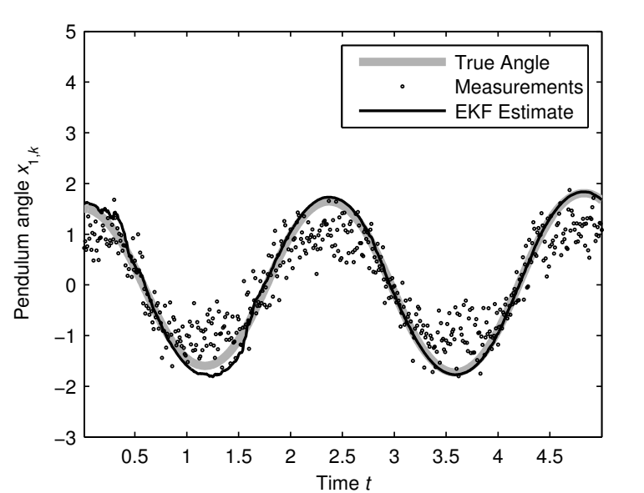
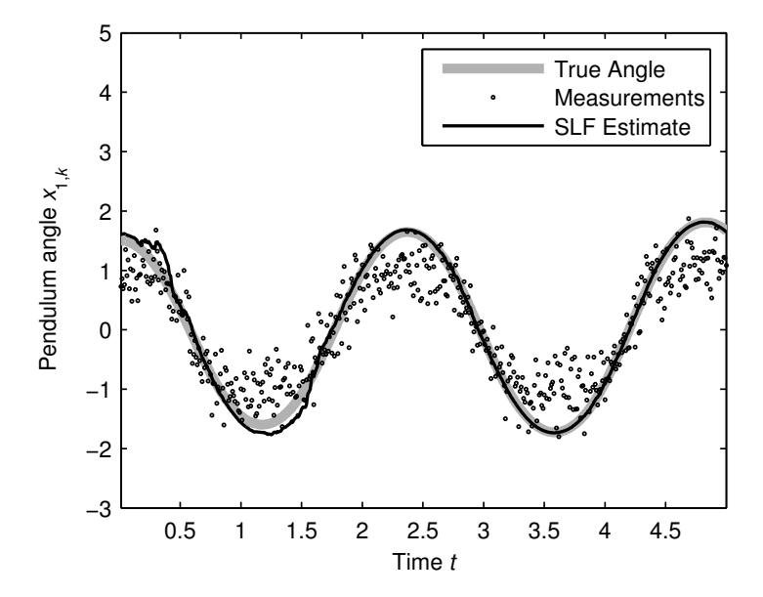
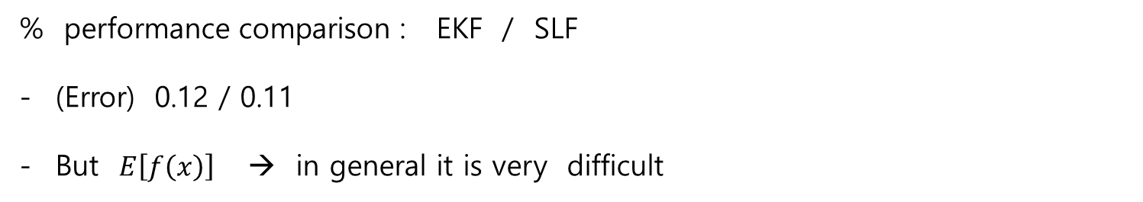
5.3 Comparison of EKF and SLF
% performance comparison : EKF / SLF
(Error) 0.12 / 0.11
But $E\left[f\left(x\right)\right]$ → in general it is very difficult

Slide 11
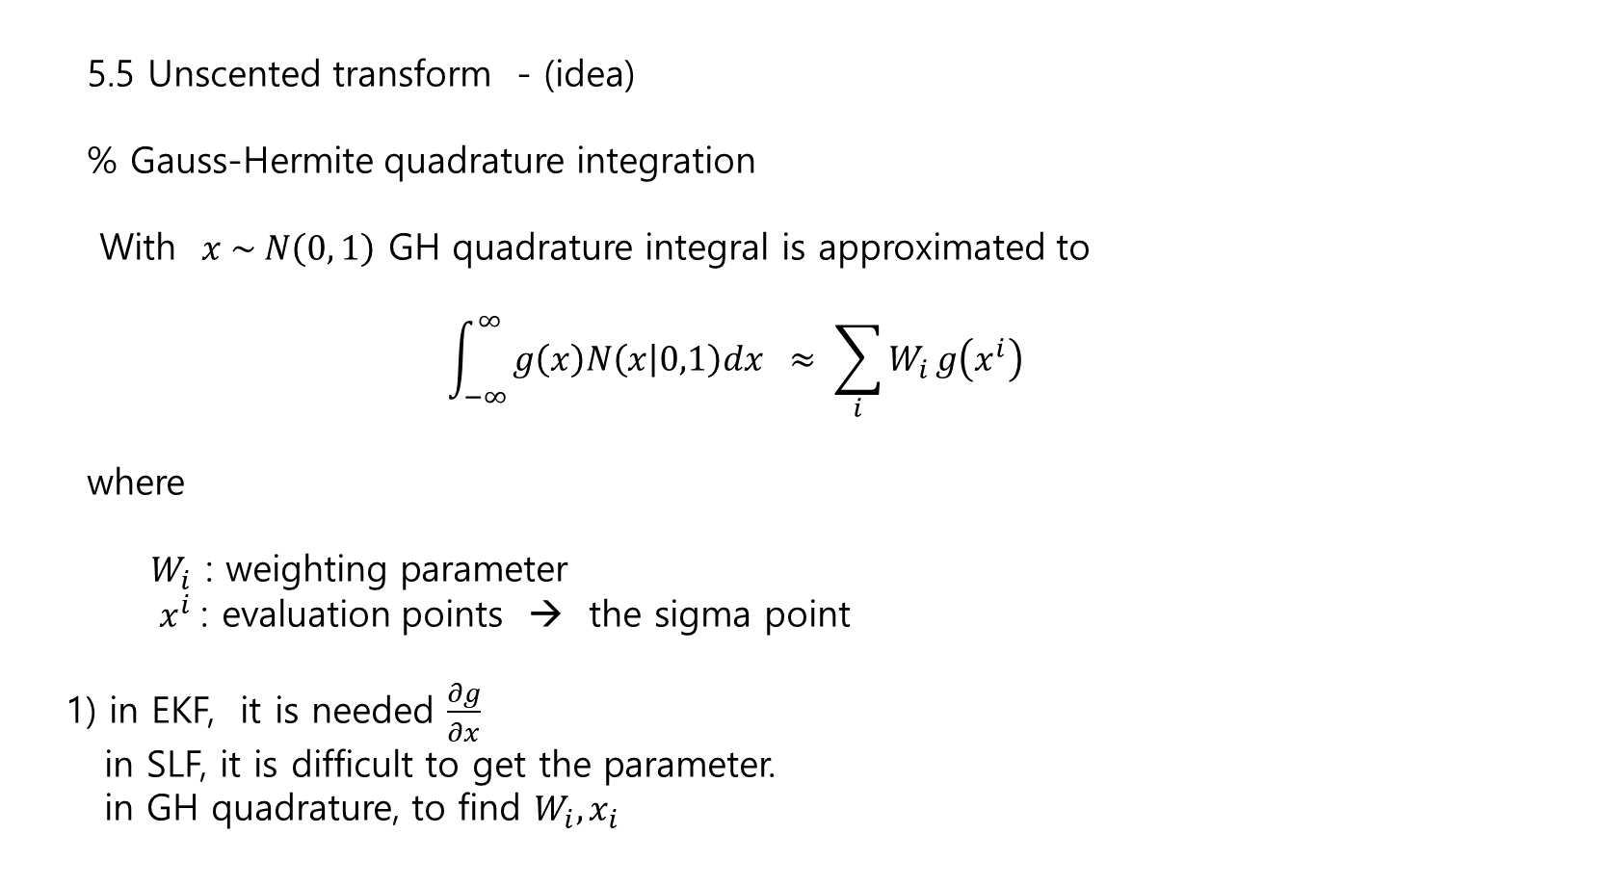
5.5 Unscented transform - (idea)
% Gauss-Hermite quadrature integration
With $x \sim N\left(0, 1\right)$ GH quadrature integral is approximated to
$$\int_{−∞}^{∞}{g\left(x\right)N\left(x | 0,1\right)dx ≈ \sum_{i}{W_{i}}g\left(x^{i}\right) }$$
where
$W_{i}$ : weighting parameter
$x^{i}$: evaluation points → the sigma point
1) in EKF, it is needed $\frac{∂g}{∂x}$
in SLF, it is difficult to get the parameter.
in GH quadrature, to find $W_{i}, x_{i}$

Slide 12
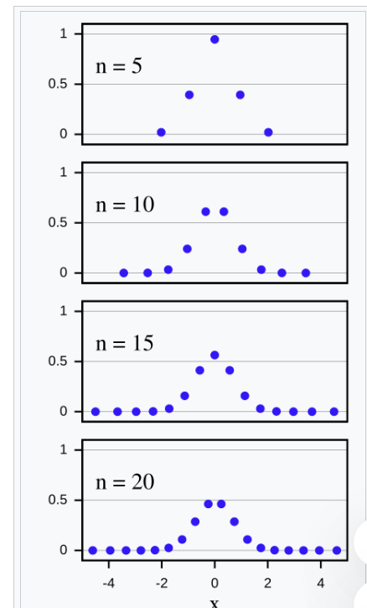

5.5 Unscented transform - (idea)
Gauss-Hermite quadrature is
$$\int_{−∞}^{∞}{e^{−x^{2}} f\left(x\right)dx \sim \sum_{i=1}^{n}{w_{i}f\left(x_{i}\right) }}$$
$$w_{i} =\frac{2^{n−1}n!\sqrt{π}}{n^{2}{\left[H_{n−1}\left(x_{i}\right)\right]}^{2}}$$
$$H_{n}\left(x\right)={\left(−1\right)}^{n}e^{x^{2}}\frac{d^{n}}{dx^{n}} e^{−x^{2}}$$
%% $x_{i} :$ sigma point

Slide 13

5.5 Unscented transform
Given
$$x\sim N\left(m,P\right) , y=g\left(x\right) , x∈ R^{n}$$
Find $E\left[Y\right] , Cov(Y)$
Unscented Transform (Algorithm 5.12)
Form sigma points $2n+1$
$$χ^{\left(0\right)}=m$$
$$χ^{\left(i\right)}=m+\sqrt{n+λ} {\left[\sqrt{P}\right]}_{i}$$
$$χ^{\left(i+n\right)}=m−\sqrt{n+λ} {\left[\sqrt{P}\right]}_{i} , i=0,1,2,…,n$$
where
$λ=α^{2}\left(n+κ\right)−n , α , κ are free parameters , \left(\sqrt{P}\right){\left(\sqrt{P}\right)}^{T}=P, {\left[P\right]}_{i} :i^{th} column of P$

Slide 14


5.5 Unscented transform
2. Propagate the sigma points thru the non-linear transformation
$$Υ^{i}=g\left(χ^{i}\right)$$
3.Estimate the mean and covariance of the transformed variables
$$E\left[g\left(x\right)\right] \sim μ_{U}= \sum_{i=0}^{i=2n }{W_{i}^{m}Υ^{i} }$$
$$Cov \left(g\left(x\right)\right) \sim S_{U} = \sum_{i=0}^{i=2n}{W_{i}^{c}\left(Υ^{i} −μ_{U}\right){\left(Υ^{i}−μ_{U}\right)}^{T}+Q}$$
$$W_{0}^{(C)}=\frac{λ}{n+λ}+\left(1−α^{2}+β\right)$$
$$W_{i}^{\left(m\right)}=\frac{1}{2\left(n+λ\right)}$$
$W_{i}^{\left(C\right)}=\frac{1}{2\left(n+λ\right)}$ for I = 1,2,…,2n
$$W_{0}^{(m)}=\frac{λ}{n+λ}$$

Slide 15
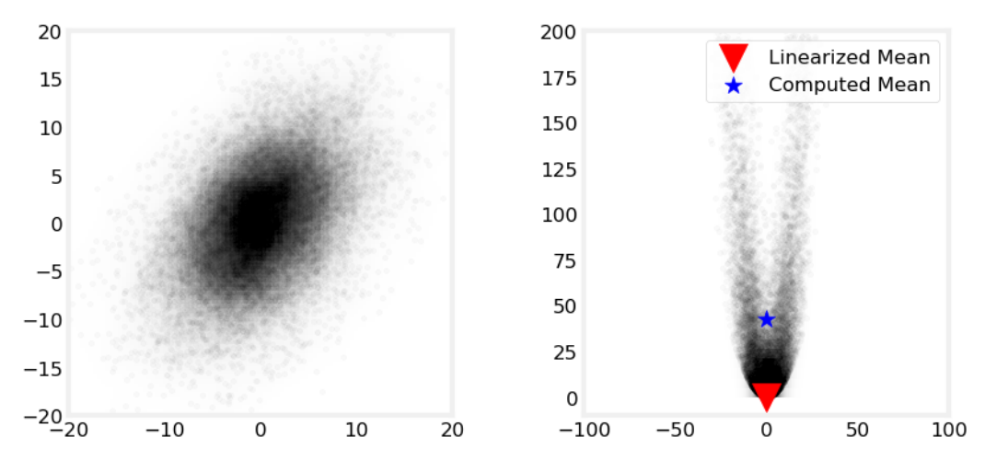
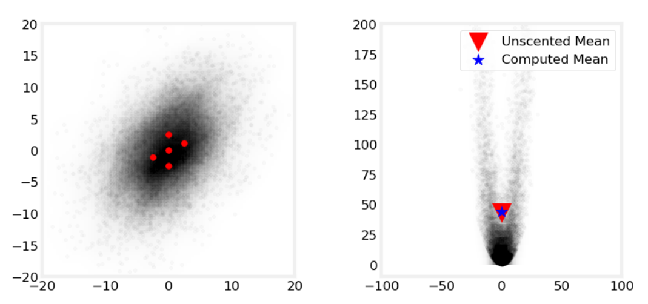
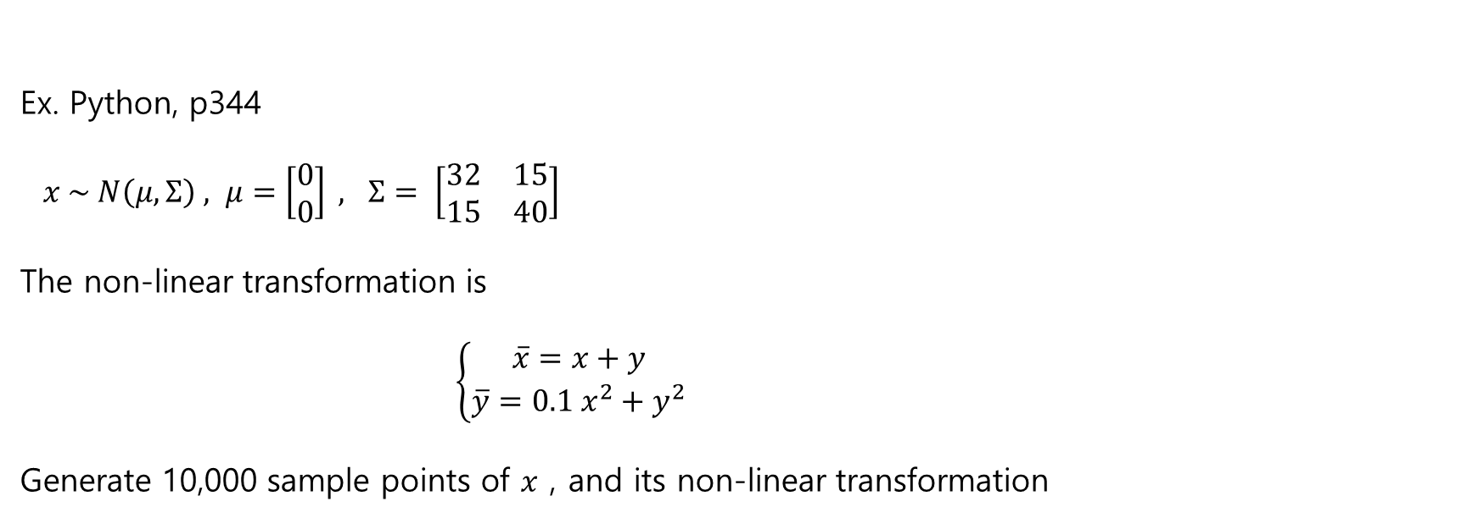
Ex. Python, p344
$x \sim N\left(μ, Σ\right) , μ=\left[\begin{matrix}0 \\ 0\end{matrix}\right] , Σ= \left[\begin{matrix}32 & 15 \\ 15 & 40\end{matrix}\right]$
The non-linear transformation is
$$\left\{\begin{aligned}\overline{x}=x+y \\ \overline{y}=0.1 x^{2}+y^{2}\end{aligned}\right.$$
Generate 10,000 sample points of $x$ , and its non-linear transformation

Slide 16
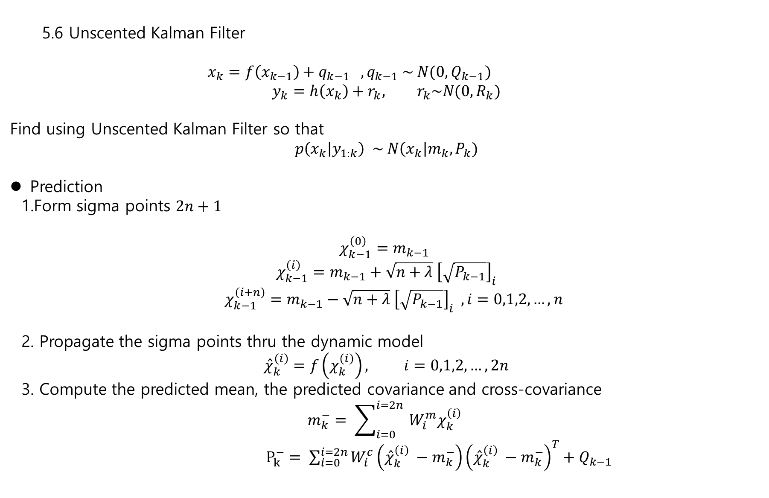
5.6 Unscented Kalman Filter
$x_{k}=f\left(x_{k−1}\right)+q_{k−1} , q_{k−1} \sim N(0, Q_{k−1})$
$$y_{k}=h\left(x_{k}\right)+r_{k}, r_{k}\sim N(0, R_{k})$$
Find using Unscented Kalman Filter so that
$$p\left(x_{k} | y_{1:k}\right) \sim N\left(x_{k}\right|m_{k}, P_{k})$$
Prediction
1.Form sigma points $2n+1$
$$χ_{k−1}^{\left(0\right)}=m_{k−1}$$
$$χ_{k−1}^{\left(i\right)}=m_{k−1}+\sqrt{n+λ} {\left[\sqrt{P_{k−1}}\right]}_{i}$$
$χ_{k−1}^{\left(i+n\right)}=m_{k−1}−\sqrt{n+λ} {\left[\sqrt{P_{k−1}}\right]}_{i} , i=0,1,2,…,n$
2. Propagate the sigma points thru the dynamic model
$${\hat{χ}}_{k}^{\left(i\right)}=f\left(χ_{k}^{\left(i\right)}\right), i=0,1,2,…, 2n$$
3. Compute the predicted mean, the predicted covariance and cross-covariance
$$m_{k}^{−}= \sum_{i=0}^{i=2n }{W_{i}^{m}χ_{k}^{\left(i\right)} }$$
$P_{k}^{−}= \sum_{i=0}^{i=2n}{W_{i}^{c}\left({\hat{χ}}_{k}^{\left(i\right)} −m_{k}^{−}\right){\left({\hat{χ}}_{k}^{\left(i\right)} −m_{k}^{−}\right)}^{T}+Q_{k−1}}$

Slide 17
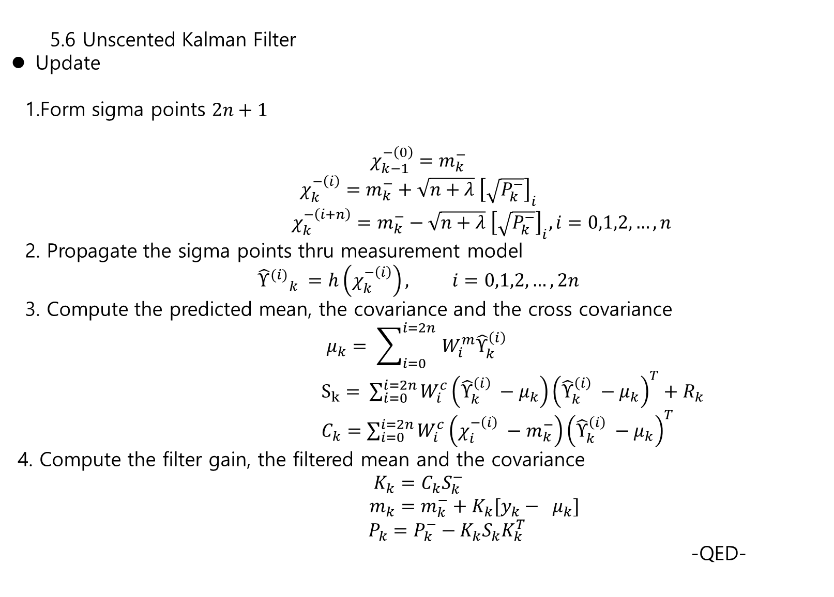
5.6 Unscented Kalman Filter
Update
1.Form sigma points $2n+1$
$$χ_{k−1}^{−\left(0\right)}=m_{k}^{−}$$
$$χ_{k}^{−\left(i\right)}=m_{k}^{−}+\sqrt{n+λ} {\left[\sqrt{P_{k}^{−}}\right]}_{i}$$
$χ_{k}^{−\left(i+n\right)}=m_{k}^{−}−\sqrt{n+λ} {\left[\sqrt{P_{k}^{−}}\right]}_{i}, i=0,1,2,…,n$
2. Propagate the sigma points thru measurement model
$${{\hat{Υ}}^{(i)}}_{k} =h\left(χ_{k}^{−\left(i\right)}\right), i=0,1,2,…, 2n$$
3. Compute the predicted mean, the covariance and the cross covariance
$$μ_{k}= \sum_{i=0}^{i=2n }{W_{i}^{m}{\hat{Υ}}_{k}^{\left(i\right)} }$$
$S_{k}= \sum_{i=0}^{i=2n}{W_{i}^{c}\left({\hat{Υ}}_{k}^{\left(i\right)} −μ_{k}\right){\left({\hat{Υ}}_{k}^{\left(i\right)} −μ_{k}\right)}^{T}+R_{k}}$
$C_{k}=\sum_{i=0}^{i=2n}{W_{i}^{c}\left(χ_{i}^{−\left(i\right)} −m_{k}^{−}\right){\left({\hat{Υ}}_{k}^{\left(i\right)} −μ_{k}\right)}^{T}}$
4. Compute the filter gain, the filtered mean and the covariance
$$K_{k}=C_{k}S_{k}^{−}$$
$m_{k}=m_{k}^{−}+K_{k}[y_{k}− μ_{k}]$
$P_{k}=P_{k}^{−}−K_{k}S_{k}K_{k}^{T}$
-QED-

Slide 18
Final Home assignment exercise 5.5
Bearings only target tracking problem
EKF / UKF / Particle Filter
The baseline code is exercise7_2.m

