Slide 1
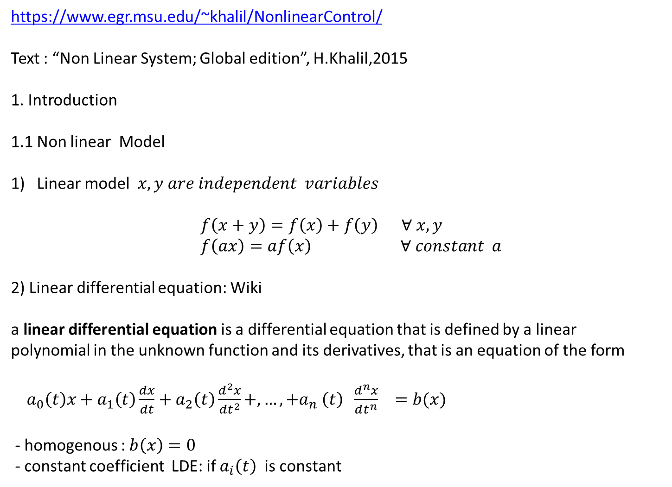
https://www.egr.msu.edu/~khalil/NonlinearControl/
Text : “Non Linear System; Global edition”, H.Khalil,2015
1. Introduction
1.1 Non linear Model
Linear model $x,y are independent variables$
$f\left(x+y\right)=f\left(x\right)+f\left(y\right) ∀ x,y$
$f\left(ax\right)=af\left(x\right) ∀ constant a$
2) Linear differential equation: Wiki
a linear differential equation is a differential equation that is defined by a linear polynomial in the unknown function and its derivatives, that is an equation of the form
$a_{0}\left(t\right)x+a_{1}\left(t\right)\frac{dx}{dt}+a_{2}\left(t\right)\frac{d^{2}x}{dt^{2}}+,…, +a_{n} \left(t\right) \frac{d^{n}x}{dt^{n}} =b(x)$
- homogenous : $b\left(x\right)=0$
- constant coefficient LDE: if $a_{i}\left(t\right)$ is constant

Slide 2

1. Introduction
1.1 Non linear Model
State space model of linear differential equations
$\dot{x} =Ax+Bu , x∈ R^{n} , u∈R^{m}$
with n independent boundary conditions ( in general initial points)
$∃ a unique x^{∗}\left(t\right)$
** Boundary conditions
$x\left(t_{0}\right) , x\left(t_{n}\right), x\left(t^{∗}\right), t^{∗} a fixed\left(known\right)$

Slide 3
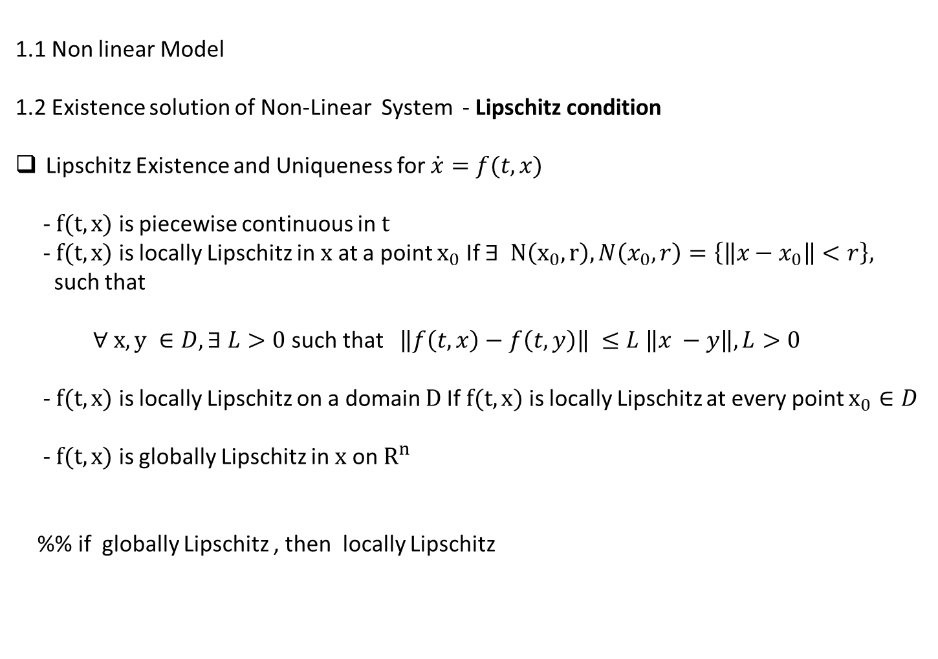
1.1 Non linear Model
1.2 Existence solution of Non-Linear System - Lipschitz condition
Lipschitz Existence and Uniqueness for $\dot{x}=f(t,x)$
- $f(t,x)$ is piecewise continuous in $t$
- $f(t,x)$ is locally Lipschitz in $x$ at a point $x_{0}$ If $∃ N\left(x_{0},r\right), N\left(x_{0},r\right)=\left\{\left\|x−x_{0}\right\|<r\right\},$
such that
$∀ x,y ∈D, ∃ L>0$ such that $\left\|f\left(t,x\right)−f\left(t,y\right)\right\| ≤L \left\|x −y\right\|, L>0$
- $f(t,x)$ is locally Lipschitz on a domain $D$If $f(t,x)$ is locally Lipschitz at every point $x_{0}∈D$
- $f(t,x)$ is globally Lipschitz in $x$ on $R^{n}$
%% if globally Lipschitz , then locally Lipschitz

Slide 4
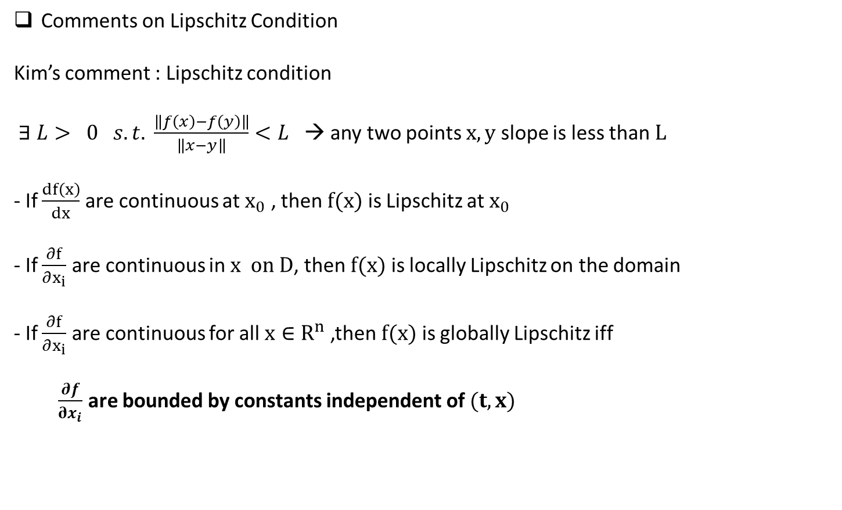
Comments on Lipschitz Condition
Kim’s comment : Lipschitz condition
$∃ L> 0 s.t. \frac{\left\|f\left(x\right)−f\left(y\right)\right\|}{\left\|x−y\right\|}<L$ → any two points $x,y$ slope is less than $L$
- If $\frac{df\left(x\right)}{dx}$ are continuous at $x_{0}$ , then $f(x)$ is Lipschitz at $x_{0}$
- If $\frac{∂f}{∂x_{i}}$ are continuous in $x on D$, then $f(x)$ is locally Lipschitz on the domain
- If $\frac{∂f}{∂x_{i}}$ are continuous for all $x∈R^{n}$,then $f(x)$ is globally Lipschitz iff
$\frac{∂f}{∂x_{i}}$ are bounded by constants independent of $(t,x)$

Slide 5
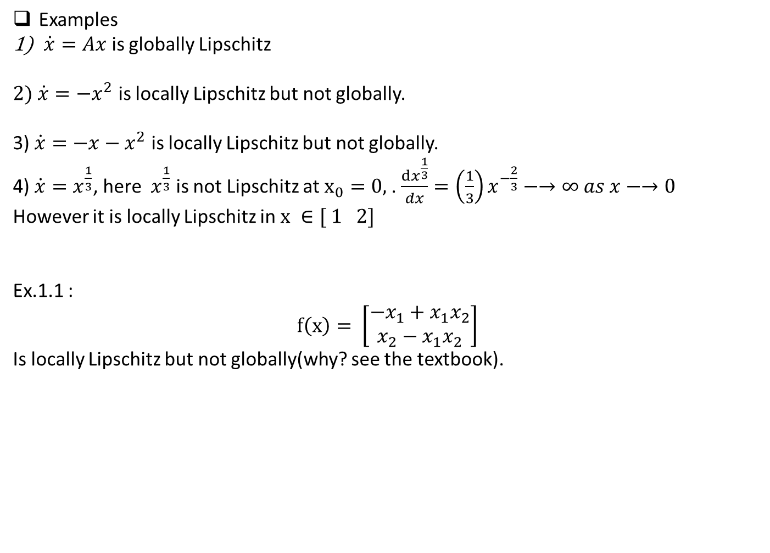
Examples
$\dot{x}=Ax$ is globally Lipschitz
$2) \dot{x}=−x^{2}$ is locally Lipschitz but not globally.
3) $\dot{x}=−x−x^{2}$ is locally Lipschitz but not globally.
4) $\dot{x}=x^{\frac{1}{3}}$, here $x^{\frac{1}{3}}$ is not Lipschitz at $x_{0}=0,$. $\frac{dx^{\frac{1}{3}}}{dx}={\left(\frac{1}{3}\right)x}^{−\frac{2}{3}}−→∞ as x−→0$
However it is locally Lipschitz in $x ∈[ 1 2]$
Ex.1.1 :
$$f\left(x\right)= \left[\begin{matrix}−x_{1}+x_{1}x_{2} \\ x_{2}−x_{1}x_{2}\end{matrix}\right]$$
Is locally Lipschitz but not globally(why? see the textbook).

Slide 6
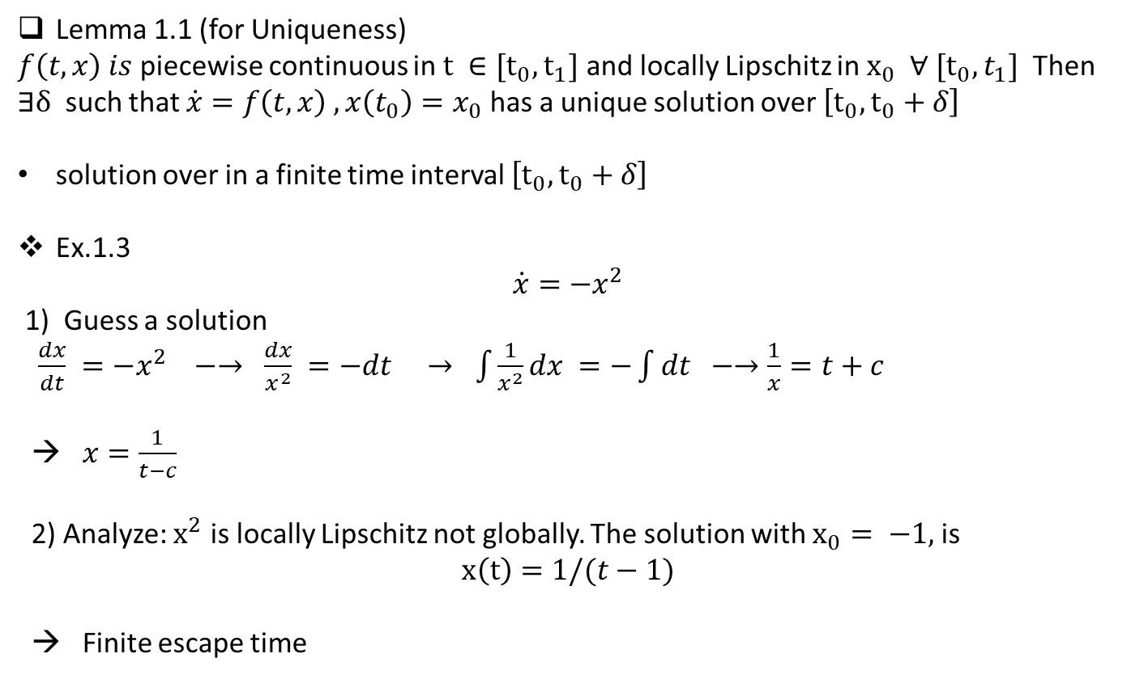
Lemma 1.1 (for Uniqueness)
$f\left(t,x\right) is$piecewise continuous in $t ∈[t_{0},t_{1}]$ and locally Lipschitz in $x_{0} ∀ [t_{0}, t_{1}]$ Then
$∃δ$ such that $\dot{x}=f\left(t,x\right) , x\left(t_{0}\right)=x_{0}$ has a unique solution over $\left[t_{0}, t_{0}+δ\right]$
solution over in a finite time interval $\left[t_{0}, t_{0}+δ\right]$
Ex.1.3
$$\dot{x}=−x^{2}$$
1) Guess a solution
$\frac{dx}{dt} =−x^{2} −→ \frac{dx}{x^{2}} =−dt → \int{\frac{1}{x^{2}}dx =−\int{dt −→\frac{1}{x}=t+c }}$
→ $x=\frac{1}{t−c}$
2) Analyze: $x^{2}$ is locally Lipschitz not globally. The solution with $x_{0}= −1,$is
$$x\left(t\right)=1/(t−1)$$
→ Finite escape time

Slide 7
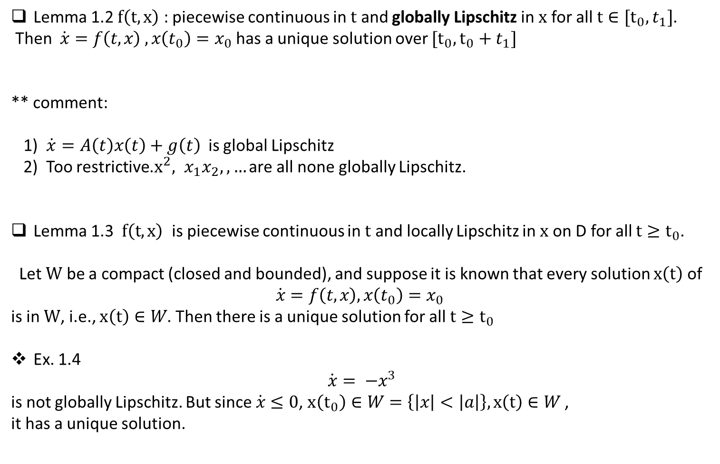
Lemma 1.2 $f\left(t,x\right)$ : piecewise continuous in $t$ and globally Lipschitz in $x$ for all $t∈[t_{0}, t_{1}]$.
Then $\dot{x}=f\left(t,x\right) , x\left(t_{0}\right)=x_{0}$ has a unique solution over $[t_{0}, t_{0}+t_{1}]$
** comment:
1) $\dot{x}=A\left(t\right)x\left(t\right)+g\left(t\right)$ is global Lipschitz
2) Too restrictive.$x^{2}, x_{1}x_{2}, ,…$ are all none globally Lipschitz.
Lemma 1.3 $f\left(t,x\right)$ is piecewise continuous in $t$ and locally Lipschitz in $x$ on D for all $t≥t_{0}$.
Let $W$ be a compact (closed and bounded), and suppose it is known that every solution $x\left(t\right)$ of
$$\dot{x}=f\left(t,x\right), x\left(t_{0}\right)=x_{0}$$
is in $W$, i.e., $x\left(t\right)∈W$. Then there is a unique solution for all $t≥t_{0}$
Ex. 1.4
$$\dot{x}= −x^{3}$$
is not globally Lipschitz. But since $\dot{x}≤0$, $x\left(t_{0}\right)∈W=\left\{\left|x\right|<\left|a\right|\right\}, x\left(t\right)∈W$,
it has a unique solution.

Slide 8
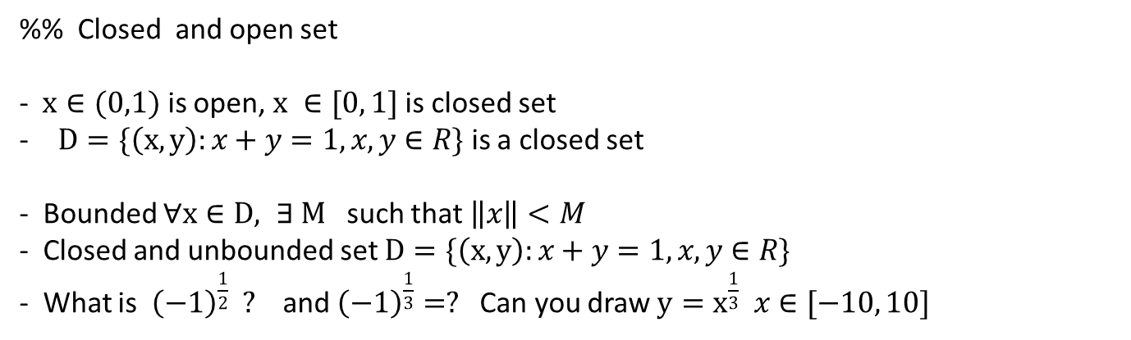
%% Closed and open set
- $x∈(0,1)$ is open, $x ∈[0, 1]$ is closed set
$D=\{\left(x,y\right):x+y=1,x, y∈R\}$ is a closed set
- Bounded $∀x∈D, ∃ M$ such that $\left\|x\right\|<M$
- Closed and unbounded set $D=\{\left(x,y\right):x+y=1, x, y∈R\}$
- What is ${\left(−1\right)}^{\frac{1}{2}} ?$and ${\left(−1\right)}^{\frac{1}{3}}=?$ Can you draw $y=x^{\frac{1}{3}} x∈[−10, 10]$

Slide 9
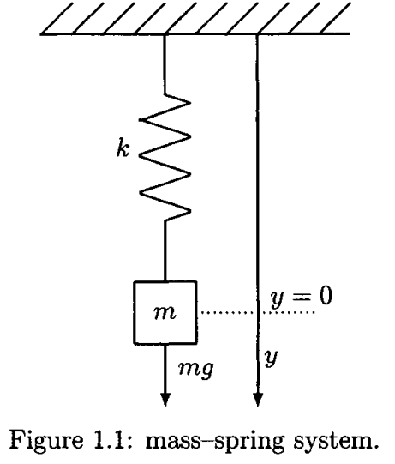
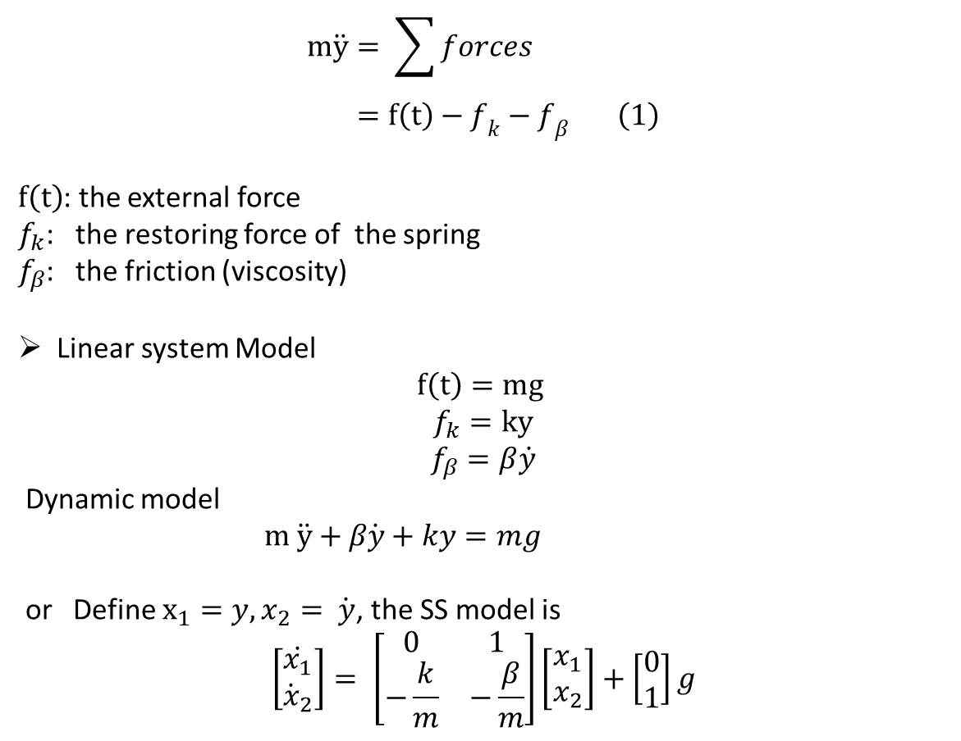
Example
$$m\ddot{y}= \sum{forces} \\ =f\left(t\right)−f_{k}−f_{β} \left(1\right)$$
$f\left(t\right)$: the external force
$f_{k}$: the restoring force of the spring
$f_{β}$: the friction (viscosity)
Linear system Model
$$f\left(t\right)=mg$$
$$f_{k}=ky$$
$$f_{β}=β\dot{y}$$
Dynamic model
$m \ddot{y}+β\dot{y}+ky=mg$
or Define $x_{1}=y, x_{2}= \dot{y}$, the SS model is
$$\left[\begin{matrix}\dot{x_{1}} \\ {\dot{x}}_{2}\end{matrix}\right]= \left[\begin{matrix}0 & 1 \\ −\frac{k}{m} & −\frac{β}{m}\end{matrix}\right]\left[\begin{matrix}x_{1} \\ x_{2}\end{matrix}\right]+\left[\begin{matrix}0 \\ 1\end{matrix}\right]g$$

Slide 10
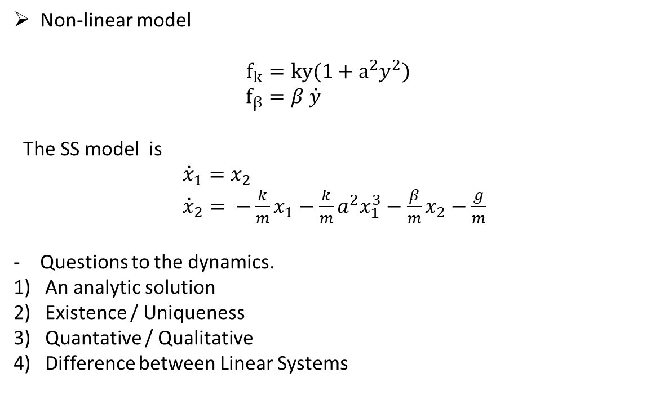
Non-linear model
$$f_{k}=ky(1+a^{2}y^{2}) \\ f_{β}=β \dot{y}$$
The SS model is
${\dot{x}}_{1}=x_{2}$ ${\dot{x}}_{2}= −\frac{k}{m}x_{1}−\frac{k}{m}a^{2}x_{1}^{3}−\frac{β}{m}x_{2}−\frac{g}{m}$
Questions to the dynamics.
An analytic solution
Existence / Uniqueness
Quantative / Qualitative
Difference between Linear Systems

Slide 11
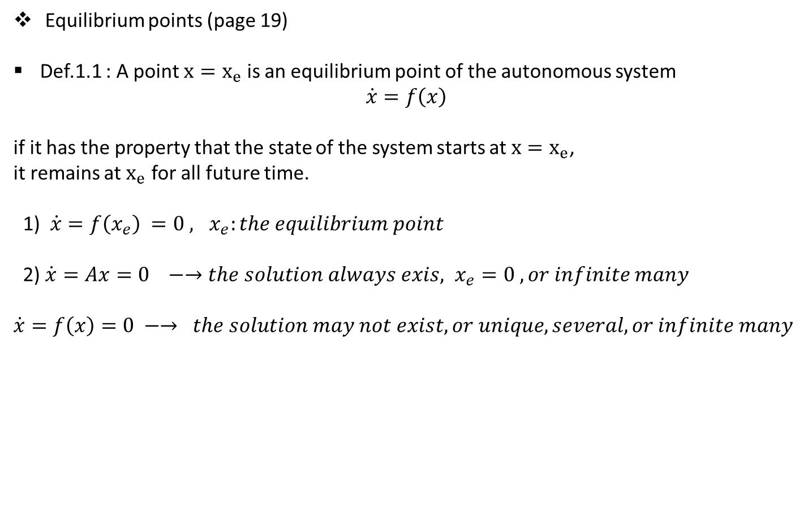
Equilibrium points (page 19)
Def.1.1 : A point $x=x_{e}$ is an equilibrium point of the autonomous system
$$\dot{x}=f\left(x\right)$$
if it has the property that the state of the system starts at $x=x_{e}$,
it remains at $x_{e}$ for all future time.
1) $\dot{x}=f\left(x_{e}\right) =0 , x_{e}:the equilibrium point$
2) $\dot{x}=Ax=0 −→the solution always exis, x_{e}=0 , or infinite many$
$\dot{x}=f\left(x\right)=0 −→ the solution may not exist, or unique, several, or infinite many$

Slide 12
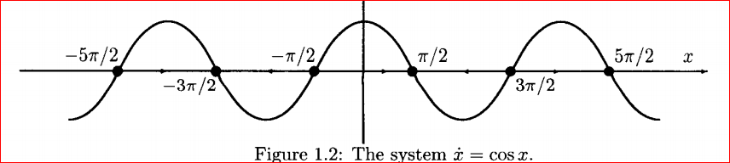

Ch.2 Two Dimensional System
The first order autonomous NL system
$\dot{x}=f(x)$
$f\left(x\right):$ the velocity vector
$\dot{x}=\cos{x }$
1) Equilibrium points
$$\cos{x_{e}}=0$$
$x_{e}=0$, → $x_{e}=\frac{\left(1+2k\right)π}{2}, k=0, ±1, ±2, …$
2) Near the equilibrium points
Attractive $x_{e}$ , for $k$ even integers
Repelling $x_{e}$ for $k$ odd integers

Slide 13
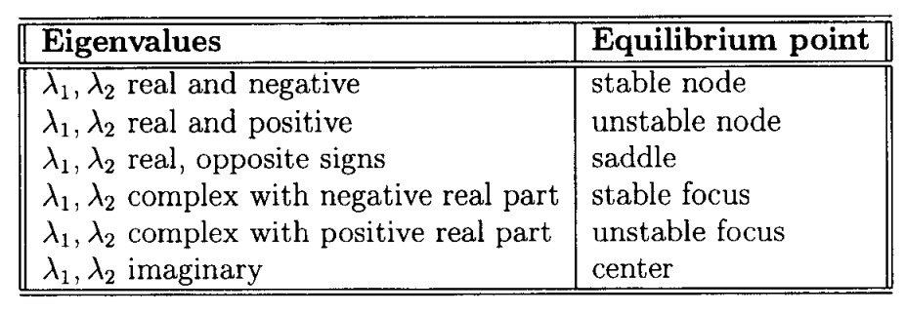

2.1 Qualitative Behavior of Linear System: Phase – Plane Analysis(or Vector field) in LTI
-Practically only in 2-Dim system
-Benefit: in NL, if there is no analytic solution to a dynamic equation, qualitatively analysis is provided
Linear system
$$\dot{x}=Ax$$
Stable node
$$\left[\begin{matrix}{\dot{x}}_{1} \\ {\dot{x}}_{2}\end{matrix}\right]= \left[\begin{matrix}−1 & 3 \\ 0 & −2\end{matrix}\right]\left[\begin{matrix}x_{1} \\ x_{2}\end{matrix}\right]$$
- $λ_{1}, λ_{2} :$ -1,-2
e-vector: [1 0]’, [-3,1]’

Slide 14

The Second order system: Phase – Plane Analysis(or Vector field) in LTI
2) Unstable node
$$\left[\begin{matrix}{\dot{x}}_{1} \\ {\dot{x}}_{2}\end{matrix}\right]= \left[\begin{matrix}1 & 3 \\ 0 & 2\end{matrix}\right]\left[\begin{matrix}x_{1} \\ x_{2}\end{matrix}\right]$$
- $λ_{1}, λ_{2} :$ real negative
3) Saddle
$$\left[\begin{matrix}{\dot{x}}_{1} \\ {\dot{x}}_{2}\end{matrix}\right]= \left[\begin{matrix}−1 & 3 \\ 0 & 2\end{matrix}\right]\left[\begin{matrix}x_{1} \\ x_{2}\end{matrix}\right]$$
- ($λ_{1}, λ_{2} )=\left(−1,2\right)$ real,opposite sign
e-vector =[1;0]; [1 1];

Slide 15

The Second order system: Phase – Plane Analysis(or Vector field) in LTI
4) Stable node
$$\left[\begin{matrix}{\dot{x}}_{1} \\ {\dot{x}}_{2}\end{matrix}\right]= \left[\begin{matrix}−2 & 1 \\ 0 & −2\end{matrix}\right]\left[\begin{matrix}x_{1} \\ x_{2}\end{matrix}\right]$$
- $λ_{1}, λ_{2}=−2$
e-vector =[ 1 0; -1 0];

Slide 16

The Second order system: Phase – Plane Analysis(or Vector field, phase portrait) in LTI
5) Oscillation
$$\left[\begin{matrix}{\dot{x}}_{1} \\ {\dot{x}}_{2}\end{matrix}\right]= \left[\begin{matrix}0 & −3 \\ 1 & 0\end{matrix}\right]\left[\begin{matrix}x_{1} \\ x_{2}\end{matrix}\right]$$
- $λ_{1}, λ_{2} :$ complex
6) Unstable focus
$$\left[\begin{matrix}{\dot{x}}_{1} \\ {\dot{x}}_{2}\end{matrix}\right]= \left[\begin{matrix}0.5 & −1 \\ 1 & 0.5\end{matrix}\right]\left[\begin{matrix}x_{1} \\ x_{2}\end{matrix}\right]$$
- $λ_{1}, λ_{2} :$ complex with a positive real

Slide 17
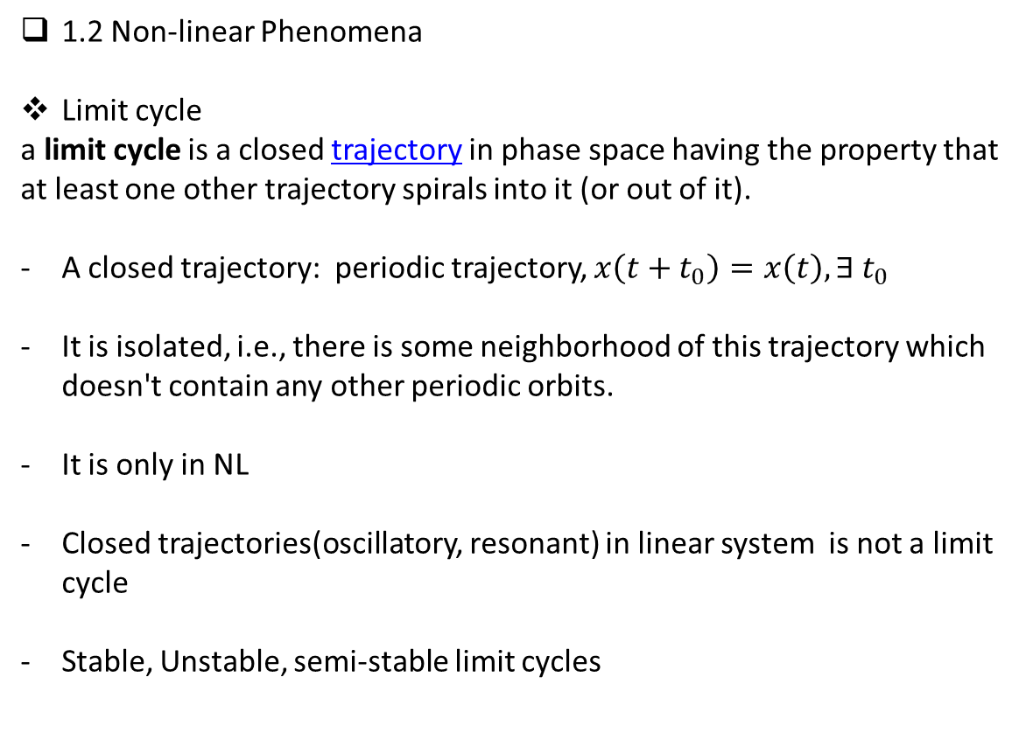
1.2 Non-linear Phenomena
Limit cycle
a limit cycle is a closed trajectory in phase space having the property that at least one other trajectory spirals into it (or out of it).
A closed trajectory: periodic trajectory, $x\left(t+t_{0}\right)=x\left(t\right), ∃ t_{0}$
It is isolated, i.e., there is some neighborhood of this trajectory which doesn't contain any other periodic orbits.
It is only in NL
Closed trajectories(oscillatory, resonant) in linear system is not a limit cycle
Stable, Unstable, semi-stable limit cycles

Slide 18

Example: Van der Pol Oscillator
$$\ddot{y}−μ\dot{\dot{\left(1−y^{2}\right)}} \dot{y}+y=0, μ>0$$
1) State-space model: Define $x_{1}=y, x_{2}=\dot{y}$.
$${\dot{x}}_{1}=x_{2} \\ {\dot{x}}_{2}={−x}_{1}+μ\left(1−x_{1}^{2}\right)x_{2}$$
If $μ=1.5$, with the initial points =(-0.1, 0.1) , (-1, 2)
$$x_{e}$$

Slide 19
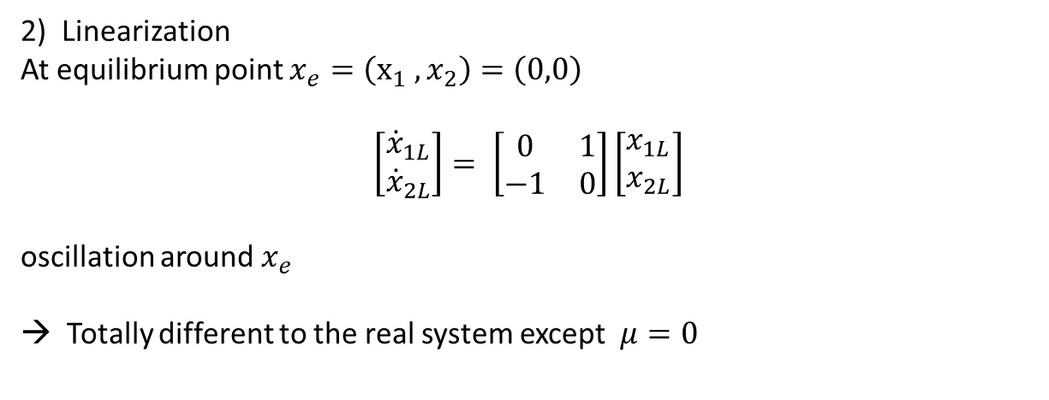
2) Linearization
At equilibrium point $x_{e}=\left(x_{1} , x_{2}\right)=\left(0,0\right)$
$$\left[\begin{matrix}{\dot{x}}_{1L} \\ {\dot{x}}_{2L}\end{matrix}\right]= \left[\begin{matrix}0 & 1 \\ −1 & 0\end{matrix}\right]\left[\begin{matrix}x_{1L} \\ x_{2L}\end{matrix}\right]$$
oscillation around $x_{e}$
→ Totally different to the real system except $μ=0$

Slide 20
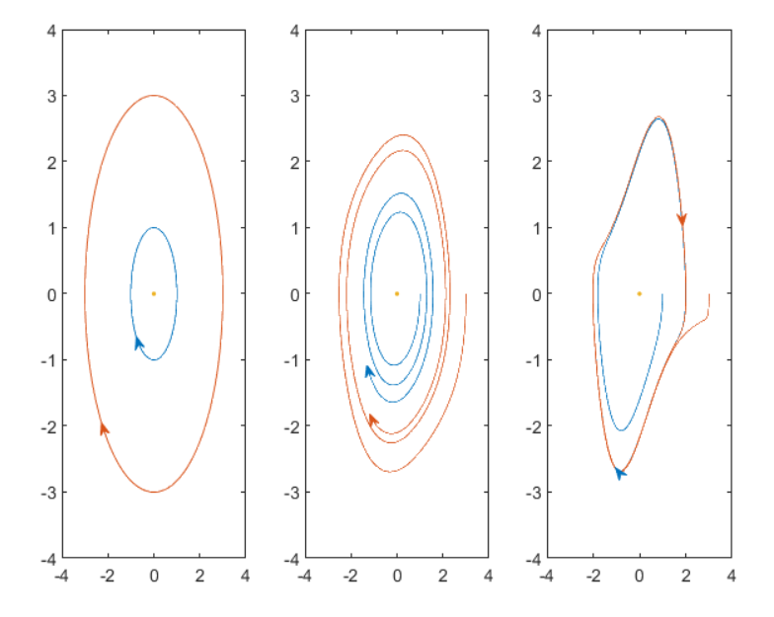
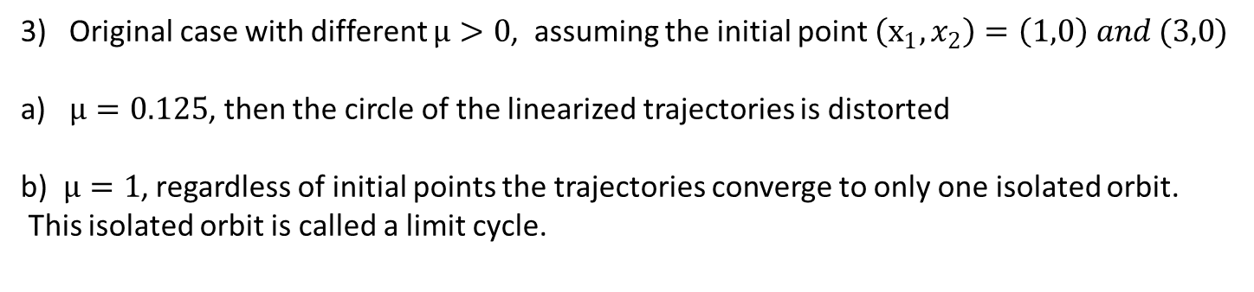
Original case with different $μ>0$, assuming the initial point $\left(x_{1}, x_{2}\right)=\left(1,0\right) and (3,0)$
$μ=0.125$, then the circle of the linearized trajectories is distorted
b) $μ=1$, regardless of initial points the trajectories converge to only one isolated orbit.
This isolated orbit is called a limit cycle.
- Linearized , $μ=0.125$, $μ=1, the trajectoy with the initial points$

Slide 21
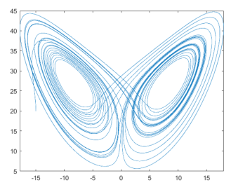
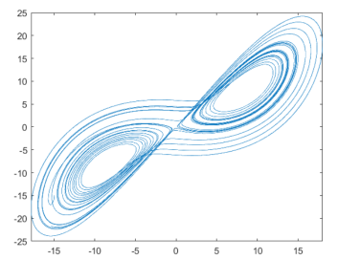
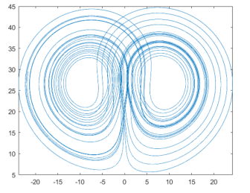
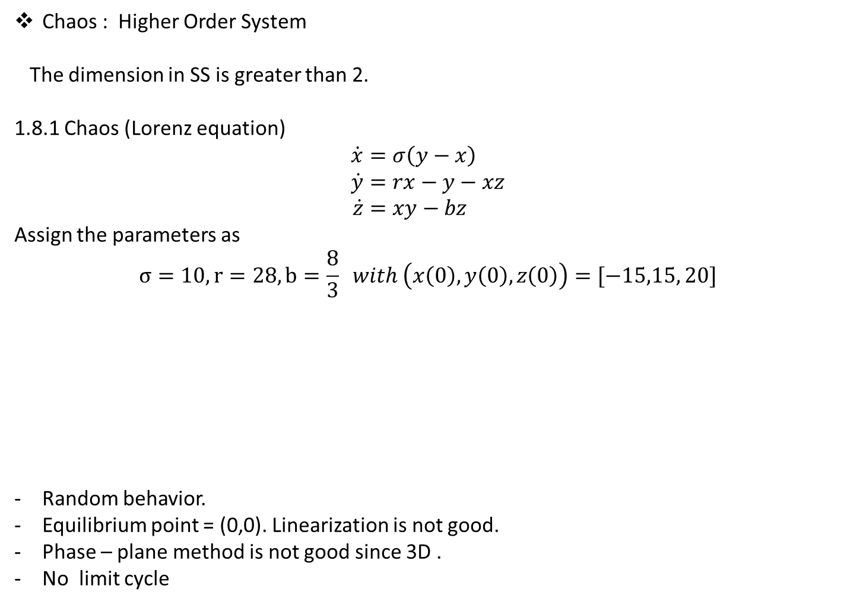
Chaos : Higher Order System
The dimension in SS is greater than 2.
1.8.1 Chaos (Lorenz equation)
$$\dot{x}=σ\left(y−x\right) \\ \dot{y}=rx−y−xz \\ \dot{z}=xy−bz$$
Assign the parameters as
$$σ=10, r=28, b=\frac{8}{3} with \left(x\left(0\right), y\left(0\right), z\left(0\right)\right)=[−15,15, 20]$$
Random behavior.
Equilibrium point = (0,0). Linearization is not good.
Phase – plane method is not good since 3D .
No limit cycle

Slide 22
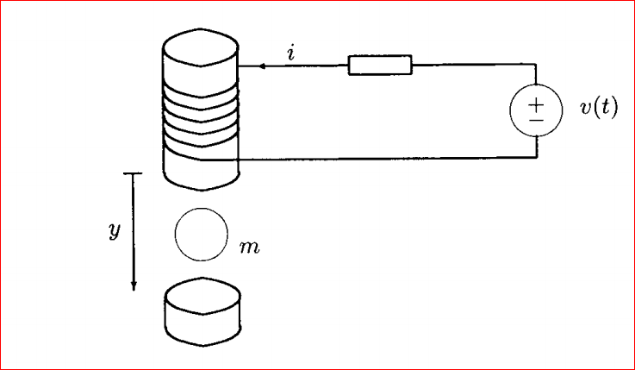
1.9 Examples of non-linear system
Magnetic Suspension system
- high speed train. Magnetic bearing, gyroscope,…

Slide 23
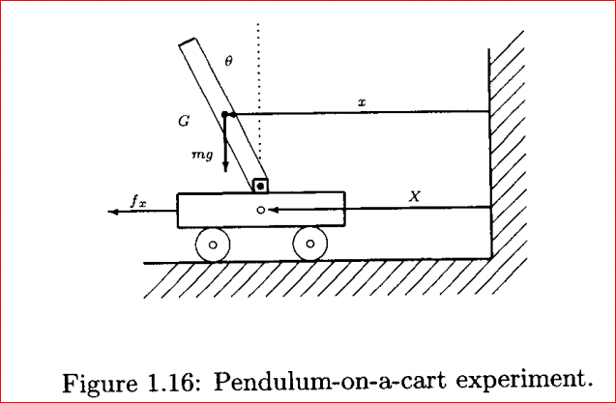
2) Inverted pendulum on a cart

Slide 24
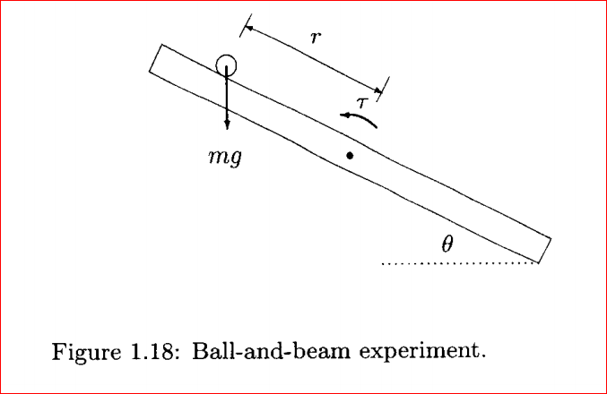
3) Ball and beam

Slide 25
Ending Remark – features of Non Linear System
- Equilibrium points
- Finite escape time
- limit cycle
- Chaos

