Slide 1
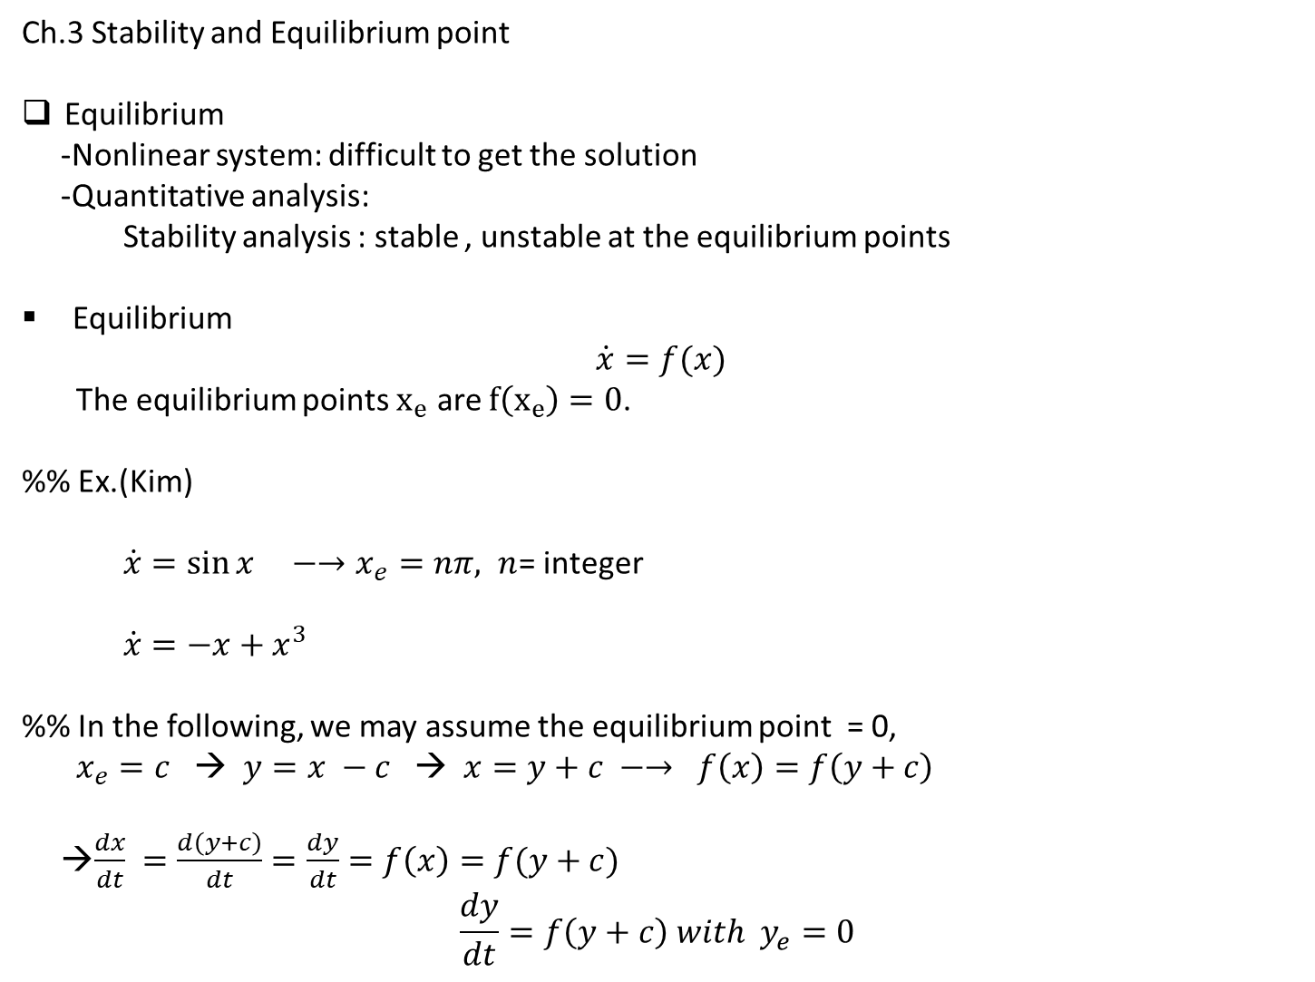
Ch.3 Stability and Equilibrium point
Equilibrium
-Nonlinear system: difficult to get the solution
-Quantitative analysis:
Stability analysis : stable , unstable at the equilibrium points
Equilibrium
$$\dot{x}=f(x)$$
The equilibrium points $x_{e}$ are $f\left(x_{e}\right)=0$.
%% Ex.(Kim)
$\dot{x}=\sin{x} −→x_{e}=nπ, n$= integer
$\dot{x}=−x+x^{3}$
%% In the following, we may assume the equilibrium point = 0,
$x_{e}=c$ → $y=x −c$ → $x=y+c −→ f\left(x\right)=f\left(y+c\right)$
→$\frac{dx}{dt} =\frac{d\left(y+c\right)}{dt}=\frac{dy}{dt}=f\left(x\right)=f(y+c)$
$$\frac{dy}{dt}=f\left(y+c\right) with y_{e}=0$$

Slide 2
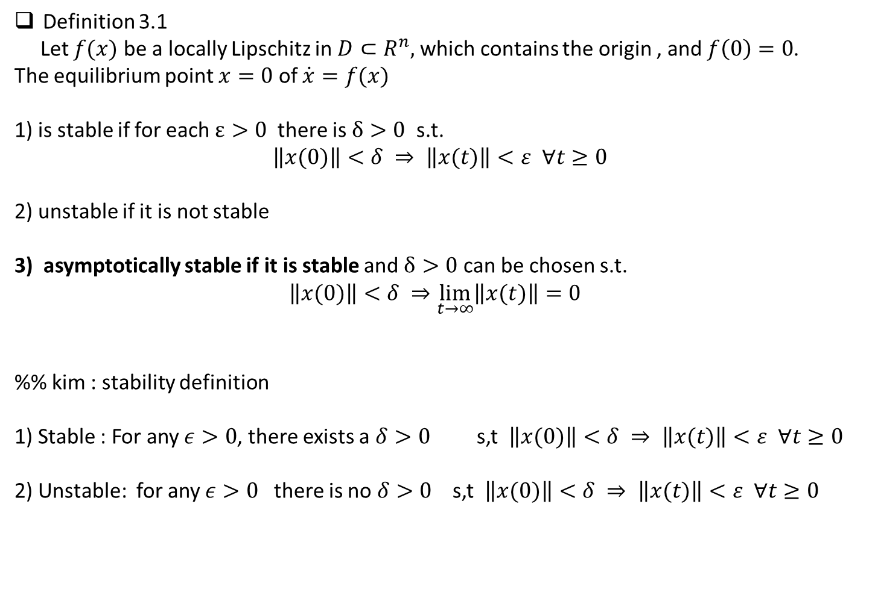
Definition 3.1
Let $f(x)$ be a locally Lipschitz in $D⊂R^{n},$which contains the origin , and $f\left(0\right)=0$.
The equilibrium point $x=0$ of $\dot{x}=f(x)$
1) is stable if for each $ε>0$ there is $δ>0$ s.t.
$$\left\|x(0)\right\|<δ ⇒ \left\|x(t)\right\|<ε ∀t≥0$$
2) unstable if it is not stable
3) asymptotically stable if it is stable and $δ>0$ can be chosen s.t.
$$\left\|x(0)\right\|<δ ⇒\lim_{t→∞}\left\|x(t)\right\|=0$$
%% kim : stability definition
1) Stable : For any $ε>0$, there exists a $δ>0$ s,t $\left\|x(0)\right\|<δ ⇒ \left\|x(t)\right\|<ε ∀t≥0$
2) Unstable: for any $ε>0$ there is no $δ>0$ s,t $\left\|x(0)\right\|<δ ⇒ \left\|x(t)\right\|<ε ∀t≥0$

Slide 3

$$\left\|x(0)\right\|<δ ⇒ \left\|x(t)\right\|<ε ∀t≥0$$

Slide 4
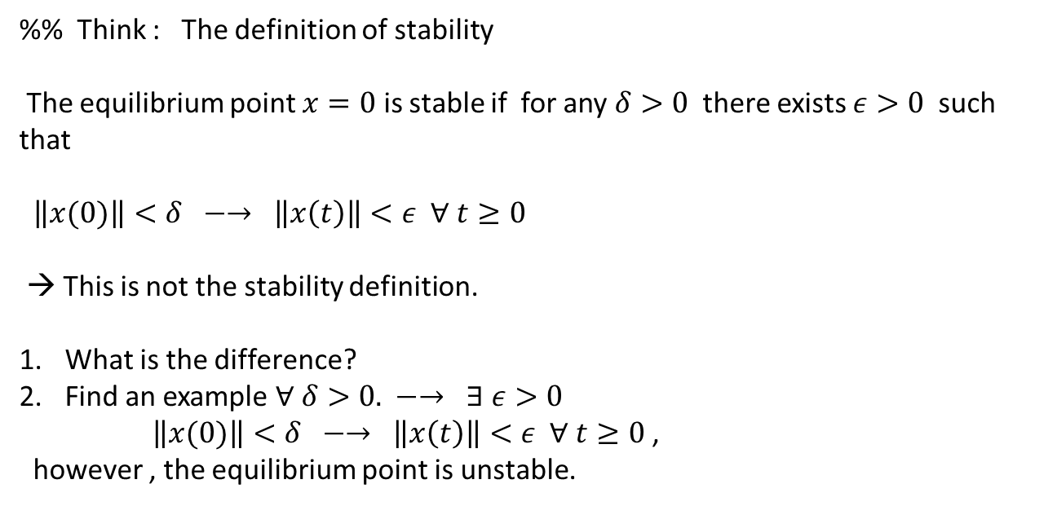
%% Think : The definition of stability
The equilibrium point $x=0$ is stable if for any $δ>0$ there exists $ε>0$ such that
$\left\|x(0)\right\|<δ −→ \left\|x\left(t\right)\right\|<ε ∀ t≥0$
→ This is not the stability definition.
What is the difference?
Find an example $∀ δ>0. −→ ∃ ε>0$
$\left\|x(0)\right\|<δ −→ \left\|x\left(t\right)\right\|<ε ∀ t≥0$,
however , the equilibrium point is unstable.

Slide 5
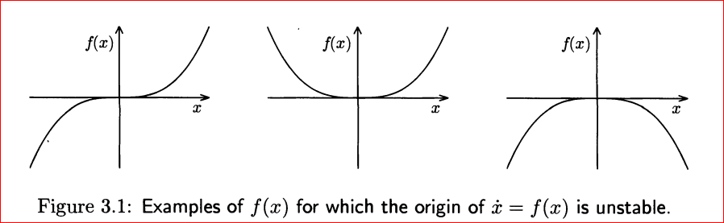
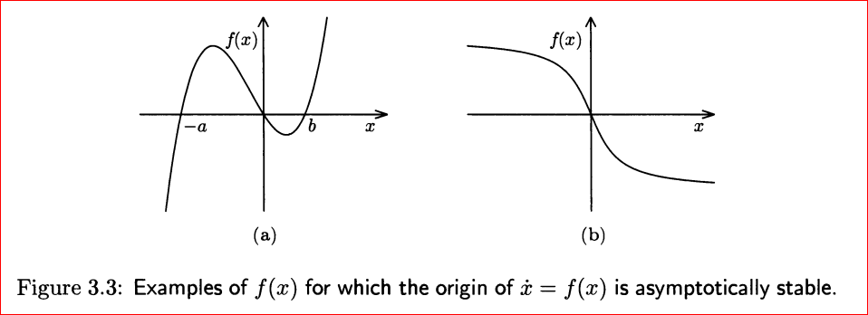

$$\dot{x}=f(x)$$

Slide 6
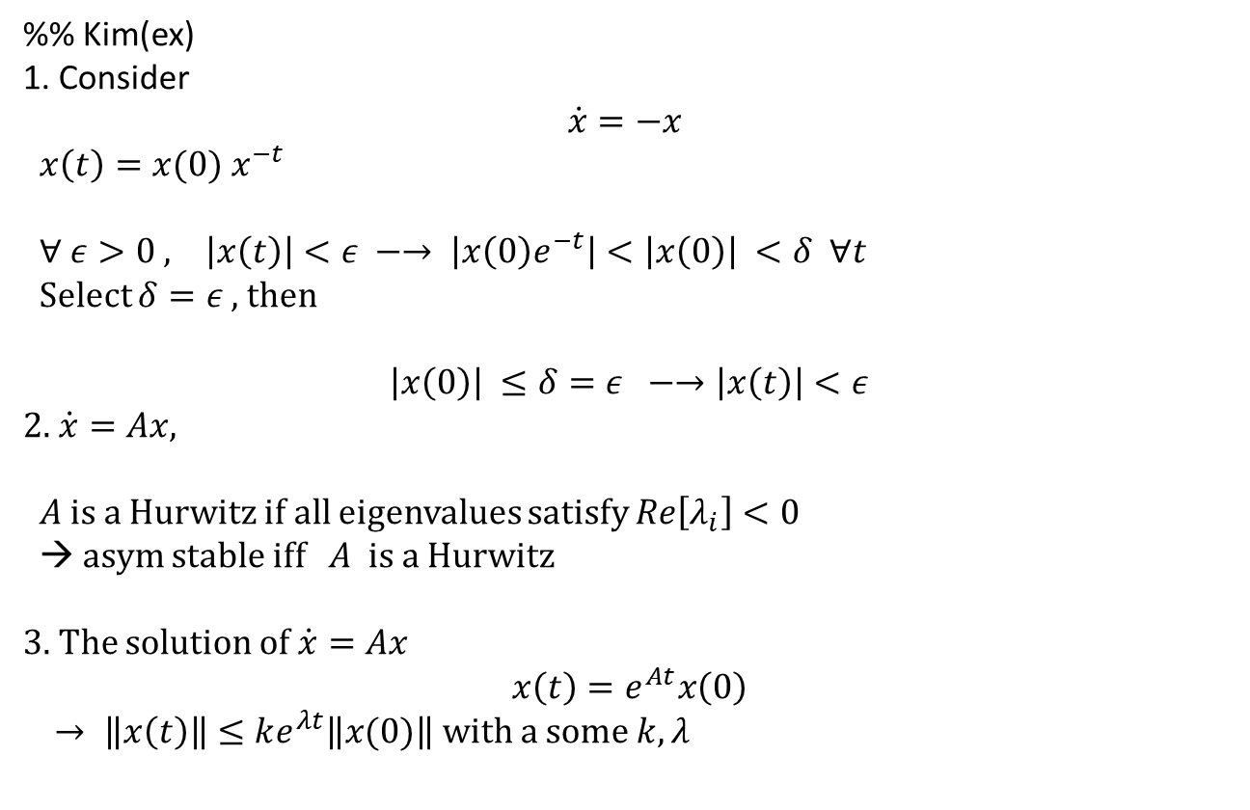
%% Kim(ex)
1. Consider
$$\dot{x}=−x$$
$x\left(t\right)=x(0) x^{−t}$
$∀ ε>0 , \left|x\left(t\right)\right|<ε −→ \left|x\left(0\right)e^{−t}\right|<\left|x\left(0\right)\right| <δ ∀t$
Select $δ=ε$, then
$$\left|x\left(0\right)\right| ≤δ=ε −→\left|x\left(t\right)\right|<ε$$
2. $\dot{x}=Ax,$
$A$ is a Hurwitz if all eigenvalues satisfy $Re\left[λ_{i}\right]<0$
→ asym stable iff $A$ is a Hurwitz
3. The solution of $\dot{x}=Ax$
$$x\left(t\right)=e^{At}x\left(0\right)$$
$→ \left\|x\left(t\right)\right\|≤ke^{λt}\left\|x(0)\right\|$ with a some $k,λ$

Slide 7
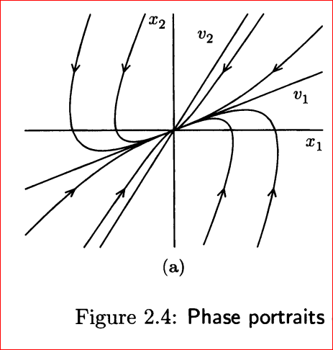
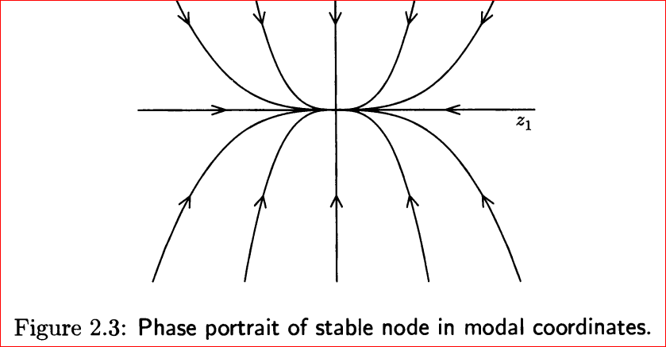
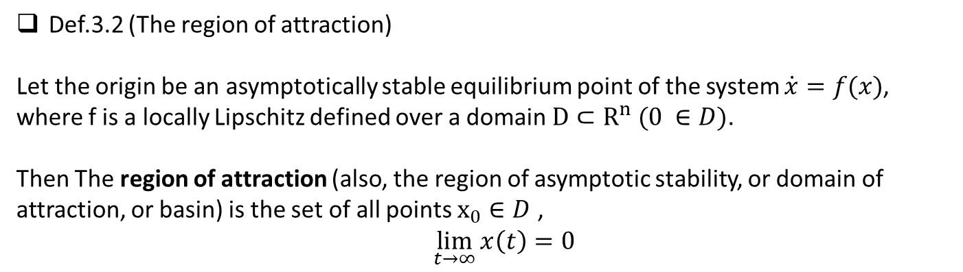
Def.3.2 (The region of attraction)
Let the origin be an asymptotically stable equilibrium point of the system $\dot{x}=f(x)$,
where f is a locally Lipschitz defined over a domain $D⊂R^{n} (0 ∈D)$.
Then The region of attraction (also, the region of asymptotic stability, or domain of
attraction, or basin) is the set of all points $x_{0}∈D$ ,
$\lim_{t→∞}{x\left(t\right)=0 }$

Slide 8
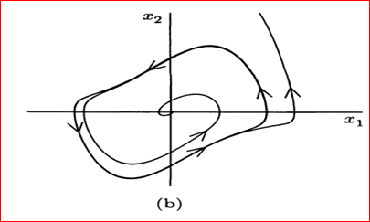

The domain of attraction: $\dot{x}=f\left(x\right), f\left(0\right)=0$
1. $\lim_{t⇒∞}{x\left(t\right)}=0,$
2. $∀ x\left(t_{0}\right)∈D,$
$\lim_{t→∞}{x\left(t\right)=0 }$

Slide 9
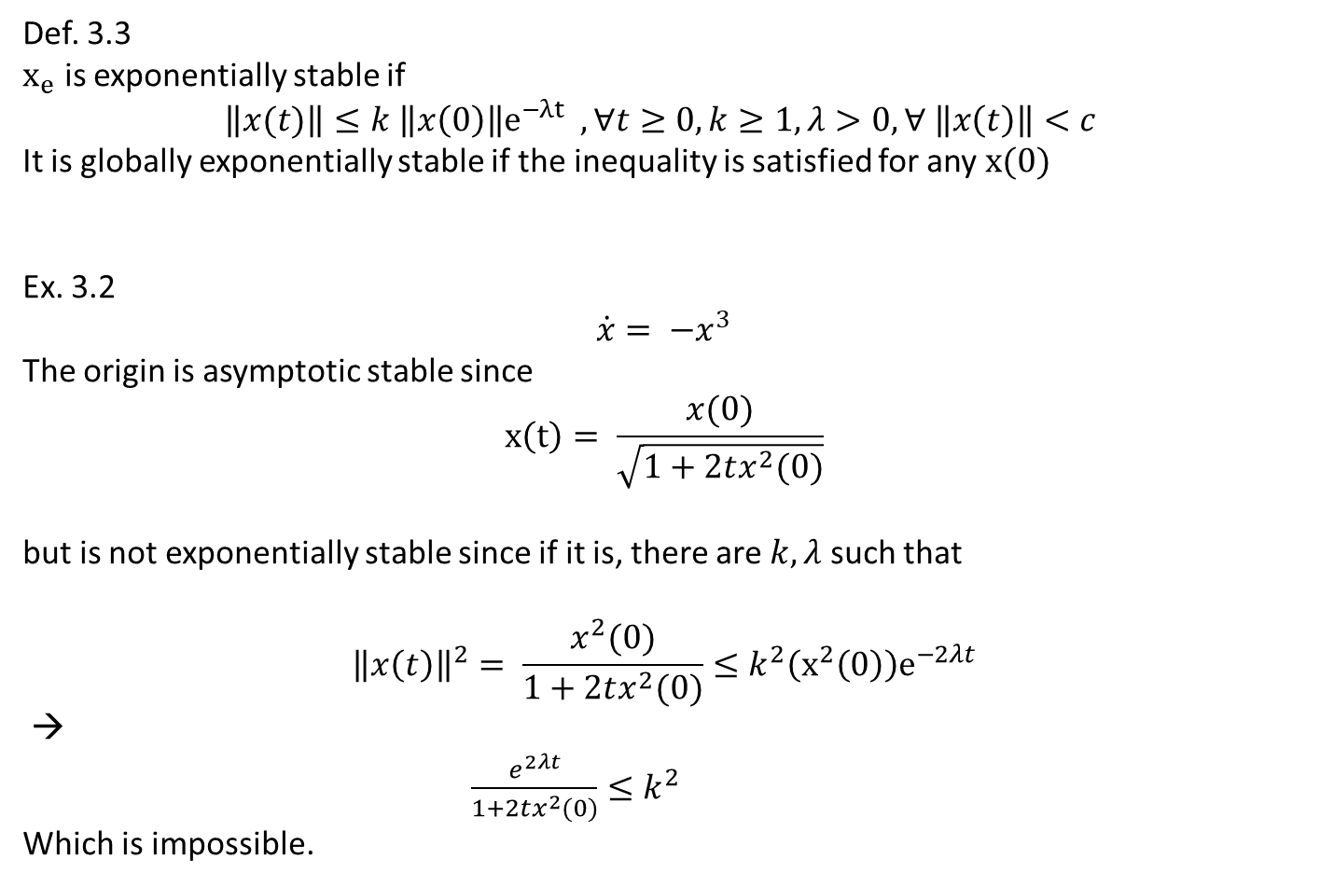
Def. 3.3
$x_{e}$ is exponentially stable if
$$\left\|x(t)\right\|≤k \left\|x\left(0\right)\right\|e^{−λt} , ∀t≥0, k≥1, λ>0, ∀ \left\|x\left(t\right)\right\|<c$$
It is globally exponentially stable if the inequality is satisfied for any $x(0)$
Ex. 3.2
$$\dot{x}= −x^{3}$$
The origin is asymptotic stable since
$$x\left(t\right)= \frac{x(0)}{\sqrt{1+2tx^{2}(0)}}$$
but is not exponentially stable since if it is, there are $k, λ$ such that
$${\left\|x\left(t\right)\right\|}^{2}= \frac{x^{2}(0)}{1+2tx^{2}(0)}≤k^{2}\left(x^{2}\left(0\right)\right)e^{−2λt}$$
→
$\frac{e^{2λt}}{1+2tx^{2}(0)}≤k^{2}$
Which is impossible.

Slide 10
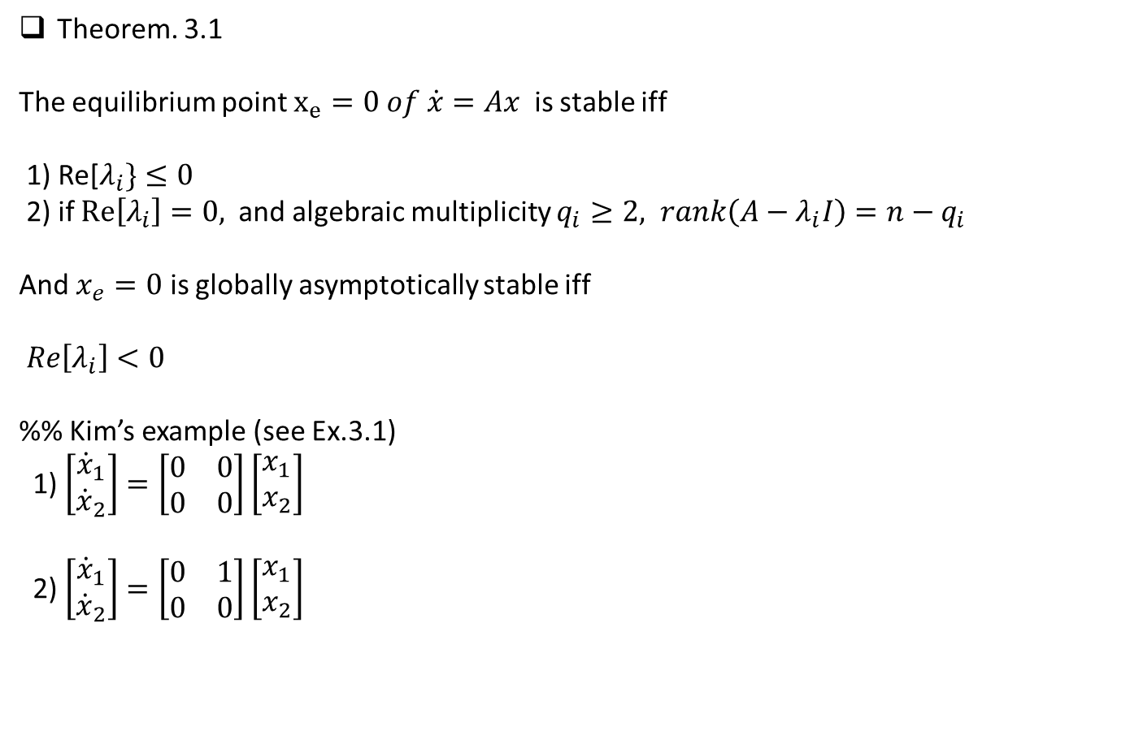
Theorem. 3.1
The equilibrium point $x_{e}=0 of \dot{x}=Ax$ is stable iff
1) Re[$λ_{i}\}≤0$
2) if $Re\left[λ_{i}\right]=0,$ and algebraic multiplicity $q_{i}≥2, rank\left(A−λ_{i}I\right)=n−q_{i}$
And $x_{e}=0$ is globally asymptotically stable iff
$Re\left[λ_{i}\right]<0$
%% Kim’s example (see Ex.3.1)
1) $\left[\begin{matrix}{\dot{x}}_{1} \\ {\dot{x}}_{2}\end{matrix}\right]=\left[\begin{matrix}0 & 0 \\ 0 & 0\end{matrix}\right]\left[\begin{matrix}x_{1} \\ x_{2}\end{matrix}\right]$
2) $\left[\begin{matrix}{\dot{x}}_{1} \\ {\dot{x}}_{2}\end{matrix}\right]=\left[\begin{matrix}0 & 1 \\ 0 & 0\end{matrix}\right]\left[\begin{matrix}x_{1} \\ x_{2}\end{matrix}\right]$

Slide 11
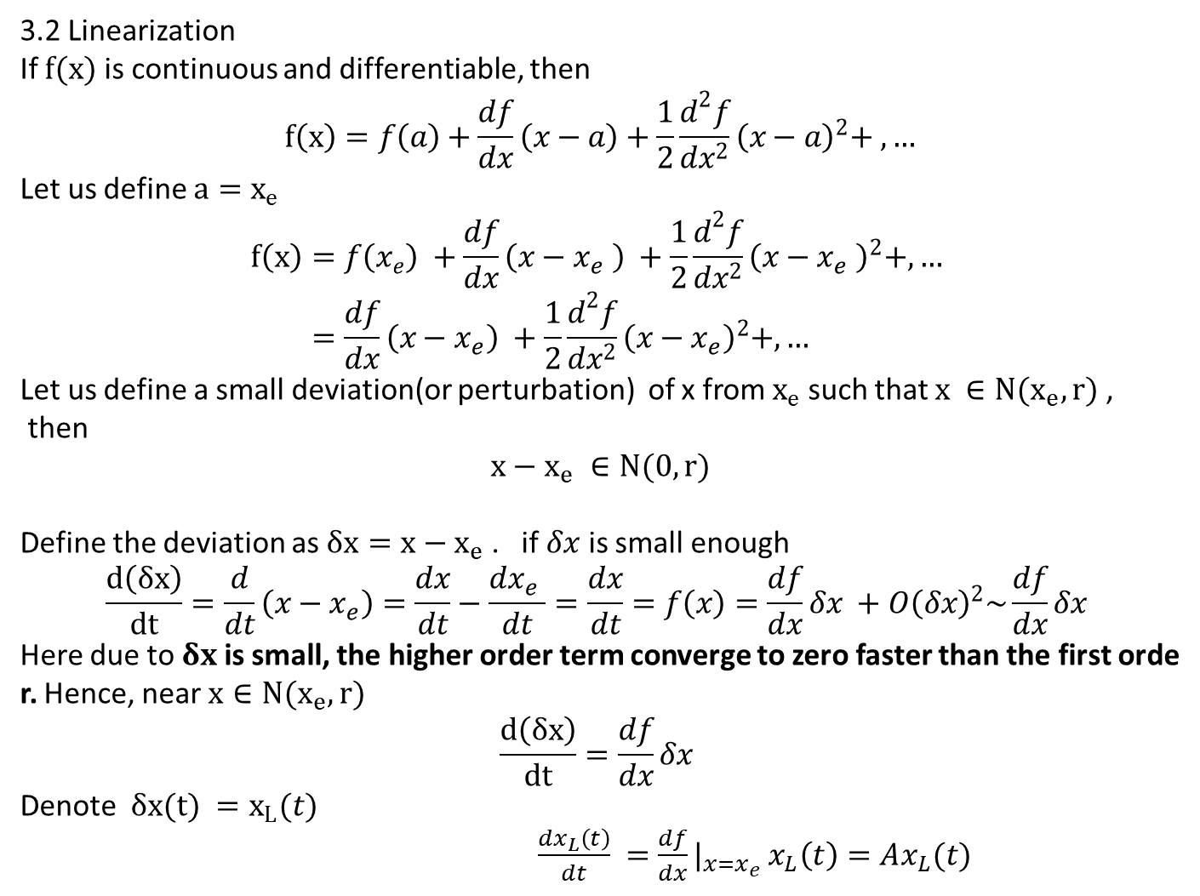
3.2 Linearization
If $f(x)$ is continuous and differentiable, then
$$f\left(x\right)=f\left(a\right)+\frac{df}{dx}\left(x−a\right)+\frac{1}{2}\frac{d^{2}f}{dx^{2}}{\left(x−a\right)}^{2}+ ,…$$
Let us define $a=x_{e}$
$$f\left(x\right)=f\left(x_{e}\right) +\frac{df}{dx}\left(x−x_{e} \right) +\frac{1}{2}\frac{d^{2}f}{dx^{2}}{\left(x−x_{e} \right)}^{2}+,… \\ =\frac{df}{dx}\left(x−x_{e}\right) +\frac{1}{2}\frac{d^{2}f}{dx^{2}}{\left(x−x_{e}\right)}^{2}+,…$$
Let us define a small deviation(or perturbation) of x from $x_{e}$ such that $x ∈N(x_{e},r)$,
then
$$x−x_{e} ∈N(0,r)$$
Define the deviation as $δx=x−x_{e}$. if $δx$ is small enough
$$\frac{d\left(δx\right)}{dt}=\frac{d}{dt}\left(x−x_{e}\right)=\frac{dx}{dt}−\frac{dx_{e} }{dt}=\frac{dx}{dt}=f\left(x\right)=\frac{df}{dx}δx +O{\left(δx\right)}^{2}\sim \frac{df}{dx}δx$$
Here due to $δx$is small, the higher order term converge to zero faster than the first order. Hence, near $x∈N(x_{e},r)$
$$\frac{d\left(δx\right)}{dt}=\frac{df}{dx}δx$$
Denote $δx(t) =x_{L}(t)$
$\frac{dx_{L}\left(t\right)}{dt} =\frac{df}{dx}|_{x=x_{e} }x_{L}\left(t\right)=Ax_{L}(t)$

Slide 12
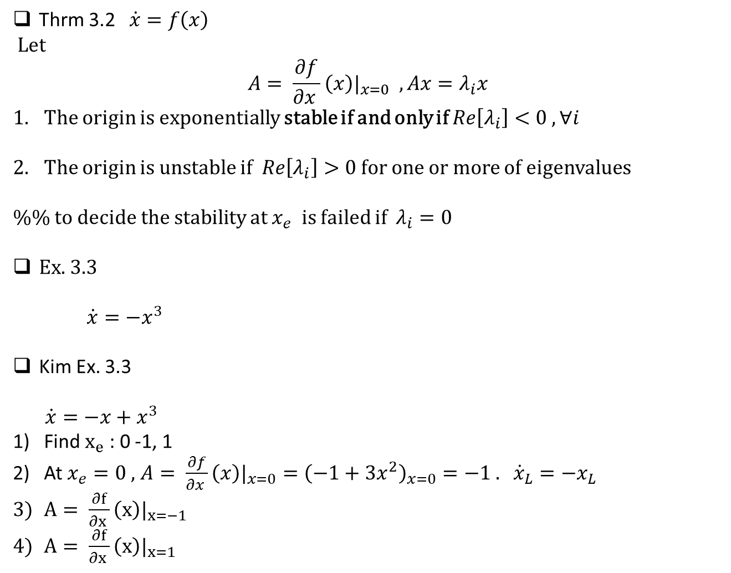
Thrm 3.2 $\dot{x}=f\left(x\right)$
Let
$$A= \frac{∂f}{∂x }\left(x\right)|_{x=0} , Ax=λ_{i}x$$
The origin is exponentially stable if and only if $Re\left[λ_{i}\right]<0 , ∀i$
The origin is unstable if $Re\left[λ_{i}\right]>0$ for one or more of eigenvalues
%% to decide the stability at $x_{e}$ is failed if $λ_{i}=0$
Ex. 3.3
$\dot{x}={−x}^{3}$
Kim Ex. 3.3
$\dot{x}=−x+x^{3}$
Find $x_{e}$: 0 -1, 1
At $x_{e}=0 ,$ $A= \frac{∂f}{∂x }\left(x\right)|_{x=0}={\left(−1+3x^{2}\right)}_{x=0}=−1 .$ ${\dot{x}}_{L}=−x_{L}$
$A= \frac{∂f}{∂x }\left(x\right)|_{x=−1}$
$A= \frac{∂f}{∂x }\left(x\right)|_{x=1}$

Slide 13
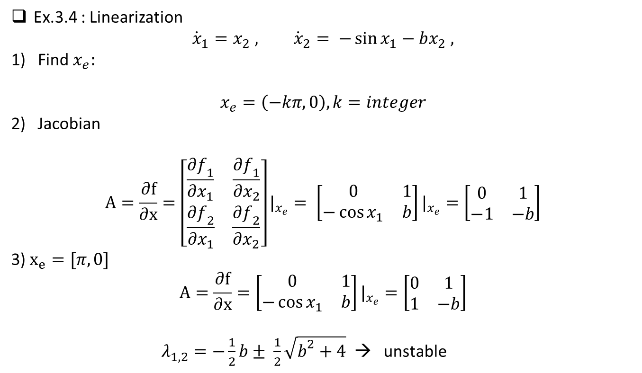
Ex.3.4 : Linearization
$${\dot{x}}_{1}=x_{2} , {\dot{x}}_{2}= −\sin{x_{1}}−bx_{2} ,$$
Find $x_{e}:$
$$x_{e}=\left(−kπ, 0\right), k=integer$$
Jacobian
$$A=\frac{∂f}{∂x}=\left[\begin{matrix}\frac{∂f_{1}}{∂x_{1}} & \frac{∂f_{1}}{∂x_{2}} \\ \frac{∂f_{2}}{∂x_{1}} & \frac{∂f_{2}}{∂x_{2}}\end{matrix}\right]|_{x_{e}}= \left[\begin{matrix}0 & 1 \\ −\cos{x_{1}} & b\end{matrix}\right]|_{x_{e}}=\left[\begin{matrix}0 & 1 \\ −1 & −b\end{matrix}\right]$$
3) $x_{e}=[π,0]$
$$A=\frac{∂f}{∂x}=\left[\begin{matrix}0 & 1 \\ −\cos{x_{1}} & b\end{matrix}\right]|_{x_{e}}=\left[\begin{matrix}0 & 1 \\ 1 & −b\end{matrix}\right]$$
$λ_{1,2}^{}=−\frac{1}{2}b± \frac{1}{2}\sqrt{b^{2}+4}$ → unstable

Slide 14
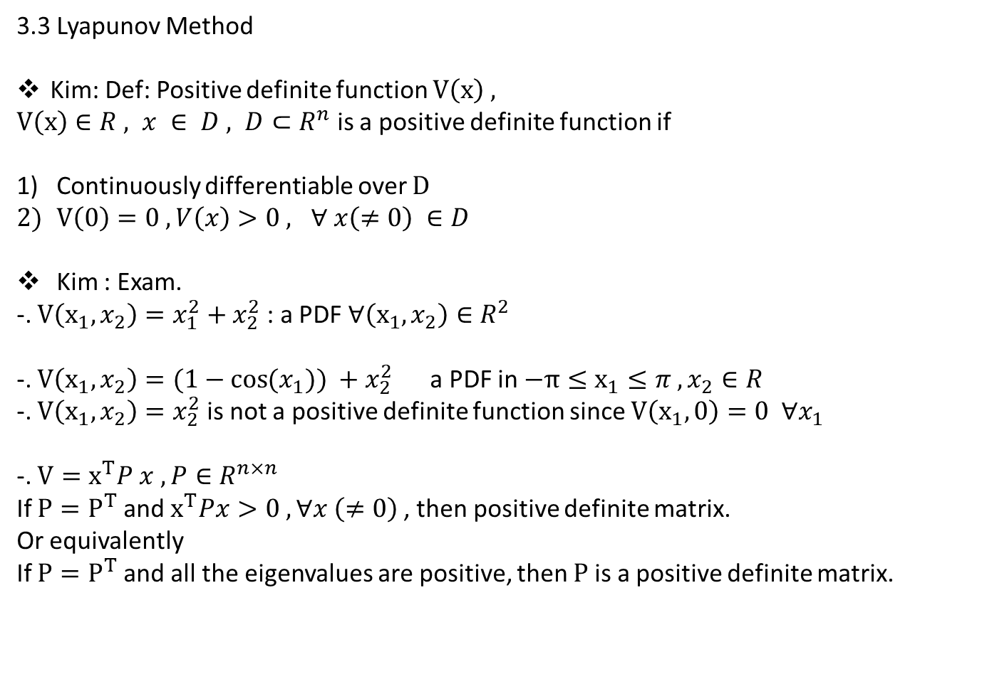
3.3 Lyapunov Method
Kim: Def: Positive definite function $V\left(x\right) ,$
$V\left(x\right)∈R , x ∈ D , D⊂R^{n}$ is a positive definite function if
Continuously differentiable over $D$
$V\left(0\right)=0 , V\left(x\right)>0 , ∀ x\left(≠0\right) ∈D$
Kim : Exam.
-. $V\left(x_{1}, x_{2}\right)=x_{1}^{2}+x_{2}^{2}$ : a PDF $∀\left(x_{1}, x_{2}\right)∈R^{2}$
-. $V\left(x_{1}, x_{2}\right)=(1−\cos{(x_{1})) }+x_{2}^{2}$ a PDF in $−π≤x_{1}≤π , x_{2}∈R$
-. $V\left(x_{1}, x_{2}\right)=x_{2}^{2}$ is not a positive definite function since $V\left(x_{1},0\right)=0 ∀x_{1}$
-. $V=x^{T}P x , P∈R^{n×n}$
If $P=P^{T}$ and $x^{T}Px>0 , ∀x \left(≠0\right)$, then positive definite matrix.
Or equivalently
If $P=P^{T}$ and all the eigenvalues are positive, then $P$ is a positive definite matrix.

Slide 15
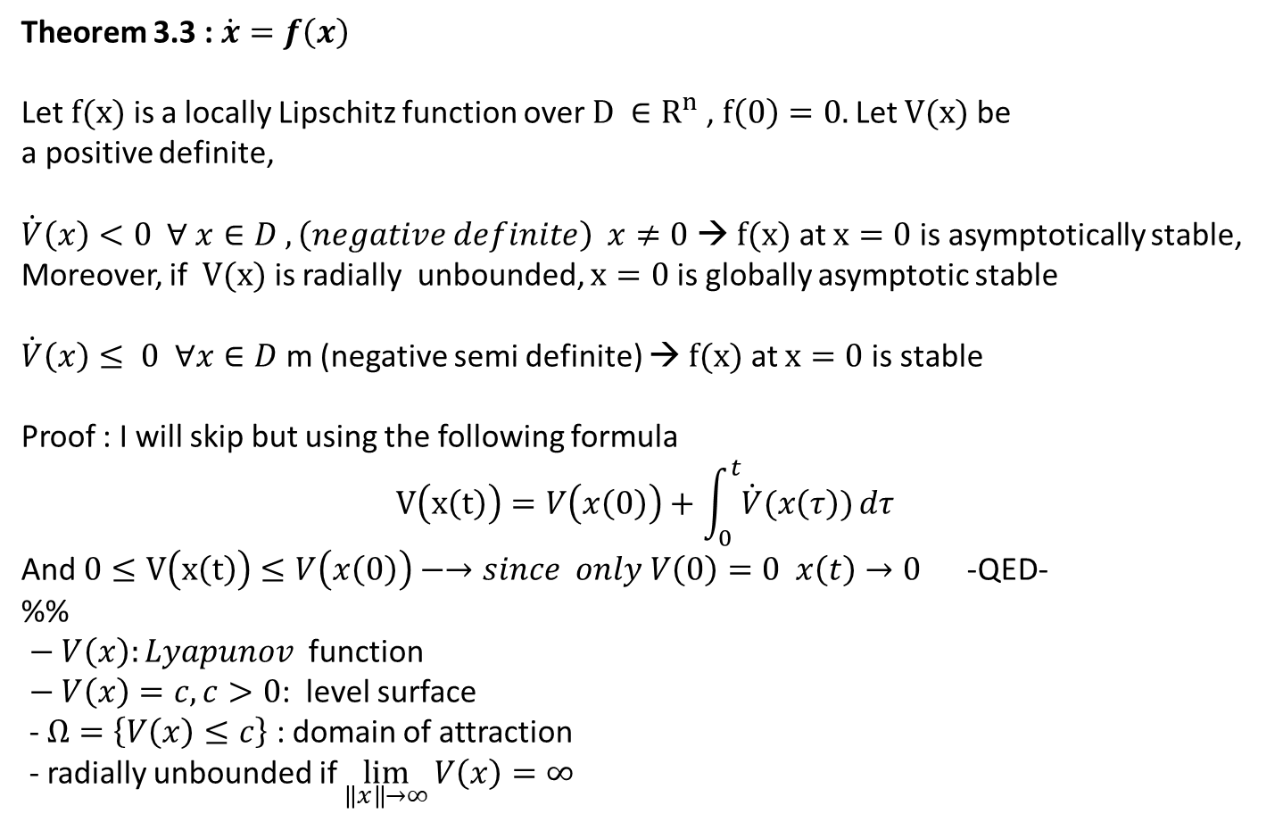
Theorem 3.3 : $\dot{x}=f\left(x\right)$
Let $f(x)$ is a locally Lipschitz function over $D ∈R^{n}$, $f\left(0\right)=0.$Let $V(x)$ be
a positive definite,
$\dot{V}\left(x\right)<0 ∀ x∈D ,\left(negative definite\right) x≠0$ → $f(x)$ at $x=0$ is asymptotically stable,
Moreover, if $V(x)$ is radially unbounded, $x=0$ is globally asymptotic stable
$\dot{V}\left(x\right)≤ 0 ∀x∈D$ m (negative semi definite) → $f(x)$ at $x=0$ is stable
Proof : I will skip but using the following formula
$$V\left(x\left(t\right)\right)=V\left(x\left(0\right)\right)+\int_{0}^{t}{\dot{V}(x\left(τ\right))}dτ$$
And $0≤V\left(x\left(t\right)\right)≤V\left(x\left(0\right)\right)−→since only V\left(0\right)=0 x\left(t\right)→0$ -QED-
%%
$− V\left(x\right):Lyapunov$ function
$− V\left(x\right)=c, c>0$: level surface
- $Ω=\left\{V\left(x\right)≤c\right\}$ : domain of attraction
- radially unbounded if $\lim_{\left\|x\right\|→∞}{V\left(x\right)=∞}$

Slide 16
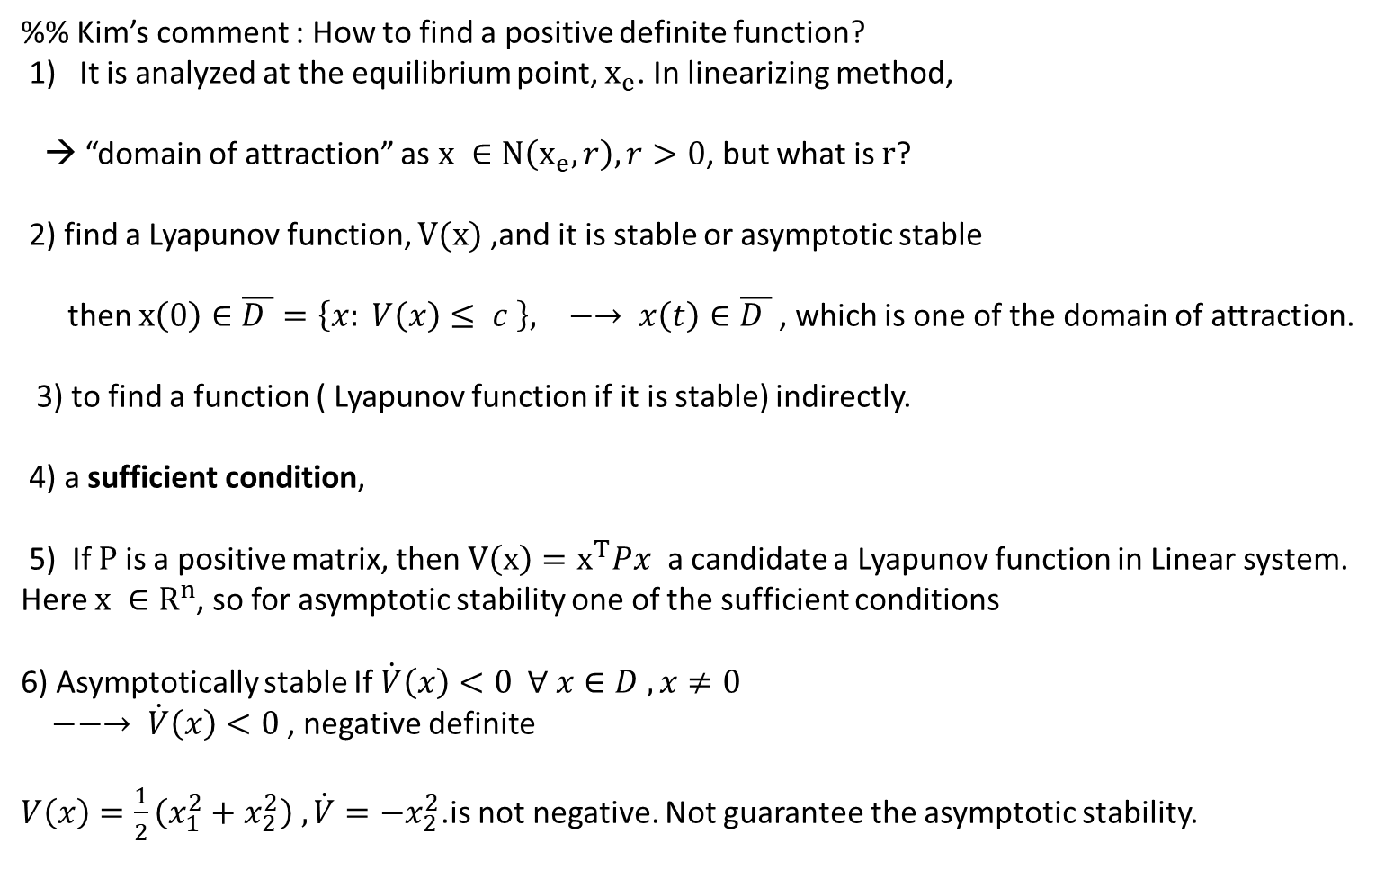
%% Kim’s comment : How to find a positive definite function?
1) It is analyzed at the equilibrium point, $x_{e}$. In linearizing method,
→ “domain of attraction” as $x ∈N\left(x_{e}, r\right), r>0$, but what is $r$?
2) find a Lyapunov function, $V(x)$ ,and it is stable or asymptotic stable
then $x\left(0\right)∈\overline{D }=\left\{x: V\left(x\right)≤ c \right\}, −→ x\left(t\right)∈\overline{D }$, which is one of the domain of attraction.
3) to find a function ( Lyapunov function if it is stable) indirectly.
4) a sufficient condition,
5) If $P$ is a positive matrix, then $V\left(x\right)=x^{T}Px$ a candidate a Lyapunov function in Linear system.
Here $x ∈R^{n}$, so for asymptotic stability one of the sufficient conditions
6) Asymptotically stable If $\dot{V}\left(x\right)<0 ∀ x∈D , x≠0$
$−−→ \dot{V}\left(x\right)<0$, negative definite
$V\left(x\right)=\frac{1}{2}\left(x_{1}^{2}+x_{2}^{2}\right) , \dot{V}=−x_{2}^{2}$.is not negative. Not guarantee the asymptotic stability.

Slide 17
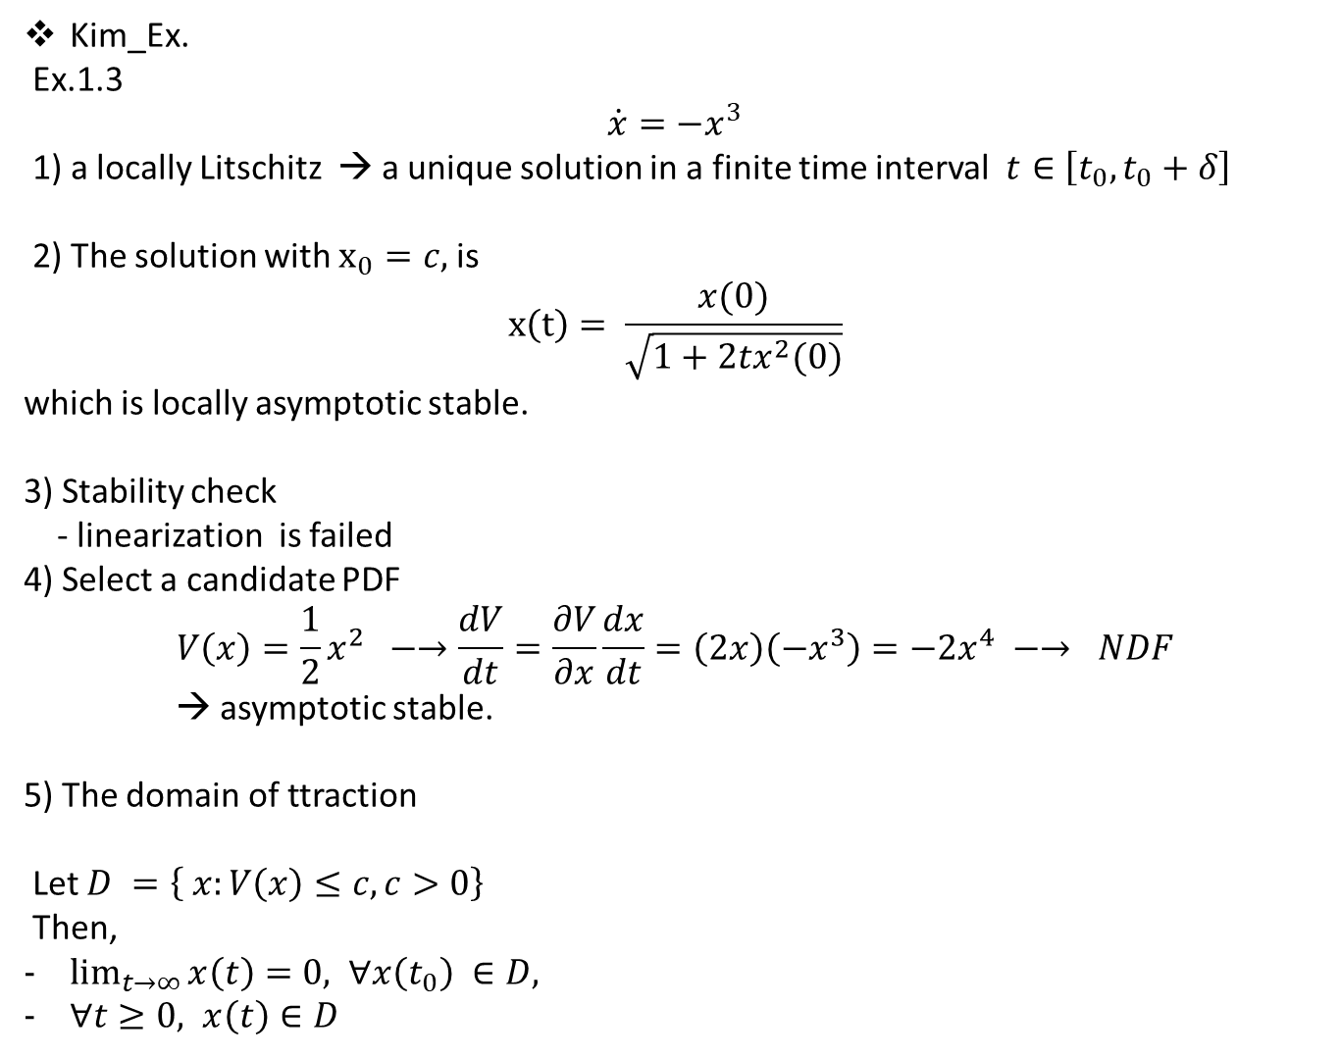
Kim_Ex.
Ex.1.3
$$\dot{x}=−x^{3}$$
1) a locally Litschitz → a unique solution in a finite time interval $t∈\left[t_{0}, t_{0}+δ\right]$
2) The solution with $x_{0}=c,$is
$$x\left(t\right)= \frac{x(0)}{\sqrt{1+2tx^{2}(0)}}$$
which is locally asymptotic stable.
3) Stability check
- linearization is failed
4) Select a candidate PDF
$$V\left(x\right)=\frac{1}{2}x^{2} −→\frac{dV}{dt}=\frac{∂V}{∂x}\frac{dx}{dt}=\left(2x\right)\left(−x^{3}\right)=−2x^{4} −→ NDF$$
→ asymptotic stable.
5) The domain of ttraction
Let $D =\left\{ x:V\left(x\right)≤c, c>0\right\}$
Then,
$\lim_{t→∞}{x\left(t\right)=0, }$ $∀x\left(t_{0}\right) ∈D,$
$∀t≥0, x\left(t\right)∈D$

