Slide 1
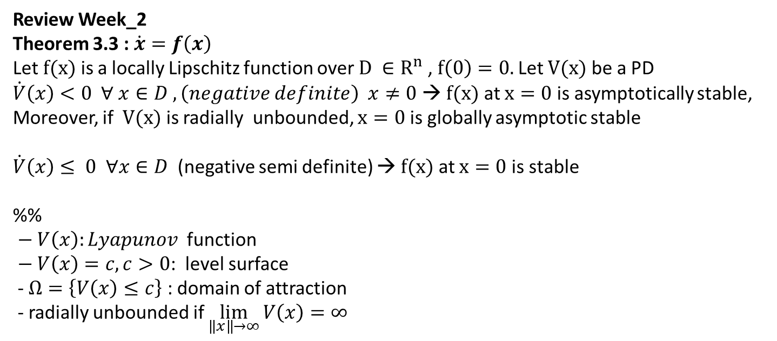
Review Week_2
Theorem 3.3 : $\dot{x}=f\left(x\right)$
Let $f(x)$ is a locally Lipschitz function over $D ∈R^{n}$, $f\left(0\right)=0.$Let $V(x)$ be a PD
$\dot{V}\left(x\right)<0 ∀ x∈D ,\left(negative definite\right) x≠0$ → $f(x)$ at $x=0$ is asymptotically stable,
Moreover, if $V(x)$ is radially unbounded, $x=0$ is globally asymptotic stable
$\dot{V}\left(x\right)≤ 0 ∀x∈D$ (negative semi definite) → $f(x)$ at $x=0$ is stable
%%
$− V\left(x\right):Lyapunov$ function
$− V\left(x\right)=c, c>0$: level surface
- $Ω=\left\{V\left(x\right)≤c\right\}$ : domain of attraction
- radially unbounded if $\lim_{\left\|x\right\|→∞}{V\left(x\right)=∞}$

Slide 2
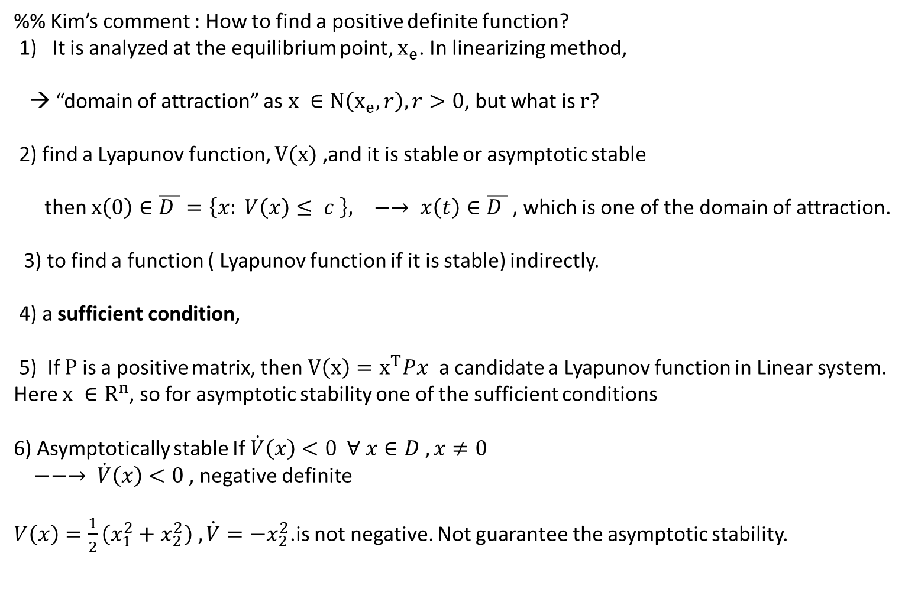
%% Kim’s comment : How to find a positive definite function?
1) It is analyzed at the equilibrium point, $x_{e}$. In linearizing method,
→ “domain of attraction” as $x ∈N\left(x_{e}, r\right), r>0$, but what is $r$?
2) find a Lyapunov function, $V(x)$ ,and it is stable or asymptotic stable
then $x\left(0\right)∈\overline{D }=\left\{x: V\left(x\right)≤ c \right\}, −→ x\left(t\right)∈\overline{D }$, which is one of the domain of attraction.
3) to find a function ( Lyapunov function if it is stable) indirectly.
4) a sufficient condition,
5) If $P$ is a positive matrix, then $V\left(x\right)=x^{T}Px$ a candidate a Lyapunov function in Linear system.
Here $x ∈R^{n}$, so for asymptotic stability one of the sufficient conditions
6) Asymptotically stable If $\dot{V}\left(x\right)<0 ∀ x∈D , x≠0$
$−−→ \dot{V}\left(x\right)<0$, negative definite
$V\left(x\right)=\frac{1}{2}\left(x_{1}^{2}+x_{2}^{2}\right) , \dot{V}=−x_{2}^{2}$.is not negative. Not guarantee the asymptotic stability.

Slide 3
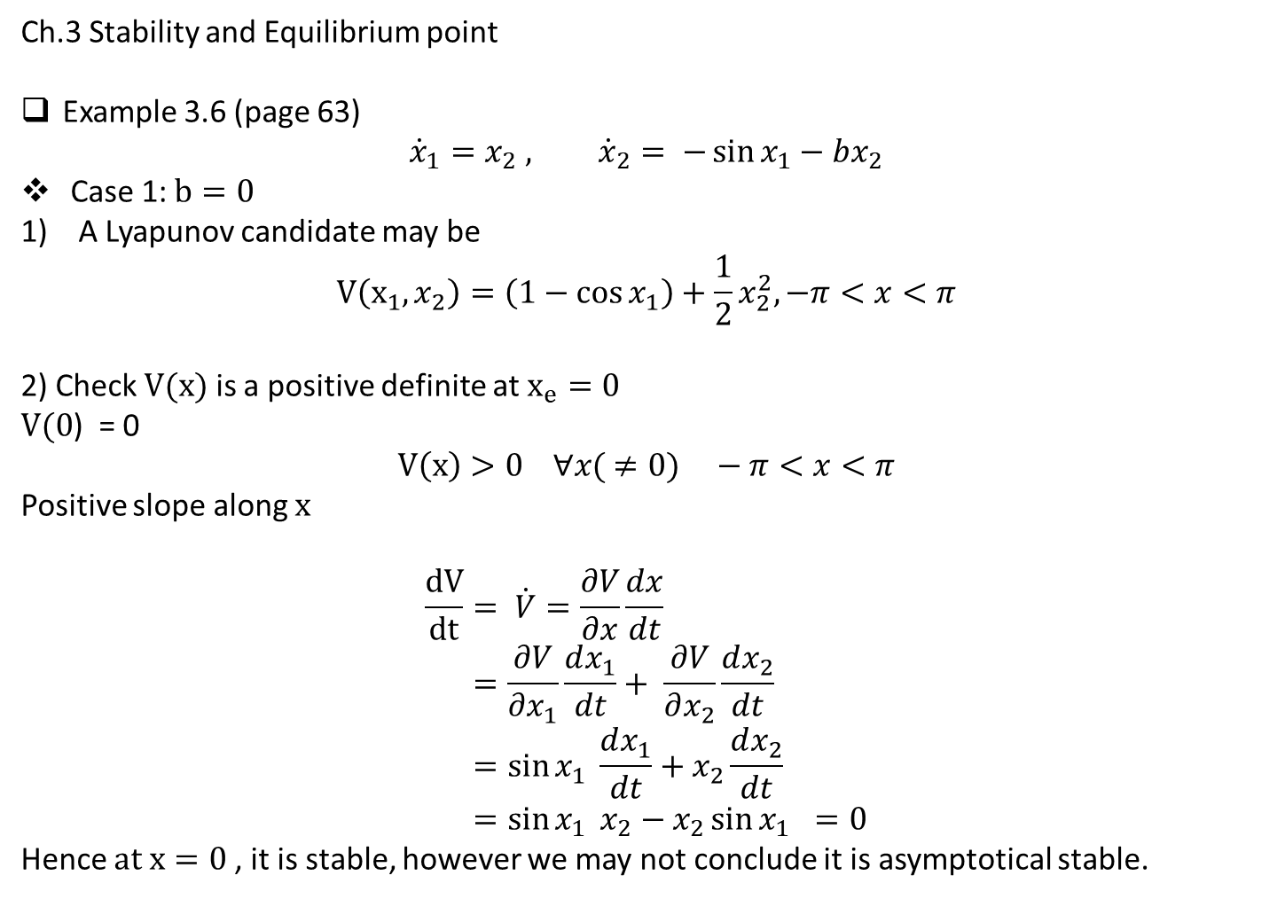
Ch.3 Stability and Equilibrium point
Example 3.6 (page 63)
$${\dot{x}}_{1}=x_{2} , {\dot{x}}_{2}= −\sin{x_{1}}−bx_{2}$$
Case 1: $b=0$
1) A Lyapunov candidate may be
$$V\left(x_{1}, x_{2}\right)=\left(1−\cos{x_{1}}\right)+\frac{1}{2}x_{2}^{2},−π<x<π$$
2) Check $V(x)$ is a positive definite at $x_{e}=0$
$V(0$) = 0
$$V\left(x\right)>0 ∀x( ≠0) −π<x<π$$
Positive slope along $x$
$$\frac{dV}{dt}= \dot{V}=\frac{∂V}{∂x}\frac{dx}{dt} \\ =\frac{∂V}{∂x_{1}}\frac{dx_{1}}{dt}+ \frac{∂V}{∂x_{2}}\frac{dx_{2}}{dt} \\ =\sin{x_{1}} \frac{dx_{1}}{dt}+x_{2}\frac{dx_{2}}{dt} \\ =\sin{x_{1}} x_{2}−x_{2}\sin{x_{1}} =0$$
Hence $at x=0$, it is stable, however we may not conclude it is asymptotical stable.

Slide 4
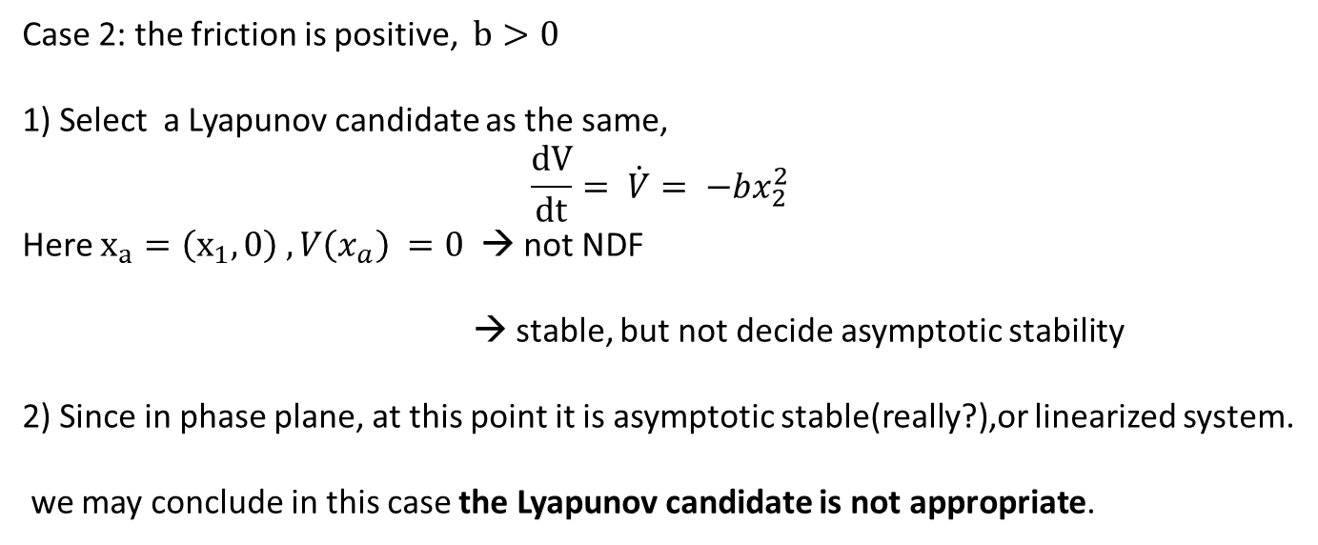
Case 2: the friction is positive, $b>0$
1) Select a Lyapunov candidate as the same,
$$\frac{dV}{dt}= \dot{V}= −bx_{2}^{2}$$
Here $x_{a}=\left(x_{1}, 0\right) , V\left(x_{a}\right) =0$ → not NDF
→ stable, but not decide asymptotic stability
2) Since in phase plane, at this point it is asymptotic stable(really?),or linearized system.
we may conclude in this case the Lyapunov candidate is not appropriate.

Slide 5
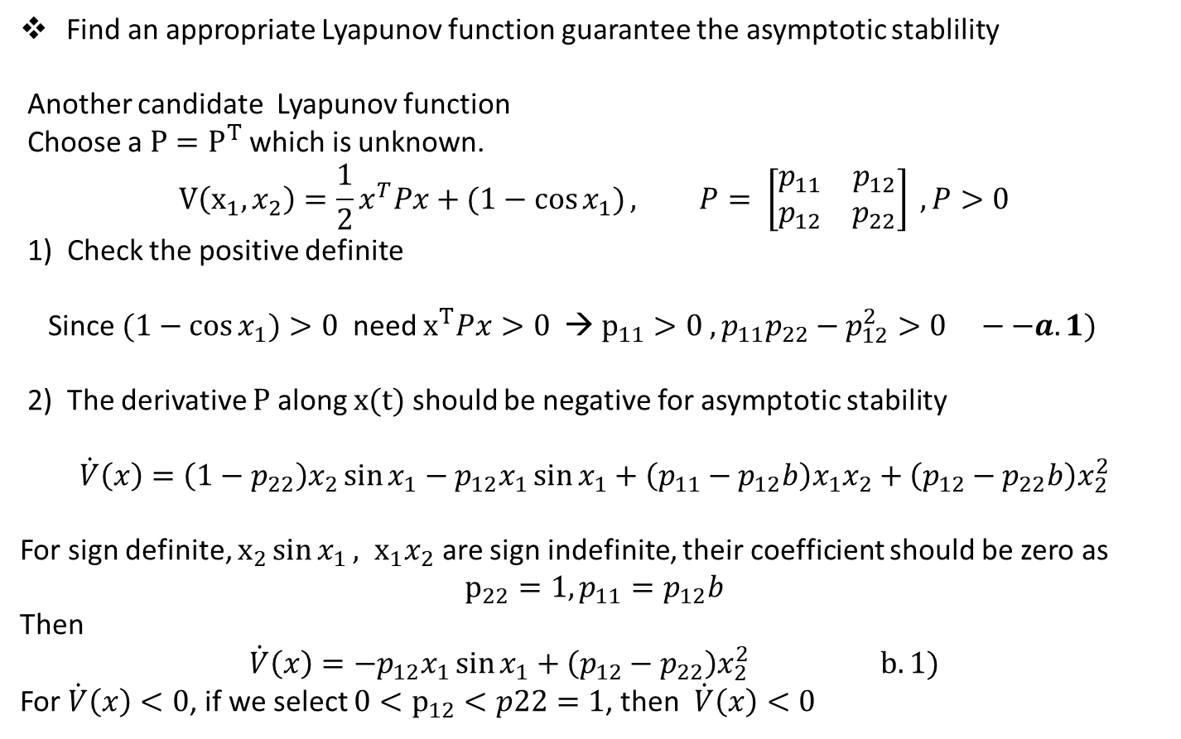
Find an appropriate Lyapunov function guarantee the asymptotic stablility
Another candidate Lyapunov function
Choose a $P=P^{T}$ which is unknown.
$$V\left(x_{1}, x_{2}\right)=\frac{1}{2}x^{T}Px+(1−\cos{x_{1})}, P= \left[\begin{matrix}p_{11} & p_{12} \\ p_{12} & p_{22}\end{matrix}\right] , P>0$$
1) Check the positive definite
Since $(1−\cos{x_{1})}>0$ need $x^{T}Px>0$ → $p_{11}>0 , p_{11}p_{22}−p_{12}^{2}>0 −−a.1)$
2) The derivative $P$ along $x(t)$ should be negative for asymptotic stability
$$\dot{V}\left(x\right)=\left(1−p_{22}\right)x_{2}\sin{x_{1}−p_{12}x_{1}}\sin{x_{1}}+\left(p_{11}−p_{12}b\right)x_{1}x_{2}+\left(p_{12}−p_{22}b\right)x_{2}^{2}$$
For sign definite, $x_{2}\sin{x_{1}}, x_{1}x_{2}$ are sign indefinite, their coefficient should be zero as
$$p_{22}=1, p_{11}=p_{12}b$$
Then
$$\dot{V}\left(x\right)=−p_{12}x_{1}\sin{x_{1}}+\left(p_{12}−p_{22}\right)x_{2}^{2} b.1)$$
For $\dot{V}\left(x\right)<0$, if we select $0<p_{12}<p22=1$, then $\dot{V}\left(x\right)<0$

Slide 6
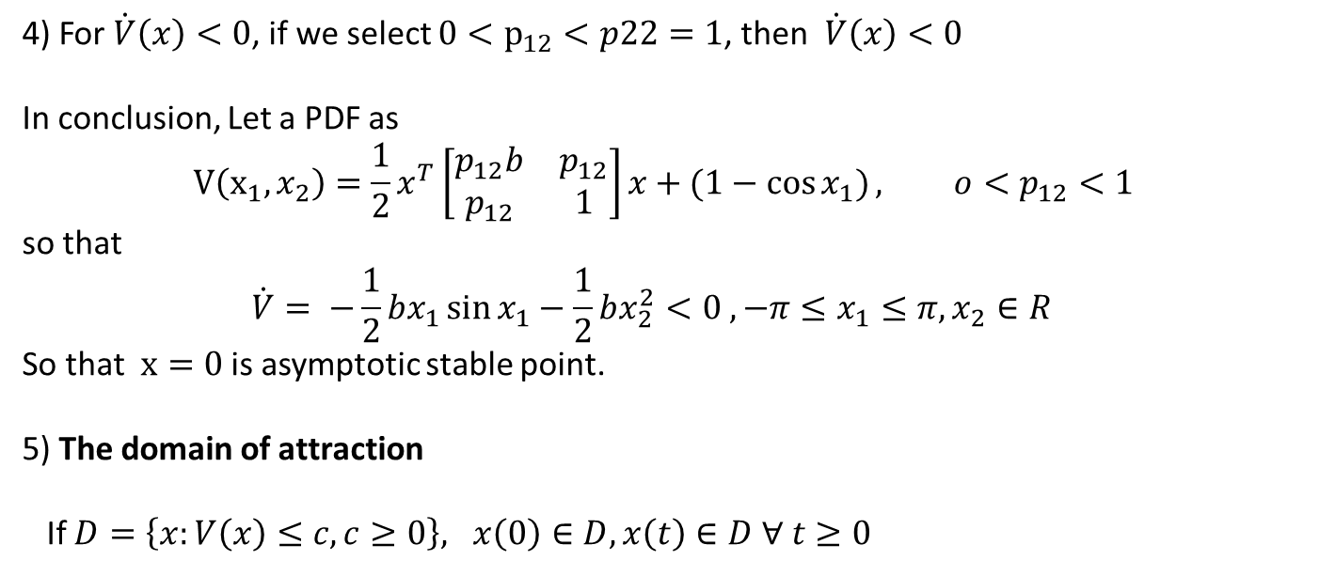
4) For $\dot{V}\left(x\right)<0$, if we select $0<p_{12}<p22=1$, then $\dot{V}\left(x\right)<0$
In conclusion, Let a PDF as
$$V\left(x_{1}, x_{2}\right)=\frac{1}{2}x^{T}\left[\begin{matrix}p_{12}b & p_{12} \\ p_{12} & 1\end{matrix}\right]x+(1−\cos{x_{1})}, o<p_{12}<1$$
so that
$$\dot{V}= −\frac{1}{2}bx_{1}\sin{x_{1}}−\frac{1}{2}bx_{2}^{2}<0 , −π≤x_{1}≤π, x_{2}∈R$$
So that $x=0$ is asymptotic stable point.
5) The domain of attraction
If $D=\left\{x:V\left(x\right)≤c, c≥0\right\}, x\left(0\right)∈D, x\left(t\right)∈D ∀ t≥0$

Slide 7
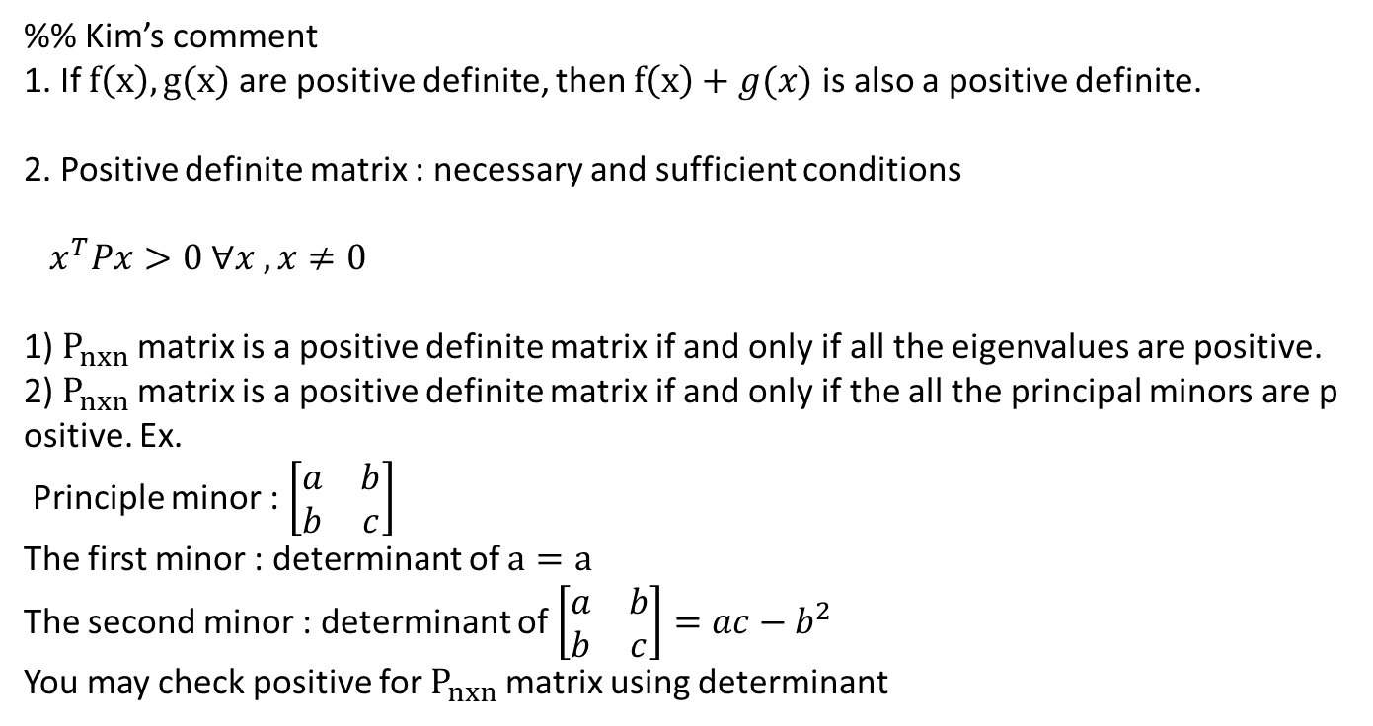
%% Kim’s comment
1. If $f\left(x\right), g(x)$ are positive definite, then $f\left(x\right)+g(x)$ is also a positive definite.
2. Positive definite matrix : necessary and sufficient conditions
$x^{T}Px>0 ∀x , x≠0$
1) $P_{nxn}$ matrix is a positive definite matrix if and only if all the eigenvalues are positive.
2) $P_{nxn}$ matrix is a positive definite matrix if and only if the all the principal minors are positive. Ex.
Principle minor : $\left[\begin{matrix}a & b \\ b & c\end{matrix}\right]$
The first minor : determinant of $a=a$
The second minor : determinant of $\left[\begin{matrix}a & b \\ b & c\end{matrix}\right]=ac−b^{2}$
You may check positive for $P_{nxn}$ matrix using determinant

Slide 8
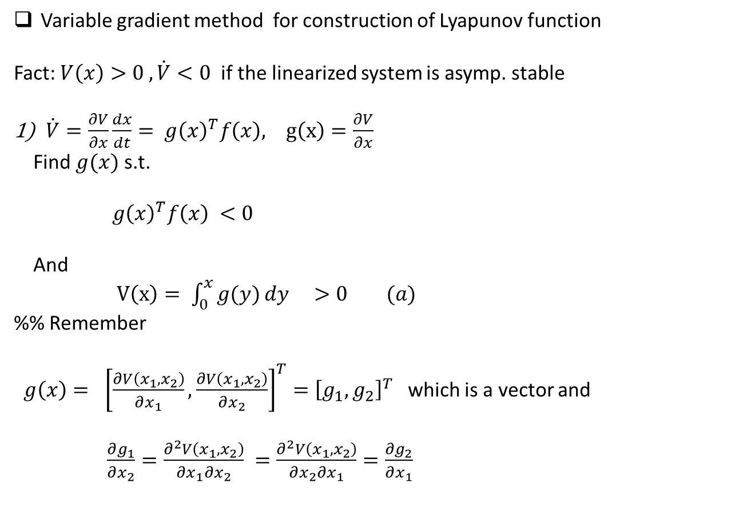
Variable gradient method for construction of Lyapunov function
Fact: $V\left(x\right)>0 , \dot{V}<0$ if the linearized system is asymp. stable
$\dot{V}=\frac{∂V}{∂x}\frac{dx}{dt}= g{\left(x\right)}^{T}f\left(x\right), g\left(x\right)=\frac{∂V}{∂x}$
Find $g(x)$ s.t.
$g{\left(x\right)}^{T}f\left(x\right) <0$
And
$V\left(x\right)= \int_{0}^{x}{g(y)}dy >0 (a)$
%% Remember
$g\left(x\right)= {\left[\frac{∂V\left(x_{1}, x_{2}\right)}{∂x_{1}}, \frac{∂V\left(x_{1}, x_{2}\right)}{∂x_{2}}\right]}^{T}={\left[g_{1}, g_{2}\right]}^{T}$ which is a vector and
$\frac{∂g_{1}}{∂x_{2}}=\frac{∂^{2}V\left(x_{1}, x_{2}\right)}{∂x_{1}∂x_{2}} =\frac{∂^{2}V\left(x_{1}, x_{2}\right)}{∂x_{2}∂x_{1}}=\frac{∂g_{2}}{∂x_{1}}$

Slide 9
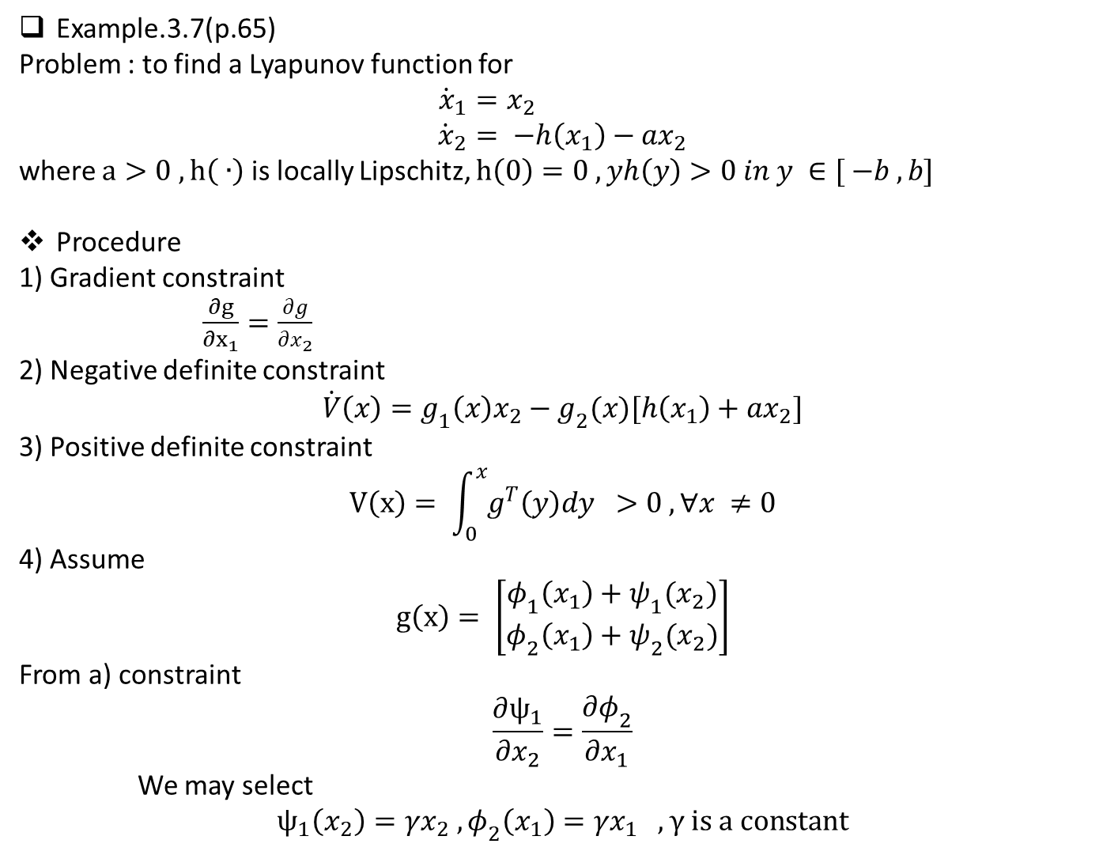
Example.3.7(p.65)
Problem : to find a Lyapunov function for
$${\dot{x}}_{1}=x_{2} \\ {\dot{x}}_{2}= −h\left(x_{1}\right)−ax_{2}$$
where $a>0 , h\left( ∙\right)$ is locally Lipschitz, $h\left(0\right)=0 , yh\left(y\right)>0 in y ∈[ −b , b]$
Procedure
1) Gradient constraint
$\frac{∂g}{∂x_{1}}=\frac{∂g}{∂x_{2}}$
2) Negative definite constraint
$$\dot{V}\left(x\right)=g_{1}\left(x\right)x_{2}−g_{2}(x)[h\left(x_{1}\right)+ax_{2}]$$
3) Positive definite constraint
$$V\left(x\right)= \int_{0}^{x}{g^{T}\left(y\right)dy } >0 , ∀x ≠0$$
4) Assume
$$g\left(x\right)= \left[\begin{matrix}φ_{1}\left(x_{1}\right)+ψ_{1}(x_{2}) \\ φ_{2}\left(x_{1}\right)+ψ_{2}(x_{2})\end{matrix}\right]$$
From a) constraint
$$\frac{∂ψ_{1}}{∂x_{2}}=\frac{∂φ_{2}}{∂x_{1}}$$
We may select
$$ψ_{1}\left(x_{2}\right)=γx_{2} , φ_{2}\left(x_{1}\right)=γx_{1} , γ is a constant$$

Slide 10
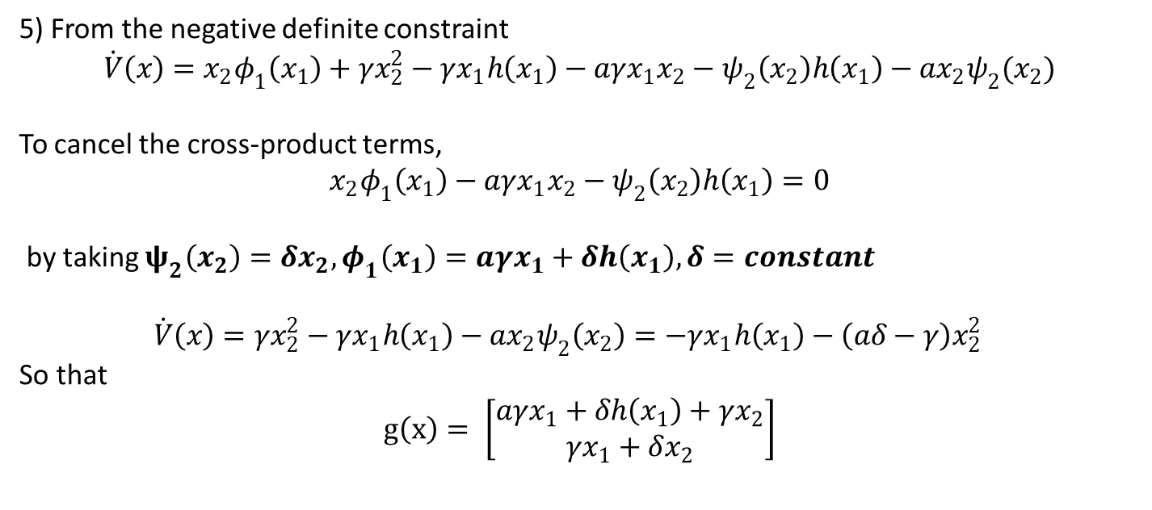
5) From the negative definite constraint
$$\dot{V}\left(x\right)=x_{2}φ_{1}\left(x_{1}\right)+γx_{2}^{2}−γx_{1}h\left(x_{1}\right)−aγx_{1}x_{2}−ψ_{2}\left(x_{2}\right)h\left(x_{1}\right)−ax_{2}ψ_{2}(x_{2})$$
To cancel the cross-product terms,
$$x_{2}φ_{1}\left(x_{1}\right)−aγx_{1}x_{2}−ψ_{2}\left(x_{2}\right)h\left(x_{1}\right)=0$$
by taking $ψ_{2}\left(x_{2}\right)=δx_{2}, φ_{1}\left(x_{1}\right)=aγx_{1}+δh\left(x_{1}\right), δ=constant$
$\dot{V}\left(x\right)=γx_{2}^{2}−γx_{1}h\left(x_{1}\right)−ax_{2}ψ_{2}\left(x_{2}\right)=−γx_{1}h\left(x_{1}\right)−\left(aδ−γ\right)x_{2}^{2}$
So that
$$g\left(x\right)= \left[\begin{matrix}aγx_{1}+δh\left(x_{1}\right)+γx_{2} \\ γx_{1}+δx_{2}\end{matrix}\right]$$

Slide 11
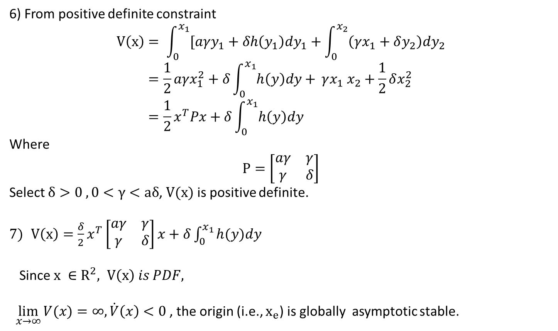
6) From positive definite constraint
$$V\left(x\right)= \int_{0}^{x_{1}}{[aγy_{1}+δh\left(y_{1}\right)dy_{1}+\int_{0}^{x_{2}}{\left(γx_{1}+δy_{2}\right)dy_{2}}} \\ =\frac{1}{2}aγx_{1}^{2}+δ\int_{0}^{x_{1}}{h\left(y\right)dy+ }γx_{1} x_{2}+\frac{1}{2}δx_{2}^{2} \\ =\frac{1}{2}x^{T}Px+δ\int_{0}^{x_{1}}{h\left(y\right)dy}$$
Where
$$P=\left[\begin{matrix}aγ & γ \\ γ & δ\end{matrix}\right]$$
Select $δ>0 , 0<γ<aδ$, $V(x)$ is positive definite.
$V\left(x\right)=\frac{δ}{2}x^{T}\left[\begin{matrix}aγ & γ \\ γ & δ\end{matrix}\right]x+δ\int_{0}^{x_{1}}{h(y)dy}$
Since $x ∈R^{2}, V\left(x\right) is PDF,$
$\lim_{x→∞}{V(x)}=∞, \dot{V}\left(x\right)<0$, the origin (i.e., $x_{e}$) is globally asymptotic stable.

Slide 12
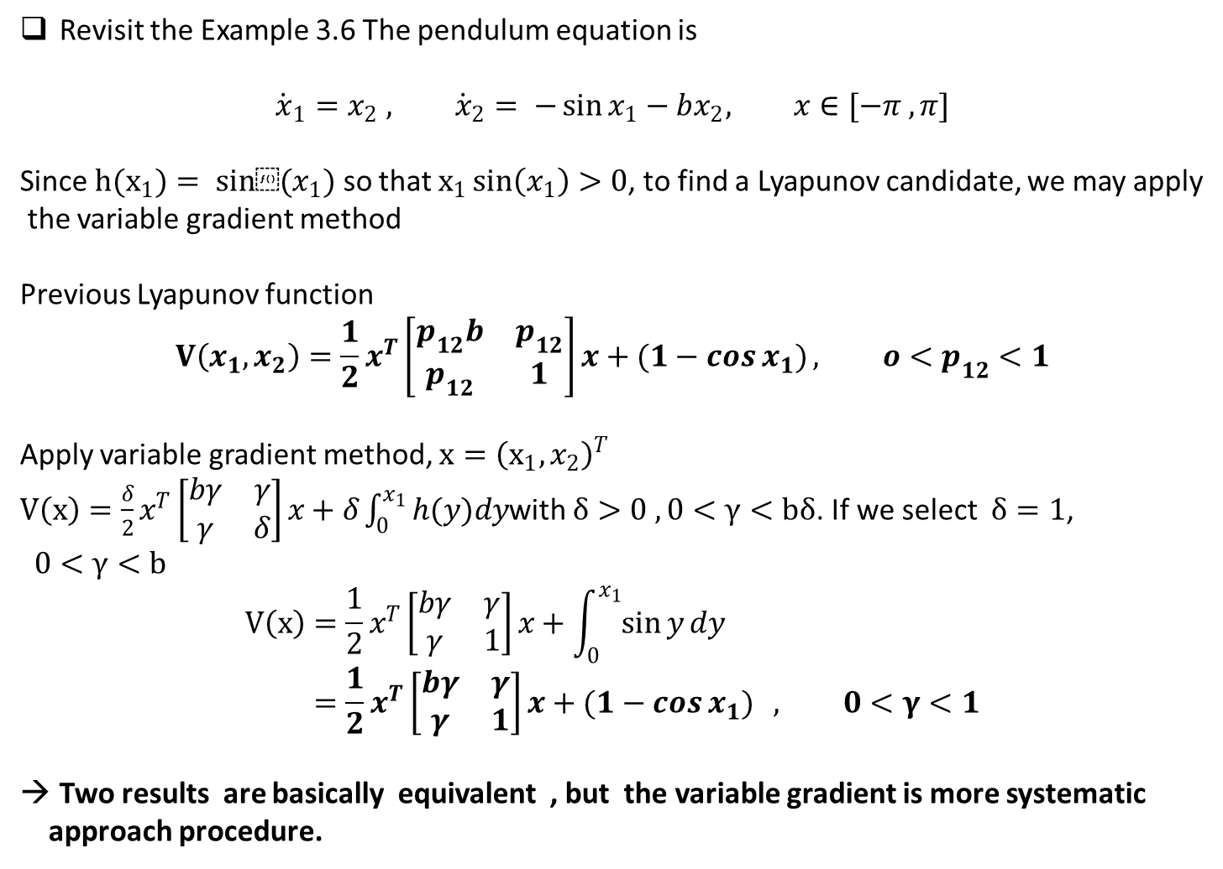
Revisit the Example 3.6 The pendulum equation is
$${\dot{x}}_{1}=x_{2} , {\dot{x}}_{2}= −\sin{x_{1}}−bx_{2}, x∈[−π , π]$$
Since $h(x_{1})= sin⁡(x_{1})$ so that $x_{1}\sin\left(x_{1}\right)>0$, to find a Lyapunov candidate, we may apply
the variable gradient method
Previous Lyapunov function
$$V\left(x_{1}, x_{2}\right)=\frac{1}{2}x^{T}\left[\begin{matrix}p_{12}b & p_{12} \\ p_{12} & 1\end{matrix}\right]x+(1−\cos{x_{1})}, o<p_{12}<1$$
Apply variable gradient method, $x={\left(x_{1}, x_{2}\right)}^{T}$
$V\left(x\right)=\frac{δ}{2}x^{T}\left[\begin{matrix}bγ & γ \\ γ & δ\end{matrix}\right]x+δ\int_{0}^{x_{1}}{h(y)dy}$with $δ>0 , 0<γ<bδ$. If we select $δ=1$, $0<γ<b$
$$V\left(x\right)=\frac{1}{2}x^{T}\left[\begin{matrix}bγ & γ \\ γ & 1\end{matrix}\right]x+\int_{0}^{x_{1}}{\sin{y}dy} \\ =\frac{1}{2}x^{T}\left[\begin{matrix}bγ & γ \\ γ & 1\end{matrix}\right]x+(1−\cos{x_{1})} , 0<γ<1$$
Two results are basically equivalent , but the variable gradient is more systematic
approach procedure.

Slide 13
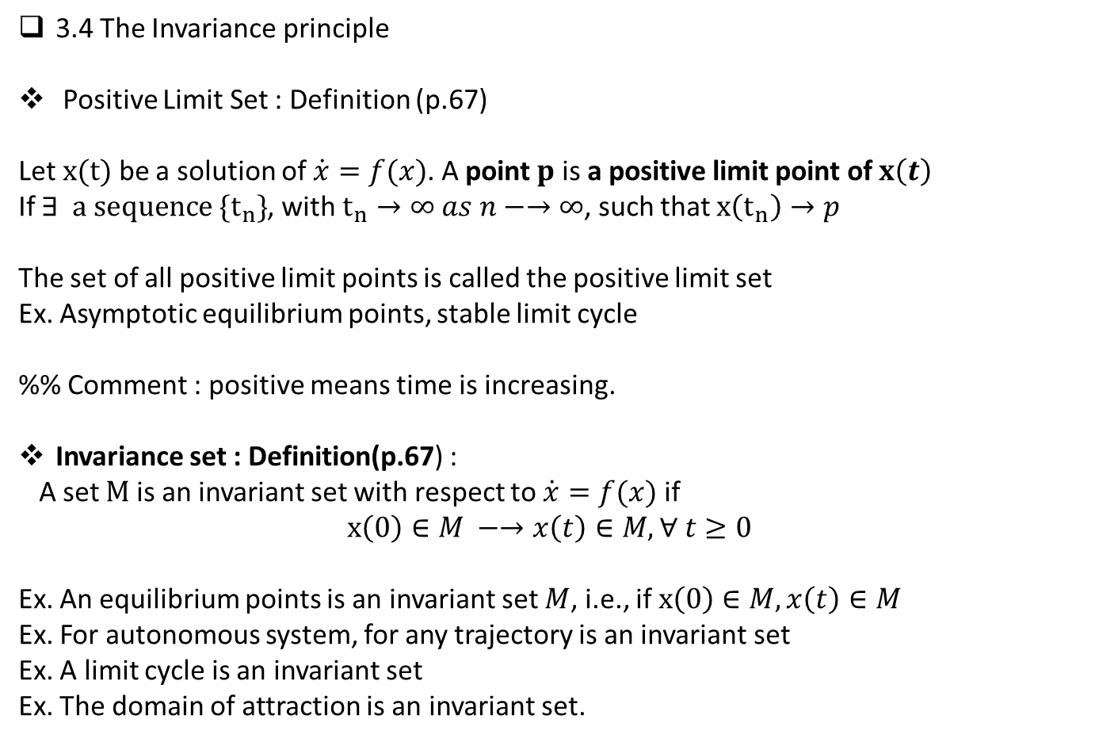
3.4 The Invariance principle
Positive Limit Set : Definition (p.67)
Let $x(t)$ be a solution of $\dot{x}=f(x)$. A point $p$ is a positive limit point of $x\left(t\right)$
If $∃ a sequence \{t_{n}\}$, with $t_{n}→∞ as n−→∞$, such that $x\left(t_{n}\right)→p$
The set of all positive limit points is called the positive limit set
Ex. Asymptotic equilibrium points, stable limit cycle
%% Comment : positive means time is increasing.
Invariance set : Definition(p.67) :
A set $M$ is an invariant set with respect to $\dot{x}=f(x)$ if
$$x\left(0\right)∈M −→x\left(t\right)∈M, ∀ t≥0$$
Ex. An equilibrium points is an invariant set $M$, i.e., if $x\left(0\right)∈M, x\left(t\right)∈M$
Ex. For autonomous system, for any trajectory is an invariant set
Ex. A limit cycle is an invariant set
Ex. The domain of attraction is an invariant set.

Slide 14
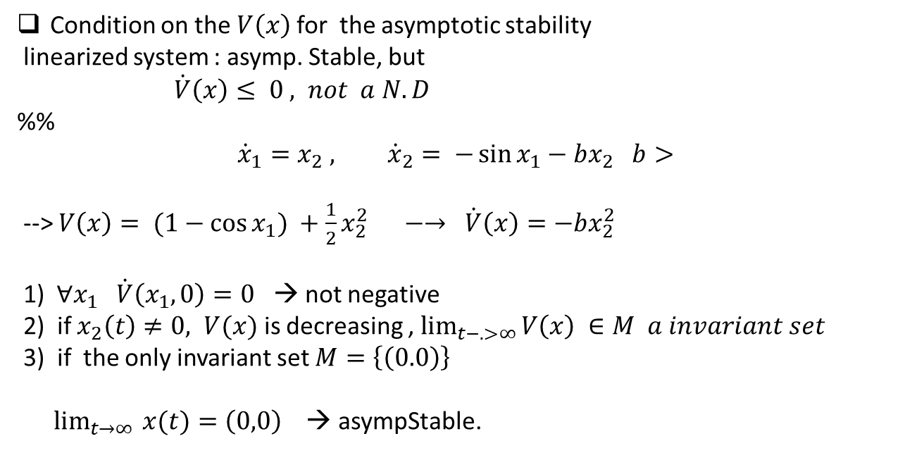
Condition on the $V\left(x\right)$for the asymptotic stability
linearized system : asymp. Stable, but
$\dot{V}\left(x\right)≤ 0 , not a N.D$
%%
$${\dot{x}}_{1}=x_{2} , {\dot{x}}_{2}= −\sin{x_{1}}−bx_{2} b>$$
--> $V\left(x\right)= (1−\cos{x_{1}) +\frac{1}{2}x_{2}^{2} } −→ \dot{V}\left(x\right)=−bx_{2}^{2}$
1) $∀x_{1} \dot{V}\left(x_{1}, 0\right)=0$ → not negative
2) if $x_{2}\left(t\right)≠0, V(x)$ is decreasing , $\lim_{t−.>∞}{V\left(x\right) ∈M a invariant set }$
3) if the only invariant set $M=\left\{\left(0.0\right)\right\}$
$\lim_{t→∞ }{x(t)}=\left(0,0\right)$ → asympStable.

Slide 15

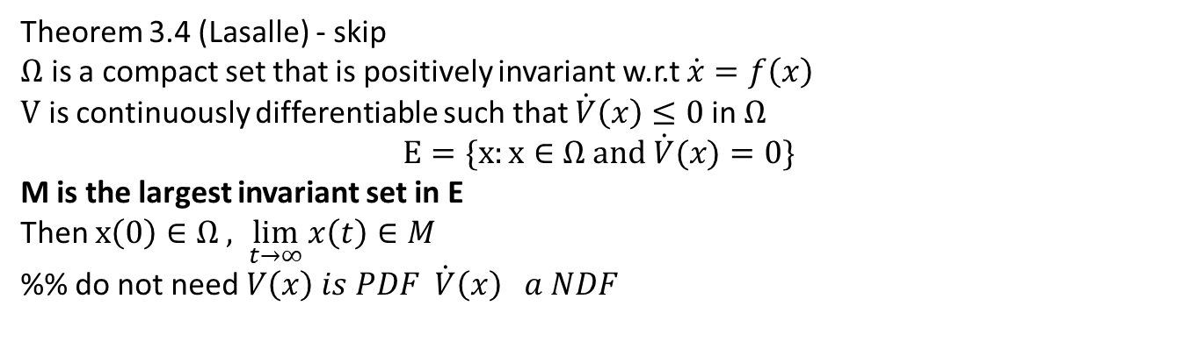

Theorem 3.4 (Lasalle) - skip
$Ω$ is a compact set that is positively invariant w.r.t $\dot{x}=f\left(x\right)$
$V$ is continuously differentiable such that $\dot{V}\left(x\right)≤0$in $Ω$
$$E=\{x:x∈Ω and \dot{V}(x)=0\}$$
M is the largest invariant set in E
Then $x\left(0\right)∈Ω , \lim_{t→∞}{x\left(t\right)}∈M$
%% do not need $V\left(x\right) is PDF \dot{V}\left(x\right) a NDF$
$$E$$
$$Ω$$

Slide 16
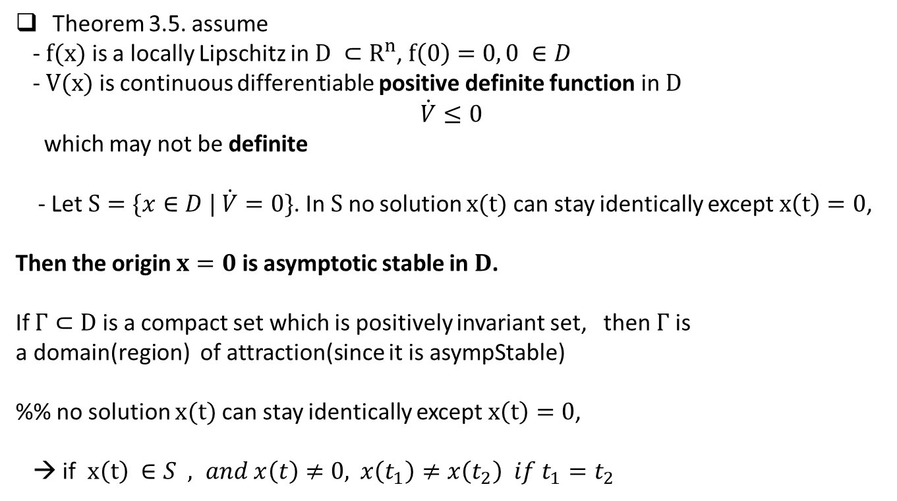
Theorem 3.5. assume
- $f(x)$ is a locally Lipschitz in $D ⊂R^{n}$, $f\left(0\right)=0, 0 ∈D$
- $V(x)$ is continuous differentiable positive definite function in $D$
$$\dot{V}≤0$$
which may not be definite
- Let $S=\{x∈D | \dot{V}=0\}$. In $S$ no solution $x(t)$ can stay identically except $x\left(t\right)=0$,
Then the origin $x=0$ is asymptotic stable in $D$.
If $Γ⊂D$ is a compact set which is positively invariant set, then $Γ$ is
a domain(region) of attraction(since it is asympStable)
%% no solution $x(t)$ can stay identically except $x\left(t\right)=0$,
→ if $x\left(t\right) ∈S , and x\left(t\right)≠0,$ $x\left(t_{1}\right)≠x\left(t_{2}\right) if t_{1}=t_{2}$

Slide 17
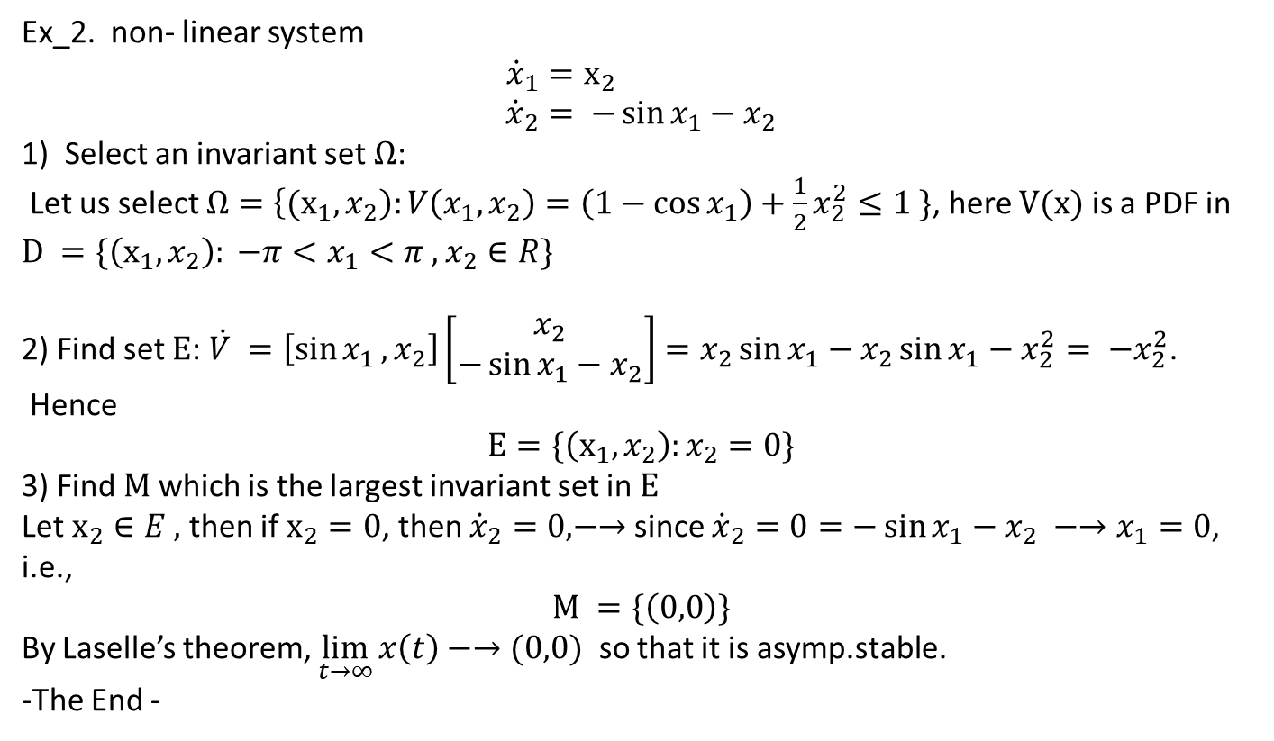
Ex_2. non- linear system
$${\dot{x}}_{1}=x_{2} \\ {\dot{x}}_{2}= −\sin{x_{1}}−x_{2}$$
1) Select an invariant set $Ω$:
Let us select $Ω=\left\{{(x}_{1}, x_{2}\right):V\left(x_{1},x_{2}\right)=\left(1−\cos{x_{1}}\right)+\frac{1}{2}x_{2}^{2}≤1 \}$, here $V(x)$ is a PDF in $D =\{\left(x_{1}, x_{2}\right): −π<x_{1}<π , x_{2}∈R\}$
2) Find set $E$: $\dot{V }=\left[\sin{x_{1}}, x_{2}\right]\left[\begin{matrix}x_{2} \\ −\sin{x_{1}}−x_{2}\end{matrix}\right]=x_{2}\sin{x_{1}}−x_{2}\sin{x_{1}}−x_{2}^{2}= −x_{2}^{2}$.
Hence
$$E=\{\left(x_{1}, x_{2}\right):x_{2}=0\}$$
3) Find $M$ which is the largest invariant set in $E$
Let $x_{2}∈E ,$then if $x_{2}=0$, then ${\dot{x}}_{2}=0, −→$ since ${\dot{x}}_{2}=0=−\sin{x_{1}}−x_{2} −→x_{1}=0$,
i.e.,
$$M =\{\left(0,0\right)\}$$
By Laselle’s theorem, $\lim_{t→∞}{x\left(t\right)−→(0,0)}$ so that it is asymp.stable.
-The End -

Slide 18
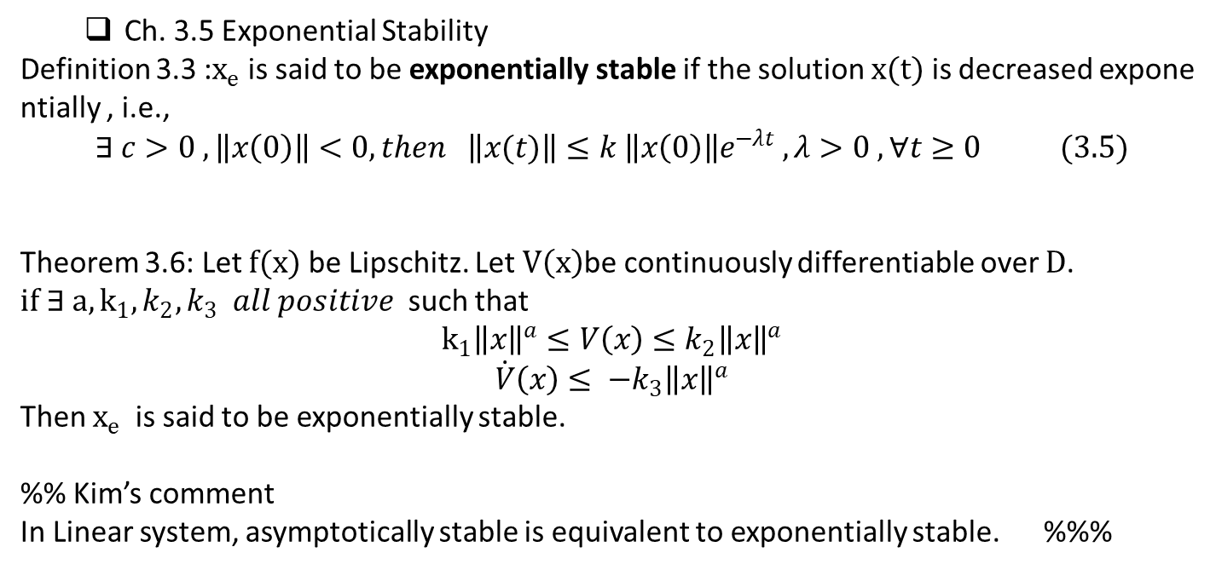
Ch. 3.5 Exponential Stability
Definition 3.3 :$x_{e}$ is said to be exponentially stable if the solution $x(t)$ is decreased exponentially , i.e.,
$$∃ c>0 , \left\|x\left(0\right)\right\|<0, then \left\|x(t)\right\|≤k \left\|x\left(0\right)\right\|e^{−λt} , λ>0 , ∀t≥0 (3.5)$$
Theorem 3.6: Let $f(x)$ be Lipschitz. Let $V\left(x\right)$be continuously differentiable over $D$. $if ∃ a, k_{1},k_{2}, k_{3} all positive$ such that
$$k_{1}{\left\|x\right\|}^{a}≤V\left(x\right)≤k_{2}{\left\|x\right\|}^{a}$$
$$\dot{V}\left(x\right)≤ −k_{3}{\left\|x\right\|}^{a}$$
Then $x_{e}$ is said to be exponentially stable.
%% Kim’s comment
In Linear system, asymptotically stable is equivalent to exponentially stable. %%%

