Slide 1

Review
Ch.9.2 Linearization with state feedback
$\dot{x}=\sin{x+u}$
→ Linearization :
${\dot{x}}_{L} =x_{L}+u$
Select
$$u=−2x+v$$
Then the closed loop is
$\dot{x}=\sin{x −2x+v}$
Ch. 9.3 Feedback Linearization
$\dot{x}=\sin{x+u}$,
Select $u=−sinx −2x+v$
$\dot{x_{c}}=\sin{x_{c}+u}=−2x_{c}+v$,

Slide 2
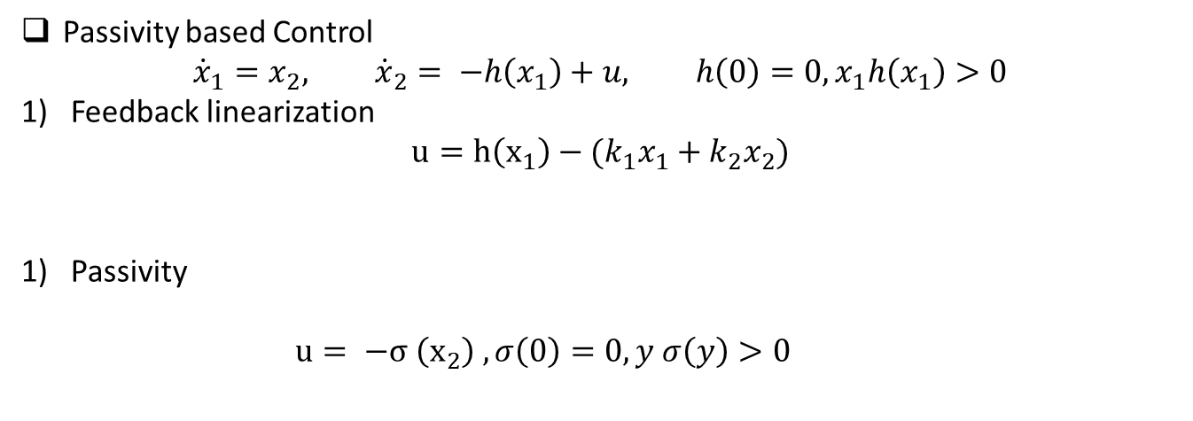
Passivity based Control
$${\dot{x}}_{1}=x_{2}, {\dot{x}}_{2}= −h\left(x_{1}\right)+u, h\left(0\right)=0, x_{1}h\left(x_{1}\right)>0$$
Feedback linearization
$$u=h\left(x_{1}\right)−(k_{1}x_{1}+k_{2}x_{2})$$
Passivity
$u= −σ \left(x_{2}\right) , σ\left(0\right)=0, y σ\left(y\right)>0$

Slide 3
Back-stepping
Controller
Plant
Plant
Controller

Slide 4
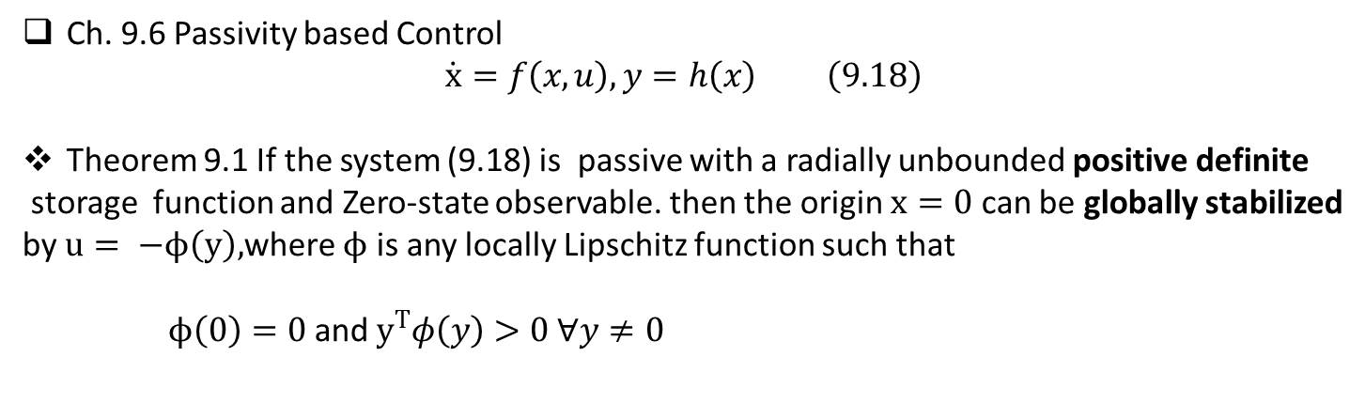
Ch. 9.6 Passivity based Control
$$\dot{x}=f\left(x,u\right), y=h\left(x\right) \left(9.18\right)$$
Theorem 9.1 If the system (9.18) is passive with a radially unbounded positive definite
storage function and Zero-state observable. then the origin $x=0$ can be globally stabilized by $u= −ϕ\left(y\right),$where $ϕ$ is any locally Lipschitz function such that
$ϕ\left(0\right)=0$ and $y^{T}φ\left(y\right)>0 ∀y≠0$
Proof: By definition
$u^{T}y≥\dot{V}\left(x, −φ\left(x\right)\right)$→ $−φ\left(y\right)y≥\dot{V}\left(x, −φ\left(x\right)\right)$ →$−\dot{V}\left(x, −φ\left(x\right)\right) ≤$ $φ\left(y\right)y$
→ By the Zero-state observable , globally asymp. stable
The output feedback controller to stabilize if the plant is passive.
The flexibility to select the controller.

Slide 5
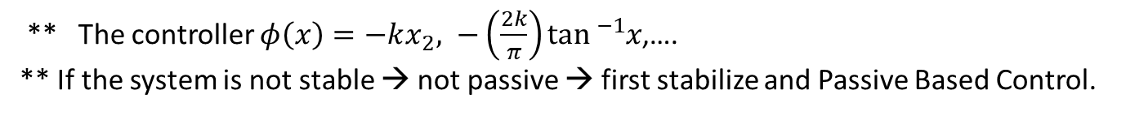
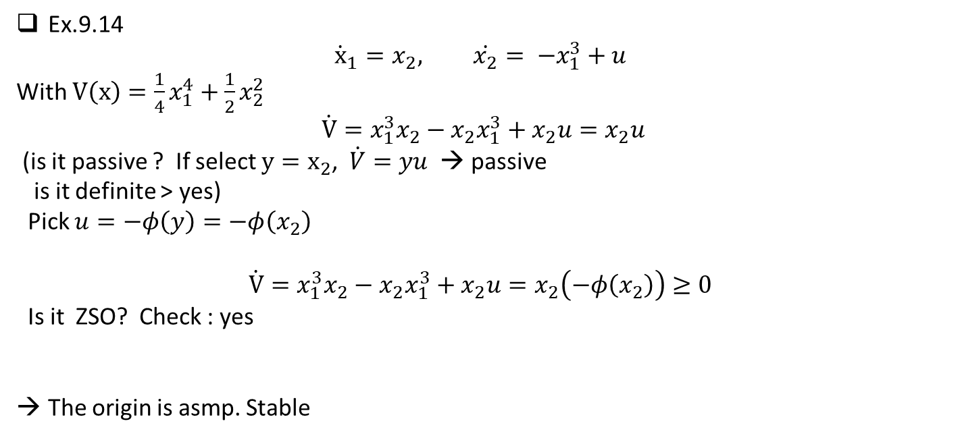
Ex.9.14
$${\dot{x}}_{1}=x_{2}, \dot{x_{2}}= −x_{1}^{3}+u$$
With $V\left(x\right)=\frac{1}{4}x_{1}^{4}+\frac{1}{2}x_{2}^{2}$
$$\dot{V}=x_{1}^{3}x_{2}−x_{2}x_{1}^{3}+x_{2}u=x_{2}u$$
(is it passive ? If select $y=x_{2}$, $\dot{V}=yu$ → passive
is it definite > yes)
Pick $u=−φ\left(y\right)=−φ\left(x_{2}\right)$
$$\dot{V}=x_{1}^{3}x_{2}−x_{2}x_{1}^{3}+x_{2}u=x_{2}\left(−φ\left(x_{2}\right)\right)≥0$$
Is it ZSO? Check : yes
The origin is asmp. Stable
** The controller $φ\left(x\right)=−kx_{2}, −\left(\frac{2k}{π}\right)\tan{{}_{}^{−1}x}$,….
** If the system is not stable → not passive → first stabilize and Passive Based Control.

Slide 6
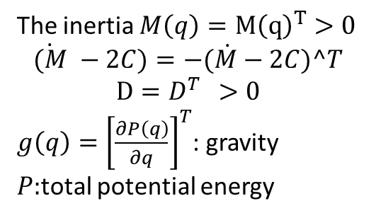
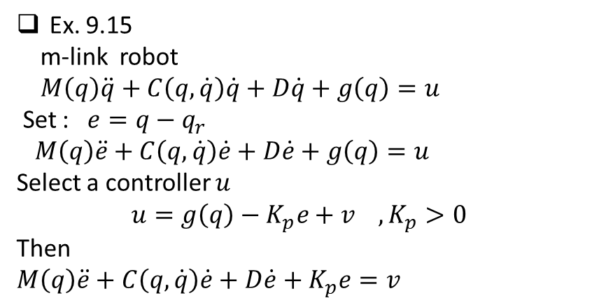
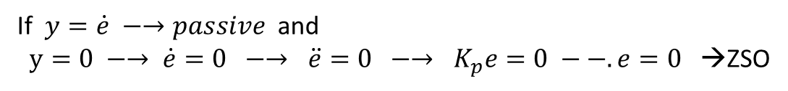
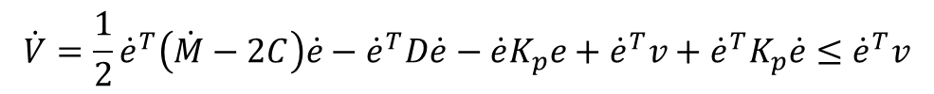

Ex. 9.15
m-link robot
$M\left(q\right)\ddot{q}+C\left(q, \dot{q}\right)\dot{q}+D\dot{q}+g\left(q\right)=u$
Set : $e=q−q_{r}$
$M\left(q\right)\ddot{e}+C\left(q, \dot{q}\right)\dot{e}+D\dot{e}+g\left(q\right)=u$
Select a controller $u$
$$u=g\left(q\right)−K_{p}e+v , K_{p}>0$$
Then
$M\left(q\right)\ddot{e}+C\left(q, \dot{q}\right)\dot{e}+D\dot{e}+K_{p}e=v$
The inertia $M\left(q\right)=M{\left(q\right)}^{T}>0$
$$\dot{(M} −2C)=−(\dot{M}−2C)^T$$
$$D=D^{T } >0$$
$g\left(q\right)={\left[\frac{∂P\left(q\right)}{∂q}\right]}^{T}$: gravity
$P:$total potential energy
Select a storage $V=\frac{1}{2}{\dot{e}}^{T}M\left(q\right)\dot{e} +\frac{1}{2}e^{T}K_{p}e$
$$\dot{V}=\frac{1}{2}{\dot{e}}^{T}\left(\dot{M}−2C\right)\dot{e}−{\dot{e}}^{T}D\dot{e}−\dot{e}K_{p}e+{\dot{e}}^{T}v+{\dot{e}}^{T}K_{p}\dot{e}≤{\dot{e}}^{T}v$$
If $y=\dot{e} −→passive$ and
$y=0 −→ \dot{e}=0 −→ \ddot{e}=0 −→ K_{p}e=0 −−. e=0$ →ZSO
The closed loop is asym.stable with
$u=g\left(q\right)−K_{p}\left(q−q_{r}\right)+K_{d}\dot{q} −→PD controller with$gravity compensation

Slide 7
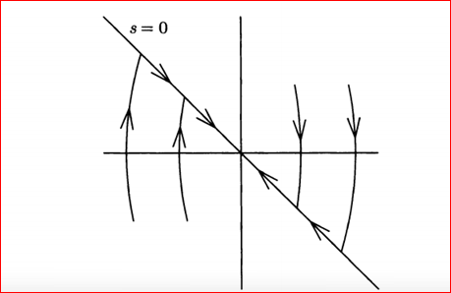
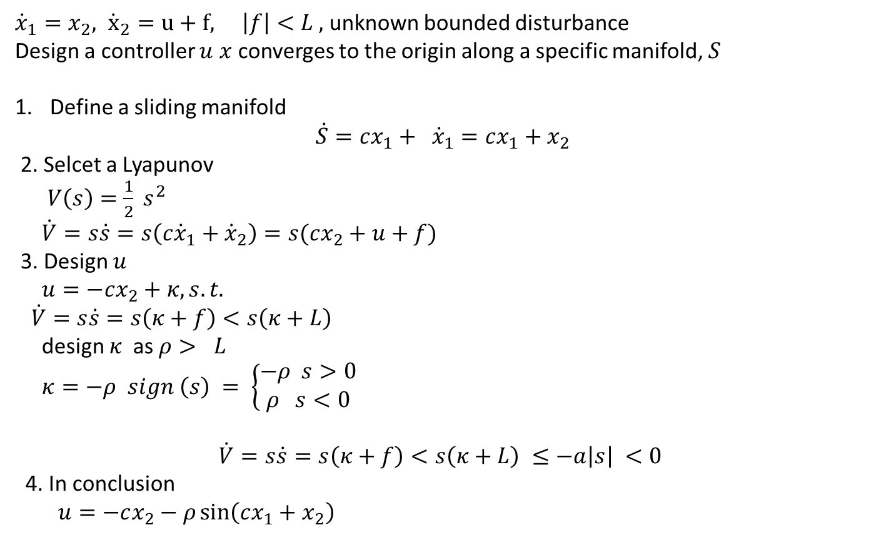
Ch.10. Robust State Feedback Stabilization
Ch.10.1 Sliding mode control
https://www.youtube.com/watch?v=_NTMkXdbX6o)
${\dot{x}}_{1}=x_{2}, {\dot{x}}_{2}=u+f, \left|f\right|<L ,$unknown bounded disturbance
Design a controller $u$ $x$converges to the origin along a specific manifold, $S$
Define a sliding manifold
$$\dot{S}=cx_{1}+ {\dot{x}}_{1}=cx_{1}+x_{2}$$
2. Selcet a Lyapunov
$V\left(s\right)=\frac{1}{2} s^{2}$
$\dot{V}=s\dot{s}=s\left(c{\dot{x}}_{1}+{\dot{x}}_{2}\right)=s(cx_{2}+u+f)$
3. Design $u$
$u=−cx_{2}+κ, s.t.$
$\dot{V}=s\dot{s}=s\left(κ+f\right)<s\left(κ+L\right)$
design $κ$ as $ρ> L$
$κ=−ρ sign \left(s\right) = \left\{\begin{aligned}−ρ s>0 \\ ρ s<0\end{aligned}\right.$
$$\dot{V}=s\dot{s}=s\left(κ+f\right)<s\left(κ+L\right) ≤−a\left|s\right| <0$$
4. In conclusion
$u=−cx_{2}−ρ\sin\left(cx_{1}+x_{2}\right)$

Slide 8
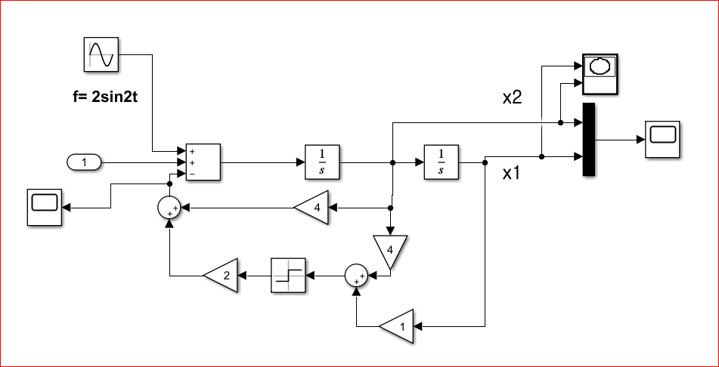
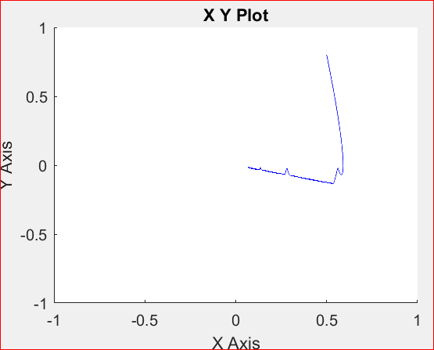
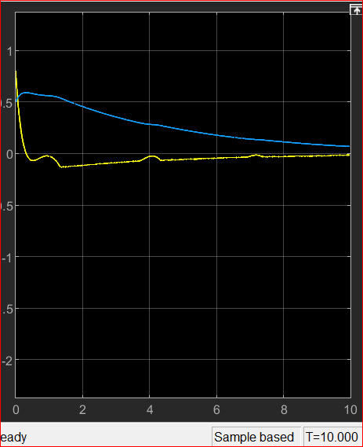
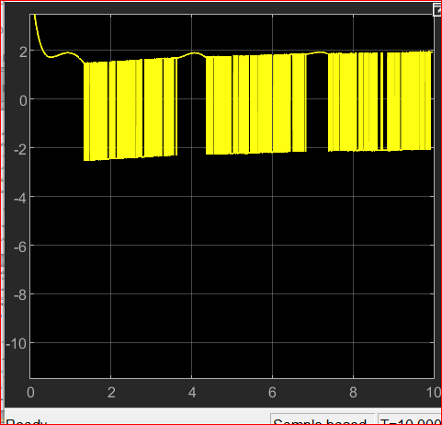
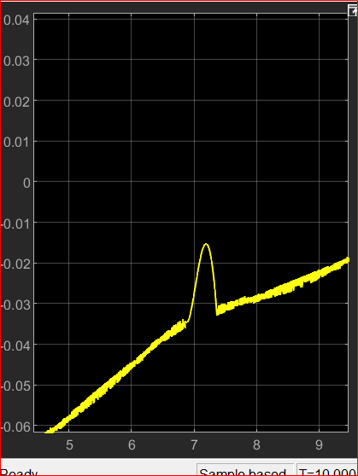

Simulink $c=4, ρ=2 , time step=0.001$
Tut_Week_8-Sliding_Disturbance.slx
Control input
Sliding manifold
chattering

Slide 9


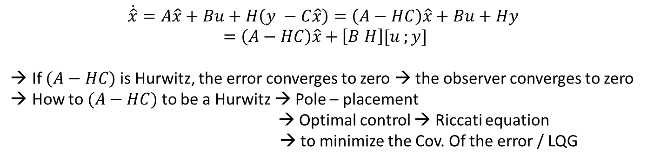


11. Non-linear Observer
Linear Observer
$$\dot{x}=Ax+Bu , y=Cx$$
Given $y$, estimate $x$
Kalman’s Observer (any other optimal observer/estimator )
Define the error $e=x−\hat{x}$
$$\dot{e}=\left(A−HC\right)e$$
It should be asymp. Stable.
$$\hat{x}:observer of x$$
$$\dot{\hat{x}}=A\hat{x}+Bu+H\left(y−C\hat{x}\right)$$
$$\dot{\hat{x}}=A\hat{x}+Bu+H\left(y −C\hat{x}\right)=\left(A−HC\right)\hat{x}+Bu+Hy$$
$$=\left(A−HC\right)\hat{x}+\left[B H\right][u ;y]$$
If $(A−HC)$ is Hurwitz, the error converges to zero → the observer converges to zero
How to $(A−HC)$ to be a Hurwitz → Pole – placement
→ Optimal control → Riccati equation
→ to minimize the Cov. Of the error / LQG

Slide 10
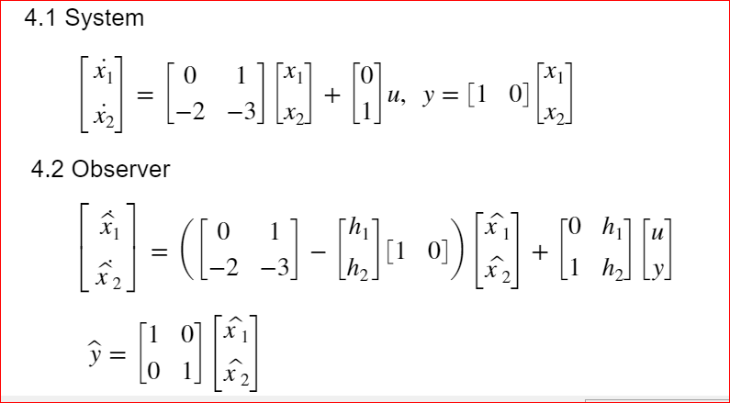
Example
Tut_Week_8_LinearObserver

Slide 11
Pole – placement :
clear variables
A =[0 1; -2 -3];
B = [0;1];
C =[1 0];
eig(A)
H = acker(A',C',[-10, -20])';
Aobs =A -H*C;
Bobs =[B H];
Cobs = eye(2,2);
%% acker : pole placement

Slide 12
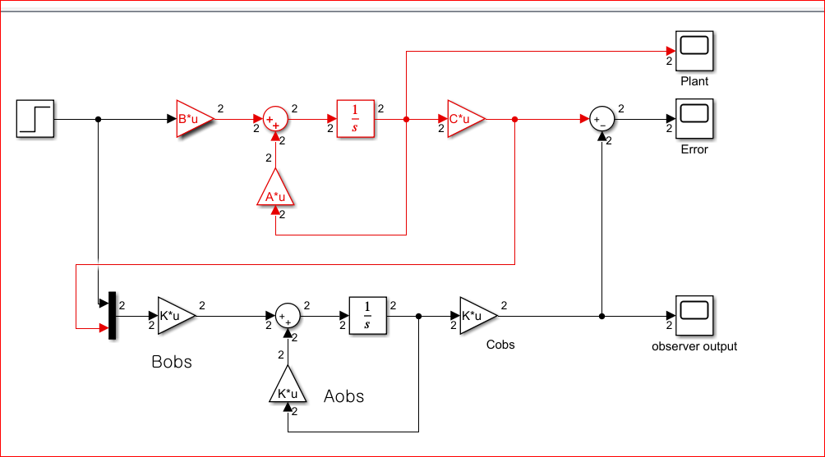
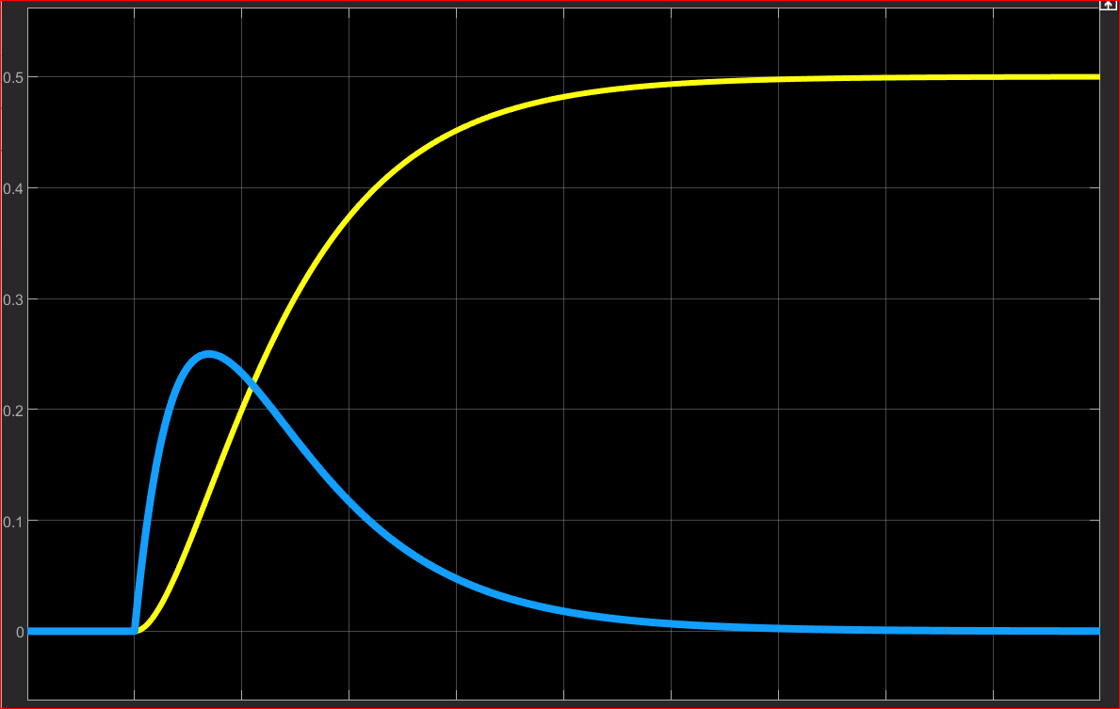
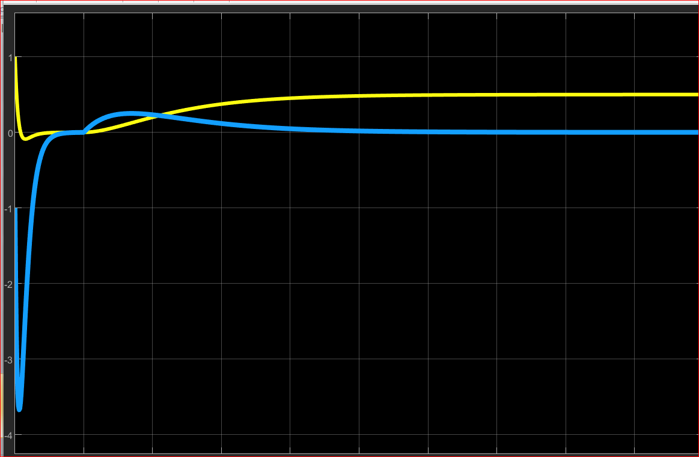
Real plant output
Observer output

Slide 13
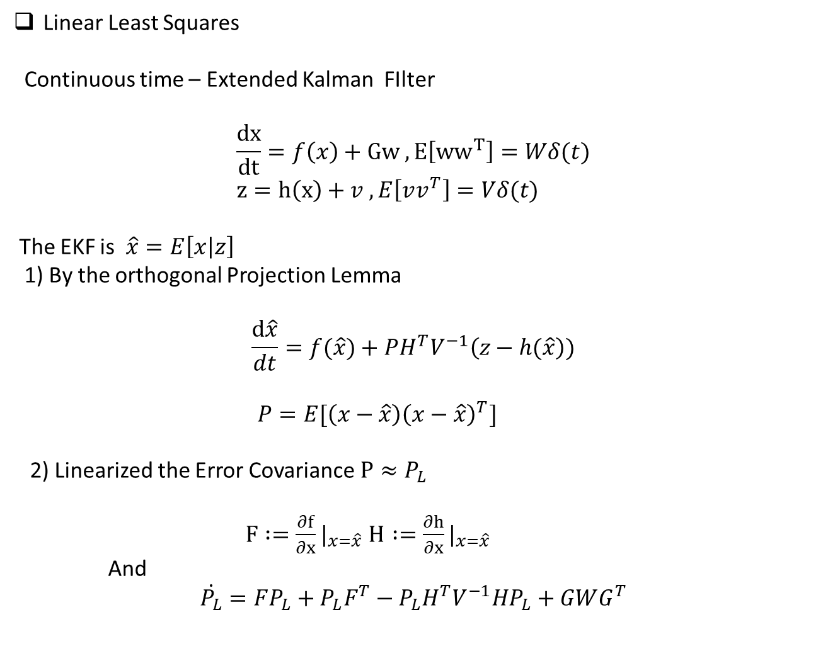
Linear Least Squares
Continuous time – Extended Kalman FIlter
$$\frac{dx}{dt}=f\left(x\right)+Gw , E\left[{ww}^{T}\right]=Wδ(t) \\ z=h\left(x\right)+v , E\left[vv^{T}\right]=Vδ(t)$$
The EKF is $\hat{x}=E\left[x | z\right]$
1) By the orthogonal Projection Lemma
$$\frac{d\hat{x}}{dt}=f(\hat{x})+PH^{T}V^{−1}\left(z−h(\hat{x}\right))$$
$P=E[\left(x−\hat{x}\right){\left(x−\hat{x}\right)}^{T}]$
2) Linearized the Error Covariance $P≈P_{L}$
$F :=\frac{∂f}{∂x}|_{x=\hat{x}}$ $H :=\frac{∂h}{∂x}|_{x=\hat{x}}$
And
$$\dot{P_{L}}=FP_{L}+P_{L}F^{T}−P_{L}H^{T}V^{−1}HP_{L}+GWG^{T}$$

Slide 14
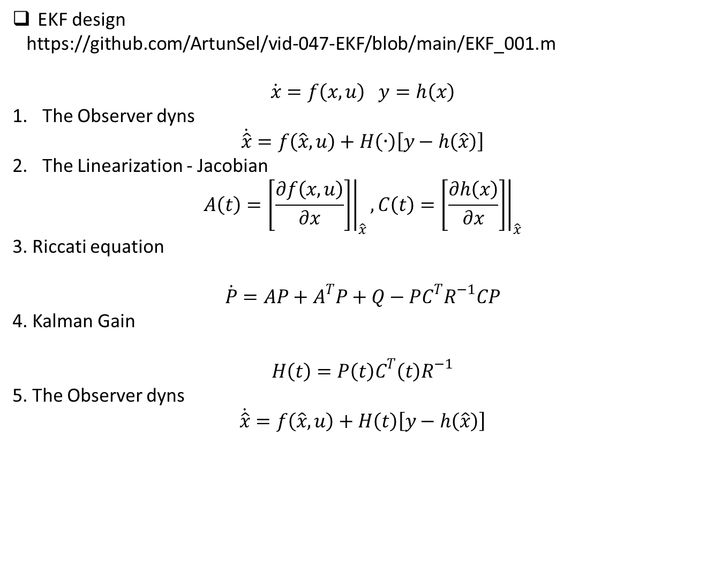
EKF design
https://github.com/ArtunSel/vid-047-EKF/blob/main/EKF_001.m
$$\dot{x}=f\left(x,u\right) y=h\left(x\right)$$
The Observer dyns
$$\dot{\hat{x}}=f\left(\hat{x},u\right)+H\left(∙\right)\left[y−h\left(\hat{x}\right)\right]$$
The Linearization - Jacobian
$$A\left(t\right)={\left.\left[\frac{∂f\left(x,u\right)}{∂x}\right]\right|}_{\hat{x}},C\left(t\right)={\left.\left[\frac{∂h\left(x\right)}{∂x}\right]\right|}_{\hat{x}}$$
3. Riccati equation
$$\dot{P}=AP+A^{T}P+Q−PC^{T}R^{−1}CP$$
4. Kalman Gain
$$H\left(t\right)=P\left(t\right)C^{T}\left(t\right)R^{−1}$$
5. The Observer dyns
$$\dot{\hat{x}}=f\left(\hat{x},u\right)+H\left(t\right)\left[y−h\left(\hat{x}\right)\right]$$

Slide 15
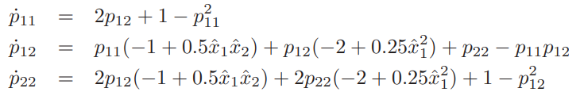
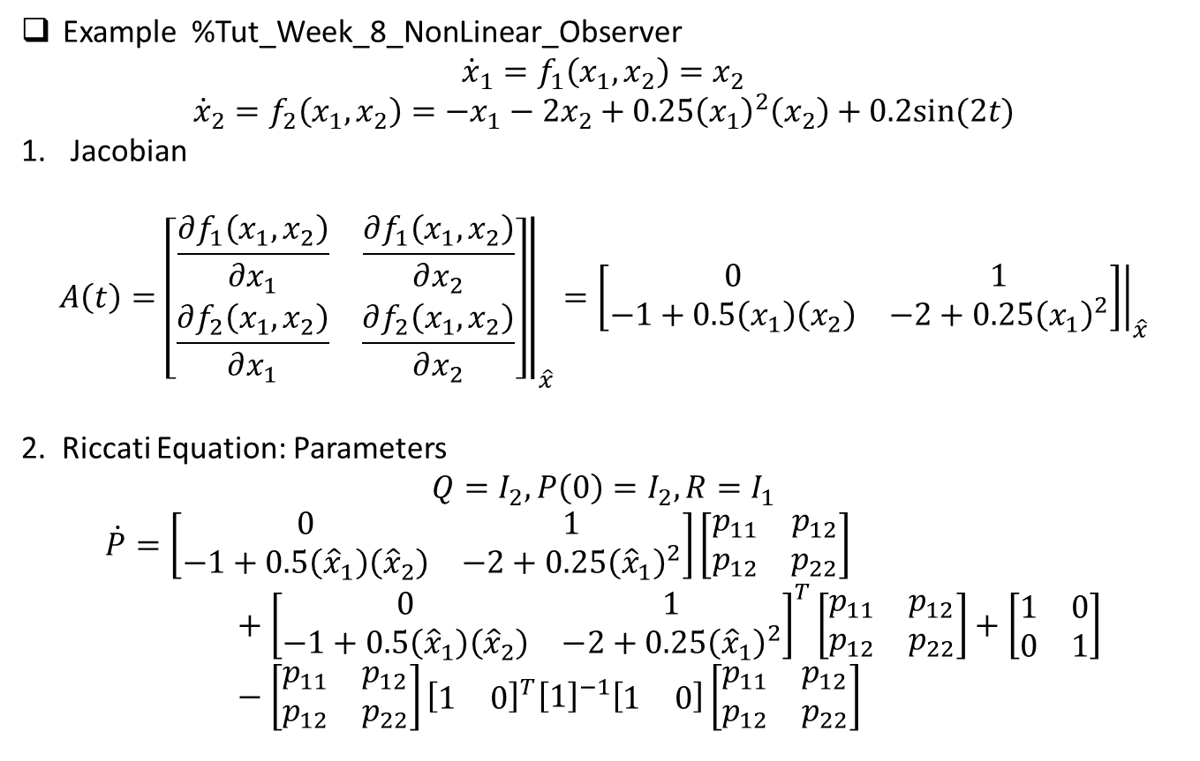
Example %Tut_Week_8_NonLinear_Observer
$${\dot{x}}_{1}=f_{1}\left(x_{1},x_{2}\right)=x_{2}$$
$${\dot{x}}_{2}=f_{2}\left(x_{1},x_{2}\right)=−x_{1}−2x_{2}+0.25{\left(x_{1}\right)}^{2}\left(x_{2}\right)+0.2sin⁡(2t)$$
Jacobian
$$A\left(t\right)={\left.\left[\begin{matrix}\frac{∂f_{1}\left(x_{1},x_{2}\right)}{∂x_{1}} & \frac{∂f_{1}\left(x_{1},x_{2}\right)}{∂x_{2}} \\ \frac{∂f_{2}\left(x_{1},x_{2}\right)}{∂x_{1}} & \frac{∂f_{2}\left(x_{1},x_{2}\right)}{∂x_{2}}\end{matrix}\right]\right|}_{\hat{x}}={\left.\left[\begin{matrix}0 & 1 \\ −1+0.5\left(x_{1}\right)\left(x_{2}\right) & −2+0.25{\left(x_{1}\right)}^{2}\end{matrix}\right]\right|}_{\hat{x}}$$
2. Riccati Equation: Parameters
$$Q=I_{2},P\left(0\right)=I_{2},R=I_{1}$$
$$\dot{P}=\left[\begin{matrix}0 & 1 \\ −1+0.5\left({\hat{x}}_{1}\right)\left({\hat{x}}_{2}\right) & −2+0.25{\left({\hat{x}}_{1}\right)}^{2}\end{matrix}\right]\left[\begin{matrix}p_{11} & p_{12} \\ p_{12} & p_{22}\end{matrix}\right]+{\left[\begin{matrix}0 & 1 \\ −1+0.5\left({\hat{x}}_{1}\right)\left({\hat{x}}_{2}\right) & −2+0.25{\left({\hat{x}}_{1}\right)}^{2}\end{matrix}\right]}^{T}\left[\begin{matrix}p_{11} & p_{12} \\ p_{12} & p_{22}\end{matrix}\right]+\left[\begin{matrix}1 & 0 \\ 0 & 1\end{matrix}\right]−\left[\begin{matrix}p_{11} & p_{12} \\ p_{12} & p_{22}\end{matrix}\right]{\left[\begin{matrix}1 & 0\end{matrix}\right]}^{T}{\left[1\right]}^{−1}\left[\begin{matrix}1 & 0\end{matrix}\right]\left[\begin{matrix}p_{11} & p_{12} \\ p_{12} & p_{22}\end{matrix}\right]$$

Slide 16
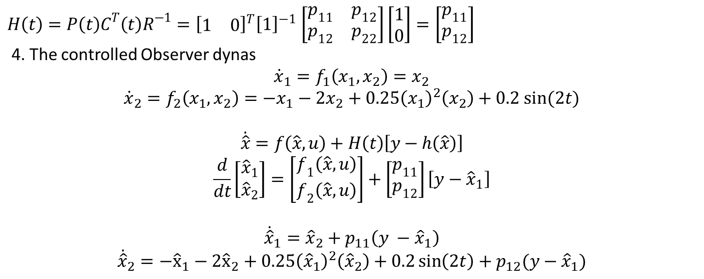
3. Compute the observer gain
$H\left(t\right)=P\left(t\right)C^{T}\left(t\right)R^{−1}={\left[\begin{matrix}1 & 0\end{matrix}\right]}^{T}{\left[1\right]}^{−1}$ $\left[\begin{matrix}p_{11} & p_{12} \\ p_{12} & p_{22}\end{matrix}\right]\left[\begin{aligned}1 \\ 0\end{aligned}\right]=\left[\begin{aligned}p_{11} \\ p_{12}\end{aligned}\right]$
4. The controlled Observer dynas
$${\dot{x}}_{1}=f_{1}\left(x_{1},x_{2}\right)=x_{2}$$
$${\dot{x}}_{2}=f_{2}\left(x_{1},x_{2}\right)=−x_{1}−2x_{2}+0.25{\left(x_{1}\right)}^{2}\left(x_{2}\right)+0.2 sin⁡(2t)$$
$$\dot{\hat{x}}=f\left(\hat{x},u\right)+H\left(t\right)\left[y−h\left(\hat{x}\right)\right]$$
$$\frac{d}{dt}\left[\begin{aligned}{\hat{x}}_{1} \\ {\hat{x}}_{2}\end{aligned}\right]=\left[\begin{aligned}f_{1}\left(\hat{x},u\right) \\ f_{2}\left(\hat{x},u\right)\end{aligned}\right]+\left[\begin{aligned}p_{11} \\ p_{12}\end{aligned}\right]\left[y−{\hat{x}}_{1}\right]$$
$${\dot{\hat{x}}}_{1}={\hat{x}}_{2}+p_{11}\left(y −{\hat{x}}_{1}\right)$$
$${\dot{\hat{x}}}_{2}=−{\hat{x}}_{1}−2{\hat{x}}_{2}+0.25{\left({\hat{x}}_{1}\right)}^{2}\left({\hat{x}}_{2}\right)+0.2\sin\left(2t\right)+p_{12}(y−{\hat{x}}_{1})$$
In the Ex.11.1 is similar to this, but the textbook consider the domain of attraction
of the state.

