Slide 1
Mid-Term: May.29 → May 20., Monday (Ch.1 ~ 4: closed book) ) 09 to 11 AM
Final Class: June.20
Final Exam: Jun.24 Monday.(open book) → the date will be confirmed.

Slide 2
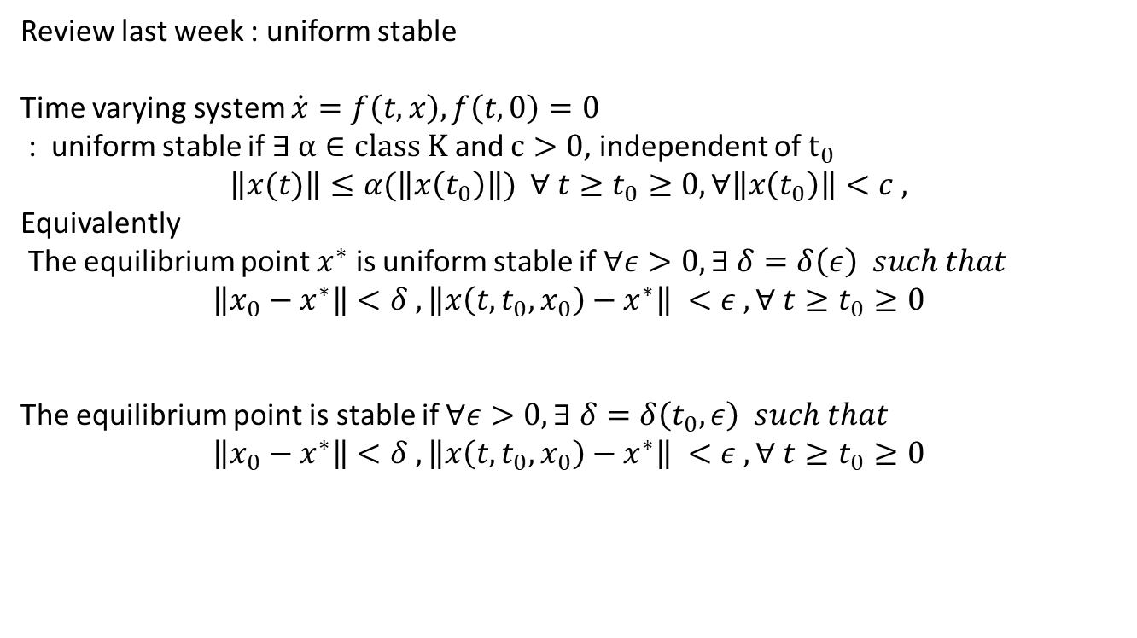
Review last week : uniform stable
Time varying system $\dot{x}=f\left(t,x\right), f\left(t,0\right)=0$
: uniform stable if $∃ α∈class Κ$ and $c>0$, independent of $t_{0}$
$$\left\|x(t)\right\|≤α(\left\|x\left(t_{0}\right)\right\|) ∀ t≥t_{0}≥0, ∀\left\|x\left(t_{0}\right)\right\|<c ,$$
Equivalently
The equilibrium point $x^{∗}$ is uniform stable if $∀ε>0, ∃ δ=δ\left(ε\right) such that$
$$\left\|x_{0}−x_{}^{∗}\right\|<δ , \left\|x\left(t,t_{0},x_{0}\right)−x^{∗}\right\| <ε , ∀ t≥t_{0}≥0$$
The equilibrium point is stable if $∀ε>0, ∃ δ=δ\left(t_{0}, ε\right) such that$
$$\left\|x_{0}−x_{}^{∗}\right\|<δ , \left\|x\left(t,t_{0},x_{0}\right)−x^{∗}\right\| <ε , ∀ t≥t_{0}≥0$$

Slide 3
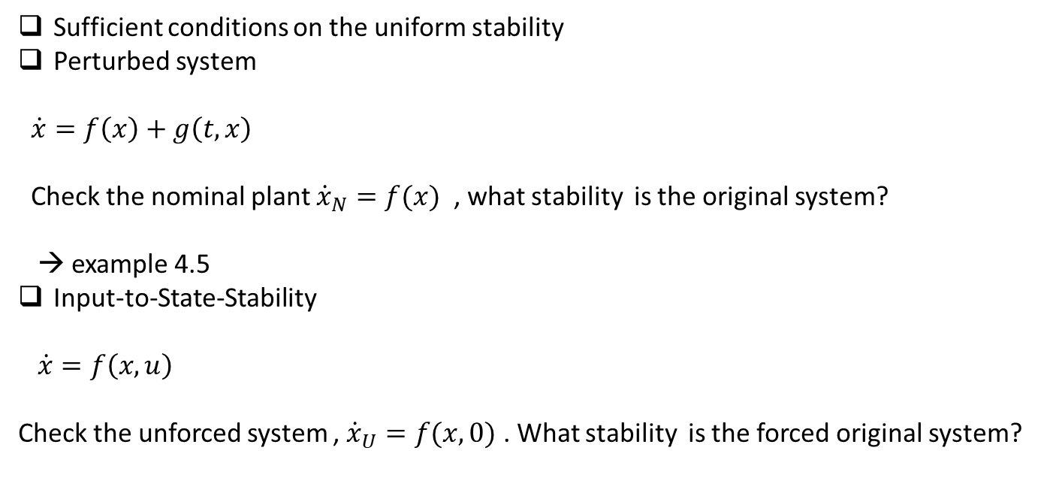
Sufficient conditions on the uniform stability
Perturbed system
$\dot{x}=f\left(x\right)+g\left(t,x\right)$
Check the nominal plant ${\dot{x}}_{N}=f(x)$ , what stability is the original system?
→ example 4.5
Input-to-State-Stability
$\dot{x}=f\left(x,u\right)$
Check the unforced system , ${\dot{x}}_{U}=f(x,0)$ . What stability is the forced original system?

Slide 4
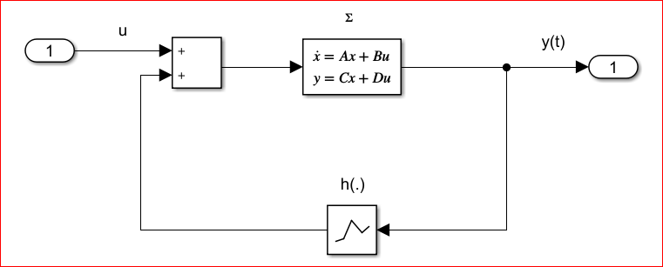
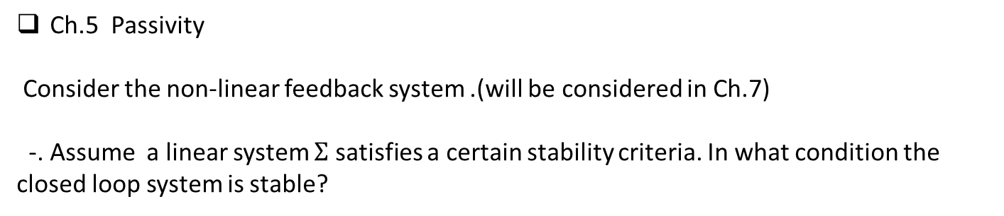
Ch.5 Passivity
Consider the non-linear feedback system .(will be considered in Ch.7)
-. Assume a linear system $Σ$ satisfies a certain stability criteria. In what condition the closed loop system is stable?
$$h\left(.\right): non−linear elements:, transistor , tunnel diode , Switching, …..$$

Slide 5
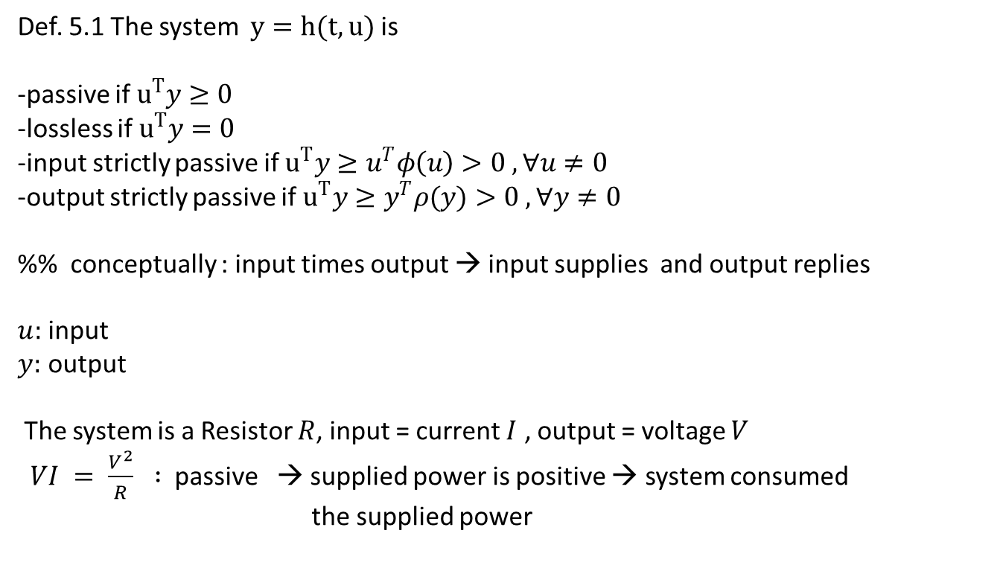
Def. 5.1 The system $y=h(t,u)$ is
-passive if $u^{T}y≥0$
-lossless if $u^{T}y=0$
-input strictly passive if $u^{T}y≥u^{T}φ\left(u\right)>0 , ∀u≠0$
-output strictly passive if $u^{T}y≥y^{T}ρ(y)>0 , ∀y≠0$
%% conceptually : input times output → input supplies and output replies
$u:$ input
$y:$ output
The system is a Resistor $R$, input = current $I$ , output = voltage $V$
$VI = \frac{V^{2}}{R} :$passive → supplied power is positive → system consumed
the supplied power

Slide 6
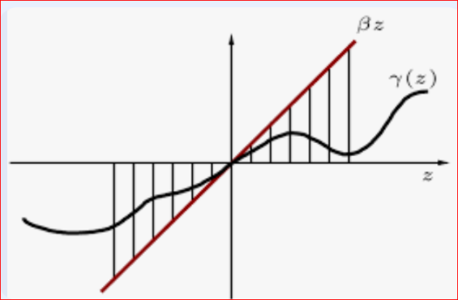
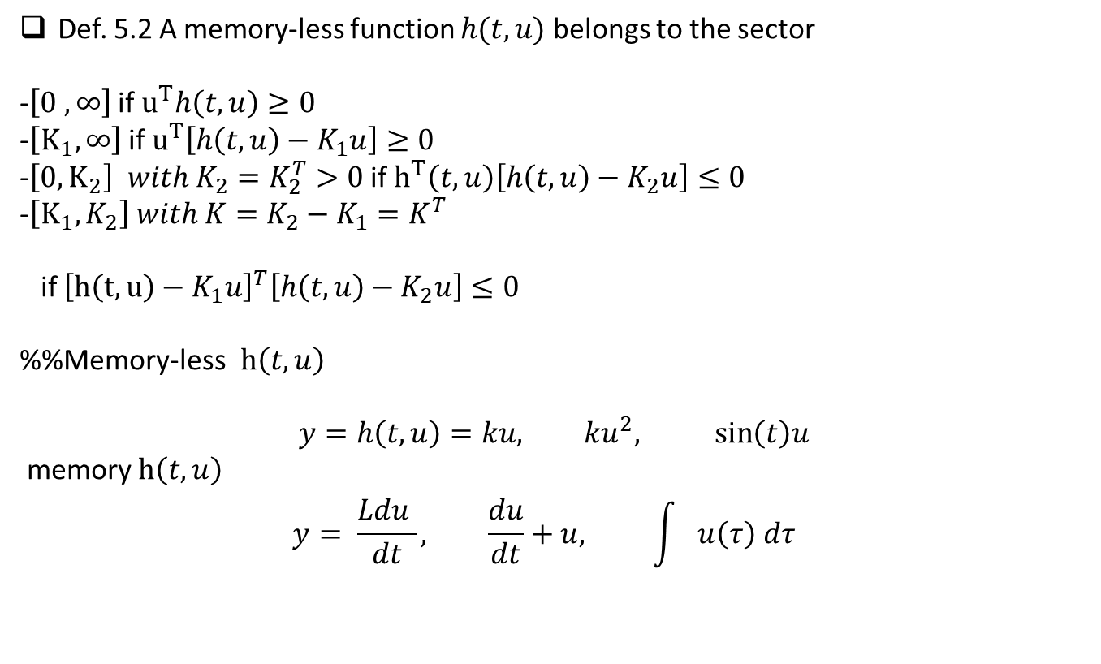
Def. 5.2 A memory-less function $h(t,u)$ belongs to the sector
-$\left[0 , ∞\right]$ if $u^{T}h\left(t,u\right)≥0$
-$\left[K_{1},∞\right]$ if $u^{T}\left[h\left(t,u\right)−K_{1}u\right]≥0$
-$\left[0, K_{2}\right] with K_{2}=K_{2}^{T}>0$ if $h^{T}\left(t,u\right)\left[h\left(t,u\right)−K_{2}u\right]≤0$
-$\left[K_{1}, K_{2}\right] with K=K_{2}−K_{1}=K^{T}$
if ${\left[h\left(t,u\right)−K_{1}u\right]}^{T}\left[h\left(t,u\right)−K_{2}u\right]≤0$
%%Memory-less$h\left(t,u\right)$
$$y=h\left(t,u\right)=ku, ku^{2}, \sin\left(t\right)u$$
memory $h\left(t,u\right)$
$$y= \frac{Ldu }{dt}, \frac{du}{dt}+u, \int{u\left(τ\right) dτ}$$

Slide 7
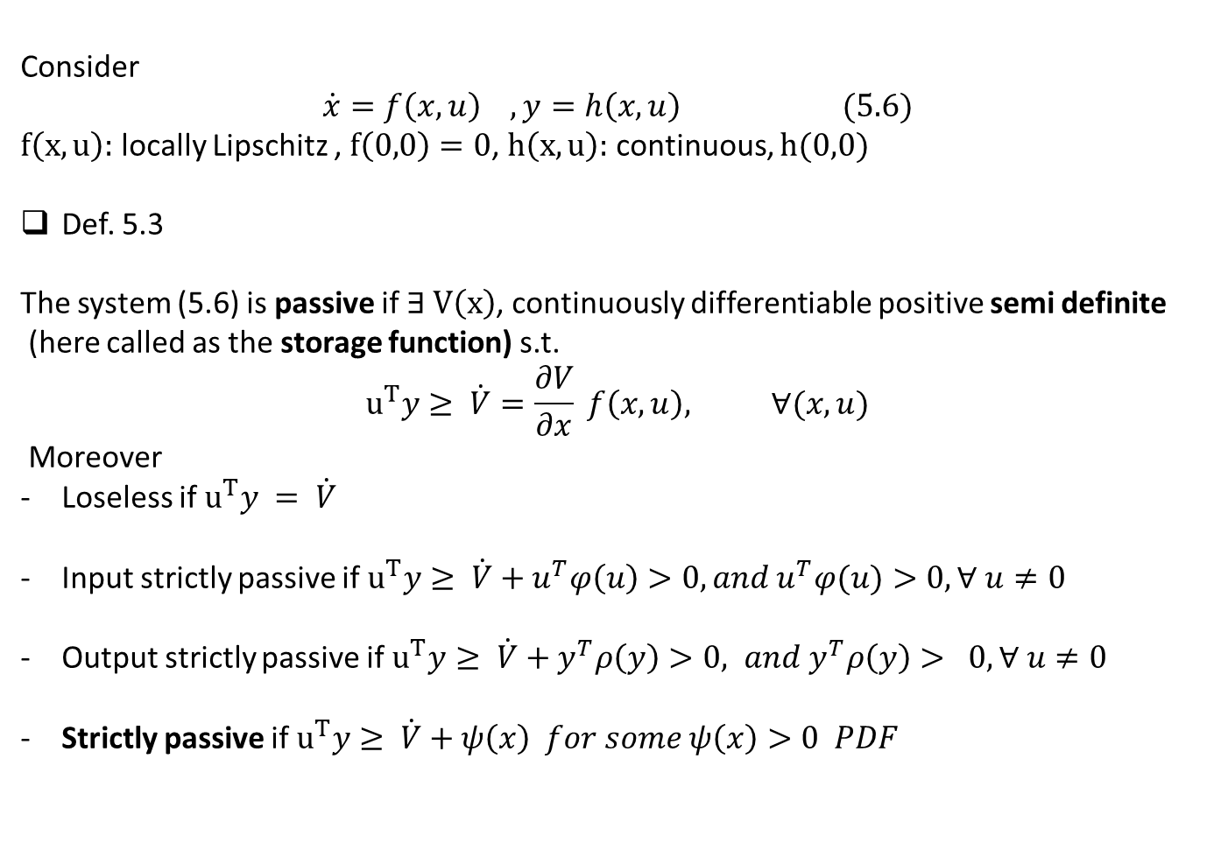
Consider
$$\dot{x}=f\left(x,u\right) , y=h\left(x,u\right) (5.6)$$
$f\left(x,u\right):$ locally Lipschitz , $f\left(0,0\right)=0$, $h\left(x,u\right):$ continuous, $h(0,0)$
Def. 5.3
The system (5.6) is passive if $∃ V\left(x\right)$, continuously differentiable positive semi definite
(here called as the storage function) s.t.
$$u^{T}y≥ \dot{V}=\frac{∂V}{∂x} f\left(x,u\right), ∀(x,u)$$
Moreover
Loseless if $u^{T}y = \dot{V}$
Input strictly passive if $u^{T}y≥ \dot{V}+u^{T}φ\left(u\right)>0, and u^{T}φ(u)>0, ∀ u≠0$
Output strictly passive if $u^{T}y≥ \dot{V}+y^{T}ρ\left(y\right)>0, and y^{T}ρ\left(y\right)> 0, ∀ u≠0$
Strictly passive if $u^{T}y≥ \dot{V}+ψ\left(x\right) for some ψ\left(x\right)>0 PDF$

Slide 8
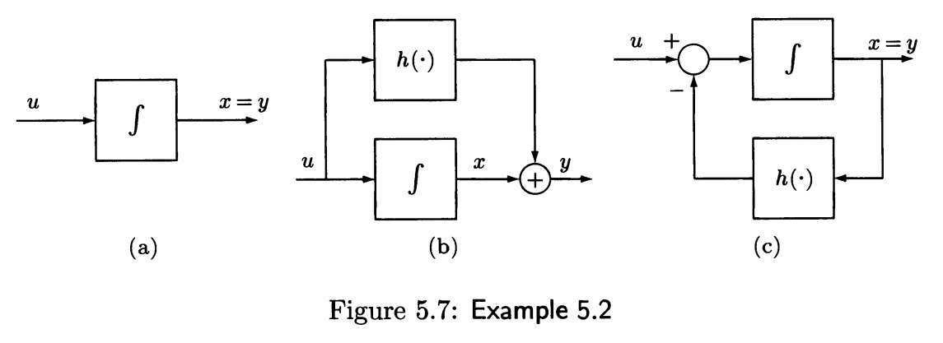
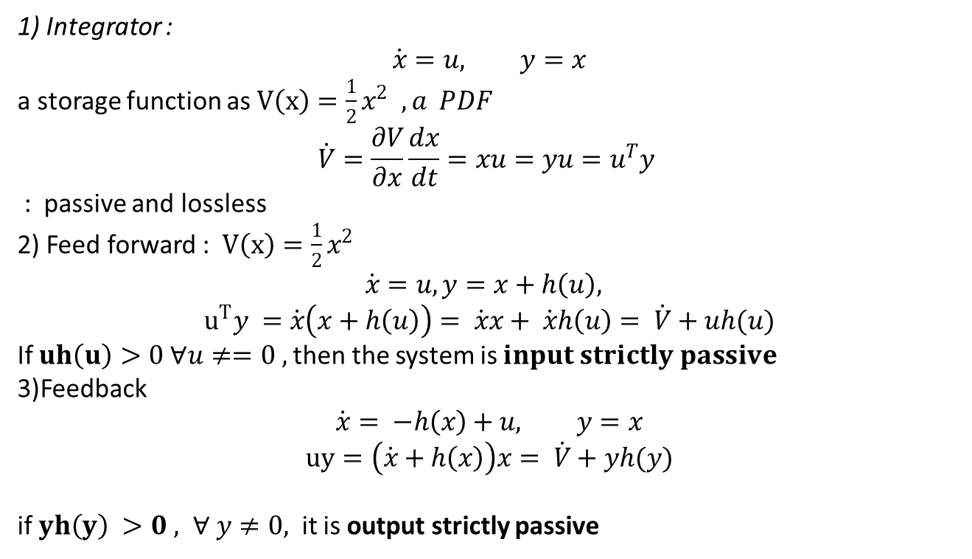
Examp. 5.2
1) Integrator :
$$\dot{x}=u, y=x$$
a storage function as $V\left(x\right)=\frac{1}{2}x^{2} ,a PDF$
$$\dot{V}=\frac{∂V}{∂x}\frac{dx}{dt}=xu=yu=u^{T}y$$
: passive and lossless
2) Feed forward : $V\left(x\right)=\frac{1}{2}x^{2}$
$$\dot{x}=u, y=x+h\left(u\right),$$
$$u^{T}y =\dot{x}\left(x+h\left(u\right)\right)= \dot{x}x+ \dot{x}h\left(u\right)= \dot{V}+uh(u)$$
If $uh\left(u\right)>0 ∀u≠=0 ,$then the system is $input strictly passive$
3)Feedback
$$\dot{x}= −h\left(x\right)+u, y=x$$
$$uy=\left(\dot{x}+h\left(x\right)\right)x= \dot{V}+yh(y)$$
if $yh\left(y\right) >0 , ∀ y≠0,$ it is output strictly passive

Slide 9
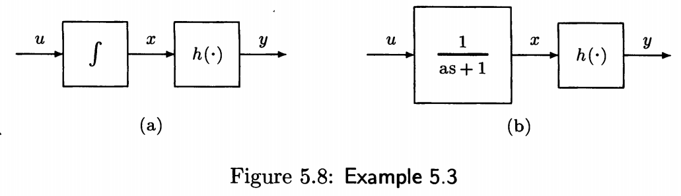
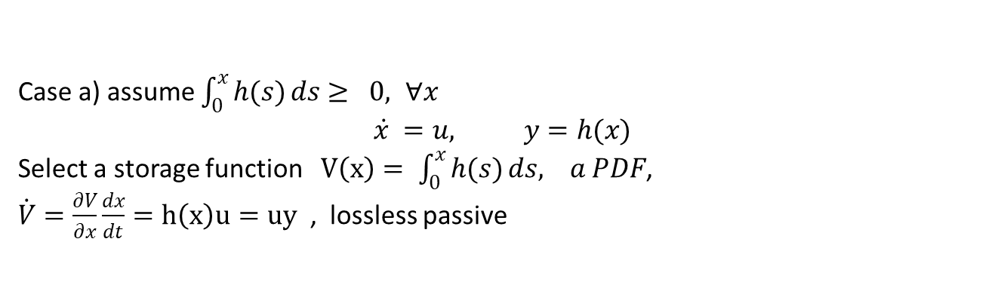
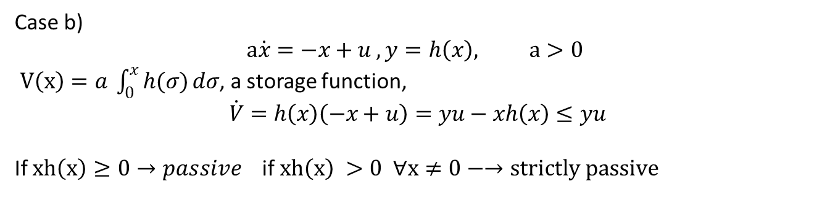
Examp. 5.3
Case a) assume $\int_{0}^{x}{h(s)}ds≥ 0, ∀x$
$$\dot{x }=u, y=h(x)$$
Select a storage function $V\left(x\right)= \int_{0}^{x}{h(s)}ds, a PDF$,
$\dot{V}=\frac{∂V}{∂x}\frac{dx}{dt}=h\left(x\right)u=uy$ , lossless passive
Case b)
$$a\dot{x}=−x+u , y=h\left(x\right), a>0$$
$V\left(x\right)=a \int_{0}^{x}{h(σ)}dσ$, a storage function,
$$\dot{V}=h\left(x\right)\left(−x+u\right)=yu−xh\left(x\right)≤yu$$
If $xh\left(x\right)≥0→passive$ if $xh\left(x\right) >0 ∀x≠0−→strictly passive$

Slide 10
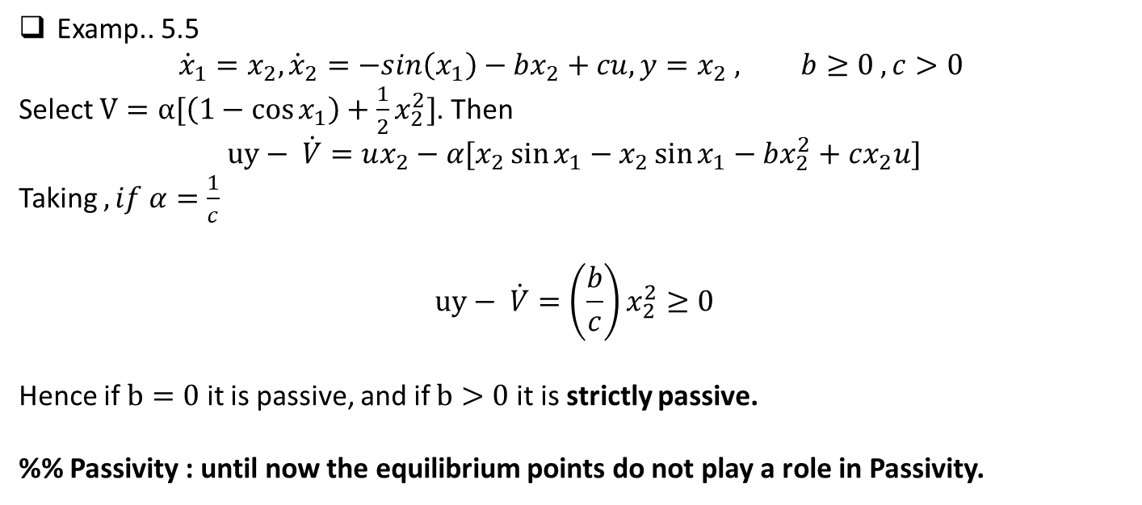
Examp.. 5.5
$${\dot{x}}_{1}=x_{2}, {\dot{x}}_{2}=−sin\left(x_{1}\right)−bx_{2}+cu, y=x_{2} , b≥0 , c>0$$
Select $V=α[\left(1−\cos{x_{1}}\right)+\frac{1}{2}x_{2}^{2}]$. Then
$$uy− \dot{V}=ux_{2}−α[x_{2}\sin{x_{1}−x_{2}\sin{x_{1}−bx_{2}^{2}+cx_{2}u]}}$$
Taking $, if α=\frac{1}{c}$
$$uy− \dot{V}=\left(\frac{b}{c}\right)x_{2}^{2}≥0$$
Hence if $b=0$ it is passive, and if $b>0$ it is strictly passive.
%% Passivity : until now the equilibrium points do not play a role in Passivity.

Slide 11
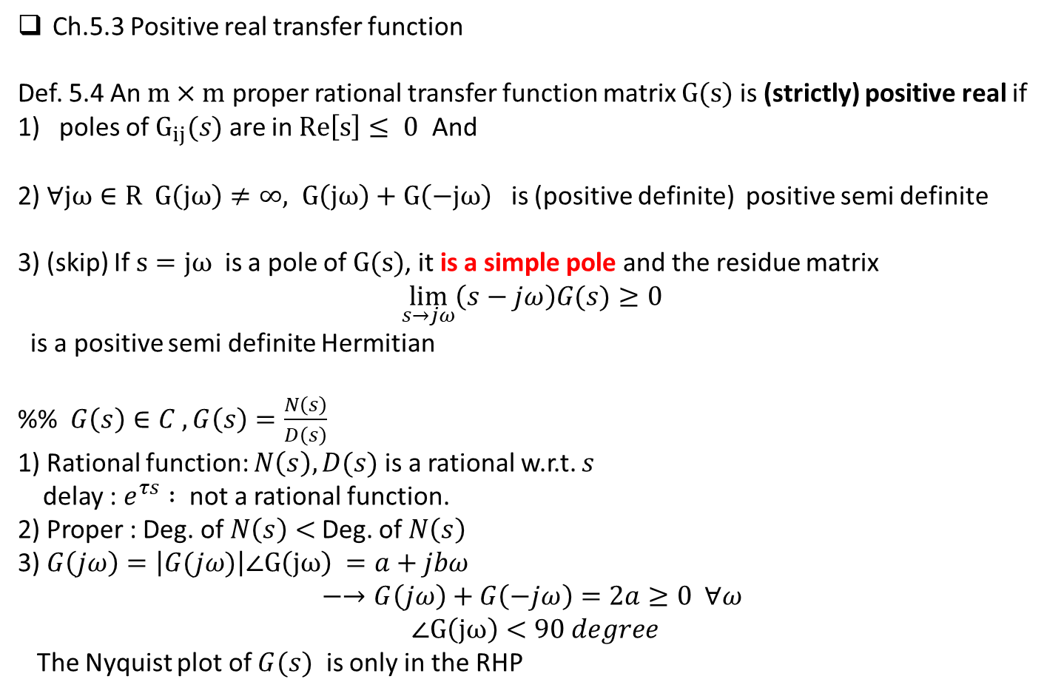
Ch.5.3 Positive real transfer function
Def. 5.4 An $m×m$ proper rational transfer function matrix $G(s)$ is (strictly) positive real if
poles of $G_{ij}(s)$ are in $Re\left[s\right]≤ 0$ And
2) $∀jω∈R G\left(jω\right)≠∞, G\left(jω\right)+G\left(−jω\right)$ is (positive definite) positive semi definite
3) (skip) If $s=jω$ is a pole of $G(s)$, it is a simple pole and the residue matrix
$$\lim_{s→jω}\left(s−jω\right)G(s)≥0$$
is a positive semi definite Hermitian
%% $G\left(s\right)∈C , G\left(s\right)=\frac{N\left(s\right)}{D\left(s\right)}$
1) Rational function: $N\left(s\right), D(s)$ is a rational w.r.t. $s$
delay : $e^{τs} :$ not a rational function.
2) Proper : Deg. of $N\left(s\right)<$Deg. of $N\left(s\right)$
3) $G\left(jω\right)=\left|G(jω)\right|∠G\left(jω\right) =a+jbω$
$$−→G\left(jω\right)+G\left(−jω\right)=2a≥0 ∀ω$$
$$∠G\left(jω\right)<90 degree$$
The Nyquist plot of $G(s)$ is only in the RHP

Slide 12
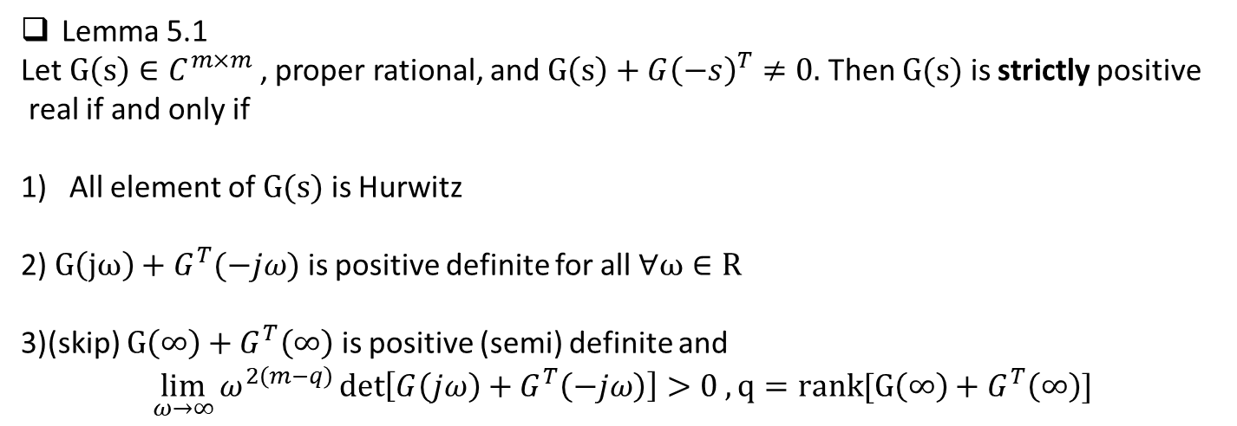
Lemma 5.1
Let $G\left(s\right)∈C^{m×m}$, proper rational, and $G\left(s\right)+G{\left(−s\right)}^{T}≠0.$ Then $G(s)$ is strictly positive
real if and only if
All element of $G(s)$ is Hurwitz
2) $G\left(jω\right)+G^{T}(−jω)$ is positive definite for all $∀ω∈R$
3)(skip) $G\left(∞\right)+G^{T}\left(∞\right)$ is positive (semi) definite and
$$\lim_{ω→∞}{ω^{2\left(m−q\right)}\det\left[G\left(jω\right)+G^{T}\left(−jω\right)\right]>0 , }q=rank[G\left(∞\right)+G^{T}\left(∞\right)]$$

Slide 13
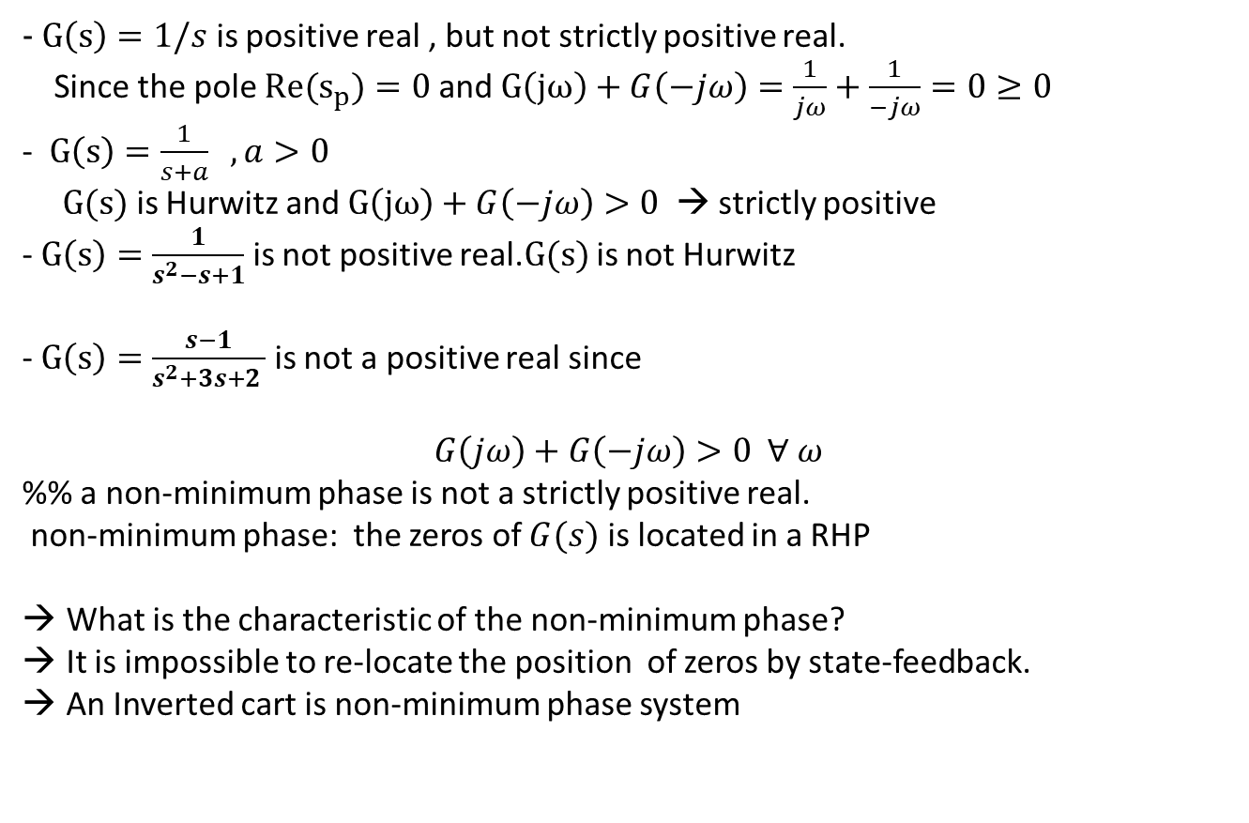
$- G\left(s\right)=1/s$ is positive real , but not strictly positive real.
Since the pole ${Re(s}_{p})=0$ and $G\left(jω\right)+G\left(−jω\right)=\frac{1}{jω}+\frac{1}{−jω}=0≥0$
- $G\left(s\right)=\frac{1}{s+a} , a>0$
$G(s)$ is Hurwitz and $G\left(jω\right)+G\left(−jω\right)>0$ → strictly positive
- $G\left(s\right)=\frac{1}{s^{2}−s+1}$ is not positive real.$G(s)$ is not Hurwitz
- $G\left(s\right)=\frac{s−1}{s^{2}+3s+2 }$ is not a positive real since
$$G\left(jω\right)+G\left(−jω\right)>0 ∀ ω$$
%% a non-minimum phase is not a strictly positive real.
non-minimum phase: the zeros of $G(s)$ is located in a RHP
What is the characteristic of the non-minimum phase?
It is impossible to re-locate the position of zeros by state-feedback.
An Inverted cart is non-minimum phase system

Slide 14
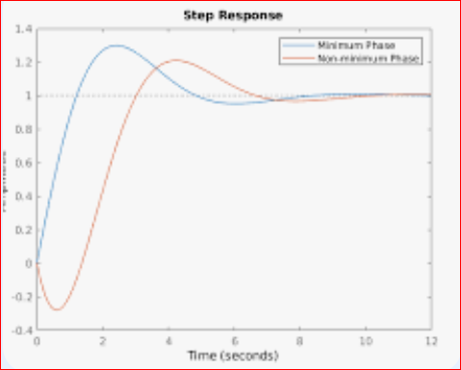
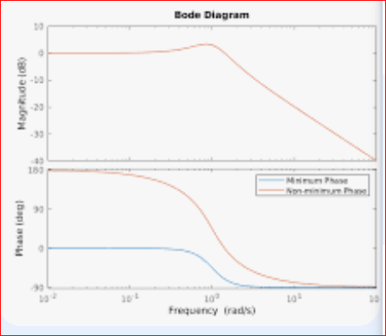
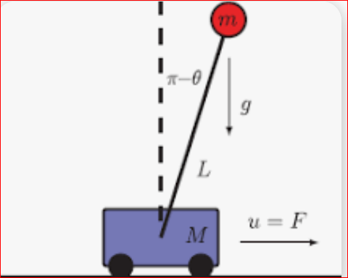
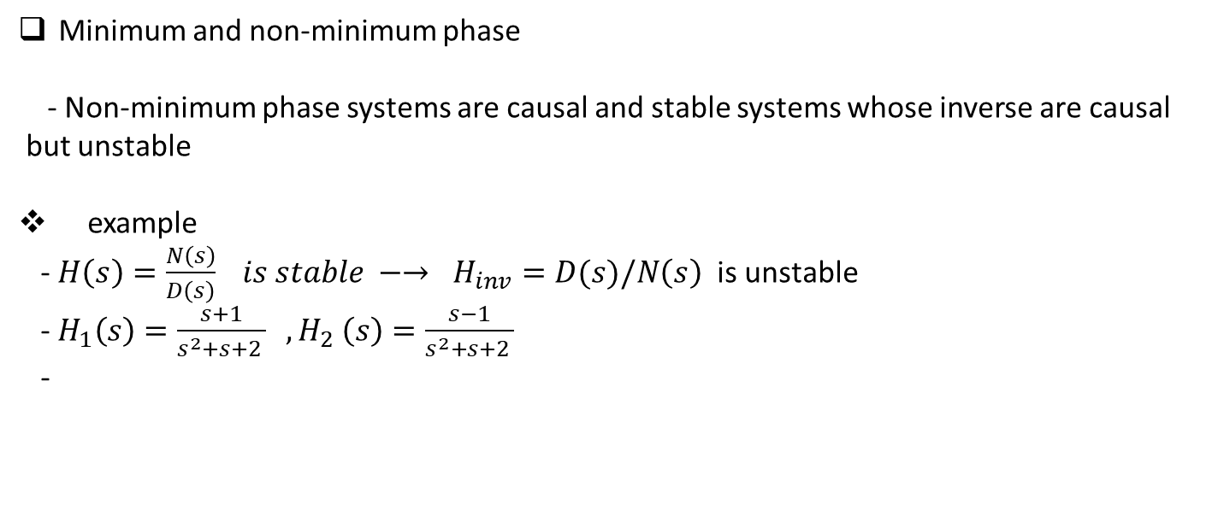
Minimum and non-minimum phase
- Non-minimum phase systems are causal and stable systems whose inverse are causal
but unstable
example
- $H\left(s\right)=\frac{N\left(s\right)}{D\left(s\right)} is stable −→ H_{inv}=D(s)/N\left(s\right)$ is unstable
- $H_{1}\left(s\right)=\frac{s+1}{s^{2}+s+2 } ,H_{2} \left(s\right)=\frac{s−1}{s^{2}+s+2 }$
-

Slide 15
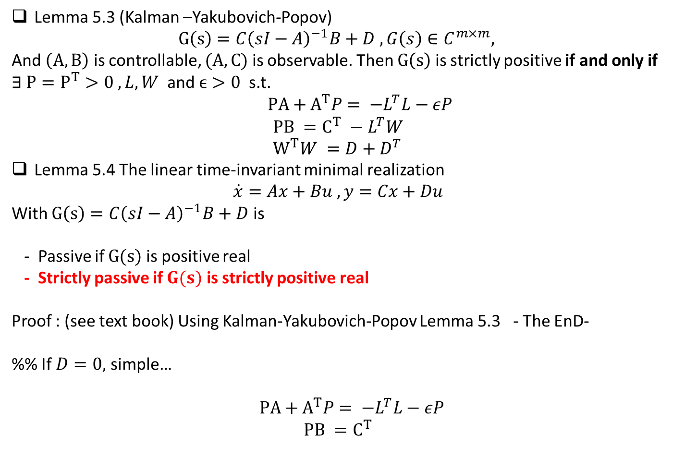
Lemma 5.3 (Kalman –Yakubovich-Popov)
$$G\left(s\right)=C{\left(sI−A\right)}^{−1}B+D , G\left(s\right)∈C^{m×m},$$
And $\left(A,B\right)$ is controllable, $(A,C)$ is observable. Then $G\left(s\right)$ is strictly positive if and only if $∃ P=P^{T}>0 , L,W$ and $ϵ>0$ s.t.
$PA+A^{T}P= −L^{T}L−εP$
$$PB =C^{T} −L^{T}W \\ W^{T}W =D+D^{T}$$
Lemma 5.4 The linear time-invariant minimal realization
$$\dot{x}=Ax+Bu , y=Cx+Du$$
With $G\left(s\right)=C{\left(sI−A\right)}^{−1}B+D$ is
- Passive if $G(s)$ is positive real
- Strictly passive if $G(s)$ is strictly positive real
Proof : (see text book) Using Kalman-Yakubovich-Popov Lemma 5.3 - The EnD-
%% If $D=0,$ simple…
$PA+A^{T}P= −L^{T}L−εP$
$$PB =C^{T}$$

Slide 16

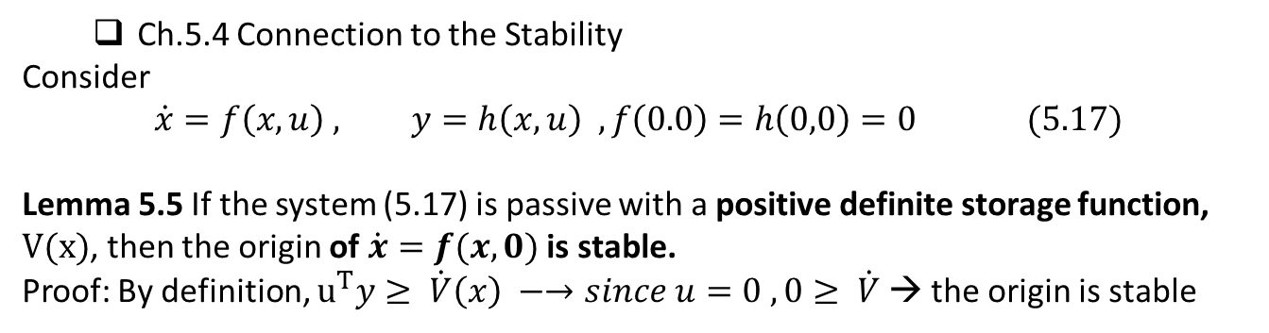
  Ch.5.4 Connection to the Stability
Consider
$$\dot{x}=f\left(x,u\right) , y=h\left(x,u\right) , f\left(0.0\right)=h\left(0,0\right)=0 (5.17)$$
Lemma 5.5 If the system (5.17) is passive with a positive definite storage function, $V(x)$, then the origin of $\dot{x}=f(x,0)$ is stable.
Proof: By definition, $u^{T}y≥ \dot{V}\left(x\right) −→since u=0 , 0≥ \dot{V}$ → the origin is stable
u(t)
$$\dot{x}=f(x,u)$$
h(x,u)
y(t)

Slide 17
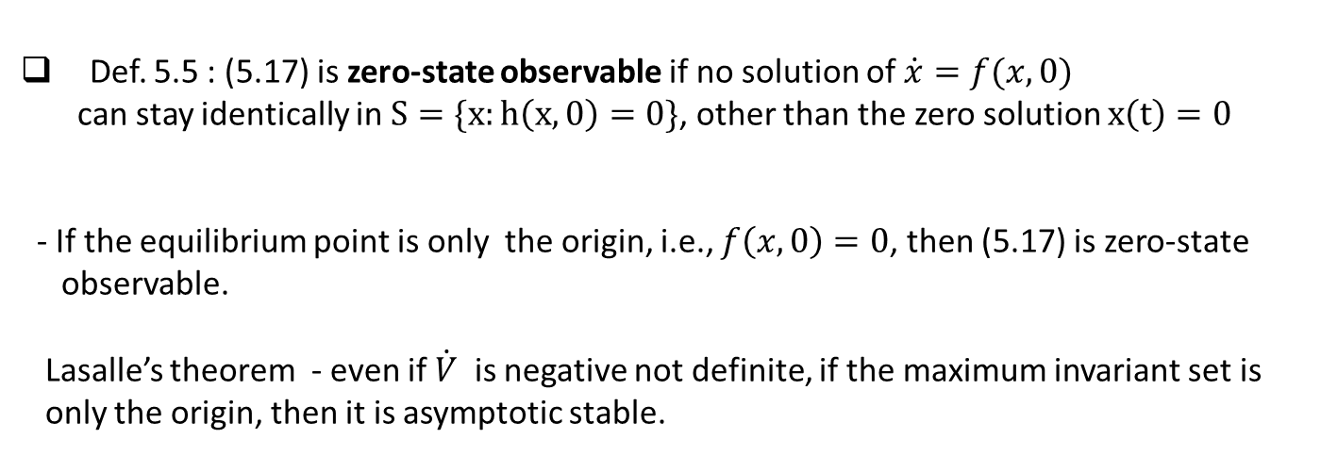
Def. 5.5 : (5.17) is zero-state observable if no solution of $\dot{x}=f(x,0)$
can stay identically in $S=\{x:h\left(x,0\right)=0\}$, other than the zero solution $x\left(t\right)=0$
- If the equilibrium point is only the origin, i.e., $f\left(x,0\right)=0$, then (5.17) is zero-state
observable.
Lasalle’s theorem - even if $\dot{V}$ is negative not definite, if the maximum invariant set is
only the origin, then it is asymptotic stable.

Slide 18
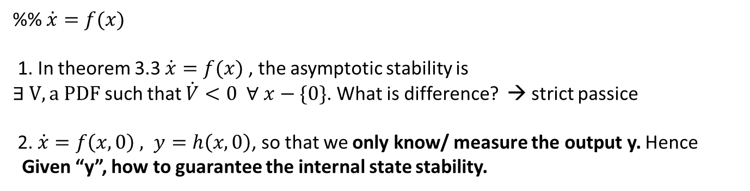
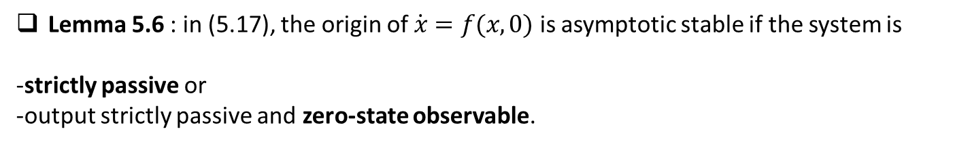
Lemma 5.6 : in (5.17), the origin of $\dot{x}=f(x,0)$ is asymptotic stable if the system is
-strictly passive or
-output strictly passive and zero-state observable.
%% $\dot{x}=f(x)$
1. In theorem 3.3 $\dot{x}=f(x)$ , the asymptotic stability is
$∃ V, a PDF$ such that $\dot{V}<0 ∀ x−\{0\}$. What is difference? → strict passice
2. $\dot{x}=f\left(x,0\right) , y=h\left(x,0\right)$, so that we only know/ measure the output y. Hence
Given “y”, how to guarantee the internal state stability.

Slide 19
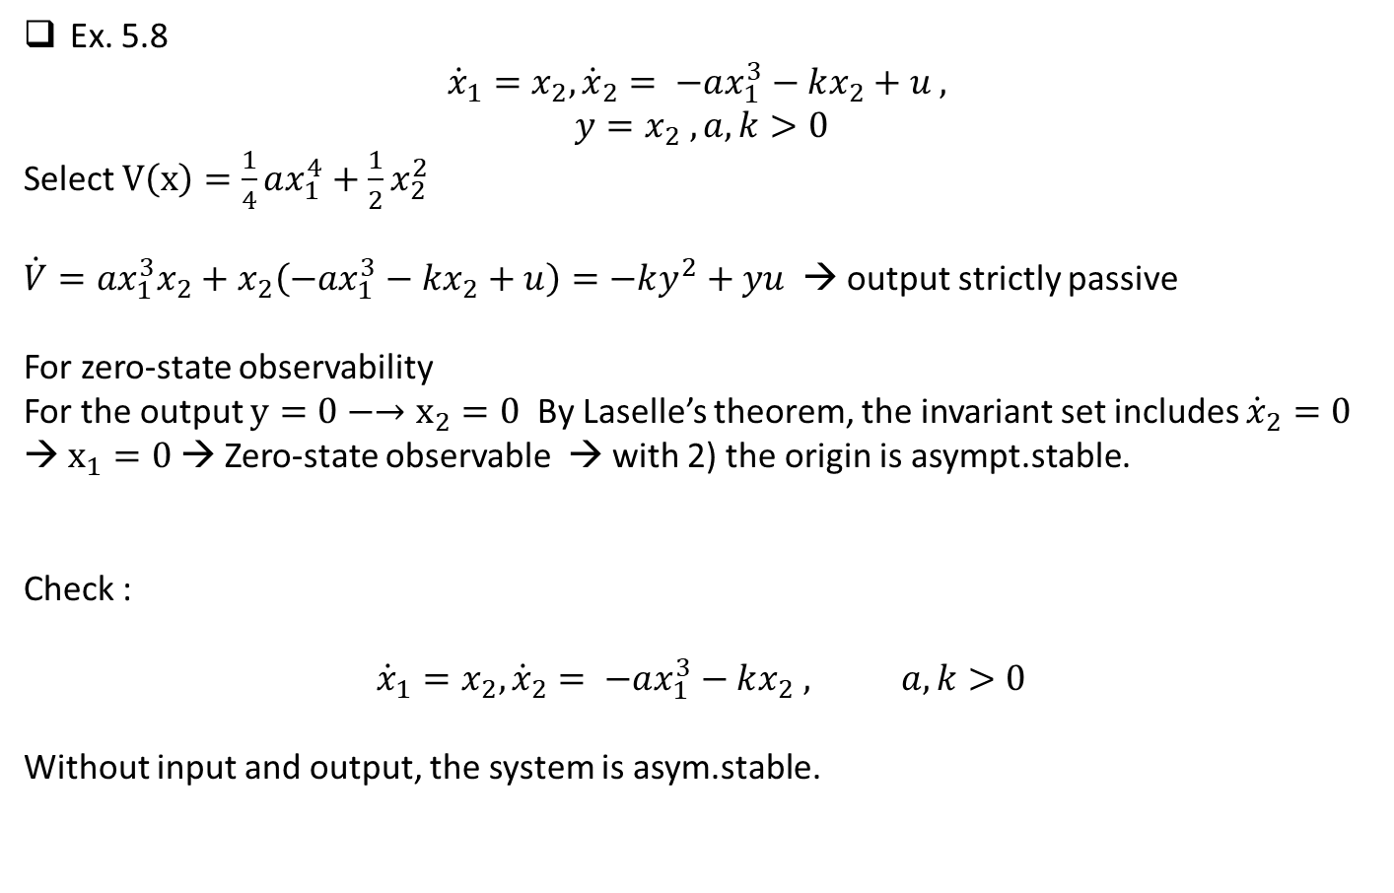
Ex. 5.8
$${\dot{x}}_{1}=x_{2}, {\dot{x}}_{2}= −ax_{1}^{3}−kx_{2}+u ,$$
$$y=x_{2} , a,k>0$$
Select $V\left(x\right)=\frac{1}{4}ax_{1}^{4}+\frac{1}{2}x_{2}^{2}$
$\dot{V}=ax_{1}^{3}x_{2}+x_{2}\left(−ax_{1}^{3}−kx_{2}+u\right)=−ky^{2}+yu$ → output strictly passive
For zero-state observability
For the output $y=0−→x_{2}=0$ By Laselle’s theorem, the invariant set includes ${\dot{x}}_{2}=0$→ $x_{1}=0$ → Zero-state observable → with 2) the origin is asympt.stable.
Check :
$${\dot{x}}_{1}=x_{2}, {\dot{x}}_{2}= −ax_{1}^{3}−kx_{2} , a,k>0$$
Without input and output, the system is asym.stable.

