Slide 1
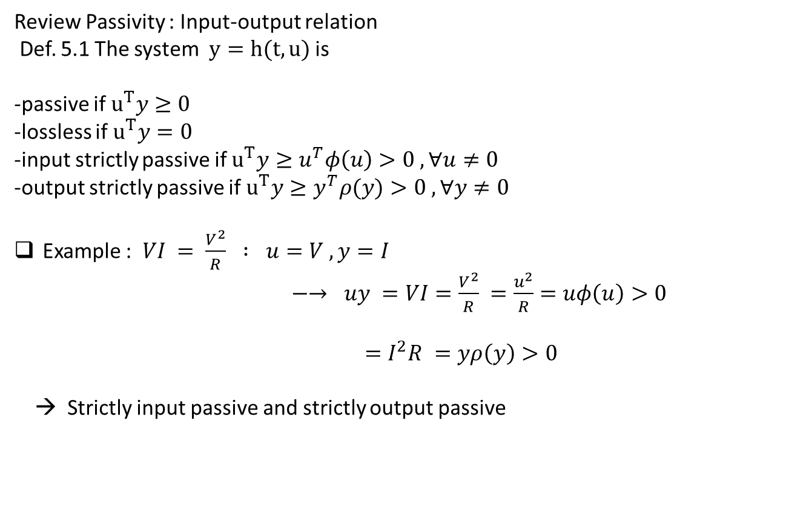
Review Passivity : Input-output relation
Def. 5.1 The system $y=h(t,u)$ is
-passive if $u^{T}y≥0$
-lossless if $u^{T}y=0$
-input strictly passive if $u^{T}y≥u^{T}φ\left(u\right)>0 , ∀u≠0$
-output strictly passive if $u^{T}y≥y^{T}ρ(y)>0 , ∀y≠0$
Example : $VI = \frac{V^{2}}{R} : u=V , y=I$
$−→ uy =VI=\frac{V^{2}}{R} =\frac{u^{2}}{R}=uφ\left(u\right)>0$
$=I^{2}R =yρ\left(y\right)>0$
→ Strictly input passive and strictly output passive

Slide 2
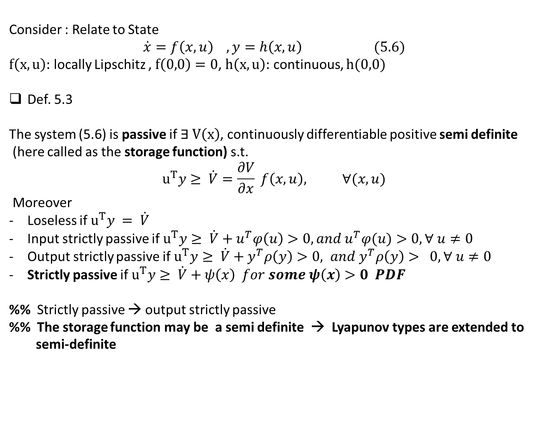
Consider : Relate to State
$$\dot{x}=f\left(x,u\right) , y=h\left(x,u\right) (5.6)$$
$f\left(x,u\right):$ locally Lipschitz , $f\left(0,0\right)=0$, $h\left(x,u\right):$ continuous, $h(0,0)$
Def. 5.3
The system (5.6) is passive if $∃ V\left(x\right)$, continuously differentiable positive semi definite
(here called as the storage function) s.t.
$$u^{T}y≥ \dot{V}=\frac{∂V}{∂x} f\left(x,u\right), ∀(x,u)$$
Moreover
Loseless if $u^{T}y = \dot{V}$
Input strictly passive if $u^{T}y≥ \dot{V}+u^{T}φ\left(u\right)>0, and u^{T}φ(u)>0, ∀ u≠0$
Output strictly passive if $u^{T}y≥ \dot{V}+y^{T}ρ\left(y\right)>0, and y^{T}ρ\left(y\right)> 0, ∀ u≠0$
Strictly passive if $u^{T}y≥ \dot{V}+ψ\left(x\right) for some ψ\left(x\right)>0 PDF$
%% Strictly passive → output strictly passive
%% The storage function may be a semi definite → Lyapunov types are extended to
semi-definite

Slide 3
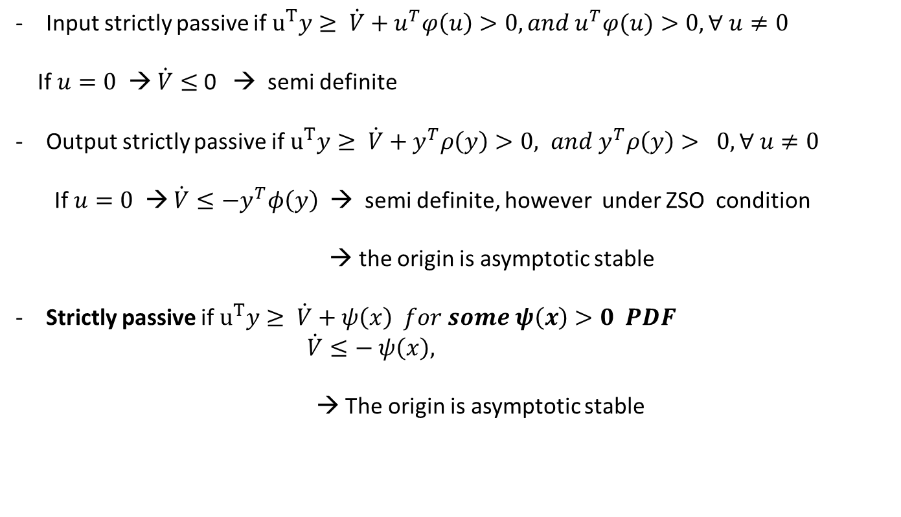
Input strictly passive if $u^{T}y≥ \dot{V}+u^{T}φ\left(u\right)>0, and u^{T}φ(u)>0, ∀ u≠0$
If $u=0$ → $\dot{V}≤$ 0 → semi definite
Output strictly passive if $u^{T}y≥ \dot{V}+y^{T}ρ\left(y\right)>0, and y^{T}ρ\left(y\right)> 0, ∀ u≠0$
If $u=0$ → $\dot{V}≤−y^{T}φ\left(y\right)$ → semi definite, however under ZSO condition
→ the origin is asymptotic stable
Strictly passive if $u^{T}y≥ \dot{V}+ψ\left(x\right) for some ψ\left(x\right)>0 PDF$
$\dot{V}≤− ψ\left(x\right),$
→ The origin is asymptotic stable

Slide 4
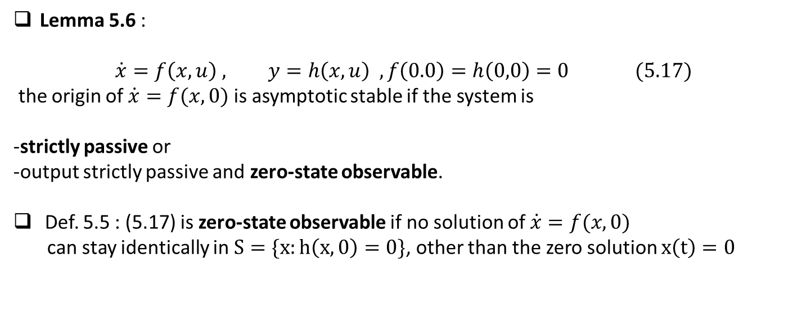
Lemma 5.6 :
$$\dot{x}=f\left(x,u\right) , y=h\left(x,u\right) , f\left(0.0\right)=h\left(0,0\right)=0 (5.17)$$
the origin of $\dot{x}=f(x,0)$ is asymptotic stable if the system is
-strictly passive or
-output strictly passive and zero-state observable.
Def. 5.5 : (5.17) is zero-state observable if no solution of $\dot{x}=f(x,0)$
can stay identically in $S=\{x:h\left(x,0\right)=0\}$, other than the zero solution $x\left(t\right)=0$

Slide 5
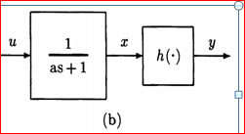
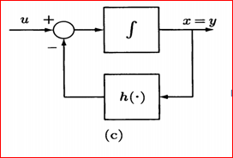
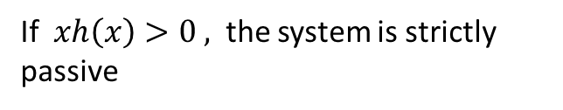
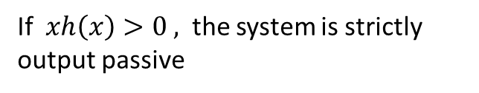
If $xh\left(x\right)>0 ,$ the system is strictly passive
If $xh\left(x\right)>0 ,$ the system is strictly output passive

Slide 6
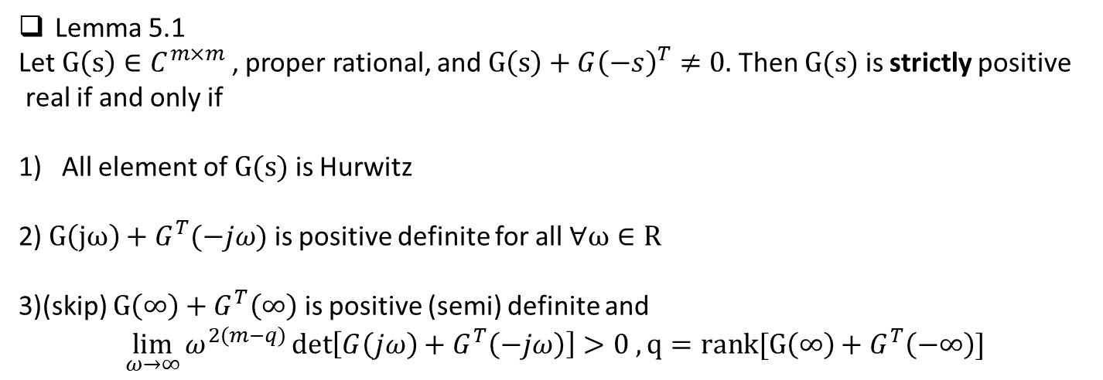
Lemma 5.1
Let $G\left(s\right)∈C^{m×m}$, proper rational, and $G\left(s\right)+G{\left(−s\right)}^{T}≠0.$ Then $G(s)$ is strictly positive
real if and only if
All element of $G(s)$ is Hurwitz
2) $G\left(jω\right)+G^{T}(−jω)$ is positive definite for all $∀ω∈R$
3)(skip) $G\left(∞\right)+G^{T}\left(∞\right)$ is positive (semi) definite and
$$\lim_{ω→∞}{ω^{2\left(m−q\right)}\det\left[G\left(jω\right)+G^{T}\left(−jω\right)\right]>0 , }q=rank[G\left(∞\right)+G^{T}\left(−∞\right)]$$

Slide 7
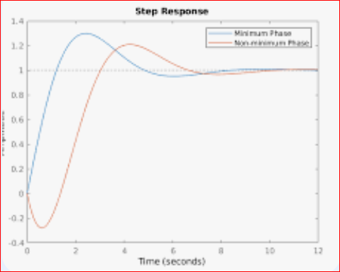
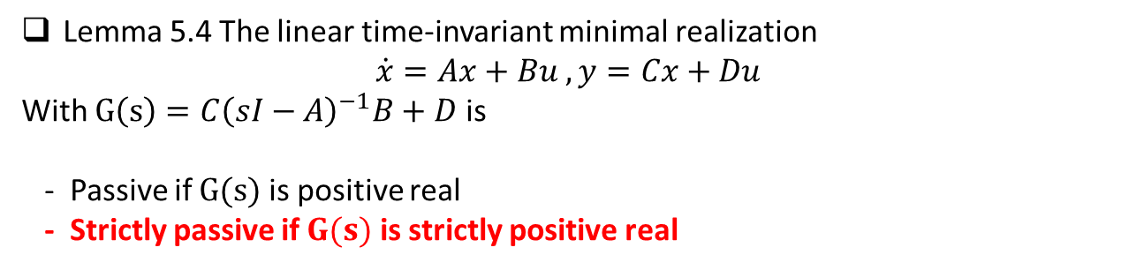
- Non-minimum phase
input = step , the output < 0 for some time → (input)(output) <0 → not passive
Lemma 5.4 The linear time-invariant minimal realization
$$\dot{x}=Ax+Bu , y=Cx+Du$$
With $G\left(s\right)=C{\left(sI−A\right)}^{−1}B+D$ is
- Passive if $G(s)$ is positive real
- Strictly passive if $G(s)$ is strictly positive real

Slide 8

Chapter 6. In-out Stability → skip
$\dot{x}=f\left(x,u\right) , y=Hu$
→ $y \left(t\right) = Φ_{1}\left(t_{0},t, x_{0}\right)+ Φ_{2} \left(t,t_{0}, u\right)$
If $\left\|u\right\|≤c_{1} −→ \left\|y\left(t\right)\right\|≤c_{2}$
Need the different norm,
${\left\|u\right\|}_{L_{∞}}=\sup{t≥0 \left\|u(t)\right\|}$
${\left\|u\right\|}_{L_{2}}=$ $√( \int_{0}^{∞}{u^{T}u dt) }$
${\left\|u\right\|}_{L_{p}}={\left( \int_{0}^{∞}{{\left\|u\right\|}^{p}}dt\right)}^{\frac{1}{p}}$
in general $L_{2}, L_{∞}$ norms are used.
Due to Passival’s theorem
$\int_{0}^{∞}{x^{2}dt =\frac{1}{2π} \int_{0}^{∞}{{\left\|X\left(jω\right)\right\|}^{2} dω}}$ → in linear system, it’s domain is also frequency domain

Slide 9
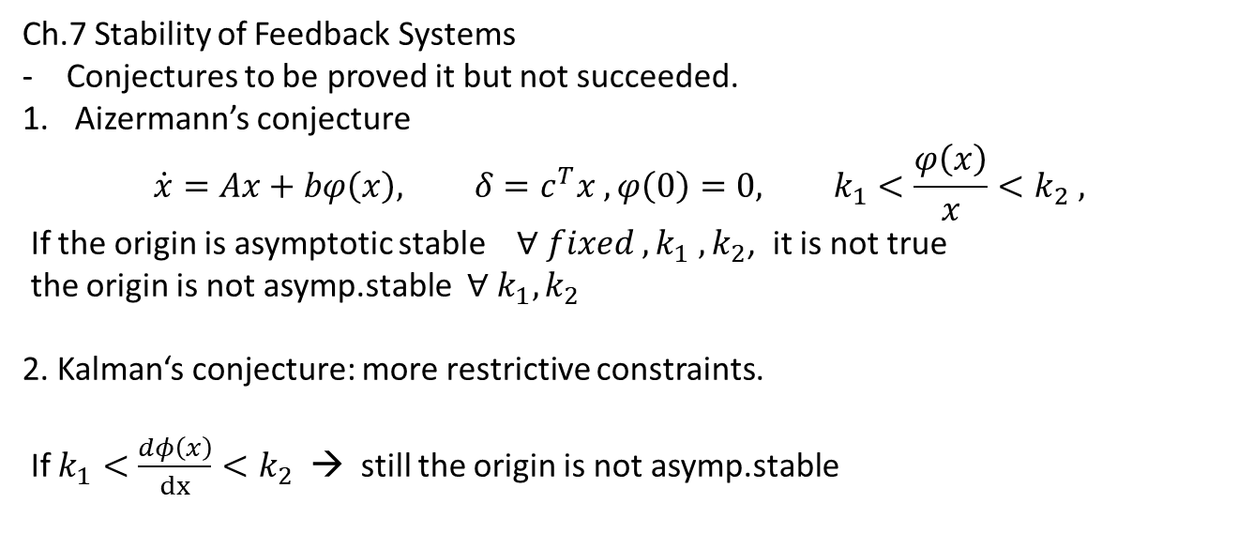
Ch.7 Stability of Feedback Systems
Conjectures to be proved it but not succeeded.
Aizermann’s conjecture
$$\dot{x}=Ax+bφ\left(x\right), δ=c^{T}x , φ\left(0\right)=0, k_{1}<\frac{φ\left(x\right)}{x}<k_{2} ,$$
If the origin is asymptotic stable $∀ fixed ,{k_{1} ,k}_{2}$, it is not true
the origin is not asymp.stable $∀ k_{1}, k_{2}$
2. Kalman‘s conjecture: more restrictive constraints.
If $k_{1}<\frac{dφ\left(x\right)}{dx}<k_{2}$ → still the origin is not asymp.stable

Slide 10
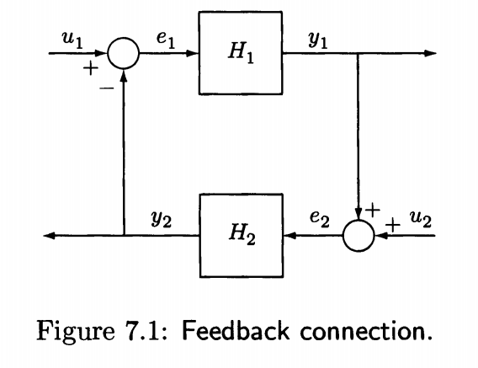
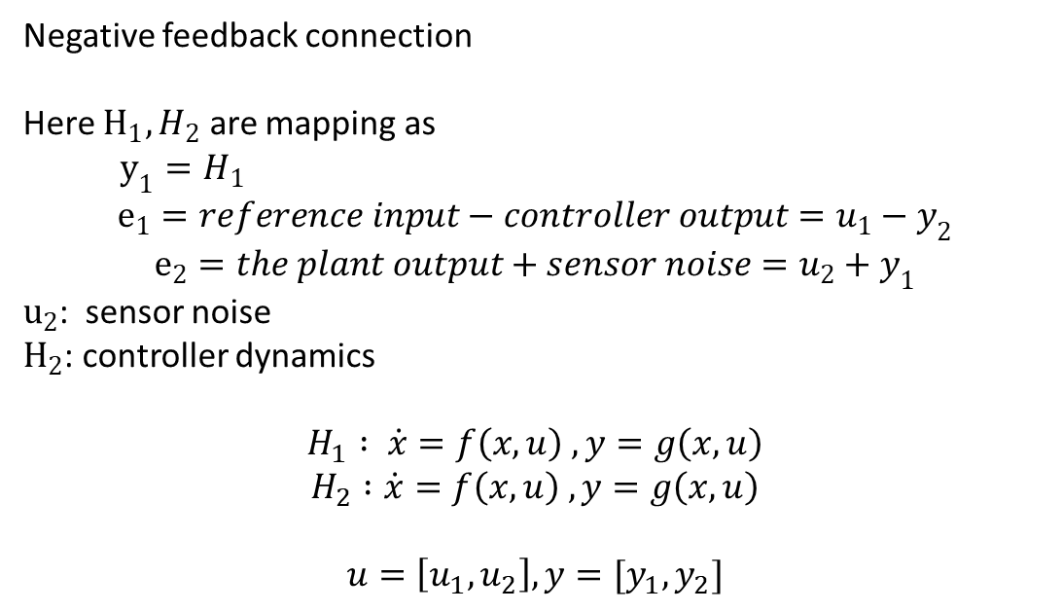
7.1 Passivity Theorems
Negative feedback connection
Here $H_{1}, H_{2}$ are mapping as
$y_{1}=H_{1}$
$$e_{1}=reference input−controller output=u_{1}−y_{2}$$
$$e_{2}=the plant output+sensor noise=u_{2}+y_{1}$$
$u_{2}$: sensor noise
$H_{2}$: controller dynamics
$$H_{1} : \dot{x}=f\left(x,u\right) , y=g\left(x,u\right)$$
$$H_{2} :\dot{x}=f\left(x,u\right) , y=g\left(x,u\right)$$
$$u=\left[u_{1}, u_{2}\right], y=[y_{1}, y_{2}]$$

Slide 11

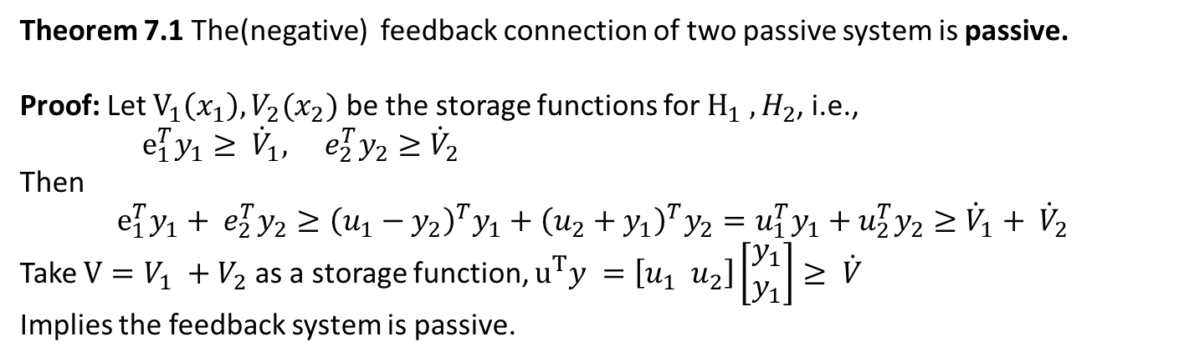
Theorem 7.1 The(negative) feedback connection of two passive system is passive.
Proof: Let $V_{1}\left(x_{1}\right), V_{2}(x_{2})$ be the storage functions for $H_{1} , H_{2}$, i.e.,
$e_{1}^{T}y_{1}≥ {\dot{V}}_{1}, e_{2}^{T}y_{2}≥{\dot{V}}_{2}$
Then
$$e_{1}^{T}y_{1}+ e_{2}^{T}y_{2}≥{\left(u_{1}−y_{2}\right)}^{T}y_{1}+{\left(u_{2}+y_{1}\right)}^{T}y_{2}=u_{1}^{T}y_{1}+u_{2}^{T}y_{2}≥{\dot{V}}_{1}+ {\dot{V}}_{2}$$
Take $V=V_{1} +V_{2}$ as a storage function, $u^{T}y =\left[u_{1} u_{2}\right]\left[\begin{matrix}y_{1} \\ y_{1}\end{matrix}\right]≥ \dot{V}$
Implies the feedback system is passive.

Slide 12
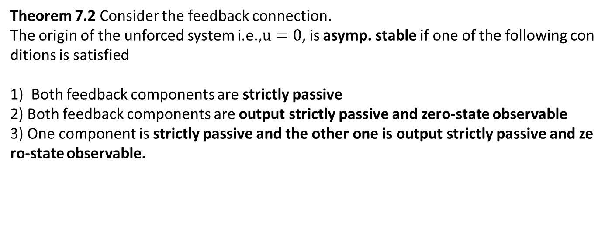
Theorem 7.2 Consider the feedback connection.
The origin of the unforced system i.e.,$u=0$, is asymp. stable if one of the following conditions is satisfied
1) Both feedback components are strictly passive
2) Both feedback components are output strictly passive and zero-state observable
3) One component is strictly passive and the other one is output strictly passive and zero-state observable.

Slide 13
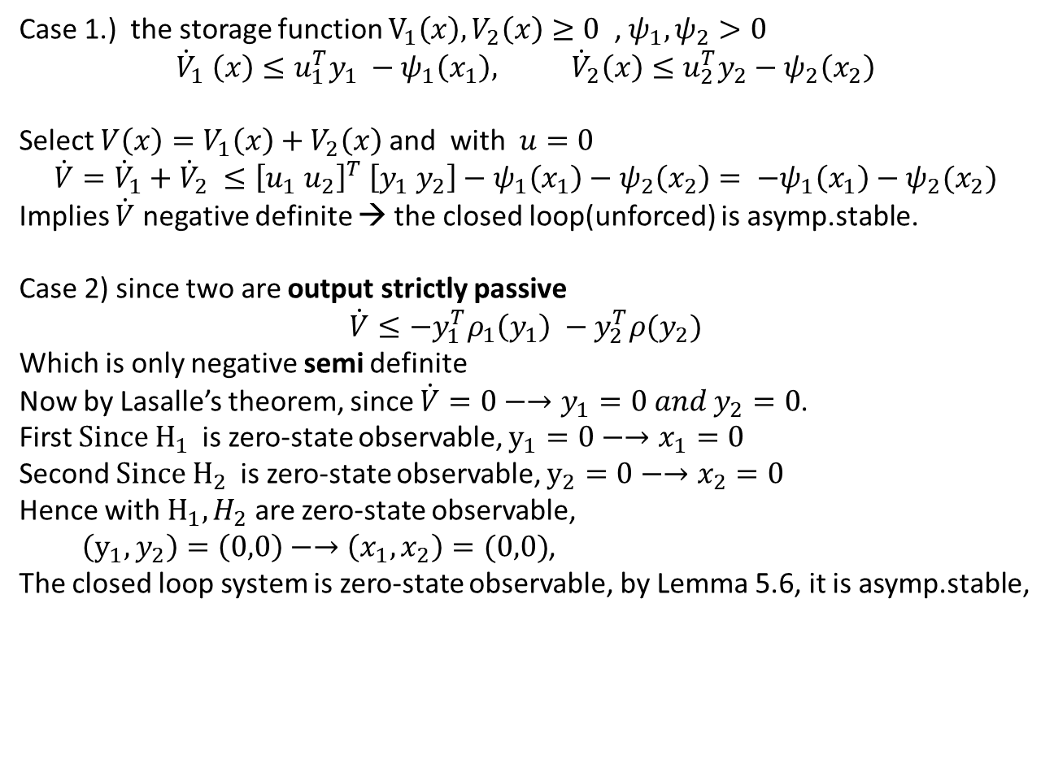
Case 1.) the storage function $V_{1}\left(x\right), V_{2}\left(x\right)≥0$ , $ψ_{1}, ψ_{2}>0$
$${\dot{V}}_{1} \left(x\right)≤u_{1}^{T}y_{1} −ψ_{1}\left(x_{1}\right), {\dot{V}}_{2}\left(x\right)≤u_{2}^{T}y_{2}−ψ_{2}\left(x_{2}\right)$$
Select $V\left(x\right)=V_{1}\left(x\right)+V_{2}\left(x\right)$ and with $u=0$
$$\dot{V}={\dot{V}}_{1}+{\dot{V}}_{2} ≤{\left[u_{1} u_{2}\right]}^{T} \left[y_{1} y_{2}\right]−ψ_{1}\left(x_{1}\right)−ψ_{2}\left(x_{2}\right)= −ψ_{1}\left(x_{1}\right)−ψ_{2}(x_{2})$$
Implies $\dot{V}$ negative definite → the closed loop(unforced) is asymp.stable.
Case 2) since two are output strictly passive
$$\dot{V}≤−y_{1}^{T}ρ_{1}\left(y_{1}\right) −y_{2}^{T}ρ(y_{2})$$
Which is only negative semi definite
Now by Lasalle’s theorem, since $\dot{V}=0−→y_{1}=0 and y_{2}=0$.
First $Since H_{1}$is zero-state observable, $y_{1}=0−→x_{1}=0$
Second $Since H_{2}$is zero-state observable, $y_{2}=0−→x_{2}=0$
Hence with $H_{1}, H_{2}$ are zero-state observable,
$\left(y_{1}, y_{2}\right)=\left(0,0\right)−→\left(x_{1}, x_{2}\right)=(0,0)$,
The closed loop system is zero-state observable, by Lemma 5.6, it is asymp.stable,

Slide 14
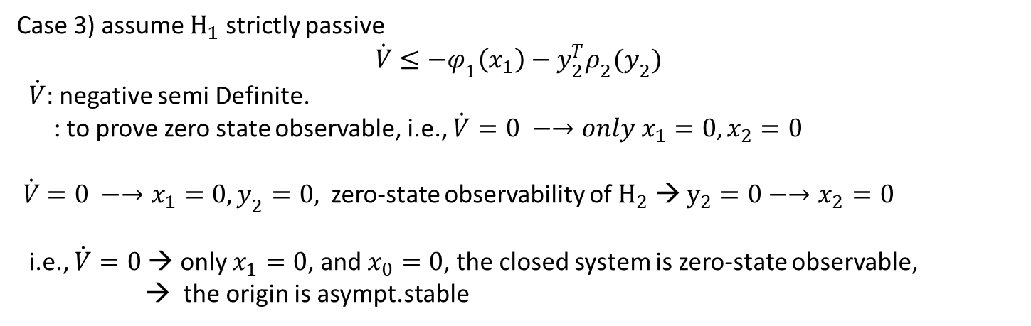
Case 3) assume $H_{1}$ strictly passive
$$\dot{V}≤−φ_{1}\left(x_{1}\right)−y_{2}^{T}ρ_{2}(y_{2})$$
$\dot{V}:$negative semi Definite.
: to prove zero state observable, i.e., $\dot{V}=0 −→only x_{1}=0, x_{2}=0$
$\dot{V}=0 −→x_{1}=0, y_{2}=0,$zero-state observability of $H_{2}$ → $y_{2}=0−→x_{2}=0$
i.e., $\dot{V}=0$→ only $x_{1}=0$, and $x_{0}=0$, the closed system is zero-state observable,
→ the origin is asympt.stable

Slide 15
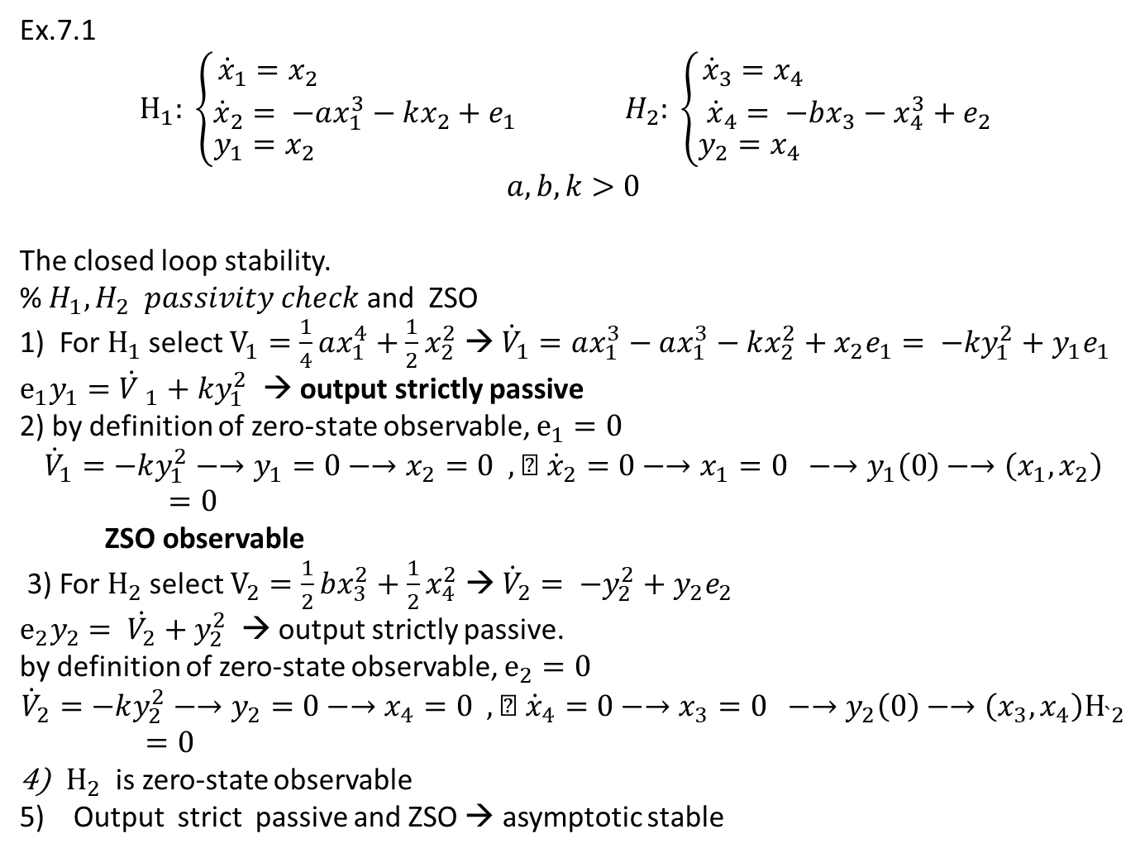
Ex.7.1
$$H_{1}: \left\{\begin{aligned}\begin{matrix}{\dot{x}}_{1}=x_{2} \\ {\dot{x}}_{2}= −ax_{1}^{3}−kx_{2}+e_{1}\end{matrix} \\ y_{1}=x_{2} \end{aligned}\right. H_{2}: \left\{\begin{aligned}\begin{matrix}{\dot{x}}_{3}=x_{4} \\ {\dot{x}}_{4}= −bx_{3}−x_{4}^{3}+e_{2}\end{matrix} \\ y_{2}=x_{4} \end{aligned}\right.$$
$$a,b,k>0$$
The closed loop stability.
% $H_{1}, H_{2} passivity check$ and ZSO
1) For $H_{1}$ select $V_{1}=\frac{1}{4}ax_{1}^{4}+\frac{1}{2}x_{2}^{2}$ → ${\dot{V}}_{1}=ax_{1}^{3}−ax_{1}^{3}−kx_{2}^{2}+x_{2}e_{1}= −ky_{1}^{2}+y_{1}e_{1}$
$e_{1}y_{1}={\dot{V }}_{1}+ky_{1}^{2}$ → output strictly passive
2) by definition of zero-state observable, $e_{1}=0$
$${\dot{V}}_{1}=−ky_{1}^{2}−→y_{1}=0−→x_{2}=0 , ➔ {\dot{x}}_{2}=0−→x_{1}=0 −→y_{1}\left(0\right)−→\left(x_{1}, x_{2}\right)=0$$
ZSO observable
3) For $H_{2}$ select $V_{2}=\frac{1}{2}bx_{3}^{2}+\frac{1}{2}x_{4}^{2}$ → ${\dot{V}}_{2}= −y_{2}^{2}+y_{2}e_{2}$
$e_{2}y_{2}= \dot{V_{2}}+y_{2}^{2}$ → output strictly passive.
by definition of zero-state observable, $e_{2}=0$
$${\dot{V}}_{2}=−ky_{2}^{2}−→y_{2}=0−→x_{4}=0 , ➔ {\dot{x}}_{4}=0−→x_{3}=0 −→y_{2}\left(0\right)−→\left(x_{3}, x_{4}\right)H_{`2}=0$$
$H_{2}$is zero-state observable
Output strict passive and ZSO → asymptotic stable

Slide 16
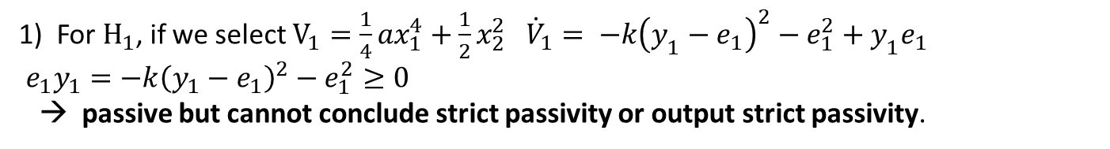
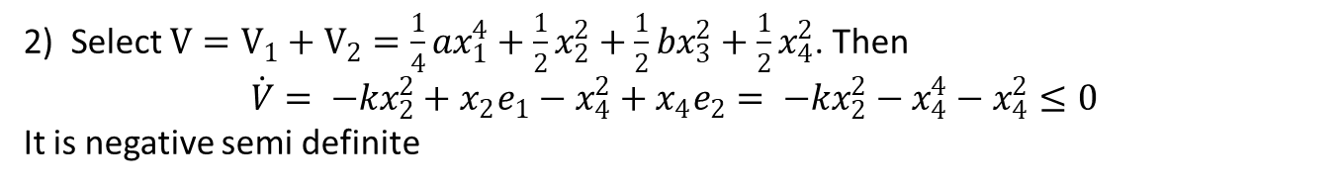
Ex. 7.2 (Combined $V_{1} and V_{2}$) :
Here the system is same to Ex.7.2 but $y_{1}=x_{2}+e_{1}$
1) For $H_{1}$, if we select $V_{1}=\frac{1}{4}ax_{1}^{4}+\frac{1}{2}x_{2}^{2} {\dot{V}}_{1}= −k{\left(y_{1}−e_{1}\right)}^{2}−e_{1}^{2}+y_{1}e_{1}$
$e_{1}y_{1}=−k{\left(y_{1}−e_{1}\right)}^{2}−e_{1}^{2}≥0$
→ passive but cannot conclude strict passivity or output strict passivity.
2) Select $V=V_{1}+V_{2}=\frac{1}{4}ax_{1}^{4}+\frac{1}{2}x_{2}^{2}+\frac{1}{2}bx_{3}^{2}+\frac{1}{2}x_{4}^{2}$. Then
$$\dot{V}= −kx_{2}^{2}+x_{2}e_{1}−x_{4}^{2}+x_{4}e_{2}= −kx_{2}^{2}−x_{4}^{4}−x_{4}^{2}≤0$$
It is negative semi definite
3) Lasalle’s theorem : $\dot{V}=0−→x_{2}=x_{4}=0−→x_{1}=0 , x_{3}=0 with e_{1}=e_{2}=0$
Therefore the origin is asymp.stable

Slide 17
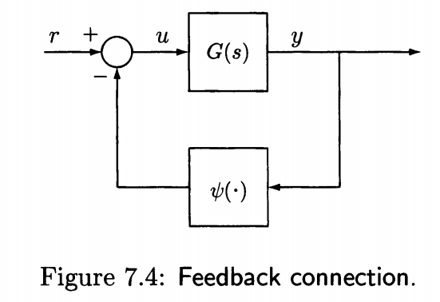
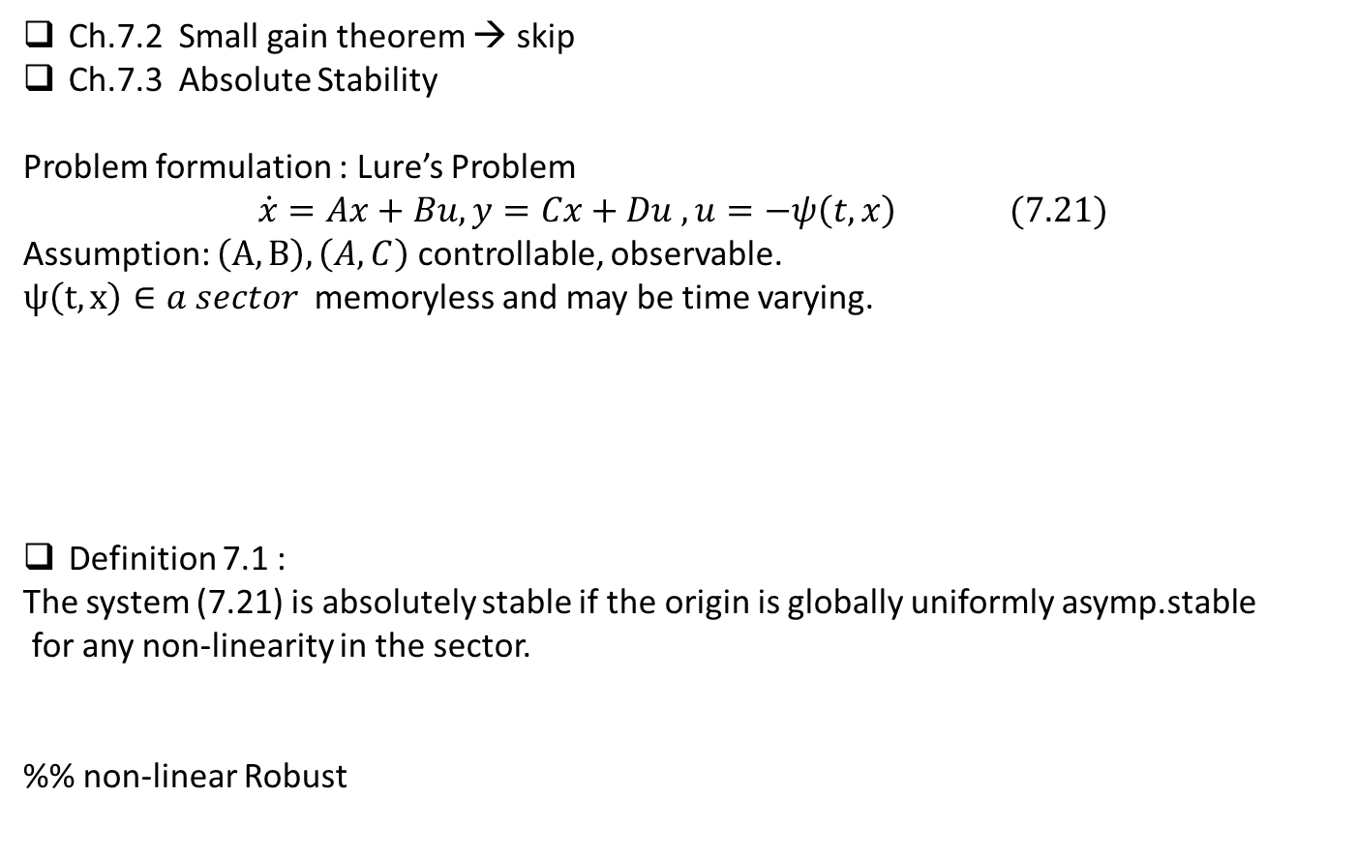
Ch.7.2 Small gain theorem → skip
Ch.7.3 Absolute Stability
Problem formulation : Lure’s Problem
$$\dot{x}=Ax+Bu, y=Cx+Du , u=−ψ\left(t,x\right) (7.21)$$
Assumption: $\left(A,B\right), \left(A,C\right)$ controllable, observable.
$ψ\left(t,x\right)∈a sector$ memoryless and may be time varying.
Definition 7.1 :
The system (7.21) is absolutely stable if the origin is globally uniformly asymp.stable
for any non-linearity in the sector.
%% non-linear Robust

Slide 18
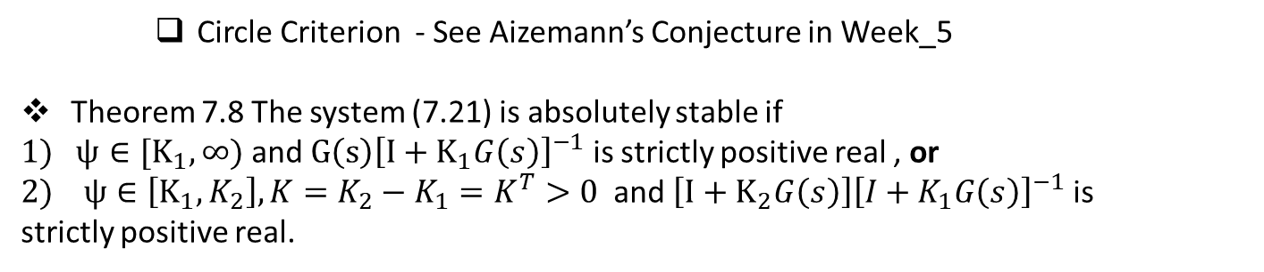
Circle Criterion - See Aizemann’s Conjecture in Week_5
Theorem 7.8 The system (7.21) is absolutely stable if
$1) ψ∈[K_{1}, ∞)$ and $G\left(s\right){\left[I+K_{1}G\left(s\right)\right]}^{−1}$ is strictly positive real , or
$2) ψ∈\left[K_{1}, K_{2}\right], K=K_{2}−K_{1}=K^{T}>0$ and $\left[I+K_{2}G\left(s\right)\right]{\left[I+K_{1}G\left(s\right)\right]}^{−1}$ is
strictly positive real.

Slide 19

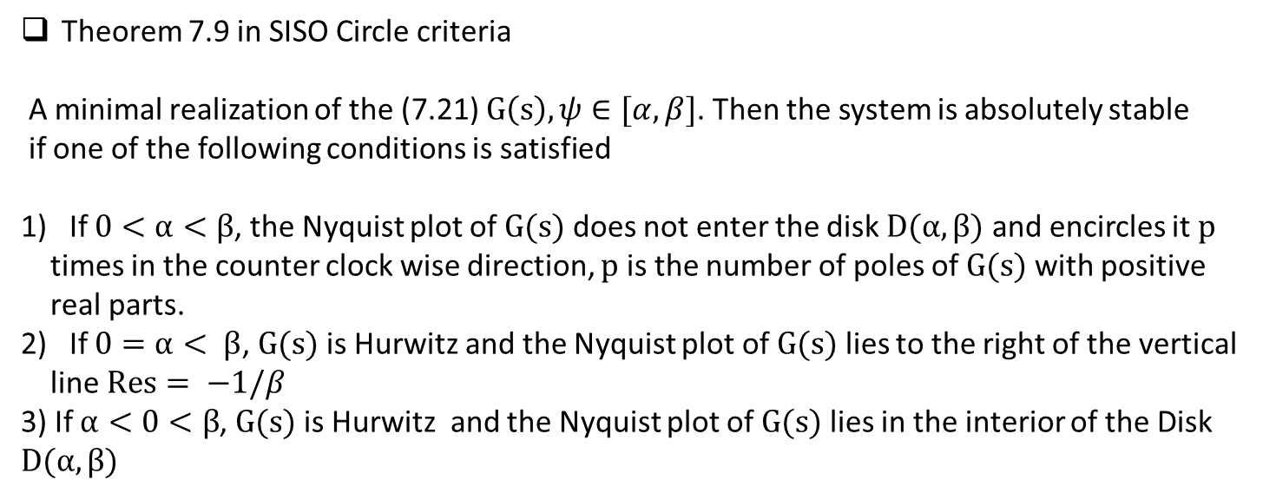



Theorem 7.9 in SISO Circle criteria
A minimal realization of the (7.21) $G\left(s\right), ψ∈[α, β]$. Then the system is absolutely stable
if one of the following conditions is satisfied
If $0<α<β$, the Nyquist plot of $G(s)$ does not enter the disk $D(α, β)$ and encircles it $p$
times in the counter clock wise direction, $p$ is the number of poles of $G(s)$ with positive
real parts.
If $0=α< β$, $G(s)$ is Hurwitz and the Nyquist plot of $G(s)$ lies to the right of the vertical
line $Res= −1/β$
3) If $α<0<β$, $G(s)$ is Hurwitz and the Nyquist plot of $G(s)$ lies in the interior of the Disk $D(α, β)$
$$\frac{1}{α}$$
$$−\frac{1}{α}$$
$$−\frac{1}{β}$$
$$−\frac{1}{β}$$

Slide 20
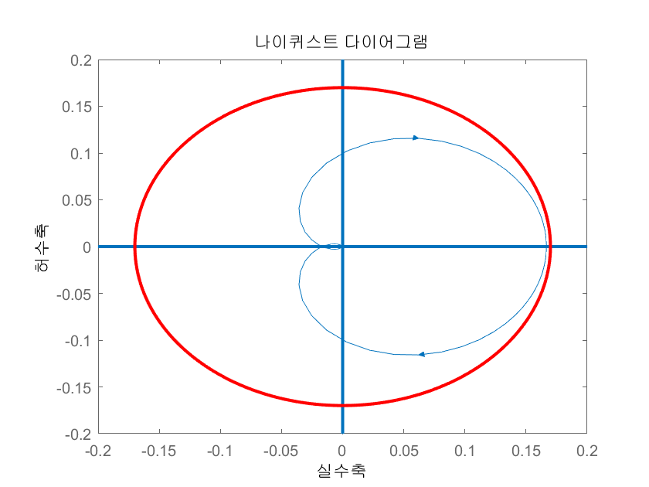
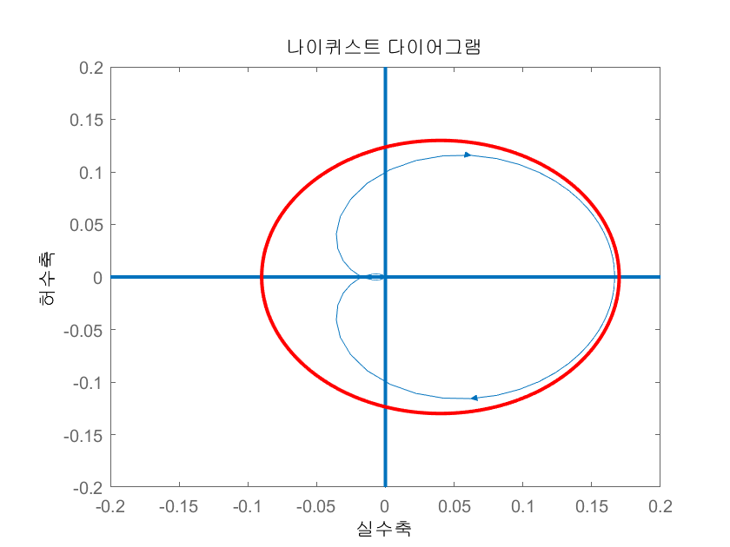
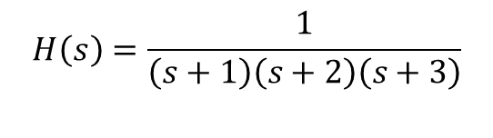
$$H\left(s\right)=\frac{1}{\left(s+1\right)\left(s+2\right)\left(s+3\right)}$$
Center = (0,0), radius = 0.17
[-1/0.17 1/0.17]
Center = (0.04, 0), radius = 0.13
[1/(-0.13+ 0.04), 1/(0.13+0.04)]

Slide 21
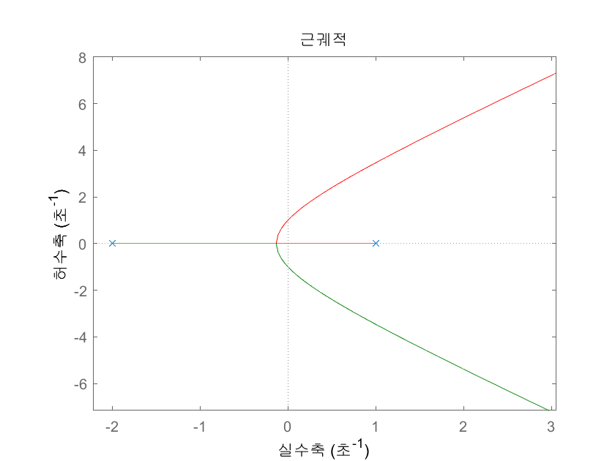
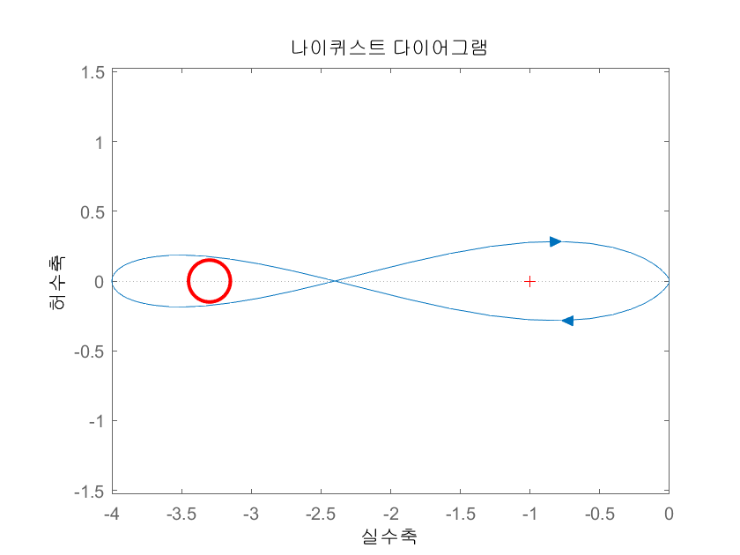
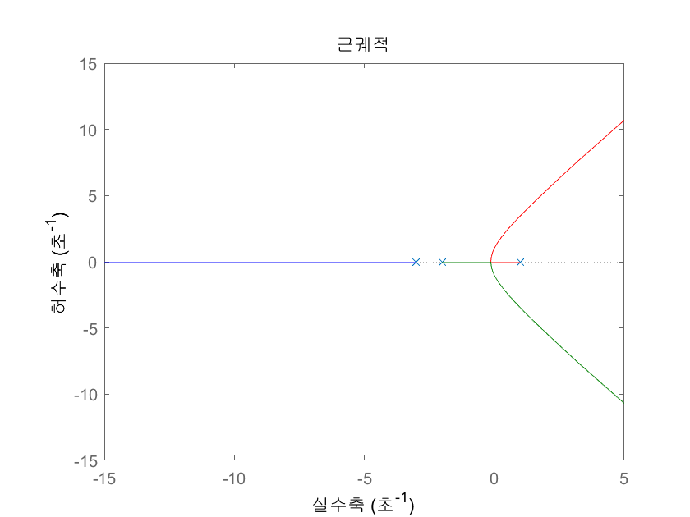
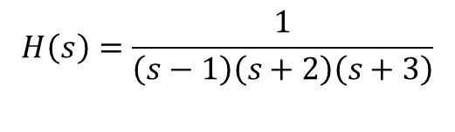
$$H\left(s\right)=\frac{1}{\left(s−1\right)\left(s+2\right)\left(s+3\right)}$$
Expand →
Center = (-3.3,0), radius = 0.15
[1/(3.3 +0.15) 1/(3.3 -0.15)]

