Slide 1
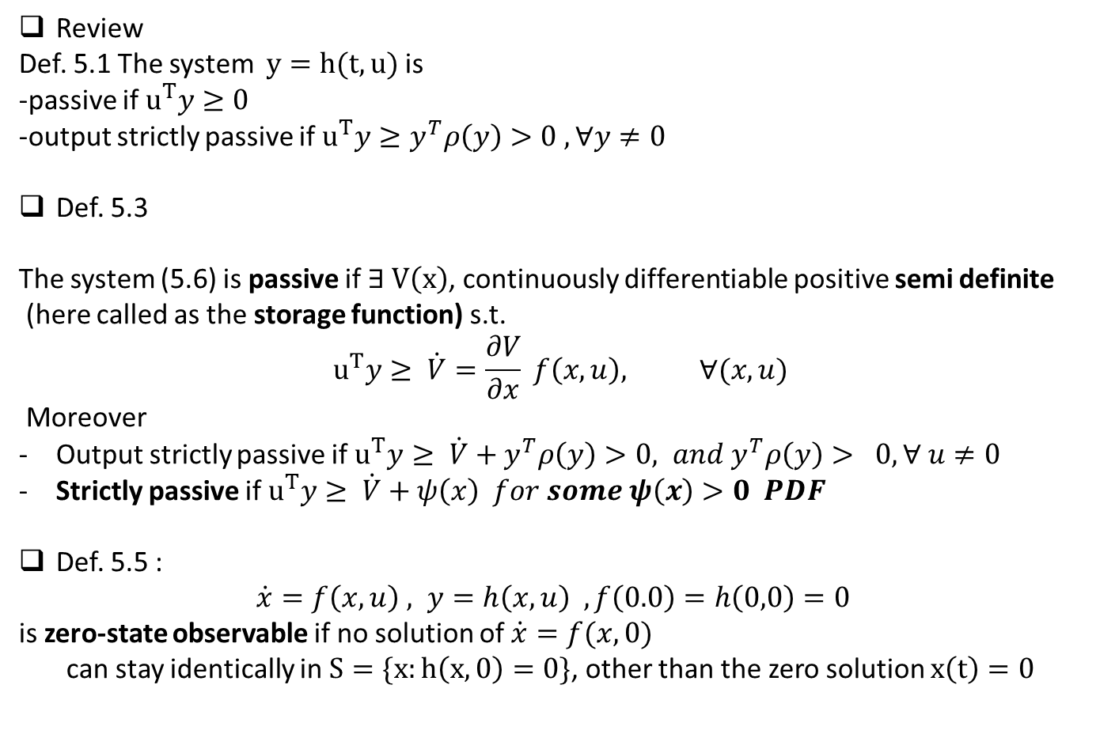
Review
Def. 5.1 The system $y=h(t,u)$ is
-passive if $u^{T}y≥0$
-output strictly passive if $u^{T}y≥y^{T}ρ\left(y\right)>0 , ∀y≠0$
Def. 5.3
The system (5.6) is passive if $∃ V\left(x\right)$, continuously differentiable positive semi definite
(here called as the storage function) s.t.
$$u^{T}y≥ \dot{V}=\frac{∂V}{∂x} f\left(x,u\right), ∀(x,u)$$
Moreover
Output strictly passive if $u^{T}y≥ \dot{V}+y^{T}ρ\left(y\right)>0, and y^{T}ρ\left(y\right)> 0, ∀ u≠0$
Strictly passive if $u^{T}y≥ \dot{V}+ψ\left(x\right) for some ψ\left(x\right)>0 PDF$
Def. 5.5 :
$\dot{x}=f\left(x,u\right) , y=h\left(x,u\right) , f\left(0.0\right)=h\left(0,0\right)=0$
is zero-state observable if no solution of $\dot{x}=f(x,0)$
can stay identically in $S=\{x:h\left(x,0\right)=0\}$, other than the zero solution $x\left(t\right)=0$

Slide 2
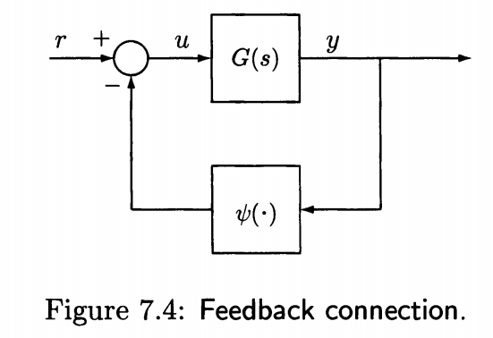
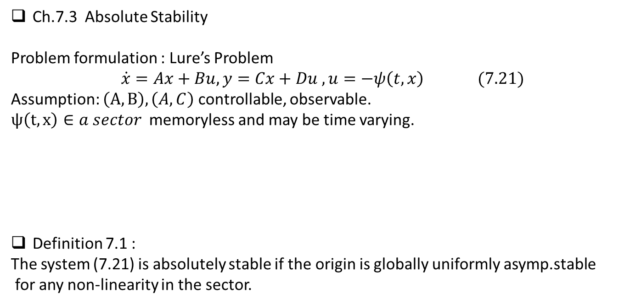
Ch.7.3 Absolute Stability
Problem formulation : Lure’s Problem
$$\dot{x}=Ax+Bu, y=Cx+Du , u=−ψ\left(t,x\right) (7.21)$$
Assumption: $\left(A,B\right), \left(A,C\right)$ controllable, observable.
$ψ\left(t,x\right)∈a sector$ memoryless and may be time varying.
Definition 7.1 :
The system (7.21) is absolutely stable if the origin is globally uniformly asymp.stable
for any non-linearity in the sector.

Slide 3

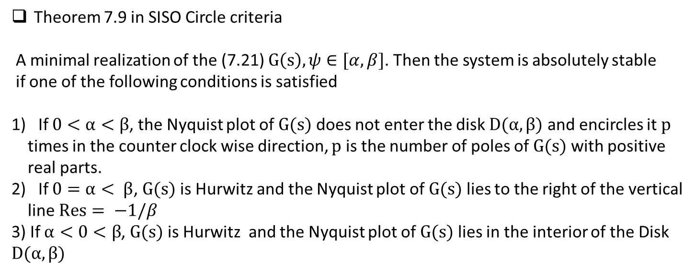



Theorem 7.9 in SISO Circle criteria
A minimal realization of the (7.21) $G\left(s\right), ψ∈[α, β]$. Then the system is absolutely stable
if one of the following conditions is satisfied
If $0<α<β$, the Nyquist plot of $G(s)$ does not enter the disk $D(α, β)$ and encircles it $p$
times in the counter clock wise direction, $p$ is the number of poles of $G(s)$ with positive
real parts.
If $0=α< β$, $G(s)$ is Hurwitz and the Nyquist plot of $G(s)$ lies to the right of the vertical
line $Res= −1/β$
3) If $α<0<β$, $G(s)$ is Hurwitz and the Nyquist plot of $G(s)$ lies in the interior of the Disk $D(α, β)$
$$\frac{1}{α}$$
$$−\frac{1}{α}$$
$$−\frac{1}{β}$$
$$−\frac{1}{β}$$

Slide 4

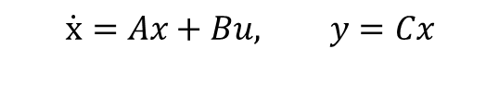
Ch.8 Special Non-linear form
Consider a linear system
Controllability and Observability
$$\dot{x}=Ax+Bu, y=Cx$$
How about a non-linear system?
$$\dot{x}=f\left(x\right)+g\left(x\right)u, y=h(x)$$
$$\dot{y}=\frac{dy}{dt}=\frac{∂h}{∂x} \left[f\left(x\right)+g\left(x\right)u\right]=L_{f}h\left(x\right)+L_{g}h\left(x\right)u$$
Lie algebra -- popular to non-linear systems
-- Too math!! → skip

Slide 5

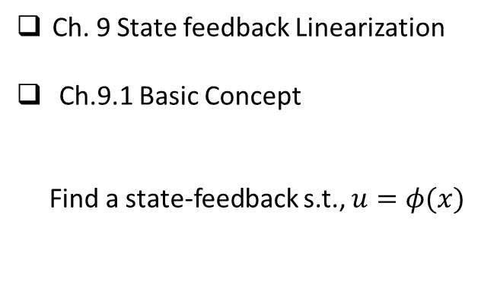

Ch. 9 State feedback Linearization
Ch.9.1 Basic Concept
Find a state-feedback s.t., $u=φ(x)$
$$\dot{x}=f\left(x,u\right),$$
$$\dot{x}=f\left(x,φ(x)\right), u=φ\left(x\right)$$
Such that the closed loop is satisfied a certain condition.

Slide 6
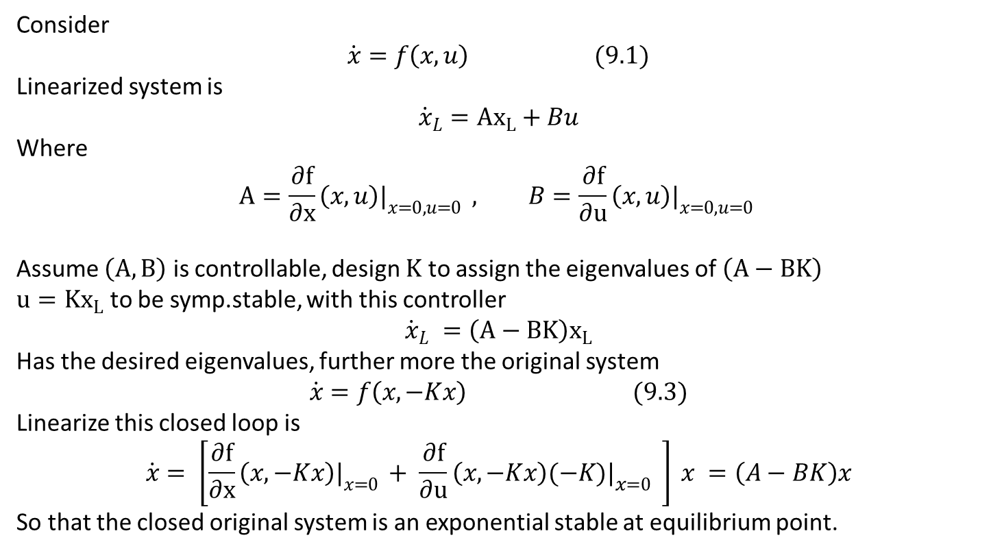
Ch.9.2 Linearization with state feedback
Consider
$$\dot{x}=f\left(x,u\right) (9.1)$$
Linearized system is
$${\dot{x}}_{L}={Ax}_{L}+Bu$$
Where
$$A=\frac{∂f}{∂x}\left(x,u\right)|_{x=0,u=0 } , B=\frac{∂f}{∂u}\left(x,u\right)|_{x=0,u=0 }$$
Assume $\left(A,B\right)$ is controllable, design $K$ to assign the eigenvalues of $\left(A−BK\right)$
$u={Kx}_{L}$ to be symp.stable, with this controller
$${\dot{x}}_{L} =\left(A−BK\right)x_{L}$$
Has the desired eigenvalues, further more the original system
$$\dot{x}=f\left(x, −Kx\right) (9.3)$$
Linearize this closed loop is
$$\dot{x}= \left[\frac{∂f}{∂x}\left(x,−Kx\right)|_{x=0 }+ \frac{∂f}{∂u}\left(x,−Kx\right){(−K)|}_{x=0 } \right] x =\left(A−BK\right)x$$
So that the closed original system is an exponential stable at equilibrium point.

Slide 7

Example
$\dot{x}=\sin{x+u}$
Linearized system
${\dot{x}}_{L} =x_{L}+u$
Select
$$u=−2x+v$$
Then the closed loop is
$\dot{x}=\sin{x −2x+v}$
Hence the closed loop is asymp. Stable at the origin

Slide 8

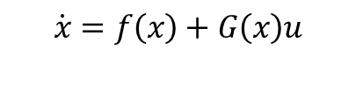
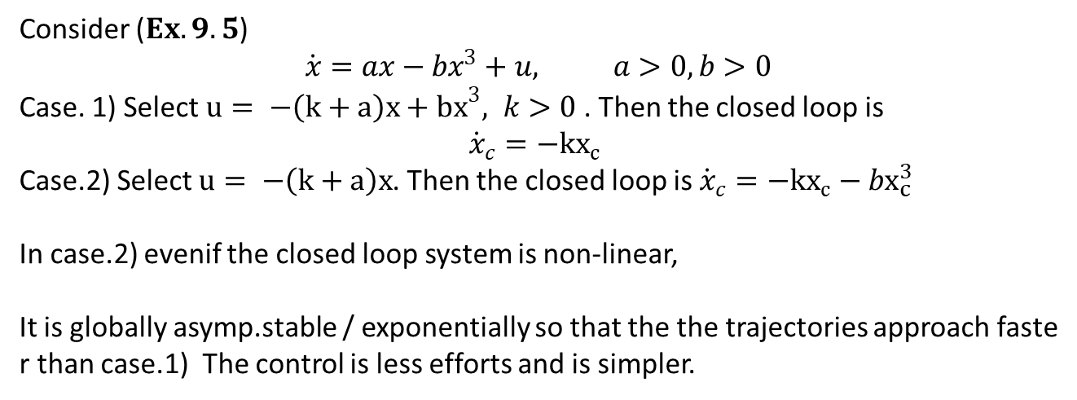

Ch. 9.3 Feedback Linearization
$$\dot{x}=f\left(x\right)+G\left(x\right)u$$
Using state feedback $u=φ\left(x\right)+v$
$$\dot{x_{c}}=Ax_{c}\left(x\right)+Bv$$
Simple case : scalar system, G(x) = constant
Consider ($Ex.9.5$)
$$\dot{x}=ax−bx^{3}+u, a>0,b>0$$
Case. 1) Select $u= −\left(k+a\right)x+{bx}^{3}, k>0$. Then the closed loop is
$${\dot{x}}_{c}=−{kx}_{c}$$
Case.2) Select $u= −\left(k+a\right)x$. Then the closed loop is ${\dot{x}}_{c}=−{kx}_{c}−bx_{c}^{3}$
In case.2) evenif the closed loop system is non-linear,
It is globally asymp.stable / exponentially so that the the trajectories approach faster than case.1) The control is less efforts and is simpler.

Slide 9
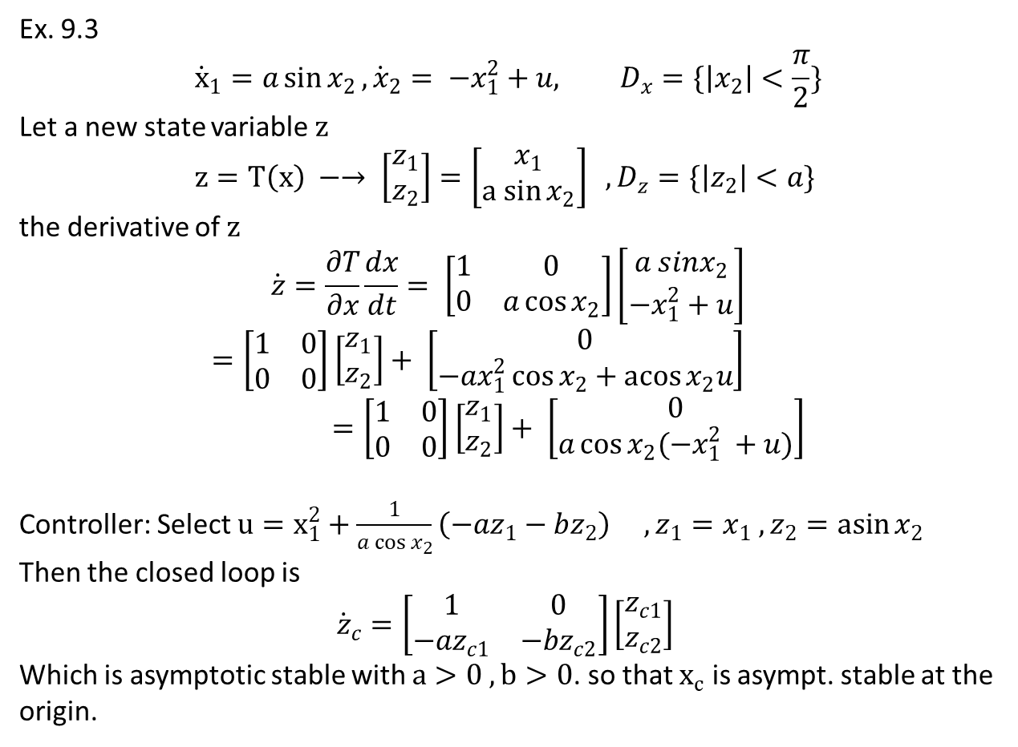
Ex. 9.3
$${\dot{x}}_{1}=a\sin{x_{2}}, {\dot{x}}_{2}= −x_{1}^{2}+u, D_{x}=\{\left|x_{2}\right|<\frac{π}{2}\}$$
Let a new state variable $z$
$$z=T\left(x\right) −→ \left[\begin{matrix}z_{1} \\ z_{2}\end{matrix}\right]=\left[\begin{matrix}x_{1} \\ a sin{x_{2}}\end{matrix}\right] , D_{z}=\{\left|z_{2}\right|<a\}$$
the derivative of $z$
$$\dot{z}=\frac{∂T}{∂x}\frac{dx}{dt}= \left[\begin{matrix}1 & 0 \\ 0 & a\cos{x_{2}}\end{matrix}\right]\left[\begin{matrix}a sinx_{2} \\ −x_{1}^{2}+u\end{matrix}\right]$$
$$=\left[\begin{matrix}1 & 0 \\ 0 & 0\end{matrix}\right]\left[\begin{matrix}z_{1} \\ z_{2}\end{matrix}\right]+ \left[\begin{matrix}0 \\ −{ax}_{1}^{2}\cos{x_{2}+\operatorname{acos}{x_{2}u}}\end{matrix}\right]=\left[\begin{matrix}1 & 0 \\ 0 & 0\end{matrix}\right]\left[\begin{matrix}z_{1} \\ z_{2}\end{matrix}\right]+ \left[\begin{matrix}0 \\ a\cos{x_{2}(−x_{1}^{2} +u)}\end{matrix}\right]$$
Controller: Select $u=x_{1}^{2}+\frac{1}{a\cos{x_{2}}}\left(−az_{1}−bz_{2}\right) , z_{1}=x_{1} , z_{2}=\operatorname{asin}{x_{2}}$
Then the closed loop is
$${\dot{z}}_{c}=\left[\begin{matrix}1 & 0 \\ −az_{c1} & −bz_{c2}\end{matrix}\right]\left[\begin{matrix}z_{c1} \\ z_{c2}\end{matrix}\right]$$
Which is asymptotic stable with $a>0 , b>0$. so that $x_{c}$ is asympt. stable at the origin.

Slide 10
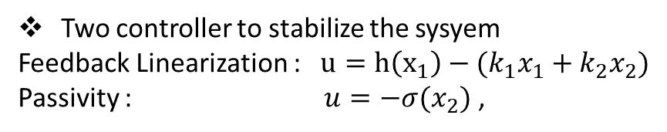
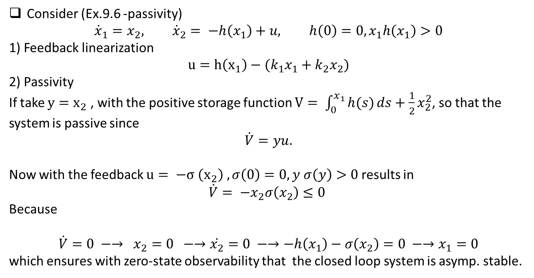
Consider (Ex.9.6 -passivity)
$${\dot{x}}_{1}=x_{2}, {\dot{x}}_{2}= −h\left(x_{1}\right)+u, h\left(0\right)=0, x_{1}h\left(x_{1}\right)>0$$
1) Feedback linearization
$$u=h\left(x_{1}\right)−(k_{1}x_{1}+k_{2}x_{2})$$
2) Passivity
If take $y=x_{2}$ , with the positive storage function $V= \int_{0}^{x_{1}}{h(s)}ds+\frac{1}{2}x_{2}^{2}$, so that the
system is passive since
$$\dot{V}=yu.$$
Now with the feedback $u= −σ \left(x_{2}\right) , σ\left(0\right)=0, y σ\left(y\right)>0$results in
$$\dot{V}= −x_{2}σ\left(x_{2}\right)≤0$$
Because
$$\dot{V}=0 −→ x_{2}=0 −→\dot{x_{2}}=0 −→−h\left(x_{1}\right)−σ\left(x_{2}\right)=0 −→x_{1}=0$$
which ensures with zero-state observability that the closed loop system is asymp. stable.
Two controller to stabilize the sysyem
Feedback Linearization : $u=h\left(x_{1}\right)−(k_{1}x_{1}+k_{2}x_{2})$
Passivity : $u=−σ(x_{2})$ ,

Slide 11
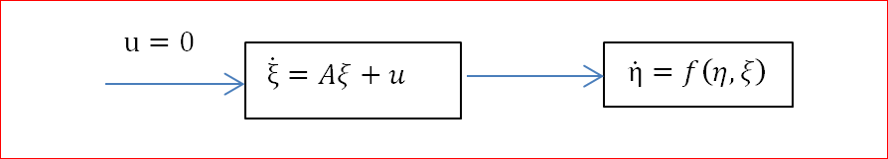

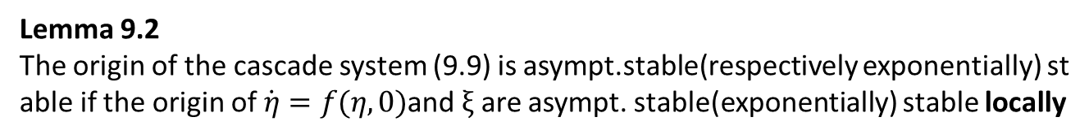
Ch.4 Partial Feedback Linearization
$$\dot{η}=f\left(η, ξ\right), \dot{ξ}=Aξ (9.9)$$
Lemma 9.2
The origin of the cascade system (9.9) is asympt.stable(respectively exponentially) stable if the origin of $\dot{η}=f(η,0)$and $ξ$ are asympt. stable(exponentially) stable locally

Slide 12
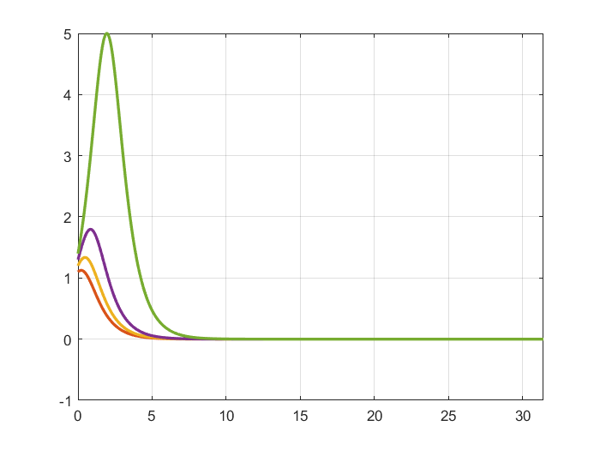
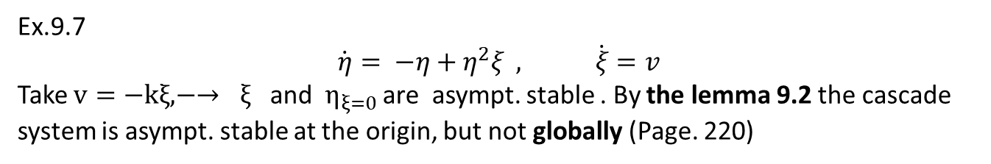

Ex.9.7
$$\dot{η}= −η+η^{2}ξ , \dot{ξ}=v$$
Take $v=−kξ, −→ ξ$ and $η_{ξ=0}$ are asympt. stable . By the lemma 9.2 the cascade system is asympt. stable at the origin, but not globally (Page. 220)
L = chebop(0, 10*pi);
L.op =@(t,x,y)[diff(x)+x-x^2.*y; diff(y)+y];
for i = 1:4
L.lbc =@(x,y) [x-(1+0.1*i); y-(1+0.1*i)];
rhs =[0;0];
U=L\rhs;
figure(1)
plot(U(1), U(2), LW,2);grid on; hold on
axis([-1 3 -3 3]);
figure(2)
plot(U(1),LW,2); hold on; grid on
end
$$η\left(t\right) , η_{0}=[1.1 1.2 1.3 1.4]$$

Slide 13
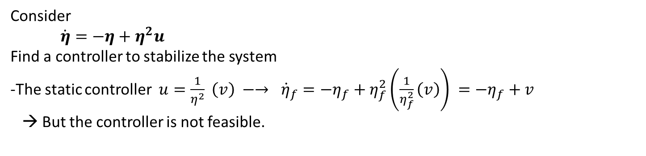
Consider
$\dot{η}=−η+η^{2}u$
Find a controller to stabilize the system
-The static controller $u=\frac{1}{η^{2}} \left(v\right) −→ {\dot{η}}_{f}={−η}_{f}+η_{f}^{2}\left(\frac{1}{η_{f}^{2}}\left(v\right)\right) =−η_{f}+v$
→ But the controller is not feasible.

Slide 14
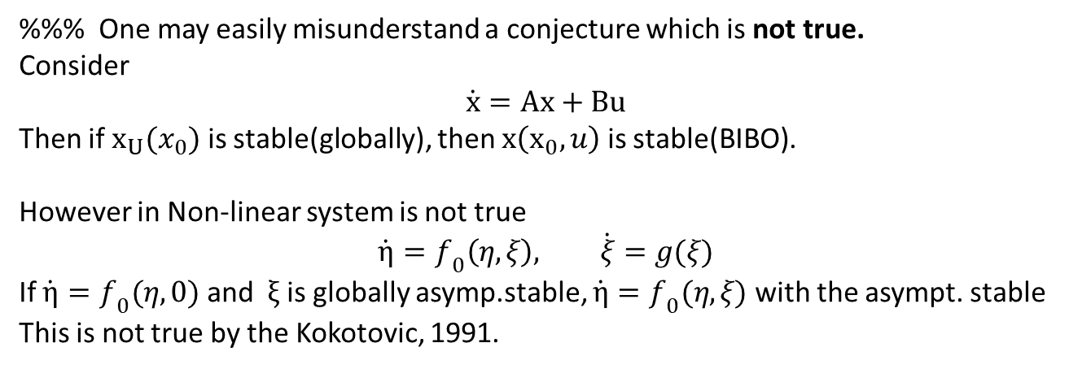
%%% One may easily misunderstand a conjecture which is not true.
Consider
$$\dot{x}=Ax+Bu$$
Then if $x_{U}(x_{0})$ is stable(globally), then $x\left(x_{0}, u\right)$ is stable(BIBO).
However in Non-linear system is not true
$$\dot{η}=f_{0}\left(η, ξ\right), \dot{ξ}=g(ξ)$$
If $\dot{η}=f_{0}(η,0)$ and$ξ$ is globally asymp.stable, $\dot{η}=f_{0}(η, ξ)$ with the asympt. stable This is not true by the Kokotovic, 1991.

Slide 15
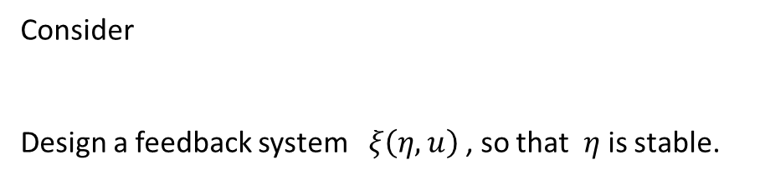

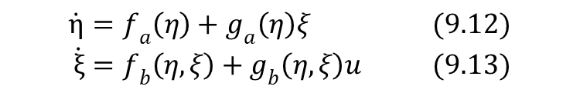
Ch.9.5 Backstepping
Theory – Kokotovic, 1990.
$$\dot{η}=f_{a}\left(η\right)+g_{a}\left(η\right)ξ (9.12) \\ \dot{ξ}=f_{b}\left(η, ξ\right)+g_{b}\left(η, ξ\right)u (9.13)$$
Consider
Design a feedback system $ξ\left(η, u\right)$, so that $η$ is stable.
$\dot{η}=f_{a}\left(η\right)+g_{a}\left(η\right)u$
Select a fictitious controller $ξ(η)$
2) Select a fictitious state $z =ξ(x) −g(x)$
3) Find a controller such that $z −→0$
$ξ :$ find a controller $ξ(x)$ to stabilize $\dot{x}=−Ax+g\left(x\right)ξ\left(x\right)$

Slide 16
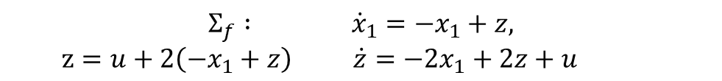
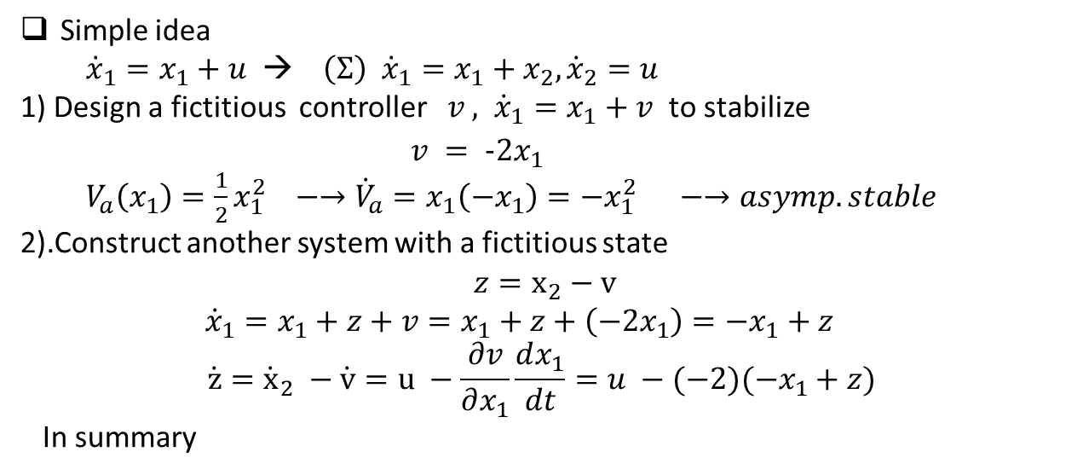


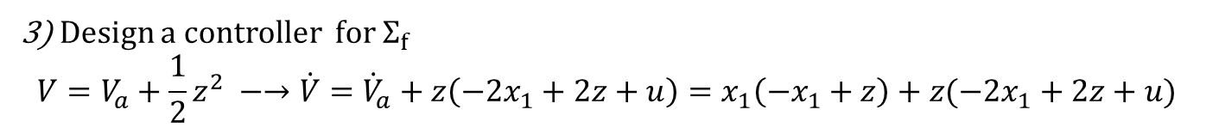
Simple idea
${\dot{x}}_{1}=x_{1}+u$ → $\left(Σ\right) {\dot{x}}_{1}=x_{1}+x_{2}, {\dot{x}}_{2}=u$
1) Design a fictitious controller $v$ $, {\dot{x}}_{1}=x_{1}+v$ to stabilize
$v = −2x_{1}$
$V_{a}\left(x_{1}\right)=\frac{1}{2}x_{1}^{2} −→{\dot{V}}_{a}=x_{1}\left(−x_{1}\right)=−x_{1}^{2} −→asymp. stable$
2).Construct another system with a fictitious state
$$z=x_{2}−v$$
${\dot{x}}_{1}=x_{1}+z+v=x_{1}+z+\left(−2x_{1}\right)=−x_{1}+z$
$$\dot{z}={\dot{x}}_{2} −\dot{v}=u −\frac{∂v}{∂x_{1}}\frac{dx_{1}}{dt}=u −(−2)(−x_{1}+z)$$
In summary
$$Σ_{f} : {\dot{x}}_{1}={−x}_{1}+z,$$
$z=u+2\left(−x_{1}+z\right) \dot{z}=−2x_{1}+2z+u$
3) Design a controller for $Σ_{f}$
$$V=V_{a}+\frac{1}{2}z^{2} −→\dot{V}={\dot{V}}_{a}+z\left(−2x_{1}+2z+u\right)=x_{1}\left(−x_{1}+z\right)+z(−2x_{1}+2z+u)$$
Select $u=2x_{1}−2z+x_{1}−z=3x_{1}−3z$
$V=−x_{1}^{2}−z^{2}$ < 0
$$u =3x_{1}−3z=3x_{1}−3\left(x_{2} −v\right)=−3x_{1}−3\left(x_{2}+2x_{1}\right)=−9x_{1}−3x_{2}$$

Slide 17
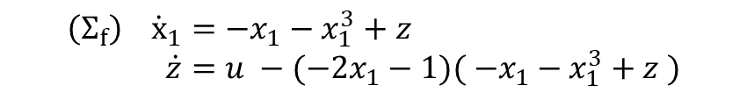
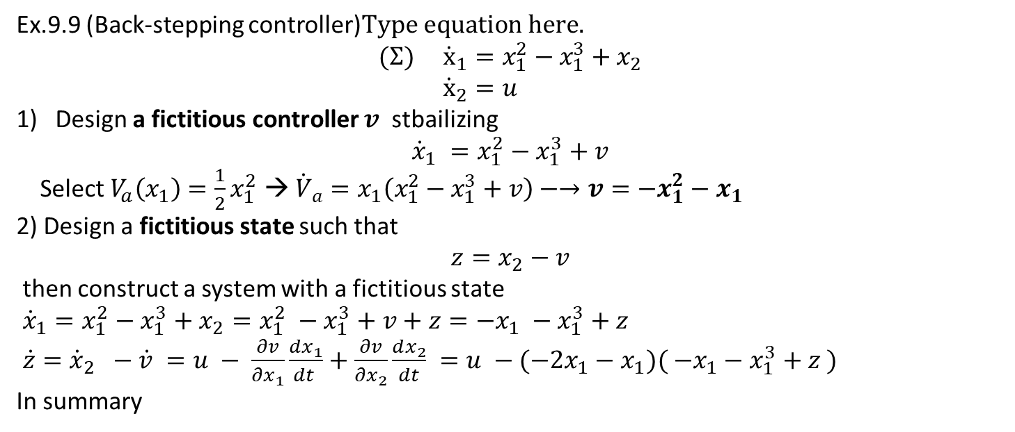
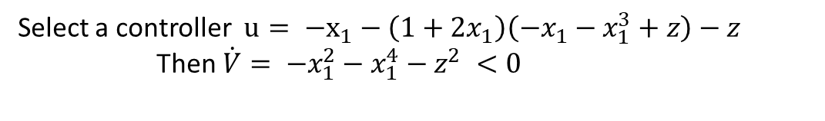


Ex.9.9 (Back-stepping controller)
$$(Σ) {\dot{x}}_{1}=x_{1}^{2}−x_{1}^{3}+x_{2} \\ {\dot{x}}_{2}=u$$
Design a fictitious controller $v$ stbailizing
$${\dot{x}}_{1} =x_{1}^{2}−x_{1}^{3}+v$$
Select $V_{a}\left(x_{1}\right)=\frac{1}{2}x_{1}^{2}$ → ${\dot{V}}_{a}=x_{1}\left(x_{1}^{2}−x_{1}^{3}+v\right)−→v={−x}_{1}^{2}−x_{1}$
2) Design a fictitious state such that
$$z=x_{2}−v$$
then construct a system with a fictitious state
${\dot{x}}_{1}=x_{1}^{2}−x_{1}^{3}+x_{2}=x_{1}^{2} −x_{1}^{3}+v+z=−x_{1} −x_{1}^{3}+z$
$\dot{z}={\dot{x}}_{2} −\dot{v} =u − \frac{∂v}{∂x_{1}}\frac{dx_{1}}{dt }+\frac{∂v}{∂x_{2}}\frac{dx_{2}}{dt} =u −(−2x_{1}−x_{1})( −x_{1}−x_{1}^{3}+z )$
In summary
$$\left(Σ_{f}\right) {\dot{x}}_{1}=−x_{1}−x_{1}^{3}+z \\ \dot{z}=u −(−2x_{1}−1)( −x_{1}−x_{1}^{3}+z )$$
3) Select a $V\left(x_{1},z\right)=V_{a}+\frac{1}{2}z^{2}$
$$\dot{V }=\dot{V_{a}}+\dot{z} \\ =x_{1}{\dot{x}}_{1}+z\dot{z} \\ =x_{1}\left(−x_{1}−x_{1}^{3}+z\right)+z(u+\left(1+2x_{1}\right)\left(−x_{1}−x_{1}^{3}+z \right)) \\ =−x_{1}^{2}−x_{1}^{4}+z(x_{1}+\left(1+2x_{1}\right)\left(−x_{1}−x_{1}^{3}+z\right)+u)$$
Select a controller $u= −x_{1}−\left(1+2x_{1}\right)\left(−x_{1}−x_{1}^{3}+z\right)−z$
Then $\dot{V}= −x_{1}^{2}−x_{1}^{4}−z^{2} <0$

Slide 18
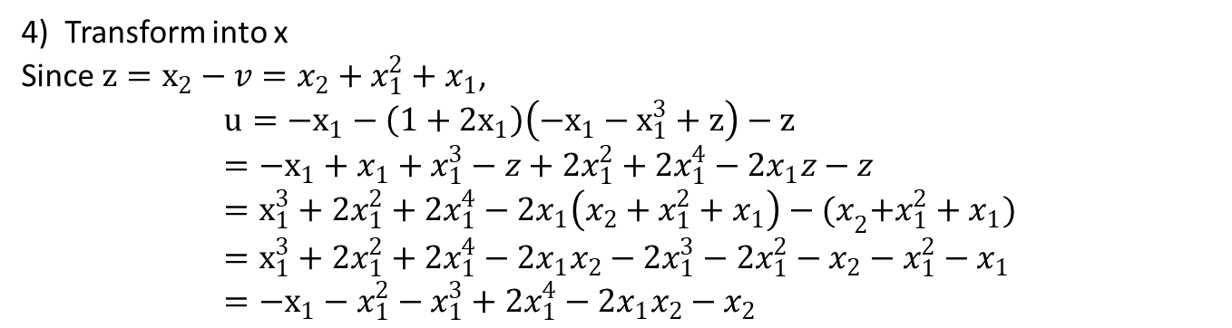
4) Transform into x
Since $z=x_{2}−v=x_{2}+x_{1}^{2}+x_{1}$,
$$u=−x_{1}−\left(1+2x_{1}\right)\left(−x_{1}−x_{1}^{3}+z\right)−z \\ =−x_{1}+x_{1}+x_{1}^{3}−z+2x_{1}^{2}+2x_{1}^{4}−2x_{1}z−z \\ =x_{1}^{3}+2x_{1}^{2}+2x_{1}^{4}−2x_{1}\left(x_{2}+x_{1}^{2}+x_{1}\right)−{(x}_{2}+x_{1}^{2}+x_{1}) \\ =x_{1}^{3}+2x_{1}^{2}+2x_{1}^{4}−2x_{1}x_{2}−2x_{1}^{3}−2x_{1}^{2}−x_{2}−x_{1}^{2}−x_{1} \\ =−x_{1}−x_{1}^{2}−x_{1}^{3}+2x_{1}^{4}−2x_{1}x_{2}−x_{2}$$

Slide 19
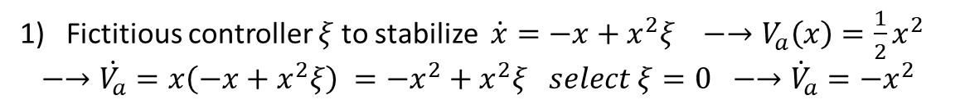

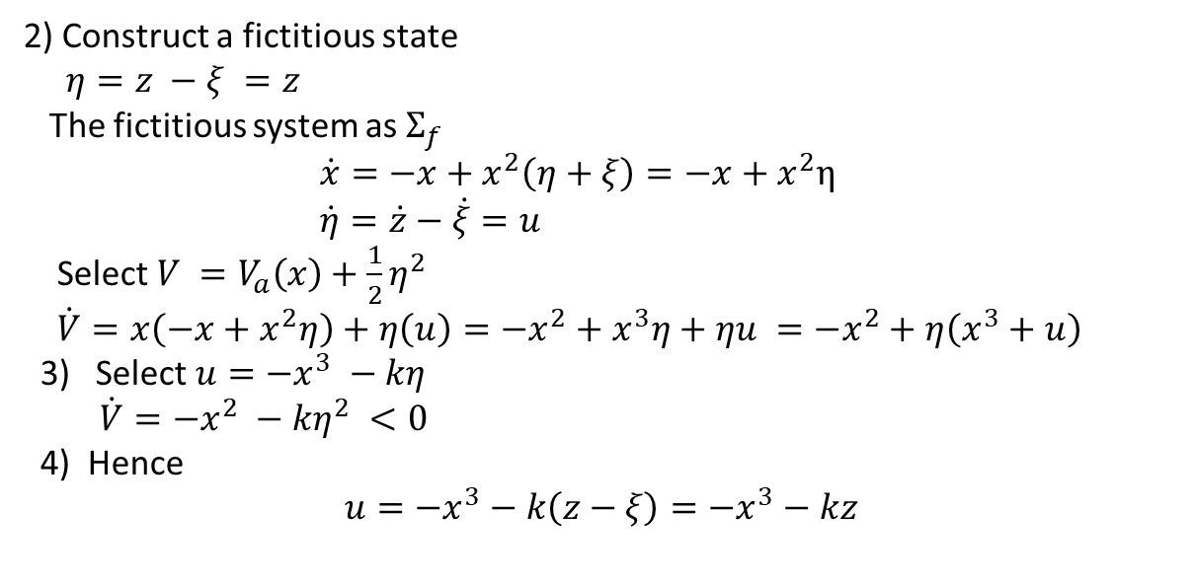
Concept: Ex. 9.12
Consider
$$\dot{x}= −x+x^{2}z , (1) \\ \dot{z}=u (2)$$
Fictitious controller $ξ$to stabilize $\dot{x}=−x+x^{2}ξ −→V_{a}\left(x\right)=\frac{1}{2}x^{2}$
$−→\dot{V_{a}}=x\left(−x+x^{2}ξ\right) =−x^{2}+x^{2}ξ select ξ=0 −→{\dot{V}}_{a}=−x^{2}$
2) Construct a fictitious state
$η=z −ξ =z$
The fictitious system as $Σ_{f}$
$\dot{x}=−x+x^{2}\left(η+ξ\right)=−x+x^{2}η$
$\dot{η}=\dot{z}−\dot{ξ}=u$
Select $V =V_{a}\left(x\right)+\frac{1}{2}η^{2}$
$\dot{V}=x\left(−x+x^{2}η\right)+η\left(u\right)=−x^{2}+x^{3}η+ηu =−x^{2}+η\left(x^{3}+u\right)$
3) Select $u=−x^{3} −kη$
$\dot{V}=−x^{2} −kη^{2} <0$
4) Hence
$$u=−x^{3}−k\left(z−ξ\right)=−x^{3}−kz$$

Slide 20
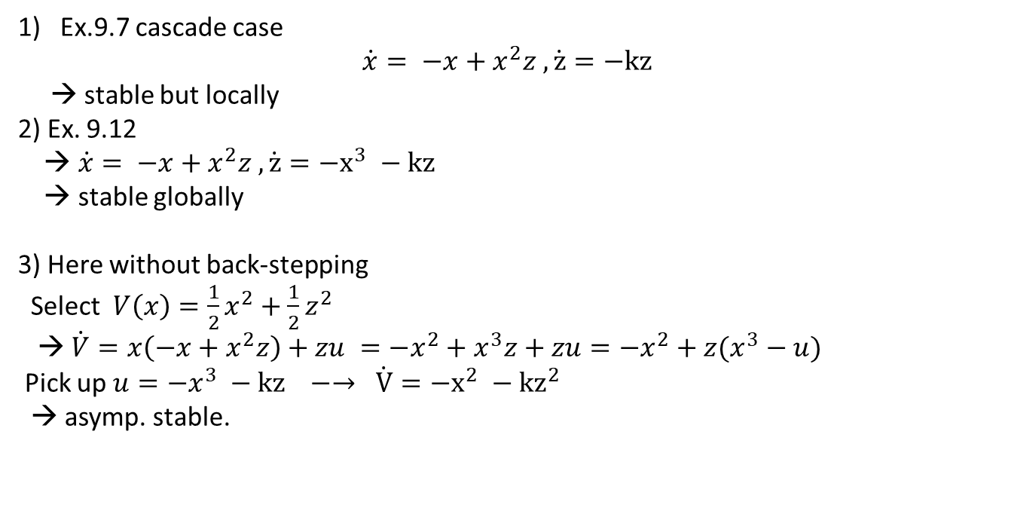

Concept: Ex. 9.12 -- > Ex.97
Consider
$$\dot{x}= −x+x^{2}z , (1) \\ \dot{z}=u (2)$$
Ex.9.7 cascade case
$$\dot{x}= −x+x^{2}z , \dot{z}=−kz$$
→ stable but locally
2) Ex. 9.12
→ $\dot{x}= −x+x^{2}z , \dot{z}=−x^{3} −kz$
→ stable globally
3) Here without back-stepping
Select $V\left(x\right)=\frac{1}{2}x^{2}+\frac{1}{2}z^{2}$
→ $\dot{V}=x\left(−x+x^{2}z\right)+zu =−x^{2}+x^{3}z+zu=−x^{2}+z(x^{3}−u)$
Pick up $u=−x^{3} −kz −→ \dot{V}=−x^{2} −{kz}^{2}$
→ asymp. stable.

Slide 21
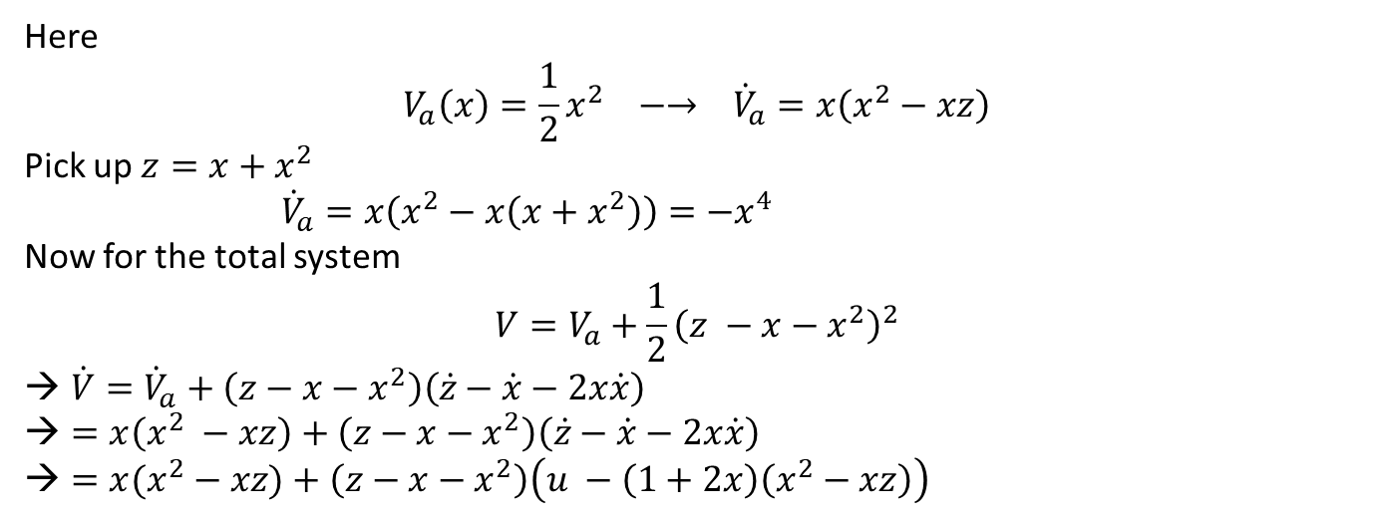

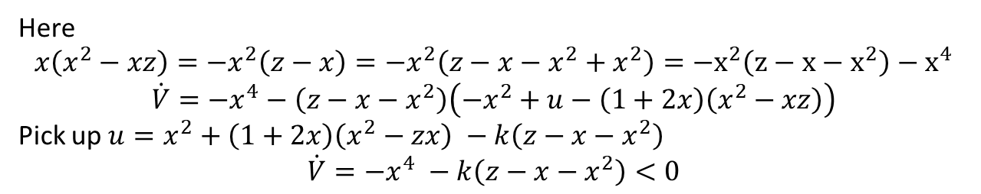
Ex. 9.13
$$\dot{x}=x^{2} −xz , (1) \\ \dot{z}=u (2)$$
Here
$$V_{a}\left(x\right)=\frac{1}{2}x^{2} −→ {\dot{V}}_{a}=x\left(x^{2}−xz\right)$$
Pick up $z=x+x^{2}$
${\dot{V}}_{a}=x\left(x^{2}−x\left(x+x^{2}\right)\right)=−x^{4}$
Now for the total system
$$V=V_{a}+\frac{1}{2}{\left(z −x−x^{2}\right)}^{2}$$
$\dot{V}={\dot{V}}_{a}+\left(z−x−x^{2}\right)\left(\dot{z}−\dot{x}−2x\dot{x}\right)$
$=x\left(x^{2} −xz\right)+\left(z−x−x^{2}\right)\left(\dot{z}−\dot{x}−2x\dot{x}\right)$
$=x(x^{2}−xz)+\left(z−x−x^{2}\right)\left(u −\left(1+2x\right)\left(x^{2}−xz\right)\right)$
Here
$$x\left(x^{2}−xz\right)=−x^{2}\left(z−x\right)=−x^{2}\left(z−x−x^{2}+x^{2}\right)={−x}^{2}\left(z−x−x^{2}\right)−x^{4}$$
$$\dot{V}=−x^{4}−\left(z−x−x^{2}\right)\left(−x^{2}+u−\left(1+2x\right)\left(x^{2}−xz\right)\right)$$
Pick up $u=x^{2}+\left(1+2x\right)\left(x^{2}−zx\right) −k\left(z−x−x^{2}\right)$
$$\dot{V}=−x^{4} −k\left(z−x−x^{2}\right)<0$$

