Slide 1
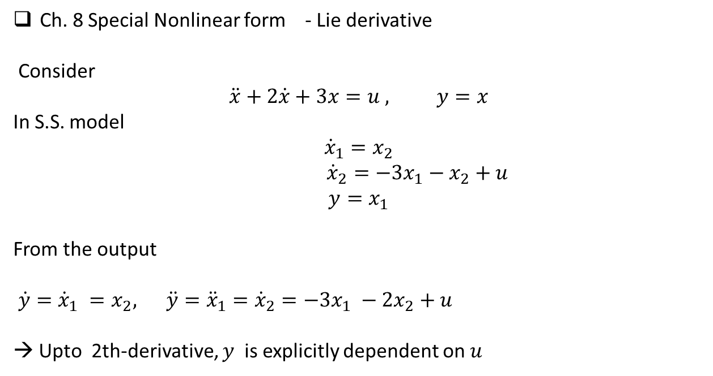
Ch. 8 Special Nonlinear form - Lie derivative
Consider
$$\ddot{x}+2\dot{x}+3x=u , y=x$$
In S.S. model
$${\dot{x}}_{1}=x_{2}$$
${\dot{x}}_{2}=−3x_{1}−x_{2}+u$
$$y=x_{1}$$
From the output
$\dot{y}={\dot{x}}_{1} =x_{2}, \ddot{y}={\ddot{x}}_{1}={\dot{x}}_{2}=−3x_{1} −2x_{2}+u$
→ Upto 2th-derivative, $y$ is explicitly dependent on $u$

Slide 2
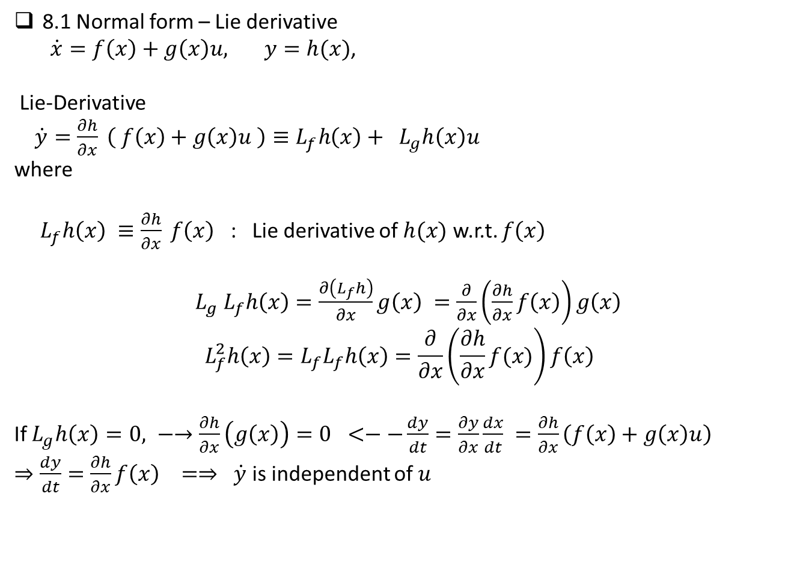
8.1 Normal form – Lie derivative
$\dot{x}=f\left(x\right)+g\left(x\right)u, y=h(x)$,
Lie-Derivative
$\dot{y}=\frac{∂h}{∂x} \left( f\left(x\right)+g\left(x\right)u \right)≡L_{f}h\left(x\right)+ L_{g}h\left(x\right)u$
where
$L_{f}h\left(x\right) ≡\frac{∂h}{∂x} f\left(x\right)$ : Lie derivative of $h(x)$ w.r.t. $f\left(x\right)$
$L_{g} L_{f}h\left(x\right)=\frac{∂\left(L_{f}h\right)}{∂x}g\left(x\right) =\frac{∂}{∂x}\left(\frac{∂h}{∂x}f\left(x\right)\right)g\left(x\right)$
$$L_{f}^{2}h\left(x\right)=L_{f}L_{f}h\left(x\right)=\frac{∂}{∂x}\left(\frac{∂h}{∂x}f(x)\right)f\left(x\right)$$
If $L_{g}h\left(x\right)=0, −→\frac{∂h}{∂x}\left(g\left(x\right)\right)=0 <−−\frac{dy}{dt}=\frac{∂y}{∂x}\frac{dx}{dt} =\frac{∂h}{∂x}\left(f\left(x\right)+g\left(x\right)u\right)$
$⇒\frac{dy}{dt}=\frac{∂h}{∂x}f\left(x\right) =⇒ \dot{y}$is independent of $u$

Slide 3
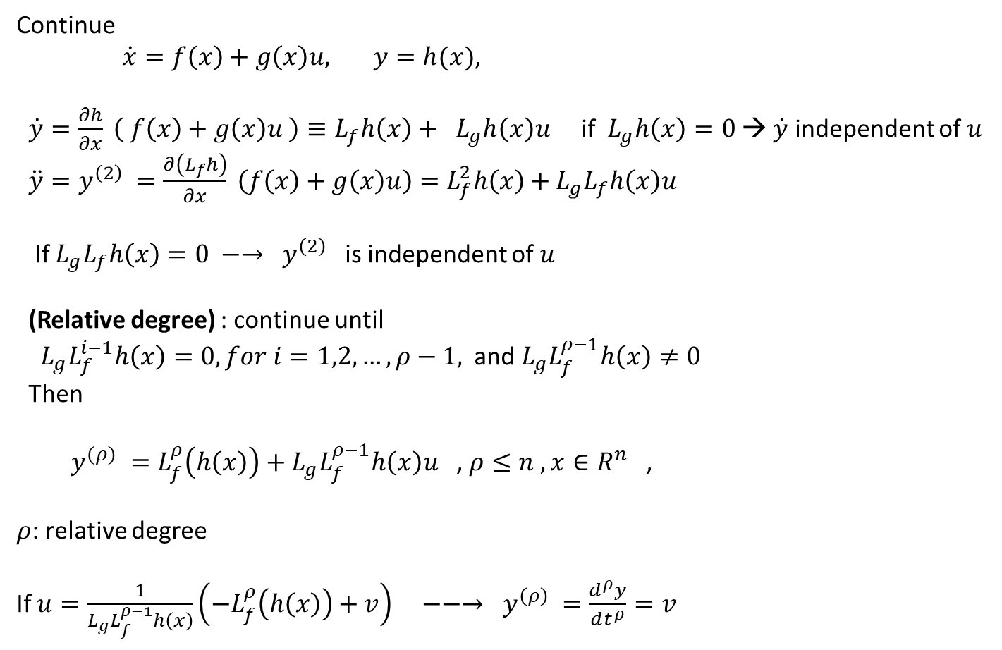
Continue
$\dot{x}=f\left(x\right)+g\left(x\right)u, y=h(x)$,
$\dot{y}=\frac{∂h}{∂x} \left( f\left(x\right)+g\left(x\right)u \right)≡L_{f}h\left(x\right)+ L_{g}h\left(x\right)u$ if $L_{g}h\left(x\right)=0$→ $\dot{y}$ independent of $u$
$\ddot{y}=y^{\left(2\right)} =\frac{∂\left(L_{f}h\right)}{∂x} \left(f\left(x\right)+g\left(x\right)u\right)=L_{f}^{2}h\left(x\right)+L_{g}L_{f}h\left(x\right)u$
If $L_{g}L_{f}h\left(x\right)=0 −→ y^{\left(2\right)}$ is independent of $u$
(Relative degree) : continue until
$L_{g}L_{f}^{i−1}h\left(x\right)=0, for i=1,2,…,ρ−1,$and $L_{g}L_{f}^{ρ−1}h\left(x\right)≠0$
Then
$y^{(ρ)} =L_{f}^{ρ}\left(h\left(x\right)\right)+L_{g}L_{f}^{ρ−1}h\left(x\right)u$ , $ρ≤n , x∈R^{n}$ ,
$ρ$: relative degree
If $u=\frac{1}{L_{g}L_{f}^{ρ−1}h\left(x\right)}\left({−L}_{f}^{ρ}\left(h\left(x\right)\right)+v\right) −−→ y^{\left(ρ\right)} =\frac{d^{ρ}y}{dt^{ρ}}=v$

Slide 4
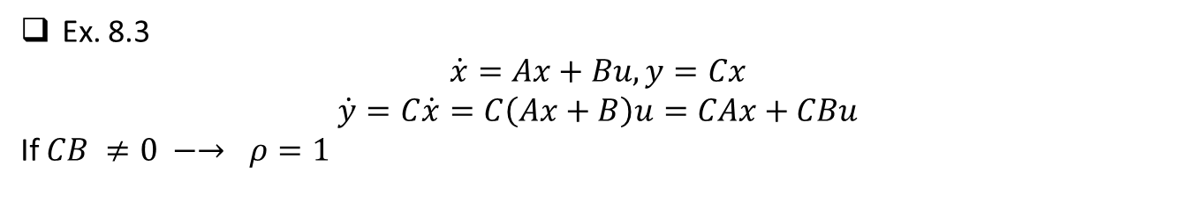
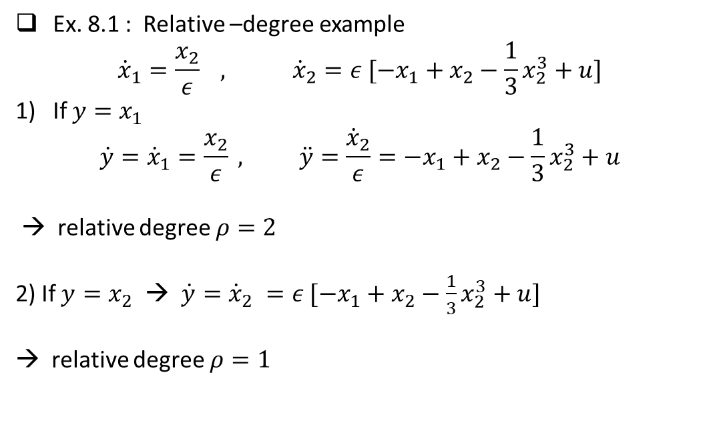
Ex. 8.1 : Relative –degree example
$${\dot{x}}_{1}=\frac{x_{2}}{ε} , {\dot{x}}_{2}=ε [−x_{1}+x_{2}−\frac{1}{3}x_{2}^{3}+u]$$
If $y=x_{1}$
$$\dot{y}={\dot{x}}_{1}=\frac{x_{2}}{ε} , \ddot{y}=\frac{{\dot{x}}_{2}}{ε}=−x_{1}+x_{2}−\frac{1}{3}x_{2}^{3}+u$$
→ relative degree $ρ=2$
2) If $y=x_{2}$ → $\dot{y}={\dot{x}}_{2} =ε [−x_{1}+x_{2}−\frac{1}{3}x_{2}^{3}+u]$
→ relative degree $ρ=1$
Ex. 8.3
$$\dot{x}=Ax+Bu, y=Cx$$
$$\dot{y}=C\dot{x}=C\left(Ax+B\right)u=CAx+CBu$$
If $CB ≠0 −→ ρ=1$

Slide 5

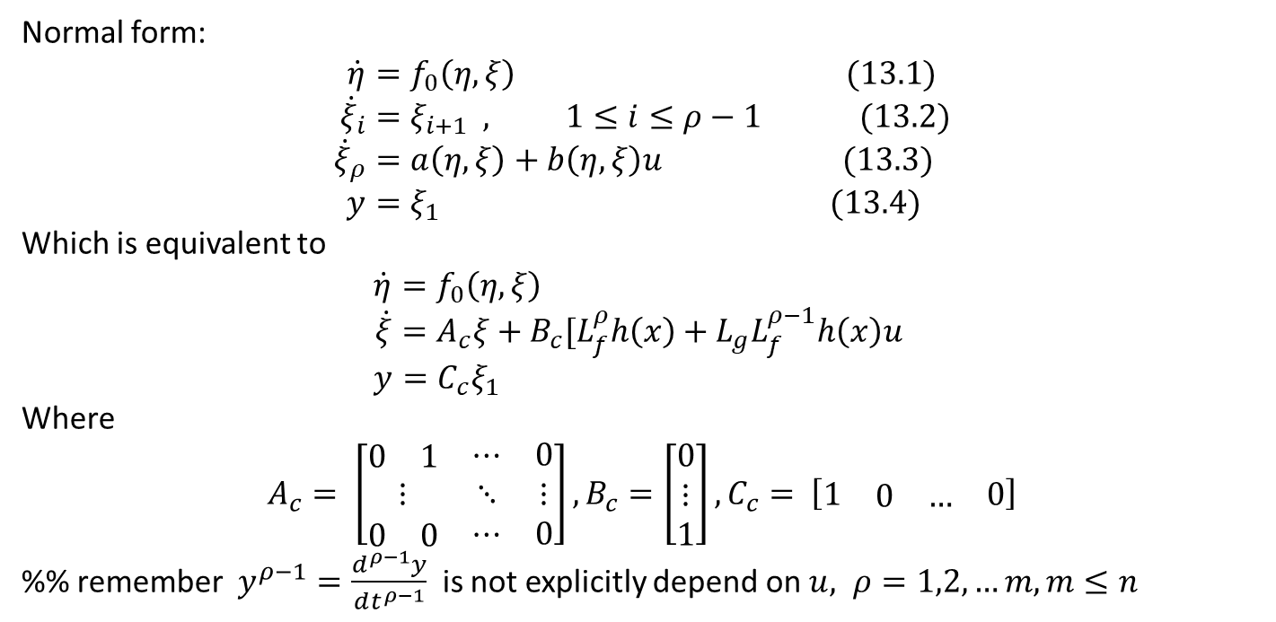
Ch.8 /13
$\dot{x}=f\left(x\right)+g\left(x\right)u, y=h(x)$,
Normal form:
$$\dot{η}=f_{0}\left(η, ξ\right) (13.1) \\ {\dot{ξ}}_{i}=ξ_{i+1} , 1≤i≤ρ−1 (13.2) \\ {\dot{ξ}}_{ρ}=a\left(η, ξ\right)+b\left(η, ξ\right)u (13.3) \\ y=ξ_{1} (13.4)$$
Which is equivalent to
$$\dot{η}=f_{0}\left(η, ξ\right) \\ \dot{ξ}=A_{c}ξ+B_{c}[L_{f}^{ρ}h\left(x\right)+L_{g}L_{f}^{ρ−1}h\left(x\right)u \\ y=C_{c}ξ_{1}$$
Where
$$A_{c}= \left[\begin{matrix}\begin{matrix}0 & 1\end{matrix} & ⋯ & 0 \\ ⋮ & ⋱ & ⋮ \\ \begin{matrix}0 & 0\end{matrix} & ⋯ & 0\end{matrix}\right], B_{c}=\left[\begin{matrix}0 \\ ⋮ \\ 1\end{matrix}\right], C_{c}= \left[\begin{matrix}1 & \begin{matrix}0 & …\end{matrix} & 0\end{matrix}\right]$$
%% remember $y^{ρ−1}=\frac{d^{ρ−1}y}{dt^{ρ−1}}$ is not explicitly depend on $u, ρ=1,2,…m, m≤n$

Slide 6
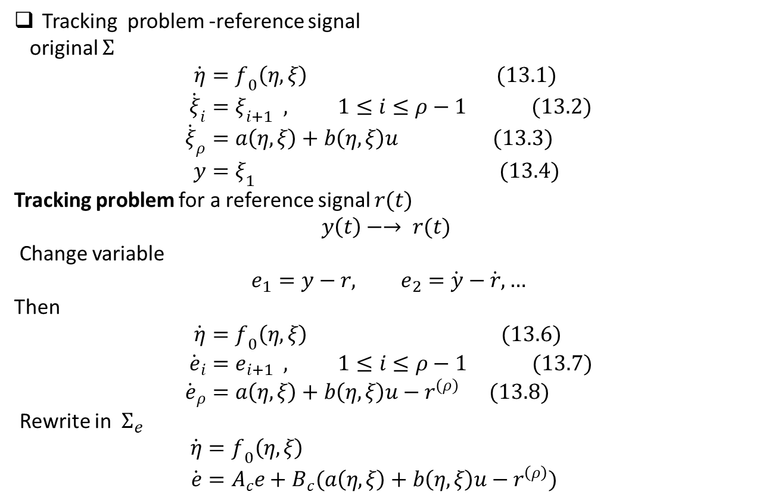
Tracking problem -reference signal
original $Σ$
$$\dot{η}=f_{0}\left(η, ξ\right) (13.1) \\ {\dot{ξ}}_{i}=ξ_{i+1} , 1≤i≤ρ−1 (13.2) \\ {\dot{ξ}}_{ρ}=a\left(η, ξ\right)+b\left(η, ξ\right)u (13.3) \\ y=ξ_{1} (13.4)$$
Tracking problem for a reference signal $r(t)$
$$y\left(t\right)−→ r(t)$$
Change variable
$$e_{1}=y−r, e_{2}=\dot{y}−\dot{r},…$$
Then
$$\dot{η}=f_{0}\left(η, ξ\right) (13.6) \\ {\dot{e}}_{i}=e_{i+1} , 1≤i≤ρ−1 (13.7) \\ {\dot{e}}_{ρ}=a\left(η, ξ\right)+b\left(η, ξ\right)u−r^{(ρ)} (13.8)$$ Rewrite in $Σ_{e}$
$$\dot{η}=f_{0}\left(η, ξ\right) \\ \dot{e}=A_{c}e+B_{c}(a\left(η, ξ\right)+b\left(η, ξ\right)u−r^{\left(ρ\right)})$$

Slide 7
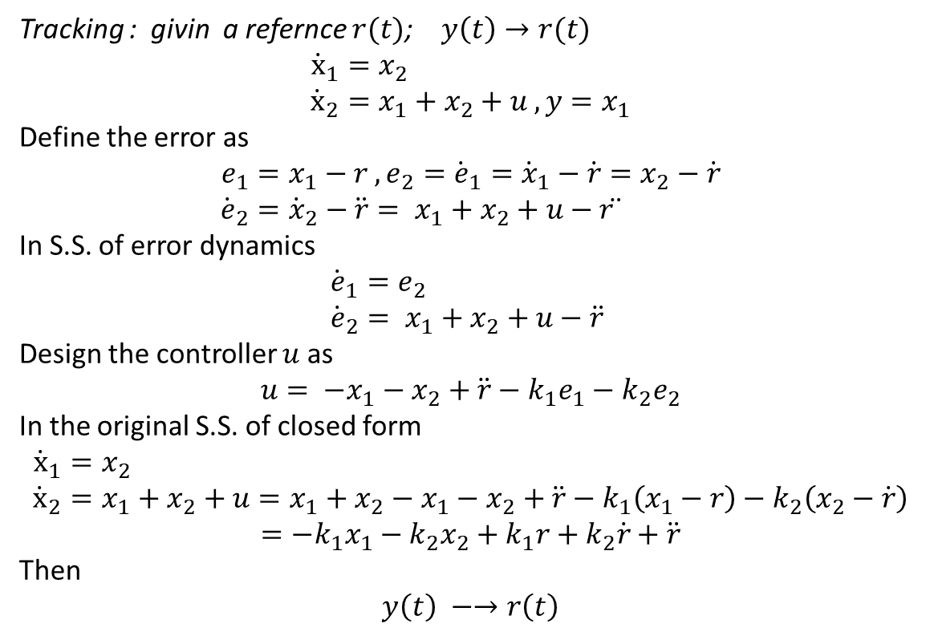
Example : Linear system
Tracking : givin a refernce $r(t)$; $y\left(t\right)→r(t)$
$${\dot{x}}_{1}=x_{2} \\ {\dot{x}}_{2}=x_{1}+x_{2}+u , y=x_{1}$$
Define the error as
$$e_{1}=x_{1}−r , e_{2}={\dot{e}}_{1}={\dot{x}}_{1}−\dot{r}=x_{2}−\dot{r} \\ {\dot{e}}_{2}={\dot{x}}_{2}−\ddot{r}= x_{1}+x_{2}+u−r ̈$$
In S.S. of error dynamics
$${\dot{e}}_{1}=e_{2} \\ {\dot{e}}_{2}= x_{1}+x_{2}+u−\ddot{r}$$
Design the controller $u$ as
$$u= {−x}_{1}−x_{2}+\ddot{r}−k_{1}e_{1}−k_{2}e_{2}$$
In the original S.S. of closed form
$${\dot{x}}_{1}=x_{2} \\ {\dot{x}}_{2}=x_{1}+x_{2}+u=x_{1}+x_{2}−x_{1}−x_{2}+\ddot{r}−k_{1}\left(x_{1}−r\right)−k_{2}\left(x_{2}−\dot{r}\right)$$
$$=−k_{1}x_{1}−k_{2}x_{2}+k_{1}r+k_{2}\dot{r}+\ddot{r}$$
Then
$$y\left(t\right) −→r\left(t\right)$$

Slide 8
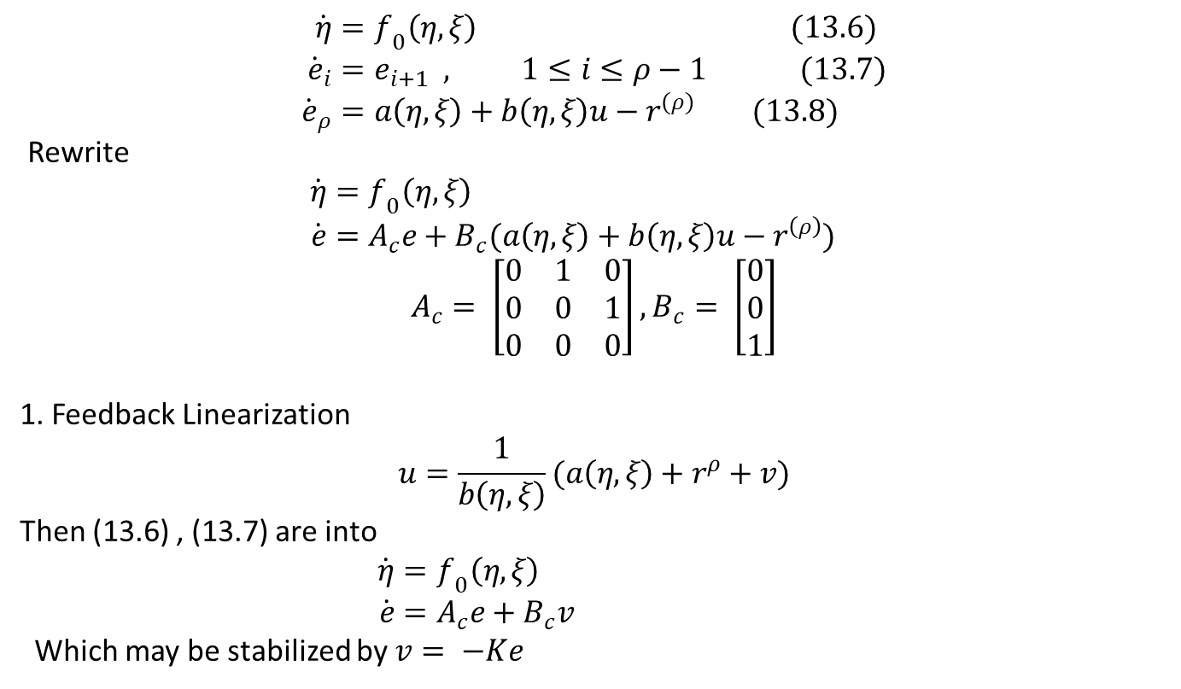
13.1 Tracking using feedback linearization
$$\dot{η}=f_{0}\left(η, ξ\right) (13.6) \\ {\dot{e}}_{i}=e_{i+1} , 1≤i≤ρ−1 (13.7) \\ {\dot{e}}_{ρ}=a\left(η, ξ\right)+b\left(η, ξ\right)u−r^{(ρ)} (13.8)$$ Rewrite
$$\dot{η}=f_{0}\left(η, ξ\right) \\ \dot{e}=A_{c}e+B_{c}(a\left(η, ξ\right)+b\left(η, ξ\right)u−r^{\left(ρ\right)})$$
$$A_{c}= \left[\begin{matrix}0 & 1 & 0 \\ 0 & 0 & 1 \\ 0 & 0 & 0\end{matrix}\right], B_{c}= \left[\begin{matrix}0 \\ 0 \\ 1\end{matrix}\right]$$
1. Feedback Linearization
$$u=\frac{1}{b\left(η, ξ\right)}(a\left(η,ξ\right)+r^{ρ}+v)$$
Then (13.6) , (13.7) are into
$$\dot{η}=f_{0}\left(η, ξ\right) \\ \dot{e}=A_{c}e+B_{c}v$$
Which may be stabilized by $v= −Ke$

Slide 9
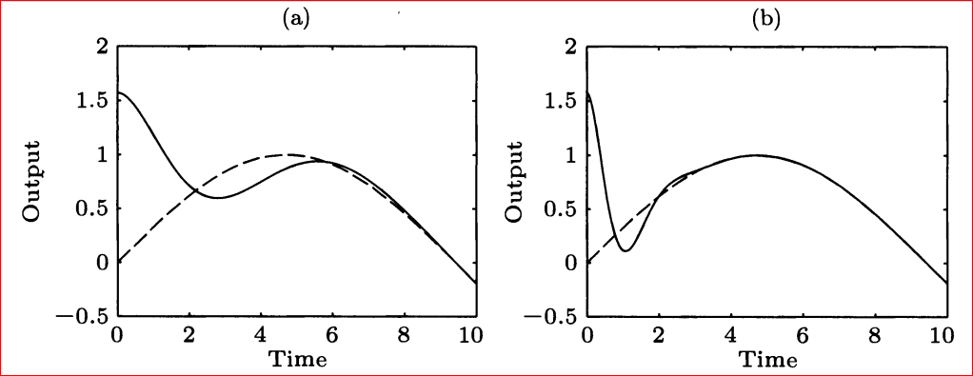
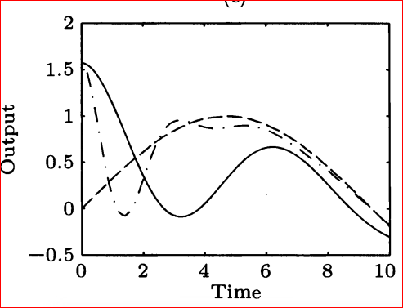
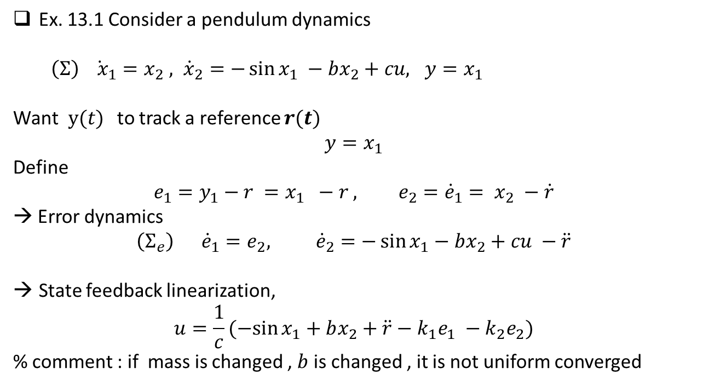
Ex. 13.1 Consider a pendulum dynamics
$\left(Σ\right) {\dot{ x}}_{1}=x_{2} , {\dot{x}}_{2}=−\sin{x_{1} −bx_{2}+cu, y=x_{1}}$
Want$y(t)$ to track a reference $r(t)$
$$y=x_{1}$$
Define
$$e_{1}=y_{1}−r =x_{1} −r , e_{2}={\dot{e}}_{1}= x_{2} −\dot{r}$$
→ Error dynamics
$$\left(Σ_{e}\right) {\dot{e}}_{1}=e_{2}, {\dot{e}}_{2}=−\sin{x_{1}}−bx_{2}+cu −\ddot{r}$$
State feedback linearization,
$$u=\frac{1}{c}(−sin{x_{1}+bx_{2}+\ddot{r}−k_{1}e_{1} −k_{2}e_{2})}$$
% comment : if mass is changed , $b$ is changed , it is not uniform converged

Slide 10
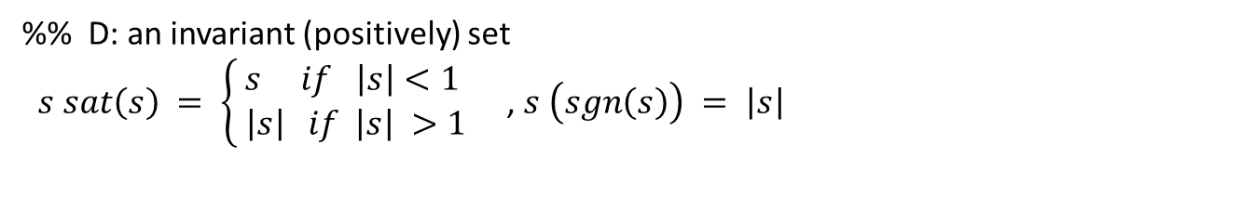
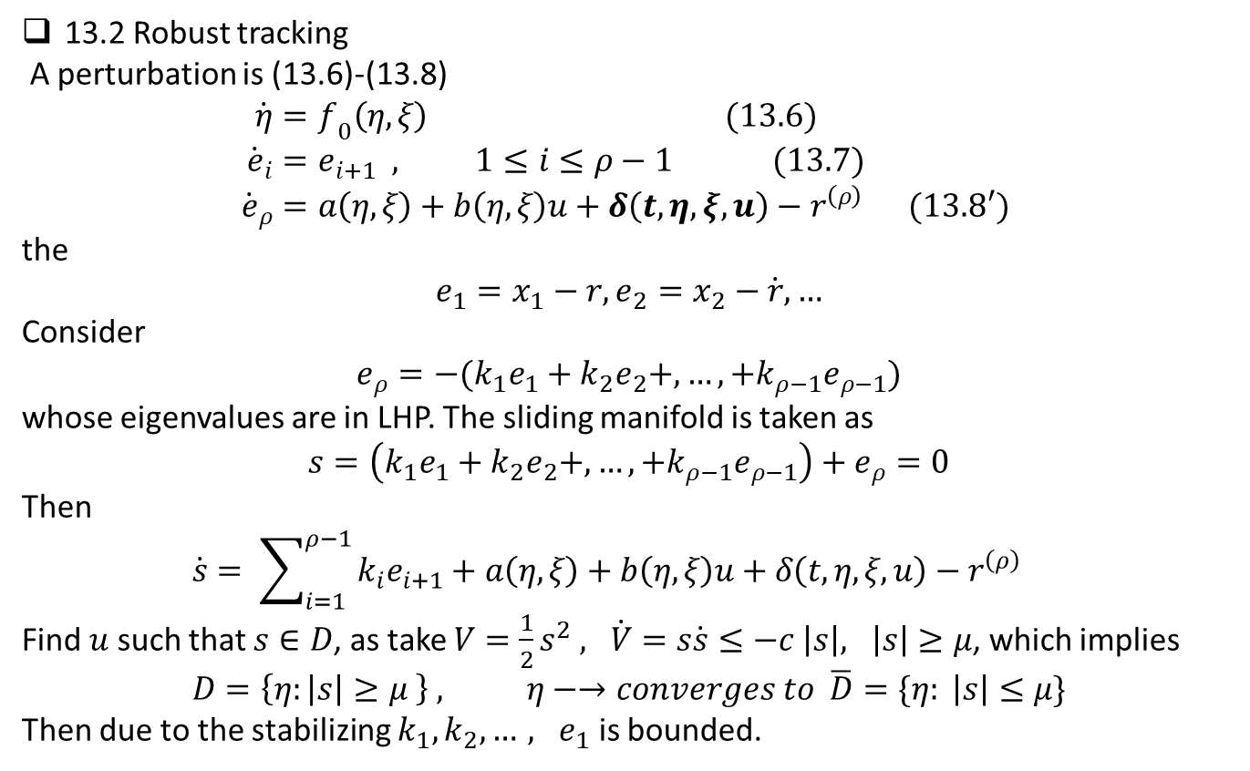
13.2 Robust tracking
A perturbation is (13.6)-(13.8)
$$\dot{η}=f_{0}\left(η, ξ\right) (13.6) \\ {\dot{e}}_{i}=e_{i+1} , 1≤i≤ρ−1 (13.7) \\ {\dot{e}}_{ρ}=a\left(η, ξ\right)+b\left(η, ξ\right)u+δ\left(t,η,ξ,u\right)−r^{\left(ρ\right)} (13.8′)$$ the
$$e_{1}=x_{1}−r, e_{2}=x_{2}−\dot{r},…$$
Consider
$$e_{ρ}=−(k_{1}e_{1}+k_{2}e_{2}+,…,+k_{ρ−1}e_{ρ−1})$$
whose eigenvalues are in LHP. The sliding manifold is taken as
$$s=\left(k_{1}e_{1}+k_{2}e_{2}+,…,+k_{ρ−1}e_{ρ−1}\right)+e_{ρ}=0$$
Then
$$\dot{s}= \sum_{i=1}^{ρ−1 }{k_{i}e_{i+1}}+a\left(η, ξ\right)+b\left(η, ξ\right)u+δ\left(t,η,ξ,u\right)−r^{\left(ρ\right)}$$
Find $u$ such that $s∈D$, as take $V=\frac{1}{2}s^{2} ,$ $\dot{V}=s\dot{s}≤−c \left|s\right|, \left|s\right|≥μ$, which implies
$$D=\left\{η:\left|s\right|≥μ \right\} , η−→converges to \overline{D}=\{η: \left|s\right|≤μ\}$$
Then due to the stabilizing $k_{1}, k_{2},…,$ $e_{1}$ is bounded.
%% D: an invariant (positively) set
$s sat\left(s\right) = \left\{\begin{aligned}s if \left|s\right|<1 \\ \left|s\right| if \left|s\right| >1\end{aligned}\right.$ , $s \left(sgn\left(s\right)\right) = \left|s\right|$

Slide 11
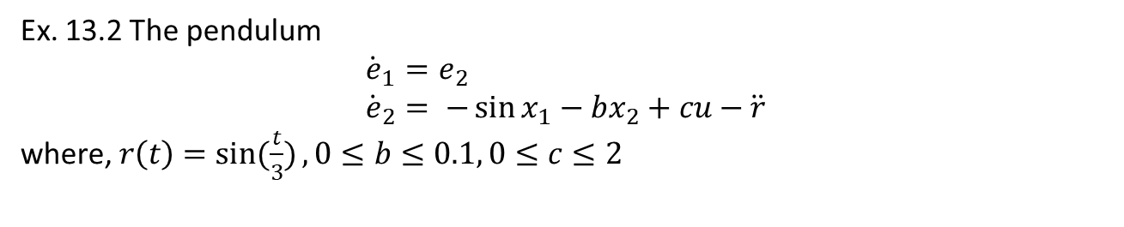
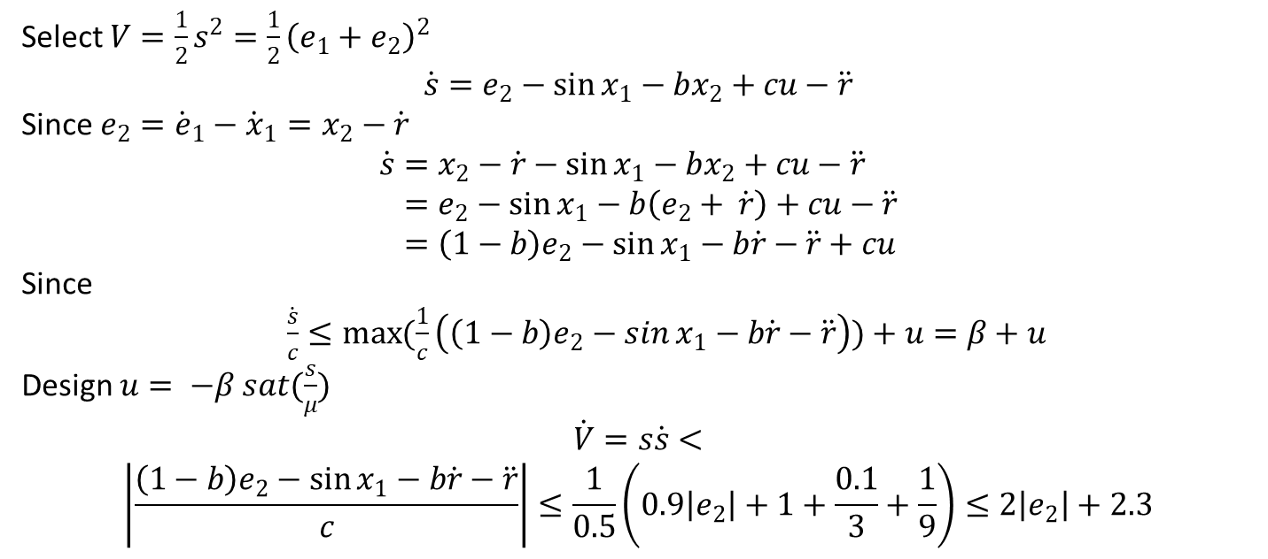
Ex. 13.2 The pendulum
$${\dot{e}}_{1}=e_{2} \\ {\dot{e}}_{2}= −\sin{x_{1}}−bx_{2}+cu−\ddot{r}$$
where, $r\left(t\right)=\sin{(\frac{t}{3})}, 0≤b≤0.1, 0≤c≤2$
Select $V=\frac{1}{2}s^{2}=\frac{1}{2}{\left(e_{1}+e_{2}\right)}^{2}$
$$\dot{s}=e_{2}−\sin{x_{1}}−bx_{2}+cu−\ddot{r}$$
Since $e_{2}={\dot{e}}_{1}−{\dot{x}}_{1}=x_{2}−\dot{r}$
$$\dot{s}=x_{2}−\dot{r}−\sin{x_{1}}−bx_{2}+cu−\ddot{r} \\ =e_{2}−\sin{x_{1}−b\left(e_{2}+ \dot{r}\right)}+cu−\ddot{r} \\ =\left(1−b\right)e_{2}−\sin{x_{1}}−b\dot{r}−\ddot{r}+cu$$
Since
$\frac{\dot{s}}{c}≤\max{(\frac{1}{c}\left(\left(1−b\right)e_{2}−\sin{x_{1}}−b\dot{r}−\ddot{r}\right))}+u=β+u$
Design $u= −β sat(\frac{s}{μ})$
$$\dot{V}=s\dot{s}<$$
$$\left|\frac{\left(1−b\right)e_{2}−\sin{x_{1}}−b\dot{r}−\ddot{r}}{c}\right|≤\frac{1}{0.5}\left(0.9\left|e_{2}\right|+1+\frac{0.1}{3}+\frac{1}{9}\right)≤2\left|e_{2}\right|+2.3$$
Take $u=−\left(2\left|e_{2}\right|+3\right) −→ \dot{V}=s\dot{s}≤−c^{′′}$ $\left|s\right|$

Slide 12
Target tracking / or collision avoidance problem
Target
Missile : only measure the angle between target and missile direction
How to collide? Proportional navigation (PN – guidance )
1. Keep the angle as constant. The angle is dependent of the relative speed and position

