Slide 1
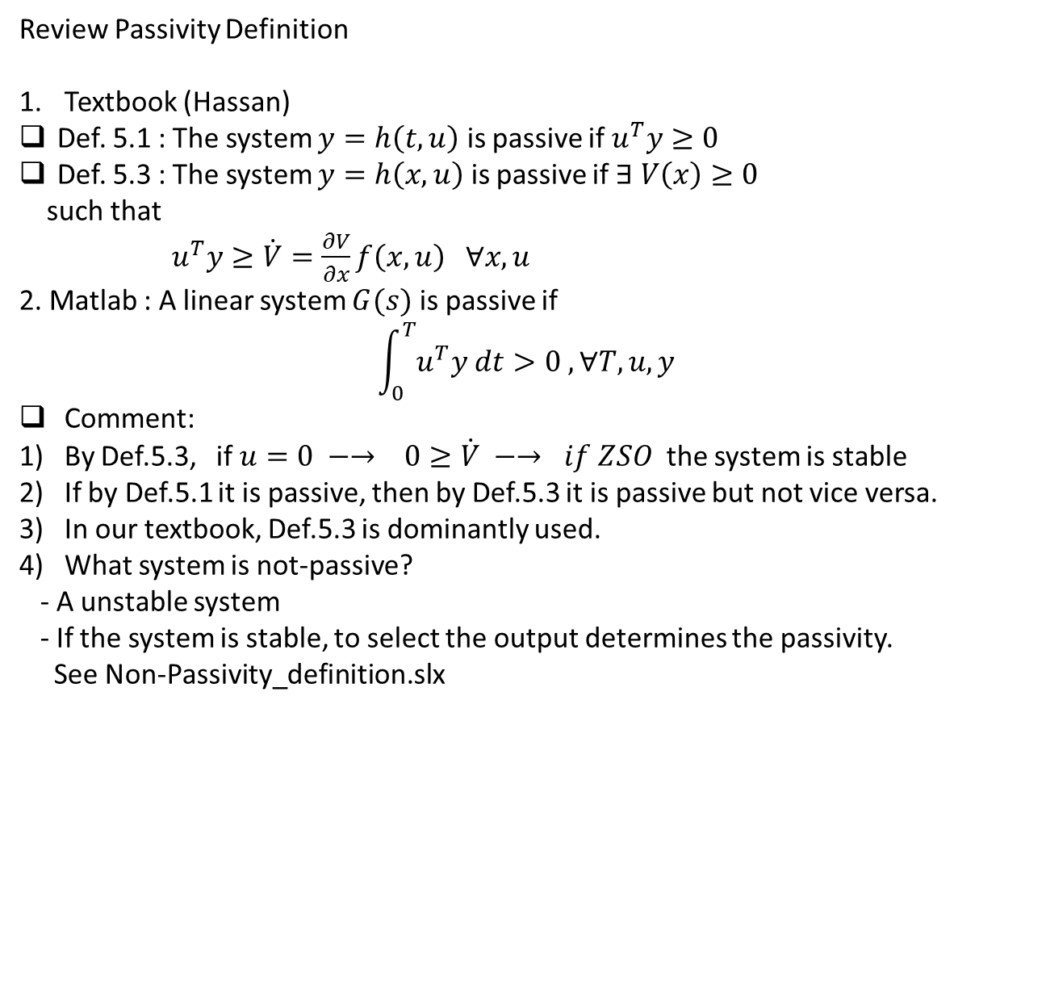
Review Passivity Definition
Textbook (Hassan)
Def. 5.1 : The system $y=h\left(t,u\right)$ is passive if $u^{T}y≥0$
Def. 5.3 : The system $y=h\left(x,u\right)$ is passive if $∃ V\left(x\right)≥0$
such that
$u^{T}y≥\dot{V}=\frac{∂V}{∂x}f\left(x,u\right) ∀x,u$
2. Matlab : A linear system $G(s)$ is passive if
$$\int_{0}^{T}{u^{T}y dt>0 , ∀T, u,y}$$
Comment:
By Def.5.3, if $u=0 −→ 0≥\dot{V} −→ if ZSO$ the system is stable
If by Def.5.1 it is passive, then by Def.5.3 it is passive but not vice versa.
In our textbook, Def.5.3 is dominantly used.
What system is not-passive?
- A unstable system
- If the system is stable, to select the output determines the passivity.
See Non-Passivity_definition.slx

Slide 2
HW_5.1
- Feedback Stabilization / Passivity based Control
- The original plant should not be changed !!
The controller you designed is added to the original plant.
HW_5.2 : Back Stepping
- To stabilize a system, there are several ways to do it. In yours (except one person), you designed the controller by the BackStepping !!

Slide 3
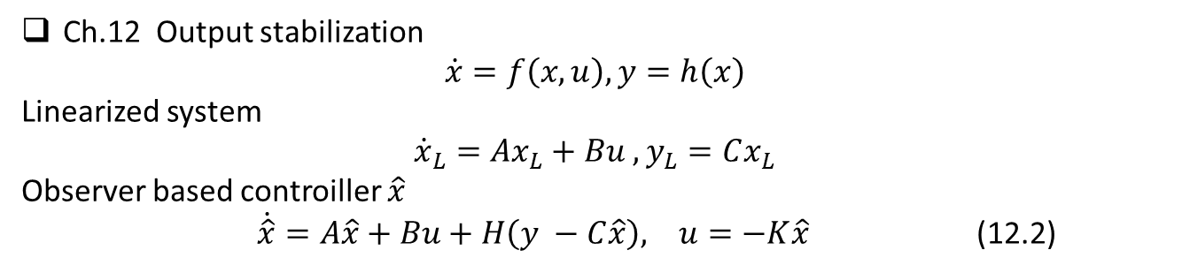
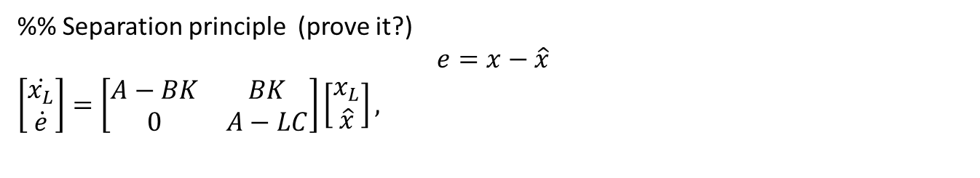
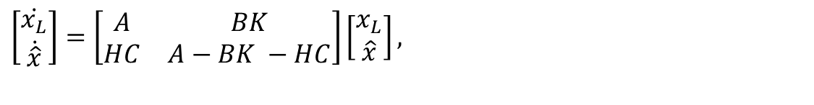
Ch.12 Output stabilization
$$\dot{x}=f\left(x,u\right), y=h\left(x\right)$$
Linearized system
$${\dot{x}}_{L}=Ax_{L}+Bu , y_{L}=Cx_{L}$$
Observer based controiller $\hat{x}$
$\dot{\hat{x}}=A\hat{x}+Bu+H\left(y −C\hat{x}\right), u=−K\hat{x}$ (12.2)
The closed loop of linearized system
$\left[\begin{matrix}\dot{x_{L}} \\ \dot{\hat{x}}\end{matrix}\right]=\left[\begin{matrix}A & BK \\ HC & A−BK −HC\end{matrix}\right]\left[\begin{matrix}x_{L} \\ \hat{x}\end{matrix}\right],$
%% Separation principle (prove it?)
$$e=x−\hat{x}$$
$\left[\begin{matrix}\dot{x_{L}} \\ \dot{e}\end{matrix}\right]=\left[\begin{matrix}A−BK & BK \\ 0 & A−LC\end{matrix}\right]\left[\begin{matrix}x_{L} \\ \hat{x}\end{matrix}\right],$

Slide 4

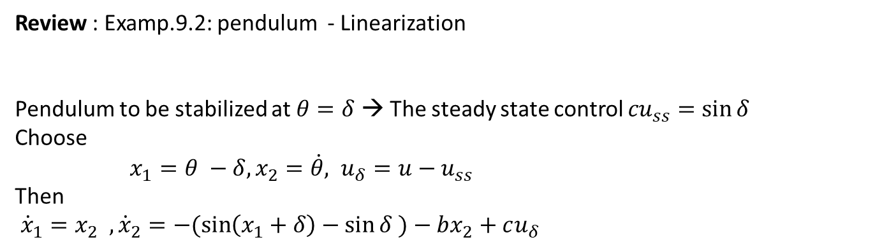
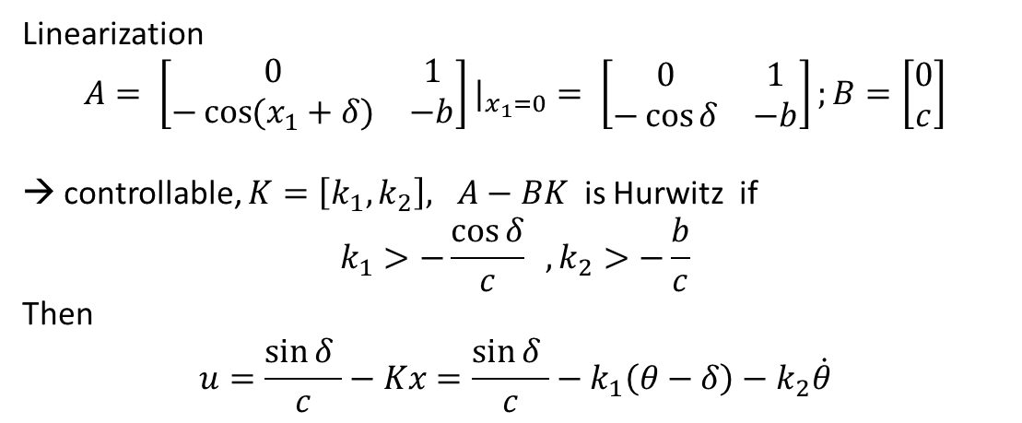
Review : Examp.9.2: pendulum - Linearization
Pendulum to be stabilized at $θ=δ$ → The steady state control ${cu}_{ss}=\sin{δ}$
Choose
$x_{1}=θ −δ, x_{2}=\dot{θ}, u_{δ}=u−u_{ss}$
Then
${\dot{x}}_{1}=x_{2} , {\dot{x}}_{2}=−(\sin\left(x_{1}+δ\right)−\sin{δ )}−bx_{2}+cu_{δ}$
$$\ddot{θ}+\sin{θ+b\dot{θ}=cu }$$
Linearization
$$A= \left[\begin{matrix}0 & 1 \\ −\cos{(x_{1}+δ)} & −b\end{matrix}\right]|_{x_{1}=0}= \left[\begin{matrix}0 & 1 \\ −\cos{δ} & −b\end{matrix}\right];B=\left[\begin{matrix}0 \\ c\end{matrix}\right]$$
→ controllable, $K=\left[k_{1}, k_{2}\right], A−BK$ is Hurwitz if
$$k_{1}>−\frac{\cos{δ}}{c} , k_{2}>−\frac{b}{c}$$
Then
$$u=\frac{\sin{δ }}{c}−Kx=\frac{\sin{δ }}{c}−k_{1}\left(θ−δ\right)−k_{2}\dot{θ}$$

Slide 5
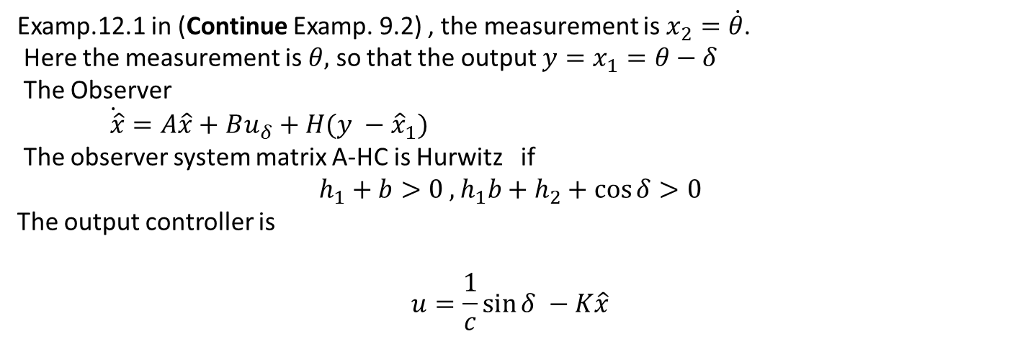
Examp.12.1 in (Continue Examp. 9.2) , the measurement is $x_{2}=\dot{θ}$.
Here the measurement is $θ,$ so that the output $y=x_{1}=θ−δ$
The Observer
$\dot{ \hat{x}}=A\hat{x}+Bu_{δ}+H(y −{\hat{x}}_{1})$
The observer system matrix A-HC is Hurwitz if
$$h_{1}+b>0 , h_{1}b+h_{2}+\cos{δ>0}$$
The output controller is
$$u=\frac{1}{c}\sin{δ −K\hat{x}}$$

Slide 6
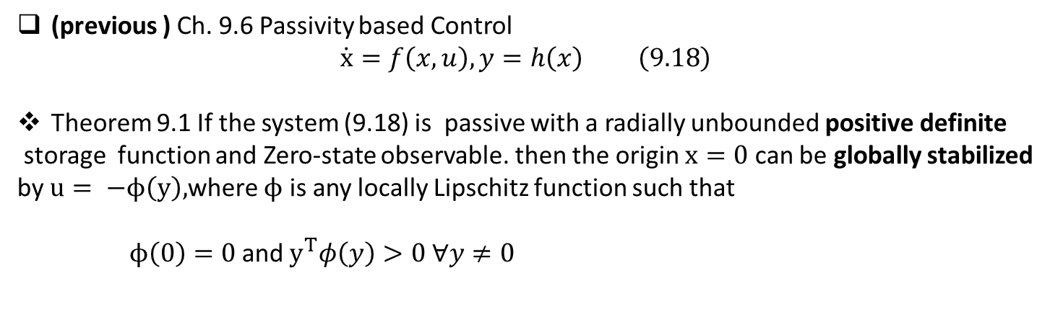
(previous ) Ch. 9.6 Passivity based Control
$$\dot{x}=f\left(x,u\right), y=h\left(x\right) \left(9.18\right)$$
Theorem 9.1 If the system (9.18) is passive with a radially unbounded positive definite
storage function and Zero-state observable. then the origin $x=0$ can be globally stabilized by $u= −ϕ\left(y\right),$where $ϕ$ is any locally Lipschitz function such that
$ϕ\left(0\right)=0$ and $y^{T}φ\left(y\right)>0 ∀y≠0$
Proof: By definition
$u^{T}y≥\dot{V}\left(x, −φ\left(x\right)\right)$→ $−φ\left(y\right)y≥\dot{V}\left(x, −φ\left(x\right)\right)$ →$−\dot{V}\left(x, −φ\left(x\right)\right) ≤$ $φ\left(y\right)y$
→ By the Zero-state observable , globally asymp. stable
The output feedback controller to stabilize if the plant is passive.
The flexibility to select the controller.

Slide 7
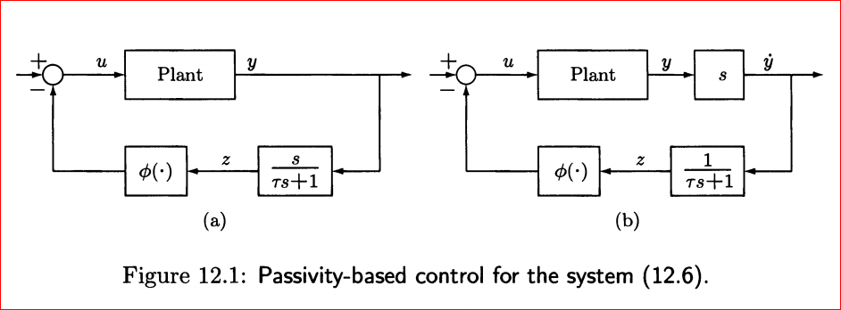
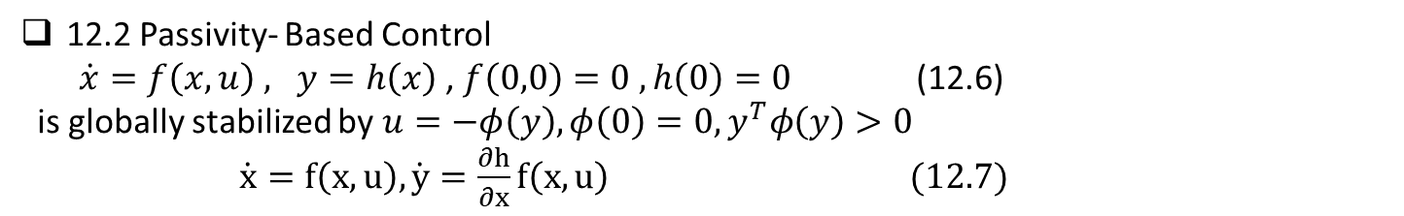
12.2 Passivity- Based Control
$\dot{x}=f\left(x,u\right) , y=h\left(x\right)$ , $f\left(0,0\right)=0 , h\left(0\right)=0$ (12.6)
is globally stabilized by $u=−φ\left(y\right), φ\left(0\right)=0, y^{T}φ\left(y\right)>0$
$\dot{x}=f\left(x,u\right), \dot{y}=\frac{∂h}{∂x}f\left(x,u\right) (12.7)$
Design a controller with output derivative

Slide 8
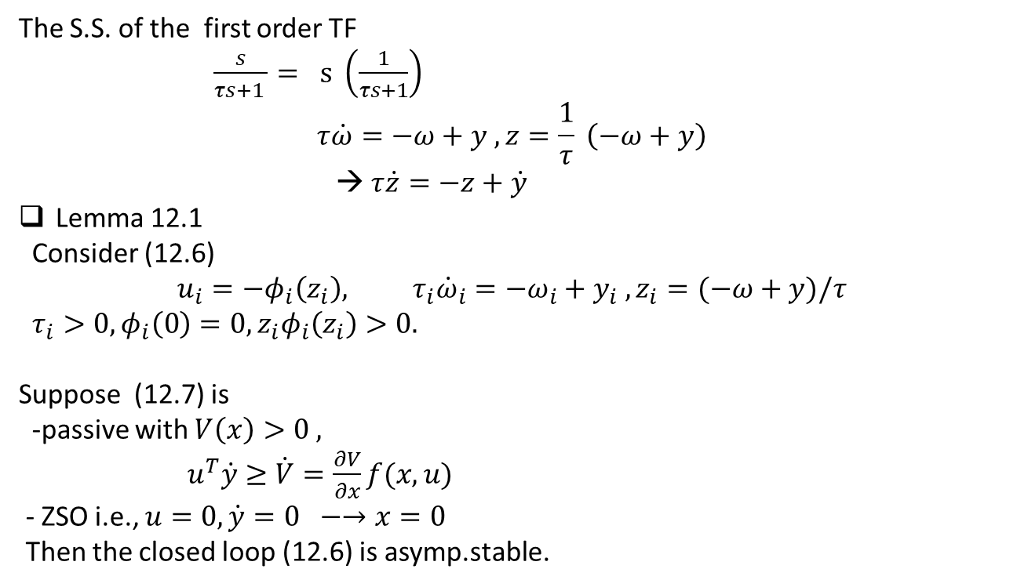
The S.S. of the first order TF
$\frac{s}{τs+1 }= s \left(\frac{1}{τs+1}\right)$
$$τ\dot{ω}=−ω+y , z=\frac{1}{τ} \left(−ω+y\right)$$
→ $τ\dot{z}=−z+\dot{y}$
Lemma 12.1
Consider (12.6)
$$u_{i}=−φ_{i}\left(z_{i}\right), τ_{i}{\dot{ω}}_{i}=−ω_{i}+y_{i} , z_{i}=(−ω+y)/τ$$
$τ_{i}>0, φ_{i}\left(0\right)=0, z_{i}φ_{i}\left(z_{i}\right)>0.$
Suppose (12.7) is
-passive with $V\left(x\right)>0 ,$
$u^{T}\dot{y}≥\dot{V}=\frac{∂V}{∂x}f(x,u)$
- ZSO i.e., $u=0, \dot{y}=0 −→x=0$
Then the closed loop (12.6) is asymp.stable.

Slide 9
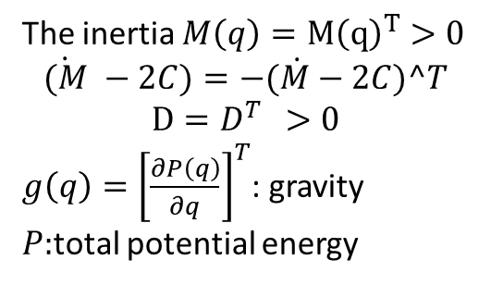
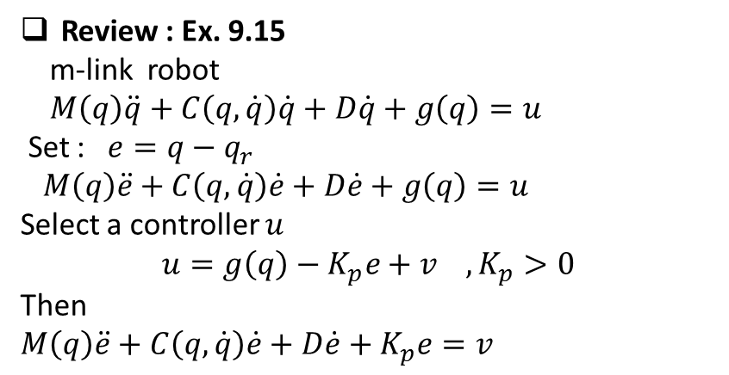
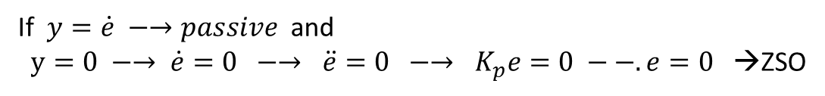

Review : Ex. 9.15
m-link robot
$M\left(q\right)\ddot{q}+C\left(q, \dot{q}\right)\dot{q}+D\dot{q}+g\left(q\right)=u$
Set : $e=q−q_{r}$
$M\left(q\right)\ddot{e}+C\left(q, \dot{q}\right)\dot{e}+D\dot{e}+g\left(q\right)=u$
Select a controller $u$
$$u=g\left(q\right)−K_{p}e+v , K_{p}>0$$
Then
$M\left(q\right)\ddot{e}+C\left(q, \dot{q}\right)\dot{e}+D\dot{e}+K_{p}e=v$
The inertia $M\left(q\right)=M{\left(q\right)}^{T}>0$
$$\dot{(M} −2C)=−(\dot{M}−2C)^T$$
$$D=D^{T } >0$$
$g\left(q\right)={\left[\frac{∂P\left(q\right)}{∂q}\right]}^{T}$: gravity
$P:$total potential energy
Select a storage $V=\frac{1}{2}{\dot{e}}^{T}M\left(q\right)\dot{e} +\frac{1}{2}e^{T}K_{p}e$
$$\dot{V}=\frac{1}{2}{\dot{e}}^{T}\left(\dot{M}−2C\right)\dot{e}−{\dot{e}}^{T}D\dot{e}−\dot{e}K_{p}e+{\dot{e}}^{T}v+{\dot{e}}^{T}K_{p}\dot{e}≤{\dot{e}}^{T}v$$
If $y=\dot{e} −→passive$ and
$y=0 −→ \dot{e}=0 −→ \ddot{e}=0 −→ K_{p}e=0 −−. e=0$ →ZSO
The closed loop is asym.stable with
$u=g\left(q\right)−K_{p}\left(q−q_{r}\right)+K_{d}\dot{q} −→PD controller with$gravity compensation

Slide 10

skew – symmetric
1) symmetric $A^{T}=A$
2) skew – symmetric
$A^{T}=−A$ex. $A=\left[\begin{matrix}0 & 2 \\ −2 & 0\end{matrix}\right]$
3) $λ\left(A\right)=0 or complex$
$λ\left(A\right)=λ\left(A^{T}\right) −→$ $λ\left(A^{T}\right)=λ\left(−A\right)$ all real eigenvalues are zero
4) $x^{T}Ax=x^{T}A^{T}x =x^{T}\left(−A\right)x$ $∀x$
→ $x^{T}\left(A+A\right)x=0 −→ {2x}^{T}Ax=0 ∀x$

Slide 11

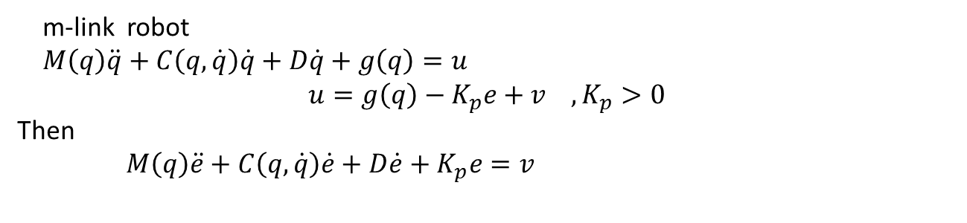
Ex.12.2 : Consider Ex.9.15 to be continue.
m-link robot
$M\left(q\right)\ddot{q}+C\left(q, \dot{q}\right)\dot{q}+D\dot{q}+g\left(q\right)=u$
$$u=g\left(q\right)−K_{p}e+v , K_{p}>0$$
Then
$M\left(q\right)\ddot{e}+C\left(q, \dot{q}\right)\dot{e}+D\dot{e}+K_{p}e=v$
By the Lemma 12.1
$$v=K_{d}z,$$
Where
$τ_{i}{\dot{ω}}_{i}=−ω_{i}+e_{i} , z_{i}=(−ω_{i}+e_{i})/τ_{i}$
In conclusion
$$u=g\left(q\right)−K_{p}\left(q−q_{r}\right)−K_{d}z$$
Previous
$u=g\left(q\right)−K_{p}\left(q−q_{r}\right)+K_{d}\dot{q} −→PD controller with$gravity compensation

Slide 12
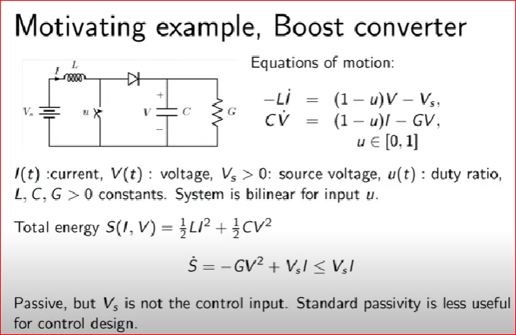
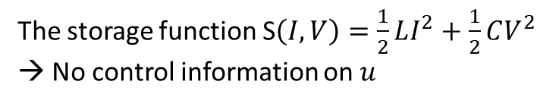
%% Krasovski Passivity
- Ytube: TC 2.3 Non-Linear Control Systems
The storage function S$\left(I,V\right)=\frac{1}{2}LI^{2}+\frac{1}{2}CV^{2}$
→ No control information on $u$

Slide 13
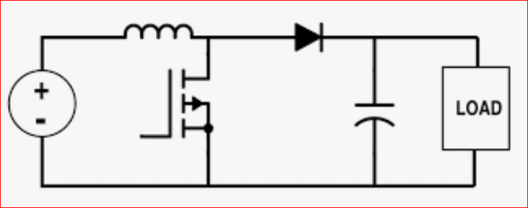
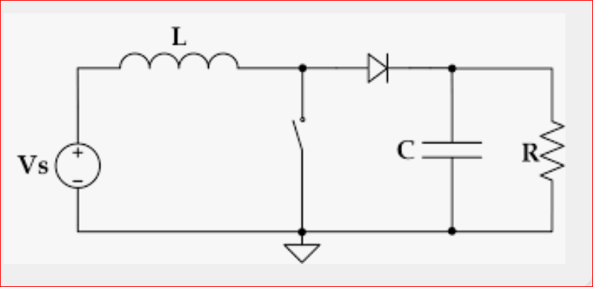
Boost Converter: DC_in – to – DC_out, DC_in <= DC_out
: Controller : switching period (duty ration)
- Diode: also On-Off due to the switch

Slide 14
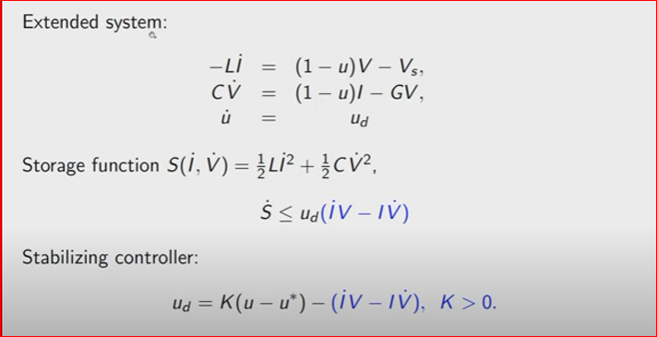
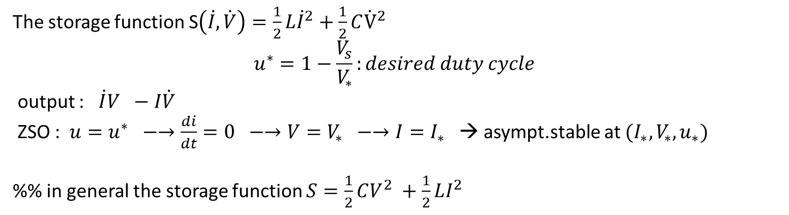
Add a new state
The storage function S$\left(\dot{I}, \dot{V}\right)=\frac{1}{2}L{\dot{I}}^{2}+\frac{1}{2}C{\dot{V}}^{2}$
$$u^{∗}=1−\frac{V_{s}}{V_{∗}}:desired duty cycle$$
output : $\dot{I}V −I\dot{V}$
ZSO : $u=u^{∗} −→\frac{di}{dt}=0 −→V=V_{∗} −→I=I_{∗}$ → asympt.stable at $(I_{∗}, V_{∗},u_{∗})$
%% in general the storage function $S=\frac{1}{2}CV^{2} +\frac{1}{2}LI^{2}$

Slide 15
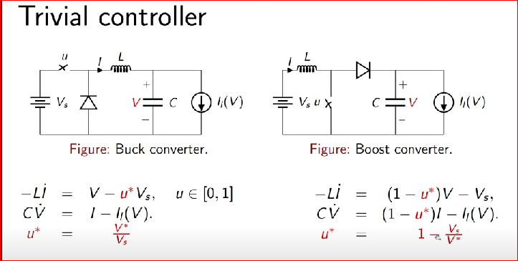

Krasovskii passivity
$$\dot{x}=f\left(x,u\right), \dot{u}=u_{d}$$
Define the storage function
$$S\left(x,u\right)= {\left|f\left(x,u\right)\right|}_{Q}=f^{T}Qf , Q>0$$
Definition: The system $\dot{x} =f\left(x,u\right) is said to be Krasovskii$ passive if $∃ h_{K}\left(x,u\right)$
output of the system such that $\dot{S}\left(x,u\right)≤u_{d}^{T}h_{k}(x,u)$

Slide 16
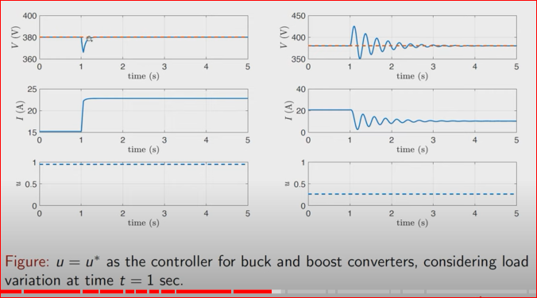
Simulation
Comment:
-The desired S.S. input stabilizes the system
-Undesired transients
-Lone settling time
→ input / output shaping → good results → see the Ytube.

Slide 17

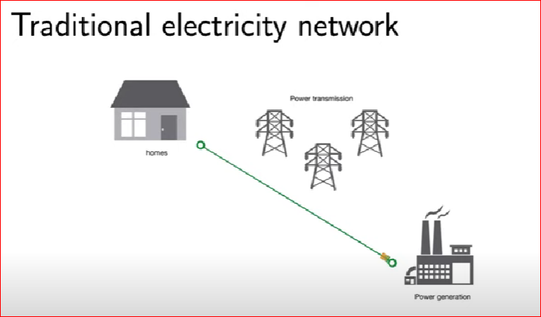

Slide 18
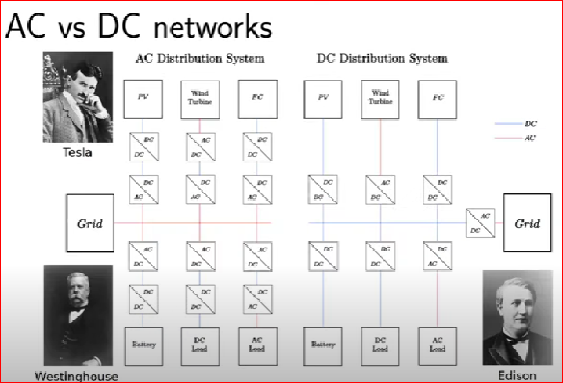

Slide 19
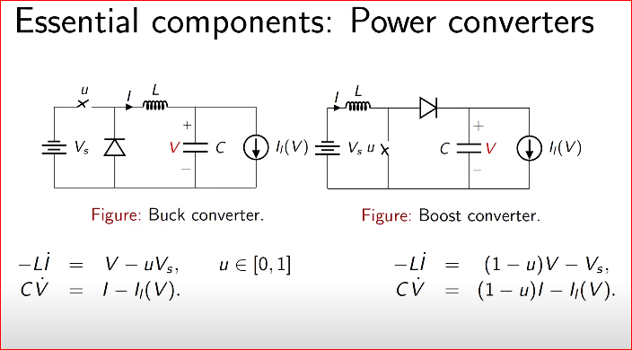

Slide 20
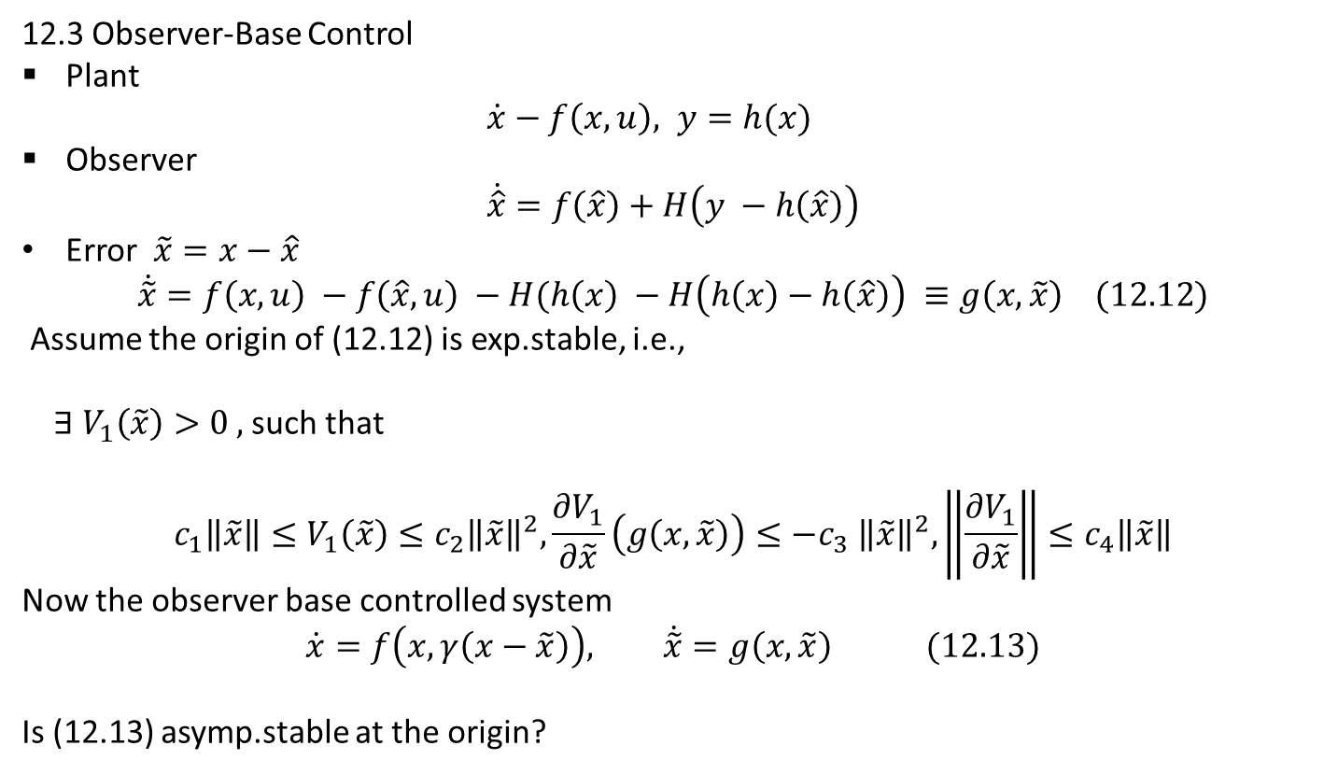
12.3 Observer-Base Control
Plant
$\dot{x}−f\left(x,u\right), y=h(x)$
Observer
$$\dot{\hat{x}}=f\left(\hat{x}\right)+H\left(y −h\left(\hat{x}\right)\right)$$
Error $\tilde{x}=x−\hat{x}$
$$\dot{\tilde{x}}=f\left(x,u\right) −f\left(\hat{x},u\right) −H(h\left(x\right) −H\left(h\left(x\right)−h\left(\hat{x}\right)\right) ≡g\left(x,\tilde{x}\right) (12.12)$$
Assume the origin of (12.12) is exp.stable, i.e.,
$∃ V_{1}\left(\tilde{x}\right)>0 ,$such that
$$c_{1}\left\|\tilde{x}\right\|≤V_{1}\left(\tilde{x}\right)≤c_{2}{\left\|\tilde{x}\right\|}^{2},\frac{∂V_{1}}{∂\tilde{x}}\left(g\left(x,\tilde{x}\right)\right)≤−c_{3} {\left\|\tilde{x}\right\|}^{2}, \left\|\frac{∂V_{1}}{∂\tilde{x}}\right\|≤c_{4}\left\|\tilde{x}\right\|$$
Now the observer base controlled system
$$\dot{x}=f\left(x, γ\left(x−\tilde{x}\right)\right), \dot{\tilde{x}}=g\left(x,\tilde{x}\right) (12.13)$$
Is (12.13) asymp.stable at the origin?

Slide 21
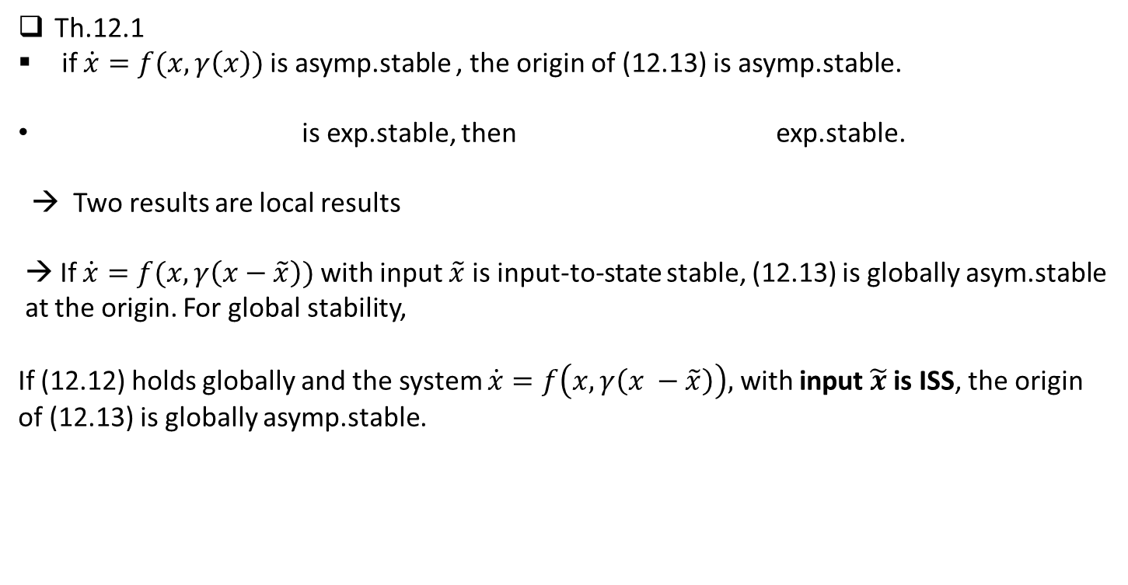
Th.12.1
if $\dot{x}=f(x, γ\left(x\right))$ is asymp.stable , the origin of (12.13) is asymp.stable.
is exp.stable, then exp.stable.
→ Two results are local results
→ If $\dot{x}=f(x, γ\left(x−\tilde{x}\right))$ with input $\tilde{x}$ is input-to-state stable, (12.13) is globally asym.stable
at the origin. For global stability,
If (12.12) holds globally and the system $\dot{x}=f\left(x, γ\left(x −\tilde{x}\right)\right),$ with input $\tilde{x}$ is ISS, the origin
of (12.13) is globally asymp.stable.

Slide 22
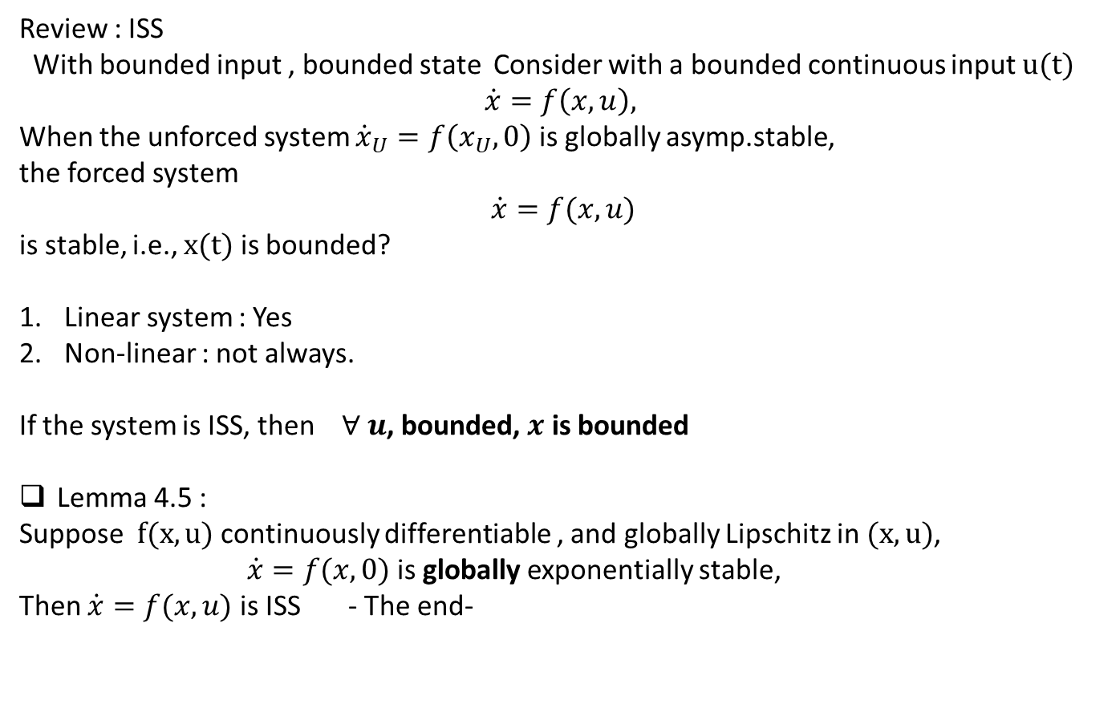
Review : ISS
With bounded input , bounded state Consider with a bounded continuous input $u(t)$
$$\dot{x}=f\left(x,u\right),$$
When the unforced system ${\dot{x}}_{U}=f\left(x_{U}, 0\right)$ is globally asymp.stable,
the forced system
$$\dot{x}=f(x,u)$$
is stable, i.e., $x(t)$ is bounded?
Linear system : Yes
Non-linear : not always.
If the system is ISS, then $∀ u$, bounded, $x$ is bounded
Lemma 4.5 :
Suppose $f(x,u)$ continuously differentiable , and globally Lipschitz in $(x,u)$,
$\dot{x}=f(x,0)$ is globally exponentially stable,
Then $\dot{x}=f(x,u)$ is ISS - The end-

