Slide 1
Mid-Term: May.29 → May 20., Monday (Ch.1 ~ 4: closed book)
Final Class: June.20
Final Exam: Jun.24 Monday.(closed book)

Slide 2
Review The last week
Definition of the stability
- Stable
- Asymp. Stable
- Exponentially Stable
2. Lyapunov function
- Variable gradient method
- Laselle’ theorem
3. Several Regions
- Domain of attraction :
- Invariant set :

Slide 3
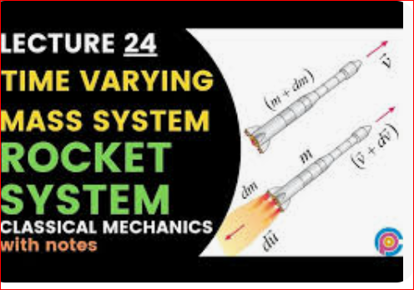
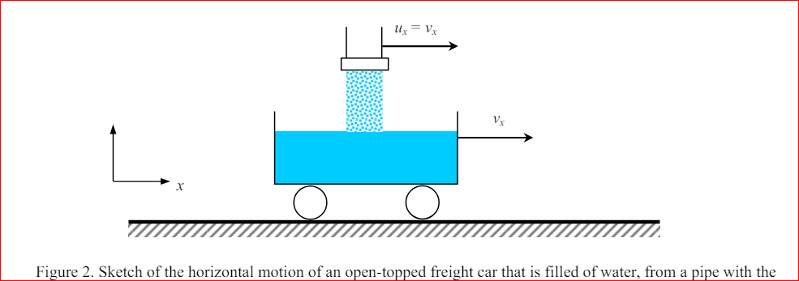
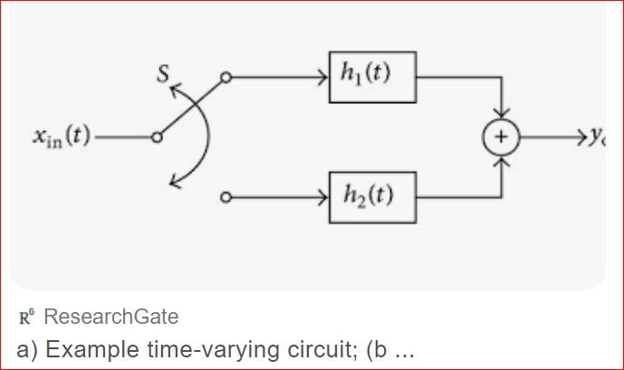
Time-varying system
- time varying mass systems – missiles,
- electrical switching systems : switching power components(Mosfet, IGBT)
- aging systems

Slide 4
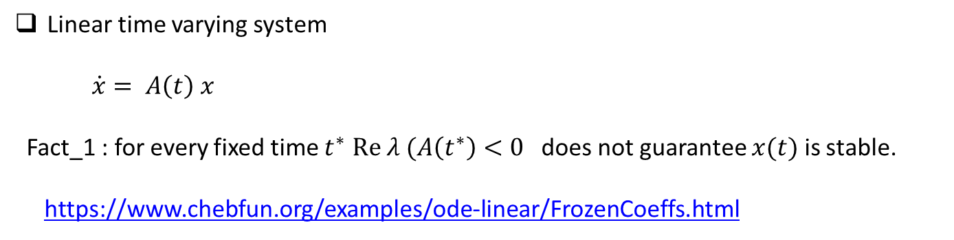
Linear time varying system
$\dot{x}= A\left(t\right) x$
Fact_1 : for every fixed time $t^{∗}$ $Re λ (A\left(t^{∗}\right)<0$ does not guarantee $x(t)$ is stable.
https://www.chebfun.org/examples/ode-linear/FrozenCoeffs.html

Slide 5
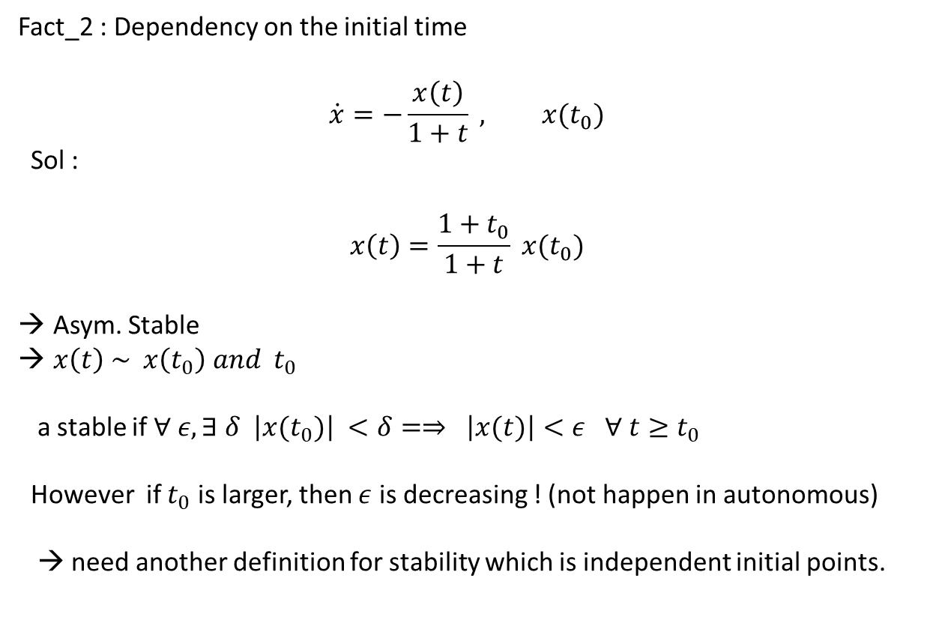
Fact_2 : Dependency on the initial time
$$\dot{x}=−\frac{x\left(t\right)}{1+t} , x(t_{0})$$
Sol :
$$x\left(t\right)=\frac{1+t_{0}}{1+t} x(t_{0})$$
Asym. Stable
$x\left(t\right) \sim x\left(t_{0}\right) and t_{0}$
a stable if $∀ ε, ∃ δ$ $\left|x(t_{0})\right| <δ=⇒ \left|x(t)\right|<ε ∀ t≥t_{0}$
However if $t_{0}$ is larger, then $ε$ is decreasing ! (not happen in autonomous)
→ need another definition for stability which is independent initial points.

Slide 6
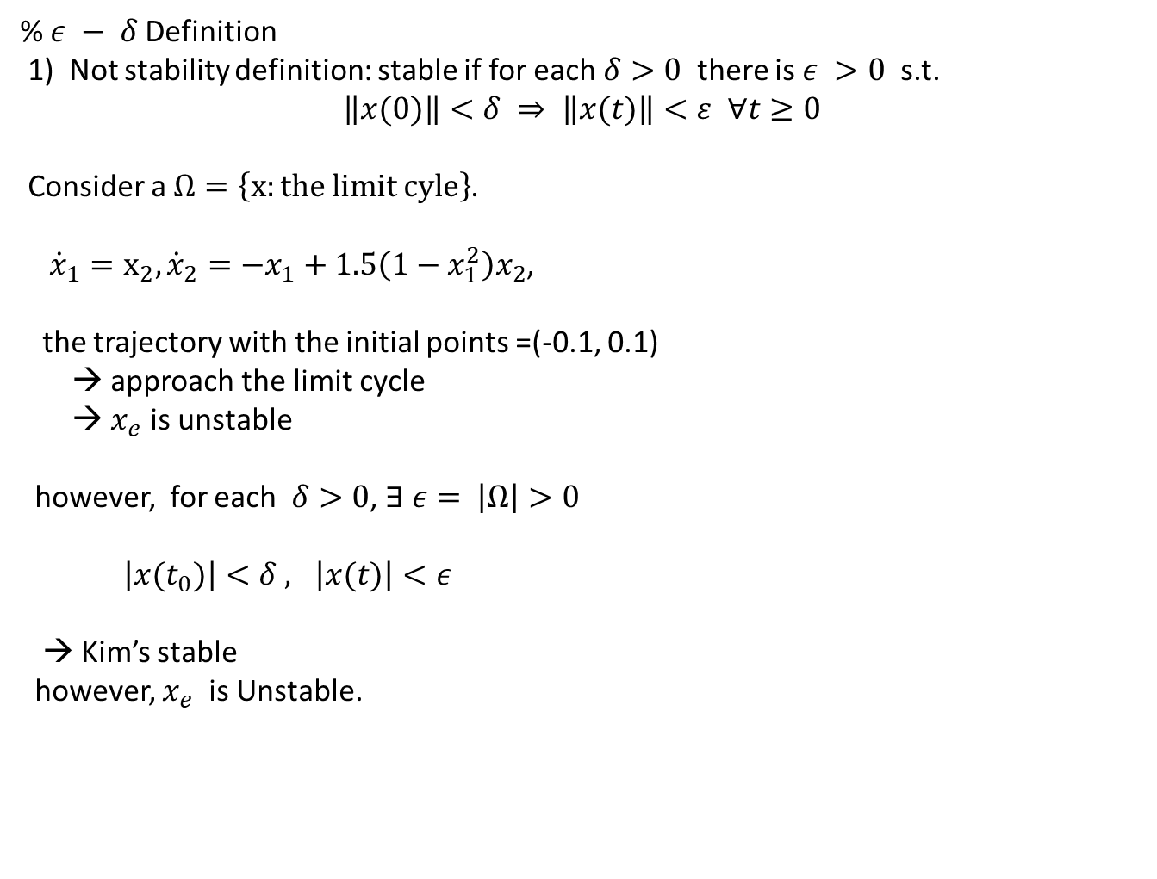
% $ε − δ$Definition
1) Not stability definition: stable if for each $δ>0$ there is $ε >0$ s.t.
$$\left\|x(0)\right\|<δ ⇒ \left\|x(t)\right\|<ε ∀t≥0$$
Consider a $Ω=\left\{x:the limit cyle\right\}$.
${\dot{x}}_{1}=x_{2}, {\dot{x}}_{2}={−x}_{1}+1.5\left(1−x_{1}^{2}\right)x_{2}$,
the trajectory with the initial points =(-0.1, 0.1)
→ approach the limit cycle
→ $x_{e}$ is unstable
however, for each $δ>0$, $∃ ε= \left|Ω\right|>0$
$\left|x(t_{0})\right|<δ , \left|x(t)\right|<ε$
→ Kim’s stable
however, $x_{e}$ is Unstable.

Slide 7
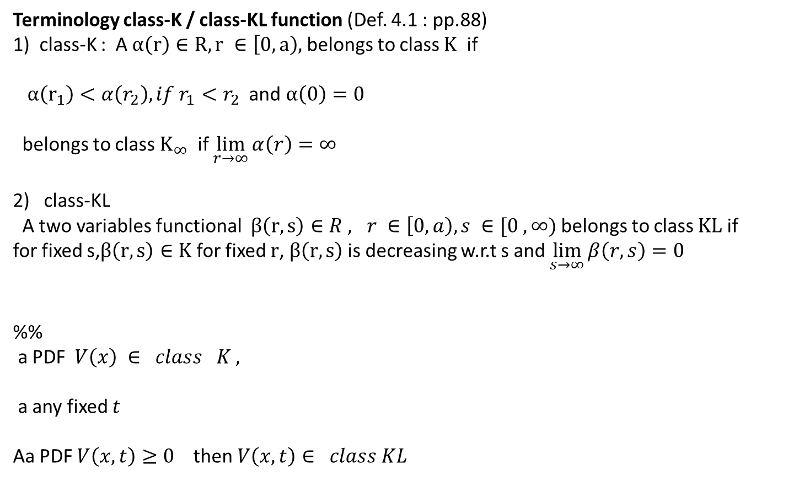
Terminology class-K / class-KL function (Def. 4.1 : pp.88)
1) class-K : A $α\left(r\right)∈R, r ∈\left[0, a\right),$ belongs to class $Κ$ if
$α\left(r_{1}\right)<α\left(r_{2}\right), if r_{1}<r_{2}$ and $α\left(0\right)=0$
belongs to class $Κ_{∞}$ if $\lim_{r→∞}{α\left(r\right)}=∞$
class-KL
A two variables functional $β\left(r,s\right)∈R , r ∈\left[0, a\right), s ∈[0 , ∞)$ belongs to class $ΚL$ if
for fixed s,$β\left(r,s\right)∈Κ$ for fixed $r$, $β\left(r,s\right)$is decreasing w.r.t s and $\lim_{s→∞}{β\left(r,s\right)=0}$
%%
a PDF $V\left(x\right) ∈ class K ,$
a any fixed $t$
Aa PDF $V\left(x,t\right)≥0$ then $V\left(x,t\right)∈ class KL$

Slide 8
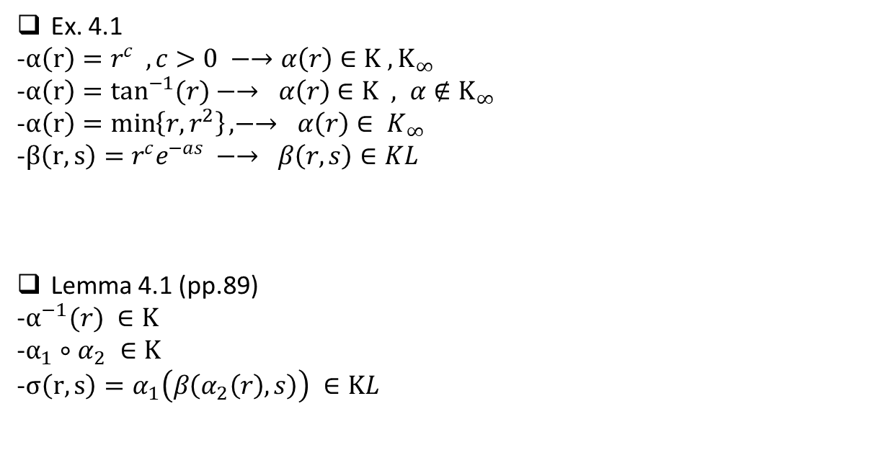
Ex. 4.1
-$α\left(r\right)=r^{c} , c>0 −→α\left(r\right)∈Κ , Κ_{∞}$
-$α\left(r\right)=\tan^{−1}{(r)}−→ α\left(r\right)∈Κ , α∉Κ_{∞}$
-$α\left(r\right)=\min\left\{r, r^{2}\right\}, −→ α\left(r\right)∈ K_{∞}$
-$β\left(r,s\right)=r^{c}e^{−as} −→ β\left(r,s\right)∈KL$
Lemma 4.1 (pp.89)
-$α^{−1}(r) ∈Κ$
-$α_{1}∘α_{2} ∈Κ$
-$σ\left(r,s\right)=α_{1}\left(β\left(α_{2}\left(r\right), s\right)\right) ∈ΚL$

Slide 9
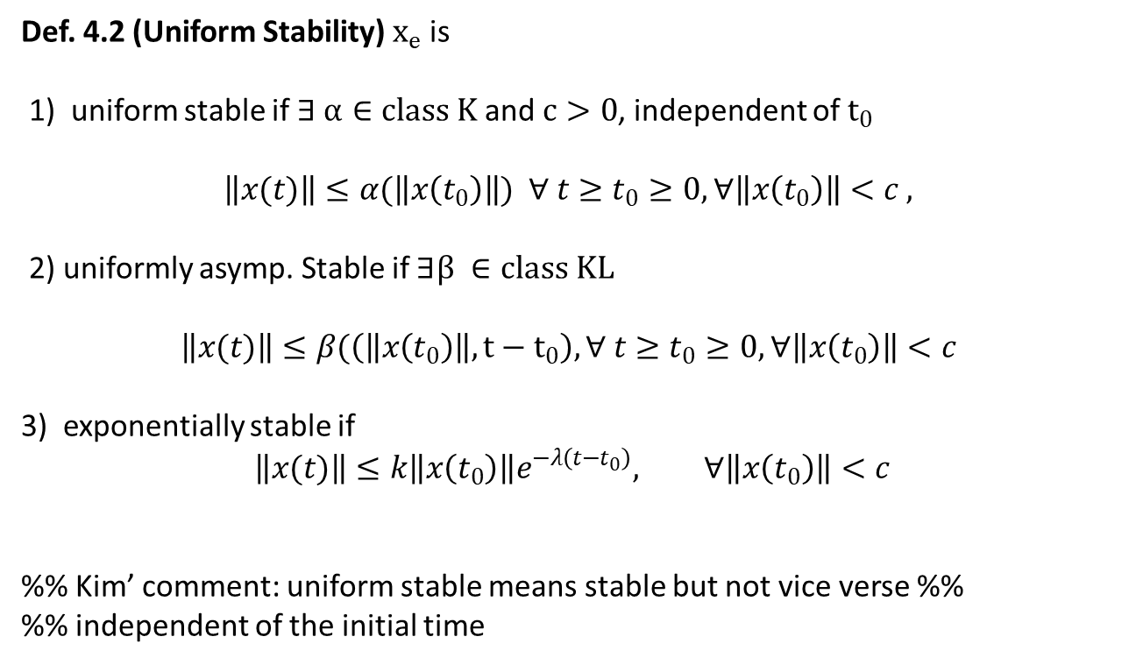
Def. 4.2 (Uniform Stability) $x_{e}$ is
1) uniform stable if $∃ α∈class Κ$ and $c>0$, independent of $t_{0}$
$$\left\|x(t)\right\|≤α(\left\|x\left(t_{0}\right)\right\|) ∀ t≥t_{0}≥0, ∀\left\|x\left(t_{0}\right)\right\|<c ,$$
2) uniformly asymp. Stable if $∃β ∈class ΚL$
$$\left\|x(t)\right\|≤β(\left(\left\|x\left(t_{0}\right)\right\|,t−t_{0}\right), ∀ t≥t_{0}≥0, ∀\left\|x\left(t_{0}\right)\right\|<c$$
3) exponentially stable if
$$\left\|x(t)\right\|≤k\left\|x\left(t_{0}\right)\right\|e^{−λ\left(t−t_{0}\right)}, ∀\left\|x\left(t_{0}\right)\right\|<c$$
%% Kim’ comment: uniform stable means stable but not vice verse %%
%% independent of the initial time

Slide 10
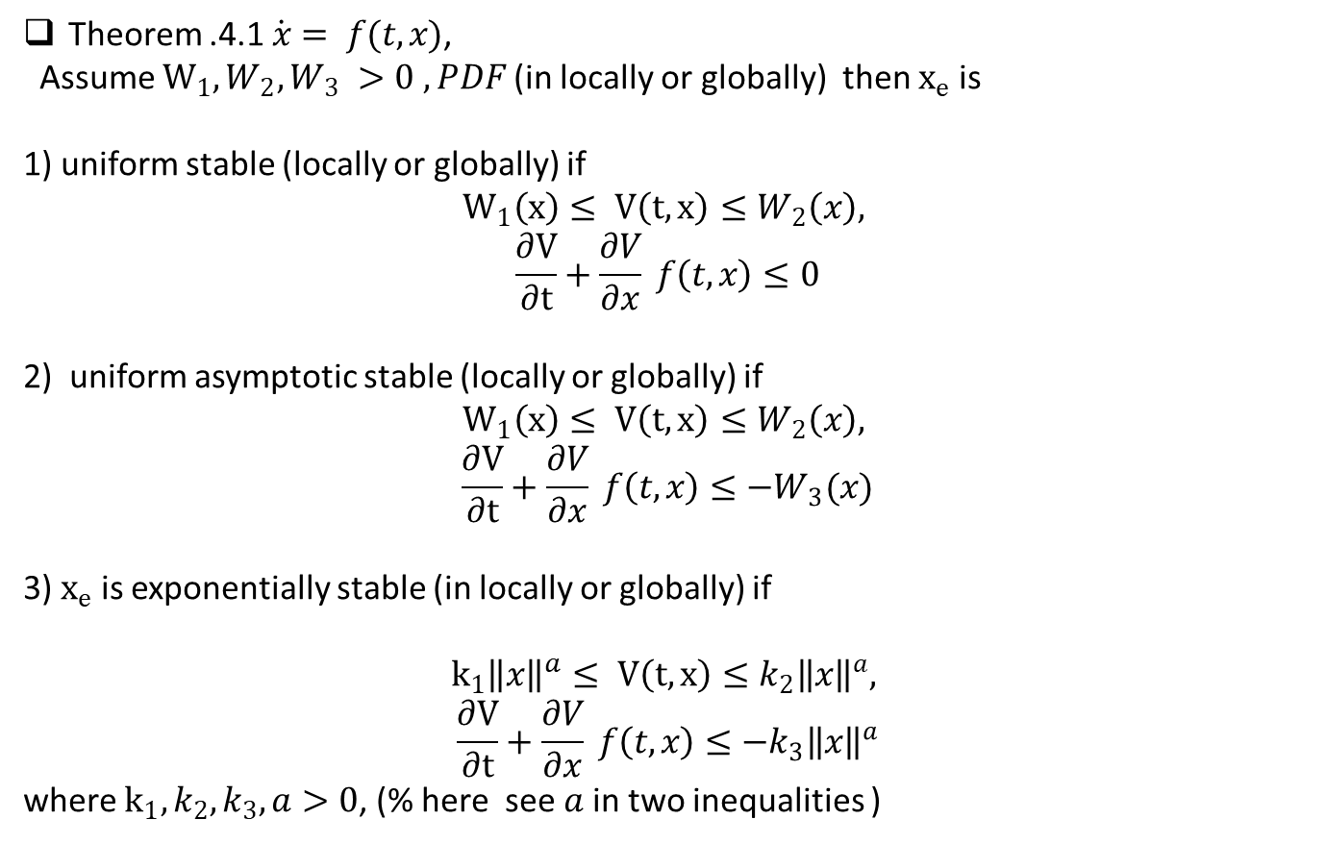
Theorem .4.1 $\dot{x}= f(t,x)$,
Assume $W_{1}, W_{2}, W_{3} >0 , PDF$(in locally or globally) then $x_{e}$ is
1) uniform stable (locally or globally) if
$$W_{1}\left(x\right)≤ V\left(t,x\right)≤W_{2}\left(x\right),$$
$$\frac{∂V}{∂t}+\frac{∂V}{∂x} f\left(t,x\right)≤0$$
2) uniform asymptotic stable (locally or globally) if
$$W_{1}\left(x\right)≤ V\left(t,x\right)≤W_{2}\left(x\right),$$
$$\frac{∂V}{∂t}+\frac{∂V}{∂x} f\left(t,x\right)≤−W_{3}(x)$$
3) $x_{e}$ is exponentially stable (in locally or globally) if
$$k_{1}{\left\|x\right\|}^{a}≤ V\left(t,x\right)≤k_{2}{\left\|x\right\|}^{a},$$
$$\frac{∂V}{∂t}+\frac{∂V}{∂x} f\left(t,x\right)≤−k_{3}{\left\|x\right\|}^{a}$$
where $k_{1}, k_{2}, k_{3}, a>0$, (% here see $a$in two inequalities )

Slide 11
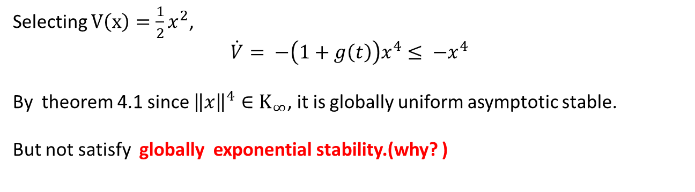
Ex. 4.2 (scalar)
$$\dot{x}= −\left(1+g\left(t\right)\right)x^{3} , g\left(t\right)≥0$$
Selecting $V\left(x\right)=\frac{1}{2}x^{2}$,
$$\dot{V}= −\left(1+g\left(t\right)\right)x^{4}≤ −x^{4}$$
By theorem 4.1 since ${\left\|x\right\|}^{4}∈Κ_{∞}$, it is globally uniform asymptotic stable.
But not satisfy globally exponential stability.(why? )

Slide 12
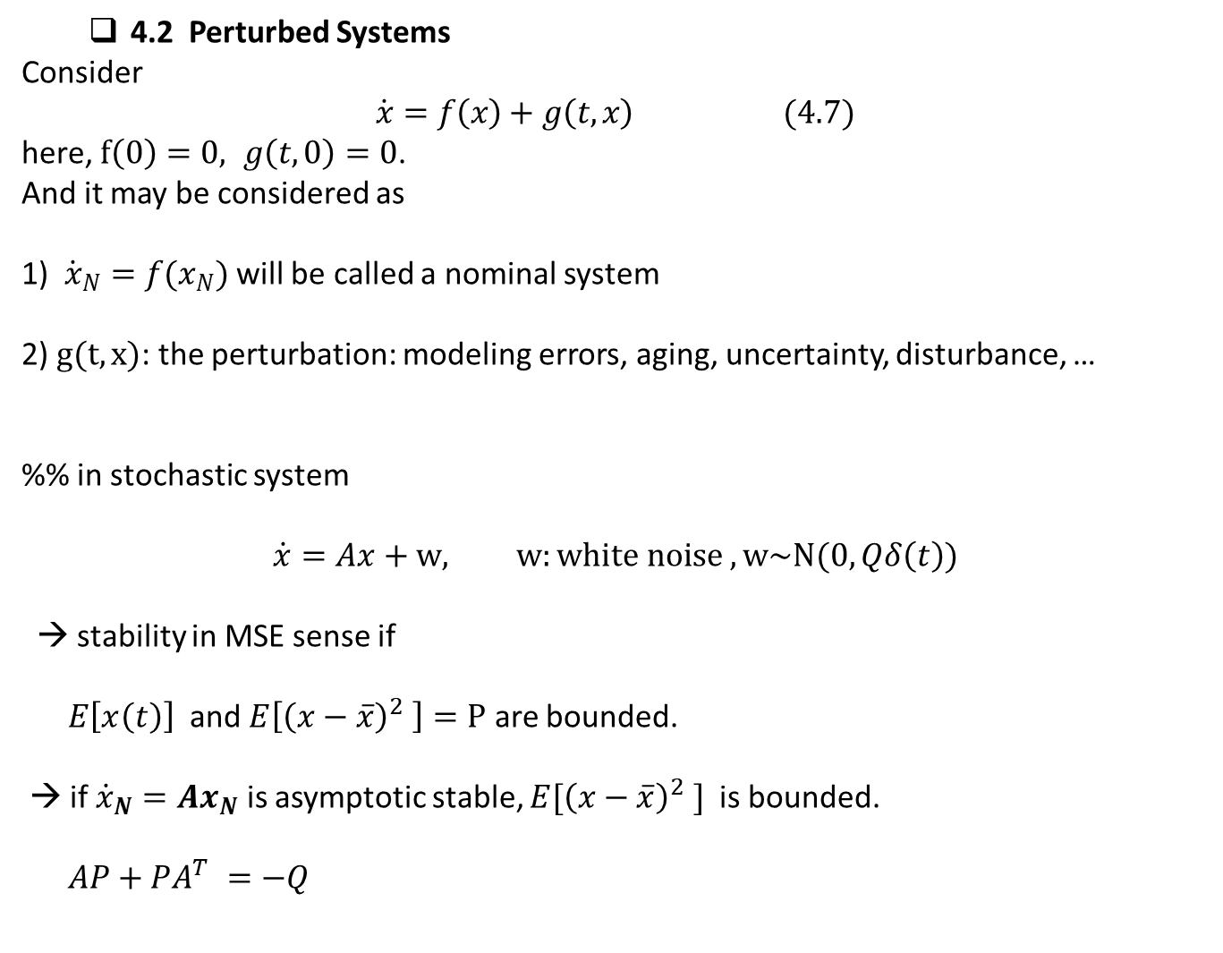
4.2 Perturbed Systems
Consider
$$\dot{x}=f\left(x\right)+g\left(t,x\right) (4.7)$$
here, $f\left(0\right)=0, g\left(t,0\right)=0$.
And it may be considered as
1) ${\dot{x}}_{N}=f(x_{N})$ will be called a nominal system
2) $g(t,x)$: the perturbation: modeling errors, aging, uncertainty, disturbance, …
%% in stochastic system
$$\dot{x}=Ax+w, w:white noise , w\sim N(0, Qδ\left(t\right))$$
→ stability in MSE sense if
$E\left[x\left(t\right)\right]$ and $E\left[{\left(x−\overline{x}\right)}^{2} \right]=P$ are bounded.
→ if ${\dot{x}}_{N}=Ax_{N}$ is asymptotic stable, $E[{\left(x−\overline{x}\right)}^{2} ]$ is bounded.
$AP+PA^{T} =−Q$

Slide 13
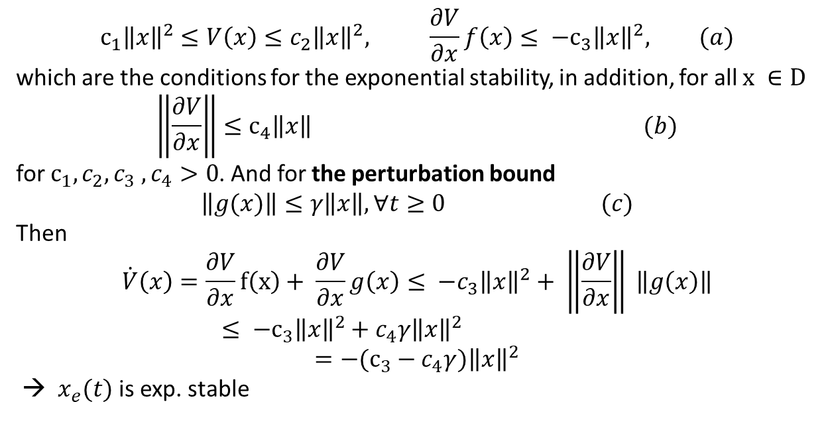
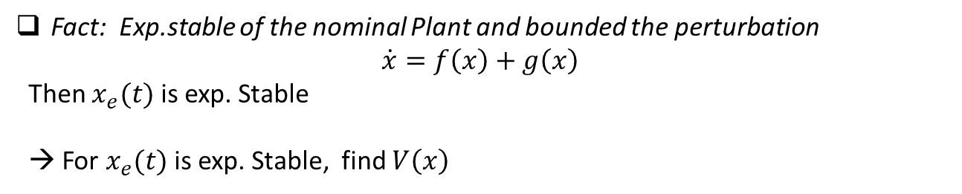
Fact: Exp.stable of the nominal Plant and bounded the perturbation
$$\dot{x}=f\left(x\right)+g\left(x\right)$$
Then $x_{e}(t)$ is exp. Stable
→ For $x_{e}(t)$ is exp. Stable, find $V\left(x\right)$
$$c_{1}{\left\|x\right\|}^{2}≤V\left(x\right)≤c_{2}{\left\|x\right\|}^{2}, \frac{∂V}{∂x}f\left(x\right)≤ −c_{3}{\left\|x\right\|}^{2}, (a)$$
which are the conditions for the exponential stability, in addition, for all $x ∈D$
$$\left\|\frac{∂V}{∂x}\right\|≤c_{4}\left\|x\right\| (b)$$
for $c_{1}, c_{2}, c_{3} , c_{4}>0$. And for the perturbation bound
$$\left\|g(x)\right\|≤γ\left\|x\right\|, ∀t≥0 (c)$$
Then
$$\dot{V}\left(x\right)=\frac{∂V}{∂x}f\left(x\right)+ \frac{∂V}{∂x}g\left(x\right)≤ −c_{3}{\left\|x\right\|}^{2}+ \left\|\frac{∂V}{∂x}\right\| \left\|g\left(x\right)\right\|≤ −c_{3}{\left\|x\right\|}^{2}+c_{4}γ{\left\|x\right\|}^{2}$$
$$=−(c_{3}−c_{4}γ){\left\|x\right\|}^{2}$$
→ $x_{e}(t)$ is exp. stable

Slide 14
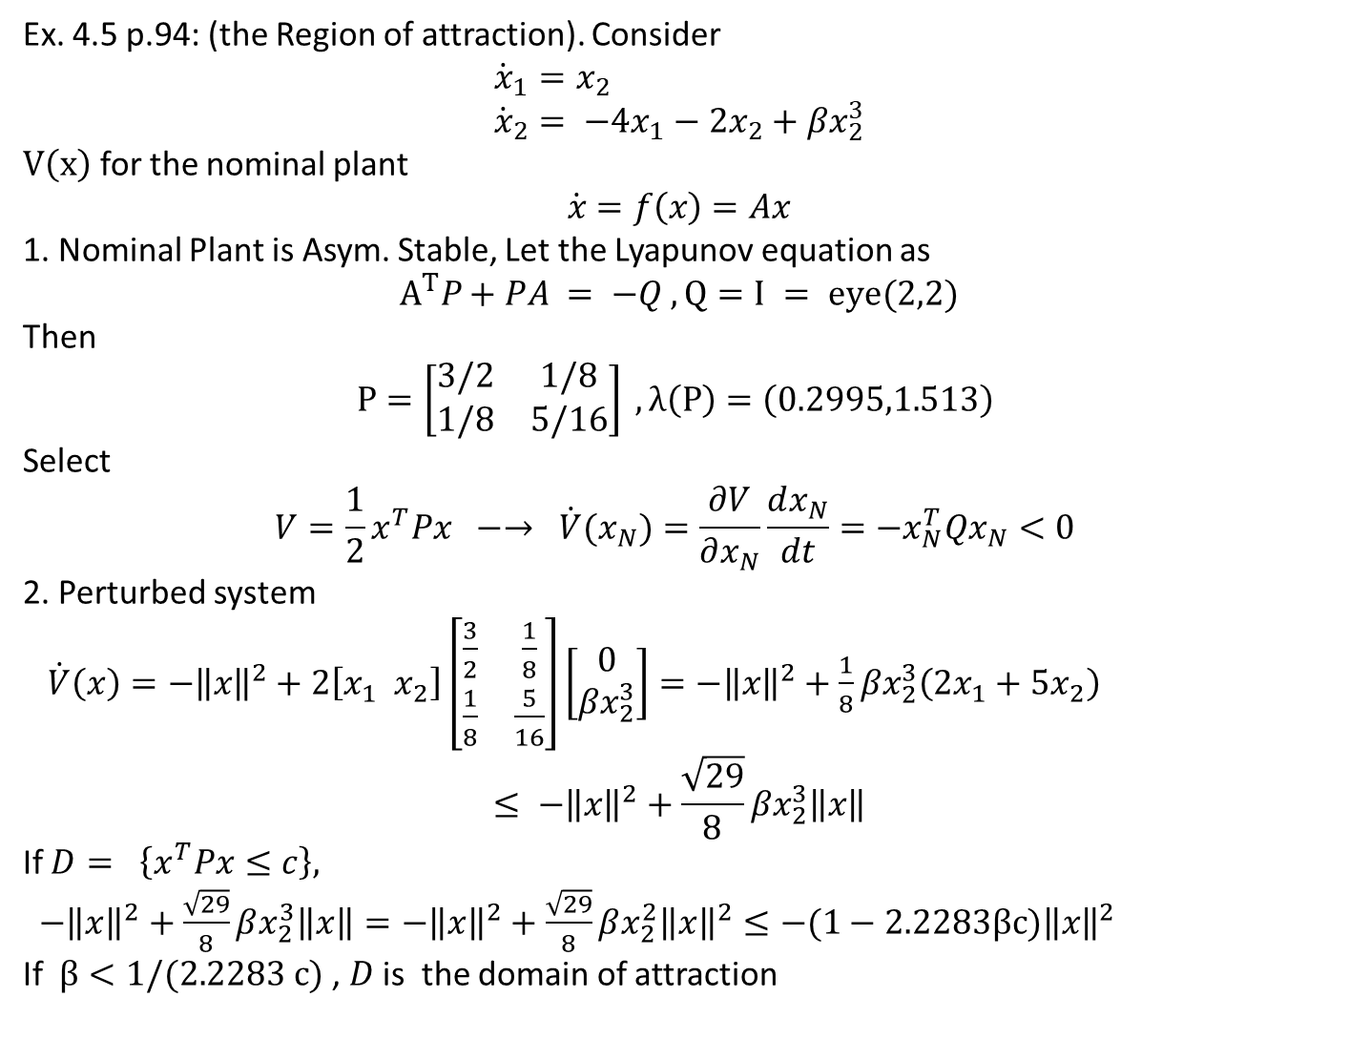
Ex. 4.5 p.94: (the Region of attraction). Consider
$${\dot{x}}_{1}=x_{2} \\ {\dot{x}}_{2}= −4x_{1}−2x_{2}+βx_{2}^{3}$$
$V\left(x\right)$ for the nominal plant
$$\dot{x}=f\left(x\right)=Ax$$
1. Nominal Plant is Asym. Stable, Let the Lyapunov equation as
$$A^{T}P+PA = −Q , Q=I = eye(2,2)$$
Then
$$P=\left[\begin{matrix}3/2 & 1/8 \\ 1/8 & 5/16\end{matrix}\right] , λ\left(P\right)=\left(0.2995,1.513\right)$$
Select
$$V=\frac{1}{2}x^{T}Px −→ \dot{V}(x_{N})=\frac{∂V}{∂x_{N}}\frac{dx_{N}}{dt}=−x_{N}^{T}Qx_{N}<0$$
2. Perturbed system
$\dot{V}\left(x\right)=−{\left\|x\right\|}^{2}+2\left[x_{1} x_{2}\right]\left[\begin{matrix}\frac{3}{2} & \frac{1}{8} \\ \frac{1}{8} & \frac{5}{16}\end{matrix}\right]\left[\begin{matrix}0 \\ βx_{2}^{3}\end{matrix}\right]=−{\left\|x\right\|}^{2}+\frac{1}{8}βx_{2}^{3}\left(2x_{1}+5x_{2}\right)$
$$≤ −{\left\|x\right\|}^{2}+\frac{\sqrt{29}}{8}βx_{2}^{3}\left\|x\right\|$$
If $D= \left\{x^{T}Px≤c\right\},$
$−{\left\|x\right\|}^{2}+\frac{\sqrt{29}}{8}βx_{2}^{3}\left\|x\right\|=−{\left\|x\right\|}^{2}+\frac{\sqrt{29}}{8}βx_{2}^{2}{\left\|x\right\|}^{2}≤−(1−2.2283βc{)\left\|x\right\|}^{2}$
If $β<1/(2.2283 c)$ , $D$ is the domain of attraction

Slide 15
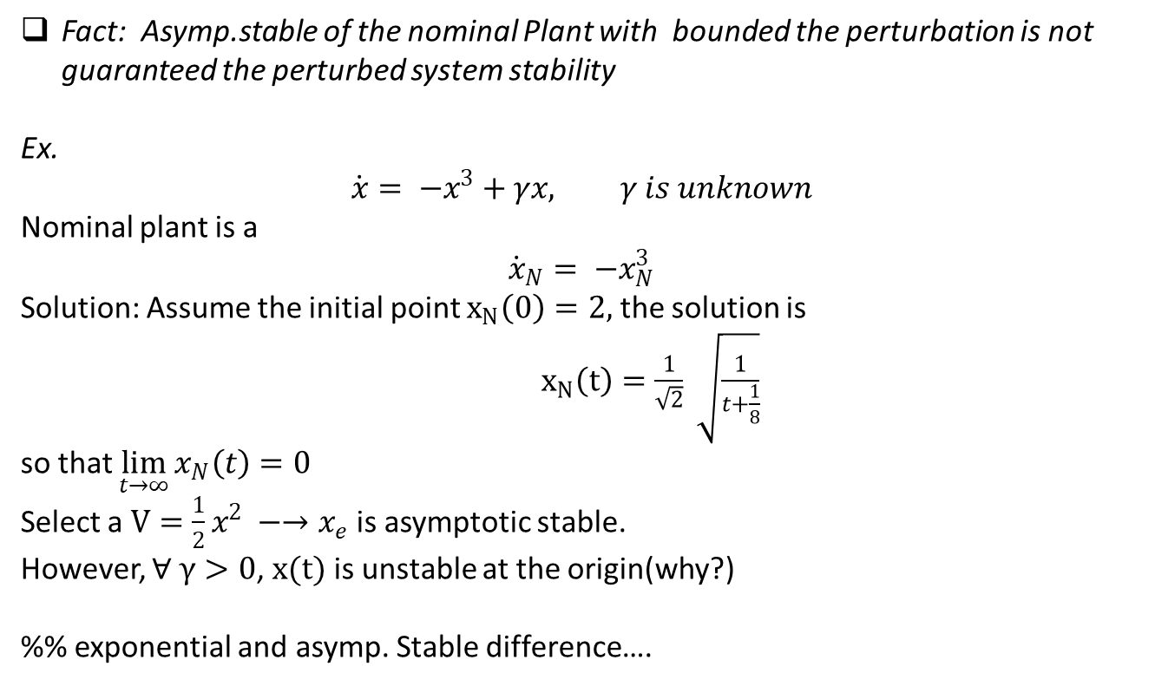
Fact: Asymp.stable of the nominal Plant with bounded the perturbation is not guaranteed the perturbed system stability
Ex.
$$\dot{x}= −x^{3}+γx, γ is unknown$$
Nominal plant is a
$${\dot{x}}_{N}= −x_{N}^{3}$$
Solution: Assume the initial point $x_{N}\left(0\right)=2,$ the solution is
$x_{N}\left(t\right)=\frac{1}{\sqrt{2}} \sqrt{\frac{1}{t+\frac{1}{8}}}$
so that $\lim_{t→∞}{x_{N}\left(t\right)=0}$
Select a $V=\frac{1}{2}x^{2} −→x_{e}$ is asymptotic stable.
However, $∀ γ>0$, $x(t)$ is unstable at the origin(why?)
%% exponential and asymp. Stable difference….

Slide 16
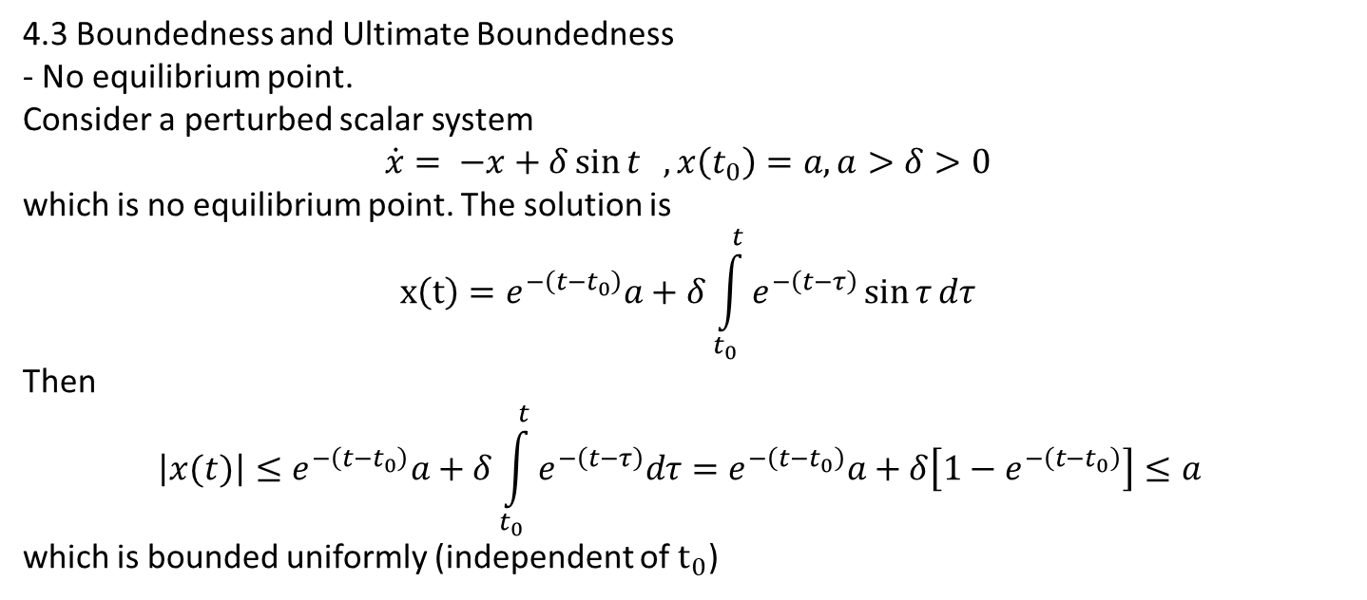
4.3 Boundedness and Ultimate Boundedness
- No equilibrium point.
Consider a perturbed scalar system
$$\dot{x}= −x+δ\sin{t} , x\left(t_{0}\right)=a, a>δ>0$$
which is no equilibrium point. The solution is
$$x\left(t\right)=e^{−\left(t−t_{0}\right)}a+δ\int_{t_{0}}^{t}{e^{−\left(t−τ\right)}\sin{τ}dτ}$$
Then
$$\left|x(t)\right|≤e^{−\left(t−t_{0}\right)}a+δ\int_{t_{0}}^{t}{e^{−\left(t−τ\right)}dτ}=e^{−\left(t−t_{0}\right)}a+δ\left[1−e^{−\left(t−t_{0}\right)}\right]≤a$$
which is bounded uniformly (independent of $t_{0}$)

Slide 17
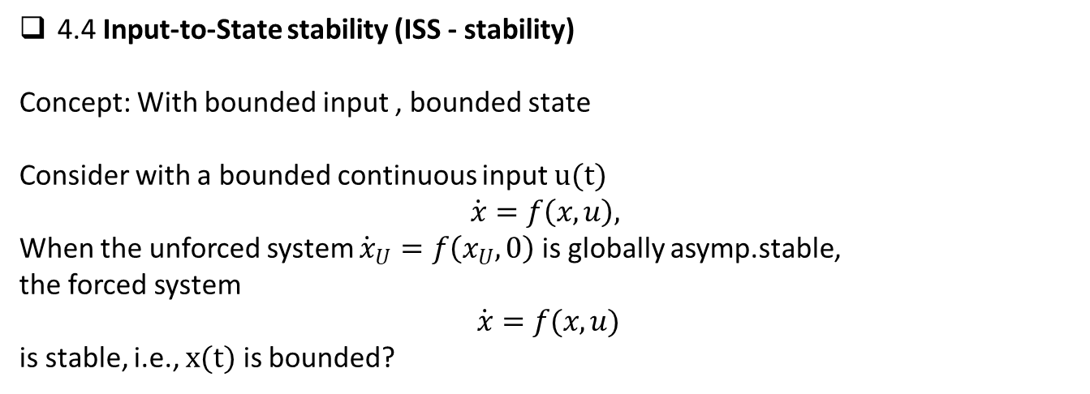
4.4 Input-to-State stability (ISS - stability)
Concept: With bounded input , bounded state
Consider with a bounded continuous input $u(t)$
$$\dot{x}=f\left(x,u\right),$$
When the unforced system ${\dot{x}}_{U}=f\left(x_{U}, 0\right)$ is globally asymp.stable,
the forced system
$$\dot{x}=f(x,u)$$
is stable, i.e., $x(t)$ is bounded?

Slide 18
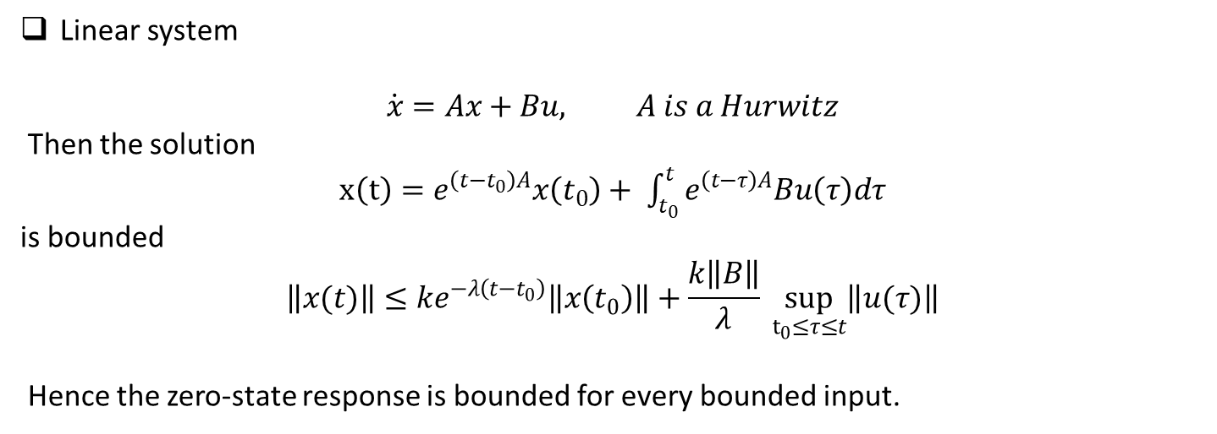
Linear system
$$\dot{x}=Ax+Bu, A is a Hurwitz$$
Then the solution
$x\left(t\right)=e^{\left(t−t_{0}\right)A}x\left(t_{0}\right)+ \int_{t_{0}}^{t}{e^{\left(t−τ\right)A}Bu\left(τ\right)dτ}$
is bounded
$$\left\|x(t)\right\|≤ke^{−λ\left(t−t_{0}\right)}\left\|x\left(t_{0}\right)\right\|+\frac{k\left\|B\right\|}{λ} \sup_{t_{0}≤τ≤t}\left\|u(τ)\right\|$$
Hence the zero-state response is bounded for every bounded input.

Slide 19
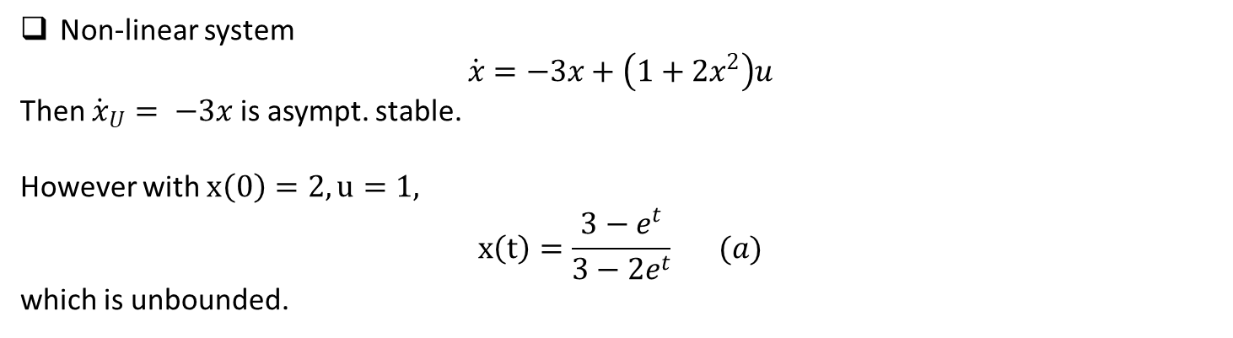
Non-linear system
$$\dot{x}=−3x+\left(1+2x^{2}\right)u$$
Then ${\dot{x}}_{U}= −3x$ is asympt. stable.
However with $x\left(0\right)=2, u=1,$
$$x\left(t\right)=\frac{3−e^{t}}{3−2e^{t}} (a)$$
which is unbounded.

Slide 20
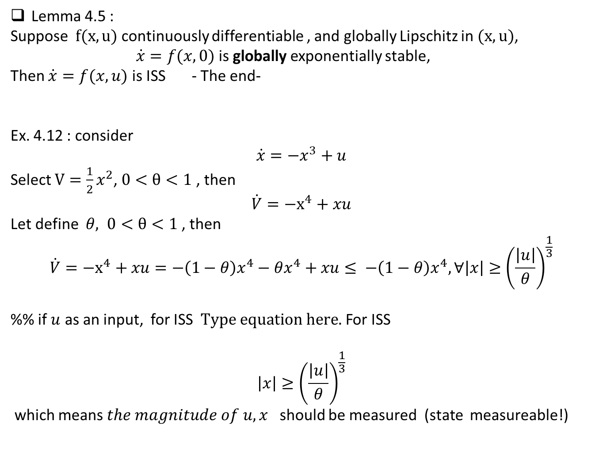
Lemma 4.5 :
Suppose $f(x,u)$ continuously differentiable , and globally Lipschitz in $(x,u)$,
$\dot{x}=f(x,0)$ is globally exponentially stable,
Then $\dot{x}=f(x,u)$ is ISS - The end-
Ex. 4.12 : consider
$$\dot{x}=−x^{3}+u$$
Select $V=\frac{1}{2}x^{2}$, $0<θ<1$ , then
$$\dot{V}=−x^{4}+xu$$
Let define $θ, 0<θ<1$ , then
$$\dot{V}=−x^{4}+xu=−\left(1−θ\right)x^{4}−θx^{4}+xu≤ −\left(1−θ\right)x^{4}, ∀\left|x\right|≥{\left(\frac{\left|u\right|}{θ}\right)}^{\frac{1}{3}}$$
%% if $u$ as an input, for ISS For ISS
$$\left|x\right|≥{\left(\frac{\left|u\right|}{θ}\right)}^{\frac{1}{3}}$$
which means $the magnitude of u,x$ should be measured (state measureable!)

Slide 21
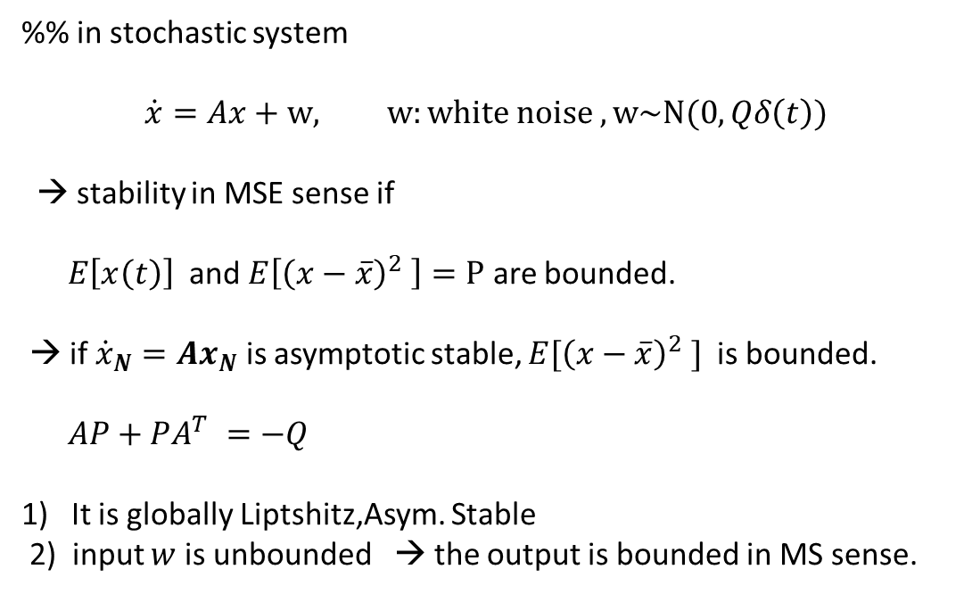
%% in stochastic system
$$\dot{x}=Ax+w, w:white noise , w\sim N(0, Qδ\left(t\right))$$
→ stability in MSE sense if
$E\left[x\left(t\right)\right]$ and $E\left[{\left(x−\overline{x}\right)}^{2} \right]=P$ are bounded.
→ if ${\dot{x}}_{N}=Ax_{N}$ is asymptotic stable, $E[{\left(x−\overline{x}\right)}^{2} ]$ is bounded.
$AP+PA^{T} =−Q$
It is globally Liptshitz,Asym. Stable
2) input $w$ is unbounded → the output is bounded in MS sense.

Slide 23
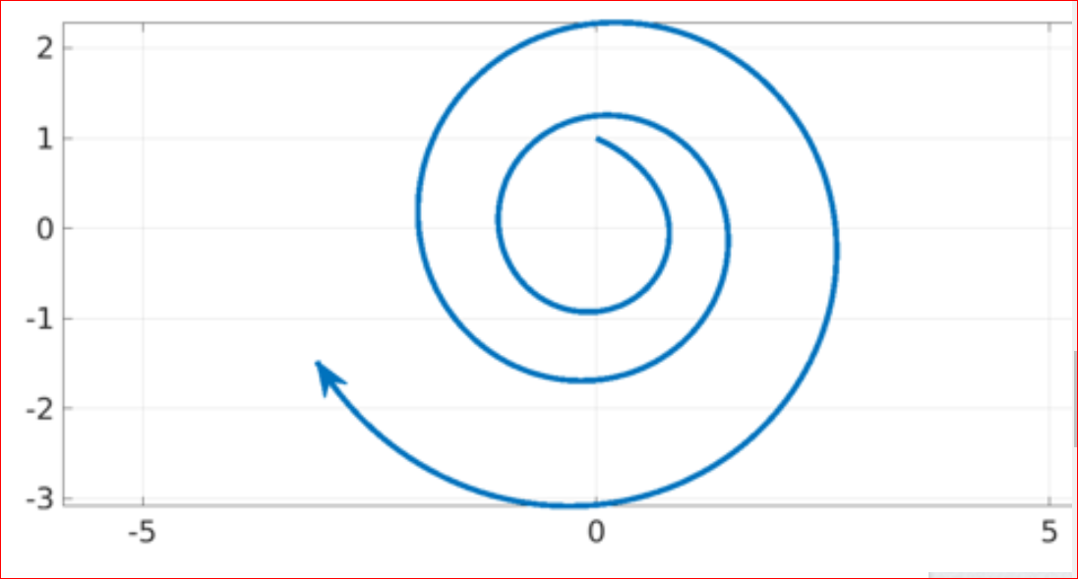

Consider
$\dot{x}\left(t\right)=A\left(t\right)x(t)$
$$A\left(t\right)=S\left(t\right)BS\left(−t\right)$$
$$S\left(t\right)= \left[\begin{matrix}\cos{t} & \sin{t} \\ −\sin{t} & \cos{t}\end{matrix}\right], B=\left\lceil \begin{matrix}−1 & m \\ 0 & −1\end{matrix}\right\rceil$$
So that
$$A\left(t\right) e= \left[\begin{matrix}−1+mcs & mc^{2} \\ −ms^{2} & −1−mcs\end{matrix}\right], c=cos t , s=sin t$$
Then eigenvalues of $A(t)$= -1 , -1 → for fixed $t$ it is asym. Stable. However $x_{e}(t)$ is unstable

