Slide 1
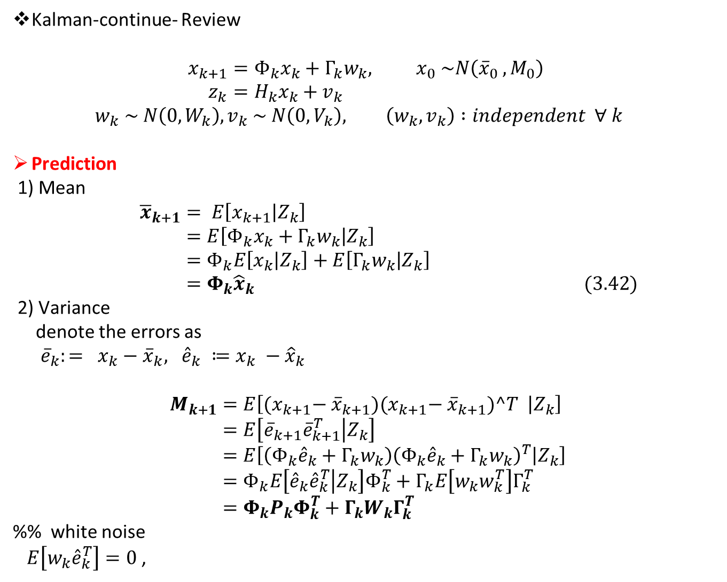
Kalman-continue- Review
$$x_{k+1}=Φ_{k}x_{k}+Γ_{k}w_{k}, x_{0} \sim N\left({\overline{x}}_{0} , M_{0}\right) \\ z_{k}=H_{k}x_{k}+v_{k}$$
$$w_{k} \sim N\left(0, W_{k}\right), v_{k} \sim N\left(0, V_{k}\right), \left(w_{k}, v_{k}\right) :independent ∀ k$$
Prediction
1) Mean
$${\overline{x}}_{k+1}= E\left[x_{k+1} | Z_{k}\right] \\ =E\left[Φ_{k}x_{k}+Γ_{k}w_{k} | Z_{k}\right] \\ =Φ_{k}E\left[x_{k} | Z_{k}\right]+E\left[Γ_{k}w_{k} | Z_{k}\right] \\ =Φ_{k}{\hat{x}}_{k} (3.42)$$
2) Variance
denote the errors as
${\overline{e}}_{k}:= x_{k}−{\overline{x}}_{k}, {\hat{e}}_{k} ≔x_{k} −{\hat{x}}_{k}$
$$M_{k+1}=E\left[{(x}_{k+1}− {\overline{x}}_{k+1}){(x}_{k+1}− {\overline{x}}_{k+1})^T | Z_{k}\right] \\ =E\left[{\overline{e}}_{k+1}{\overline{e}}_{k+1}^{T} | Z_{k}\right] \\ =E\left[\left(Φ_{k}{\hat{e}}_{k}+Γ_{k}w_{k}\right){\left(Φ_{k}{\hat{e}}_{k}+Γ_{k}w_{k}\right)}^{T} | Z_{k}\right] \\ =Φ_{k}E\left[{\hat{e}}_{k}{\hat{e}}_{k}^{T} | Z_{k}\right]Φ_{k}^{T}+Γ_{k}E\left[w_{k}w_{k}^{T}\right]Γ_{k}^{T} \\ =Φ_{k}P_{k}Φ_{k}^{T}+Γ_{k}W_{k}Γ_{k}^{T}$$
%% white noise
$E\left[w_{k}{\hat{e}}_{k}^{T}\right]=0$,

Slide 2
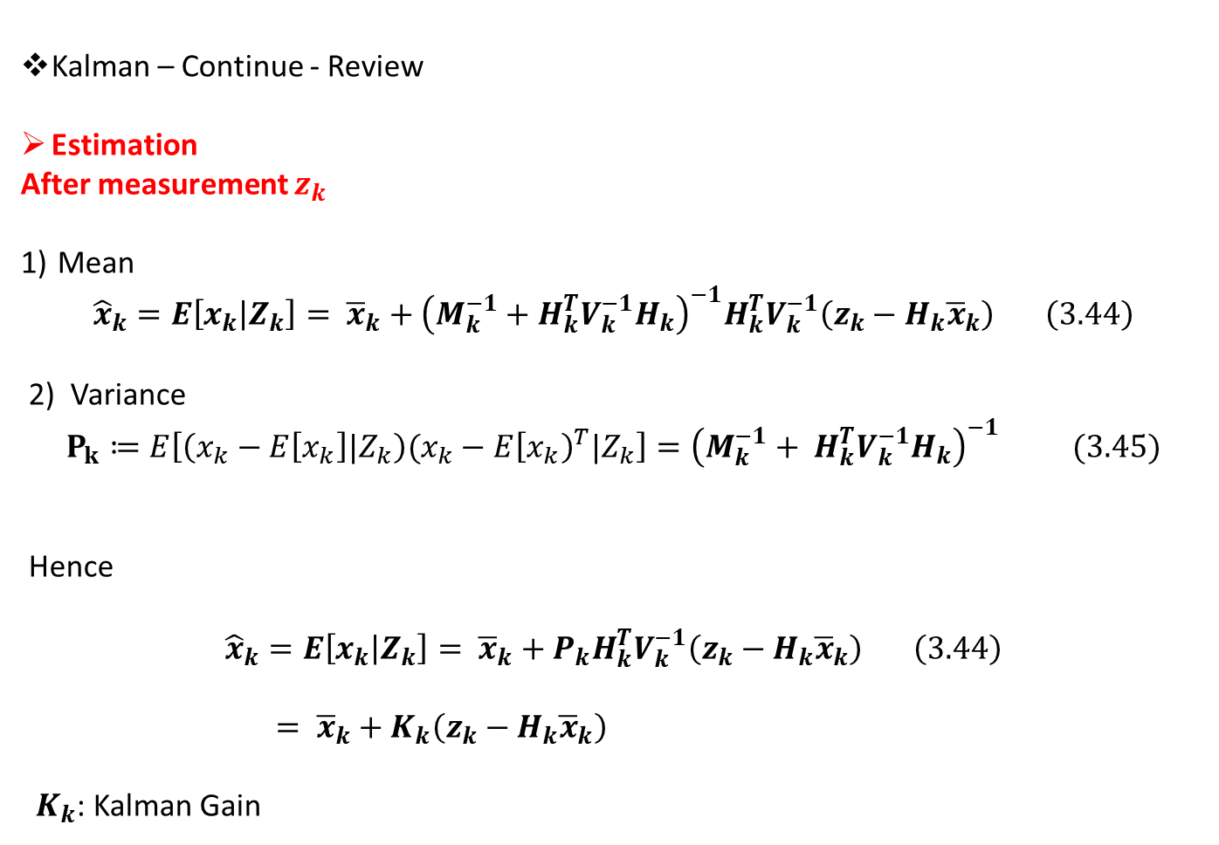
Kalman – Continue - Review
Estimation
After measurement $z_{k}$
Mean
$${\hat{x}}_{k}=E\left[x_{k} | Z_{k}\right]= {\overline{x}}_{k}+{\left(M_{k}^{−1}+H_{k}^{T}V_{k}^{−1}H_{k}\right)}^{−1}H_{k}^{T}V_{k}^{−1}\left(z_{k}−H_{k}{\overline{x}}_{k}\right) \left(3.44\right)$$
2) Variance
$$P_{k}≔E\left[\left(x_{k}−E\left[x_{k}\right]|Z_{k}\right)(x_{k}−E{\left[x_{k}\right)}^{T}|Z_{k}\right]={\left(M_{k}^{−1}+ H_{k}^{T}V_{k}^{−1}H_{k}\right)}^{−1} (3.45)$$
Hence
$${\hat{x}}_{k}=E\left[x_{k} | Z_{k}\right]= {\overline{x}}_{k}+P_{k}H_{k}^{T}V_{k}^{−1}\left(z_{k}−H_{k}{\overline{x}}_{k}\right) \left(3.44\right)$$
$= {\overline{x}}_{k}+K_{k}\left(z_{k}−H_{k}{\overline{x}}_{k}\right)$
$K_{k}$: Kalman Gain

Slide 3
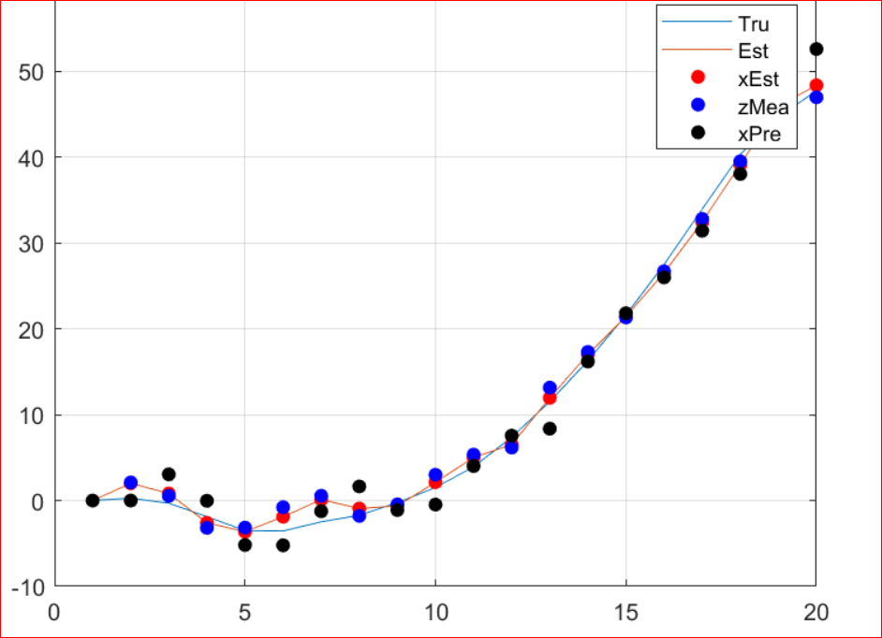
Github ; 2023_stochastic / Tut_week_5.mlx

Slide 4
Ch.4 Least Squares, The Orthogonal Projection
- another way to find Kalman filter: Orthogonal projection
In Ch.3 , the initial conditions and the process / measurement noise are
All gaussian case to get Kalman gain
However, it is not necessary to assume these Gaussian.
- Least Squares (linear, non-linear)

Slide 5

4.1 Linear Least Squares
The problem : A sequential measurements $z_{k}$, which is
$$z_{k}=C_{k}x+v_{k} , k=1,2,…,N, x∈R^{m} .$$
Find the estimator $\tilde{x}$ of $x$ to minimize the cost function as
$$J=\frac{1}{2}\sum_{k=1}^{N}{{\left( z_{k}−C_{k}\tilde{x}\right)}^{T}}\left(z_{k}−C_{k}\tilde{x}\right)$$
$$=\frac{1}{2}\sum_{k=1}^{N}{{\left\|z_{k}−C_{k}\tilde{x})\right\|}^{2}}$$
$\arg_{\tilde{x}}{\min{J}}$

Slide 6
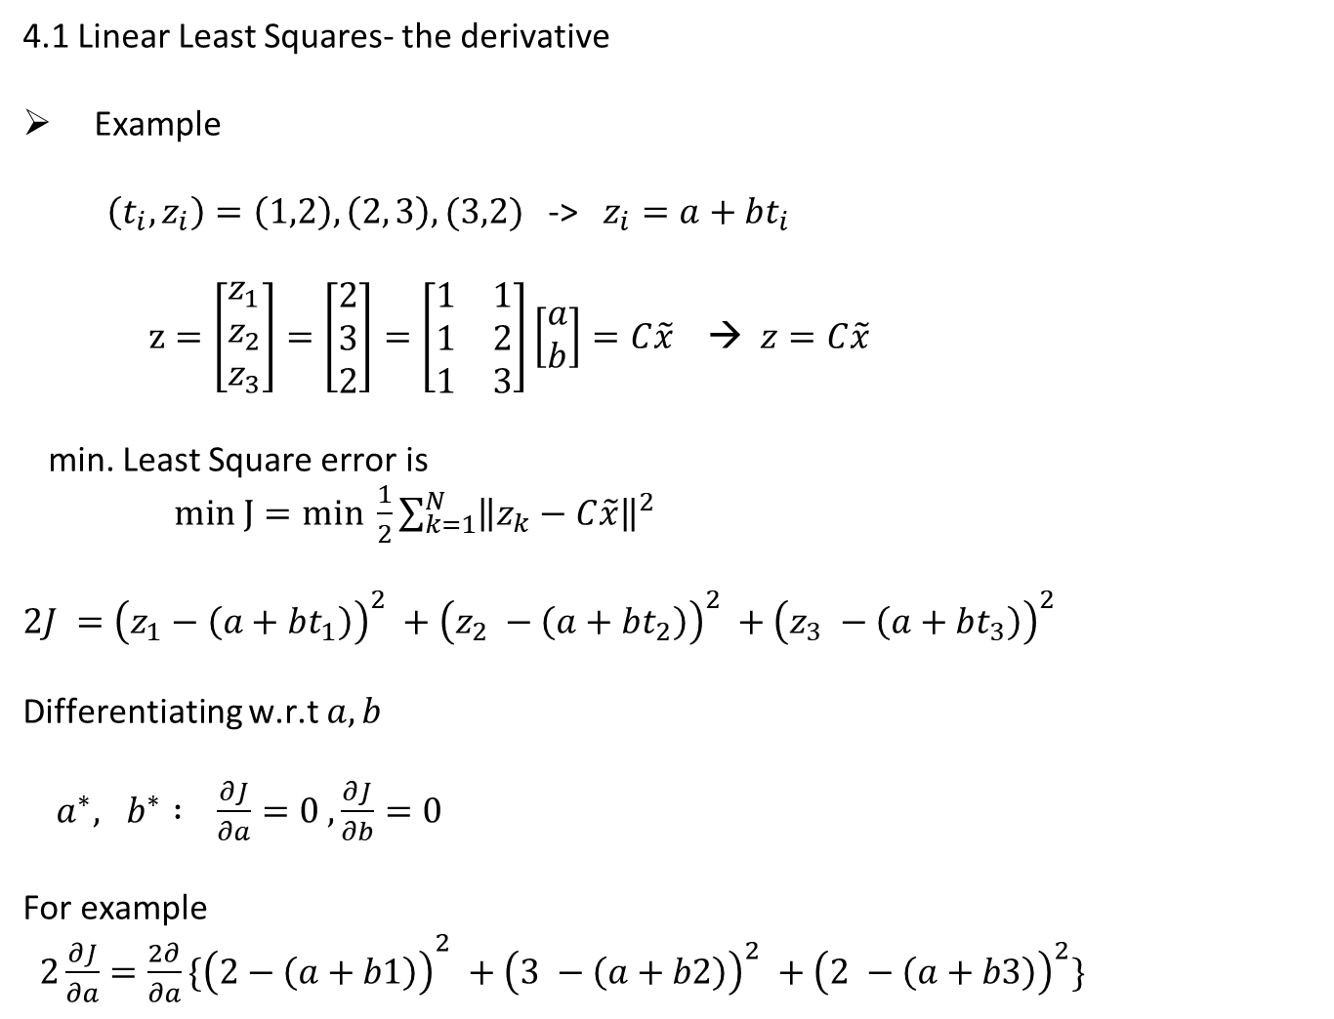
4.1 Linear Least Squares- the derivative
Example
$\left(t_{i}, z_{i}\right)=\left(1,2\right), \left(2, 3\right), (3,2)$ -> $z_{i}=a+bt_{i}$
$z=\left[\begin{matrix}z_{1} \\ z_{2} \\ z_{3}\end{matrix}\right]=\left[\begin{matrix}2 \\ 3 \\ 2\end{matrix}\right]=\left[\begin{matrix}1 & 1 \\ 1 & 2 \\ 1 & 3\end{matrix}\right]\left[\begin{matrix}a \\ b\end{matrix}\right]=C\tilde{x}$ → $z=C\tilde{x}$
min. Least Square error is
$min J=min \frac{1}{2}\sum_{k=1}^{N}{{\left\|z_{k}−C\tilde{x}\right\|}^{2} }$
$2J ={\left(z_{1}−\left(a+bt_{1}\right)\right)}^{2} +{\left(z_{2} −\left(a+bt_{2}\right)\right)}^{2} +{\left(z_{3} −\left(a+bt_{3}\right)\right)}^{2}$
Differentiating w.r.t $a,b$
$a^{∗}, b^{∗} : \frac{∂J}{∂a}=0 ,\frac{∂J}{∂b}=0$
For example
${2\frac{∂J}{∂a}=\frac{2∂}{∂a}\{\left(2−\left(a+b1\right)\right)}^{2} +{\left(3 −\left(a+b2\right)\right)}^{2} +{\left(2 −\left(a+b3\right)\right)}^{2}\}$

Slide 7
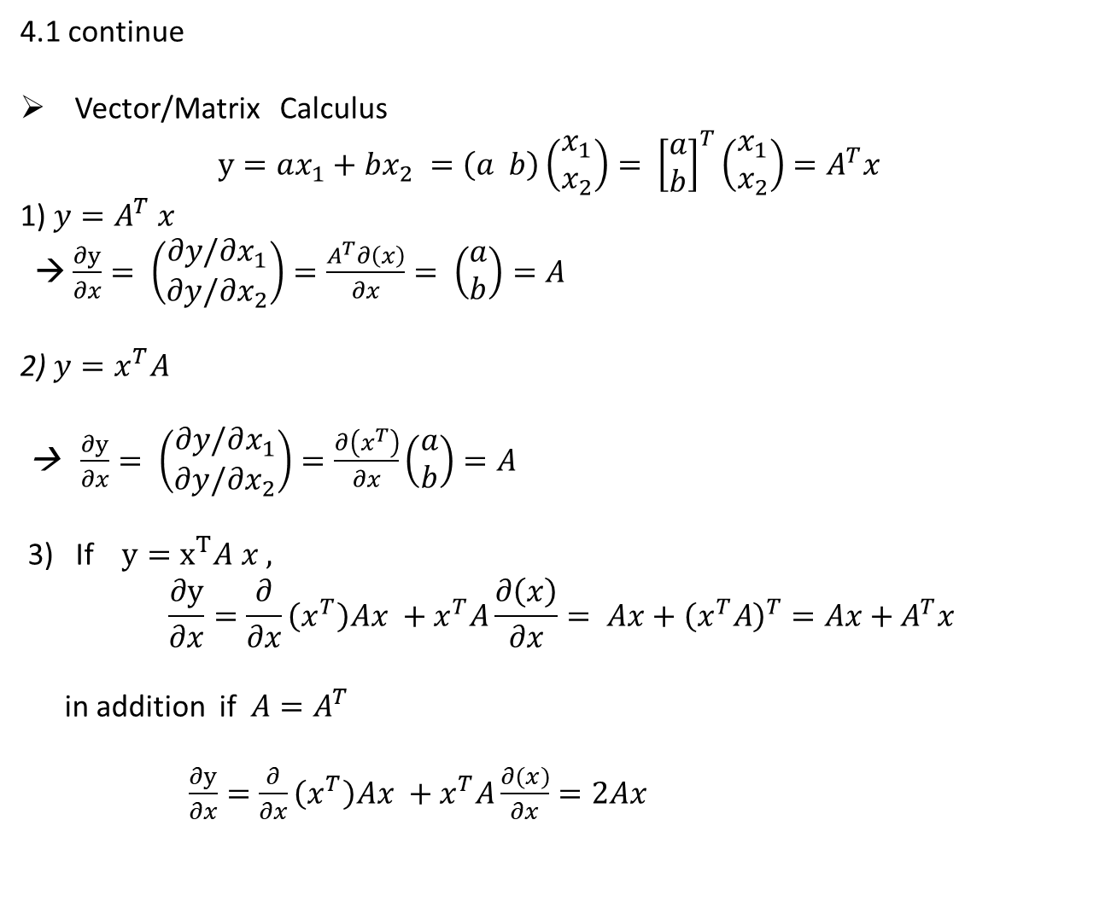
4.1 continue
Vector/Matrix Calculus
$y=ax_{1}+bx_{2} =\left(a b\right)\left(\begin{matrix}x_{1} \\ x_{2}\end{matrix}\right)= {\left[\begin{matrix}a \\ b\end{matrix}\right]}^{T}\left(\begin{matrix}x_{1} \\ x_{2}\end{matrix}\right)=A^{T}x$
1) $y=A^{T} x$
→ $\frac{∂y}{∂x}= \left(\begin{matrix}∂y/∂x_{1} \\ ∂y/∂x_{2}\end{matrix}\right)=\frac{A^{T}∂\left(x\right)}{∂x}= \left(\begin{matrix}a \\ b\end{matrix}\right)=A$
2) $y=x^{T}A$
→ $\frac{∂y}{∂x}= \left(\begin{matrix}∂y/∂x_{1} \\ ∂y/∂x_{2}\end{matrix}\right)=\frac{∂\left(x^{T}\right)}{∂x}\left(\begin{matrix}a \\ b\end{matrix}\right)=A$
3) If $y=x^{T}A x ,$
$$\frac{∂y}{∂x}=\frac{∂}{∂x}\left(x^{T}\right)Ax +x^{T}A\frac{∂\left(x\right)}{∂x}= Ax+{\left(x^{T}A\right)}^{T}=Ax+A^{T}x$$
in addition if $A=A^{T}$
$\frac{∂y}{∂x}=\frac{∂}{∂x}\left(x^{T}\right)Ax +x^{T}A\frac{∂\left(x\right)}{∂x}=2Ax$

Slide 8
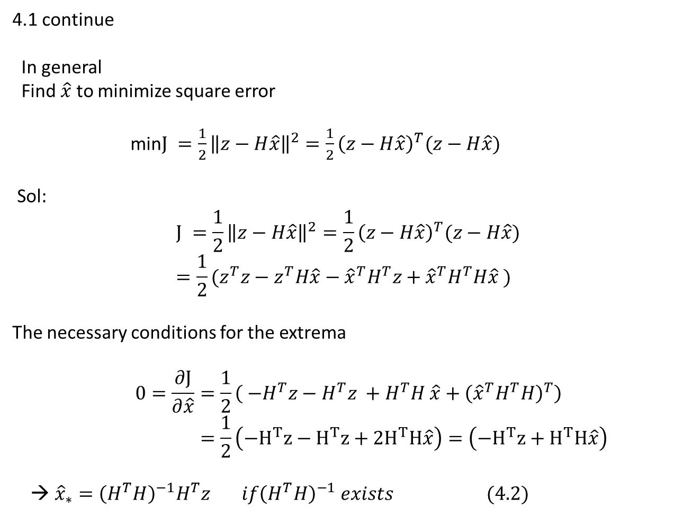
4.1 continue
In general
Find $\hat{x}$ to minimize square error
min$J =\frac{1}{2}{\left\|z−H\hat{x}\right\|}^{2}=\frac{1}{2}{\left(z−H\hat{x}\right)}^{T}(z−H\hat{x})$
Sol:
$$J =\frac{1}{2}{\left\|z−H\hat{x}\right\|}^{2}=\frac{1}{2}{\left(z−H\hat{x}\right)}^{T}(z−H\hat{x}) \\ =\frac{1}{2}(z^{T}z−z^{T}H\hat{x}−{\hat{x}}^{T}H^{T}z+{\hat{x}}^{T}H^{T}H\hat{x} )$$
The necessary conditions for the extrema
$$0=\frac{∂J}{∂\hat{x}}=\frac{1}{2}\left( {−H}^{T}z−H^{T}z +H^{T}H \hat{x}+{\left({\hat{x}}^{T}H^{T}H\right)}^{T}\right) \\ =\frac{1}{2}\left(−H^{T}z−H^{T}z+{2H}^{T}H\hat{x}\right)=\left(−H^{T}z+H^{T}H\hat{x}\right)$$
→ ${\hat{x}}_{∗}={\left(H^{T}H\right)}^{−1}H^{T}z if{\left(H^{T}H\right)}^{−1} exists (4.2)$

Slide 9
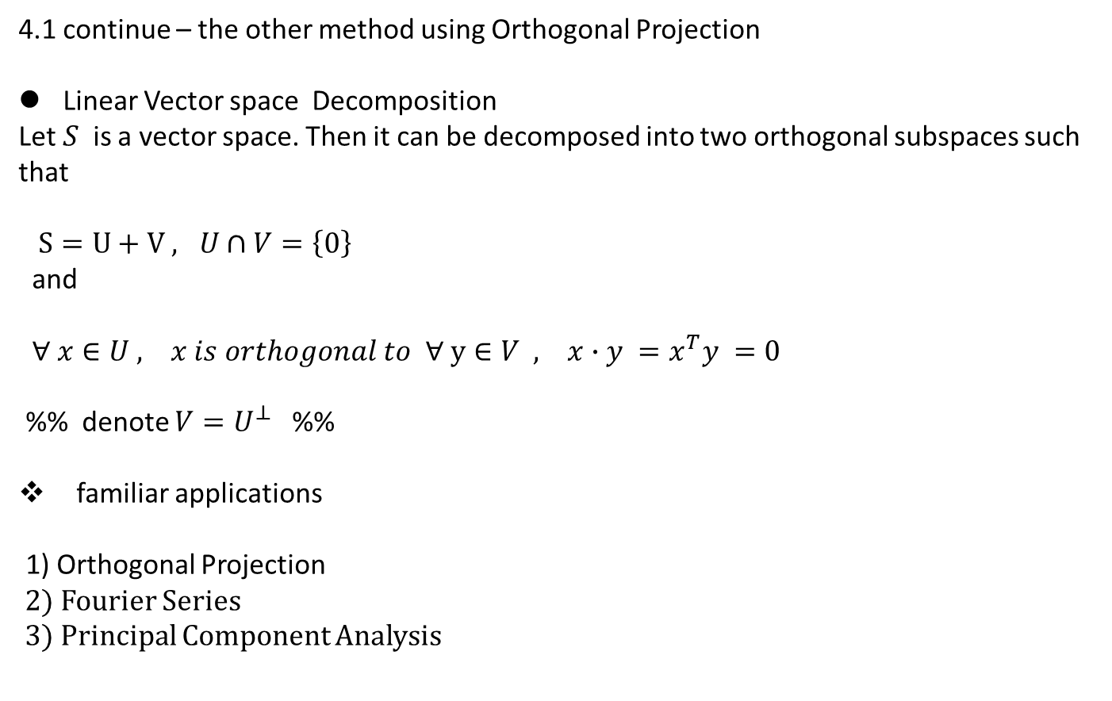
4.1 continue – the other method using Orthogonal Projection
Linear Vector space Decomposition
Let $S$ is a vector space. Then it can be decomposed into two orthogonal subspaces such that
$S=U+V , U∩V=\left\{0\right\}$
and
$∀ x∈U , x is orthogonal to ∀ y∈V , x∙y =x^{T}y =0$
%% denote $V=U^{⊥}$ %%
familiar applications
1) Orthogonal Projection
2) Fourier Series
3) Principal Component Analysis

Slide 10
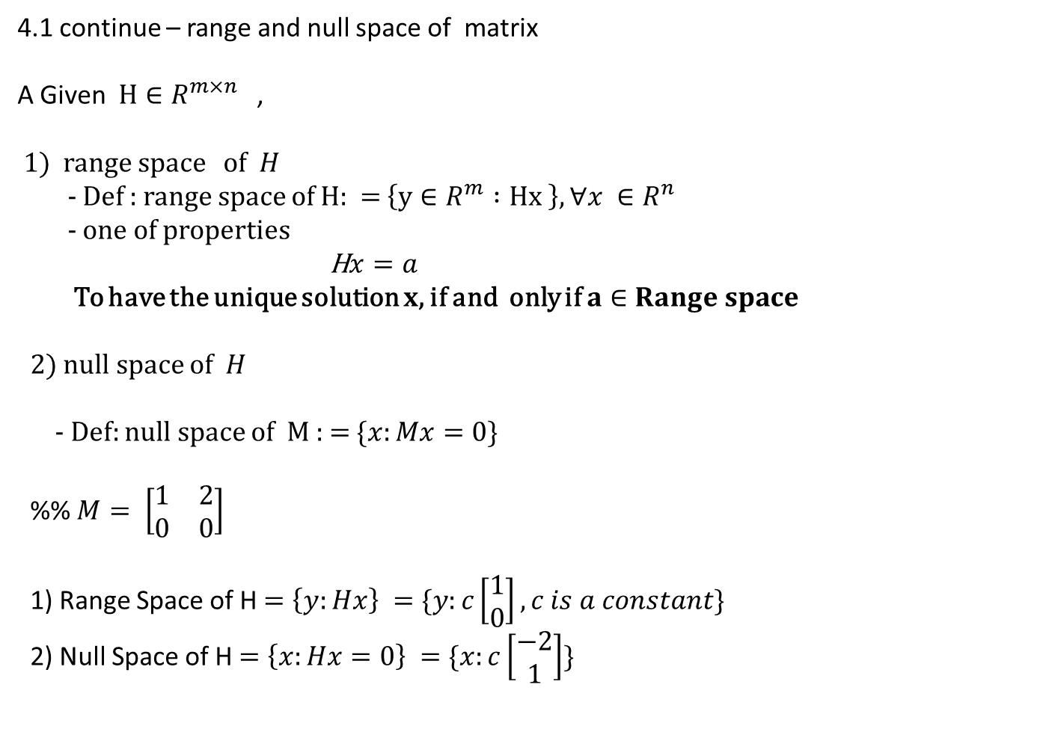
4.1 continue – range and null space of matrix
A Given $H∈R^{m×n}$ ,
1) range space of $H$
- Def : range space of $H:$ = $\left\{y∈R^{m} :Hx \right\},∀x ∈R^{n}$
- one of properties
H$x=a$
To have the unique solution $x$, if and only if $a∈Range space$
2) null space of $H$
- Def: null space of M : = $\{x:Mx=0\}$
%% $M= \left[\begin{matrix}1 & 2 \\ 0 & 0\end{matrix}\right]$
1) Range Space of H$=\left\{y:Hx\right\} =\{y:c\left[\begin{matrix}1 \\ 0\end{matrix}\right], c is a constant\}$
2) Null Space of H$=\left\{x:Hx=0\right\} =\{x:c\left[\begin{matrix}−2 \\ 1\end{matrix}\right]\}$

Slide 11
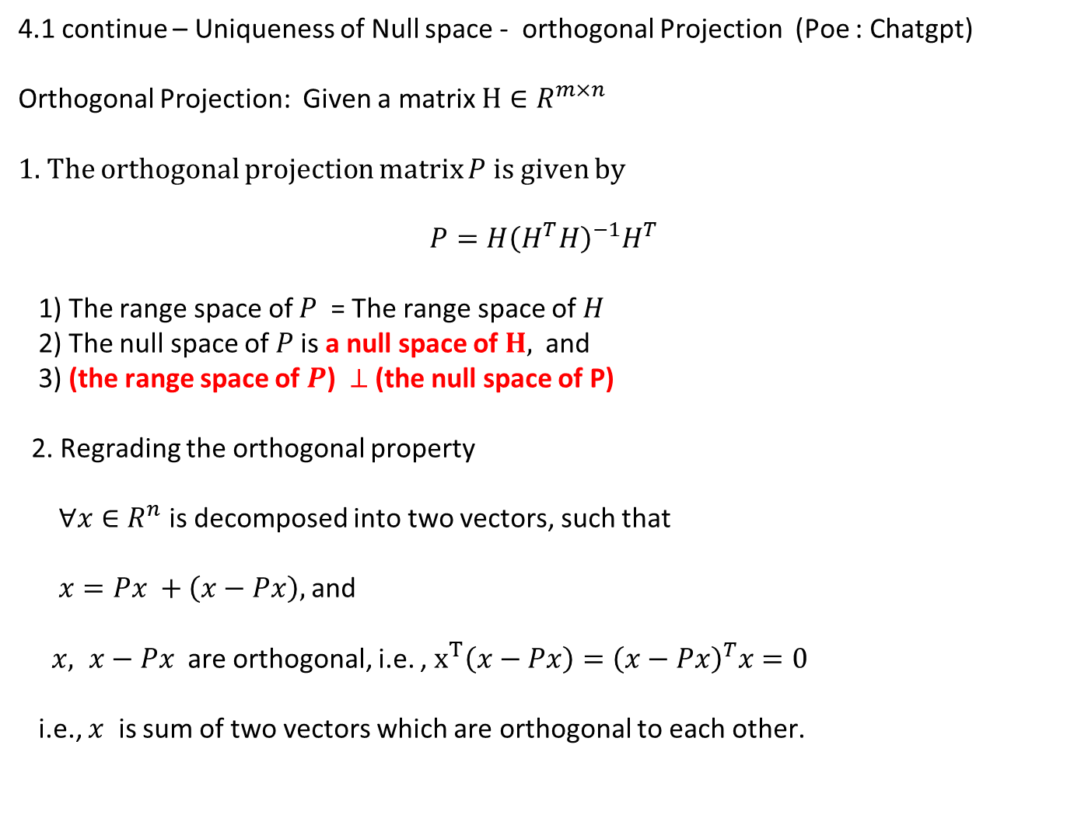
4.1 continue – Uniqueness of Null space - orthogonal Projection (Poe : Chatgpt)
Orthogonal Projection: Given a matrix $H∈R^{m×n}$
1. The orthogonal projection matrix $P$ is given by
$$P=H{\left(H^{T}H\right)}^{−1}H^{T}$$
1) The range space of $P$ = The range space of $H$
2) The null space of $P$is a null space of $H,$ and
3) (the range space of $P$) $⊥$(the null space of P)
2. Regrading the orthogonal property
$∀x∈R^{n}$ is decomposed into two vectors, such that
$x=Px +\left(x−Px\right),$ and
$x, x−Px$ are orthogonal, i.e. , $x^{T}\left(x−Px\right)={\left(x−Px\right)}^{T}x=0$
i.e., $x$ is sum of two vectors which are orthogonal to each other.

Slide 12
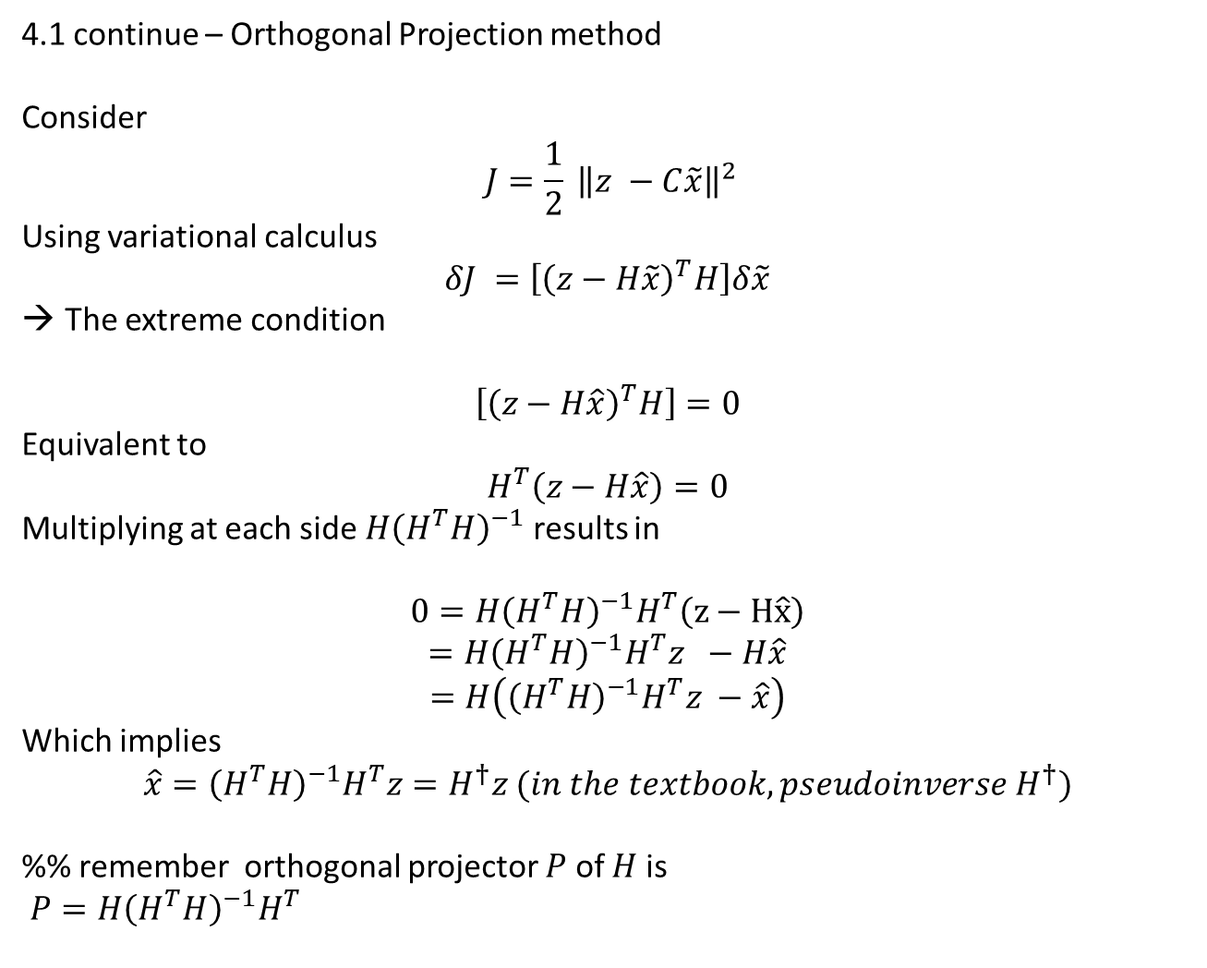
4.1 continue – Orthogonal Projection method
Consider
$$J=\frac{1}{2} {\left\|z −C\tilde{x}\right\|}^{2}$$
Using variational calculus
$$δJ =\left[{\left(z−H\tilde{x}\right)}^{T}H\right]δ\tilde{x}$$
The extreme condition
$$\left[{\left(z−H\hat{x}\right)}^{T}H\right]=0$$
Equivalent to
$$H^{T}\left(z−H\hat{x}\right)=0$$
Multiplying at each side $H{\left(H^{T}H\right)}^{−1}$ results in
$$0=H{\left(H^{T}H\right)}^{−1}H^{T}\left(z−H\hat{x}\right)$$
$$=H{\left(H^{T}H\right)}^{−1}H^{T}z −H\hat{x}$$
$$=H\left({\left(H^{T}H\right)}^{−1}H^{T}z −\hat{x}\right)$$
Which implies
$$\hat{x}={\left(H^{T}H\right)}^{−1}H^{T}z=H^{†}z (in the textbook, pseudoinverse H^{†})$$
%% remember orthogonal projector $P$ of $H$ is
$P=H{\left(H^{T}H\right)}^{−1}H^{T}$

Slide 13
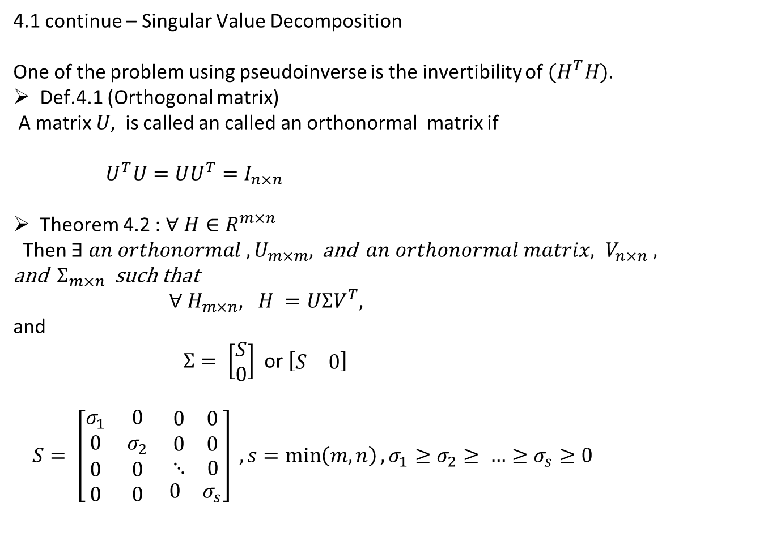
4.1 continue – Singular Value Decomposition
One of the problem using pseudoinverse is the invertibility of $(H^{T}H)$.
Def.4.1 (Orthogonal matrix)
A matrix $U,$ is called an called an orthonormal matrix if
$U^{T}U=UU^{T}=I_{n×n}$
Theorem 4.2 : $∀ H∈R^{m×n}$
Then $∃ an orthonormal , U_{m×m},$and $an orthonormal matrix, V_{n×n} ,$
and $Σ_{m×n}$ such that
$∀ H_{m×n}, H =UΣV^{T},$
and
$Σ= \left[\begin{matrix}S \\ 0\end{matrix}\right]$ or $\left[\begin{matrix}S & 0\end{matrix}\right]$
$S= \left[\begin{matrix}σ_{1} & 0 & \begin{matrix}0 & 0\end{matrix} \\ 0 & σ_{2} & \begin{matrix}0 & 0\end{matrix} \\ \begin{matrix}0 \\ 0\end{matrix} & \begin{matrix}0 \\ 0\end{matrix} & \begin{matrix}\begin{matrix}⋱ & 0\end{matrix} \\ \begin{matrix}0 & σ_{s}\end{matrix}\end{matrix}\end{matrix}\right] , s=\min\left(m,n\right), σ_{1}≥σ_{2}≥ …≥σ_{s}≥0$

Slide 14
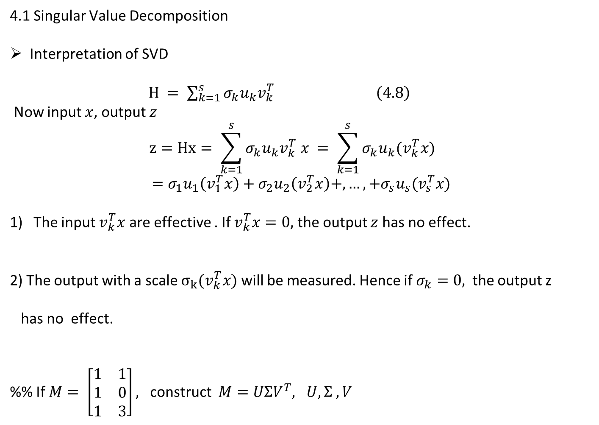
4.1 Singular Value Decomposition
Interpretation of SVD
$H = \sum_{k=1}^{s}{σ_{k}u_{k}v_{k}^{T} } \left(4.8\right)$
Now input $x$, output $z$ $$z=Hx= \sum_{k=1}^{s}{σ_{k}u_{k}v_{k}^{T} x = \sum_{k=1}^{s}{σ_{k}u_{k}{(v}_{k}^{T}x) }}$$
$$=σ_{1}u_{1}\left(v_{1}^{T}x\right)+σ_{2}u_{2}\left(v_{2}^{T}x\right)+,…,+σ_{s}u_{s}(v_{s}^{T}x)$$
The input $v_{k}^{T}x$ are effective . If $v_{k}^{T}x=0,$ the output $z$ has no effect.
2) The output with a scale $σ_{k}(v_{k}^{T}x)$ will be measured. Hence if $σ_{k}=0,$ the output z
has no effect.
%% If $M= \left[\begin{matrix}1 & 1 \\ 1 & 0 \\ 1 & 3\end{matrix}\right],$ construct $M=UΣV^{T}, U,Σ , V$

Slide 15
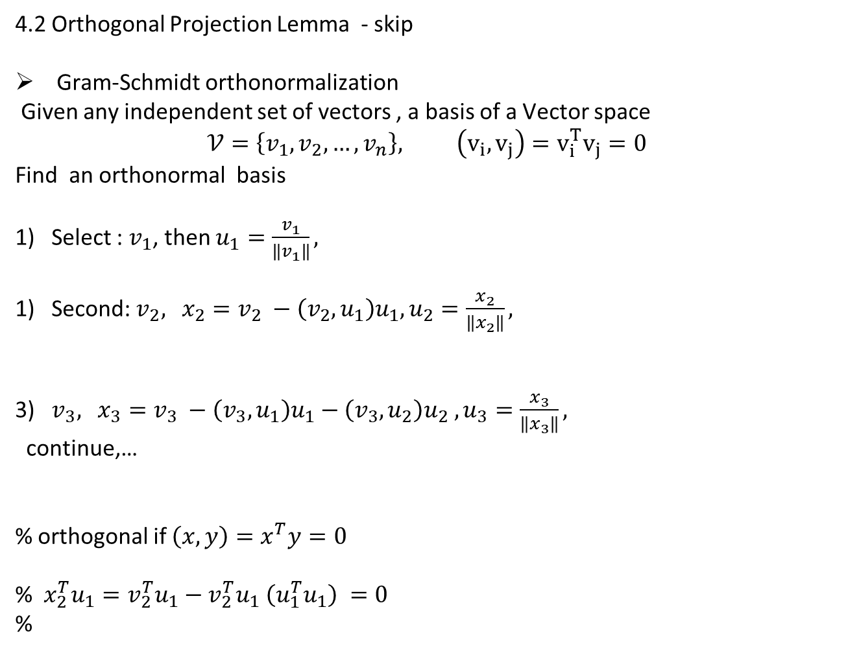
4.2 Orthogonal Projection Lemma - skip
Gram-Schmidt orthonormalization
Given any independent set of vectors , a basis of a Vector space
$$𝒱=\left\{v_{1}, v_{2},…,v_{n}\right\}, \left(v_{i}, v_{j}\right)=v_{i}^{T}v_{j}=0$$
Find an orthonormal basis
Select : $v_{1}$, then $u_{1}=\frac{v_{1}}{\left\|v_{1}\right\|},$
Second: $v_{2},$ $x_{2}=v_{2} −\left(v_{2}, u_{1}\right)u_{1}, u_{2}=\frac{x_{2}}{\left\|x_{2}\right\|},$
3) $v_{3},$ $x_{3}=v_{3} −\left(v_{3}, u_{1}\right)u_{1}−\left(v_{3},u_{2}\right)u_{2} , u_{3}=\frac{x_{3}}{\left\|x_{3}\right\|},$
continue,…
% orthogonal if $\left(x,y\right)=x^{T}y=0$
% $x_{2}^{T}u_{1}=v_{2}^{T}u_{1}−v_{2}^{T}u_{1} \left(u_{1}^{T}u_{1}\right) =0$
%

Slide 16
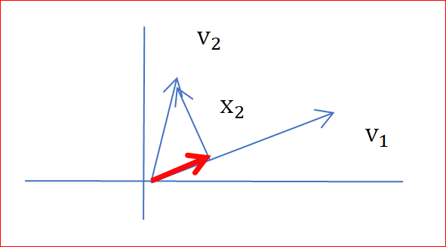

Ex; Given $V_{1},V_{2},$find $\left(x_{1}, x_{2}\right)$ orthogonal , i.e. $x_{1}^{T}x_{2}=0$
Pick up $x_{1}=V_{1}$
Select $x_{2}=V_{2} −{(V}_{2}^{T}x_{1}) x_{1}$
→ normalize at every step.

Slide 17
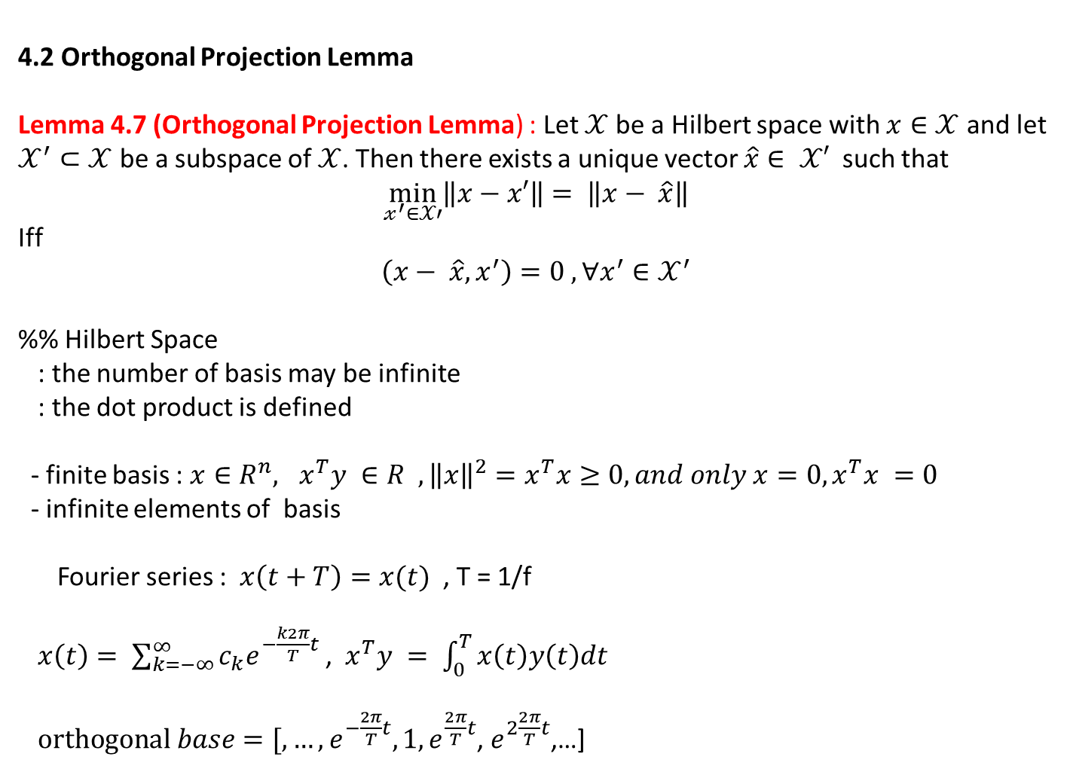
4.2 Orthogonal Projection Lemma
Lemma 4.7 (Orthogonal Projection Lemma) : Let $𝒳$ be a Hilbert space with $x∈𝒳$ and let $𝒳^{′}⊂𝒳$ be a subspace of $𝒳$. Then there exists a unique vector $\hat{x}∈ 𝒳′$ such that
$$\min_{𝓍^{′}∈𝒳′}\left\|x−x′\right\|= \left\|x− \hat{x}\right\|$$
Iff
$$\left(x− \hat{x}, x^{′}\right)=0 , ∀x^{′}∈𝒳^{′}$$
%% Hilbert Space
: the number of basis may be infinite
: the dot product is defined
- finite basis : $x∈R^{n}, x^{T}y ∈R , {\left\|x\right\|}^{2}=x^{T}x≥0, and only x=0, x^{T}x =0$
- infinite elements of basis
Fourier series : $x\left(t+T\right)=x(t)$ , T = 1/f
$x\left(t\right)= \sum_{k=−∞}^{∞}{c_{k}e^{−\frac{k2π}{T}t}}$, $x^{T}y = \int_{0}^{T}{x\left(t\right)y\left(t\right)dt}$
$orthogonal base=[,…, e^{−\frac{2π}{T}t}, 1, e^{\frac{2π}{T}t}$, $e^{2\frac{2π}{T}t}$,…]

Slide 18
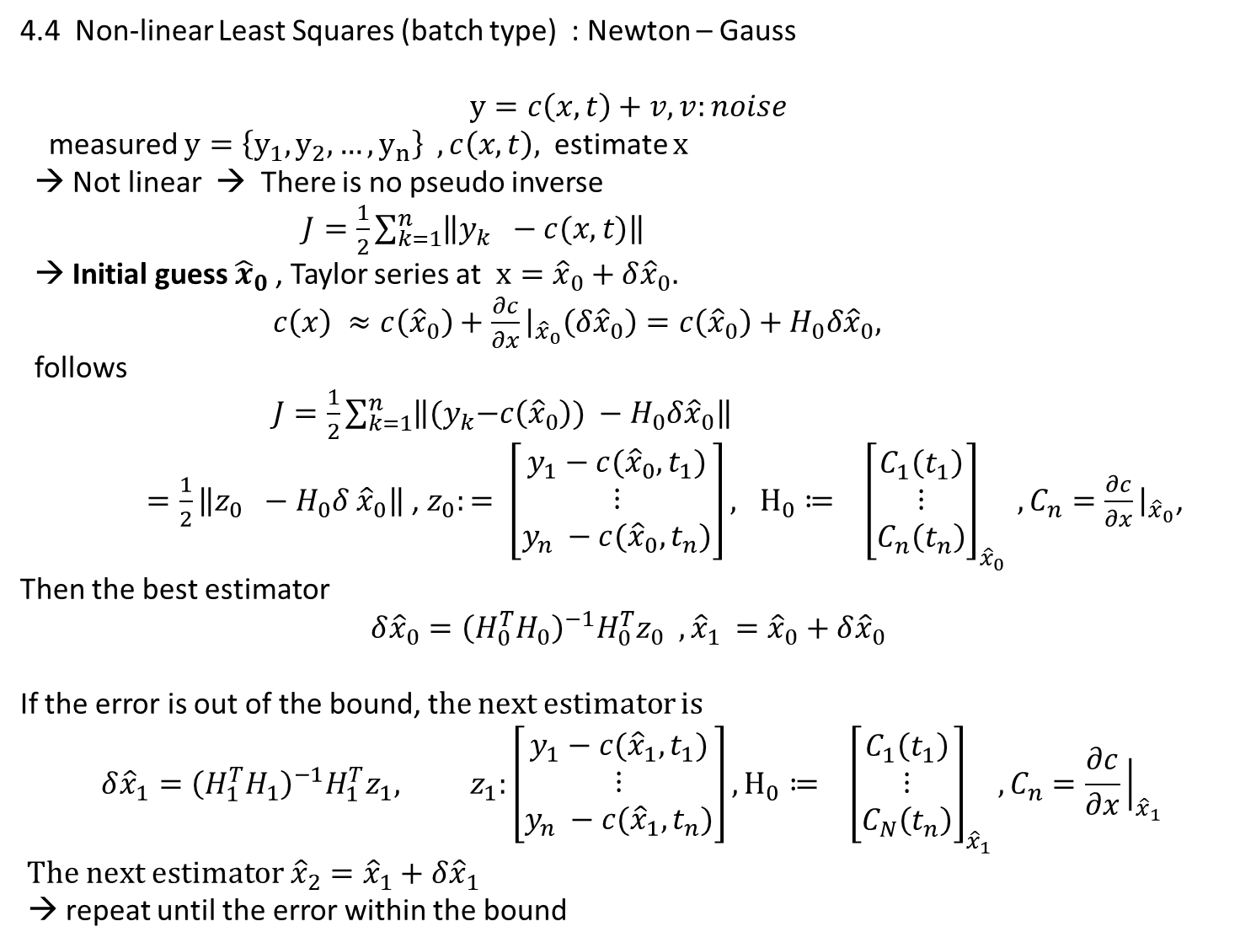
4.4 Non-linear Least Squares (batch type) : Newton – Gauss
$$y=c\left(x, t\right)+v, v:noise$$
measured $y=\left\{y_{1}, y_{2},…, y_{n}\right\} , c\left(x,t\right),$estimate $x$
→ Not linear → There is no pseudo inverse
$J=\frac{1}{2}\sum_{k=1}^{n}{\left\|y_{k} −c(x,t)\right\|}$
→ Initial guess ${\hat{x}}_{0}$, Taylor series at $x={\hat{x}}_{0}+δ{\hat{x}}_{0}.$
$c\left(x\right) ≈c\left({\hat{x}}_{0}\right)+\frac{∂c}{∂x}{\left.​\right|}_{{\hat{x}}_{0}}\left(δ{\hat{x}}_{0}\right)=c\left({\hat{x}}_{0}\right)+H_{0}δ{\hat{x}}_{0},$
follows
$J=\frac{1}{2}\sum_{k=1}^{n}{\left\|{(y}_{k}−c\left({\hat{x}}_{0}\right)) −H_{0}δ{\hat{x}}_{0}\right\|}$
$=\frac{1}{2}\left\|z_{0} −H_{0}δ{ \hat{x}}_{0}\right\|$ , $z_{0}:= \left[\begin{matrix}y_{1}−c({\hat{x}}_{0}, t_{1}) \\ ⋮ \\ y_{n} −c({\hat{x}}_{0},t_{n})\end{matrix}\right], H_{0}≔ {\left[\begin{matrix}C_{1}\left(t_{1}\right) \\ ⋮ \\ C_{n}\left(t_{n}\right)\end{matrix}\right]}_{{\hat{x}}_{0}} , C_{n}=\frac{∂c}{∂x}{\left.​\right|}_{{\hat{x}}_{0}}$,
Then the best estimator
$${δ\hat{x}}_{0}={\left(H_{0}^{T}H_{0}\right)}^{−1}H_{0}^{T}z_{0} , {\hat{x}}_{1 }={\hat{x}}_{0}+δ{\hat{x}}_{0}$$
If the error is out of the bound, the next estimator is
$${δ\hat{x}}_{1}={\left(H_{1}^{T}H_{1}\right)}^{−1}H_{1}^{T}z_{1}, z_{1}:\left[\begin{matrix}y_{1}−c({\hat{x}}_{1}, t_{1}) \\ ⋮ \\ y_{n} −c({\hat{x}}_{1},t_{n})\end{matrix}\right],H_{0}≔ {\left[\begin{matrix}C_{1}\left(t_{1}\right) \\ ⋮ \\ C_{N}\left(t_{n}\right)\end{matrix}\right]}_{{\hat{x}}_{1}}, C_{n}=\frac{∂c}{∂x}{\left.​\right|}_{{\hat{x}}_{1}}$$
The next estimator ${\hat{x}}_{2}={\hat{x}}_{1}+δ{\hat{x}}_{1}$
→ repeat until the error within the bound

Slide 19
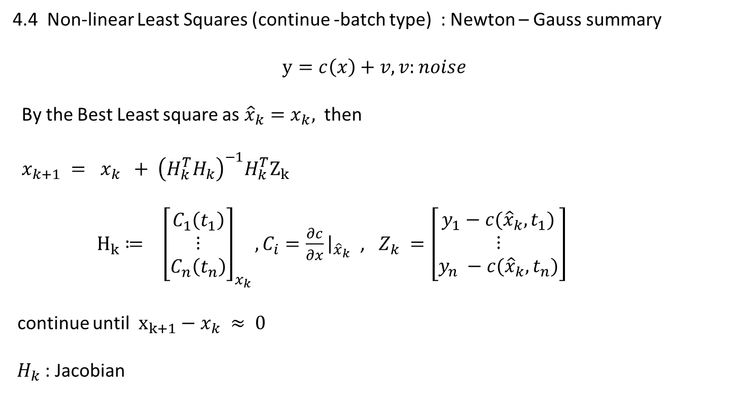
4.4 Non-linear Least Squares (continue -batch type) : Newton – Gauss summary
$$y=c\left(x\right)+v, v:noise$$
By the Best Least square as ${\hat{x}}_{k}=x_{k},$ then
$x_{k+1} = x_{k} + {\left(H_{k}^{T}H_{k}\right)}^{−1}H_{k}^{T}Z_{k}$
$H_{k}≔ {\left[\begin{matrix}C_{1}\left(t_{1}\right) \\ ⋮ \\ C_{n}\left(t_{n}\right)\end{matrix}\right]}_{x_{k}}, C_{i}=\frac{∂c}{∂x}{\left.​\right|}_{{\hat{x}}_{k}}$ , $Z_{k} =\left[\begin{matrix}y_{1}−c({\hat{x}}_{k}, t_{1}) \\ ⋮ \\ y_{n} −c({\hat{x}}_{k},t_{n})\end{matrix}\right]$
continue until $x_{k+1}−x_{k} ≈ 0$
$H_{k}$: Jacobian

Slide 20
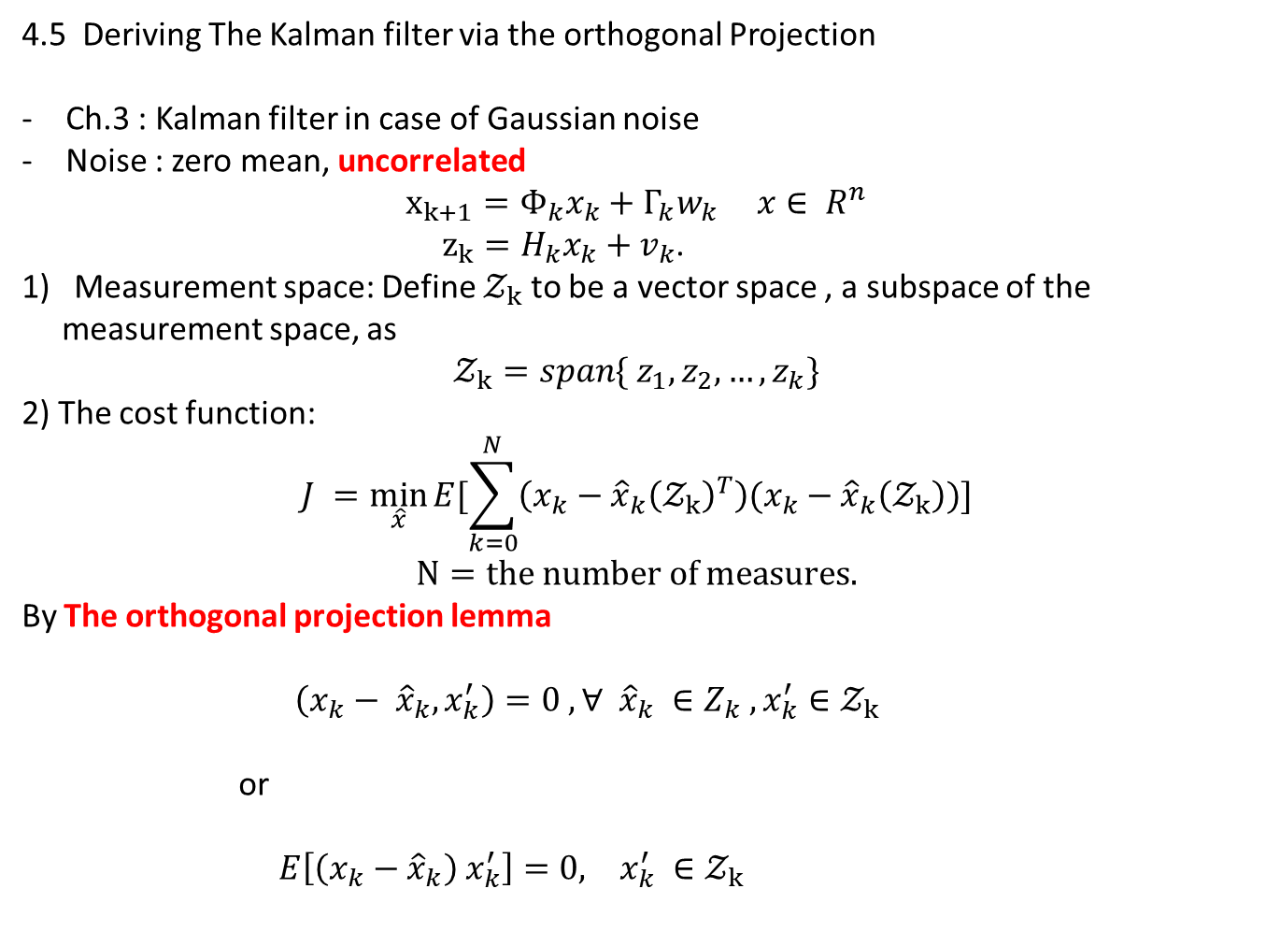
4.5 Deriving The Kalman filter via the orthogonal Projection
Ch.3 : Kalman filter in case of Gaussian noise
Noise : zero mean, uncorrelated
$$x_{k+1}=Φ_{k}x_{k}+Γ_{k}w_{k} x∈ R^{n}$$
$z_{k}=H_{k}x_{k}+v_{k}$.
Measurement space: Define $𝒵_{k}$ to be a vector space , a subspace of the
measurement space, as
$$𝒵_{k}=span\{ z_{1}, z_{2},…, z_{k}\}$$
2) The cost function:
$$J =\min_{\hat{x}}{E[\sum_{k=0}^{N}{\left(x_{k}−{\hat{x}}_{k}{\left(𝒵_{k}\right)}^{T}\right)(x_{k}}−{\hat{x}}_{k}\left(𝒵_{k}\right))]}$$
$$N=the number of measures.$$
By The orthogonal projection lemma
$\left(x_{k}− {\hat{x}}_{k}, x_{k}^{′}\right)=0 , ∀ {\hat{x}}_{k} ∈Z_{k} , x_{k}^{′}∈𝒵_{k}$
or
$E\left[\left(x_{k}−{\hat{x}}_{k}\right) x_{k}^{′}\right]=0, x_{k}^{′} ∈𝒵_{k}$

Slide 21
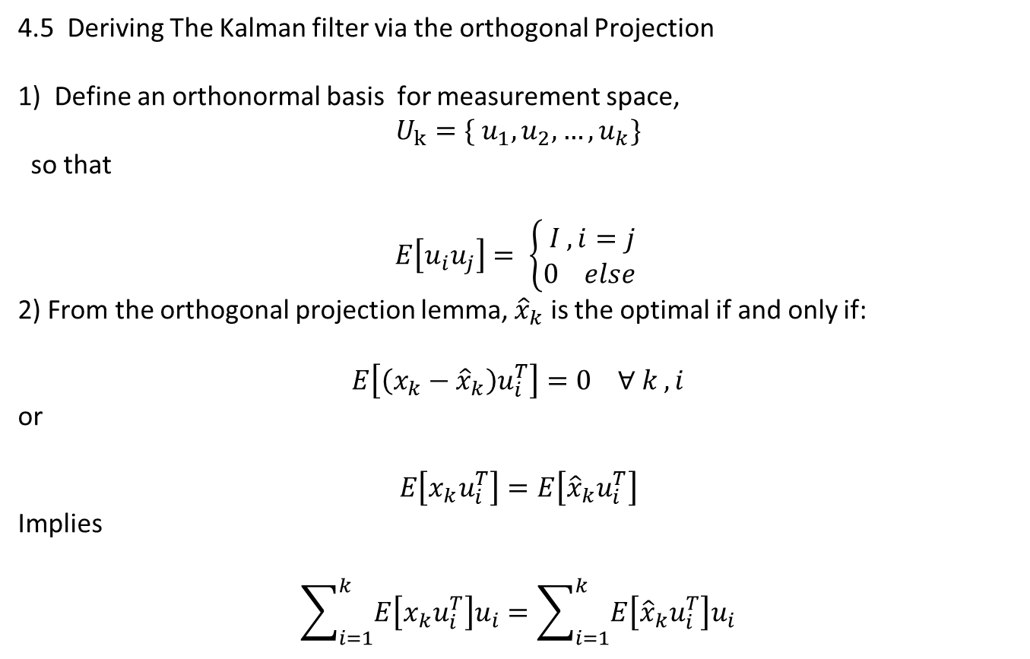
4.5 Deriving The Kalman filter via the orthogonal Projection
1) Define an orthonormal basis for measurement space,
$$U_{k}=\{ u_{1}, u_{2},…, u_{k}\}$$
so that
$$E\left[u_{i}u_{j}\right]= \left\{\begin{aligned}I , i=j \\ 0 else \end{aligned}\right.$$
2) From the orthogonal projection lemma, ${\hat{x}}_{k}$ is the optimal if and only if:
$$E\left[\left(x_{k}−{\hat{x}}_{k}\right)u_{i}^{T}\right]=0 ∀ k , i$$
or
$$E\left[x_{k}u_{i}^{T}\right]=E\left[{\hat{x}}_{k}u_{i}^{T}\right]$$
Implies
$$\sum_{i=1}^{k}{E\left[x_{k}u_{i}^{T}\right]u_{i}}=\sum_{i=1}^{k}{E\left[{\hat{x}}_{k}u_{i}^{T}\right]u_{i}}$$

Slide 22
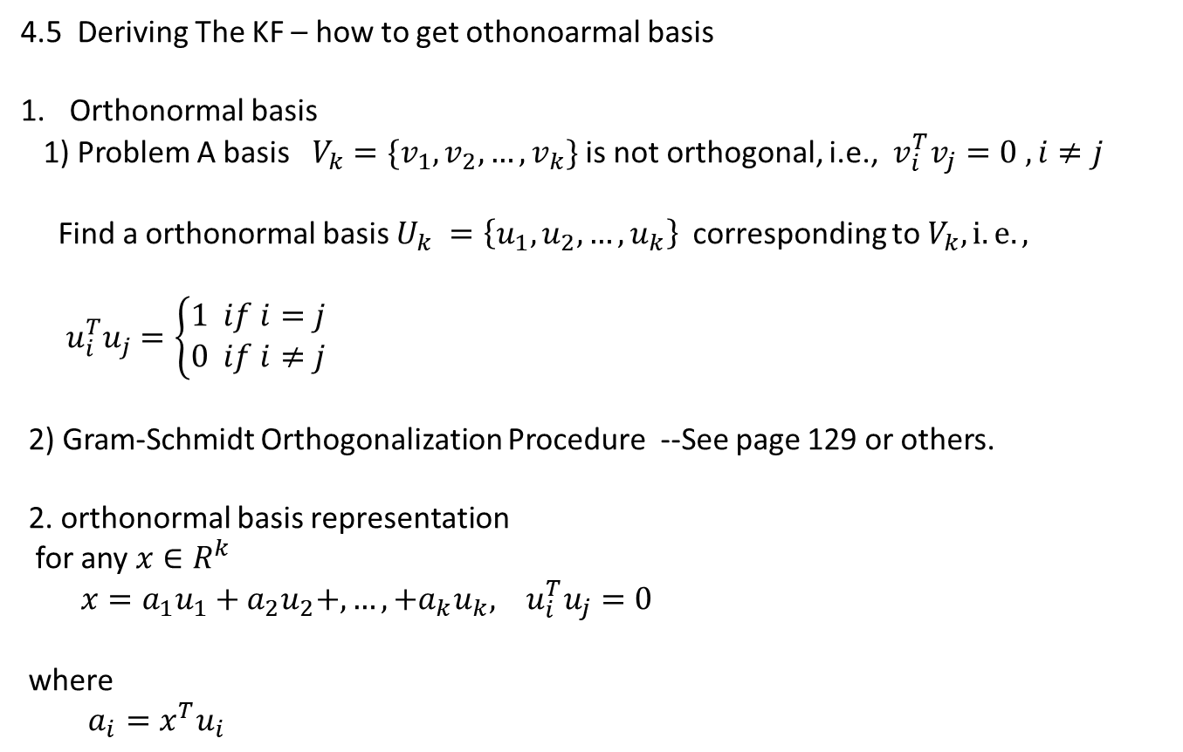
4.5 Deriving The KF – how to get othonoarmal basis
Orthonormal basis
1) Problem A basis $V_{k}=\{v_{1}, v_{2},…, v_{k}\}$ is not orthogonal, i.e., $v_{i}^{T}v_{j}=0 , i≠j$
Find a orthonormal basis $U_{k} =\left\{u_{1}, u_{2},…, u_{k}\right\}$corresponding to $V_{k}, i.e.,$
$u_{i}^{T}u_{j}=\left\{\begin{aligned}1 if i=j \\ 0 if i≠j\end{aligned}\right.$
2) Gram-Schmidt Orthogonalization Procedure --See page 129 or others.
2. orthonormal basis representation
for any $x∈R^{k}$
$x=a_{1}u_{1}+a_{2}u_{2}+,…,+a_{k}u_{k}, u_{i}^{T}u_{j}=0$
where
$a_{i}=x^{T}u_{i}$

Slide 23
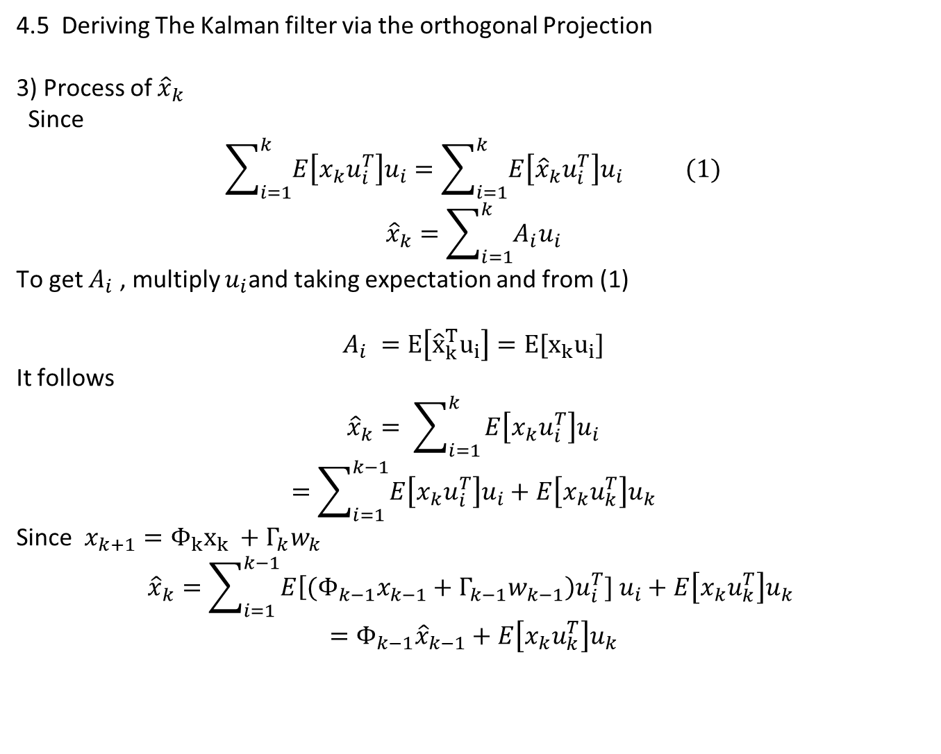
4.5 Deriving The Kalman filter via the orthogonal Projection
3) Process of ${\hat{x}}_{k}$
Since
$$\sum_{i=1}^{k}{E\left[x_{k}u_{i}^{T}\right]u_{i}}=\sum_{i=1}^{k}{E\left[{\hat{x}}_{k}u_{i}^{T}\right]u_{i}} (1)$$
$${\hat{x}}_{k}=\sum_{i=1}^{k}{A_{i}u_{i}}$$
To get $A_{i}$ , multiply $u_{i}$and taking expectation and from (1)
$$A_{i} =E\left[{\hat{x}}_{k}^{T}u_{i}\right]=E[x_{k}u_{i}]$$
It follows
$${\hat{x}}_{k}= \sum_{i=1 }^{k}{E\left[x_{k}u_{i}^{T}\right]u_{i}}$$
$$=\sum_{i=1}^{k−1}{E\left[x_{k}u_{i}^{T}\right]u_{i}+E\left[x_{k}u_{k}^{T}\right]u_{k}}$$
Since $x_{k+1}=Φ_{k}x_{k} +Γ_{k}w_{k}$
$${\hat{x}}_{k}=\sum_{i=1}^{k−1}{E\left[{(Φ}_{k−1}x_{k−1}+Γ_{k−1}w_{k−1}\right)u_{i}^{T}] u_{i}+E\left[x_{k}u_{k}^{T}\right]u_{k} }$$
$$=Φ_{k−1}{\hat{x}}_{k−1}+E\left[x_{k}u_{k}^{T}\right]u_{k}$$

Slide 24
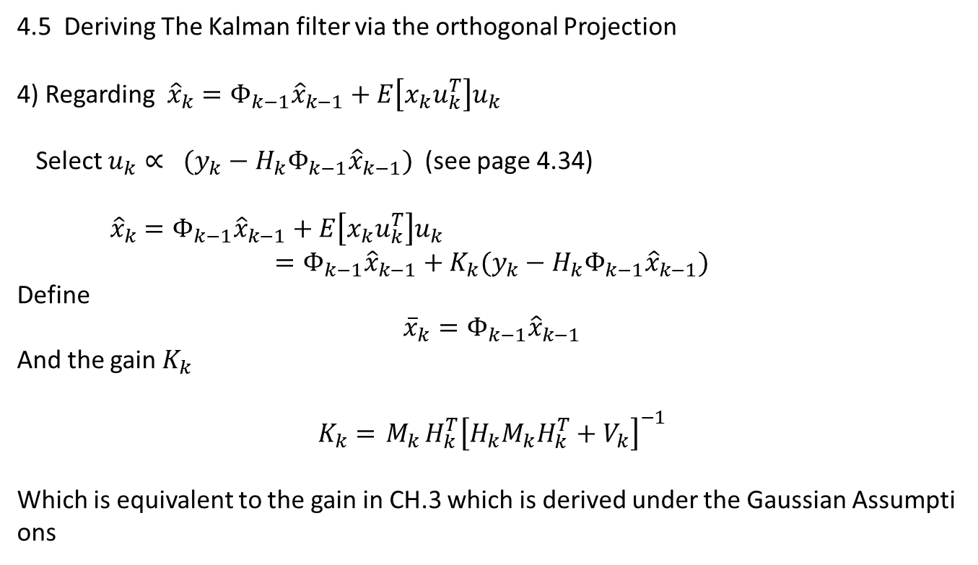
4.5 Deriving The Kalman filter via the orthogonal Projection
4) Regarding ${\hat{x}}_{k}$ $=Φ_{k−1}{\hat{x}}_{k−1}+E\left[x_{k}u_{k}^{T}\right]u_{k}$
Select $u_{k}∝ (y_{k}−H_{k}Φ_{k−1}{\hat{x}}_{k−1})$ (see page 4.34)
${\hat{x}}_{k}$ $=Φ_{k−1}{\hat{x}}_{k−1}+E\left[x_{k}u_{k}^{T}\right]u_{k}$
$$=Φ_{k−1}{\hat{x}}_{k−1}+K_{k}(y_{k}−H_{k}Φ_{k−1}{\hat{x}}_{k−1})$$
Define
$${\overline{x}}_{k}=Φ_{k−1}{\hat{x}}_{k−1}$$
And the gain $K_{k}$
$$K_{k}={ M}_{k}H_{k}^{T}{\left[H_{k}M_{k}H_{k}^{T}+V_{k}\right]}^{−1}$$
Which is equivalent to the gain in CH.3 which is derived under the Gaussian Assumptions

Slide 25
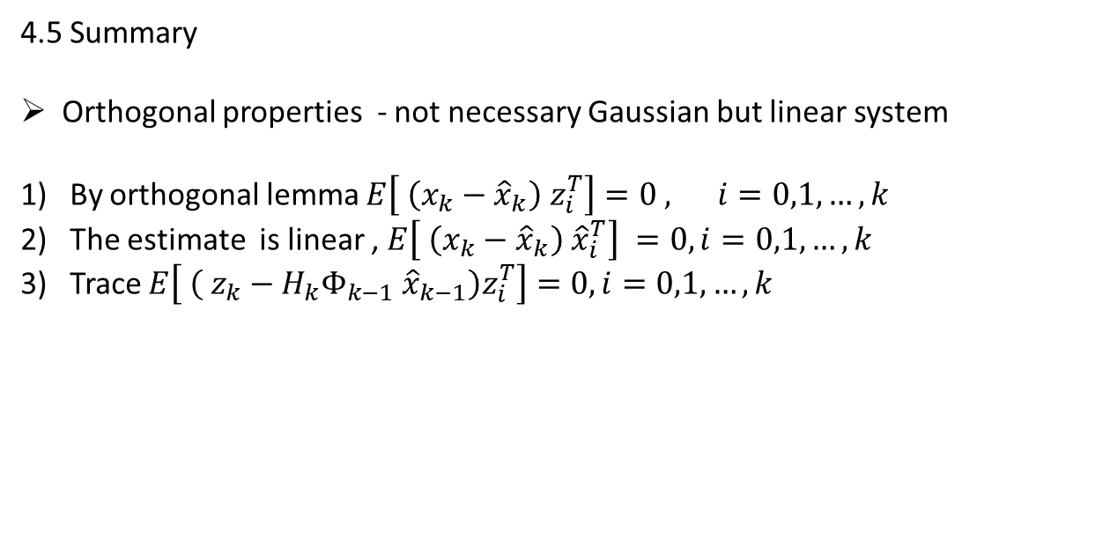
4.5 Summary
Orthogonal properties - not necessary Gaussian but linear system
By orthogonal lemma $E\left[ \left(x_{k}−{\hat{x}}_{k}\right) z_{i}^{T}\right]=0 , i=0,1,…, k$
The estimate is linear , $E\left[ \left(x_{k}−{\hat{x}}_{k}\right) {\hat{x}}_{i}^{T}\right] =0,i=0,1,…, k$
Trace $E\left[ \left( z_{k}−H_{k}Φ_{k−1} {\hat{x}}_{k−1}\right)z_{i}^{T}\right]=0,i=0,1,…, k$

Slide 26

Kalman : Drift :
$$x_{k+1}=Φ_{k}x_{k}+Γ_{k}w_{k}, x_{0} \sim N\left({\overline{x}}_{0} , M_{0}\right) \\ z_{k}=H_{k}x_{k}+v_{k}$$
$$w_{k} ,v_{k},V_{k}, independent ∀ k, mean=0, σ_{w}^{2} , σ_{v}^{2}=V_{k}$$
Prediction
1) Mean
$${\overline{x}}_{k+1}= E\left[x_{k+1} | Z_{k}\right] \\ =Φ_{k}{\hat{x}}_{k} (3.42)$$
2) Variance
$$M_{k+1}=E\left[{(x}_{k+1}− {\overline{x}}_{k+1}){(x}_{k+1}− {\overline{x}}_{k+1})^T | Z_{k}\right] \\ =Φ_{k}P_{k}Φ_{k}^{T}+Γ_{k}W_{k}Γ_{k}^{T}$$

Slide 27
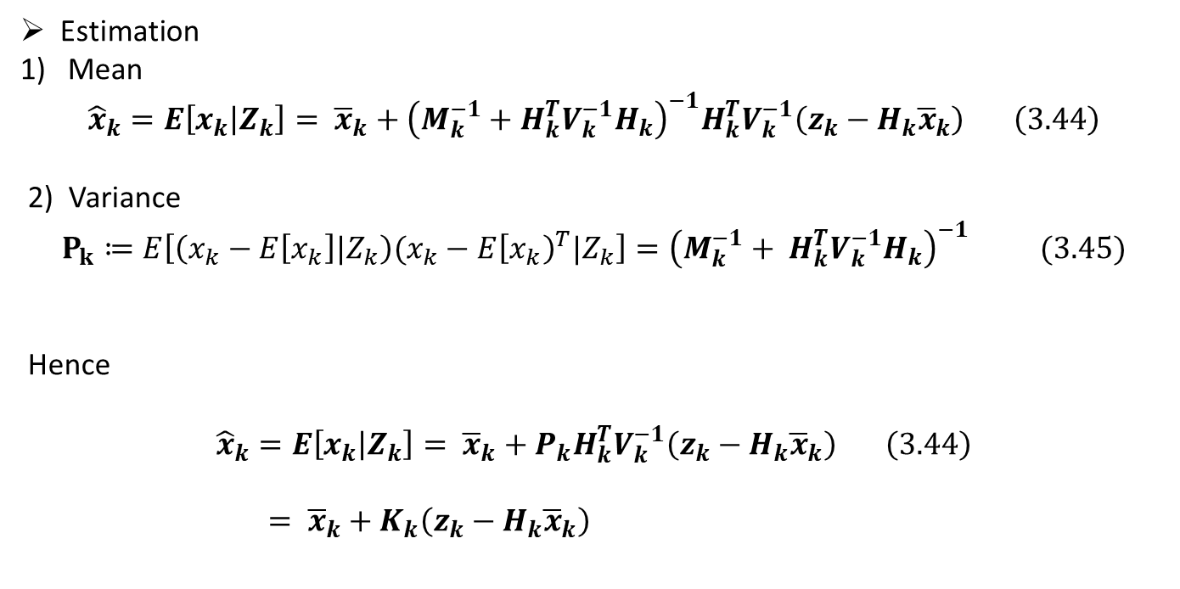
Estimation
Mean
$${\hat{x}}_{k}=E\left[x_{k} | Z_{k}\right]= {\overline{x}}_{k}+{\left(M_{k}^{−1}+H_{k}^{T}V_{k}^{−1}H_{k}\right)}^{−1}H_{k}^{T}V_{k}^{−1}\left(z_{k}−H_{k}{\overline{x}}_{k}\right) \left(3.44\right)$$
2) Variance
$$P_{k}≔E\left[\left(x_{k}−E\left[x_{k}\right]|Z_{k}\right)(x_{k}−E{\left[x_{k}\right)}^{T}|Z_{k}\right]={\left(M_{k}^{−1}+ H_{k}^{T}V_{k}^{−1}H_{k}\right)}^{−1} (3.45)$$
Hence
$${\hat{x}}_{k}=E\left[x_{k} | Z_{k}\right]= {\overline{x}}_{k}+P_{k}H_{k}^{T}V_{k}^{−1}\left(z_{k}−H_{k}{\overline{x}}_{k}\right) \left(3.44\right)$$
$= {\overline{x}}_{k}+K_{k}\left(z_{k}−H_{k}{\overline{x}}_{k}\right)$

Slide 28
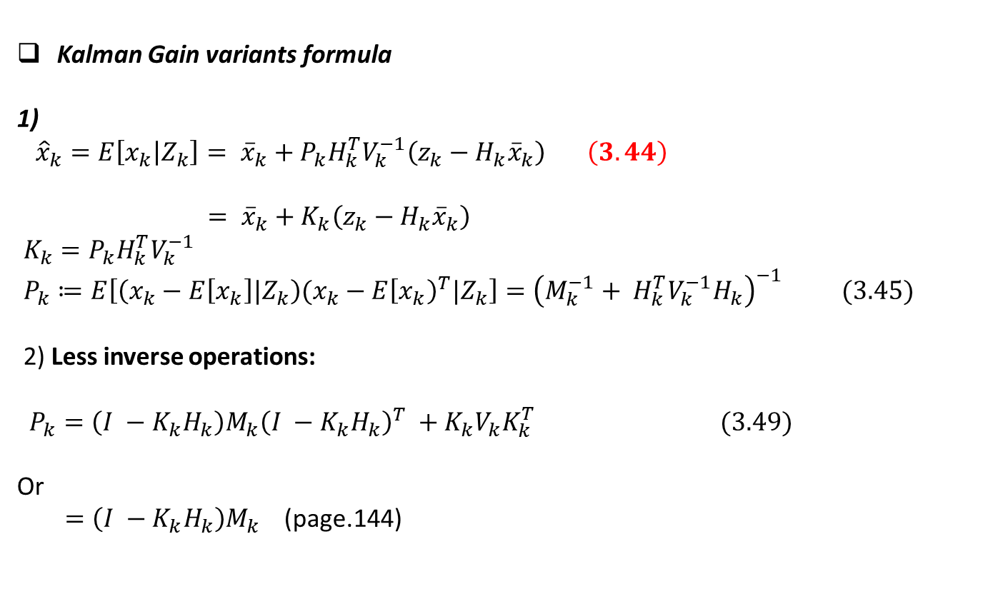
Kalman Gain variants formula
1)
${\hat{x}}_{k}=E\left[x_{k} | Z_{k}\right]= {\overline{x}}_{k}+P_{k}H_{k}^{T}V_{k}^{−1}\left(z_{k}−H_{k}{\overline{x}}_{k}\right) \left(3.44\right)$
$= {\overline{x}}_{k}+K_{k}\left(z_{k}−H_{k}{\overline{x}}_{k}\right)$
$K_{k}=P_{k}H_{k}^{T}V_{k}^{−1}$
$P_{k}≔E\left[\left(x_{k}−E\left[x_{k}\right]|Z_{k}\right)(x_{k}−E{\left[x_{k}\right)}^{T}|Z_{k}\right]={\left(M_{k}^{−1}+ H_{k}^{T}V_{k}^{−1}H_{k}\right)}^{−1} (3.45)$
2) Less inverse operations:
$P_{k}=\left(I −K_{k}H_{k}\right)M_{k}{\left(I −K_{k}H_{k}\right)}^{T} +K_{k}V_{k}K_{k}^{T} (3.49)$
Or
$=\left(I −K_{k}H_{k}\right)M_{k}$ (page.144)

