Slide 1








%% State – Output Feedback
$$Γ_{k}$$
Delay
$$H_{k}$$
State Feedback
$$Φ_{k}$$
$$Λ_{k}$$
$$Γ_{k}$$
Delay
$$H_{k}$$
Output Feedback
$$Φ_{k}$$
$${\tilde{Λ}}_{k}$$

Slide 2
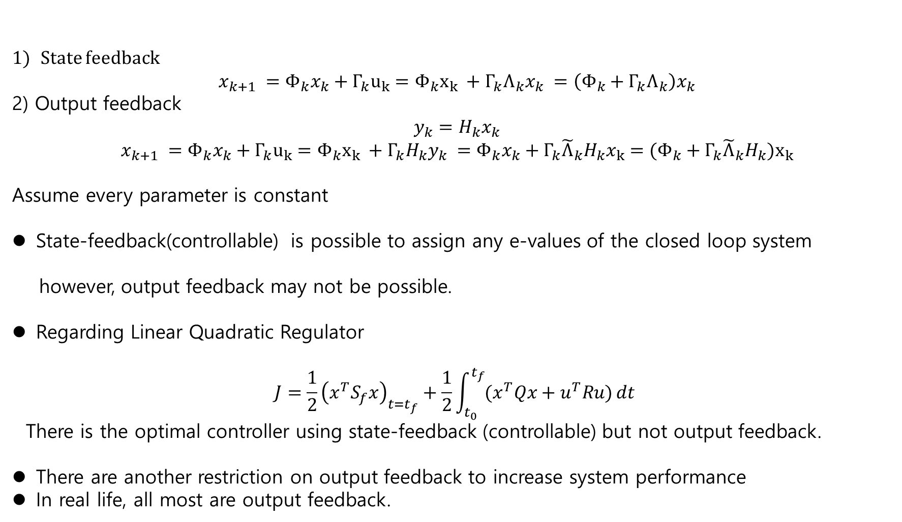
State feedback
$$x_{k+1} =Φ_{k}x_{k}+Γ_{k}u_{k}={Φ_{k}x}_{k} +{Γ_{k}Λ}_{k}x_{k} =\left(Φ_{k}+Γ_{k}Λ_{k}\right)x_{k}$$
2) Output feedback
$$y_{k}=H_{k}x_{k}$$
$$x_{k+1} =Φ_{k}x_{k}+{Γ_{k}u}_{k}={Φ_{k}x}_{k} +Γ_{k}H_{k}y_{k} =Φ_{k}x_{k}+Γ_{k}{\tilde{Λ}}_{k}H_{k}x_{k}=({Φ_{k}+Γ_{k}{\tilde{Λ}}_{k}H_{k})x}_{k}$$
Assume every parameter is constant
State-feedback(controllable) is possible to assign any e-values of the closed loop system
however, output feedback may not be possible.
Regarding Linear Quadratic Regulator
$$J=\frac{1}{2}{\left(x^{T}S_{f}x\right)}_{t=t_{f}}+\frac{1}{2}\int_{t_{0}}^{t_{f}}{(x^{T}Qx+u^{T}Ru)}dt$$
There is the optimal controller using state-feedback (controllable) but not output feedback.
There are another restriction on output feedback to increase system performance
In real life, all most are output feedback.
%% State – Output Feedback

Slide 3

%% State – Output Feedback
Before Kalman, almost all systems are related to output feedback
$$Y\left(s\right)=H\left(s\right)X\left(s\right)$$
→ root locus , assign the poles in part but not all in the LHP, Nyquist
remember PID controllers-→ Output feedback
Kalman’s Ideas/contribution
- Even if output feedback, the closed loop can be assigned to any eigen-value using the estimator
- Even if output feedback, the optimal controller of Linear Quadratic Regulator can be designed.
How?
With the output as an input, design the estimator for the state : $\hat{x}\left(t\right)\sim x\left(t\right)$
Then using $\hat{x}\left(t\right)$, design the state feedback.

Slide 4
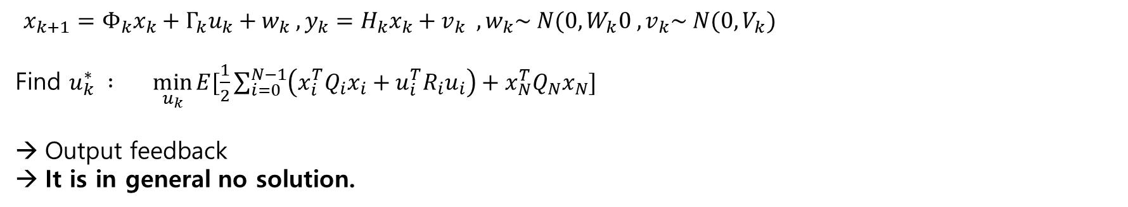
%% State – Output Feedback
$x_{k+1}=Φ_{k}x_{k}+Γ_{k}u_{k}+w_{k} , y_{k}=H_{k}x_{k}+v_{k} , w_{k}\sim N(0, W_{k}0 , v_{k}\sim N(0, V_{k})$
Find $u_{k}^{∗} : \min_{u_{k}}{E[\frac{1}{2}\sum_{i=0}^{N−1}{\left(x_{i}^{T}Q_{i}x_{i}+u_{i}^{T}R_{i}u_{i}\right)+x_{N}^{T}Q_{N}x_{N}}]}$
Output feedback
It is in general no solution.
$$Γ_{k}$$
Delay
$$H_{k}$$
Output Feedback
$$Φ_{k}$$
$${\tilde{Λ}}_{k}$$

Slide 5
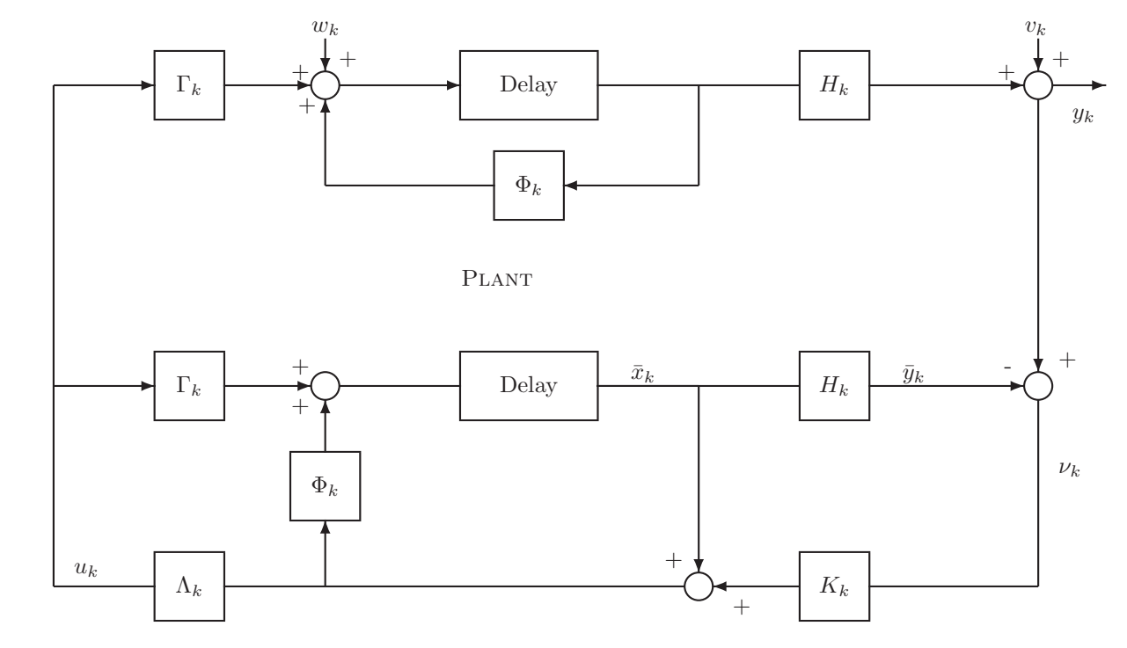

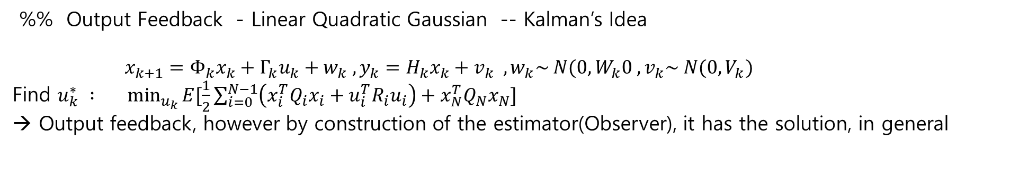

%% Output Feedback - Linear Quadratic Gaussian -- Kalman’s Idea
$x_{k+1}=Φ_{k}x_{k}+Γ_{k}u_{k}+w_{k} , y_{k}=H_{k}x_{k}+v_{k} , w_{k}\sim N(0, W_{k}0 , v_{k}\sim N(0, V_{k})$
Find $u_{k}^{∗} : \min_{u_{k}}{E[\frac{1}{2}\sum_{i=0}^{N−1}{\left(x_{i}^{T}Q_{i}x_{i}+u_{i}^{T}R_{i}u_{i}\right)+x_{N}^{T}Q_{N}x_{N}}]}$
→ Output feedback, however by construction of the estimator(Observer), it has the solution, in general
$u_{k}=Λ_{k}{\hat{x}}_{k}$
${{{\hat{x}}_{k}={\overline{x}}_{k}+ K}_{k}(y−H}_{k}{\overline{x}}_{k}$)

Slide 6
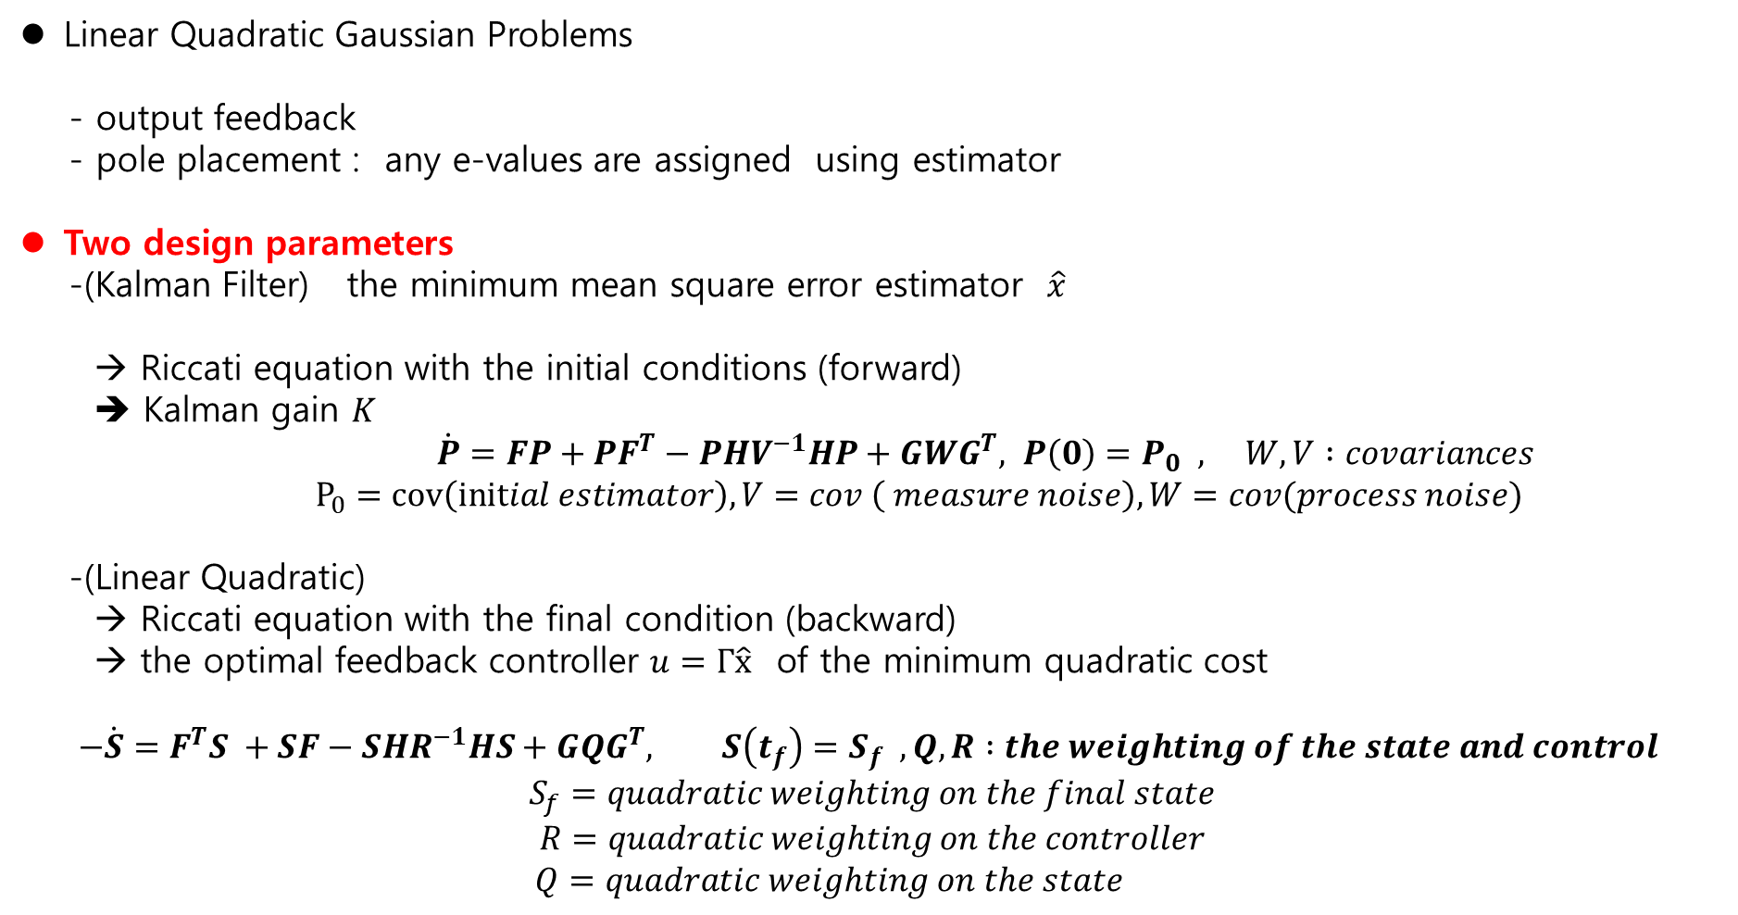
%% State – Output Feedback
Linear Quadratic Gaussian Problems
- output feedback
- pole placement : any e-values are assigned using estimator
Two design parameters
-(Kalman Filter) the minimum mean square error estimator $\hat{x}$
→ Riccati equation with the initial conditions (forward)
➔ Kalman gain $K$
$\dot{P}=FP+PF^{T}−PHV^{−1}HP+GWG^{T}, P\left(0\right)=P_{0} , W,V :covariances$
$P_{0}=cov\left(initial estimator\right), V=cov \left( measure noise\right), W=cov(process noise)$
-(Linear Quadratic)
→ Riccati equation with the final condition (backward)
→ the optimal feedback controller $u=Γ\hat{x}$ of the minimum quadratic cost
$$−\dot{S}=F^{T}S +SF−SHR^{−1}HS+GQG^{T}, S\left(t_{f}\right)=S_{f} , Q,R :the weighting of the state and control$$
$$S_{f}=quadratic weighting on the final state$$
$$R=quadratic weighting on the controller$$
$Q=quadratic weighting on the state$

Slide 7
Ch.9 Stochastic Control and the Linear Quadratic Gaussian Control Problem
9.1 Dynamic Programming: An illustration
9.2 Stochastic Dynamic System
9.2.1 Stochastic Control Problem with Perfect Observation
9.3 Dynamic Programming Algorithm
9.4 Stochastic LQ Problems with Perfect Information
9.41 Application of the Dynamic Programming Algorithm

Slide 8
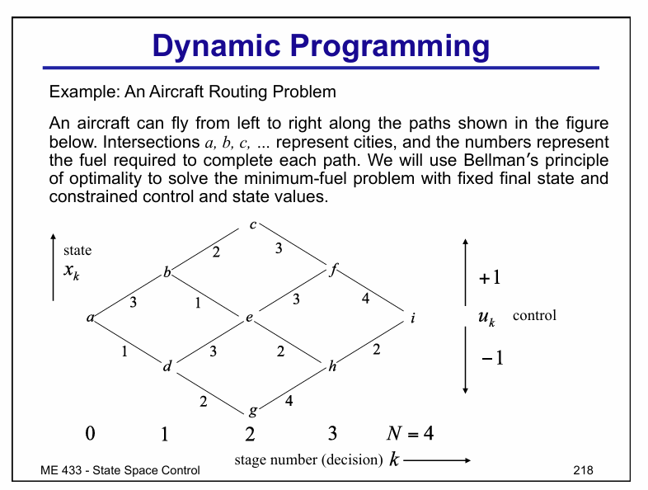
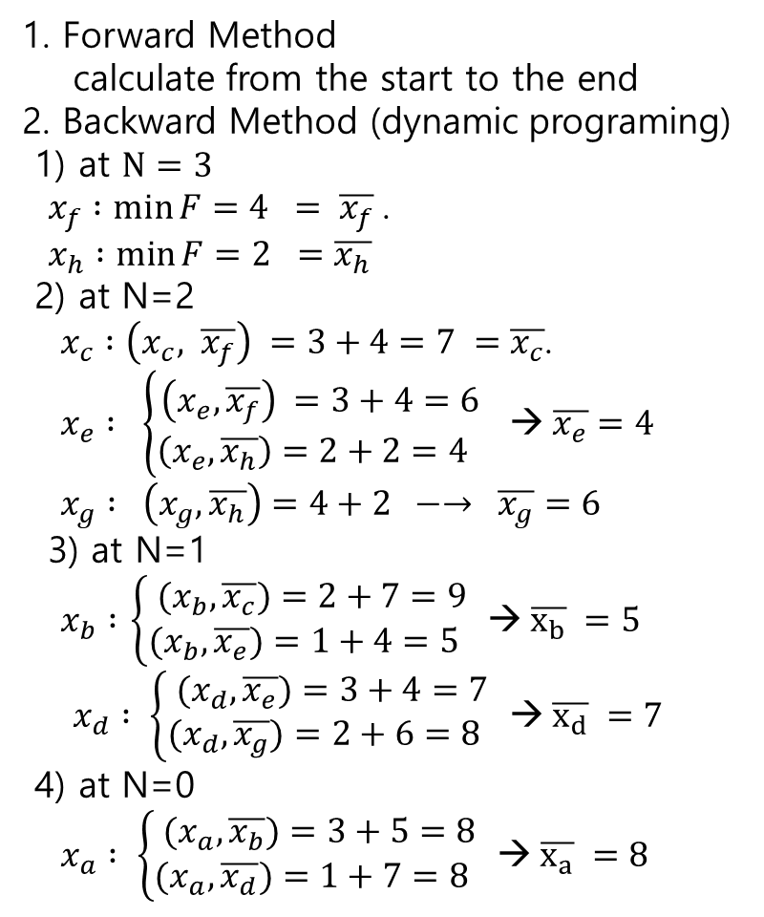
%% Dynamic Programming
1. Forward Method
calculate from the start to the end
2. Backward Method (dynamic programing)
1) at $N=3$
$x_{f} :\min{F=4 = \overline{x_{f}}}$.
$x_{h} :\min{F}=2 =\overline{x_{h}}$
2) at N=2
$x_{c} :\left(x_{c}, \overline{x_{f}}\right) =3+4=7 =\overline{x_{c}}$.
$x_{e} : \left\{\begin{aligned}\left(x_{e}, \overline{x_{f}}\right) =3+4=6 \\ \left(x_{e}, \overline{x_{h}}\right)=2+2=4 \end{aligned}\right.$ →$\overline{x_{e}}=4$
$x_{g} :$ $\left(x_{g}, \overline{x_{h}}\right)=4+2 −→ \overline{x_{g}}=6$
3) at N=1
$x_{b} :$ $\left\{\begin{aligned}{(x}_{b}, \overline{x_{c}})=2+7=9 \\ (x_{b}, \overline{x_{e}})=1+4=5 \end{aligned}\right.$ →$\overline{x_{b}} =5$
$x_{d} : \left\{\begin{aligned}(x_{d}, \overline{x_{e}})=3+4=7 \\ (x_{d}, \overline{x_{g}})=2+6=8 \end{aligned}\right.$ →$\overline{x_{d}} =7$
4) at N=0
$x_{a} : \left\{\begin{aligned}(x_{a}, \overline{x_{b}})=3+5=8 \\ (x_{a}, \overline{x_{d}})=1+7=8 \end{aligned}\right.$ →$\overline{x_{a}} =8$
Number of Multiplications
1) forward: 4+ 4+4+4+4+4 = 24
2) backward: 12

Slide 9
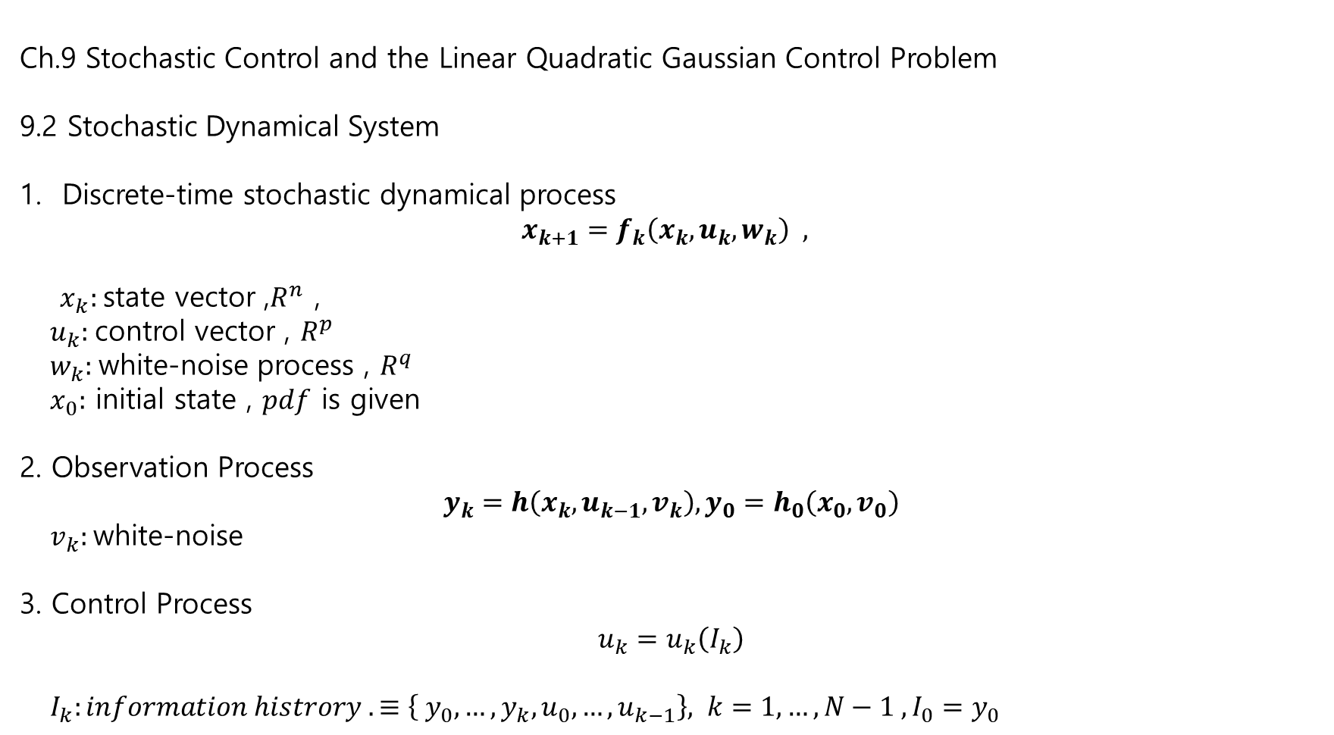
Ch.9 Stochastic Control and the Linear Quadratic Gaussian Control Problem
9.2 Stochastic Dynamical System
Discrete-time stochastic dynamical process
$$x_{k+1}=f_{k}\left(x_{k}, u_{k},w_{k}\right) ,$$
$x_{k}:$state vector ,$R^{n}$ ,
$u_{k}:$control vector , $R^{p}$
$w_{k}:$white-noise process , $R^{q}$
$x_{0}:$ initial state , $pdf$ is given
2. Observation Process
$$y_{k}=h\left(x_{k}, u_{k−1}, v_{k}\right), y_{0}=h_{0}\left(x_{0}, v_{0}\right)$$
$v_{k}:$white-noise
3. Control Process
$$u_{k}=u_{k}\left(I_{k}\right)$$
$I_{k}:information histrory . ≡\left\{ y_{0}, …, y_{k}, u_{0},…, u_{k−1}\right\}, k=1,…, N−1 , I_{0}=y_{0}$

Slide 10
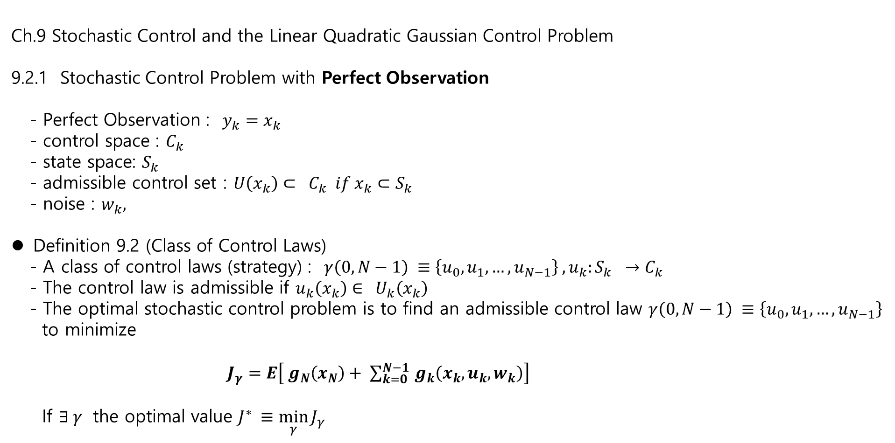
Ch.9 Stochastic Control and the Linear Quadratic Gaussian Control Problem
9.2.1 Stochastic Control Problem with Perfect Observation
- Perfect Observation : $y_{k}=x_{k}$
- control space : $C_{k}$
- state space: $S_{k}$
- admissible control set : $U\left(x_{k}\right)⊂ C_{k} if x_{k}⊂S_{k}$
- noise : $w_{k},$
Definition 9.2 (Class of Control Laws)
- A class of control laws (strategy) : $γ\left(0, N−1\right) ≡\left\{u_{0}, u_{1},…, u_{N−1}\right\} , u_{k}:S_{k} →C_{k}$
- The control law is admissible if $u_{k}\left(x_{k}\right)∈ U_{k}\left(x_{k}\right)$
- The optimal stochastic control problem is to find an admissible control law $γ\left(0, N−1\right) ≡\left\{u_{0}, u_{1},…, u_{N−1}\right\}$
to minimize
$J_{γ}=E\left[ g_{N}\left(x_{N}\right)+ \sum_{k=0}^{N−1 }{g_{k}\left(x_{k}, u_{k}, w_{k}\right)}\right]$
If $∃ γ$ the optimal value $J^{∗} ≡\min_{γ}{J_{γ}}$

Slide 11
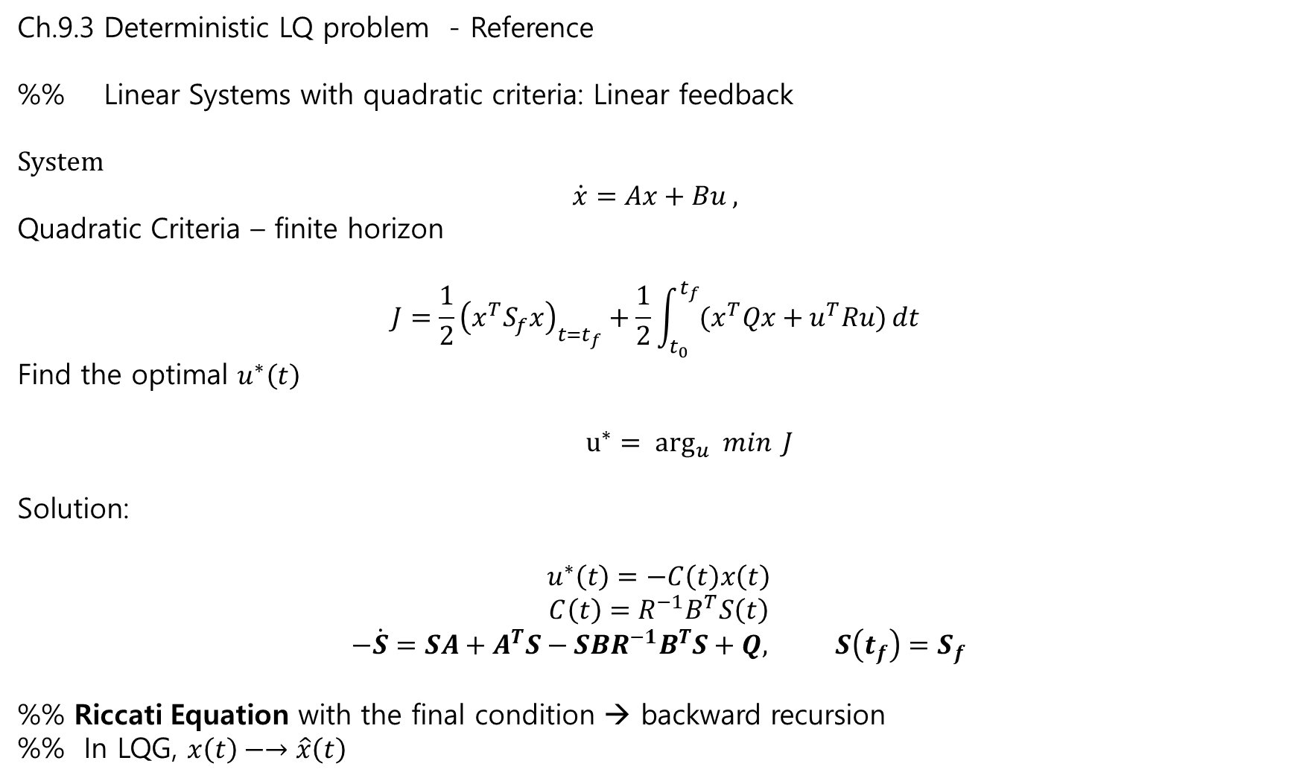
Ch.9.3 Deterministic LQ problem - Reference
%% Linear Systems with quadratic criteria: Linear feedback
System
$$\dot{x}=Ax+Bu ,$$
Quadratic Criteria – finite horizon
$$J=\frac{1}{2}{\left(x^{T}S_{f}x\right)}_{t=t_{f}}+\frac{1}{2}\int_{t_{0}}^{t_{f}}{(x^{T}Qx+u^{T}Ru)}dt$$
Find the optimal $u^{∗}\left(t\right)$
${u^{∗}= arg}_{u} min{J}$
Solution:
$$u^{∗}\left(t\right)=−C\left(t\right)x\left(t\right)$$
$$C\left(t\right)=R^{−1}B^{T}S\left(t\right)$$
$$−\dot{S}=SA+A^{T}S−SBR^{−1}B^{T}S+Q, S\left(t_{f}\right)=S_{f}$$
%% Riccati Equation with the final condition → backward recursion
%% In LQG, $x\left(t\right)−→\hat{x}\left(t\right)$

Slide 12
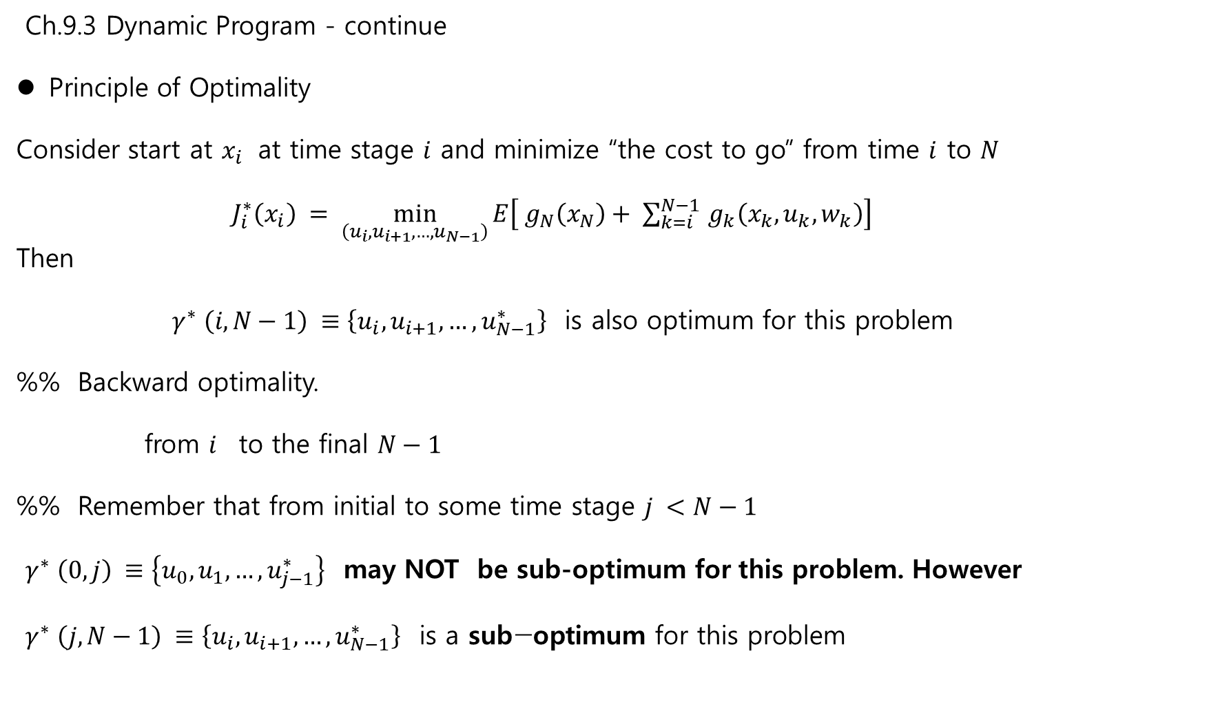
Ch.9.3 Dynamic Program - continue
Principle of Optimality
Consider start at $x_{i}$ at time stage $i$ and minimize “the cost to go” from time $i$ to $N$
$J_{i}^{∗}\left(x_{i}\right) = \min_{\left(u_{i}, u_{i+1},…, u_{N−1}\right)}{E\left[ g_{N}\left(x_{N}\right)+ \sum_{k=i}^{N−1 }{g_{k}\left(x_{k}, u_{k}, w_{k}\right)}\right]}$
Then
$γ^{∗} \left(i, N−1\right) ≡\left\{u_{i}, u_{i+1},…, u_{N−1}^{∗}\right\}$ is also optimum for this problem
%% Backward optimality.
from $i$ to the final $N−1$
%% Remember that from initial to some time stage $j <N−1$
$γ^{∗} \left(0, j\right) ≡\left\{u_{0}, u_{1},…, u_{j−1}^{∗}\right\}$ may NOT be sub-optimum for this problem. However
$γ^{∗} \left(j, N−1\right) ≡\left\{u_{i}, u_{i+1},…, u_{N−1}^{∗}\right\} \text{is} \text{a} \text{sub}\text{−}\text{optimum} \text{for} \text{this} \text{problem}$

Slide 13

Ch.9.3 Continue
Lemma 9.3(Fundamental Lemma for Stochastic Control)
Suppose the minimum to
$$\min_{u∈U }{g(x,u)}$$
exists and $E[g\left(x,u\right)]$ exists. Then
$$\min_{u(x)∈U}{E\left[g\left(x,u\right)\right]=E[ \min_{u∈U}{g(x,u)]}}$$
%% The expectation operator can be out of minimum.

Slide 14
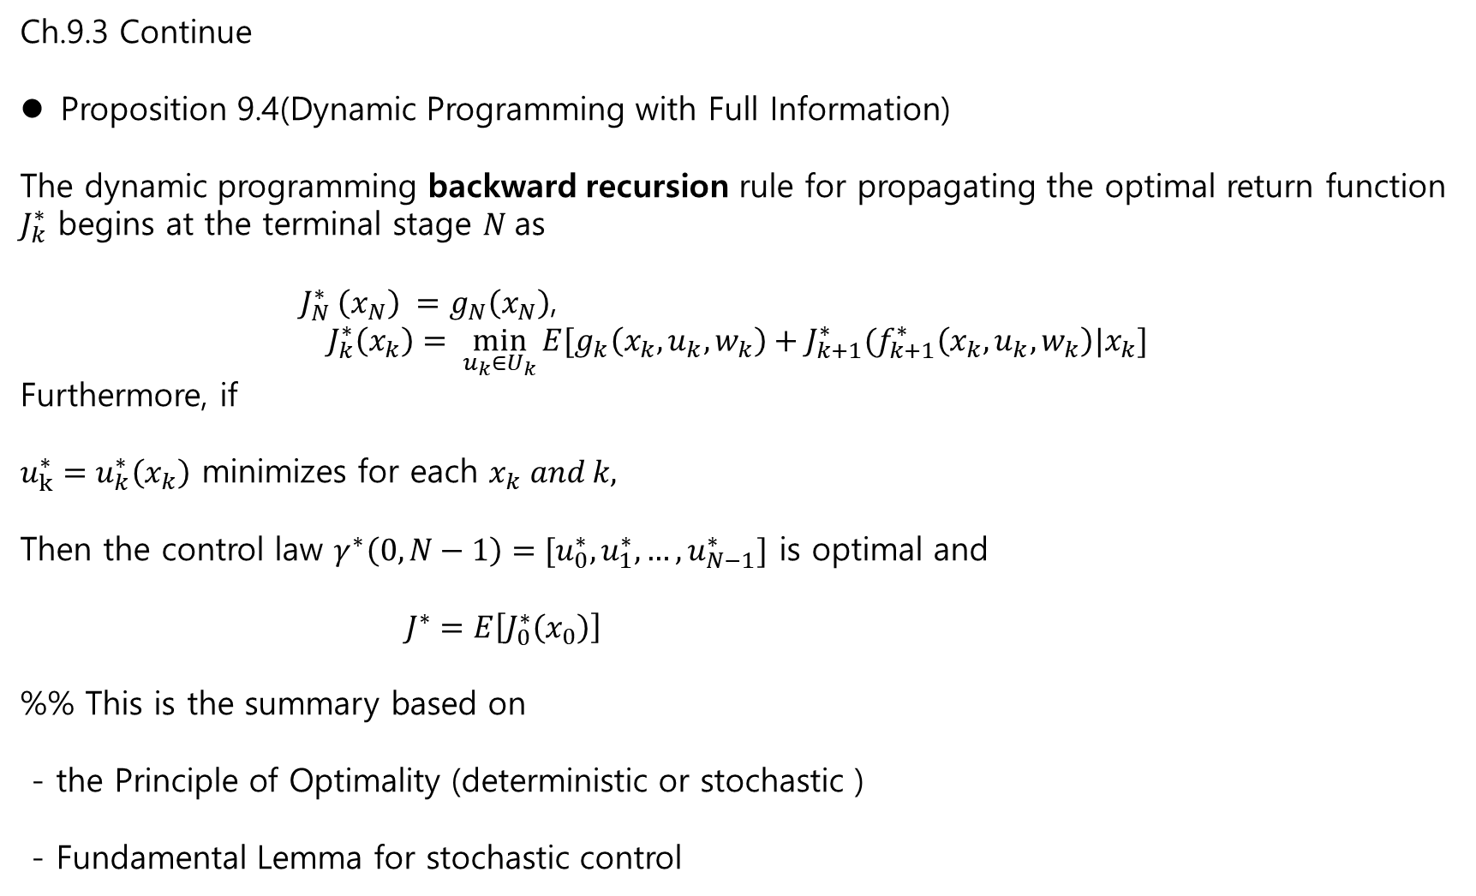
Ch.9.3 Continue
Proposition 9.4(Dynamic Programming with Full Information)
The dynamic programming backward recursion rule for propagating the optimal return function $J_{k}^{∗}$ begins at the terminal stage $N$as
$J_{N}^{∗} \left(x_{N}\right) =g_{N}\left(x_{N}\right)$,
$$J_{k}^{∗}\left(x_{k}\right)= \min_{u_{k}∈U_{k}}{E[g_{k}\left(x_{k}, u_{k}, w_{k}\right)+J_{k+1}^{∗}(f_{k+1}^{∗}\left(x_{k}, u_{k}, w_{k}\right)|x_{k}]}$$
Furthermore, if
$u_{k}^{∗}=u_{k}^{∗}\left(x_{k}\right)$ minimizes for each $x_{k} and k,$
Then the control law $γ^{∗}\left(0, N−1\right)=[u_{0}^{∗}, u_{1}^{∗},…,u_{N−1}^{∗}]$ is optimal and
$J^{∗}=E\left[J_{0}^{∗}\left(x_{0}\right)\right]$
%% This is the summary based on
- the Principle of Optimality (deterministic or stochastic )
- Fundamental Lemma for stochastic control

Slide 15
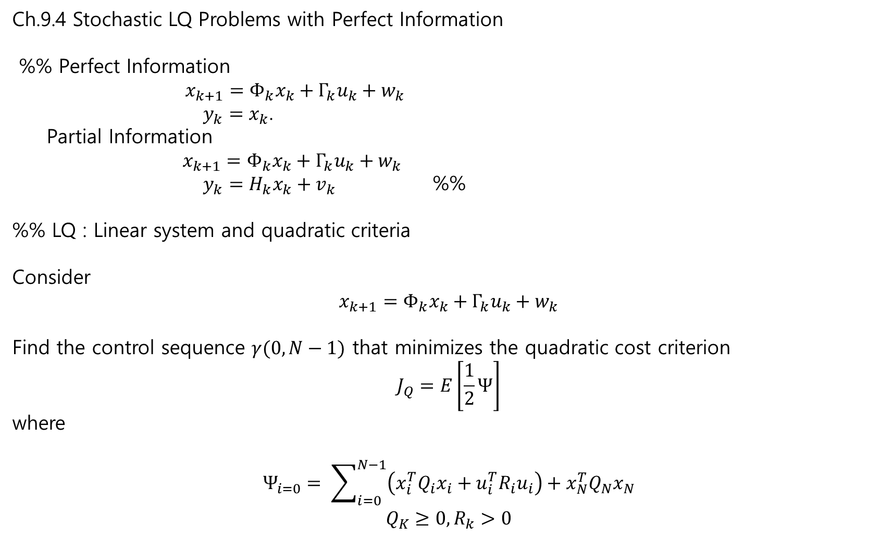
Ch.9.4 Stochastic LQ Problems with Perfect Information
%% Perfect Information
$x_{k+1}=Φ_{k}x_{k}+Γ_{k}u_{k}+w_{k}$
$y_{k}=x_{k}$.
Partial Information
$x_{k+1}=Φ_{k}x_{k}+Γ_{k}u_{k}+w_{k}$
$y_{k}=H_{k}x_{k}+v_{k}$ %%
%% LQ : Linear system and quadratic criteria
Consider
$$x_{k+1}=Φ_{k}x_{k}+Γ_{k}u_{k}+w_{k}$$
Find the control sequence $γ(0, N−1)$ that minimizes the quadratic cost criterion
$$J_{Q}=E\left[\frac{1}{2}Ψ\right]$$
where
$$Ψ_{i=0}= \sum_{i=0}^{N−1}{\left(x_{i}^{T}Q_{i}x_{i}+u_{i}^{T}R_{i}u_{i}\right)+x_{N}^{T}Q_{N}x_{N}}$$
$$Q_{K}≥0, R_{k}>0$$
Here, it is needless to construct the estimator
Hence, the controller may be equivalent to
that of the deterministic

Slide 16
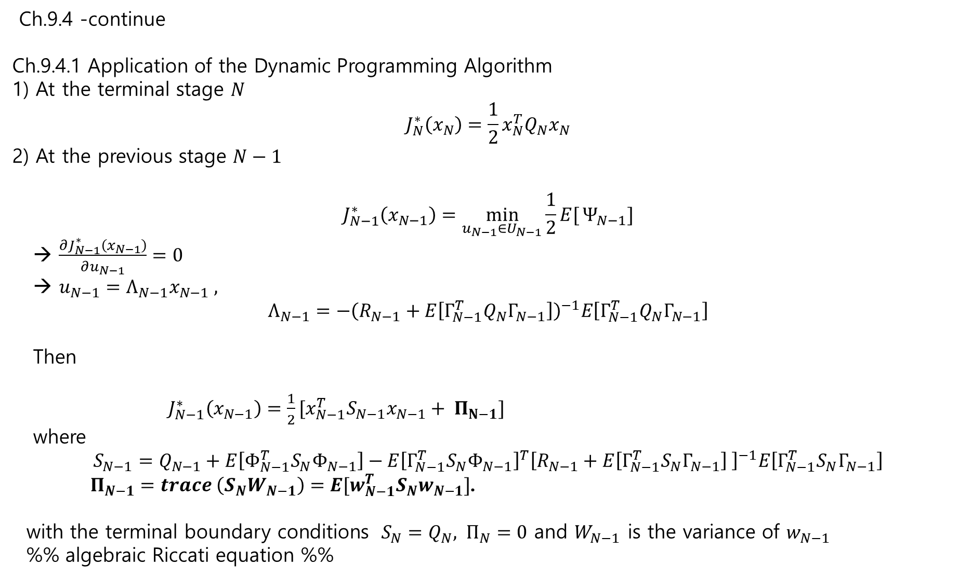
Ch.9.4 -continue
Ch.9.4.1 Application of the Dynamic Programming Algorithm
1) At the terminal stage $N$
$$J_{N}^{∗}\left(x_{N}\right)=\frac{1}{2}x_{N}^{T}Q_{N}x_{N}$$
2) At the previous stage $N−1$
$$J_{N−1}^{∗}\left(x_{N−1}\right)=\min_{u_{N−1}∈U_{N−1}}{\frac{1}{2}E[}Ψ_{N−1}]$$
→ $\frac{∂J_{N−1}^{∗}\left(x_{N−1}\right)}{∂u_{N−1}}=0$
→ $u_{N−1}=Λ_{N−1}x_{N−1} ,$
$$Λ_{N−1}=−{\left(R_{N−1}+E\left[Γ_{N−1}^{T}Q_{N}Γ_{N−1}\right]\right)}^{−1}E\left[Γ_{N−1}^{T}Q_{N}Γ_{N−1}\right]$$
Then
$J_{N−1}^{∗}\left(x_{N−1}\right)=\frac{1}{2}[x_{N−1}^{T}S_{N−1}x_{N−1}+ Π_{N−1}]$
where
$$S_{N−1}=Q_{N−1}+E\left[Φ_{N−1}^{T}S_{N}Φ_{N−1}\right]−E{\left[Γ_{N−1}^{T}S_{N}Φ_{N−1}\right]}^{T}{\left[R_{N−1}+E\left[Γ_{N−1}^{T}S_{N}Γ_{N−1}\right] \right]}^{−1}E\left[Γ_{N−1}^{T}S_{N}Γ_{N−1}\right]$$
$Π_{N−1}=trace \left(S_{N}W_{N−1}\right)=E[w_{N−1}^{T}S_{N}w_{N−1}]$.
with the terminal boundary conditions $S_{N}=Q_{N}, Π_{N}=0$ and $W_{N−1}$ is the variance of $w_{N−1}$
%% algebraic Riccati equation %%

Slide 17
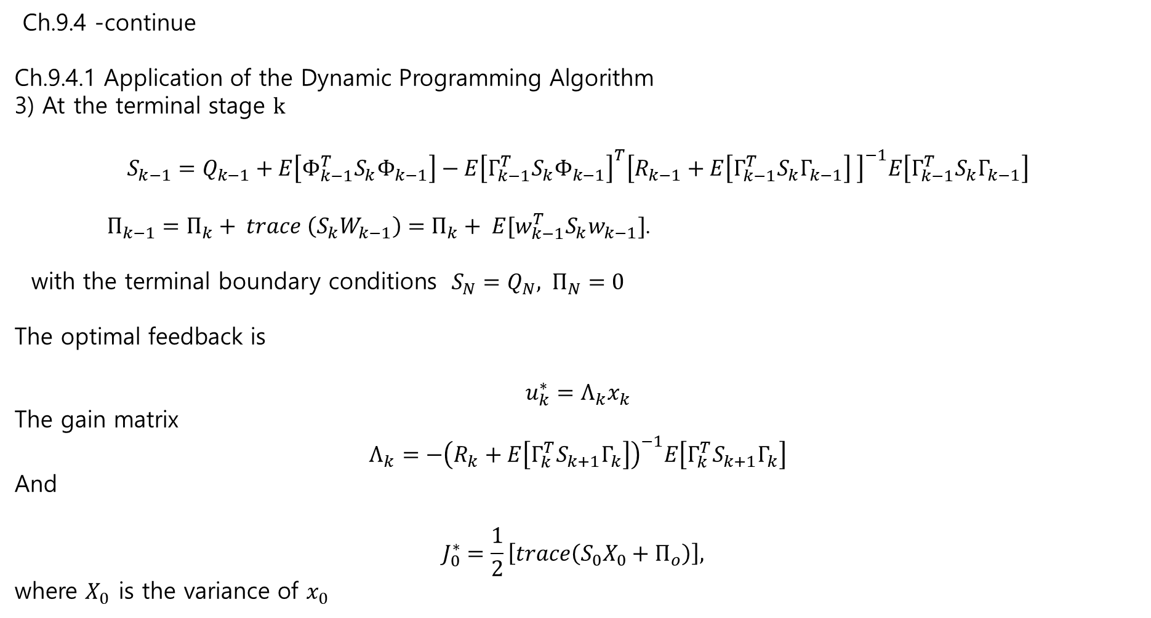
Ch.9.4 -continue
Ch.9.4.1 Application of the Dynamic Programming Algorithm
3) At the terminal stage $k$
$$S_{k−1}=Q_{k−1}+E\left[Φ_{k−1}^{T}S_{k}Φ_{k−1}\right]−E{\left[Γ_{k−1}^{T}S_{k}Φ_{k−1}\right]}^{T}{\left[R_{k−1}+E\left[Γ_{k−1}^{T}S_{k}Γ_{k−1}\right] \right]}^{−1}E\left[Γ_{k−1}^{T}S_{k}Γ_{k−1}\right]$$
$Π_{k−1}=Π_{k}+ trace \left(S_{k}W_{k−1}\right)=Π_{k}+ E[w_{k−1}^{T}S_{k}w_{k−1}]$.
with the terminal boundary conditions $S_{N}=Q_{N}, Π_{N}=0$
The optimal feedback is
$$u_{k}^{∗}=Λ_{k}x_{k}$$
The gain matrix
$$Λ_{k}=−{\left(R_{k}+E\left[Γ_{k}^{T}S_{k+1}Γ_{k}\right]\right)}^{−1}E\left[Γ_{k}^{T}S_{k+1}Γ_{k}\right]$$
And
$$J_{0}^{∗}=\frac{1}{2}\left[trace\left(S_{0}X_{0}+Π_{o}\right)\right],$$
where $X_{0}$ is the variance of $x_{0}$

Slide 18

%% Deterministic linear Quadratic Regulator – discrete-time finite horizon problem
Discrete-time system
$x_{k+1}=Φx_{k}+Γu_{k}$
The cost function
$$J=\frac{1}{2}\sum_{i=0}^{N−1}{\left(x_{i}^{T}Qx_{i}+u_{i}^{T}Ru_{i}\right)+x_{N}^{T}Q_{F}x_{N}}$$
Find $u_{0}, u_{1},…$
$$J_{i}^{∗}\left(x_{0}\right)= \min_{u_{t}, …,u_{N−1}}{J}$$
Sol.
$$u_{k}^{∗}=Λ_{k}x_{k}$$
$$Λ_{k}=−{\left(R+Γ^{T}S_{k+1}Γ\right)}^{−1}Γ^{T}S_{k+1}Φ$$
where
$$S_{k−1}=Q+Φ^{T}S_{k}Φ−{Γ^{T}S}_{k}Φ^{T}{\left[R+Γ^{T}S_{k}Γ\right]}^{−1}Γ^{T}S_{k}Φ$$
$$S_{N}=Q_{F}$$

Slide 19
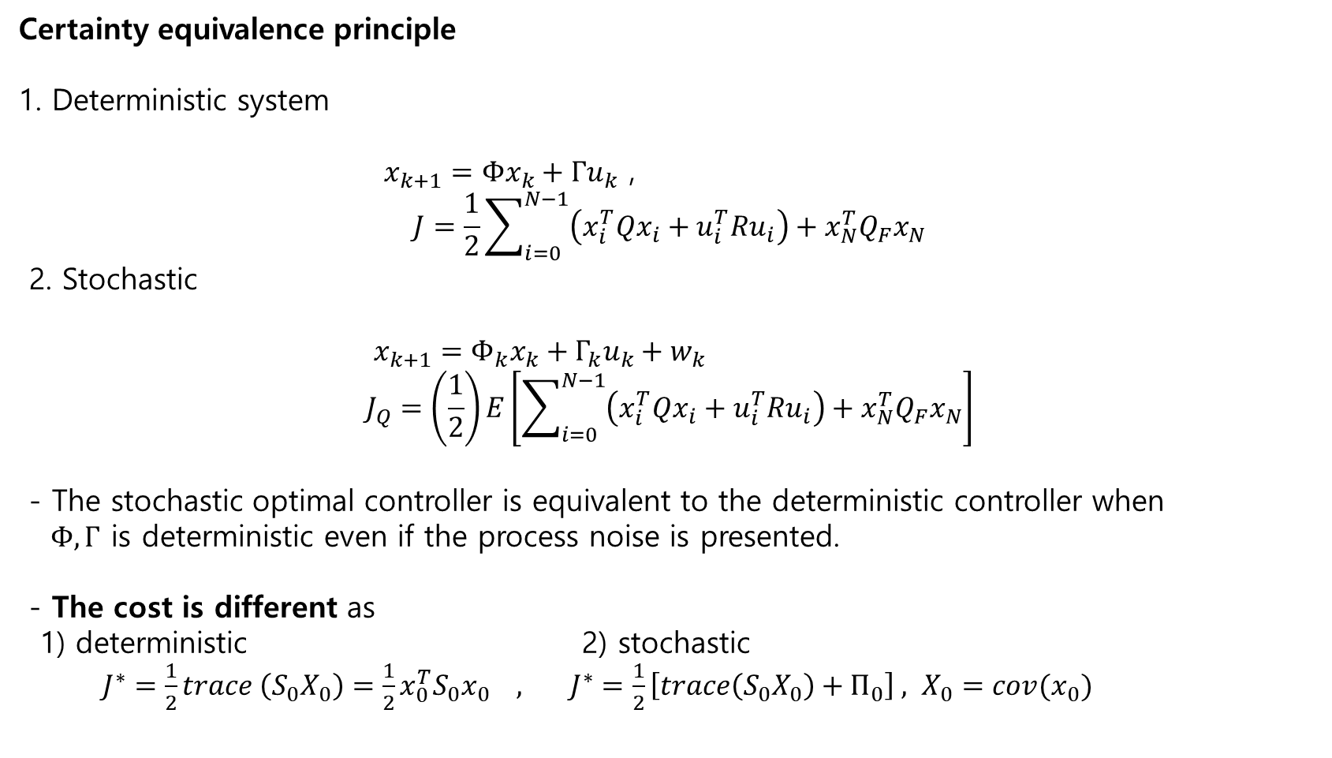
Certainty equivalence principle
1. Deterministic system
$x_{k+1}=Φx_{k}+Γu_{k}$ ,
$$J=\frac{1}{2}\sum_{i=0}^{N−1}{\left(x_{i}^{T}Qx_{i}+u_{i}^{T}Ru_{i}\right)+x_{N}^{T}Q_{F}x_{N}}$$
2. Stochastic
$x_{k+1}=Φ_{k}x_{k}+Γ_{k}u_{k}+w_{k}$
$$J_{Q}=\left(\frac{1}{2}\right)E\left[\sum_{i=0}^{N−1}{\left(x_{i}^{T}Qx_{i}+u_{i}^{T}Ru_{i}\right)+x_{N}^{T}Q_{F}x_{N}}\right]$$
- The stochastic optimal controller is equivalent to the deterministic controller when
$Φ, Γ$ is deterministic even if the process noise is presented.
- The cost is different as
1) deterministic 2) stochastic
$J^{∗}=\frac{1}{2}trace \left(S_{0}X_{0}\right)=\frac{1}{2}x_{0}^{T}S_{0}x_{0} , J^{∗}=\frac{1}{2}\left[trace\left(S_{0}X_{0}\right)+Π_{0}\right] , X_{0}=cov(x_{0})$

Slide 20
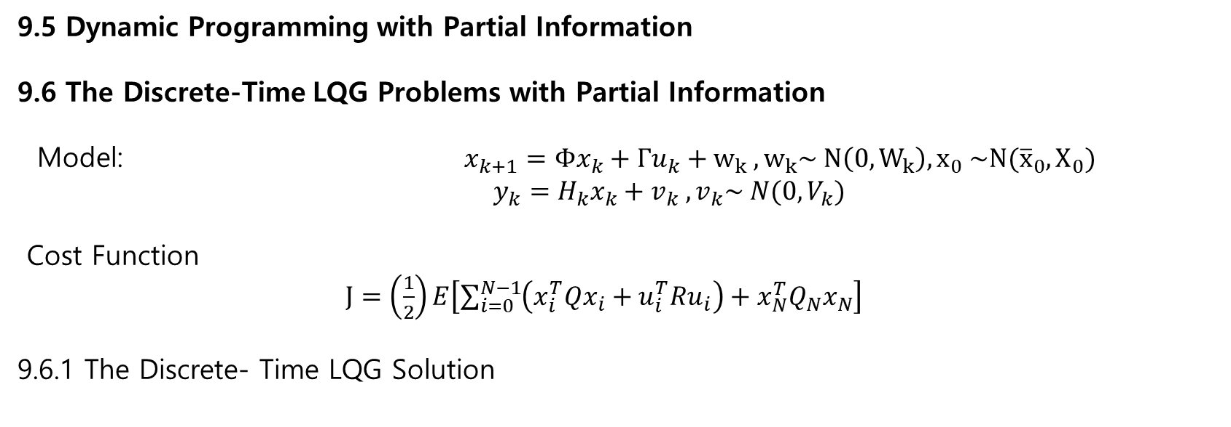
9.5 Dynamic Programming with Partial Information
9.6 The Discrete-Time LQG Problems with Partial Information
Model: $x_{k+1}=Φx_{k}+Γu_{k}+w_{k} , w_{k}\sim N\left(0, W_{k}\right), x_{0} \sim N({\overline{x}}_{0}, X_{0})$
$y_{k}=H_{k}x_{k}+v_{k} , v_{k}\sim N(0, V_{k})$
Cost Function
$J=\left(\frac{1}{2}\right)E\left[\sum_{i=0}^{N−1}{\left(x_{i}^{T}Qx_{i}+u_{i}^{T}Ru_{i}\right)+x_{N}^{T}Q_{N}x_{N}}\right]$
9.6.1 The Discrete- Time LQG Solution

Slide 21
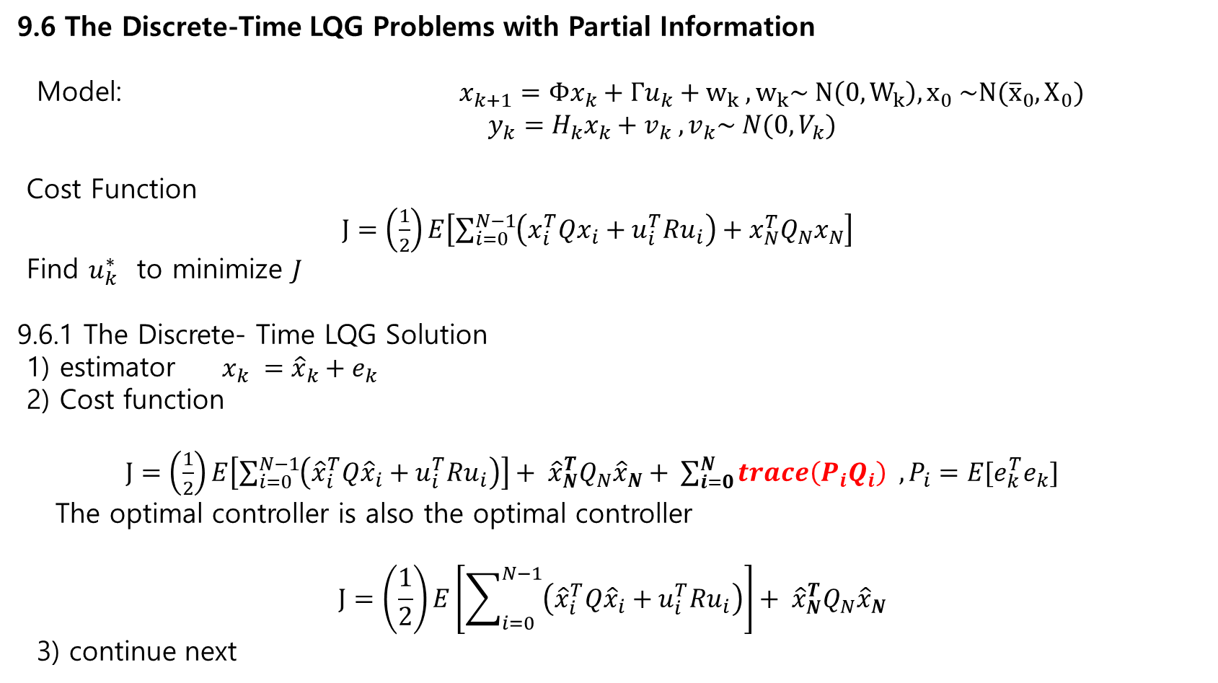
9.6 The Discrete-Time LQG Problems with Partial Information
Model: $x_{k+1}=Φx_{k}+Γu_{k}+w_{k} , w_{k}\sim N\left(0, W_{k}\right), x_{0} \sim N({\overline{x}}_{0}, X_{0})$
$y_{k}=H_{k}x_{k}+v_{k} , v_{k}\sim N(0, V_{k})$
Cost Function
$J=\left(\frac{1}{2}\right)E\left[\sum_{i=0}^{N−1}{\left(x_{i}^{T}Qx_{i}+u_{i}^{T}Ru_{i}\right)+x_{N}^{T}Q_{N}x_{N}}\right]$
Find $u_{k}^{∗}$ to minimize $J$
9.6.1 The Discrete- Time LQG Solution
1) estimator $x_{k} ={\hat{x}}_{k}+e_{k}$
2) Cost function
$J=\left(\frac{1}{2}\right)E\left[\sum_{i=0}^{N−1}{\left({\hat{x}}_{i}^{T}Q{\hat{x}}_{i}+u_{i}^{T}Ru_{i}\right)}\right]+ {\hat{x}}_{N}^{T}Q_{N}{\hat{x}}_{N}+ \sum_{i=0}^{N}{trace\left(P_{i}Q_{i}\right) , P_{i}=E[e_{k}^{T}e_{k}]}$
The optimal controller is also the optimal controller
$$J=\left(\frac{1}{2}\right)E\left[\sum_{i=0}^{N−1}{\left({\hat{x}}_{i}^{T}Q{\hat{x}}_{i}+u_{i}^{T}Ru_{i}\right)}\right]+ {\hat{x}}_{N}^{T}Q_{N}{\hat{x}}_{N}$$
3) continue next

Slide 22
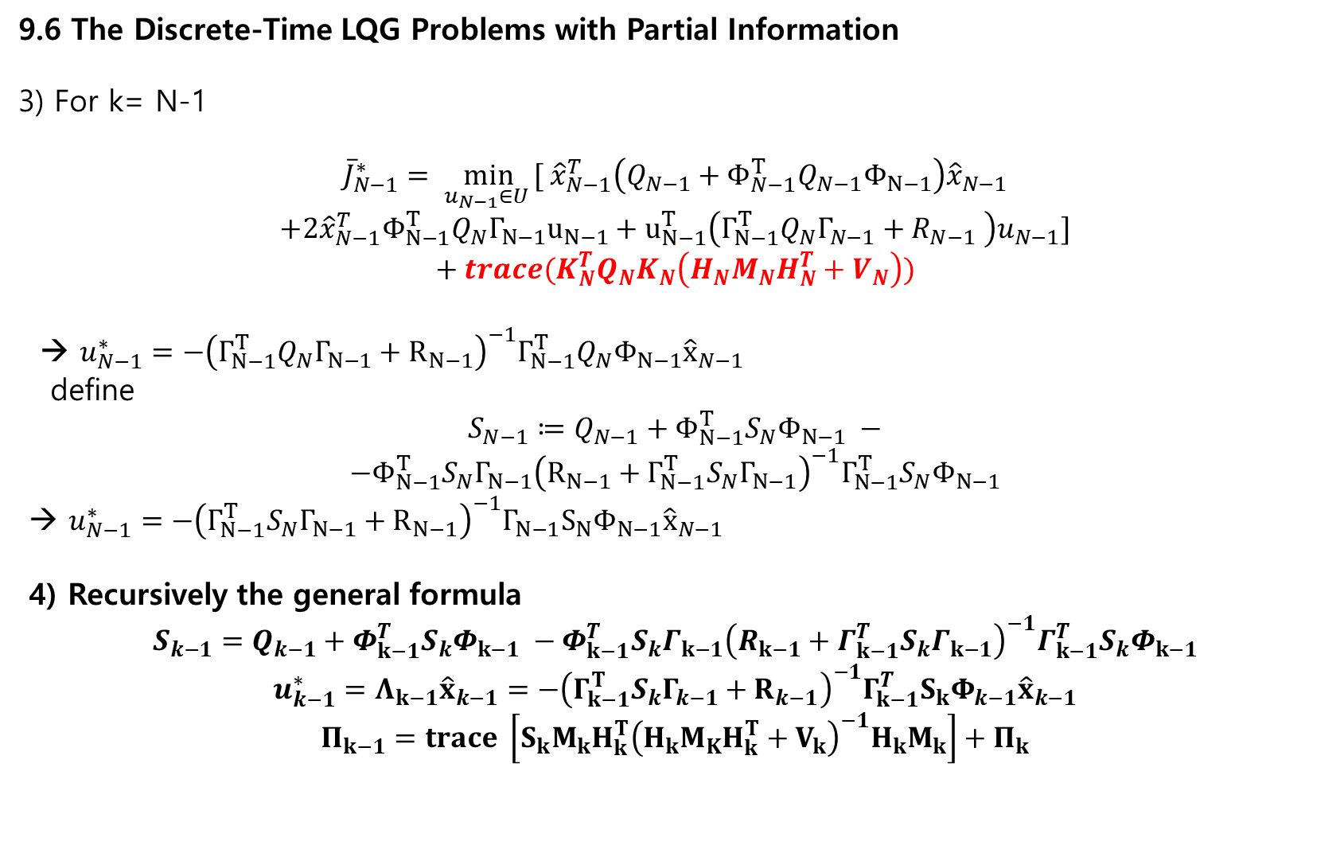
9.6 The Discrete-Time LQG Problems with Partial Information
3) For k= N-1
$${\overline{J}}_{N−1}^{∗}= \min_{u_{N−1}∈U }{[ {\hat{x}}_{N−1}^{T}\left(Q_{N−1}+Φ_{N−1}^{T}Q_{N−1}Φ_{N−1}\right){\hat{x}}_{N−1}}$$
$$+2{\hat{x}}_{N−1}^{T}Φ_{N−1}^{T}Q_{N}Γ_{N−1}u_{N−1}+u_{N−1}^{T}\left(Γ_{N−1}^{T}Q_{N}Γ_{N−1}+R_{N−1} \right)u_{N−1}]$$
$$+ trace(K_{N}^{T}Q_{N}K_{N}\left(H_{N}M_{N}H_{N}^{T}+V_{N}\right))$$
→ $u_{N−1}^{∗}=−{\left(Γ_{N−1}^{T}Q_{N}Γ_{N−1}+R_{N−1}\right)}^{−1}Γ_{N−1}^{T}Q_{N}Φ_{N−1}{\hat{x}}_{N−1}$
define
$$S_{N−1}≔Q_{N−1}+Φ_{N−1}^{T}S_{N}Φ_{N−1} −$$
$$−Φ_{N−1}^{T}S_{N}Γ_{N−1}{\left(R_{N−1}+Γ_{N−1}^{T}S_{N}Γ_{N−1}\right)}^{−1}Γ_{N−1}^{T}S_{N}Φ_{N−1}$$
→ $u_{N−1}^{∗}=−{\left(Γ_{N−1}^{T}S_{N}Γ_{N−1}+R_{N−1}\right)}^{−1}Γ_{N−1}S_{N}Φ_{N−1}{\hat{x}}_{N−1}$
4) Recursively the general formula
$$S_{k−1}=Q_{k−1}+Φ_{k−1}^{T}S_{k}Φ_{k−1} −Φ_{k−1}^{T}S_{k}Γ_{k−1}{\left(R_{k−1}+Γ_{k−1}^{T}S_{k}Γ_{k−1}\right)}^{−1}Γ_{k−1}^{T}S_{k}Φ_{k−1}$$
$$u_{k−1}^{∗}=Λ_{k−1}{\hat{x}}_{k−1}=−{\left(Γ_{k−1}^{T}S_{k}Γ_{k−1}+R_{k−1}\right)}^{−1}Γ_{k−1}^{T}S_{k}Φ_{k−1}{\hat{x}}_{k−1}$$
$$Π_{k−1}=trace \left[S_{k}M_{k}H_{k}^{T}{\left(H_{k}M_{K}H_{k}^{T}+V_{k}\right)}^{−1}H_{k}M_{k}\right]+Π_{k}$$

