Slide 1
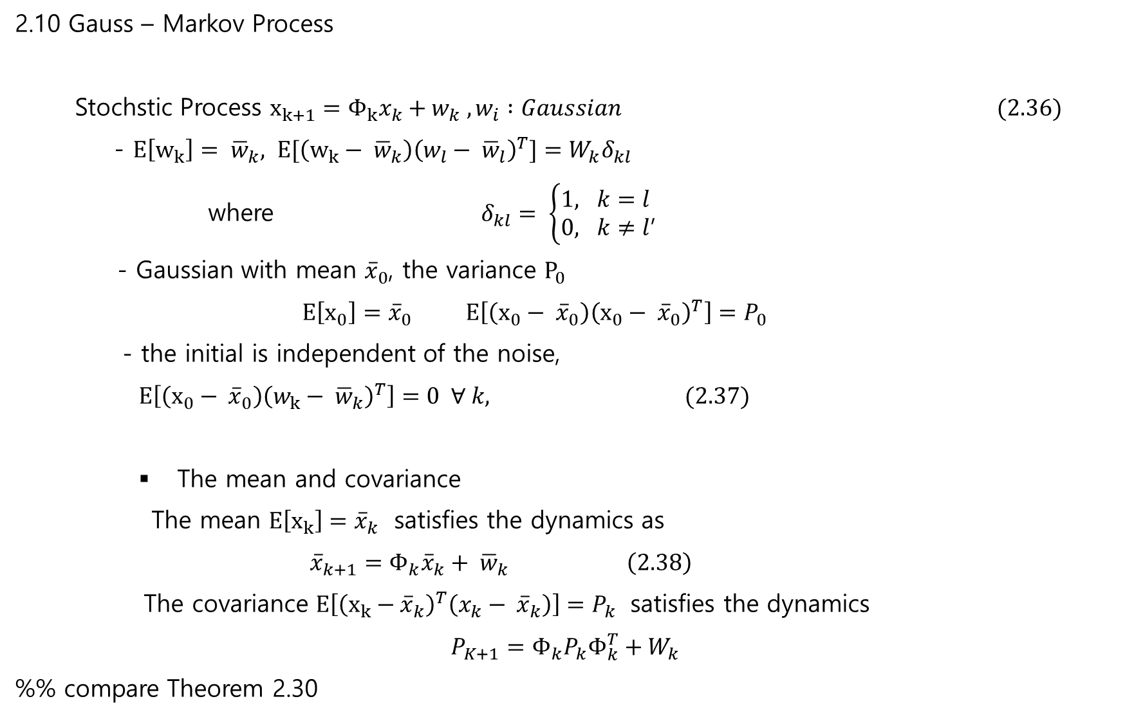
2.10 Gauss – Markov Process
Stochstic Process $x_{k+1}=Φ_{k}x_{k}+w_{k} , w_{i} :Gaussian (2.36)$
- $E\left[w_{k}\right]= {\overline{w}}_{k}, E[\left(w_{k}− {\overline{w}}_{k}\right){\left(w_{l}− {\overline{w}}_{l}\right)}^{T}]=W_{k}δ_{kl}$
where $δ_{kl}= \left\{\begin{matrix}1, k=l \\ 0, k≠l\end{matrix}\right.$,
- Gaussian with mean ${\overline{x}}_{0}$, the variance $P_{0}$
$$E\left[x_{0}\right]={\overline{x}}_{0} E\left[\left(x_{0}− {\overline{x}}_{0}\right){\left(x_{0}− {\overline{x}}_{0}\right)}^{T}\right]=P_{0}$$
- the initial is independent of the noise,
$$E\left[\left(x_{0}− {\overline{x}}_{0}\right){\left(w_{k}− {\overline{w}}_{k}\right)}^{T}\right]=0 ∀ k, (2.37)$$
The mean and covariance
The mean $E\left[x_{k}\right]={\overline{x}}_{k}$ satisfies the dynamics as
$${\overline{x}}_{k+1}=Φ_{k}{\overline{x}}_{k}+ {\overline{w}}_{k} \left(2.38\right)$$
The covariance $E\left[{\left(x_{k}−{\overline{x}}_{k}\right)}^{T}\left(x_{k}− {\overline{x}}_{k}\right)\right]=P_{k}$ satisfies the dynamics
$$P_{K+1}=Φ_{k}P_{k}Φ_{k}^{T}+W_{k}$$
%% compare Theorem 2.30

Slide 2
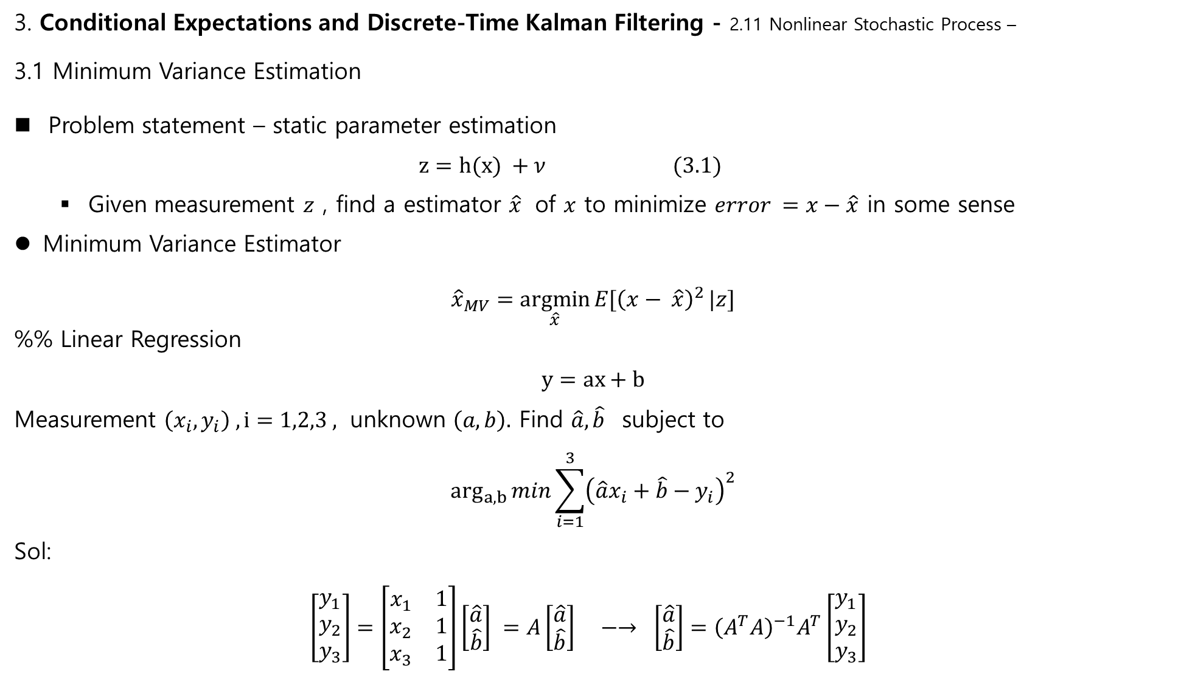
3. Conditional Expectations and Discrete-Time Kalman Filtering - 2.11 Nonlinear Stochastic Process –
3.1 Minimum Variance Estimation
Problem statement – static parameter estimation
$$z=h(x) +ν (3.1)$$
Given measurement $z$ , find a estimator $\hat{x}$ of $x$ to minimize $error =x−\hat{x}$ in some sense
Minimum Variance Estimator
$${\hat{x}}_{MV}=\underset{\hat{x}}{argmin}{E[{\left(x− \hat{x}\right)}^{2}}|z]$$
%% Linear Regression
$$y=ax+b$$
Measurement $\left(x_{i}, y_{i}\right) , i=1,2,3 ,$ unknown $\left(a,b\right).$ Find $\hat{a}, \hat{b}$ subject to
$$\arg_{a,b}{min\sum_{i=1}^{3}{{\left(\hat{a}x_{i}+\hat{b}−y_{i}\right)}^{2}}}$$
Sol:
$$\left[\begin{matrix}y_{1} \\ y_{2} \\ y_{3}\end{matrix}\right]=\left[\begin{matrix}x_{1} & 1 \\ x_{2} & 1 \\ x_{3} & 1\end{matrix}\right]\left[\begin{matrix}\hat{a} \\ \hat{b}\end{matrix}\right] =A\left[\begin{matrix}\hat{a} \\ \hat{b}\end{matrix}\right] −→ \left[\begin{matrix}\hat{a} \\ \hat{b}\end{matrix}\right]={\left(A^{T}A\right)}^{−1}A^{T}\left[\begin{matrix}y_{1} \\ y_{2} \\ y_{3}\end{matrix}\right]$$

Slide 3
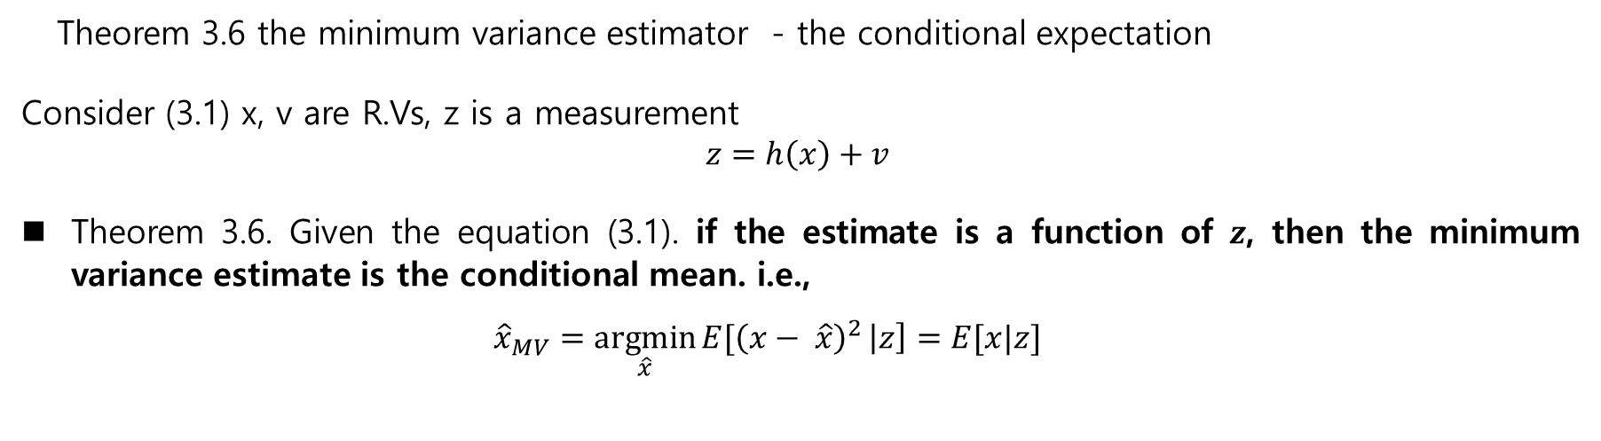
Theorem 3.6 the minimum variance estimator - the conditional expectation
Consider (3.1) x, v are R.Vs, z is a measurement
$$z=h\left(x\right)+v$$
Theorem 3.6. Given the equation (3.1). if the estimate is a function of $z$, then the minimum variance estimate is the conditional mean. i.e.,
$${\hat{x}}_{MV}=\underset{\hat{x}}{argmin}{E[{\left(x− \hat{x}\right)}^{2}}\left|z\right]=E[x|z]$$

Slide 4

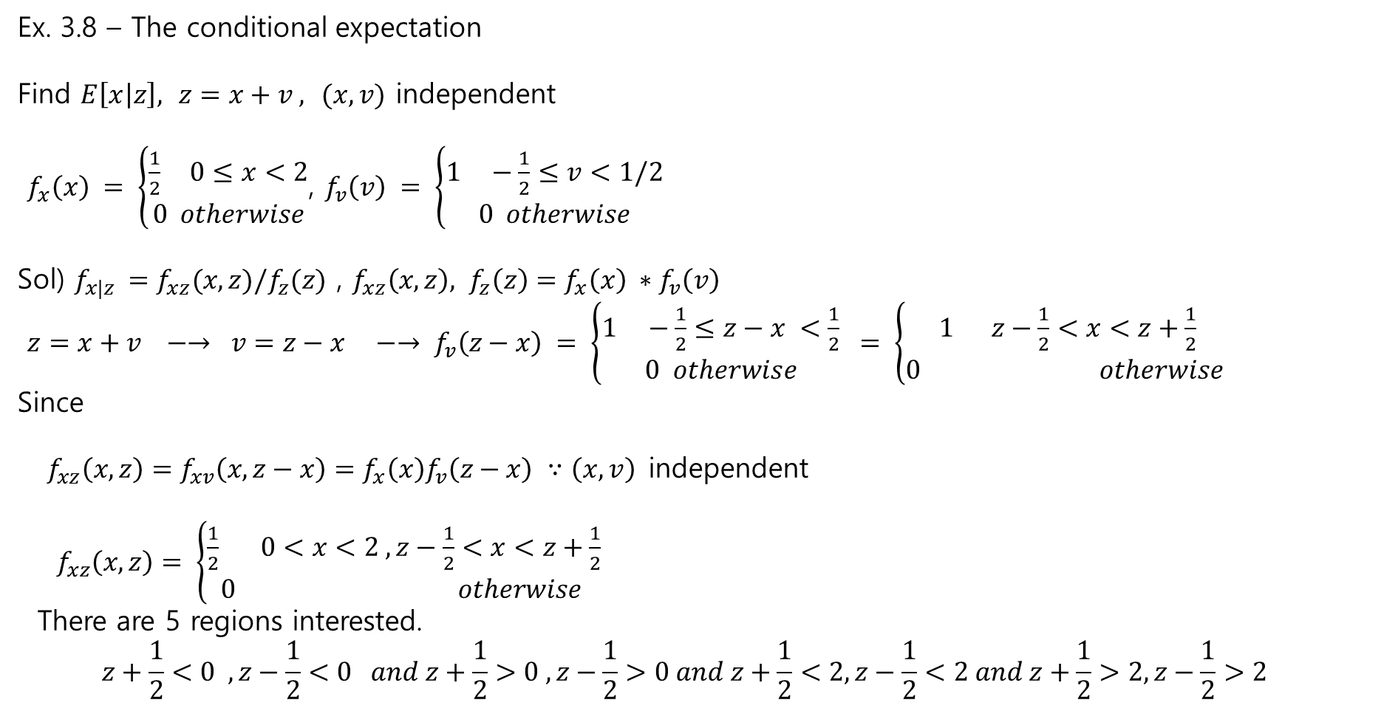

Ex. 3.8 – The conditional expectation
Find $E\left[x | z\right], z=x+v , (x,v)$ independent
$f_{x}\left(x\right) = \left\{\begin{aligned}\frac{1}{2} 0≤x<2 \\ 0 otherwise\end{aligned}\right.$, $f_{v}\left(v\right) = \left\{\begin{aligned}1 −\frac{1}{2}≤v<1/2 \\ 0 otherwise\end{aligned}\right.$
Sol) $f_{x|z }=f_{xz}(x,z)/f_{z}(z)$ , $f_{xz}\left(x,z\right), f_{z}\left(z\right)=f_{x}\left(x\right) ∗f_{v}\left(v\right)$
$$z=x+v −→ v=z−x −→ f_{v}\left(z−x\right) = \left\{\begin{aligned}1 −\frac{1}{2}≤z−x <\frac{1}{2} \\ 0 otherwise\end{aligned}\right. = \left\{\begin{aligned}1 z−\frac{1}{2}<x<z+\frac{1}{2} \\ 0 otherwise \end{aligned}\right.$$
Since
$f_{xz}\left(x,z\right)=f_{xv}\left(x,z−x\right)=f_{x}\left(x\right)f_{v}\left(z−x\right) ∵\left(x,v\right)$independent
$$f_{xz}\left(x,z\right)= \left\{\begin{aligned}\frac{1}{2} 0<x<2 , z−\frac{1}{2}<x<z+\frac{1}{2} \\ 0 otherwise \end{aligned}\right.$$
There are 5 regions interested.
$$z+\frac{1}{2}<0 , z−\frac{1}{2}<0 and z+\frac{1}{2}>0 , z−\frac{1}{2}>0 and z+\frac{1}{2}<2, z−\frac{1}{2}<2 and z+\frac{1}{2}>2, z−\frac{1}{2}>2$$
$$f_{x}(x)$$
$$x$$

Slide 5
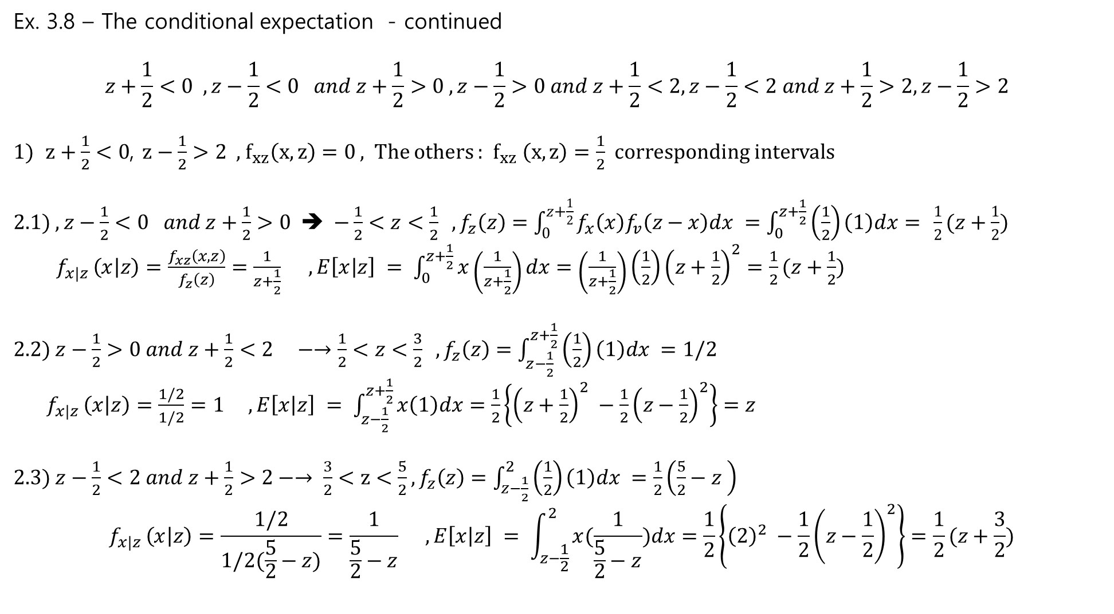
Ex. 3.8 – The conditional expectation - continued
$$z+\frac{1}{2}<0 , z−\frac{1}{2}<0 and z+\frac{1}{2}>0 , z−\frac{1}{2}>0 and z+\frac{1}{2}<2, z−\frac{1}{2}<2 and z+\frac{1}{2}>2, z−\frac{1}{2}>2$$
$z+\frac{1}{2}<0$, $z−\frac{1}{2}>2$, $f_{xz}\left(x,z\right)=0$ , The others : $f_{xz} \left(x,z\right)=\frac{1}{2}$ corresponding intervals
2.1) $, z−\frac{1}{2}<0 and z+\frac{1}{2}>0$ ➔ $−\frac{1}{2}<z<\frac{1}{2} , f_{z}\left(z\right)=\int_{0}^{z+\frac{1}{2}}{f_{x}\left(x\right)f_{v}\left(z−x\right)dx }=\int_{0}^{z+\frac{1}{2}}{\left(\frac{1}{2}\right)\left(1\right)dx= }\frac{1}{2}(z+\frac{1}{2})$
$$f_{x|z }\left(x | z\right)=\frac{f_{xz}\left(x,z\right)}{f_{z}\left(z\right)}=\frac{1}{z+\frac{1}{2}} , E\left[x | z\right] = \int_{0}^{z+\frac{1}{2}}{x\left(\frac{1}{z+\frac{1}{2}}\right)dx=\left(\frac{1}{z+\frac{1}{2}}\right)\left(\frac{1}{2}\right){\left(z+\frac{1}{2}\right)}^{2}=\frac{1}{2}(z+\frac{1}{2})}$$
2.2) $z−\frac{1}{2}>0 and z+\frac{1}{2}<2 −→\frac{1}{2}<z<\frac{3}{2} ,f_{z}\left(z\right)=\int_{z−\frac{1}{2}}^{z+\frac{1}{2}}{\left(\frac{1}{2}\right)\left(1\right)dx =1/2}$
$$f_{x|z }\left(x | z\right)=\frac{1/2}{1/2}=1 , E\left[x | z\right] = \int_{z−\frac{1}{2}}^{z+\frac{1}{2}}{x\left(1\right)dx=\frac{1}{2}\left\{{\left(z+\frac{1}{2}\right)}^{2} −\frac{1}{2}{\left(z−\frac{1}{2}\right)}^{2}\right\}=z}$$
2.3) $z−\frac{1}{2}<2 and z+\frac{1}{2}>2−→ \frac{3}{2}<z<\frac{5}{2},f_{z}\left(z\right)=\int_{z−\frac{1}{2}}^{2}{\left(\frac{1}{2}\right)\left(1\right)dx =\frac{1}{2}\left(\frac{5}{2}−z \right)}$
$$f_{x|z }\left(x | z\right)=\frac{1/2}{1/2(\frac{5}{2}−z)}=\frac{1}{\frac{5}{2}−z} , E\left[x | z\right] = \int_{z−\frac{1}{2}}^{2}{x(\frac{1}{\frac{5}{2}−z})dx=\frac{1}{2}\left\{{\left(2\right)}^{2} −\frac{1}{2}{\left(z−\frac{1}{2}\right)}^{2}\right\}=\frac{1}{2}(z+\frac{3}{2})}$$

Slide 6
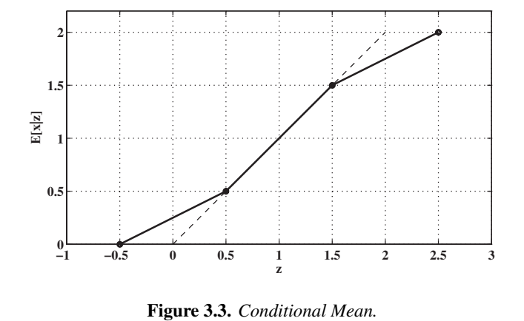
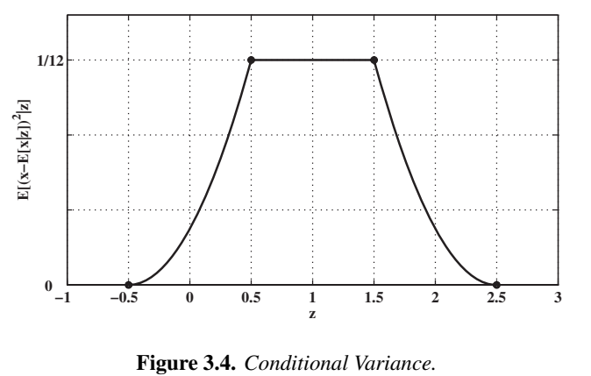
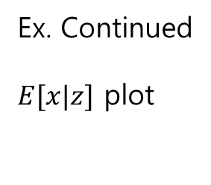

Ex. Continued
$E[x|z]$ plot
$$0<x<2, −\frac{1}{2}<v<\frac{1}{2}$$
$$z=x+v$$
Unconditional
-$E\left[z\right] =E\left[x+v\right]=E\left[x\right]$
- $σ_{z}^{2}=?$

Slide 7

3.2 conditional Estimate of a Gaussian R.V.
Modelling
$$z=Hx+v (3.2)$$
$x\sim N\left(\overline{x},M\right), v\sim N\left(0, V\right),(x ⊥ v)$ , $(x,v)$ is independent.
Find ${\hat{x}}_{MV}=\hat{x}=\underset{a}{argmin}{E[{\left(x− a\right)}^{2}}\left|z\right]$
Preview : due to Theorem 3.6
${\hat{x}}_{MV}=\hat{x}=\underset{a}{argmin}{E[{\left(x− a\right)}^{2}}\left|z\right] =E\left[X | z\right]$ → $E[X|z]= \int{x}f\left(x | z\right)dx$ → $f\left(x | z\right)=\frac{f\left(x,z\right)}{f\left(z\right)}$
Procedure
1) $Z$ is a Gaussian(it needs to prove) :
$E\left[Z\right]=H\overline{x}, σ_{z}^{2}=HMH^{T}+V$, theorem 2.30 → $z \sim N\left(H\overline{x}, HMH^{T}+V\right)$
$f_{z}\left(z\right)\sim C exp\left(−\frac{1}{2}{\left(z−H\overline{x}\right)}^{T}{\left(HMH^{T}+V\right)}^{−1}\left(z−H\overline{x}\right)\right)$

Slide 8
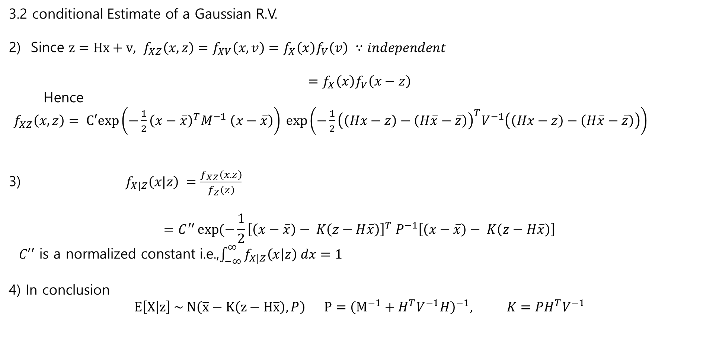
3.2 conditional Estimate of a Gaussian R.V.
2) Since $z=Hx+v, f_{XZ}\left(x,z\right)=f_{XV}\left(x,v\right)=f_{X}\left(x\right)f_{V}\left(v\right) ∵independent$
$$=f_{X}\left(x\right)f_{V}\left(x−z\right)$$
Hence
$f_{XZ}\left(x,z\right)= C′exp\left(−\frac{1}{2}{\left(x−\overline{x}\right)}^{T}M^{−1} \left(x−\overline{x}\right)\right) \exp\left(−\frac{1}{2}{\left(\left(Hx−z\right)−\left(H\overline{x}−\overline{z}\right)\right)}^{T}V^{−1}\left(\left(Hx−z\right)−\left(H\overline{x}−\overline{z}\right)\right)\right)$
3) $f_{X|Z}\left(x|z\right) =\frac{f_{XZ}\left(x.z\right)}{f_{Z}\left(z\right)}$
$$=C^{′′}\exp{(−\frac{1}{2}}{\left[\left(x−\overline{x}\right)− K\left(z−H\overline{x}\right)\right]}^{T} P^{−1}\left[\left(x−\overline{x}\right)− K\left(z−H\overline{x}\right)\right]$$
$C′′$ is a normalized constant i.e.,$\int_{−∞}^{∞}{f_{X|Z}\left(x | z\right) dx=1}$
4) In conclusion
$$E\left[X | z\right] \sim N\left(\overline{x}−K\left(z−H\overline{x}\right), P\right) P={\left(M^{−1}+H^{T}V^{−1}H\right)}^{−1}, K=PH^{T}V^{−1}$$

Slide 9
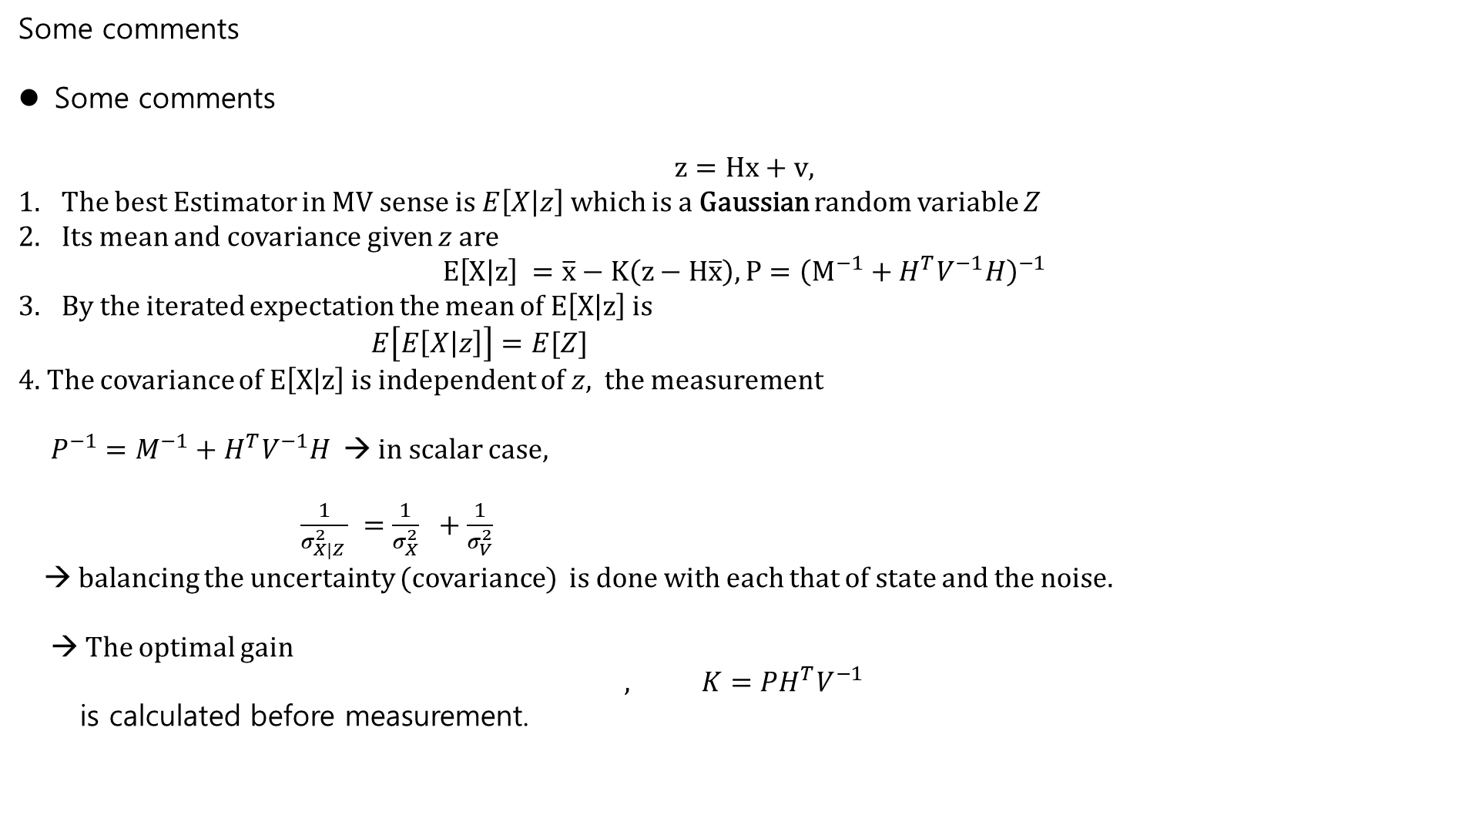
Some comments
Some comments
$$z=Hx+v,$$
The best Estimator in MV sense is $E\left[X | z\right]$ which is a Gaussian random variable $Z$
Its mean and covariance given $z$ are
$$E\left[X | z\right] =\overline{x}−K\left(z−H\overline{x}\right), P={\left(M^{−1}+H^{T}V^{−1}H\right)}^{−1}$$
By the iterated expectation the mean of $E\left[X | z\right]$ is
$E\left[E\left[X | z\right]\right]=E[Z]$
4. The covariance of $E\left[X | z\right]$ is independent of $z,$ the measurement
$P^{−1}=M^{−1}+H^{T}V^{−1}H$ → in scalar case,
$\frac{1}{σ_{X|Z }^{2}} =\frac{1}{σ_{X}^{2}} +\frac{1}{σ_{V}^{2}}$
→ balancing the uncertainty (covariance) is done with each that of state and the noise.
→ The optimal gain
$$, K=PH^{T}V^{−1}$$
is calculated before measurement.

Slide 10

3.2.3 Batch and Sequential Measurements
Data
$$\left\{x_{i}\right\}=\left\{x_{1}, x_{2},…, x_{n}\right\}$$
Find a sample mean of $\left\{x_{i}\right\}$
1) Batch Process
$$m_{x}=\frac{1}{n}\sum_{i=1}^{n}{x_{i}}$$
2) Recursive Process
$S_{k}=\frac{1}{k}\sum_{i=1}^{k}{x_{i}}$
Then
$$S_{k+1}=\frac{1}{k+1} \sum_{i=1}^{k+1}{x_{i}}$$
$=\frac{1}{k+1}\sum_{i=1}^{k}{x_{i}}+\frac{1}{k+1}x_{k+1}$
$=\frac{k}{k+1}S_{k}+\frac{1}{k+1}x_{k+1}$
which is equivalent to the average by the Batch Method at $k=n$

Slide 11
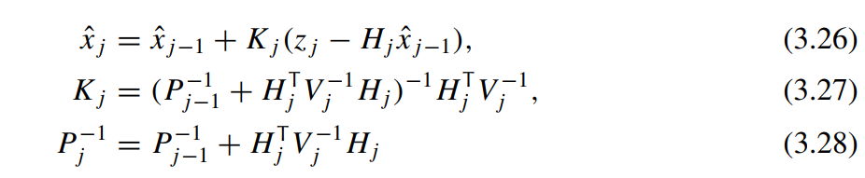

3.2.3 Batch / Recursive
Recursive for Kalman
1) The measurement $z=Hx+ν$
$$z= \left[\begin{matrix}z_{1} \\ ⋮ \\ z_{n}\end{matrix}\right]= \left[\begin{matrix}H_{1} \\ ⋮ \\ H_{n}\end{matrix}\right]x+ \left[\begin{matrix}v_{1} \\ ⋮ \\ ν_{n}\end{matrix}\right]=Hx+V$$
2) The Error covariance $P$
$$P^{−1}=M^{−1}+H^{T}VH =M^{−1}+ \sum_{k=1}^{n}{H_{k}^{T}V_{k}^{−1}H_{k}}$$
Define
$$P_{j−1}^{−1}=M^{−1}+\sum_{k=1}^{j−1}{H_{k}^{T}V_{k}^{−1}H_{k}}$$
$$P_{j}^{−1}=M^{−1}+\sum_{k=1}^{j}{H_{k}^{T}V_{k}^{−1}H_{k}}=M^{−1}+\sum_{k=1}^{j−1}{H_{k}^{T}V_{k}^{−1}H_{k}}+H_{j}^{T}V_{j}^{−1}H_{j}=P_{j−1}^{−1}+ H_{j}^{T}V_{j}^{−1}H_{j}$$
3) By Induction

Slide 12
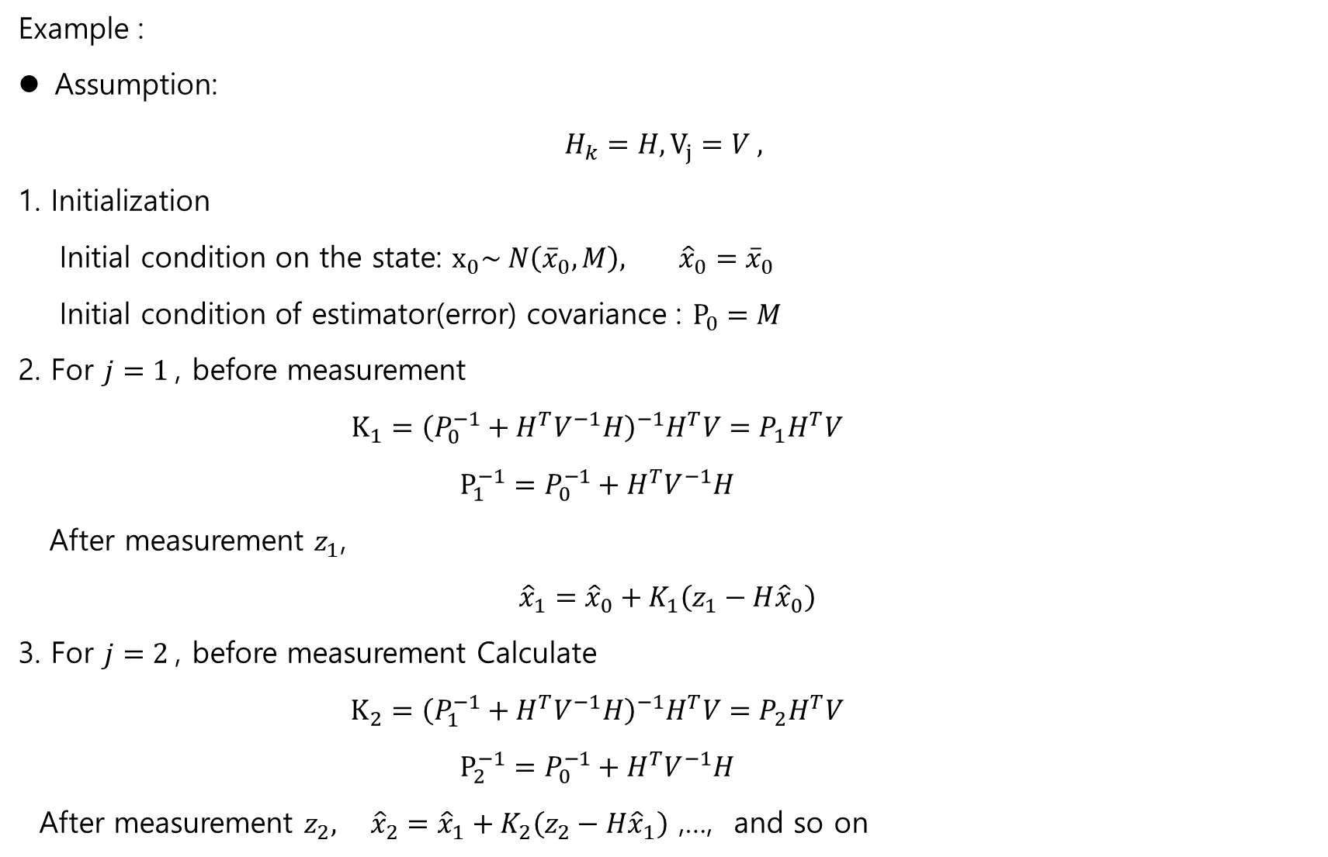
Example :
Assumption:
$$H_{k}=H, V_{j}=V ,$$
1. Initialization
Initial condition on the state: $x_{0}\sim N\left({\overline{x}}_{0}, M\right), {\hat{x}}_{0}={\overline{x}}_{0}$
Initial condition of estimator(error) covariance : $P_{0}=M$
2. For $j=1$, before measurement
$$K_{1}={\left(P_{0}^{−1}+H^{T}V^{−1}H\right)}^{−1}H^{T}V=P_{1}H^{T}V$$
$$P_{1}^{−1}=P_{0}^{−1}+H^{T}V^{−1}H$$
After measurement $z_{1}$,
$${\hat{x}}_{1}={\hat{x}}_{0}+K_{1}\left(z_{1}−H{\hat{x}}_{0}\right)$$
3. For $j=2$, before measurement Calculate
$$K_{2}={\left(P_{1}^{−1}+H^{T}V^{−1}H\right)}^{−1}H^{T}V=P_{2}H^{T}V$$
$$P_{2}^{−1}=P_{0}^{−1}+H^{T}V^{−1}H$$
After measurement $z_{2}, {\hat{x}}_{2}={\hat{x}}_{1}+K_{2}\left(z_{2}−H{\hat{x}}_{1}\right)$ ,…, and so on

Slide 13
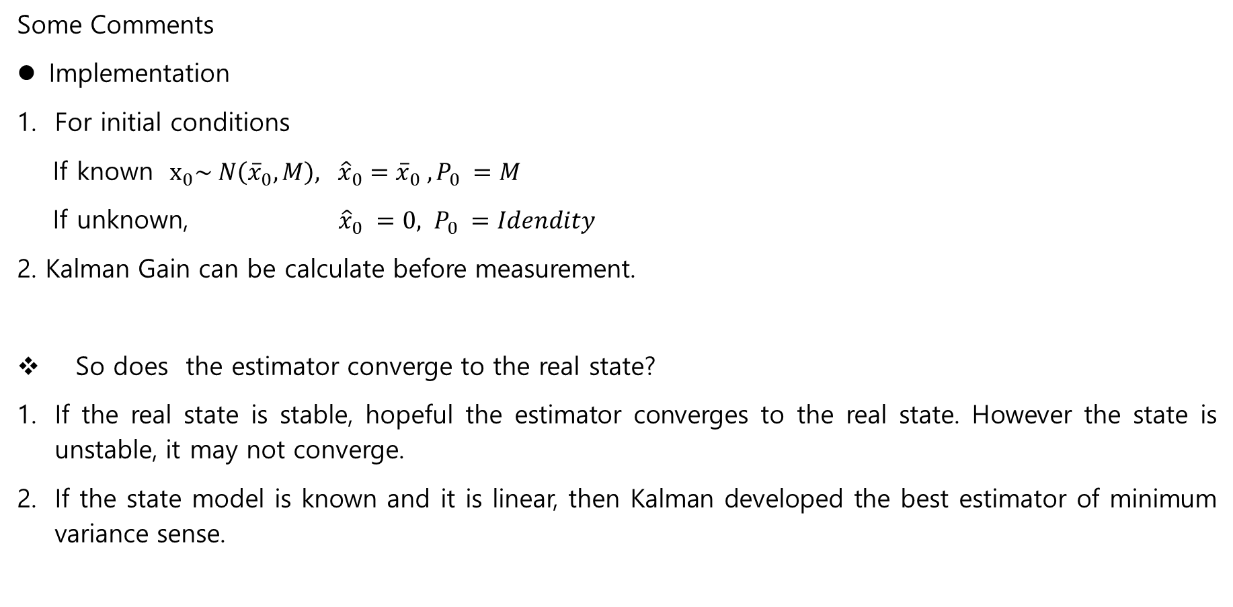
Some Comments
Implementation
For initial conditions
If known $x_{0}\sim N\left({\overline{x}}_{0}, M\right), {\hat{x}}_{0}={\overline{x}}_{0} , P_{0} =M$
If unknown, ${\hat{x}}_{0} =0, P_{0} =Idendity$
2. Kalman Gain can be calculate before measurement.
So does the estimator converge to the real state?
If the real state is stable, hopeful the estimator converges to the real state. However the state is unstable, it may not converge.
If the state model is known and it is linear, then Kalman developed the best estimator of minimum variance sense.

Slide 14




Some Comments
Orthogonality between error and the estimator $\hat{x}$
Define
$e_{k}=x_{k} −{\hat{x}}_{k}$
Then using some matrix calculation (page94)
$E\left[e_{k}{\hat{x}}_{k}^{T}\right]=\left(I −P_{k}H_{k}^{T}V_{k}^{−1}H_{k}\right)E\left[e_{k−1}{\hat{x}}_{k−1}\right]$
Since
$E\left[e_{0}{\hat{x}}_{0}\right]=0 −→E\left[e_{k}{\hat{x}}_{k}^{T}\right]=E\left[\left(x_{k}−{\hat{x}}_{k}\right){\hat{x}}_{k}\right]= 0$
→ Two random variables are orthogonal.→ independent
.
$$x_{k}$$
$${x_{k}− \hat{x}}_{k}$$
$${\hat{x}}_{k}$$

Slide 15

3.4 The Discrete Kalman Filter
Non- drift
$z_{k}={Hx}_{k}+v_{k}$, ${ x}_{0}\sim N({\overline{x}}_{0} , M), v \sim N\left(0, V\right)$
2. Drift (system has own dynamics)
$$x_{k+1}=Φ_{k}x_{k}+Γ_{k}w_{k}, x_{0} \sim N\left({\overline{x}}_{0} , M_{0}\right) \\ z_{k}=H_{k}x_{k}+v_{k}$$
$$w_{k} \sim N\left(0, W_{k}\right), v_{k} \sim N\left(0, V_{k}\right), \left(w_{k}, v_{k}\right) :independent ∀ k$$

Slide 16

Kalman
$$x_{k+1}=Φ_{k}x_{k}+Γ_{k}w_{k}, x_{0} \sim N\left({\overline{x}}_{0} , M_{0}\right) \\ z_{k}=H_{k}x_{k}+v_{k}$$
$$w_{k} \sim N\left(0, W_{k}\right), v_{k} \sim N\left(0, V_{k}\right), \left(w_{k}, v_{k}\right) :independent ∀ k$$
Prediction
1) Mean
$${\overline{x}}_{k+1}= E\left[x_{k+1} | Z_{k}\right] \\ =E\left[Φ_{k}x_{k}+Γ_{k}w_{k} | Z_{k}\right] \\ =Φ_{k}E\left[x_{k} | Z_{k}\right]+E\left[Γ_{k}w_{k} | Z_{k}\right] \\ =Φ_{k}{\hat{x}}_{k} (3.42)$$
2) Variance
$$M_{k+1}=E\left[{(x}_{k+1}− {\overline{x}}_{k+1}){(x}_{k+1}− {\overline{x}}_{k+1})^T | Z_{k}\right] \\ =E\left[{\overline{e}}_{k+1}{\overline{e}}_{k+1}^{T} | Z_{k}\right] \\ =E\left[\left(Φ_{k}{\hat{e}}_{k}+Γ_{k}w_{k}\right){\left(Φ_{k}{\hat{e}}_{k}+Γ_{k}w_{k}\right)}^{T} | Z_{k}\right] \\ =Φ_{k}E\left[{\hat{e}}_{k}{\hat{e}}_{k}^{T} | Z_{k}\right]Φ_{k}^{T}+Γ_{k}E\left[w_{k}w_{k}^{T}\right]Γ_{k}^{T} \\ =Φ_{k}P_{k}Φ_{k}^{T}+Γ_{k}W_{k}Γ_{k}^{T}$$

Slide 17
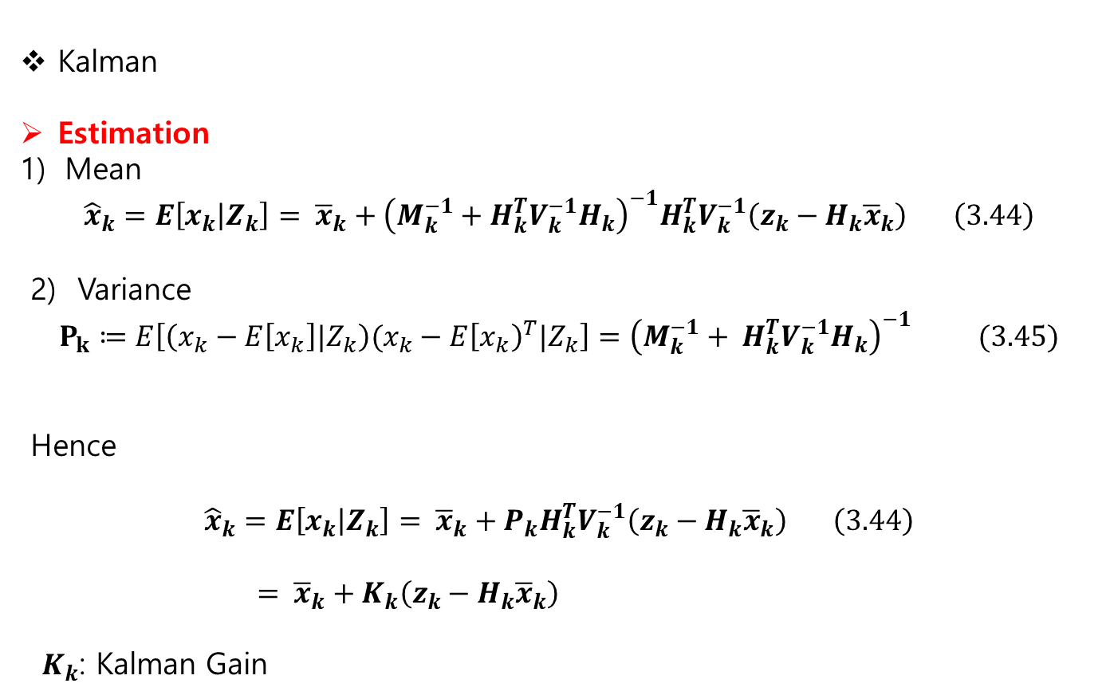
Kalman
Estimation
Mean
$${\hat{x}}_{k}=E\left[x_{k} | Z_{k}\right]= {\overline{x}}_{k}+{\left(M_{k}^{−1}+H_{k}^{T}V_{k}^{−1}H_{k}\right)}^{−1}H_{k}^{T}V_{k}^{−1}\left(z_{k}−H_{k}{\overline{x}}_{k}\right) \left(3.44\right)$$
2) Variance
$$P_{k}≔E\left[\left(x_{k}−E\left[x_{k}\right]|Z_{k}\right)(x_{k}−E{\left[x_{k}\right)}^{T}|Z_{k}\right]={\left(M_{k}^{−1}+ H_{k}^{T}V_{k}^{−1}H_{k}\right)}^{−1} (3.45)$$
Hence
$${\hat{x}}_{k}=E\left[x_{k} | Z_{k}\right]= {\overline{x}}_{k}+P_{k}H_{k}^{T}V_{k}^{−1}\left(z_{k}−H_{k}{\overline{x}}_{k}\right) \left(3.44\right)$$
$= {\overline{x}}_{k}+K_{k}\left(z_{k}−H_{k}{\overline{x}}_{k}\right)$
$K_{k}$: Kalman Gain

Slide 18
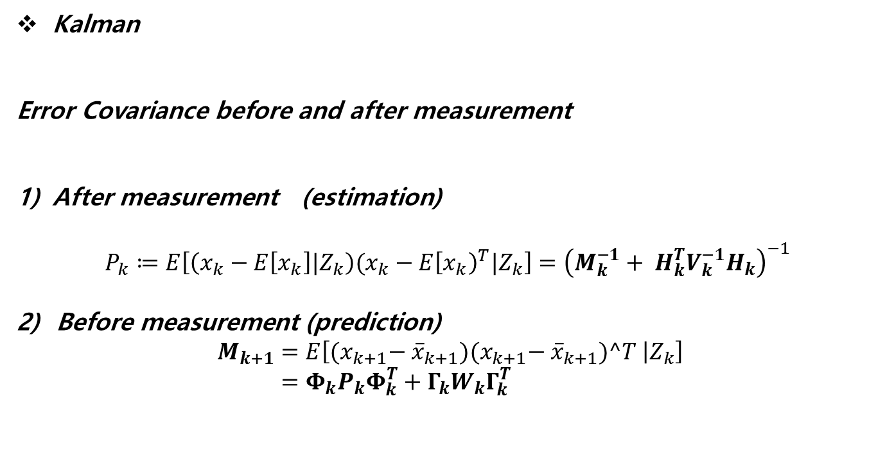
Kalman
Error Covariance before and after measurement
After measurement (estimation)
$$P_{k}≔E\left[\left(x_{k}−E\left[x_{k}\right]|Z_{k}\right)(x_{k}−E{\left[x_{k}\right)}^{T}|Z_{k}\right]={\left(M_{k}^{−1}+ H_{k}^{T}V_{k}^{−1}H_{k}\right)}^{−1}$$
2) Before measurement (prediction)
$$M_{k+1}=E\left[{(x}_{k+1}− {\overline{x}}_{k+1}){(x}_{k+1}− {\overline{x}}_{k+1})^T | Z_{k}\right] \\ =Φ_{k}P_{k}Φ_{k}^{T}+Γ_{k}W_{k}Γ_{k}^{T}$$

Slide 19
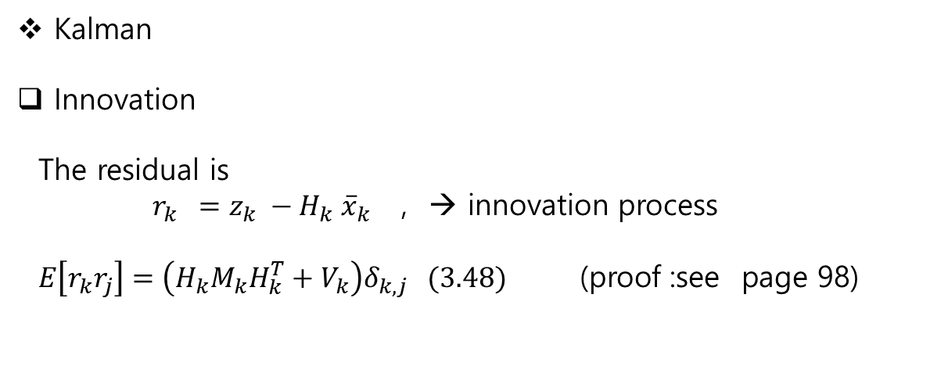
Kalman
Innovation
The residual is
$r_{k} =z_{k} −H_{k} {\overline{x}}_{k}$ , → innovation process
$E\left[r_{k}r_{j}\right]=\left(H_{k}M_{k}H_{k}^{T}+V_{k}\right)δ_{k,j} (3.48)$ (proof :see page 98)

Slide 20
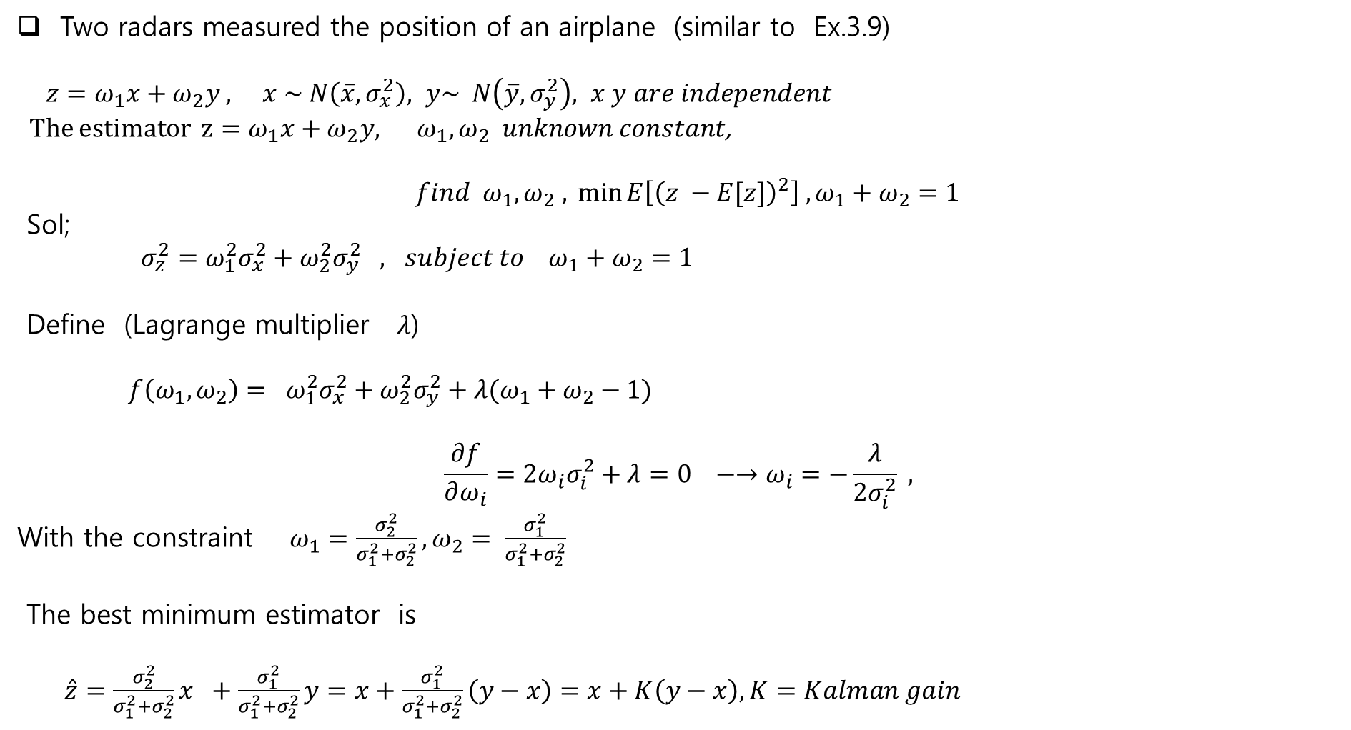
Two radars measured the position of an airplane (similar to Ex.3.9)
$z=ω_{1}x+ω_{2}y , x \sim N\left(\overline{x}, σ_{x}^{2}\right), y\sim N\left(\overline{y}, σ_{y}^{2}\right), x y are independent$
The estimator $z=ω_{1}x+ω_{2}y, ω_{1},ω_{2} unknown constant$,
$$find ω_{1}, ω_{2} ,{\min{E\left[{\left(z −E[z]\right)}^{2}\right] , ω_{1}+ω_{2}=1}}$$
Sol;
$σ_{z}^{2}=ω_{1}^{2}σ_{x}^{2}+ω_{2}^{2}σ_{y}^{2} , subject to ω_{1}+ω_{2}=1$
Define (Lagrange multiplier $λ$)
${ f\left(ω_{1}, ω_{2}\right)= ω}_{1}^{2}σ_{x}^{2}+ω_{2}^{2}σ_{y}^{2}+λ(ω_{1}+ω_{2}−1)$
$$\frac{∂f}{∂ω_{i}}=2ω_{i}σ_{i}^{2}+λ=0 −→ω_{i}=−\frac{λ}{2σ_{i}^{2}} ,$$
With the constraint $ω_{1}=\frac{σ_{2}^{2}}{σ_{1}^{2}+σ_{2}^{2}}, ω_{2}= \frac{σ_{1}^{2}}{σ_{1}^{2}+σ_{2}^{2}}$
The best minimum estimator is
$\hat{z}=\frac{σ_{2}^{2}}{σ_{1}^{2}+σ_{2}^{2}}x +\frac{σ_{1}^{2}}{σ_{1}^{2}+σ_{2}^{2}}y=x+\frac{σ_{1}^{2}}{σ_{1}^{2}+σ_{2}^{2}}\left(y−x\right)=x+K\left(y−x\right), K=Kalman gain$

