Slide 1
Ch.6 continuous-Time Gauss-Markov Systems:
6.1 The Continuous- Time Kalman Filter
6.2 Properties of the continuous-time Riccati equation
6.3 Stationarity
6.4 Power Spectral Densities
6.5 Continuous-time Linear Systems Driven by Stationary Signals
6.6 Discrete-Time Linear Systems Driven by Stationary Random Processes
6.6 The Steady State Kalman Filter: The Wiener Filter

Slide 2
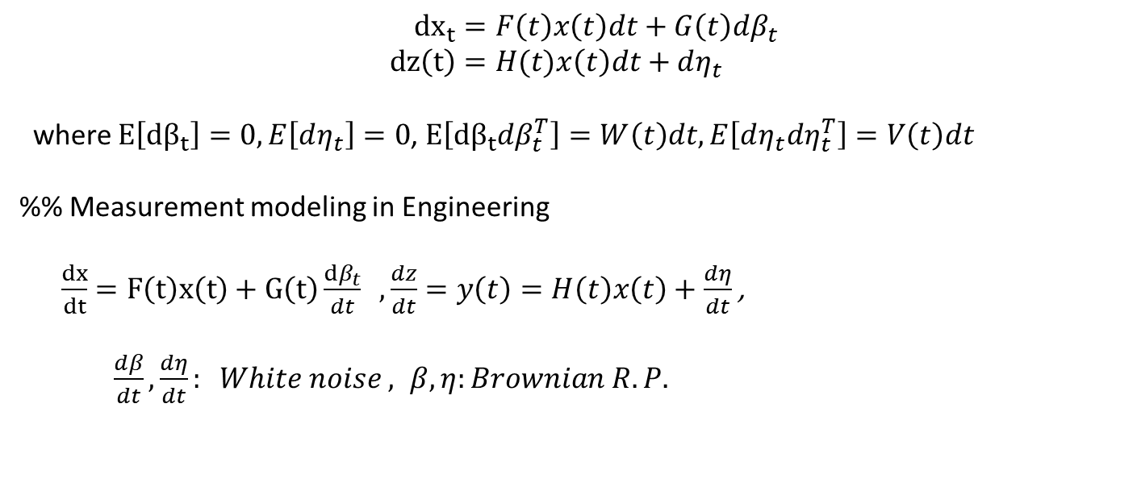
6.1 The Continuous- Time Kalman Filter(Kalman-Bucy Filter)
$${dx}_{t}=F\left(t\right)x\left(t\right)dt+G\left(t\right)dβ_{t} \\ dz\left(t\right)=H(t)x\left(t\right)dt+dη_{t}$$
where $E\left[dβ_{t}\right]=0, E\left[dη_{t}\right]=0$, $E\left[dβ_{t}dβ_{t}^{T}\right]=W\left(t\right)dt, E\left[dη_{t}dη_{t}^{T}\right]=V\left(t\right)dt$
%% Measurement modeling in Engineering
$\frac{dx}{dt}=F\left(t\right)x\left(t\right)+G\left(t\right)\frac{dβ_{t}}{dt} , \frac{dz}{dt}=y\left(t\right)=H\left(t\right)x\left(t\right)+\frac{dη}{dt}$ ,
$\frac{dβ}{dt}, \frac{dη}{dt}: White noise , β, η:Brownian R.P.$

Slide 3
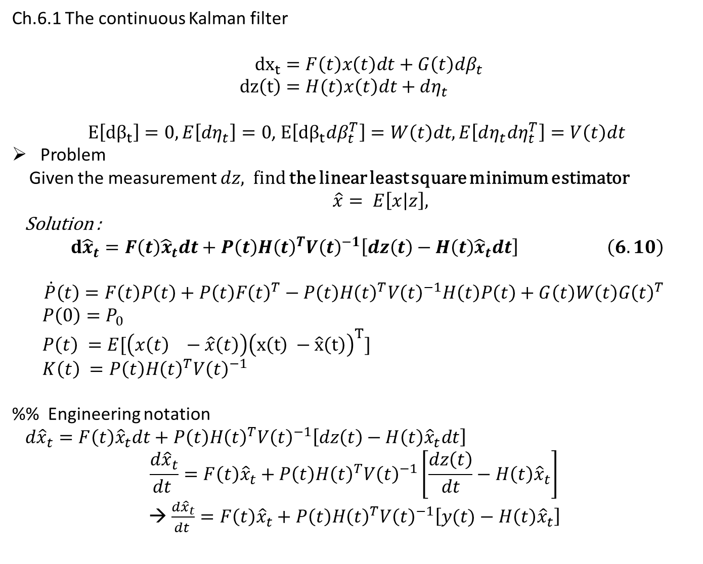
Ch.6.1 The continuous Kalman filter
$${dx}_{t}=F\left(t\right)x\left(t\right)dt+G\left(t\right)dβ_{t} \\ dz\left(t\right)=H(t)x\left(t\right)dt+dη_{t}$$
$E\left[dβ_{t}\right]=0, E\left[dη_{t}\right]=0$, $E\left[dβ_{t}dβ_{t}^{T}\right]=W\left(t\right)dt, E\left[dη_{t}dη_{t}^{T}\right]=V\left(t\right)dt$
Problem
Given the measurement $dz,$find the linear least square minimum estimator
$\hat{x}= E\left[x | z\right],$
Solution :
$d{\hat{x}}_{t}=F\left(t\right){\hat{x}}_{t}dt+P\left(t\right)H{\left(t\right)}^{T}V{\left(t\right)}^{−1}\left[dz\left(t\right)−H\left(t\right){\hat{x}}_{t}dt\right] \left(6.10\right)$
$$\dot{P}\left(t\right)=F\left(t\right)P\left(t\right)+P\left(t\right)F{\left(t\right)}^{T}−P\left(t\right)H{\left(t\right)}^{T}V{\left(t\right)}^{−1}H\left(t\right)P\left(t\right)+G\left(t\right)W\left(t\right)G{\left(t\right)}^{T}$$
$P\left(0\right)=P_{0}$
$P\left(t\right) =E[\left(x\left(t\right) −\hat{x}\left(t\right)\right){\left(x\left(t\right) −\hat{x}\left(t\right)\right)}^{T}]$
$K\left(t\right) =P\left(t\right)H{\left(t\right)}^{T}V{\left(t\right)}^{−1}$
%% Engineering notation
$d{\hat{x}}_{t}=F\left(t\right){\hat{x}}_{t}dt+P\left(t\right)H{\left(t\right)}^{T}V{\left(t\right)}^{−1}\left[dz\left(t\right)−H\left(t\right){\hat{x}}_{t}dt\right]$
$$\frac{d{\hat{x}}_{t}}{dt }=F\left(t\right){\hat{x}}_{t}+P\left(t\right)H{\left(t\right)}^{T}V{\left(t\right)}^{−1}\left[\frac{dz\left(t\right)}{dt}−H\left(t\right){\hat{x}}_{t}\right]$$
→ $\frac{d{\hat{x}}_{t}}{dt }=F\left(t\right){\hat{x}}_{t}+P\left(t\right)H{\left(t\right)}^{T}V{\left(t\right)}^{−1}\left[y(t)−H\left(t\right){\hat{x}}_{t}\right]$

Slide 4
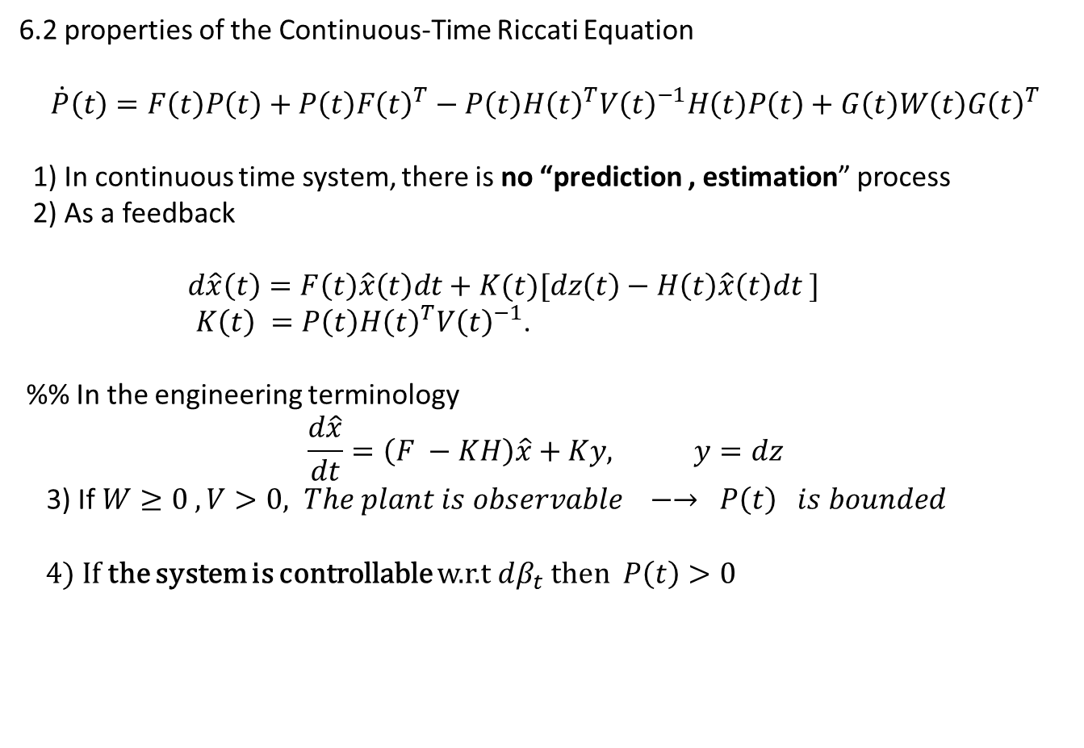
6.2 properties of the Continuous-Time Riccati Equation
$$\dot{P}\left(t\right)=F\left(t\right)P\left(t\right)+P\left(t\right)F{\left(t\right)}^{T}−P\left(t\right)H{\left(t\right)}^{T}V{\left(t\right)}^{−1}H\left(t\right)P\left(t\right)+G\left(t\right)W\left(t\right)G{\left(t\right)}^{T}$$
1) In continuous time system, there is no “prediction , estimation” process
2) As a feedback
$d\hat{x}\left(t\right)=F\left(t\right)\hat{x}\left(t\right)dt+K(t)[dz\left(t\right)−H\left(t\right)\hat{x}\left(t\right)dt ]$
$K\left(t\right) =P\left(t\right)H{\left(t\right)}^{T}V{\left(t\right)}^{−1}$.
%% In the engineering terminology
$$\frac{d\hat{x}}{dt}=\left(F −KH\right)\hat{x}+Ky, y=dz$$
3) If $W≥0 , V>0, The plant is observable −→ P\left(t\right) is bounded$
4) If the system is controllable w.r.t $dβ_{t}$ then $P\left(t\right)>0$

Slide 5
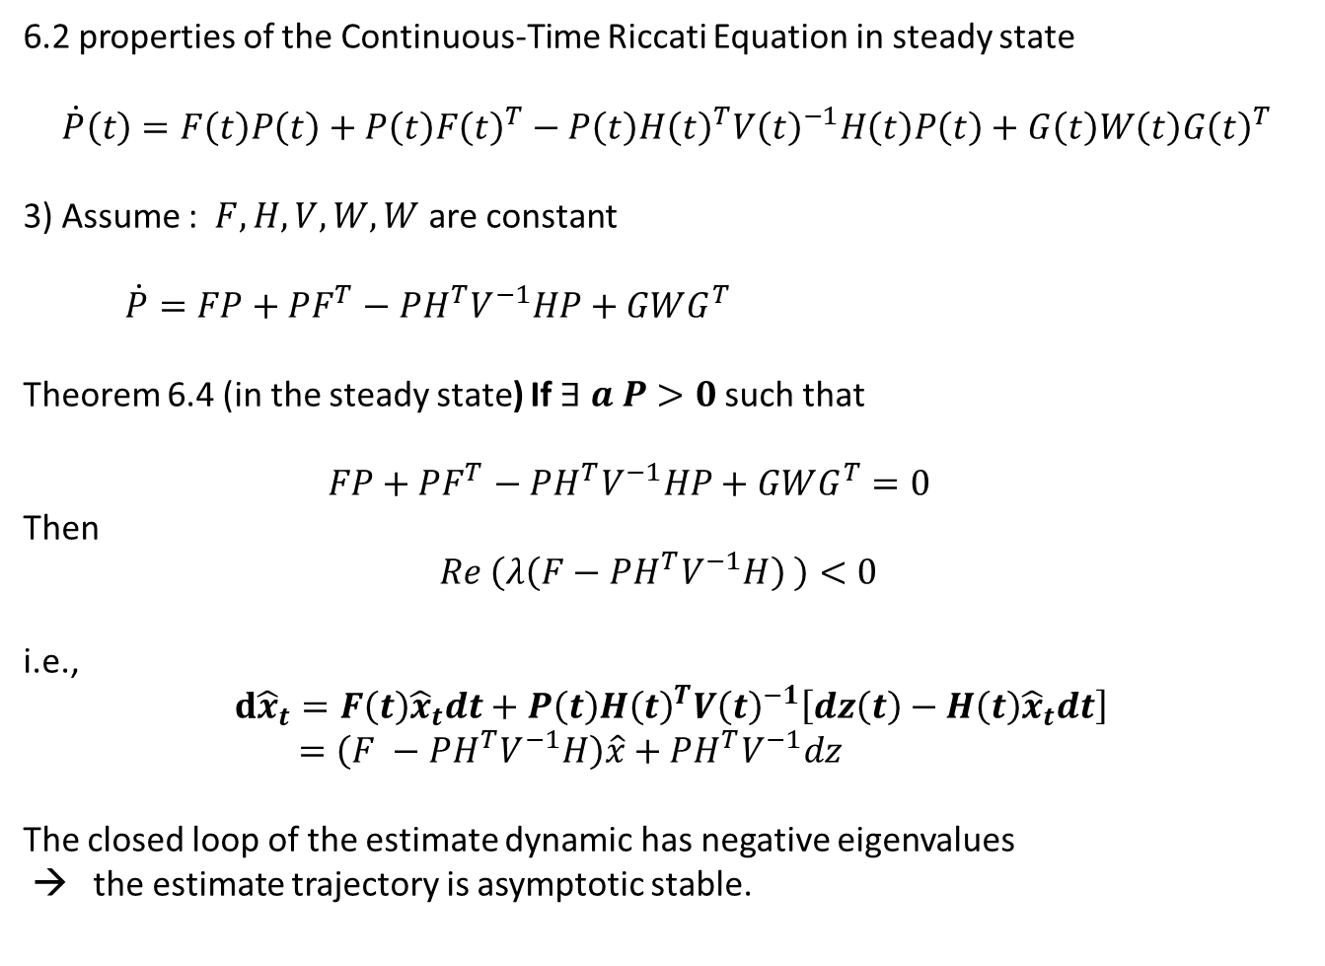
6.2 properties of the Continuous-Time Riccati Equation in steady state
$$\dot{P}\left(t\right)=F\left(t\right)P\left(t\right)+P\left(t\right)F{\left(t\right)}^{T}−P\left(t\right)H{\left(t\right)}^{T}V{\left(t\right)}^{−1}H\left(t\right)P\left(t\right)+G\left(t\right)W\left(t\right)G{\left(t\right)}^{T}$$
3) Assume : $F,H,V,W,W$ are constant
$\dot{P}=FP+PF^{T}−PH^{T}V^{−1}HP+GWG^{T}$
Theorem 6.4 (in the steady state) If $∃ a P>0$such that
$FP+PF^{T}−PH^{T}V^{−1}HP+GWG^{T}=0$
Then
$$Re \left(λ\left(F−PH^{T}V^{−1}H\right) \right)<0$$
i.e.,
$$d{\hat{x}}_{t}=F\left(t\right){\hat{x}}_{t}dt+P\left(t\right)H{\left(t\right)}^{T}V{\left(t\right)}^{−1}\left[dz\left(t\right)−H\left(t\right){\hat{x}}_{t}dt\right]$$
$=\left(F −PH^{T}V^{−1}H\right)\hat{x}+PH^{T}V^{−1}dz$
The closed loop of the estimate dynamic has negative eigenvalues
→ the estimate trajectory is asymptotic stable.

Slide 6
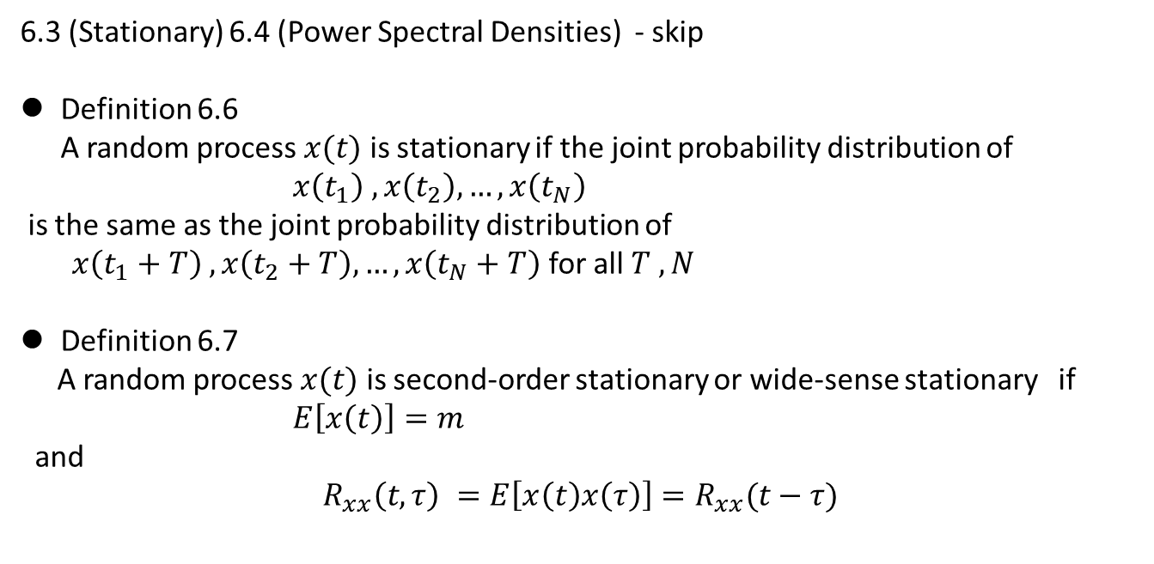
6.3 (Stationary) 6.4 (Power Spectral Densities) - skip
Definition 6.6 A random process $x(t)$ is stationary if the joint probability distribution of
$x\left(t_{1}\right) , x\left(t_{2}\right), …, x\left(t_{N}\right)$
is the same as the joint probability distribution of
$x\left(t_{1}+T\right) , x\left(t_{2}+T\right), …, x\left(t_{N}+T\right)$ for all $T , N$
Definition 6.7
A random process $x(t)$ is second-order stationary or wide-sense stationary if
$E\left[x\left(t\right)\right]=m$
and
$$R_{xx}\left(t,τ\right) =E\left[x\left(t\right)x\left(τ\right)\right]=R_{xx}(t−τ)$$

Slide 7
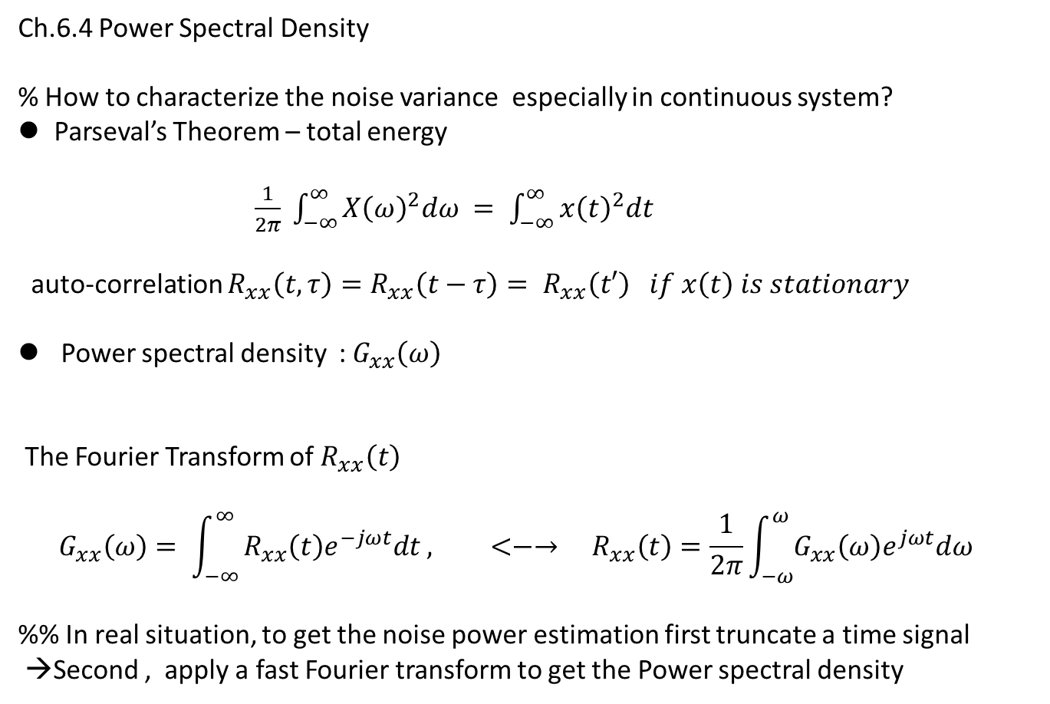
Ch.6.4 Power Spectral Density
% How to characterize the noise variance especially in continuous system?
Parseval’s Theorem – total energy
$\frac{1}{2π} \int_{−∞}^{∞}{X{\left(ω\right)}^{2}dω = \int_{−∞}^{∞}{x{\left(t\right)}^{2}dt}}$
auto-correlation $R_{xx}\left(t,τ\right)=R_{xx}\left(t−τ\right)= R_{xx}\left(t′\right) if x\left(t\right) is stationary$
Power spectral density : $G_{xx}\left(ω\right)$
The Fourier Transform of $R_{xx}\left(t\right)$
$$G_{xx}\left(ω\right)= \int_{−∞}^{∞}{R_{xx}\left(t\right)e^{−jωt}dt , <−→ R_{xx}\left(t\right)=\frac{1}{2π}\int_{−ω}^{ω}{G_{xx}\left(ω\right)e^{jωt}dω} }$$
%% In real situation, to get the noise power estimation first truncate a time signal
→Second , apply a fast Fourier transform to get the Power spectral density

Slide 8
Ch.6.5 Continuous-Time Linear Systems Driven by Stationary Signals
Ch.6.6 Discrete- Time Linear Systems Driven by Stationary Random Processes
Ch.6.7 The Steady-State Kalman Filter: The Wiener Filter
Wiener Filter is one of the optimal filter to delete the noise inference on the output.
Kalman Filter is an example a Wiener filter
But to realize a Wiener filter, it is impossible due to non-causal characteristic
→ For realization an optimal filter in linear constant systems, instead of the Wiener filter , the Kalman filter in the steady state gain is used.

Slide 9
Ch.6 The Extended Kalman Filter
7.1 Linearized Kalman Filter
7.1.1 Continuous-Time Theory
7.1.2 Discrete-Time Version
7.2 Extended Kalman Filter
7.3 The Iterative Extended Kalman Filter
7.4 Filter Divergence
7.4.1 What is Divergence?
7.4.2 The role of Process Noise Weighting in the Steady State
7.4.2 An analysis of Divergence

Slide 10
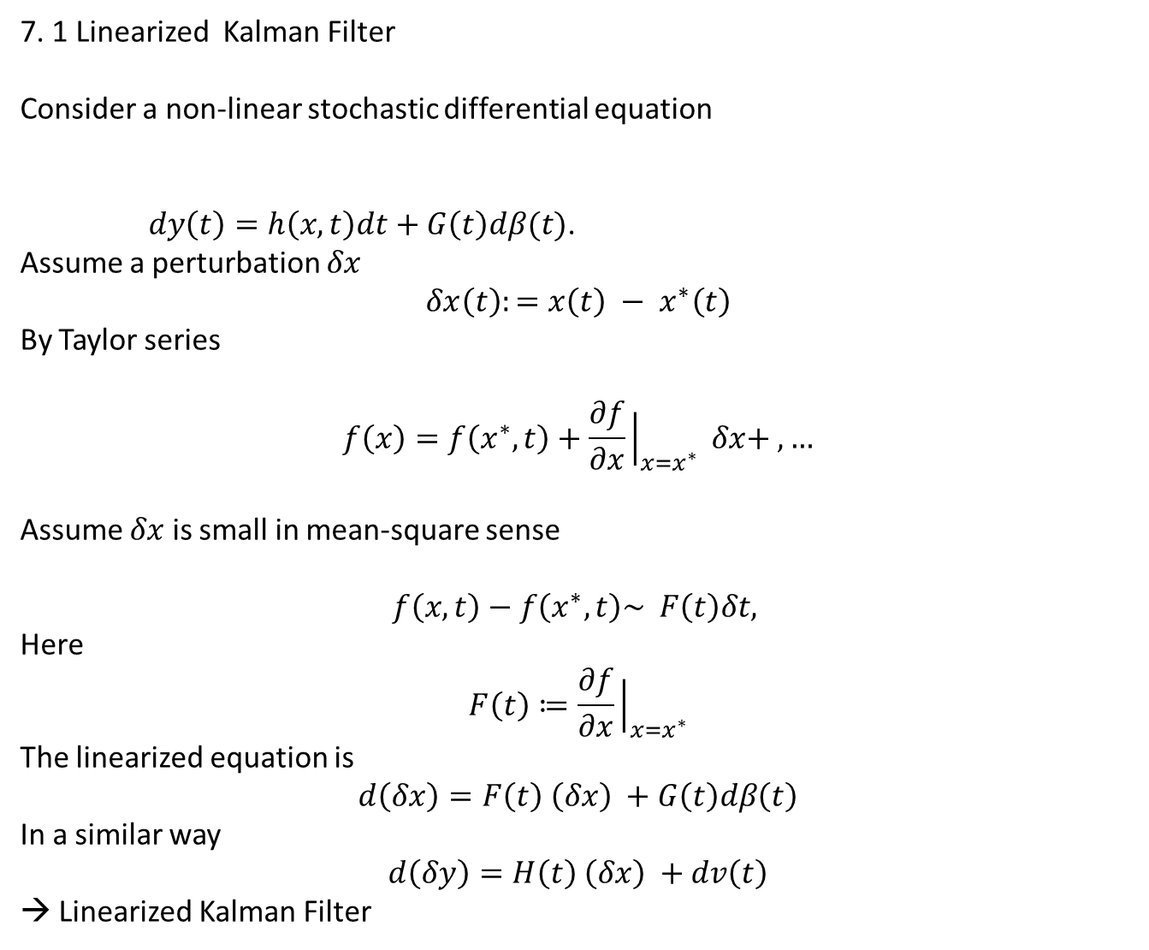
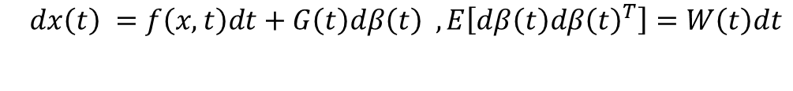
7. 1 Linearized Kalman Filter
Consider a non-linear stochastic differential equation
$dy\left(t\right)=h\left(x,t\right)dt+G\left(t\right)dβ(t)$.
Assume a perturbation $δx$
$$δx\left(t\right):={x\left(t\right) − x}^{∗}\left(t\right)$$
By Taylor series
$$f\left(x\right)=f\left(x^{∗},t\right)+\frac{∂f}{∂x}{\left.​\right|}_{x=x^{∗}} δx+ ,…$$
Assume $δx$ is small in mean-square sense
$$f\left(x,t\right)−f\left(x^{∗},t\right)\sim F\left(t\right)δt,$$
Here
$$F\left(t\right)≔\frac{∂f}{∂x}{\left.​\right|}_{x=x^{∗}}$$
The linearized equation is
$$d\left(δx\right)=F\left(t\right) \left(δx\right) +G\left(t\right)dβ\left(t\right)$$
In a similar way
$$d\left(δy\right)=H\left(t\right) \left(δx\right) +dv\left(t\right)$$
→ Linearized Kalman Filter
$$dx\left(t\right) =f\left(x,t\right)dt+G\left(t\right)dβ\left(t\right) , E\left[dβ\left(t\right)dβ{\left(t\right)}^{T}\right]=W\left(t\right)dt$$

Slide 11
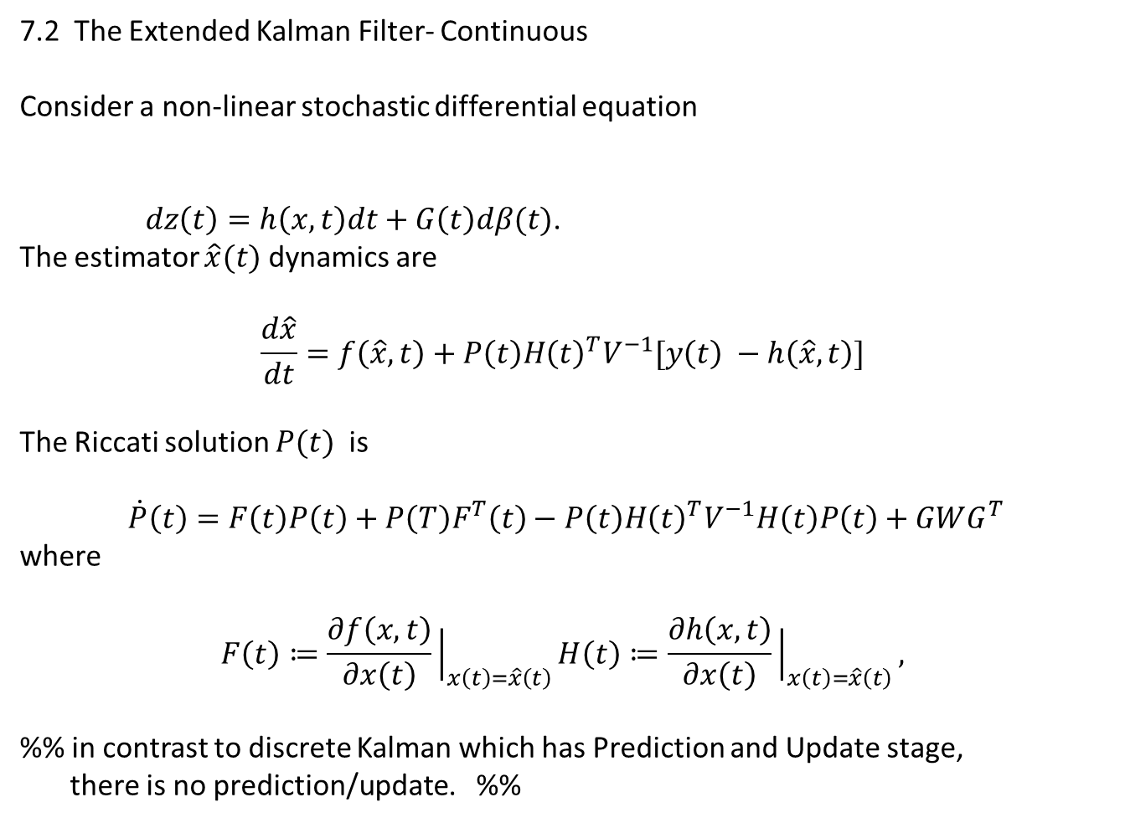
7.2 The Extended Kalman Filter- Continuous
Consider a non-linear stochastic differential equation
$dz\left(t\right)=h\left(x,t\right)dt+G\left(t\right)dβ(t)$.
The estimator $\hat{x}(t)$ dynamics are
$$\frac{d\hat{x}}{dt}=f\left(\hat{x},t\right)+P\left(t\right)H{\left(t\right)}^{T}V^{−1}[y\left(t\right) −h\left(\hat{x},t\right)]$$
The Riccati solution $P(t)$ is
$$\dot{P}\left(t\right)=F\left(t\right)P\left(t\right)+P\left(T\right)F^{T}\left(t\right)−P\left(t\right)H{\left(t\right)}^{T}V^{−1}H\left(t\right)P\left(t\right)+GWG^{T}$$
where
$$F\left(t\right)≔\frac{∂f\left(x,t\right)}{∂x\left(t\right)}{\left.​\right|}_{x\left(t\right)=\hat{x}\left(t\right)}H\left(t\right)≔\frac{∂h\left(x,t\right)}{∂x\left(t\right)}{\left.​\right|}_{x\left(t\right)=\hat{x}\left(t\right)},$$
%% in contrast to discrete Kalman which has Prediction and Update stage,
there is no prediction/update. %%
$$dx\left(t\right) =f\left(x,t\right)dt+G\left(t\right)dβ\left(t\right) , E\left[dβ\left(t\right)dβ{\left(t\right)}^{T}\right]=W\left(t\right)dt$$

Slide 12
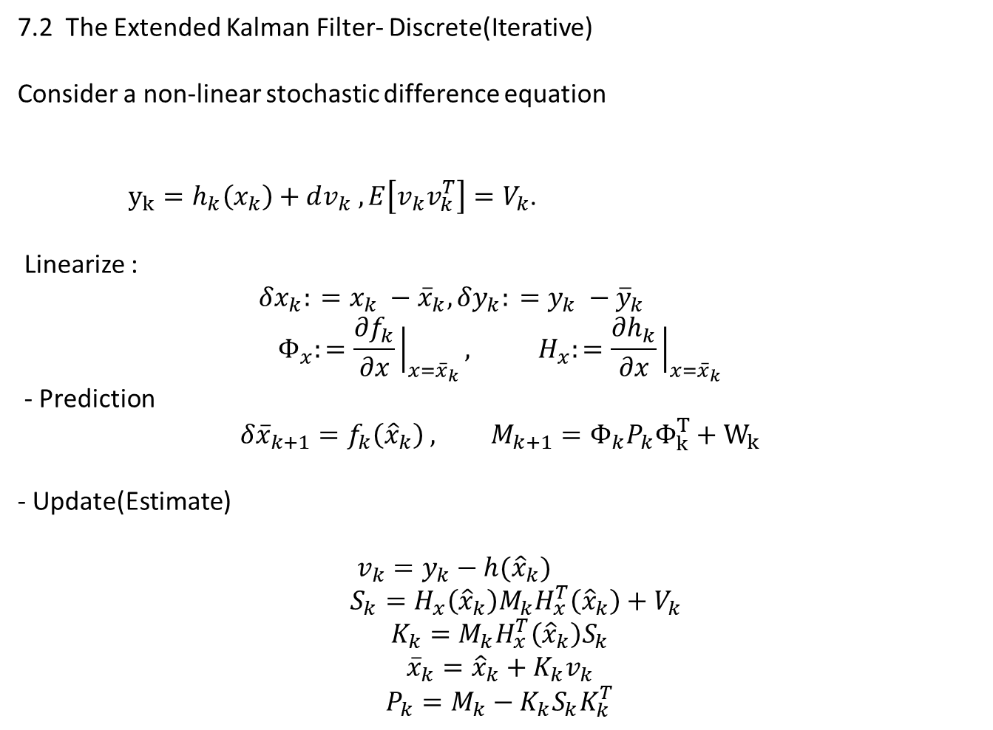

7.2 The Extended Kalman Filter- Discrete(Iterative)
Consider a non-linear stochastic difference equation
$y_{k}=h_{k}\left(x_{k}\right)+dv_{k} , E\left[v_{k}v_{k}^{T}\right]=V_{k}$.
Linearize :
$δx_{k}: =x_{k} −{\overline{x}}_{k},δy_{k}: =y_{k} −{\overline{y}}_{k}$
$$Φ_{x}:=\frac{∂f_{k}}{∂x}{\left.​\right|}_{x={\overline{x}}_{k}}, H_{x}:=\frac{∂h_{k}}{∂x}{\left.​\right|}_{x={\overline{x}}_{k}}$$
- Prediction
$$δ{\overline{x}}_{k+1}=f_{k}\left({\hat{x}}_{k}\right) , M_{k+1}=Φ_{k}P_{k}Φ_{k}^{T}+W_{k}$$
- Update(Estimate)
$v_{k}=y_{k}−h({\hat{x}}_{k})$
$S_{k}=H_{x}\left({\hat{x}}_{k}\right)M_{k}H_{x}^{T}\left({\hat{x}}_{k}\right)+V_{k}$
$$K_{k}=M_{k}H_{x}^{T}\left({\hat{x}}_{k}\right)S_{k}$$
$${\overline{x}}_{k}={\hat{x}}_{k}+K_{k}v_{k}$$
$$P_{k}=M_{k}−K_{k}S_{k}K_{k}^{T}$$
$$x_{k+1}=f_{k}\left(x_{k}\right)+G_{k}β_{k} , E\left[β_{k}β_{k}^{T}\right]=W_{k}$$

Slide 13
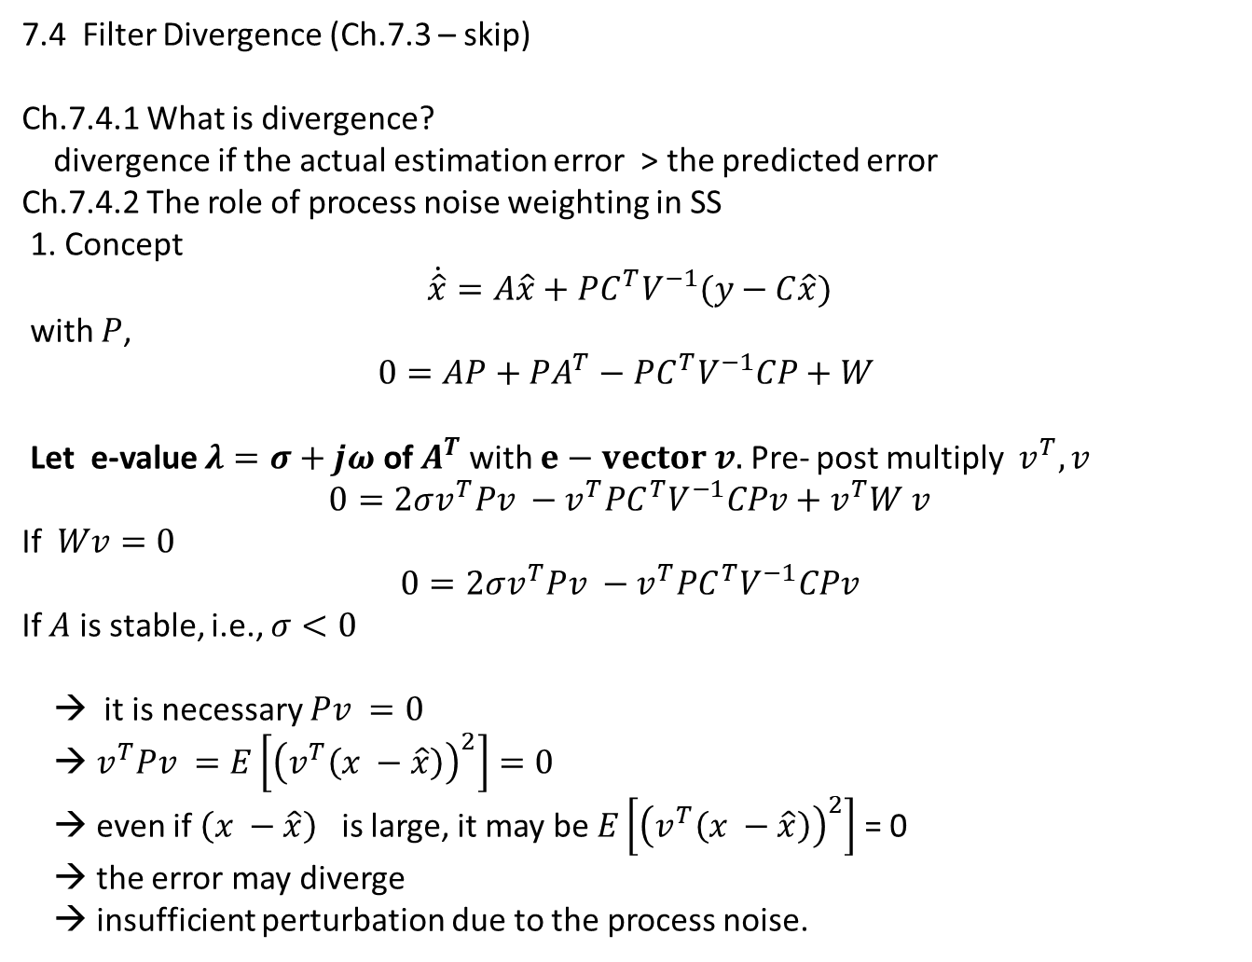
7.4 Filter Divergence (Ch.7.3 – skip)
Ch.7.4.1 What is divergence?
divergence if the actual estimation error > the predicted error
Ch.7.4.2 The role of process noise weighting in SS
1. Concept
$$\dot{\hat{x}}=A\hat{x}+PC^{T}V^{−1}(y−C\hat{x})$$
with $P$,
$$0=AP+PA^{T}−PC^{T}V^{−1}CP+W$$
Let e-value $λ=σ+jω$ of $A^{T}$ with $e−vector v.$Pre- post multiply $v^{T}, v$
$$0=2σv^{T}Pv −v^{T}PC^{T}V^{−1}CPv+v^{T}W v$$
If $Wv=0$
$$0=2σv^{T}Pv −v^{T}PC^{T}V^{−1}CPv$$
If $A$ is stable, i.e., $σ<0$
→ it is necessary $Pv =0$
→ $v^{T}Pv =E\left[{\left(v^{T}\left(x −\hat{x}\right)\right)}^{2}\right]=0$
→ even if $\left(x −\hat{x}\right)$ is large, it may be $E\left[{\left(v^{T}\left(x −\hat{x}\right)\right)}^{2}\right]$ = 0
→ the error may diverge
→ insufficient perturbation due to the process noise.

Slide 14
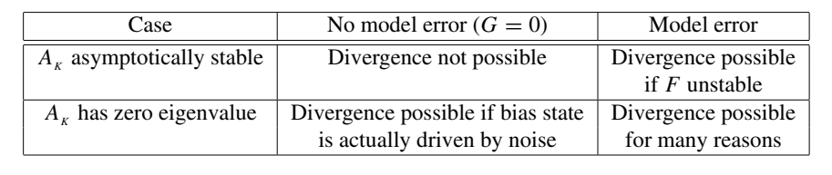
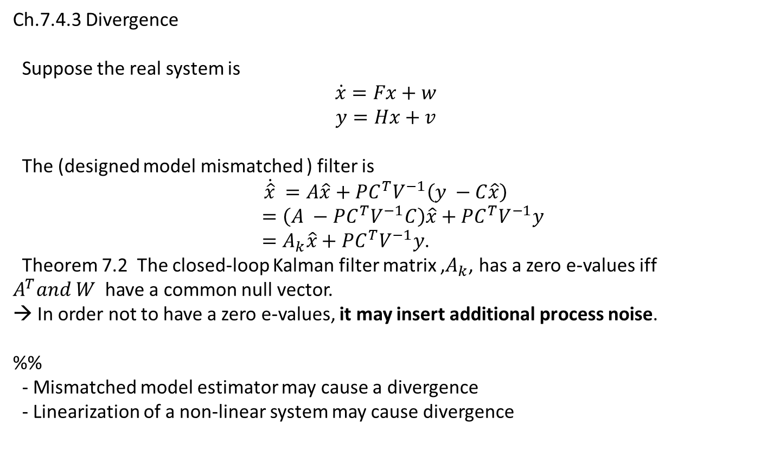
Ch.7.4.3 Divergence
Suppose the real system is
$$\dot{x}=Fx+w$$
$$y=Hx+v$$
The (designed model mismatched ) filter is
$$\dot{\hat{x}} =A\hat{x}+PC^{T}V^{−1}\left(y −C\hat{x}\right)$$
$=\left(A −PC^{T}V^{−1}C\right)\hat{x}+PC^{T}V^{−1}y$
$=A_{k}\hat{x}+PC^{T}V^{−1}y$.
Theorem 7.2 The closed-loop Kalman filter matrix ,$A_{k}$, has a zero e-values iff
$A^{T}and W$ have a common null vector.
→ In order not to have a zero e-values, it may insert additional process noise.
%%
- Mismatched model estimator may cause a divergence
- Linearization of a non-linear system may cause divergence

